Slide 1
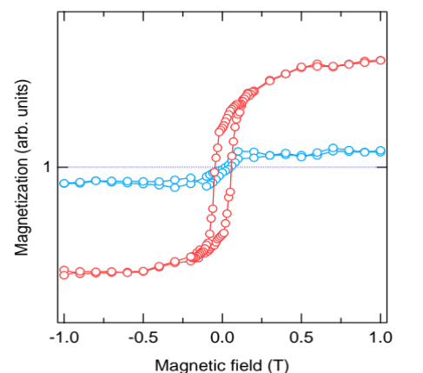
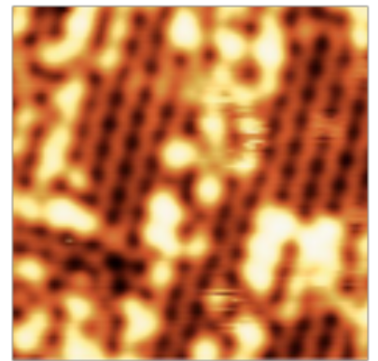
Iron spin-reorientation transition
by dynamic interface alloy formation with Mn
F. Komori¹, S. Nakashima¹, T. Miyamachi¹, Y. Tatetsu²,
Y. Takahashi, Y. Takagi³, Y. Gohda², T. Yokoyama³
¹ Institute for Solid State Physics, The University of Tokyo
²Dep. of Materials Sci. and Eng., Tokyo Institute of Technology
³Dep. of Materials Mol. Sci., Institute for Molecular Science
Mn/Fe hetero-film

