Slide 1




On-surface Bottom-up coupling of azine derivatives displaying strong acceptor behaviour
Jose A. Martin-Gago
gago@icmm.csic.es
http://www.icmm.csic.es/esisna/

Slide 2
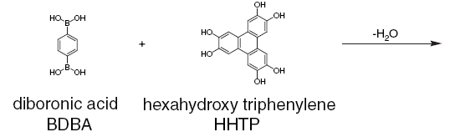
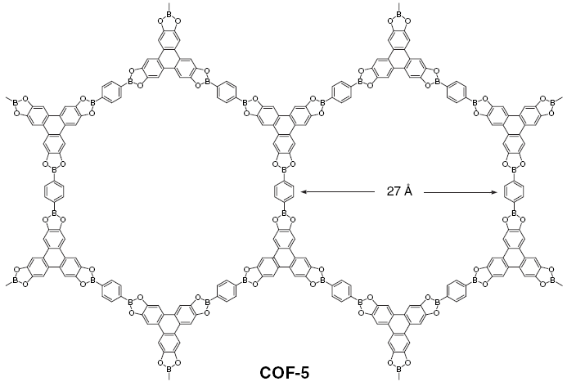
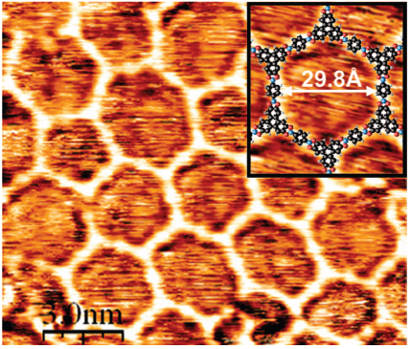
On-surface synthesis: from building blocks to networks, supramolecular structures, new molecules or nanostructures
a
Three pioneering examples
b
A. P. Côté, et al. , Science, 2005, 310, 1166

Slide 3
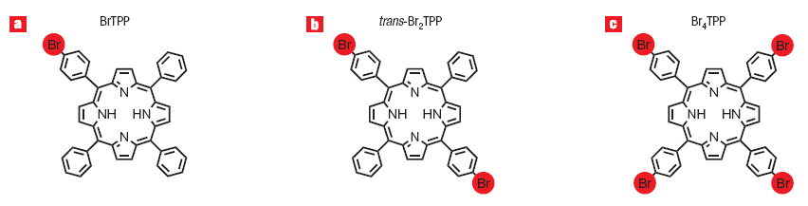
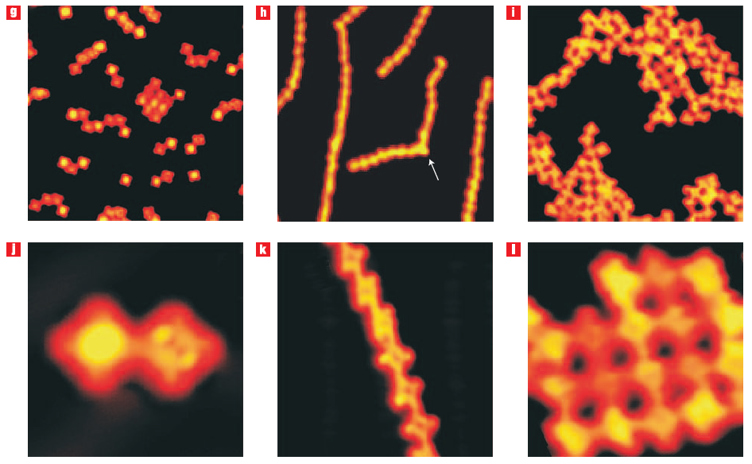
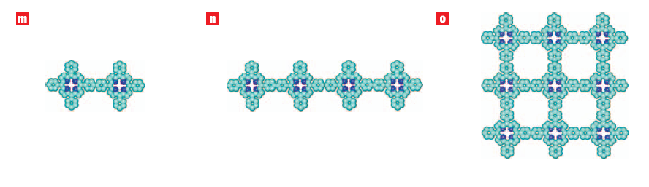
On-surface synthesis: from building blocks to networks, supramolecular structures, new molecules or nanostructures
a
b
c
d
e
f
Three pioneering examples
g
h
i
L. Grill, et al. Nature Nanotechnology, 2007, 2, 687
j
k
l

Slide 4
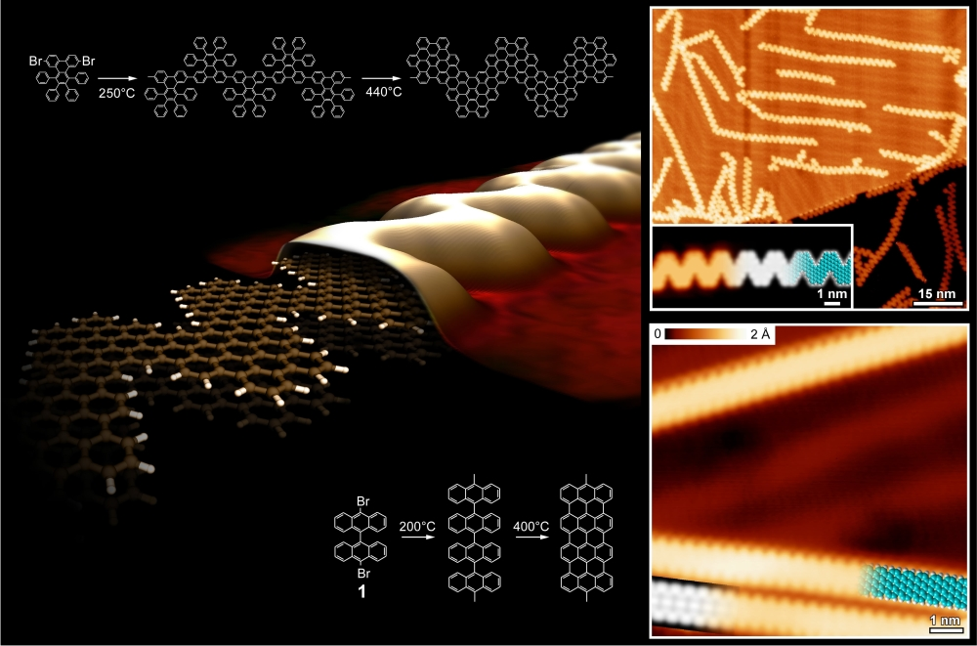
ULLMANN COUPLING
Nature 466, 470-473 (2010)

Slide 5
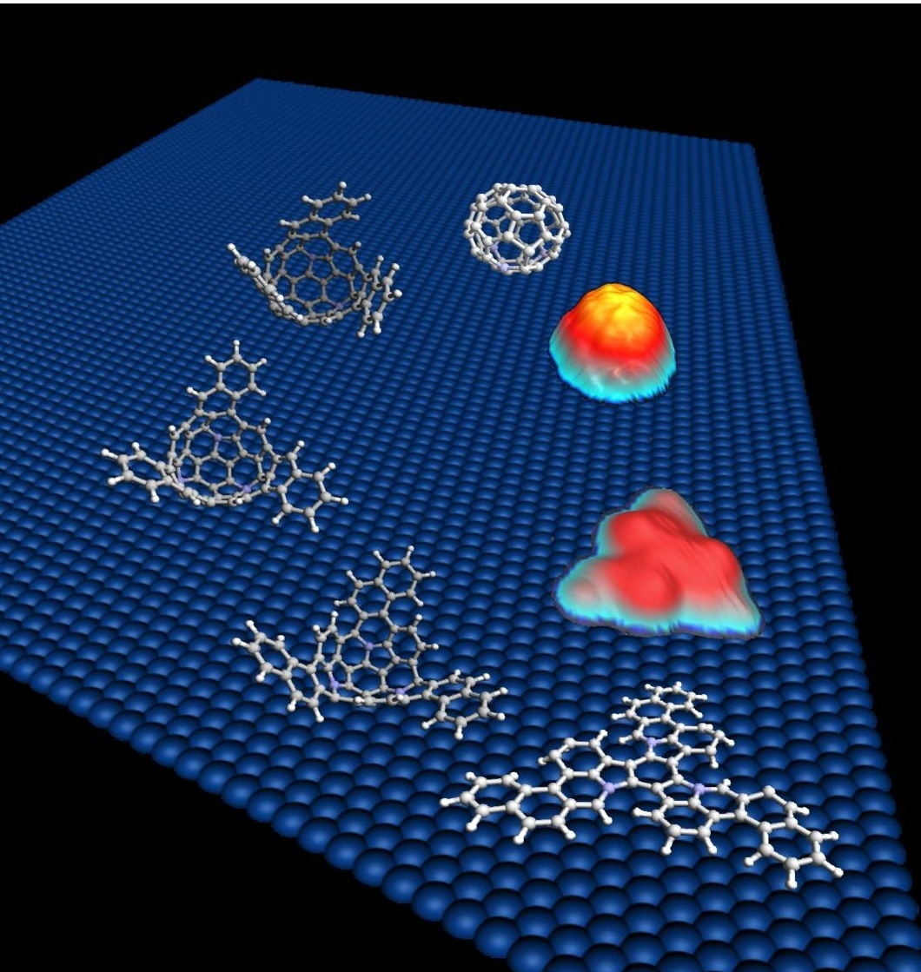
On-surface synthesis: from building blocks to networks, supramolecular structures, new molecules or nanostructures
Three pioneering examples
G.Otero et al Nature 454, 865-868 (2008))

Slide 6
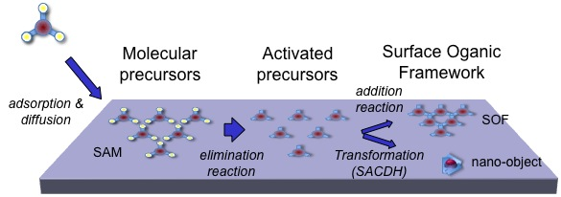
General process
Protecting group
v
    J. Mendez, M.F. López, J.A. Martin-Gago, Chem. Soc. Rev. 40, 4578–4590 (2011)

Slide 7
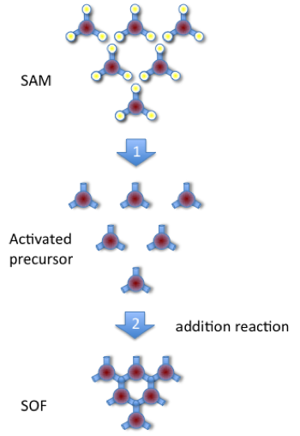
On-surface synthesis: Figure of Merits
Formation of new species not available by conventional techniques
Protecting
group
Stable structures with efficient electron transfer
UHV- compatible: surface science techniques for a controlled growth and characterization, mainly STM
J.A. Martín-Gago, Nat. Chem. (2011), 3, 11-NEWS AND VIEWS

Slide 8
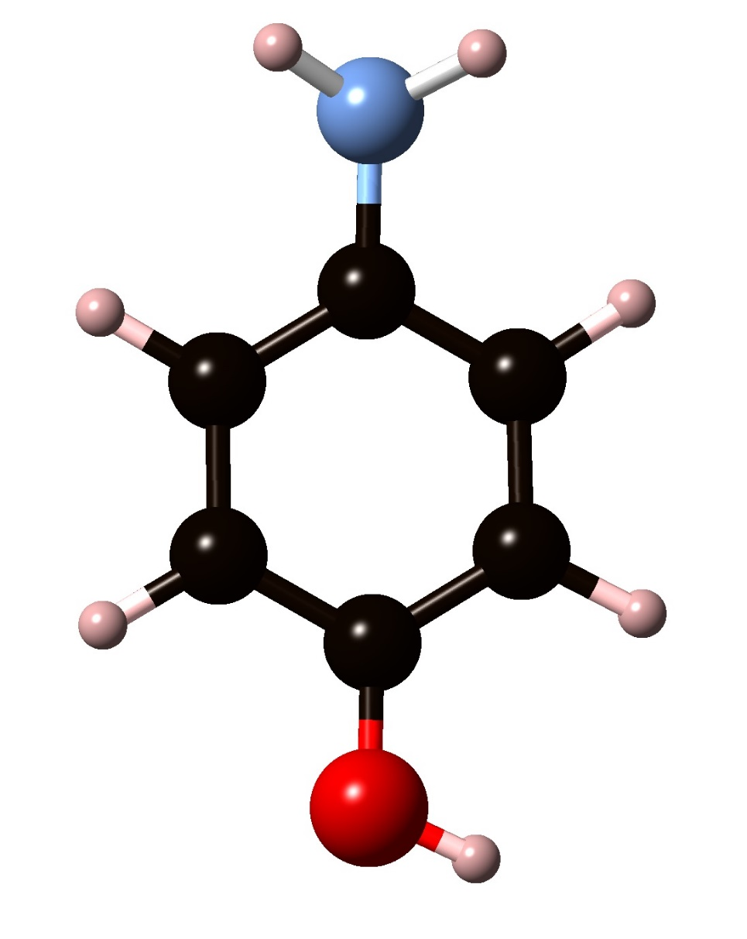
p-aminophenol
Amino
two groups (–NH₂ and OH), which may be oxidized
hydroxyl
Presence of two kinds of functional groups with different reactivity, which enables selective reaction.
Which is the group that is more susceptible to be dehydrogenated on surfaces:
amino or hydroxyl?
Can we polymerize aminophenol to form a conductive polymer?
depend on the surface and on face: Cu(110) Pt(111) Cu(111)
Notes:
Motivation for studying this simple molecule

Slide 9
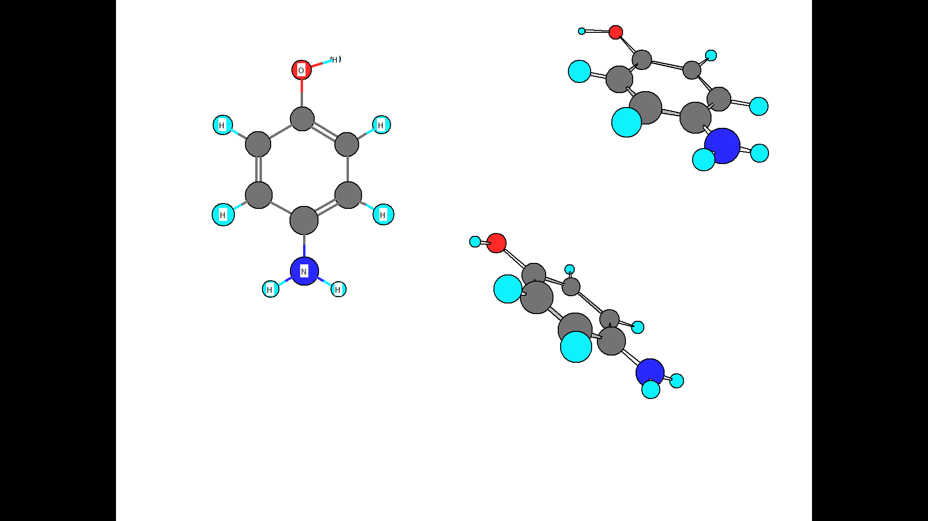
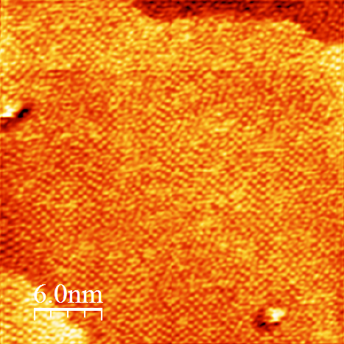
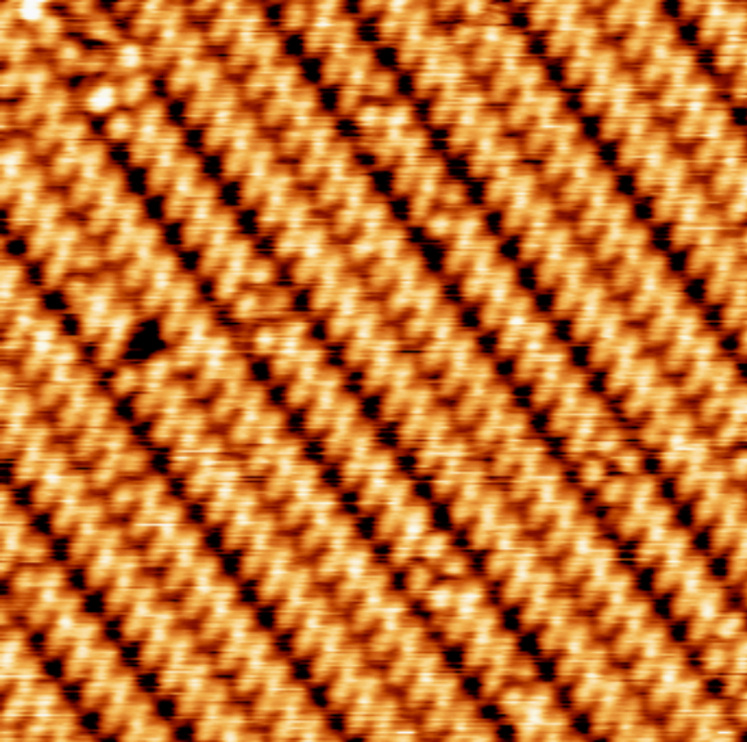
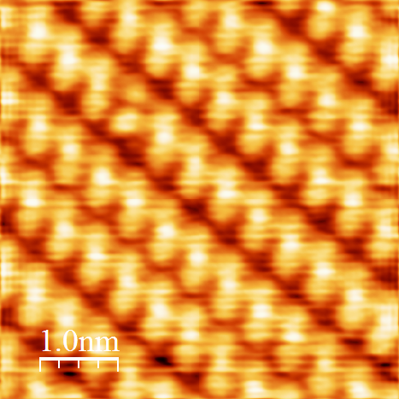
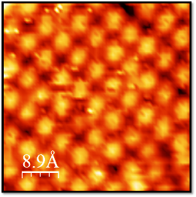
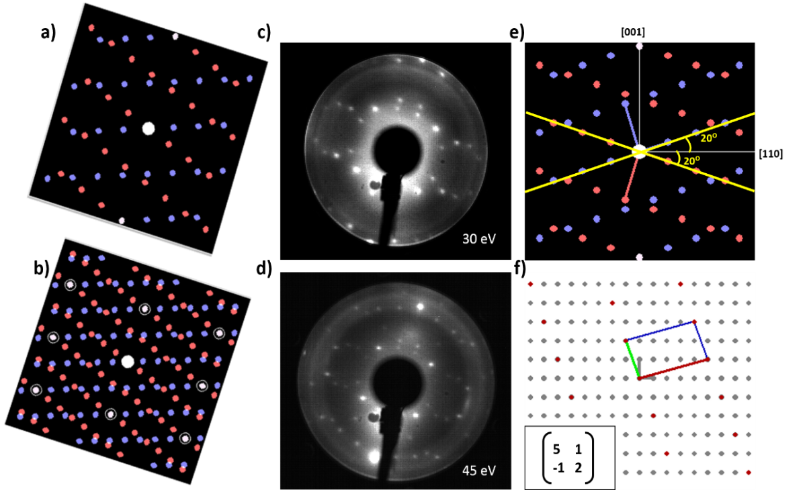
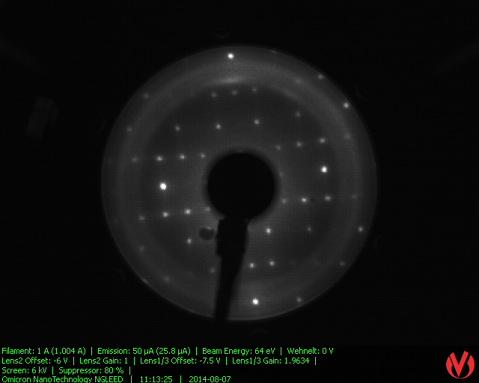
STM
RT
STM and LEED
250°C
STM
Spheres
Size ≈ 1PAP
(12.2 nm x 12.2 nm), I = 0.31 nA, V = 1035 mV
2 PAP
(12 nm x 12 nm), I = 1.1 nA, V = 850 mV
1 PAP
LEED
Elliptical shape
Size ≈ 2PAP
LEED
(4X4)
5 1
-1 2
54eV
Notes:
The starting point of our method is the evaporation in ultra-high vacuum (UHV) of p-Ap molecules on an atomically clean Cu(110) surface.
the surface molecular species observed are larger and elliptical in shape and of uniform size, with a bright feature in the center. Further, they are well-organized into
precisely aligned linear rows oriented at an angle of 208 with.
The LEED pattern (see inset) indicates that the molecular arrangement is commensurate with the substrate

Slide 10
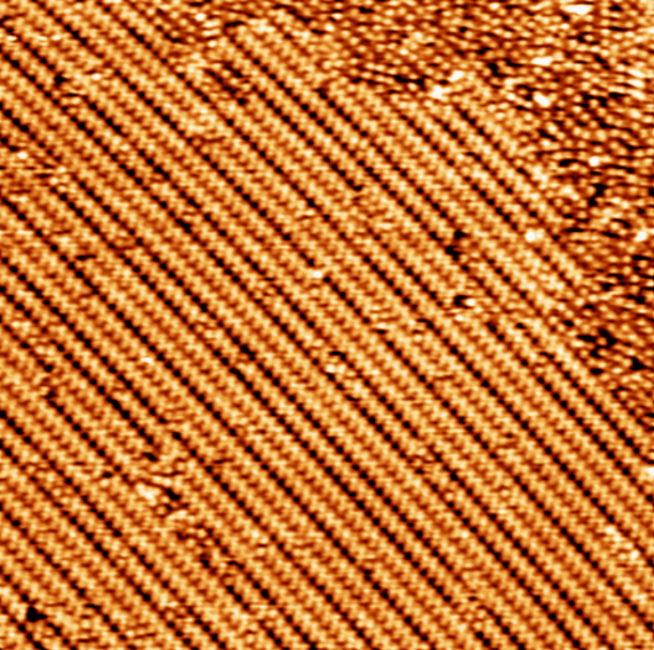
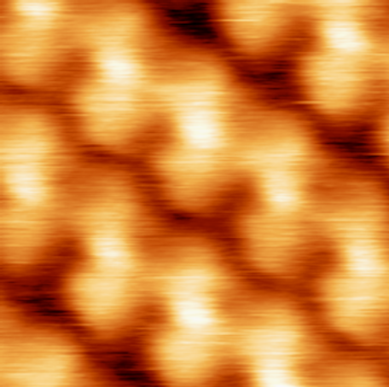
4-Aminophenol: adsorption and coupling on Cu(110)
Polymeric 1D chains covering the whole surface!!!!.

Slide 11
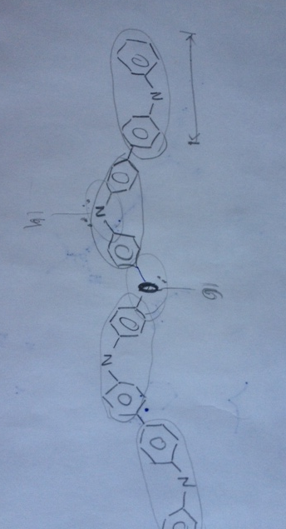
Which is the structure?

Slide 12
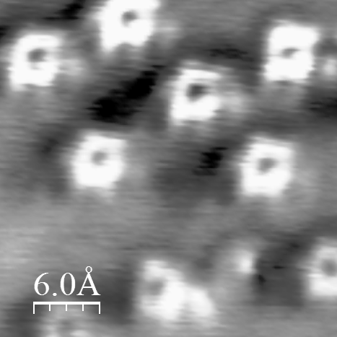
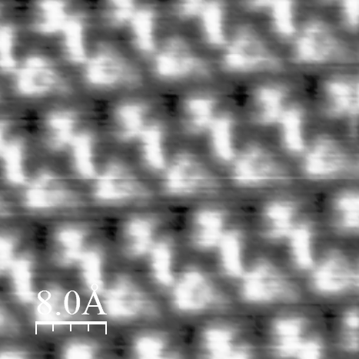
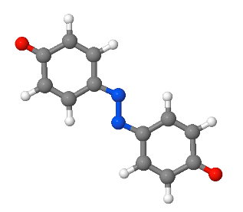
NC-AFM/STM
RT
CO-functionalized tip→ intramolecular resolution
HT
Δf
Δf
3nm X 3nm
4nm X 4nm
Dimers
Notes:
and the nc-AFM image (in the inset) clearly shows the hexagonal carbon rings confirming the presence of single isolated molecules.
The nc-AFM images of the HT phase (Figure 3b) show intramolecular features with two bright protrusions that can be assigned to two equivalent ring structures linked together as a covalent dimer.

Slide 13
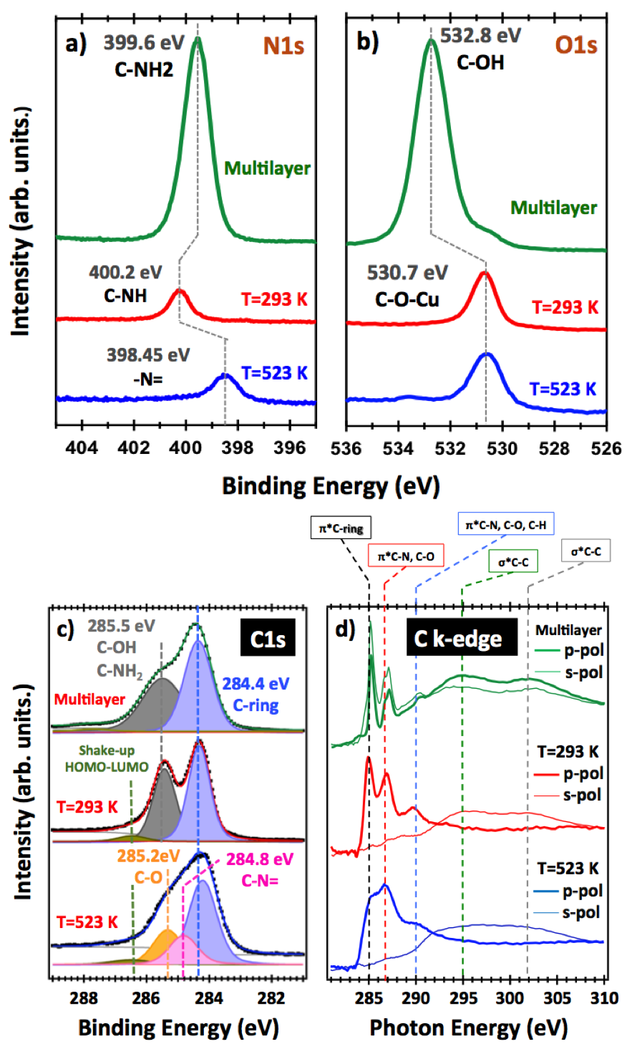
XPS Analysis
hν=500 eV
hν=650 eV
N1s
O1s
ML
RT
HT

Slide 14
XPS Analysis
hν=500 eV
hν=650 eV
Ratio presrves_No disappearance of any of the elements in p-AP
N1s
O1s
ML
: - Pristine molecule
RT
- O1s : dehydrogenated
substrate stabilization
- N1s : partially dehydrogenated
Hydrogen bond
- O1s : No changes
- N1s : iminic (-N=)
reaction takes place through N
HT

Slide 15
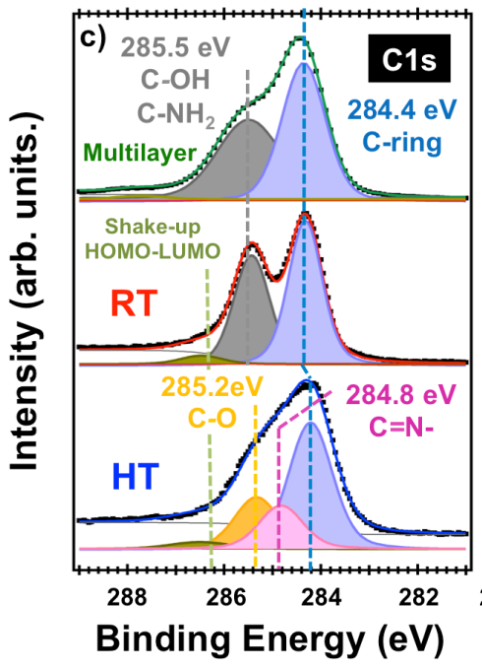
XPS Analysis
hν=400 eV
ML and RT : No BE shifts
HT : Shift toward ↓ BE ~ 0.3 eV
Charge
transfer

Slide 16
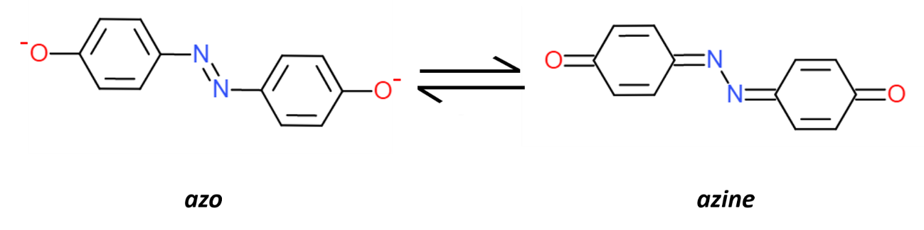
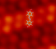
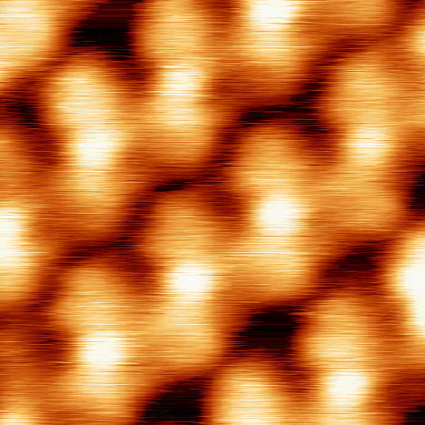
XPS + STM + NC-AFM
HT PHASE
Nc-AFM: Dimers
No metalorganic
XPS: -reaction takes place through N
    - O,N dehydrogenated
STM images
Konrad Boom et Al.
J. Am. Chem. Soc. 2013, 135, 11501
PAP/Cu(110)
Notes:
the STM images show a bright protrusion in the center of the dimer, that is, at the NN position, which can be qualitatively attributed to a charge density increase due to the formation of the covalent bond in the QAz molecule. In an azo-coupled molecule, such as azobenzene, two independent lobes are observed at the rings
with a depression in the center of the molecule.[

Slide 17
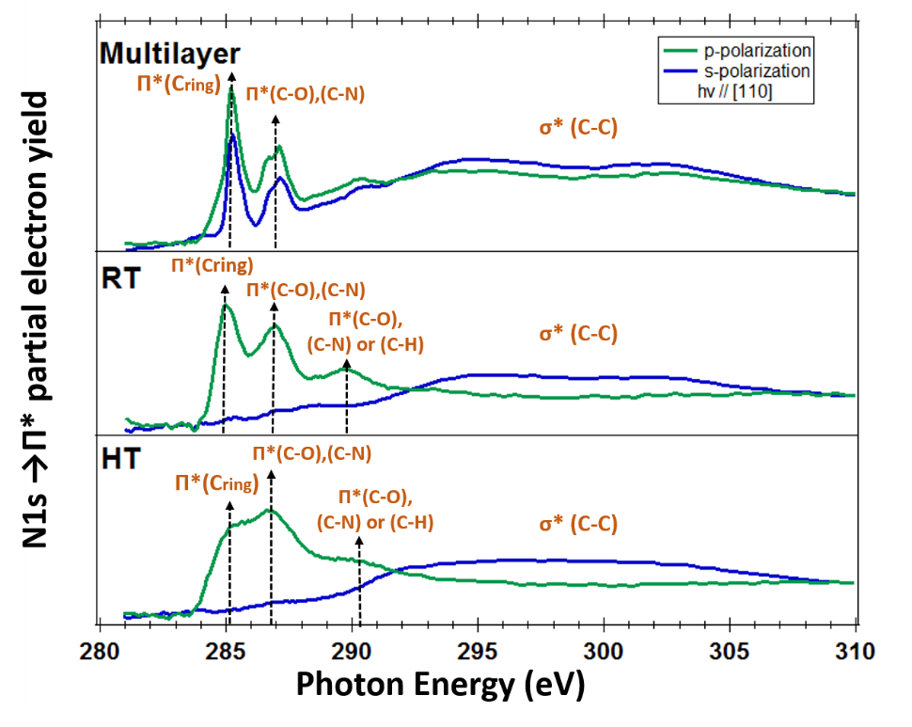
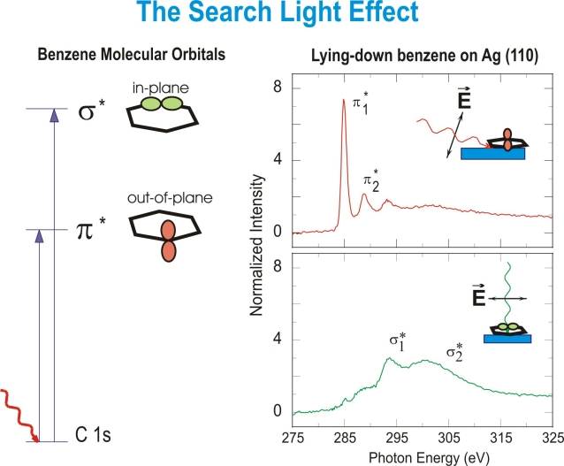
NEXAFS Analysis
p-polarization
s-polarization
Ipol"s"
≈ α tan ϒ
Ipol“p"
C
T= 293K = 5.6 ⁰
T= 523 K = 5.4 ⁰
FLAT LYING
Notes:
To obtain further insights into the structure of the HT phase and the role of the surface, we used NEXAFS spectroscopy. By varying the surface orientation with respect
to the linear polarization of the incident light in NEXAFS, the spectral response corresponding to the p*-symmetry components shows dichroic anisotropy (Figure 2 d).[23] The curve that corresponds to the multilayer p-Ap presents no important variations with polarization. However, both RT and HT phases show a strong enhancement of the p* part of the spectra in p-polarization and quenching in s-polarization. This dichroic behavior indicates that the carbon ring is oriented
parallel to the metal surface, with an average tilt of 58,

Slide 18
NEXAFS Analysis
C K-edge
LT → RT
  Similar electronic
  structure
C
π* (C=N)
Molecules present some aromaticity

Slide 19
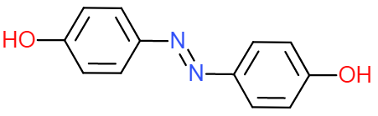
XPS + STM + NC-AFM + NEXAFS
HT PHASE
XPS: -reaction takes place through N
    - O,N dehydrogenated
Nc-AFM: Dimers
STM images
?
Electronic structure
Theory

Slide 20
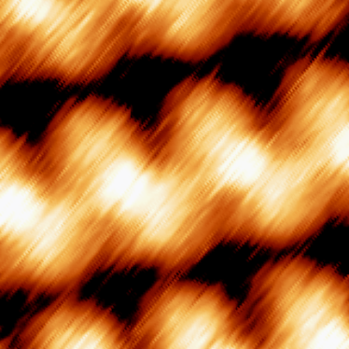
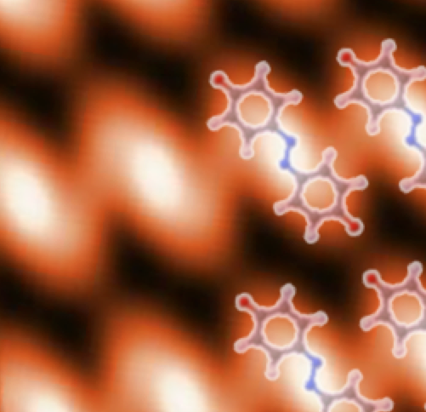
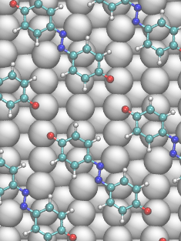
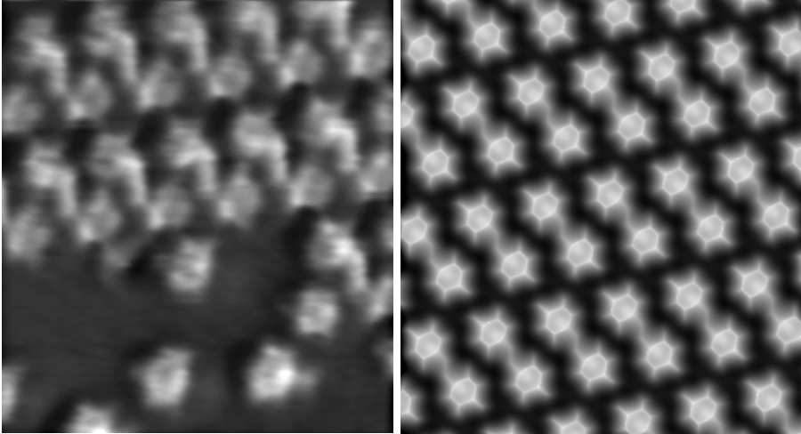
Simulations DFT Calculations
EXPERIMENTAL
THEORY
Theory in agreement with experiments for azine structure

Slide 21
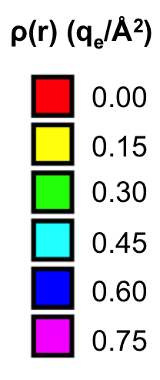
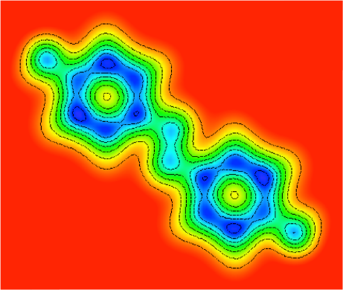
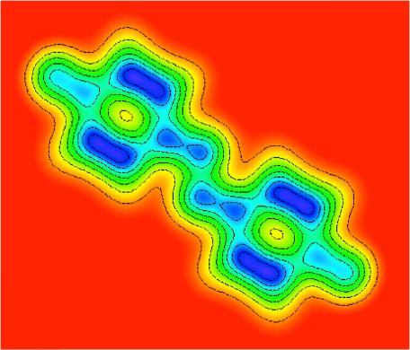
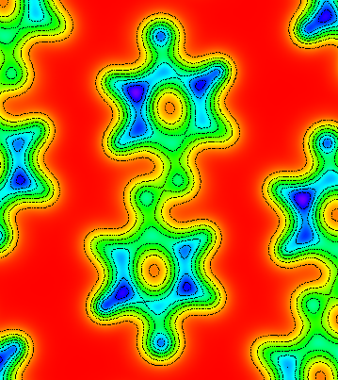
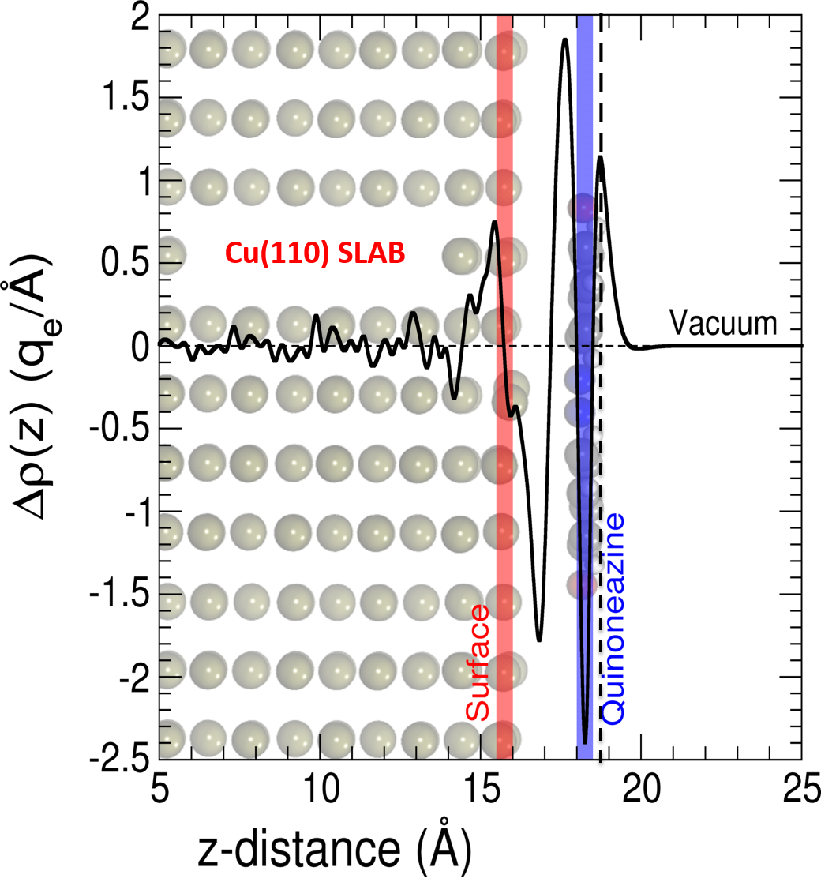
Simulations DFT Calculations
AZINE/Cu(110)
AZO (g)
AZINE (g)
CHARGE TRANSFER : 1,21 e/molecule
  Intramolecular charge distribution:
Partial conjugation
Azo character
TTF on Cu: 0.7 eV

Slide 22
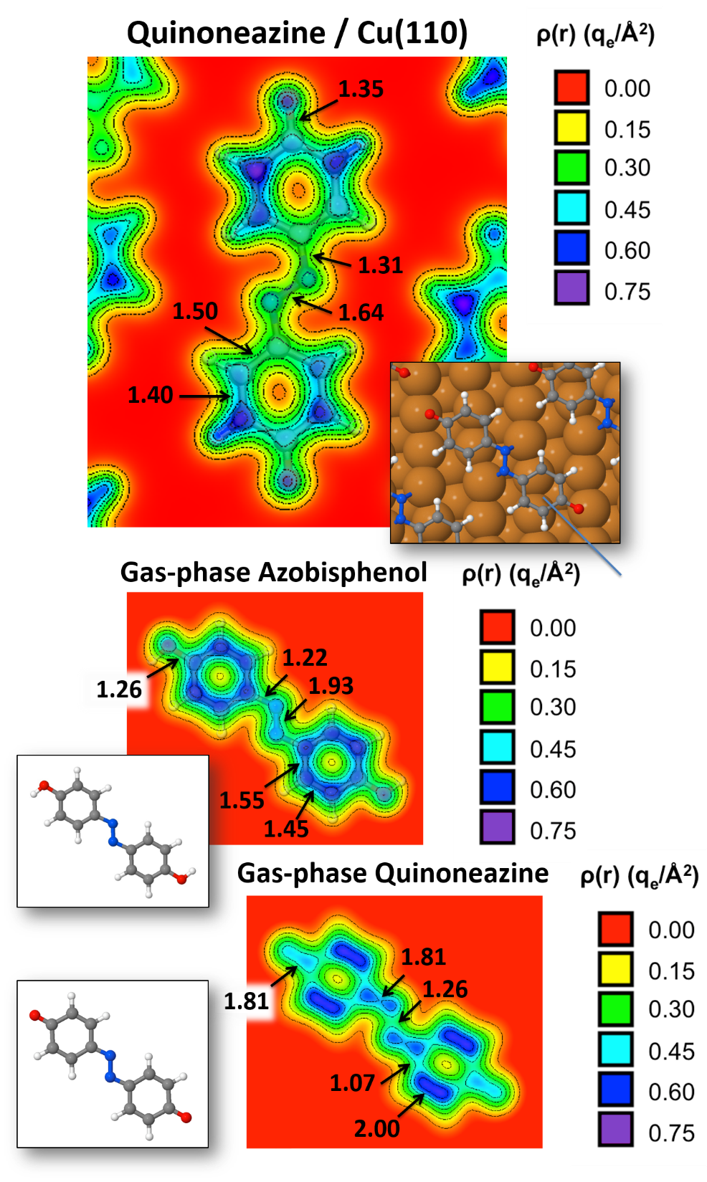
Bond order analysis

Slide 23
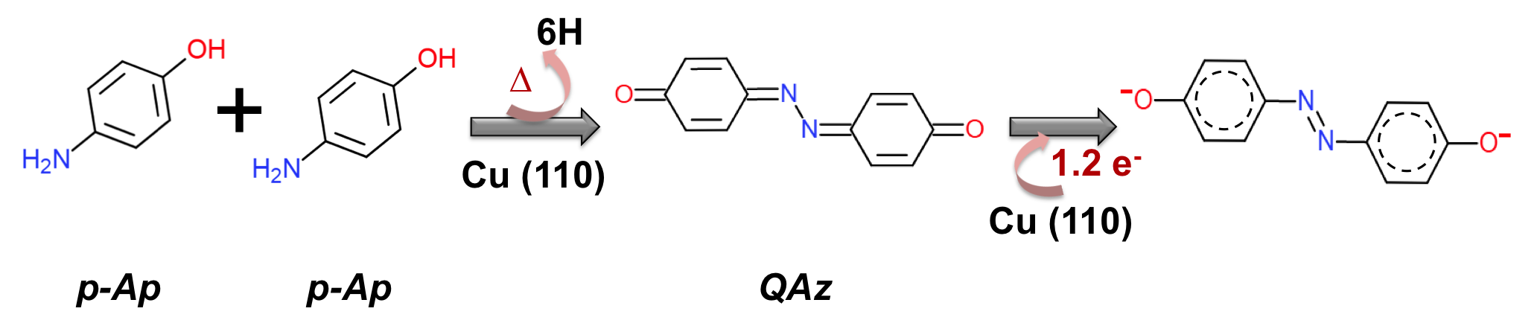
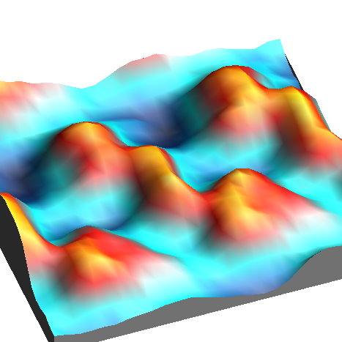
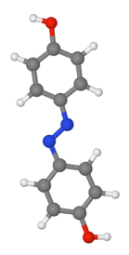
Conclusions
Strong surface-molecule interaction, the quinoneazine molecule accommodates 1.2 electrons at its carbonyl ends, inducing an intramolecular charge redistribution and leading to partial conjugation of the rings, conferring azo-character at the nitrogen sites.
Organic electronic devices:Molecular electronics → alternative silicon technology → conductive polymers, donor-acceptor compounds improving the interphase between donor-acceptor.
MORE DETAILS : N. Ruiz del Arbol et al. Angew. Chem. Int. Ed. June, 2018

Slide 24
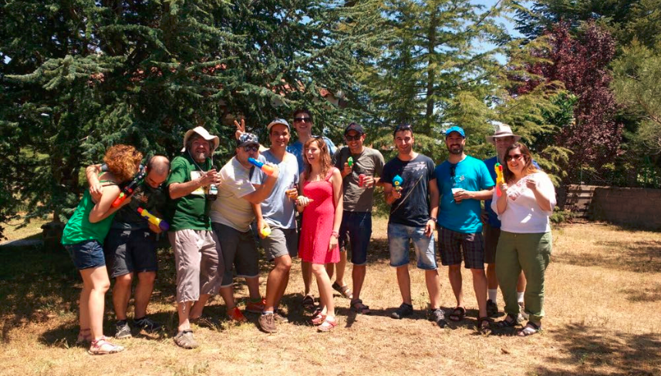

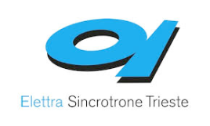





ESISNA
Irene Palacio, Gonzalo Otero-Irurueta, José I. Martínez, Pedro L. de Andrés, María F. López, José A. Martín-Gago.
Oleksander Stetsovych, María Moro-Lagares, Pingo Mutombo, Martin Svec, Pavel Jelínek.
Luca floreano, Albano Cossaro.
Gary J. Ellis.

Slide 25
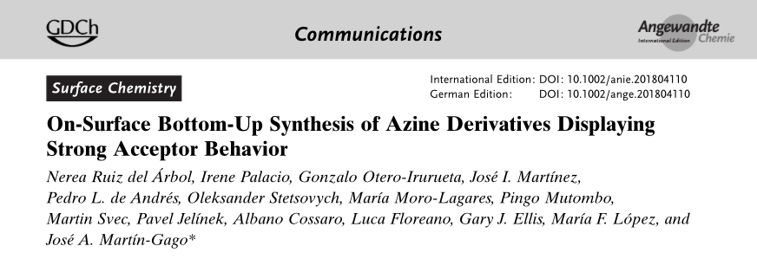
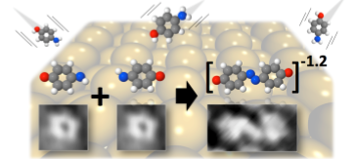

Slide 26
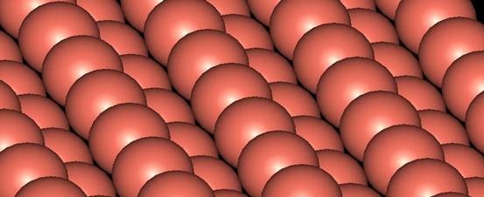
Experiment
Quinoneazine
Important intermediate molecule in bio –proceses
- important for redox- apications
Safari et Al.,
RSC Adv., 2014, 4, 46224.
AZINES
LT STM/NC-AFM
XPS
NEXAFS
THEORY
Pathway reaction
Notes:
on-surface chemistry route has now been used to synthesize the strong electron-acceptor organic molecule quinoneazine directly on a Cu(110) surface, via thermally
activated covalent coupling of para-aminophenol precursors.The mechanism is described using a combination of in situ surface characterization techniques and theoretical methods
This molecule has been theoretically proposed for
organic electrodes owing to their extreme redox voltages, and
it can also be employed as an intermediate in the preparation
of several chemically and biologically active compounds.[

Slide 27
Conclusions
Strong surface-molecule interaction, the quinoneazine molecule accommodates 1.2 electrons at its carbonyl ends, inducing an intramolecular charge redistribution and leading to partial conjugation of the rings, conferring azo-character at the nitrogen sites.
Organic electronic devices:Molecular electronics → alternative silicon technology → conductive polymers, donor-acceptor compounds improving the interphase between donor-acceptor.
MORE DETAILS : N. Ruiz del Arbol et al. Angew. Chem. Int. Ed. June, 2018

Slide 28


EXPERIMENTS
Molecular electronics → alternative silicon technology → conductive polymers
Role of the surface
Cu(110)
?
P-aminophenol (PAP)
?
5,57 Å
Pt(111)

Slide 29







250 ᴼC
STM and XPS : PAP/Pt (111)
Chains
150 ᴼC
Temperature
Molecules + chains
RT
At 250°C → Oxygen undergoes a reduction reaction.
N 1S presents two different chemical states
Molecules

Slide 30



XPS Analysis : PAP/Pt (111)
No oxygen @ 250ºC
Amine and imine bonds @ 250ºC
Leucoemeraldine
Emeraldine
Pernigraniline
0.37
0.63

Slide 31
Theoretical details
* Density Functional Theory was used effectively combining the localized-basis-
set and plane-wave schemes as implemented in the Fireball and Quantum Espresso
(PwScf) Simulation packages.
* Inclusion of Van der Waals corrections in a perturbative framework (Grimme
Aprox.).
* The exchange-correlation effects have been accounted by using the PW91
parametrization, and norm-­conserving scalar­‐relativistic pseudopotentials
have been considered to model the ion-­electron interaction.
Theoretical STM Imaging
* Tunnelling currents calculated using a Keldysh–Green function formalism,
together with the first-­principles tight‐binding Hamiltonian obtained from
the local-orbital DFT‐Fireball method.
* Pyramidal-terminated clean W-tip.
* Constant-current conditions (I=0.2 nA & V=+0.2V).

Slide 32


CONCLUSIONS
P-aminophenol
(PAP)
Cu(110)
OD
Pt(111)
1D
0.37
0.63
The role of the surface
- Different dimensionality
Different reactivity regarding other methodologies
OSS : discover new materials for innovation

