Slide 1
Capturing interface processes at the atomic scale by high-speed surface X-ray diffraction
National Institute of Advanced Industrial Science and Technology (AIST)
Tetsuroh Shirasawa
Tokyo Gakugei Univ.
Wolfgang Voegeli, Etsuo Arakawa, Toshio Takahashi
National Institute for Materials Science (NIMS)
Takuya Masuda, Kohei Uosaki
Photon Factory, KEK
Tadashi Matsushita
Notes:
Thank you chairman for the kind introduction.
My talk is about a high speed surface x-ray diffraction.
We show its capability of capturing interface phenomena.

Slide 2
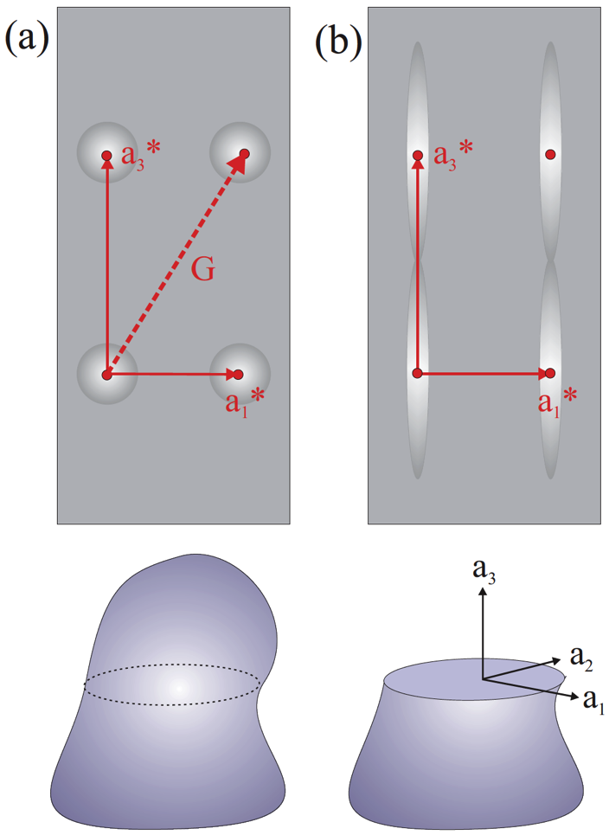
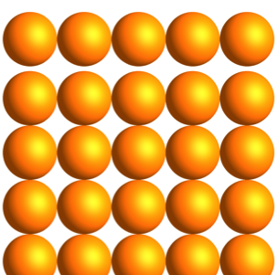
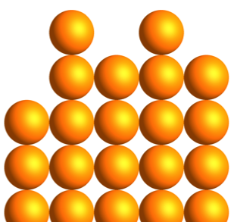
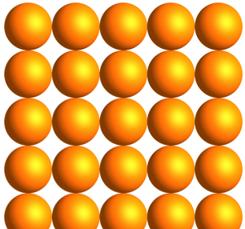
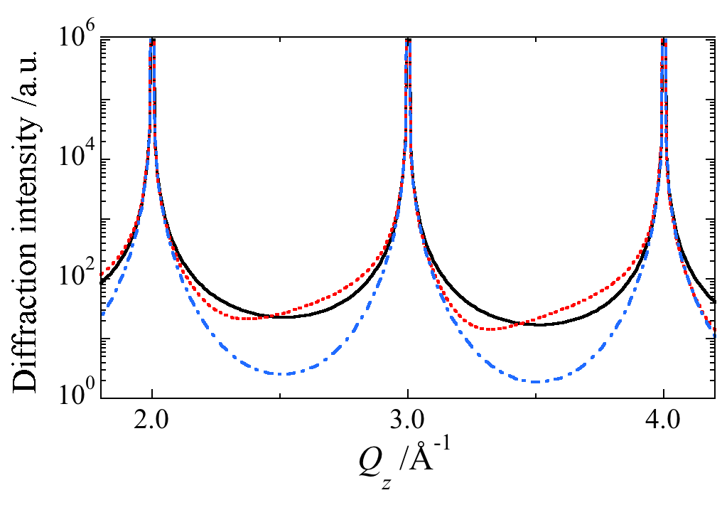
Surface X-ray Diffraction
The most reliable tool for the surface structure analysis
CTR
(Crystal Truncation Rod)
Ideal Surface
Displacement
Roughness
0.1Å
Bragg peak
ー Ideal
--- Displacement
-・- Roughness
Substrate
Bragg peak
CTR Intensity [a.u.]
Crystal
Surface
Elements of Modern X-ray Physics (2nd ed., Wiley)
L [r.l.u.]
Notes:
Surface x-ray diffraction is probably the most reliable method for the determination of surface and interface structure.
When the electron density of crystal is truncated at the surface, the rod-shaped x-ray scattering appears along the direction perpendicular the surface, it is called CTR.
The CTR profile is very sensitive to the surface structure.
As shown in the example, only a small amount of displacement of the surface atomic layer and surface roughness results in the big change in the CTR profile,
So we can analyze such structures by measuring CTR profile.

Slide 3
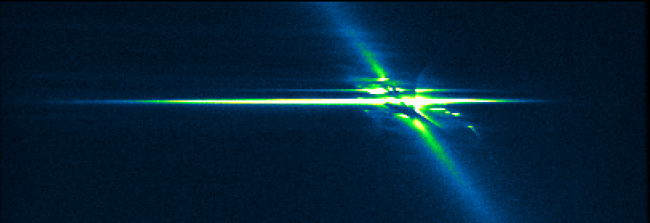
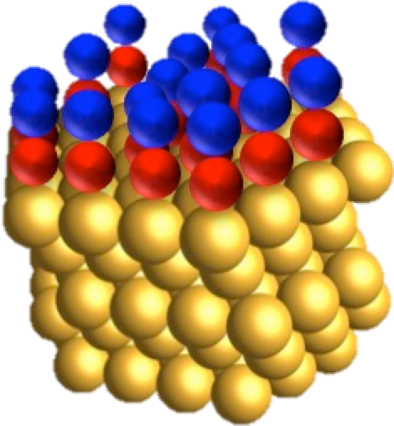
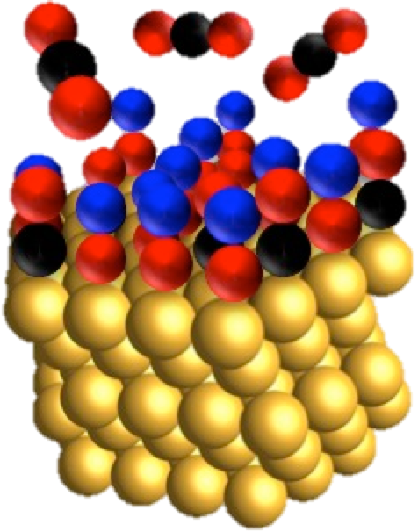
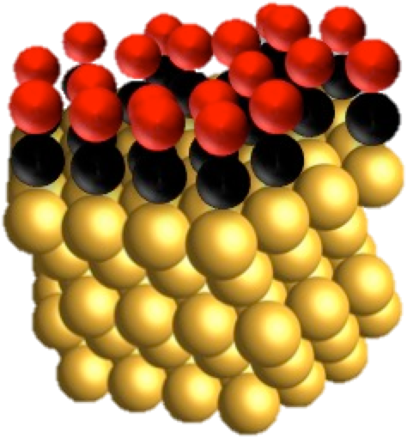
High-speed SXRD
Conventional method
Rainbow SXRD
Point by point
CTR at once
Monochro.
X-rays
2D detector
CTR
Surface
CTR
E-dispersive X-rays
CTR Intensity
White SR
Surface
Q_{z}
CTR Intensity
Curved crystal
t 〜 1 s
Q_{z}
Data acquisition time (t)
CTR Intensity
Point det: t > tens of min.
2D det: t > mins.
Operando observation
Notes:
For the quantitative analysis we have to measure the CTR profile.
One drawback of the method is the measurement is time consuming. So we have developed a high speed method.
Commonly for the CTR measurement, a monochromatic x-ray is used and the profile is measured point-by-point by rotating the sample and detector.
The measurement is rather lengthy: typical data acquisition time is more than tens of minutes when a point detector is used and it is more than several minutes when a two-dimensional detector is used.
Our method uses an energy dispersive convergent x-rays which is produced by the curved crystal polychromator, and the scattering distribution is simultaneously recorded by the two-dimensional detector, so that a range of CTR profile is recorded as a function of x-ray energy without moving anything.
The typical data acquisition time is 1s, which allows in operando observation of irreversible surface phenomena.

Slide 4
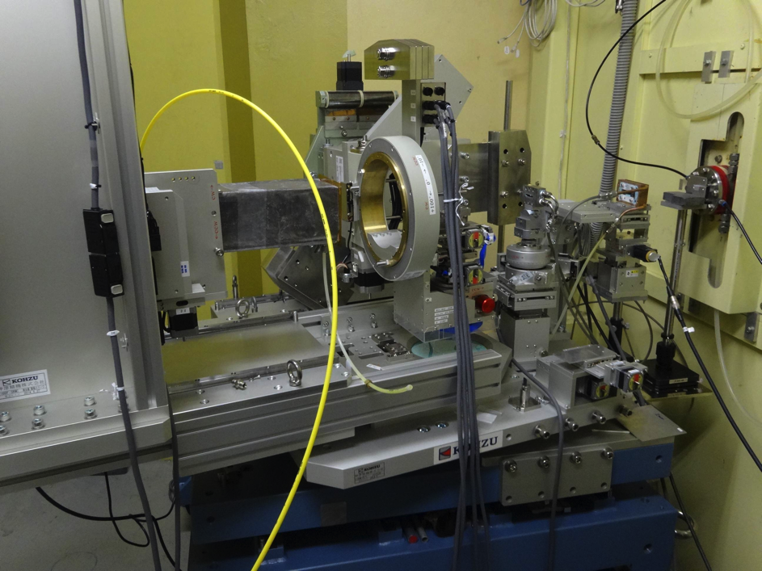
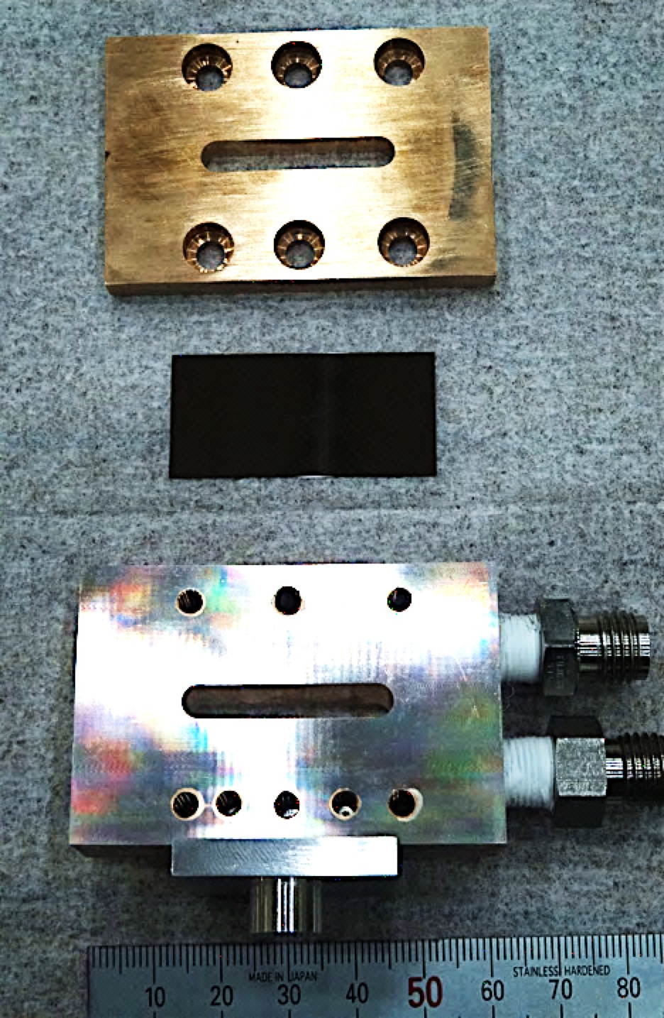
Diffractometer
KEK, PF-AR NW2A
Gonio. table
Polychro. stage
(x, y, z, θ, tilt)
Tapered undulator
(Side view for clarity)
Top view
θ
Detector stage (δ, γ)
S
N
S
N
S
N
S
16 – 23 keV
10⁸ ph/s/eV
Detector arm
White SR
N
S
N
S
N
S
N
Sample stage
(x, y, z, φ, tilt)
χ circle
Polychromator
Detector
~200mm
500–1000mm
Polychromator
Sample stage
Polychro.
χ circle
X-ray window
Detector
(PILATUS-100K)
X-rays
Si(110)
0.2mmt
Bender
(r = 425mm)
Detector arm
Gonio. table
Notes:
Here we show the experimental layout.
The experiments were done at KEK PF-AR, and we used a tapered undulator to produce a high-flux white X-ray beam with a smooth spectrum
The typical energy range was 16-23 keV. The x-ray flux is somehow sufficient for CTR measurements.
Whole the goniometer is mounted on the rotatable table to be aligned with respect to the polychromatic x-rays..
The polychromator is a single crystal Si water. It was elastically bent in a solid bender.

Slide 5
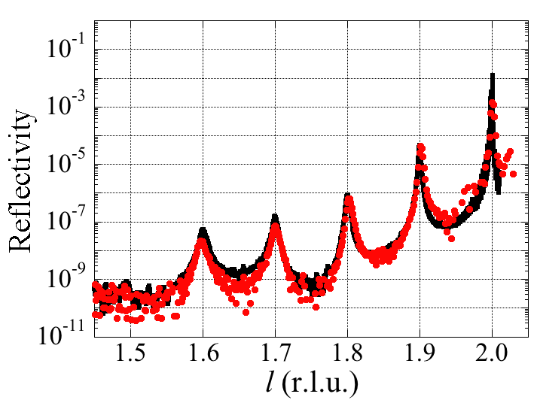
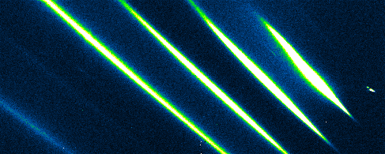
Fast CTR measurement
GaAs/AlAs superlattice
ー Angle scan (3 hours)
● E-dispersive (10 s)
AlAs 8 layer
GaAs 12 layer
・・・
50 reps.
002
AlAs 8 layer
GaAs 12 layer
1st
GaAs(001)
2nd
4th
3rd
4th
3rd
2nd
1st
10s
Qz (Q//=0)
High-speed
Quantitative
Notes:
We show an example of the CTR measurement.
The reference sample is the aluminum arsenide and gallium arsenide superlattice.
This is a detector image taken with an exposure time of 10 s.
You see the four superlattice reflections.
The oblique distribution is a diffuse scattering,
This is the intensity plot along CTR. Whole the profile was obtained in the single acquisition and it is identical to the profile obtained by the angle scan method.

Slide 6
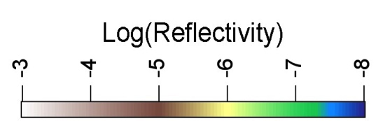
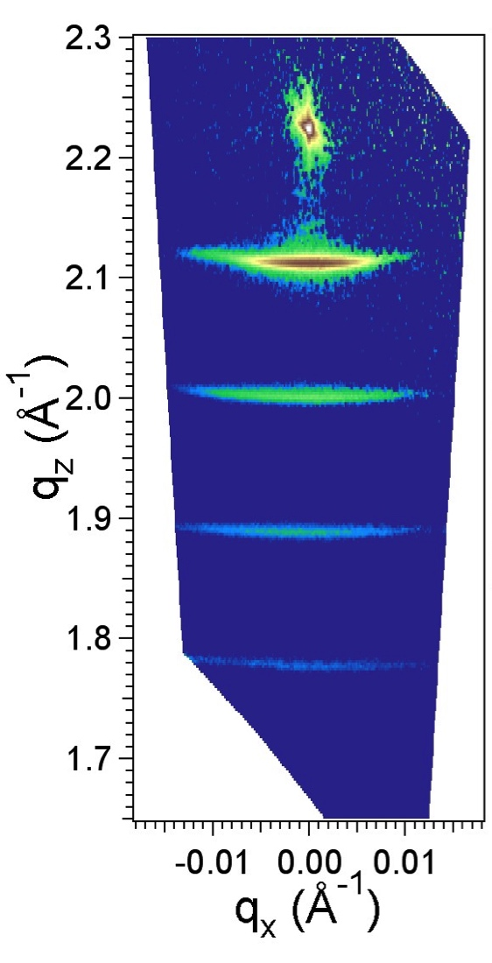
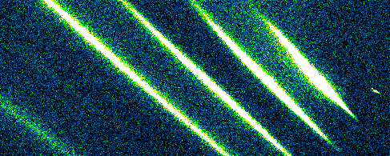
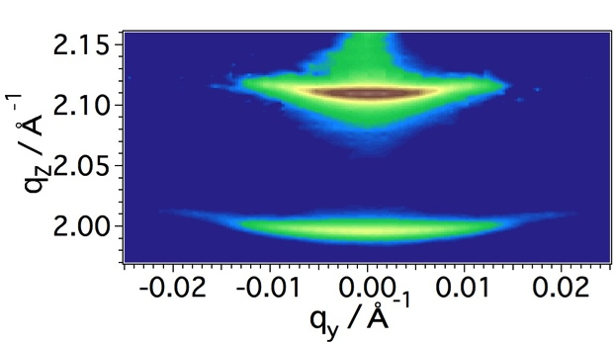
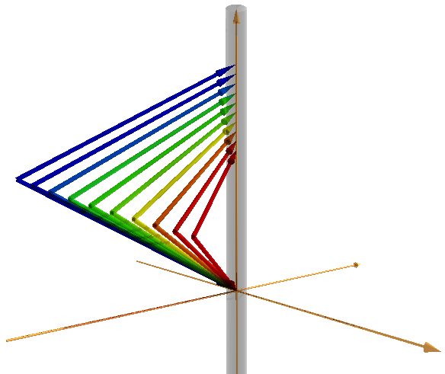
Fast Reciprocal Space Mapping
Angle scan
(point detector)
1 s
4th
3rd
2nd
1st
1s
Conversion
10⁴ s
002
Log intensity
-3 -4 -5 -6 -7 -8
1st
1st
q_{z}
2nd
2nd
2θ
q_{y}q_{z}
plane
k_{out}
3rd
4th
k_{in}
q_{y}
θ
Quick characterization of thinfilm structure
Orientation
Domain shape
Strain
q_{x}
q_{y}
Notes:
We can also construct the reciprocal space map from the single image by converting the diffuse scattering distribution to the q space, which is much faster than the angle scan method.
This would be very useful for the study of thin film structures.

Slide 7
Real time monitoring
Electrochemical reaction
Thin film growth
Notes:
We would like to show the examples of real time monitoring of interface phenomena.

Slide 8

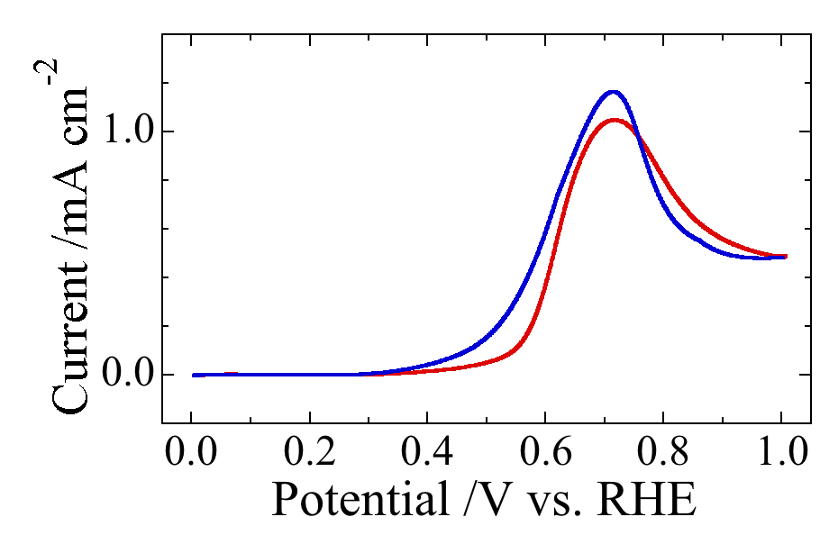

Methanol electrochemical decomposition on Pt(111)
Direct Methanol
Fuel Cell
CH₃OH → CO_{ad}+4H⁺ + 4e⁻
6e⁻
CO_{ad} + OH_{ad} → CO₂ + H⁺ + e⁻
Methanol
/Water
Air
CH₃OH
+
H₂O
2/3O₂
+
6e⁻ + 6H⁺
6H⁺
CO₂
CO₂
CO₂
+
6H⁺ + 6e⁻
Water
3H₂O
Anode
PEM
Cathode
H
O
O
C
Portable DMFC (TOSHIBA)
0.5M CH₃OH
0.1M HClO₄
CO stripping kinetics
Notes:
The system is the electrochemical decomposition of methanol on Pt single crystal electrode.
This reaction is technologically important due to the fuel cell application.
On the anode surface, the methanol is catalytically reacted with water and finally oxidized to CO2, emitting six protons and six electrons.
The problem of the catalytic reaction is the so-called CO poisoning.
The methanol is immediately decomposed to CO, and the CO covers most part of the surface and catalytic activity is lost.
With increasing potential, OH adsorption occurs and the CO reacts with the surface OH and desorbs from the surface, at the same time the methanol decomposition is activated.
We studied the kinetics of CO poisoning layer to show the capability of the high-speed method.

Slide 9
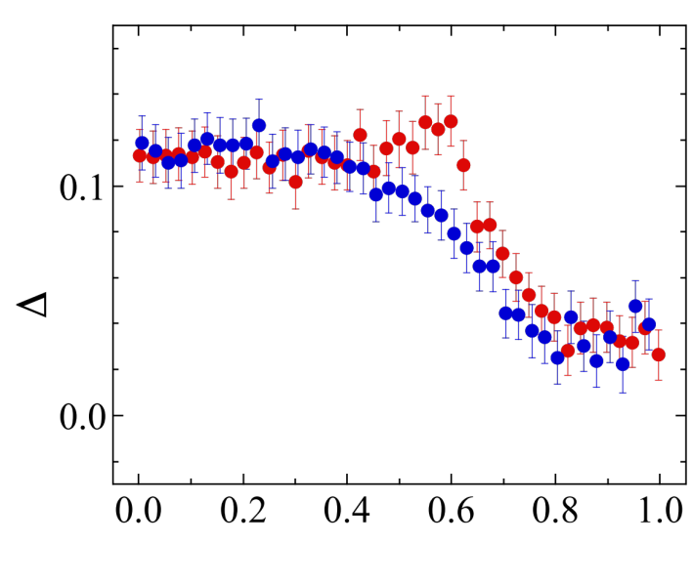
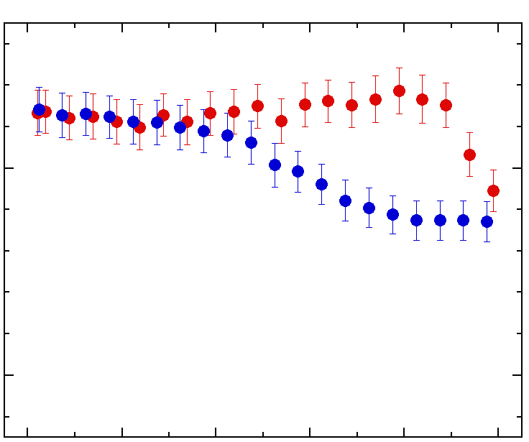

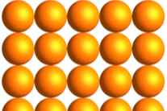
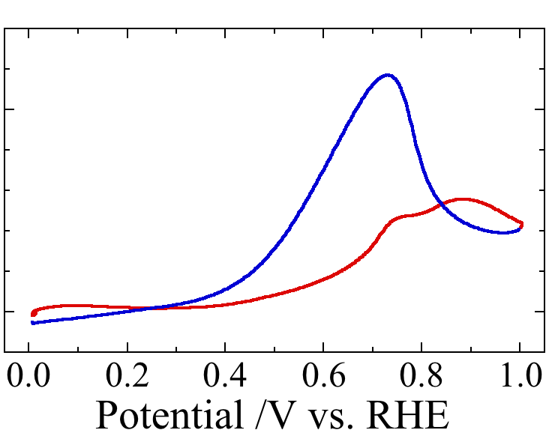
Pt electrode surface structure change during reaction
CO₂
O
C
Δt = 1s
Displacement
H
O
50 mV/s
Δz / Å
5 mV/s
Pt
0.5M CH₃OH
0.1M HClO₄
Larger hysteresis
→ CO desorption is rds.
Shirasawa et al.,
JPC C 121, 24726 (2017)
Notes:
We measured CTR profile during potential scan with the time resolution of 1 s.
The upper panel shows the vertical displacement of the Pt surface layer obtained by the structure analysis and the lower panel shows the reaction current.
We can see a clear correlation between the displacement and the reaction current,
In the potential region of 0.0–0.4 V the surface is covered with the CO, and the surface layer is lifted up due to the strong interaction with CO.
In the higher potential region, the Dz₁ decreases abruptly around 0.6 V due to the desorption of CO. At the same time the reaction current increases steeply.
The point is that in the negative going potential scan, the delta z stats to increase due to the re-adsorption of CO, and it displays the hysteresis which is well correlated with the current hysteresis.
By increasing the potential scan rate, the hysteresis becomes larger, clearly demonstrating that the CO stripping is the rate determining step for the methanol decomposition.
Such a non equilibrium state is observed not be observed in static measurement

Slide 10
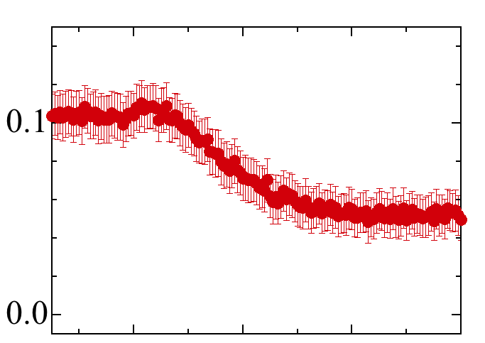
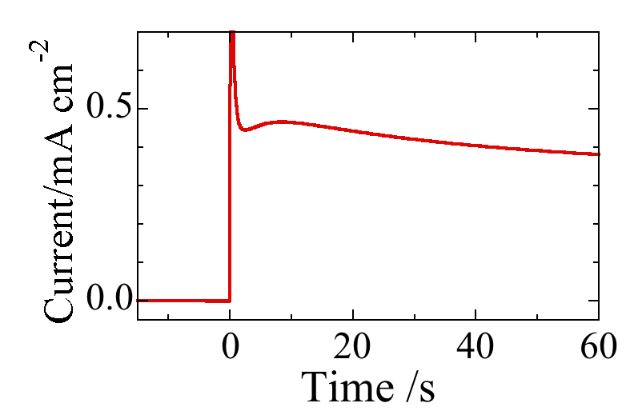
CO stripping process
O
C
｜
O
C
｜
O
C
｜
O
C
｜
O
C
｜
O
C
｜
H
O
｜
0.5M CH₃OH/0.1M HClO₄
・ OH adsorption at step edges
・ CO oxidation at step edges
・ CO diffusion toward step edges
・ Strongly adsorbed less-dense CO layer
①
②
step
edge
CO₂
Δz / Å
H
O
｜
O
C
｜
O
C
｜
O
C
｜
O
C
｜
CO₂
CO₂
0.8V
0.0V
O
C
｜
H
O
｜
O
C
｜
O
C
｜
H
O
｜
・ OH adsorption and CO oxidation at terrace
Notes:
We also studied the behavior of CO stripping by using potential step experiments.
After the potential step from 0.0 V to 0.8 V delta z decreases due to the CO stripping.
Take a close look at the initial region, in the first several seconds delta z does not decrease, instead rather increases from the initial position, and after that it decreases.
This behavior can not be explained by a simple reduction of CO-covered area, because in this model the delta z should decrease from the beginning.
So we propose a model like this,
It is know that OH are preferably adsorbs at defect sites such as step edges, so the CO oxidation would occur at the active sites first.
So, the CO molecules at terrace diffuses toward the active sites in order to compensate the concentration gradient. At the same time, less-dense CO layer is formed.
According to first principles calculations the CO-Pt interaction becomes strong when the CO density is reduced, because of the relaxation of CO-CO repulsive interaction.
Therefore, in such a less-dense CO layer Pt displacement becomes larger due to the stronger interaction.
When OH adsorption occurs on the terrace, the CO stripping is accelerated.
Of course this scenario is speculation. In order to make a firm conclusion we have to perform a systematic study using stepped surfaces.

Slide 11
Thin film growth
Bi
Bi₂Te₃
Notes:
In the rest of the time we show the thin film growth process of bismuth and bismuth telluride topological insulator very briefly.

Slide 12
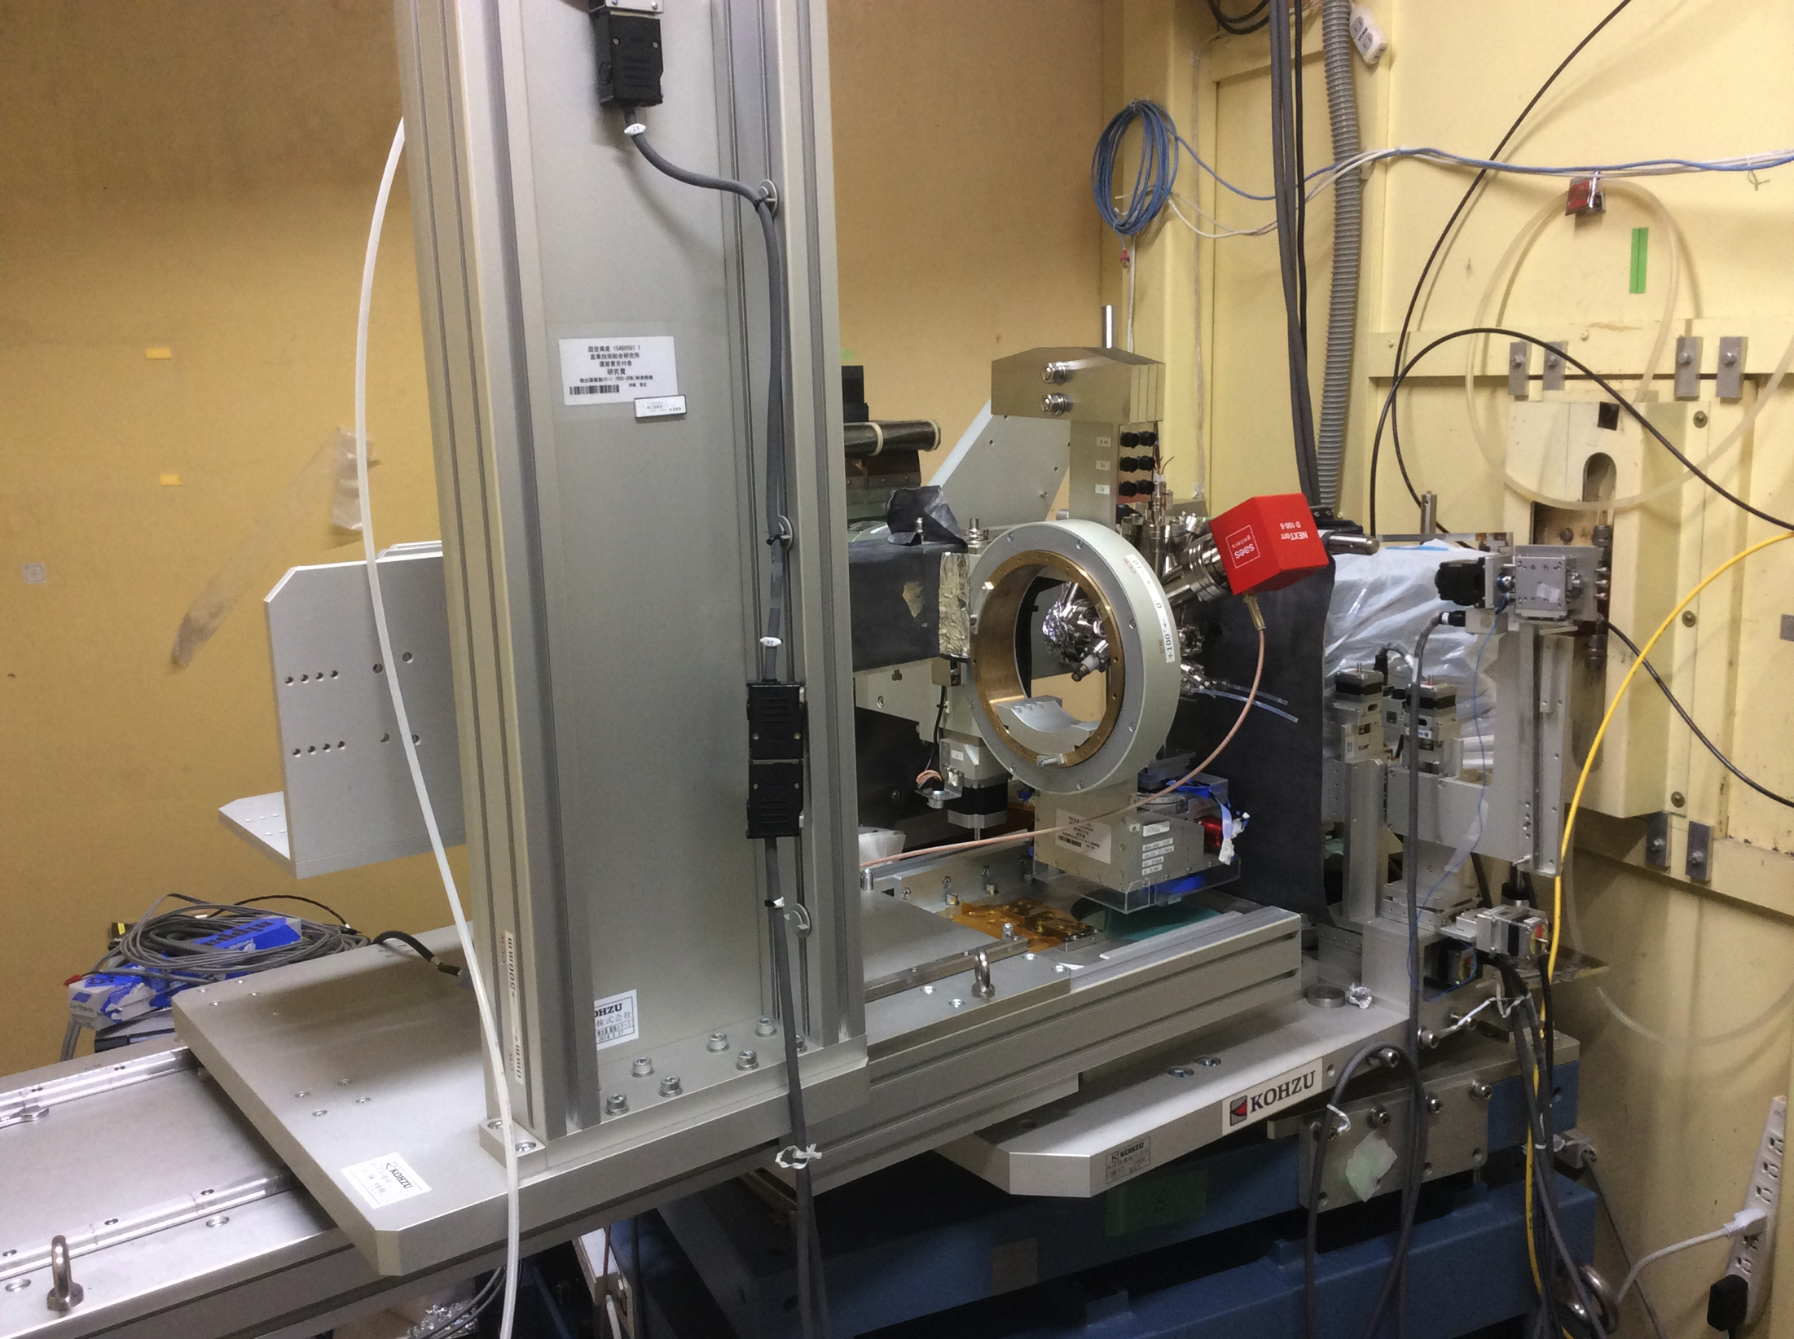
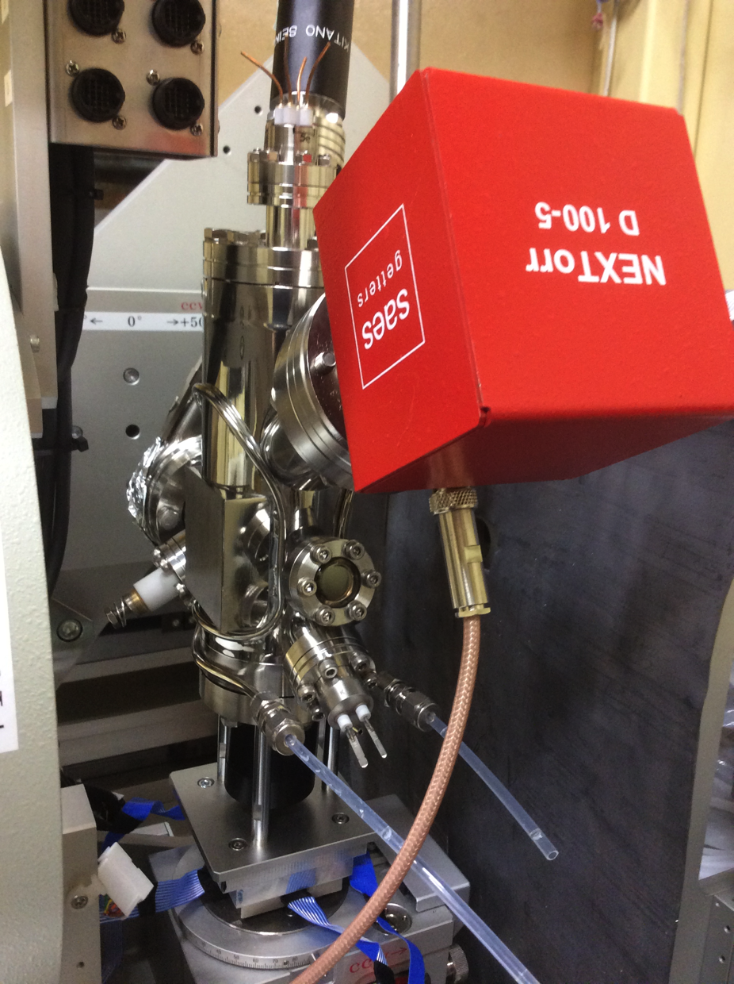
Baby MBE
< 1 x 10⁻⁸ Pa
70 mm
Be
Notes:
The film was grown in the baby molecular beam epitaxy chamber, which is equipped with a evaporator and ion and non evaporation getter pump.

Slide 13
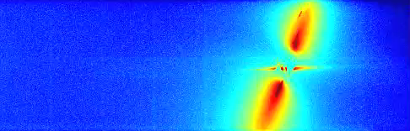
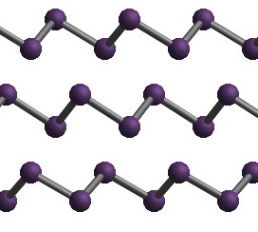
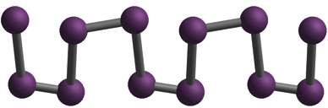
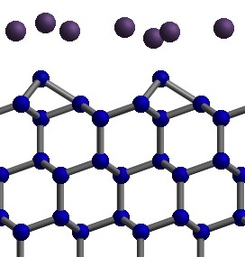
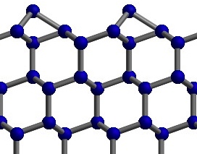
Bi thin film growth
Δt = 1s
3.4 Å⁻¹
1.3 Å⁻¹
Bi wetting layer
Si 111
Bulk Bi(001)
Bi(001)
BP(012)
BP → Bulk Bi at surface region
by LEED (λ_{L} ~ 1nm）
Black Phosphorus (BP)
Nagao et al., PRL 93, 105501 (2004).
BP → Bulk Bi whole the film
Bi wetting layer
Si(111)-7x7
Notes:
The first example is bismuth.
We show the movie of the detector images taken with a time resolution of 1 s.
For each image we can analyze the whole thin film structure from the top to bottom.
In the beginning, the elongation of CTR represents a formation of wetting layer, and then the black Phosphorus structure is formed.
Above a critical thickness of 2 nm, the structure is completely transformed at the bulk Bi structure.
The phase transition was previously observed by LEED, but the penetration depth is about 1 nm.
The present analysis confirms that the structure transition occurs whole the film.

Slide 14
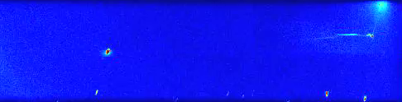
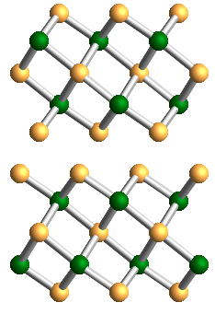
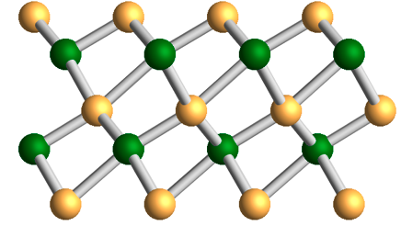
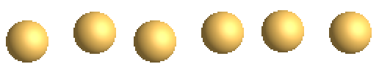
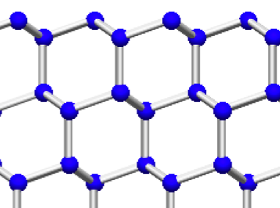
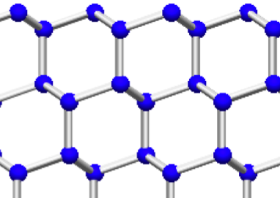
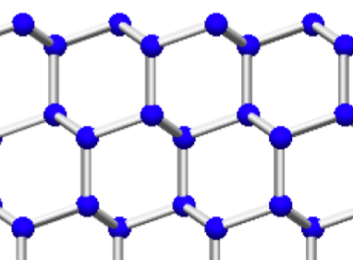
Bi₂Te₃ thin film growth
Δt = 1s
4.0 Å⁻¹
2.0 Å⁻¹
Bulk Bi₂Te₃
Wetting layer
Si 222
Si 111
Bi₂Te₃
Thinness limit of TI is 2~3 QL
Li et al., Adv. Mater. 22, 4002 (2010).
Deformed Bi₂Te₃
The wetting layer and deformed Bi₂Te₃ buffer the substrate potential
Wetting layer
Si(111)-7x7
Notes:
The next example is the bismuth telluride topological insulator.
In the beginning the wetting layer is formed, and the fist Bi2Te3 quintuple layer is strongly deformed, and then the bulk like structure is grown on it.
The deformed structure is remained at the interface.
The interface structures would be strongly related to the thinness limit of topological state.
It was shown that the topological surface states disappears below the 2 quintuple layers.
We think the wetting layer and the deformed first quintuple layer play a critical role for the decoupling of the upper layer from the substrate potential and the formation of the topological surface state.

Slide 15
Summary
Energy-dispersive SXRD for the high-speed measurement
2D det.
Curved crystal
White SR
Real-time monitoring of sol.-liq. and sol.-sol. interfaces (Δt = 1s)
Electro-decomposition of methanol on Pt(111) electrode.
Thin film growth of Bi and Bi₂Te₃
CTR intensity
Q_{z}
Operando observation
Thank you
for your attention!
Notes:
In summary, we have developed an energy dispersive surface x-ray diffraction for the high-speed measurement.
We show examples of the real-time monitoring of the solid-liquid and solid-solid interface systems, demonstrating the capability of the in operando observation.
Thank you for the attention.

