Slide 1

Free-Standing Graphene on 3C-SiC Nanostructures
Mojtaba Amjadipour, Jennifer MacLeod, Josh Lipton-Duffin, Anton Tadich, John Boeckl, Francesca Iacopi, and Nunzio Motta

Slide 2
Overview
Why graphene on SiC?
Epitaxial graphene growth on SiC
Use of atomic hydrogen for epitaxial graphene growth
Graphene on FIB patterned SiC nanostructures
Free-standing graphene on SiC

Slide 3
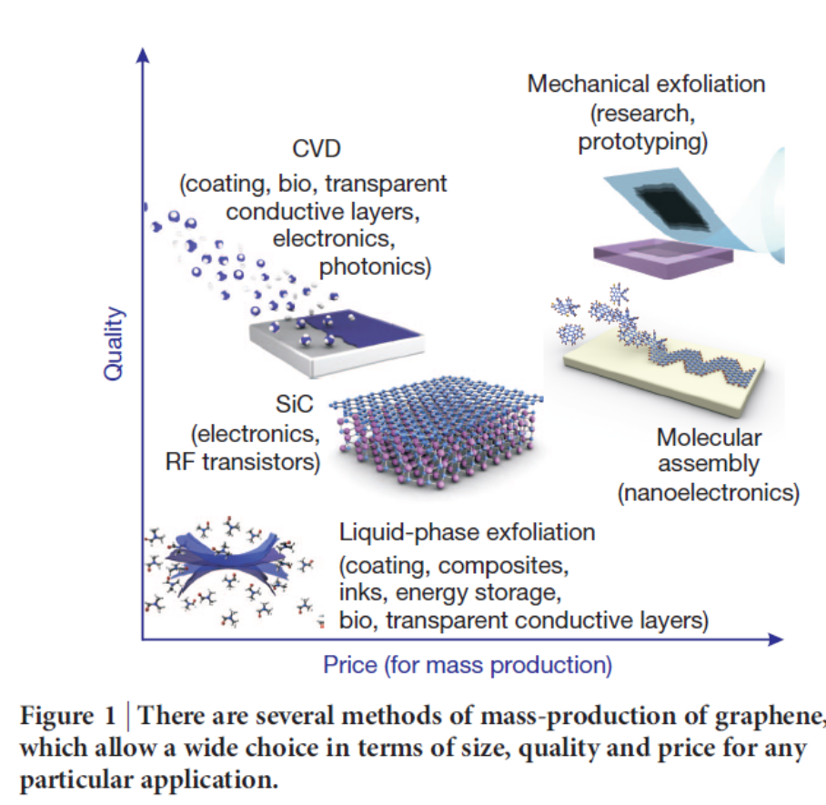
Graphene growth on SiC by Si sublimation
SiC is a common material for electronics
No transfer is required, Direct growth on semiconductor
Compatibility with the semiconductor industry
Potential combination with other 2D materials
One drawback is that bulk SiC is very expensive, so we use thin film SiC on silicon
Geim, A.K., Science, 2009. 324(5934): p. 1530-1534
Notes:
Graphene is a wonder material with many superlatives to its name.
One of the most elastic material
Very stable chemically
Sustains current densities six times better than copper
How can we make graphene?
We can produce graphene by a vaious methods such as liquid phase exfoliation, CVD, Mechanical expholiation of graphite, molecular assembly, and graphitization of SiC. We are focused on Ggraphene growth on SiC.

Slide 4
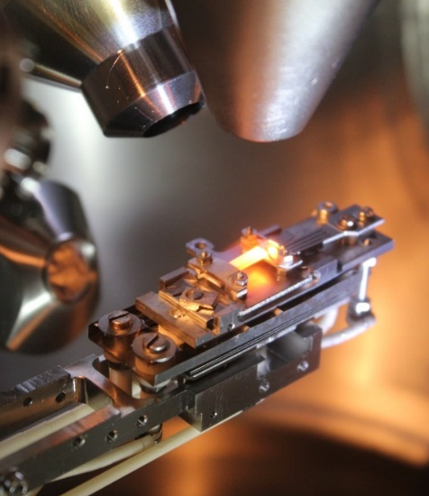
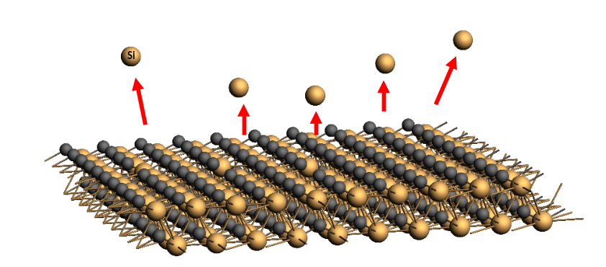
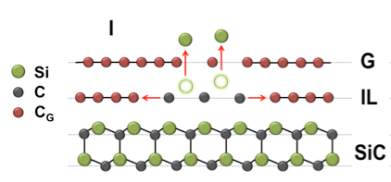
How does graphene grow on SiC?
Si leaving SiC as a result of high temperature annealing (~1100 ˚C)
Si
SiC/Si during annealing by direct current heating in UHV (~1200 ˚C)
F.Zarotti, B.Gupta. et al. Carbon 98 - (2016) 307-312
Notes:
How does graphene grow on SiC?
By annealing SiC at high temperatures, the silicon atoms leave the substrate and the remaining carbon atoms shape to graphene. The growth process of epitaxial graphene on SiC is studied thorouly in our group.

Slide 5
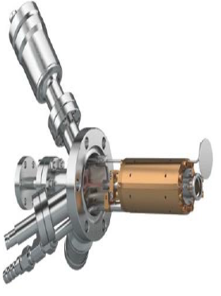
Atomic
Hydrogen
SiC
How does atomic H help for graphene growth?
STM image
Atomic hydrogen etching of SiC:
Removes contamination
Flattens the surface
Degassing at 600 ˚C
STM, The moiré pattern
XPS survey spectrum
Atomic Hydrogen Etching at 1000 ˚ C
Graphene Growth at 1250 ˚C
EFM-H atomic hydrogen source (FOCUS GmbH)
-1.1 V, 1 nA
(V_{bias}=-1.4 V, I =0.3 nA)
Notes:
There are a few ways available for opening a bandgap in graphene. But one of the very interesting ones is through quntum confinement. By this method we try to confine the movment of electron in graphene lattice by sgrinking its size to few nanometers. By that it is reported that a bandgap can be creatyed for graphene. There are a few ways available for producing graphene nanoribbons. But here we are focused on use of Ion milling for graphene nanoribbon production. Use of ion milling give us a great pre cision in milling. However, it is very challenging due to the damage that ions can cause to the solid such as amorphisationa and contamination through impalining ion elements in the solid.

Slide 6
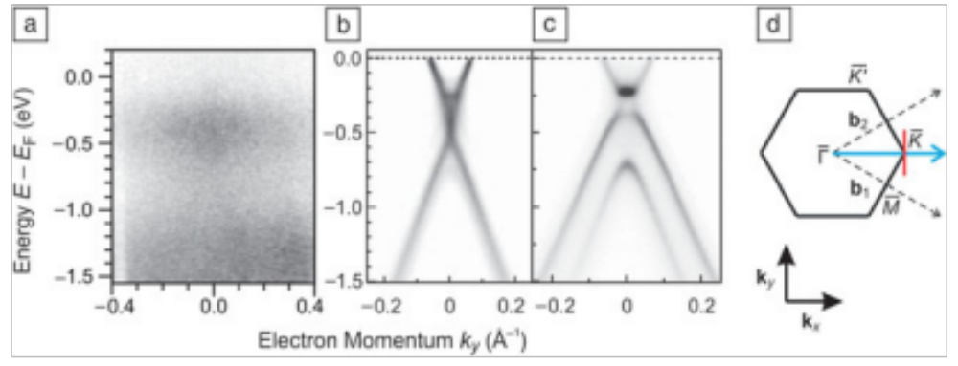
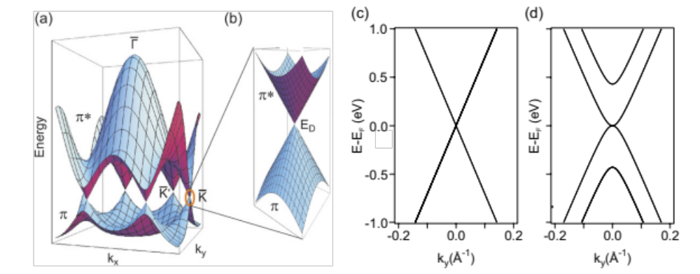
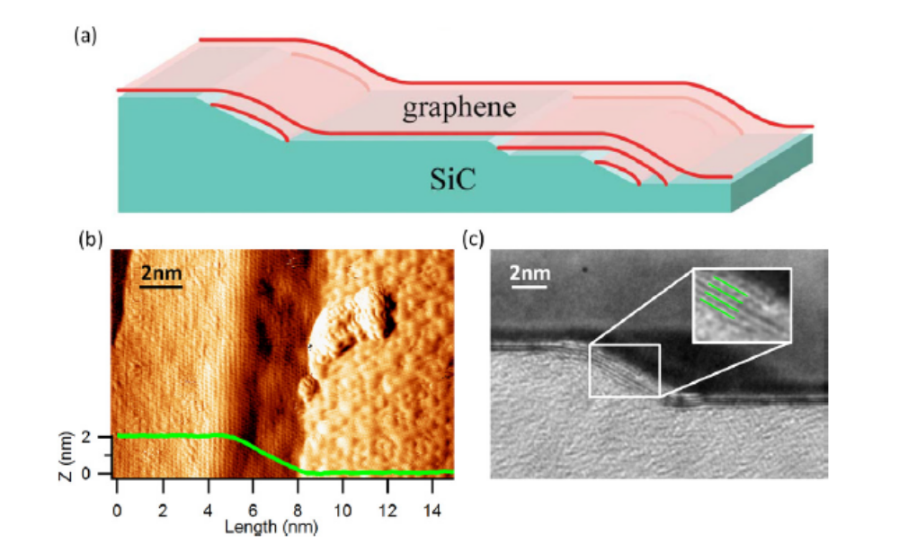
Bandgap in graphene?
Experiment
Riedl et al.
MRS Bull. 37, Dec 2012
Quantum confinement
Monolayer
Bilayer
lack of bandgap is a major challenge for graphene electronics
graphene sidewall ribbons on SiC
McCann and Fal’ko,Phys.Rev.Lett.96 086805, 2006.
Norimatsu W and Kusunoki M 2010 Phys. E, 42 691
Notes:
Graphene is a semimetal with zero band gap. Lack of bandgap challenges the use of graphene instead of silicon. Therefore there has been a lot of effeort in the recent years in order to find a way to open a bandgap for graphene.

Slide 7
Nanoscale Graphene Fabrication
Common procedure for patterning:
Nanolithography using scanning tunnelling microscopy
very time consuming which makes it incompatible with industrial processes
FIB (Ga⁺)
Photolithography
requires coating and removal of a resist layer
Focused Ion Beam Milling
Flexible and easy to use for a variety of materials

Slide 8
Effect of Ga Exposure on Graphene Growth?
HIM Image
HIM Image
EDX Mapping
Annealing at 1200 ˚C
M. Amjadipour et al. Nanotechnology 28.34 (2017): 345602.
Notes:
In this study we showed the effect Ga ion poisoning on the graphene nanoribbon fabrication, and also we propose a procedure how to overcome the damage and produce high quality grapherne on FIB patterned nanostructures of SiC.

Slide 9
How to Protect The Surface?
(V_{bias}=-1.8 V, I =1 nA)
No Damage
Using Si Layer
HIM Image
M. Amjadipour et al. Nanotechnology 28.34 (2017): 345602.
Notes:
In this study we showed the effect Ga ion poisoning on the graphene nanoribbon fabrication, and also we propose a procedure how to overcome the damage and produce high quality grapherne on FIB patterned nanostructures of SiC.

Slide 10
Si Protective Layer
An electron beam evaporator (EFM 3, FOCUS GmbH) was used to deposit a Si layer
Uniform Si coverage
AFM Image
M. Amjadipour et al. Nanotechnology 28.34 (2017): 345602.
Notes:
Figure ‎4‑10. (a) SEM image showing the area covered by the clamp of the sample holder which was not coated by silicon. (b) Higher magnification HIM image showing that the surface is covered by the silicon thin film. (c) Atomic force microscopy (AFM) image taken from the area coated by Si indicating its uniform coverage at the micron scale, where only typical SiC features are present. The inset shows a higher-resolution image with a line profile taken on the region indicated by the yellow line; the variation in height across the terrace is less than 0.5 nm. AFM images were taken using an NT-MDT Solver Pro microscope equipped with an NT-MDT NSG30 cantilever and operated in non-contact mode.

Slide 11
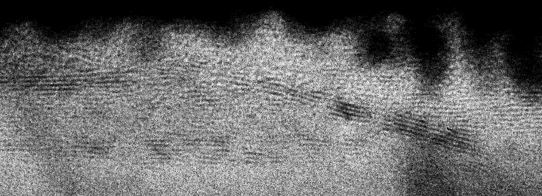
STEM Study
3 nm
Graphene
Pt
Pt
3C-SiC
Silicon Substrate
1 µm
STEM HAADF(high-angle annular dark-field)
@FEI Scios UQ
Notes:
There are a few ways available for opening a bandgap in graphene. But one of the very interesting ones is through quntum confinement. By this method we try to confine the movment of electron in graphene lattice by sgrinking its size to few nanometers. By that it is reported that a bandgap can be creatyed for graphene. There are a few ways available for producing graphene nanoribbons. But here we are focused on use of Ion milling for graphene nanoribbon production. Use of ion milling give us a great pre cision in milling. However, it is very challenging due to the damage that ions can cause to the solid such as amorphisationa and contamination through impalining ion elements in the solid.

Slide 12

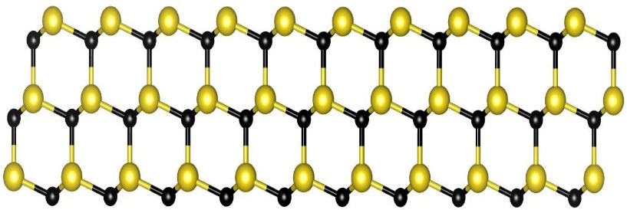

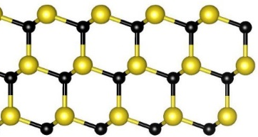
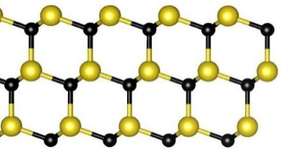
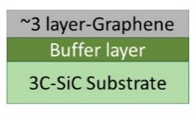
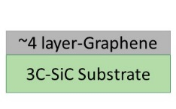
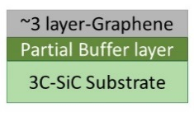
Photoelectron Spectroscopy (PES) Measurement C 1s 330 eV
Free-Standing Graphene on 3C-SiC/Si(111)
Free-standing Graphene
Graphene
Buffer Layer
Exposure to H⁺
Si
Partially bonded
C
Dangling bond
H
As Grown Graphene
Free-Standing
H-desorbed
H-desorbed partially
C 1s 330 eV
C 1s 330 eV
C 1s 330 eV
C 1s 330 eV
Graphene
H-intercalation
700 ˚C
850 ˚C
Buffer
SiC
600 ˚C, 30 mins
M. Amjadipour et al. Nanotechnology 29.14 (2018): 45601.
Notes:
The comparison of the peak intensity further confirms this, as the ratio of graphene-related spectral weight to silicon carbide spectral weight, $R=\frac{I_{gr}+I_{S1}+I_{S2}}{I_{SiC}}≅12$ , remains constant through the intercalation. In this expression

Slide 13
Free-Standing Graphene on 3C-SiC/Si(111)
Low Energy Electron Diffraction (LEED) Study
M. Amjadipour et al. Nanotechnology 29.14 (2018): 45601.

Slide 14
Free-Standing Graphene on 3C-SiC/Si(111)
Near-Edge X-ray Absorption Fine Structure (NEXAFS) Study
Intensity Increase
Carbon K-edge NEXAFS spectrum
Normal Angle
Grazing Angle
Analyser
Analyser
At grazing angle π* feature enhances
lower interaction of the graphene layer with the substrate
At normal angle σ* feature enhances
Sample
Sample
C-H bonding at the interface
M. Amjadipour et al. Nanotechnology 29.14 (2018): 45601.
Notes:
The unoccupied electronic states of graphene grown on a 3C-SiC/Si thin film were studied using near-edge x-ray absorption fine structure (NEXAFS) to further understand how the hydrogen intercalation affects the interface layer. Figure 5-4 shows the carbon K-edge NEXAFS spectrum from monolayer epitaxial graphene grown on 3C-SiC/Si thin film. NEXAFS was acquired with two different incident angles of the synchrotron light with respect to the surface normal: 0° (normal) and 70° (grazing). The NEXAFS spectra are characterised by two main peaks at 285.3 and 291.6 eV which correspond to transitions from the C1s core level to π* and σ* empty states respectively
Varying the incident angle modifies the probability for different transitions for C1s. 1s - π* has higher probability for the electric field vector perpendicular to the molecular plane, and 1s - σ* is maximised for a parallel field [9]. As a consequence, the intensity of the σ* peak significantly decreases at grazing angles, and the π* transition has the opposite behaviour. NEXAFS was conducted on three different samples before and after H-intercalation with different numbers of graphene layers: monolayer, bilayer and ~ 3 graphene layers.
lower interaction of the graphene layer with the substrate
The difference between NEXAFS and traditional photoemission experiments is that in photoemission, the initial photoelectron itself is measured, while in NEXAFS the fluorescent photon or Auger electron or an inelastically scattered photoelectron may also be measured. The distinction sounds trivial but is actually significant: in photoemission the final state of the emitted electron captured in the detector must be an extended, free-electron state. By contrast in NEXAFS the final state of the photoelectron may be a bound state such as an exciton since the photoelectron itself need not be detected.

Slide 15
Free-Standing Graphene on 3C-SiC/Si(111)
DR is equal to -1 for a perfect graphene
Dichroic Ratio
Graphene condition | DR for As-grown | DR for H-intercalated | DR change
~ 1 layer | -0.542 | -0.610 | -0.068
~ 2layers | -0.545 | -0.596 | -0.051
~ 3 layers | -0.63 | -0.663 | -0.026
$$DR= \frac{I_{ϴ_{1}}− I_{ϴ_{2}}}{I_{ϴ_{1}}+ I_{ϴ_{2}}}$$
$I_{ϴ_{1}}$and $I_{ϴ_{2}}$show the π* peak region intensity for normal and grazing incident angle.
H-intercalation improves flatness
Graphene
Buffer Layer
M. Amjadipour et al. Nanotechnology 29.14 (2018): 45601.
Notes:
In order to further study the H-intercalation process, a dichroic ratio $DR= \frac{I_{ϴ_{1}}− I_{ϴ_{2}}}{I_{ϴ_{1}}+ I_{ϴ_{2}}}$ is calculated, where $I_{ϴ_{1}}$and $I_{ϴ_{2}}$show the π* peak region intensity which is extrapolated by integrating the area under the peak for normal incident angle ${(ϴ}_{1}=0)$ and grazing incident angle ${(ϴ}_{2}=90)$. The dichroic ratio is a measure for assessing the alignment of graphene, and is expected to equal to -1 for a completely flat graphene and becomes 0 for a randomly oriented sample. [59]. H-intercalation improves the DR and makes the graphene flatter (Table 5-1 and Figure 5-7). This increase in DR is smaller for the sample with more graphene layers (from -0.068 for monolayer to -0.026 for the three-layer one). This is due to the fact that most of the improvement in the orientation of graphene stems from elimination of the buffer layer after H-intercalation, and by increasing the number of the graphene layer, the contribution of the buffer layer to the signal becomes less significant.

Slide 16
Free-Standing Graphene on 3C-SiC/Si(111)
H-intercalated graphene is stable in air
M. Amjadipour et al. Nanotechnology 29.14 (2018): 45601.

Slide 17
Conclusion
1- Epitaxial graphene growth on SiC
2- Effect of atomic hydrogen etching of SiC on graphene growth
3- Fabricating graphene nanoribbons using focused ion beam (FIB)
4- Producing free standing graphene on SiC by atomic hydrogen exposure
Notes:
There are a few ways available for opening a bandgap in graphene. But one of the very interesting ones is through quntum confinement. By this method we try to confine the movment of electron in graphene lattice by sgrinking its size to few nanometers. By that it is reported that a bandgap can be creatyed for graphene. There are a few ways available for producing graphene nanoribbons. But here we are focused on use of Ion milling for graphene nanoribbon production. Use of ion milling give us a great pre cision in milling. However, it is very challenging due to the damage that ions can cause to the solid such as amorphisationa and contamination through impalining ion elements in the solid.

Slide 18
Acknowledgements
Supervisory Team:
Prof Nunzio Motta, Prof Francesca Iacopi, Dr Jennifer MacLeod, Prof Jose Alarco.
CARF:
Dr Annalena Wolf, Dr Josh Lipton Duffin, Dr Peter Hines, Dr Jamie Riches, Dr Christopher East.
Australian Synchrotron:
Dr Anton Tadich.
Team mates:
Dr Bharati Gupta, Jonathan Bradford, Nima Khoshsirat.
Central Analytical Research Facility (CARF)

