Slide 1


The role of lattice dynamics in the superconductivity enhancement at FeSe/SrTiO₃ interface
Jiandong Guo
Institute of Physics, Chinese Academy of Sciences
VASSCAA-9, Aug. 15, 2018, Sydney

Slide 2

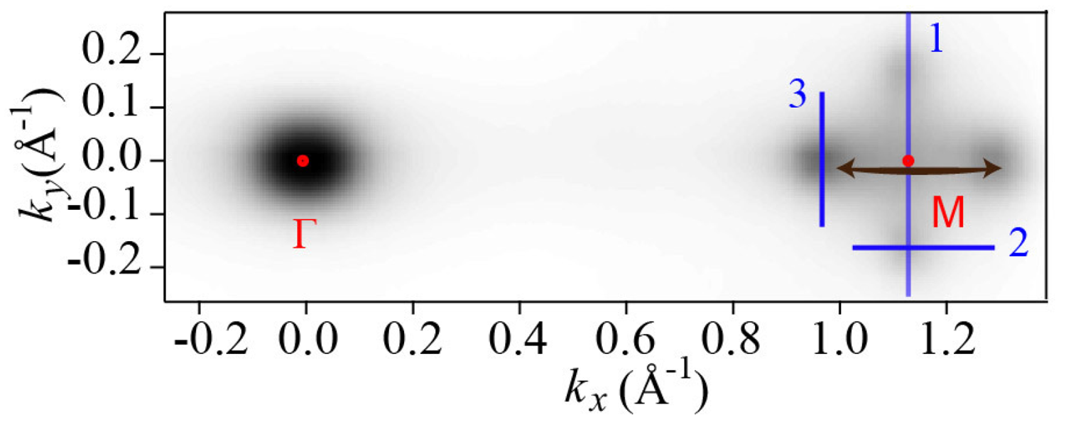
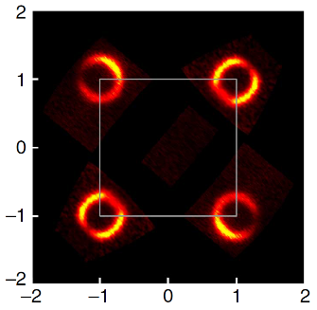
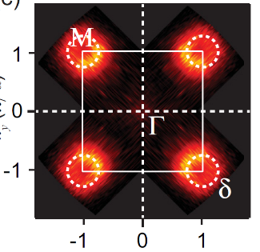
Tuning the superconductivity of FeSe
Carrier doping & interfacial coupling!
T_{C}/K
FeSe bulk
FeSe/Graphene
K-Doped FeSe Film
K-Doped Bulk FeSe
Liquid Gated FeSe/STO
(Li_{0.84}Fe_{0.16})OHFe_{0.98}Se
60 K
Interface Enhanced
40 K
Electron Doped
20 K
FeSe/SrTiO₃(001)(110)
FeSe/TiO₂
FeSe/BaTiO₃
FeSe/strained SrTiO₃
0 K
Bulk
Wu et al., PNAS 2008
Xue et al., Science 2011
Xue et al., PRB 2016 Feng et al., Nano Lett. 2016
Hosono et al., PNAS 2016 Chen et al., Nat. Mater 2015
Xue et al., APL 2016 Feng et al., Nat. Comm. 2014
Xue et al., PRL 2016 Shen et al., PRL 2017

Slide 3
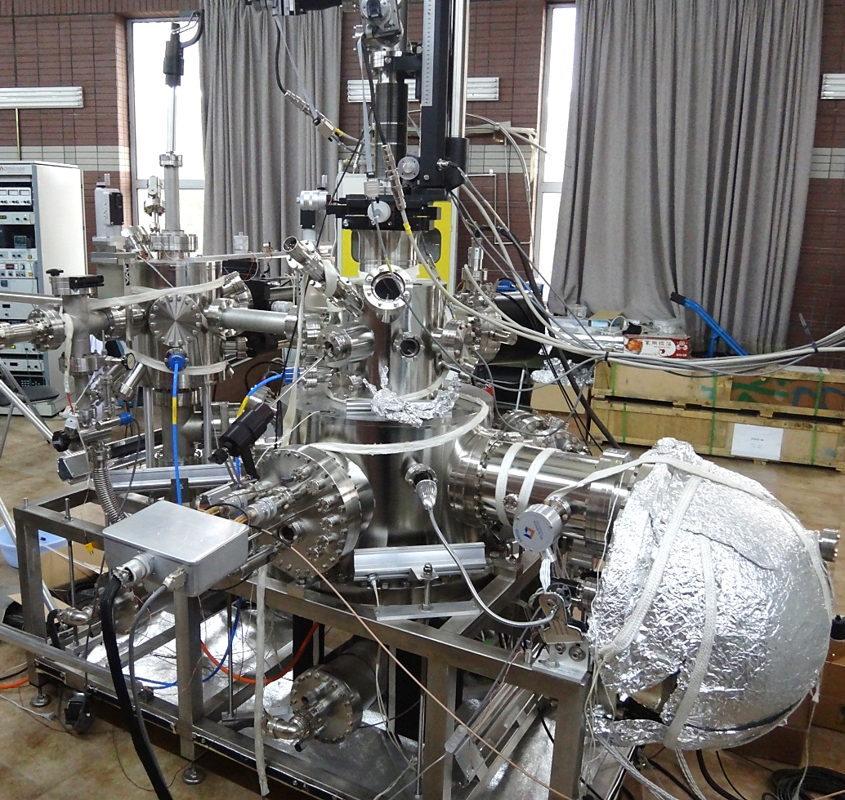
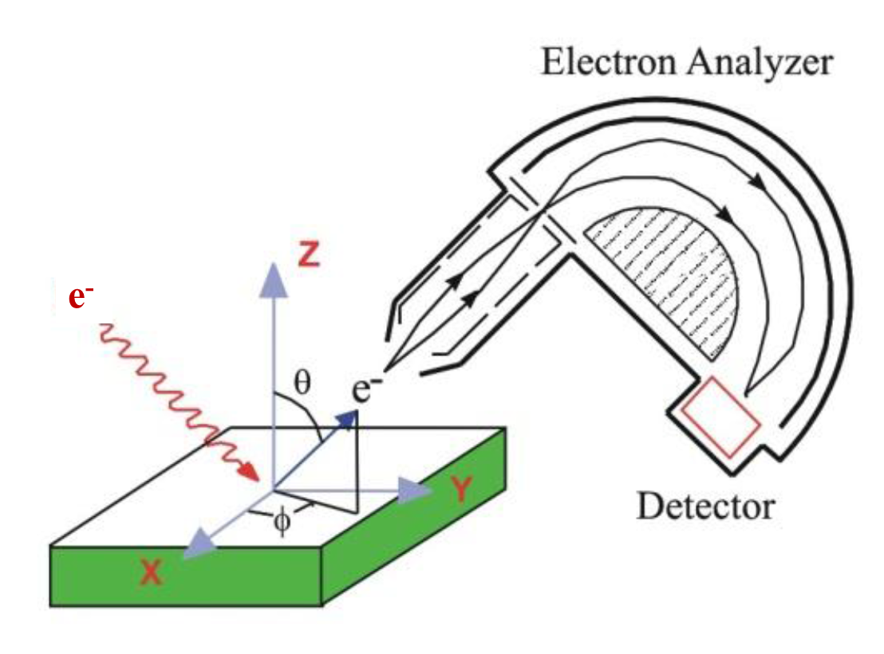
To probe the interfacial coupling…
Electron Energy Loss Spectroscopy (HREELS)
2D resolved HREELS
MBE
system
LEED
ARPES
HREELS
Ultimate ΔE < 0.7 meV
Ultimate Δθ < 0.1º
Δq < 0.005Å⁻¹
High detection efficiency
Large momentum range
Energy
Analyzer
Zhu et al., Rev. Sci.Instrum. 86, 083902 (2015)
Notes:
0.002A
3meV

Slide 4
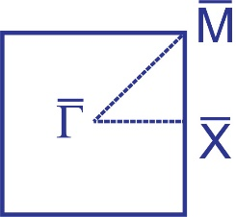
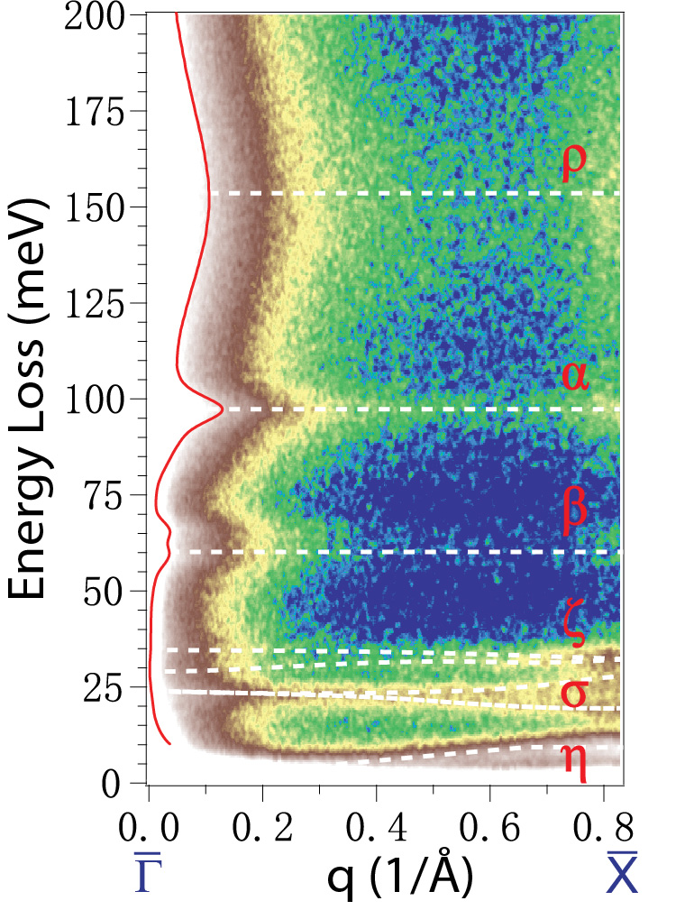
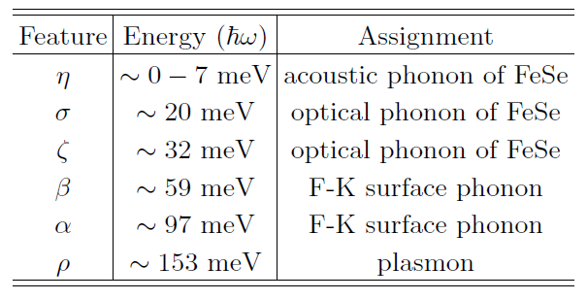
Low-energy excitations on FeSe/SrTiO₃
1uc-FeSe/STO at 35 K
STO
FeSe

Slide 5
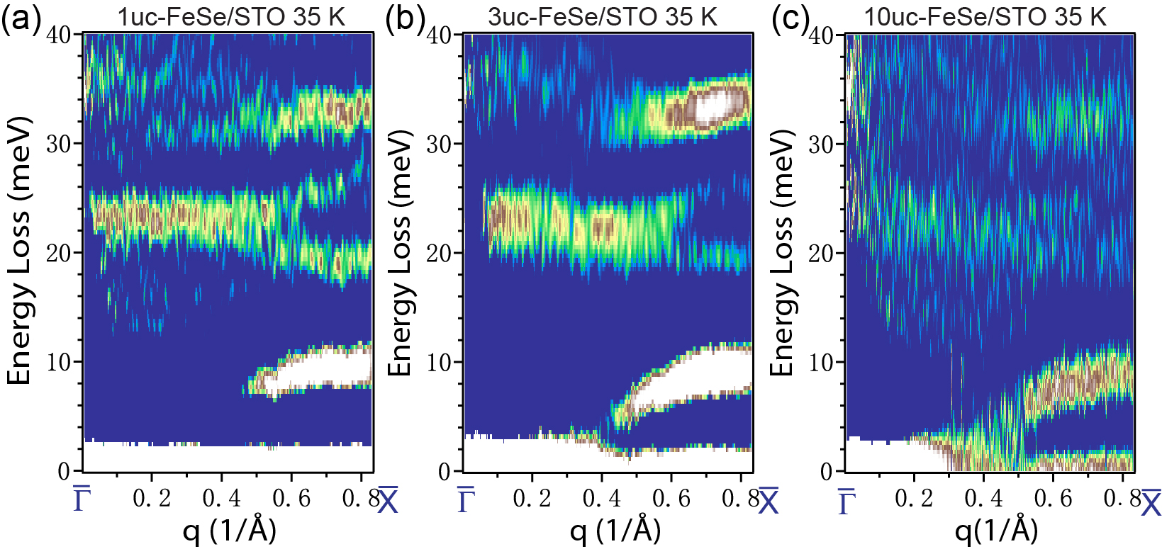
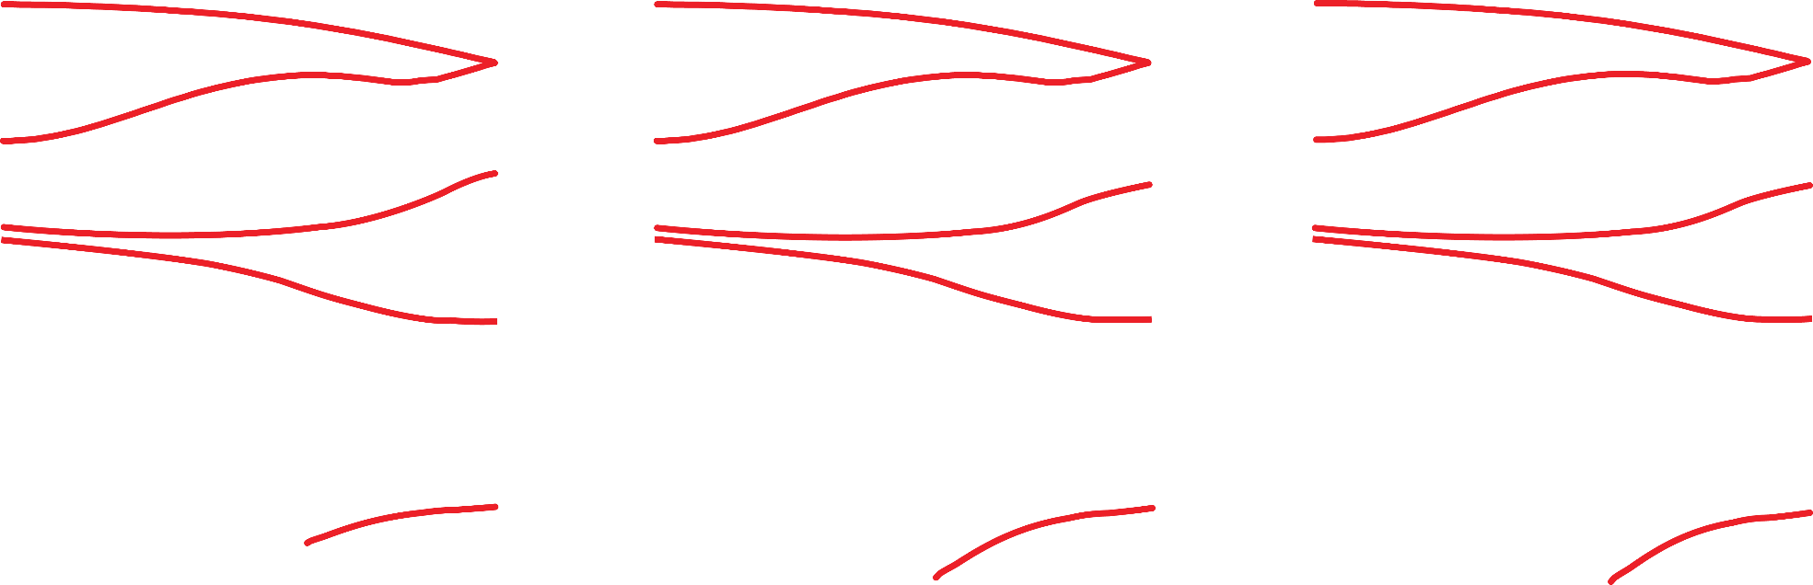
Fe- and Se-derived phonons
No thickness dependence
No interface effect
Not related to SC enhancement
PRB 97, 035408 (2018)

Slide 6
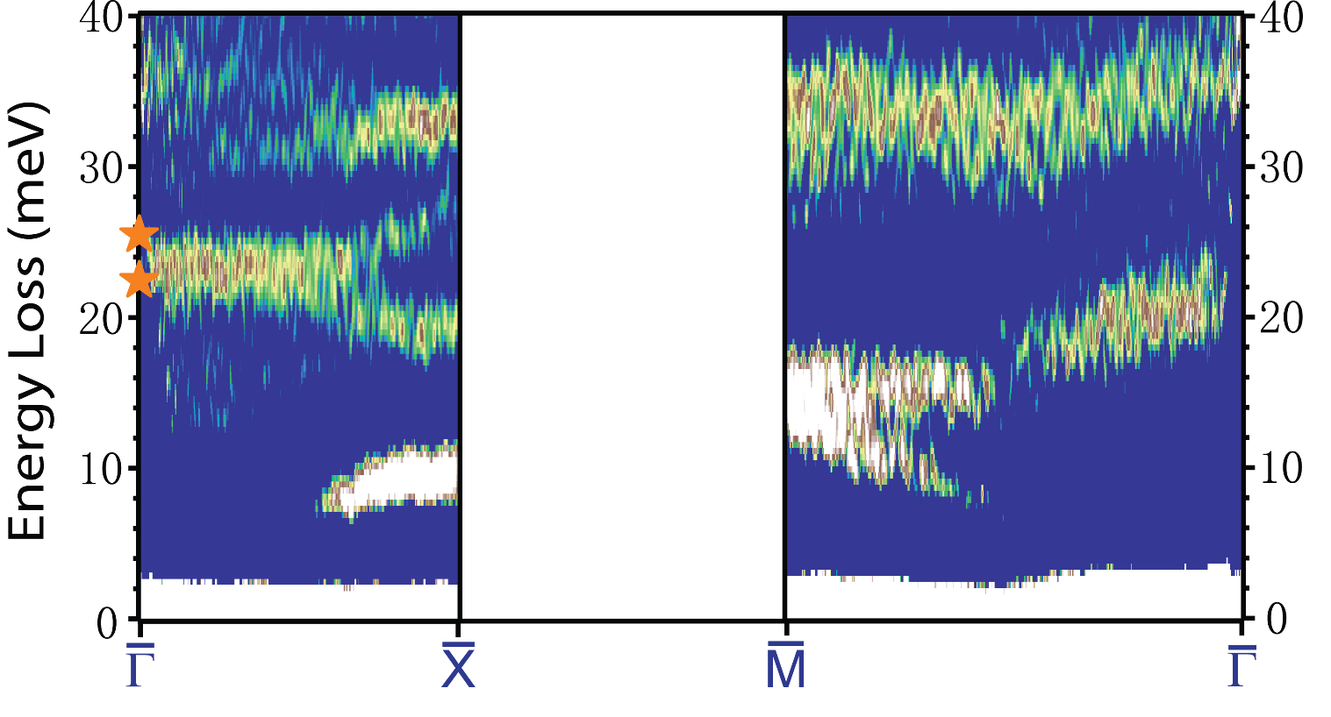

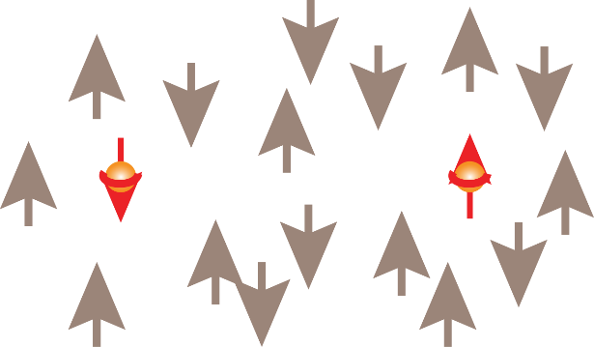
AFM order or spin fluctuation
DFT calculation:
UTK: Yan Wang
Steve Johnston
ORNL: Tom Berlijn
Initial pairing in FeSe
J
spin channel J
AFM correlation or spin fluctuation is identical for both FeSe films and bulks. Not enhanced at the interface.
Notes:
Bulk: colinear; 20 meV the most important. Cal: Checkerboard & colinear

Slide 7
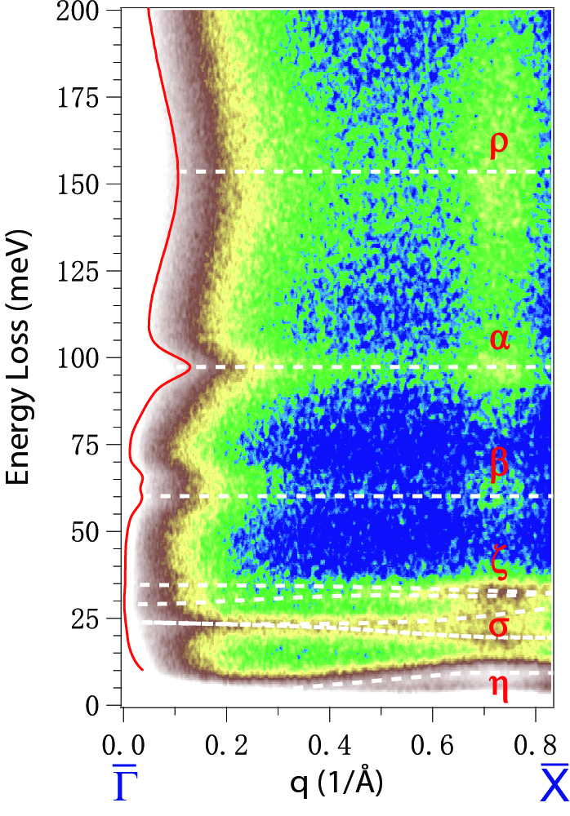
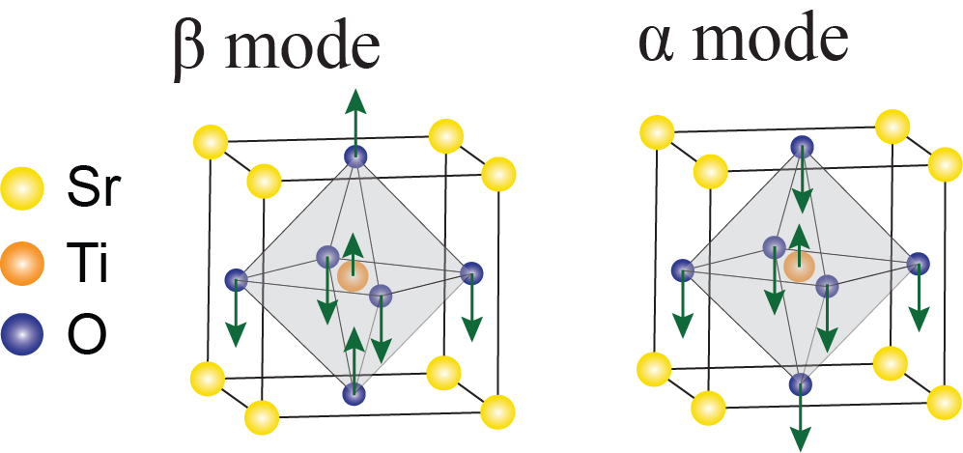
STO surface phonons on 1 uc FeSe/SrTiO₃
1uc-FeSe/STO at 35 K
Fuchs-Kliewer (F-K) phonon:
Optical modes of vibration on the surface of ionic crystals, such as oxides.
β mode: 59 meV
α mode: 97 meV
Penetrating electric field generated by F-K phonons
PRB 94, 081116(R) (2016)

Slide 8
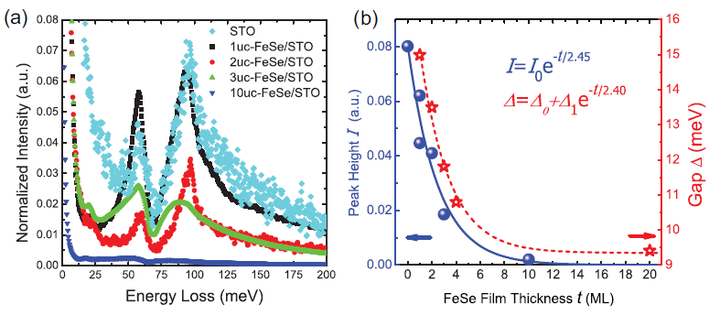
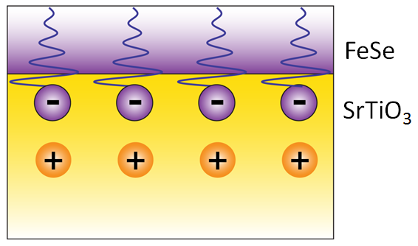
SrTiO₃ phonons penetrating into FeSe
Penetration Length: ~ 2.5 u.c.
Gap data: D. L. Feng et al., Nano Letters 16, 1869 (2016)
F-K phonons of oxides
Superconductivity Enhancement
Phys. Rev. B 94, 081116(R) (2016)

Slide 9
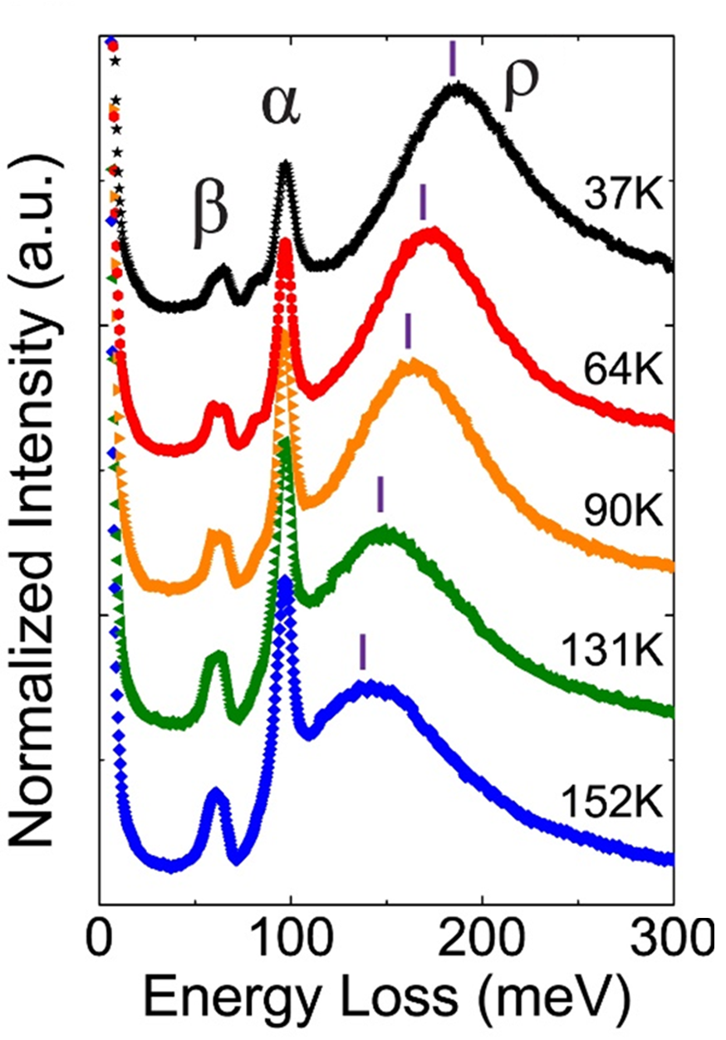
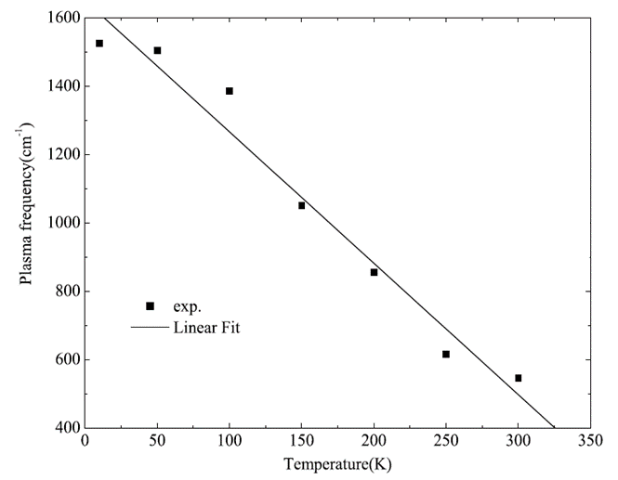

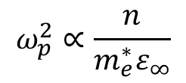


The microscopic picture…
1uc-FeSe/STO at 35 K
Surface plasmon ρ ~ 150 meV
Nb:SrTiO₃
Nb:SrTiO₃
$$ω_{p}^{2}∝\frac{n}{m_{e}^{∗}ε_{∞}}$$
$n≈1.4×{10}^{20}{cm}^{−3}$
$$ω_{pl}≈200 meV \text{at}\text{ 10}\text{K}$$
C Z Bi, JPCM 18, 2553–2561 (2006)
$m_{e}^{∗}$: polaron effective mass
F. Gervais, PRB 47, 8187 (1993)
G. Verbist, Ferroelectrics 130:1, 27-34 (1992)

Slide 10
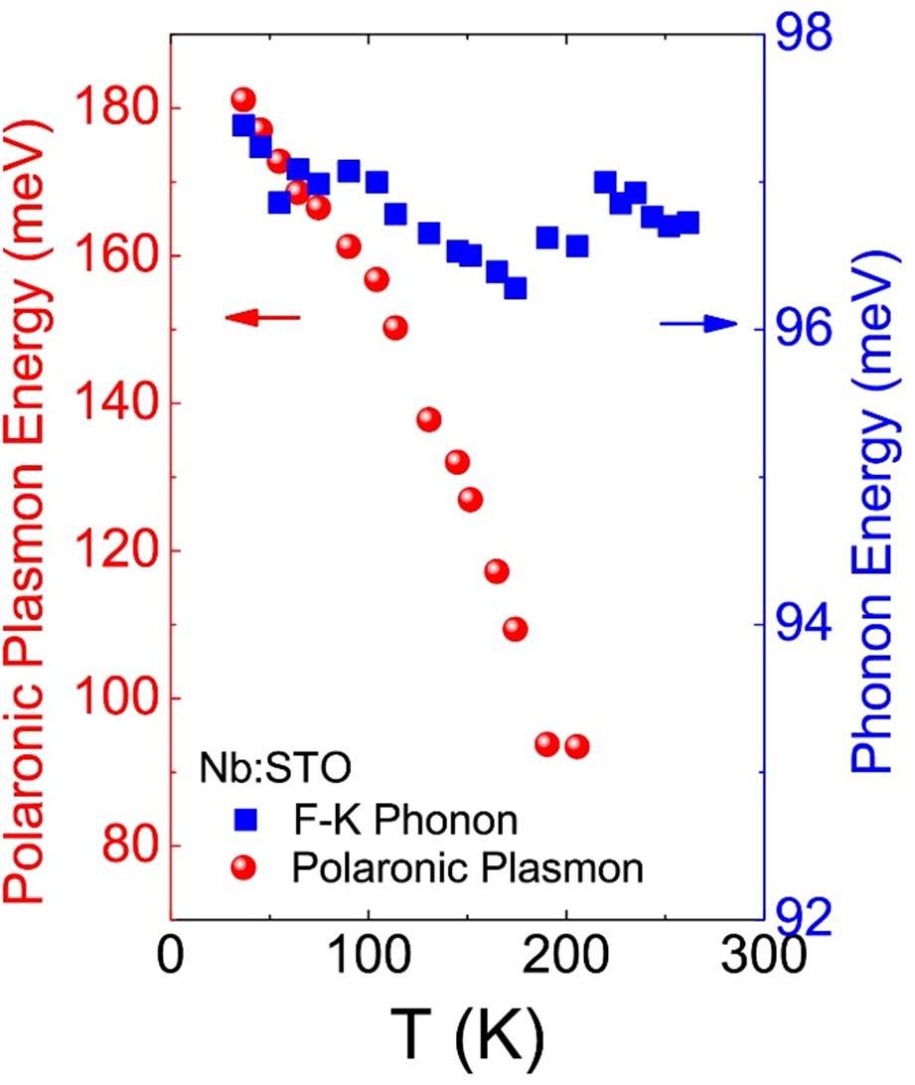
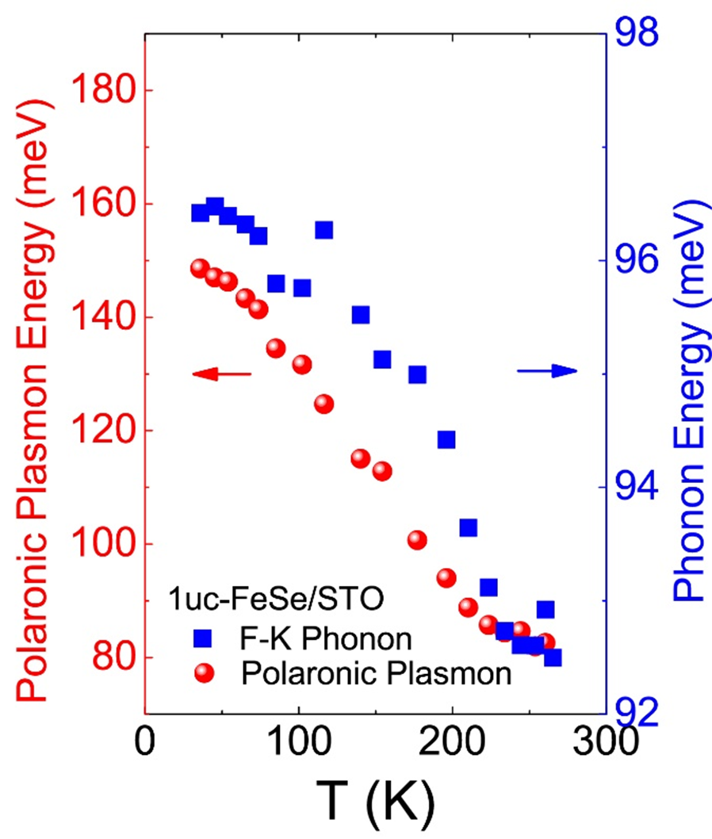
Plasmon vs. phonon
Nb:STO
1uc-FeSe/STO
uncorrelated
correlated

Slide 11
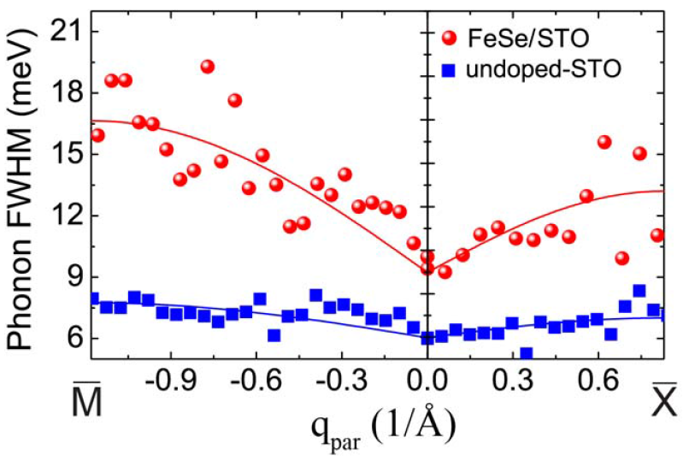
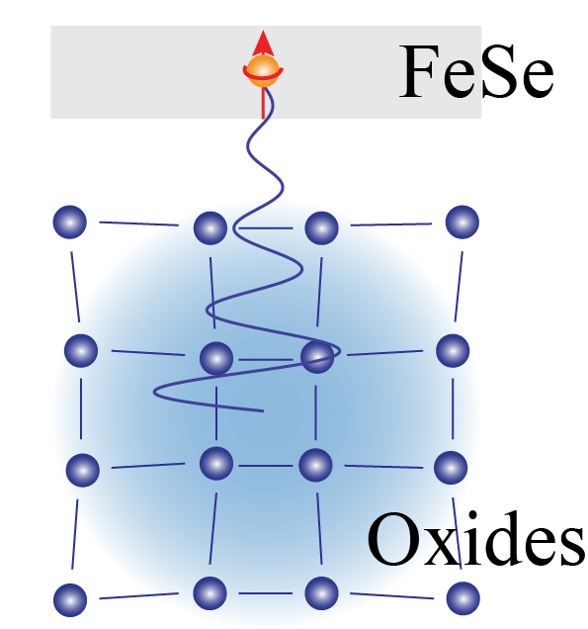
The interfacial electron-boson coupling
Interfacial polaronic plasmon
interfacial polaron
STO lattice can dress electrons in FeSe through the mediation of electric field generated by FK phonons, i.e. interfacial polaron.

Slide 12
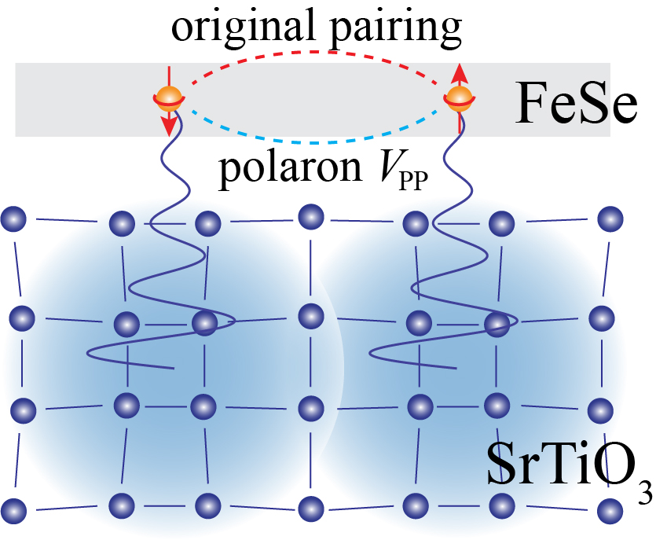
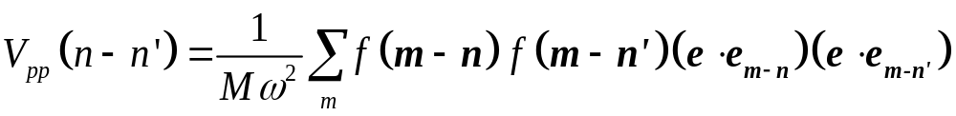
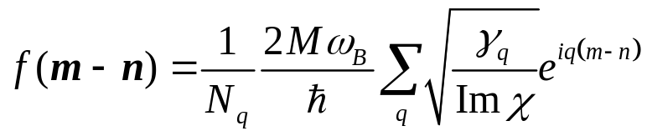
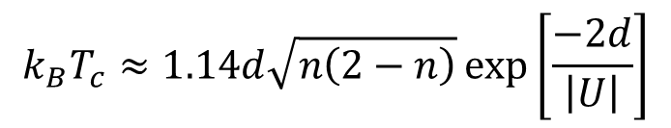
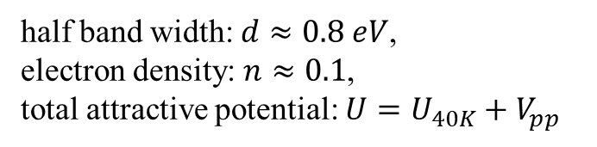
Non-adiabatic polaron-polaron interaction
V_{pp}
Additional attractive potential V_{pp}
γ_{q}: Phonon linewidth
Im[χ]: Lindhard function
J. Devreese, et al. Reports on Progress in Physics 72, 066501 (2009).
Hubbard model with a negative U
At the coherent length of 1.2 nm, V_{pp} can enhance the T_{C} to ~70K.
$$k_{B}T_{c}≈1.14d\sqrt{n\left(2−n\right)}\exp\left[\frac{−2d}{\left|U\right|}\right]$$
half band width: $d≈0.8 eV$,
electron density: $n≈0.1$,
total attractive potential: $U=U_{40K}+V_{pp}$
USTC：Zhenyu Zhang et al.
Notes:
Give a summary at the beginning. F: force constant, e is the phonon polarization vector and e(m-n) is the unit vector in the direction from electron site m and ion site n

Slide 13
Summary
AFM correlation: <40 K
spin channel J
Dynamic Interfacial Polaron: 40 ~65 K
additional attractive interaction in short range
Local Pairing: ξ_{pair}~ 1.2 nm
Superconductivity is enhanced by the non-adiabatic polaron-polaron interaction, i.e. dynamic interfacial polaron.

Slide 14

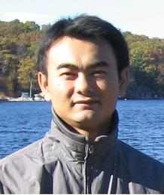

Acknowledgement
Sample growth：
Shuyuan Zhang
Xuetao Zhu
Jiaqi Guan
Phonon cal.: Yan Wang, Steve Johnston (UTK)
Bipolaron modeling: Tong Wei, Zhenyu Zhang (USTC)
Thank you for your attention!

Slide 15
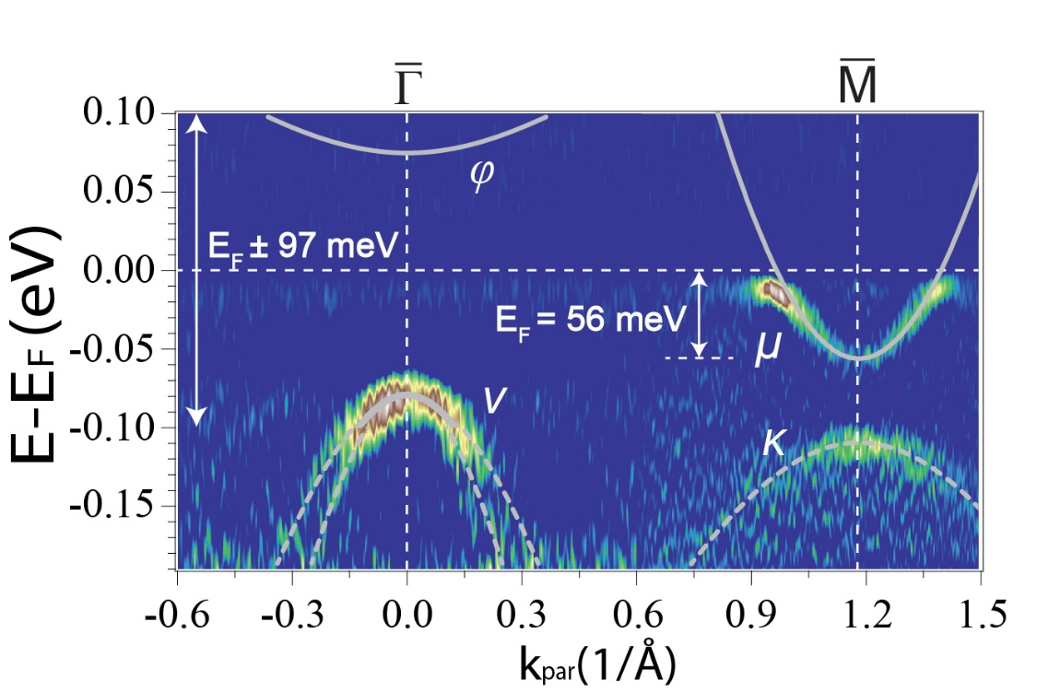
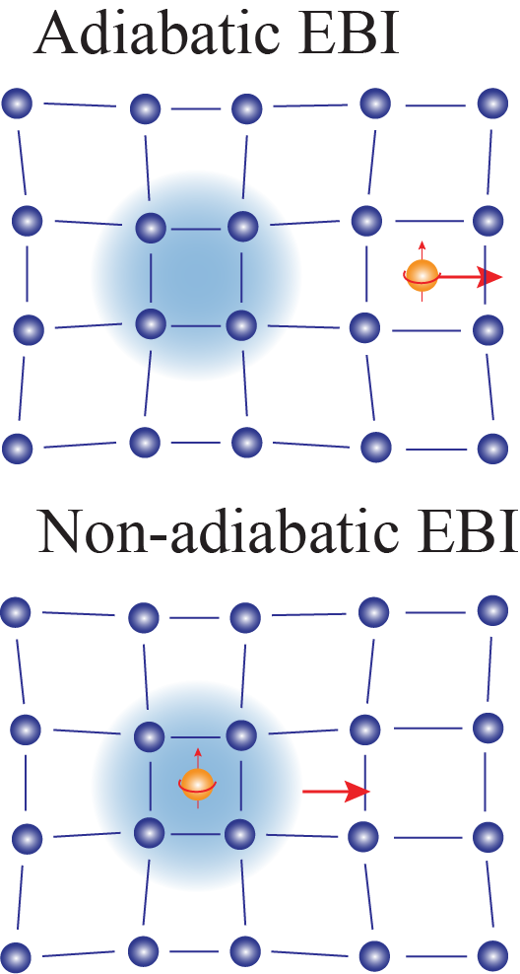
Dynamic interfacial polarons
Adiabatic Limit:
1uc-FeSe/STO at 35 K
Low phonon energy (ħω_{B})
High Fermi Energy (E_{F})
Metal
ħω_{B}/E_{F} << 1
Retarded response
Non-adiabatic Limit:
High phonon energy (ħω_{B})
Low Fermi Energy (E_{F})
E_{F} ~ 56 meV < ħω_{B} ~ 97 meV
Dynamic (non-adiabatic) interfacial polaron (ħω_{B}/E_{F} ~ 1.7)
ħω_{B}/E_{F} >> 1
Instantaneous response
Beyond the
BCS framework

Slide 16
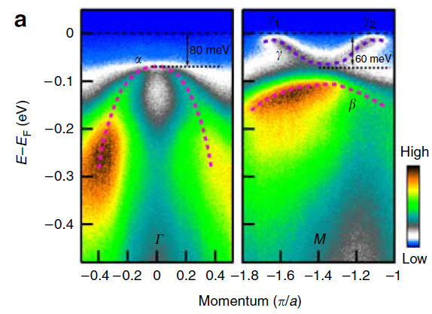
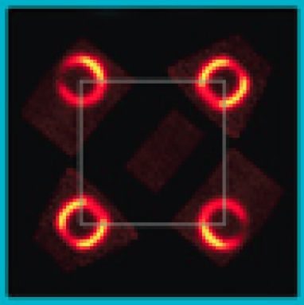
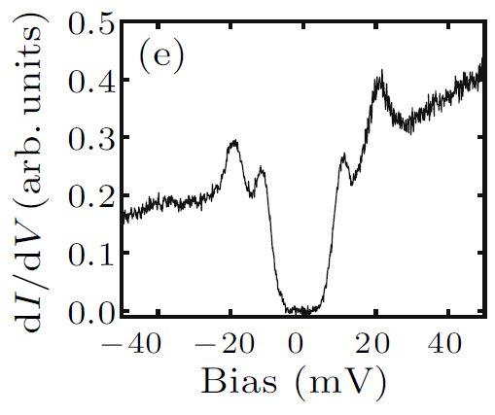
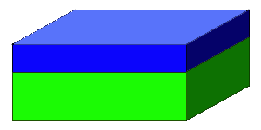
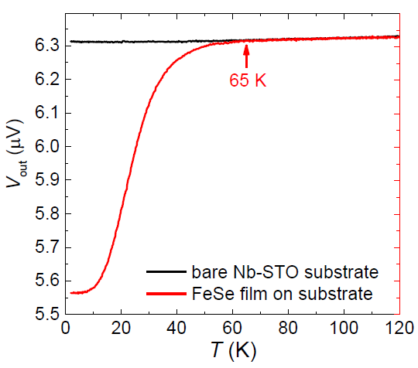
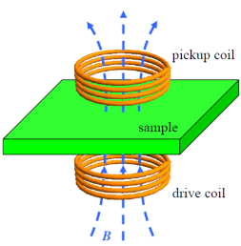
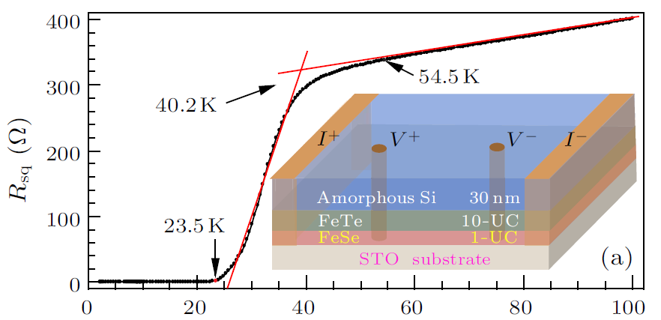
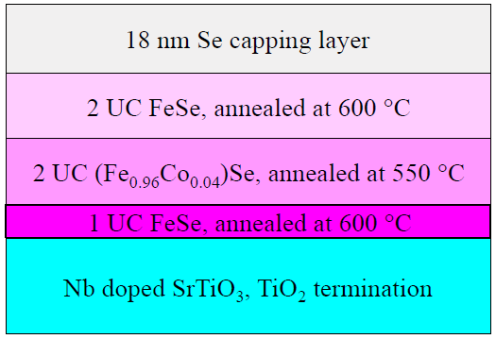
SC enhancement at the FeSe/SrTiO₃ interface
2012---Now, ARPES, Δ~15-20meV, T_{g}~55-70 K
2012, STS, Δ~20meV
Liu, D. et al. Nat. Commun. 3, 931, (2012).
FeSe
Tan, S. et al. Nat Mater. 12, 634, (2013).
Q.-Y. Wang. et al. CPL 29, 037402, (2012).
Lee, J. et al. Nature 515, 245, (2014).
SrTiO₃
2014, ex situ transport
2015, ex situ dimagnetism
T_{c}^{onset} = 65 K
T_{c}^{onset} = 40.2 K T_{c}^{zero} = 23.5 K
Zhang, W.-H. et al. CPL 31, 017401, (2014).
Sun, Y. et al. Sci. Rep. 4, 6040, (2014).
Z. Zhang et al., Sci. Bull. 60, 1301 (2015)

Slide 17
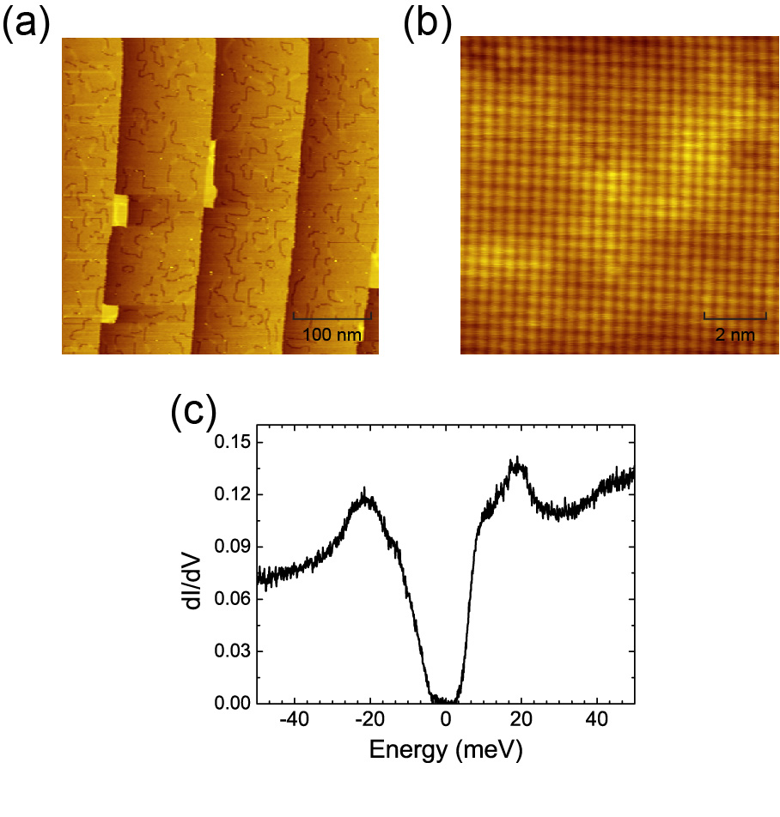
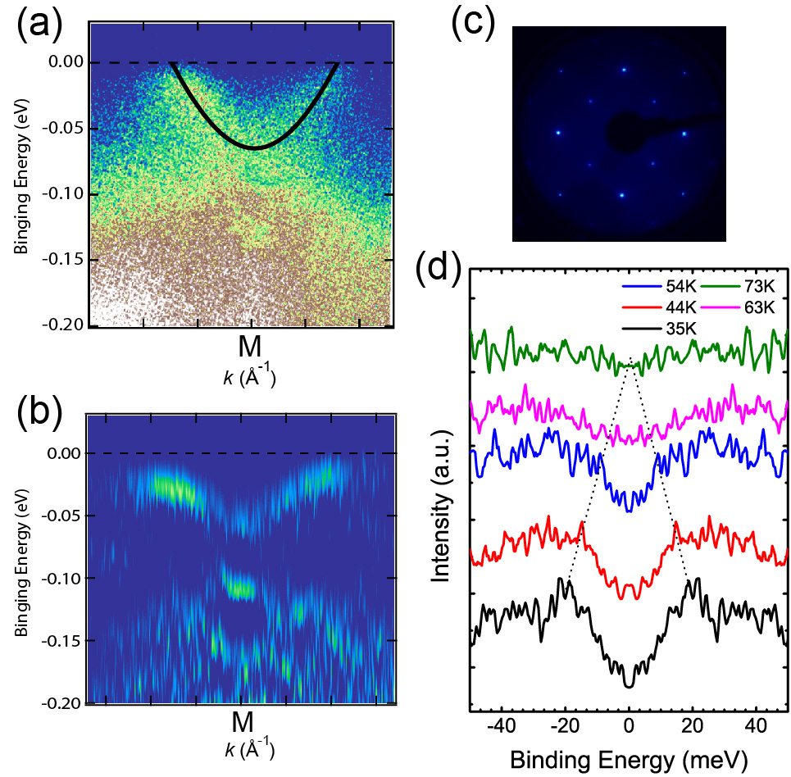
Single-layer FeSe on SrTiO₃
STM & STS
LEED & ARPES
Δ ~ 20 meV
T_{C} ≈ 65-70K

