Slide 1



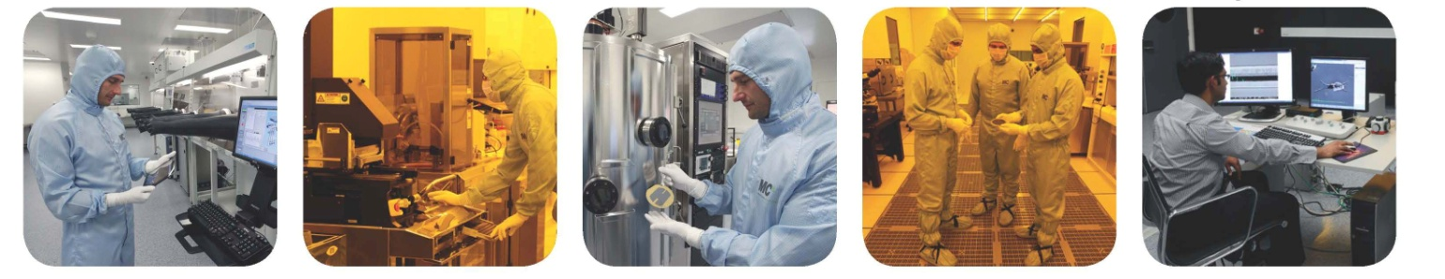
Determining the Effect of Substrate Cleaning on the Solution Stability of Plasma Polymer Films
Dr. Karyn Jarvis
ANFF-Vic Biointerface Engineering Hub, Swinburne University of Technology

Slide 2
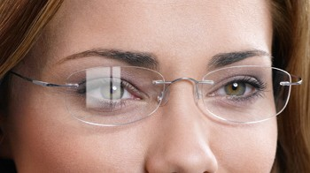
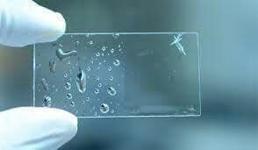
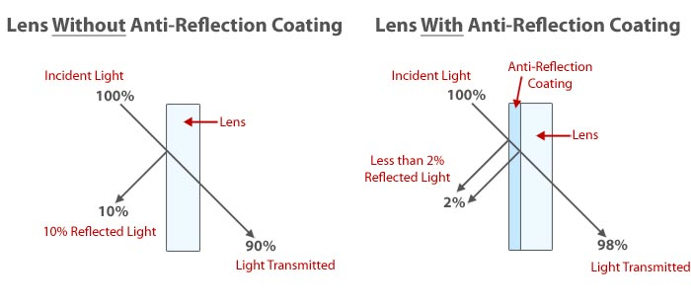
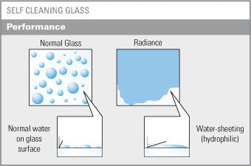
Functional Thin Films

Slide 3
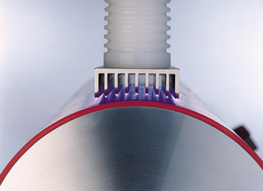
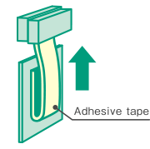
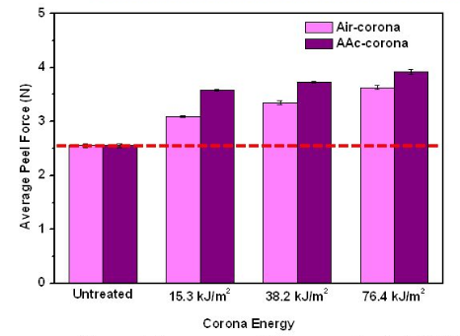
Adhesion and Pre-Treatment
Corona Pre-Treatment
Bombards the surface with ozone, oxygen and oxygen free radicals to increase oxygen content, wettability and therefore film adhesion
N. Kalapat, T. Amornsakchai, T. Srikhirin, Surface and Coatings Technology, 234, 2013, p. 67

Slide 4
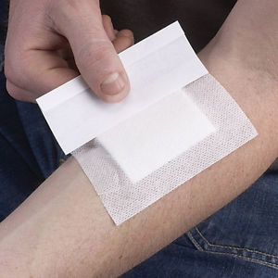
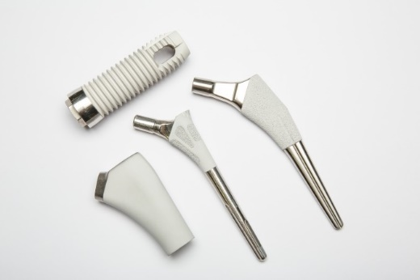
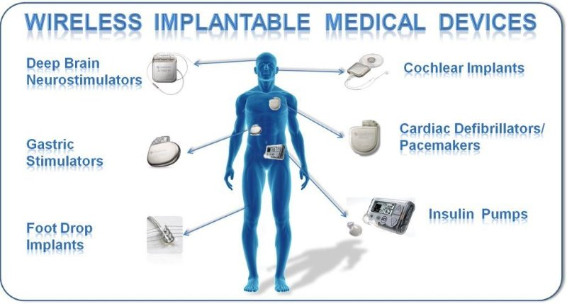
Biomedical Thin Films
Anti-bacterial
Anti-wear
Drug delivery
Promote/prevent cell adhesion
High demand for coatings suitable for use in physiological conditions
Significant changes in film in aqueous solution have implications on their incorporation into biomedical devices

Slide 5
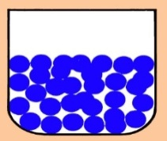
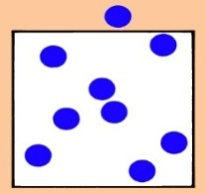
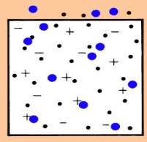
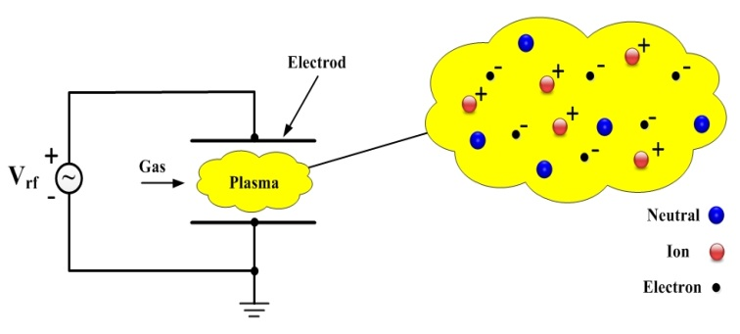
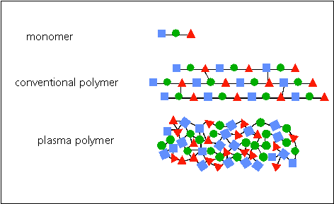
Plasma Polymerisation
Monomer
(Liquid)
Monomer
(Vapour)
Monomer
(Plasma)
Plasma Polymer Film
Electrode
Monomer
Surface chemistry and thickness of the film can be manipulated by modifying:
Plasma power (W)
Monomer flow rate (sccm)
Polymerization time (min.)
Conventional
Polymer
Plasma
Polymer

Slide 6
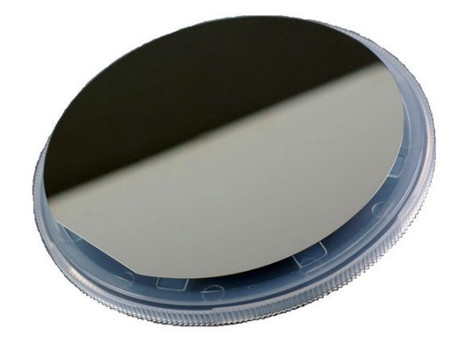
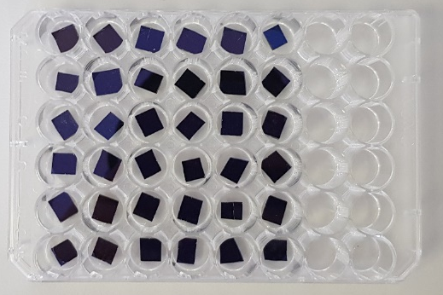
Surface Pre-treatment and Plasma Polymerisation
Substrates
Untreated Silicon wafer
Cleaned Silicon wafer
  Liquid cleaned (Decon 90, Milli-Q then isopropanol)
  Air Plasma (10 W, 10 min, 2 sccm)
  UV/Ozone (10 minutes)
  Liquid cleaned then air plasma
  Liquid cleaned then UV/Ozone
Plasma Deposition
Acrylic Acid and Octadiene (20 W, 20 min, 2 sccm)
Solution Stability
Milli-Q and pH 7.4 PBS for 1 hour, 24 hours or 7 days
Characterisation
X-ray Photoelectron Spectroscopy (XPS)
Variable Angle Spectroscopic Ellipsometry
Microscopy

Slide 7
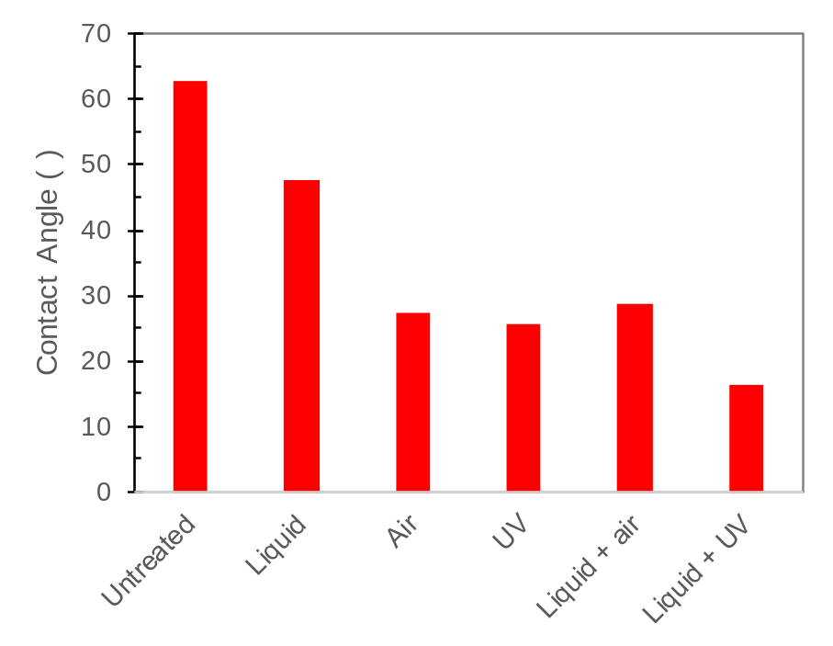
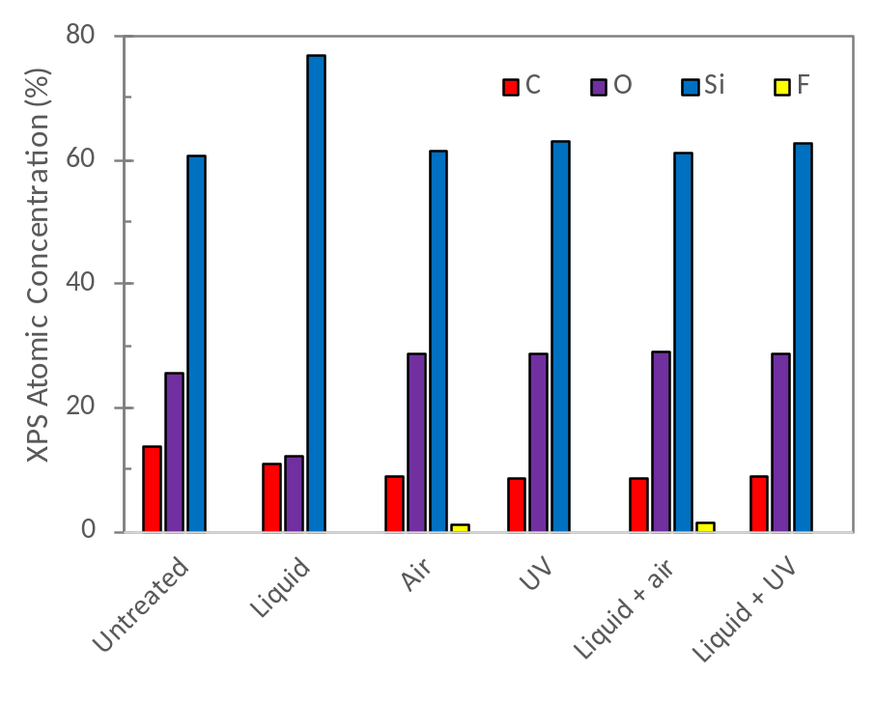
Substrates

Slide 8
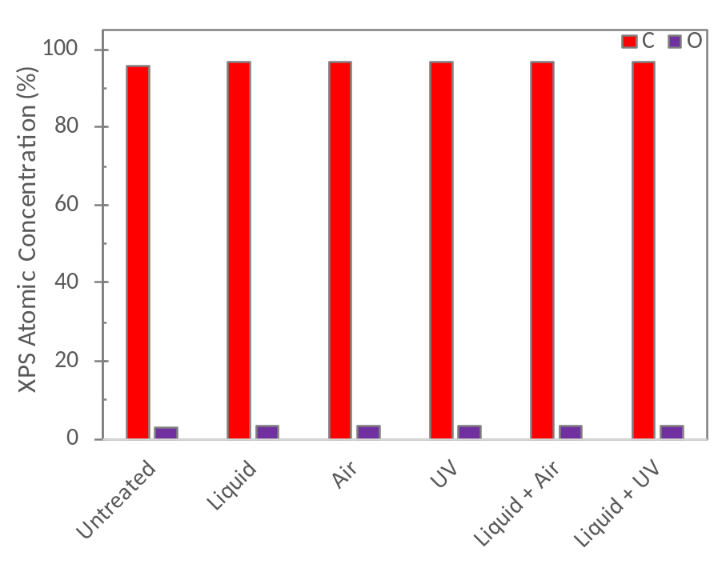
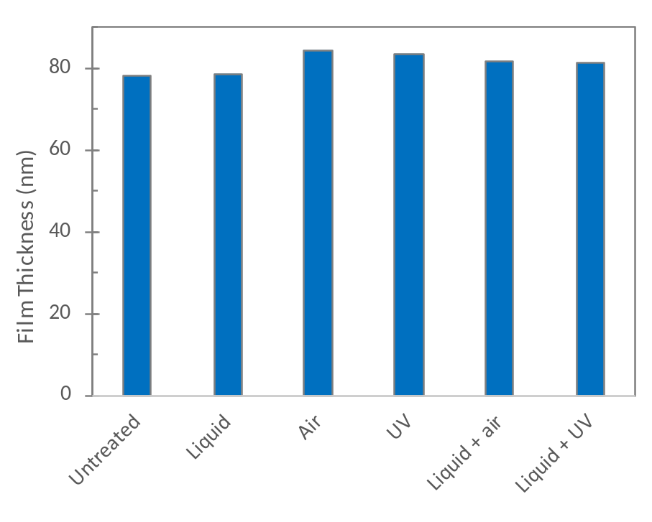
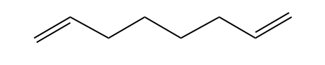
Plasma Polymerised Octadiene
CA ~ 90°

Slide 9
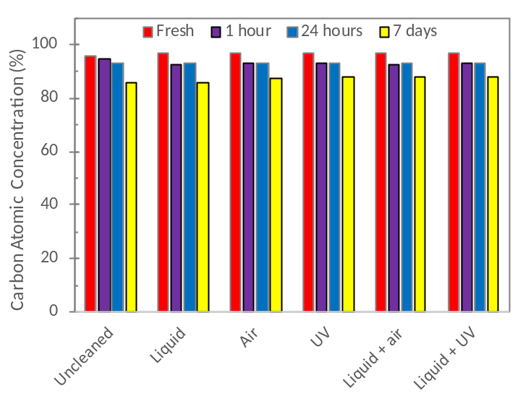
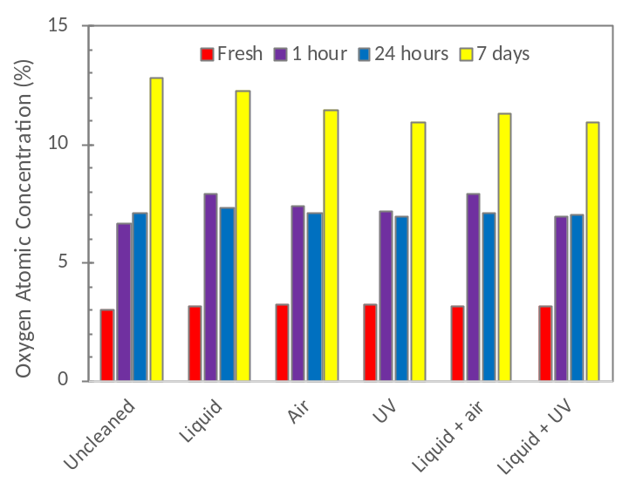
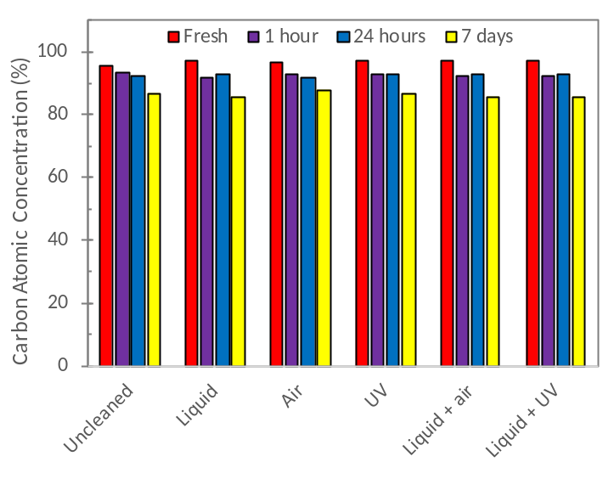
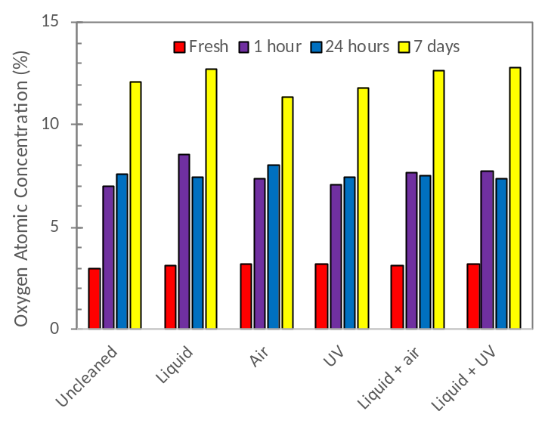
Plasma Polymerised Octadiene
Milli-Q
PBS

Slide 10
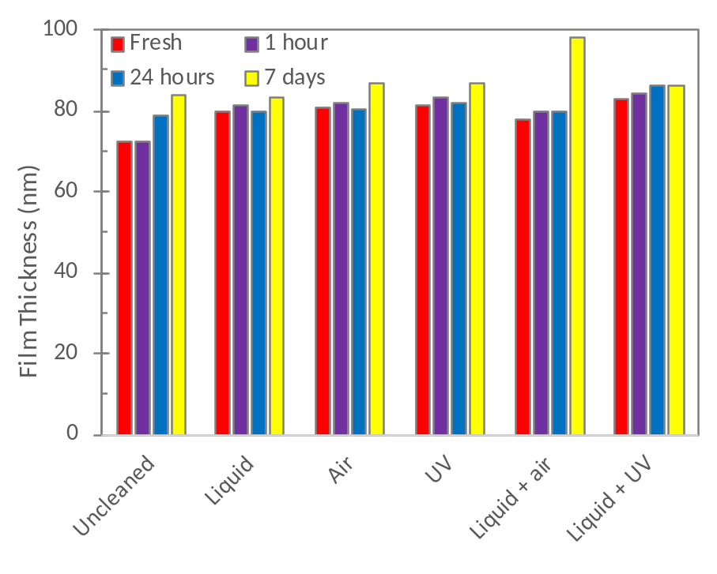
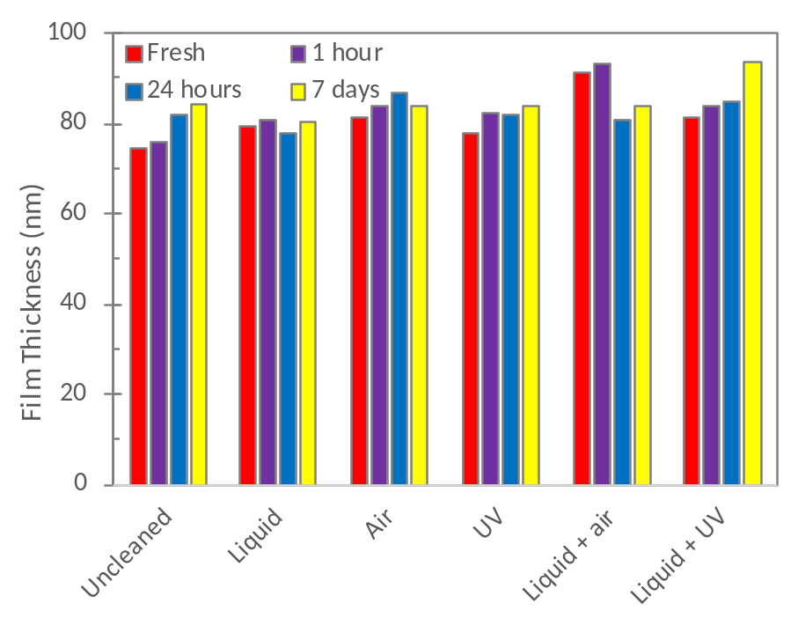
Plasma Polymerised Octadiene
Milli-Q
PBS

Slide 11
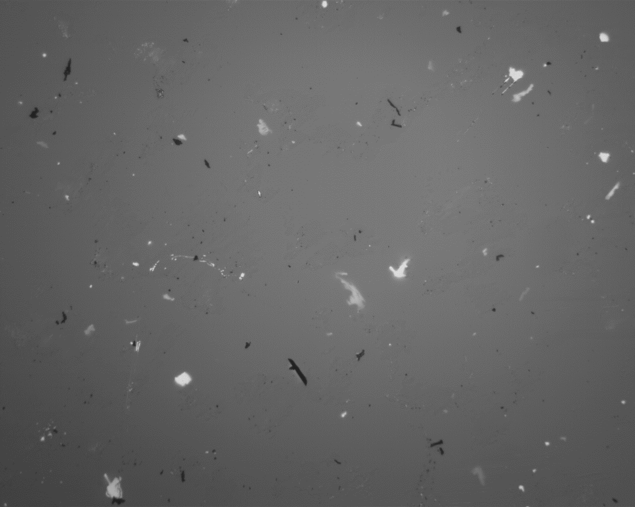
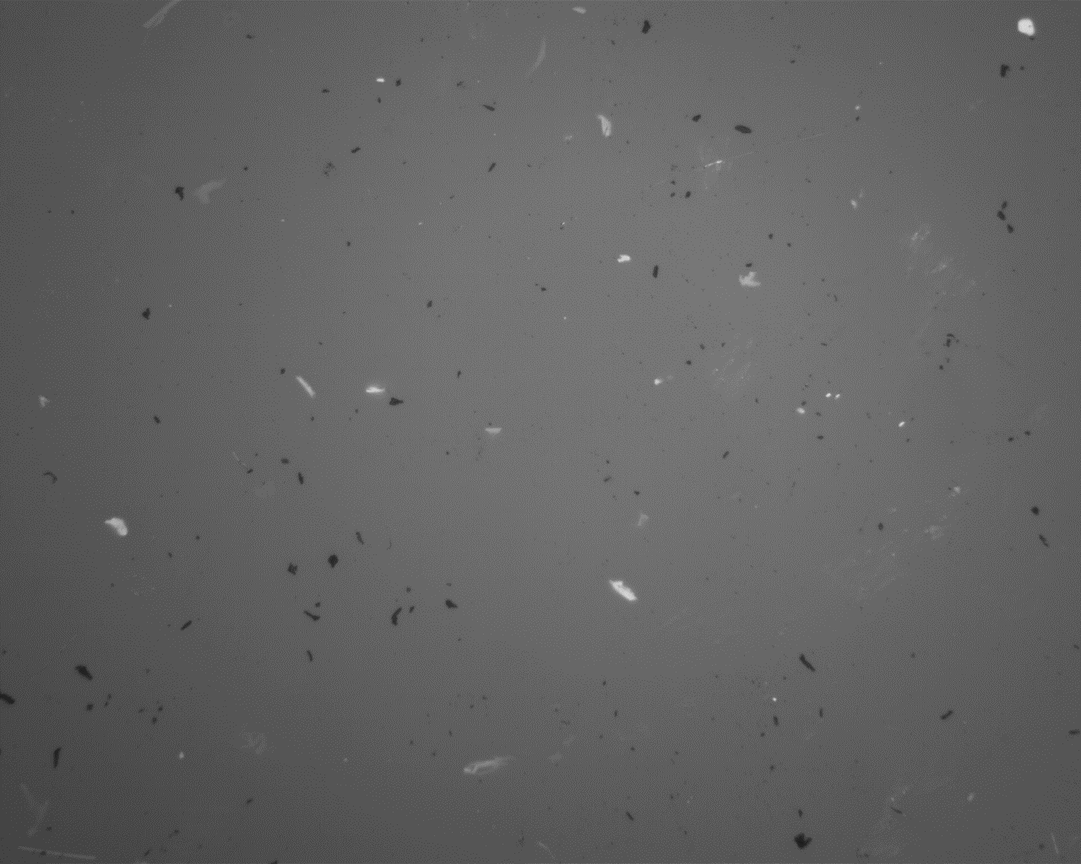
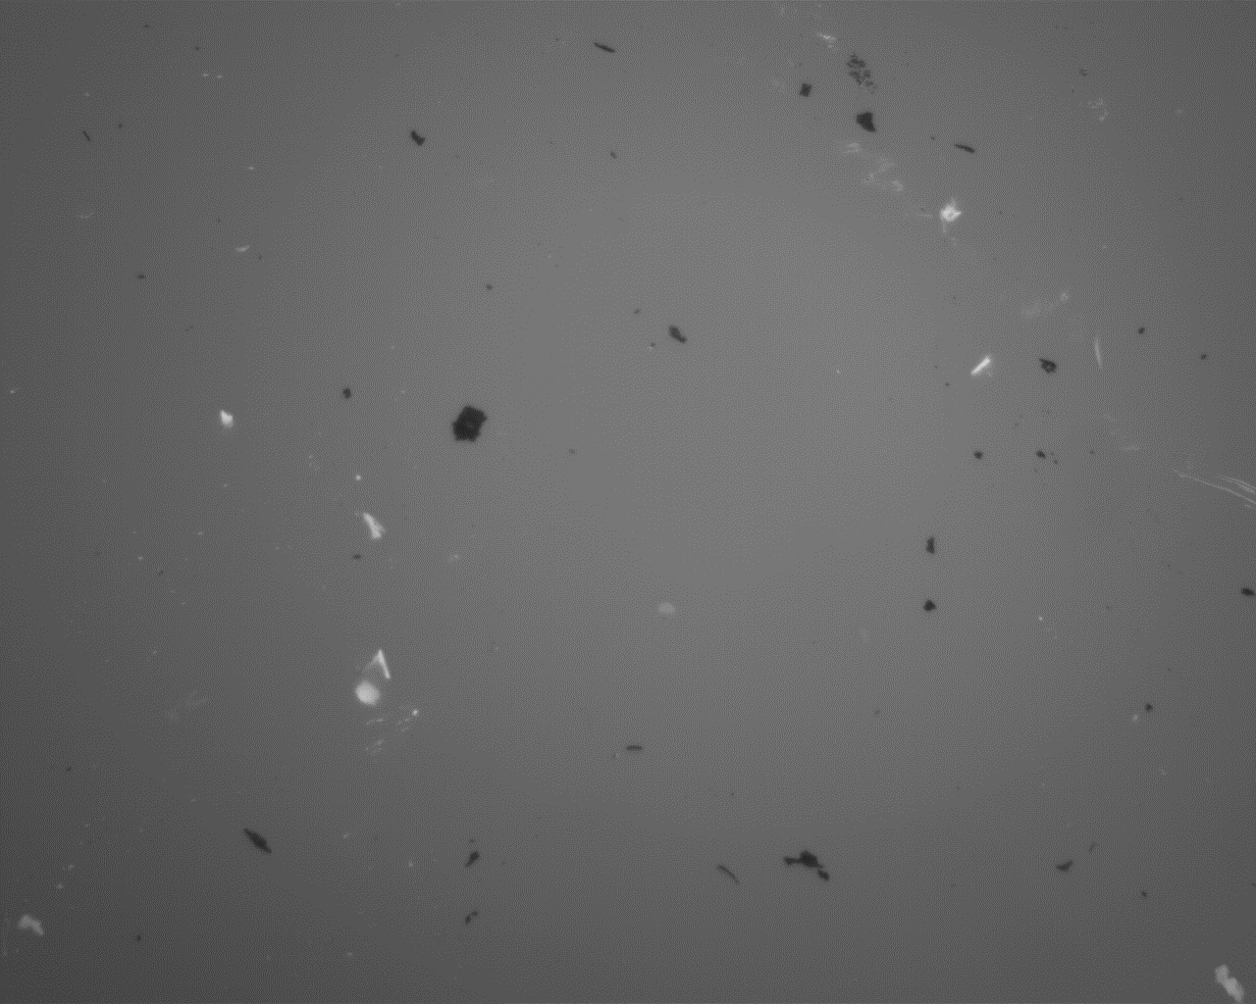
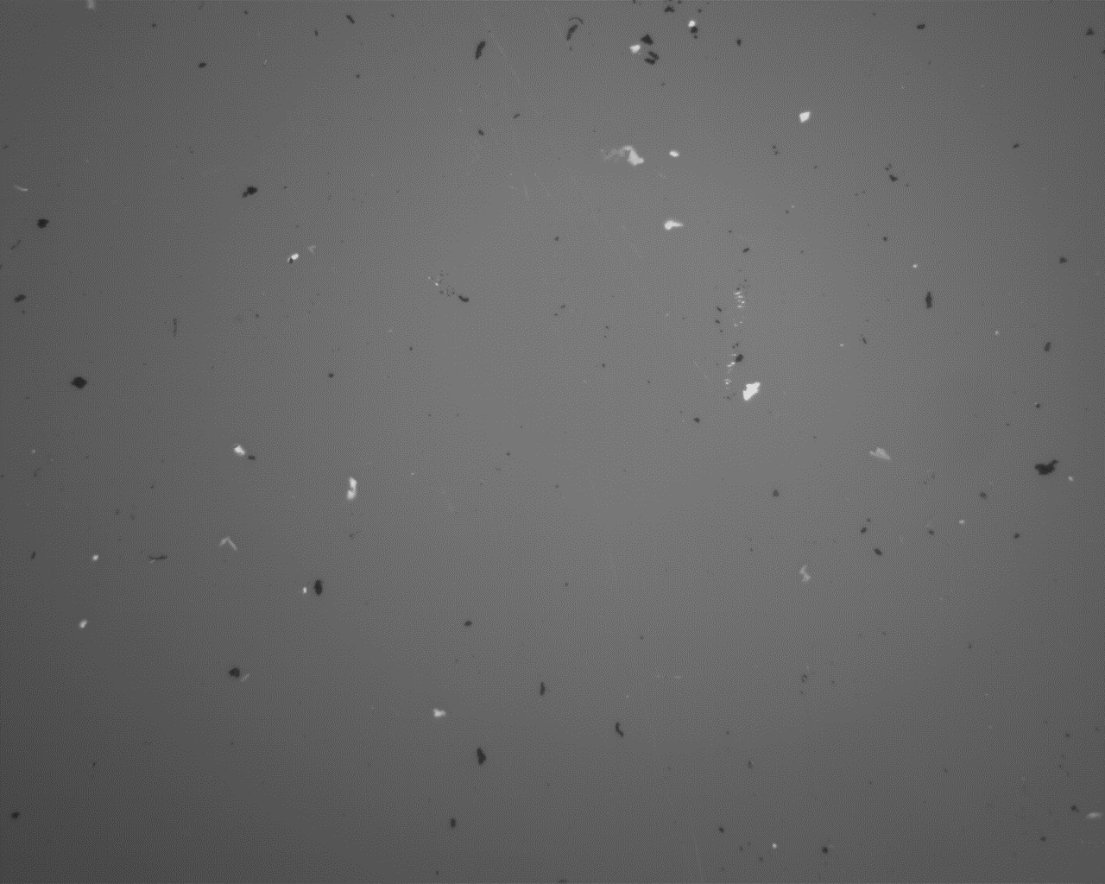
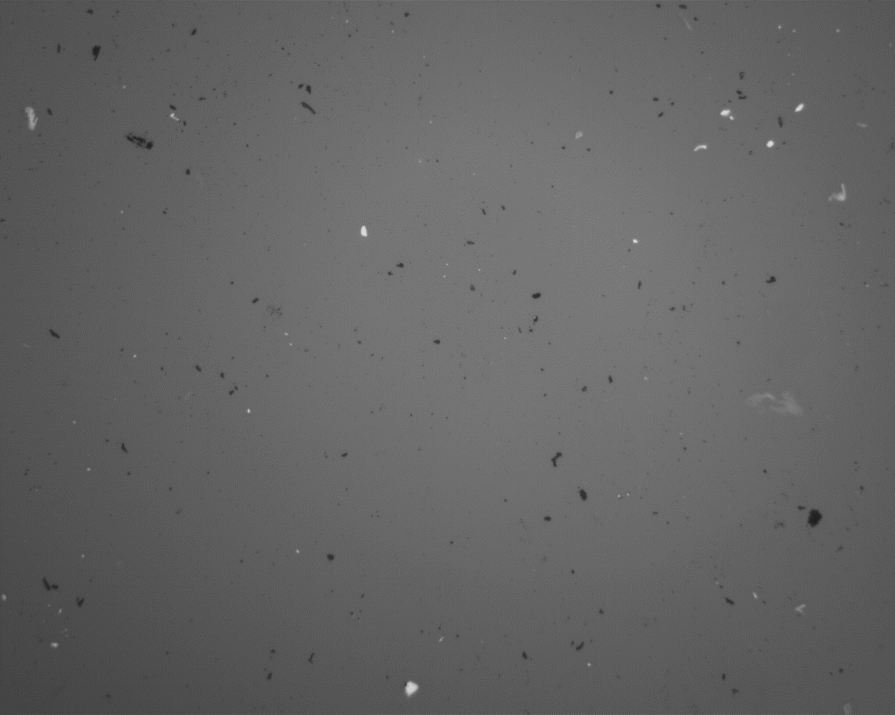
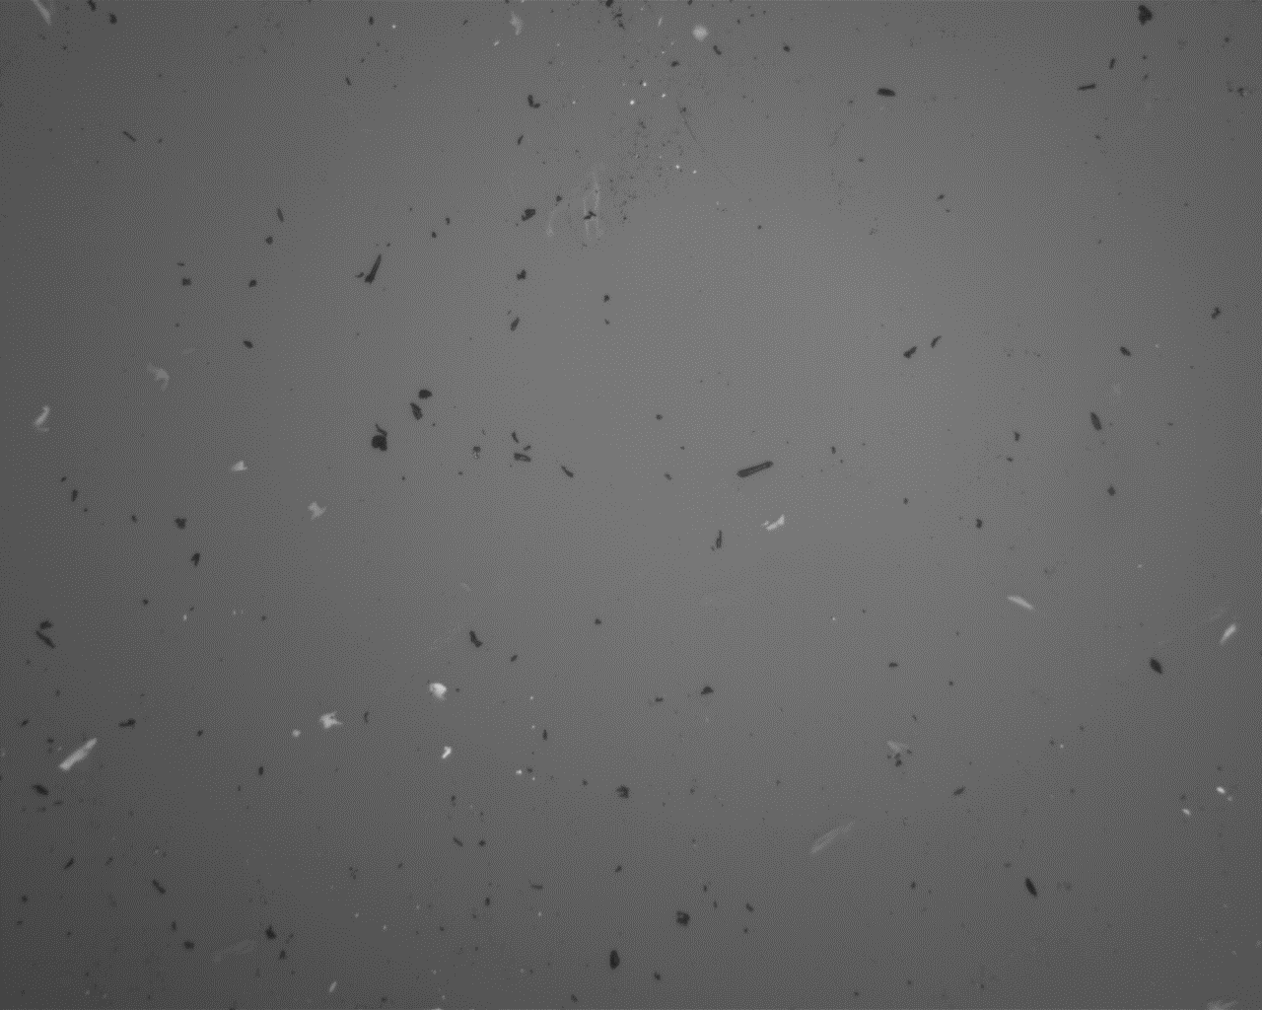
Plasma Polymerised Octadiene
Not immersed
Untreated
Liquid
Air
UV
Liquid Air
Liquid UV
500 µm

Slide 12
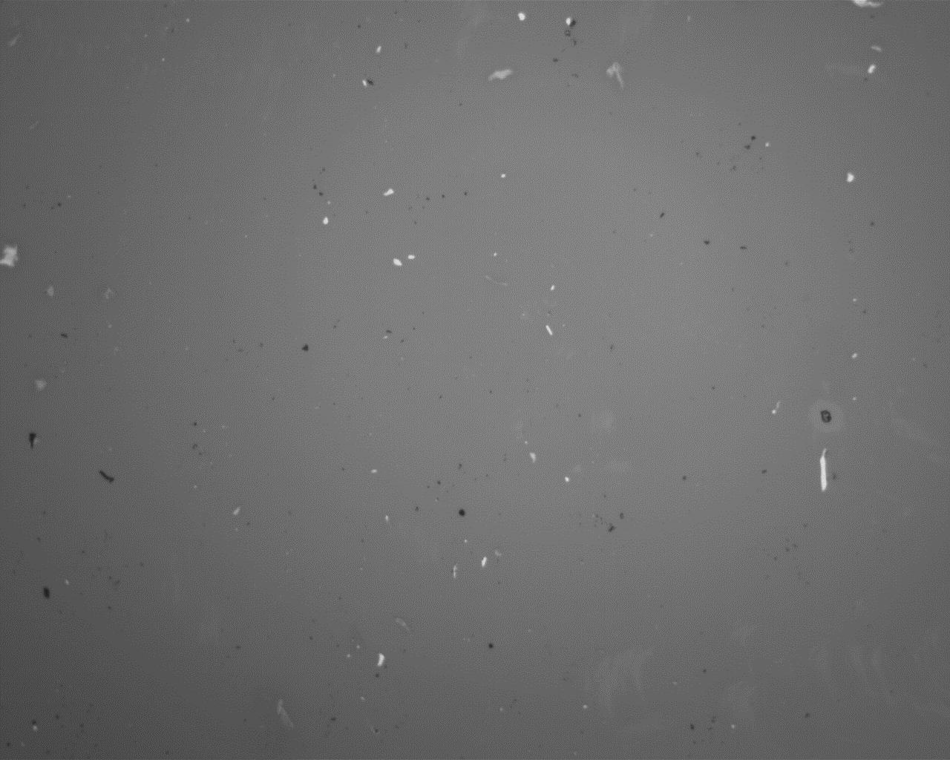
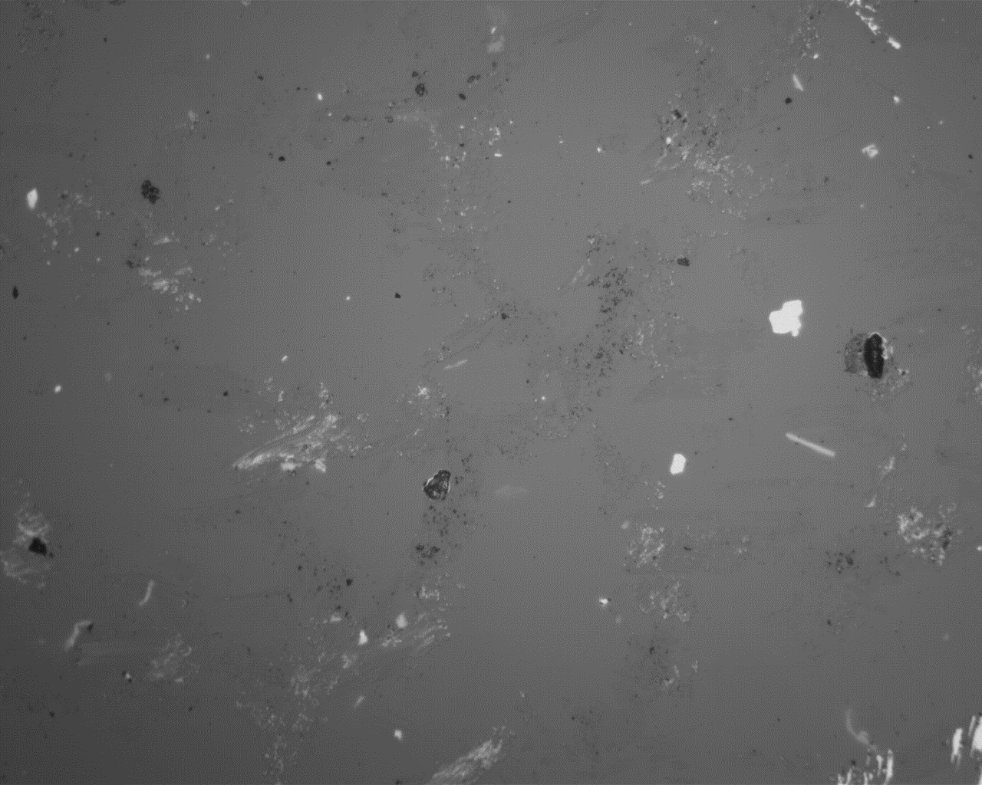
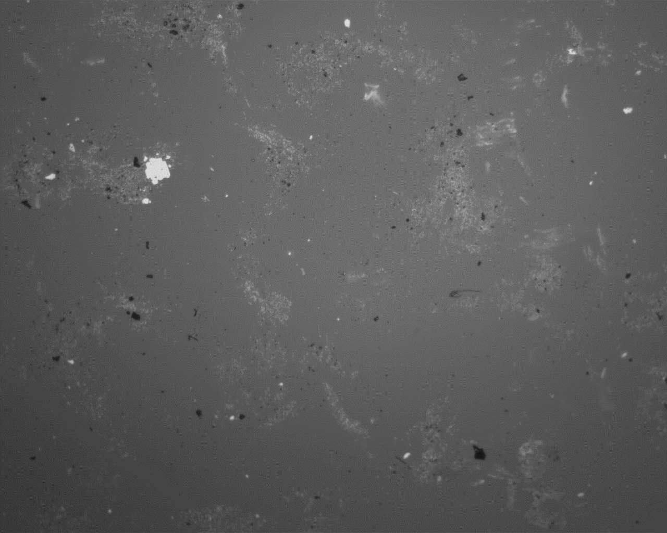
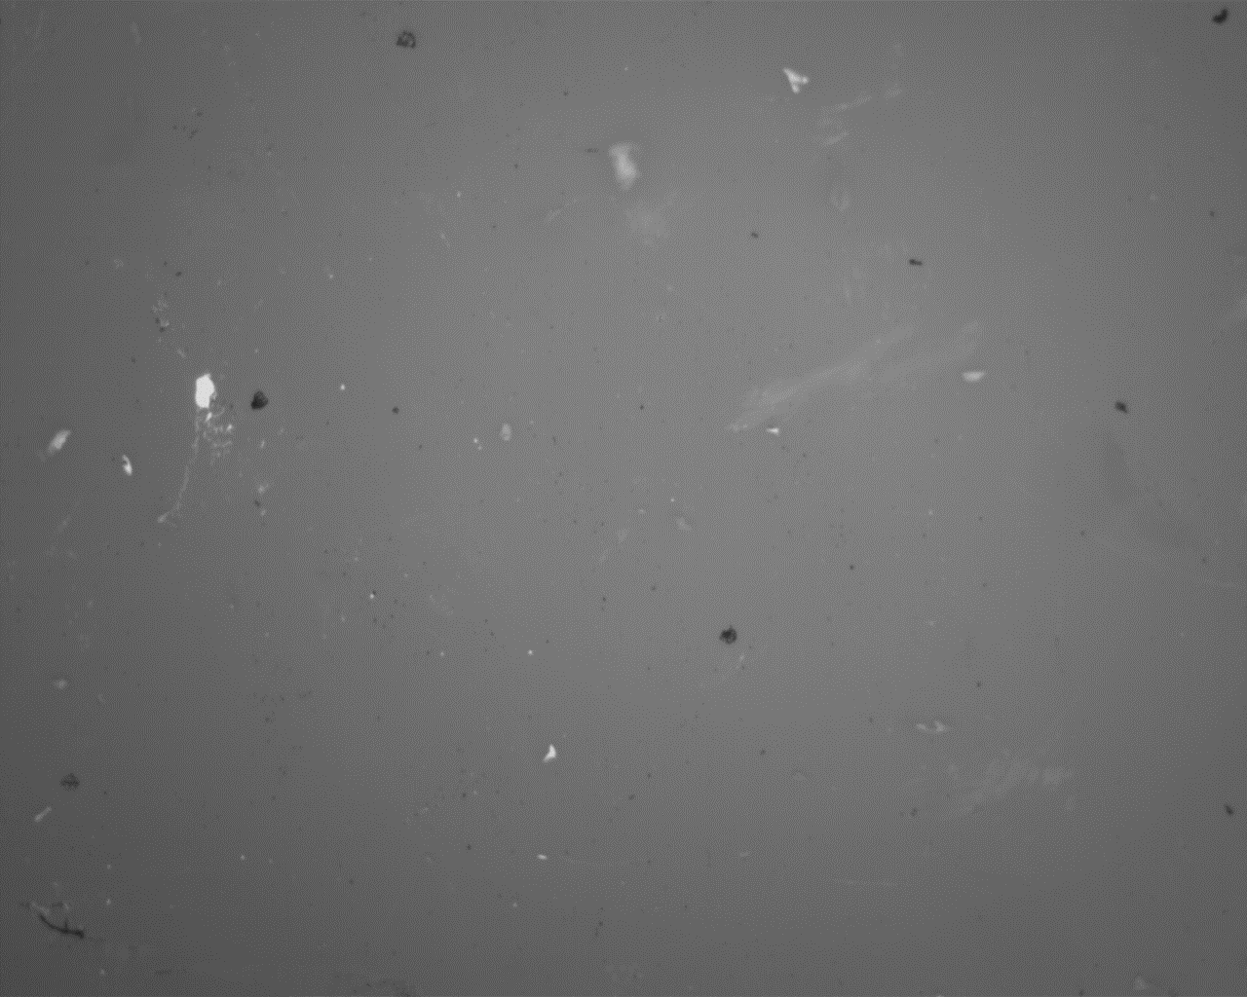
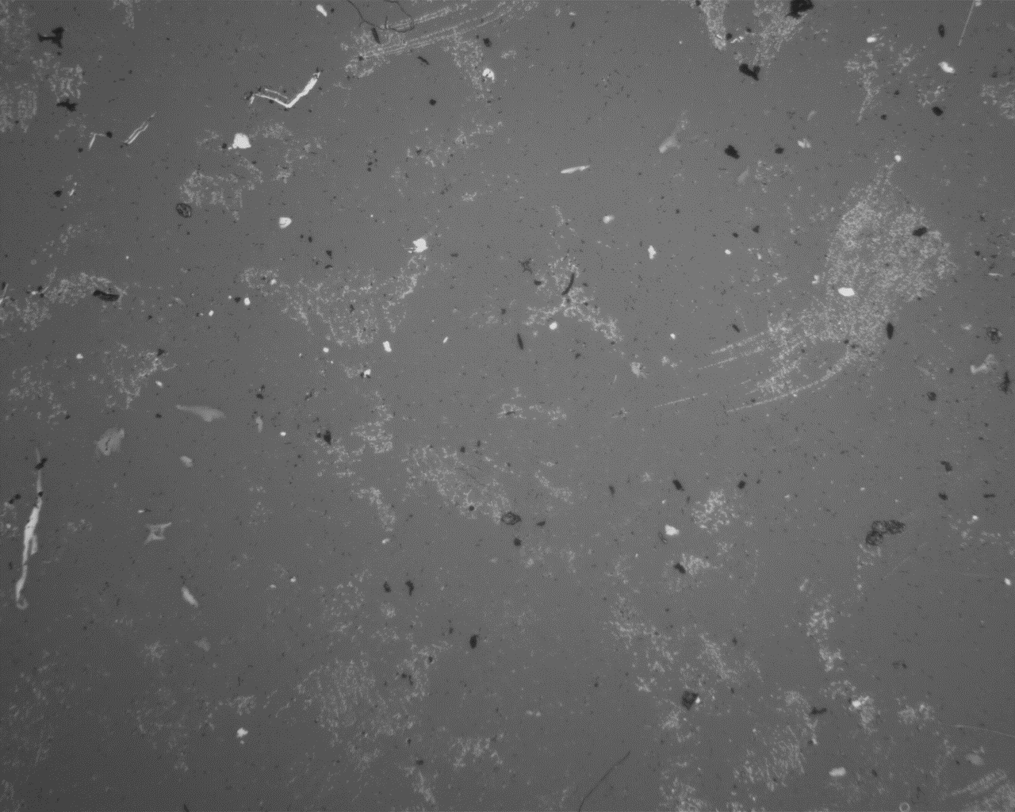
Plasma Polymerised Octadiene
Immersed
Air – Milli-Q
Untreated – Milli-Q 1 hour
Untreated – Milli-Q 24 hours
Air – PBS
Untreated – Milli-Q 7days
All untreated surfaces immersed in Milli-Q were more ‘marked’ than treated surfaces
500 µm
All surfaces, irrespective of surface treatment or Milli-Q/PBS immersion appeared similar for 1 hour

Slide 13
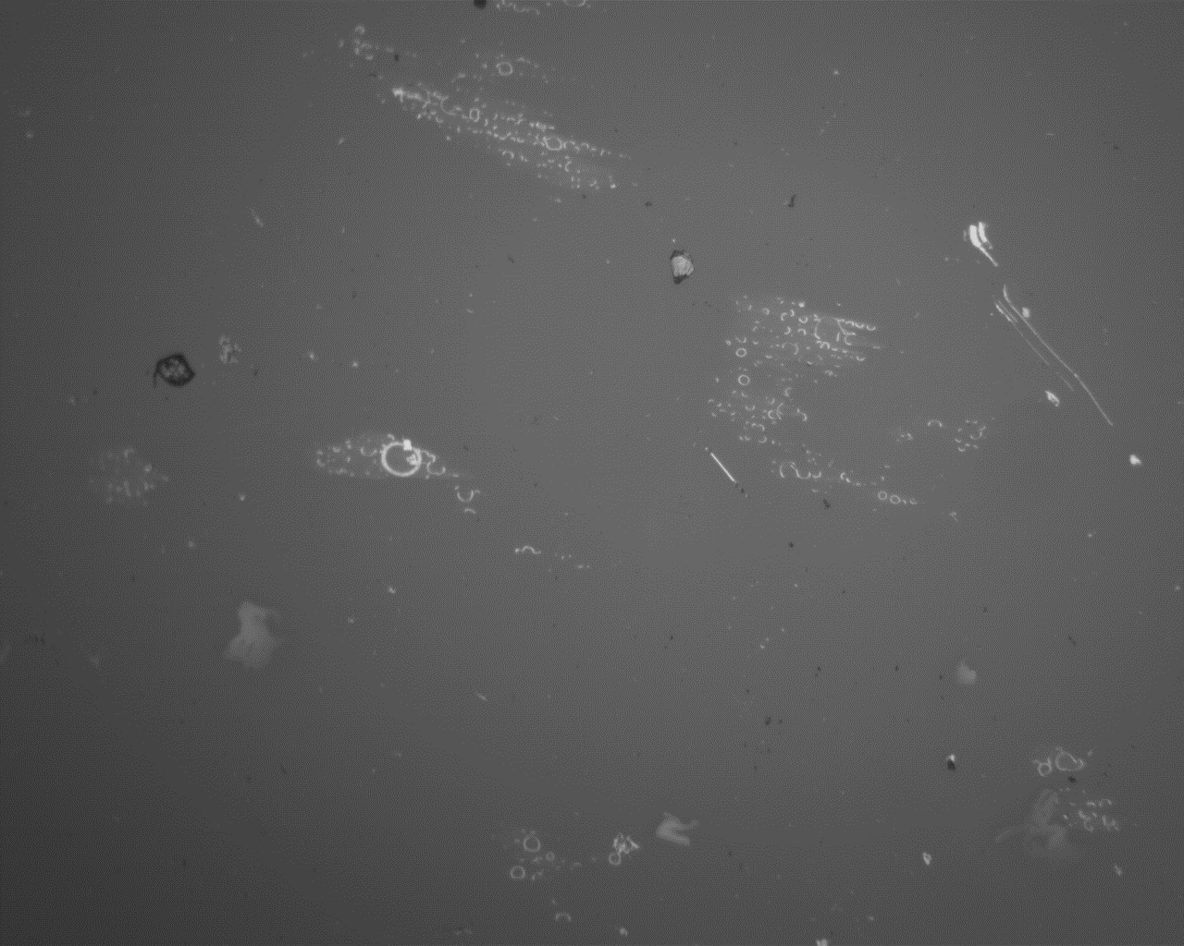
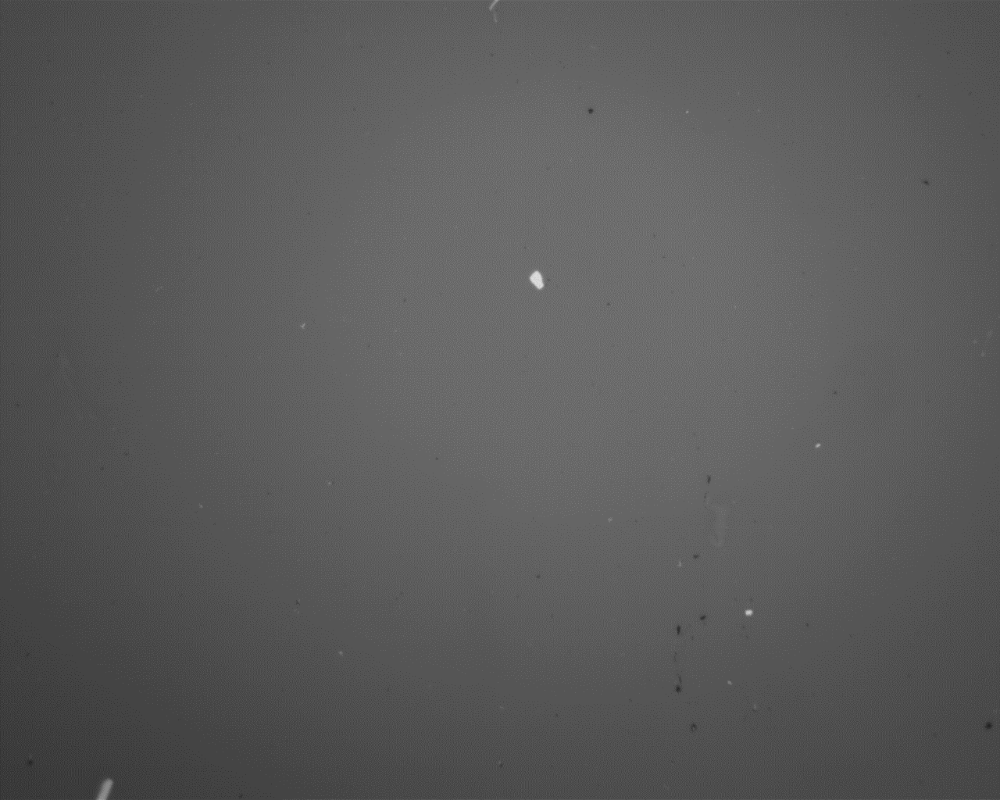
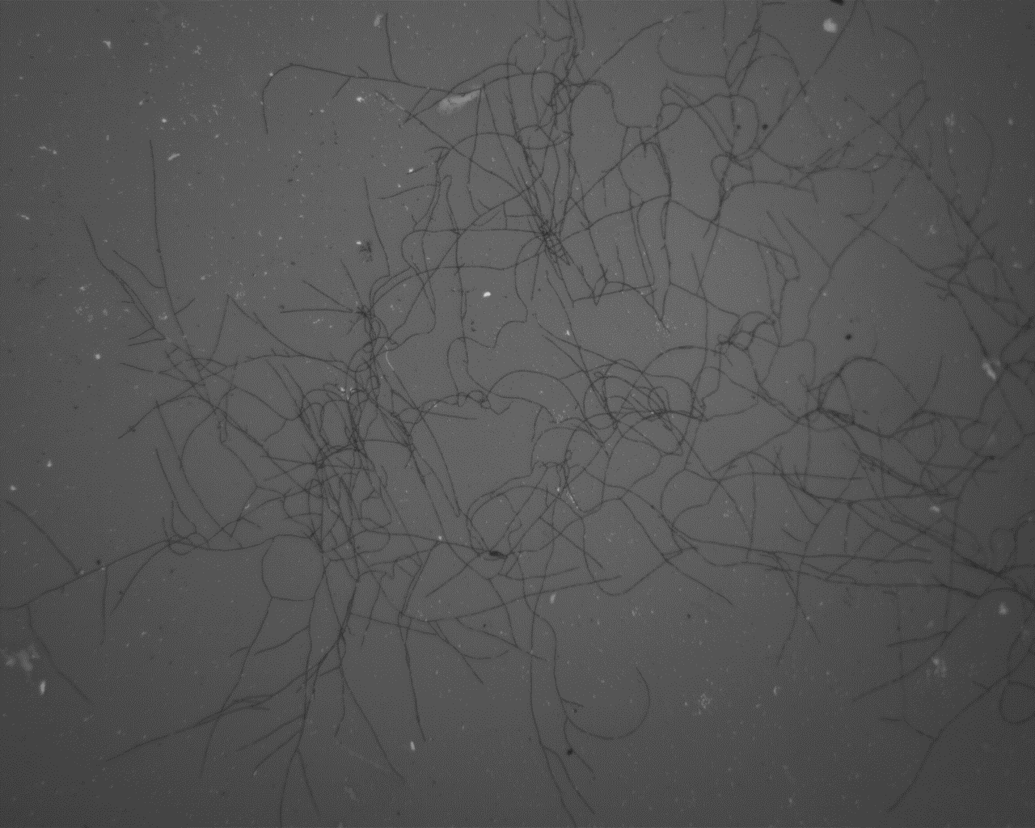
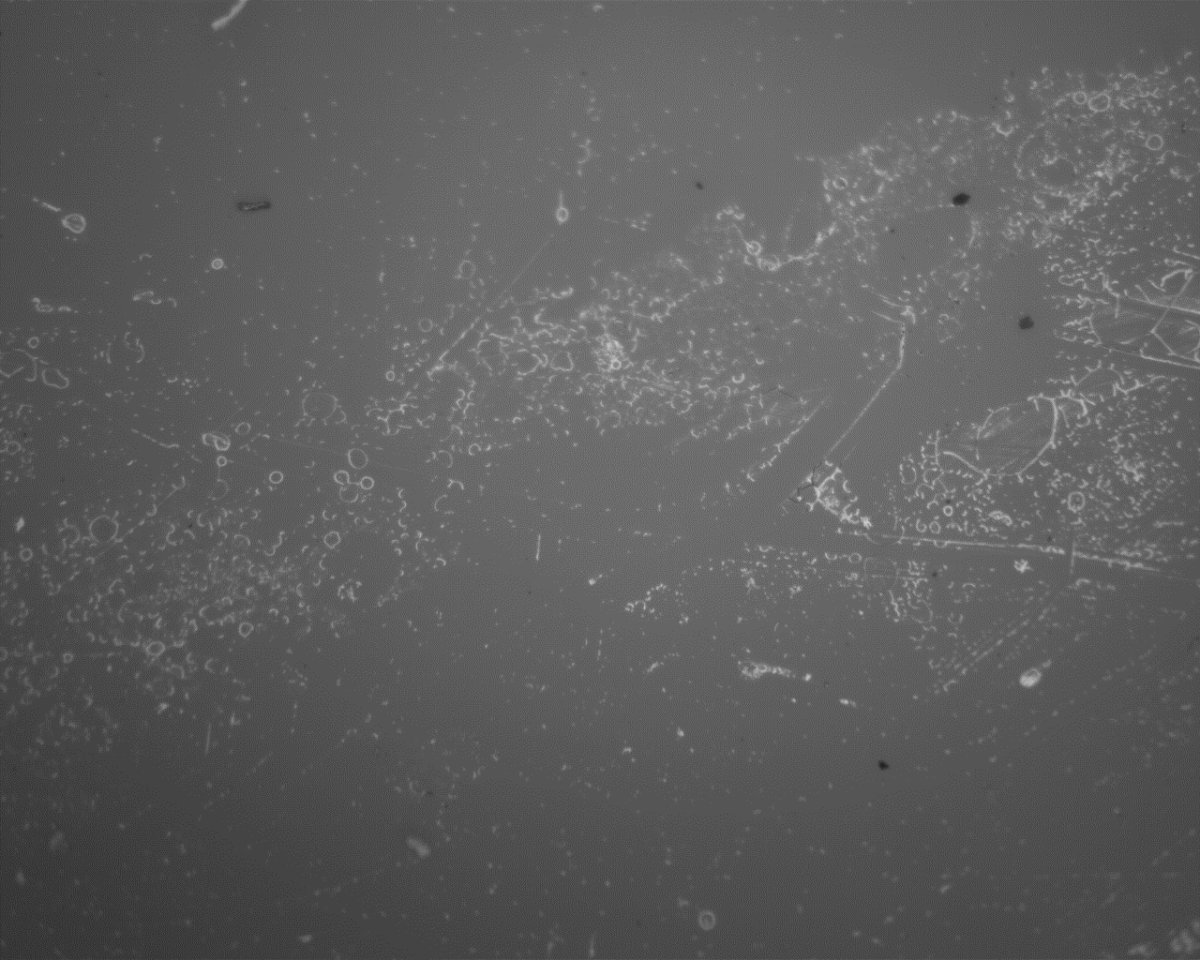
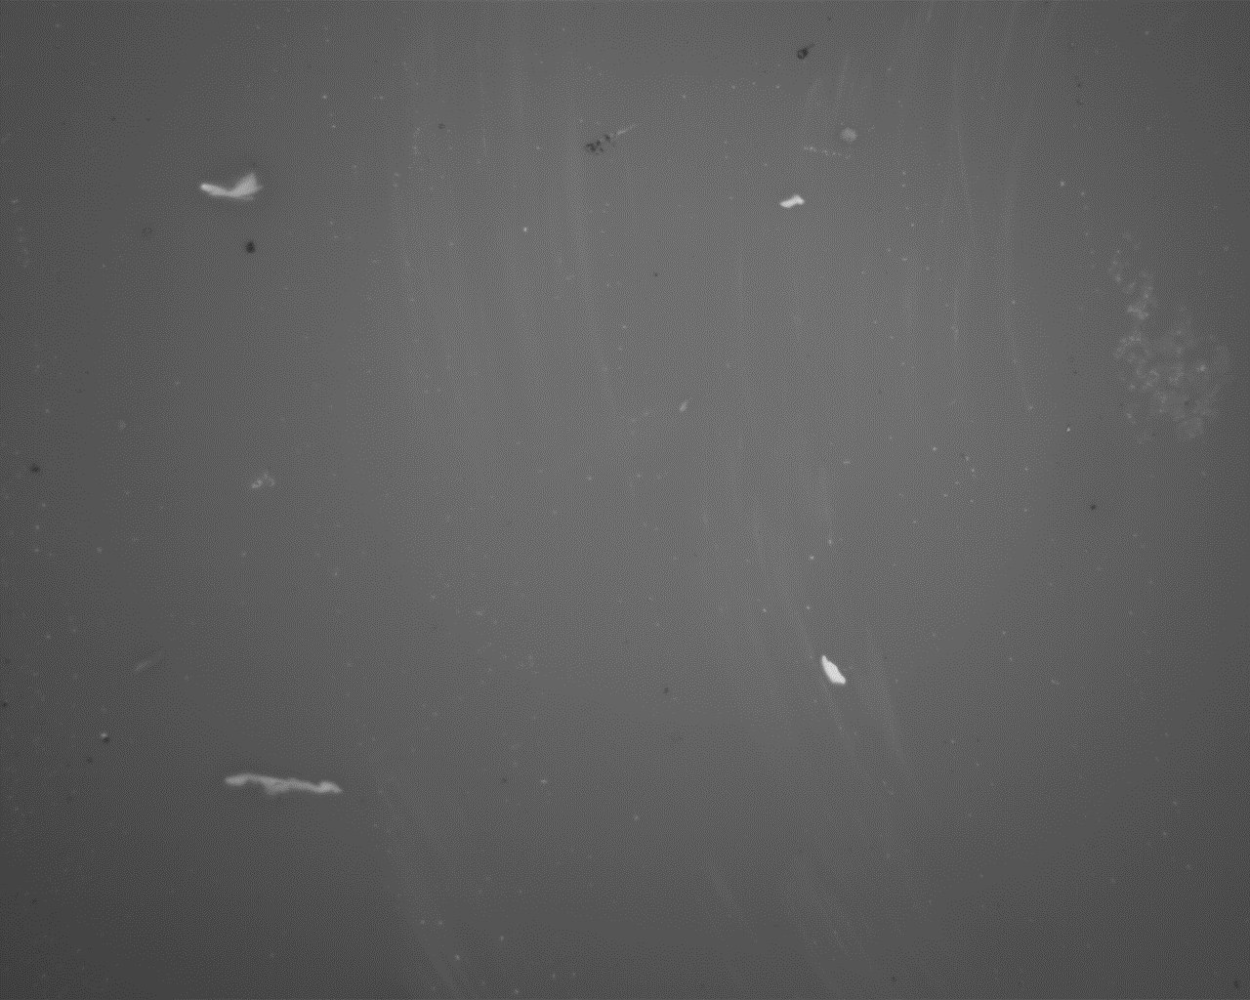
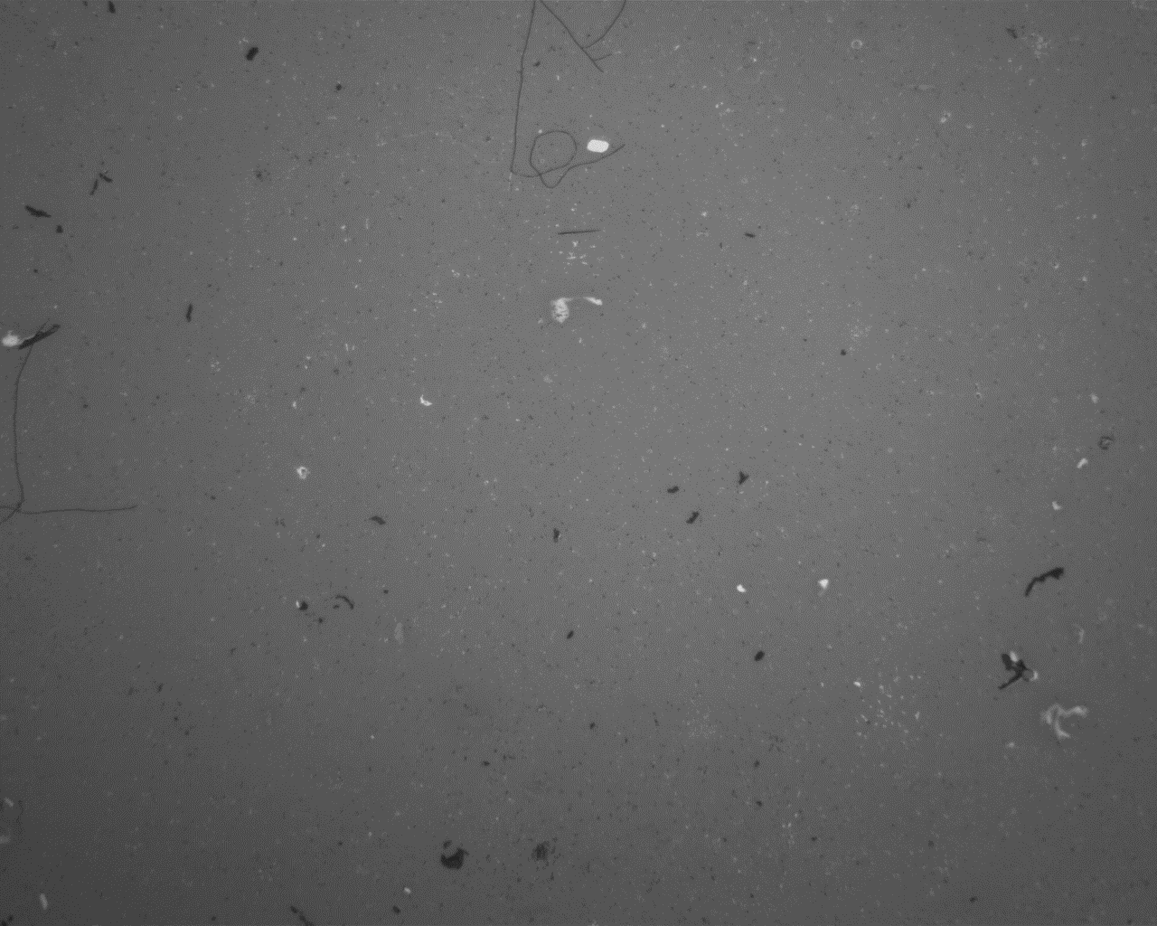
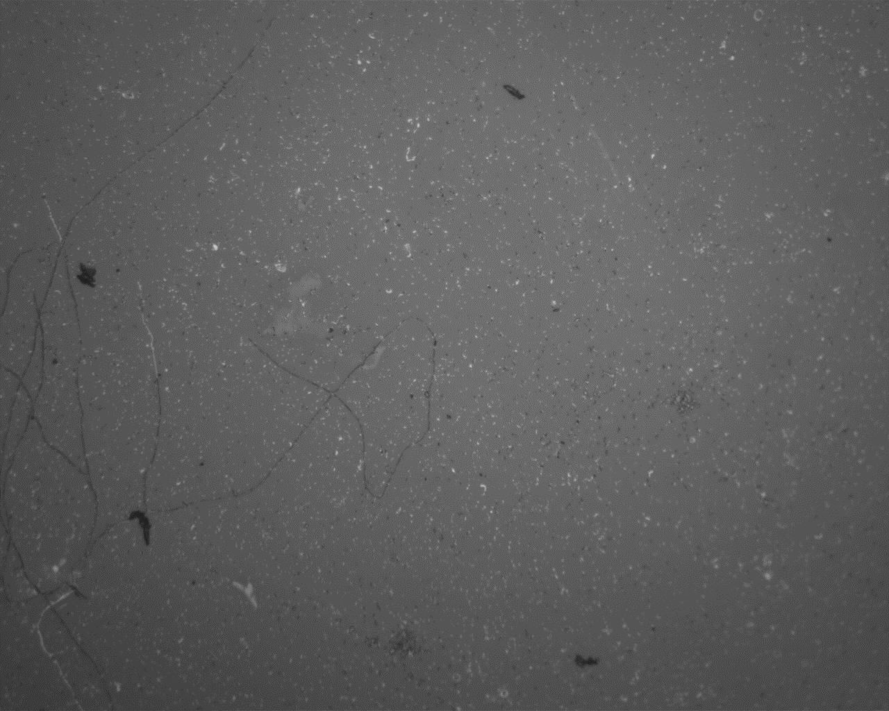
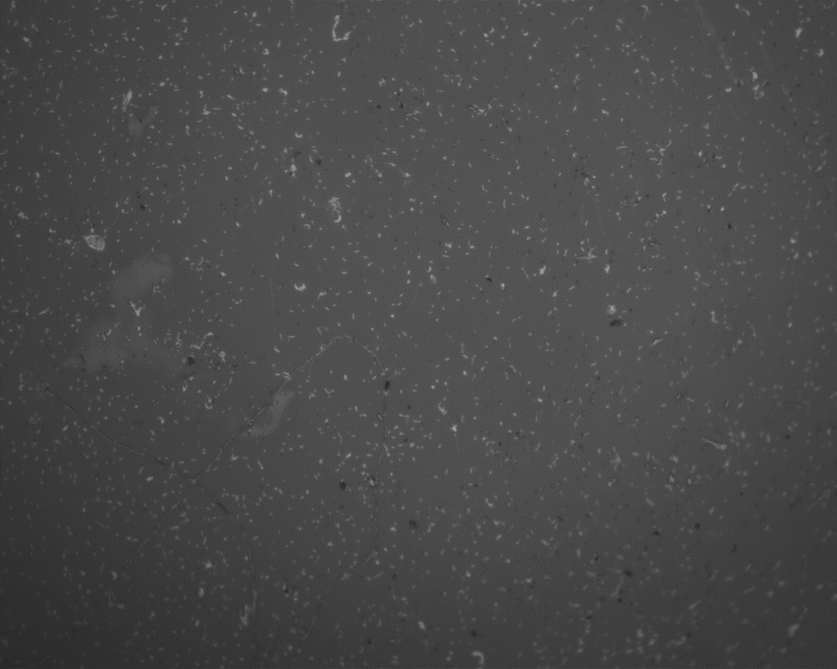
Plasma Polymerised Octadiene
Immersed
Liquid UV – Milli-Q
Liquid UV – PBS
Liquid UV – PBS
200 µm
200 µm
500 µm
Air – Milli-Q
Air – PBS
Air – Milli-Q
200 µm
200 µm
200 µm
500 µm
100 µm
White smears with bubble marks were observed on the majority of surfaces after Milli-Q immersion for 24 hours
Same marks were not observed after PBS immersion for 24 hours
All surfaces, irrespective of surface treatment, had similar appearances for Milli-Q or PBS immersion after 7 days

Slide 14
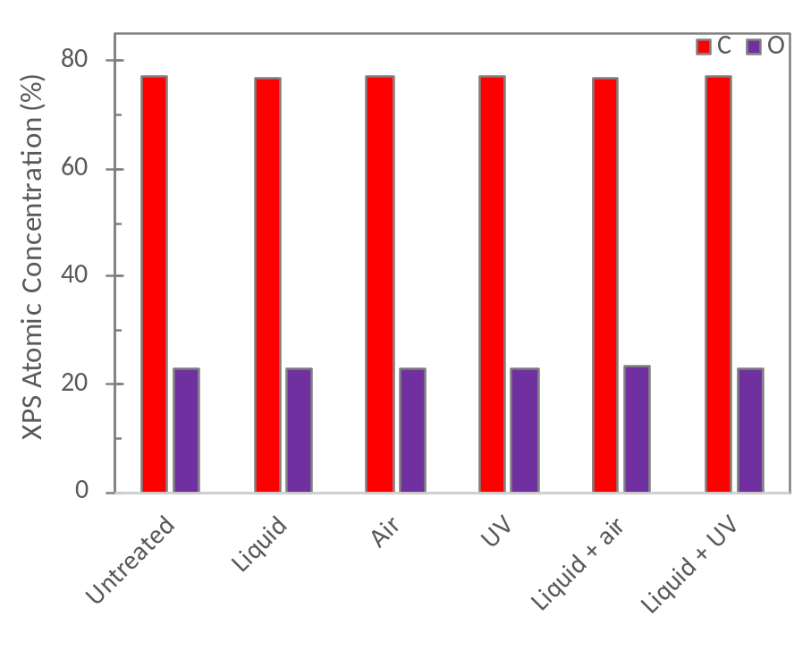
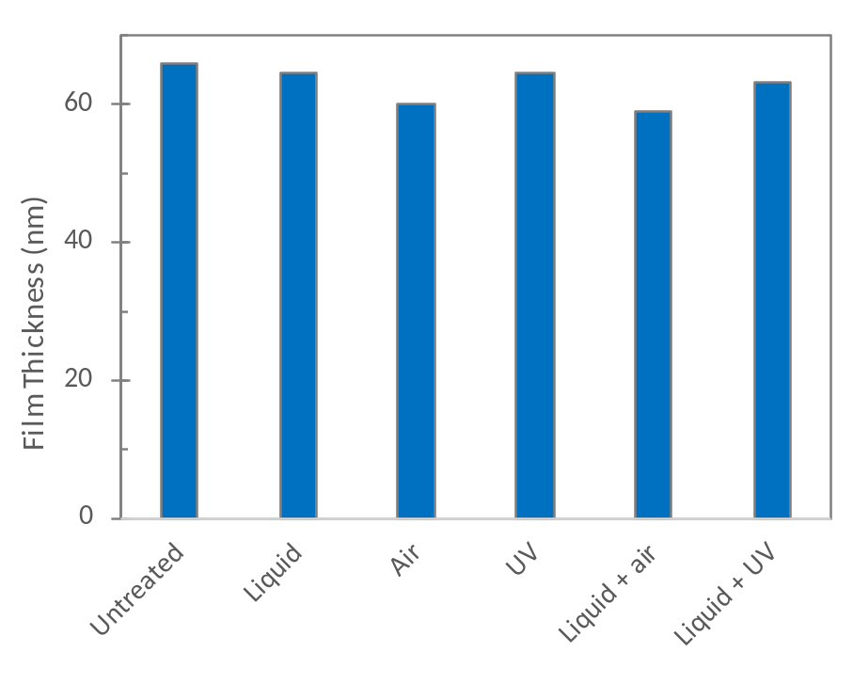

Plasma Polymerised Acrylic Acid
CA ~ 45°

Slide 15





Plasma Polymerised Acrylic Acid
Milli-Q
PBS

Slide 16


Plasma Polymerised Acrylic Acid
Milli-Q
PBS

Slide 17






Plasma Polymerised Acrylic Acid
Not immersed
Untreated
Liquid
Air
UV
Liquid Air
Liquid UV
500 µm

Slide 18






Plasma Polymerised Acrylic Acid
Immersed
Air – MQ 1 hour
Air – PBS 1 hour
Untreated – Milli-Q 1 hour
500 µm
500 µm
500 µm
Untreated – MQ 1 hour
Liquid UV – PBS 1 hour
Untreated – PBS 1 hour
200 µm
500 µm
500 µm
Film defects could be observed in some treated surfaces after 1 hour in both Milli-Q and PBS
Untreated surfaces resulted in minimal defects after 1 hour

Slide 19



Plasma Polymerised Acrylic Acid
Immersed
Liquid Air – Milli-Q 24 hours
250 µm
50 µm
100 µm
100 µm
Same ‘speckled’ appearance due to hole propagation as was observed for plasma polymerised octadiene after 7 days in Milli-Q, but was observed after only 24 hours for plasma polymerised acrylic acid. No significant change in appearance of solutions in PBS

Slide 20






Plasma Polymerised Acrylic Acid
Immersed
Liquid Air – Milli-Q 7 days
UV– PBS 7 days
Liquid UV– PBS 7 days
100 µm
500 µm
500 µm
Untreated– Milli-Q 7 days
Liquid– PBS 7 days
Untreated – PBS 7 days
100 µm
500 µm
100 µm
Same ‘speckled’ appearance due to hole propagation was observed after 7 days in Milli-Q with some addition of larger holes
Significant defects: UV and liquid
Complete film loss: Liquid UV, Liquid air & Air

Slide 21
Summary and Conclusions
Immersion in Milli-Q or PBS did not result of film failure for plasma polymerised octadiene, but did for half of the plasma polymerized acrylic acid films
Total film delamination after cracking was observed rather decreases in film thickness
Different dissolution mechanisms were observed for Milli-Q and PBS immersion:
Under observed conditions, surface treatment did not seem to influence the quality of plasma polymerized octadiene films, may be due to hydrophobicity or deposition conditions
For plasma polymerised acrylic acid, untreated surfaces actually appear to produce the most stable films, even though surface treatment increase wettability and oxygen concentration
Substrate cleaning prior to deposition of plasma polymerised octadiene and acrylic acid films does not appear to significantly influence film stability, but this may be dependent on deposition conditions

Slide 22
Future work
Optical profilometry and imaging FTIR to gain topographical/chemical information about ‘marked’ surfaces
Change plasma power and/or distance from electrode to determine its effect on film crosslinking/adhesion and swelling

