Slide 1


Simple linear relationship between reactive gas flow rate and discharge power at mode transition on reactive sputter deposition of metal oxides
Takeo Nakano, Kei Oya, Kosuke Kimura
Seikei University, Japan
Masayoshi Nagao, Hisashi Ohsaki
National Institute of Advanced Industrial Science
and Technology (AIST), Japan
14 Aug, 2018 VASSCAA-9 @SMC Centre, Sydney

Slide 2
Reactive sputtering process: metal mode & compound mode
substrate
substrate
Ar
Ar
RG
RG
pump
pump
target
target
compound (oxide) mode
metal mode

Slide 3
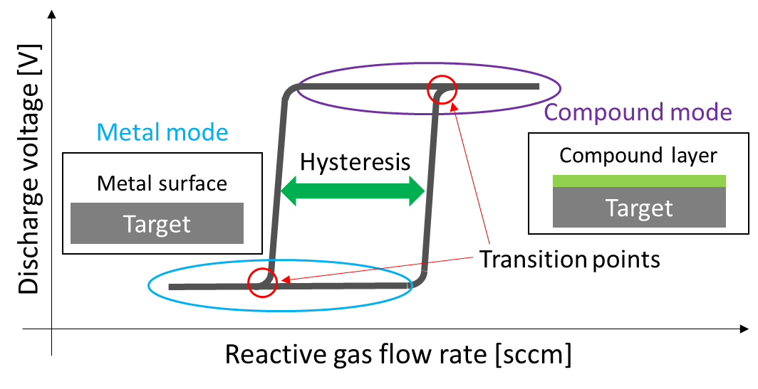
Hysteresis in Reactive Sputtering
3
Region | Deposition rate | Film composition
Metal | High | Metal-rich
Compound | Low | Stoichiometric
Transition point
information is important!

Slide 4
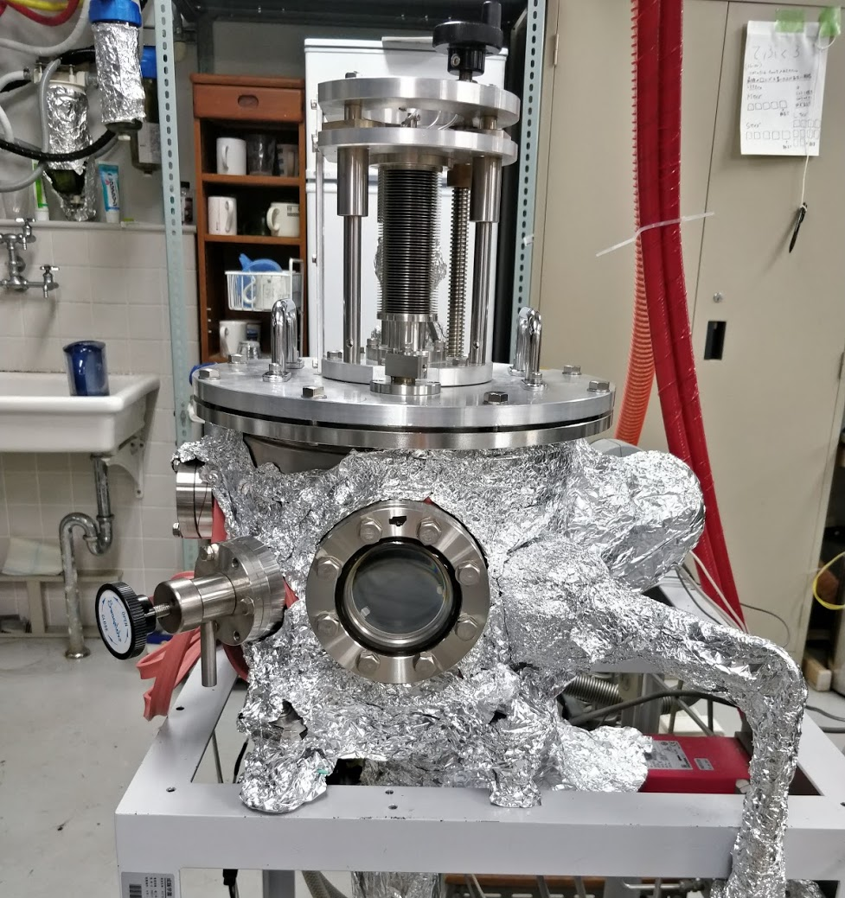
Experimental
Chamber:
SUS, 25 cmφ x 18 cm h
Base Pressure < 5 x 10⁻⁵ Pa
Target, Gas:
V, Ti, Zr; 50 mmφ
Ar 10 sccm + O₂, via MFC
Power Source:
DC in power regulation
Mode change was monitored by the Voltage jump
Depla, et al., JAP 101 (1987) 13301.

Slide 5
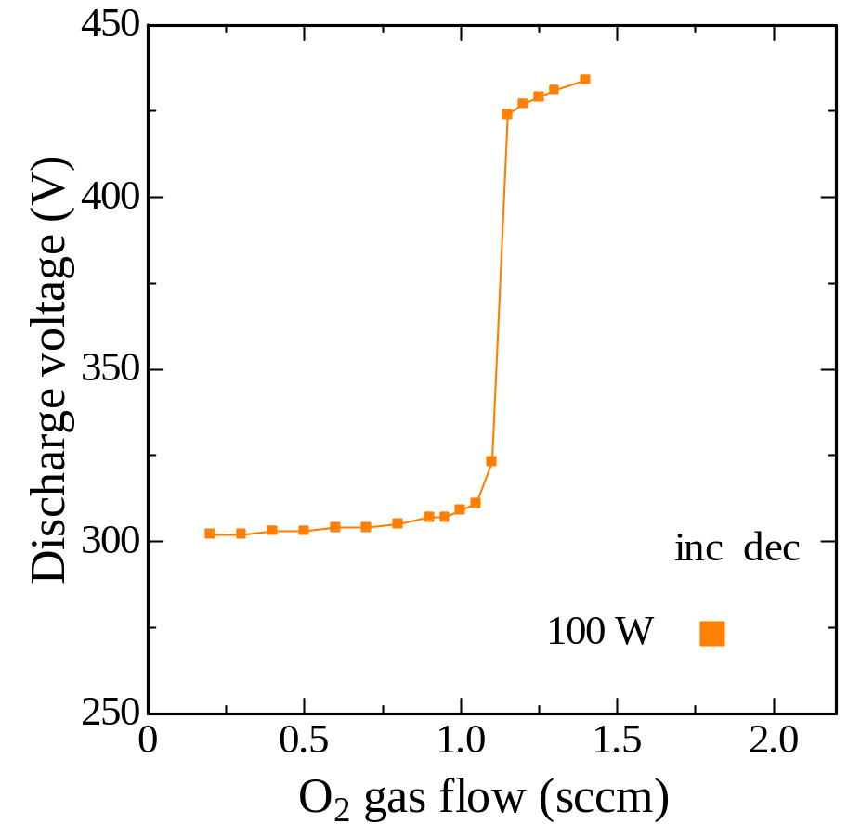
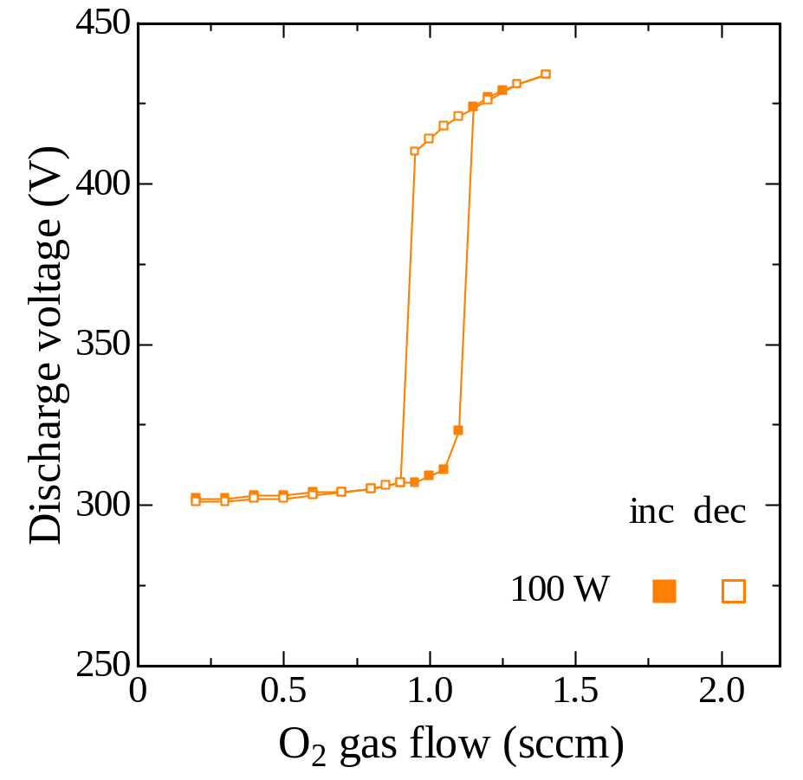
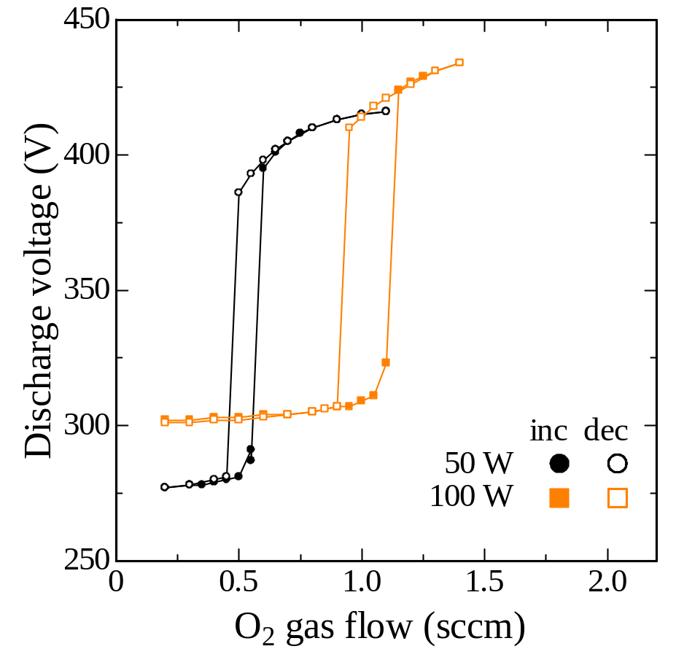
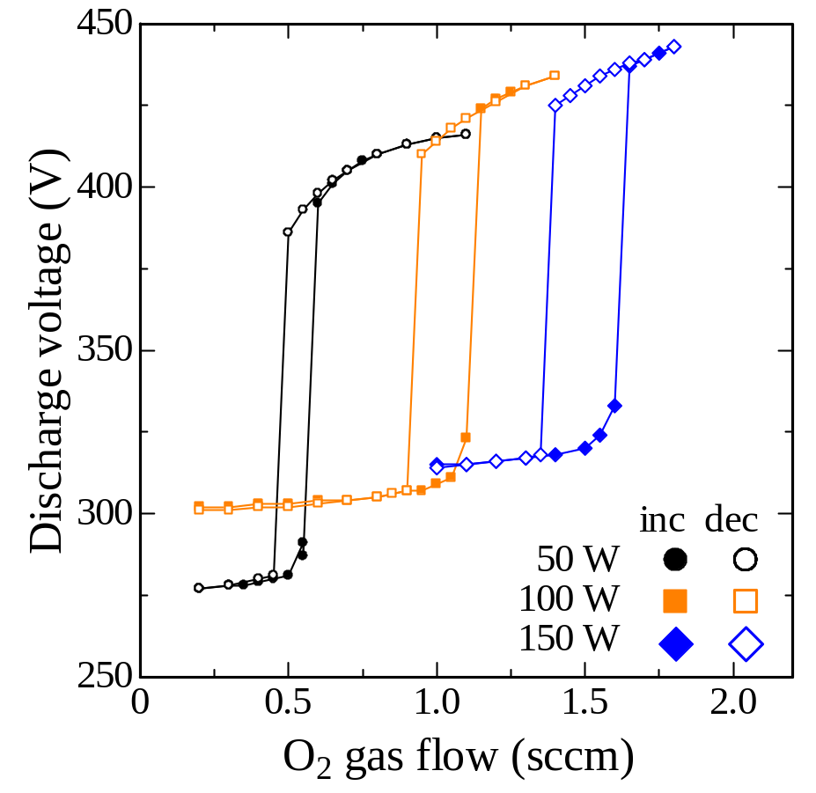
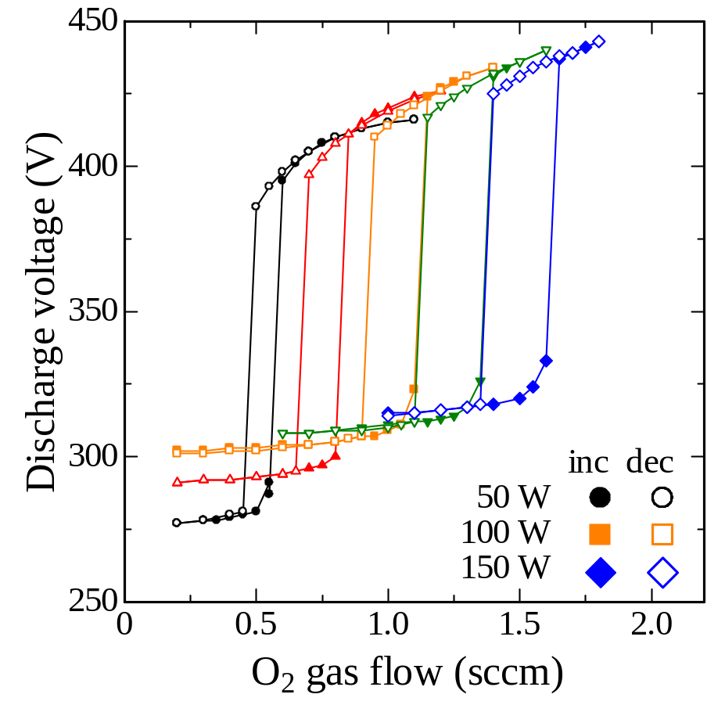
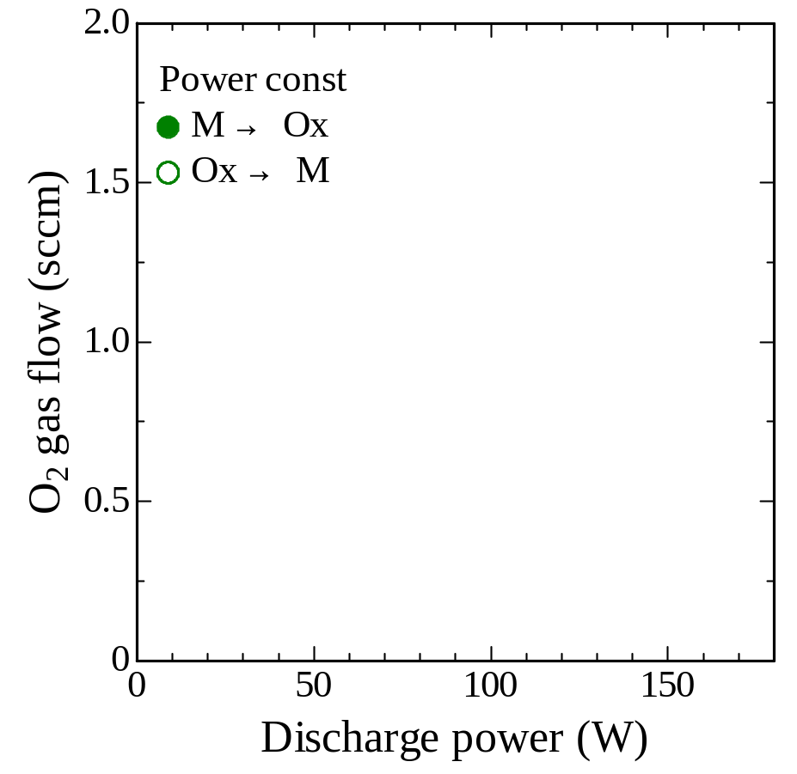
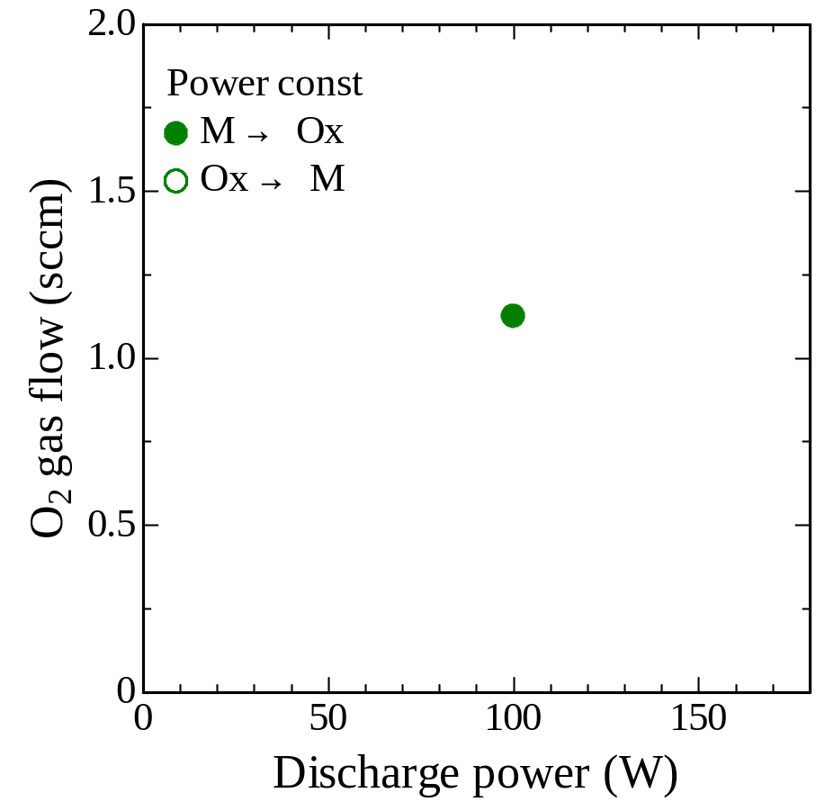
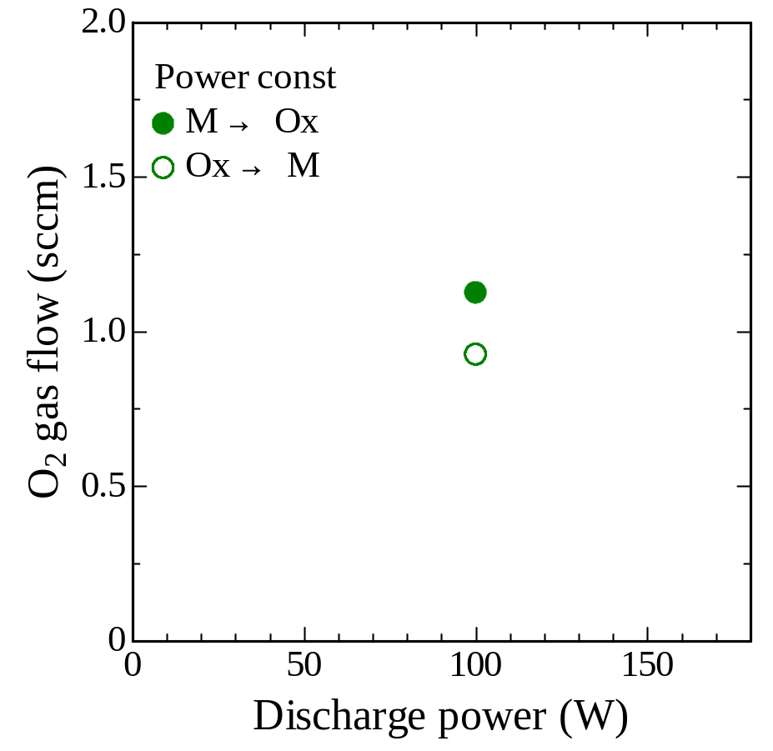
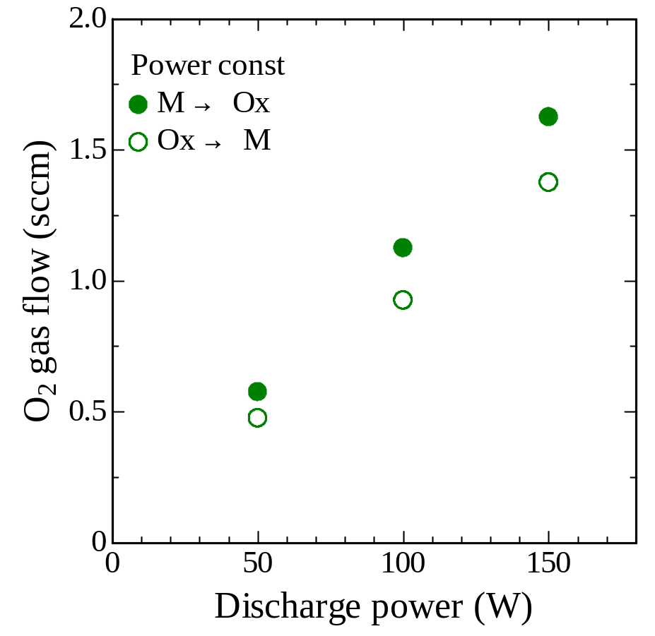
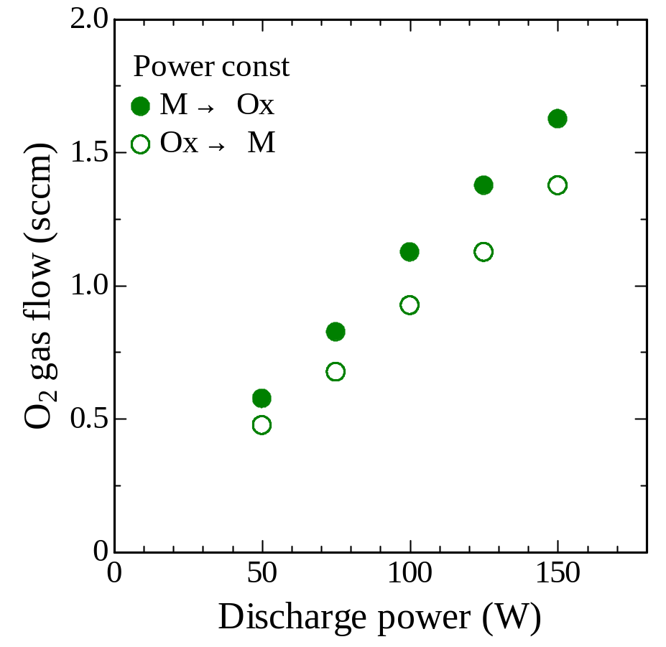
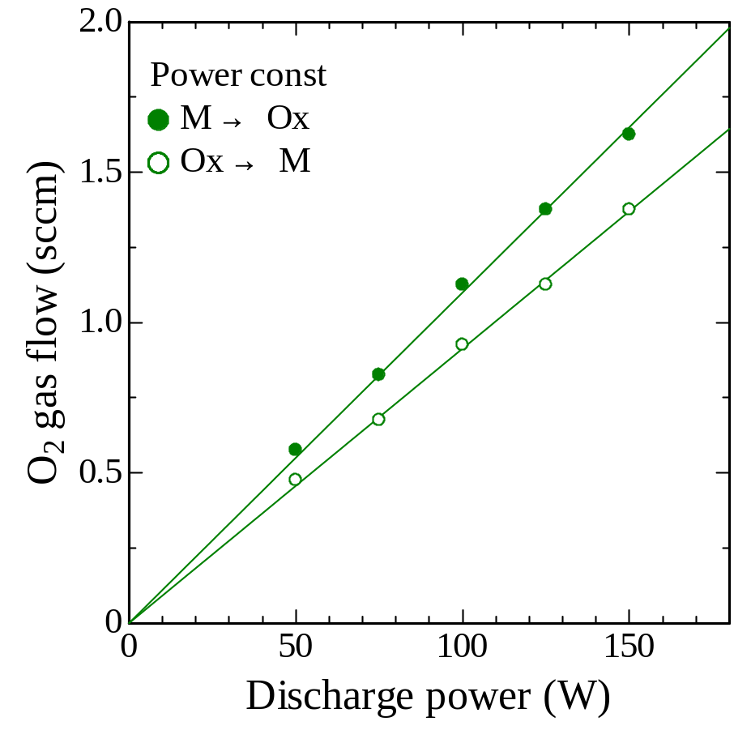
Power Const. operation
V @ Ar 0.5 Pa

Slide 6
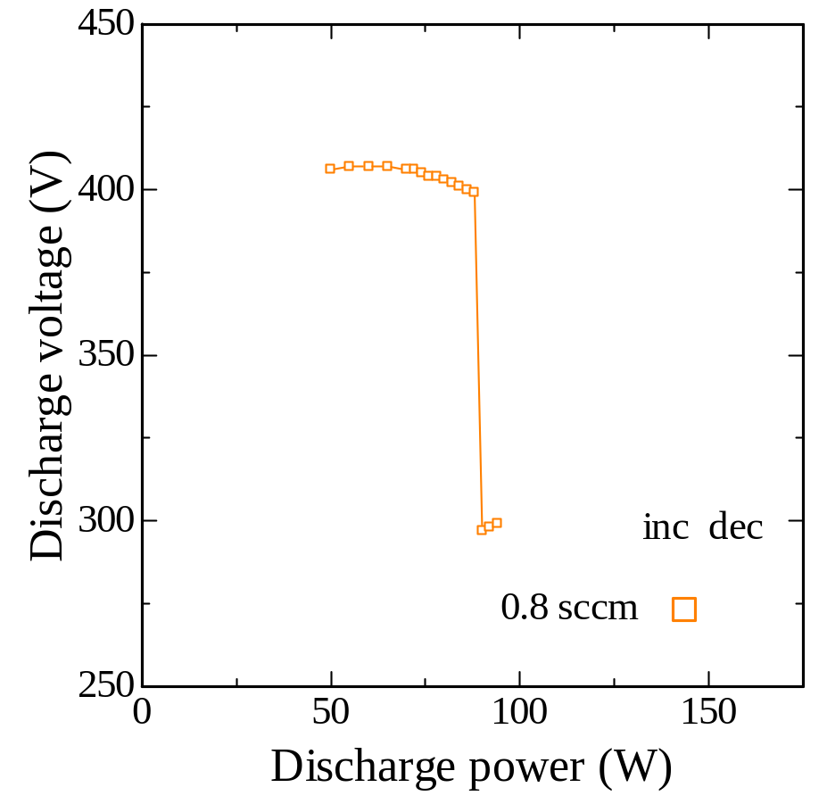
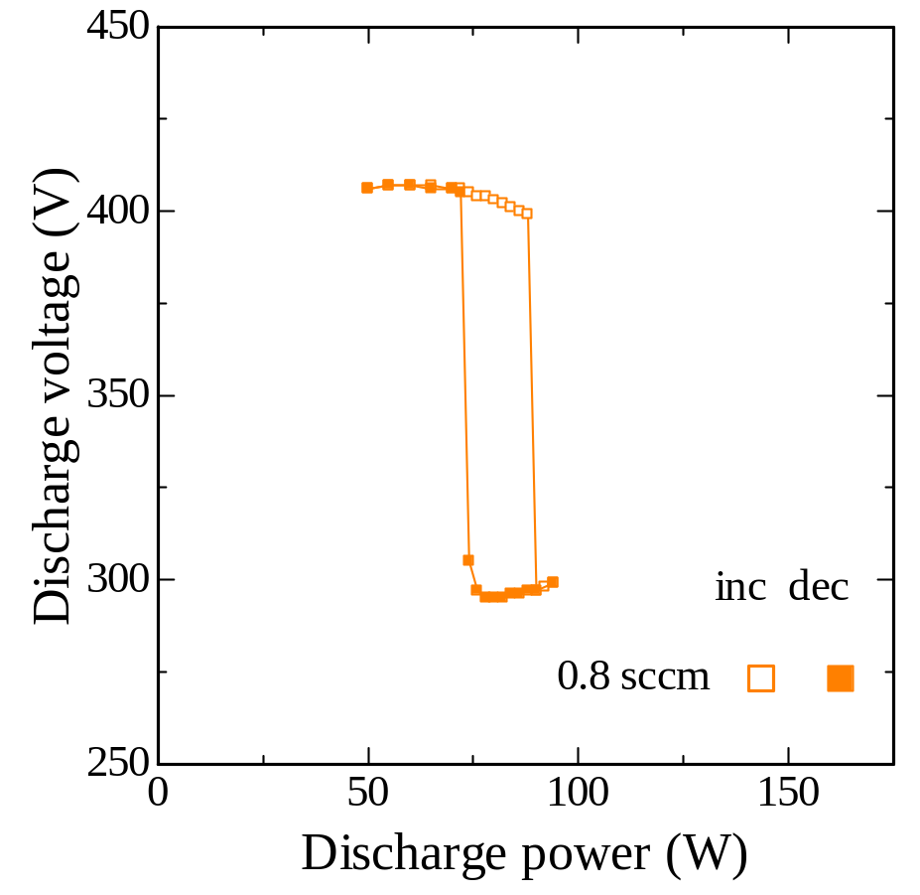
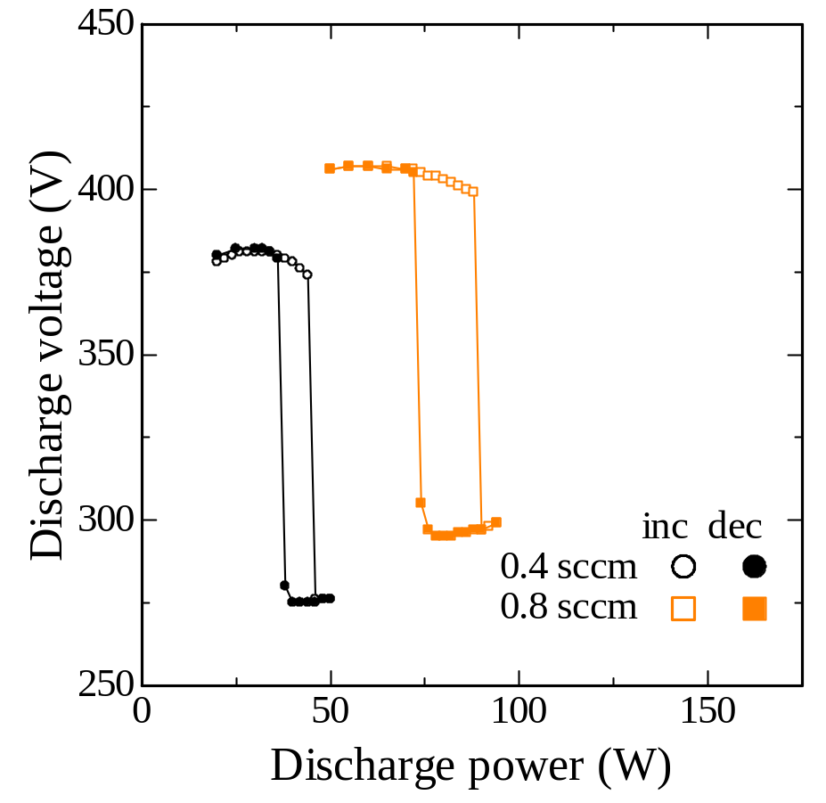
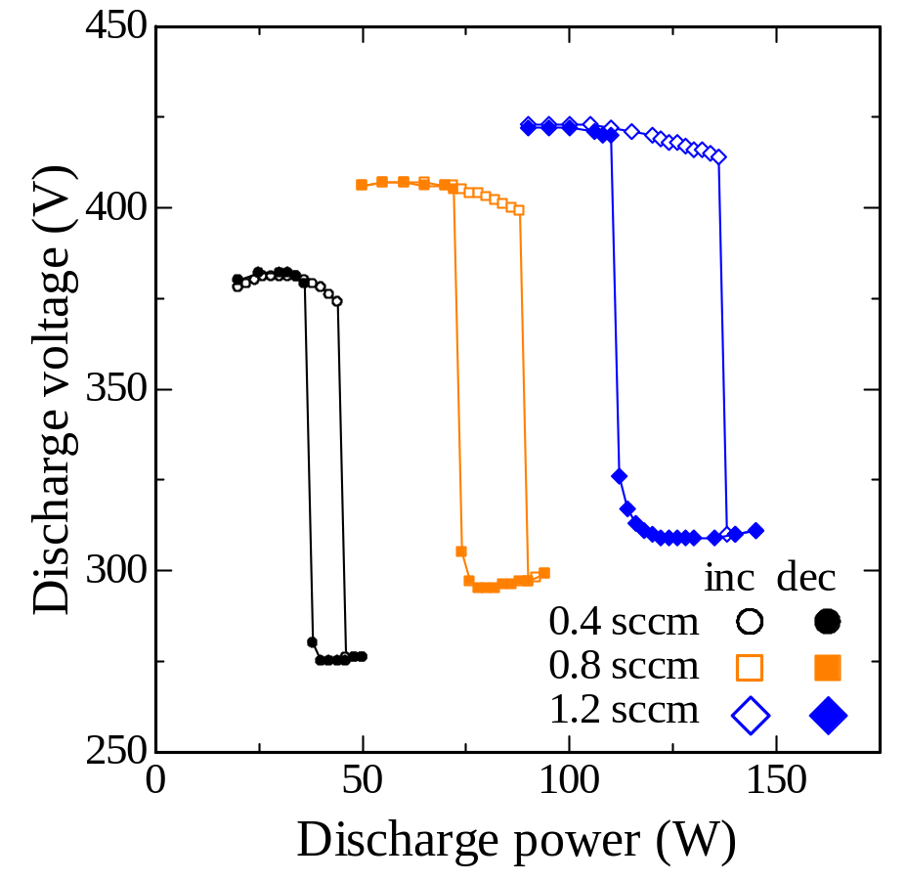
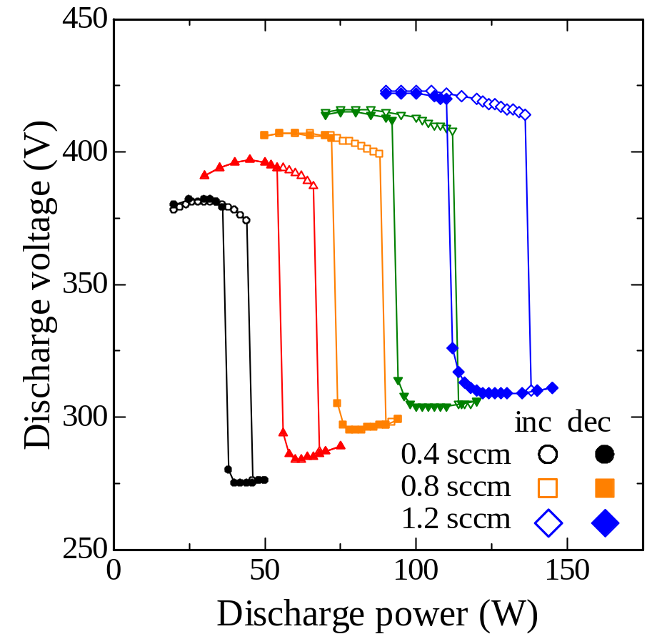
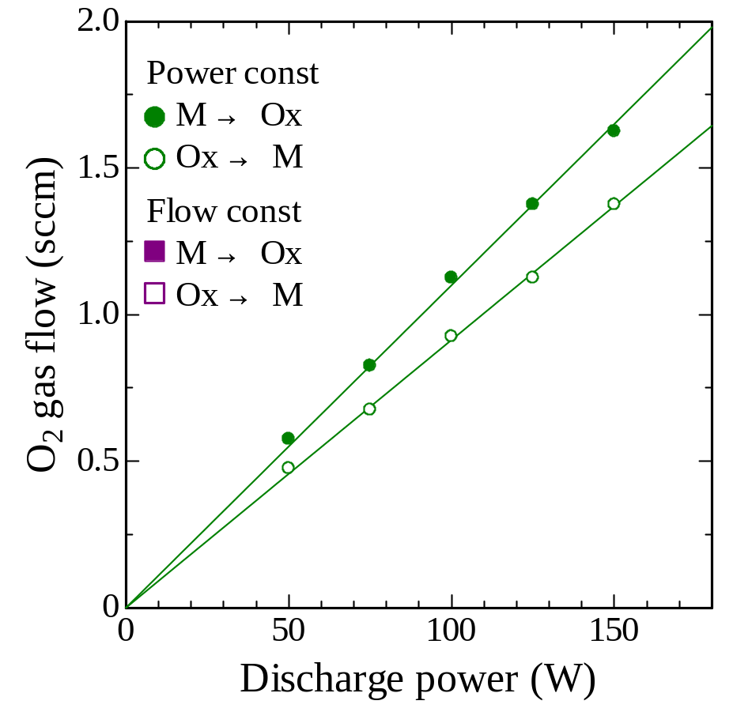

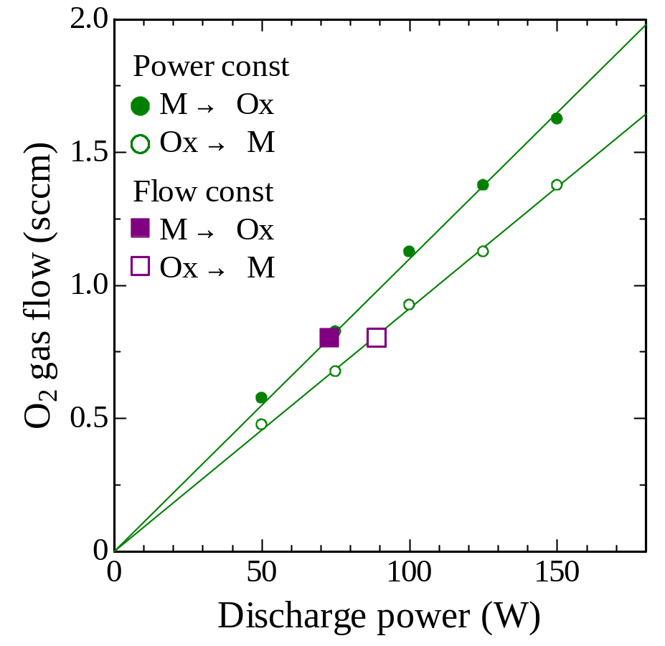
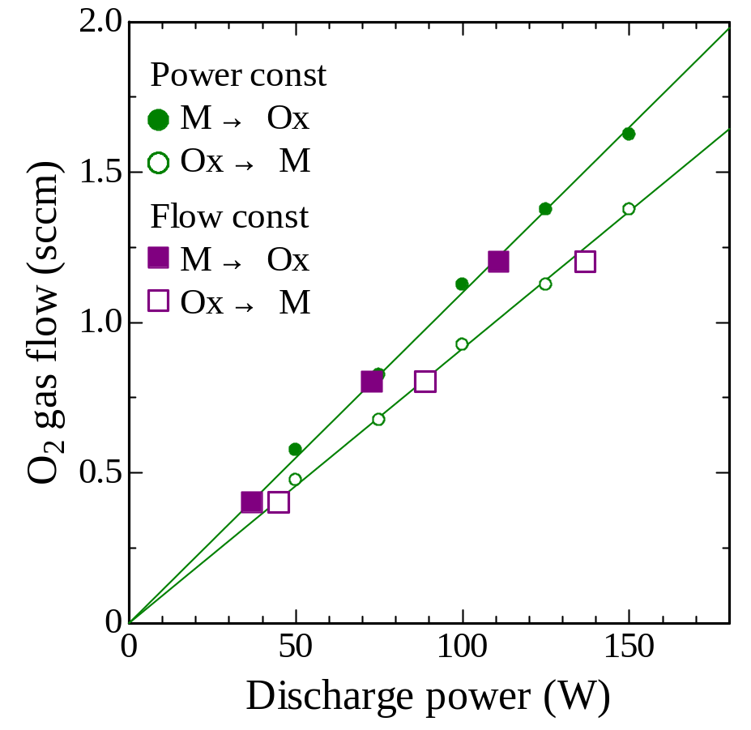
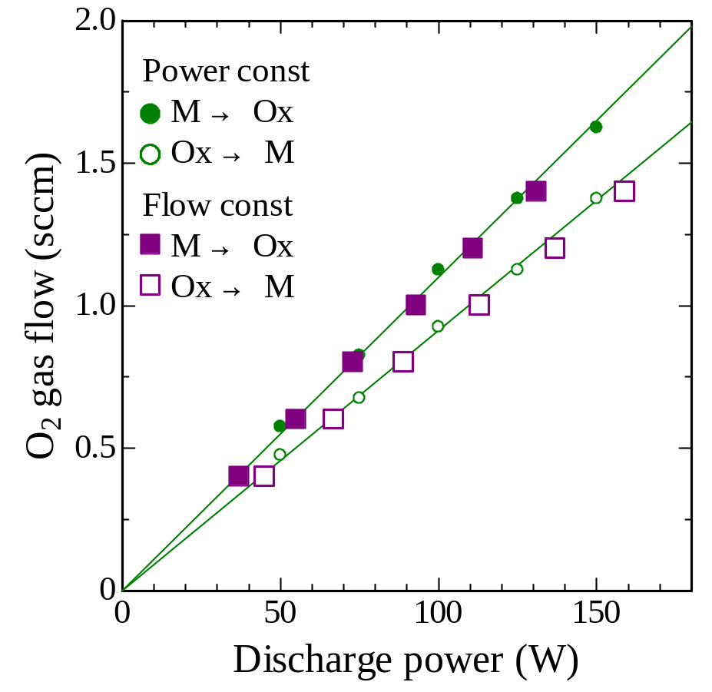
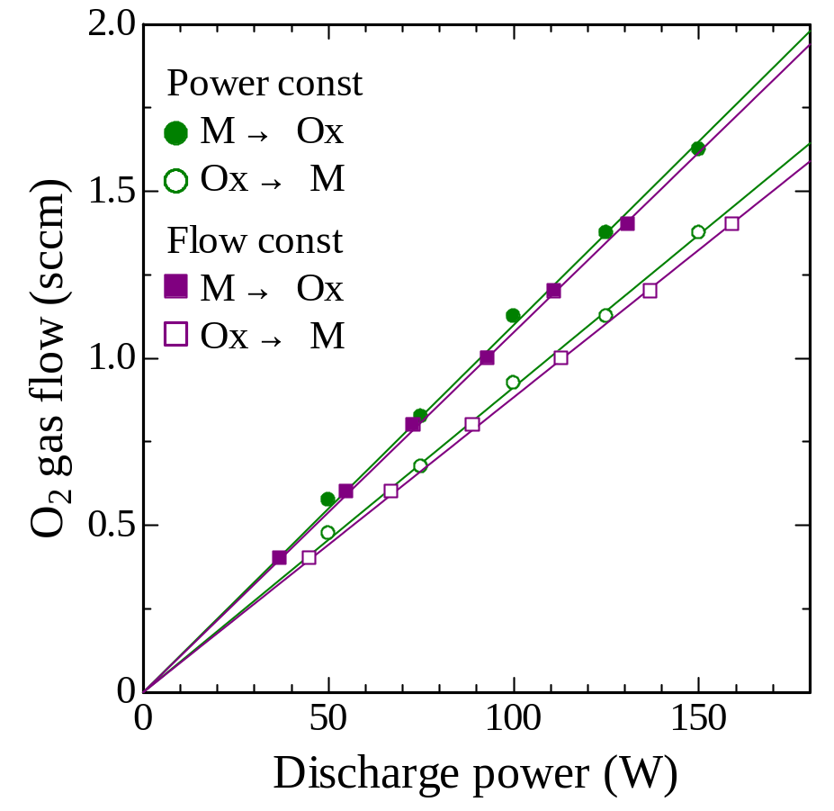
Flow Const. operation
V @ Ar 0.5 Pa

Slide 7
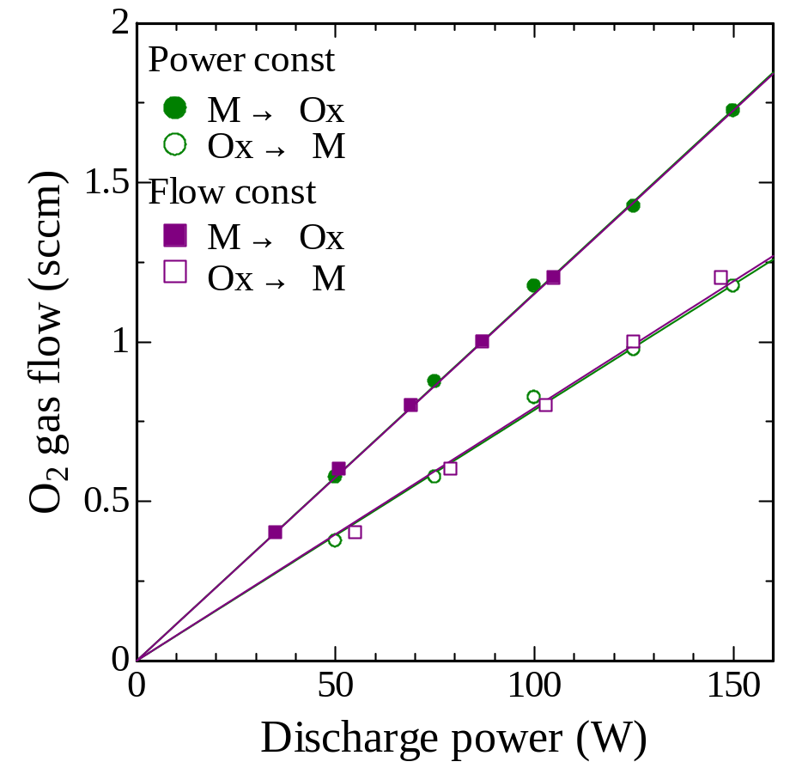
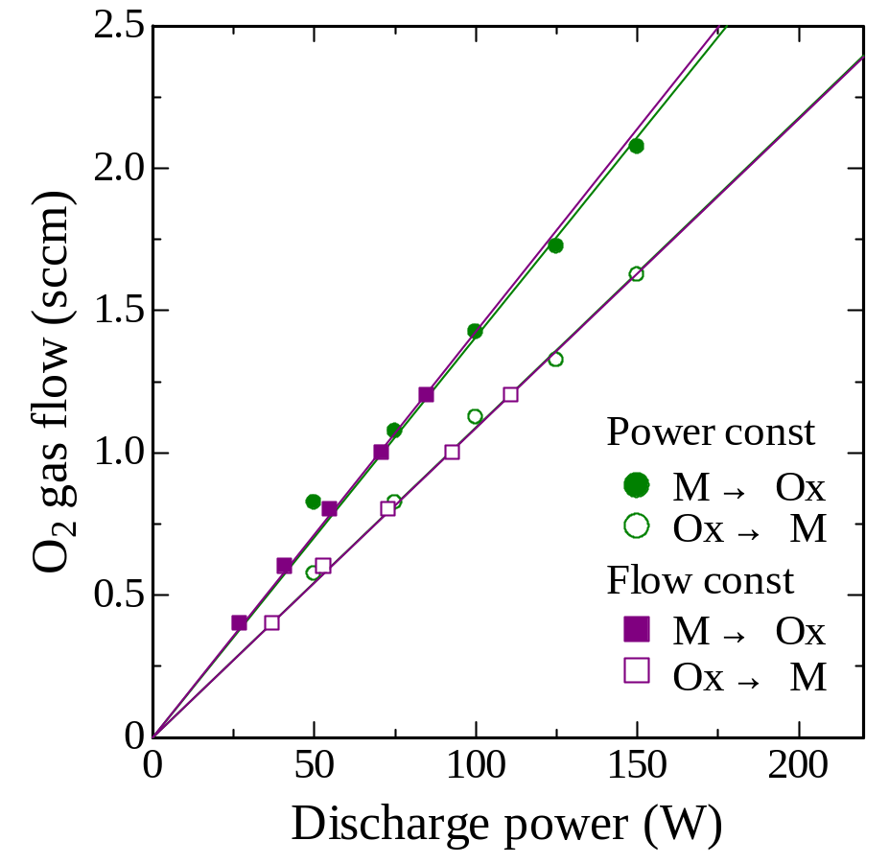
Ti & Zr, Q -P plot
Zr @ Ar 0.5 Pa
Ti @ Ar 0.5 Pa

Slide 8
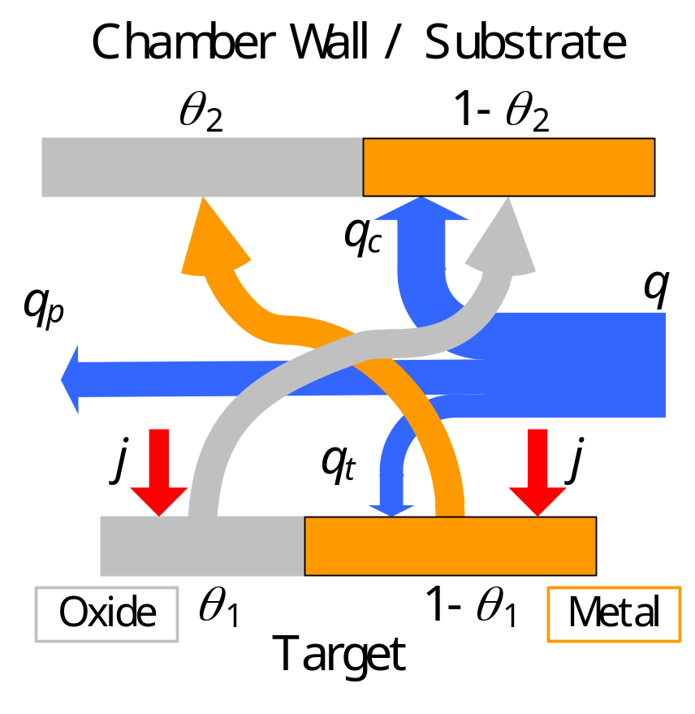
Berg’s Model
This model is composed of balance equations:
  [at target] Oxidation of metal region vs Sputter etching of oxide region
  [at chamber wall] Oxidation + oxide deposition on metal region
  vs metal deposition on oxide region
Berg, et al., JVSTA 5 (1987) 202.

Slide 9
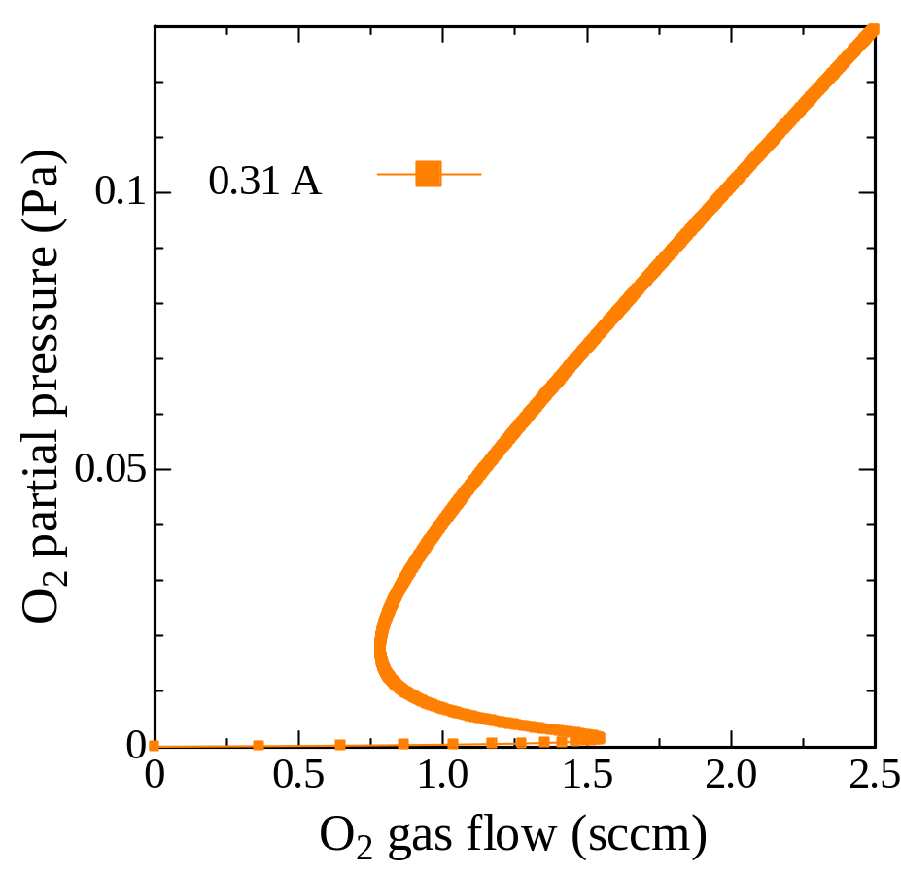
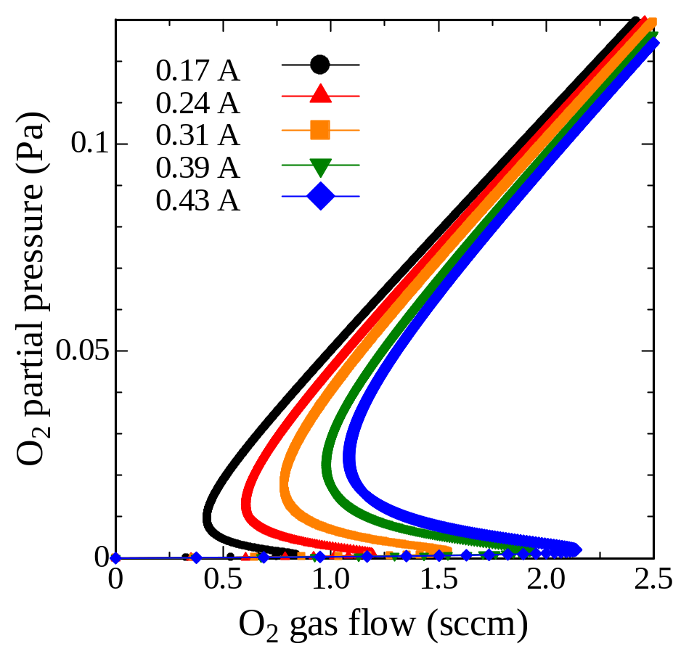
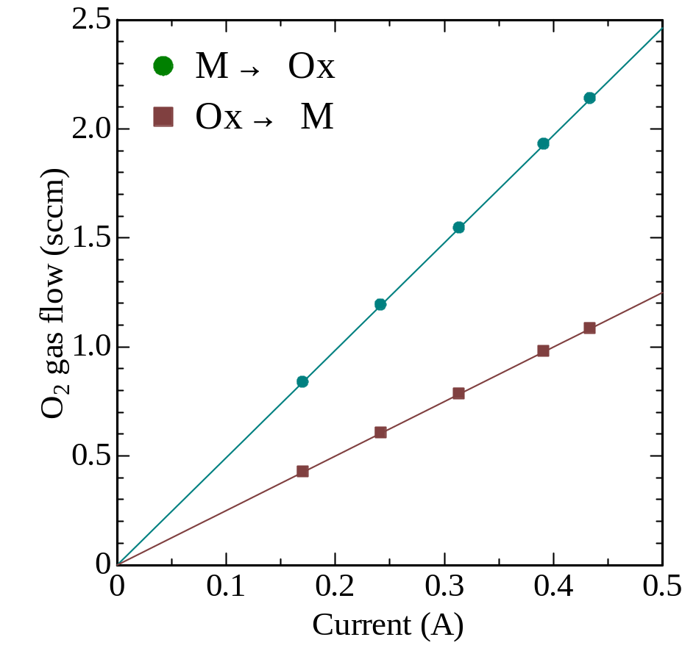
Reproduction of Hysteresis

Slide 10
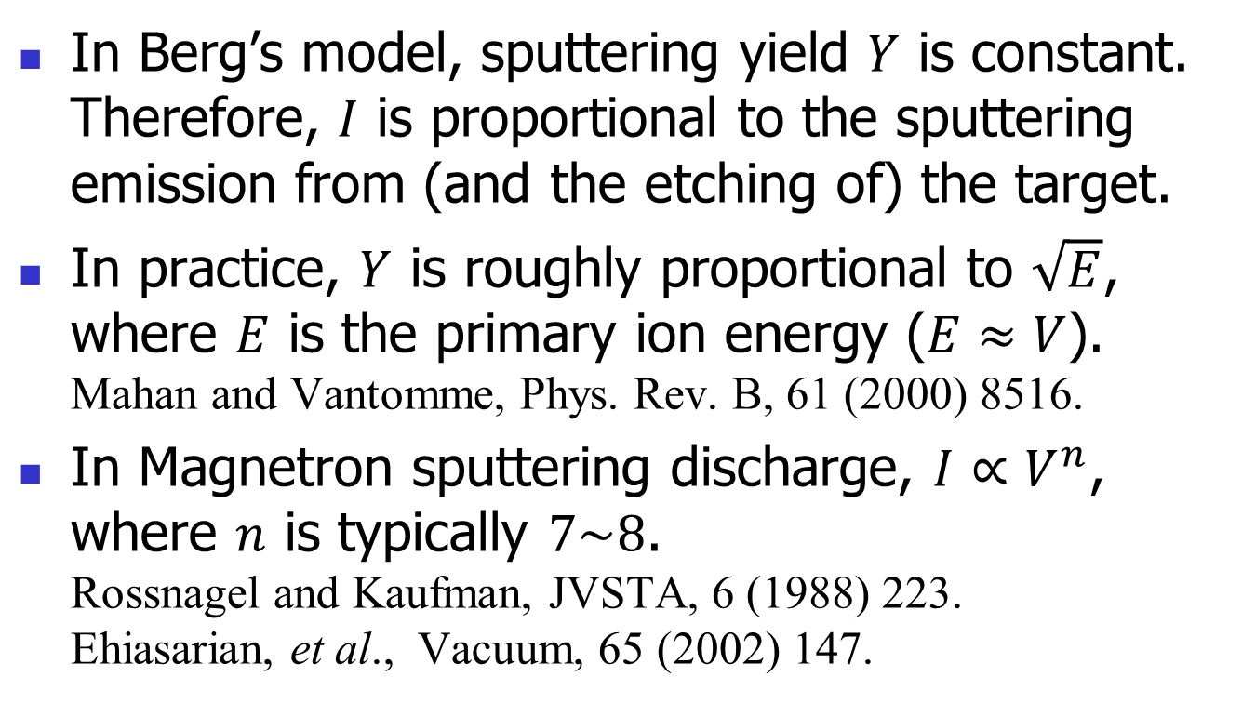
Linear Relationship in Q -P map?
In Berg’s model, sputtering yield $Y$ is constant. Therefore, $I$ is proportional to the sputtering emission from (and the etching of) the target.
In practice, $Y$ is roughly proportional to $\sqrt{E}$, where $E$ is the primary ion energy ($E≈V$).
Mahan and Vantomme, Phys. Rev. B, 61 (2000) 8516.
In Magnetron sputtering discharge, $I∝V^{n}$, where $n$ is typically $7\sim 8$.
Rossnagel and Kaufman, JVSTA, 6 (1988) 223.
Ehiasarian, et al., Vacuum, 65 (2002) 147.

Slide 11
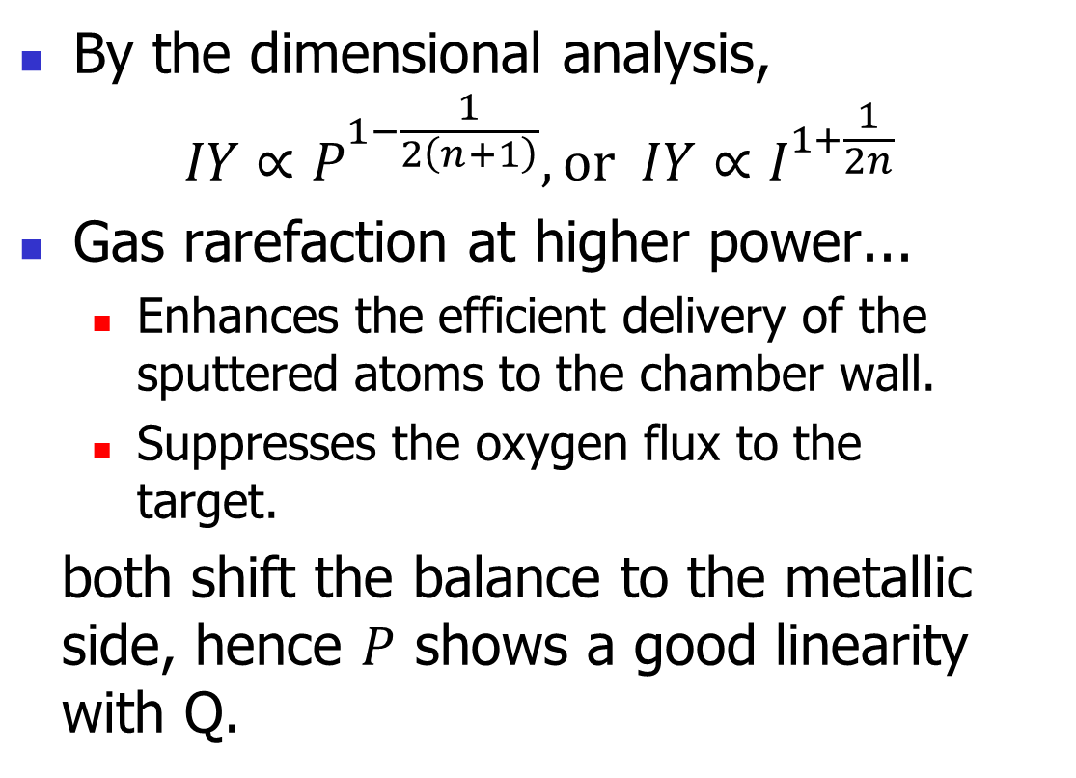
Linear Relationship in Q -P map?
By the dimensional analysis,
$IY∝P^{1−\frac{1}{2\left(n+1\right)}}, or IY∝I^{1+\frac{1}{2n}}$
Gas rarefaction at higher power...
  Enhances the efficient delivery of the
  sputtered atoms to the chamber wall.
  Suppresses the oxygen flux to the
  target.
both shift the balance to the metallic
side, hence $P$ shows a good linearity
with Q.

Slide 12
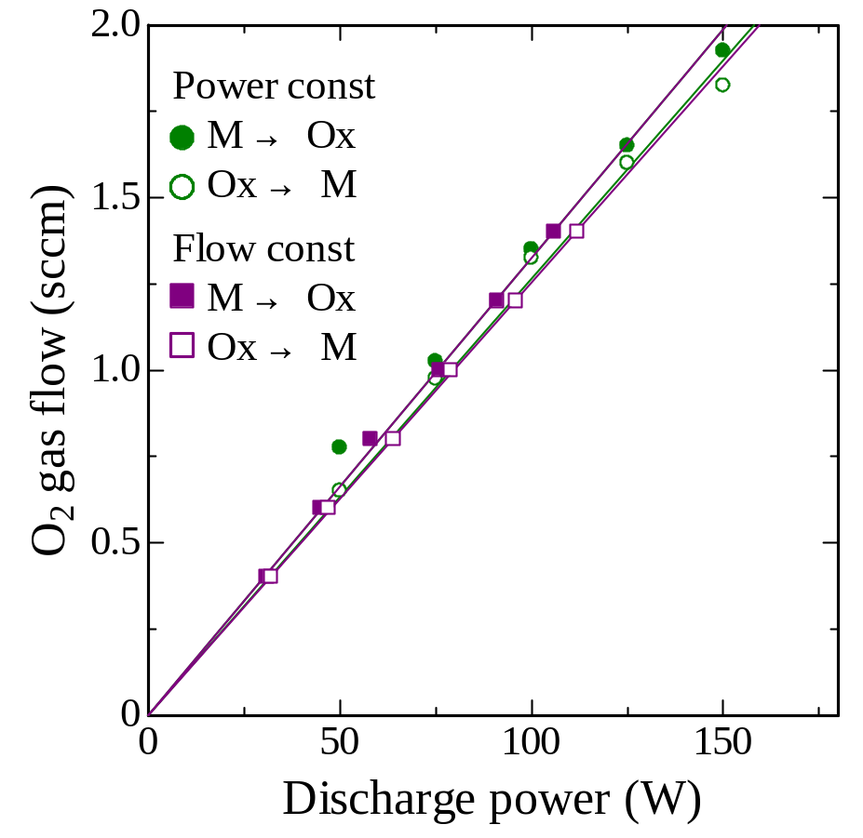
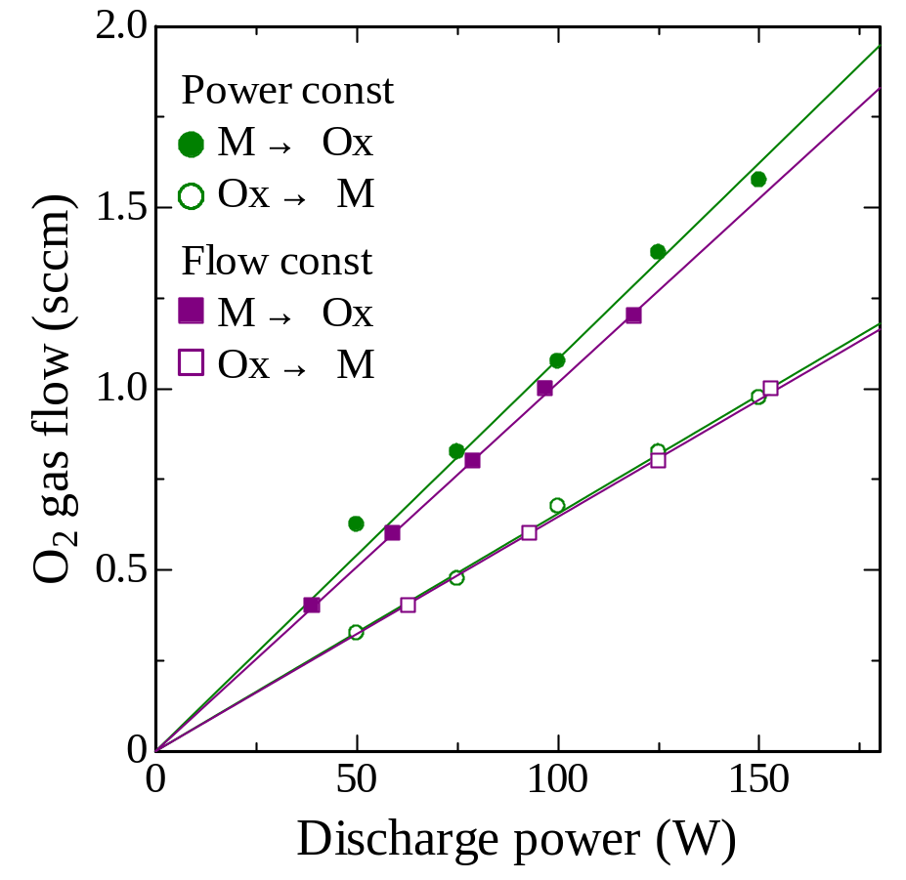
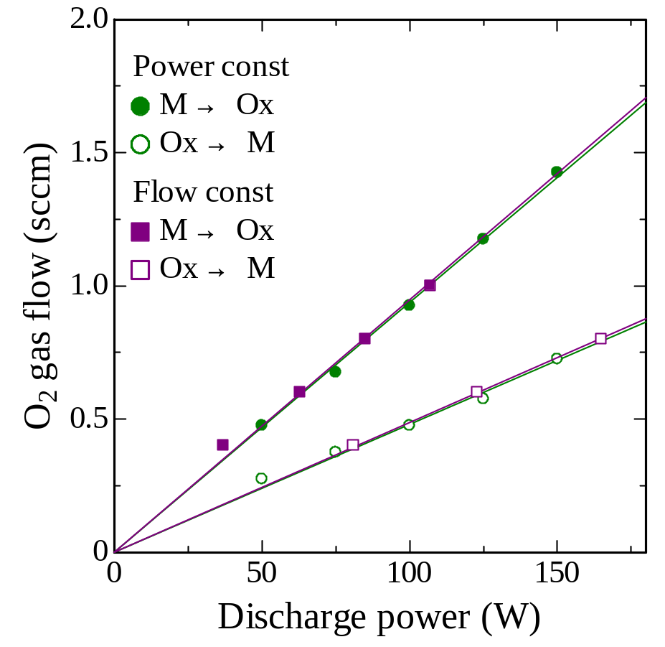
V Q-P plot, pressure dep.
V @ Ar 0.2 Pa
V @ Ar 1.0 Pa
V @ Ar 0.5 Pa
V @ Ar 2.0 Pa

Slide 13
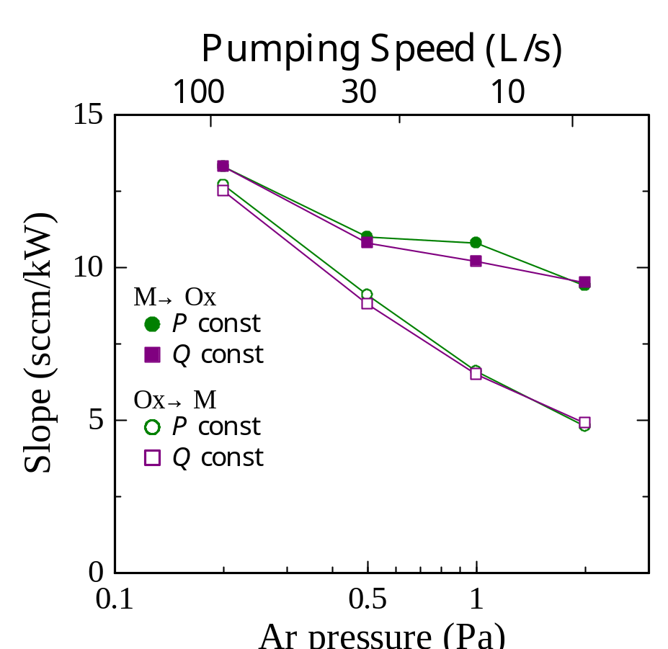
Q-P plot slope vs pressure
Higher gas pressure (i.e.,
Lower pumping speed)
the slope was reduced and the hysteresis was widen
It is in agreement with the prediction of Berg’s model, and the general behavior or the reactive sputtering.

Slide 14
Practical usage of this concept
At a certain condition of
Ar pressure and flow rate,
mode transitions can be
predicted by a single
experiment.
Films of similar properties can be expected at different discharge power by choosing the deposition conditions in the Q-P map.

Slide 15
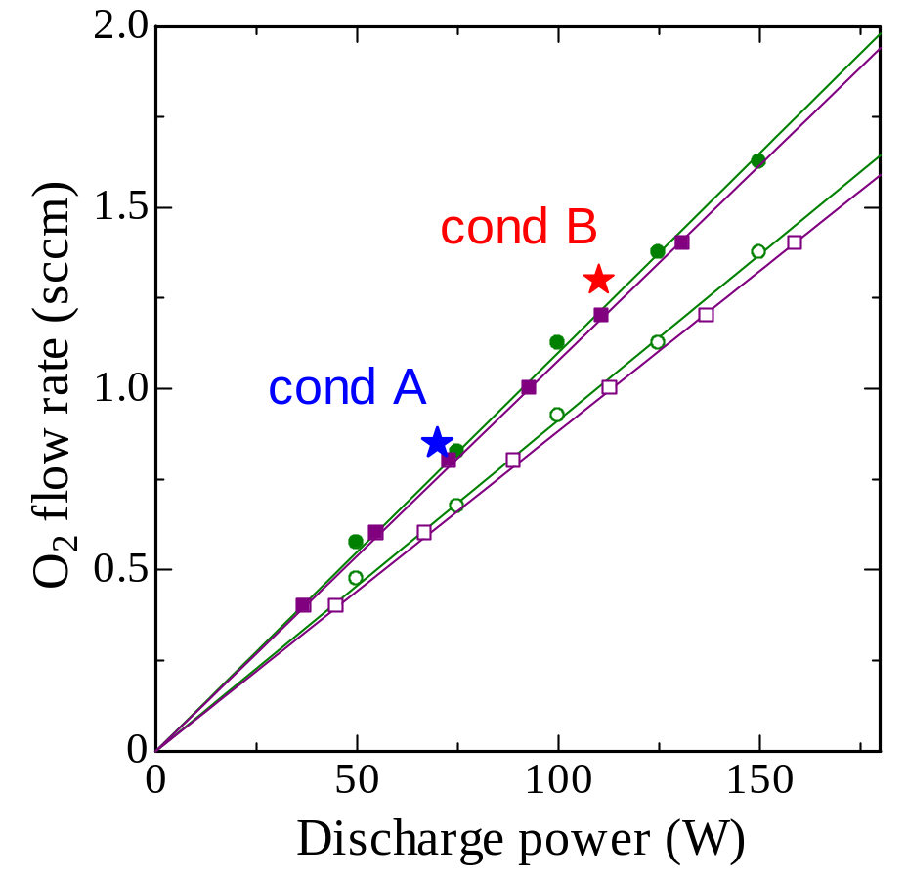
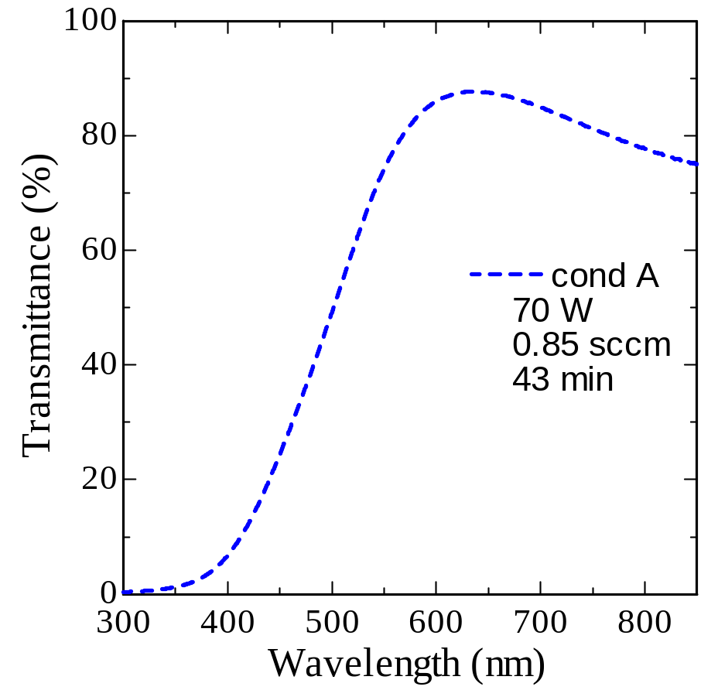
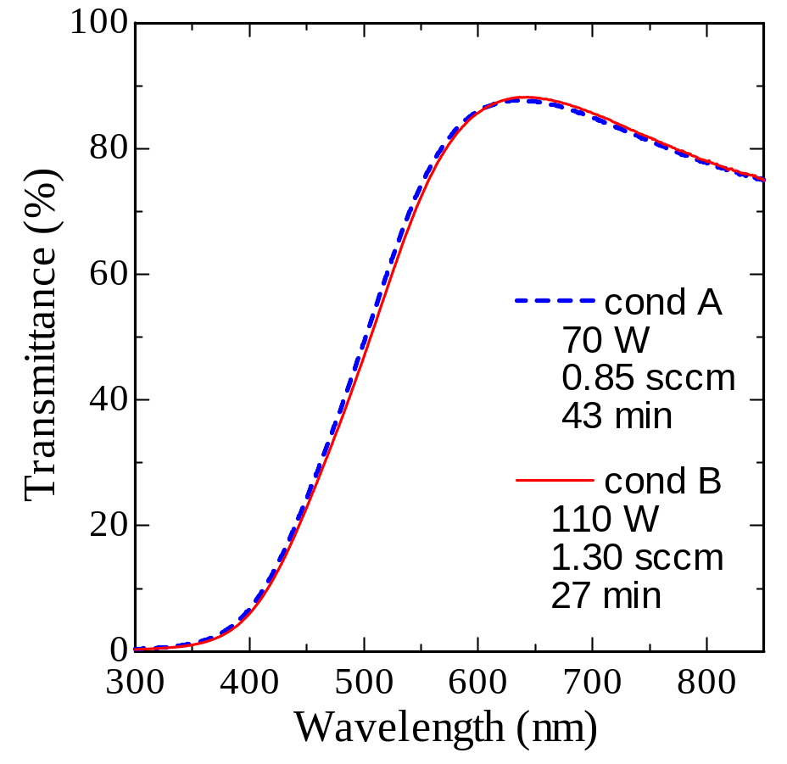
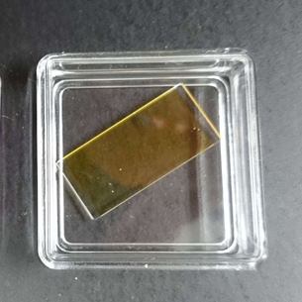
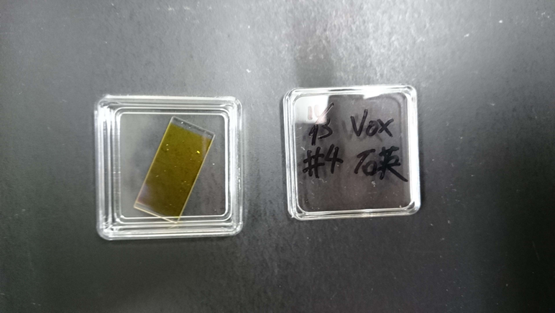
Optical Transmittance of Vanadia films
V @ Ar 0.5 Pa

Slide 16
Concluding remarks
In reactive sputtering of some metal oxides, M→Ox and Ox→M mode transition points lay
on corresponding straight lines in Q-P map.
It denotes the sputtering emission from (and
the etching of) the target is effectively proportional to the discharge power.
The concept may be useful in deposition condition selection, and the control of
the properties of deposited films.

Slide 17
Motivation of this study
In actual deposition processes, the target current increase accompanies the target voltage increase;
→Hence the sputtering yield also increases.
Is there any good measure to predict the mode transition conditions?

Slide 18
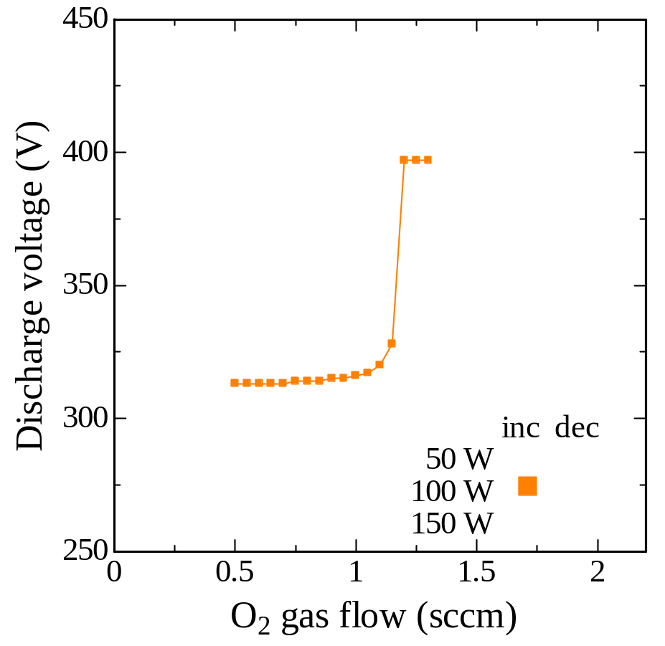
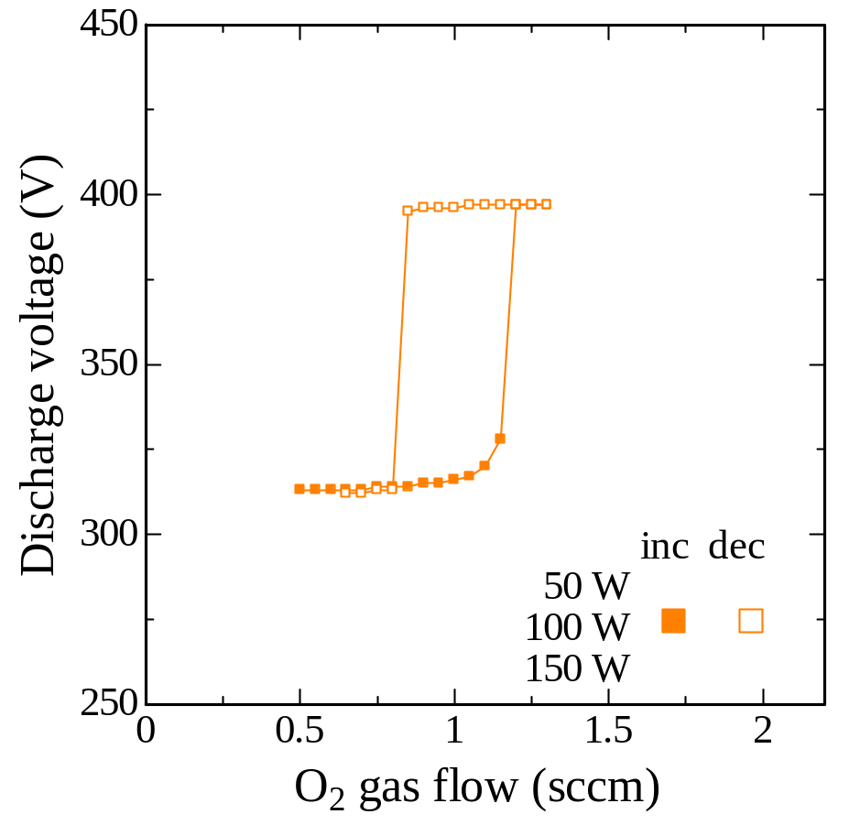
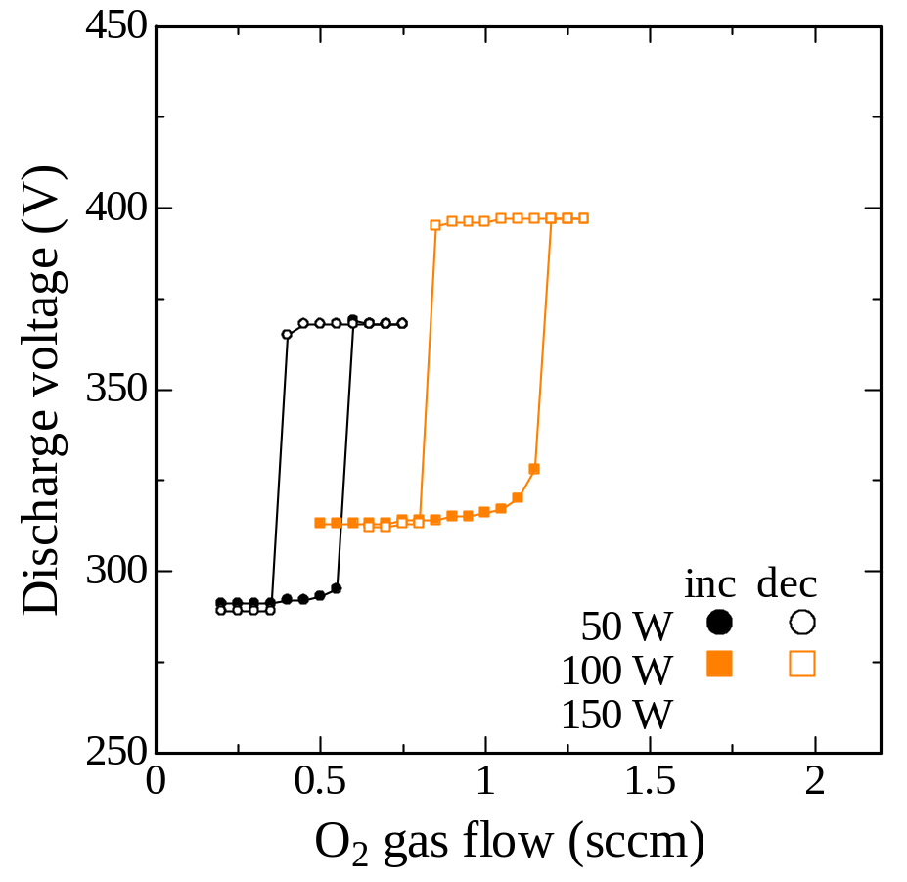
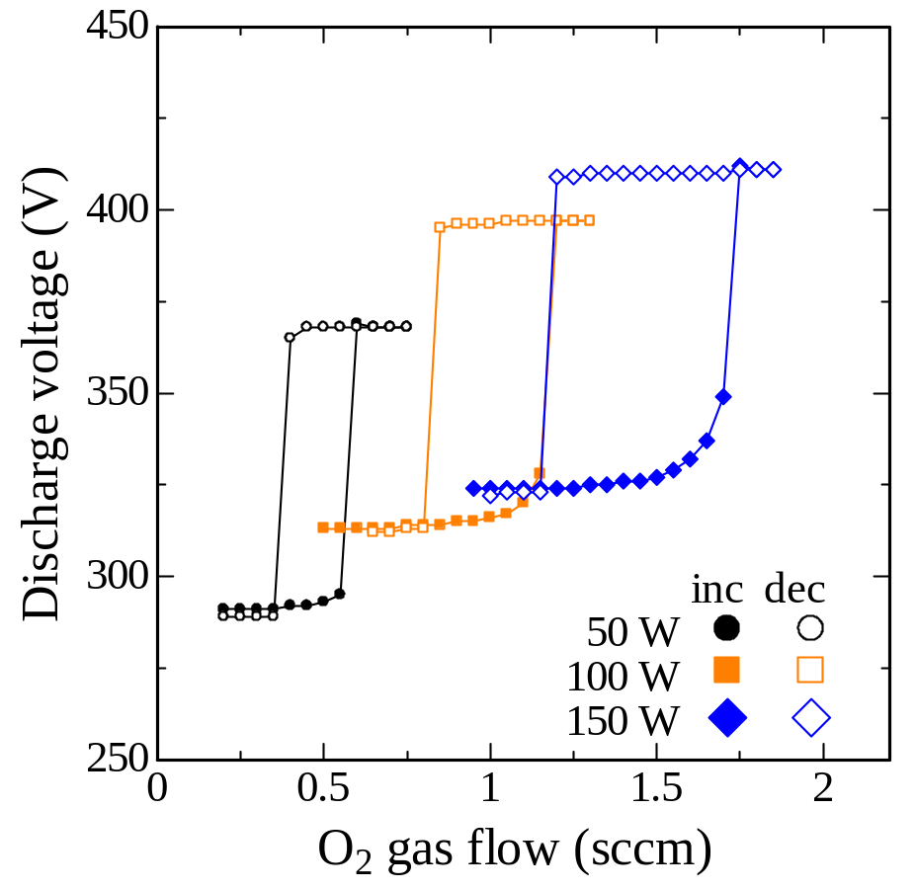
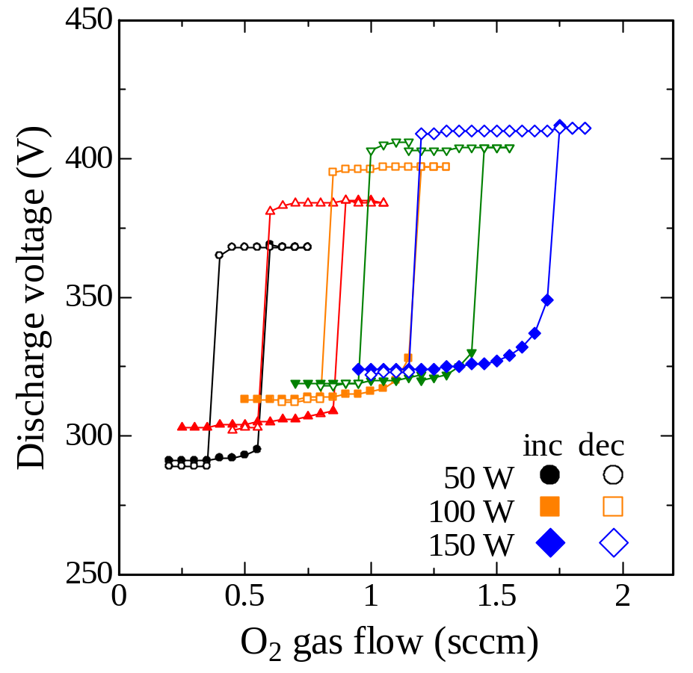
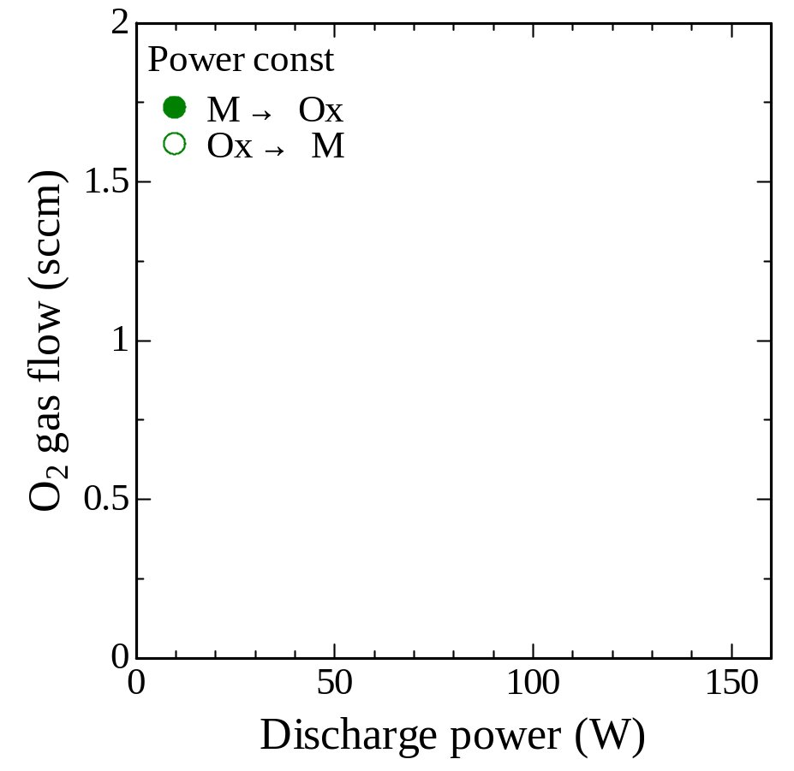
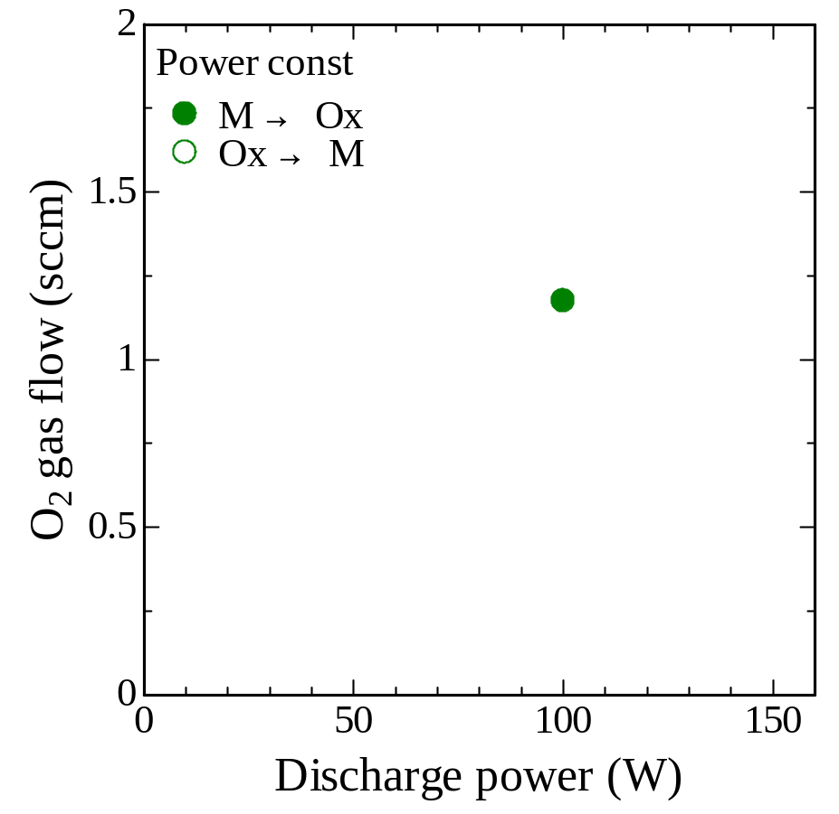

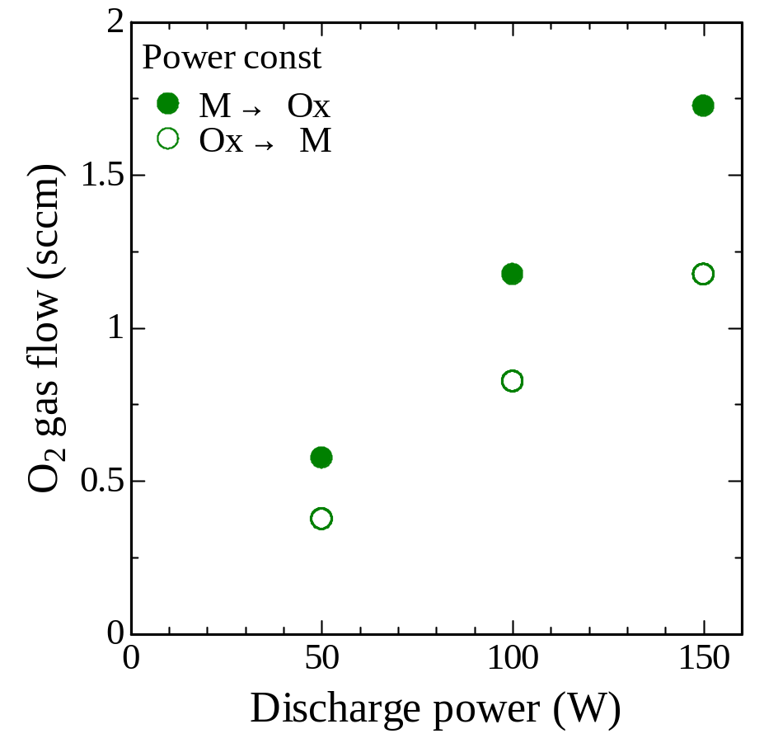
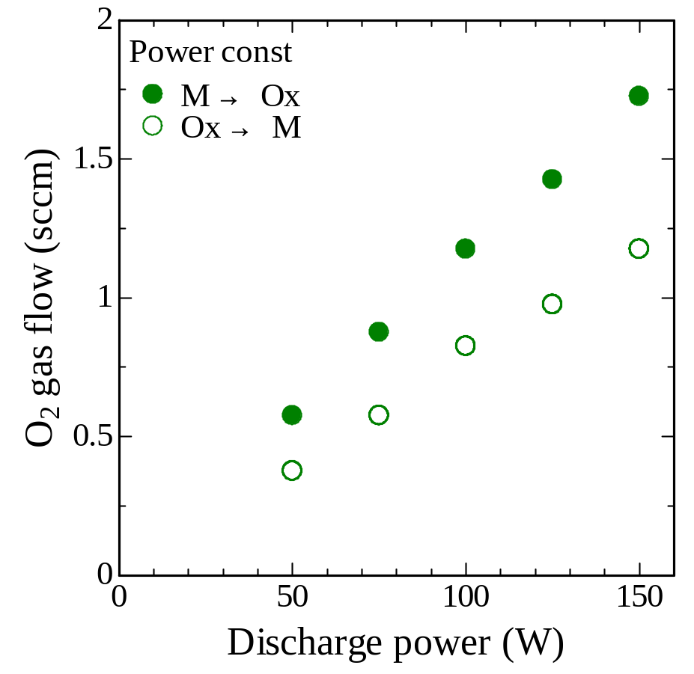
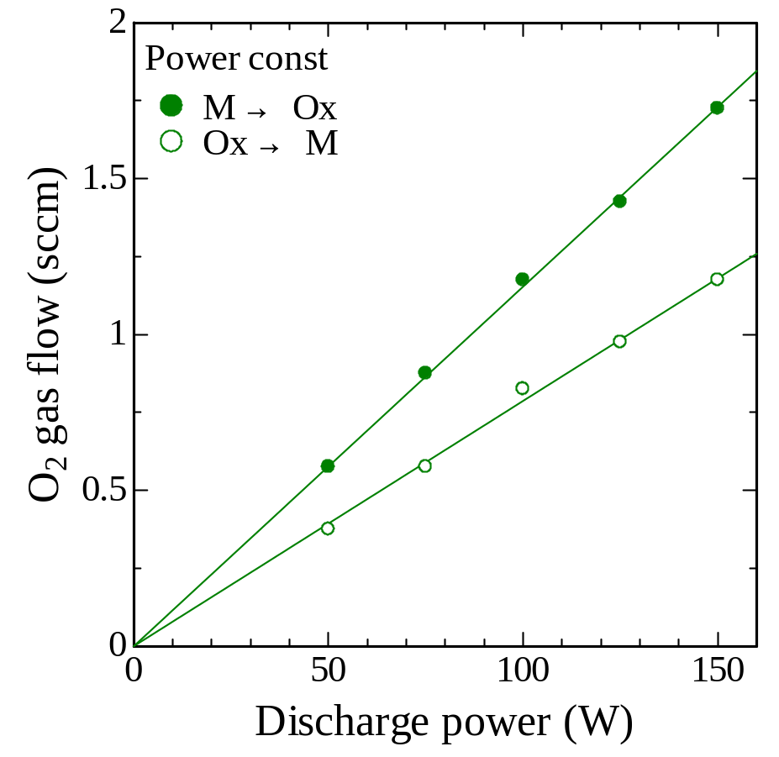
Power Const. measurements
Ti / Ar 0.5 Pa, 10 sccm

Slide 19










Flow Const. measurements
Ti / Ar 0.5 Pa, 10 sccm

