Slide 1
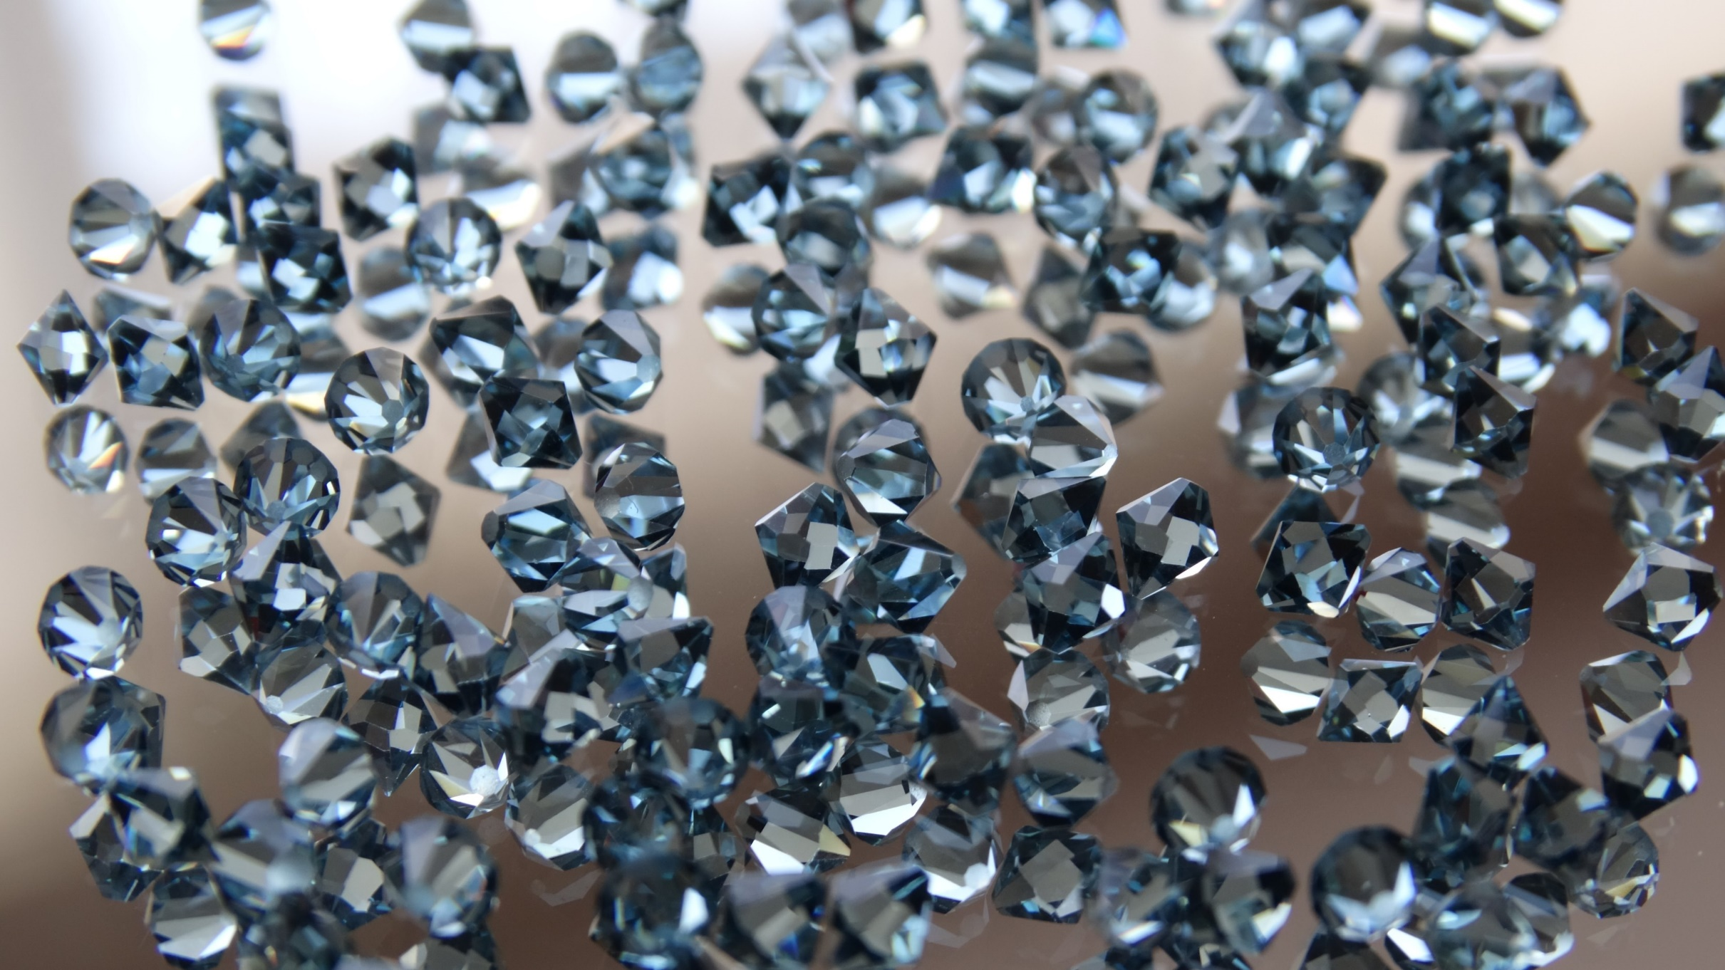


Dependence of Thermal Conductivity of MPCVD Diamond Thin Films on Oxygen Concentration
Fatima tuz Zahra, James Downes
Department of Physics & Astronomy,
Macquarie University, Sydney, Australia.

Slide 2


Outline
Properties and Applications
Diamond Growth
CVD Method
Results
Conclusion/Future Work

Slide 3
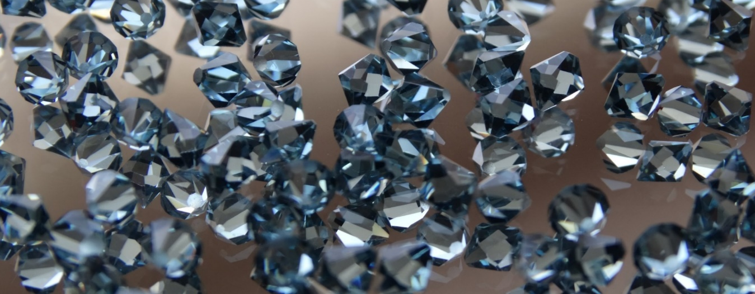
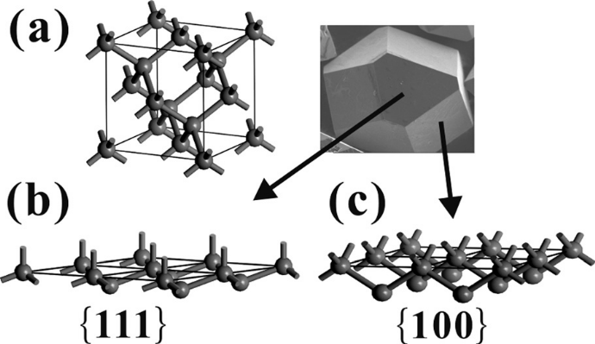
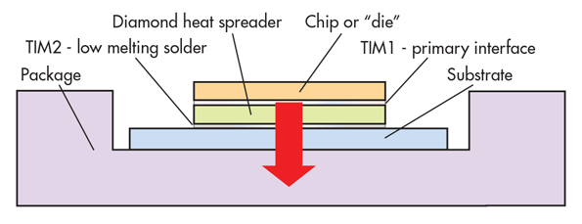
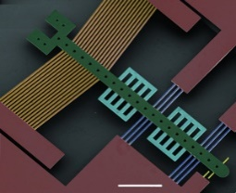
Properties & Applications of Diamond
FCC crystal structure with covalently bonded carbon atoms along <111> direction.
34% lattice filled with carbon atoms.
S. Sun et al., Cryst. Eng. Comm., 16, 2290, (2014)
Fig.1. (a) Crystal structure of diamond, morphological demonstration of (b) plane {111} and (c) plane {100} of diamond lattice
V. S. S. Srikanth and X. Jiang, Synthetic Diamond Films: Preparation, Electrochemistry, Characterization, and Applications, 2011, 21–55
High thermal conductivity (2000-2300 W/m.K)
Application: Thermal management in electronic devices
https://www.mwrf.com/materials/diamonds-are-gan-pa-s-best-friend
Fig. 2 Diamond as a heat spreader
Insulator when pure and semiconductor (E_{g}≈ 5.47eV) when doped (Wort & Balmer, 2008)
Application: CMOS, and MEMS/NEMS technology (Sumant et al.,2010)
https://www.rdmag.com/news/2014/08/thin-diamond-films-provide-new-material-micro-machines
Fig. 3. Diamond as an actuator in MEMS

Slide 4
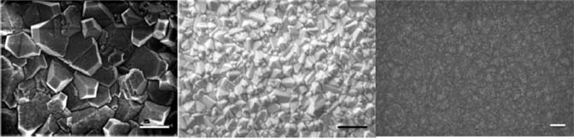
Classification of Diamond Thin Films (DTFs)
MicroCrystalline diamonds (MCDs)
NanoCrystalline diamonds (NCDs)
(>100nm )
UltraNanoCrystalline diamonds (UNCDs)
<1% sp² bonded carbon
(>10 nm and ≤100nm)
High %Q thin films
with good thermal
transport properties
(≤10 nm)
~1% sp² bonded carbon
~5% sp² bonded carbon
Fig. 5. Morphology of NCDs
Fig. 6. Morphology of MCDs
(Yet to be published)
Fig. 4. Morphology of UNCDs
A. V. Sumant, O. Auciello, R. W. Carpick, S. Srinivasan, and J. E. Butler, MRS Bull., 35, 281–288, 2010

Slide 5

Diamond Growth
Typical Pressure (5–6.5 GPa)
Type Ia (low %N)
Synthesis Temperature (1300-1700°C)
Type Ib (Substantial %N)
Natural Diamond
HPHT#
Diamond Growth
Ideal for single production of single crystal diamond
Type IIa (Nitrogen Free)
Restrains low temperature growth, and not economic
Type IIb (High %B)
Chemical Vapour Deposition
Ideal for low/intermediate temperature and low pressure diamond growth
Formula to calculate %Q of DTFs*
$$\%Q=\left(\frac{I_{D}}{I_{D}+{\sum{I}}_{G}}\right)×{100}^{}$$
High quality (%Q) diamond thin films can be achieved
where I_{D} and I_{G} are Raman intensities of diamond and graphitic peaks respectively.
#HPHT: High Pressure High Temperature
*E. Salgueiredo, M. Amaral, M. A. Neto, A. J. S. Fernandes, F. J. Oliveira, and R. F. Silva, Vacuum, 85, 701–704, 2011.
Ideal to grow UNCDs, NCDs, and MCDs at desired process parameters

Slide 6
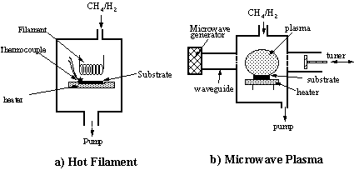
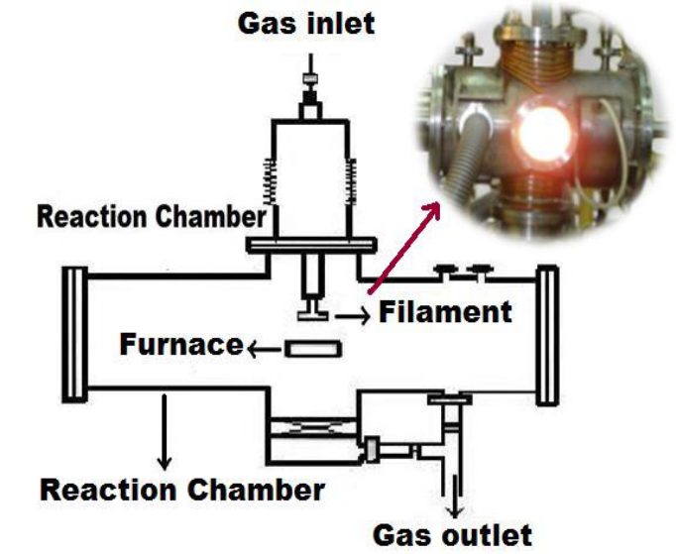
Chemical Vapour Deposition (CVD) Method
Microwave Plasma CVD (MPCVD)
Hot Filament CVD
Electrodeless process avoiding the contamination of films due to electrode erosion.
Unstable growth,
High possibility of contamination
Confinement of plasma in the
centre of the deposition chamber
Fig. 8. Schematic of HFCVD
Fig. 7. Schematic of MPCVD
Sensitive to oxidizing
and corrosive gases, limited
choice of gas mixtures
Vast choice of variation in
process parameters and gas
mixtures
P. W. May, Philos. Trans. R. Soc. A Math. Phys. Eng. Sci., vol. 358, no. 1766, pp. 473–495, 2000.

Slide 7


CVD Method
(Chemical Process)
H
H
H
CH₃
H
C
C
C
C
C
C
C
C
Plasma activation
${CH}_{3}^{∙}$are created
after
H₂+CH₄ react
Atomic hydrogen
creates reactive
sites by
abstracting
surface H
C
C
C
C
CH₃
CH₃
CH₃
H
H
Input Gases
(H₂ and CH₄)
C
C
C
C
C
C
C
C
C
C
C
C
H
Formation of sp³ bonded diamond lattice
Same reaction on adjacent sites, with
continuous H abstraction.
CH₃
CH₃
CH₃
CH₃
C
C
C
C
C
C
C
C
${CH}_{3}^{∙}$reacts with sites, adds C atom to the lattice
C
C
C
C
H
H
H
H
C
C
C
C
C
C
C
C
P. W. May, “Diamond thin films: a 21st-century material,” Philos. Trans. R. Soc. A Math. Phys. Eng. Sci., vol. 358, no. 1766, pp. 473–495, 2000.
Fig. 9. Illustration of diamond formation during CVD

Slide 8
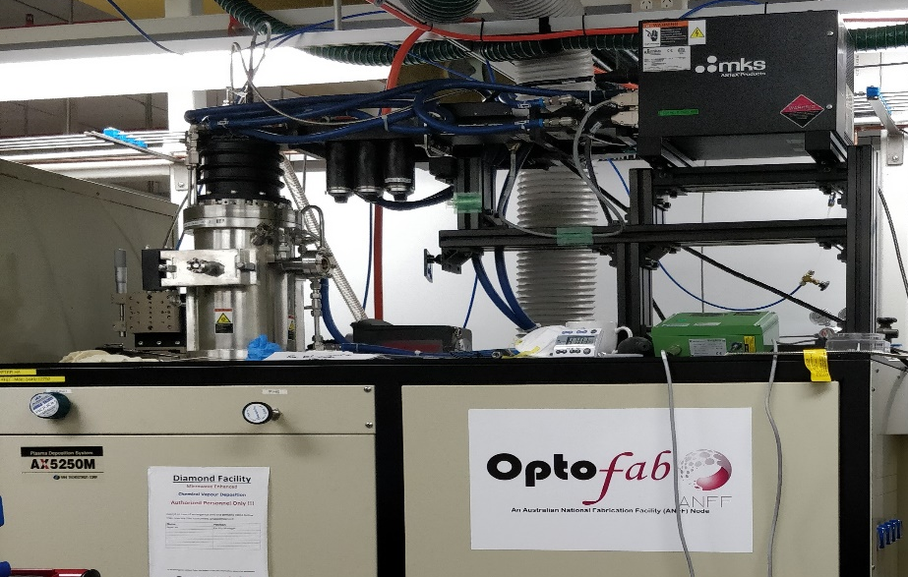
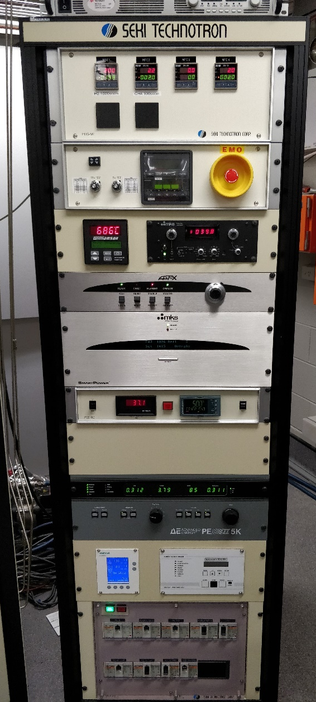
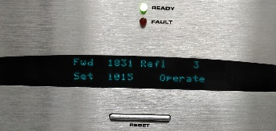
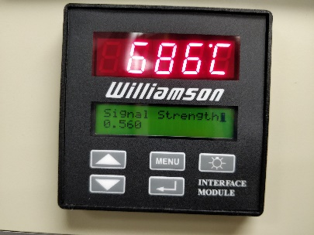
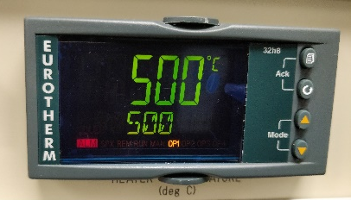
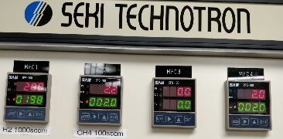
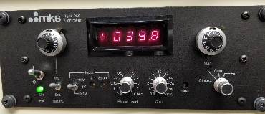

MPCVD Method
Seki Technotron MPCVD system
Si substrate cleaned using Acetone
Seeded using 10% Acetone and diamond solution.
H₂: 198sccm
CH₄: 2sccm
O₂: 0.0-1.5sccm
Substrate temp.:
~700°C
Power: 1000 W
Pressure: 40Torr
Time: 24hrs
Heater: 500 °C
Microwave power and Gas pressure
Deposition time, Heater temp.
Substrate pretreatment
Gas flowrates
Substrate temperature
Process Parameters

Slide 9
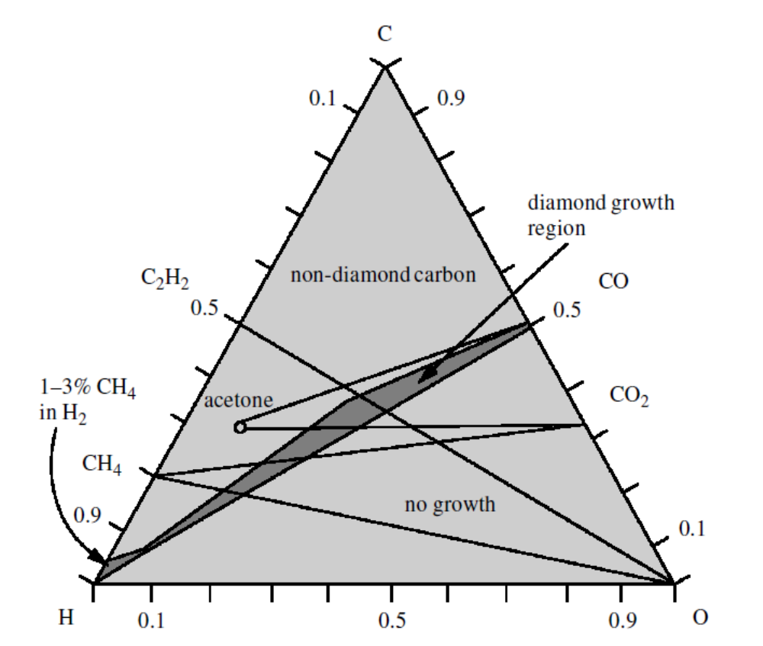

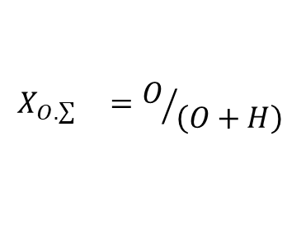
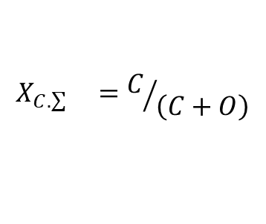

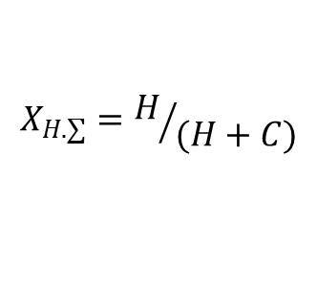


C-H-O Diagram
Expected chemical reactions
$$CH_{4}+ O_{2}→CO_{2}+2H_{2}$$
$$CO_{2}+H_{2}→CO+H_{2}O$$
$$CO+H_{2} →C+H_{2}O$$
A. Inspektor, Y. Liou, T. Mckenna, and R. Messier, Surf. Coatings Technol., vol. 39/40, p. 211, 1989.
$$X_{C.\sum{}}=C/{\left(C+O\right)}$$
$$X_{H.∑}=H/{(H+C)}$$
Atomic fraction of gas composition
$$X_{C.\sum{}}=\sim 0.7−0.4$$
$X_{H.∑}=$ 0.995
$$X_{O.\sum{}}=\sim 0.003−0.007$$
$$X_{O.\sum{}}=O/{\left(O+H\right)}$$
Fig. 10. C-H-O composition diagram
P. K. Bachmann, D. Leers, and H. Lydtin, “Towards a General Concept of Diamond Chemical Vapor-Deposition,” Diam. Relat. Mat., vol. 1, no. 1, pp. 1–12, 1991.

Slide 10
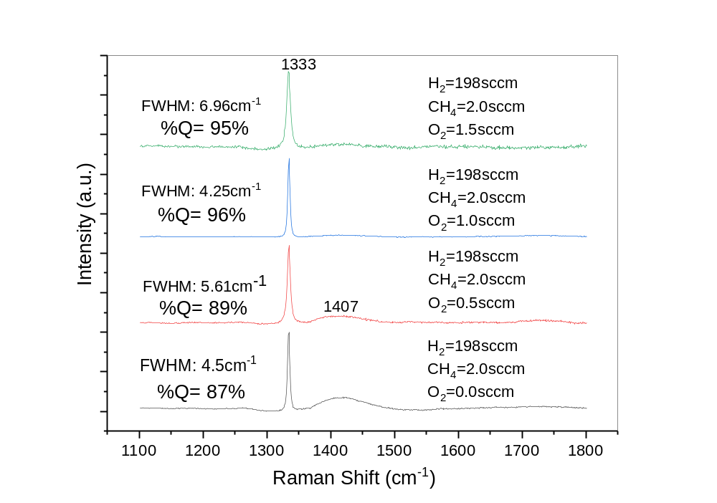
Structural Analysis
(Raman Spectroscopy)
Fig. 11. Raman spectra of DTFs prepared by varying the oxygen concentration (0.0-1.5sccm)

Slide 11
Morphology
(Scanning Electron Microscopy (SEM) )
O₂=0.0sccm
O₂=0.5sccm
10µm
1µm
O₂=1.0sccm
O₂=1.5sccm
10µm
1µm
10µm
1µm
Fig. 12. SEM micrographs of DTFs prepared by varying the oxygen concentration (0.0-1.5sccm)

Slide 12
Conclusion
Successful growth of MCDs using MPCVD system
Future Work
Raman analysis confirmed good quality diamond thin films
Low temperature growth of diamond and correlate the structure and morphology to thermal transport properties
Increase in oxygen assisted in uniform diamond growth
Raman thermography will be used to study the thermal conductivity of the samples.
Oxygen addition enhanced the quality of DTFs by efficient etching of sp² bonded carbon
The oxygen should be added according to its etching efficiency of carbon

Slide 13

Acknowledgment
Dr. Peter Thang Ha for his assistance in sample preparation
Dr. Alex Fuerbach to train me for Raman spectroscopy
Dr. Chao Shen to train me for SEM analysis

Slide 14
ThankYou

