Slide 1
Broadband extraordinary optical transmission in a narrow subwavelength gap of infrared wire-grid-polarizers
Wonyoung Kim, Minsuk Kim, Tae Young Kim, Kyu-Tae Lee, Minbaek Lee and Chang Kwon Hwangbo*
Department of Physics, Inha University
South Korea

Slide 2
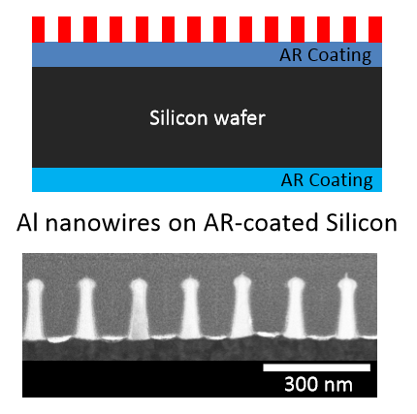
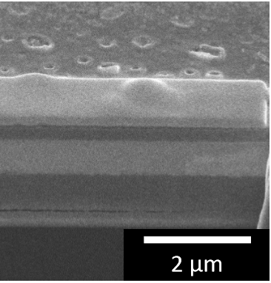
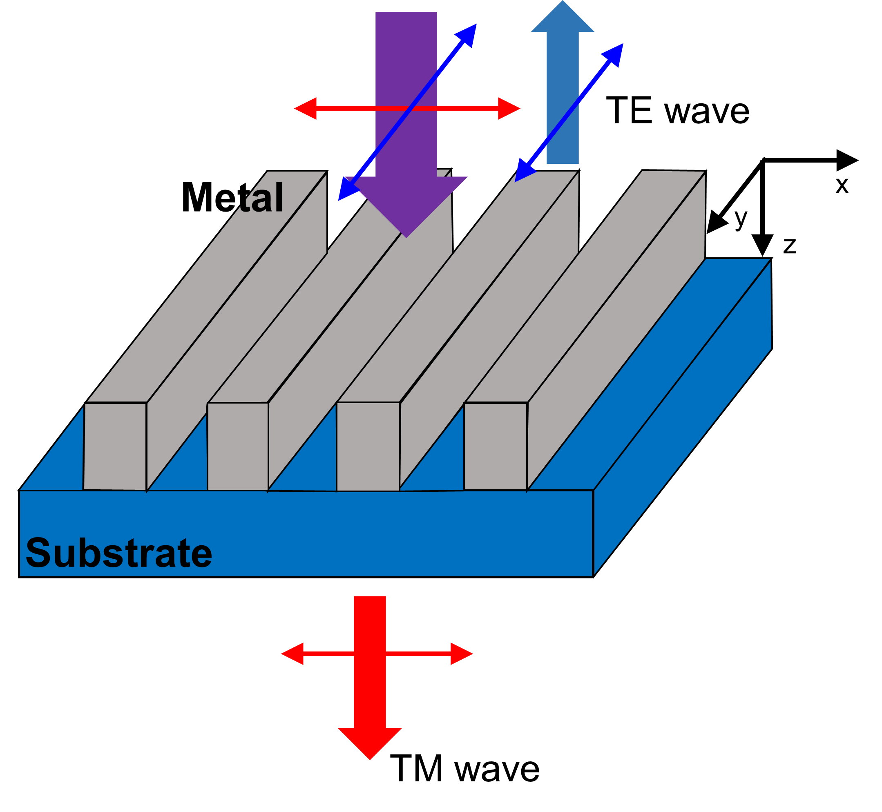
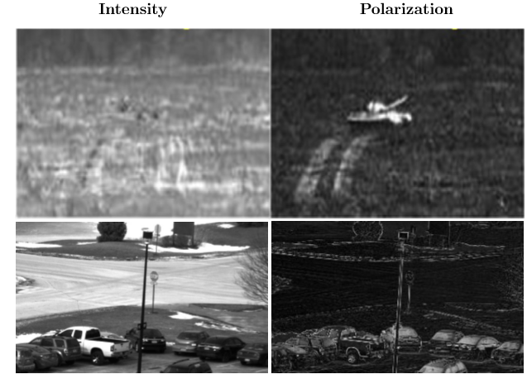

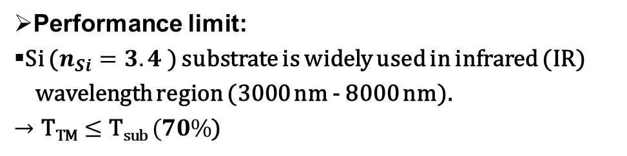
Conventional Wire Grid Polarizers
Wire Grid Polarizer (WGP) is a 1D array of Al
nanowires on flat Si-substrate (fsWGP).
B.F. Andresen et al., Proc. SPIE 8704, (2013)
(Si, Ge)
$$\text{T}\text{TM}≤\text{T}\text{sub}$$
Performance limit:
Si ($n_{Si}=3.4$) substrate is widely used in infrared (IR)
wavelength region (3000 nm - 8000 nm).
$→\text{T}\text{TM}≤\text{T}\text{sub} (70\%$)
Applications
Spectroscopic polarimetry
Night vision image analysis
F. Snik et al., Proc. SPIE 9099, (2014)
Notes:
Let’s start my presentation.
1Dnano wire
The Wire Grid Polarizers (a.k.a WGPs) are used to many industry and sensing.
In particular, high-performance IR WGP is required for night vision analysis and resolution enhancement of spectroscopic polarimetry in the IR region.

Slide 3
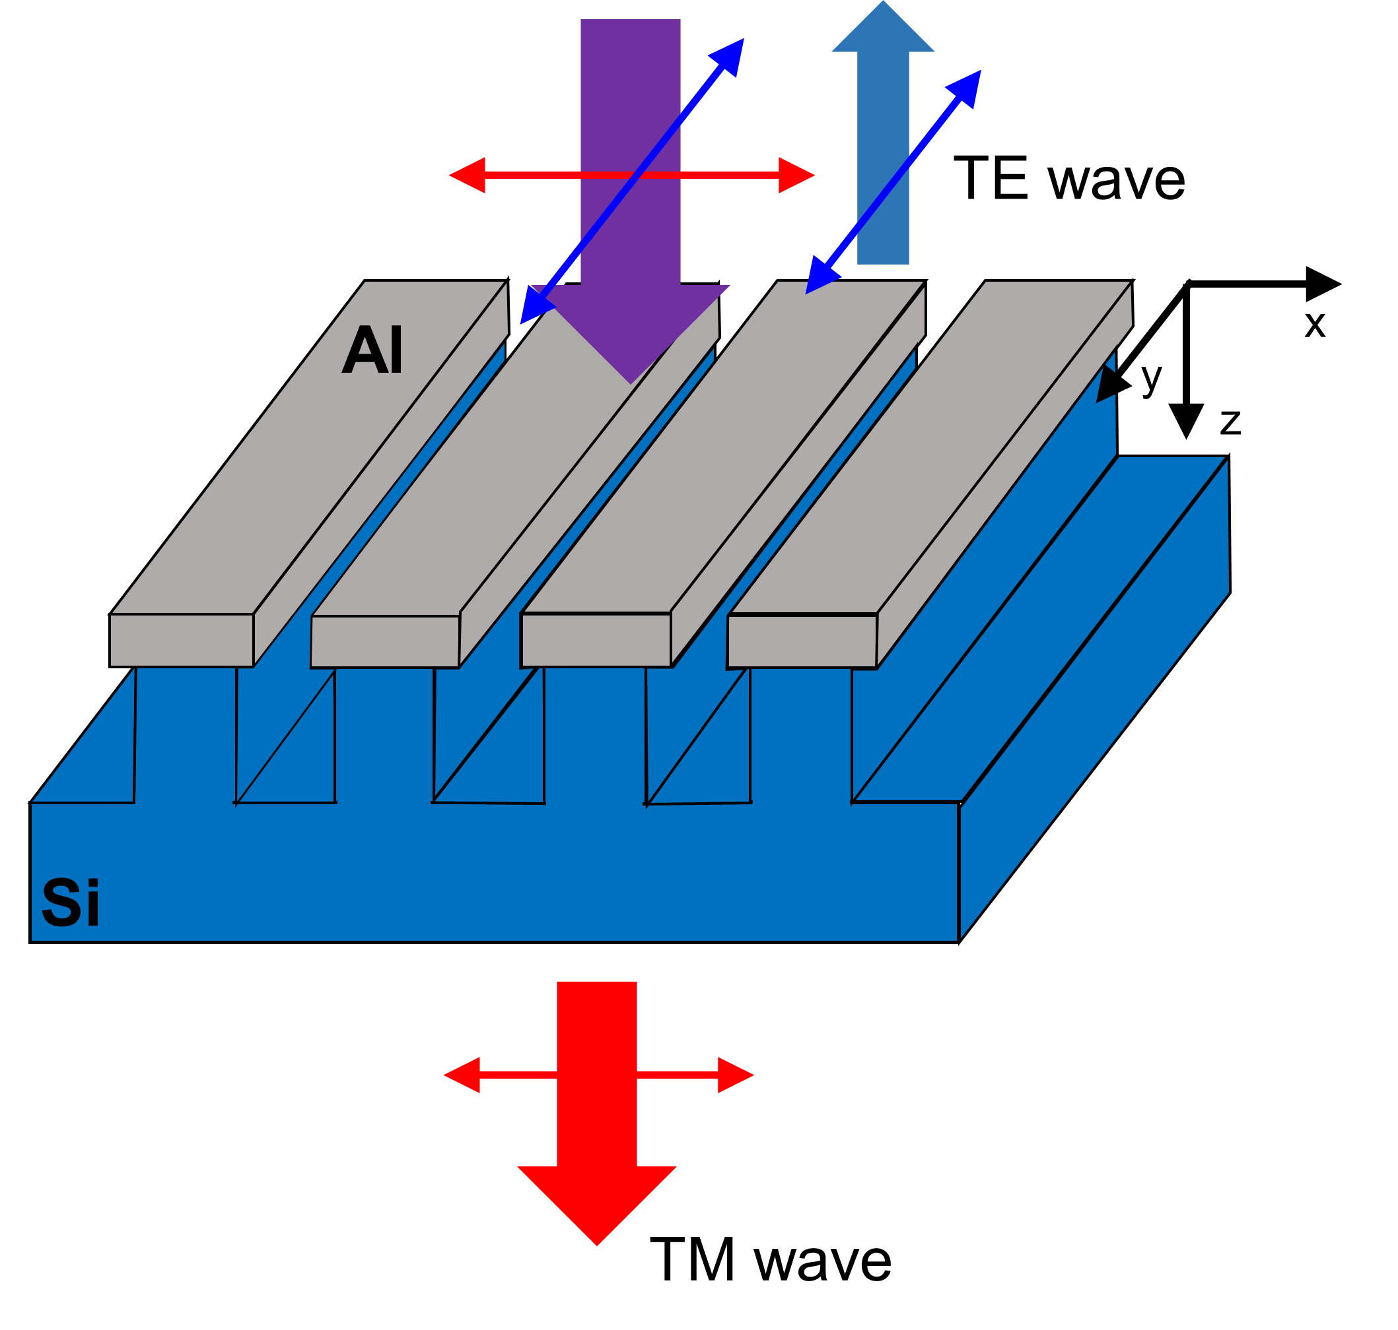
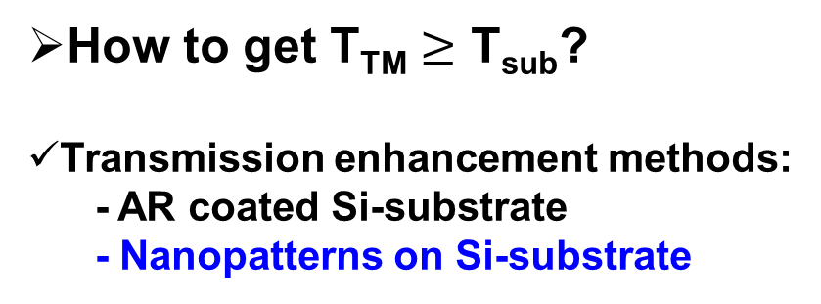

Target
How to get $\text{T}\text{TM}≥\text{T}\text{sub}$?
Transmission enhancement methods:
- AR coated Si-substrate
- Nanopatterns on Si-substrate
New WGP structure:
WGP on a nanopatterned Si
substrate (psWGPs)
WGPs with 1D Al-nanowires on
Si nanopatterns are fabricated by
using oblique angle deposition
technique.
Optical and structural properties
are studied as a function of air
gap (0~30 nm) between
nanowires along with FDTD
simulation.
W
h
Air
gap
$$\text{T}\text{TM}≥\text{T}\text{sub}$$
Notes:
But in IR region, substrate is very limited like Si, Ge etc. but these material’s refractive index is large, so it occurs transmittance limit.
To solve this problem, In this study, WGPs with improved transmittance were fabricated and designed by architecture modification of WGPs.

Slide 4
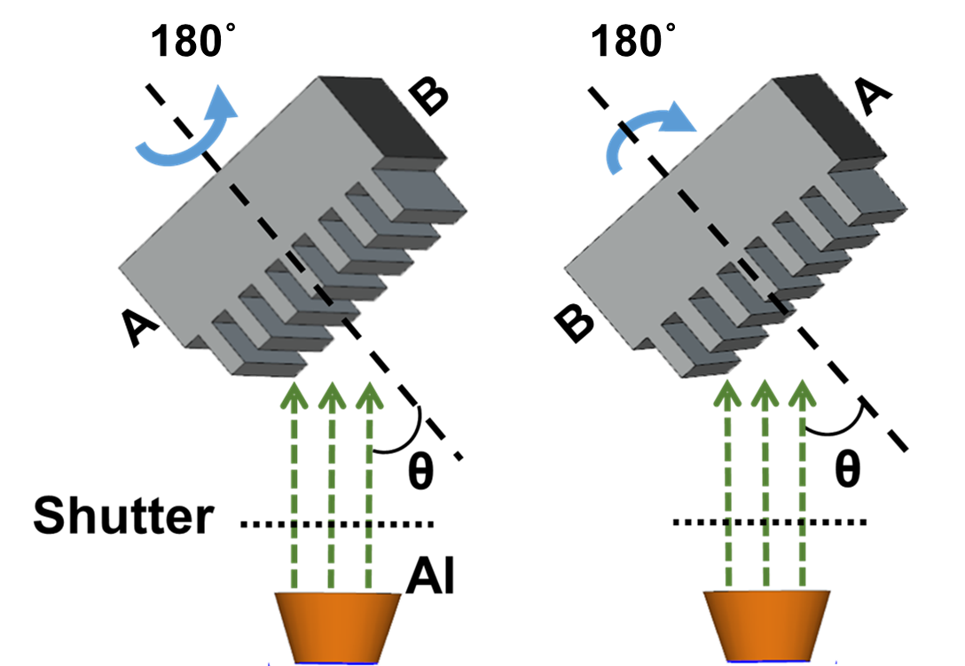
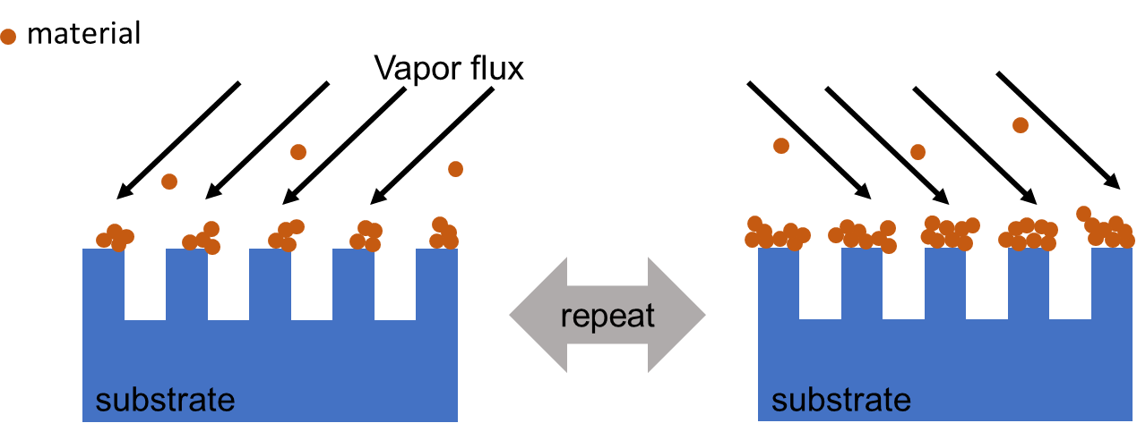

Oblique angle deposition
$$180°$$
Serial bi-deposition method for zigzag nanostructure.
Width and height of nanowires can be controlled by OAD.
Notes:
We using OAD method to fabricate WGPs on Si nanograting substrate.
Using OAD method can be deposit Al nanowire on the Si nanogratings.
Control the substrate tilt angle and deposition time, we can make various of Al nanowire structure.

Slide 5
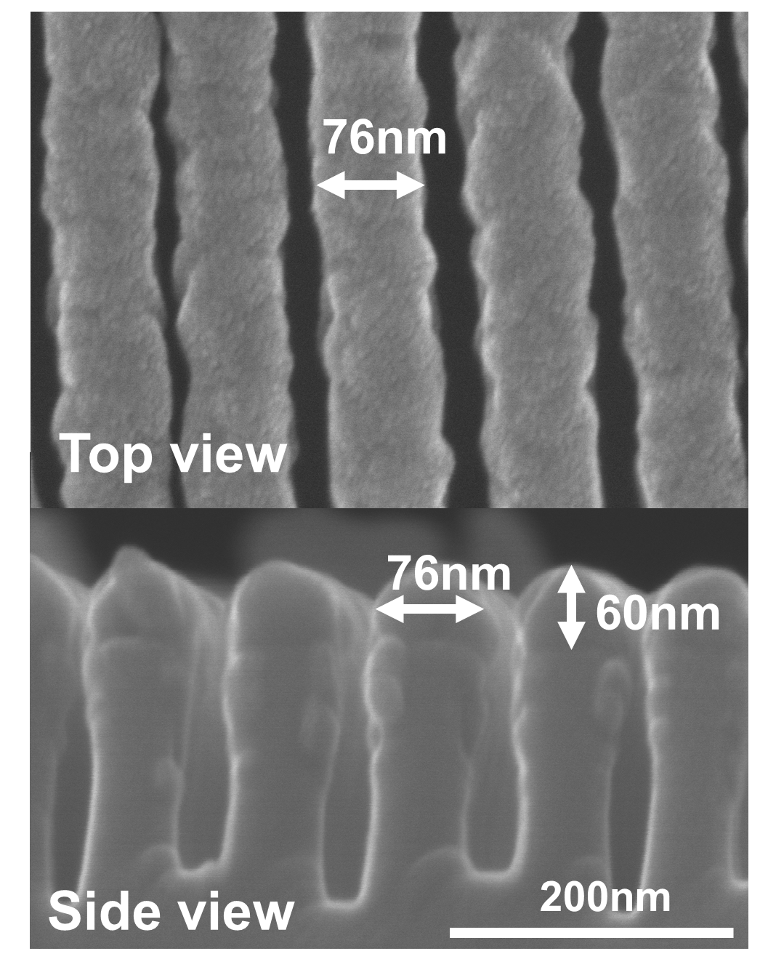
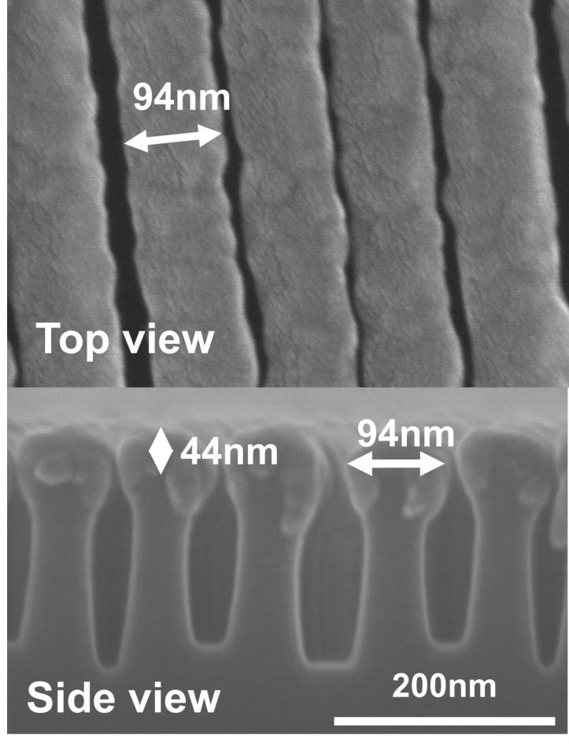
Top and side views of WGPs
h=60 nm, w=76 nm
air-gap=24nm
h=44 nm, w=94 nm
air-gap=6nm
Notes:
This is measurement result of Air gap 6nm sample.
It has over 80% of transmittance of TM wave and 29dB of PER in 3000 to 8000 nm region. It’s very broadband region.
And calculate result and measurement result is very similar.
Electric field distribution analysis and admittance analysis were performed to analyze the increase of transmittance in such a narrow air gap.

Slide 6
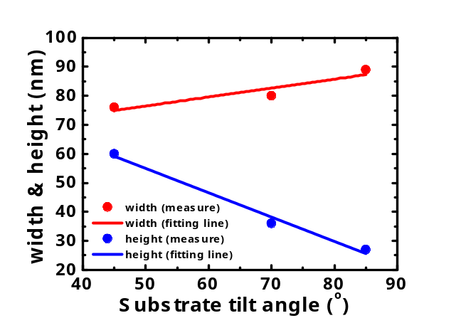
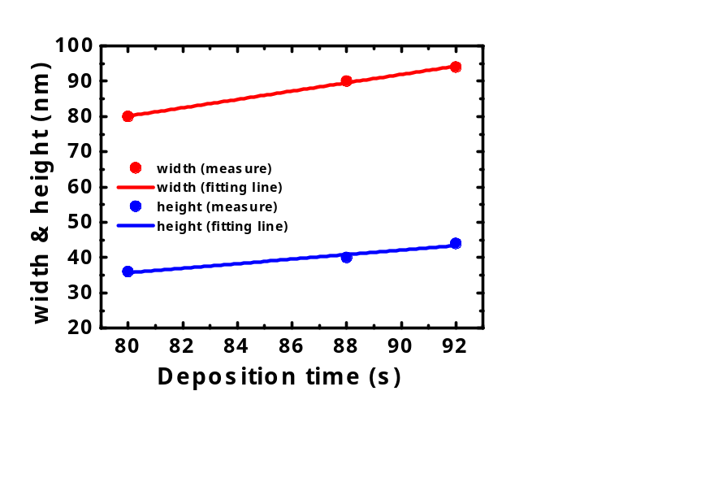
Oblique angle deposition
$$180°$$
Serial bi-deposition method for zigzag nanostructure.
Width and height of nanowires can be controlled by OAD.
Notes:
We using OAD method to fabricate WGPs on Si nanograting substrate.
Using OAD method can be deposit Al nanowire on the Si nanogratings.
Control the substrate tilt angle and deposition time, we can make various of Al nanowire structure.

Slide 7
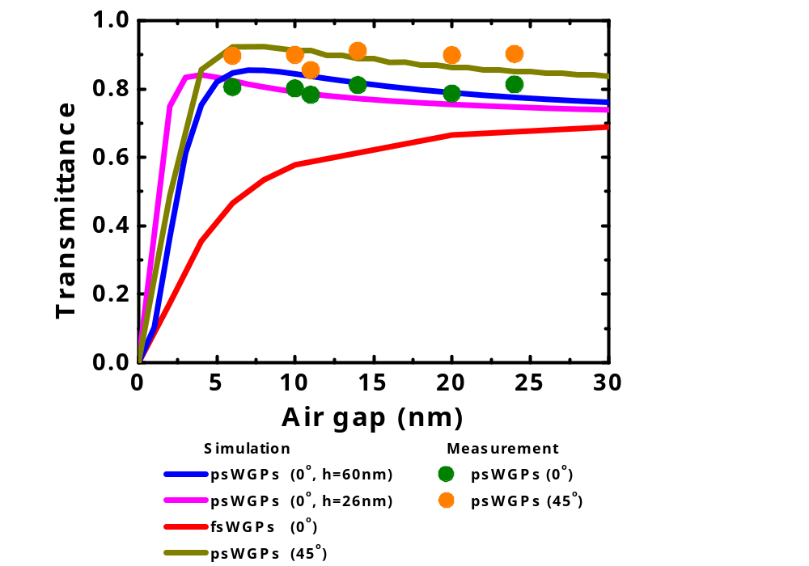
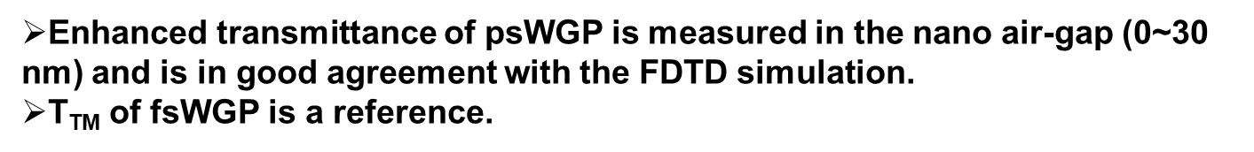
Transmittance (TM wave) vs air gap
Proposed psWGP
Air gap
Al
Si
Conventional fsWGP
Air gap
Al
Si
At 4000nm wavelength
Enhanced transmittance of psWGP is measured in the nano air-gap (0~30 nm) and is in good agreement with the FDTD simulation.
$\text{T}\text{TM}$ of fsWGP is a reference.
Notes:
We using patterned Si substrate and OAD method, we can fabricate this structure of WGPs.
In the case of the conventional WGPs, the smaller the air gap, the lower the transmittance. Like this red line.
But the case of patterned one, the smaller the air gap, the higher the transmittance, like this blue line.
A sample with several air gaps could be fabricated by adjusting the deposition angle of OAD and the deposition rate.
Measured result also fallow the calculate tendency.

Slide 8
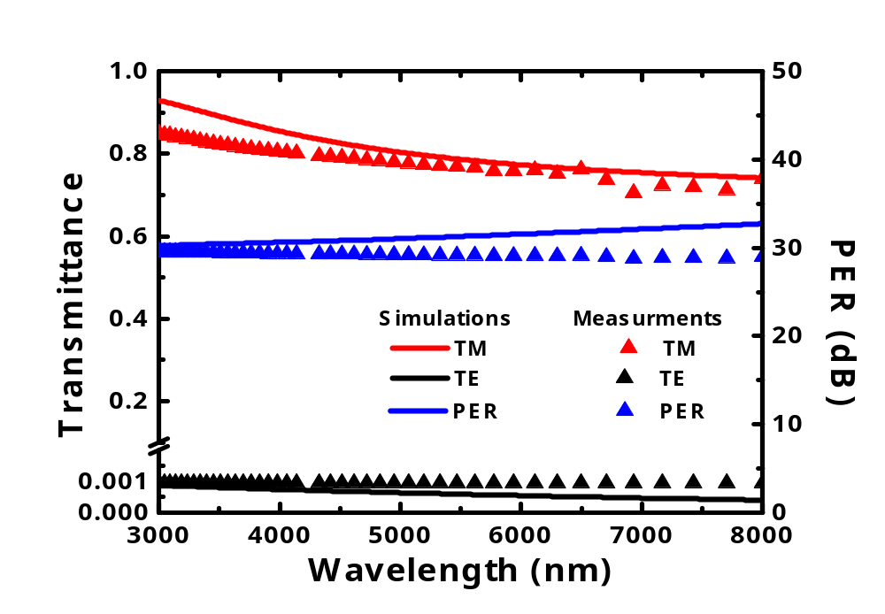
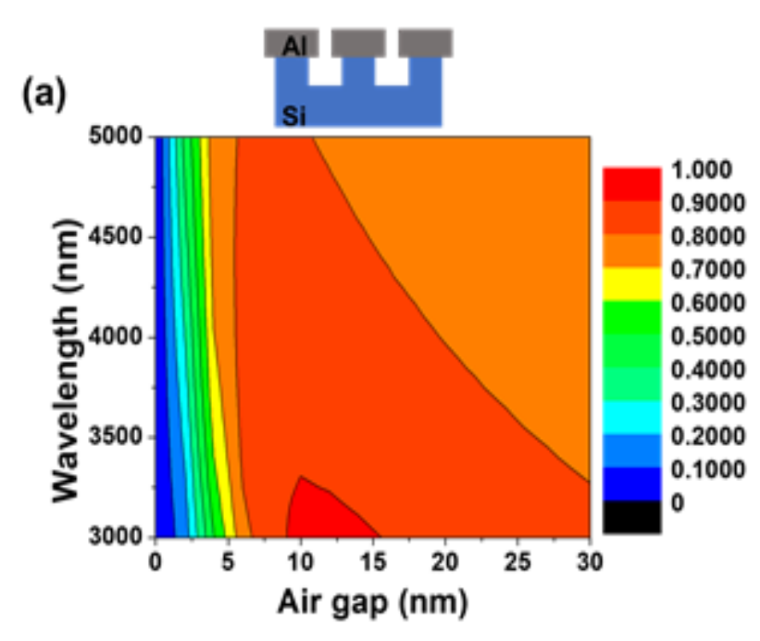



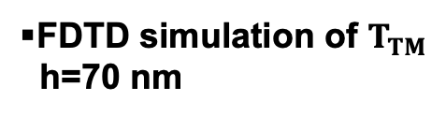
$T_{TM}$ and PER in IR wavelength
psWGP:
air-gap=6 nm, h=44 nm, w=94 nm
$$T_{TM}$$
FDTD simulation of $T_{TM}$
h=70 nm
$Broadband transmittance$
$\text{in}\text{ 3000 − 8000 }\text{nm} \text{wavelength} \text{region}$
$Average T_{TM}=80\%$, PER=29 dB
Polarization Extinction Ratio: $PER=10log_{10}\left(\frac{T_{TM}}{T_{TE}}\right)$
Notes:
This is measurement result of Air gap 6nm sample.
It has over 80% of transmittance of TM wave and 29dB of PER in 3000 to 8000 nm region. It’s very broadband region.
And calculate result and measurement result is very similar.
Electric field distribution analysis and admittance analysis were performed to analyze the increase of transmittance in such a narrow air gap.

Slide 9
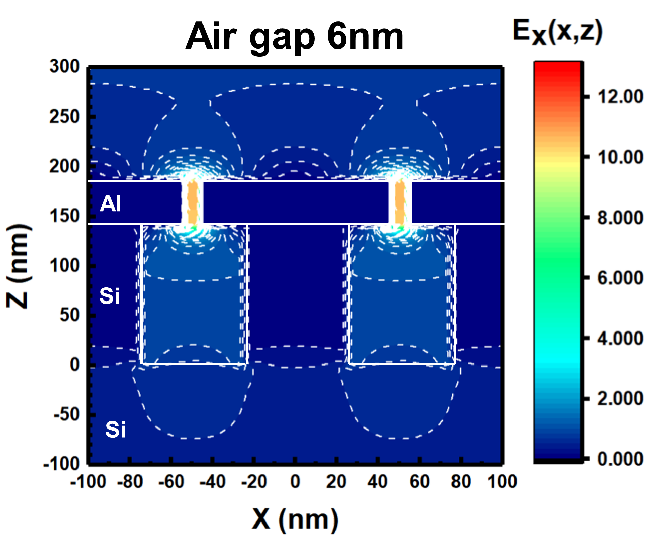
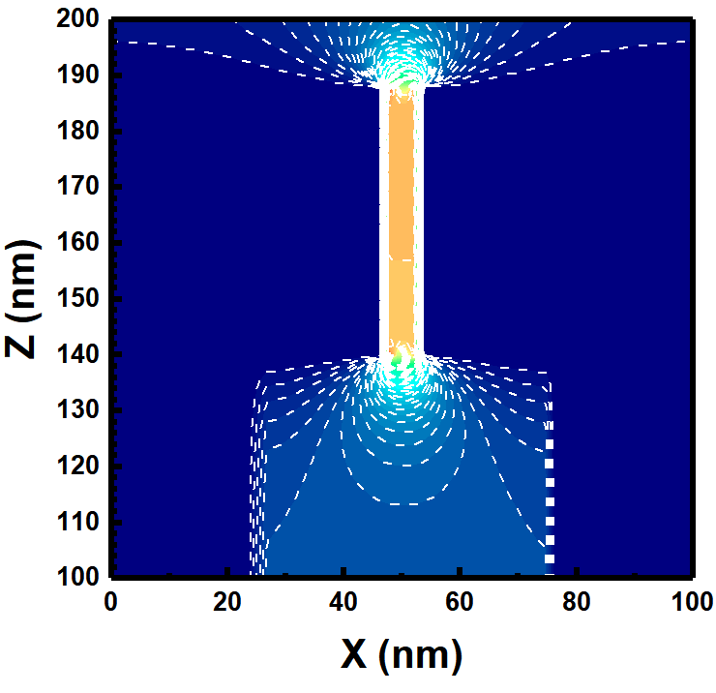
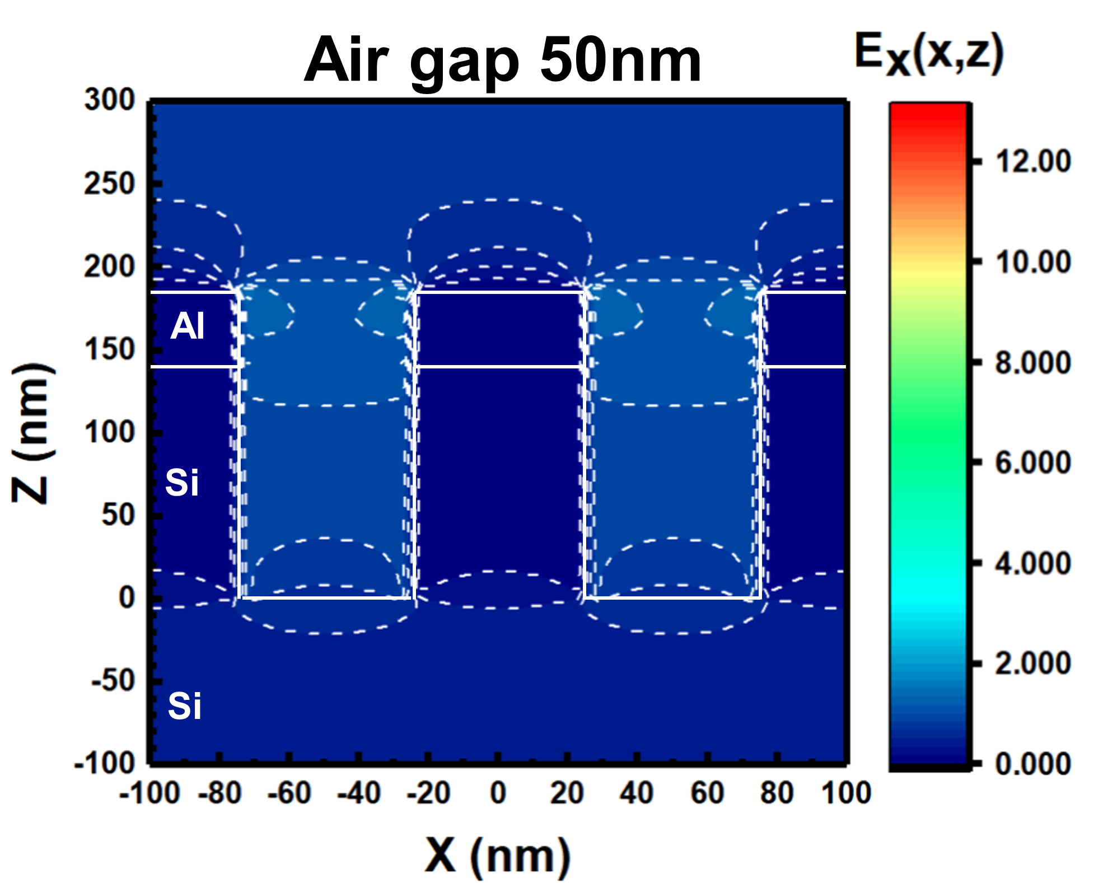
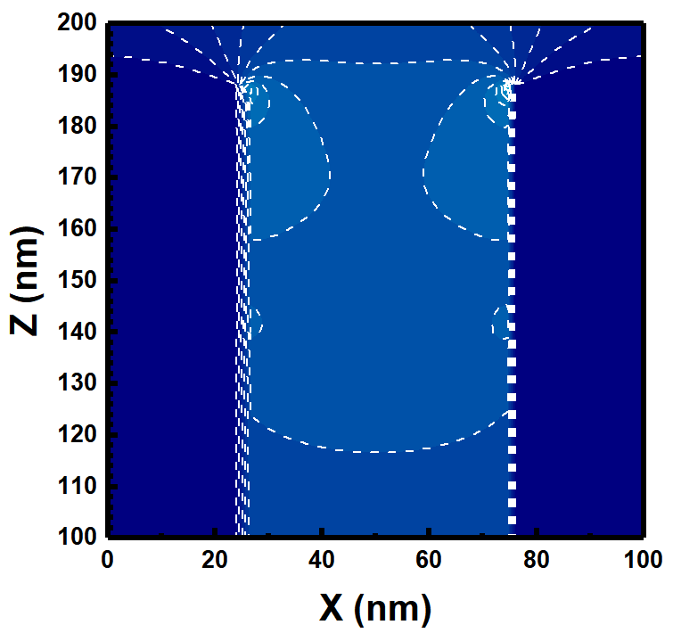
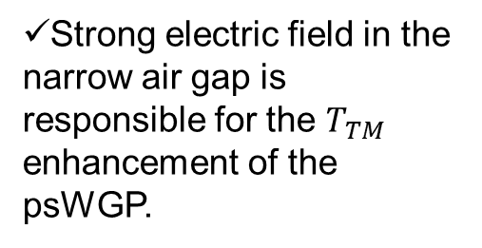
Electric field distribution
Al
Strong electric field in the narrow air gap is responsible for the $T_{TM}$ enhancement of the psWGP.
Si
Al
Si
J.S. Cetnar et. al., Appl Phys Lett 100, 231912 (2012)
Strong E-field in narrow air gap→ Higher transmittance ($\text{T}\text{TM}$)
Notes:
As the air gap decreases, the magnitude of the electric field increases.
This is a phenomenon associated with extra ordinary transmission, where light travels through a very narrow gap (6nm air gap) which smaller than wavelength.
The electric field of the air gap of patterned Si substrate WGPs is more than twice as large as that of flat Si substrate WGPs.
As a result, it can be seen that light can be transmitted through a gap narrower than the wavelength, and when an Si grating under the Al nanowire is present, the electric field becomes stronger and the transmittance increases.

Slide 10
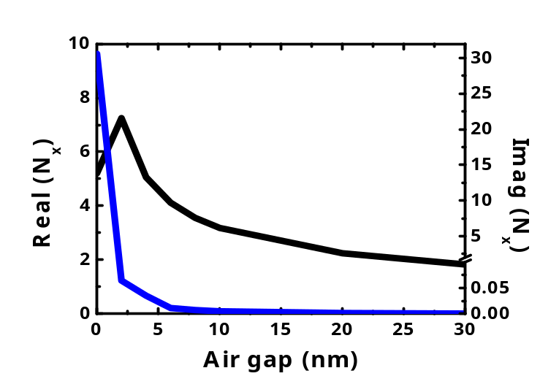
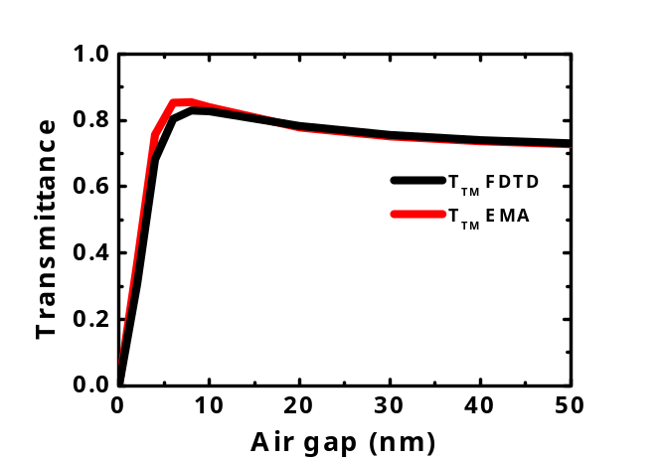
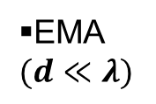

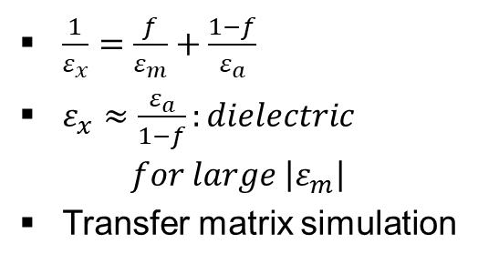

Effective medium approximation
@ 4000nm
Al-nanowires
Si-nanopatterns
$N_{x}$ vs air gap
Uniaxial layers
EMA
$$(d≪λ)$$
y
Air
Air
x
Al
EMA Al
z
EMA Si
Si
Si
$\frac{1}{ε_{x}}=\frac{f}{ε_{m}}+\frac{1−f}{ε_{a}}$
$ε_{x}≈\frac{ε_{a}}{1−f}:dielectric$
$$for large \left|ε_{m}\right|$$
Transfer matrix simulation
psWGP
FDTD simulation
$T_{TM}$ calculation with FDTD
matches well that with EMA
Notes:
To further investigate the improved optical property of the psWGP structure, a surface admittance analysis is performed by regarding an array of Al nanowires and a Si nanopattern as each layer with an anisotropic uniaxial thin film using the effective medium approximation (EMA) method. The EMA is a method to describe the macroscopic properties of the periodic nanostructures in the long wavelength limit in which the period of the nanowire is 1/40 or less of the incident wavelength.

Slide 11
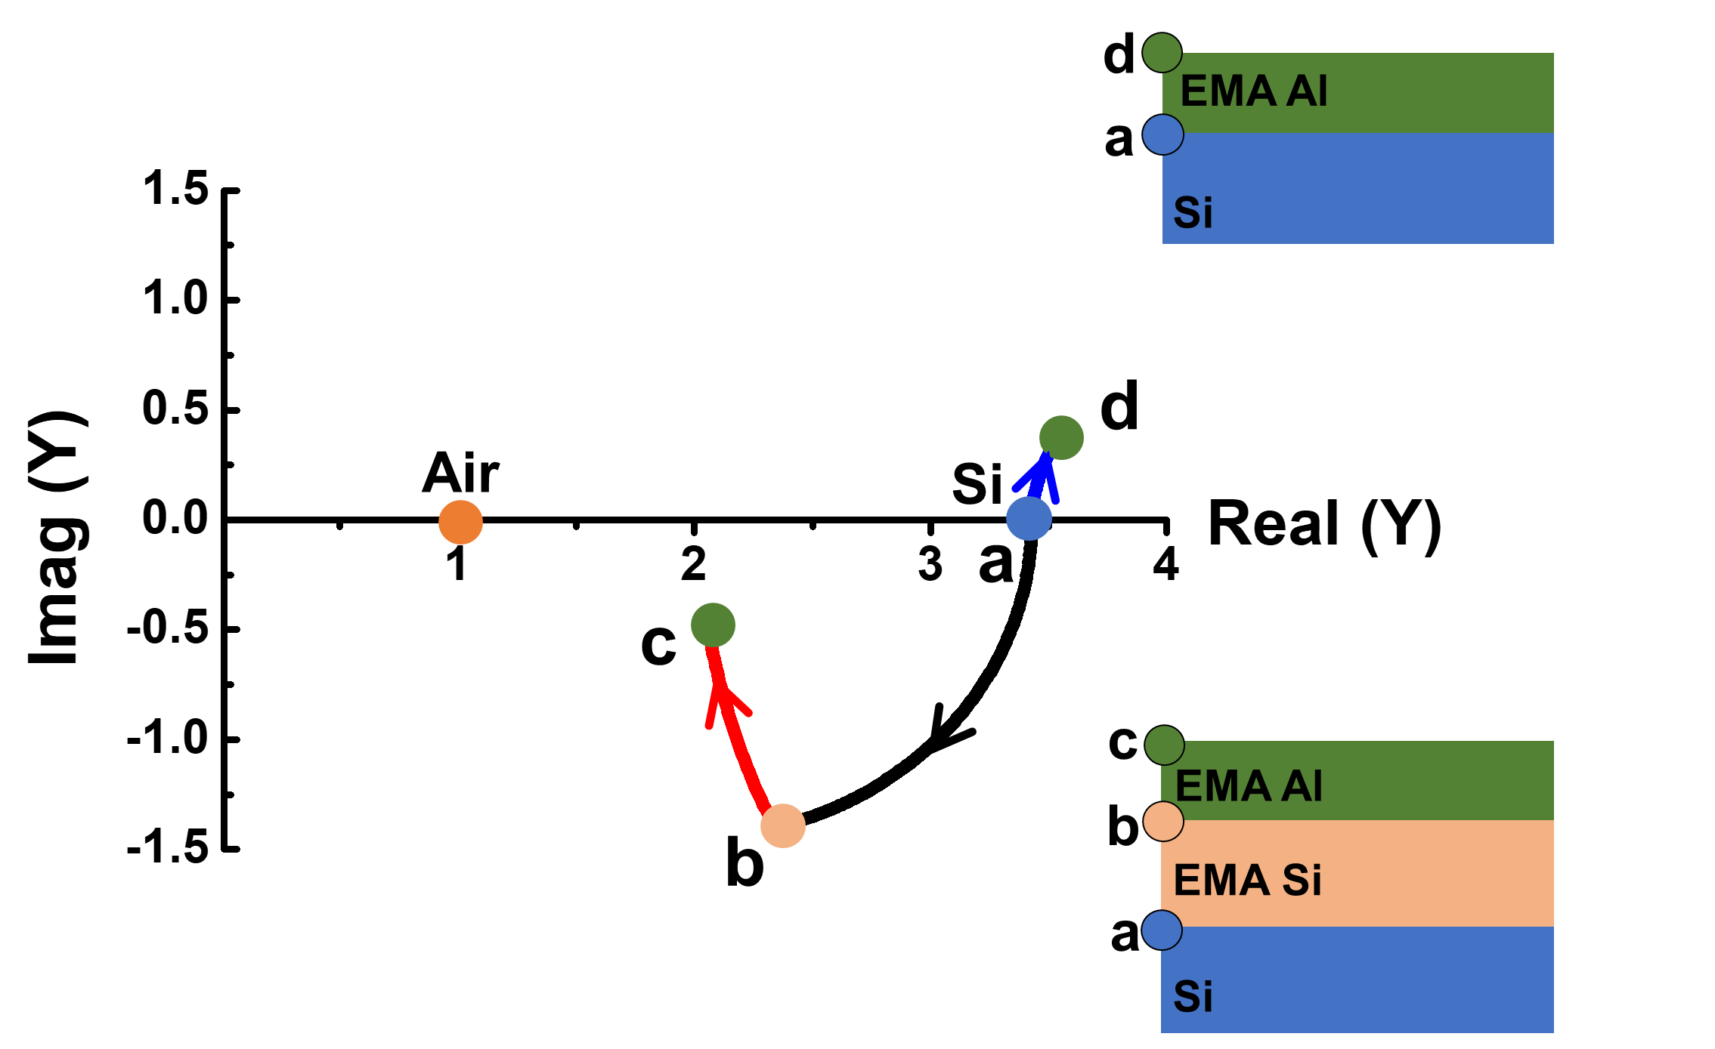
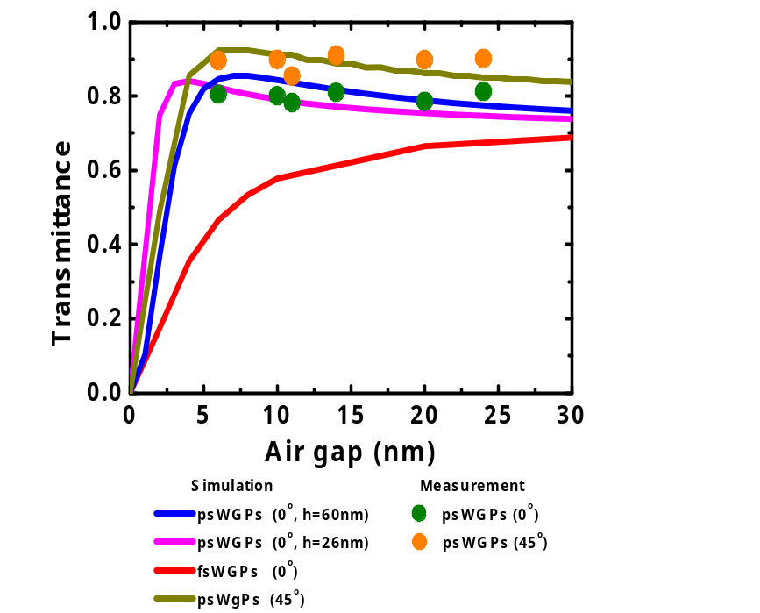

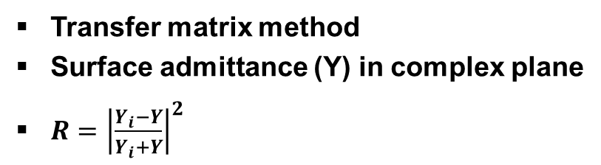


Admittance diagram (Y)
Transfer matrix method
Surface admittance (Y) in complex plane
$R={\left|\frac{Y_{i}−Y}{Y_{i}+Y}\right|}^{2}$
$$Y_{i}$$
$$Y_{d}$$
$$Y_{c}$$
Better admittance matching due to Si-nanopatterns
→ Higher transmittance in the nano air-gap
Notes:
Admittance diagram analysis was performed using Nx obtained by EMA method.
In the admittance diagram, the transmittance is determined by the distance from the admittance of the air and is expressed by the following equation. That is, the closer the admittance of the admittance to the admittance of the air, the more the transmittance increases.
In fsWGP, if the Al air gap is as small as 6 nm, it starts at point A and goes in the direction of point D. This is because the final admittance advances in the direction away from the admittance of air, and the transmittance is lowered. (68.4%)
In the case of PSWGP, the Si grating and the Al nanowire with an air gap of 6 nm are matched, and the end admittance point C becomes close to the admittance of air. That is, the transmittance is increased. (85.5%)

Slide 12
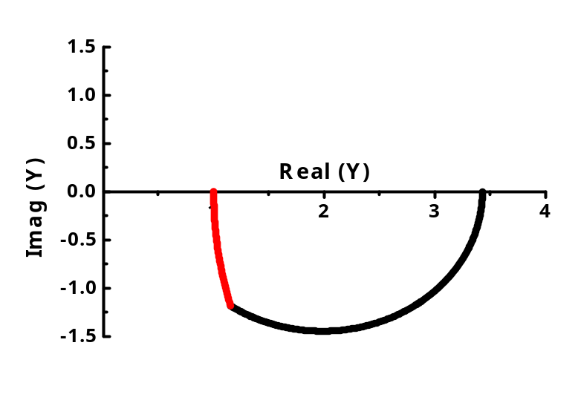
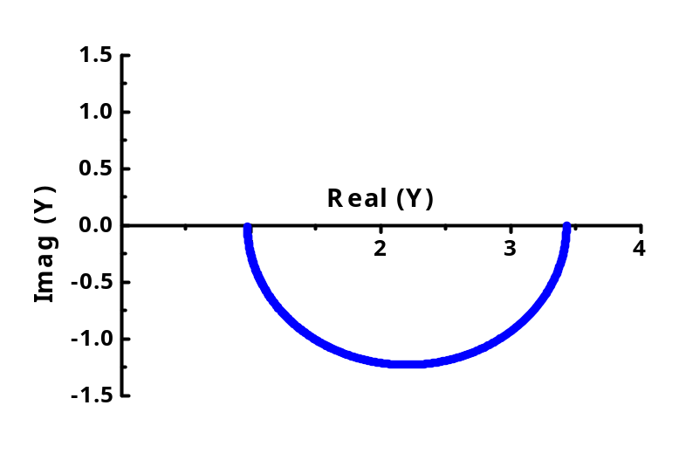
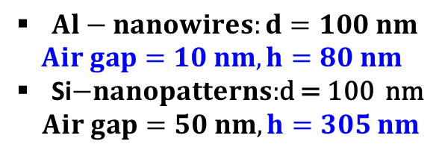

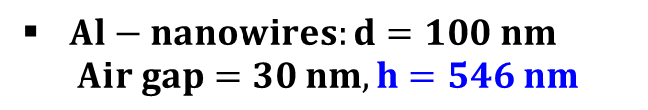
Perfect admittance matching
New WGP designs for $\text{T}\text{TM}\text{=100\%}$
c
b
Al
b
Al
a
a
Si
Si
Air
Si
Air
Si
c
a
b
a
b
$Al−nanowires:d=100 nm$
$$Air gap=10 nm, h=80 nm$$
Si$−nanopatterns:$d = 100 nm
$Air gap=50 nm, h=305 nm$
$Al−nanowires:d=100 nm$
$$Air gap=30 nm, h=546 nm$$

Slide 13
Conclusion
We demonstrate the transmission improvement of TM wave in the narrow air-gap of WGP with 1D Al-nanowires on Si-nanopatterns fabricated by the oblique angle deposition method.
The strong electric field in the narrow air-gaps and the better admittance matching due to the Si- nanopatterns are attributed to the enhancement of transmittance.
The strategy presented in this study could suggest future IR WGPs with improved performance.

Slide 14
Thank you for your attention!

Slide 15
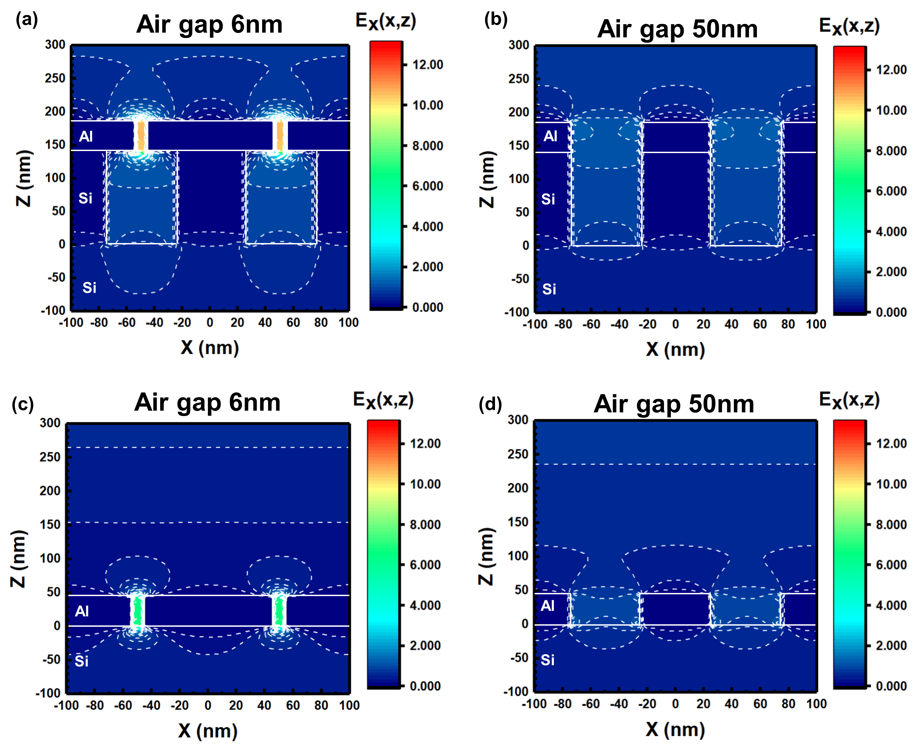
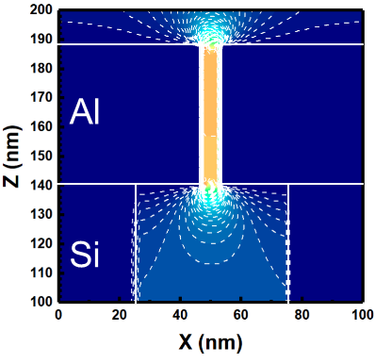
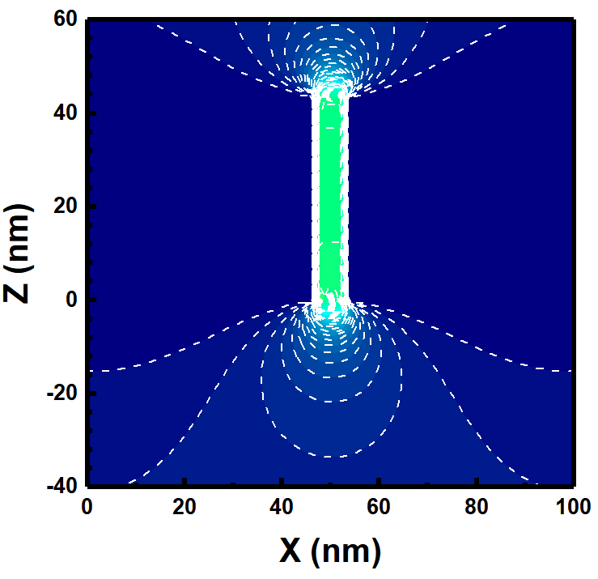
Electric field distributions
Al
Si
Strong E-field in narrow air gap→ High transmittance
Notes:
Such strong electric field in the narrow air gap is responsible for the transmittance enhancement of the psWGPs., A similar transmittance enhancement of TM wave for WGPs in THz wavelength regime was attributed to the high electric field in the narrow air gap

Slide 16
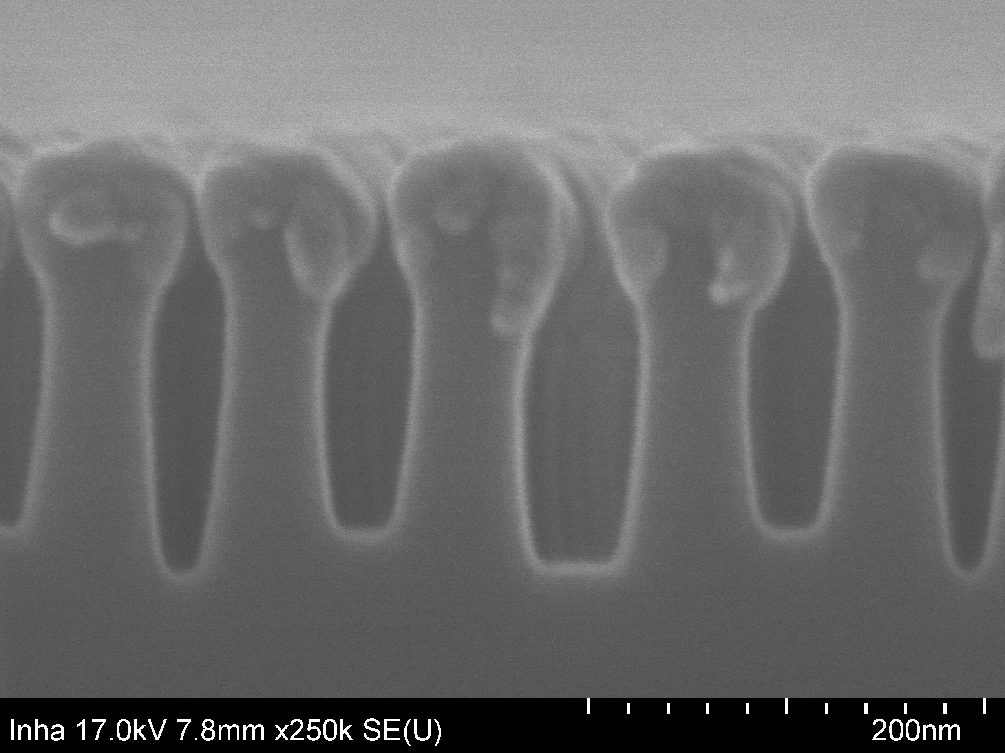
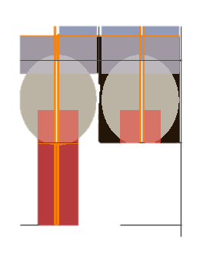
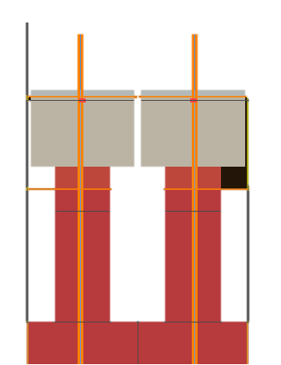
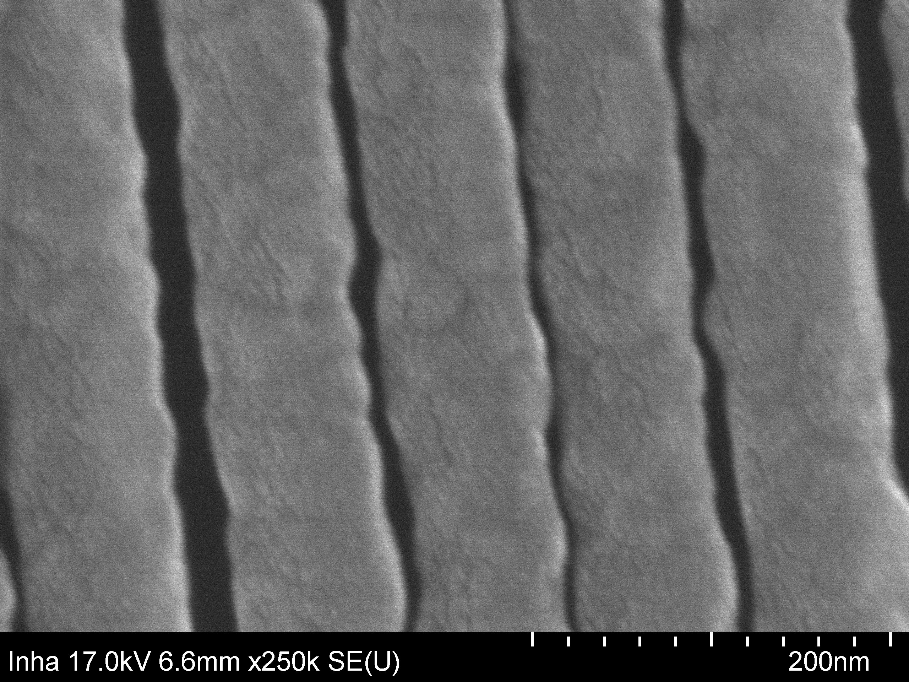

44 nm
44 nm
94 nm
94 nm
94nm
Top view
x
44nm
94nm
Rectangle model (mesh $Δ_{x,z}$=1 nm) : 85.00 %
Ellipse model (mesh $Δ_{x,z}$=1 nm) : 84.18 %
Difference : about 0.82 % ($λ$=4000 nm)
y
Side view
200nm

