Slide 1

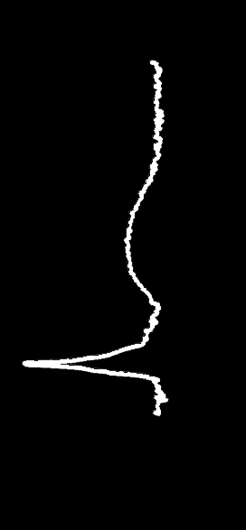
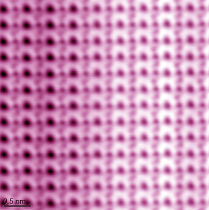
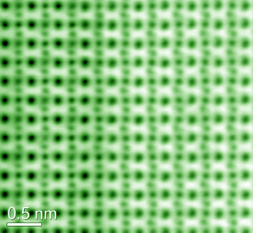
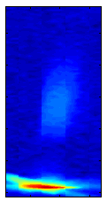

Octahedral Engineering and
Interfacial Structure of Heteroepitaxial Complex Oxides
Liang Qiao
University of Electronic Science and Technology of China
2018.08.13

Slide 2
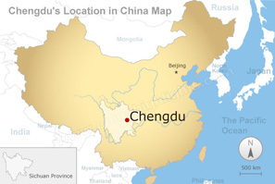








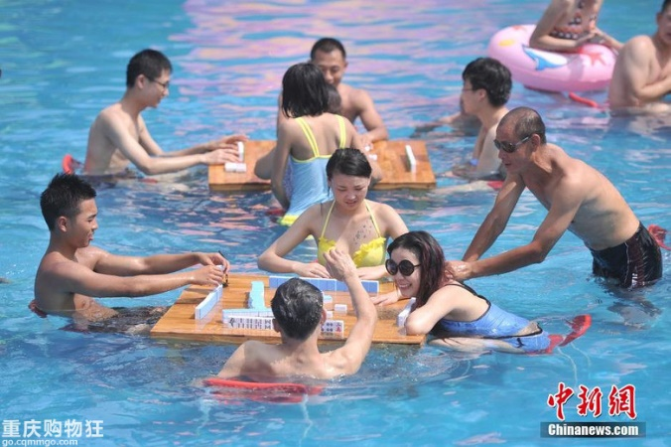


Welcome to Chengdu

Slide 3
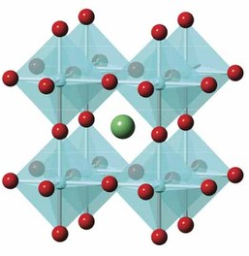
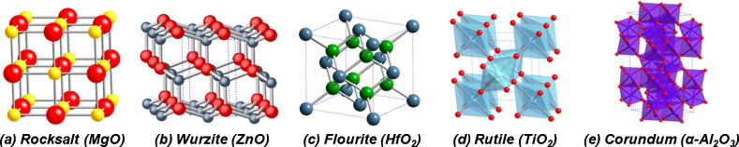
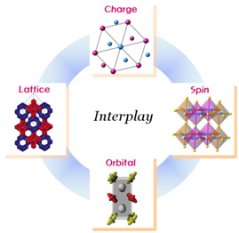
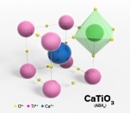
Oxide materials
Extremely flexible crystal structure and chemical composiiton:
Perovskite Rocksalt Wurzite Flourite Rutile Corundum
CaTiO₃ MgO ZnO HfO₂ TiO₂ a-Al₂O₃
Fascinating functional properties unparalleled by any other materials:
1. Band gaps: IR = > visible = > UV.
2. Superconducting = > metallic = > semiconducting = > insulating.
3. Ferromagnetic = > paramagnetic = > antiferromagnetic.
4. Dielectric = > ferroelectric = > piezoelectric.
5. Coupling behaviors exceed bulk limit, e.g. multiferroic, thermoelectric (magnetic chromic)….
6. Variable valence states.
Other important technological characters:
1. widely abundant, affordable, and cost-effective
2. Non-toxic, environmentally friendly and compatible
3. Super thermal and chemical stability (and good for extreme conditions)
4. Electronics, spintronics, and photonics applications
5. Electrochemical and redox activity (for chemical and biological sensors)

Slide 4

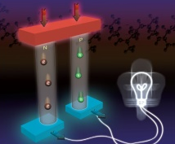
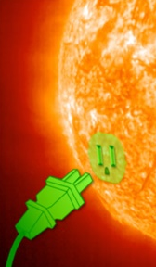
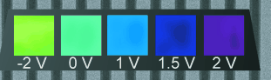


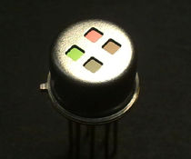





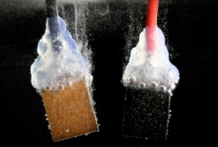

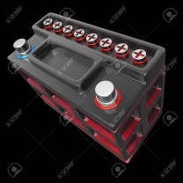



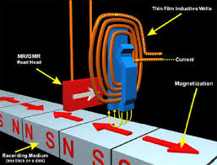
Examples of applications:
Sensor
Energy
Thermo-
chromic
Thermo-
electric
Electro-
chromic
Solid-state
cooling
（photo)
catalytic
Opto-
electronic
Complex oxides
Electronic
Water
splitting
Electro-chemical
Spintronic
Magnetic
Battery
IT

Slide 5
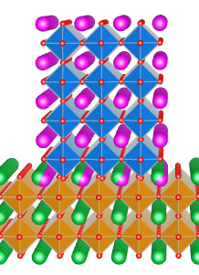
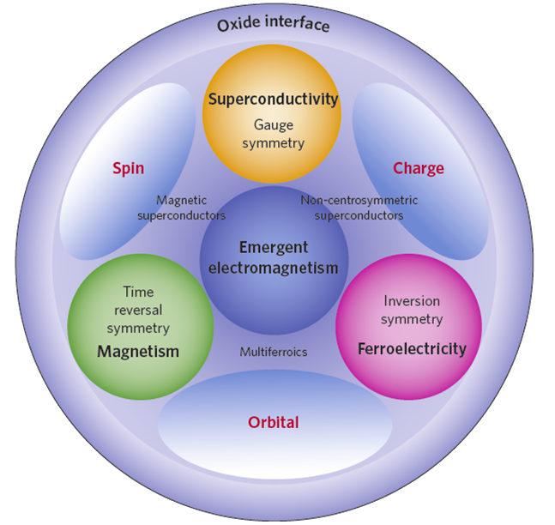
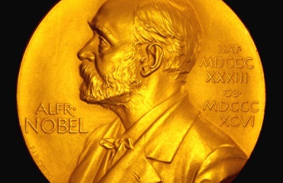
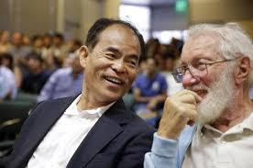
Oxide heterointerfaces: new possibilities
Thin films:
2014
Physics
2000
Physics
Interface
The interface is the device
The interface is still
the device
Hwang et al, Nature Materials (2012)

Slide 6
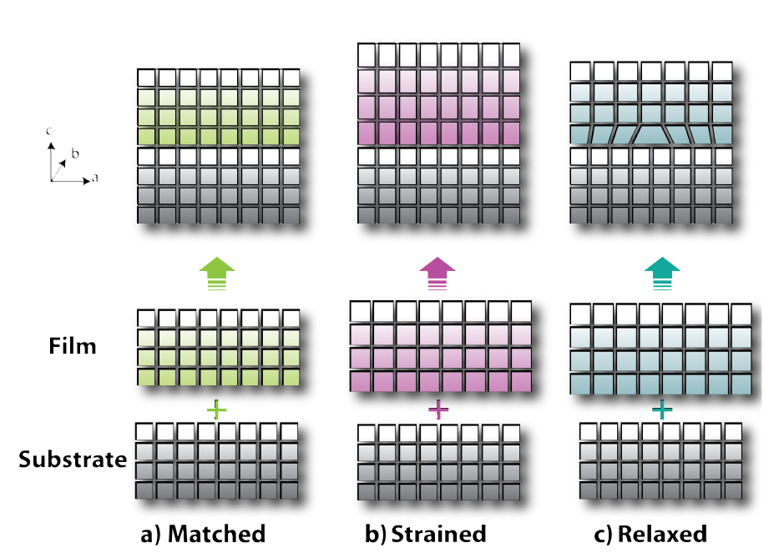
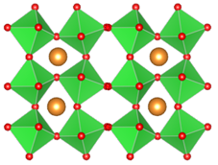
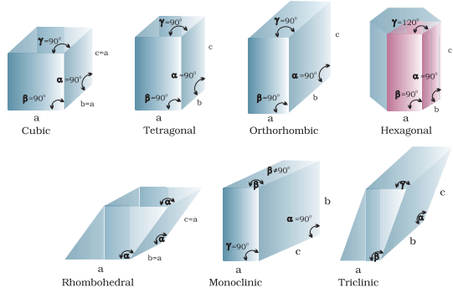
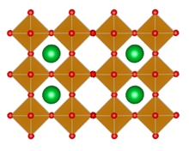
Structures of the interface
Thin films:
Lattice mismatch
Interface
Symmetry
mismatch

Slide 7
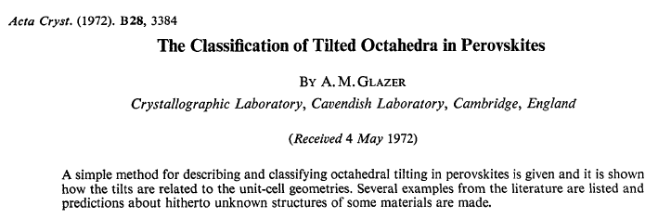
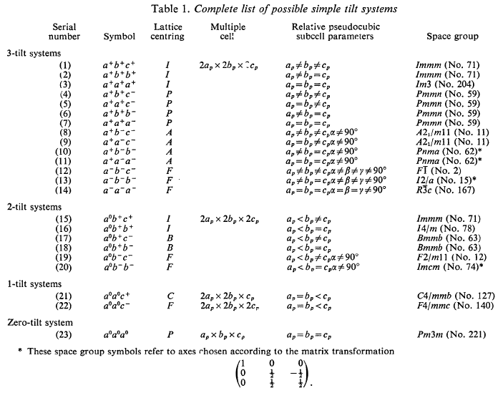
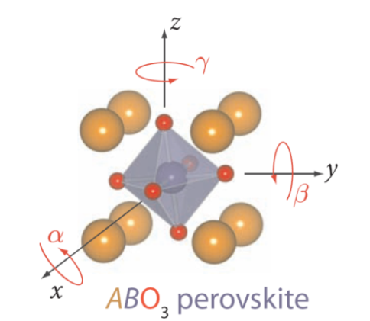
Octahedral tilting: bulk oxides
Glazer notation: a⁻a⁻c⁺
“+” tilt —> in phase
“-” tilt —> out of phase

Slide 8
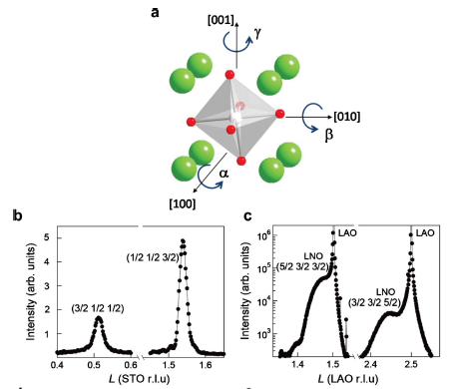
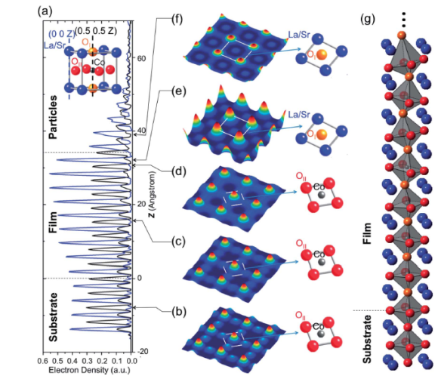
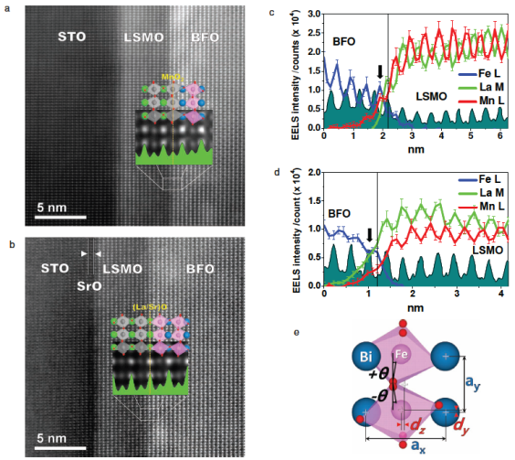
Octahedral tilting: Strategy for thin films
Half-order diffraction
Coherent Bragg Rod Analysis (COBRA)
STEM-BF
May et al., Phys.Rev.B (2010)
Feng & Yacoby et al., EES (2014)
Borisevich et al., ACS Nano (2010)
Robust
Quick (relatively)
Straightforward
Average analysis
Not good for SL
Local analysis
Detail info
Limited by sample quality, size & modeling
Local analysis
Detail info
Limited by sample Prep, machine, operation & data analysis

Slide 9
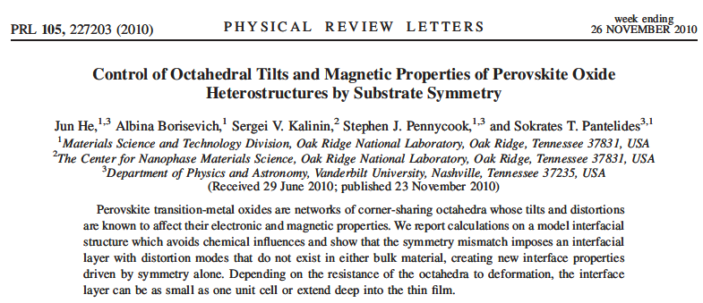
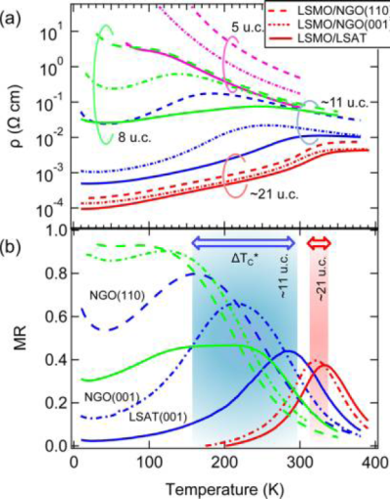
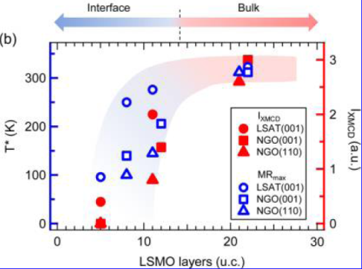
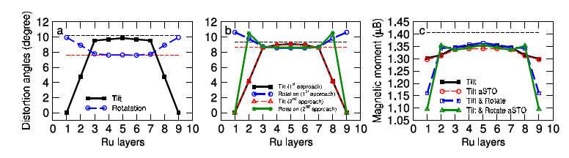
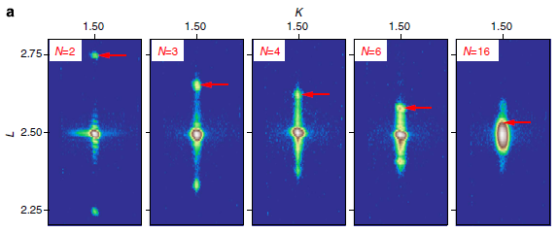
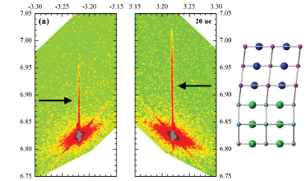
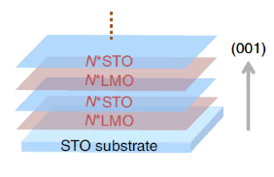
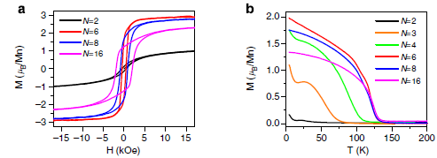
Significance in thin-film systems
He et al., Phys.Rev.Lett (2010)
May et al., Nano.Lett (2014)
Zhai et al., Nat.Comm (2015)
Boschker et al., Phys.Rev.Lett (2012)

Slide 10
Significance in thin-film systems
What we know:
Symmetry mismatch
Widely-exist
Previously-ignored
PseudoCubic/PseudoTegragonal ? Not exactly !!
Can affect physics/properties
By altering electronic structure / bonding structure
What we need to do:
Re-investigation / new look of some questions
Ferroelectric (CaTiO₃) / Ferromagnetism (LaCoO₃)
General strategy: Symmetry Engineering

Slide 11

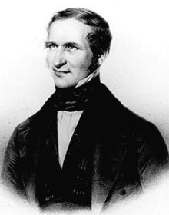
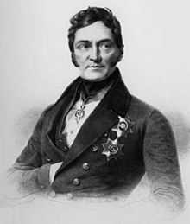
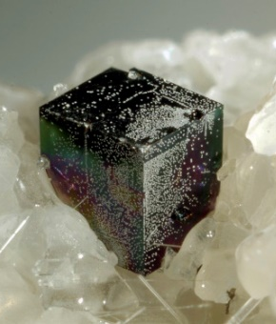
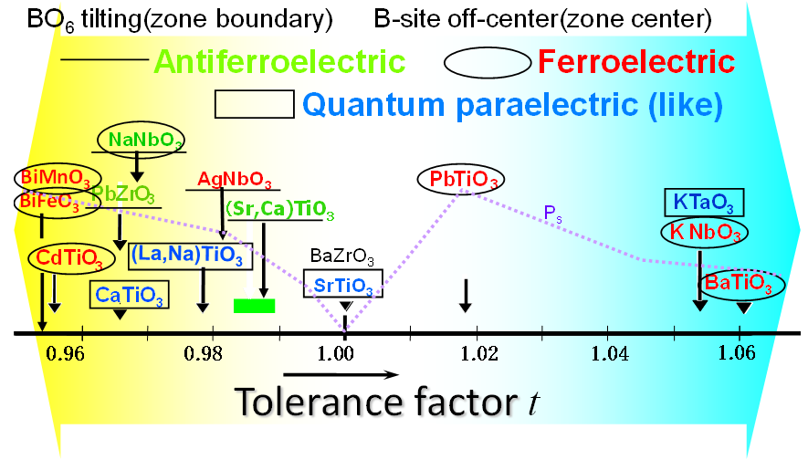
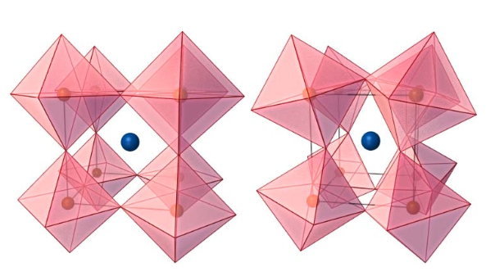

Theme 1: Symmetry Engineering in Ferroelectric CaTiO₃
CaTiO₃ – the prototype of Perovskite
CaTiO₃ natural mineral
Gustav Rose
(1798 – 1873)
Lev Perovski
(1792 – 1856)
Non-cubic
Orthorhombic (Pbnm)
Cubic (Pm3m)
Notes:
Russian mineralogist

Slide 12

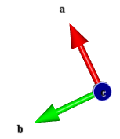
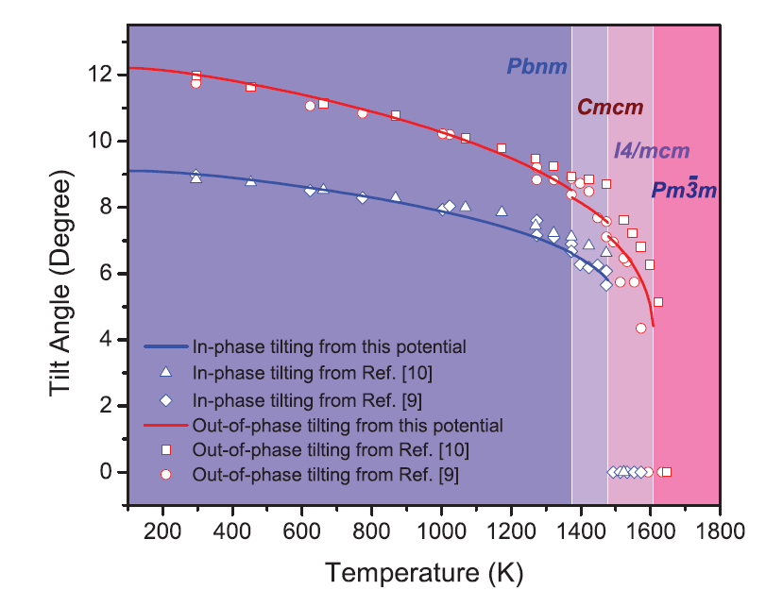
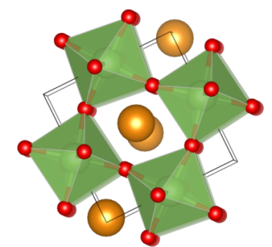
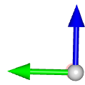
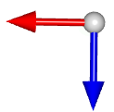
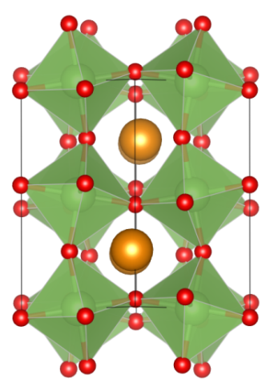




Crystal structural and octahedral distortions
a
b
b
a
c
c
Pbnm
a⁻a⁻c⁺
I4/mcma⁰a⁰c⁻
Pm3m
a⁰a⁰a⁰
Bulk CaTiO₃ @ room temperature
Glazer notation: a⁻a⁻c⁺
“+” tilt —> in phase
“-” tilt —> out of phase
Tilting is very strong !

Slide 13





Competing mechanisms
Octahedral
distortion
Polar
distortion
t < 1
Incipient ferroelectricity

Slide 14




Epitaxial strain – enhancing ferroelectricity
Choi et al, Science (2004)
BaTiO₃
Fong et al, Science (2004)
PbTiO₃
Hanei et al, Nature (2004)
SrTiO₃

Slide 15



Can CaTiO₃ be ferroelectric ?
Eklund et al, PRB (2009)
orthorhombic
ab-ePbnm
c-ePbnm
nonpolar
monoclinic
Pm
P2₁
polar
orthorhombic
Pmc2₁
Pmn2₁
polar
CaTiO₃

Slide 16








Strategy: epitaxial strain and symmetry control
LSAT
NdGaO₃
Cubic
Pn3mZ (a⁰a⁰c⁰)
a = 3.868 Å
Orthorhombic
Pbnm (a⁻a⁻c⁺)
a_{pc} = 3.860 Å
NGO
LSAT

Slide 17






Structural characterization
HAADF-STEM
XRD-OOP & RSM
XRD-IP (202)_{PC} scan
202
022
CTO
LSAT
CTO
NGO
 | a_{PC} (Å) | b_{PC} (Å) | c_{PC} (Å)
LSAT | 3.868 | 3.868 | 3.801
NGO | 3.855 | 3.865 | 3.816
Fully strain and coherent film on both substrate
Film on NGO shows lower symmetry

Slide 18





Symmetry reduction
NGO
Film on NGO show monoclinic (triclinic) distortion, with beta ~91.15 deg.
_
(206)_{O}
(444)_{O}
(602)_{O}
(444)_{O}
LSAT
Film on LSAT doesn’t show obvious monoclinic, near a tetragonal structure.
_
_
(024)_{C}
(204)_{C}
(024)_{C}
(204)_{C}

Slide 19













Synchrotron half-order diffraction
CaTiO₃/NGO: a⁻b⁺c⁻
CaTiO₃/LSAT: a⁺a⁺c⁻(a⁺a⁺c⁰)

Slide 20








Quantification of octahedral tilts
LSAT a⁻b⁺c⁻
α = 4.6
β = 5.4
γ = 0.9
α = 7.1
β = 10.2
γ = 2.3
NGO a⁻b⁺c⁻
Rondinelli et al, MRS Bulletin (2012)

Slide 21


ABF-STEM interface symmetry
CaTiO₃ on NGO
CaTiO₃ on LSAT
interface
interface

Slide 22


Ferroelectric and dielectric properties
Strained CaTiO₃ is ferroelectric
Film on LSAT show T_{c} of ~ 140 K and in-plane remnant polarization of 5 μC/cm²
Monoclinic octahedral distortion suppress the ferroelectric transition

Slide 23


LGD modeling: S-T phase diagram
Landua free energy:
a⁺a⁺c⁻
a⁺a⁺c⁰
a⁻b⁺c⁻

Slide 24










LaCoO₃: unconventional magnetism
Theme 2: Symmetry Engineering in epitaxial Magnetic LaCoO₃
Epitaxial film
Bulk
Fuchs et al., Phys.Rev.B (2008) and (2009)
Nanoparticle & nanowires
Yamaguchi et al., Phys.Rev.B (1996)
Fita et al., Phys.Rev.B (2008)

Slide 25








LaCoO₃: unconventional magnetism
Chio et al., Nano.Lett (2012)
Biskup et al., Phys.Rev.Lett (2014)
Chio et al., Chem.Mater. (2014)

Slide 26








Magnetic phase diagram for ultra-thin LaCoO₃ films
100 ~ 300 K
S
1.5
1.1
5 K
0.7
0.6 (bulk)
Spin ordering
5 K
Spin transition
Thickness dependent magnetism for ultra-thin epitaxial LaCoO₃
Why thinner films lose magnetism?

Slide 27








Interfacial structure probed by synchrotron XRD
5 uc
15 uc
15 uc
5 uc film is pseudotetragonal, but 15 uc film is monoclinic
Symmetry change reflection modification of octahedral tilting structure

Slide 28




Quantification of CoO₆ octahedral tilts
a⁻a⁻c⁰
5 uc
α = 0.5 ± 0.5°
γ = 0.3 ± 0.3°
a⁻a⁻c⁰
15 uc
[001]
α = 7.2 ± 0.5°
γ = 0.6 ± 0.3°
[110]

Slide 29



Direct imaging tilts by STEM
15 uc
[010] STEM-HAADF
[110] STEM-HAADF
[110] Inverted ABF

Slide 30



Octahedral evolution at the heterojunction
15 uc
5 uc
Different octahedral behavior
Gradual tilt evolution for 15uc film

Slide 31





Local octahedral and bonding structure
5 uc, a⁻a⁻c⁰
15 uc, a⁻a⁻c⁰
Bulk, a⁻a⁻a⁻
Sterbinsky et al., Phys.Rev.B (2012)
EXASF
Magnetic No Yes No
Yes No
Octahedral tilt and distortion impact magnetic properties

Slide 32










Correlation of tilting and magnetism
$$θ$$
$${ r}_{Co−O}^{}$$
e_{g}*
$$W$$
$$∝ r_{Co−O}^{−3.5}sin(θ/2)$$
e_{g}
t_{2g}*
$$∆_{CF}$$
$${ ∝ r}_{Co−O}^{−5}$$
$$∆_{ex}$$
t_{2g}
$∆ {=∆}_{CF}−∆_{ex}$ $−W/2$
5uc 15uc Bulk LCO/STO LCO/LAO
The key is octahedral volume instead of unit cell volume

Slide 33





[LCO(5uc)/STO(5uc)]₃ vs. LCO(15uc)

Slide 34
Summary
Symmetry mismatch at perovakite based heterointerface is widely exist, and should not be ignore
Octahedral mismatch/rotation can impact properties of materials (ferroelectricoty for CaTiO₃ and magnetism for LaCoO₃).
Symmetry engineering might to work as a new and general strategy to control the functional properties of these materials

Slide 35






Acknowledgements
Sarah Heigh, Andrew Thomas
J. H. Jang, A. Borisevich (TEM), D. J. Singh (theory), Z. Gai (SQUID), R. K. Vasudevan, A. Tselev, A.P. Baddorf (STM), D.B. Geohegan, S.V. Kalinin, H.M. Meyer, H.M. Christen, M.D. Biegalski
PNNL: S.A. Chambers, P.V. Sushko, T.C. Droubay, T.C. Kaspar, V. Shutthanandan, T. Varga, M.E. Bowden, G.J. Exarhos, R. Colby, B. Kabius
ANL: Zhenxing Feng, H. Zhou, S.M. Heald,
SSRL: M. Apurva
Penn State: Yijia Gu and Long-qing Chen
Thanks !!

