Slide 1

Modelling Driven Discoveries in Molecular Spectroscopy
Feng Wang (王凤)
Molecular Modelling Discovery Laboratory
Swinburne University of Technology
August 14th, 2018
fwang@swin.edu.au

Slide 2
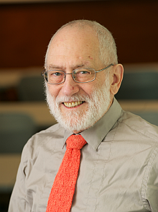
In memory of Prof. R. J. Le Roy
(30.09.1943 – 10.08.2018)
University of Waterloo, Canada

Slide 3
Building Blocks of Materials
Quantum mechanical properties of building blocks of materials
  provide quantitative foundations of chemistry
  Testing ground of new theories of molecular structure, reactivity & dynamics
high-resolution spectroscopic techniques combined with complementary theoretical and computational/digital advances

Slide 4
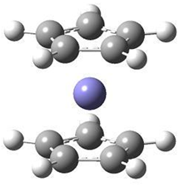
Outline
I Ferrocene
II XPS of biomolecules
III Molecular isomers
IV Summary
Notes:
-Core shells involvement in properties and reactions---H-bonds also affects core.
-Fragment and chemical principle based design/rational design learned from existing drugs
-Additional symmetry and momentum space information: EOES
-electron-position annihilation likely happens at LOVO not HOMO
-vib spctroscopy: VCD/ROA (resverotoral), IR-H-bond blue shift
Case study---Ferrocene

Slide 5
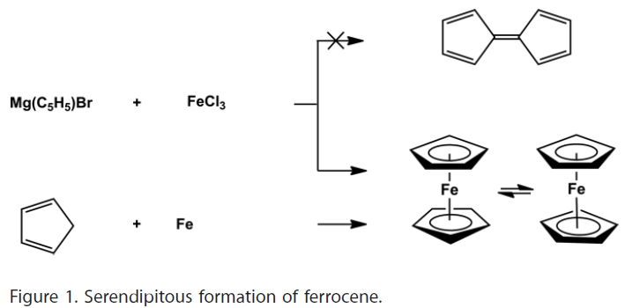
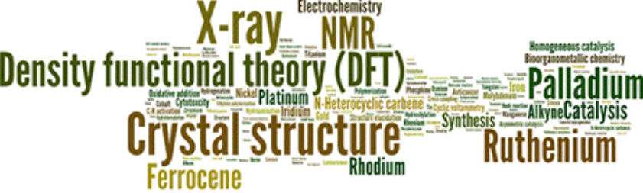
I. Ferrocene
Serendipity and scientific discovery (1952)
Organometallic Chemistry

Slide 6
Why Ferrocene?
The unique features of Fc (ferrocenyl derivatives) lead to potential for applications, e.g., smart materials with required properties
  organic synthetic
  electrochemical,
  electronic,
  optoelectronic,
  catalytic,
  pharmaceutical and
  biological, etc
The possibility to tune or to switch the properties of such materials relies mostly on the redox activity of the Fc/Fc⁺ couple

Slide 7
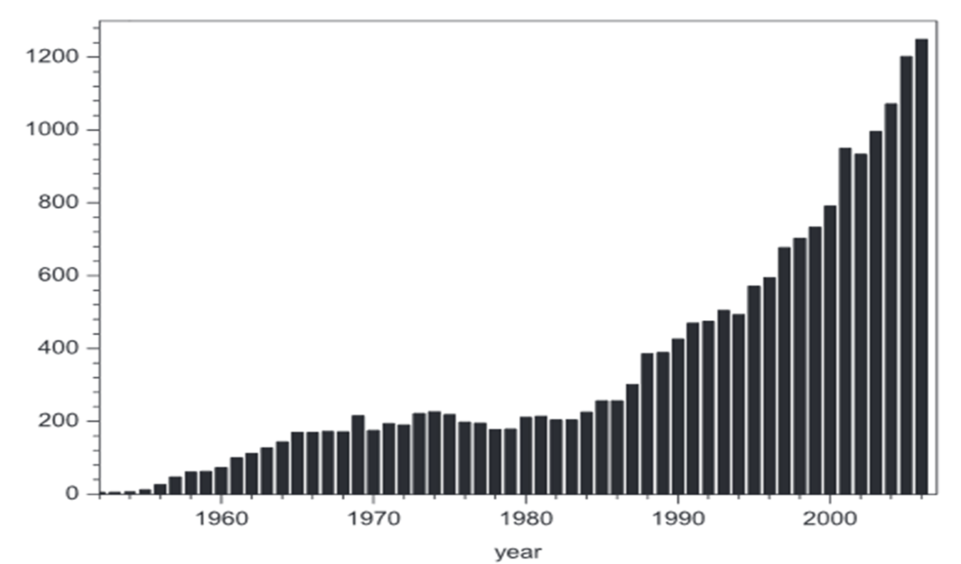

Why Ferrocene?
Applications &
full of challenges
Related literature of Fc*
  23,000 articles related
  to Fc in 2010
* Petr Stepnicka, Ed. Ferrocenes: Ligands, Materials and Biomolecules, John Wiley & Sons, Ltd. (2008).

Slide 8
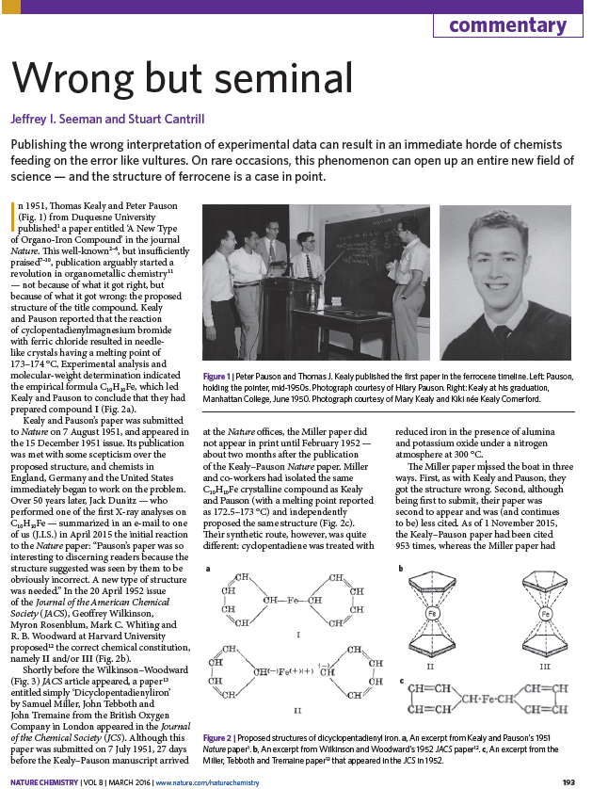
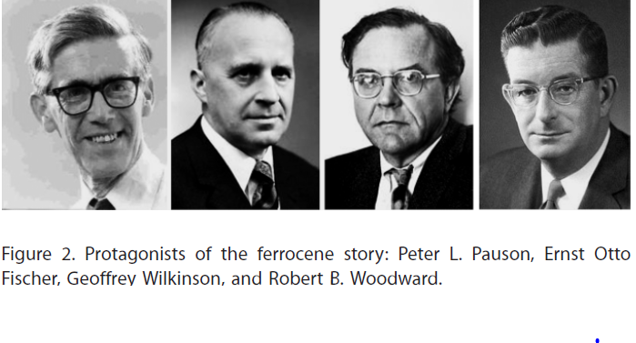
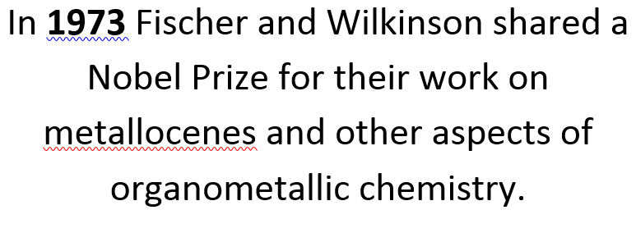
Ferrocene: Nature Chemistry Vol 6 March, 2016

Slide 9
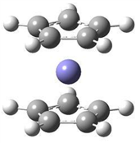
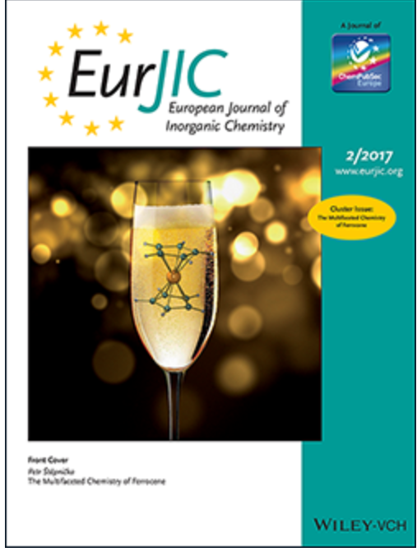
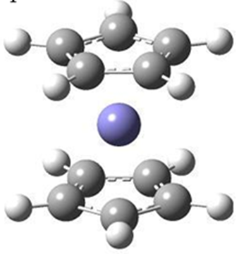
65 years of Fc (2017) --- still a number of unanswered questions
Staggered Fc is not
the most stable
structure of Fc

Slide 10
Fc --- full of challenges
Conformation: Eclipsed and Staggered?
Ionization: where is the first ionized electron from?
Temperature dependent properties & spectroscopy;
Behaviour of electrons of the transition metals of sandwich complexes;
Ligand dependent ferrocenyl configuration in Fc derivatives, Why?
Etc.

Slide 11
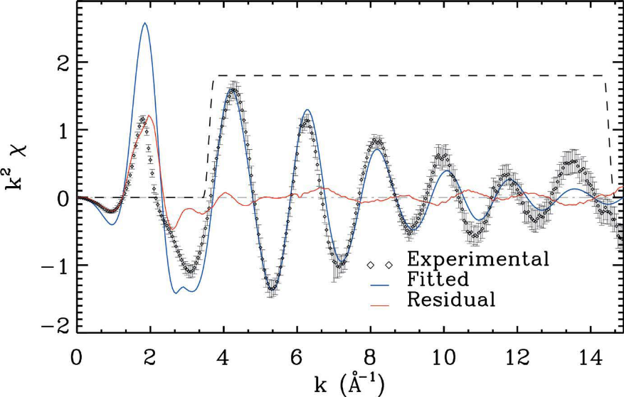
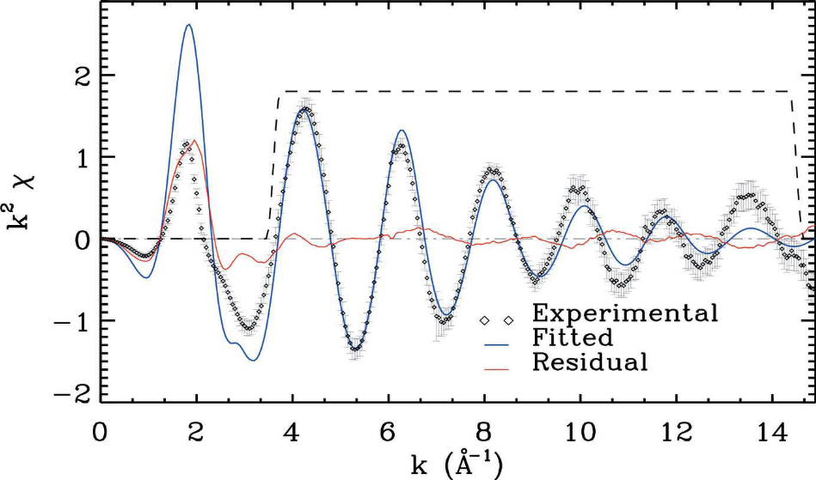
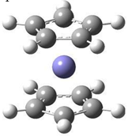
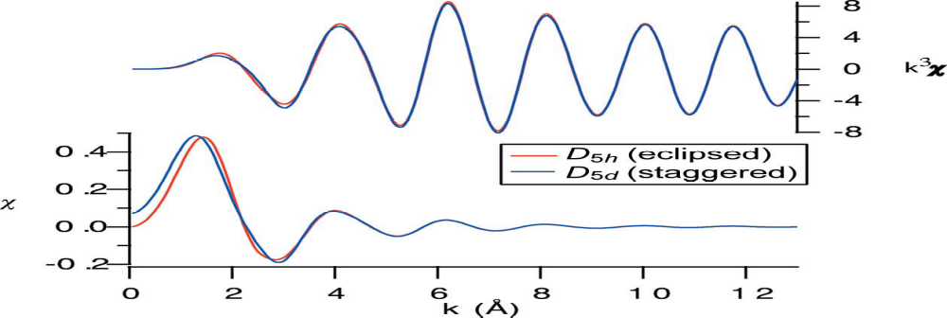
XAFS analysis of Fc*
*C. T. Chantler, N.s A. Rae, M. T. Islam, S. P. Best, J. Yeo, L. F. Smale, J. Hester, N. Mohammadi and F. Wang, J. Synchrotron Rad. (2012). 19, 145–158

Slide 12
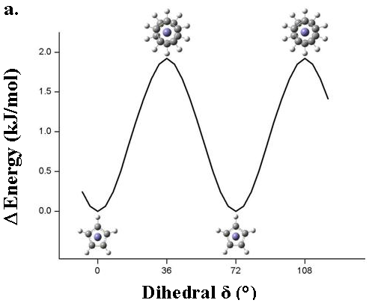
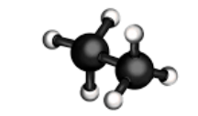
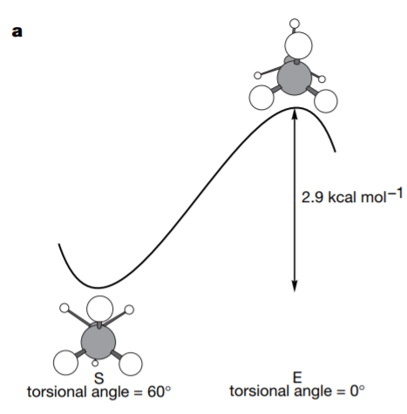
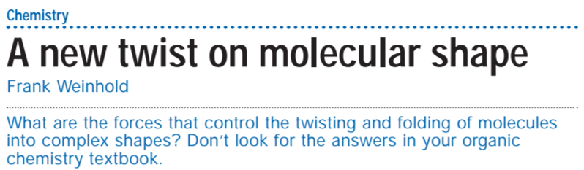
The puzzle of Fc conformers
0.9 Kcal.mol⁻¹
*N. Mohammadi, A. Ganesan, C.T. Chantler and F. Wang, J. Organometallic Chem 713 (2012) 51-59.
*V Pophristic & L. Goodman,
Nature, 411(2001)565

Slide 13
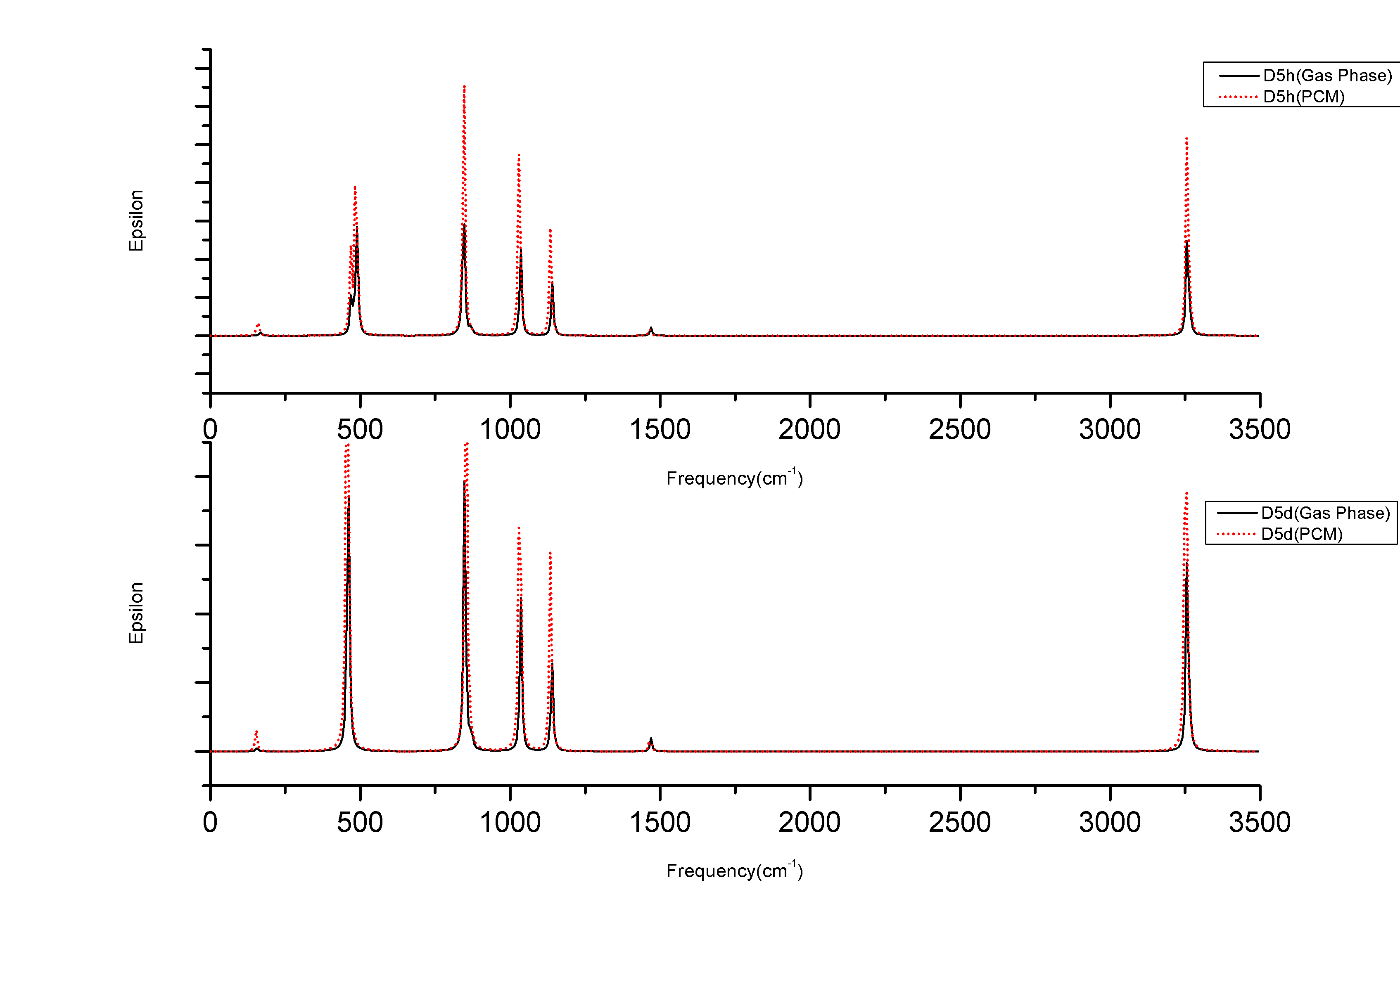
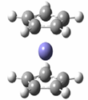
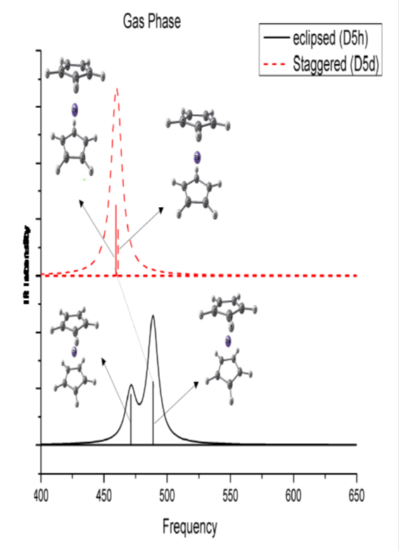

Simulated IR of Fc (without scaling)*
D5h
D5d
*N. Mohammadi, A. Ganesan, C.T. Chantler and F. Wang, J. Organometallic Chem. 713 (2012) 51-59.

Slide 14

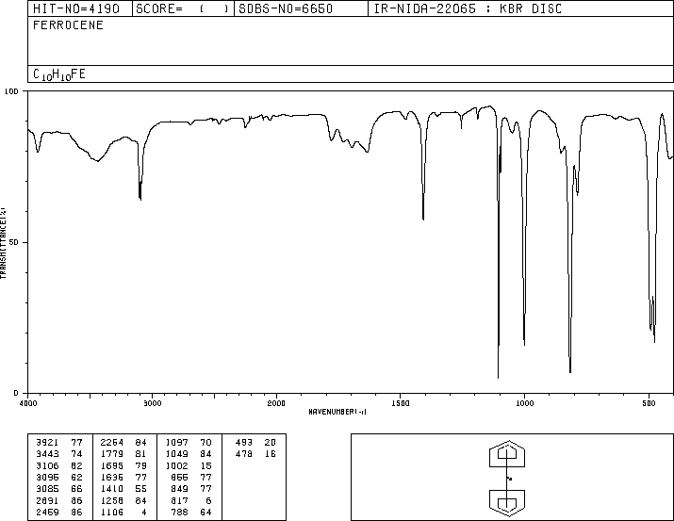

Early IR expt. (1958) of Fc*
IR (Raman) does not give a simple answer about centre of symmetry.
*E.R. Lippincott, R.D. Nelson, Spectrochim. Acta 10 (1958) 307-329.

Slide 15
But….One more comparison between theory and expt
Lippincott & Nelson
*N. Mohammadi, F. Wang, S. Best, D. Appadoo & C.T. Chantler, https://arxiv.org/abs/1306.0633(2013)

Slide 16
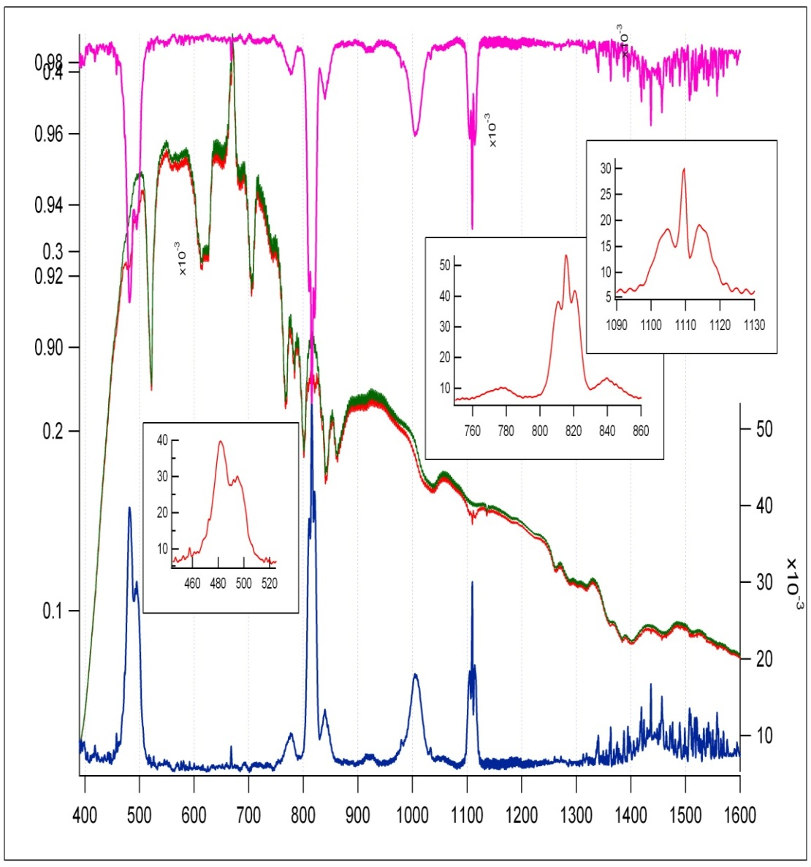
Fc IR measurement at AS (gas phase)*
*S. Best, C. T. Chantler, F. Wang, D. Appadoo etc (2013),

Slide 17
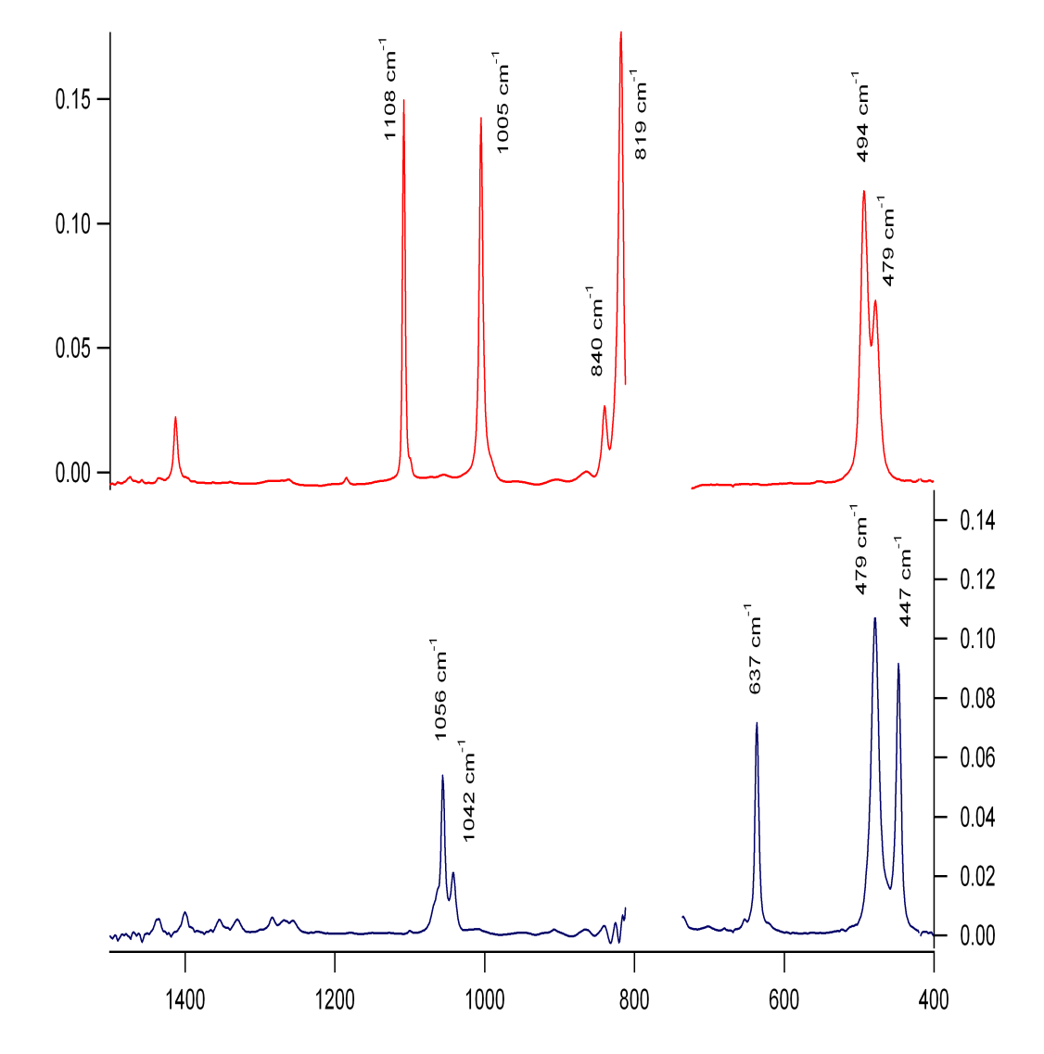
Deuterated Fc-d10*
Theory
Expt

Slide 18
IR of decamethyl DmFc*
E-DmFc is less stable than S-DmFc
*J. D. Bourke, M. T. Islam, S. P. Best, C. Q. Tran, F Wang & C. T. Chantler,
JPC Lett, 7(2016)2792-2796.

Slide 19
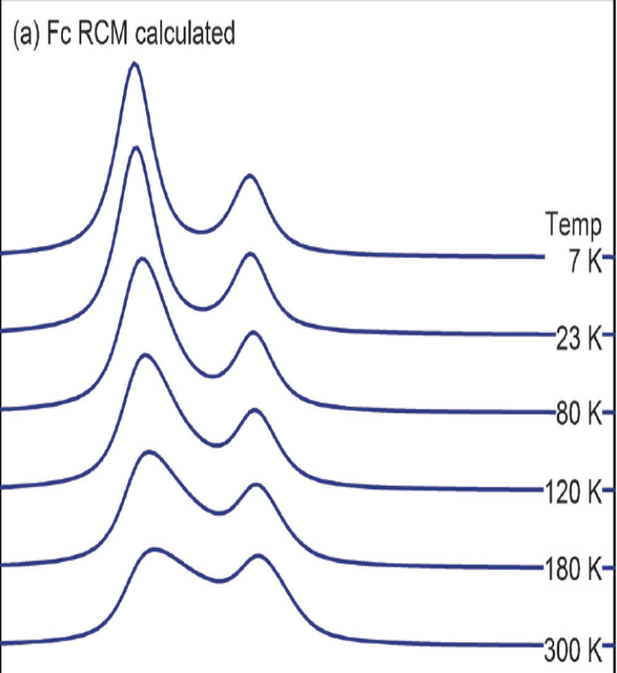
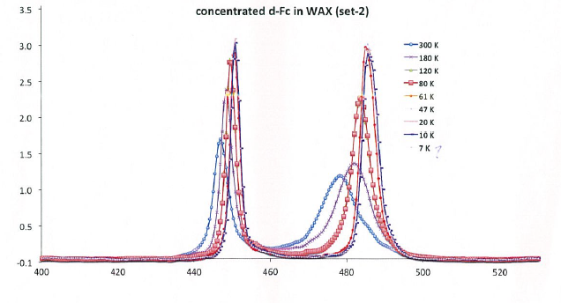
Temp-dependent Fc-IR in Wax
Reaction coordinate method (RCM)*
Fc-d10-IR: evidences of the mixture?
*S. Best, F. Wang, M. T. Islam, S. Islam, D. Appadoo, R. M. Trevorah, C. T. Chantler,,
Chem. Eur. J., .22(2016)18019-18026.

Slide 20
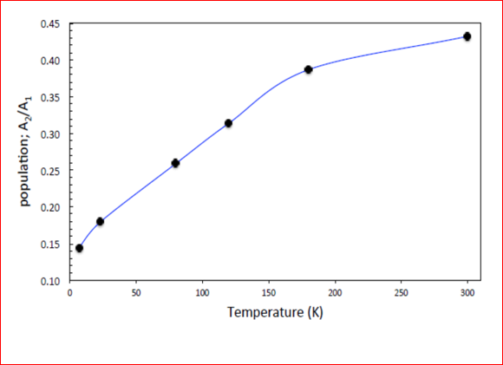
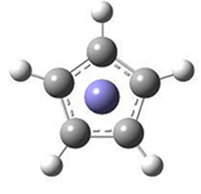


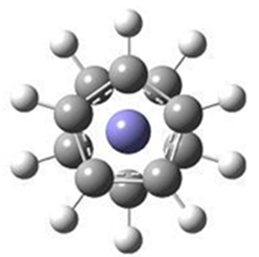

Temp effects on the Fc conformers*
*S. Best, F. Wang, M. T. Islam, S. Islam, D. Appadoo, R. M. Trevorah, C. T. Chantler,
Chem. Eur. J., .22(2016)18019-18026.

Slide 21

Fc T-dependent IR of Ec/Stg*
*S. Best, F. Wang, M. T. Islam, S. Islam, D. Appadoo, R. M. Trevorah, C. T. Chantler,,
Chem. Eur. J., .22(2016)18019-18026.

Slide 22


Theory is powerful
EOES---excess orbital energy spectrum
  Most significant response of MOs
EDA---energy decomposition analysis
  Contributions of physical energy components
MD --- molecular dynamic
  Dynamics of the conformational changes with temperature

Slide 23
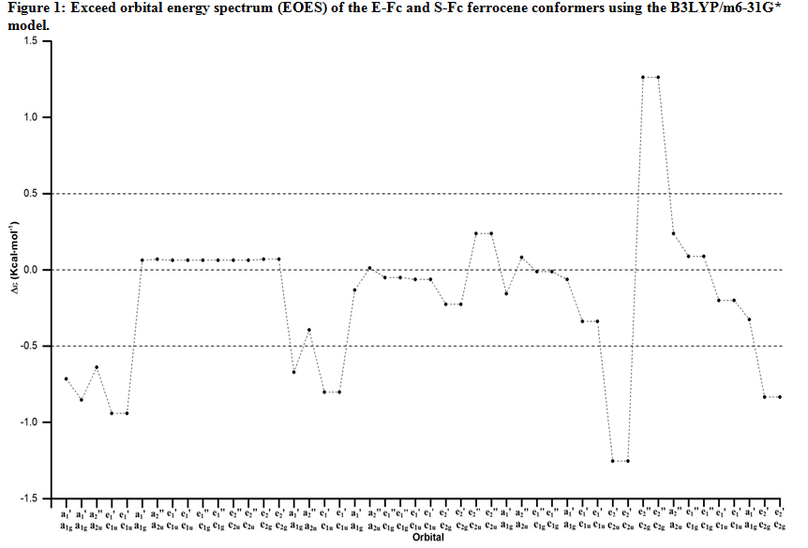
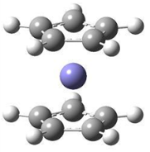


EOES of Fc -- Fe electrons etc*
  Δε_{i} = ε_{i}^{E-Fc} - ε_{i}^{S-Fc}
Valence
MO37-40
Fe 3s/3p
MO16, MO18-19
HOMO
MO47-48
Fe 1s, 2s/2p
*S Islam and F. Wang, RSC Adv., 5(2015)11933-11943.

Slide 24
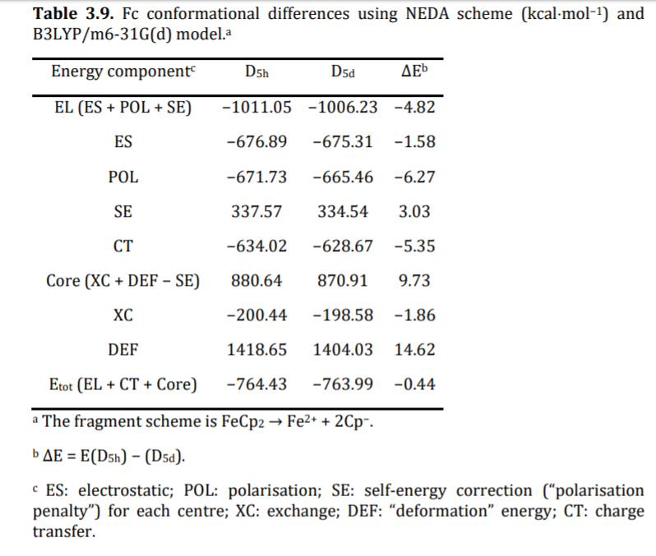
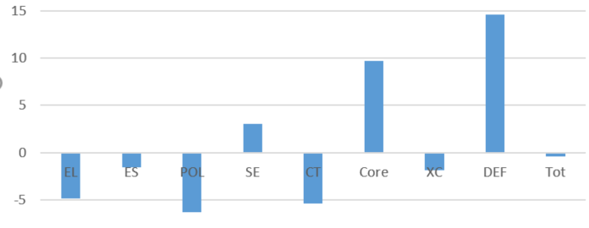
Energy Decomposition Analysis (EDA)

Slide 25
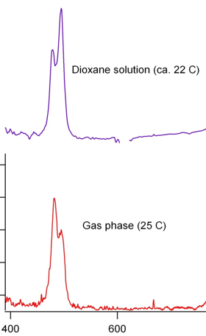

Solvent effects on the IR spectra of Fc*
Expt
S. Islam et al (to be submitted, 2018)

Slide 26
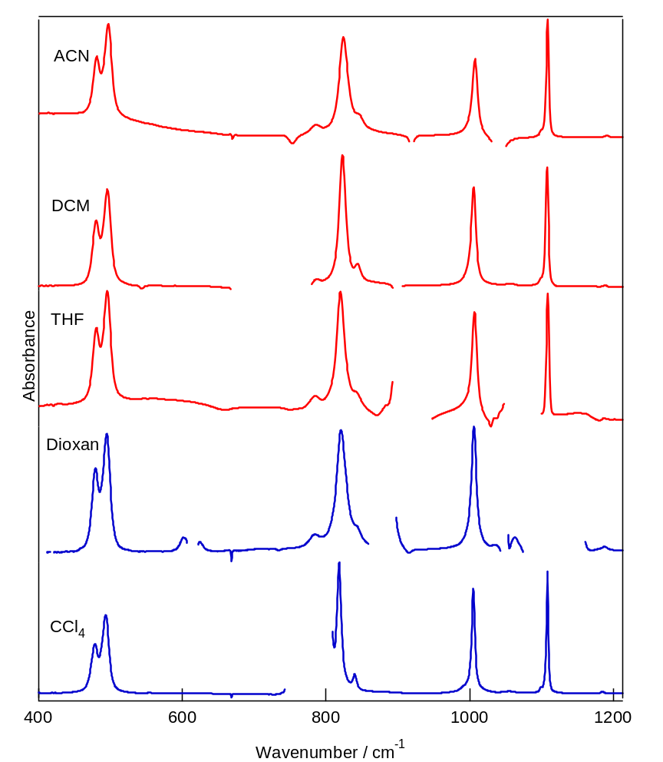
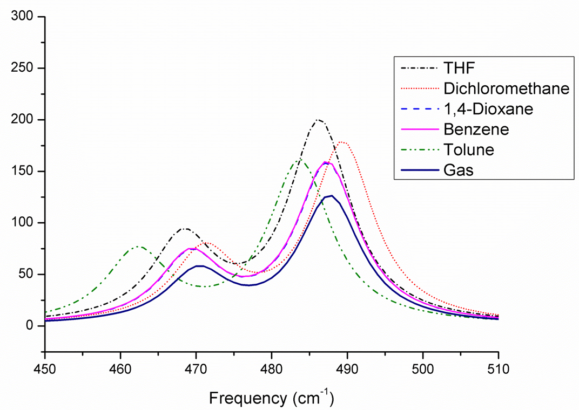
Fc-IR Expt/Cal. in solution*
Expt
Cal.
(agree with Lippincott & Nelson in 1958)
*N. Mohammadi, F. Wang, S. Best, D. Appadoo & C.T. Chantler, https://arxiv.org/abs/1306.0633(2013)

Slide 27
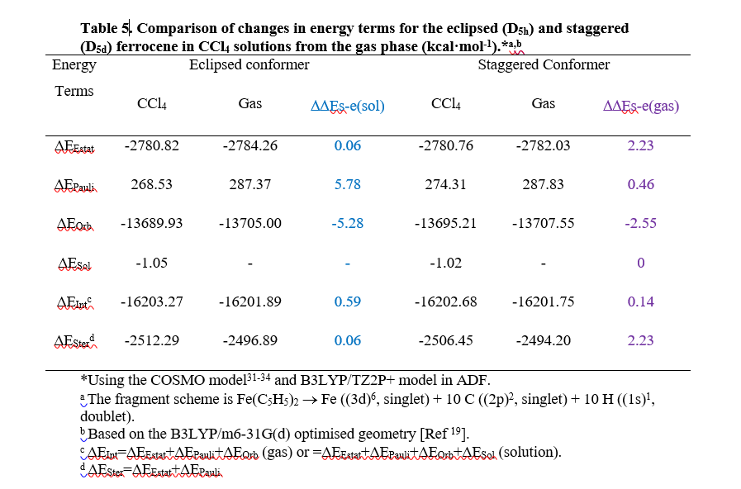
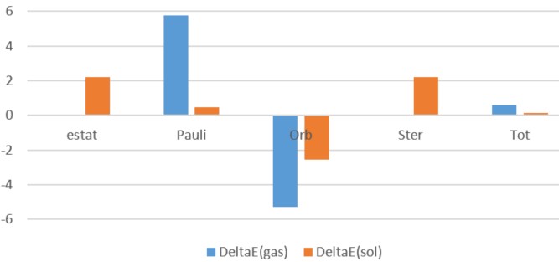
EDA: Solvent effects*
*S. Islam, et al (in preparation, 2018)

Slide 28
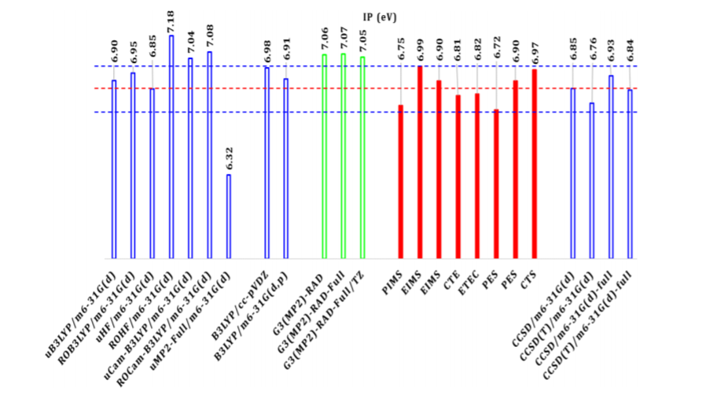
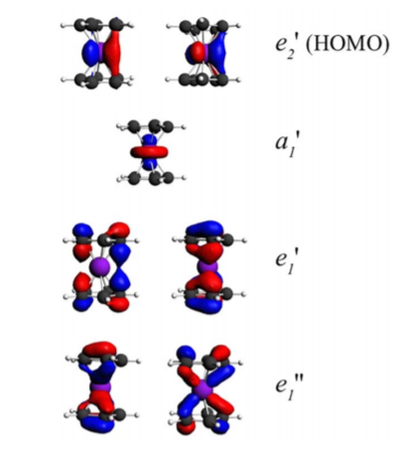
1st ionization potential of Fc
#
S. Islam, V. Vasyliev, and F. Wang (to be submitted, 2018)
# A. Boccia et al, JCP, 128(2008)154315.

Slide 29
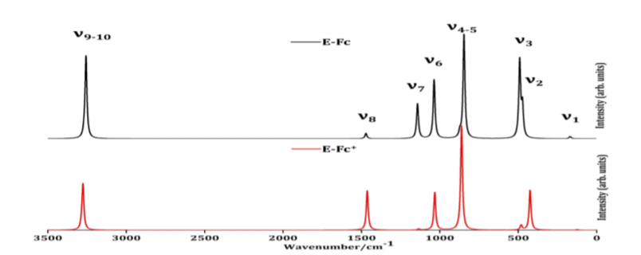
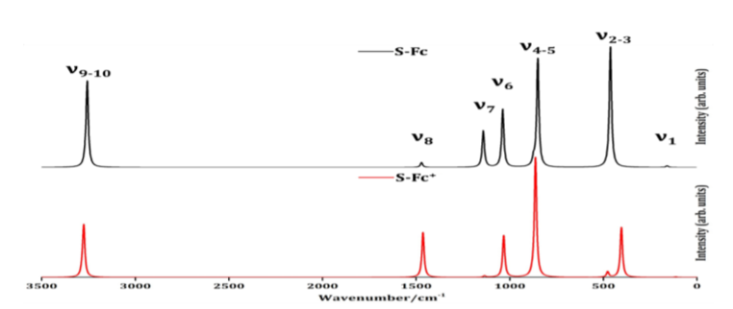
Simulated IR spectra of Fc and Fc⁺
* S. Islam, V. Vasyliev and F. Wang (to be submitted, 2018)

Slide 30
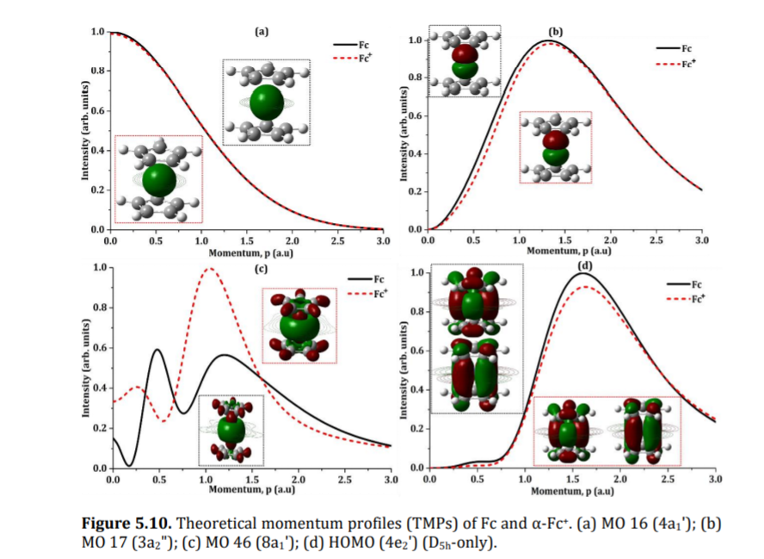
Orbital momentum profile of Fc⁺ and Fc
* S. Islam, V. Vasyliev and F. Wang (to be submitted, 2018)

Slide 31
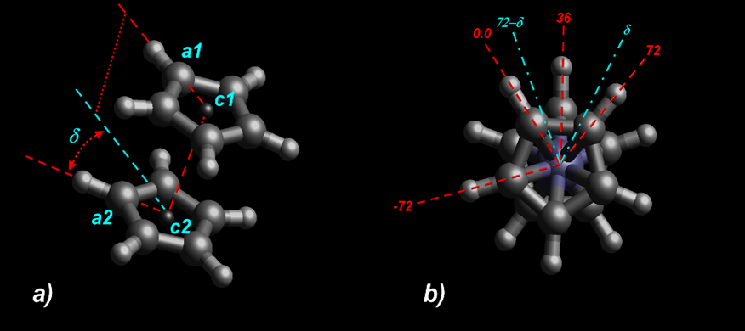
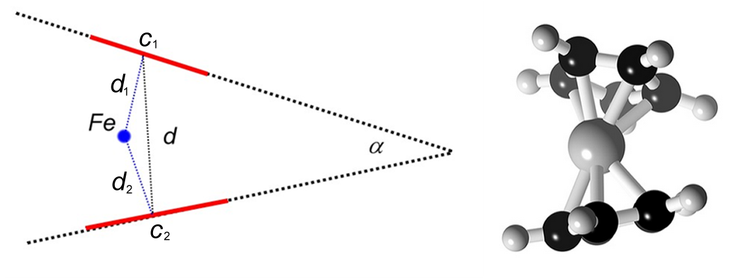

MD Simulation of Fc* molecular carousel: Fc topology
δ =0° →eclipsed Fc, Center-of-Mass
δ=36° → staggered Fc.
*V. Vasyliev, S. Islam and F. Wang (to be submitted, 2018)

Slide 32
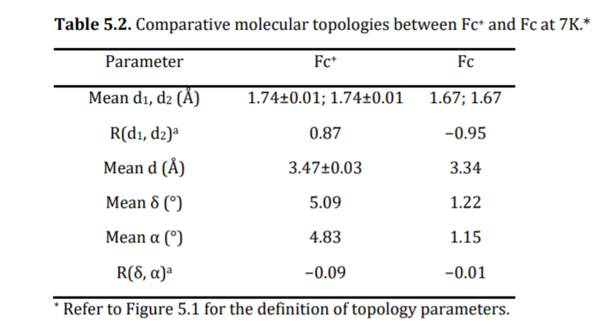
Results from MD simulations
*V. Vasyliev, S. Islam and F. Wang (to be submitted, 2018)

Slide 33
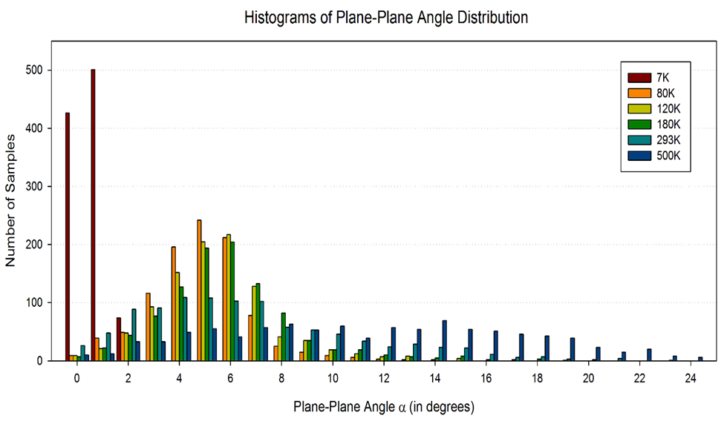
Fc Cp tilting angle α distributions*
*V. Vasyliev, S. Islam and F. Wang (to be submitted, 2018)

Slide 34


Fc exhibits not strictly D₅ at room T*
Fc MD 325 fs, 20C, sideView and topView
*V. Vasyliev, S. Islam and F. Wang (to be submitted,2018)

Slide 35
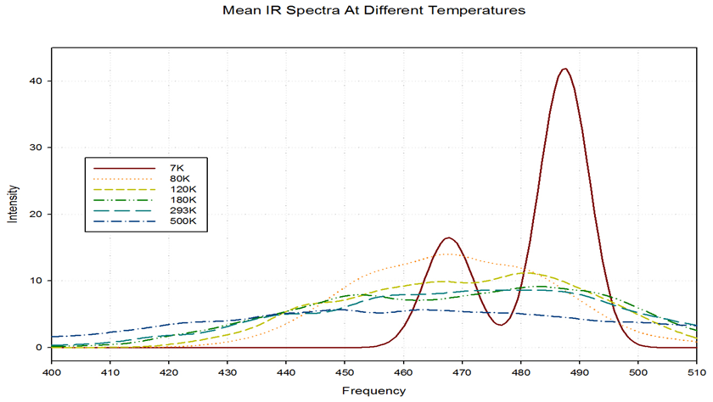
Mean Fc IR spectra at different Ts*
*V. Vasyliev, S. Islam and F. Wang (to be submitted, 2018)

Slide 36
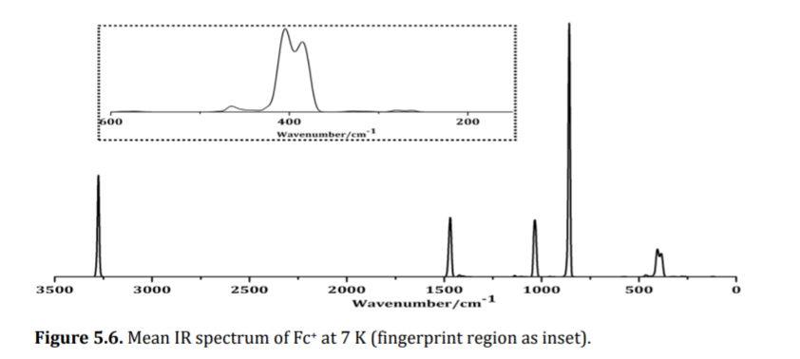
Mean Fc⁺ IR spectra at 7 K*
*V. Vasyliev, S. Islam and F. Wang (to be submitted, 2018)

Slide 37



Fc/Au(111) (and Fc/Ag(111))
S. Islam, Y. Wang and F. Wang (in preparations, 2018)

Slide 38

Adsorption energies of Fc/Au(111)
ΔE = E(D5h)−E(D5d) (kcal/mol). ΔE of free Fc is 1.07 kcal/mol
Adsorption of the E-Fc is more favoured than S-Fc on both surfaces on ⊥
E-Fc is preferred over S-Fc by 2.31 kcal/mol and 1.61 kcal/mol, respectively on Au(111) and on Ag(111).
Interaction of Fc with metal surfaces enhances the energy barrier between Fc conformers from the isolated systems.
S. Islam, Y. Wang and F. Wang (in preparation, 2018)

Slide 39


II XPS of biomolecules
Core IPs of DNA/RNA bases^{1,2}
¹Theory: Zhu, Q., Wang, F. et al, 2009. J. Syn. Rad. 16, 545.
²Expt. Plekan et al., 2008 Chem. Phys. 347 360.

Slide 40




Core spectra for purine bases*
Q: defined trends in C1s of the “same” C-frames?
No
*Wang, F. Zhu, Q. and Ivanova, E. J. Syn. Rad.,15, 624-631(2008).

Slide 41


C1s spectra of amino acids (AA) theory and expt. IPs^{1,2}
Theory:1 A. Ganesan and F. Wang, JCP, 131(2009)044321.
Expt: 2 Plekan.O et al., JPCA, 112(2008)7806-7815.

Slide 42







dipeptides: phenylalanylphenylalanine*
Simulation
O1s
N1s
C1s
Dissociation?
Not dissociation, What else?
* A. P. Wickrama Arachchilage, F. Wang, V. Feyer, O. Plekan, K. C. Prince, 136, 124301 (2012)

Slide 43




Phenylalanylphenylalanine*
Dehydration
* A. P. Wickrama Arachchilage, F. Wang, V. Feyer, O. Plekan, K. C. Prince, 136, 124301 (2012).

Slide 44

Nitroimidazole radiosensitizers*
Comparison
L. Feketeová, O. Plekan, M Goonewardane, M. Ahmed, A. L. Albright, J. White,
R. A. J. O'Hair, M. R. Horsman, F. Wang and K.C. Prince, JPCA, 119 (2015)9986–9995.

Slide 45




III Isomer Studies and Chirality
Anti-dioxides---methoxyphenols
*S. Islam, A. Ganesan, R. Auchettl, O. Plekan, R.G. Acres, F. Wang, K.C. Prince, JCP (submitted, 2018)

Slide 46


Conformation and relaxation dependent: 2-MP through space
*S. Islam, A. Ganesan, R. Auchettl, O. Plekan, R.G. Acres, F. Wang, K.C. Prince, JCP (submitted, 2018)

Slide 47



Through-bond interaction of 4-MP
*S. Islam, A. Ganesan, R. Auchettl, O. Plekan, R.G. Acres, F. Wang, K.C. Prince, JCP (submitted, 2018)

Slide 48


The magic of theory: gallic acid valence IP

Slide 49
Signalling Mols in Bacteria Quorum Sensing
C1s
O1s
Q. Arooj, K. Prince, R.G. Acres^{2,#}, P. Bolognesi, L. Avaldi and F. Wang, (to be submitted, 2018)

Slide 50



C1s XPS and ¹³C-NMR
Q. Arooj, K. Prince, R.G. Acres^{2,#}, P. Bolognesi, L. Avaldi and F. Wang, (to be submitted, 2018)

Slide 51

NMR spectra of RSVL*
*Wang, F and Chatterjee, S, J. Chem. Phys. B, 2017, 121, 4745-4755.

Slide 52
Summary
  The energy difference of E-Fc and S-Fc is very small, but eclipsed Fc is energy in favour;
  E-Fc is dominant in very low T (<80K) but the S is populated when T increases. At room T, it is in fact a mixture of both E and S; confirmed by MD simulations;
  In solution, E-Fc is dominated in room T due to solvent effects enhancement of E-Fc;
  Surface and Fc interaction enhances the conformer energy barrier and ⊥ is in favoured over ll, and Au(111) over Ag(111);
  Guidance from theory is critically important to spectroscopy of biomolecules, as most spectroscopic measurements are usually less sensitive to shape changes of biomolecule.
  For complete data sets, combining theory and measurements is the only game in town.

Slide 53









Acknowledgements
Dr. S. Islam Dr S. Chartterjee Dr A. Wickrama Dr A. Genasen
Dr L. Selvam
Mr F. Backler

Slide 54








Acknowledgements
A/Prof Q. Zhu Dr. S. Saha
Dr. V. Vasyliev (ANU)
Dr F. Chen
Ms R. Auchettl (Hon)
Ms M. Goonewardane (Hon)
Ms M Van Dongen
Hon
Ms Q. Arooj

Slide 55






Acknowledgements
Funding & Resources
Collaborators
  Prof. Kevin Prince (Elettra Synchrotron, Italy)
  Dr. Lorenzo Avaldi (NRC, Italy)
  Prof. C. Chantler (Univ. Melb., Aus)
  Dr. S. Best (Univ. Melb. Aus)
  Dr. V. Vasyliev (NCI, ANU)
  Dr. D. Appadoo (AS)
  A/Prof. Z. J. Yang (HZU, China)
  Prof. H. Nakai (Waseda U, Japan)
  A/Prof Seth Olsen

Slide 56




Acknowledgements
2013, The Last Adventure, Tsukuba, Japan

