Slide 1

Electric Field-Tuned Topological Phase Transition in Ultra-Thin Na₃Bi
Mark Edmonds
Lecturer
ARC DECRA Fellow
School of Physics and Astronomy

Slide 2



Acknowledgements
Monash University (STM/ARPES/XPS)
Prof. Michael S. Fuhrer
James Collins
Chang Liu
Dr Jack Hellerstedt
Australian Synchrotron (ARPES/XPS)
Dr Anton Tadich
Advanced Light Source (ARPES)
Dr Sung-Kwan Mo
Dr Hyejin Ryu
Dr Shujie Tang
Singapore University of Technology and Design (Theory/DFT)
Dr Shengyuan Yang
Weikang Wu
National University of Singapore (Theory/DFT)
Dr Lídia C Gomes
Dr João NB Rodrigues
Prof. Shaffique Adam

Slide 3
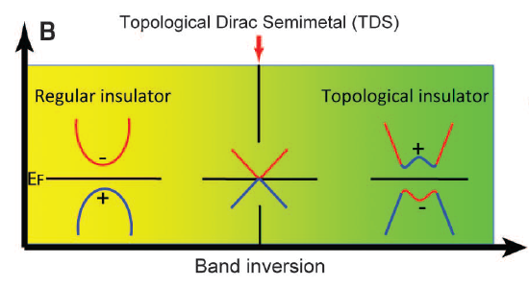
Outline
Introduction
- 2D Topological Insulators.
- Electric-field induced topological phase transitions.
Results
- Ultra-thin Na₃Bi – Growth and Electronic Properties Characterization
“Platform for a topological transistor”

Slide 4
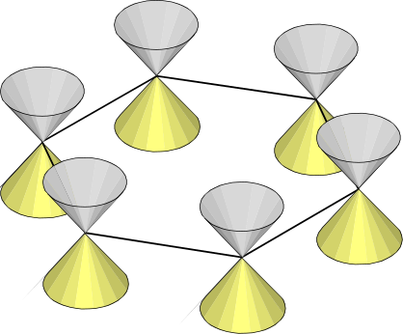
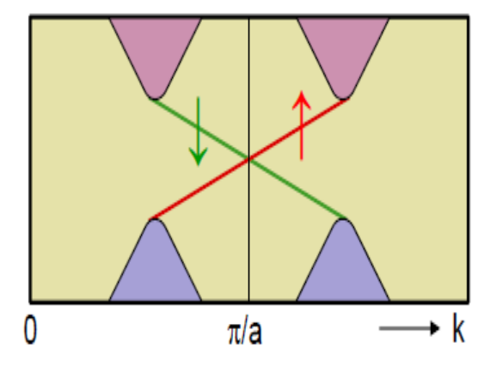

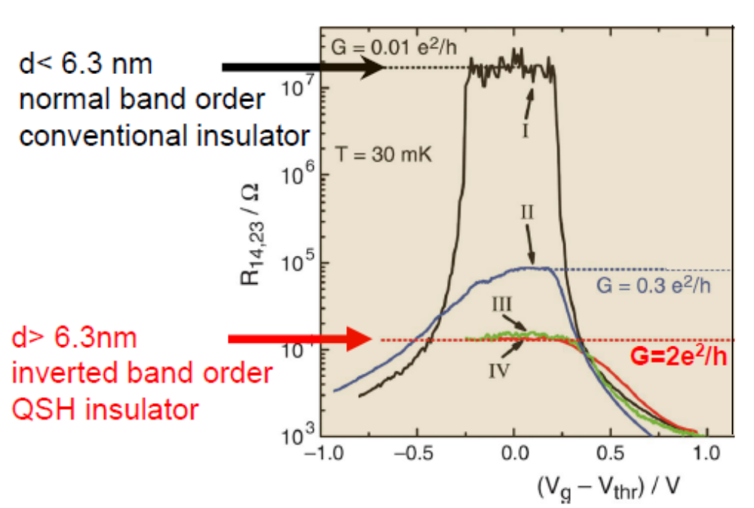
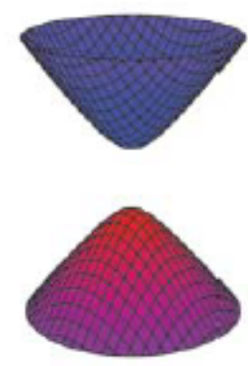
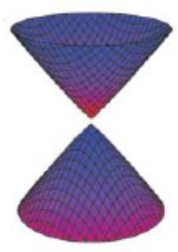
2D Topological Insulators
Graphene
Bulk energy gap with 1D spin-filtered edge states
E
Spin-orbit
coupling
Bulk Gap
μeV
Energy
p_{y}
p_{x}
Kane and Mele, PRL 95, 226801 (2005)
HgTe Quantum Wells
d<6.3 nm
Insulator
d>6.3 nm
QSH Insulator
Hg_{x}Cd_{1-x}Te
HgTe
Hg_{x}Cd_{1-x}Te
Band Inversion
Bulk Gap
10meV
d
Bernevig et al, Science 314, 1757 (2006)
Konig et al, Science 318, 766 (2007)

Slide 5
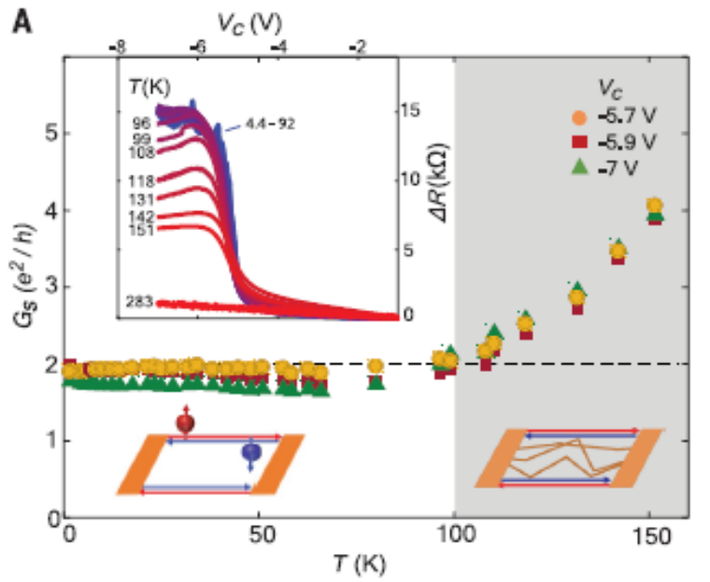
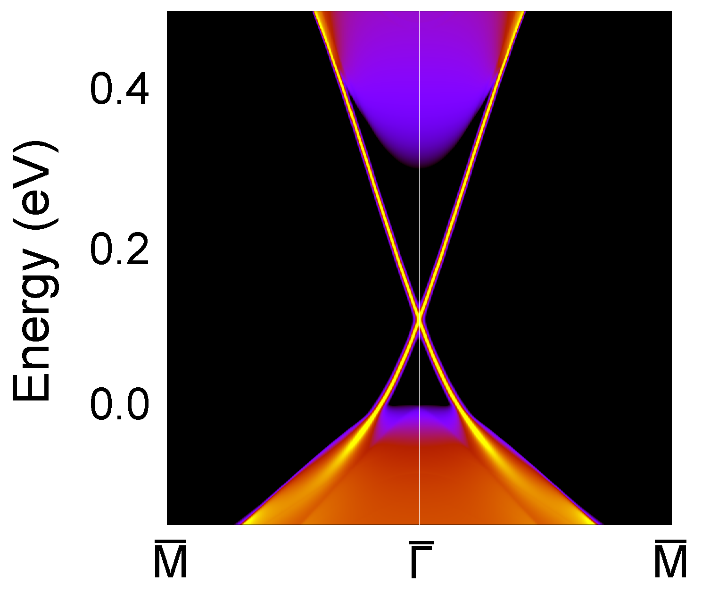
Wide Bandgap 2D Topological Insulators
QSH up to 100K in WTe₂
STM/ARPES
Bismuthene E_{G}~0.7 eV Reis et al., Science (2017)
ML WTe₂ E_{G}~50 meV Tang et al., Nature Physics (2017)
Transport
S. Wu et al., Science 359, 76 (2018)
How do you turn off a QSH insulator device?
Metallic Conduction
E_{F}
On
On

Slide 6
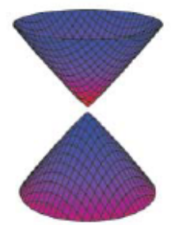
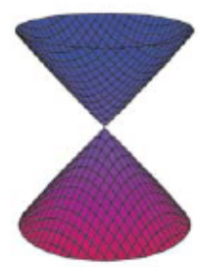
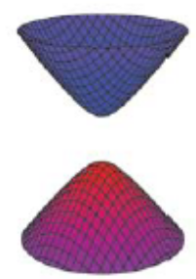
Electric Field Tuned Topological Phase Transition ‘A Topological Transistor’
Field Strength
0
E_{C}
E_{F}
E_{F}
E_{F}
QSH Insulator
Dirac Semimetal
Regular Insulator
On
On
Off
Quantum spin Hall insulators:
1T’ TMDs: Science 346, 1344 (2014)
Topological Dirac semimetals:
Na₃Bi: Sci. Rep 5, 14639 (2015)

Slide 7
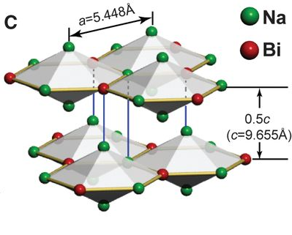
Na₃Bi: A 3D Topological Dirac Semimetal
C₃ point group
Only 2 bands Na 3s and Bi 6p lie near E_{F}
Rotation symmetry protects against gap formation leading to Dirac nodes centred at ±k_{D}
Z. Wang et al., PRB 85, 195320 (2012)
Z.K. Liu et al., Science 343, 864 (2014)

Slide 8
Dirac Semimetals in 2D
What happens when Na₃Bi is confined to 2D?
Bulk Na₃Bi
Ultra-Thin Na₃Bi
Quantum
Confinement
Spin-Orbit
Coupling
k_{z}
Is few-layer Na₃Bi a wide bandgap 2D topological or conventional insulator?

Slide 9
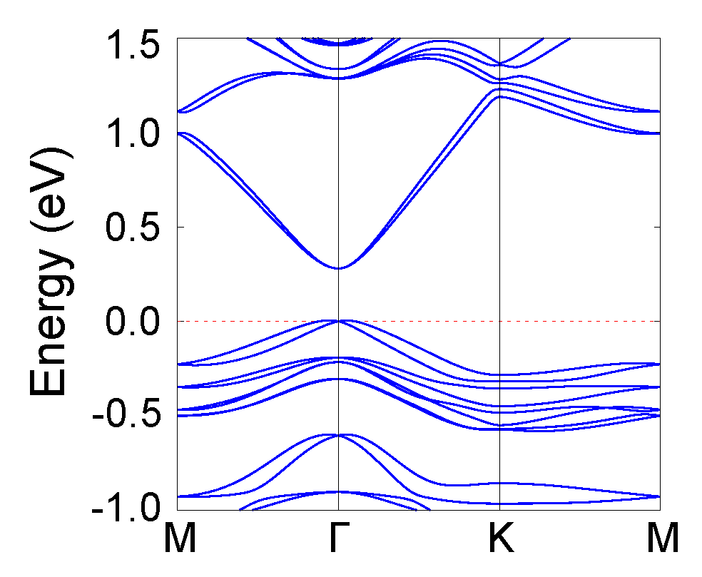
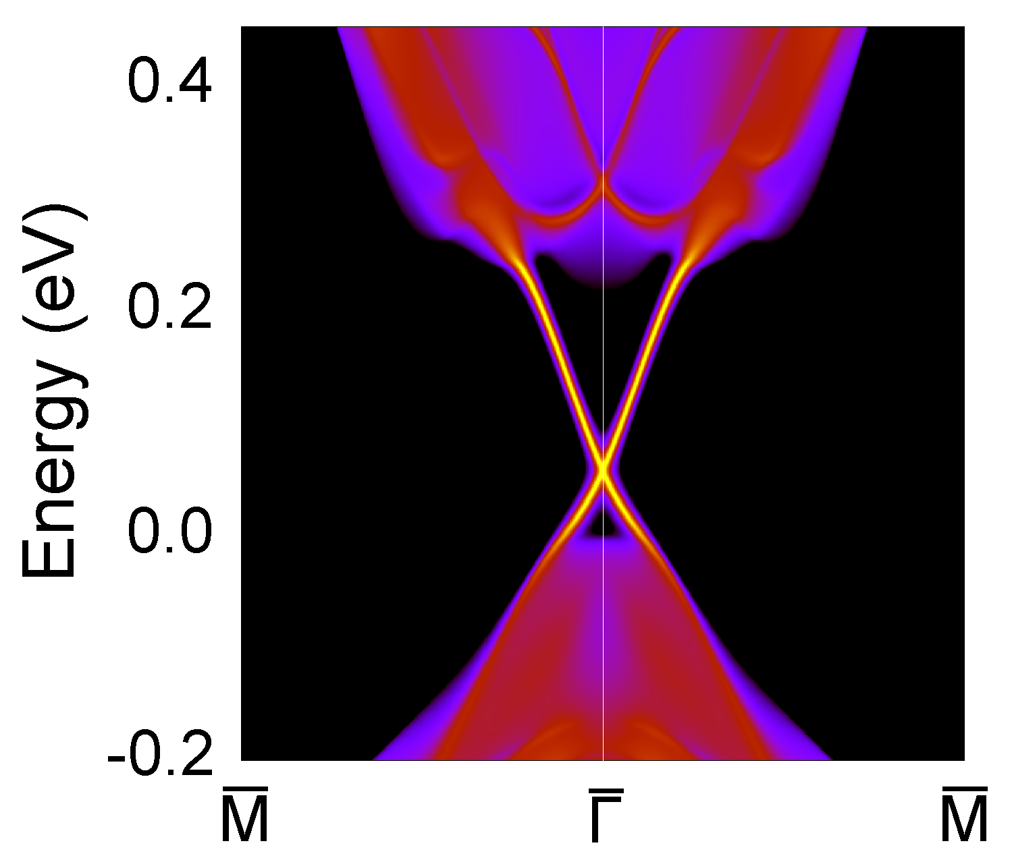
DFT: Monolayer and Bilayer Na₃Bi are TI’s (quantum spin Hall)
Monolayer
C. Niu et al., PRB 95, 075404 (2017)
ML
Na₃Bi Edges
0.30 eV
Bilayer
Collins et al., arXiv:1805.08378
BL
Na₃Bi Edges
0.22 eV

Slide 10
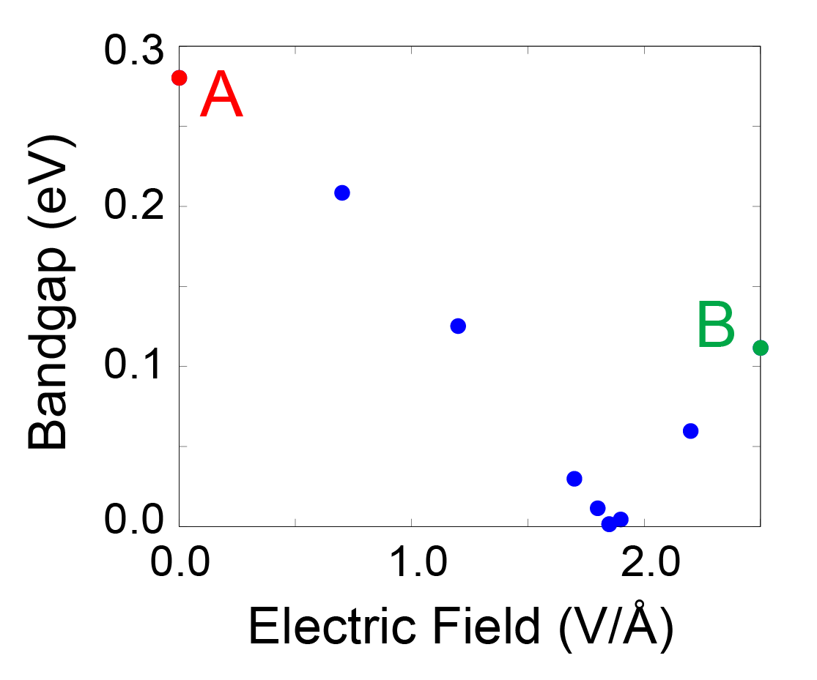
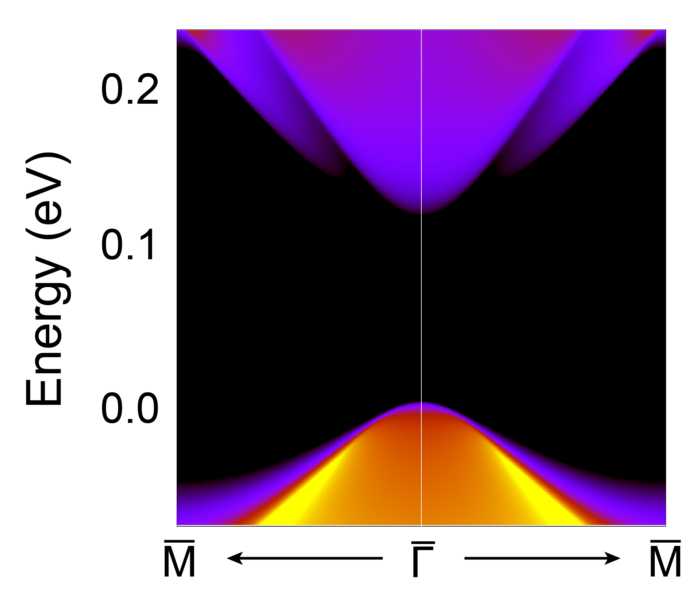
Is a topological phase transition expected in ultra-thin Na₃Bi?
DFT as a function of E⊥
Collins et al., arXiv:1805.08378

Slide 11
Key Questions
Is it possible to experimentally isolate ultra-thin Na₃Bi?
Is it a wide bandgap 2D topological or conventional insulator?
Can an electric field induce a topological phase transition?

Slide 12

Molecular Beam Epitaxy Growth of Na₃Bi
Growth
Na:Bi (10:1)
T_{Na}<T_{Substrate}<T_{Bi}
RHEED
LEED
Substrate
$$\overline{Γ}−\overline{K}$$
RHEED
RHEED
XPS
Turbo
Shutter
Bi
Na
Na₃Bi is free-standing on Si substrate

Slide 13
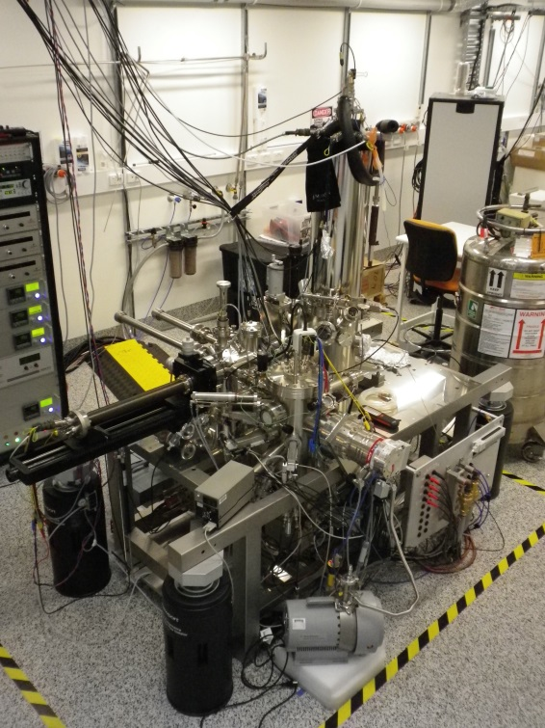
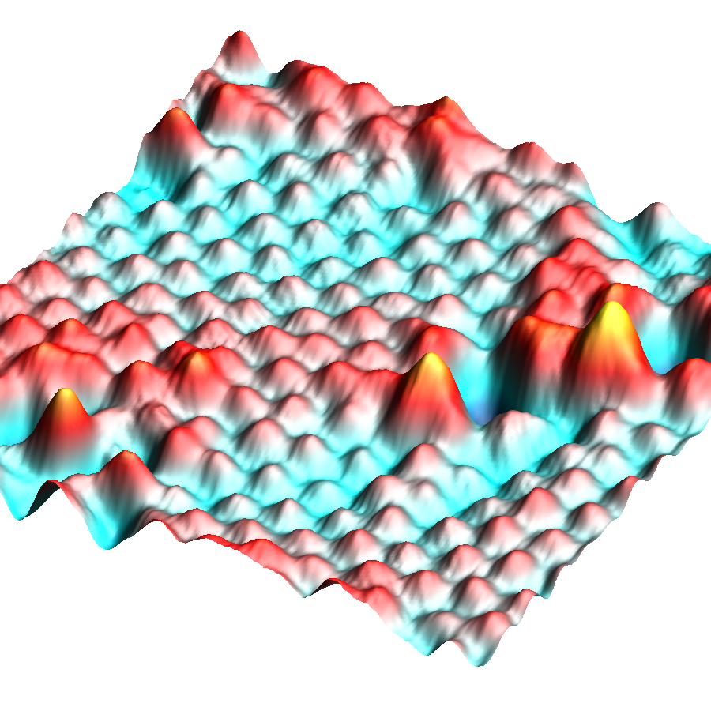

Scanning Tunnelling Microscopy and Spectroscopy
Visualizing Atomic Structure
Probing Local Density of States
y
x
Measure: I as function of V
I
Determine:
$$dI/dV∝ρ_{S}\left(E_{F}−eV\right)$$
V
e⁻
e⁻

Slide 14
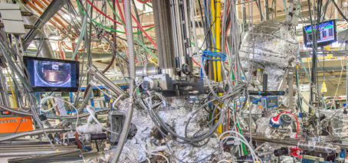


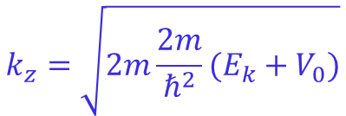
Angle-Resolved Photoelectron Spectroscopy
Advanced Light Source (Berkeley, USA)
Measure: E_{k} and θ
$$E_{B}=hv−E_{k}−Φ$$
Determine:
$$k_{||}=\sqrt{2mE_{k}}sinθ/ℏ$$
$$k_{z}=\sqrt{2m\frac{2m}{ℏ^{2}}(E_{k}+V_{0})}$$
(EDC’s as a function of hv)

Slide 15
Ultra-thin Na₃Bi: Opening a bandgap
Valence Band
Conduction Band
ML
BL
Experiment
GGA w/
Na(2) vacancy
GGA Pristine
70nm
Bandgap of ML and BL >300 meV; much greater than kT at room temp

Slide 16
Ultra-thin Na₃Bi: ARPES
DFT
ML
BL
No k_{z} dispersion – Electronically 2D
70nm

Slide 17
Key Questions
Is it possible to experimentally isolate ultra-thin Na₃Bi?
Is it a wide bandgap 2D topological or conventional insulator?
Can an electric field induce a topological phase transition?

Slide 18
Confirming Ultra-Thin Na₃Bi is a 2D Topological Insulator
Non-trivial 1D edge state, consistent with a 2D Topological Insulator

Slide 19
Key Questions
Is it possible to experimentally isolate ultra-thin Na₃Bi?
Is it a wide bandgap 2D topological or conventional insulator?
Can an electric field induce a topological phase transition?

Slide 20
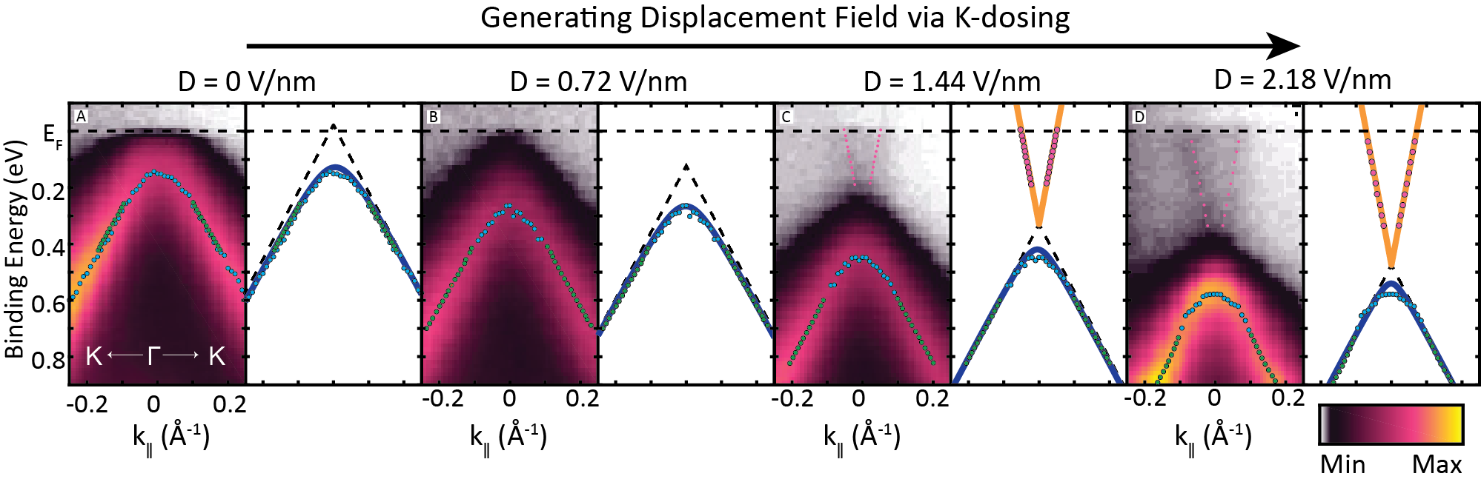
Electric Field: K Dosing
Exp. Model
Inferred
Bandgap (eV)
Gap is reduced with E-field
Does gap completely close or reopen?
Measured

Slide 21
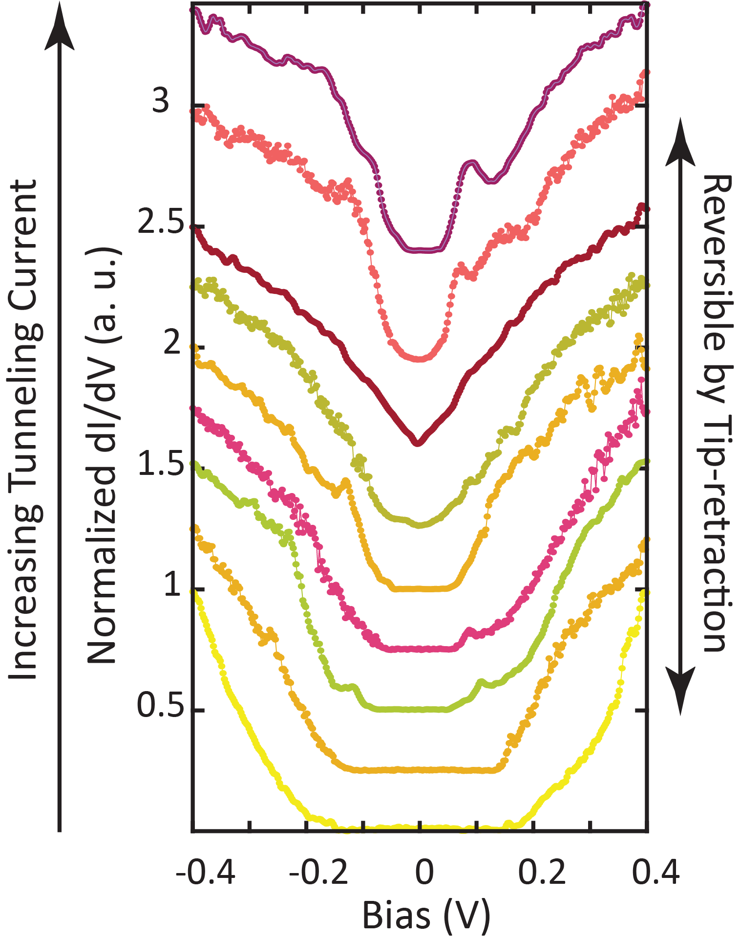
Electric Field: STM tip-sample distance
600 pA
1.02 nm (1.18 V/nm)
1.075 nm (1.12 V/nm)
Increasing Tunnelling Current
1.45 nm (0.828 V/nm)
10 pA

Slide 22
Electric field-tuned bandgap and topological transition
ML
BL

Slide 23
Conclusions
Large area epitaxial ultra-thin Na₃Bi with bulk bandgap >300 meV (2D Topological Insulator)
Electric field induced transition
Topological Insulator (>300 meV) Semi-metal Conventional Insulator (100 meV)
“Platform for a topological transistor”
Electric field-tuned topological phase transition in ultra-thin Na₃Bi: arXiv:1805.08378
Publications on thin film Na₃Bi
Growth of Na₃Bi: Hellerstedt, et al., Nano Letters 16, 3210 (2016)
F4-TCNQ doping of Na₃Bi: Edmonds et al., ACS Appl. Mat. Int. 8, 16412 (2016)
Charge puddling in Na₃Bi: Edmonds et al., Science Advances 3, eaao6661 (2017)
Gating Na₃Bi on SiO₂: Hellerstedt et al., PRMaterials 1, 054203 (2017)
Temperature-dependent n-to-p transition: Liu et al., PRB 96, 235412 (2017)
PhD and Postdoc positions available
contact mark.edmonds@monash.edu

Slide 24
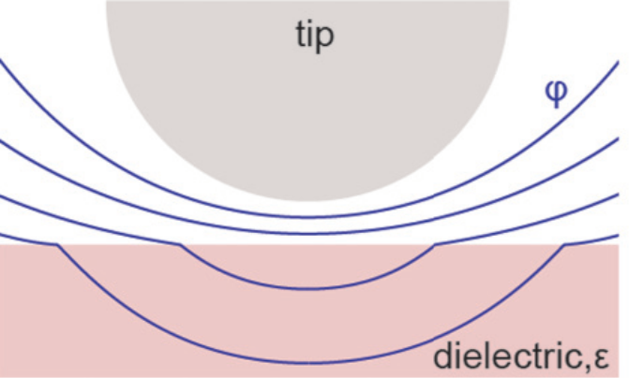
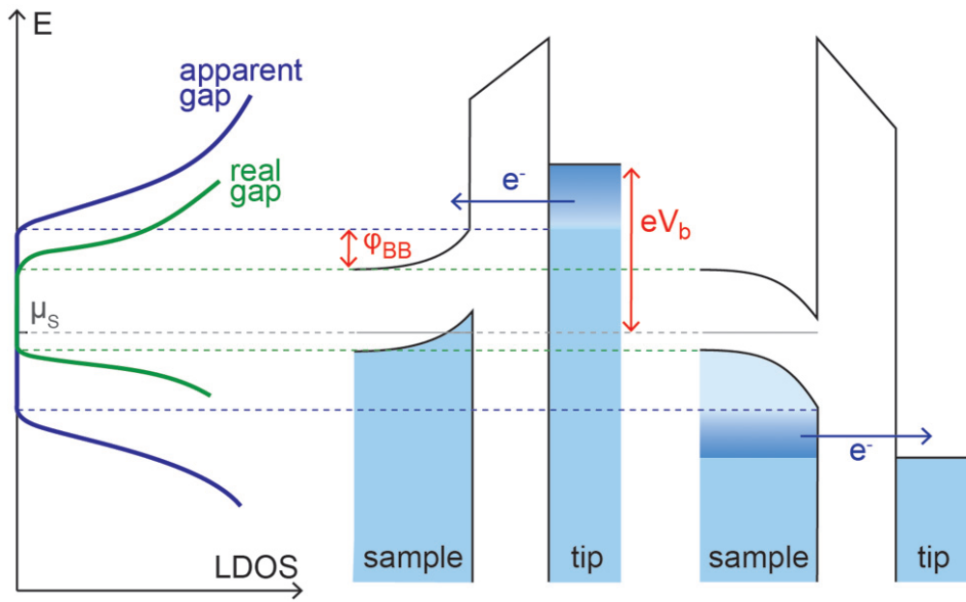
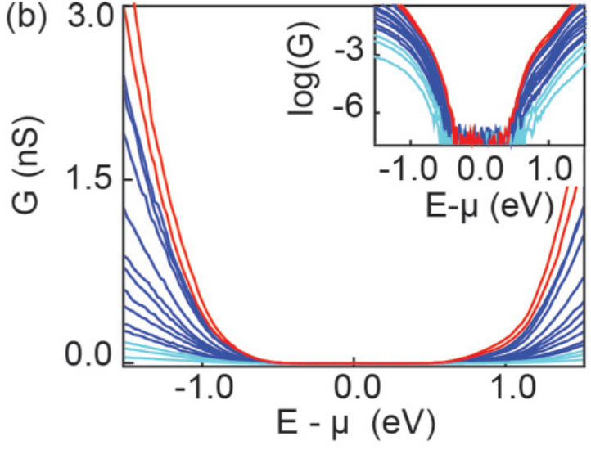
Gap closing not explained by tip induced band bending
Electric field in poorly screened electronic materials (i.e. low-doped semiconductors) can penetrate sample
TIBB observed on (Sr1−xLax )2IrO4
Battisti et al., PRB 95, 235141 (2017)

Slide 25


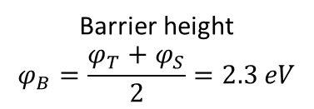
Converting tunnelling current into tip-sample distance (electric field)
x
I
ln(I) vs z (Linear)
s
V
e⁻
e⁻
Non-linear
(Mirror Potential)
Measure relative changes in height
Barrier height
$$φ_{B}=\frac{φ_{T}+φ_{S}}{2}=2.3 eV$$
Determine absolute distance, s (Point contact & Mirror Potential)
Determine potential difference, Δϕ (Tip & Sample Work function)
$φ_{S}=1.7 eV$ (Kelvin Probe)
$$φ_{T}=2.9 eV$$

Slide 26
Electric Field: STM tip-sample distance
), 1.075 nm (1.12 V/nm), and 1.02 nm (1.18 V/nm)
1.02 nm (1.18 V/nm)
1.075 nm (1.12 V/nm)
1.45 nm (0.828 V/nm)

