Slide 1
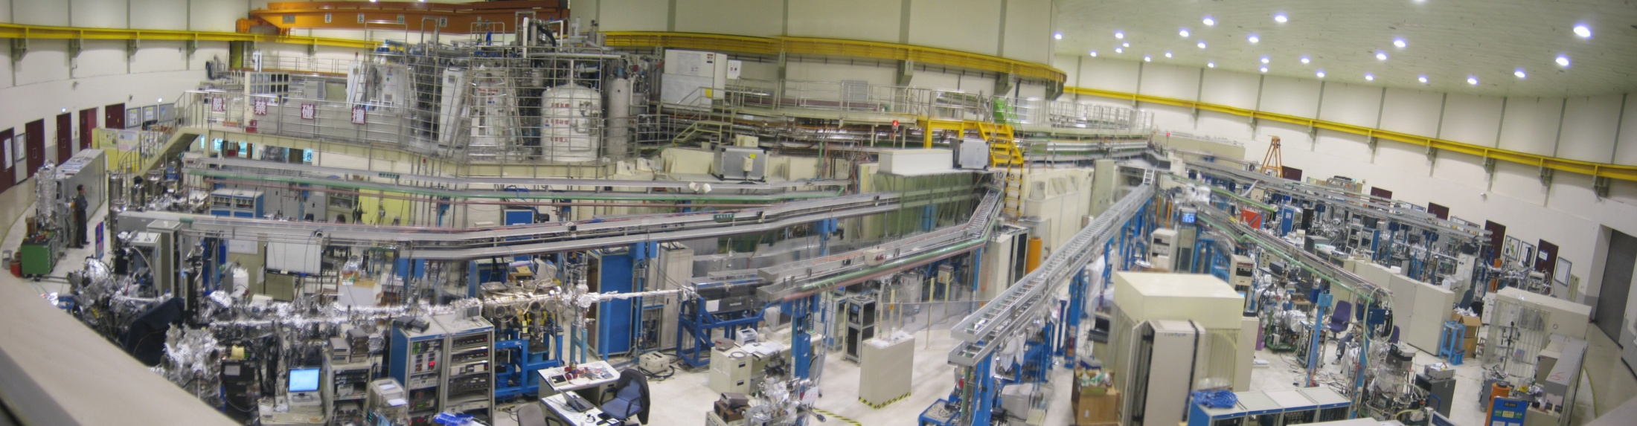
Sulfides, Surfaces and Synchrotrons
A/Prof Sarah Harmer
Institute for Nanoscale Science and Technology
College of Science and Engineering
NSRRC

Slide 2
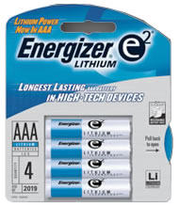
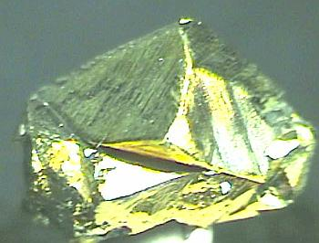
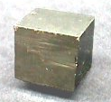
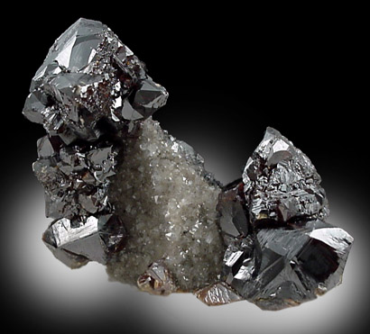

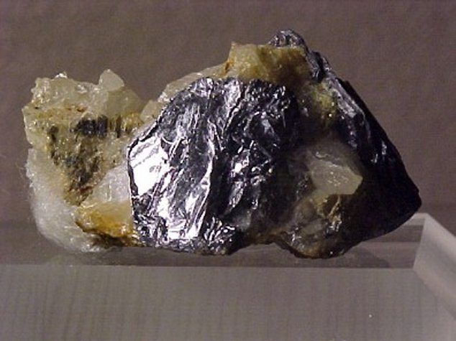
Transition Metal Sulfides
Chalcopyrite, CuFeS₂
Molybdenite is used as a
dry lubricant
Pyrite
FeS₂
Li/FeS₂ low T batteries
Sphalerite,
(Zn,Fe)S
Molybdenite, MoS₂

Slide 3
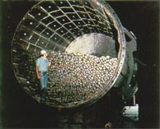
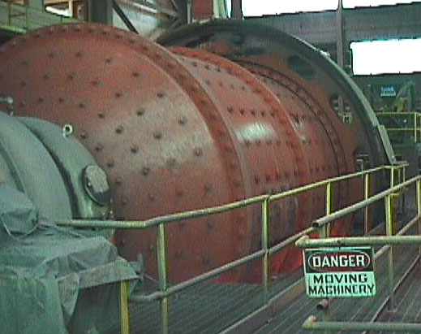
Extraction of Metals from Sulfide Ores
Grinding
Production of fractured & cleaved surfaces
Exposure to air, water, activators
Flotation
Exposure of fracture surfaces to water, collectors, depressants, activators and foaming agents.
Roasting & Smelting Or Heap Leaching
Low grade ores
Electrowinning

Slide 4
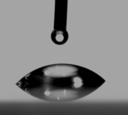
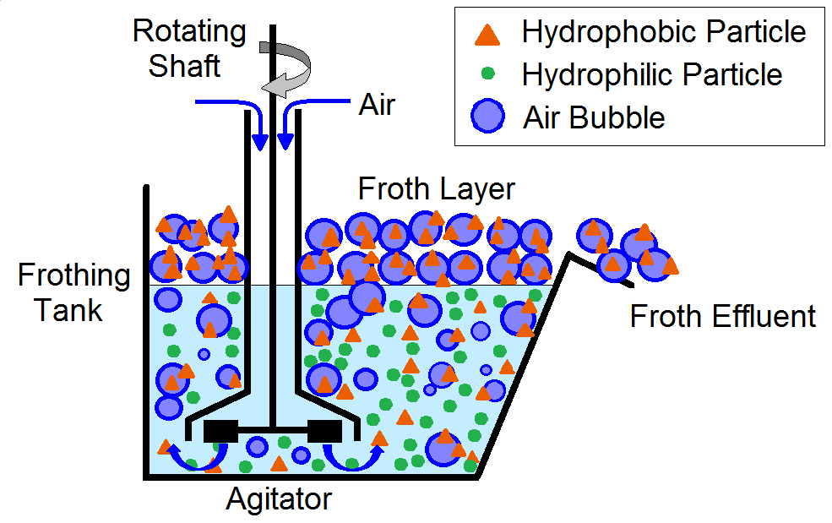
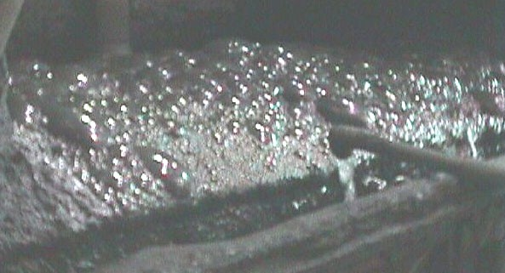
Extraction of Metals from Sulfide Ores
Grinding
Production of fractured surfaces
Exposure to air, water, activators
Flotation
Exposure of fracture surfaces to water, collectors, depressants, activators and foaming agents.
Roasting & Smelting Or Heap Leaching
Low grade ores
Electrowinning

Slide 5
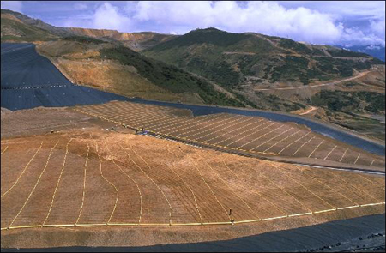
Extraction of Metals from Sulfide Ores
Grinding
Production of fractured surfaces
Exposure to air, water, activators
Flotation
Exposure of fracture surfaces to water, collectors, depressants, activators and foaming agents.
Roasting & Smelting Or Heap Leaching
Low grade ores
Electrowinning
Barrick's Pierina Mine in Peru

Slide 6
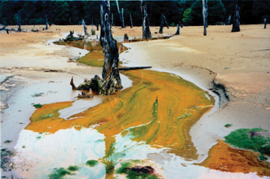
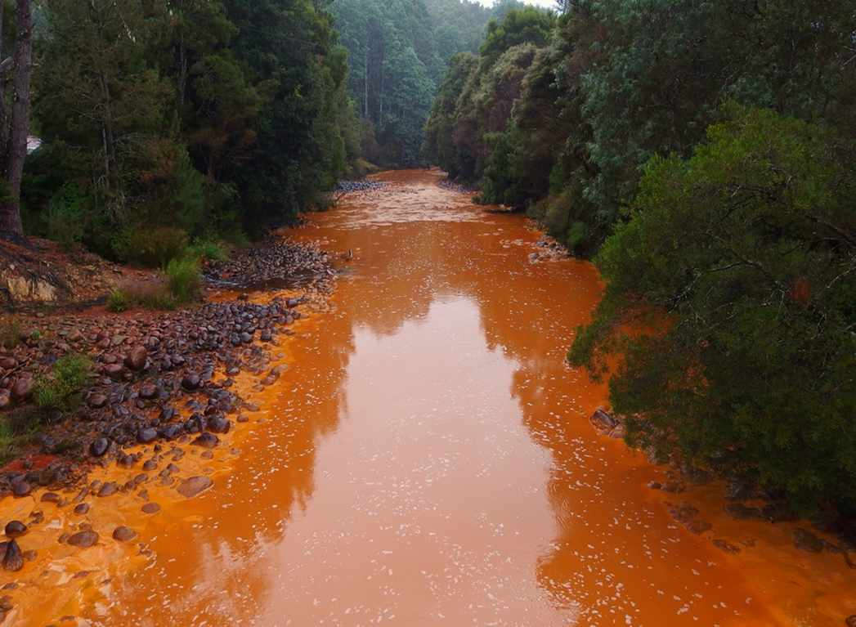
Extraction of Metals from Sulfide Ores
Grinding
Production of fractured surfaces
Exposure to air, water, activators
Flotation
Exposure of fracture surfaces to water, collectors, depressants, activators and foaming agents.
Roasting & Smelting Or Heap Leaching
Low grade ores
Electrowinning
Mt Lyell and Queens river, Tasmania

Slide 7
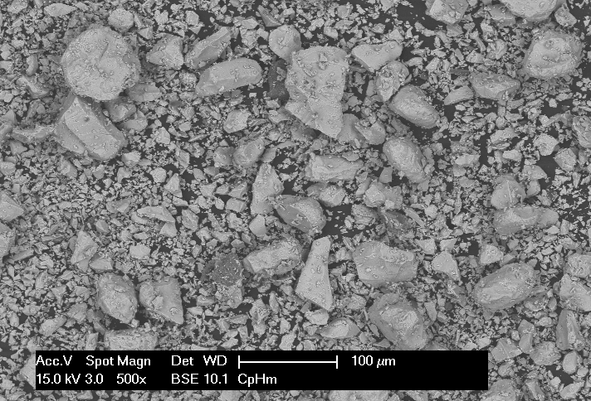
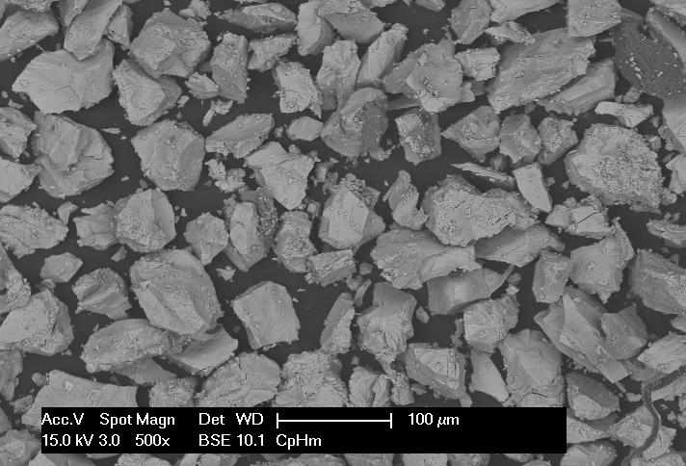
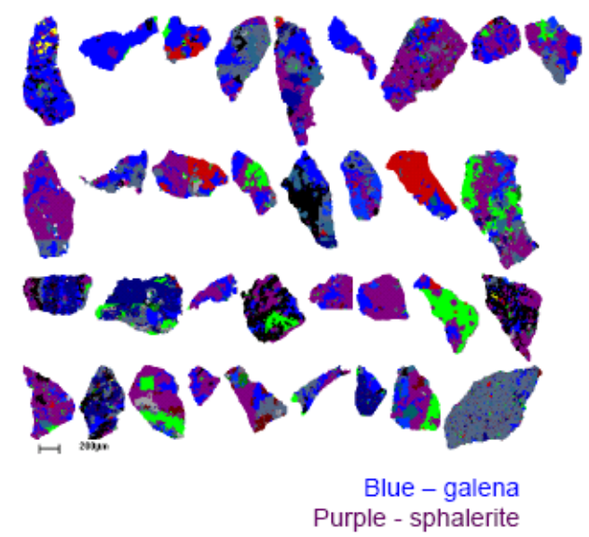
The Challenge
Minerals are inherently heterogeneous, impacting their wettability, processing and separation
Impact
Compression
Examples:
Composite Minerals
  Incomplete liberation
  Reactions with liberated minerals, i.e Cu Activation
  Regions of differing chemistry
  Texture
  Particle shape
Galvanic mineral-mineral interactions
  Change oxidation and dissolution
  processes
Locking of particles
T.G. Vizcarra, S.L. Harmer, E.M. Wightman, N.W. Johnson, E.V. Manlapig (2011). Minerals Engineering, 24(8), 807-816.

Slide 8
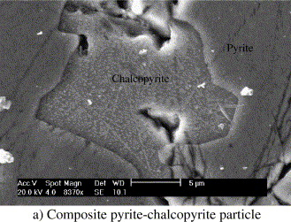
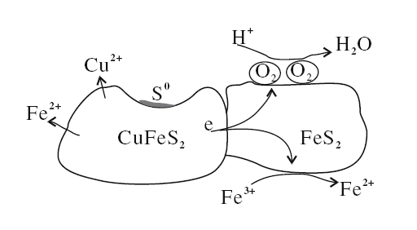
The Challenge
Minerals are inherently heterogeneous, impacting their wettability, processing and separation
Galvanic Interactions
Examples:
Composite Minerals
  Incomplete liberation
  Reactions with liberated minerals, i.e Cu Activation
  Regions of differing chemistry
  Texture
  Particle shape
Galvanic mineral-mineral interactions
  Change oxidation and dissolution processes
Pyrite
Chalcopyrite
Al-Harahshesh et al. Int. J. Min Proc. 2006, 80, p 205
Liu Qing You, Environmental Geology, 2007, 52, p11

Slide 9
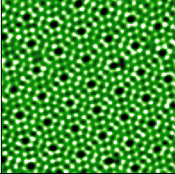
Surface Analytical Techniques
Low Energy Electron Diffraction (LEED)
Low Energy Ion Scattering (LEIS)
Scanning Tunneling Microscopy (STM)
Atomic Force Microscopy (AFM)
Photoemission Spectroscopy & X-ray Absorption Spectroscopy
Time of flight Secondary Ion Mass Spectrometry (ToF-SIMS)
nano-Secondary Ion Mass Spectrometry (nanoSIMS)
Si (111) 7x7 reconstruction

Slide 10
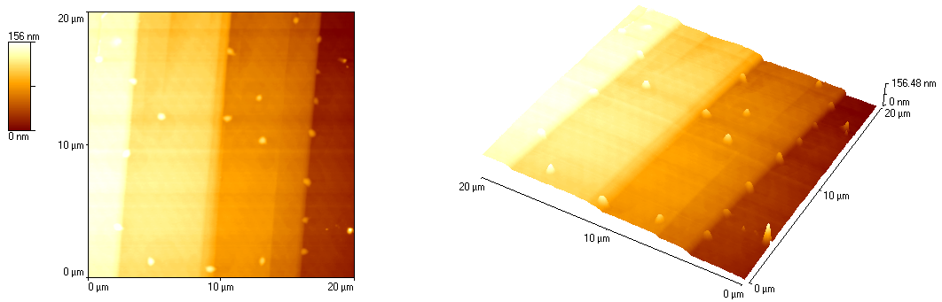
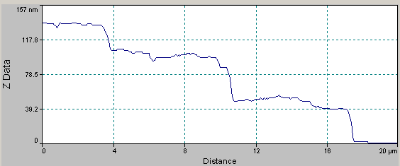
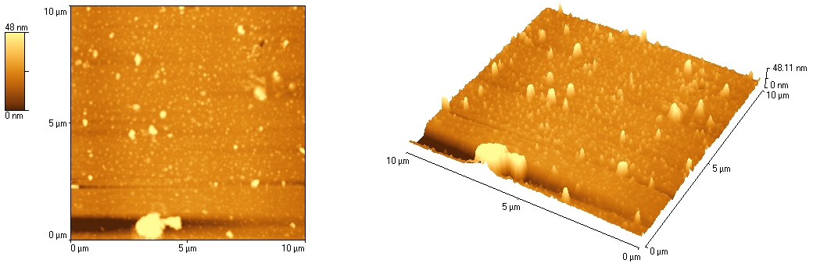
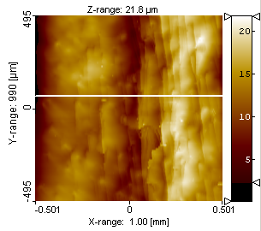
Fractured and Cleaved Mineral Surfaces
ZnS (110)
Cleavage
ZnS (110)
CuFeS₂
Fracture
CuFeS₂

Slide 11
God made solids, but surfaces are the work of the devil
Wolfgang Pauli
Surfaces are the playgrounds for
solid state physics
E.W. Plummer

Slide 12
Surface Analytical Techniques
Photoemission Spectroscopy & X-ray Absorption Spectroscopy
Photoemission Electron Microscopy (PEEM)
Scanning Photoemision Electron Microscopy (SPEM)
Scanning Transmission X-ray Microscopy (STXM)
Coherent Diffraction Imaging (CDI)
Time of flight Secondary Ion Mass Spectrometry (ToF-SIMS)
nano-Secondary Ion Mass Spectrometry (nanoSIMS)
IR Micro
STXM
Raman Micro
PEEM
XPS
XFM
Chemical Sensitivity
Nano
SIMS
SEM
Light Micro
TEM
SPM
1000
100
10
1
0.1
Spatial Resolution (nm)

Slide 13
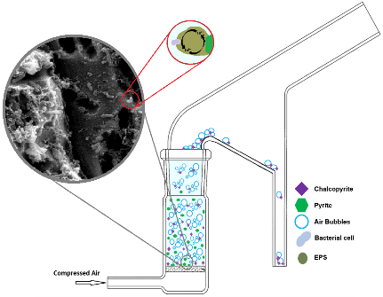
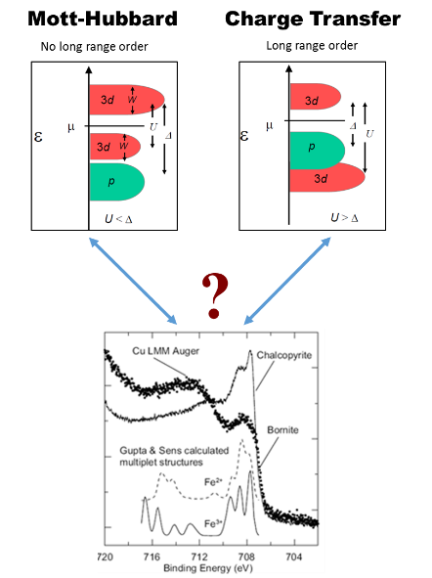
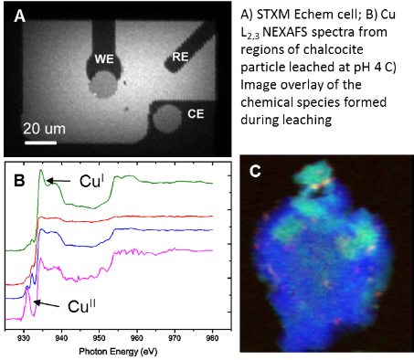
Fundamental Supports the Applied
Bio-flotation: A Green Mining process
Electronic Structure of 3d Transition Metal Compounds
*
Development & Application of in situ Microspectroscopic Analysis of Materials using Synchrotron Radiation
*K. Sato, Y. Harada, M.Taguchi, S. Shin, and A.Fujimori ICTMC16 Berlin 2008

Slide 14
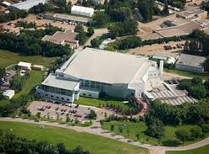
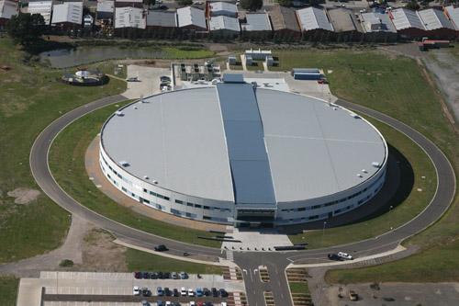
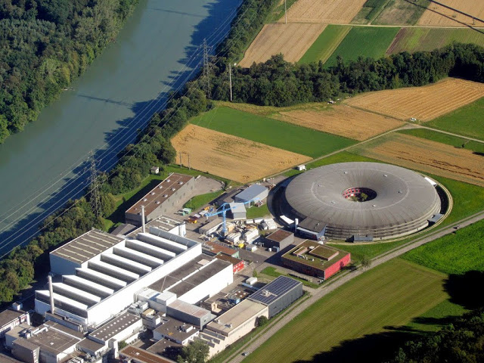

Synchrotrons
SLS
CLS
Australian
Synchrotron
NSRRC

Slide 15
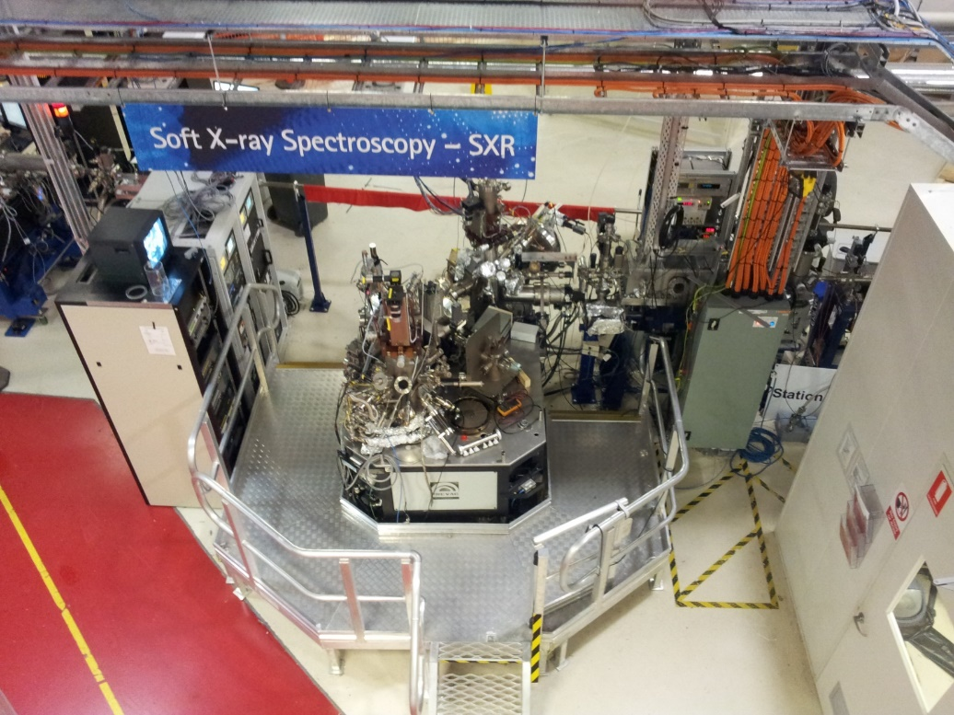
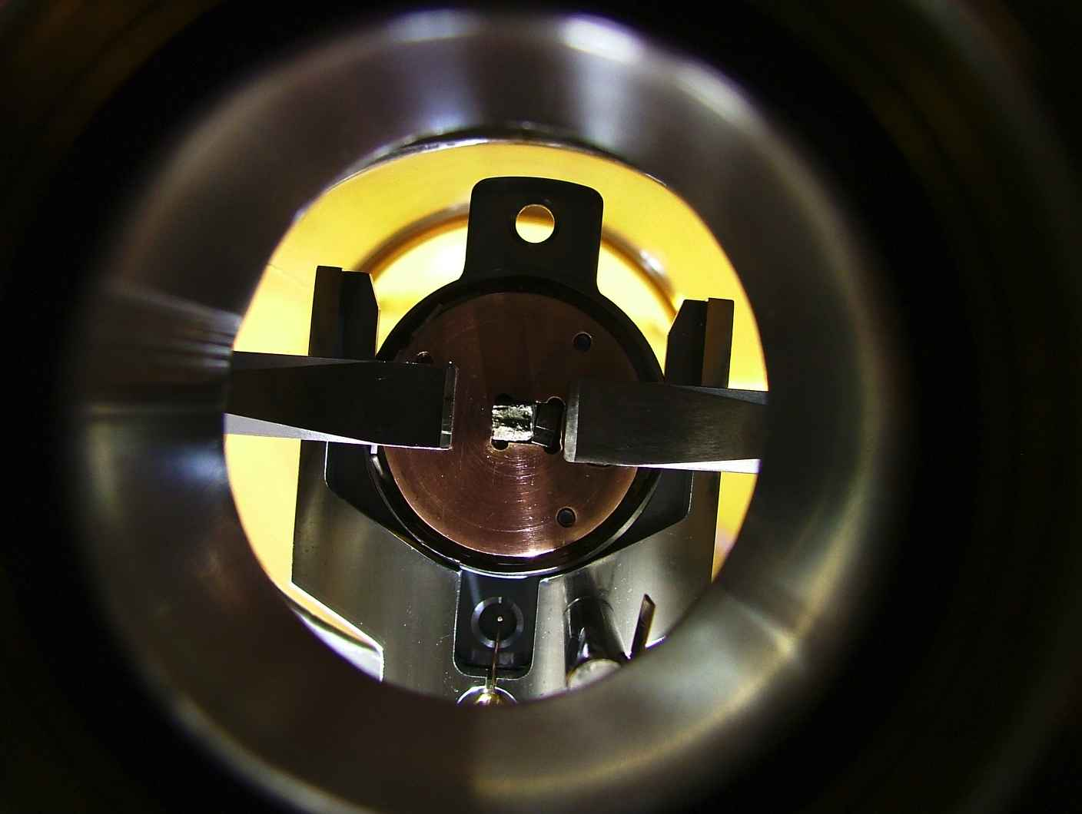
XPS and NEXAFS @ the AS
90-2600eV photon source
Beamline energy resolution of less than 0.1 eV across 3d transition metal 2p lines
Linear and circular polarization
In situ fracture and dosing
UHV Fracture Chamber
Notes:
This is the ASRP endstation currently ** in Taiwan. Its capable of both XAS and XPS, it has pre chamber for deposition **** that should be fited with a LEED system in the not to distant future.
It has a cnetral exchange chamber UFO, with load lock, magazine for storage and an UHV fracture chamber for sample prep. The analystical chamber is fitted with a flood gun Al x-ray gun and e analysers.
This equipmetn was used to study sphalerite

Slide 16
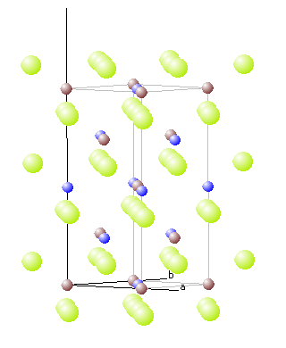
Chalcopyrite, CuFeS₂
Chalcopyrite is the most common & widespread Cu containing mineral found in sulfide deposits.
Structure: chalcopyrite
Unit cell: tetragonal
Bond lengths: Cu-S: 2.302 Å
Fe-S: 2.2566 Å
Bonding: Covalent
Band gap: 0.6 eV (semiconductor)
Local magnetic moment: 3.85 µ_{B}
Cleavage: Poor along (012) & (11-2)
Fracture: Conchoidal
Non-polar
Polar
(012)
(11-2)
Harmer, S.L., Pratt, A.R., Nesbitt, H.W. and Fleet, M.E. (2004) American Mineralogist, 89 (7), 1026.
G.Donnay, L.M. Corliss, J.D.H. Donnay, N. Elliot and J.M. Hastings: Phys. Rev. 112 (1958) 1917.

Slide 17
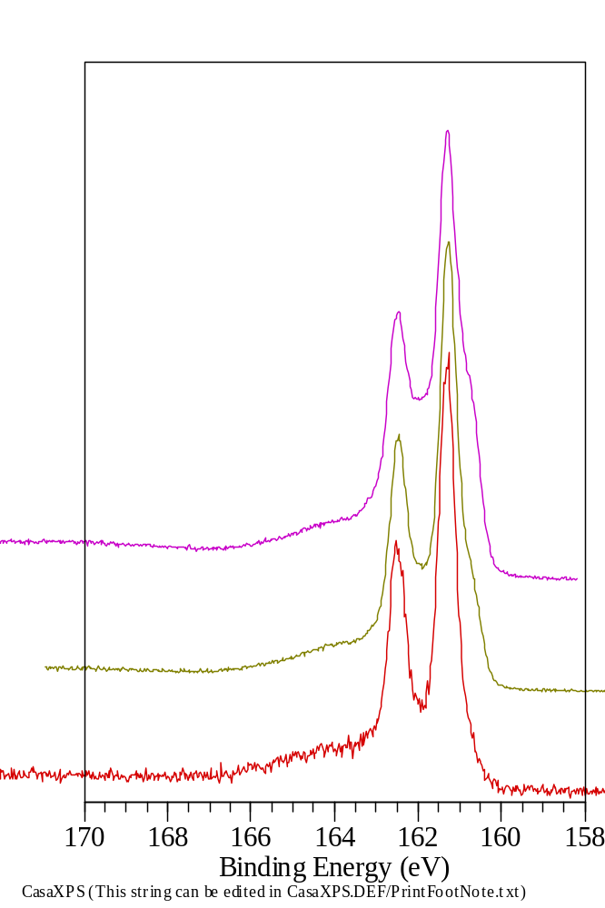
S 2p SXPS spectra from UHV fractured CuFeS₂
S 2p
CuFeS₂
Surface core level shift formed as a result of fracture
Surface reconstruction to form S dimers
High binding energy tail resulting from ligand to metal charge transfer S 3p - Fe 3d
260 eV
400 eV
810 eV

Slide 18
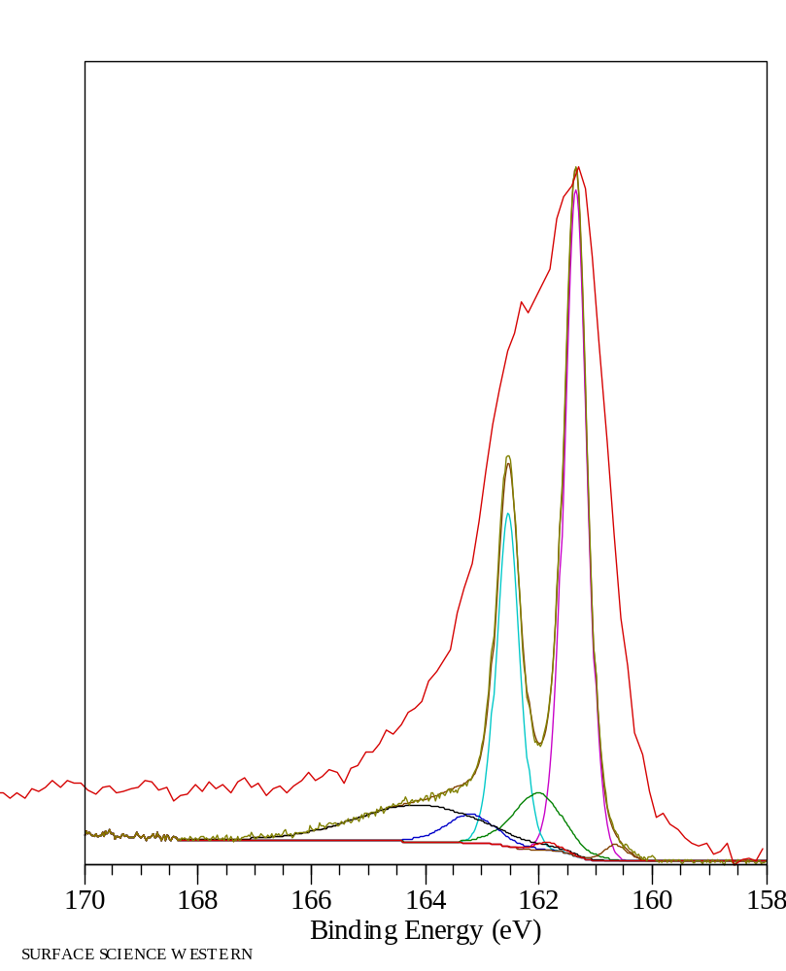
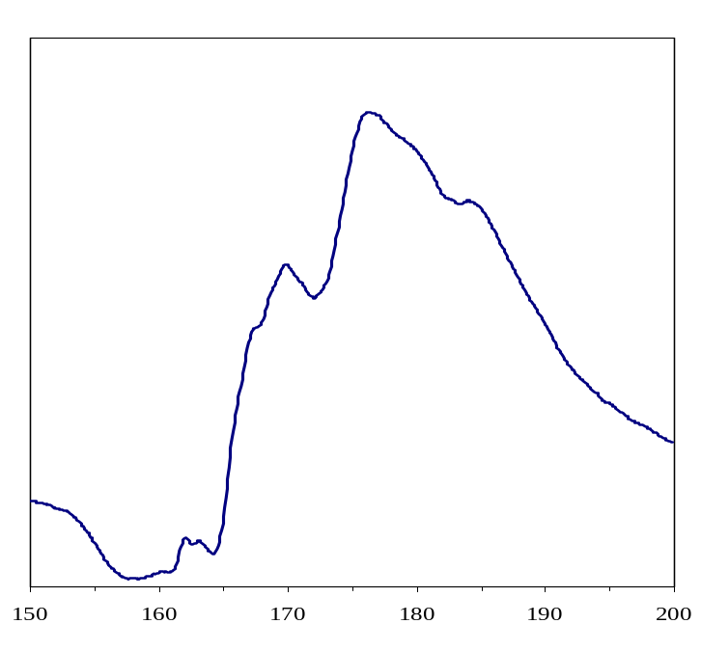
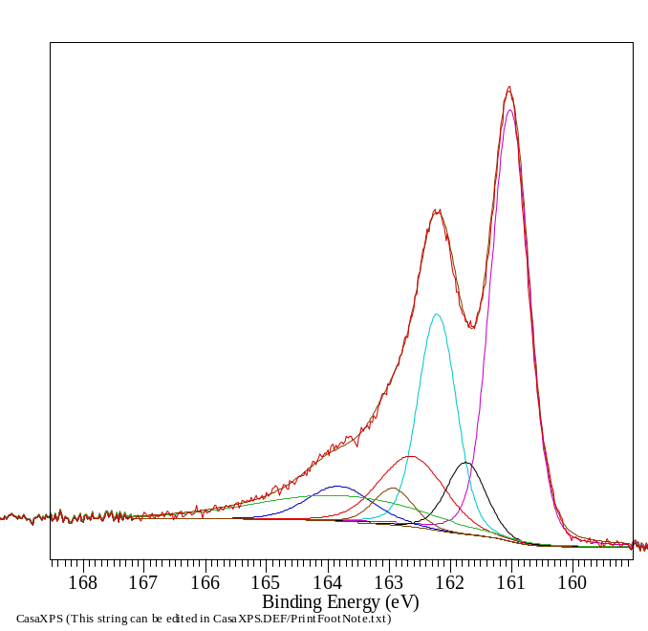
S 2p XPS spectra of Chalcopyrite
Tail locked to bulk S²⁻
S 2p
NEXAFS S L_{2,3}
1hr
pH 4
0.1M KNO3
S 3p → Fe 3d

Slide 19
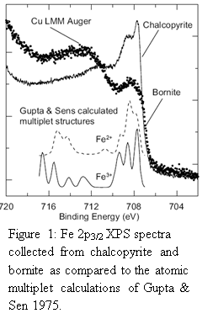
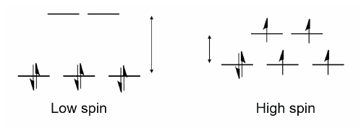
XPS of High Spin Transition Metal 2p lines
Chalcopyrite (CuFeS₂), Fe^{III} in tetrahedral co-ordination
Bornite (Cu₅FeS₄), Fe^{III} in tetrahedral and trigonal co-ordination
Accurate fits of the XPS Fe 2p cannot be determined without SRXPS.
Gupta and Sen’s multiplet splitting calculations considered free ions

Slide 20
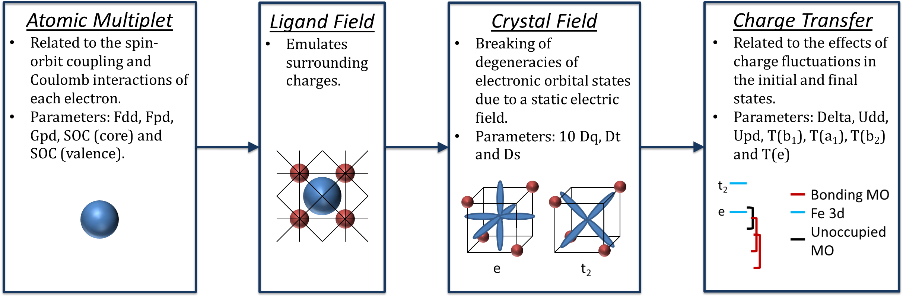
TT-Mulitplets: Multiconfigurational Self-consistent Field

Slide 21
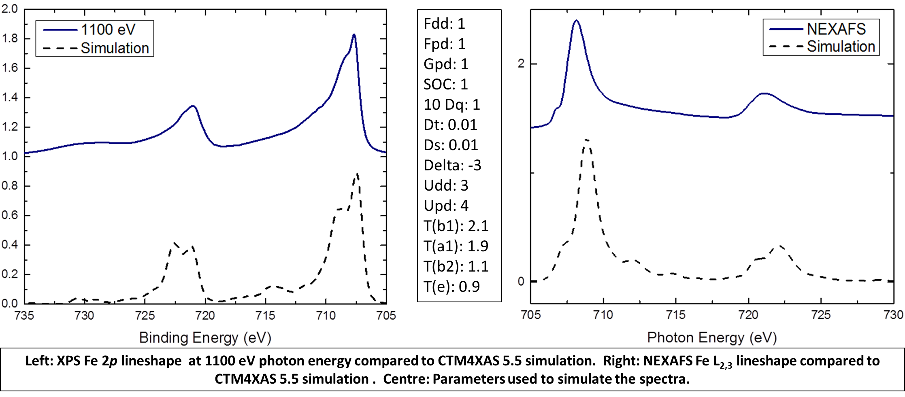
Chalcopyrite Fe 2p and L_{2,3}
Tetrahedral
Slater Integral Reduction | Spin Orbit Coupling | Crystal Field Parameter (10 Dq) (eV) | Charge Transfer Parameters (eV) |  |  |  |  | Lorentzian Broadening | Guassian Broadening
 |  |  | Delta | Udd | Upd | T(eg) | T(t2g)
0.7 | 1 | -1.4 | -4 | 3 | 4 | 1 | 2 | 0.2 | 0.3

Slide 22
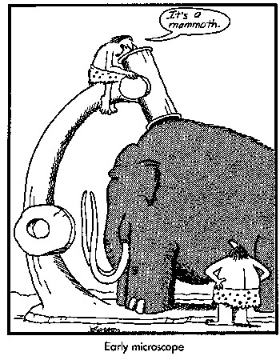
Nano-Spectroscopy
Scanning Photoemission Spectroscopy (SPEM)
Photoemission Electron Microscopy (PEEM)
Scanning Transmission
X-ray Microscopy (STXM)

Slide 23
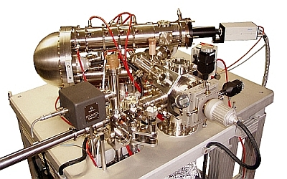
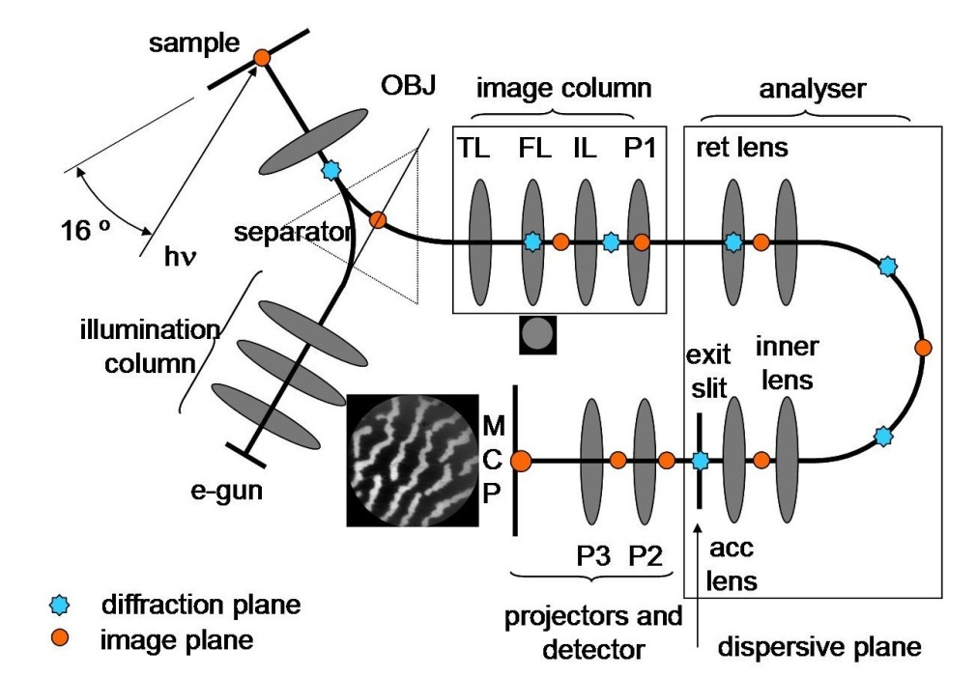
XPEEM
X-ray Photoemission Electron Microscopy
  micro XPS
Photoemission Electron Microscopy (10 nm)
  micro XAS
  magnetic linear and circular dichroism
Low Energy Electron Microscopy (< 5nm spatial resolution)
Micro Low Energy Electron Diffraction
Micro Photoelectron Diffraction
Auger Emission Electron Microscopy

Slide 24
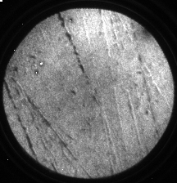
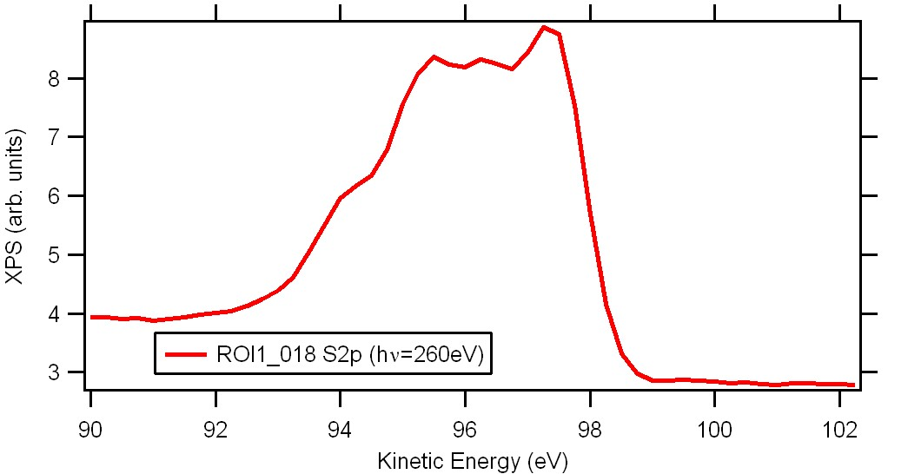
Leached Chalcopyrite
A polished sample of chalcopyrite was leached at pH 1 for 0-30 mins and analysed
using XPEEM.
S 2p fov =10mm

Slide 25
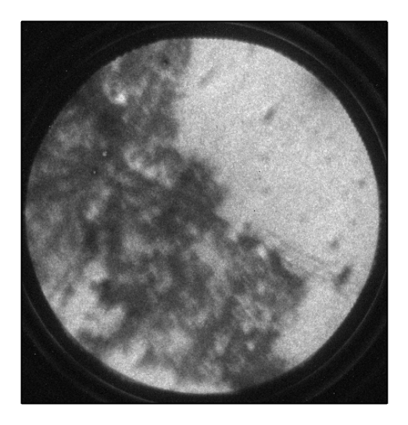
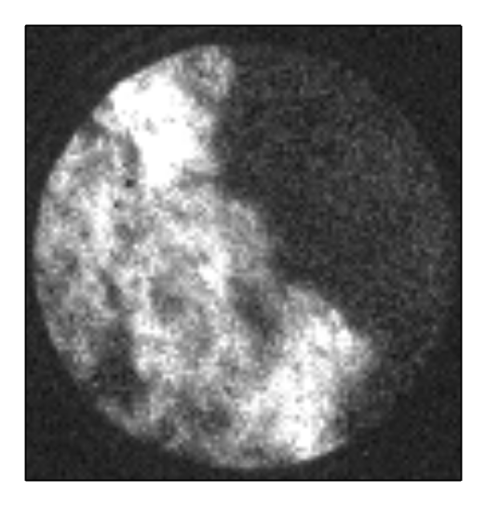
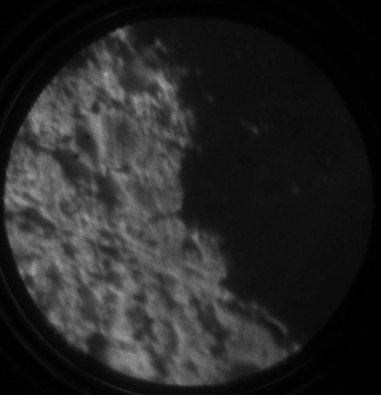
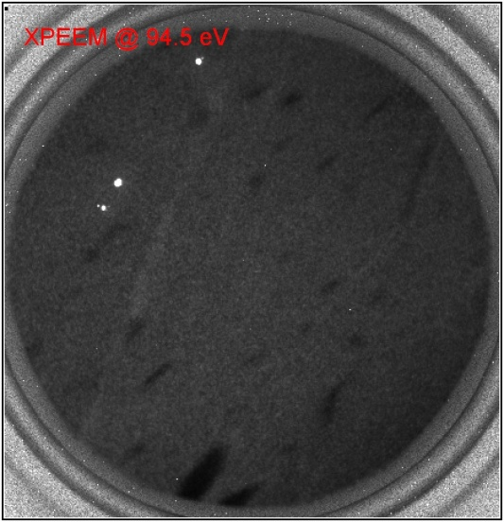
Leached Chalcopyrite (CuFeS₂) in contact with Covellite (CuS)
140
Fe L_{2,3}
600
600
120
Intensity
500
500
400
100
400
300
80
300
200
200
60
100
90
92
94
96
98
100
102
100
706
716
726
Kinetic energy (eV)
700
710
720
Photon energy (eV)
S_{n}
S_{n}
O
Fe^{III}
CuFeS₂ Leached at pH 1 30 min
CuFeS₂ (left) in contact with CuS (right)
Leached at pH 1 for 30 min

Slide 26




Analysis of mixed sulphide samples using PEEM
FOV 450μm

Slide 27


Analysis of mixed sulphide samples using PEEM
Chalcopyrite,
CuFeS₂
Hematite,
Fe₂O₃
Pyrite,
FeS₂

Slide 28


Scanning Transmission X-ray Microscopy (STXM)
X-rays focused using zone plate optics. The sample is rastered at the focus and the transmitted intensity is measured.
Chemical/elemental information is obtained by determining the X-ray absorption by the sample (NEXAFS). Spatial resolution limit of 20nm.
NEXAFS spectra a fixed positions or single image at fixed energy
Samples must be transparent to X-rays energies of interest

Slide 29





In situ Electrochemical Cell for STXM

Slide 30





In situ Electrochemical Cell
24 micron
16 micron

Slide 31






Cu(I)
Cu(0)
Cu(II)

Slide 32



Wet or Dry: does it make a difference to surface chemistry?
Sample Preparation
Samples must be thin enough to allow transmission of X-rays at the desired energy.
50-300 nm for Carbon K edge
Up to 1 µm for Copper L edge
Liquid samples are fixed
between two windows which
are sealed with epoxy resin.
Right: An image of chalcocite in a liquid cell taken at the copper edge. Dark blotches indicate leaching of copper from larger particles.
Middle: Two SiN₂ windows are used to hold a liquid sample.
Left: A sample is attached to the holder inside the endstation.

Slide 33


Slide 35


Chalcocite, pH 4 H₂SO₄ – wet sample
Djurleite – Cu₃₁S₁₆
– Cu⁺₆₀Cu²⁺₂S²⁻₃₂
Fuerstenau, M. C., Jameson, G. J., & Yoon, R.-H. (2007). Froth flotation: a century of innovation: Society for Mining, Mettalurgy, and Exploration. pp 251

Slide 36

Results: Chalcocite + pH 4 H₂SO₄ – wet sample
Fitted 3D image with 4 spectra:
  Chalcocite, Cu₂S
  Djurleite, Cu₃₁S₁₆
  Cu(I) pre-edge feature
  Cu(II)-oxide
Blue = Chalcocite + pre-edge
Green = Djurleite
Red = Cu(II)-oxide

Slide 37
Conclusions
STXM has allowed us to identify the fine structure of Cu(II) peak which is otherwise elusive due to finite resolution
Fitting with a linear combination of spectra extracted from 3D images shows the distribution of species
The pre-edge feature is clearly Cu(I) sulfide – evident due to the energy and relative intensity of the peak
The change in relative intensity of the pre-edge peak is most likely from distortions in spectra caused by sample thickness
There is evidence of djurleite (Cu₃₁S₁₆) in the chalcocite sample in solution, but not in the dry sample

Slide 38

Minerals Processing
Bio-flotation is a ‘green’ alternative
Bacterial cells and extracellular polymeric substances (EPS) used to modify surface chemistry of minerals
  Direct contact
  Indirect contact
  Indirect non-contact
Bacterial Extracellular Polymeric
Substances play a vital role in surface modification
μ-Froth Flotation
Hydrophobic Particles
Hydrophilic Particles
Air Bubbles
Bacterial cell

Slide 39

Leptospirillum Ferrooxidans
Spiral shaped with 0.3-0.5microns in width and 0.9-3microns in length
Chemolithoautotroph
Acidophilic
Found deep underground at
mine sites
Contributes to acid mine drainage
Oxidation of Iron in aerobic conditions
https://sites.google.com/site/fmssgrade12biology/use-of-microbes-in-metal-ores
Coram, N. J. and D. E. Rawlings (2002). Applied and Environmental Microbiology 68(2): 838-845.
Vilinska, A. and K. H. Rao (2008Transactions of Nonferrous Metals Society of China 18(6): 1403-1409
Notes:
Aerobic Iron-oxidising bacteria which can convert metals into a soluble form.
Have been found to be the primary iron-oxidizers in industrial continuous – flow biooxidation tanks. They are the dominating bacteria in biooxidation field as the high ferric-ferrous iron ratio does not inhibit the species.
Important contributors in acid mine drainage.
Gram negative and spiral shaped with 0.3-0.5 microns in width and 0.9-3.0 microns in length.
Chemolithautotrophic: this means that the bacteria are microbes that utilize chemicals (chemo) from the bedrock (litho) as an energy source for making their own (auto) food (trouph).
Carbon fixing through ferrous iron as their electron donor and oxygen as the electron acceptor. This makes them metabotically restricted.
Found deep underground in the mines enveloped in a pink biofilm which then floats on the surface of the flowing water through the mine.
Coram, Nicolette J. Molecular Relationship between Two Groups of the Genus Leptospirillum and the Finding that Leptospirillum ferriplium sp. nov. Dominates South African Commercial Biooxidation Tanks That Operate at 40ºC. Applied and Environmental Microbiology vol 68(2) February 2002. 838-845.
L.F can be selectivly attached to sulphides, esentually modifying the surface of the mineral.
Does not oxidize sulphur. Vilinska, A. and K. H. Rao (2008). "< i> Leptosririllum ferrooxidans</i>-sulfide mineral interactions with reference to bioflotation nad bioflocculation." Transactions of Nonferrous Metals Society of China 18(6): 1403-1409.
Life cycle and iron cycle in soil??

Slide 40

Leptospirillum Ferrooxidans
Spiral shaped with 0.3-0.5microns in width and 0.9-3microns in length
Chemolithoautotroph
Acidophilic
Found deep underground at
mine sites
Contributes to acid mine drainage
Oxidation of Iron in aerobic conditions
4
5
3
1
2
https://sites.google.com/site/fmssgrade12biology/use-of-microbes-in-metal-ores
Coram, N. J. and D. E. Rawlings (2002). Applied and Environmental Microbiology 68(2): 838-845.
Vilinska, A. and K. H. Rao (2008Transactions of Nonferrous Metals Society of China 18(6): 1403-1409
Notes:
Aerobic Iron-oxidising bacteria which can convert metals into a soluble form.
Have been found to be the primary iron-oxidizers in industrial continuous – flow biooxidation tanks. They are the dominating bacteria in biooxidation field as the high ferric-ferrous iron ratio does not inhibit the species.
Important contributors in acid mine drainage.
Gram negative and spiral shaped with 0.3-0.5 microns in width and 0.9-3.0 microns in length.
Chemolithautotrophic: this means that the bacteria are microbes that utilize chemicals (chemo) from the bedrock (litho) as an energy source for making their own (auto) food (trouph).
Carbon fixing through ferrous iron as their electron donor and oxygen as the electron acceptor. This makes them metabotically restricted.
Found deep underground in the mines enveloped in a pink biofilm which then floats on the surface of the flowing water through the mine.
Coram, Nicolette J. Molecular Relationship between Two Groups of the Genus Leptospirillum and the Finding that Leptospirillum ferriplium sp. nov. Dominates South African Commercial Biooxidation Tanks That Operate at 40ºC. Applied and Environmental Microbiology vol 68(2) February 2002. 838-845.
L.F can be selectivly attached to sulphides, esentually modifying the surface of the mineral.
Does not oxidize sulphur. Vilinska, A. and K. H. Rao (2008). "< i> Leptosririllum ferrooxidans</i>-sulfide mineral interactions with reference to bioflotation nad bioflocculation." Transactions of Nonferrous Metals Society of China 18(6): 1403-1409.
Life cycle and iron cycle in soil??

Slide 41
Extracellular Polymeric Substances
Attachment can assist with dissolution of metals
EPS composition: Polysaccharides, Proteins, Free fatty acids
  complex to form biofilm
  influenced by growth conditions
Proteins increase hydrophobicity
Polysaccharides decrease hydrophobicity, with potential of selectivity
Biofilm formation from Leptospirillum ferrooxidans on Chalcopyrite
Dwyer, R., et. al (2012) Mineral Processing and Extractive Metallurgy
Govender, Y. & Gericke, M. Minerals Engineering 2011, 24, 1122-1127.
Liu, Q.et. al (2000) International Journal of Mineral Processing
Subramanian, S. et. al (2003) International Journal of Mineral Processing

Slide 42

Interaction between Leptospirillum ferrooxidans and
CuFeS₂ and FeS₂
A
B
L.f attachment at 48 Hr to Chalcopyrite (A) and Pyrite (B)
Attachment Summary
L.f selectively attaches to pyrite
Selective attachment from 0 – 168 Hrs
EPS/biofilm formation at 48 Hrs
Flotation Summary
Cells with PIPX collector
EPS supernatant at 48 and 72 hours
Belinda Bleeze, Jing Zhao and Sarah L. Harmer (2018) Selective Attachment of Leptospirillum Ferrooxidans for Separation of Chalcopyrite and Pyrite through Bio-Flotation, Minerals, 8, 86.

Slide 43





XPEEM Iron L_{2,3} NEXAFS
HH Media 48 Hr
EPS – fresh 48 Hr
EPS – 7 days
a
a
a
b
b
b
Peak | Energy | Functionality
a | 706.8 – 707.7 | Fe L₃: Transitions from Fe 2p to Fe 3d
b | 708 - 709 | Transitions from Fe 2p to: Fe 3d-S 3p hybridized states Fe oxides and hydroxides
c | 712 | Pyrite: transitions from Fe 2p to: Fe 4sp - S 3p ; and Fe 4p -S 3p hybridized states
Changes in the ratio of Fe (II): Fe (III) at different exposure times
Reasonable distribution of Fe (II)
Kalegowda, Y. et. al (2015), Surface Science
Acres, R. G., et. al (2010) Journal of synchrotron radiation

Slide 44





Copper NEXAFS
EPS – fresh 48 Hr
EPS – frozen 48 Hr
EPS – 72 Hr
a
a
b
b
b
HH Media – 48 Hr
b
Peak | Energy | Functionality
a | 930 – 931.2 | Cu (II) Cu (II) oxidation products (CuO)
b | 932.3 – 932.6 | Cu (I) in Cp, Cu L₃ in metallic standards
Copper (II) present in EPS at 48 Hrs
Distribution changes with exposure condition
Kalegowda, Y., et. al (2015) Surface Science Acres, R. G., et. al (2010) Journal of synchrotron radiation
Todd, E., et. al (2003) Geochimica et Cosmochimica Acta

Slide 45

Carbon K edge NEXAFS
EPS – frozen 48 hr
a
b
c
Increase of COOH (polysaccharides) over time
Peak | Energy | Functionality
a | 285 – 285.2 | Aromatic C-H or C=C
b | 287.3 – 287.5 | Aliphatic C
c | 288.4 – 288.8 | COOH carboxyl
Singh, B., et. al (2014) Organic Geochemistry Boese, J., et. al (1997) Journal of Electron Spectroscopy and Related Phenomena
Notes:
K edge comes from the s orbital, meaning there is no distinct directionality. This makes it possible to fit the spectra

Slide 46




In situ STXM analysis of L.f on pyrite
Liquid cell allows for C K edge NEXAFS analysis of hydrated EPS
30 μm
1 μm

Slide 47
Conclusions
Indirect – contact mechanism of attachment
  Irreversible attachment
  Presence of EPS
Iron, copper and oxygen NEXAFS all indicate the presence of metal oxides
Oxy-hydroxide formation in the absence of cells
EPS oxidises Fe^{II} to Fe³⁺ and removes it from the surface
EPS acts as a depressant and should be further investigated as a replacement for cyanide
Increasing presence of COOH and iron oxyhydroxides correlates the increased suppression of pyrite
Most changes/differences occur within 48 h
  early biofilm formation (attachment studies)
A
Bulk leaching solution
(O₂, Fe²⁺, Fe³⁺, SO₄²⁻)
Reaction Space
(EPS with complexed Fe³⁺ ions)
OM
PS
CM
Sulfur globuli
Fe
Bacterial cell
S₂O₃²⁻
Fe³⁺
Fe²⁺
Altered surface chemistry of mineral

Slide 48







Acknowledgements
Connor Retallick
Zoe Pettifer
Belinda Bleeze
Prof Adam Hitchcock
Norcada Inc
National Synchrotron Radiation Research Centre (NSRRC)
BL05B2 Beamline Scientists
Australian Research Council
  Future Fellowship
  Travel Grant
Adelaide Microscopy
Ruth Williams, Lyn Waterhouse and Ken Neubauer
Australian Microscopy & Microanalysis Research Facility
Australian Nanotechnology Network
Australian Synchrotron
ELETTRA

Slide 49
NCRIS Funding
Flinders University will acquire a Photoemission electron microscope in the next year.
Positions will be advertised:
  A Flagship Engineer with experience in PEEM and XPS
  Solid State physicist with experience in Density Functional Theory calculations

Slide 51








Lamngmuir dosing of in situ fractured Chalcopyrite
hν = 260 eV
hν = 846 eV
A
B
C
D
E
F

