Slide 1
XPSSurfA
An Online Open-Access XPS Database
Anders Barlow
Centre for Materials and Surface Science
La Trobe University, Melbourne, Australia
VASSCAA-9, 15th August 2018, Sydney, Australia

Slide 2





Acknowledgements
CMSS and Department of Chemistry and Physics, La Trobe University
Anders Barlow
Rob Jones
Paul Pigram
Andrew McDonald
La Trobe University Library
Andrew Williams
Clayton Bolitho
Rachel Salby
Eva Fisch
Simon Huggard
La Trobe University ICT
Benji Wakely
Australian National Data Service (ANDS)
Kathryn Unsworth
Angeletta Leggio
VASSCAA-9, 15th August 2018, Sydney, Australia

Slide 3
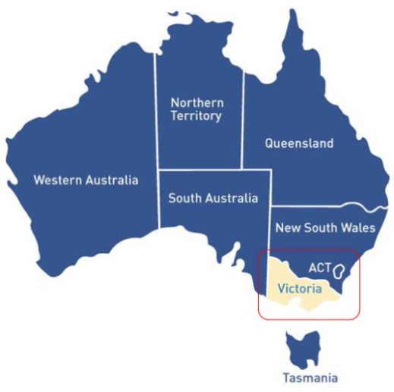
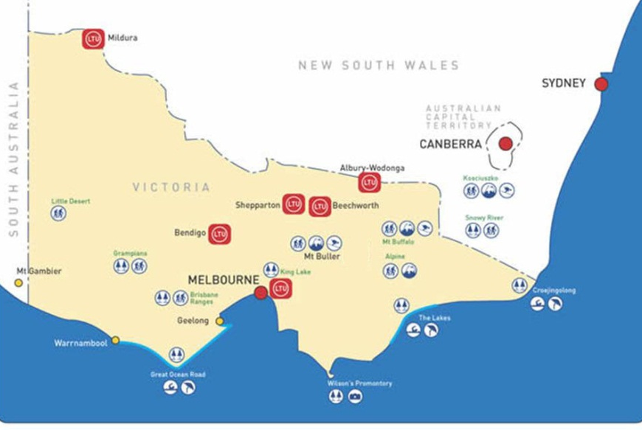
La Trobe University, Melbourne, Australia
La Trobe’s principal campus
15 km from Melbourne’s CBD
VASSCAA-9, 15th August 2018, Sydney, Australia

Slide 4
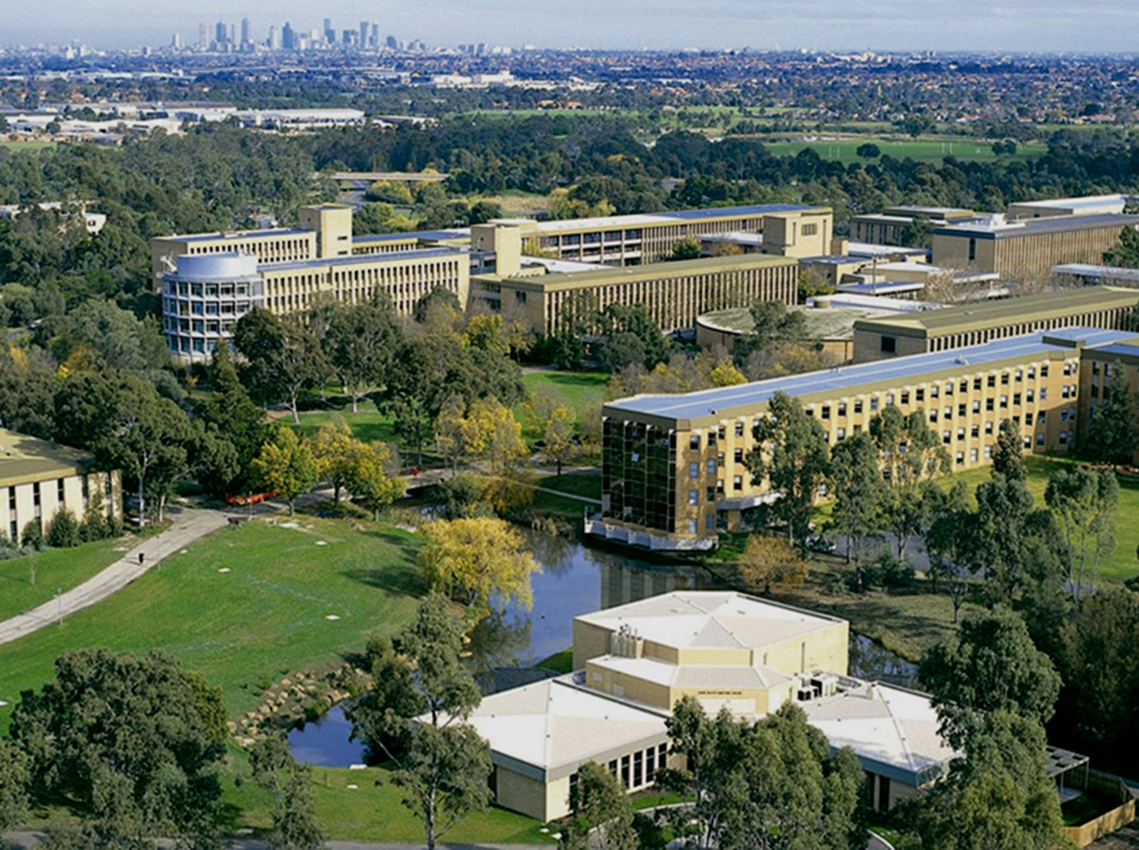
Department of Chemistry and Physics

Slide 5
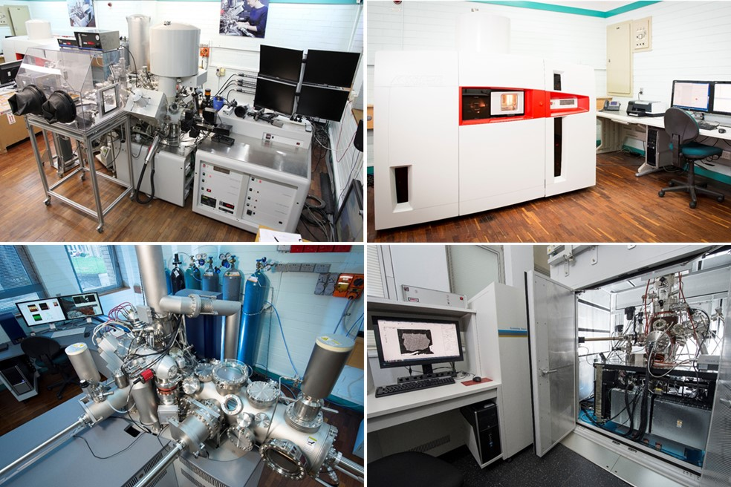
Centre for Materials and Surface Science (CMSS)
…and SEM-EDX, AFM, XRD, Contact Angle
VASSCAA-9, 15th August 2018, Sydney, Australia

Slide 6
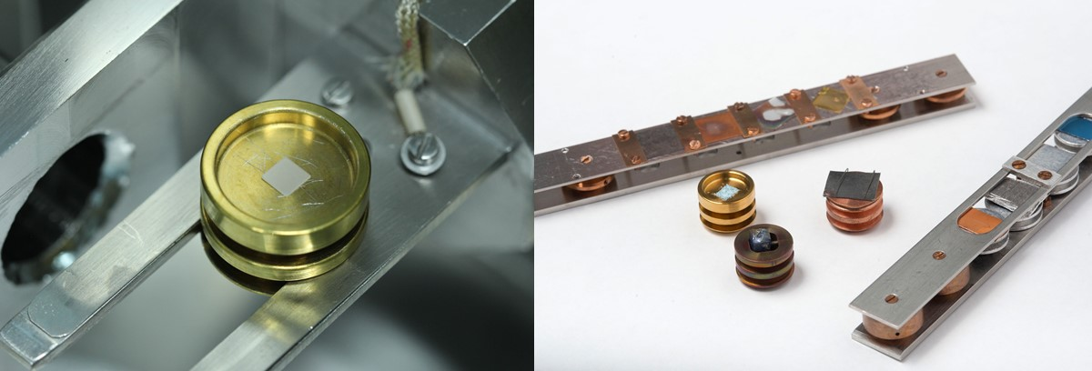
Interactions with Academia and Industry
Around 20 Australian and International Universities
    Molecular interactions at surfaces
    Understanding bio-surfaces
    Functional nano-particle systems
    Understanding complex mineral
    systems at the nanoscale
    Carbon electronics
Around 50 companies since 1999
    Pharmaceutical
    Plastics and polymers
    Automotive
    Semiconductor and electronics
    Food and food services
    Defence
VASSCAA-9, 15th August 2018, Sydney, Australia

Slide 7
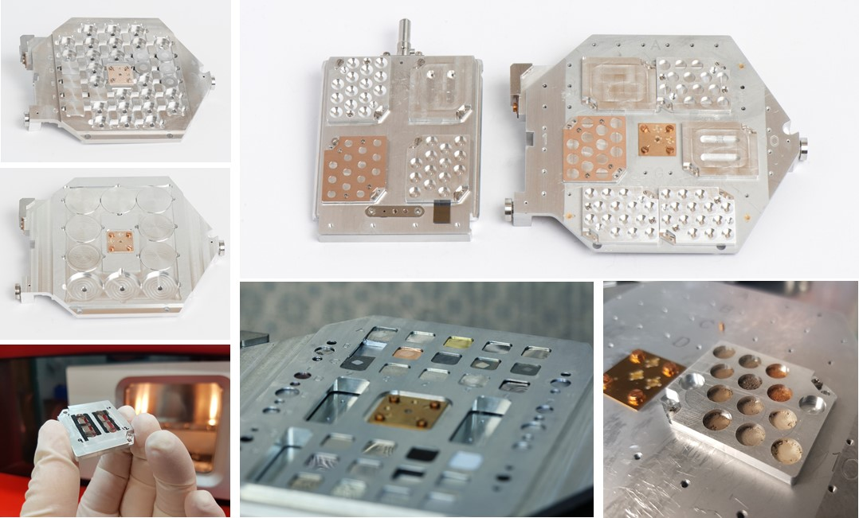
A Focus on Efficiency
We have a number of initiatives to improve our sample handling and throughput
VASSCAA-9, 15th August 2018, Sydney, Australia

Slide 8
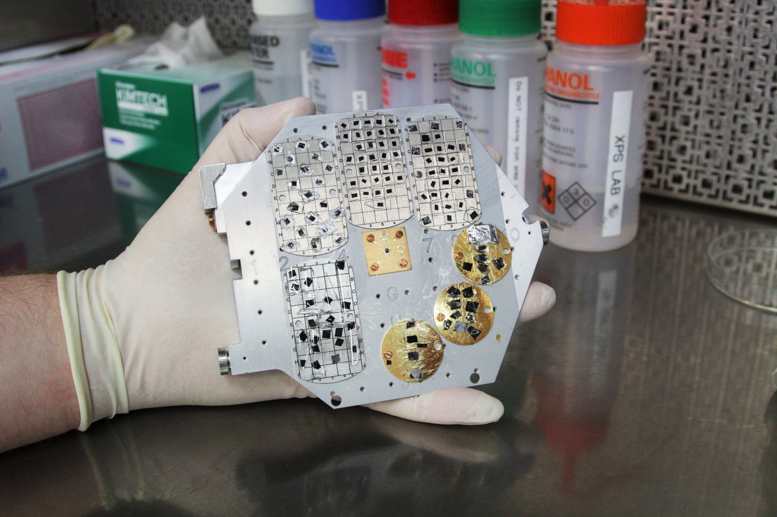
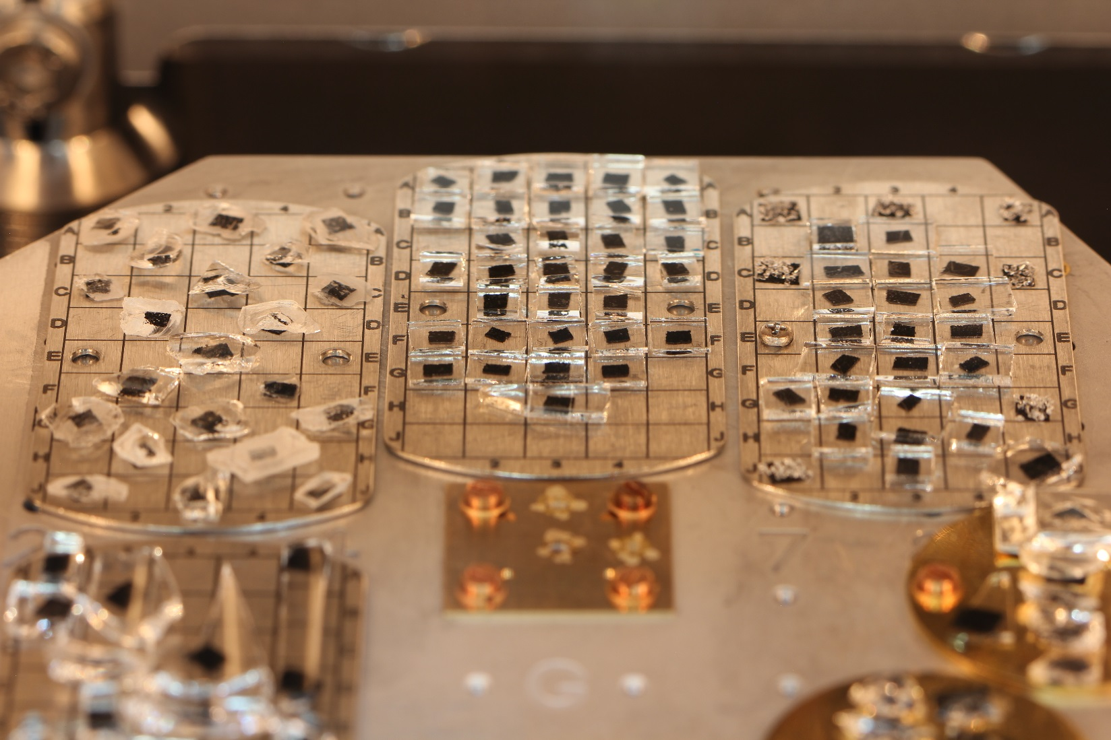
Throughput is the name of the game!
Recent large-scale data acquisition at CMSS
114 samples
422 positions
401 hours non-stop (17 days)
2939 spectra

Slide 9
Resources for the XPS Analyst
Our collaborators often ask…
Where can I find peak positions for XPS spectra?
What energy should I calibrate to?
What does this peak shape mean?
Are my peaks overlapping with something?
Is this a satellite or something chemical?
There are a number of valuable resources
NIST XPS Database srdata.nist.gov/xps/
XPS Simplified xpssimplified.com/periodictable.php
XPS Fitting www.xpsfitting.com/
La Surface www.lasurface.com/
CasaXPS www.casaxps.com/ and YouTube
More recently eSpectra with data from Surface Science Spectra journal
John Moulder and coworkers, PHI Handbook of XPS
Beamson and Briggs Polymer Database
Briggs and Seah, Watts and Wolstenholme, Grant and Briggs …and many more texts
VASSCAA-9, 15th August 2018, Sydney, Australia

Slide 10
Motivation
To assist our user base by generating a database of XPS spectra collected on our instrumentation
Complete datasets
  All peaks and transitions, capturing background and loss structures
Multiple modalities
  Pass energies, instruments
Detailed descriptors for all datasets and materials
Easy data usage
  VAMAS standard files, utilise reference data alongside experimental data
Freely Available, Online and Collaborative
VASSCAA-9, 15th August 2018, Sydney, Australia

Slide 11
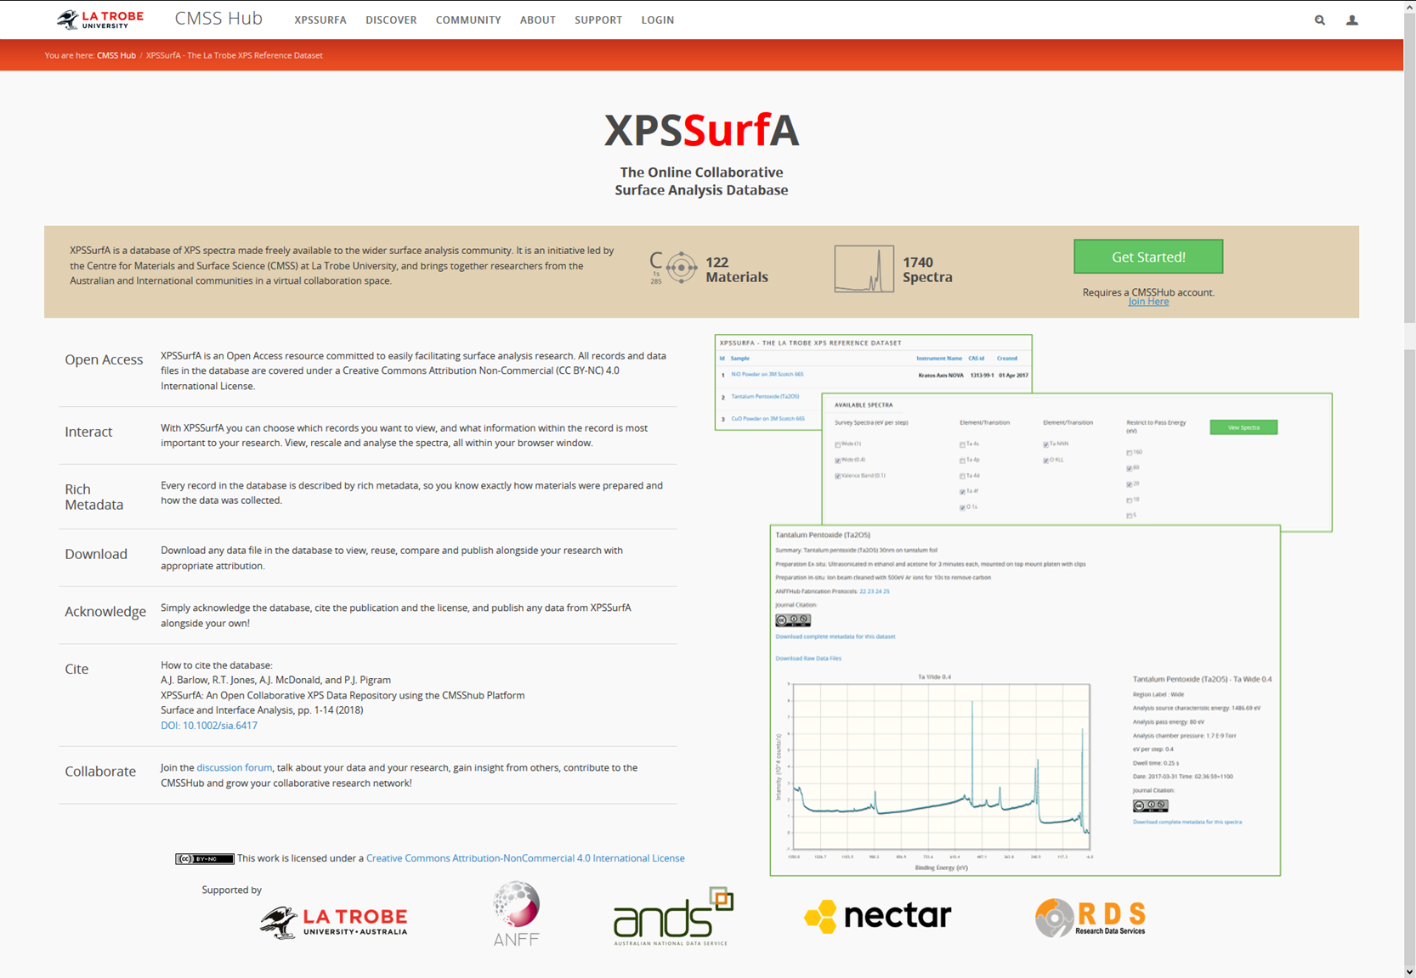
VASSCAA-9, 15th August 2018, Sydney, Australia

Slide 12
XPSSurfA cmsshub.latrobe.edu.au/xpsdatabase
Repository of XPS
Spectral Datasets
Open Access
Rich Metadata
Complete datasets
Self-Consistent
Interactive
Downloadable
Collaborative
  As of August 2018: 122 datasets, 1740 spectra
  Licensed under Creative Commons By Attribution Non-Commercial 4.0
  Materials and datasets described in detail
  All elements and transitions in a given material are collected for a range of instrument modes
  All data collected on the same instrumentation using prescribed protocols
  Users can view datasets online, and interrogate spectra within their browser
  All datasets and metadata are available for download in a number of formats
  Part of the CMSShub platform: groups, networking, profiles, forums
VASSCAA-9, 15th August 2018, Sydney, Australia

Slide 13
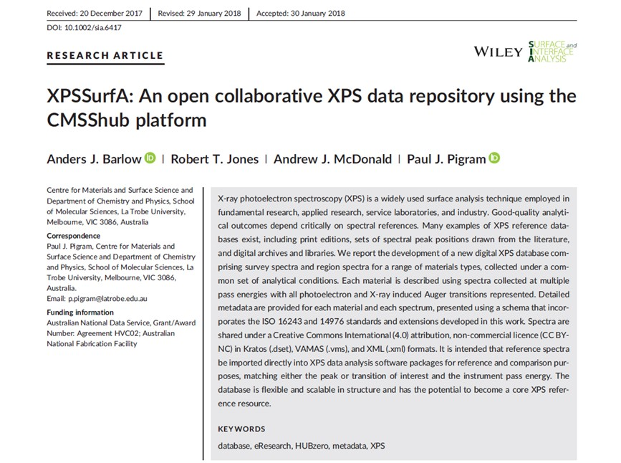
XPSSurfA cmsshub.latrobe.edu.au/xpsdatabase
Barlow et al., Surf. Interface. Anal. 50, 527-540 (2018)
VASSCAA-9, 15th August 2018, Sydney, Australia

Slide 14
Online Demo
(if everyone could please cross their fingers…)
VASSCAA-9, 15th August 2018, Sydney, Australia

Slide 15
XPSSurfA cmsshub.latrobe.edu.au/xpsdatabase
Open Access
Rich Metadata
Complete datasets
Self-Consistent
Interactive
Downloadable
Collaborative
Flexible and Scalable
Adheres to the FAIR data framework
  Findable - data are assigned unique persistent identifiers, described by rich metadata and are indexed in a searchable resource;
  Accessible - data are retrieved via their unique identifiers and their metadata using well‐established protocols;
  Interoperable - data are stored using formalised standards that are broadly utilised in the surface analysis context and include references to related data and metadata;
  Reusable - metadata is rich, accurate and relevant to the database, with clear provenance and all data are published under a license that promotes usage.
Wilkinson et al., The FAIR guiding principles for scientific data management and stewardship, Scientific Data 3,160018 (2016)
VASSCAA-9, 15th August 2018, Sydney, Australia

Slide 16
XPSSurfA cmsshub.latrobe.edu.au/xpsdatabase
Open Access
Rich Metadata
Complete datasets
Self-Consistent
Strongly standards based
Data acquisition follows well-defined protocols
Protocols informed by ISO standards and IUVSTA recommendations
  ISO 14976:1998 Surface chemical analysis - Data transfer format
  ISO 15472:2010 Surface chemical analysis - XPS - calibration of energy scales
  ISO 16243:2011 Surface chemical analysis - recording and reporting data in XPS
  ISO 18115:2001 Surface chemical analysis - vocabulary
  ISO 18116:2005 Surface chemical analysis - guidelines for preparation and mounting of specimens for analysis
  JE Castle and CJ Powell, Report on the 34th IUVSTA workshop ‘XPS: from spectra to results - towards an expert system’, Surf Interface Anal. 36, 225‐237 (2004)
Interactive
Downloadable
Collaborative
Flexible and Scalable
VASSCAA-9, 15th August 2018, Sydney, Australia

Slide 17
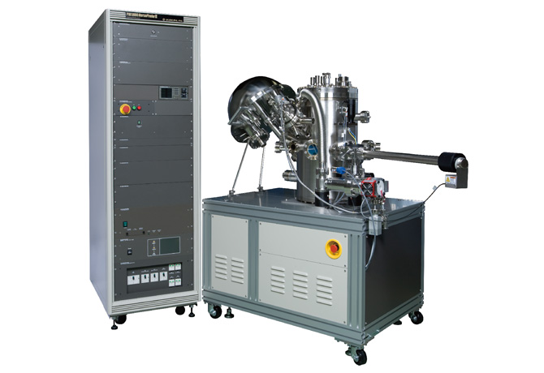
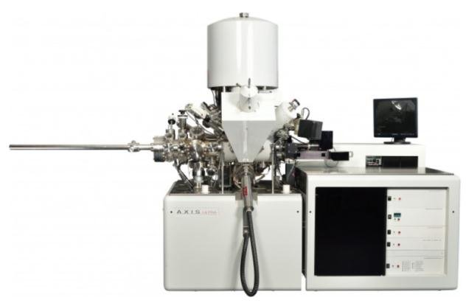
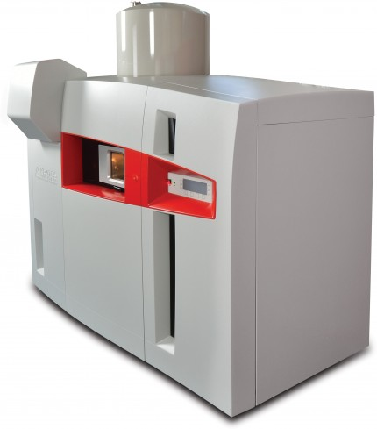
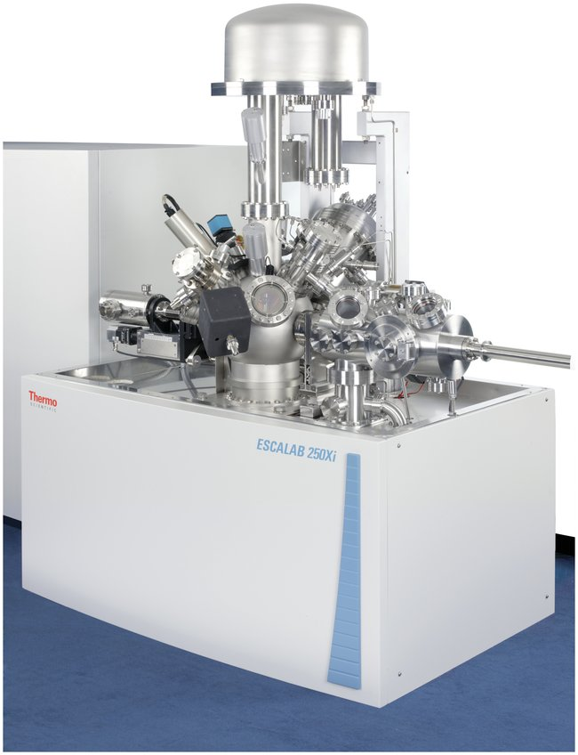
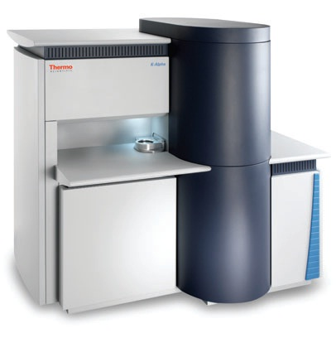
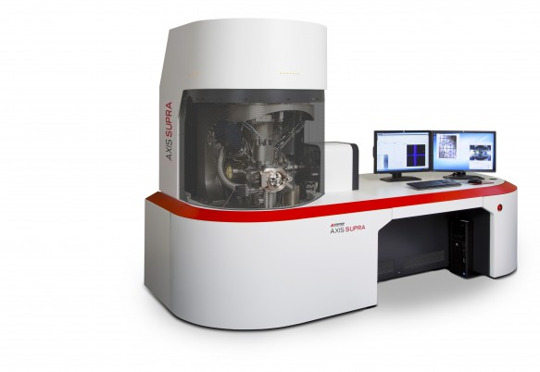
XPSSurfA cmsshub.latrobe.edu.au/xpsdatabase
Open Access
Rich Metadata
Complete datasets
Self-Consistent
Download data in a number of formats
Kratos .dset, VAMAS .vms, extensible markup .xml
Interactive
Downloadable
Collaborative
Flexible and Scalable
VASSCAA-9, 15th August 2018, Sydney, Australia

Slide 18
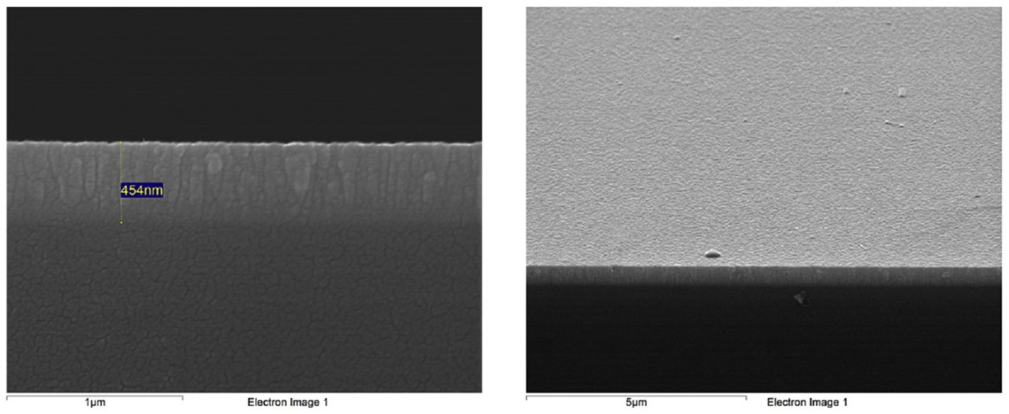
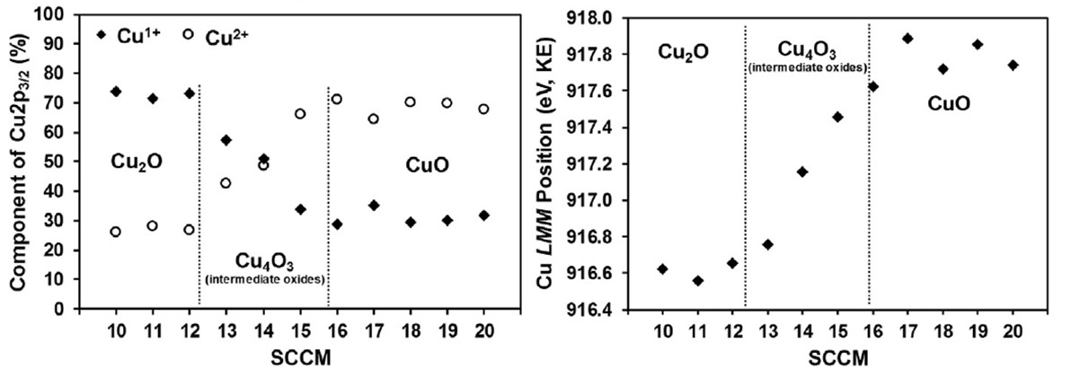
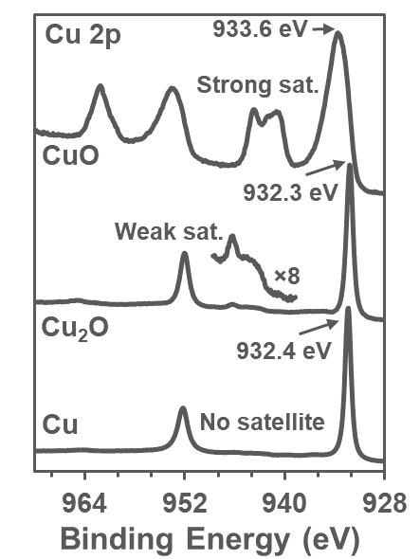
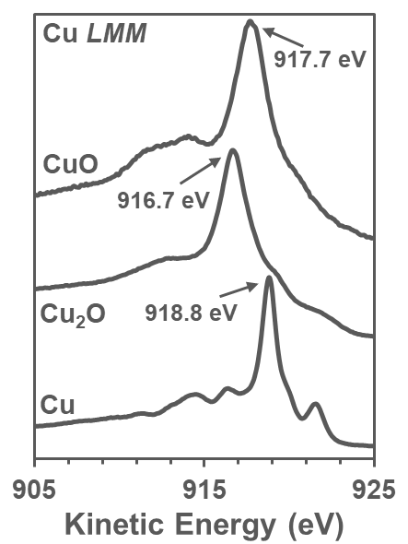
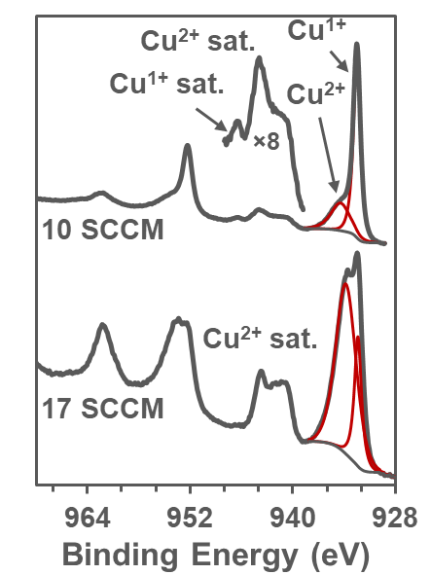
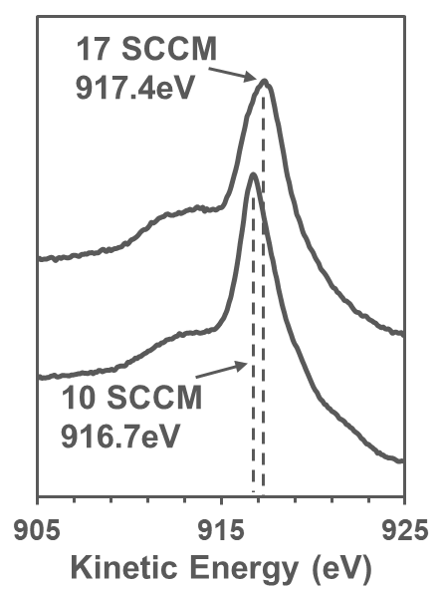
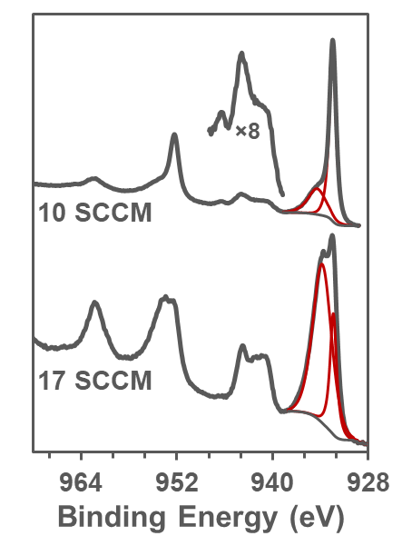
Examples of Usage Thus Far
Magnetron Sputtered Thin Copper Oxide Films
XPSSurfA Reference Data
Validated Experimental Data
Thin copper oxide films are promising p-type oxides with potential applications in solar cells, electronics, energy storage and memristors.
XPSSurfA data were used to validate spectra acquired from mixed copper oxide thin films. These data were crucial in the identification of Cu₂O, Cu₄O₃ and CuO in the films.
Y. Alajlani et al., Vacuum 144, 217-228 (2017)
VASSCAA-9, 15th August 2018, Sydney, Australia

Slide 19
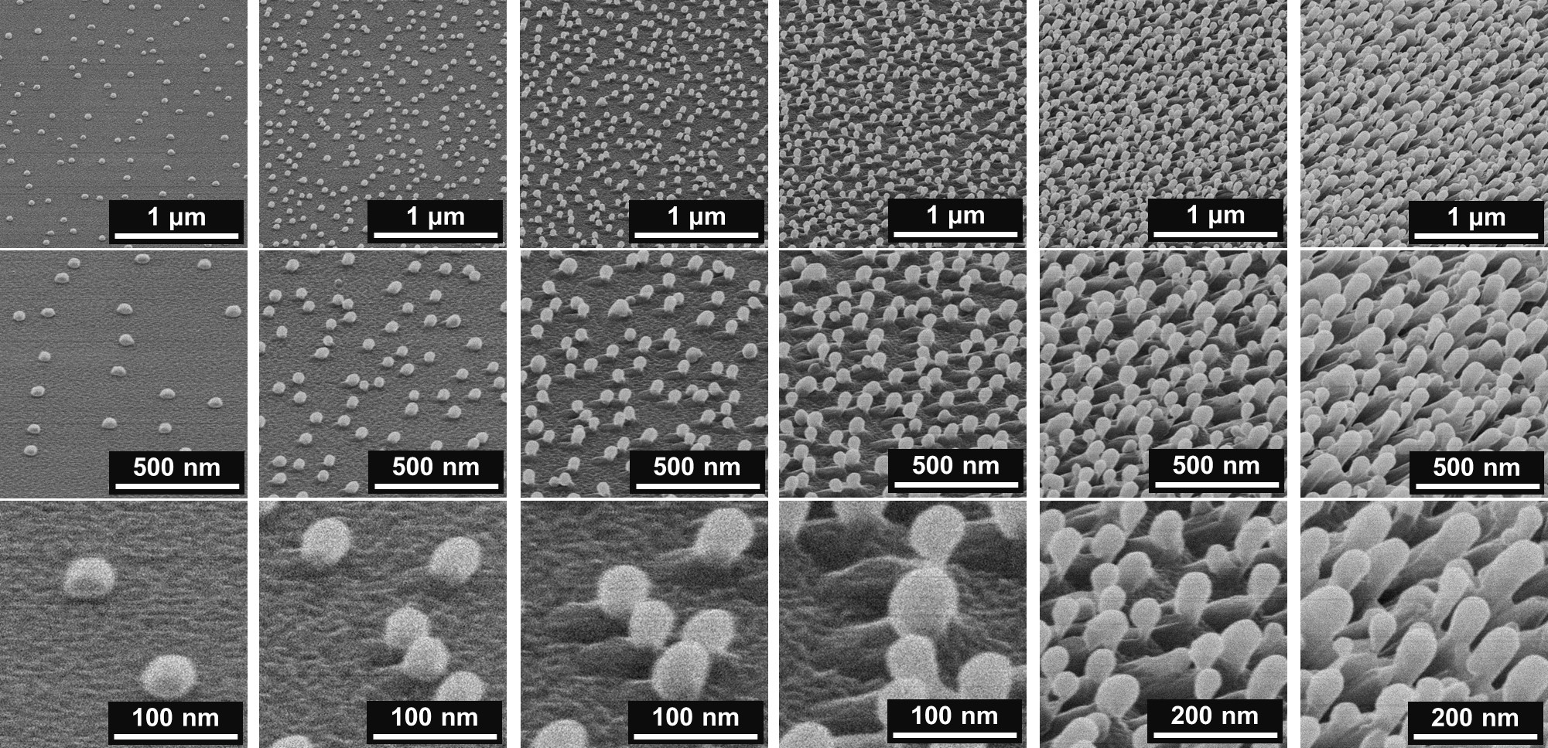
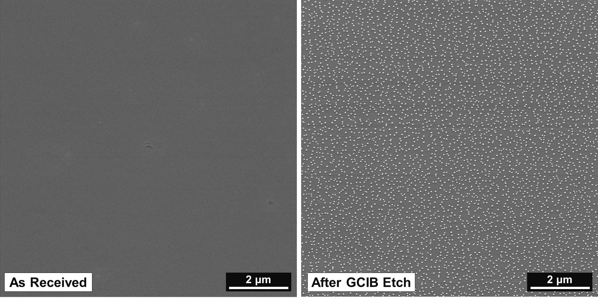
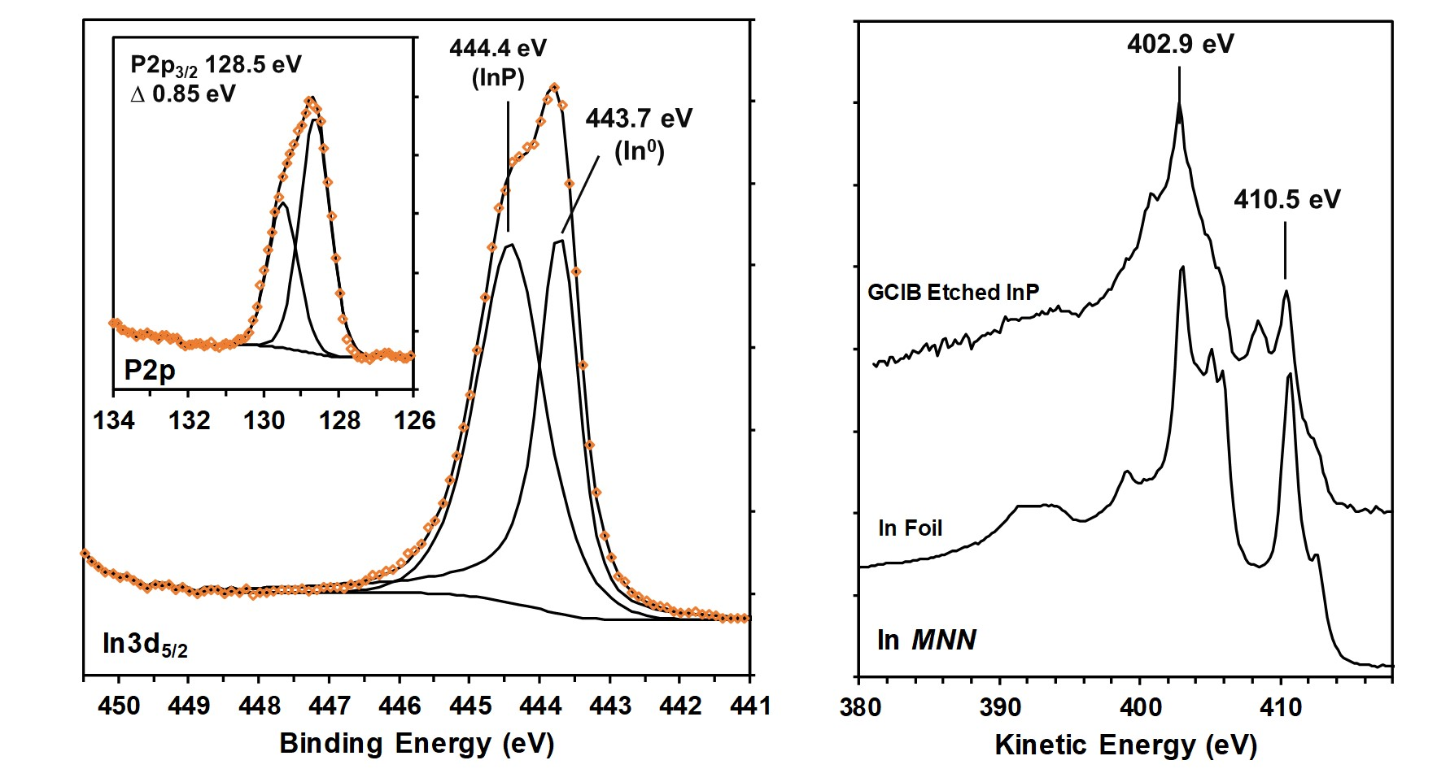
Examples of Usage Thus Far
GCIB Etched Indium Phosphide
XPSSurfA
Barlow et al., Appl. Surf. Sci. 459, 678-685 (2018) DOI: 10.1016/j.apsusc.2018.07.195
VASSCAA-9, 15th August 2018, Sydney, Australia

Slide 20
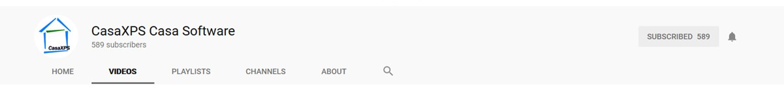
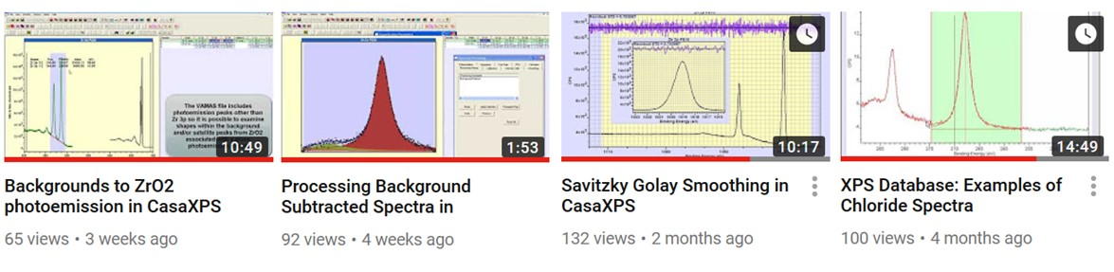
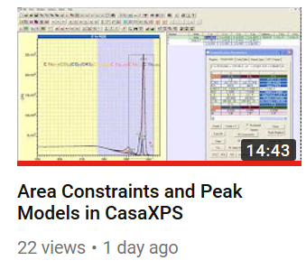
Examples of Usage Thus Far
CasaXPS YouTube Channel, Neal Fairley
Complete datasets, all transitions, multiple measurements
Multiple related datasets and materials
Collaborative, download data and follow video tutorials
Creative Commons, usage of XPSSurfA data in CasaXPS training
VASSCAA-9, 15th August 2018, Sydney, Australia

Slide 21
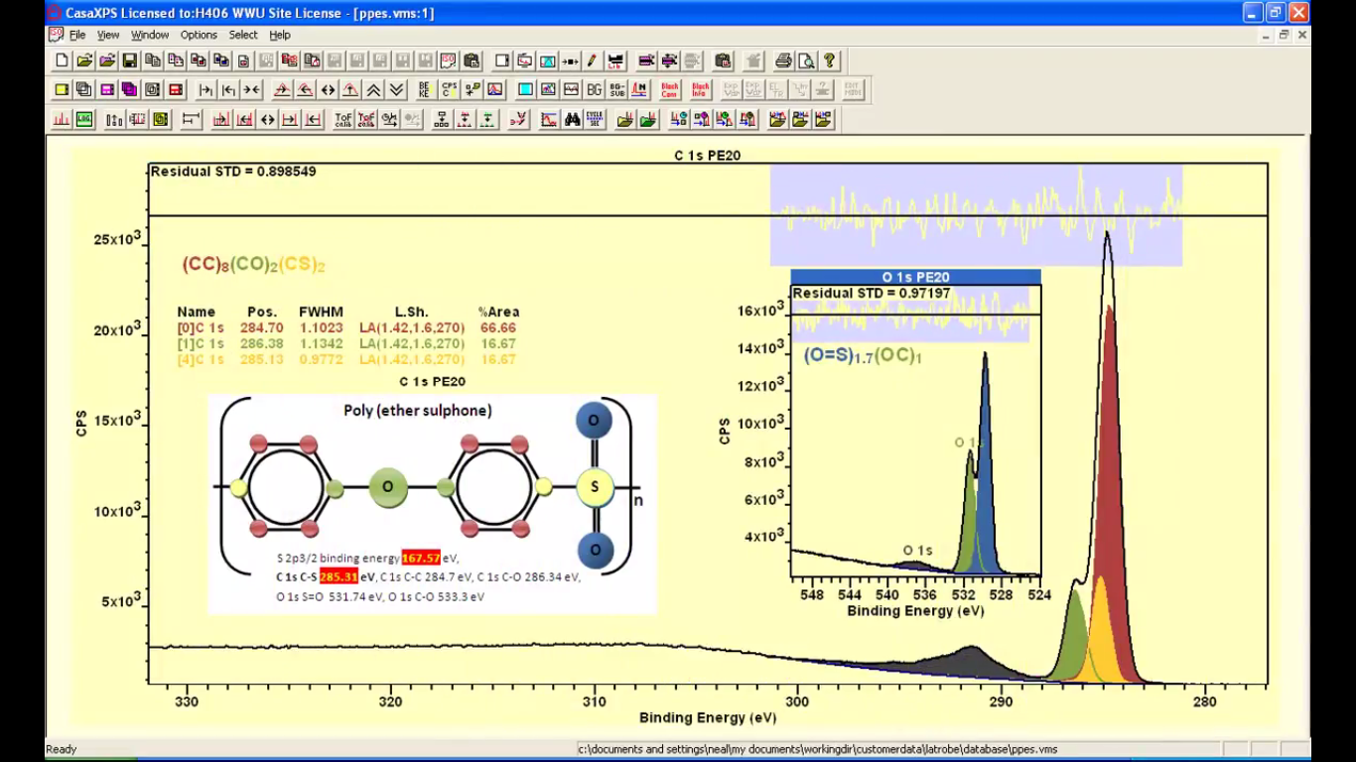
Examples of Usage Thus Far
CasaXPS YouTube Channel, Neal Fairley

Slide 22
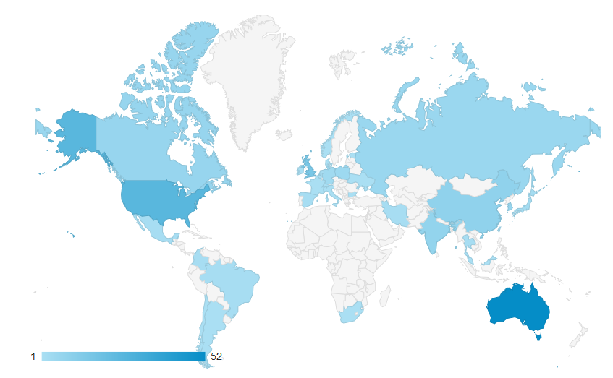
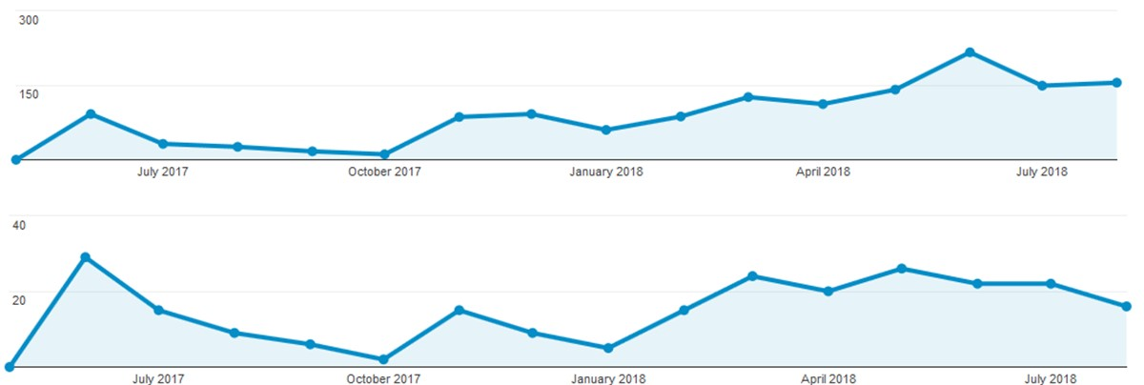
Google Analytics
All Users
Returning Users
ANFF/AMMRF
Showcase
Article Published
XPSSurfA
Online
First CasaXPS
YouTube Video
VASSCAA-9, 15th August 2018, Sydney, Australia

Slide 23
XPSSurfA - Summary cmsshub.latrobe.edu.au/xpsdatabase
Open Access XPS Database
Self-consistent complete datasets, fully downloadable and richly described
Heavily standards and protocol based data collection and description
Flexible, scalable and collaborative
Barlow et al., Surf. Interface. Anal. 50, 527-540 (2018)
VASSCAA-9, 15th August 2018, Sydney, Australia

Slide 24
Acknowledgements
CMSS and Department of Chemistry and Physics, La Trobe University
Anders Barlow
Rob Jones
Paul Pigram
Andrew McDonald
La Trobe University Library
Andrew Williams
Clayton Bolitho
Rachel Salby
Eva Fisch
Simon Huggard
La Trobe University ICT
Benji Wakely
Australian National Data Service (ANDS)
Kathryn Unsworth
Angeletta Leggio
VASSCAA-9, 15th August 2018, Sydney, Australia

Slide 25
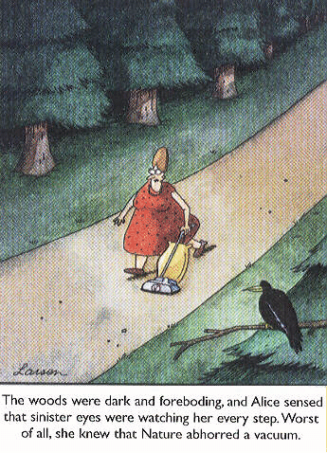

Slide 26
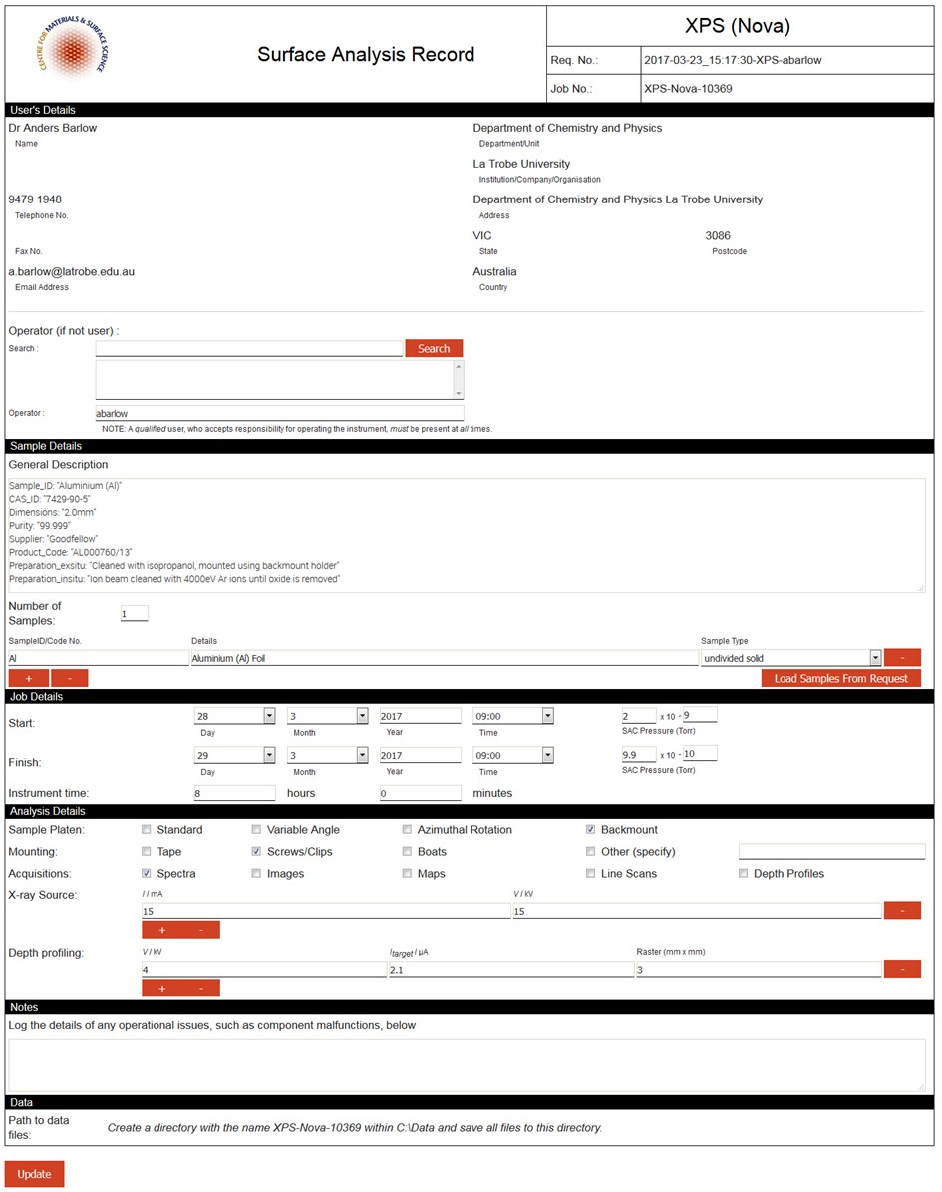
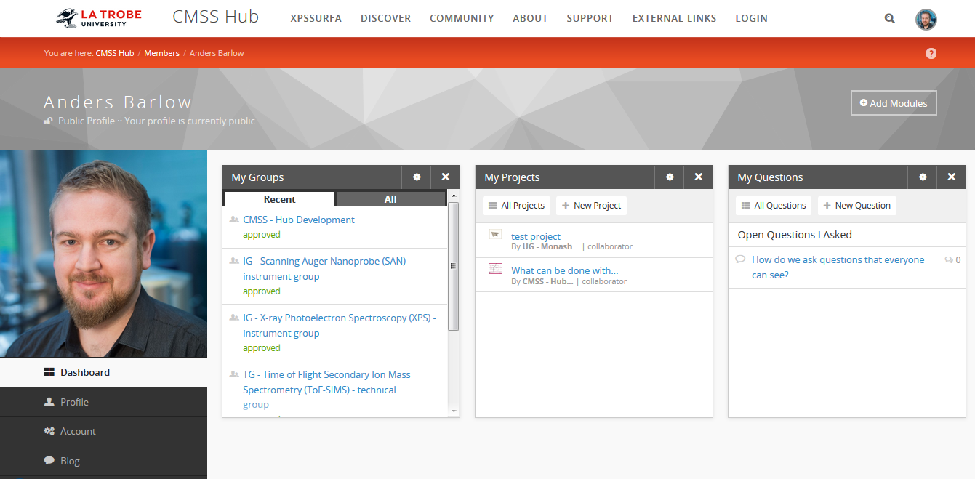
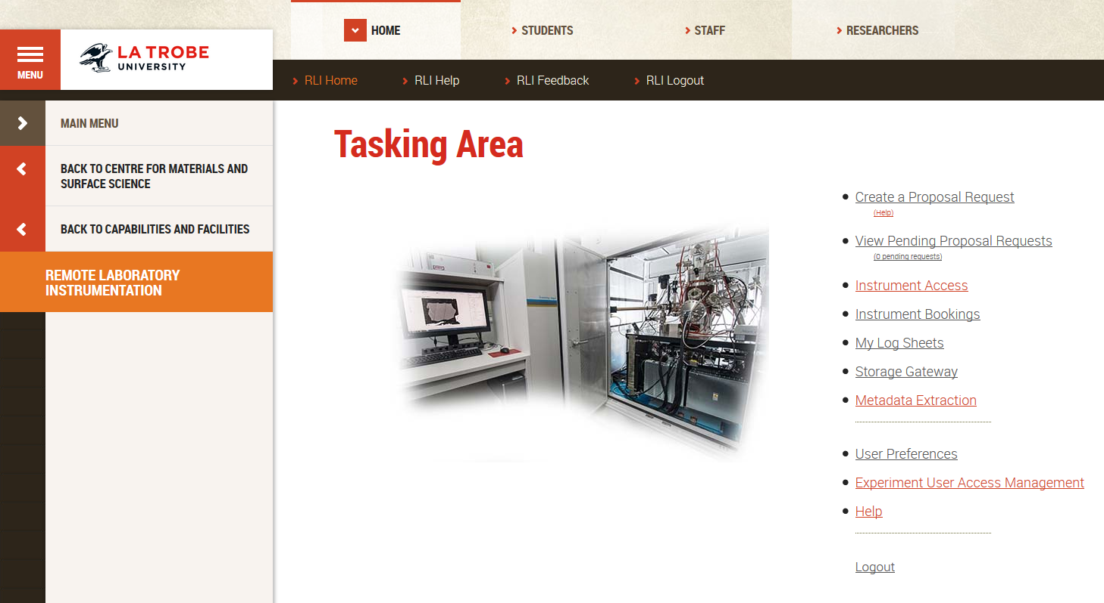
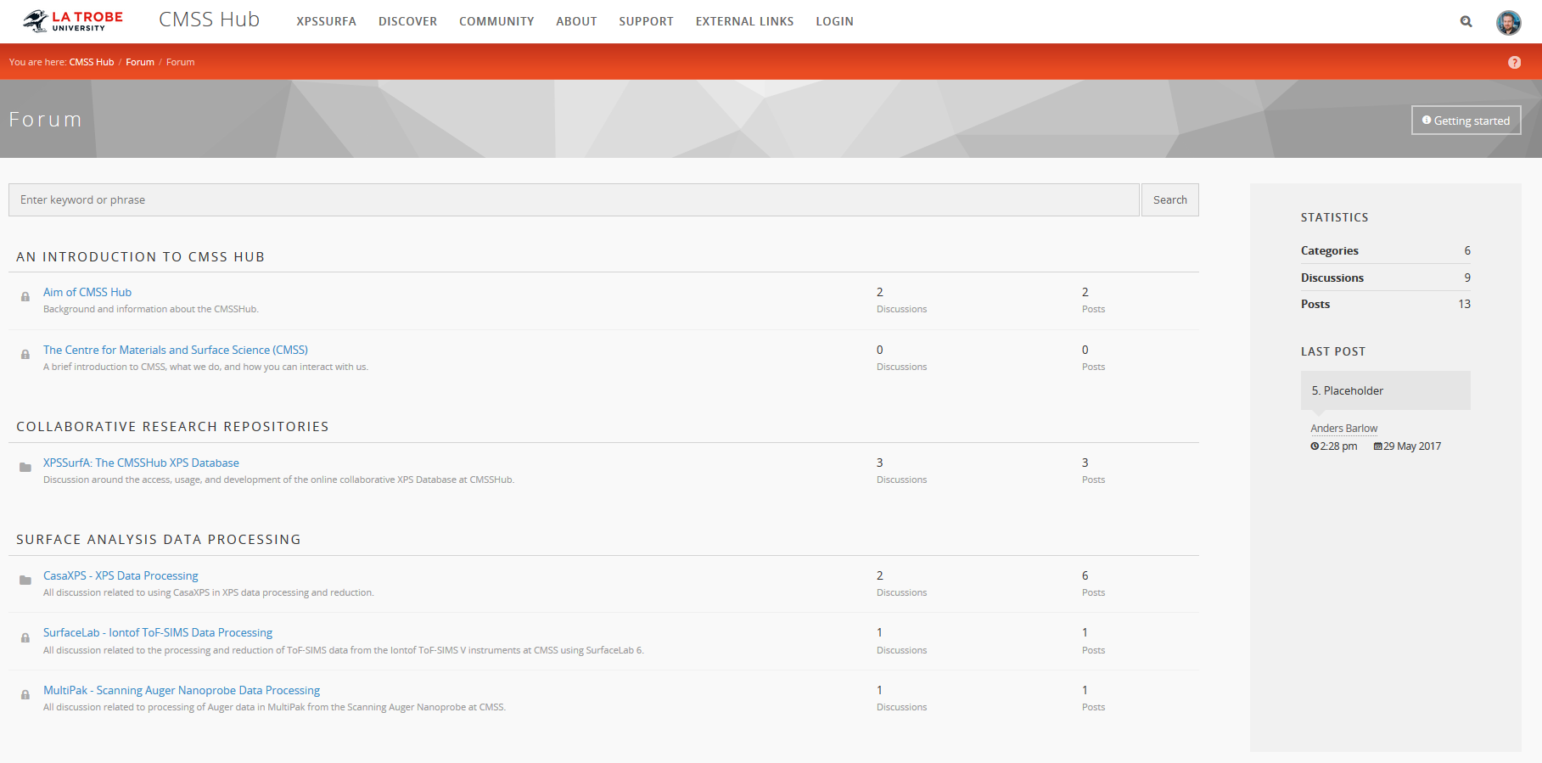
A Focus on Efficiency
Online management and collaboration systems
Remote Laboratory Instrumentation (RLI)
CMSSHub
VASSCAA-9, 15th August 2018, Sydney, Australia

Slide 27
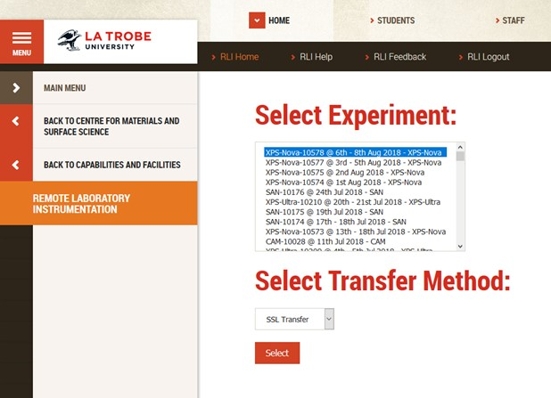
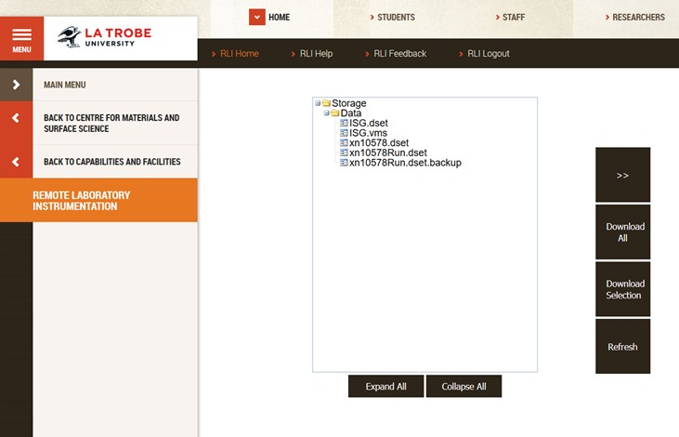
A Focus on Efficiency
How do we handle data transfer?
XPS – VAMAS standard, .vms files
Broad access to CasaXPS site licenses in Australian universities
Standardised file format, focussed software training, excellent support
VASSCAA-9, 15th August 2018, Sydney, Australia

Slide 28
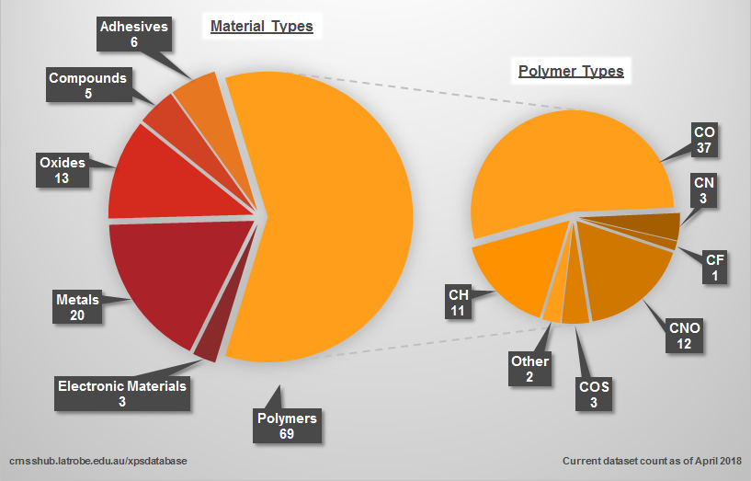
XPSSurfA
Breakdown of materials in the database
VASSCAA-9, 15th August 2018, Sydney, Australia

