Slide 1

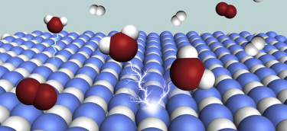


Tuning the Electronic Structure of NiO by Li doping for Electrocatalytic Water Oxidation
Kelvin HL Zhang
Xiamen University
kelvinzhang@xmu.edu.cn

Slide 2






Xiamen, China
Beijing
beach
Xiamen
Taiwan
Australia
The campus

Slide 3
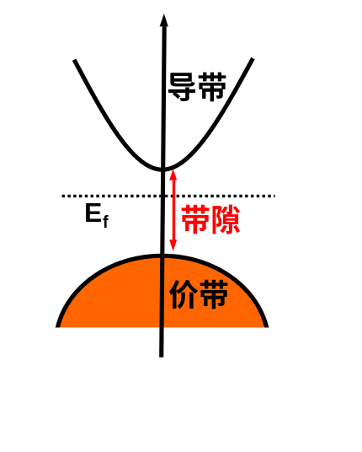

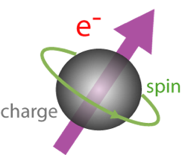


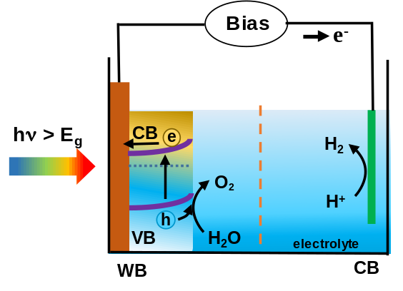
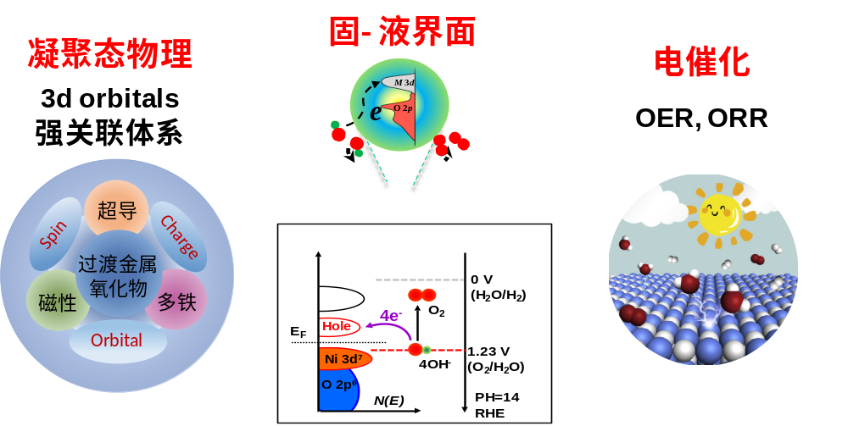
XIAMEN
UNIVERSITY
Research in my group
Optical, electronic and magnetic properties of solid materials
Optoelectronic,
data storage devices
CB
E_{g}
Giant magneto
resistance
VB
Wide bandgap, mobility, doping
Transition metal d orbitals
partially filled d orbitals
electron correlation
multiple oxidization states
Transparent
Oxide Semicond.
Super-conductor
Electronic Structure
low bandgap, mobility, kinetics
Photo-elec
trocatalysis
Electro
catalysis
Photoelectrochemistry
electrocatalyst
Lithium ion battery
OER
ORR
Clean energy materials
3

Slide 4
Energy and Environmental issues
Quality of life and energy
Pasten and Santamarina, energy policy 49, 468 (2012)
4

Slide 5

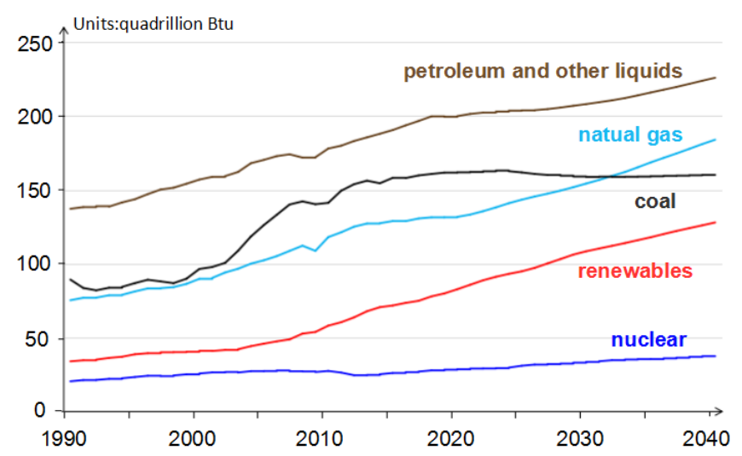
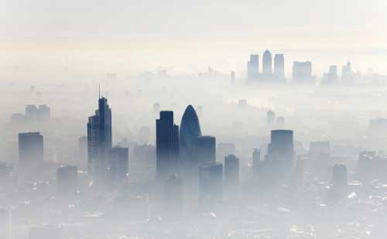

Energy and Environmental issues
Energy crisis
U.S. Energy Information Administration 2017
Air pollution
雾霾
Globe warming
酸雨
Source: https://www.eia.gov/
5

Slide 6
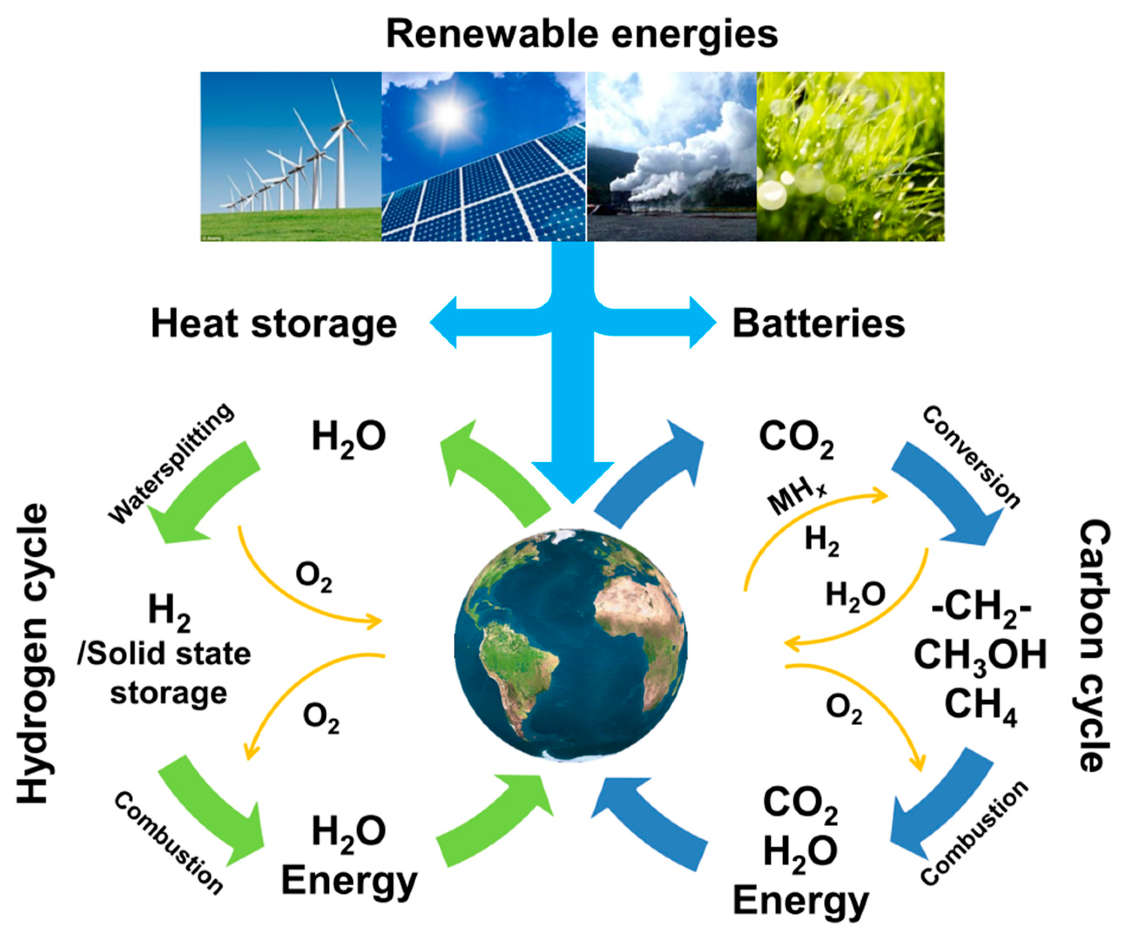
Electrochemical energy conversion & storage
6

Slide 7
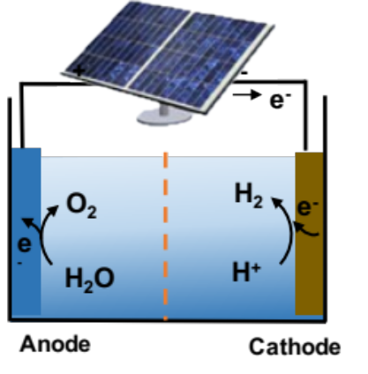
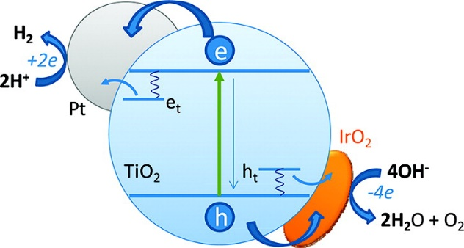
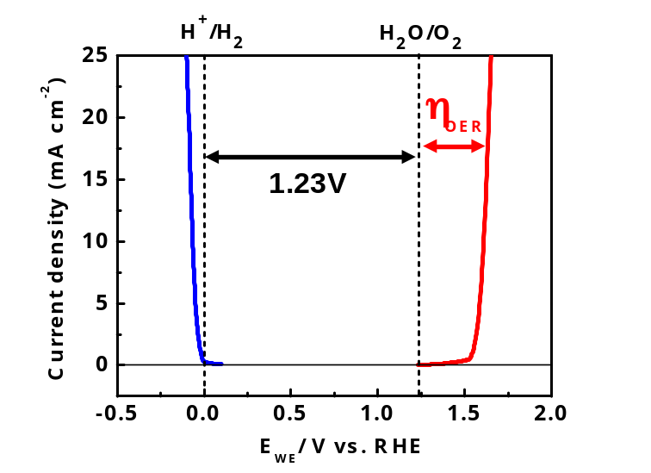
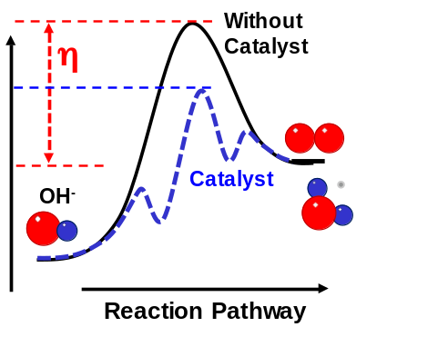

Electrolysis and photochemical water splitting
Photo-catalytic
Photoelectrochemical
PV-Electrolysis
PV
Lewis and Nocera,
PNAS 103, 15729 (2006)
Anode Cathode
Cathode: hydrogen evolution reaction (HER):
2H⁺ + 2e⁻ → H₂ E = 0 V (vs RHE)
Anode: oxygen evolution reaction (OER):
2H₂O → O₂ + 4H⁺ + 4e⁻ E = 1.23 V
but slow kinetics with high overpotentials!
HER
OER
Cost-effective catalysts needed!
7

Slide 8
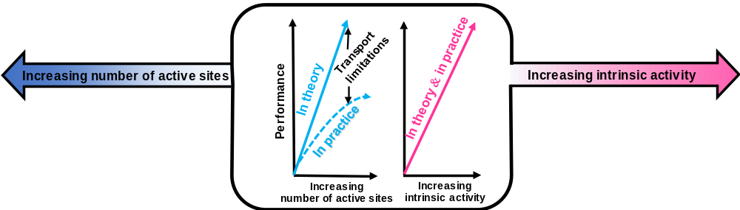
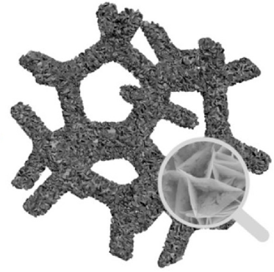
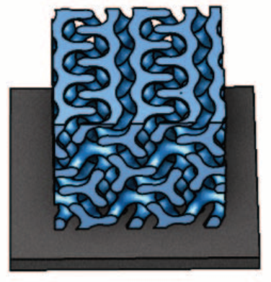
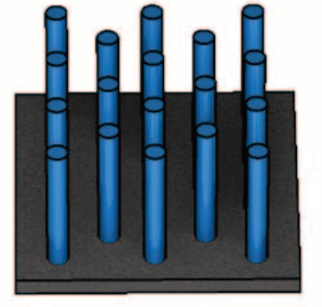
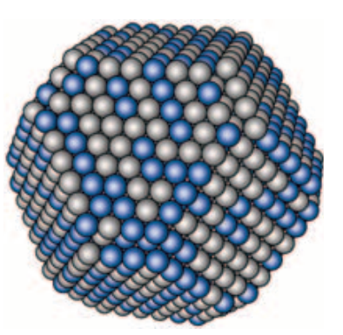
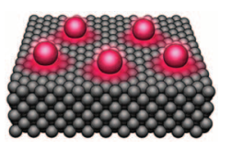
Correlation between catalytic activity and electronic structure
IrO₂ , RuO₂ (Ir: $31,040/kg)
Transition metal oxides (Ni $5/kg, Co, Fe, Mn)
low cost, effective?
Suen, et al., Chem. Soc. Rev. 46, 337 (2017)
How do we design catalysts?
What determines the intrinsic activity of an electrocatalyst?
Catalyst development strategies
Nanostructures
The activity strongly correlates with surface electronic structure
Pt
d center
Pt₃Ni
Seh et al., Science 355, 146 (2017)
Pt₃Ni(111)
8

Slide 9
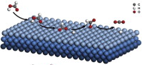
Correlation between electronic structure and catalytic activity
Elementary steps in heterogeneous catalysis
Adsorption of reactants
Desorption of products
Reaction of adsorbed intermediates
Adsorptive property of a catalyst = Catalytic activity
Not so strong, not so weak = best (阴阳平衡)
B. Hammer et al., Advances in catalysis, 45(2000), 71-129
Norskov et al. Nature Chemistry 1 (2009), 37-46
9

Slide 10
Correlation between electronic structure and catalytic activity
“d band theory”, where surface physicist meet surface chemist
The binding energy of an adsorbate to a surface is largely dependent on the electronic structure of the surface
Too weak
Too strong
Too strong
Too weak
A higher d-band center (smaller E_{d} - E_{F}) results in stronger bonding.
A lower d-band center (larger E_{d} - E_{F}) weaker bonding.
B. Hammer et al., Advances in catalysis, 45(2000), 71-129
Norskov et al. Nature Chemistry 1 (2009), 37-46
10

Slide 11
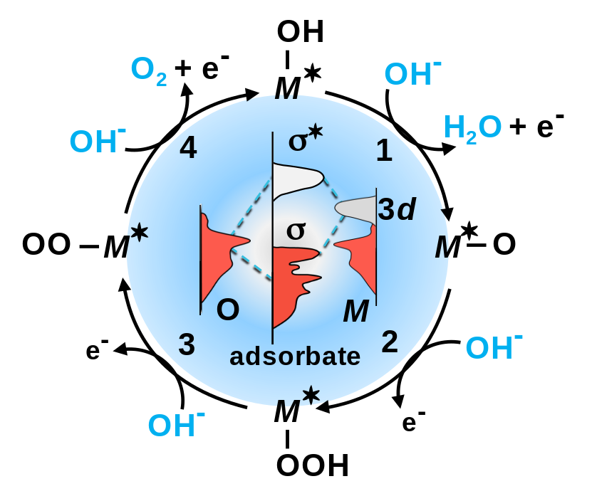
Correlation between catalytic activity and electronic structure
Oxygen evolution reaction involves four proton-electron transfer steps.
The activity strongly correlates with surface electronic structure!
Four proton electron transfer steps:
1. H₂O(l) + * ⇌ HO* + H⁺ + e⁻
2. HO* ⇌ O* + H⁺ + e⁻
3. O* + H₂O(l) ⇌ HOO* + H⁺ + e⁻
4. HOO* ⇌ * +O₂ +H⁺ + e⁻
Norskov et. al. J. Electroanal. Chem. 607, 83 (2007).
Man et al. ChemCatChem, 3, 1159 (2011)
11

Slide 12
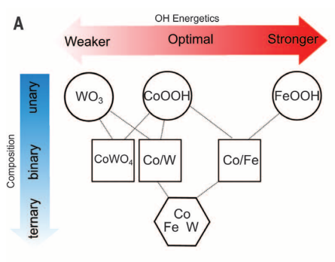
Correlation between catalytic activity and electronic structure
Oxygen evolution reaction involves four proton-electron transfer steps.
The activity strongly correlates with surface electronic structure!
Four proton electron transfer steps:
1. H₂O(l) + * ⇌ HO* + H⁺ + e⁻
2. HO* ⇌ O* + H⁺ + e⁻
3. O* + H₂O(l) ⇌ HOO* + H⁺ + e⁻
4. HOO* ⇌ * +O₂ +H⁺ + e⁻
Tuning the absorption energetics of OER intermediates via doping/alloying for the design of ternary FeCoW oxyhydroxides, the best catalyst so far.
0.191 V at 10 mA cm⁻²
Science, 352, 333 (2016)
12

Slide 13
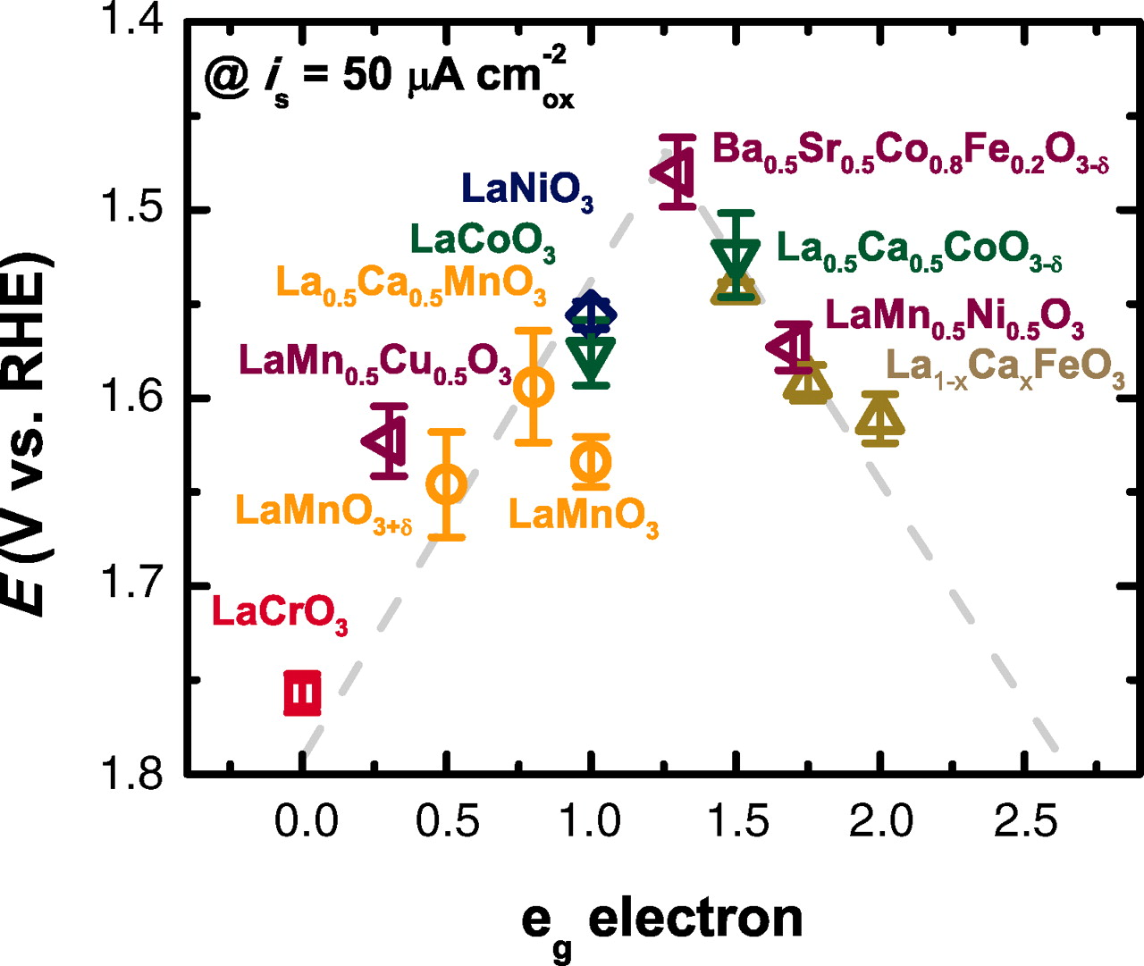
Correlation between electronic structure and catalytic activity
e_{g} orbital with 1 electron show the highest OER activity
Using epitaxial strain to tune the electronic structure and OER activity
e_{g}
t_{2g}
Suntivich et. al.
Science 334, 1383 (2011)
JR Petrie, H.N. Lee et. al. JACS 138, 2488 (2016)
13

Slide 14
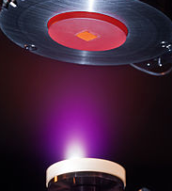
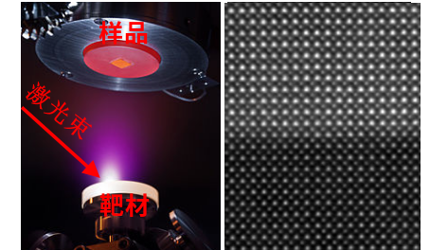
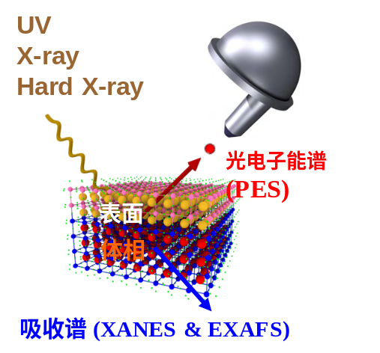
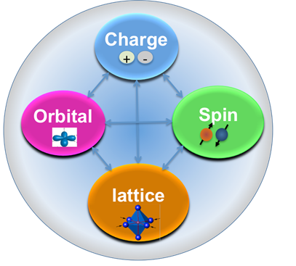
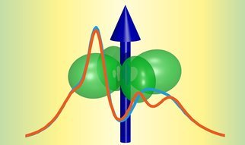
Research Approach
The aim: understand the electronic structure and catalytic activity relationship
Epitaxial thin films
Pulsed laser deposition
Electro-chemistry
Electrocatalysts
(OER, ORR)
Photoelectro-chemistry
Intrinsic
Material
Descriptor
doping, defect, strain crystal orientations
Surface chemistry
Novel Physics
Solid-liquid interface
Density Functional Theory
Electronic, Optical and Magnetic Properties
14

Slide 15
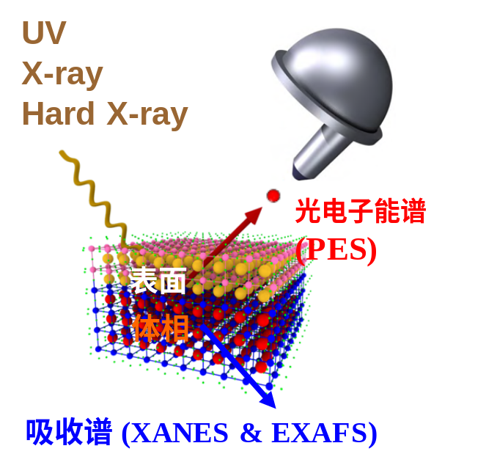
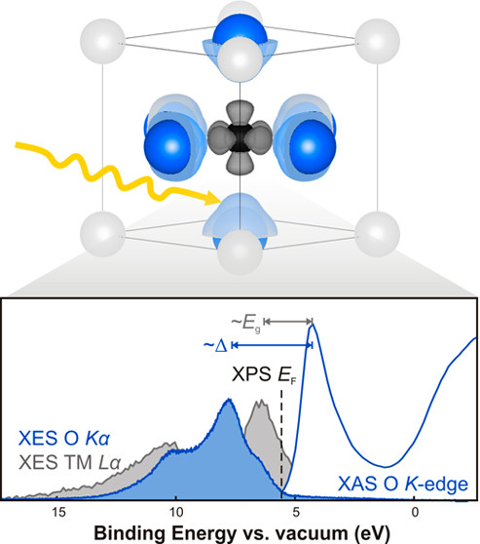
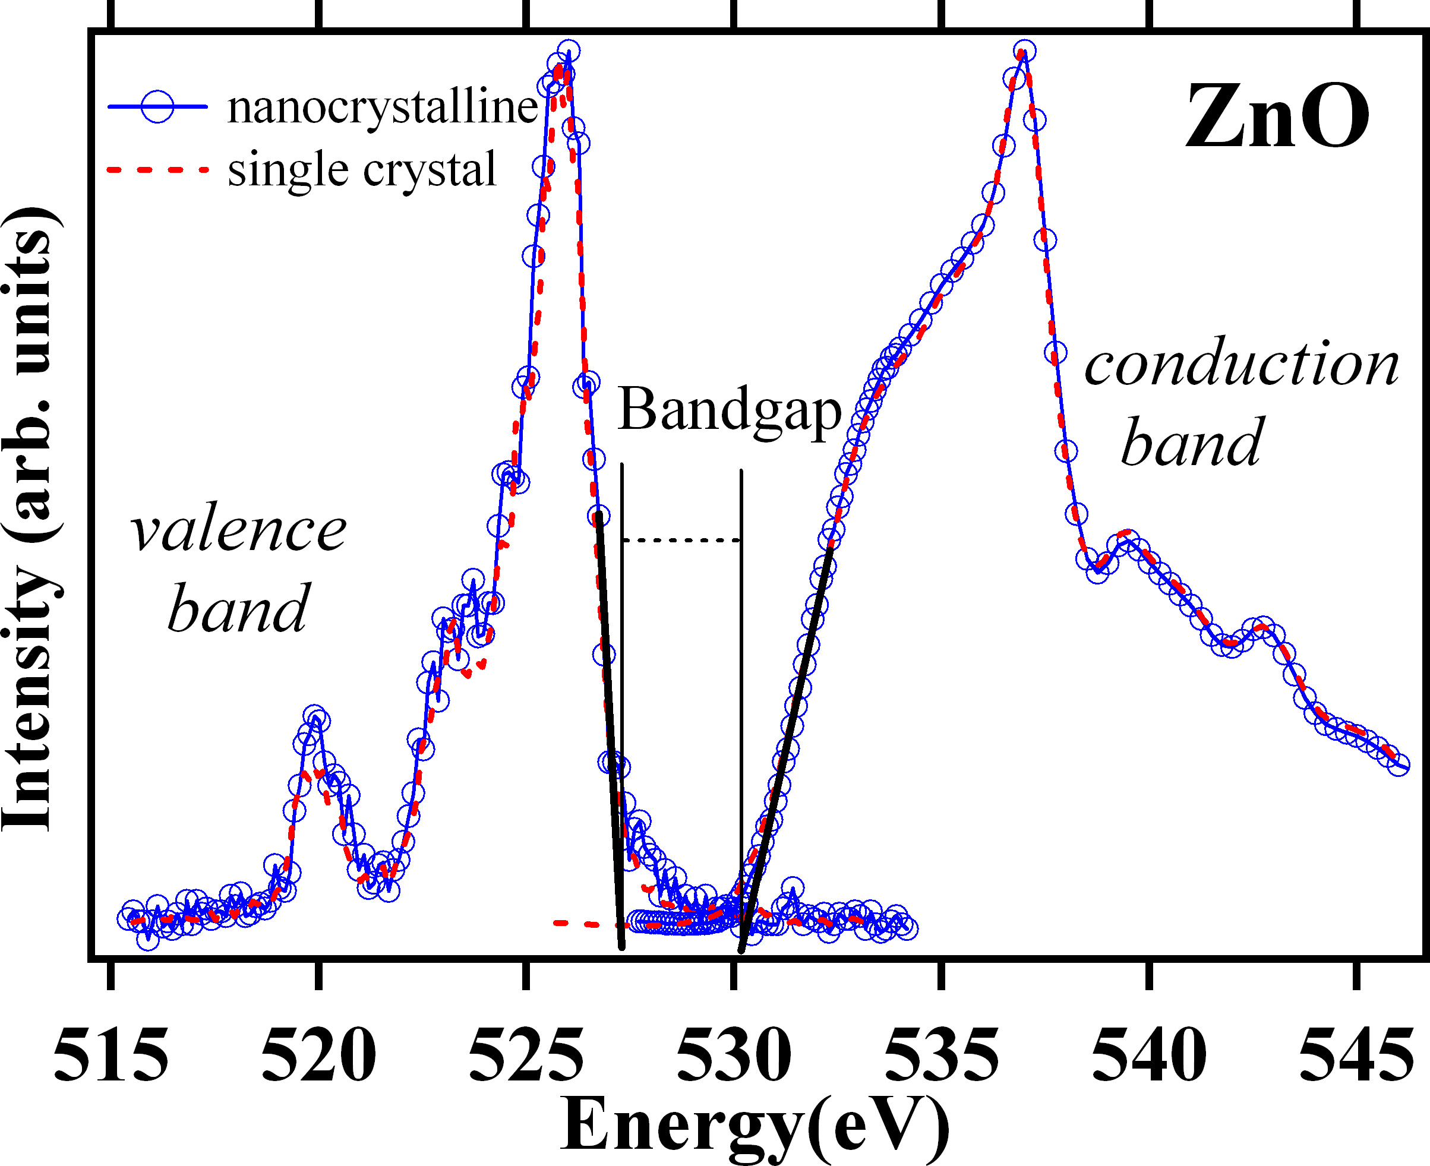
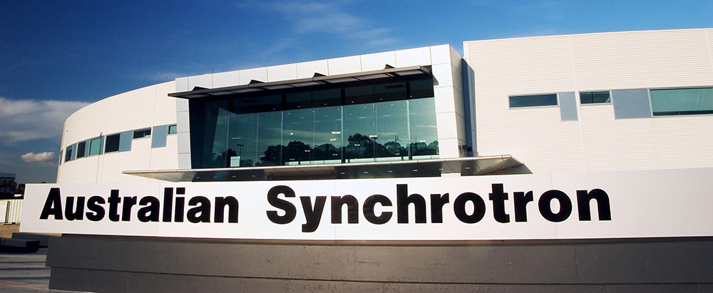
Photoemission spectroscopy and X-ray absorption
XPS-VB
O K-edge
XAS
CB
Hole
E_{F}
Ni 3d⁸
O 2p⁶
VB
X-ray
O 1s
O K-edge X-ray absorption (XAS) probe O 1s to unoccupied states with O 2p character hybridized with metal 3d, related to unoccupied density of states at CB.
15

Slide 16
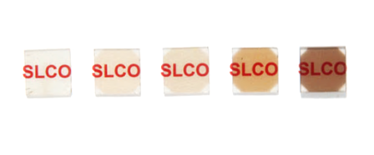
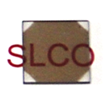

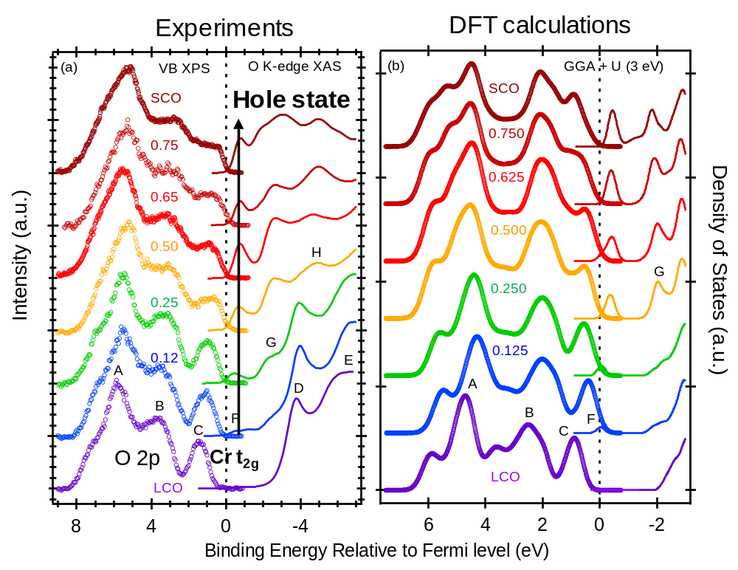
Electronic structures of La_{1-x}Sr_{x}CrO₃(0≤ x ≤ 1)
LaCrO₃
0.65
SrCrO2.8
0.25
0.50
Mott insulators
Eg= 2.9 eV
Transparent p-type oxide semiconductor
Insulator-to-metal transition
SrCrO3.0
Reversible redox phase transition
PRL 110, 077401 (2013)
Adv. Mater. 27, 5191 (2015)
APL 111, 063501 (2017)
Phys. Rev. B 91, 155129 (2015)
Nat. Comm. 5, 4669 (2014)
JPCL 6, 1757 (2017)
XPS
LaCrO
La
0.75
Sr
0.25
CrO
3
3
Energy
Energy
Cr
e
CB
CB
g
Cr
e
E
Eg = 3eV
g
f
E
Hole
Cr t
VB
f
VB
2g
Cr t
2g
O2p
O K-edge
XAS
O2p
X-ray
O 1s
O 1s
Works at Scott Chambers’ group in PNNL
16

Slide 17
Tuning the Electronic Structures of NiO by Li doping

Slide 18
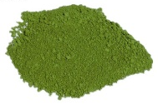
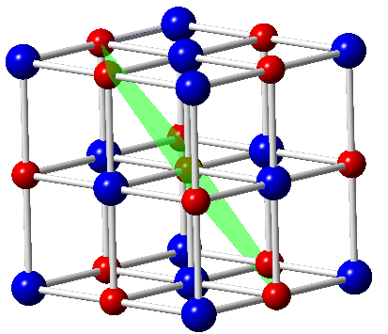
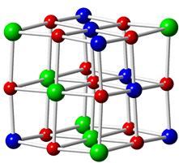
The electronic structure of NiO: a century inspiring debate
Li⁺
Transparent P-type semiconductor: Eg = 3.6 eV;
Antiferromagnetic (T_{N} = 523 K)
Application — Hole transport layer in solar cells
— Data storage
O²⁻
Ni²⁺: 3d⁸
18

Slide 19
The electronic structure of NiO: a century inspiring debate
Li⁺
Transparent P-type semiconductor: Eg = 3.6 eV;
Antiferromagnetic (T_{N} = 523 K)
Application — Hole transport layer in solar cells
— Data storage
O²⁻
Ni²⁺: 3d⁸
Electronic structure is interesting, because of strong electron correlation!!
Physicists’ picture
Chemists’ picture
VS
CB
CB
e_{g}
e_{g}
Energy
Eg= 3.6 eV
Energy
Eg
O 2p⁶
e_{g}
VB
e_{g}
VB
Ni 3d t_{2g}
Ni 3d t_{2g}
O 2p⁶
Physicists believe NiO is a charge transfer insulator (the top of valence band is O 2p)
Electrochemists believe they are cycling Ni²⁺/Ni³⁺ redox potential
G. Sawatzky, et al PRL 62, 221 (1989)
G. Sawatzky, et al PRL 53, 2339 (1984)
JB Goodenough, J. Phys. Chem. Solids (1958)
Allan Jacobson JACS 115 4173 (1993)
John Harding, PRB 85, 115127 (2012)
18

Slide 20
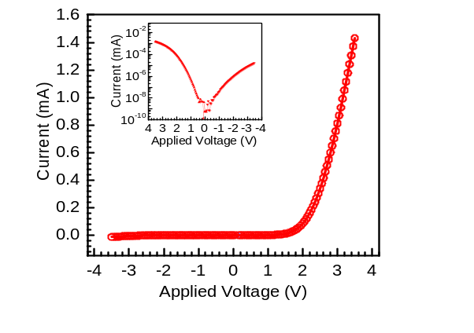
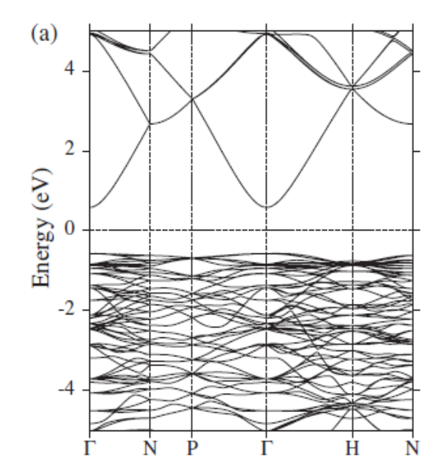
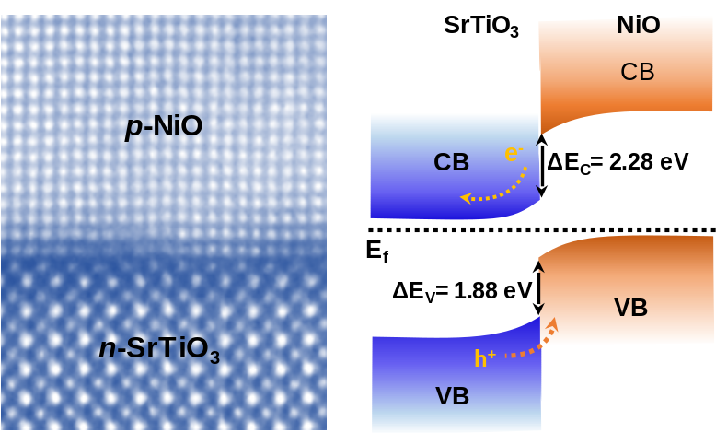

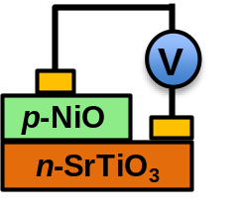
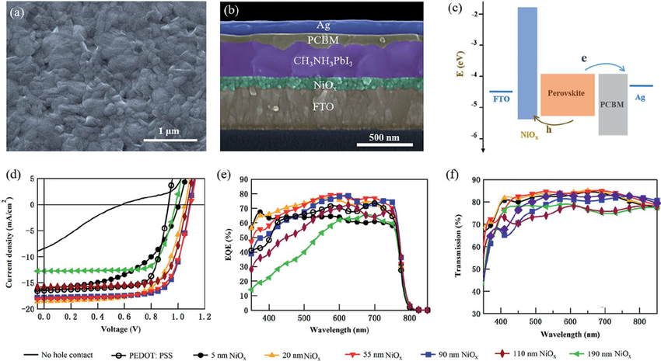
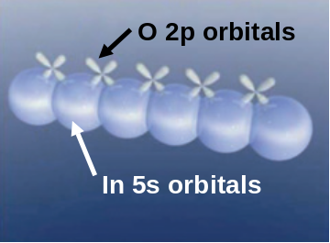
Search for P-type transparent oxide semiconductors
Most of the oxide semiconductors are n-type: ZnO, In₂O₃, SnO₂, TiO₂
It is challenging to achieve p-type oxide, because of the electronic structure of metal oxides, i.e., localized nature of O 2p at the valence band.
“Oxide Electronics”
Bandstructure of In₂O₃
CB
In 5s
Medvedeva, PRL 97 086401 (2006)
Zhang et al., J. Mater. Chem. C 6, 2275 (2018)
Hole transport layer in solar cells
VB: O 2p
Grätzel, Science (2015)
Zhang et al., J. Phys.: Condens. Matter. 28, 383002 （2016）
19

Slide 21
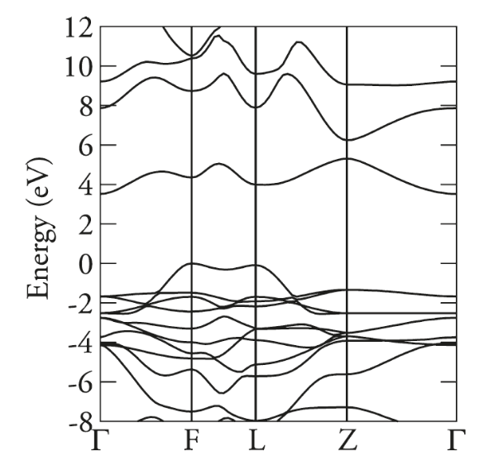
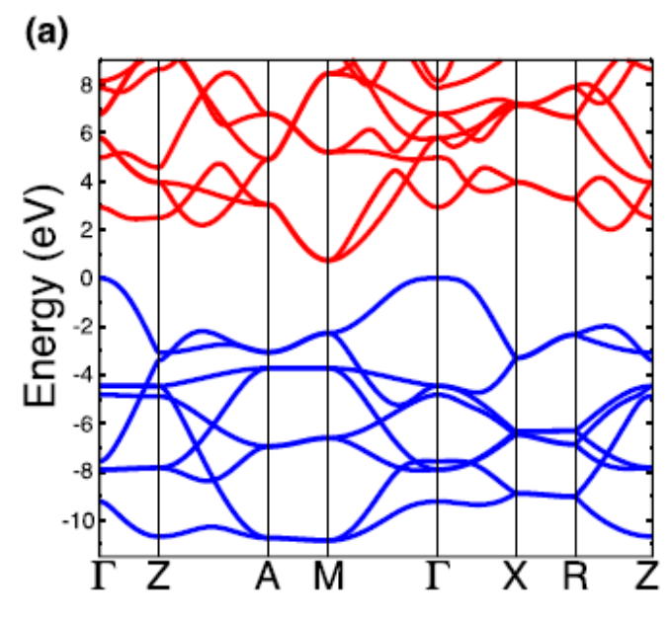
Search for P-type transparent oxide semiconductors
Solution: introducing states hybridized with O 2p hybridization at the top of valence band
Late transition metal cations (Ni, Co, Cu) 3d
Lone pair states (Bi 6s², Sn 5s²)
CuAlO₂
SnO
CB
CB
VBM: O 2p⁶ + Cu 3d¹⁰
VBM: O 2p⁶ + Sn 5s²
H. Hosono, et al. Nature 389, 939(1997).
Scanlon and Watson, Phys. Rev. Lett. 103, 096405 (2009).
JB Varley, Van der Walle et al. APL 103, 082118 (2013).
20

Slide 22
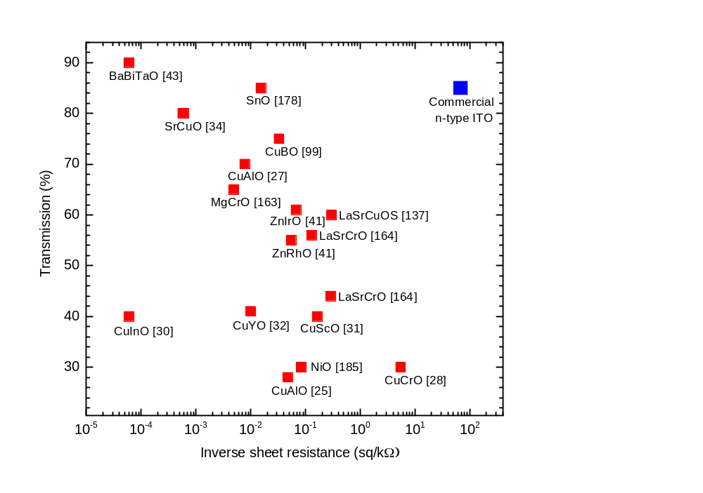
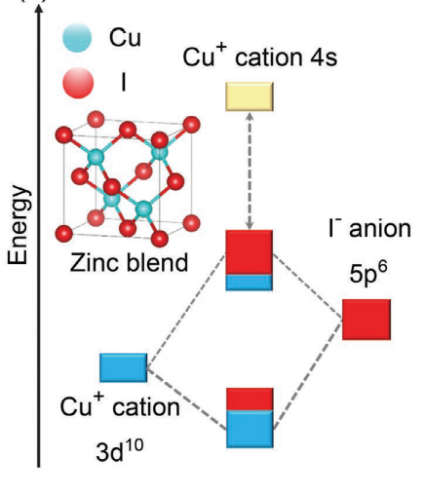
P-type transparent oxide semiconductors
XIAMEN
UNIVERSITY
CuSCN
E_{g}= 3.5 eV
μ=0.1 cm²V⁻¹s⁻¹
Thomas Anthopoulos,
Adv. Electronic Mater. (2017)
CuI
E_{g}= 3.1 eV
μ=44 cm²V⁻¹s⁻¹
Hideo Hosono,
Adv. Mater. (2018)
μ=7.6 cm²V⁻¹s⁻¹
ZnCo₂O₄
ZnIr₂O₄
? μ=0.01—30 cm²V⁻¹s⁻¹
?μ=10 cm²V⁻¹s⁻¹
Invited topical Review: P-type Transparent Conducting Oxides, J. Phys.: Condens. Matter. 28, 383002 （2016）
21

Slide 23
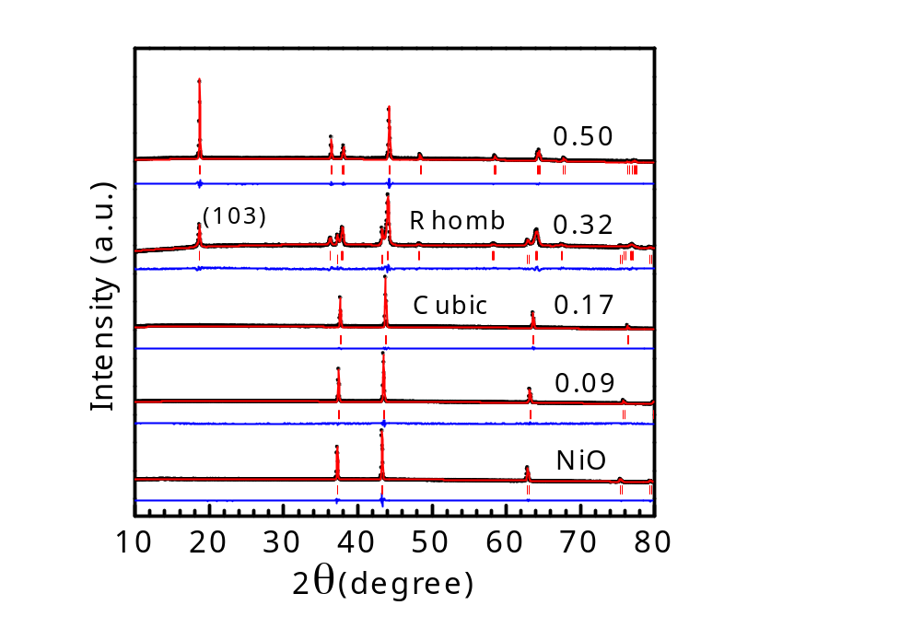
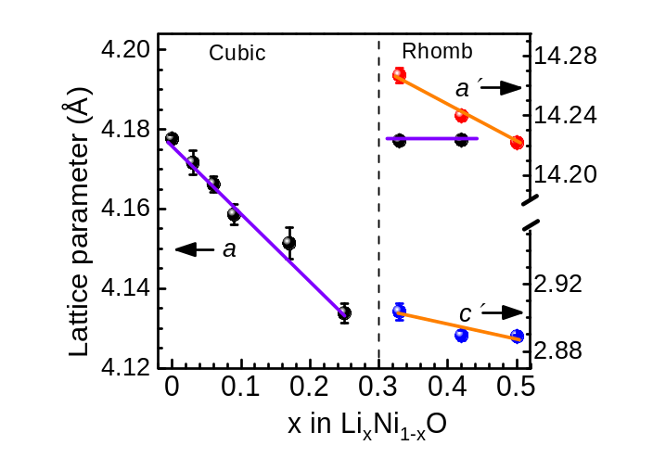
Li doped NiO (Li_{x}Ni_{1-x}O )
Li_{x}Ni_{1-x}O powders (x=0, 0.06, 0.09, 0.17, 0.25, 0.32, 0.50) were synthesized by grinding NiO and Li₂O and heating at 750ºC in flow of O₂ for 12 hours
Li_{0.5}Ni_{0.5}O
NiO
Ni³⁺
Li⁺
Ni²⁺
Ni²⁺ (3d⁸) Ni³⁺ (3d⁷)
Li randomly occupy at Ni sites for x< 0.32;
Lattice constants decrease as x increase;
Phase transition from Cubic to Rhombohedral at x>0.32;
Ionic radii
Li⁺ (90 pm)
Ni²⁺ (83 pm)
Ni³⁺ (70 pm)
22

Slide 24
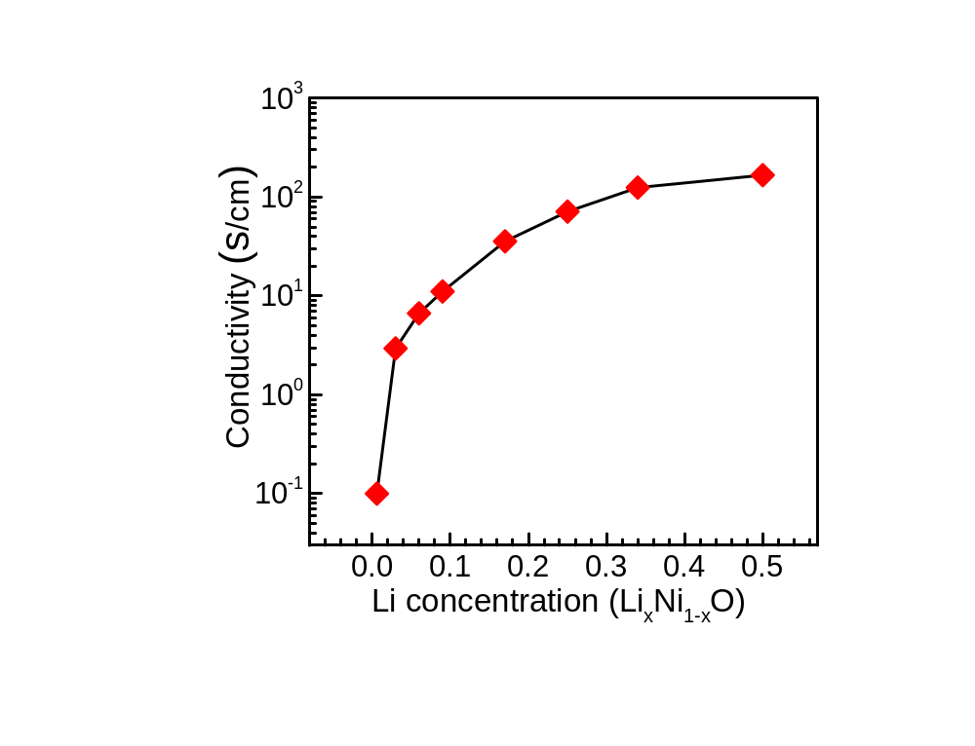






Optical and electronic properties of Li_{x}Ni_{1-x}O(0≤ x ≤ 0.5)
At x= 0.32, cubic to rhombohedra phase transition
With more Li doping, i.e., P-type doping, films become more conductive
“Bandgaps” from 3.6 eV to 0.5 eV, no insulator-to-metal transition
Cubic to Rhombohedra
NiO 0.01 0.03 0.09 0.25 0.50
J. Mater. Chem. C 6, 2275 (2018)
23

Slide 25


Electronic structures by XPS and O K-edge XAS spectra
XPS-VB
O K-edge
XAS
CB
Hole
Hole
E_{F}
Ni 3d⁸
O 2p⁶
VB
X-ray
O 1s
XPS-VB and O K-edge XAS spectra indicate development of hole state above VB, while the materials keep a semiconducting behavior.
Combined with optical absorption, we determined the hole state is ~ 1.0 eV above VB.
O K-edge X-ray absorption (XAS) probe O 1s to unoccupied states with O 2p character hybridized with Ni 3d, related to unoccupied density of states at CB.
24

Slide 26



Ni oxidation states and bond lengths
Ni K-edge
EXAFS
Ni²⁺
Ni³⁺
Unpublished data with Y.H. Du at SSLS (Singapore)
Ni³⁺
Ni²⁺
O²⁻
O^{1.7-}
Ni K-edge NEXAFS indicates more Ni³⁺ states with Li doping;
EXAFS indicate Ni-O bonding length decreases;
25

Slide 27



Li_{x}Ni_{1-x}O (x<0.06) with enhanced p-type conductivity and work function
Li_{x}Ni_{1-x}O
J. Mater. Chem. C 6, 2275 (2018)
26

Slide 28


Li_{x}Ni_{1-x}O (x<0.06) with enhanced p-type conductivity and work function
J. Mater. Chem. C 6, 2275 (2018)
27

Slide 29




Li_{x}Ni_{1-x}O (x<0.06) as hole transport layer in solar cells
The work functions of NiO can be tuned by Li or O;
The VB aligns perfect with organic perovskites.
J. Mater. Chem. A (Accepted)
Advanced Materials, 29, 1702176 (2017)
in collaboration with Judith Driscoll and Richard Friend, Cambridge
28

Slide 30





Interfacial electronic structure and band alignment at p-n heterojunctions
photoelectron
X-ray
2 nm NiO
N-SrTiO3(001)
Appl. Phys. Lett. 112, 171605 (2018)
ACS Appl. Mater.& Interface 9, 26549 (2017)
29

Slide 31





Electrocatalytic activity Test
1. Preparation of electrode
Ink: Li_{x}Ni_{1-x}O powder+Nafion+Ethonal
Drop-casting on glassy carbon electrode
(0.30 mg/cm²)
2. Electrochemical Test
LSV, CV, Tafel, EIS
Rotating disk electrode
Electrochemical Station
30

Slide 32

OER electrocatalytic activities of Li_{x}Ni_{1-x}O
OER activities of Li_{x}Ni_{1-x}O. (a) linear scan voltammetrys vs reversible hydrogen electrode (RHE), (b) tafel splots, (c) electrochemical impedance spectroscopy and (d) cyclic voltammetry for Li_{x}Ni_{1-x}O.
Li_{x}Ni_{1-x}O showing increasing OER activity as Li doping
31

Slide 33



Correlation of OER activity with electronic structures
The hole state at 1.1 eV above VB induced by Li provide an empty state for electron transfer from OH- to the catalyst.
DFT +U calculations (with Prof J. Cheng)
G.L. Fu et al. Submitted
32

Slide 34




Correlation of OER activity with electronic structures
G.L. Fu et al. Submitted
33

Slide 35

Summary
Li doping in NiO introduce hole state at 1.1 eV above VB for new functionalities.
P-type transparent semiconductor as a hole transport layer for PV
Transparent p-n heterojunctions for UV photodetectors and photocatalytic water splitting;
Combined XRD, XPS and hard XAS spectra, DFT support formation of Ni³⁺ states with Li doping. Hole is of Ni 3d character!
The hole state associated with Ni³⁺ enhances the absorption of OH group on catalyst surface, hence the OER activity.
P- LSCO
N- SrTiO3
Enhanced control over defects/doping will enable new science and unprecedented functional properties, leading to new applications.

Slide 36




Acknowledgement
Group: Gaoliang Fu(electrocatalyst); Jiaye Zhang(electronics);
Pulsed Laser Deposition
Judith Driscoll (Cambridge); Lang Chen (SusTech); Oliver Bierwagen (Paul-Drude-Institut, Berlin)
XPS-XAS (Diamond, Australia, Singapore)
David Payne (Imperial), Dongchen Qi (La Trobe, Australia), Anton Tadich (Australian Synchrotron) Russell Egdell (Oxford), Louis Piper (Binghamton, USA), Tien -Lin Lee (Diamond，UK); Jan Philipp Hofmann (Eindhoven);
DFT: Aron Walsh (Imperial), Jun Cheng (Xiamen)
STEM: Vlado Lazarov (York)
Scott Chambers at PNNL
Email: kelvinzhang@xmu.edu.cn

Slide 37



存在问题！！
OER过程中表面非晶化, 形成Co(OH)₂
氧化物中的晶格氧参与反应
OER与pH值有关系
Catalysis Today, 2016，262, 2-10
Nature Materials, 2017，16, 925-931
Nature Chemistry, 2017，9, 457-465

Slide 38





催化活性与电子结构关系---研究总体思路
关键科学问题: 电子结构与电催化OER活性内在构效关系
物理性质
3d轨道强关联
OER活性 吸附能
电催化理论计算
同步辐射光子
能谱
理论计算
原位电化学X射线
吸收谱
电子结构
激光溅射沉积实现原子级精准调控
掺杂
氧缺陷
晶面取向
应力
(001)
(110)
单晶薄膜模型催化剂: 钙钛矿LaNiO₃ 和尖晶石Co₃O₄

Slide 39





基于外延单晶薄膜的模型电催化
(a)
(b)
(c)
Film
Covering
Nb:STO
RDE
(d)

Slide 40





In-operando — 同步辐射吸收谱(XANES & EXAFS)
RE
EXAFS
XANES
Ni K edge
CE
&WE
XANES: 价态, 电子结构
EXAFS: 键长， 配位数

Slide 41



尖晶石(spinel)：Co₃O₄, Ni_{x}Co_{3-x}O₄
T_{d} -Co²⁺
O_{h}-Co³⁺
有疑问或争议科学问题！
Active site
氧缺陷
氧缺陷提高催化性能，几乎所有文献指出由于氧缺陷提高导电性所致?
从半导体物理角度, Co₃O₄ 为p-型半导体。氧缺陷引入hole-killer, 只能降低导电性！
Co₃O₄ 电子结构问题。
晶面取向
不同文献报道不同活性面:
CO oxidization: (011)>(111)=(001)
Methane combustion: (112)>(011)=(001)
OER: 极为争议;
JPCL 5, 2370 (2014); JACS138, 36 (2015);
PCCP 17, 29387(2015)
核心问题是Co²⁺(T_{d} ), Co³⁺(O_{h})哪个更活跃?
Low temperature CO oxidization；
Xie et al., Nature 458, 746 (2009)
Methane combustion;
Hu et al., JACS 130, 16136 (2008)
Oxygen evolution reaction;
JACS, 135, 13521 (2013); Nat. Mater. 16, 335 (2017)

Slide 42




XIAMEN
UNIVERSITY
研究方法
脉冲激光沉积(PLD)外延生长功能氧化物单晶薄膜和异质结
优势: 原子级精准控制生长,晶面取向,缺陷/掺杂,表界面
基于同步辐射的光电子能谱(PES) + 吸收谱(XANES & EXAFS), DFT等;
研究材料电子结构, 光学, 磁学，表界面等物理性能.
电化学，光电化学
XPS
PLD
LaCrO₃
SrTiO₃

Slide 43
Acknowledgement
Group: Gaoliang Fu; Jiaye Zhang;……
Pulsed Laser Deposition
Judith Driscoll (Cambridge); Lang Chen (SusTech); Oliver Bierwagen (Paul-Drude-Institut, Berlin)
XPS-XAS (Diamond, Australia, Singapore)
David Payne (Imperial), Dongchen Qi (La Trobe, Australia), Anton Tadich (Australian Synchrotron) Russell Egdell (Oxford), Louis Piper (Binghamton, USA), Tien -Lin Lee (Diamond，UK); Jan Philipp Hofmann (Eindhoven);
DFT: Aron Walsh (Imperial), Jun Cheng (Xiamen)
STEM: Vlado Lazarov (York)
Scott Chambers at PNNL
Email: kelvinzhang@xmu.edu.cn

Slide 44
The electronic structure of NiO: a century inspiring debate
Li⁺
Transparent P-type semiconductor: Eg = 3.6 eV;
Antiferromagnetic (T_{N} = 523 K)
Application — Hole transport layer in solar cells
— Data storage
O²⁻
Ni²⁺: 3d⁸
Electronic structure is interesting, because of strong electron correlation!!
Physicists’ picture
Chemists’ picture
VS
CB
CB
e_{g}
e_{g}
Energy
Eg= 3.6 eV
Energy
Eg
O 2p⁶
e_{g}
VB
e_{g}
VB
Ni 3d t_{2g}
Ni 3d t_{2g}
O 2p⁶
Physicists believe NiO is a charge transfer insulator (the top of valence band is O 2p)
Electrochemists believe they are cycling Ni²⁺/Ni³⁺ redox potential
G. Sawatzky, et al PRL 62, 221 (1989)
G. Sawatzky, et al PRL 53, 2339 (1984)
JB Goodenough, J. Phys. Chem. Solids (1958)
Allan Jacobson JACS 115 4173 (1993)
John Harding, PRB 85, 115127 (2012)

Slide 45



P-type transparent conducting oxide as hole transport layer in solar cells
Yang, et al Nat. Nanotech 2016
Chen, Grätzel et al Science 2015

Slide 46






Reciprocal space map of Li_{x}Ni_{1-x}O (x=0, 0.006, 0.03, 0.06, 0.09) thin films on MgO(001)
Li⁺
O²⁻
Ni²⁺
Li_{x}Ni_{1-x}O

Slide 47



Summary
Sr doped LaCrO₃ as a new p-type TCOs
Ordered oxygen vacancies in SrCrO_{3-x} leading to fast redox at low temperature
The fundamental electronic structure is elusive and inspiring; Li doping NiO can introduce hole state for new functionalities.
e_{g}
Eg= 3.5 eV
Energy
O 2p6
P- LSCO
e_{g}
N- SrTiO3
Ni 3d t_{2g}
Enhanced control over defects/doping will enable new science and unprecedented functional properties, leading to new applications.
28

Slide 48


XIAMEN
UNIVERSITY
Perovskite Transition Metal Oxides
ABO₃
A=La³⁺, Sr²⁺
B=Cr^{3/4+}
Lev Perovski
Russian mineralogist
A: lanthanide or alkaline earth metal e.g., La³⁺, Sr²⁺;
B: transition metal (TM) cations, e.g. Cr;
H_{Tc} superconductor; Bednorz and Müller, Zeitschrift für Physik B, 64,189 (1986)
Colossal magnetoresistance; Jin and Ramesh et al. Science, 264 413 (1994)
electrocatalyst, solar cells (Special Issue: PEROVSKITES, Science, 2017)
14

Slide 49

Why Sr doped LaCrO₃
XIAMEN
UNIVERSITY
Sr doped LaCrO₃ is important material for SOFC and catalytic applications
Pure LaCrO₃ is a Mott insulator with bandgap of 2.9 eV; The top of VB mainly from Cr 3d t_{2g} states; SrCrO₃ is a metallic oxide.
Sr doping (x) for insulator-to-metal transition (La_{1-x}Sr_{x}MO₃)
3d¹
3d²
3d³
3d⁴
3d⁵
3d⁶
3d⁷
3d⁹
Ti³⁺
V³⁺
Cr³⁺
Mn³⁺
Fe³⁺
Co³⁺
Ni³⁺
Cu²⁺
x=0.17
Insulating?
x=0.17
Insulating?
x=0.17
Metallic
x=0.05
x=0.03
LaCrO₃
Bandgaps of parent LaM³⁺O₃
LaFeO₃
La₂CuO₄
LaVO₃
LaMnO₃
LaCoO₃
LaTiO₃
LaNiO₃
Imada, Fujimori, Tokura, Rev. Mod. Phys. 70, 1039 (1998)
15

Slide 50


Why Sr doped LaCrO₃
XIAMEN
UNIVERSITY
Sr doped LaCrO₃ is important material for solid oxide fuel cell and catalytic applications
Pure LaCrO₃ is a Mott insulator with bandgap of 2.9 eV; The top of VB mainly from Cr 3d t_{2g} states; SrCrO₃ is a metallic oxide.
Optical absorption spectra of LaCrO₃
Cr e_{g}
Eg
A
B
Cr t_{2g}
O2p
B
A
forbidden
Phys. Rev. Lett. 110, 077401 (2013)
Adv. Funct. Mat., 23, 2952 (2013)
16

Slide 51


Sr掺杂对La_{1-x}Sr_{x}CrO₃(0≤ x ≤ 1)电学, 光学性质的影响
XPS
理解LaCrO₃的本身能带结构;
Cr和其他3d TM 钙钛矿一样,存在MIT转变;
较低温度(250ºC)发生可逆的氧化-还原(Redox)反应。
O K-edge
XAS
X-ray
O 1s
O 1s
Phys. Rev. B 91, 155129 (2015); Adv. Mater. 27, 5191 (2015);
Nat. Comm., 5, 4669 (2014); Appl. Phys. Lett. 111, 063501 (2017);

Slide 52





我们可以提供
高质量外延单晶薄膜, 异质结, 表界面修饰 (custom-designed)
基于同步辐射的光电子能谱(PES) + 吸收谱(XANES & EXAFS)
表界面电子结构， 电荷转移； 价态， 配位数，键长
Email: kelvinzhang@xmu.edu.cn
27

Slide 53

Electrochemical Energy Conversion
2

Slide 54



同步辐射光源(Synchrotron radiation)
同步辐射光源(Synchrotron radiation)，一种利用高速运行的电子(相对论性)在磁场中偏转时产生同步辐射的高性能新型, 超高强度的光源。
简单原理: 变化的电场产生磁场！
欧盟7个
美国5个
日本3个
新加坡 1个
中国上海
I09, B07(ambient pressure XPS), I06(XMCD)
Diamond, UK
4

Slide 55

基于同步辐射的光电子能谱(PES)+吸收谱(XANES & EXAFS)
不仅可以采集组分,价态,配位数,键长
1. 采集电子结构信息(价带,导带的态密度)
英国Diamond Light Source
5

Slide 56

基于同步辐射的光电子能谱(PES)+吸收谱(XANES & EXAFS)
2. 不仅是surface sensitive;
Hard X-ray XPS有空间分辨
Electron mean free path
Seah & Dench, Surf. Interface. Anal.1,2(1979)
15 nm
3 nm
3. Ambient-pressure XPS
In-Operando XANES&EXAFS
英国Diamond Light Source
6

Slide 57



研究方向二: 透明氧化物半导体电子结构
Ga₂O₃, BaSnO₃
Understanding the electronic structure is important !
Missile Warning Sensor

Slide 58



方向一:透明氧化物半导体(In₂O₃、Ga₂O₃、BaSnO₃)
触摸屏,光伏
透明 — 大于3.1 eV 带隙
导电性 — 半导体掺杂
In₂O₃
Sn掺杂In₂O₃ (ITO)
Energy
Energy
导带
导带
E_{f}
带隙
>3.1 eV
带隙
>3.1 eV
《阿凡达》
E_{f}
价带
价带
紫外探测，导弹预警
Understanding the electronic structure is important !
Facchetti, T. J. Marks,Transparent Electronics: From Synthesis to Applications (Wiley, 2010)
KHL Zhang et al. Phys. Rev. Lett. 110, 056803 (2013)
KHL Zhang, Scott Chambers, Oxide Semiconductors (Wiley, 2019)
8

Slide 59



面临的挑战和机遇
1. 铟的地壳含量较少, 价格越高(与银相当)
已商业化透明导电电极Sn掺杂的In₂O₃（ITO）占据95%的市场份额, for Flat Panel Displays.
2. 大部分是N-型, 实现P-型氧化物半导体是本领域的难题；
U.S. Geological
Survey 2015
中国是主要铟原料供应国， 却是ITO薄膜重要进口国
14

Slide 60


科学问题: n-type conductivity in undoped materials
Pure In₂O₃, ZnO and SnO₂ show considerable free electron densities up to 1x10¹⁸ cm⁻³
The origin of n-type conductivity?
Historically, the n-type conductivity was attributed to oxygen vacancies (Vo)
However, DFT and experiments show the state of Vo is deeply localized
In³⁺
O²⁻
DFT calculation of the formation energy of intrinsic defect in SnO₂
In
e
e
A. Zunger et al. PRL 88, 095501 (2002)
15

Slide 61




In₂O₃ 薄膜, 纳米结构可控生长
O²⁻
In³⁺
O²⁻
In³⁺
O²⁻
In³⁺
DFT 计算In₂O₃晶面表面能(J/m²)
实验与理论结合, 揭示In₂O₃表面能各向异性所控制的生长形貌, 为In₂O₃的纳米合成提供指导。
在(111)面上实现缺陷少, 高迁移率In₂O₃外延薄膜。
Surface | Tasker Type | energy
100 | polar | 1.95
110 | Neutral | 1.07
111 | Quadrupolar | 0.89
Zhang, Cowley, et al. ACS Nano 6, 6717 (2012)
Zhang, Egdell, et al. Phys. Rev. B 84, 233301 (2011)
Walsh, Zhang, Catlow et al. Phys. Rev. B 83, 161202 (2011)
17
Notes:
61

Slide 62



Epitaxial growth of In₂O₃ and 3%Sn-doped In₂O₃ (ITO) on YSZ (111)
Carrier concentrations (n) determined by Hall measurement and further verified by Infrared reflectivity.
The amount of free carrier put the Fermi level of In₂O₃ at 0.1 eV below CBM, while 0.3 eV above CBM for ITO
In₂O₃
n= 2 × 10¹⁸ cm⁻³
ITO
n= 1 × 10²¹ cm⁻³
CB
In5s
CB
In5s
E_{F}
E_{F}
Sn⁴⁺ 5s
VB
O2p⁶
VB
O2p⁶
18

Slide 63


Surface electron accumulation and downward band bending at the surface region of In₂O₃
O2p⁶
In₂O₃: n= 3 × 10¹⁷ cm⁻³
ITO: n= 1 × 10²¹ cm⁻³
A well-defined peak observed at Fermi level (E_{F}) for In₂O₃ ??
The peak intensity corresponds to carrier concentration of 2×10²⁰cm⁻³.
Note the bulk carrier concentration for In₂O₃ is only 3 × 10¹⁷cm⁻³
KHL Zhang, PDC King and RG Egdell, et. al Phys. Rev. Lett. 110, 056803 (2013)
19

Slide 64

In₂O₃ 表面电子结构研究
Electron mean free path
Surf. Interface. Anal.1,2(1979)
hγ=1000 eV
hγ=6000 eV
E_{F}
10 nm
2 nm
In 5s²
In 5s²
表面
2 nm
In₂O₃
表面二维电子气
ZnO, maybe?
SnO₂ ---- Phys. Rev. B, 90 155413 (2014);
SrTiO₃ --- Nat. Mater. 13, 1085 (2014);
InN---- Phys. Rev. Lett. 92, 036804 (2004);
体相
一系列基于同步辐射光电子能谱发现In₂O₃表面存在表面二维电子气。解决了自1980年以来关于氧化铟表面电子态的争论。
Zhang, Egdell*, King, et. al., Phys. Rev. Lett. 110, 056803 (2013) (PRL亮点论文)
Zhang, Egdell, et al. Chem. Mater. 21, 4353 (2009); Zhang, et al. Surface Science 6, 6717 (2012)
20

Slide 65
In₂O₃ 表面电子结构研究
Electron mean free path
Surf. Interface. Anal.1,2(1979)
15 nm
3 nm
In 5s²
In 5s²
表面
2 nm
In₂O₃
表面二维电子气
ZnO, maybe?
SnO₂ ---- Phys. Rev. B, 90 155413 (2014);
SrTiO₃ --- Nat. Mater. 13, 1085 (2014);
InN---- Phys. Rev. Lett. 92, 036804 (2004);
体相
一系列基于同步辐射光电子能谱发现In₂O₃表面存在表面二维电子气。解决了自1980年以来关于氧化铟表面电子态的争论。
Zhang, Egdell*, King, et. al., Phys. Rev. Lett. 110, 056803 (2013) (PRL亮点论文)
Zhang, Egdell, et al. Chem. Mater. 21, 4353 (2009); Zhang, et al. Surface Science 6, 6717 (2012)
21

Slide 66

Microscopic origin: oxygen vacancies (V_{o})？
The surface V_{O} have low ionization energy and act as the source for the 2DEG.
1.6% of surface V_{O} sites gives rise to 2DEG
A gap state (GS) is observed at 1.5 eV below CB from our photoemission measurement;
DFT calculation show bulk V_{O} is 1.1 eV below CBM.
Too deep to be ionized to generate free electrons
Lany and Zunger, Phys. Rev. Lett. 108, 016802 (2012)
22

Slide 67



基于同步辐射的光电子能谱(PES) + 吸收谱(XANES & EXAFS)
表面一价 In⁺ 5s²存孤对电子存在！
Sn²⁺, Pb²⁺, Bi³⁺
Mudd, McConville, Zhang, et. al., Phys. Rev. B (Submitted)
23

Slide 68



Implications for device applications
2DEG (downward band bending) are also observed in SnO₂, CdO, IGZO, SrTiO₃,InN, which may explain intrinsic n-type conductivity.
SnO₂ ----Phys. Rev. B, 90 155413 (2014);
CdO -----Phys. Rev. B, 78, 165127 (2008);
SrTiO₃ ---Nature materials 10, 114 (2011);
InN------- Phys. Rev. Lett. 92, 036804 (2004);
IGZO----J. Appl. Phys. 109, 073726 (2011)
The exist of 2DEG explains why these oxides can be used as ultra-sensitive gas sensor:
2DEG is sensitive to the oxidizing gas, so does the conductance.
2DEG in IGZO surface
O₃ or NO₂
Conductance vs NO₂ concentration
In₂O₃ nanowire
DH Zhang, et al. Nano Lett. 4, 1919 (2004).
24

Slide 69




二维电子气(2DEG)的调控
4 nm NiO
E_{f}
1.2 nm NiO
ACS Nano 11, 6040 (2017)
In₂O₃
25

Slide 70


