Slide 1
Antimicrobial nanobiomaterials for scaffolds and medical devices
Andrea J. O’Connor
Department of Biomedical Engineering,
Particulate Fluids Processing Centre
University of Melbourne
Australia a.oconnor@unimelb.edu.au

Slide 2
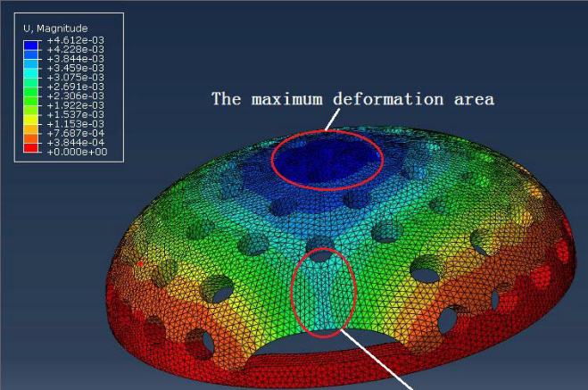
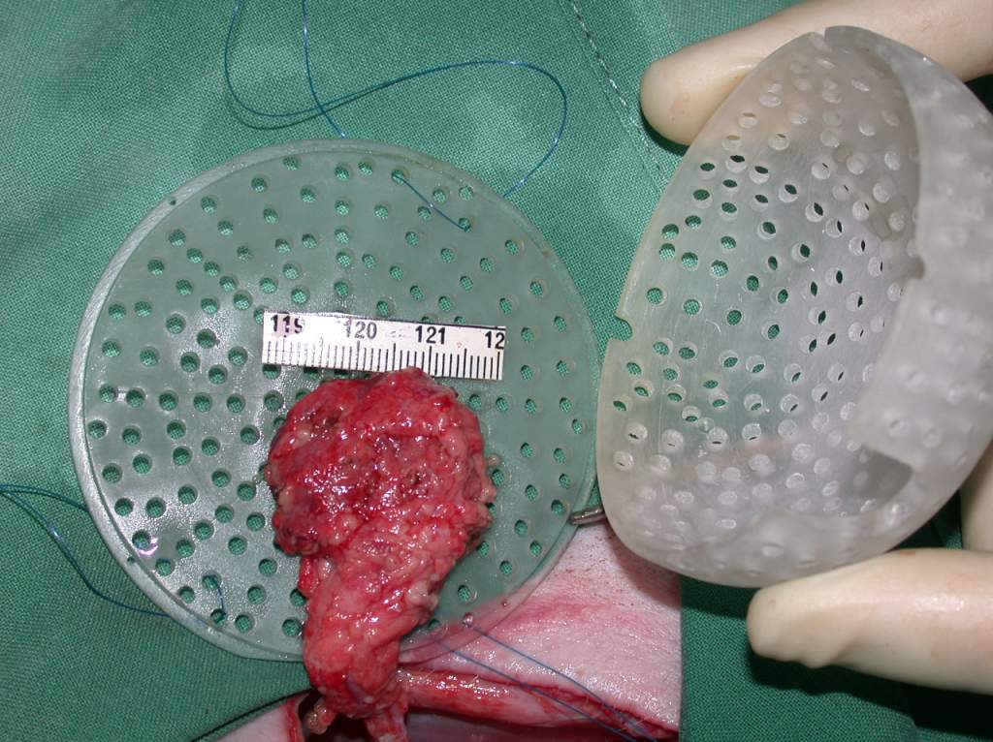
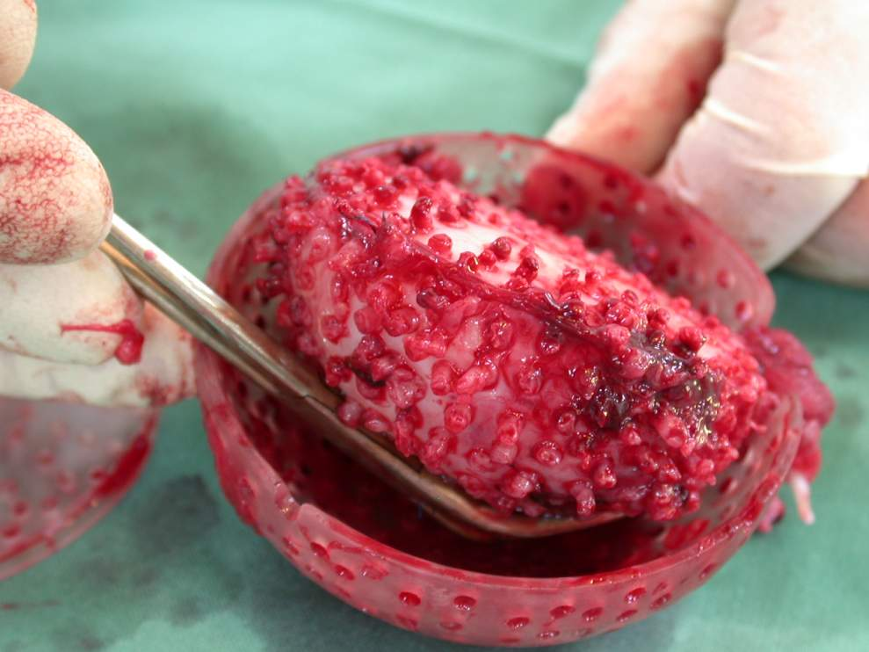
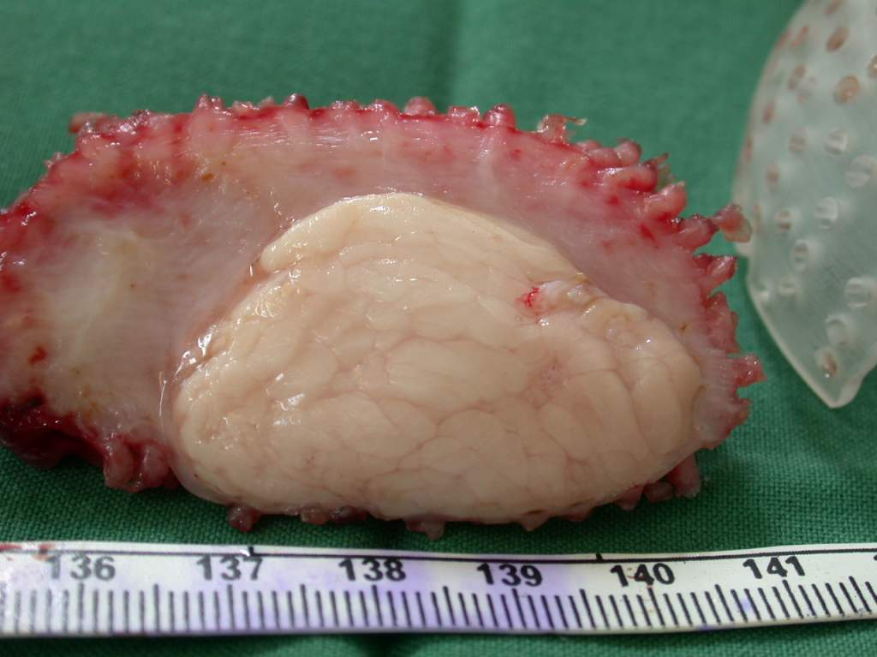
Clinical challenges in tissue engineering and implanted medical devices
In vivo bioreactors for soft tissue engineering
Images: OBI
Notes:
Chambers required for strength while maintaining internal biomimetics
Pig’s work well up - ~ 80 mL tissue, largely fat can be grown

Slide 3
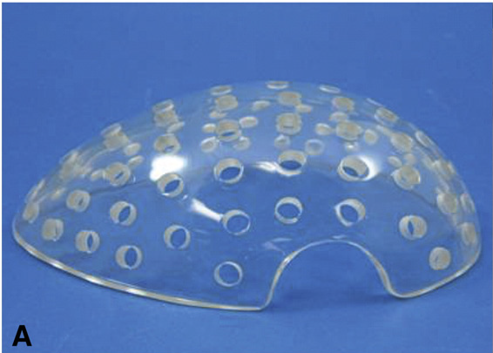
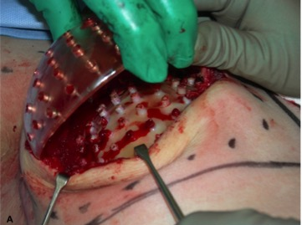
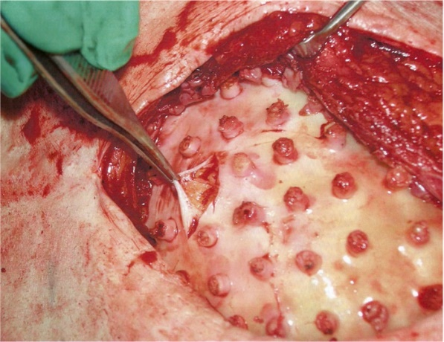
Human clinical trial: Neopec project
Proof of concept:
in one patient 210 mL new tissue was generated
tissue was stable and soft 6 months later
Morrison, W.A., D. Marre, D. Grinsell, A. Batty, N. Trost, A.J. O’Connor, EBioMedicine, 2016. 6: 238-245.
Notes:
Intraoperative view upon chamber removal of patient 2. The 210ml space is entirely filled with tissue.
Detail of tissue generated in patient 2 showing adipose tissue under fibrous capsule in the lateral aspect.
Study provides evidence that generation of large well-vascularized tissue engineered constructs using the TEC is feasible in humans

Slide 4
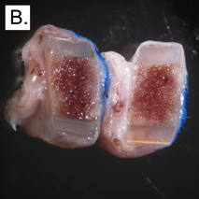
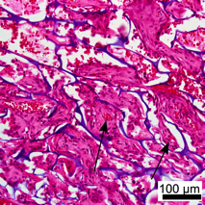
Many challenges remain…
Some TE construct goals:
mimic native tissue microenvironments
impart tunable forces to cells
encourage vascularisation and desired cell-cell interactions
maintain space, surfaces for cell attachment and migration
deliver bioactive molecules
use materials that biodegrade with suitable profile and byproducts
patient to patient variability
force regulation…over time in vivo
foreign body responses to implanted materials
cell density, assembly, communication
avoiding device-associated infections / biofilms

Slide 5
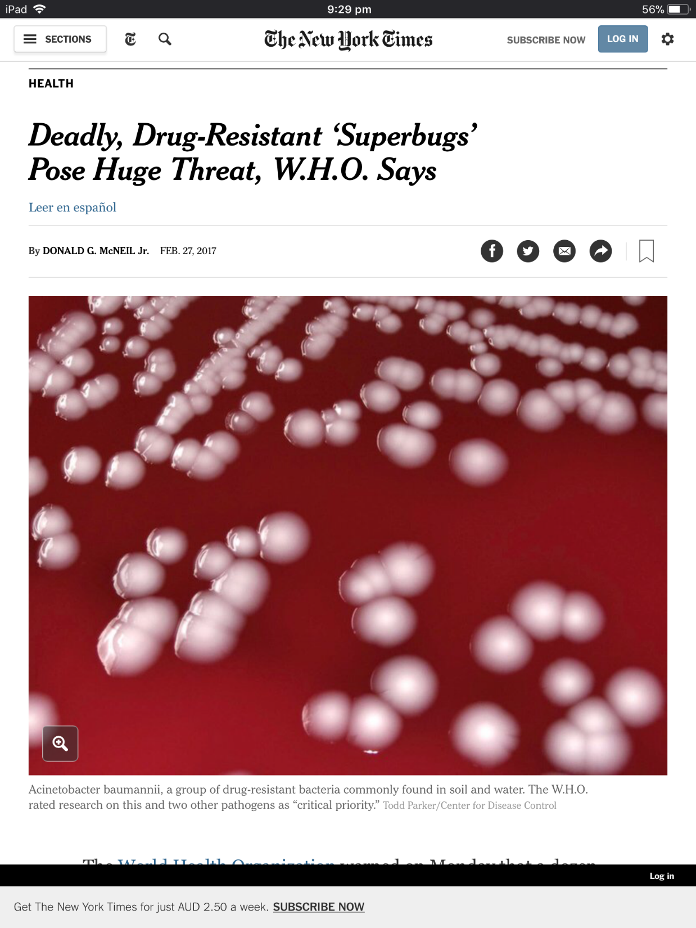
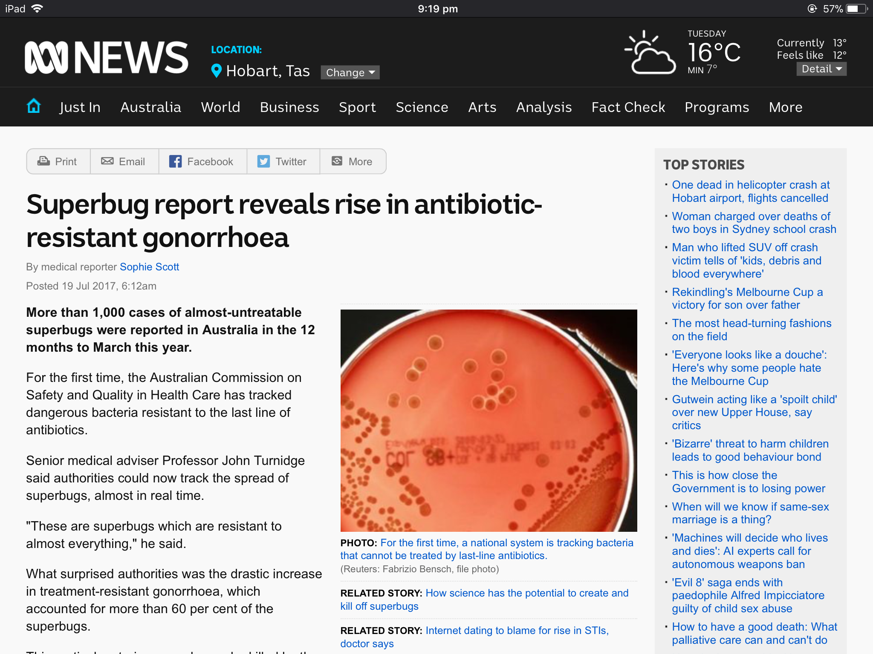


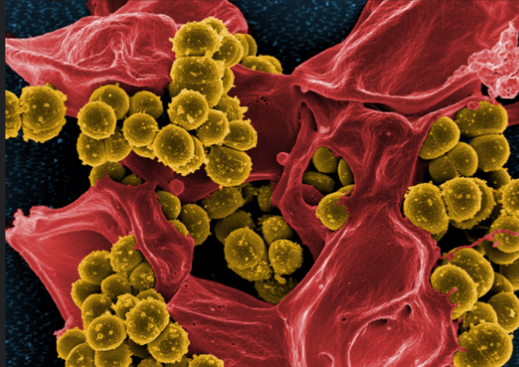

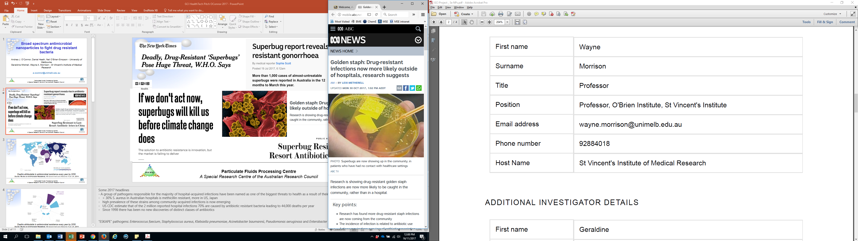

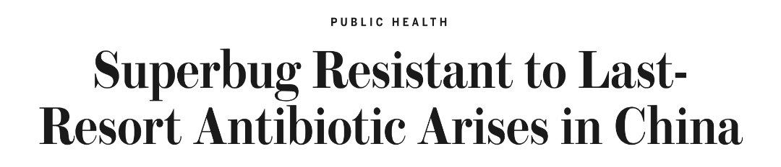
Notes:
Some 2017 headlines
- A group of pathogens responsible for the majority of hospital-acquired infections have been named as one of the biggest threats to health as a result of their growing multidrug resistance by WHO
> 30% S. aureus in Australian hospitals is methicillin resistant, more in US, Japan
high prevalence of these strains among community-acquired infections is now emerging
US CDC estimate that of the 2 million reported hospital infections 70% are caused by antibiotic resistant bacteria leading to 44,000 deaths per year
“ESKAPE” pathogens: Enterococcus faecium, Staphylococcus aureus, Klebsiella pneumoniae, Acinetobacter baumannii, Pseudomonas aeruginosa and Enterobacter species

Slide 6

Current impacts:
Resistant infections: > 700,000 deaths /yr
societal cost (USA) ~US$35 billion
Chronic wounds: > 20 million people
cost (global) ~US$31 billion
Annual death rates. Review on Antimicrobial Resistance, 2014
Notes:
By 2050 – more people will die from AMR infection than cancer
Up to 70% of all chronic wounds are colonized by biofilms
Refs:
Australian National Antimicrobial Resistance Strategy 2015-2019
Leaper, D., O. Assadian, and C.E. Edmiston, Approach to chronic wound infections. British Journal of Dermatology, 2015. 173(2): p. 351-358.
Bumpus, K. and M.A. Maier, The ABC’s of wound care. Current cardiology reports, 2013. 15(4): p. 1-6.

Slide 7
Bacterial infection and biofilm formation
leading complications following implantation of foreign materials into the body to repair / regenerate tissue
standard antibiotic therapy often requires very high, possibly toxic doses leading to impaired healing
multidrug-resistant bacteria developing and spreading
biofilms resist antibiotic penetration, difficult to treat
Notes:
A bacterial biofilm is defined as a complex community of aggregated bacteria embedded within a self-secreted polymeric matrix and adherent to an organic or inorganic surface. The biofilm state confers added defence and survival mechanisms to the resident bacterial community, including protection from the actions of the host immune system and enhanced resistance to antimicrobial agents. The release of planktonic bacteria from the biofilm additionally contributes to the persistence of the biofilm infection.

Slide 8
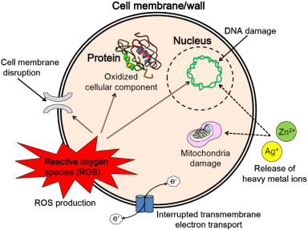
Antibiotic nanoparticles
Aim to overcome challenges of drug resistance and cytotoxicity
Inherently antimicrobial nanoparticles & antibiotic-conjugated nanoparticles
Simple with unique abilities to kill / inhibit bacteria
e.g., Ag, ZnO, TiO₂, Se nanoparticles
High doses may be toxic to mammalian cells
Huh, Kwon, J.Controlled Release, 2011
Notes:
These nanosized material properties differ from their corresponding bulk materials, e.g., high SA / V, ability to generate reactive oxygen species that enable them to inhibit bacterial growth and/or destroy bacteria.
Aim to overcome challenges of drug resistance and cytotoxicity
Inherently antimicrobial nanoparticles and antibiotic-conjugated nanoparticles
Simple with unique abilities to kill / inhibit bacteria
E.g., silver, zinc oxide, titanium dioxide, selenium nanoparticles
May be toxic to mammalian cells/tissues at high concentrations
Se: essential trace element naturally found in humans
Se-NPs: Low toxicity to human cells

Slide 9
Selenium-based Engineered Nanoparticles (Se-NPs)
Se: essential trace element
Selenoproteins: important for antioxidant defence systems and redox control of cell reactions
Antimicrobial activity towards Gram +ve bacteria
Low mammalian cytotoxicity
Notes:
Smaller size of Se NPs showed higher cytotoxicity.
Have window to operate with low cytotoxicity and good antimicrobial activity
excellent antimicrobial activity of the selenium nanoparticles towards Gram-positive bacteria, such as S. aureus and MRSA, but limited efficacy against Gram-negative bacterial strains, both in vitro and in vivo
[The amount of Se in the body ranges from 10 to 20 mg in adults, the recommended daily allowance is 55 μg/day and high doses of Se are toxic (more than 400 μg/day) . ]

Slide 10
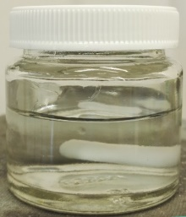
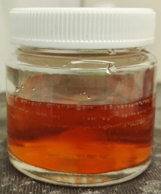
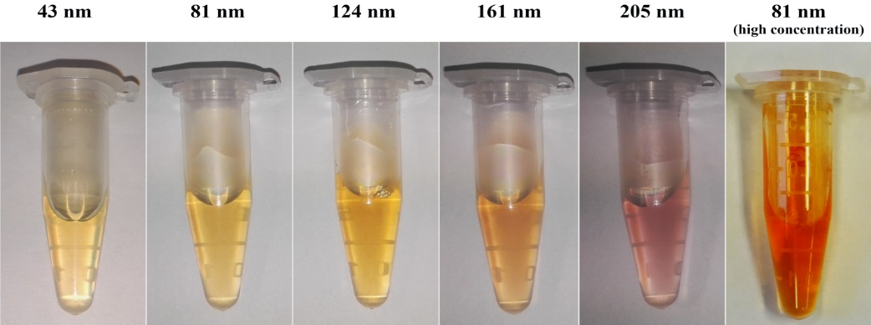
Se nanoparticle synthesis: size control
Se nanoparticles synthesised via redox reaction
Notes:
Selenium dioxide was used as the selenite precursor and sodium thiosulfate (Na₂S₂O₃) as the reducing agent with PVA (PVA, MW 9,000-10,000, 80% hydrolyzed) as a stabilizer.
Sizes via Zetasizer (DLS)
Zeta potential ~ -10 mV

Slide 11
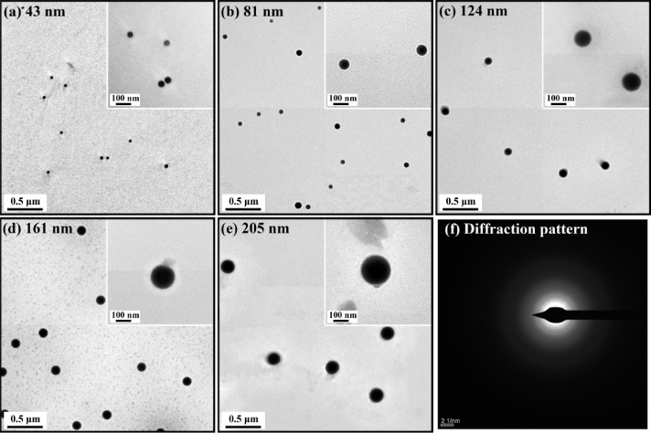
Se nanoparticle characterization
TEM EDS
OH
OH
OH
OH
OH
Se
HO
DLS FTIR
PVA
HO
HO
Notes:
TEM – spherical, amorphous, PVA layer visible coating
EDS (Energy Dispersive Spectroscopy) – composed of Se (Cu, C, O from TEM grid and PVA)
DLS – monomodal, narrow distributions
FTIR - the PVA on the surface of Se NPs showed a shift in the hydroxyl peak to 3350 cm⁻¹ ⁻ indicated that PVA was conjugated to the surface of Se NPs through the –OH group . new peak at 1649 cm⁻¹ also indicated interactions between C=O (carbonyl) from PVA and the Se NPs

Slide 12
Se nanoparticle characterization
Mean size of Se NPs (nm) | 43 | 81 | 124 | 161 | 205
Mean zeta potential (mV) | -8.25 (± 0.10) | -10.00 (± 0.70) | -10.85 (± 0.49) | -11.90 (± 1.41) | -8.73 (± 0.26)
Zeta potential
Stability in aqueous media
Notes:
Stability tested in SBF +/- human plasma

Slide 13
Mammalian cell responses: proliferation
Proliferation of human dermal fibroblasts with Se nanoparticles
Notes:
All sizes of Se NPs would not affect HDF viability when concentration <= 5 µg/mL.
When the concentration is up to 10 µg/mL, Se NPs show a chronic toxicity on HDF.
Bigger sizes of Se NPs exhibited lower toxicity.
(cck-8 assay)

Slide 14
Mammalian cell responses: cell lysis
LDH (lactate dehydrogenase) release of human dermal fibroblasts with Se nanoparticles (6h)
Notes:
LDH release indicates cell lysis
All sizes of Se NPs showed no higher level of released LDH than control for Se <= 12.5 µg/mL.
For Se >= 25 µg/mL, Se NPs started showing toxicity on HDF.
Bigger sizes of Se NPs exhibited lower toxicity.
Cyto Tox 96® nonradioactive assay

Slide 15
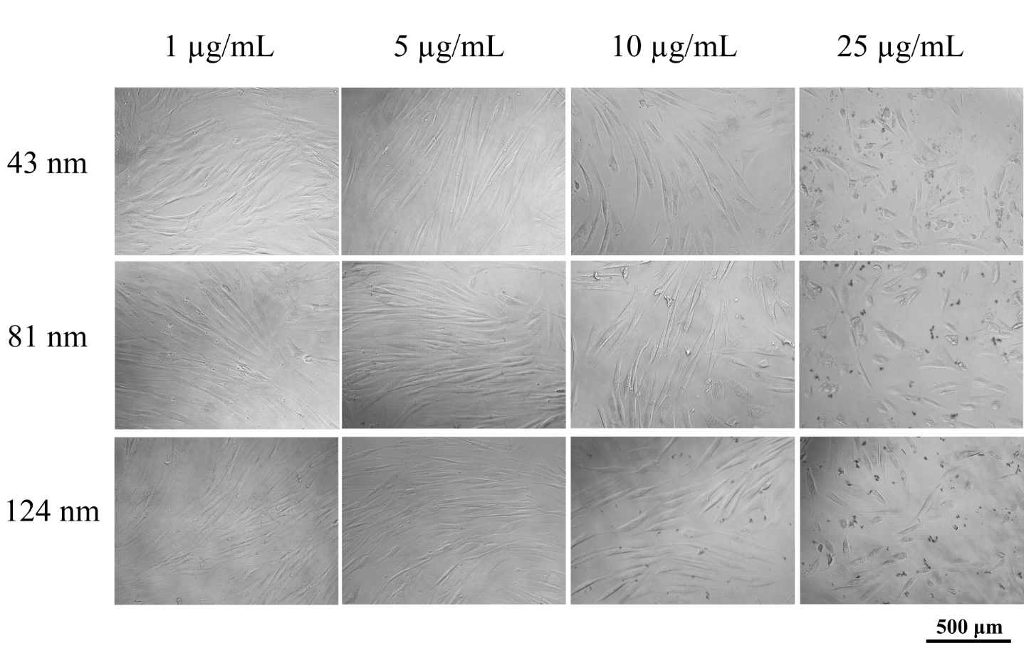
Mammalian cell responses: morphology
HDF with Se nanoparticles after 4 days in culture
Notes:
After extended exposure, some changes visible at higher concentrations

Slide 16
Mammalian cell responses: ROS production
ROS levels of HDF with Se nanoparticles after 6h
Biological effects and reactive oxygen species production vs. [Se]
Wang, Xie, Acta Zoonutrimenta Sinica. 2003;3:001.
Notes:
With increasing concentrations of Se NPs, the ROS production by HDF first decreased then increased. This phenomenon is consistent to the Weinberg curve about the relationship between biological effect of different Se doses and reactive oxygen species
In this relationship, increases the concentration of selenium will help the cells clear ROS. However, high doses of selenium will catalyse the production of ROS.

Slide 17
Mammalian cell responses: ROS scavenging
ROS Scavenging activity of Se nanoparticles: HDF + 200 mM H₂O₂
Notes:
ROS production level of HDF with 200 mM H₂O₂ added and different concentrations and sizes of Se NPs, HDF with 200 mM H₂O₂ only act as control.
All the sizes of Se NPs tested exhibited lower ROS levels than the control.
Smaller sizes and higher concentrations of Se NPs each showed a greater ROS scavenging activity.

Slide 18
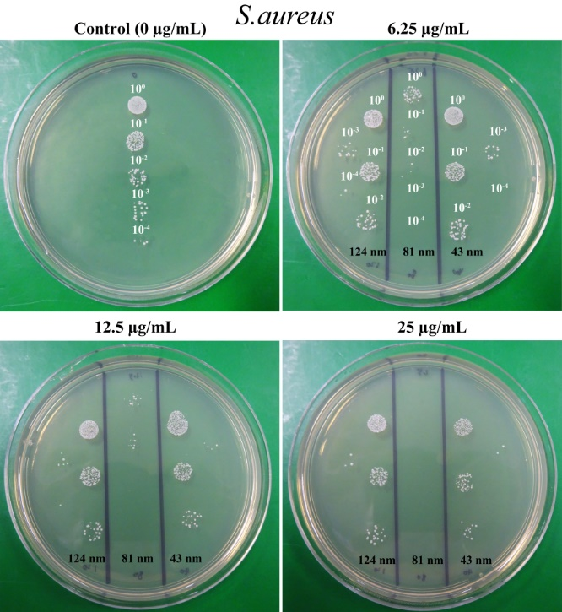
Antibacterial activity: S. aureus
Notes:
The most effective size to inhibit the growth of S.aureus was the 81 nm Se NPs.
Inhibition stated at v low conc’s

Slide 19
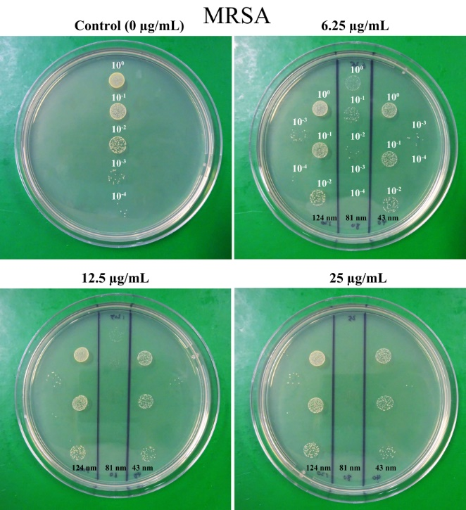
Antibacterial activity: MRSA

Slide 20
Antibacterial activity: size effects
By weight concentration
Notes:
Maximum effect for 81 nm NPs – why?
S aureus

Slide 21
Antibacterial activity: size effects
Number concentration (number/ml) | Weight concentration (µg/ml)
 | 43 nm | 81 nm | 124 nm | 161 nm | 205 nm
4.00×10⁸ | 0.063 | 0.390 | 2.188 | 6.250 | 34.38
8.00×10⁸ | 0.125 | 0.780 | 4.375 | 12.50 | 68.75
1.60×10⁹ | 0.250 | 1.560 | 8.750 | 25.00 | 137.5
3.20×10⁹ | 0.500 | 3.125 | 17.50 | 50.00 | 275.0
6.40×10⁹ | 1.000 | 6.250 | 35.00 | 100.0 | 550.0
1.28×10¹⁰ | 2.000 | 12.50 | 70.00 | 200.0 | 1100
2.56×10¹⁰ | 4.000 | 25.00 | 140.0 | 400.0 | 2200
By number concentration
Notes:
To investigate if the nanoparticles itself or the selenium ions released from the Se NPs plays the dominant role in antibacterial activity, Se NPs were added to S.aureus at the same number of particles, not selenium weight concentration, and the growth inhibition analysed
The Se NPs with size of 81 nm still showed the best inhibition of S.aureus growth (Fig. 7). In the highest number concentration of 2.56 ×10¹⁰ particles/ml, with much higher weight concentration than 81 nm Se NPs, the 124 nm and 161 nm Se NPs showed much closer inhibition effects, but still not as good as for 81 nm NPs. These results indicated that the size effects played the dominant role in antibacterial activity, rather than the concentration of the selenium ions released from the Se NPs.
S aureus

Slide 22
Mechanisms of antibacterial activity
ATP level of S.aureus with treated with Se nanoparticles
Notes:
The fast depletion of cellular ATP with bacteria cells is a characteristic of energy-uncoupling effects, suggesting a potential mechanism by which Se NPs interfere with cellular metabolism
The 81 nm Se NPS induced the greatest depletion of ATP in S.aureus cells
bacteria in pure MHB as a control
* represents the P-value < 0.05, ** represents the P-value < 0.01 and *** represents the P-value < 0.001.

Slide 23
Mechanisms of antibacterial activity
ROS production of S.aureus treated with Se nanoparticles
Notes:
The oxidative stress induced by high ROS production in response to nanoparticles is considered as an important mechanism of bacterial death
Se NPs promoted the ROS production in S.aureus cells in a dose dependent manner
Both 43 nm and 81 nm Se NPs showed a relatively high induction of ROS production

Slide 24
Mechanisms of antibacterial activity
Membrane potential change of S.aureus treated with Se nanoparticles
untreated control
Notes:
Depolarisation of cell membranes is a well-established mechanism of action of antimicrobial agents
The 43 nm and 81 nm Se NPs could depolarize the S.aureus cells in a dose dependent manner, which meant that the Se NPs changed membrane potential of S.aureus cells.
bacteria in pure MHB as the untreated control and bacteria treated with CCCP as the depolarized control

Slide 25
Mechanisms of antibacterial activity
HIM images of S.aureus treated with Se nanoparticles

Slide 26
Selenium NP mechanisms of action
Activity is size dependent
  Mid size optimal for antibacterial effects
  Smaller sizes more cytotoxic to mammalian cells
Increase bacteria ROS production
Cause depletion of bacteria ATP
Change bacteria membrane potential
Notes:
These suggests a balance must be achieved to determine the optimum antibacterial activity of the different sizes of Se NPs, maximising the damage from ROS production while at the same time minimising the ability to form antioxidant selenoproteins
Next: applications – in vivo testing and incorporation into scaffolds

Slide 27
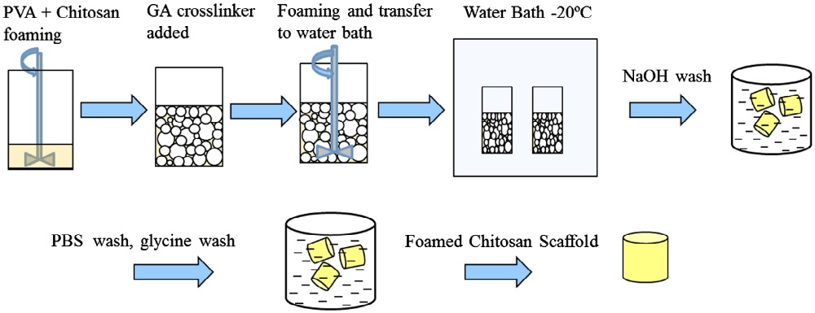
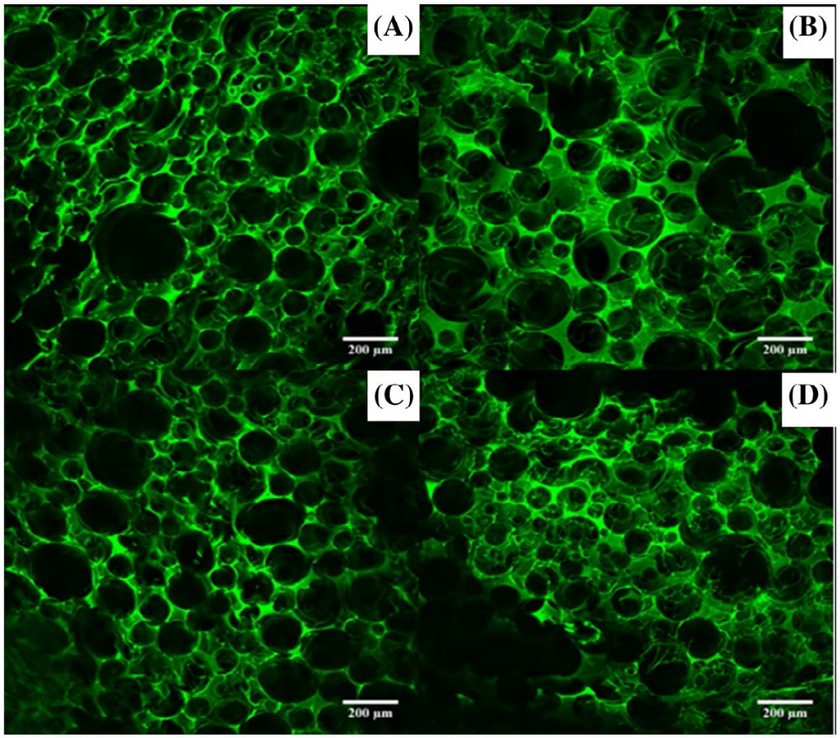
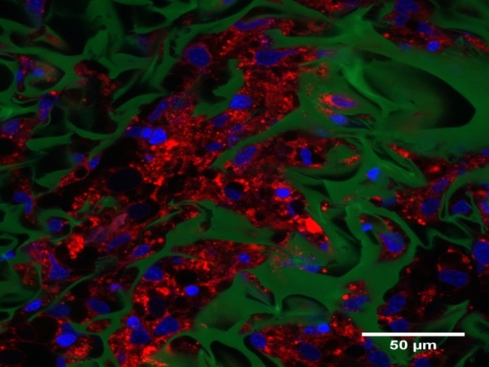
Antimicrobial nanocomposite scaffolds
Biswas, Tran, Tallon, O’Connor, J. Biomater. Sci. 2017
Notes:
Confocal micrographs of cross sections of scaffolds foamed with different surfactant
concentrations (A) 5 mg/ml PVA, (B) 10 mg/ml PVA, (C) 15 mg/ml PVA and (D) 20 mg/ml PVA. CS: 25 mg/
ml, MS: 1500 rpm and FT: 6 min.

Slide 28
Foaming process control
Biswas, Tran, Tallon, O’Connor, J. Biomater. Sci. 2017
Notes:
A: Chitosan (CS): 25 mg/ml PVA: 20mg/ml Mixing time: 5 min
B: CS: 25 mg/ml Mixing time: 5 min, Mixing speed: 1500 rpm
C: CS: 25 mg/ml PVA: 20mg/ml Mixing speed: 1500 rpm
D: PVA: 20 mg/ml Mixing time: 5 min, Mixing speed: 1500 rpm
N=3, ±s.d
PVA: decreases interfacial tension as surface active, stabilising foam
Chitosan concentration:
increases viscosity, slows down film drainage
At low conc, air was not entrained as viscosity too low
At high conc, air entrapment process less effective, probably due to the larger resistance to shear

Slide 29
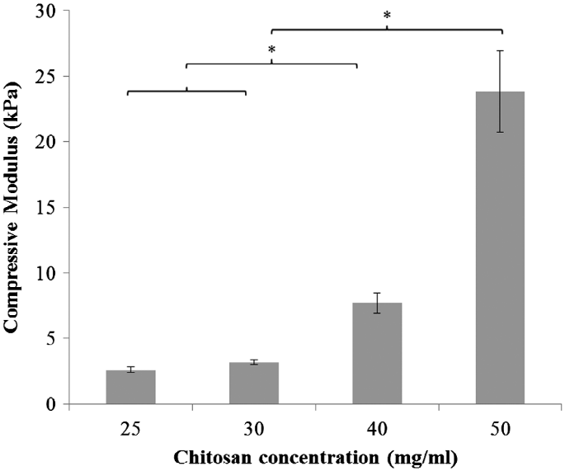
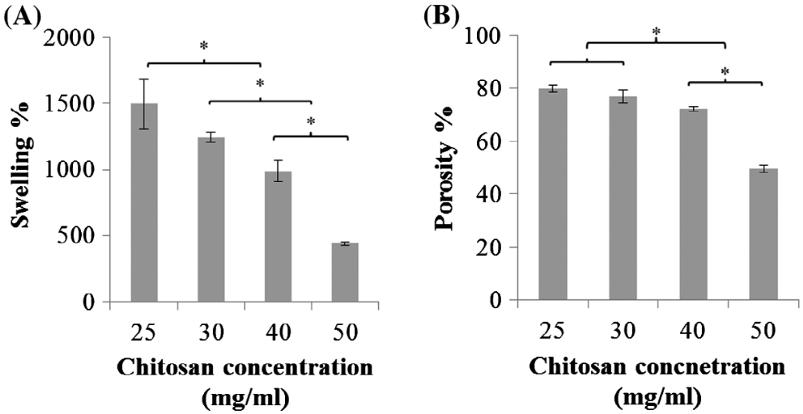
Scaffold porosity and mechanics
Compressive modulus (kPa)
Chitosan concentration
Chitosan concentration (mg/ml)
Biswas, Tran, Tallon, O’Connor, J. Biomater. Sci. 2017
Notes:
Effect of chitosan concentration on (A) porosities and (B) swelling ratios of chitosan/PVA scaffolds.
Notes: Scaffold synthesis conditions PVA: 20 mg/ml, mixing speed: 1500 rpm and foaming time: 6 min, respectively. n = 4,
data = average ± standard deviation. *Indicates statistically significant deviation of means (p < 0.05, ANOVA).
Effect of chitosan concentration on compressive moduli of scaffolds.
Notes: Scaffold synthesis conditions MS: 1500 rpm, PVA: 20 mg/ml, FT: 6 min, n = 3, mean± sd
*p < 0.05, ANOVA
-> tuneable systems with pore architectures and mechanics

Slide 30
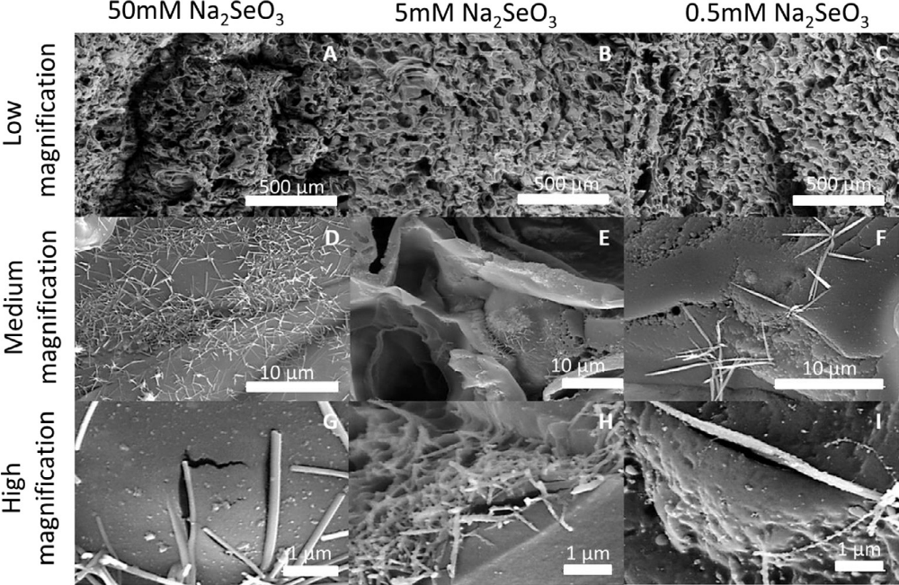
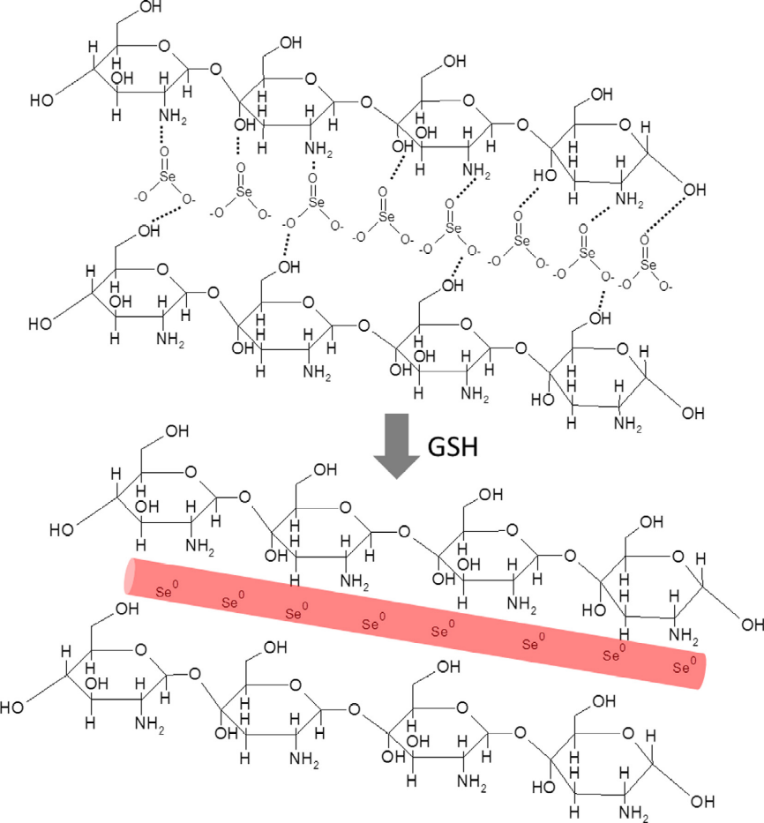
In situ decoration of chitosan scaffolds with Se
Biswas et al. JCIS, 2018.
Notes:
Surface morphology (using scanning electron microscopy) of the of Se-chitosan/PVA scaffolds prepared by in situ reduction of Se from Na2SeO3 solution onto chitosan/PVA scaffolds. Se formed needle-like structures on all scaffolds which were attributed to interaction of Se2O3 anions with positively charged chitosan molecules.
Schematic representation of our hypothesis for Se nanorod formation: Selenite ions align along the chitosan polymer backbone via hydrogen bonding and subsequently form Se nanorods via GSH-mediated reduction.
GSH: reduced glutathione as a reducing agent

Slide 31
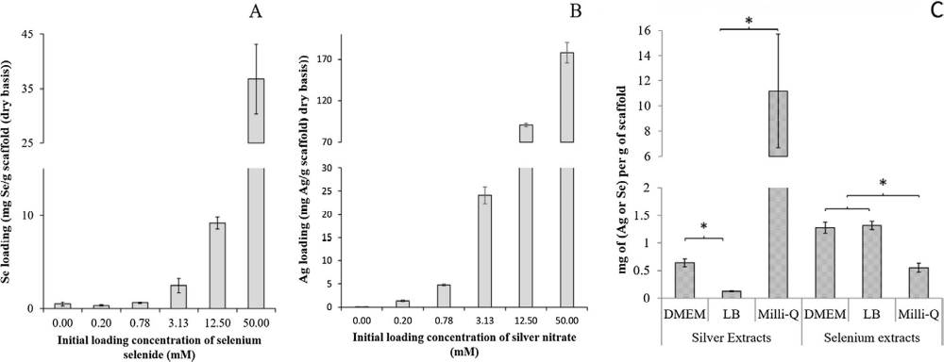
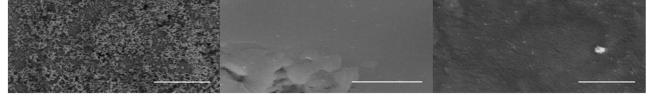
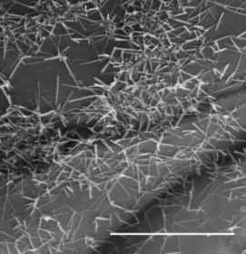
Release of selenium and silver from NP decorated scaffolds (24 h)
10 µm
10 µm
Notes:
Scaffolds reduced with either 50mM Sodium selenide or 50 mM AgNO_{3.} [Ag-loaded scaffolds were formed in situ by the polyol-mediated reduction of AgNO3 by chitosan/PVA]
Note different NP shapes – surface area/vol
In water:
. Ag likely to release via passive diffusion of Ag nanoparticles from the scaffold surface and release of Ag ions due to oxidation by dissolved oxygen
. Se is not readily oxidised directly in aerobic conditions
In media: Ag likely to form AgCl ppts – so less detected. AgCl complexes can still be antimicrobial
N=3, ±s.d

Slide 32
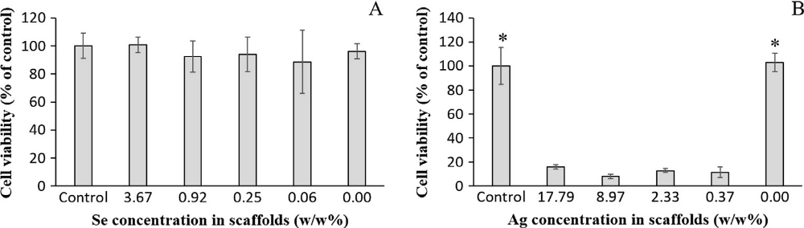
Mammalian cytotoxicity: 3T3 fibroblasts
Notes:
Effect of Se scaffold extracts on cell viability
Effect of Ag scaffold extracts on cell viability (note much higher Ag loadings in scaffolds cf Se from same starting solution concentrations)
[Fluorescence readings were normalized by cells grown in the DMEM positive control and expressed as % cell viability.
Data: mean± S.D., n = 4. * (p < .05, ANOVA)]

Slide 33
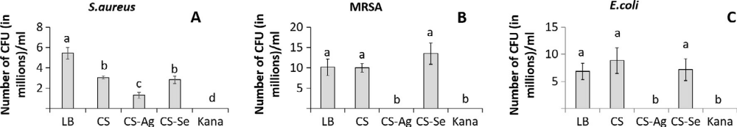
Scaffold antibacterial properties: colony forming unit assays
LB: media (control)
CS: chitosan scaffold extract (control)
CS-Ag: chitosan-Ag scaffold extract
CS-Se: chitosan-Se scaffold extract
Kana: kanamycin (control)
a,b,c,d: Means with different letters are significantly different (p < 0.05, ANOVA)
Notes:
Colony forming unit counts (CFU/ml) for (A) Staphylococcus aureus; (B) Methicillin-resistant staphylococcus aureus (MRSA) and (C) Escherichia coli cultures, treated with various extract treatments: LB: LB media, CS: chitosan/PVA control extract, CS-Ag: Ag chitosan/PVA (17.8 w/w% Ag), CS-Sel: Se chitosan/PVA (3.7 w/w% Se), Kana: Kanamycin (6 mg /ml). Data: mean ± S.D, n = 3.

Slide 34
Bacterial membrane damage tests
Notes:
Schematic representation of selective bacterial staining:
Syto9 is membrane permeant and binds to DNA of live bacterial cells;
PI can only enter bacterial cells whose cell walls and membrane have been damaged and binds DNA, displacing Syto9.
The labelled cells pass through a flow cytometer to generate 2D fluorescence intensity plots (Syto9/PI) of the labelled cell population.

Slide 35
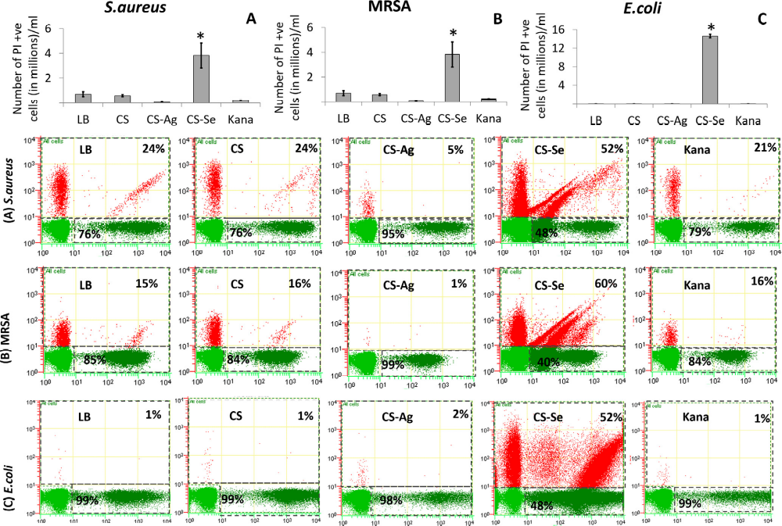
Notes:
Potential to make bacteria sensitive to antibiotics again by making membranes permeable
Can also increase dose as non-cytotoxic at tested ranges
Live (green) and membrane damaged (red) bacteria results by selective staining and flow cytometry
(A, B and C): Number of membrane damaged bacterial cells/ml enumerated from Syto9/PI fluorescence intensity plots. Bottom :
Representative 2D plots showing Syto9/PI fluorescence intensities for the three bacterial species with various extract treatments. The relative% of dead cells is indicated at the top right corner and the relative% of live cells is indicated at the bottom left corner for the 2D intensity plots.
(A) Staphylococcus aureus; (B) Methicillin-resistant staphylococcus aureus (MRSA) and (C) Escherichia coli cultures, treated with various extract treatments: LB: LB media, CS: chitosan/PVA control extract, CS-Ag: Ag chitosan/PVA (17.8 w/w% Ag), CS-Se: Se chitosan/PVA (3.7 w/w% Se), Kana: Kanamycin (6 mgml1).
Data: mean ± S.D, n = 3. * (p < .05, ANOVA

Slide 36
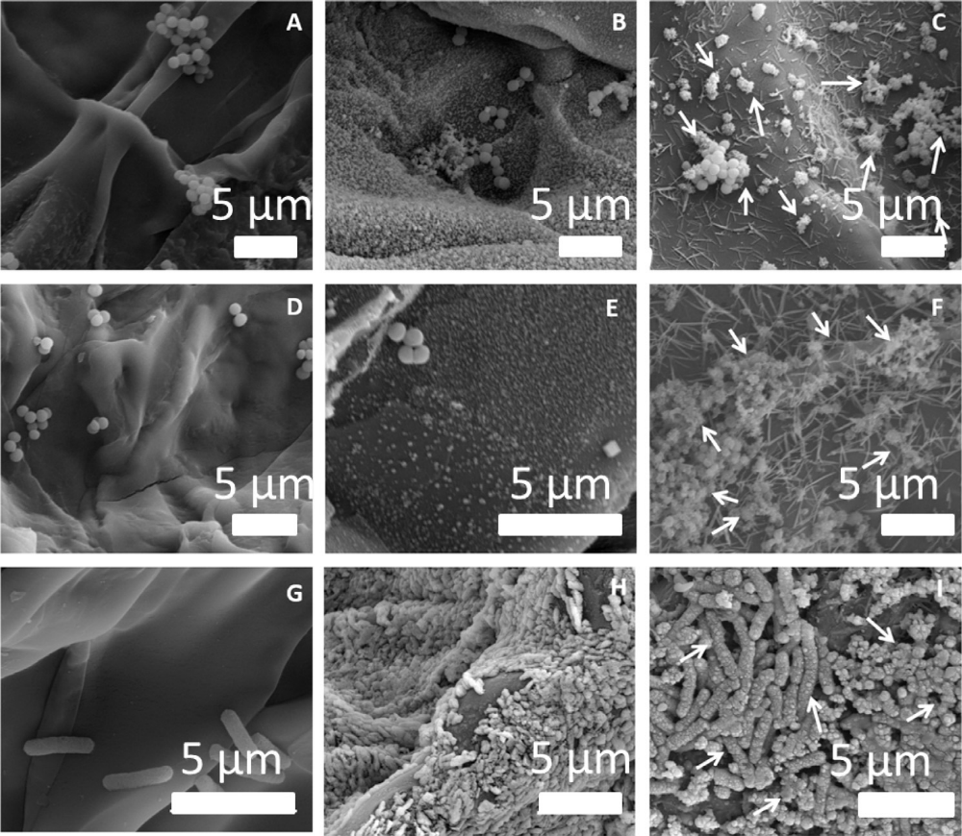
Surface morphologies of bacteria cultured on different scaffolds
Chitosan Ag-chitosan Se-chitosan
E.coli MRSA S. Aureus
Notes:
Electron micrographs showing the surface morphology of various species of bacteria cultured onto different scaffolds.
Arrows show blebbing indicating membrane damage. Likely associated with ROS production
Chitosan/PVA scaffolds: (A, D, G); Ag scaffolds (17.7 w/w%): (B, E, H); Se scaffolds (3.7 w/w%): (C, F, I). S. aureus (A, B, C); MRSA (D, E, F); E. coli (G, H, I).

Slide 37
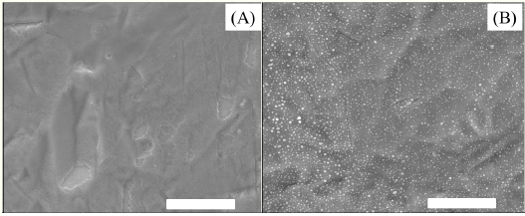
Nanoparticle coating onto fracture fixation plates
SEM images of surfaces of uncoated (A) and Se NP coated Ti plates (B). Scale bars: 5 μm. Coating density is approximately 6x10⁶ particles /mm²

Slide 38
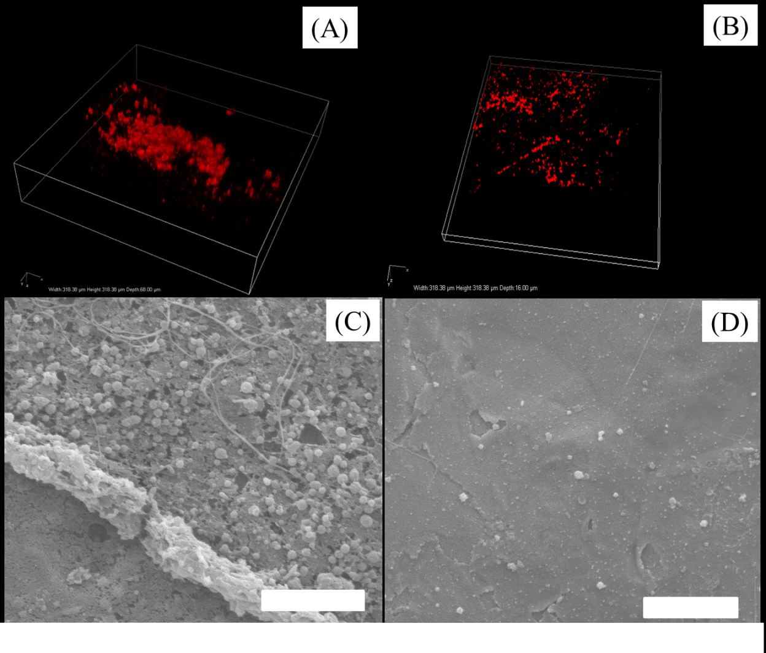
In vivo biofilm formation: MRSA
Uncoated Se NP coated
Confocal immuno-stained images (A,B)
SEM images (C,D)
Scale bars: 20 μm.
Notes:
4 weeks in vivo
Staining: rabbit anti-MRSA (Ray biotech) and mouse anti-Staph epidermidis (Acris Antibodies) were used to recognize MRSA and MRSE on the plates. Appropriate secondary antibody fluorescent conjugates (Goat anti-rabbit IgG conjugated to Alexa Fluor 555 and rabbit anti-mouse IgG conjugated to Cy5, both from Molecular Probes

Slide 39
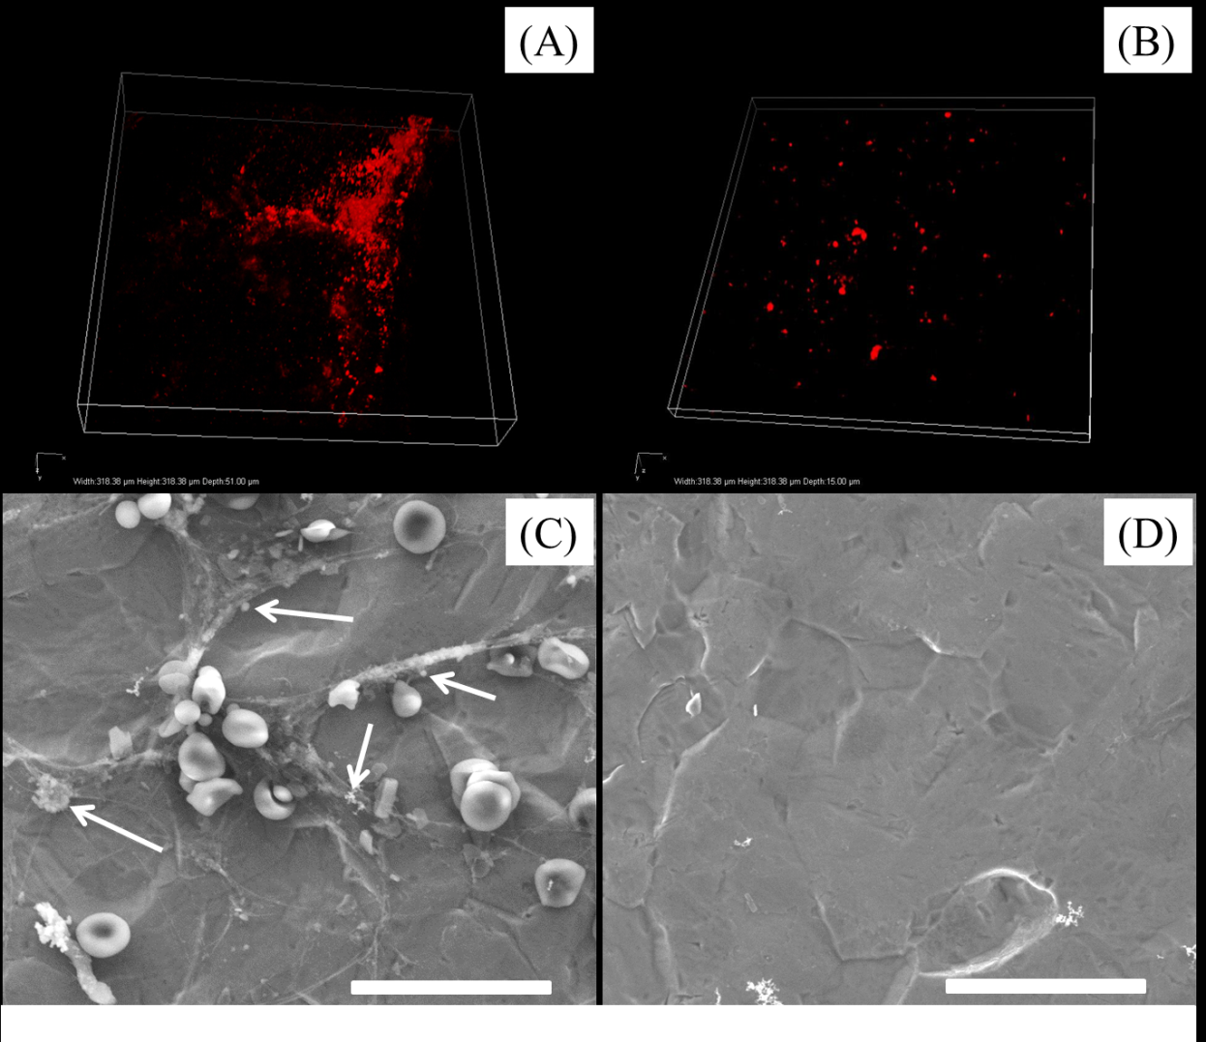
In vivo biofilm formation: MRSE
Uncoated Se NP coated
Confocal immuno-stained images (A,B)
SEM images (C,D)
Scale bars: 20 μm.
Notes:
Representative SEM images of uncoated and coated plates showing thicker and denser biofilm on the uncoated plates.
Some red blood cells are visible in (C). Arrows show bacteria

Slide 40
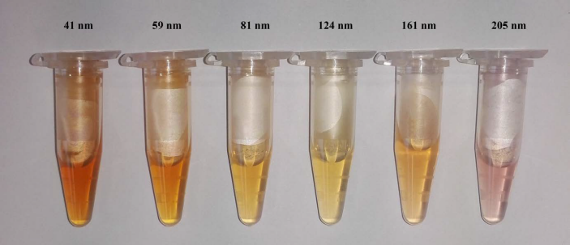
Conclusions
Selenium-based Engineered Nanoparticles (Se-NPs):
Size dependent antibacterial activity
Low cytotoxicity
Facile synthesis in suspension or in situ
Effective in vivo and incorporated in
hydrogel scaffolds
Impacts on bacteria:
  ROS
  ATP
  membrane depolarisation
  membrane permeability
Notes:
These suggests a balance must be achieved to determine the optimum antibacterial activity of the different sizes of Se NPs, maximising the damage from ROS production while at the same time minimising the ability to form antioxidant selenoproteins

Slide 41







Acknowledgements
Uni. of Melbourne:
Geoff Stevens
Sally Gras
Kerry Landman
Barry Hughes
Michelle de Silva
Nicolin Tirtaamadja
Debapriya Mitra
Dewi Go
Yang Cao
Tristan Croll
Javad Jafari
Silvia Leo
Gordon Lynch
Carolina Tallon
Collaborators:
Wayne Morrison – O’Brien Institute
Keren Abberton – O’Brien Institute
Jason Palmer – O’Brien Institute
Geraldine Mitchell – O’Brien Institute
Keith McLean – CSIRO
David Haylock – CSIRO
Patrick Hartley – CSIRO
Andrew Hung – RMIT
Anand Deva – Macquarie University
Phong Tran – QUT
Michelle Sun - South Australian Institute of Ophthalmology
Facilities:
Bio21 Advanced Microscopy Facility
- Roger Curtin
Melbourne University Materials Characterisation and Fabrication Platform
- Babak Nasr
Katharina Ladewig
Terry Hartnett
Tim Henderson
Dalton Harvie
Tao Huang
Zhexing Wang
Peter Lee
Dhee Biswas
Stephen Burger
Kate Murphy
Daniel Heath
James Holden
Neil O’Brien Simpson

