Slide 1
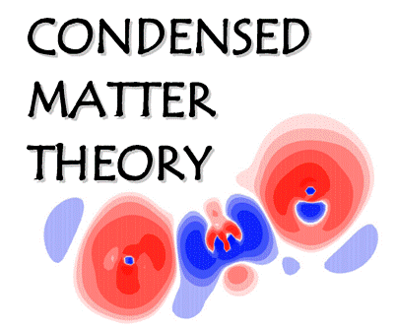
Rational Design of Nano-Catalysts for Sustainable Chemicals and Fuels: Insights from Theory and Simulation
Catherine Stampfl
School of Physics, The University of Sydney, Sydney, New South Wales 2006, Australia
Notes:
The title of my talk is “Rational Design of Nano-Catalysts for Sustainable chemicals and Fuels” Insights from Theory and Simulation”

Slide 2

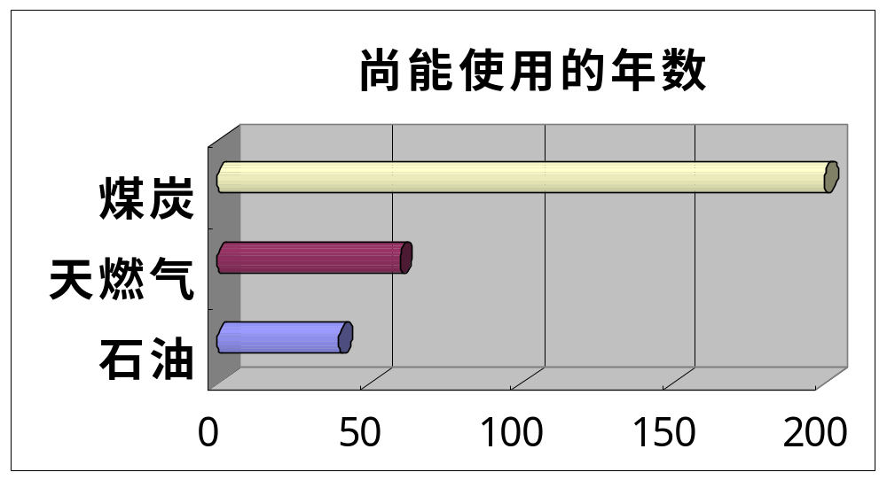
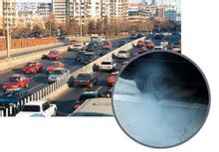
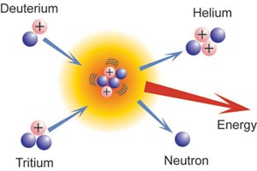



Motivation
Significant pressure to develop new green/sustainable
energy sources.
Depletion of fossil fuels
The remaining service life
Pollution
coal
natural gas
oil
1
Notes:
As we are all aware, there is significant pressure to develop new green/sustainable energy sources, such as wind , solar, amd nuclear energy and so on. This is due to both the depletion of fossils fuels – the remaining service life of coal is around 200 years, natural gas, bit over 50 years, and oil, around 40 years – and to environmental pollution caused by traditional energy utilization.

Slide 3

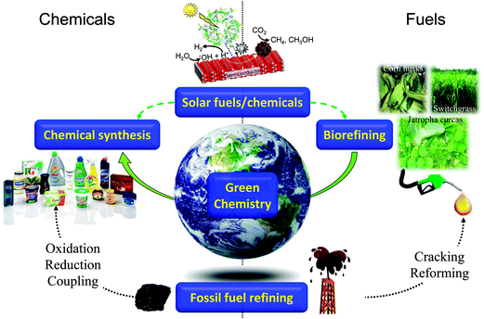
Achieving sustainable resources is a Grand Challenge of this century
Catalysts can play a key role in the development of sustainable production of chemicals
and fuels, notably bio-derived and solar mediated
A. F. Lee et al.
Chem. Soc.
Rev., 2014,
43, 7887
Notes:
Catalysts can play a key role in this development, for sustainable production of chemicals and fuels. The are used in “chemical synthesis”, “solar fuels/chemicals”, biorefining, fossil fuel refining.

Slide 4
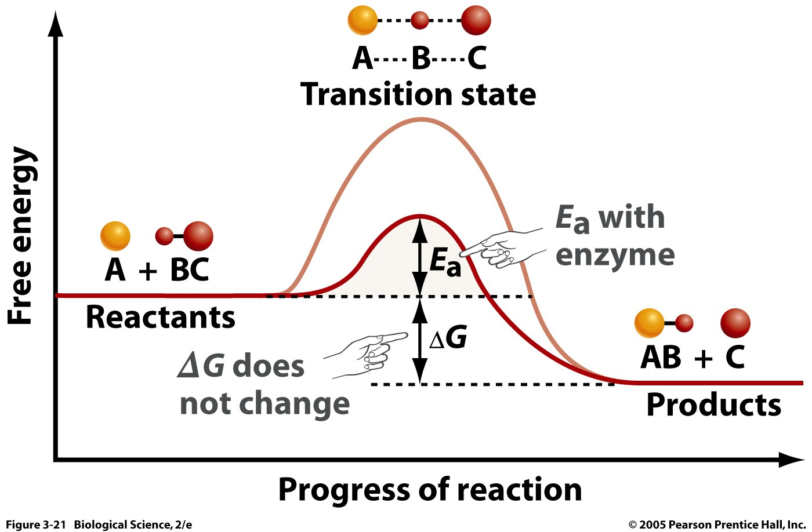

Catalysts
Catalysis is ubiquitous in all aspects of everyday life.
It empowers new product development and
refinement across a wealth of industries, including
- life sciences
- pharmaceutical and
agricultural sectors,
- electronics,
- chemicals,
- renewable energy
technologies.
Contributes to 35% of
the world’s GDP
with catalyst

Slide 5

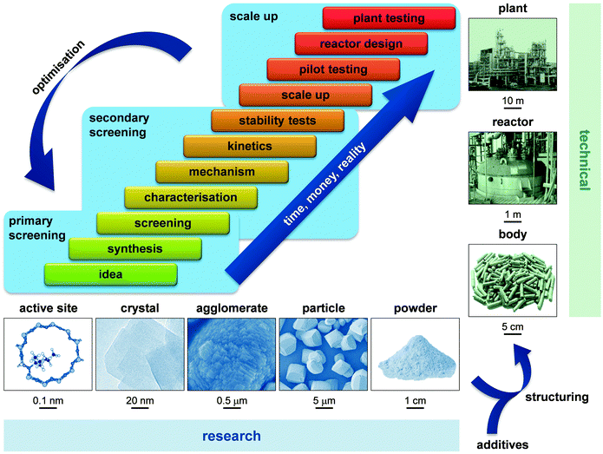
Many stages
In the
development
of new
catalysts
Theory/
computation
scale of
catalyst
scale
S. Mitchell et al. Chem. Soc. Rev., 2013, 42, 6094
Notes:
In the development of new catalysts there are many different stages, from the initial idea, synthesis, characterization, mechanism, to the scale up and testing. Along the way there is a loop of optimization. Correspondingly, the scale of the catalyst being investigated ranges through from atomic to metre. For theory and computation, we are focussed on the atomic and nanoscale.

Slide 6
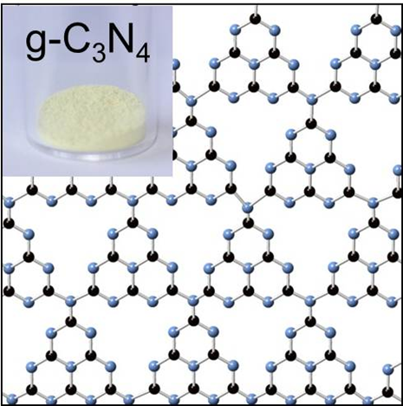
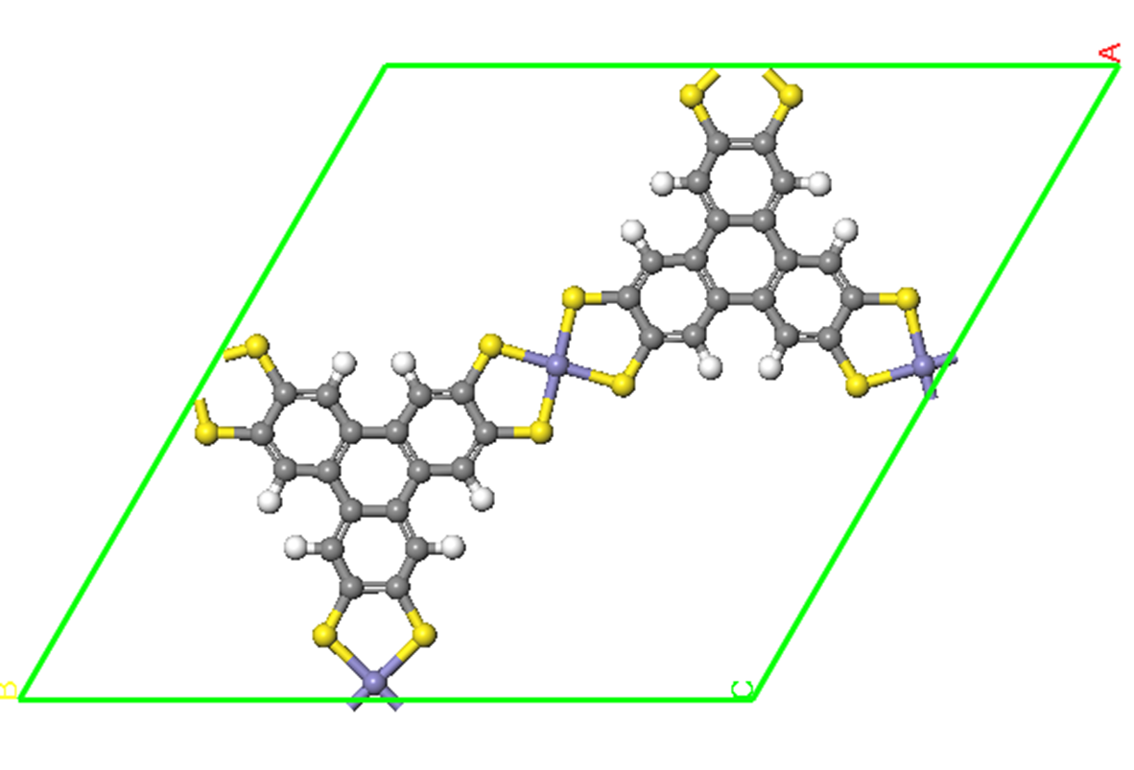
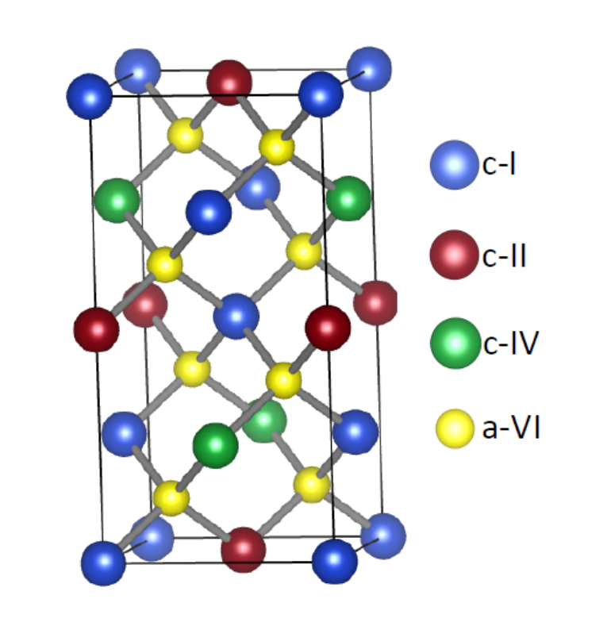
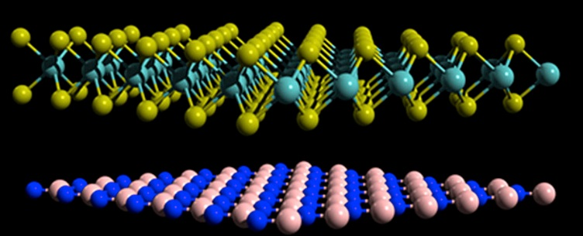
Outline
Examples of how theory and computation can be
used in synergy with experiment to:
Understand and interpret –
Effects of Layered Supports of graphitic carbon
nitride with Ru Nanoparticles for Ammonia Synthesis
2. Prediction and screening –
Bifunctionalization of Metal-organic Framework
catalysts
“AI” - Machine learning -
Kesterite I₂-II-IV-V₄ semiconductors
and Hybrid 2D materials
Notes:
In the talk I will discuss some recent examples from our research of how theory and computation is used in synergy with experiment to 1, understand and interpret experimental results, screen and predict new potential catalysts, and 3. Do machine learning of a class of materials in order to identify and predict structures with desirable properties. In particular, Effects of Layered Supports of graphitic carbon nitride with Ru Nanoparticles for Ammonia Synthesis, Bifunctionalization of Metallorganic Framework catalysts, and machine learning of Kesterite I2-II-IV-V4 semiconductors And Hybrid 2D materials.

Slide 7
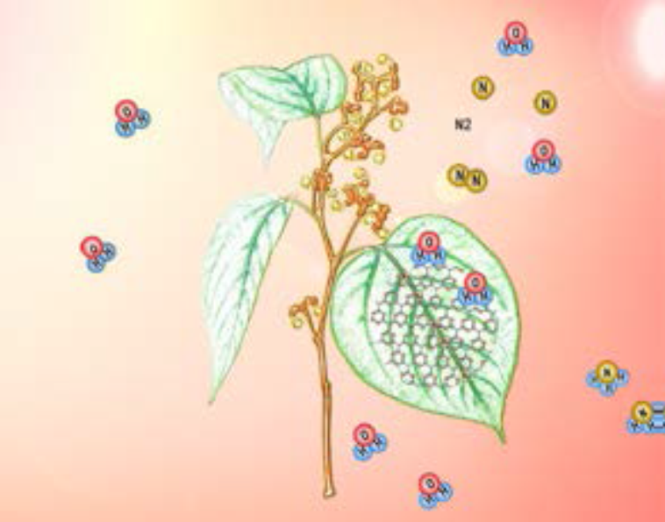
Ammonia Synthesis
1. Understand and interpret
Very important chemical – fertilizer, building block
for synthesis of pharmaceutical products
160M tons per year.
Haber-Bosch has some disadvantages;
uses high value-added clean energy H₂,
harsh reaction conditions (high
temperature 400-500 C and pressure,
150-300 bar)
Use solar energy to produce ammonia from abundant nitrogen gas and water
Beneficial for both relieving energy demands and developing a sustainable
chemical industry.
Notes:
Ammonia is a very important chemical – fertilizer, building block for synthesis of pharmaceutical products, 160M tons per year. Our first example involves the idea of using solar energy as the driving force to produce ammonia from abundant nitrogen gas and water over two-dimensional graphitic carbon nitride with Ru nanoparticles. Over the catalyst, adsorbed atomic hydrogen is produced from water, and nitrogen gas is dissociated prior to reaction steps to form ammonia.

Slide 8
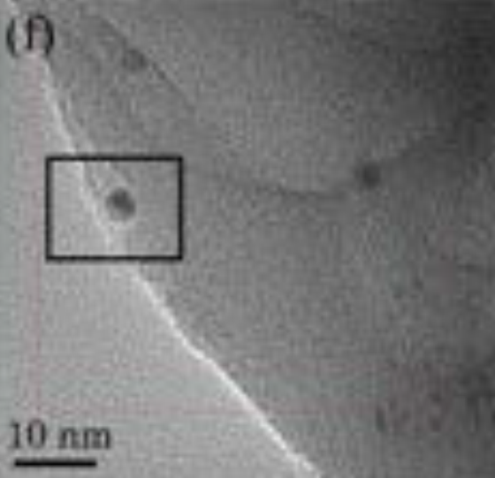
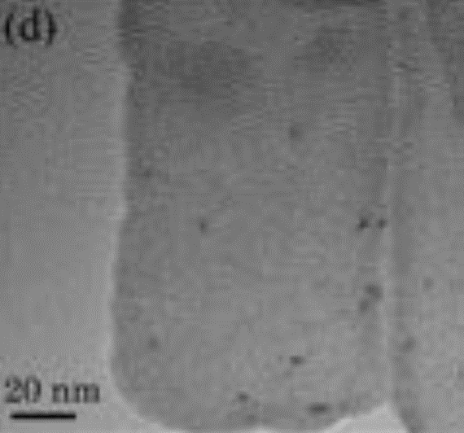
Ammonia Synthesis
2D semiconductor materials attracting significant
recent interest in catalysis and other fields, new
properties and opportunities to tailor them
The graphitic carbon nitride (g-C₃N₄) structure acts
as both support and light harvester. Ru nanoparticles
act as electron trap and active centre
Two forms of g-C₃N₄ were prepared:
Bulk:
Formed by
thermally
decomposing
in urea at 550C
for 4 hrs
Exfoliated:
synthesized by
exfoliating bulk
form
Nanoparticles
at step edges
Nanoparticles
dispersed
Huimin Liu et al. submitted

Slide 9

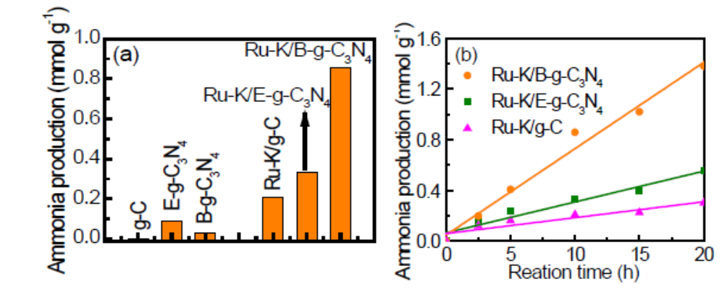
Around 2.6 times more ammonia produced over the bulk
Ru-K/g-C₃N₄ than the exfoliated one
WHY ?

Slide 10
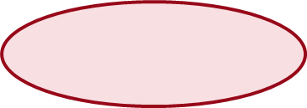

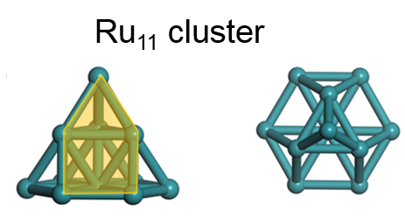
First-principles calculations
Cleavage of the N₂ bond is the rate-determining step
Investigate the structure and energetics of nitrogen
dissociation over the two catalysts
H₂ + 2* = 2H*
N₂ + 2* = 2N*
N* + H* = NH*+*
NH* + H* = NH₂*+*
NH₂* + H* = NH₃*+*
NH₃* = NH₃ + *
Direct dissociation
Associative dissociation
Consider both pathways
Consider both catalysts

Slide 11
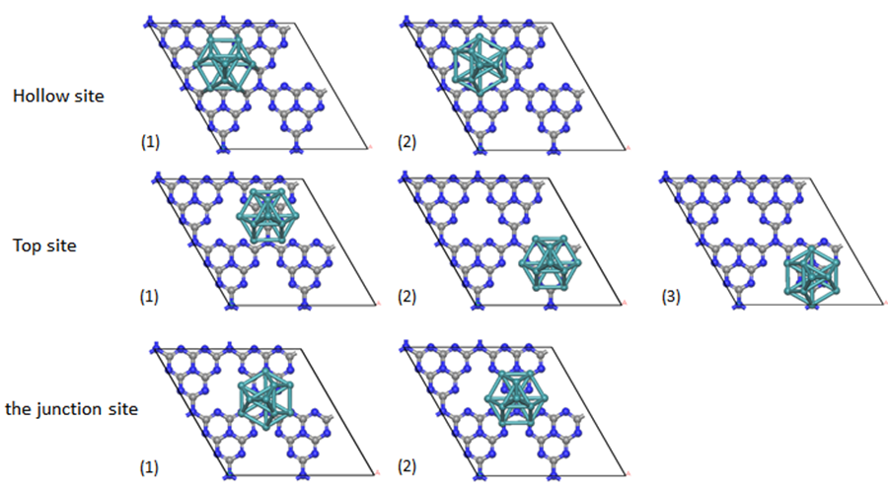
First-Principles investigations
Exfoliated, single layer
Determine favourable
structures for Ru₁₁
nanoparticle
Most favorable

Slide 12

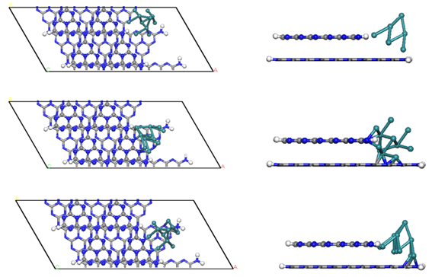

Bulk-like system
Determine favourable
structures for Ru₁₁
nanoparticle –
favours step edge
Most favorable

Slide 13
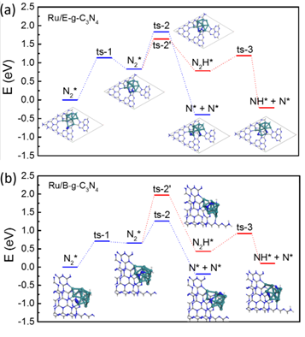
Reaction Energy for N₂ dissociation
Two catalysts different
mechanism:
Exfoliated – associative N₂
dissociation, barrier 1.13 eV
Bulk – direct N₂ dissociation,
barrier 0.71 eV
Lowest energy barrier for
direct N₂ dissociation
over bulk Ru/g-C₃N₄
– higher rate of ammonia formation
- Stronger nanoparticle-substrate interaction
Agreement with Experiment

Slide 14
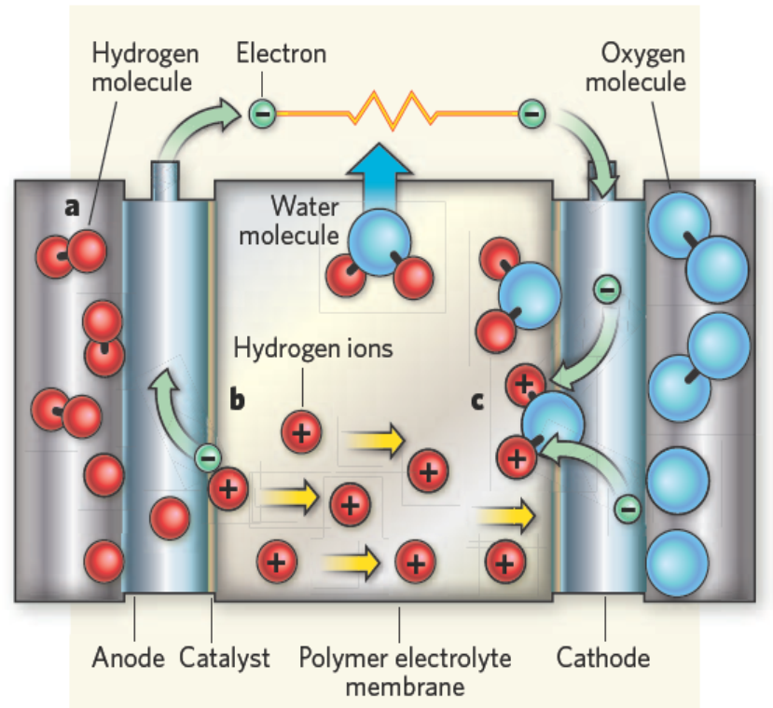
Bifunctional MOF catalysts
2. Prediction and screening
Polymer electrolyte fuel cell
Anode: 2H₂ – 4e– → 4H⁺
Cathode:O₂ + 4H⁺ + 4e– → 2H₂O
Promising
clean and sustainable
power source
Rate of oxygen
reduction at cathode
is much
slower than the
reaction at the anode.
Determines the
performance
Most effective
electrocatalysts
for cathode
based on platinum
group metals.
Drawbacks -high
price, poor
durability,
methanol
poisoning effects

Slide 15
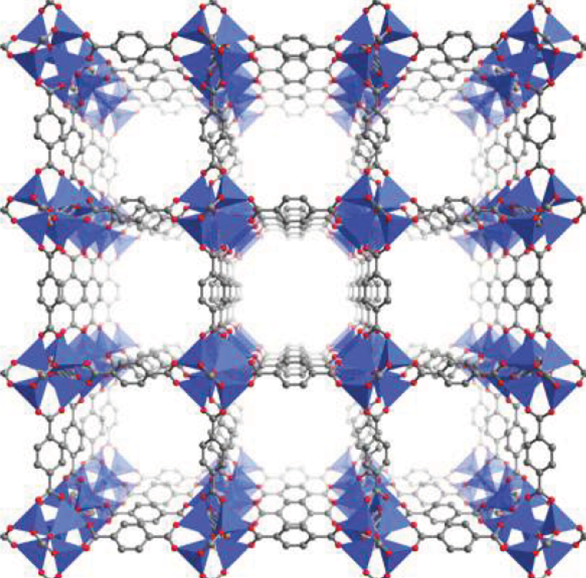
MOFs materials
Need to find new low cost and high durability non-precious group metal (PGM) alternative electrocatalysts; recent investigations
- metal-free heteroatom-doped carbon materials,
- transition metal−nitrogen−carbon catalysts,
- transition metal oxides
Metal-organic Framework
(MOF) catalysts
high surface area
uniformly distributed coordinated metal
controllable porous structure
6000 members of
crystalline framework
materials
Over

Slide 16
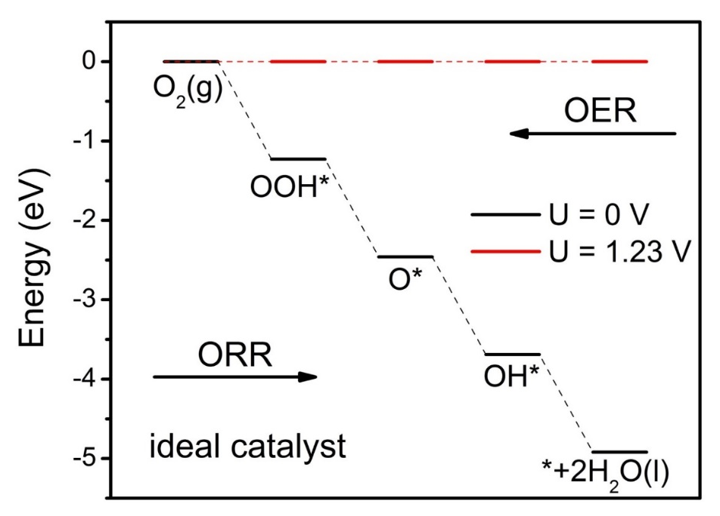
Ideal Catalyst for ORR/OER
ORR
(oxygen reduction reaction)
(R1)
(R2)
(R3)
(R4)
O₂(g) + 4H⁺ + 4e⁻↔OOH* + 3H⁺ + 3e⁻
OOH* + 3H⁺ + 3e⁻↔ O* + H₂O(aq) + 2H⁺ + 2e⁻
O* + 2H⁺ + 2e⁻↔ OH* + H⁺ + e⁻
OH* + H⁺ + e⁻↔ H₂O(aq)
OER
U=0V equivalent to gas-phase
hydrogen oxidation reaction
U=1.23V where fuel cell has the
maximum potential allowed by
thermodynamics
(oxygen evolution reaction)
ORR and OER are reverse reactions; share
same reaction pathway and free energy diagram
only difference is reaction direction
Norskov et al., J. Phys. Chem. B 108, 17886 (2004)

Slide 17
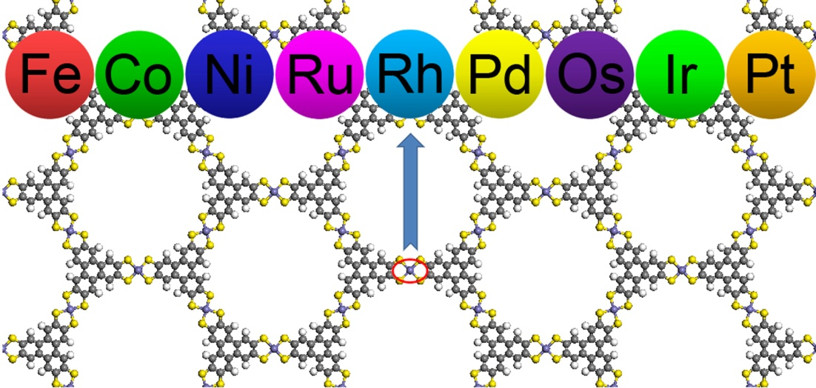
Metal Dithiolene nanosheets
Investigate metal dithiolene nanosheets as ORR/OER catalysts
9 different metal centres
P. Zhang et al. Catal. Sci. Tech. 8, 3666-3672 (2018).
Notes:
In this work, MC4S4 nanosheets with nine different central metals (where M = Fe, Co, Ni, Ru, Rh, Pd, Os, Ir and Pt) as ORR catalysts have been systemically studied.

Slide 18
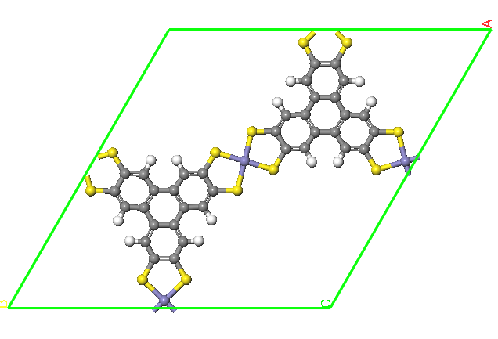
Atomic structure of M₃(THT)₂
Atomic
structure of the
unit cell
C H
There are
three metal
sites per
unit cell
S M
P. Zhang et al. Catal. Sci. Tech. 8, 3666-3672 (2018).

Slide 19
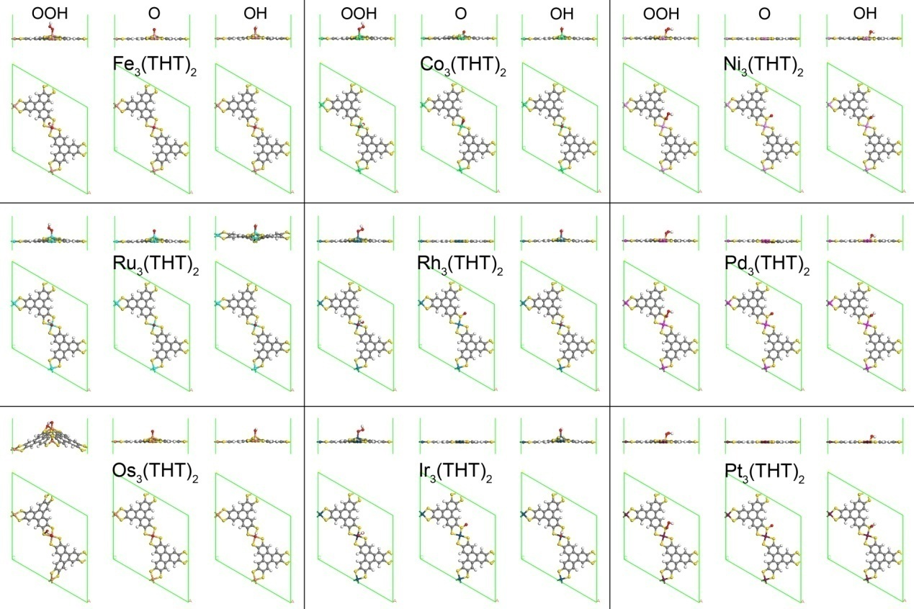
Adsorption structures of ORR intermediates

Slide 20
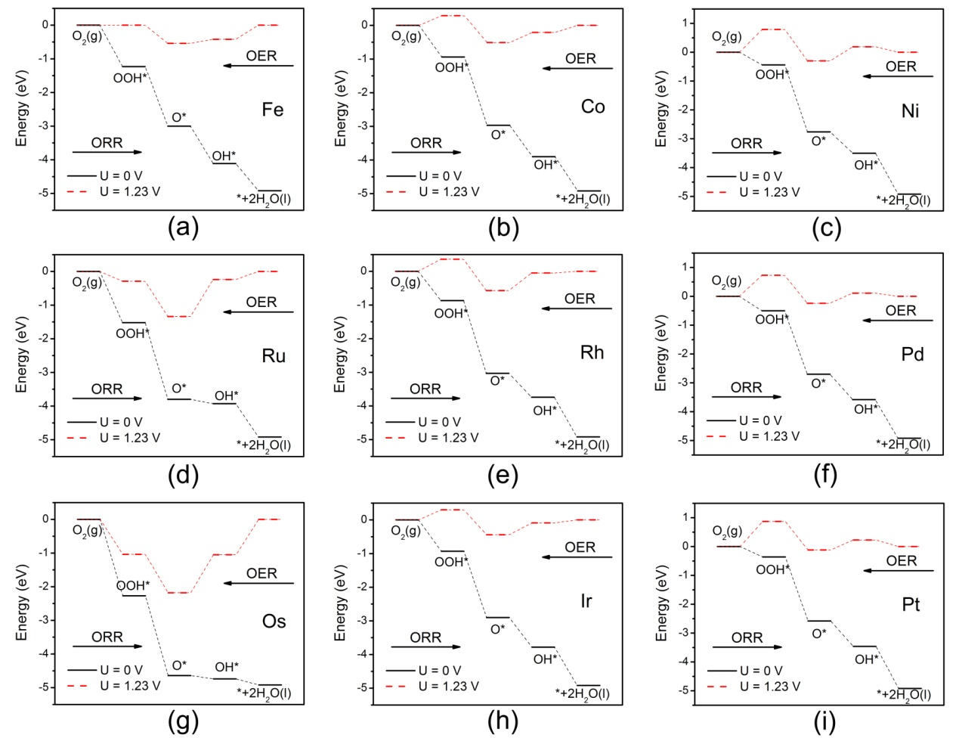
Reaction Free Energy diagrams of ORR/OER on M₃(THT)₂
Co
best
ORR
Fe
best
OER

Slide 21
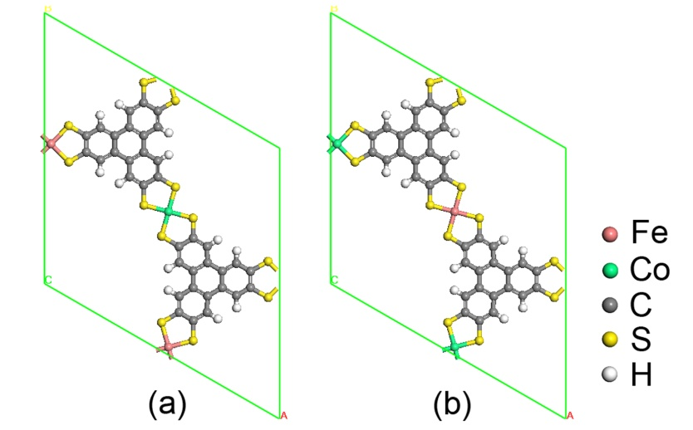
Atomic structure of Fe_{x}Co_{3-x}(THT)₂
Consider combination
of Co and Fe, i.e.,
FeCo₂
Fe₂Co
P. Zhang et al. Catal. Sci. Tech. 8, 3666-3672 (2018).

Slide 22
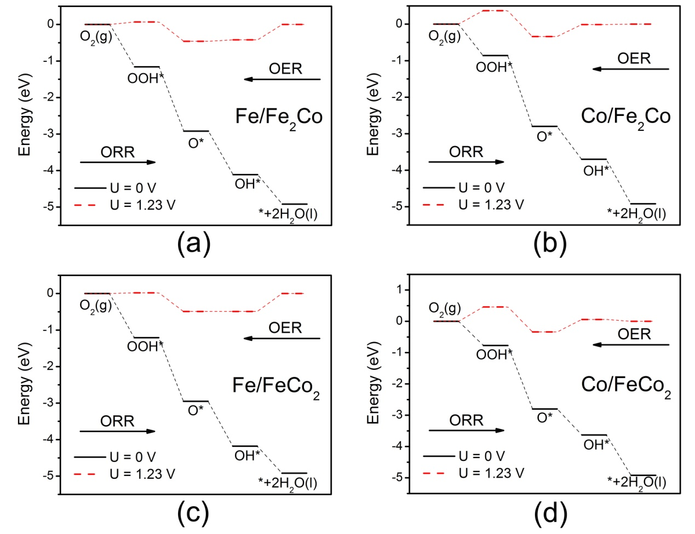
ORR/OER on Fe_{x}Co_{3-x}(THT)₂
Good
OER
Good
ORR

Slide 23
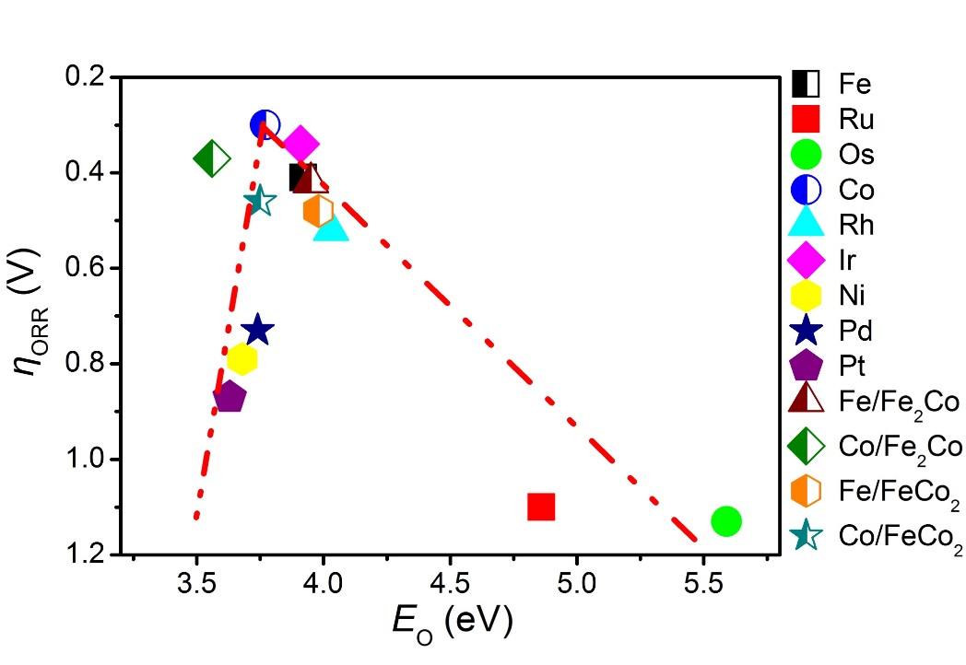
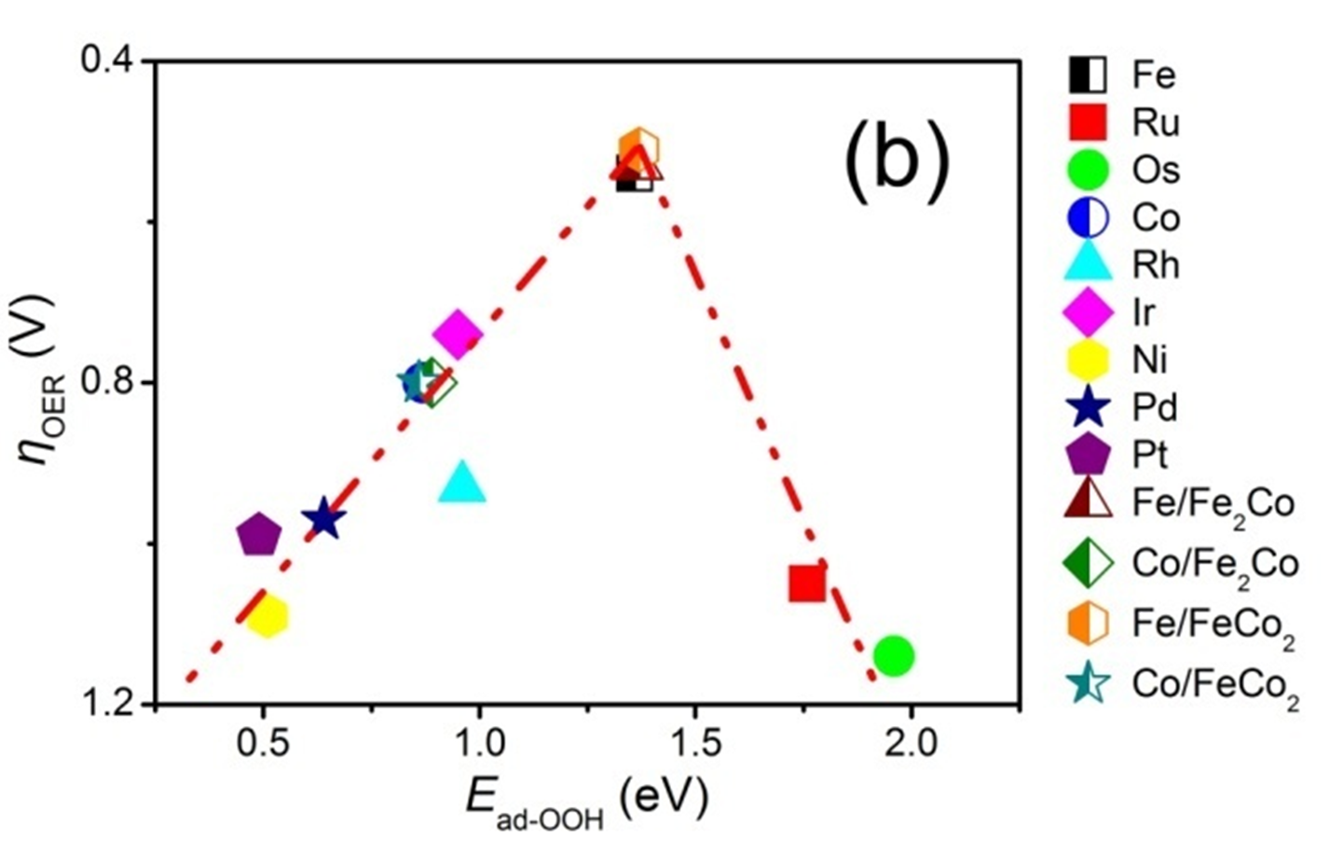
Fe_{x}Co_{3-x}(THT)₂ nanosheets promising bifunctional catalysts
ORR on M₃(THT)₂
OER on M₃(THT)₂
“Volcano Plots” - activity as function of key intermediate binding strength
Predict Fe_{x}Co_{3-x}(THT)₂ nanosheets potential
promising bifunctional catalyst for ORR and OER
P. Zhang et al. Catal. Sci. Tech. 8, 3666-3672 (2018).

Slide 24

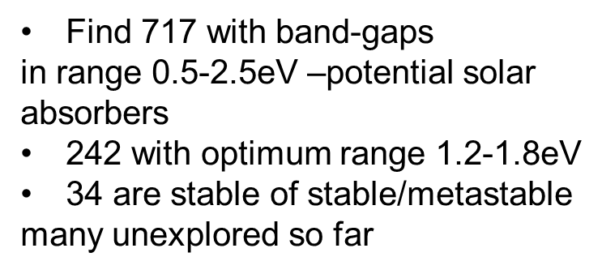
3. Machine Learning Materials
Machine Learning the Band-gap
of 1568 kesterite I₂-II-IV-V₄ compounds
Kesterite I₂-II-IV-V₄ semiconductors are promising
solar absorbers
Use a combination of accurate first-principles
calculations and machine learning to predict
the properties of the band gap (and if direct or
indirect) for 1568 kesterite I₂-II-IV-V₄ semiconductors
The zinc-blende-based kesterite structure.
The cations with valence I (c-I), II (c-II), and
IV (c-IV) blue, red, and green spheres.
The anion has a valence VI (a-VI) and is
indicated by a yellow sphere.
L. Weston and C. Stampfl Phys. Rev. Mat. accepted

Slide 25
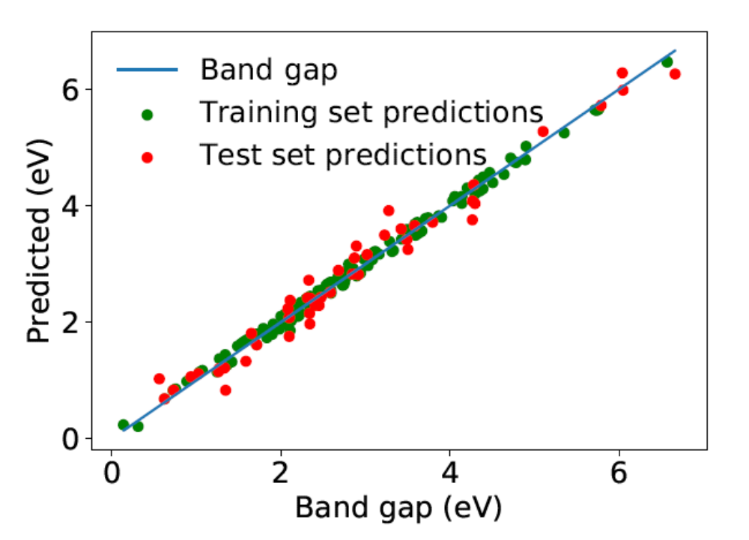
Machine Learning the Band-gap
of 1568 kesterite I₂-II-IV-V₄ compounds
Accurate hybrid
functional calculations
for 200 randomly
selected materials
Used to train machine
learning models
Use 12-dimensional feature space for predictor of the
magnitude of the band-gap
L. Weston and C. Stampfl
Phys. Rev. Mat. accepted

Slide 26
Machine Learning the Band-gap
of kesterite I₂-II-IV-V₄ compounds
For the I₂-II-IV-VI₄ compounds, we consider: I = Li, Na, K, Rb, Cs, Cu, Ag; II = Be, Mg, Ca, Sr, Ba, Zn, Cd, Hg; IV = C, Si, Ge, Sn, Ti, Zr, Hf; and, VI = O, S, Se, Te.
Model R² RMSE (eV)
Linear Regression 0.796 0.590
SVR-L 0.789 0.592
SVR-RBF 0.957 0.283
Decision Tree 0.823 0.492
Random Forest 0.874 0.435
Boosted Reg. Tree 0.934 0.358
SVR – support vector regression
L- linear
RBF – radial bias function
The stability of these 242 compounds is assessed by calculating the enthalpy of formation and making use of the Materials Project database [A. Jain et al. APL Mater. 1, 011002 (2013)] - 34 found to be stable/metastable

Slide 27
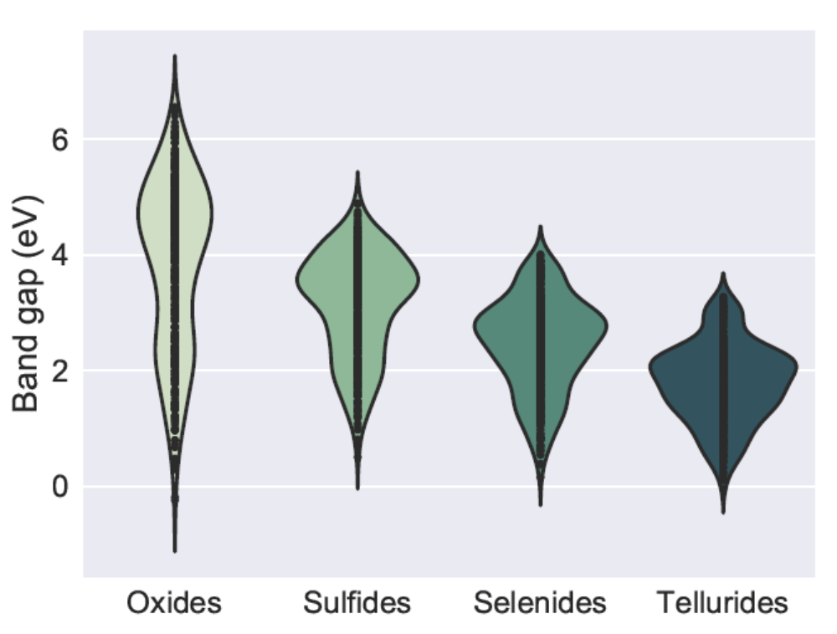
Machine Learning the Band-gap
of 1568 kesterite I₂-II-IV-V₄ compounds
A violin plot for the predicted
band gap distributions for the
oxides, sulﬁdes, selenides and
tellurides.
The width of each distribution
at a given energy indicates the
number of materials with a
band gap around that energy
The oxides have larger band gaps with a mean band gap Eav = 3.82 eV; distribution
over a very wide energy range
Trend moving down the periodic table for the anions is for smaller band gaps and
a more localized distribution. For the tellurides, Eav = 1.78 eV
L. Weston and C. Stampfl
Phys. Rev. Mat. accepted

Slide 28
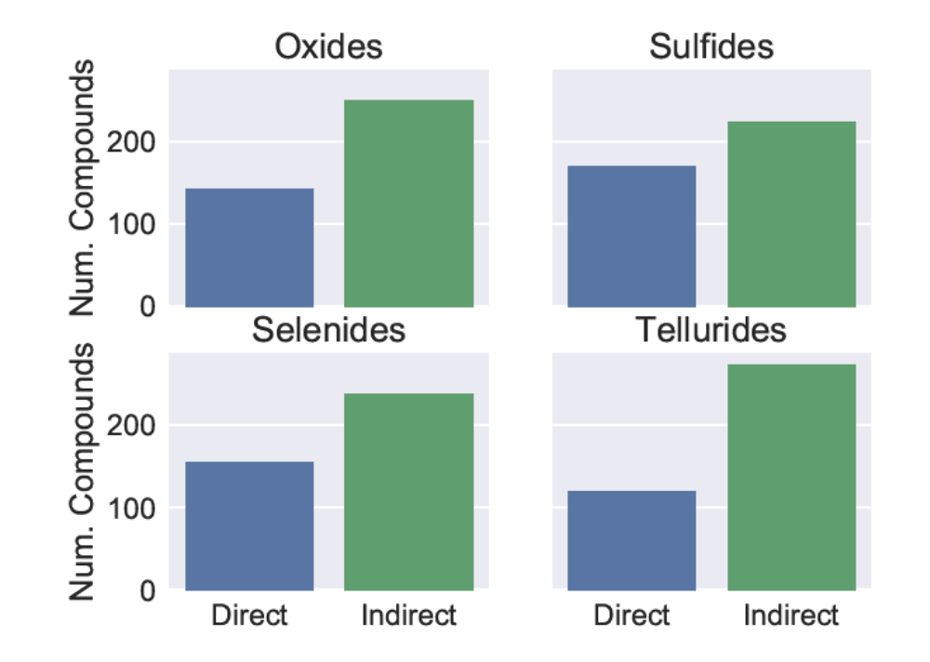
Machine Learning the Band-gap
of 1568 kesterite I₂-II-IV-V₄ compounds
Prediction of direct versus
indirect band-gap more
challenging – required more
feature engineering and
training.
Resulting method predicts
the nature of the band gap
with an accuracy of 89 %
using logistic regression.
The direct–indirect predictions over all materials studied, 70% are found to have indirect gaps
L. Weston and C. Stampfl
Phys. Rev. Mat. accepted

Slide 29
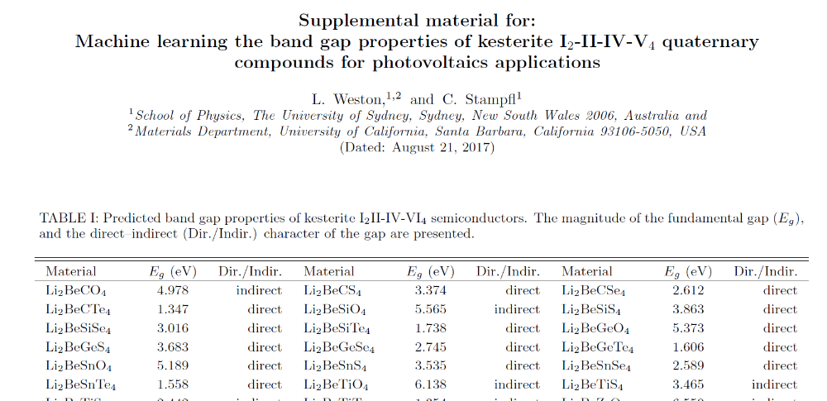
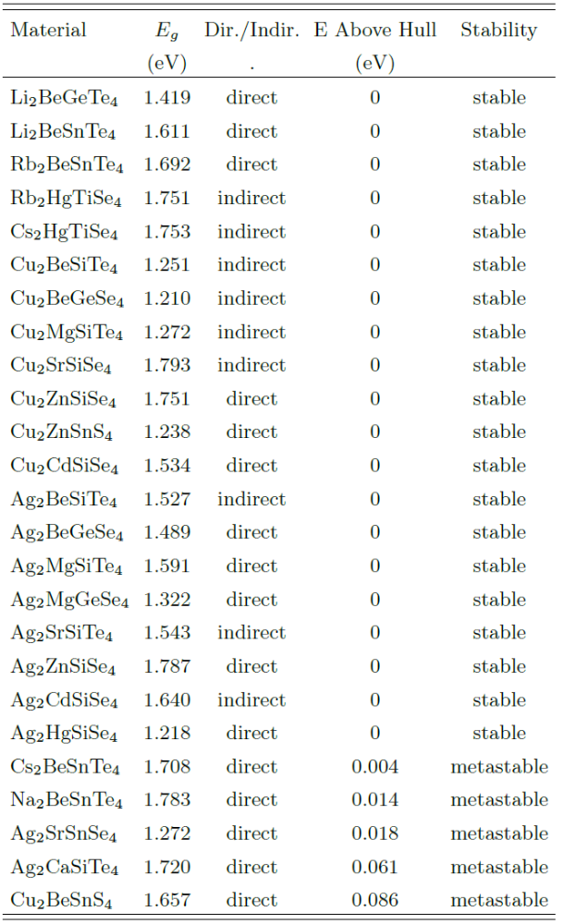
Band-gap properties of 1568 kesterite I₂-II-IV-V₄ compounds
All results
The 34 stable/metastable structures
with predicted band-gaps in the
optimum range 1.2-1.8eV
L. Weston and C. Stampfl
Phys. Rev. Mat. accepted

Slide 30
3. Machine Learning Materials
Hybrid 2D materials
Hybrid materials built from
2D monolayers are gaining
attention as novel materials
with potentially more easily
tuneable properties
Using DFT and Machine Learning
can predict the interlayer distance
of 1432 bilayer structures and
band-gaps
Electronic structure calculations can
make these predictions accurately, but are too
time-consuming to calculate the properties
of every possible multilayer hybrid 2D material

Slide 31
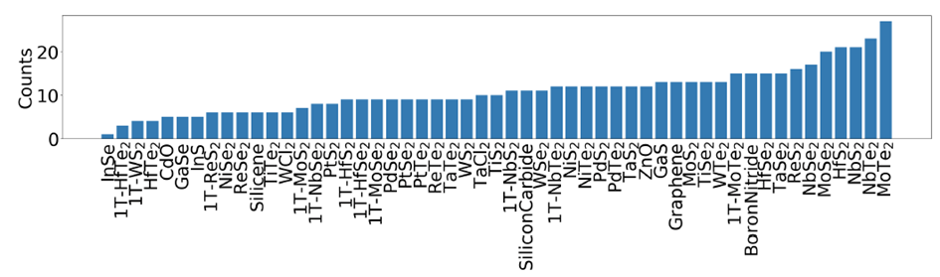
Machine Learning Hybrid 2D Materials
Calculations for 267 bilayer systems from the 53 monolayer structures
Obtain predicted interlayer distances for 1432 structures
The number of bilayers in which each monolayer is a component
Sherif Abdulkader Tawik,* Olexandr Isayev, Catherine Stampfl, Joe Shapter, David A. Winkler and Michael J. Ford, Submitted

Slide 32
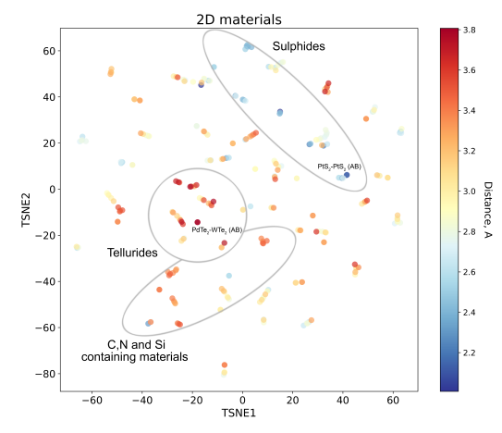
Machine Learning Hybrid 2D materials
DFT calculated
Interlayer distances
for the training
take into account van der
Waals interaction between
layers
Descriptor – relevant
mathematical representation
of the structure and properties of
Materials
Use: “Property-Labelled Materials
Fragments” [1] modified for 2D
materials
[1] O. Isayev et al, Nat. Comm. 8, 15679 (2017)

Slide 33
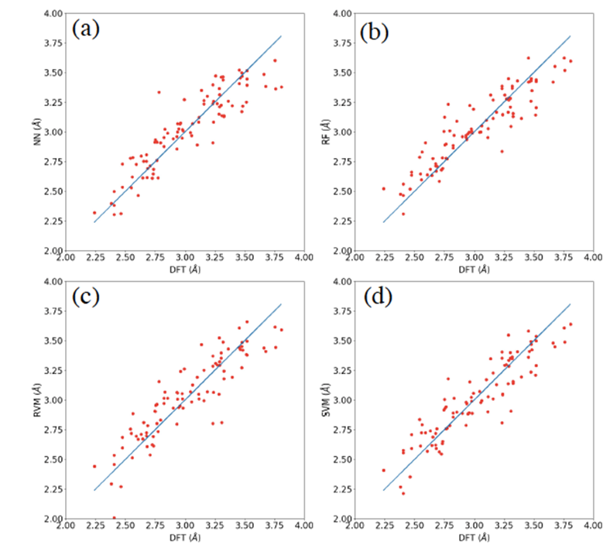
Machine Learning Hybrid 2D Materials
Interlayer distances
Four Machine Learning models
are trained and performance
compared
(a) Feedforward Neural Network
(b) Random Forest
(c) Relevance vector Machine
(d) Support vector Machine
Shows comparison between
the interlayer distances in
the bilayers obtained using DFT
and the ML approaches
Sherif Abdulkader Tawik,* Olexandr Isayev, Catherine Stampfl, Joe Shapter, David A. Winkler and Michael J. Ford, Submitted

Slide 34
Machine Learning Hybrid 2D Materials
Interlayer distances
 | NN |  | RF |  | RVM |  | SVM
Smallest 5 | PtS₂|PtS₂ | 2.10 | PtS₂|PtS₂ | 2.12 | PdS₂|PdS₂ | 1.75 | PtS₂|PtS₂ | 2.02
 | PdS₂|PdS₂ | 2.12 | PdS₂|PtS₂ | 2.16 | PdS₂|NiS₂ | 2.01 | PdS₂|PdS₂ | 2.12
 | PtS₂|PtSe₂ | 2.16 | PdS₂|PdS₂ | 2.18 | PtS₂|PtS₂ | 2.06 | PdS₂|NiS₂ | 2.21
 | PdS₂|PtS₂ | 2.22 | PdSe₂|PtS₂ | 2.22 | PdS₂|NiTe₂ | 2.09 | PdS₂|NbS₂ | 2.27
 | PdSe₂|PtS₂ | 2.22 | PdSe₂|PdS₂ | 2.24 | PdS₂|NbS₂ | 2.15 | PdS₂|1T-NbS₂ | 2.28
Largest 5 | GaSe|WTe₂ | 3.63 | MoTe₂|MoTe₂ | 3.63 | MoTe₂|TaTe₂ | 3.66 | WTe₂|1T-MoTe₂ | 3.65
 | WTe₂|WTe₂ | 3.64 | MoTe₂|PdTe₂ | 3.67 | PdTe₂|TaTe₂ | 3.70 | ReTe₂|WTe₂ | 3.66
 | PdTe₂|BoronNitride | 3.65 | MoTe₂|WTe₂ | 3.69 | WTe₂|WTe₂ | 3.76 | MoTe₂|PdTe₂ | 3.68
 | PdTe₂|Graphene | 3.66 | ReTe₂|WTe₂ | 3.70 | MoTe₂|PdTe₂ | 3.77 | WTe₂|WTe₂ | 3.73
 | GaSe|WCl₂ | 3.68 | WTe₂|WTe₂ | 3.72 | MoTe₂|WTe₂ | 3.80 | MoTe₂|WTe₂ | 3.74
interlayer distances for 1432 structures – band gaps for 210
Sherif Abdulkader Tawik,* Olexandr Isayev, Catherine Stampfl, Joe Shapter, David A. Winkler and Michael J. Ford, Submitted

Slide 35
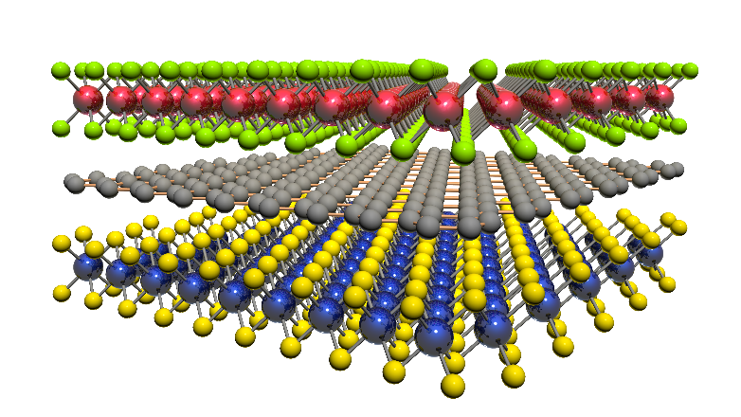
2D bilayers
A recent data mining study^{[1]} reported the existence of 1,825 2D materials that could be exfoliated from known experimental inorganic compounds.
This set can make ~1.7 million bilayer structures, around 10⁹ trilayers.
This quickly becomes an
intractable problem for DFT
to explore/screen
– could be task for ML
[1] N. Mounet et al. Nat. Nano, 13, 246 (2018)

Slide 36


Acknowldegements
This work was supported by resources provided by
the National Computational Infrastructure (NCI), with funding from the Australian Research Council, ARC

Slide 37



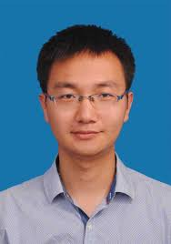







Acknowledgements
Huimin Liu, Ping Wu, Haitao Li, Zibin Chen, Xin Zeng, Yuxiang Zhu, Yijiao Jiang, Xiaozhou Liao, Brian Haynes, Jinhua Ye, Catherine Stampfl, Jun Huang
N₂ reduction over Ru/g-C₃N₄
Bifunctionalization of Metallorganic
Framework (MOF) catalysts
Dr Peng Zhang
Machine Learning Materials
Dr Leigh Weston
Prof. Mike Ford
Dr Sherif Tawfik
Dr O. Isayev
Prof D. Winkler
Prof J. Shapter
Lawrence Berkeley
laboratory
UTS

Slide 38
Questions?

Slide 39
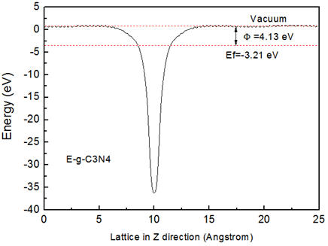
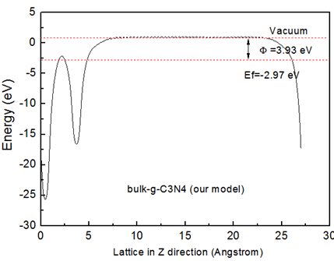
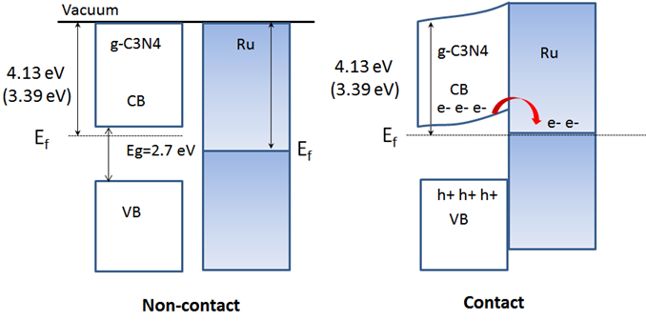
Work function
The work function of
bulk Ru is 5.4 eV;
That of g-C3N4 is
4.13 eV (or 3.39 eV)

Slide 40
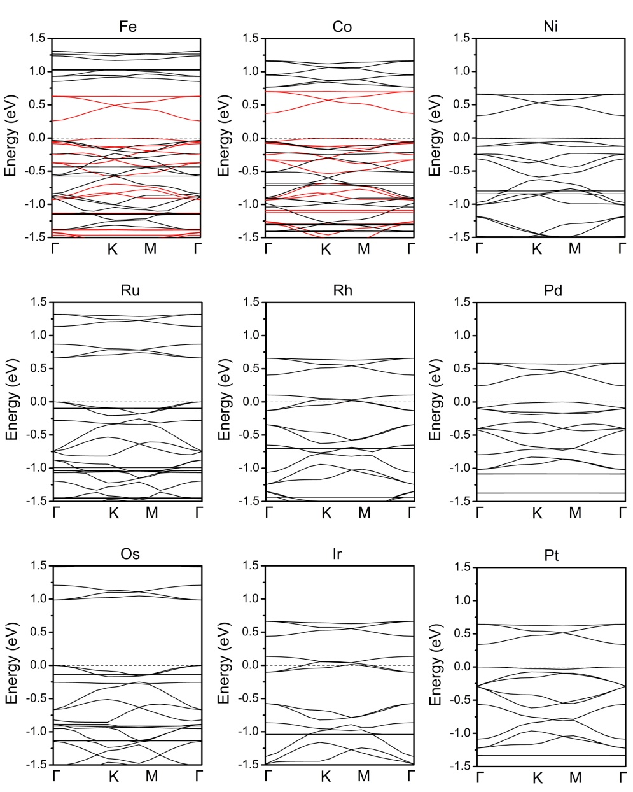
Electronic structure of M3(THT)2
 | Fe | Co | Ni
E_{g} | 0.24 | 0.38 | 0.33
Spin | Polar | Polar | Unpolar
 | Ru | Rh | Pd
E_{g} | 0.65 | 0 | 0.24
Spin | Unpolar | Unpolar | Unpolar
 | Os | Ir | Pt
E_{g} | 0.98 | 0 | 0.33
Spin | Unpolar | Unpolar | Unpolar

Slide 41
d-band center (eV)
Fe | Ru | Os
-1.23 | -1.88 | -2.05
Co | Rh | Ir
-1.56 | -2.13 | -.59
Ni | Pd | Pt
-1.88 | -2.62 | -3.01

Slide 42
E_{ad} | OOH | O | OH
Fe | 1.36 | 3.92 | 2.51
Ru | 1.76 | 4.86 | 2.35
Os | 1.96 | 5.59 | 3.18
Co | 0.87 | 3.77 | 2.07
Rh | 0.96 | 4.03 | 2.08
Ir | 0.95 | 3.91 | 2.18
Ni | 0.51 | 3.68 | 1.93
Pd | 0.64 | 3.74 | 2.05
Pt | 0.49 | 3.63 | 1.90
Fe/Fe₂Co | 1.37 | 3.95 | 2.52
Co/Fe₂Co | 0.89 | 3.56 | 2.07
Fe/FeCo₂ | 1.37 | 3.98 | 2.58
Co/FeCo₂ | 0.86 | 3.75 | 2.02

Slide 43
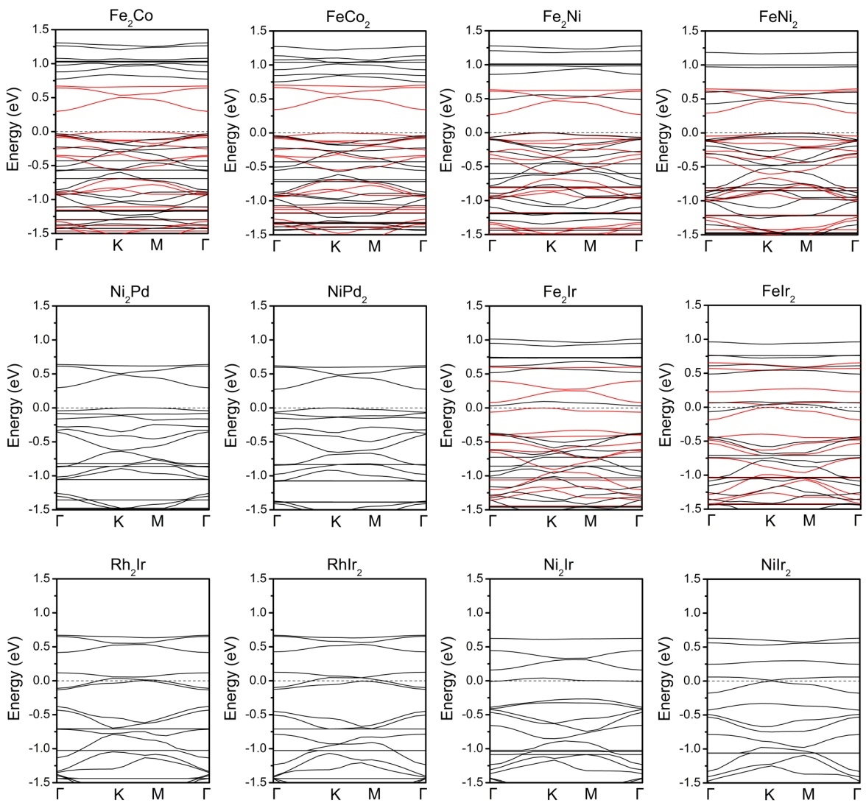
Electronic structures of M3(THT)2

Slide 44
 | Fe | Co | Ni | Fe₂Co | FeCo₂ | Fe₂Ni | FeNi₂
E_{g} | 0.24 | 0.38 | 0.33 | 0.30 | 0.35 | 0.27 | 0.30
Spin | Polar | Polar | Unpolar | Polar | Polar | Polar | Polar
 | Ru | Rh | Pd | Ni₂Pd | NiPd₂ | Fe₂Ir | FeIr₂
E_{g} | 0.65 | 0 | 0.24 | 0.30 | 0.27 | 0.03 | 0
Spin | Unpolar | Unpolar | Unpolar | Unpolar | Unpolar | Polar | Polar
 | Os | Ir | Pt | Rh₂Ir | RhIr₂ | Ni₂Ir | NiIr₂
E_{g} | 0.98 | 0 | 0.33 | 0 | 0 | 0 | 0
Spin | Unpolar | Unpolar | Unpolar | Unpolar | Unpolar | Unpolar | Unpolar

Slide 45
d-band center (eV)
Fe | Fe/Fe2Co | Fe/Fe2Co
-1.23 | -1.14 | -1.15
Co | Co/FeCo2 | Co/FeCo2
-1.56 | -1.56 | -1.57

Slide 46
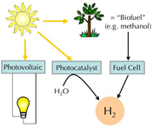
Motivation
Three technologies for
harvesting the energy
of the sun, producing
electricity or H₂
(hydrogen) fuel:
Photovoltaics
Photocatalysts
Fuel cells
1
Notes:
Because the energy crisis caused by the depletion of fossil fuels and the environmental pollution caused by the traditional way of energy utilization, it is urgently to develop new green/sustainable energy sources, including nuclear energy, wind energy, water conservancy, solar energy and so on.

Slide 47
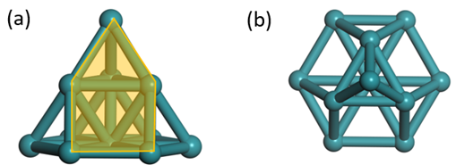
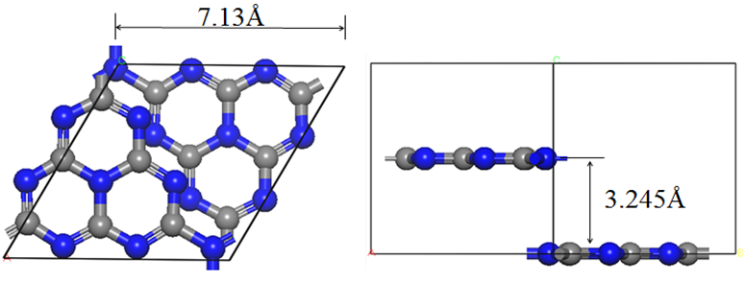

Slide 48
Ammonia Synthesis
Synthetic ammonia process is also called Haber-Bosch process which produces ammonia from gaseous N2 and H2. The elementary reaction steps are the following,
H₂ + 2* = 2H*
N₂ + 2* = 2N*
N* + H* = NH*+*
NH* + H* = NH₂*+*
NH₂* + H* = NH₃*+*
NH₃* = NH₃ + *
Haber-Bosch has disadvantages such
As using high value-added clean energy H2,
Harsh reaction conditions (high temperature 400-500 C
And pressure, 150-300 bar)
Cleavage of the strong N2 bond is
The rate-determining step

Slide 49
Motivation
Two factors determine the performance of ORR catalysts:
1. The elemental composition and the interactions between different components
2. Specific surface area and porous structure
Chem. Soc. Rev. 2015,44,2168.
Notes:
Two factors determine the performance of ORR catalysts: the first one is the elemental composition and the interactions between different components, which determines the intrinsic catalytic activity of catalysts.

Slide 50

MOFs materials
high surface area
uniformly distributed coordinated metal
controllable porous structure
Notes:
MOFs materials, consisting of well-organized metal centers and organic linkers, are appealing for ORR catalysts due to their high surface areas and well-defined porous structures. The high surface area and the uniformly distributed coordinated metal atoms of MOFs maximize active site density, and the controllable porous structure will be favorable to the sufficient exposure of active sites and good transport properties of ORR-relevant species. These advantages make MOFs as promising electrocatalysts for ORR.
A key issue in determining the performance of the ORR catalysts is the metal/ligand structures in the MOF materials. Although many pioneering investigations on MOF-derived ORR catalysts have been carried out, only limited MOF structures have been studied.

Slide 51

Volcano relationship
Adsorption energy
Activity
J. Phys. Chem. B 2004,108,17886.
Notes:
One example is the classic volcano relationship between the catalytic activity of ORR catalyst and the adsorption strength of O atom on the surface of metal catalyst. It is cleat that Pt displays the best ORR catalytic activity due to its favorable adsorption strength of ORR intermediates. Based on the Sabatier principle, an ideal ORR catalyst should bind the ORR intermediates not too strongly nor too weakly. From this figure we know that, Ag and Au on the right leg donot display good catalytic activity due to their weak adsorption of ORR intermediates. On the other hand, Fe and Co on the left leg also donot exhibit good catalytic because of their strong adsorption strength.

Slide 52


Slide 53

Machine Learning Hybrid 2D Materials

Slide 54


Slide 55

Urea

Slide 56

Pharmaceutical produced from ammonia: Sulfanilamide (sulphanilamide) sulfonamide antiobiotic molecule

Slide 57

Reaction Free Energy diagrams of ORR/OER on M₃(THT)₂
Schematic free energy diagrams of ORR/OER at electrode potential U=0 (a)
and (b) U=1.23 V.

