Slide 1
Defects physics in emergent 2D material SnSe with binary phosphorous structure
Yi Zheng (郑 毅)
Department of Physics, Zhejiang University
phyzhengyi@zju.edu.cn
http://person.zju.edu.cn/yizheng
1

Slide 2
Contents
Unique SnSe
  Binary BP
  Thermoelectric
Defects physics in SnSe
  Hole doping by SnSe₂
  3D Fermi surface by point dislocations
Conclusions and Perspective
2

Slide 3
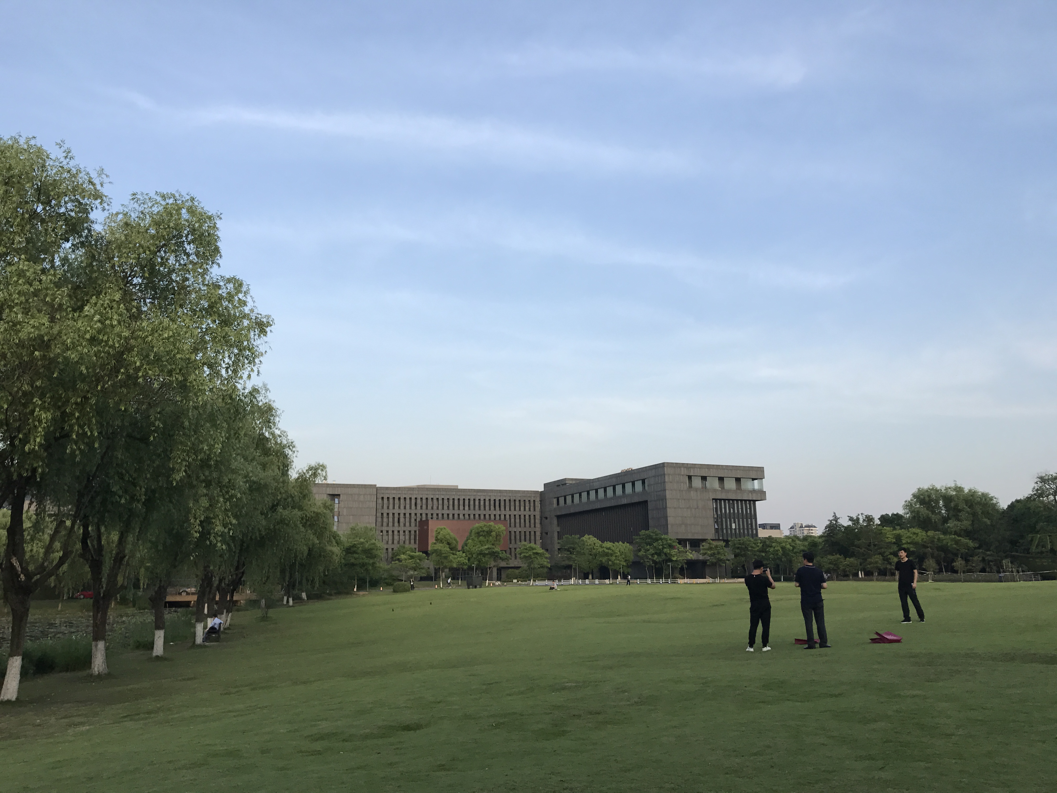
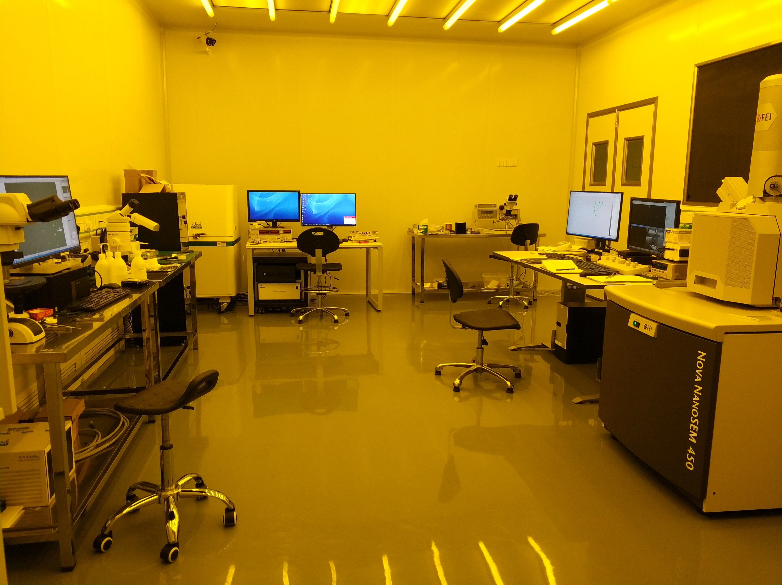
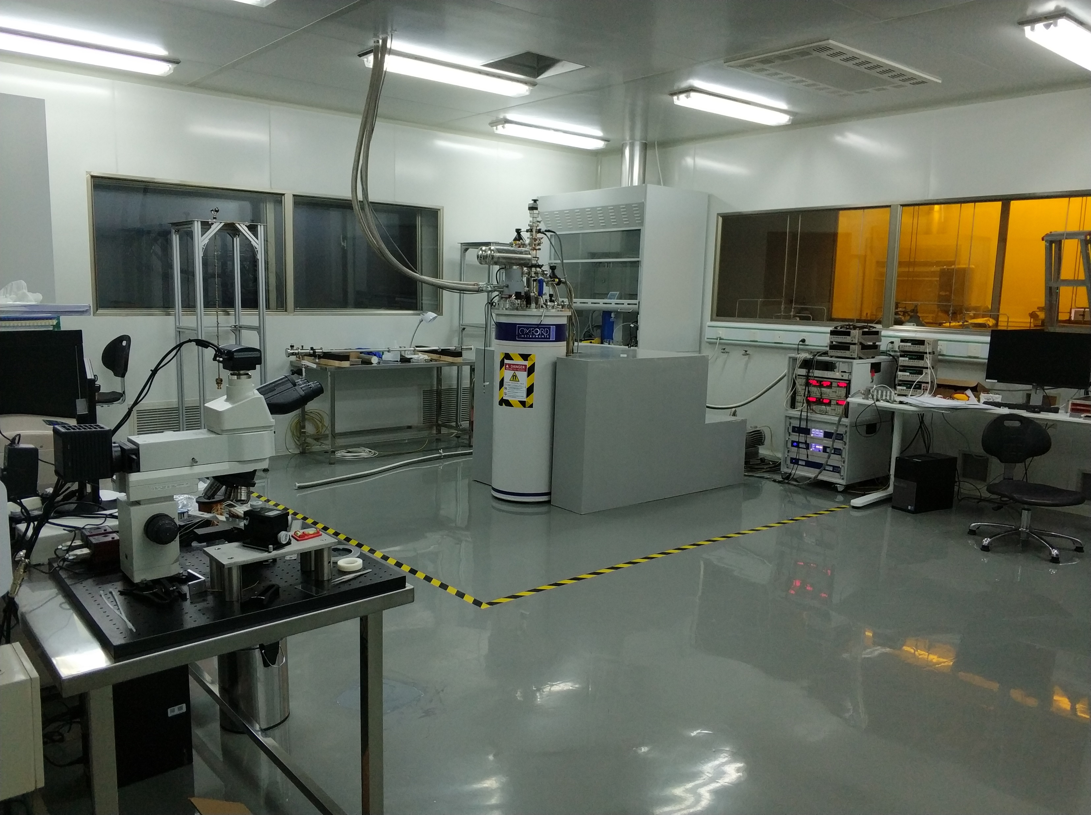
Our Device Lab
I. Topological Semimetals
  Weyl SMs
    PRB 93, 12112(R) (2016); ESI highly cited
    Front. Phys. 12, 127205 (2017)
II. Novel 2D materials
  SnSe Family
  SnSe₂ Family
  ….
3

Slide 4
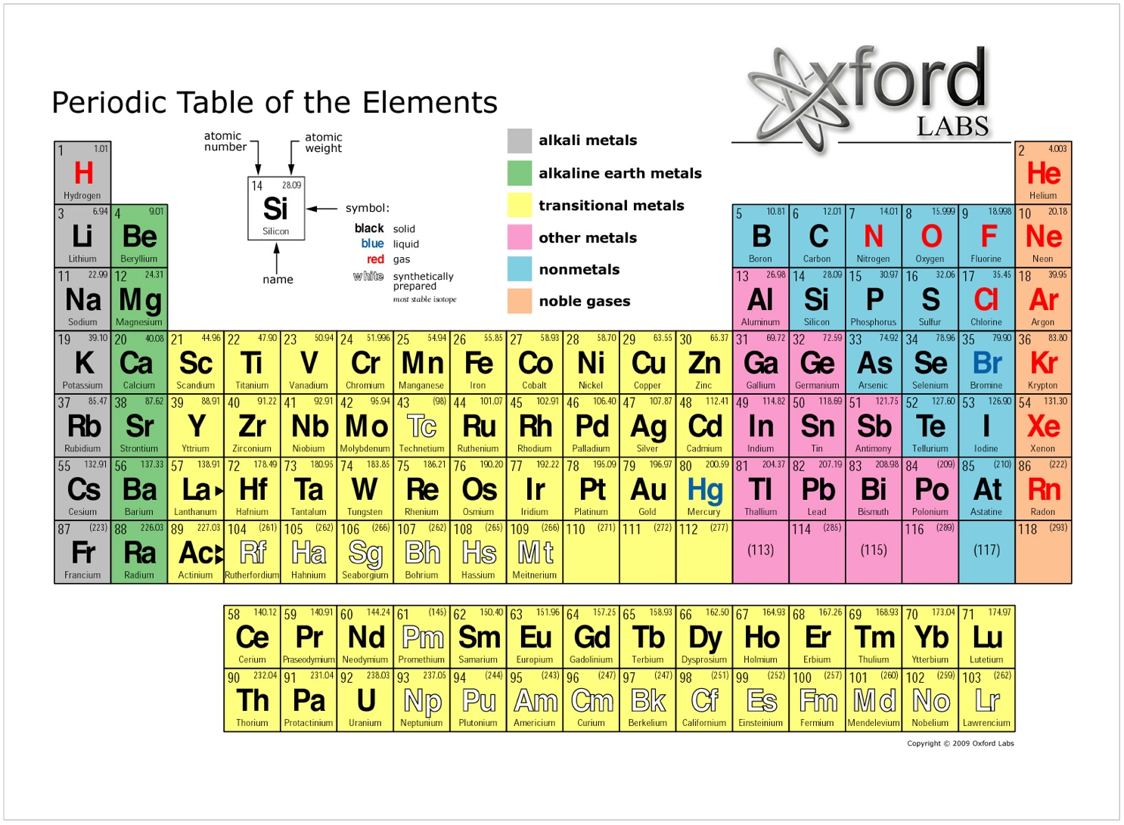
Binary BP
XIII
XIV
XV
XVI
XVII
4

Slide 5
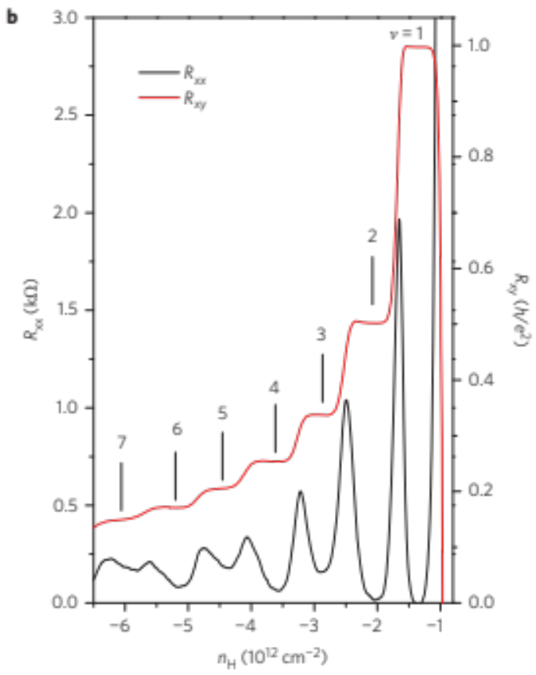
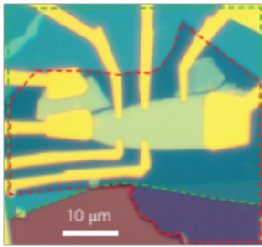
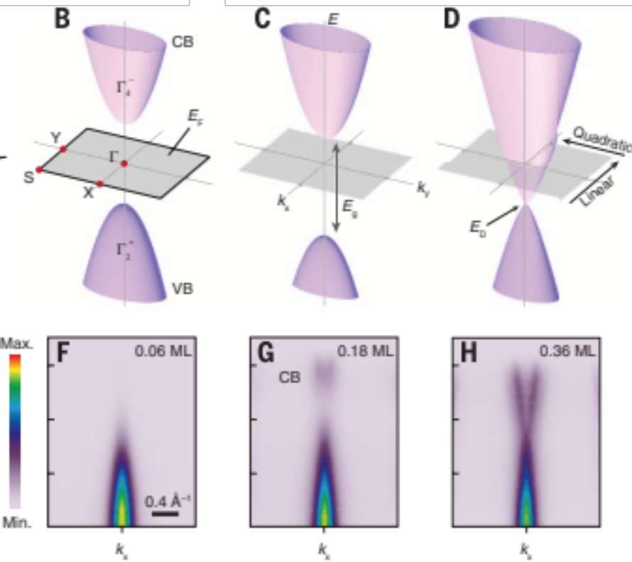
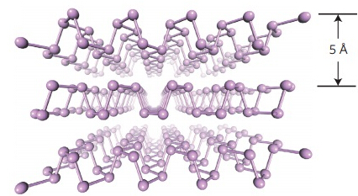
Motivation
Semi-Dirac transition
“Giant Stark Effect”
Y. B. Zhang group
Nat. Nano 2014, 2015, 2016
Science 349, 723 (2015)
5

Slide 6
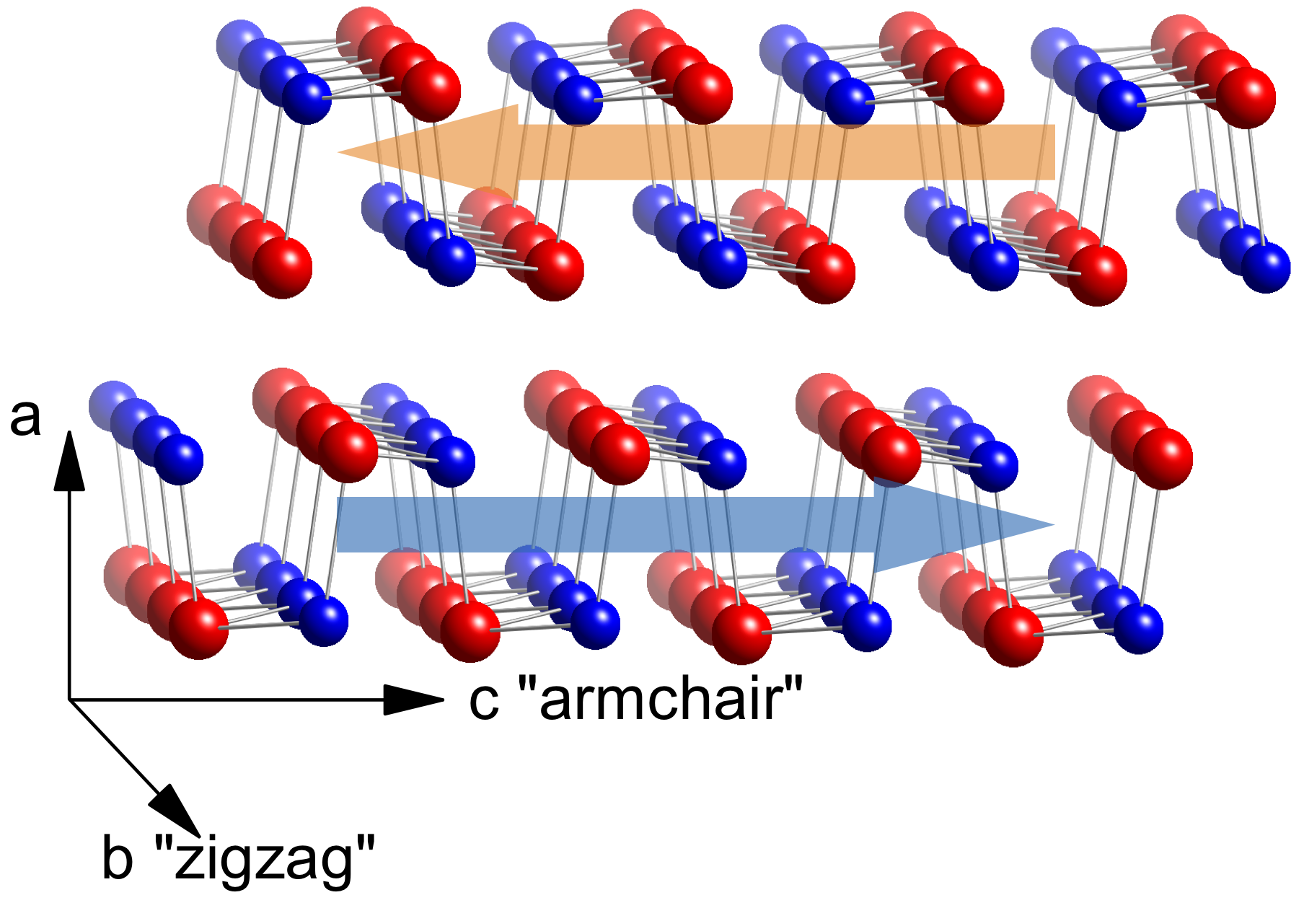
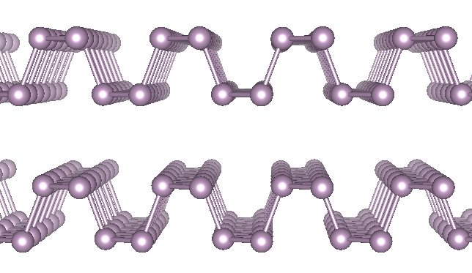
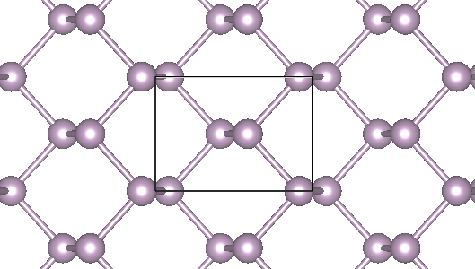
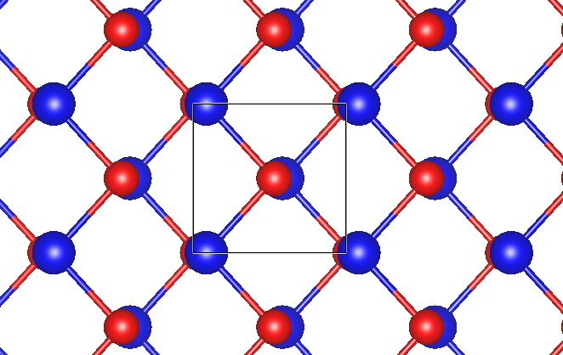
Motivation
6

Slide 7
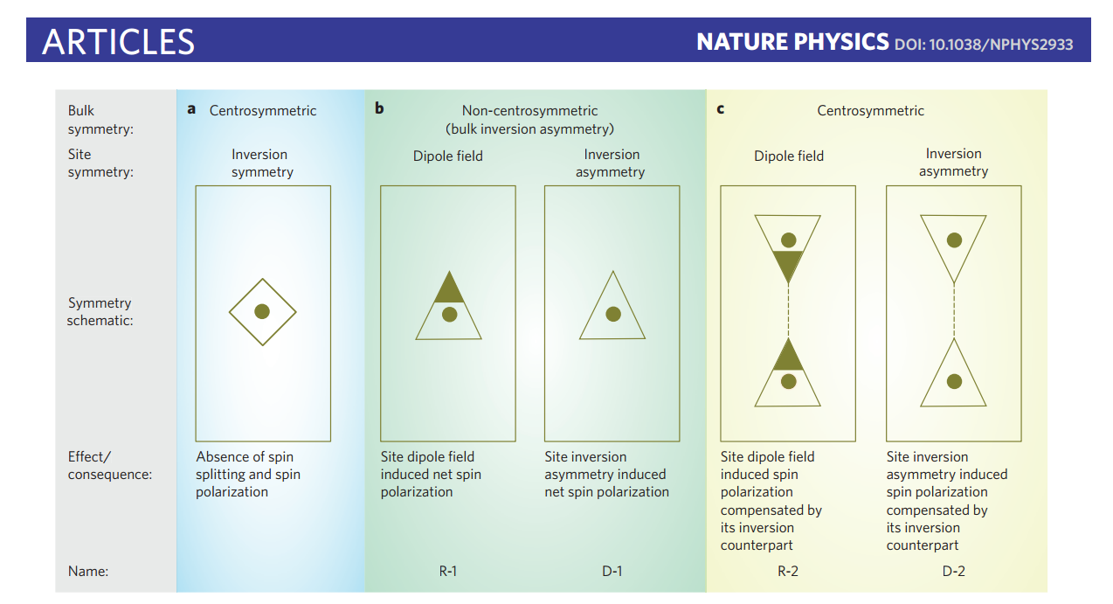
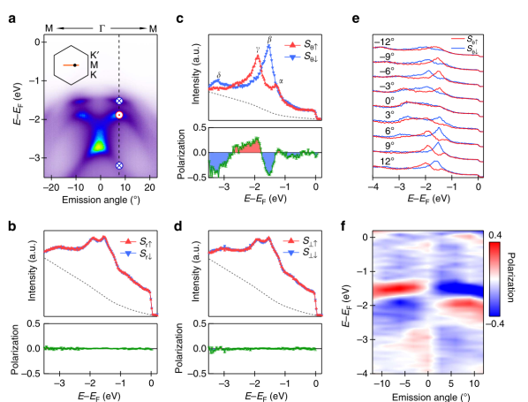
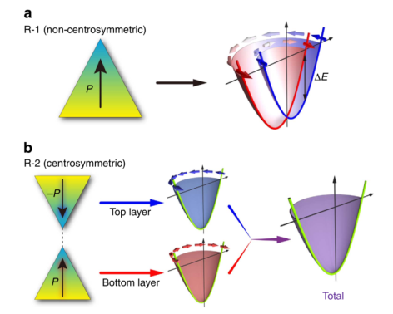
Motivation
a: NaCl-type
b:R-1 InAs GaSb
D-1 GeTe ZnS
c:R-2 PtSe2
D-2 WSe2
PtSe2
7

Slide 8
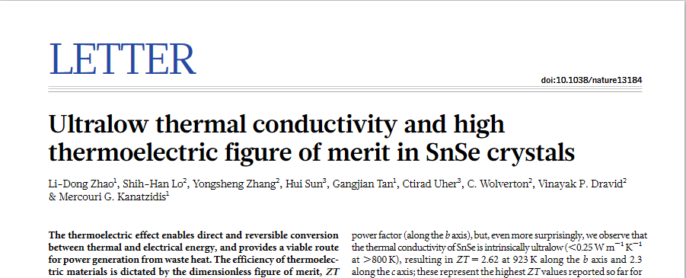
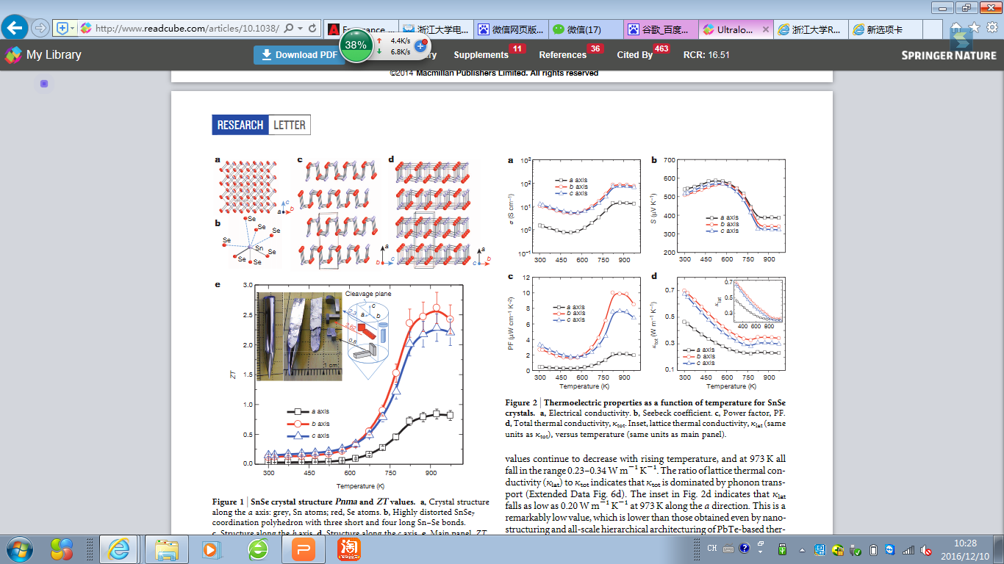
Motivation
Intrinsic p-type Semi？
high ZT (Physics? Electronic structure)
Stable in air (Exfoliation and devices)
8

Slide 9
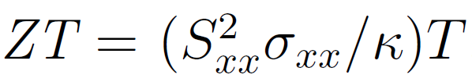
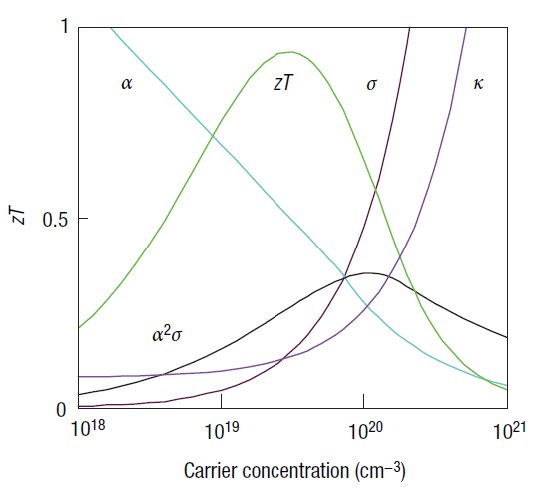

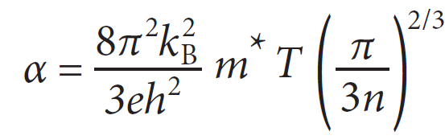


Figure of merit, ZT
Seebeck coefficient
Conductivity
Thermo-
conductivity
SnSe:
Due to phonon anharmonicity in SnSe,
Lowest lattice thermal conductivities known for crystalline materials .
9
Li et. al., Nat. phy. 2015

Slide 10
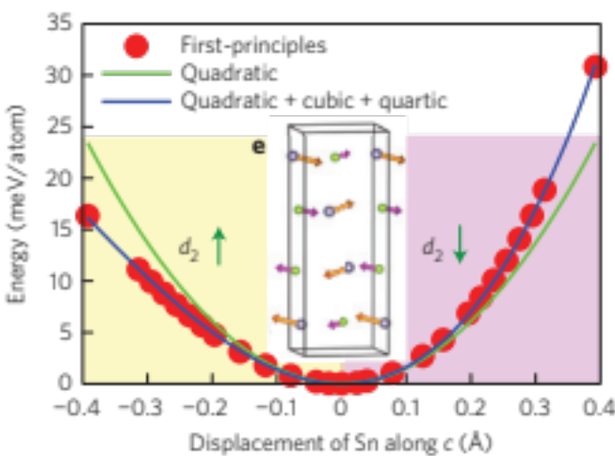
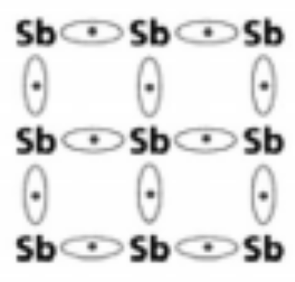
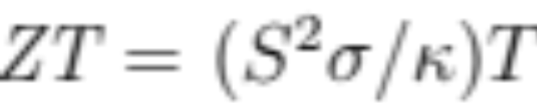
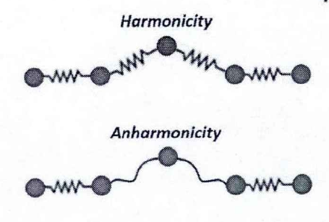
High ZT: General Picture
Single Parabolic Band
I. Unharmonic Phonon
II. Multi-valley
III. Other mechanisms
10

Slide 11
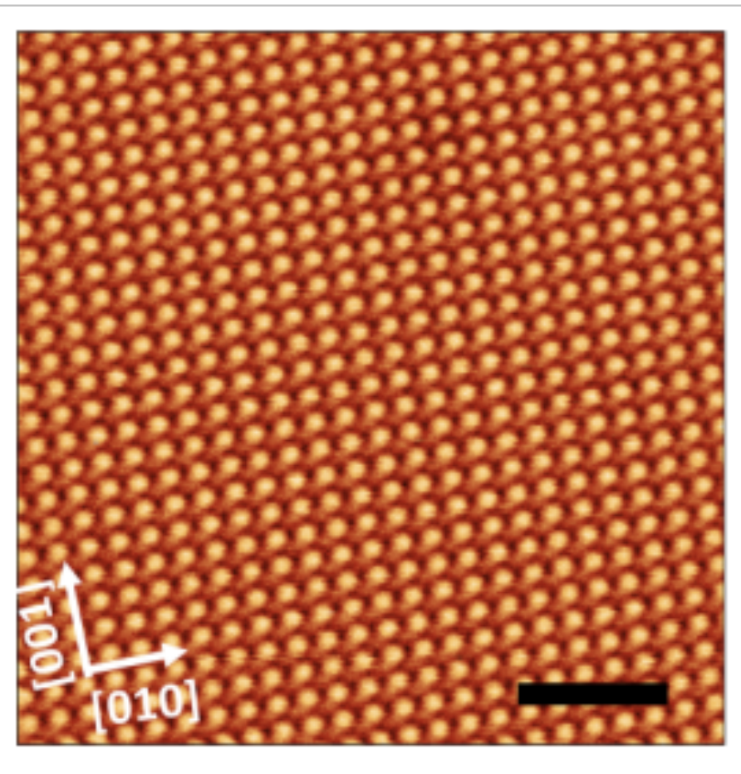
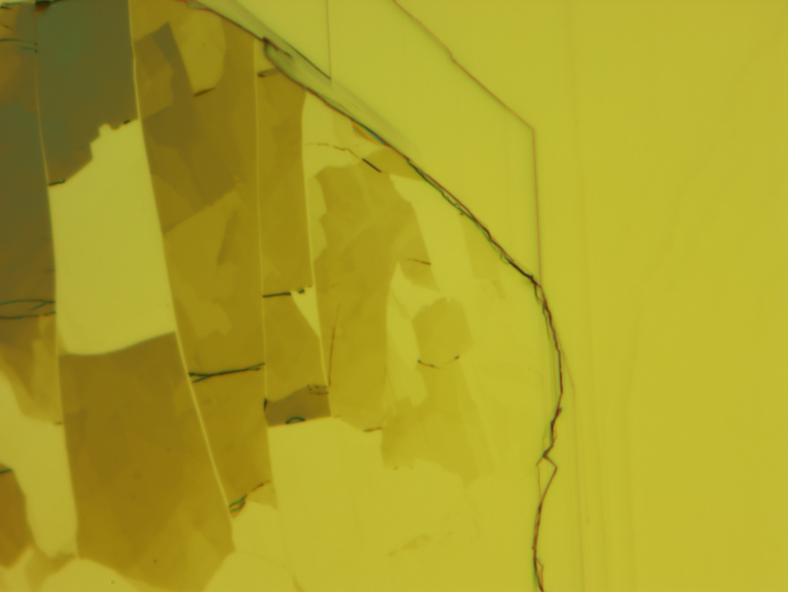
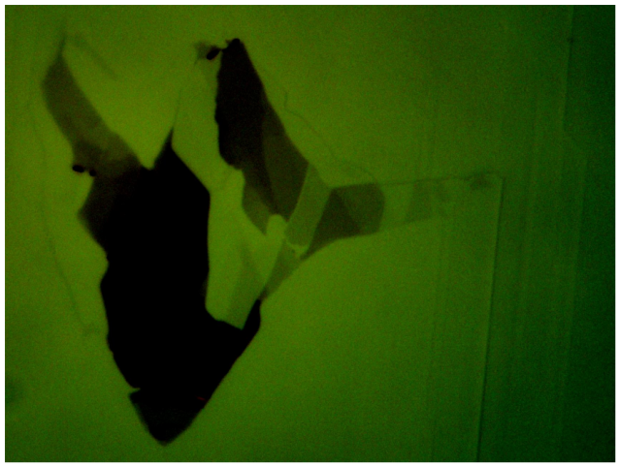
SnSe₂ Microdomains
Wang et. al., Nat. Commun. 9, 47 (2018)
11

Slide 12
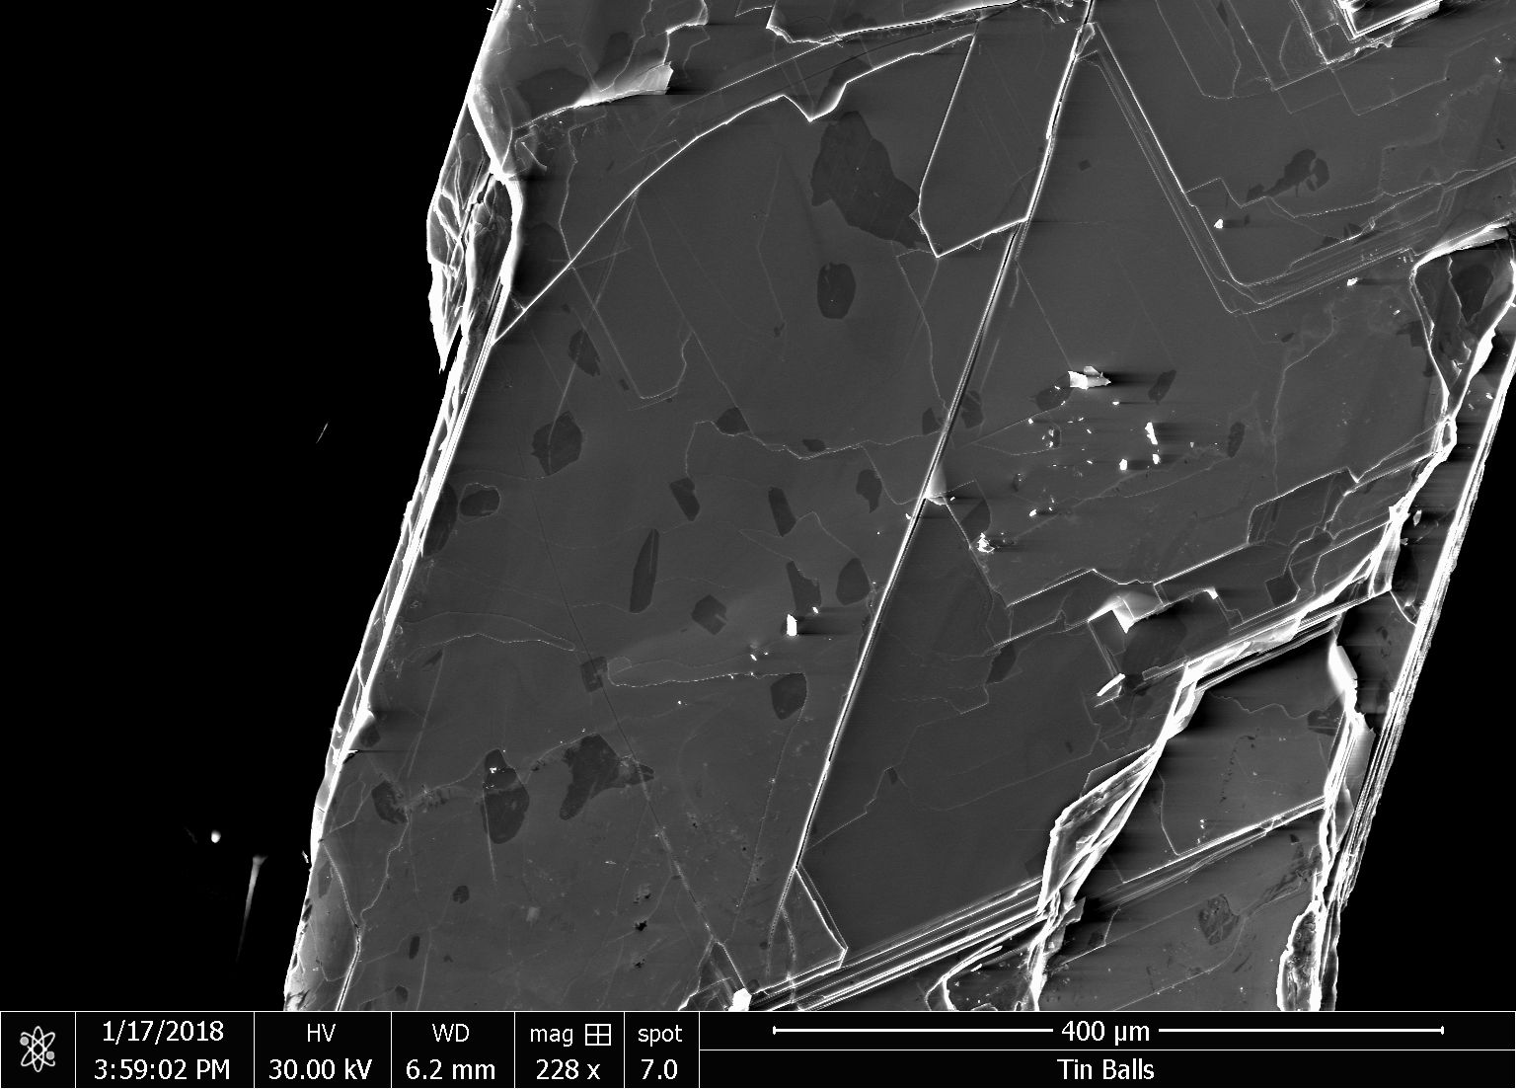
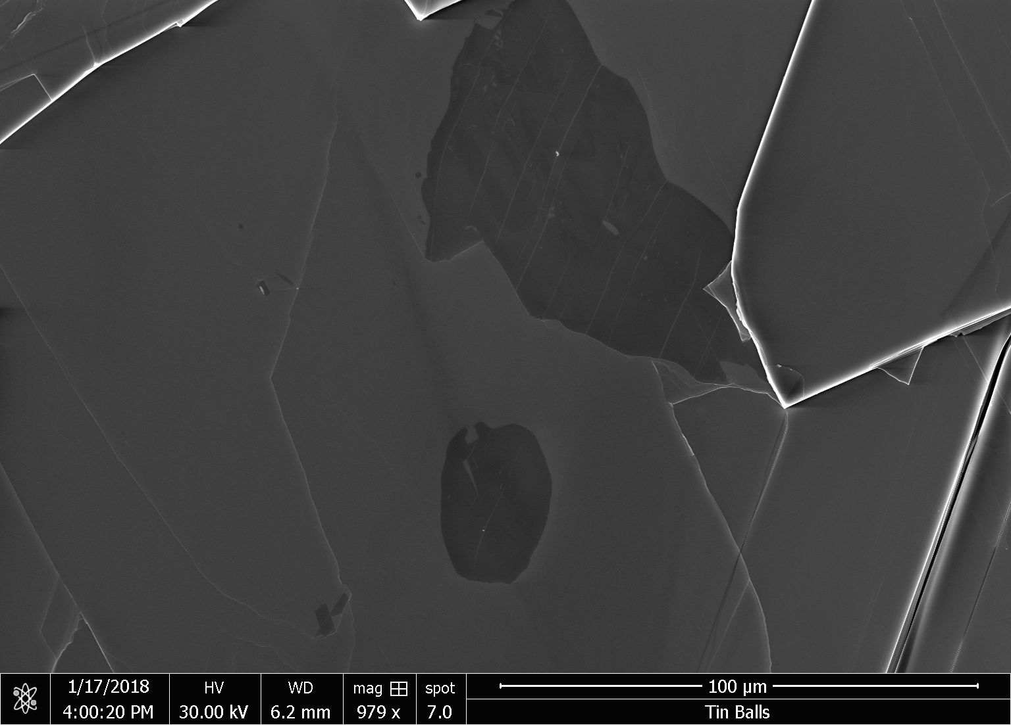
SnSe₂ Microdomains in SEM
12

Slide 13
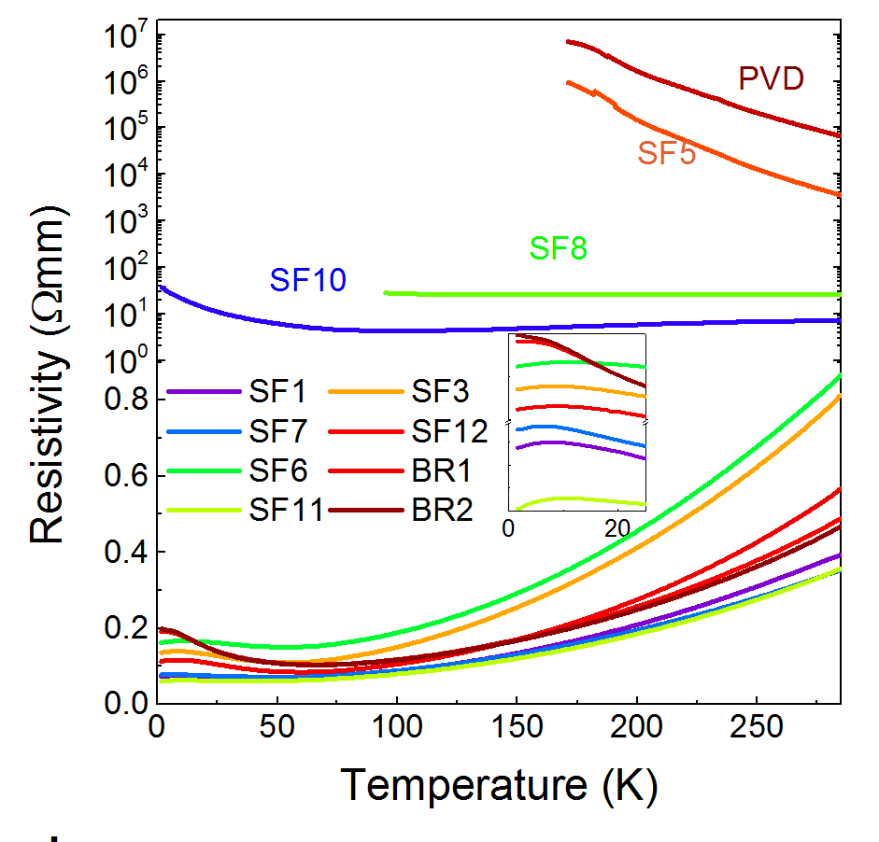
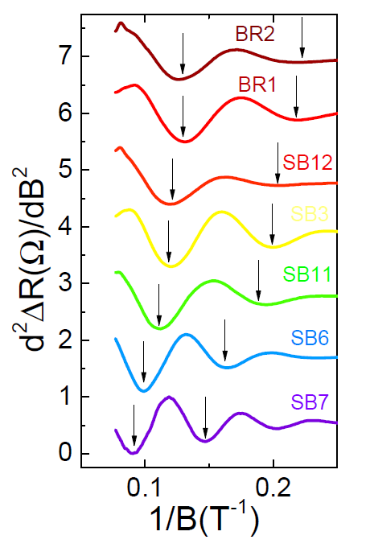
Extrinsic Hole Doping
Semiconducting
Metallic
13

Slide 14
Methods | Growth steps One step for self flux and Bridgeman Two steps for PVD |  |  |  | Se:Sn | SnSe2 | point dislocations | n (10¹⁸)
Self Flux (SF)
 | 1. Heating up | 2. Persistent time |  | 3. Cooling
 | 10 hrs to 950ºC; all batches | 1500 mins | SF1 | natural cooling: 1day | 1 | 0.9% | 4.5×10⁴ mm⁻² | 1.16
 |  |  | SF6 |  | 1 | 0.3% |  | 0.69
 |  |  | SF7 |  | 1 | 3.73% |  | 1.23
 |  | 3000 mins | SF3 | 4000mins to 400ºC | 1 | <0.3% | none | 0.592
 |  |  | SF5 |  | 1 | none |  | --
 |  | 6000 mins | SF8 | 9999mins to 400ºC | 1 | <0.1% |  | --
 |  | 9999 mins | SF10 | natural cooling: 1day | 1 | <0.1% |  | --
 |  |  | SF11 |  | 1 | 2.6% |  | 1.079
 |  |  | SF12 |  | 0.95 | <0.3% |  | 0.794
Bridgeman (BR) | 10 hrs to 950ºC | 9999mins | BR1 | natural cooling；1day | 1 | 2.49% | none | 0.699
 |  |  | BR2 |  | 1 | Not uniform Some >1% Some <0.3% |  | 0.591
PVD | Step1 |  |  | Step2 | 1 | none | Aera1: 5×10⁴ mm⁻² Aera2~Aera10: None | --
 | same as batch1 step1 | Grind the single crystal to powder |  | 700ºC----800ºC In a two-zone furnace persistent for one week
14

Slide 15
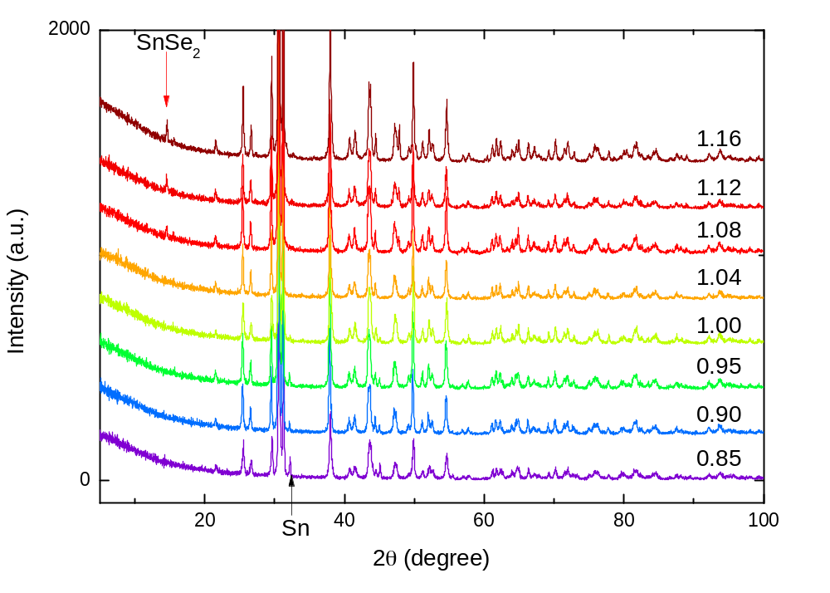
Extrinsic Hole Doping
15

Slide 16
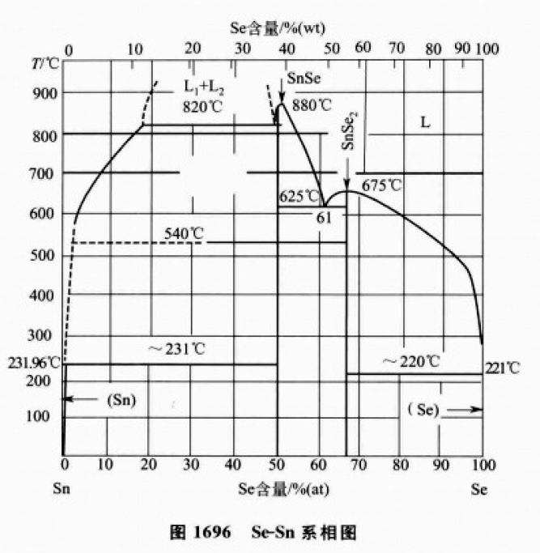
SnSe-SnSe₂ Phase Diagram
16

Slide 17
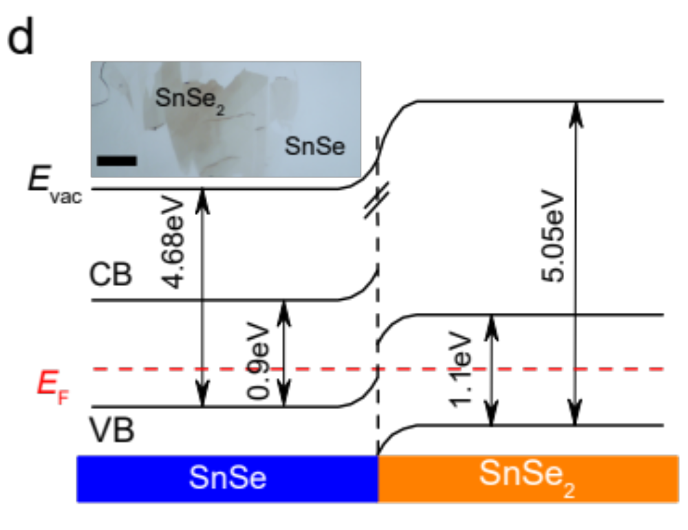
Interfacial Charge Transfer
17

Slide 18
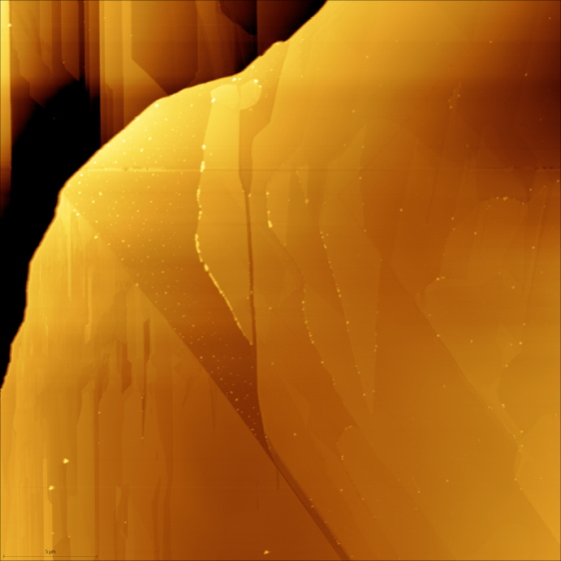
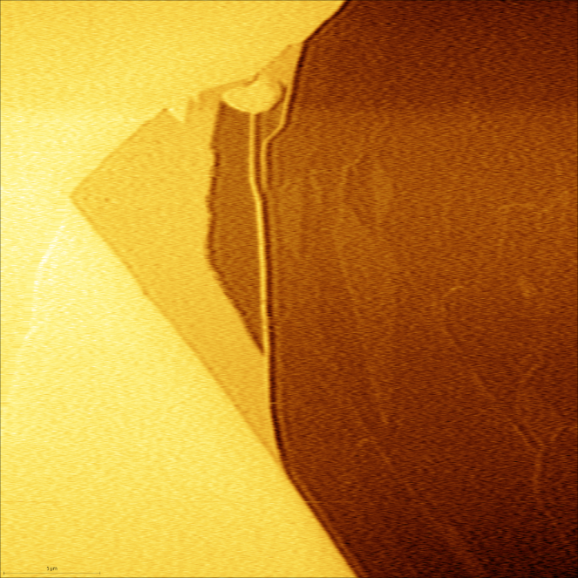
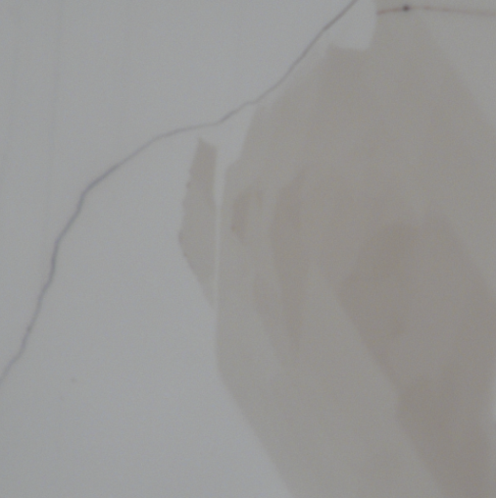
Scanning Kelvin Probe Microscopy
4.39 eV
1
3
4.56 eV
2
4.85 eV
topography
SKPM potential
18

Slide 19
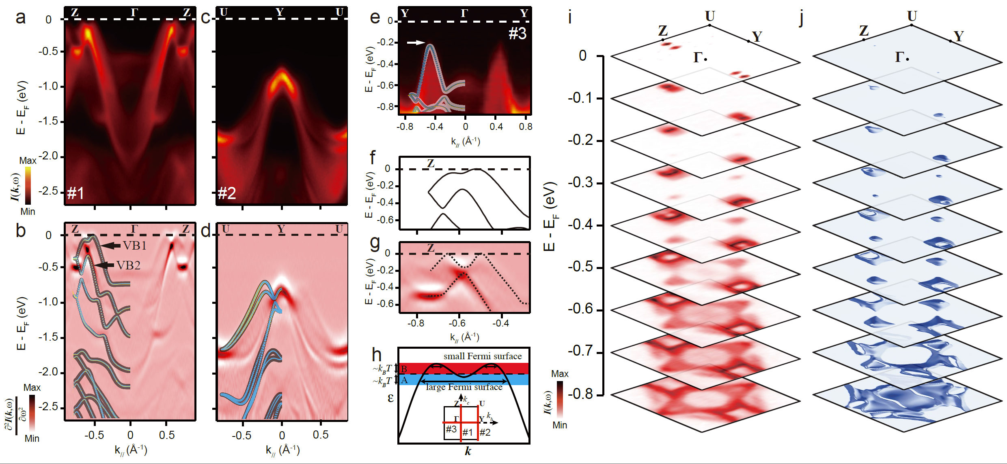
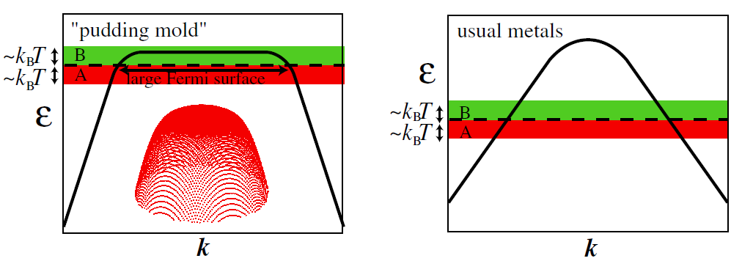
ARPES study of SnSe: Pudding mold
Pudding mold
Kazuhiko, JPSJ, 2007
Nat. Commun. 9, 47 (2018)
19

Slide 20
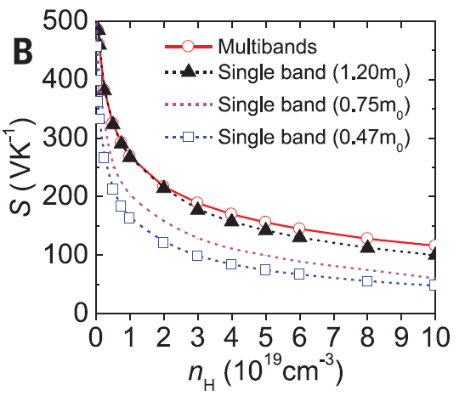
ARPES study of SnSe: Multi-valley
Zhao et. al., Science, 2016
Nat. Commun. 9, 47 (2018)
20

Slide 21
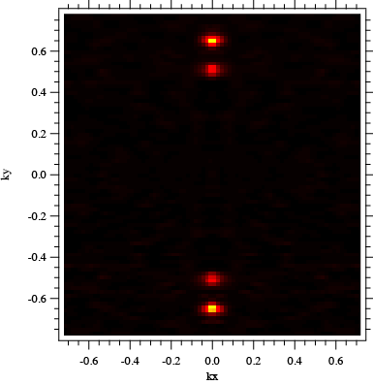
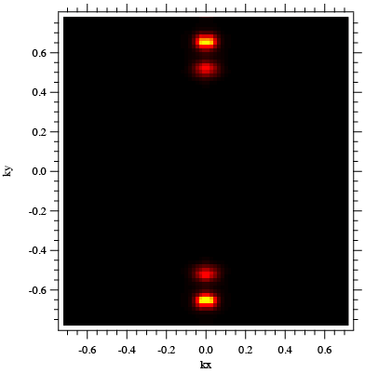
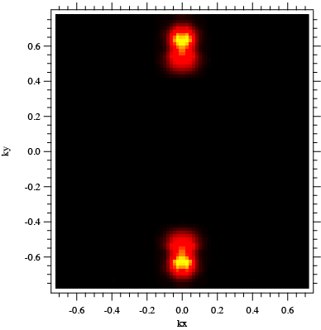
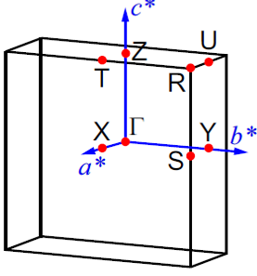
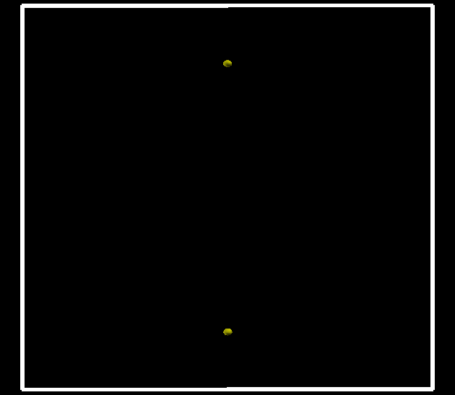
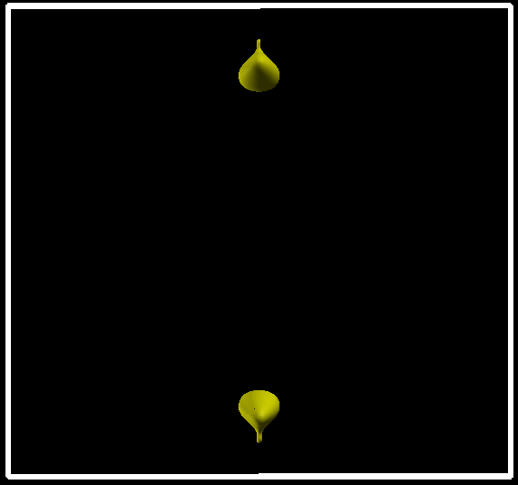
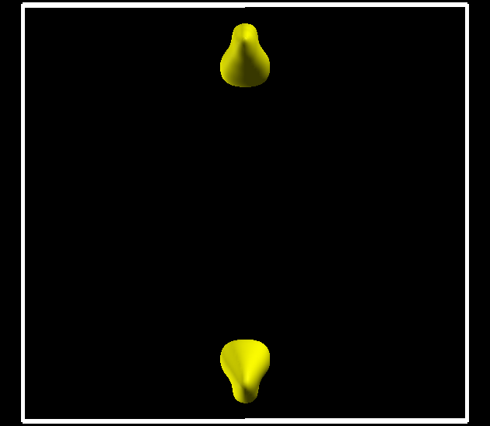
ARPES: Constant Energy Cuts
Ky
Ky
Ky
Kz
Fermi Surface
E_{B}=0.05
E_{B}=0.1
E_{B}=0.2
E_{B}=0.3
E_{B}=0.4
E_{B}=0.05
E_{B}=0.1
21

Slide 22
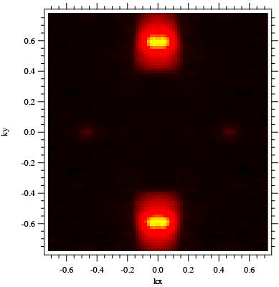
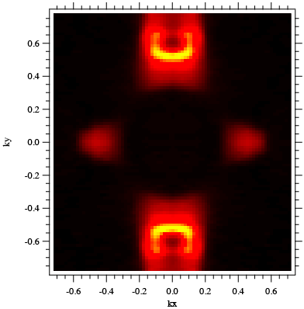
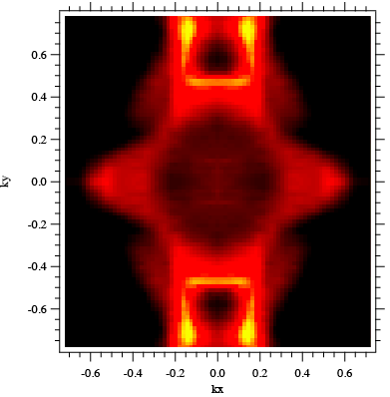



ARPES: Constant Energy Cuts
Ky
Ky
Ky
Kz
Fermi Surface
E_{B}=0.2
E_{B}=0.4
E_{B}=0.6
Kz
E_{B}=0.2
E_{B}=0.5
22

Slide 23

Multi-Valley Seebeck
23

Slide 24

Weak Localization: Intervalley Scattering
Nat. Commun. 9, 47 (2018)
24

Slide 25

Anisotropic WL
25

Slide 26

Anisotropic MR
26

Slide 27

3D Fermi Surface
Nat. Commun. 9, 47 (2018)
27

Slide 28

Point Dislocations
4.5*10⁴ mm²
28

Slide 29

Interweaving of SnSe Monolayers
Nat. Commun. 9, 47 (2018)
29

Slide 30

Bismuth-doped n-SnSe: Transport
Unpublished
30

Slide 31

Bismuth-doped n-SnSe: ARPES
DFT
Unpublished
31

Slide 32
Conclusions
Exotic Energy Bands and Defects Physics in SnSe
  Pudding-mold shaped VB
    Multi-valley transport
    Quasi-linear (Dirac-like) dispersion
  Two types of peculiar defects
    Local SnSe₂ phase segregation
      - Main hole doping mechanism in SnSe
    Point dislocations
      - 3D Fermi surface!
Perspective:
  2D limit, correlated System
    Multi-ferroicity (Ferroelectric+Ferroelasticity)
    Unharmonic Phonon modes (Electron-phonon)
  Electronic devices…
32

Slide 33


Collaborators
SIMIT, Prof. Dawei Shen (ARPES)
AP Yunhao Lu (DFT)
NUS Assit. Prof Jiong Lu (STM)
Prof. Zhu-An Xu
MOST of China
33

Slide 34

Our Group
Exp.
DFT

