Slide 1



Elemental 2D Materials Beyond Graphene
Yi Du (杜 轶)
¹ Institute for Superconducting and Electronic Materials (ISEM)/
Australian Institute for Innovative Materials (AIIM)
University of Wollongong , Australia
² Beihang-UOW Joint Research Centre, Beihang University, China
BUAA-UOW JOINT RESEARCH CENTRE
AUSTRALIAN
INSTITUTE for
INNOVATIVE
MATERIALS

Slide 2
CONTENTS
Background
Growth and Structures
Electronic Structures
Phonon Properties
Chemical Stability
Interlayer Interaction
Conclusion
Acknowledgement

Slide 3
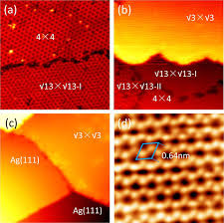
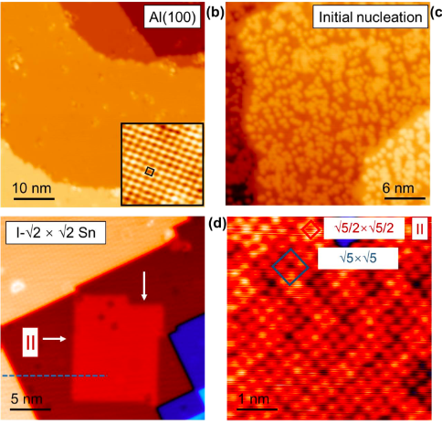
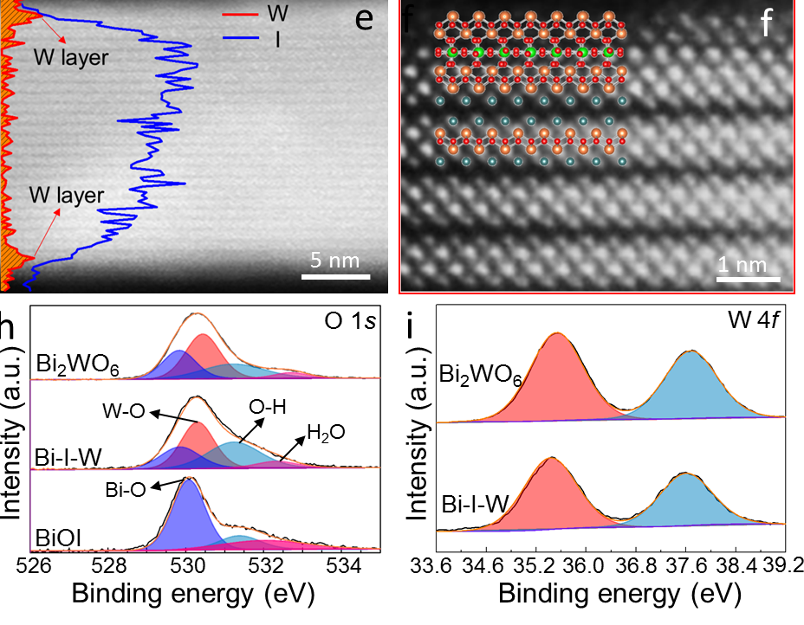
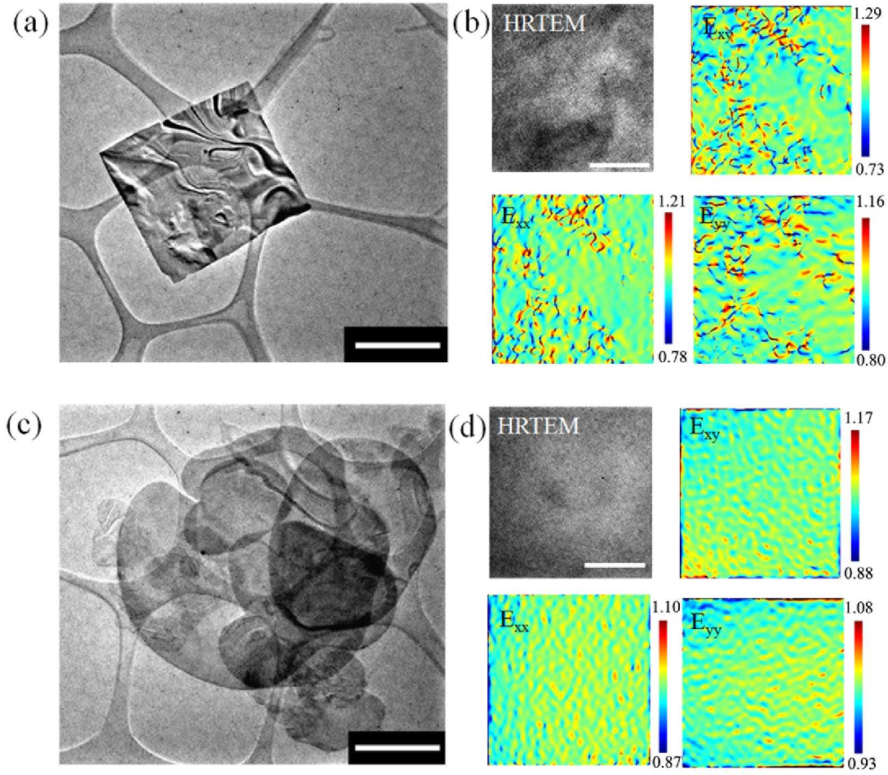
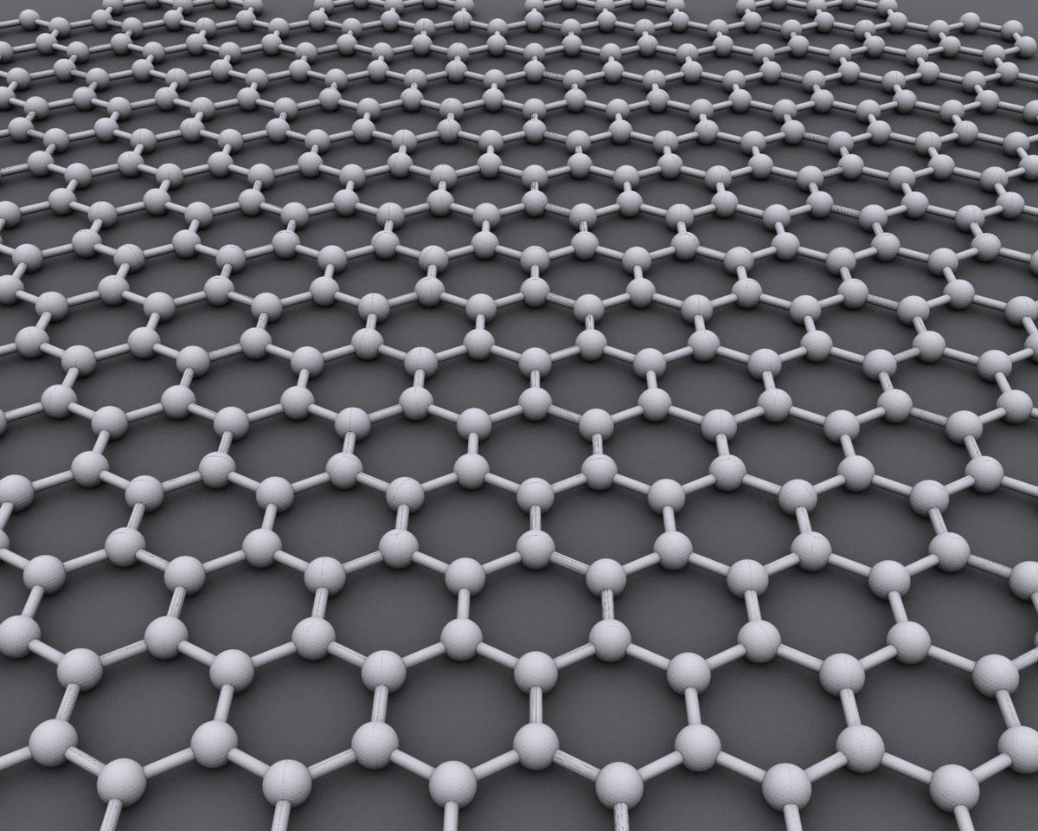
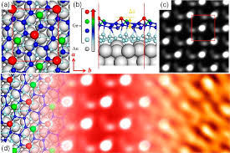
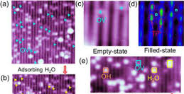

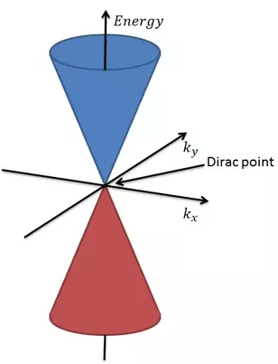
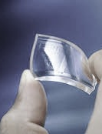
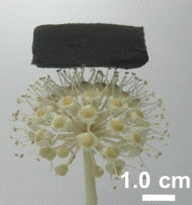
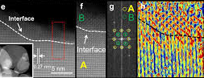
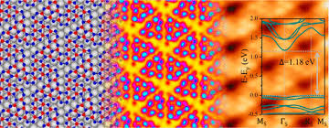


Background
silicene
Stanene
2D heterostructures
germanene
Oxide surface
Graphene
What are 2D materials beyond
2D BiOX nanosheet
Blue phosphorene

Slide 4
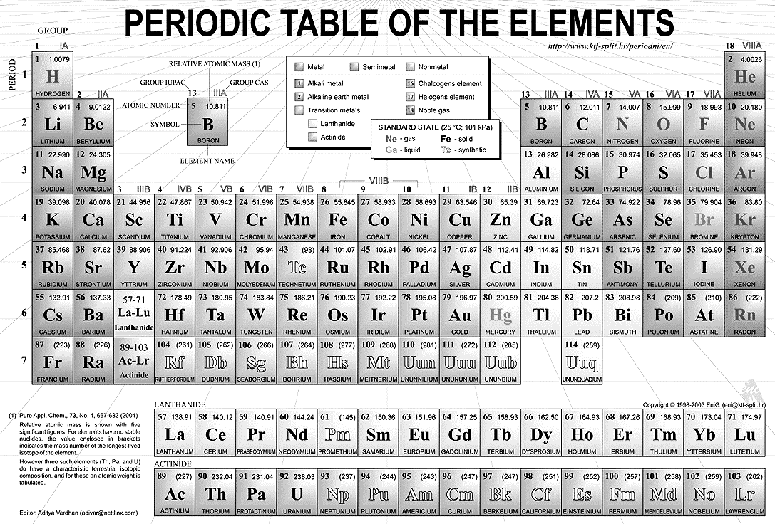

Background
Carbon sp³, sp² | Silicon sp³, sp² | Germanium sp³, sp²
Graphene | Silicene | Germanene

Slide 5
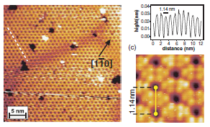
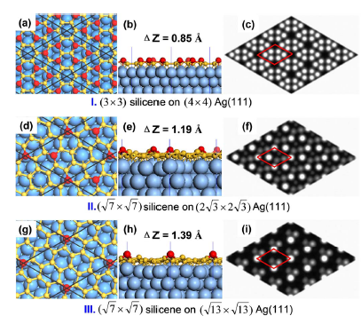
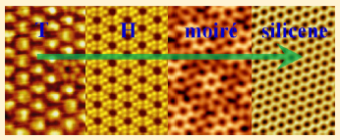

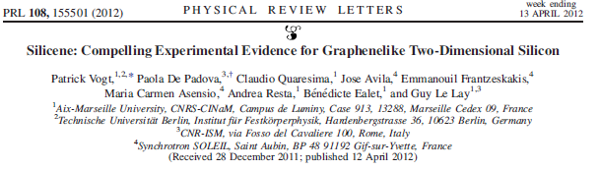
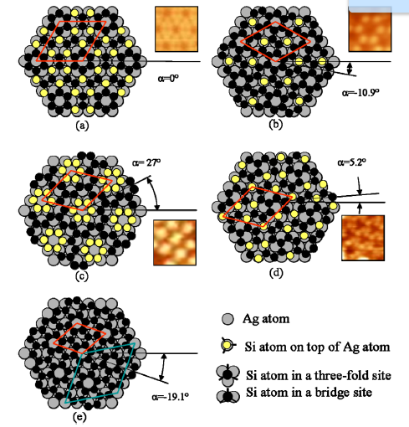
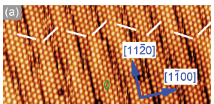
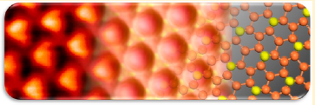

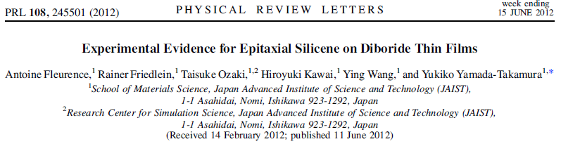
Background
¹ Lalmi B, et al Appl. Phys. Lett. 2010, 97, 223109
² Vogt, P. et al Phys. Rev. Lett. 2012, 108, 155501.
² Feng, B. et al Nano Lett. 2012, 12, 3507.
³ Fleurence, A. et al Phys. Rev. Lett. 2012, 108, 245501.
⁴ Meng, L. et al Nano Lett. 2013, 13, 685.
¹ Gao, J. et al Sci. Rep. 2012, 2, 861.
² Jamgotchian, H. et al JPCM. 2012, 24, 1720001.
³ Enriquez, H. et al JPCM. 2012 , 24, 314211.

Slide 6
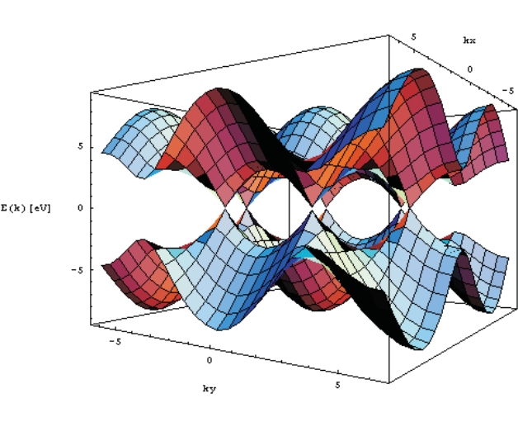
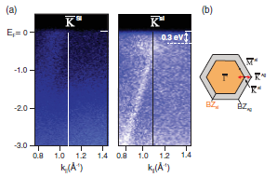
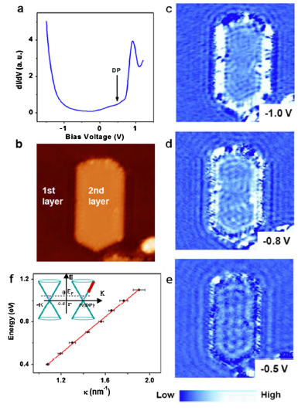
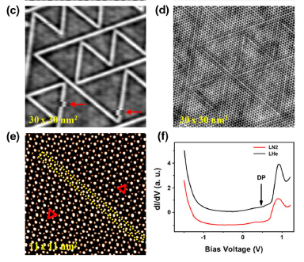
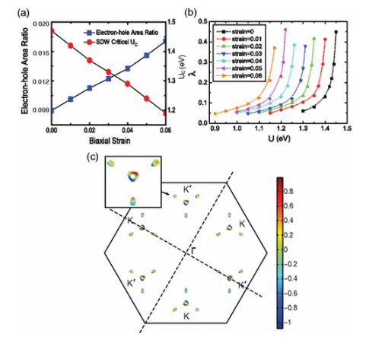
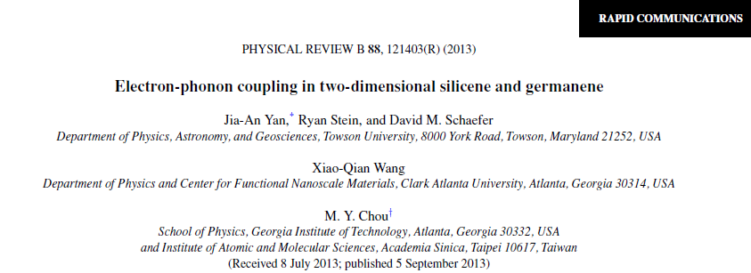
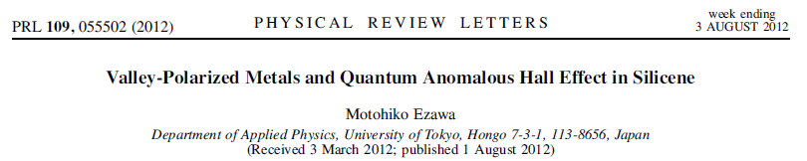
Background
¹ Vogt, P. et al Phys. Rev. Lett. 2012, 108, 155501.
² Chen, L. et al Phys. Rev. Lett. 2012, 109, 056804.
³ Chen, L. et al Phys. Rev. Lett. 2013, 110, 085504.
⁴ Ezawa, M. et al Phys. Rev. Lett. 2012, 109, 0355502.
⁵ Yan, J. , L. et al Phys. Rev. B. 2013, 88, 121403(R).
⁶ Liu, F., L. et al Phys. Rev. Lett. 2013, 111, 066804.
⁷ P. De Padova et al, Appl. Phys. Lett. 2011, 98, 233109

Slide 7
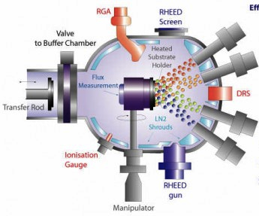
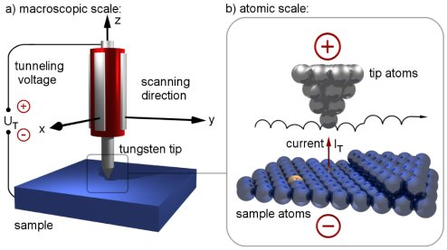
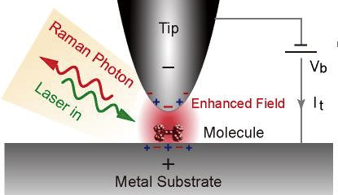
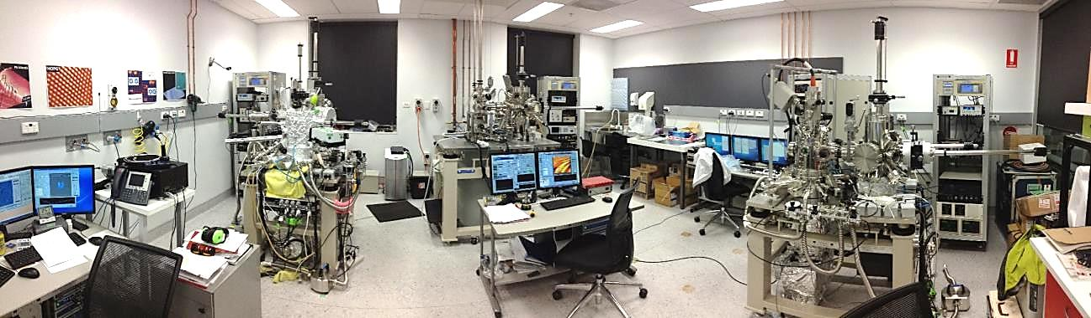
Background
STM Facilities we used in these works are low-temperature high-magnetic-field STM/SNOM systems (STM1500/SNOM1400 UNISKO Co., Japan)
Molecular beam epitaxial (MBE) deposition
Ultra-high vacuum (UHV) < 5 X 10⁻¹¹ torr
Ag(111), Au(111), Cu(111) single crystals are used as the substrates
Deposition rate: 0.8 ML/min

Slide 8
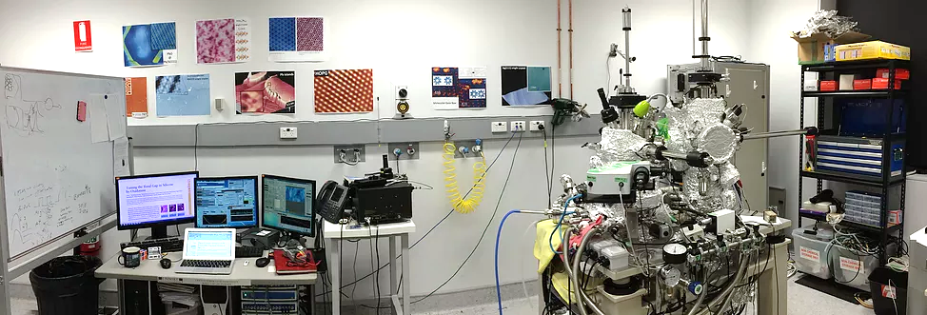
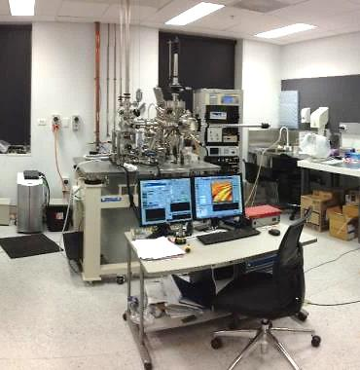
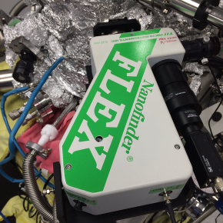
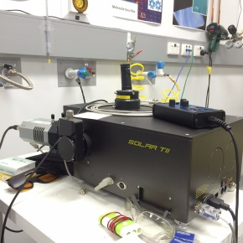
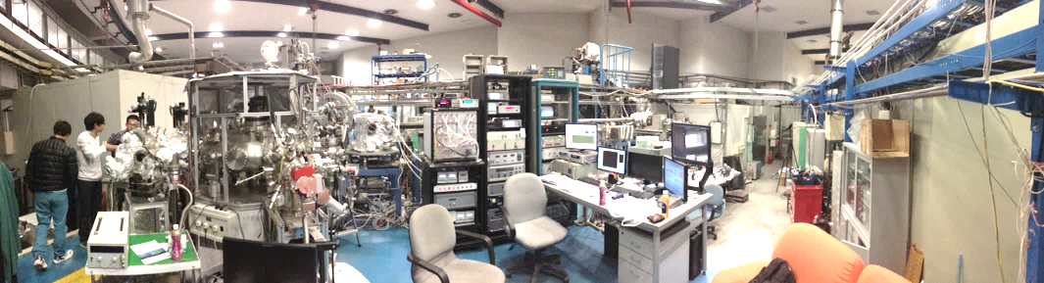

Background
STM Facilities we used in these works are low-temperature high-magnetic-field STM/SNOM systems (STM1500/SNOM1400 UNISKO Co., Japan)
Molecular beam epitaxial (MBE) deposition
Ultra-high vacuum (UHV) < 5 X 10⁻¹¹ torr
Ag(111), Au(111), Cu(111) single crystals are used as the substrates
Deposition rate: 0.8 ML/min
SNOM1400
STM1500
ARPES Facility we used is located at Photoemission Beamline in Beijing Synchrotron Radiation Facility (BSRF), Institute of High-Energy Physics, Chinese Academy of Sciences.
in-situ Raman

Slide 9
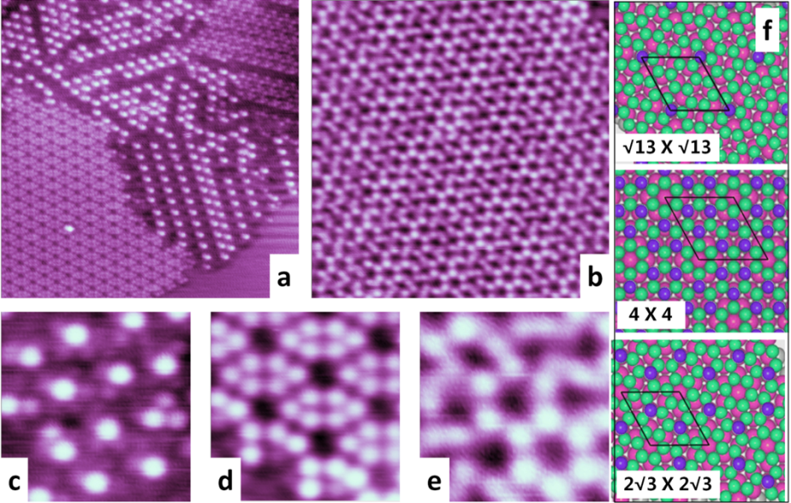
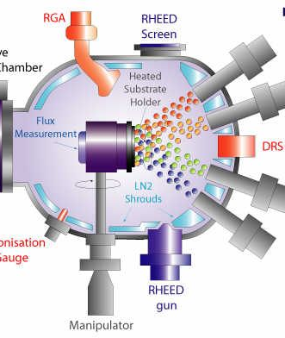
Growth and Structures
Silicene/Ag(111)
Molecular beam epitaxial (MBE) deposition
Substrate temperature
190 ºC
230 ºC
300 ºC
Topographic images of silicene buffer layers grown on Ag(111). (a) STM topography image of mixed two major phases of silicene buffer layer, √13×√13 (-I and –II) and 4×4, in different domains (scanning area 16 nm×16 nm, V_{bias}= -0.5 V, I= 4 nA). (b) STM topography image of silicene 2√3×2√3 phase (scanning area 10 nm×10 nm, V_{bias}= -0.8 V, I= 4 nA). (c)-(e) High-resolution STM images of √13×√13-I, 4×4 and 2√3×2√3 phases, respectively (scanning area 2 nm×2 nm, V_{bias}= -0.02 V, I= 5 nA). (f) Illustration of silicene monolayers on Ag(111), in which dark balls represent Si atoms and light balls represent underlayer Ag atoms in Ag(111). Purple and green atoms represent top-layer and bottom-layer Si atoms, respectively, in buckled-structured silicene. Pink atoms represent Ag atoms in the substrate.
Y. Du, et al. ACS Nano 8, 10019 (2014)

Slide 10
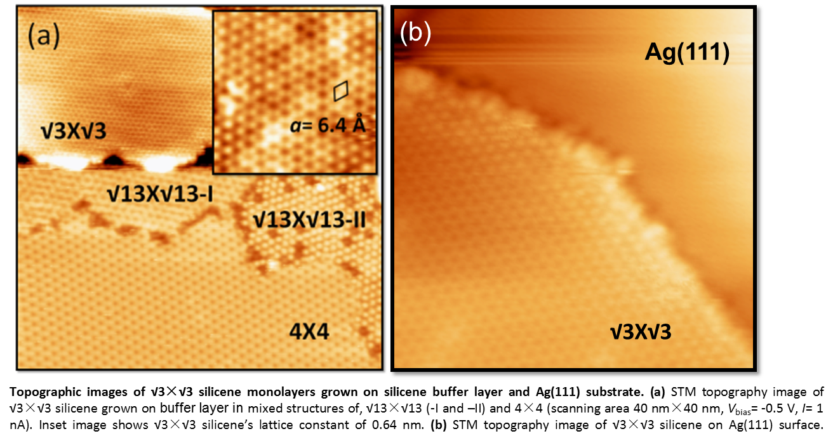
Growth and Structures
Silicene/Ag(111)
Lattice constant (0.64 nm) is √3 times of the predicted value (1x1 silicene) !
J. Zhuang, et al., Phys. Rev. B 91, 161409(R) (2015)

Slide 11
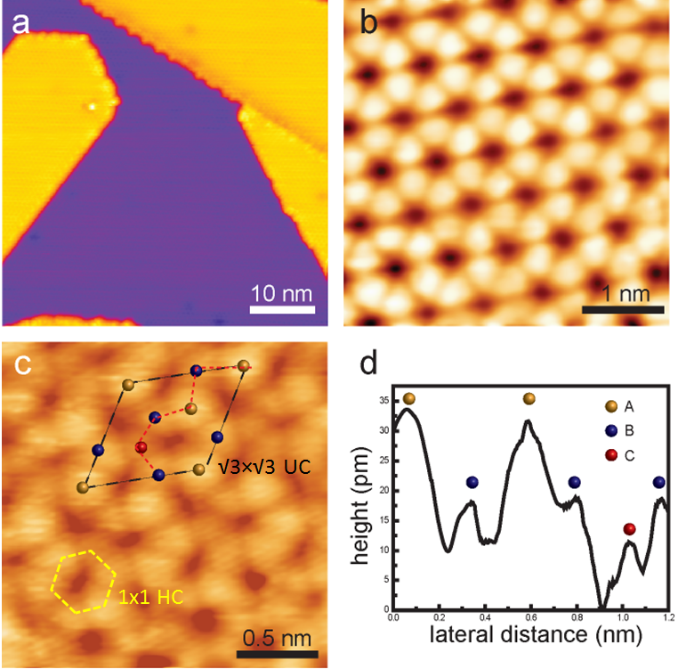
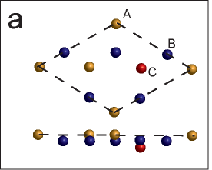
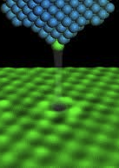
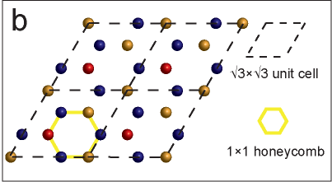
Growth and Structures
Silicene/Ag(111)
e
(b)
Si atom
p_{z}
f
Atomic structure of √3×√3 silicene monolayers grown on silicene buffer layer and Ag(111) substrate. (a) STM topography image of multilayer √3×√3 silicene grown on Ag(111), (b) STM topography image of √3×√3 honeycomb structure, (c) atomic arrangement of √3×√3 which consists of 1×1 silicene honeycomb structure, (d) line profile corresponding to red dashed line in (c), (e) and (f) ABĀ stacking model in silicene layers
Z. Li, et al., ACS Cent. Sci. 2, 517 (2016)
J. Zhuang et al., Adv. Mater. (accepted, 2017, DOI: 10.1002/adma.201606716).

Slide 12
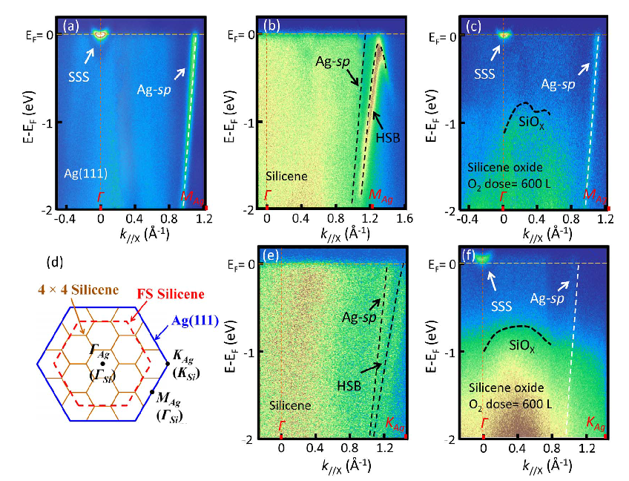

Electronic Structures
Silicene
Silicene buffer layer
Energy vs. k dispersion measured by ARPES for
(a) clean Ag(111) surface,
(b) 4×4 silicene grown on Ag(111) along the Γ-M_{Ag} direction, and
(c) oxidized silicene on Ag(111) along the Γ-M_{Ag} direction, respectively. SSS in (a) and (b) denotes the Shockley surface state. HSB in (b) denotes
the hybrid surface band.
(d) STM topographic image of silicene buffer layer
(e) 4×4 silicene grown on Ag(111) along the C-KAg direction, and
(f) oxidized silicene on Ag(111) along the Γ-M_{Ag} direction, respectively.
(d)
X. Xun et al., Sci. Rep. 4, 7543 (2014)
H. Liu et al., 2D Mater. 3, 025034 (2016)

Slide 13
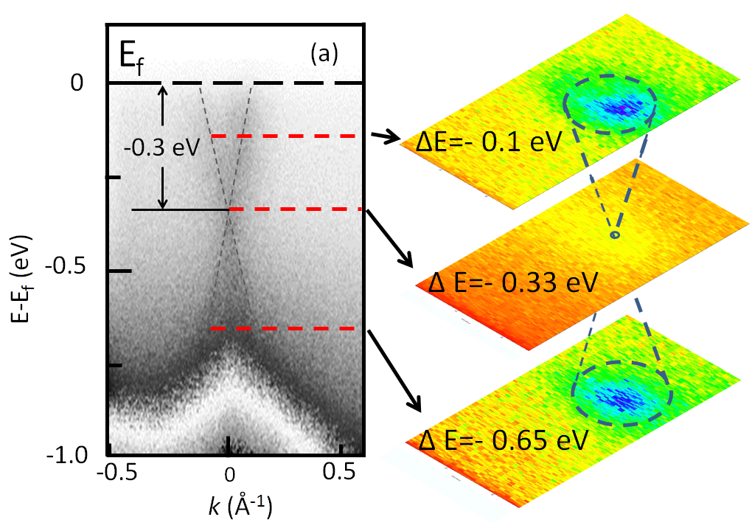
Electronic Structures
Silicene
(a)
√3×√3 silicene
(b)
(a) ARPES investigation reveals energy dispersion as a function of κ for √3×√3 silicene. The Dirac cone structure is well defined with the Dirac point at E= -0.33 eV. The Ag(111) induces a minor electron doping to the silicene layer.
(b) Energy cuts indicate the cone structure in silicene. The Femi velocity is estimated about 3.5 x 10⁵ m/s
ARPES
J. Zhuang, et al., Phys. Rev. B 91, 161409(R) (2015)

Slide 14
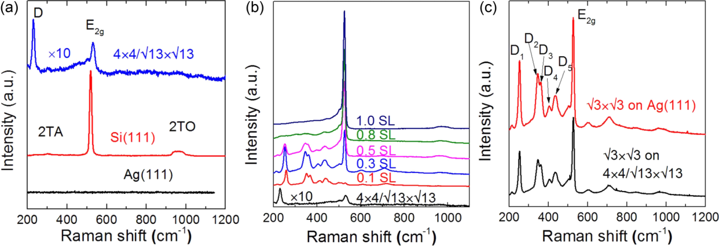
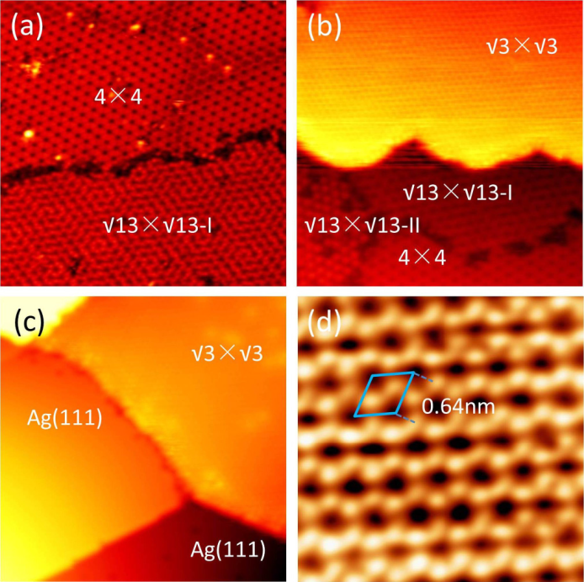
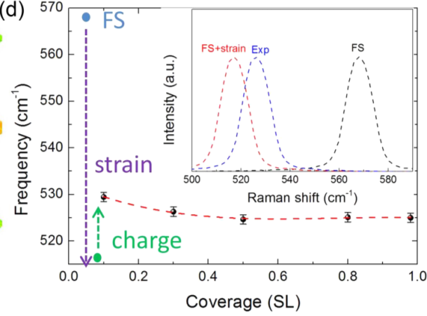
Phonon Properties
Silicene
J. Zhuang, et al., Phys. Rev. B 91, 161409(R) (2015)
EPC effects in silicene reflected by Raman spectra. (a) Raman spectra of Ag(111) substrate, Si(111), and √13×√13/4×4 buffer layer. (b) Raman spectra of √3×√3 silicene grown on √13×√13/4×4 buffer layer with different coverage. “SL” denotes the coverage of the √3×√3 silicene layer. (c) Raman spectra of √3×√3 silicene layer (coverage of 0.3 ML) grown on Ag(111) surface and √13×√13/4×4 buffer layer, respectively. (d) E_{2g} mode frequency as a function of coverage. Both the (d) and the inset of (d) are sketched to illustrate the strain and doping effects on Raman peak position of E_{2g} mode in √3×√3 silicene, in which the strain effect softens the E_{2g} mode, while charge doping will upshift the E_{2g} mode.

Slide 15

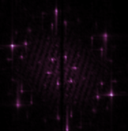






Chemical Stability
Silicene
a
Silicene buffer layers in O₂
Topographic images of silicene oxidized under different oxygen doses from 60 L to 600 L. (1L: exposing sample under O₂ 1X10⁻⁶ torr for 1 sec). All buffer layer structures are found very easily oxidized. Under higher oxygen dose (600-1200 L) bare Ag(111) surface is observed possibly due to shrink of silicene oxide layers. Insets are FFT image corresponding to each STM results.
60 L
600 L
d
e
f
100 L
1200 L
Y. Du, et al. ACS Nano 8, 10019 (2014)

Slide 16

Chemical Stability
Silicene
√3×√3 silicene layers in O₂
STM study on oxygen intercalated silicene multilayers exposed in oxygen dose of 600 L at room temperature. The 4x4/√13x√13 silicene buffer layer was fully oxidized and transferred into a amorphous structure. The top √3x√3 silicene, on the other hand, exhibits many winkled structure in the surface, which suggests its quasi-freestanding nature. Based on STM study, we emphasized that our proposed method to obtain (quasi-) freestanding silicene by chemical intercalation is feasible. The phonon modes and electronic structures in these oxygen-intercalated silicene, however, require further investigations in order to fulfil the potential application demands in future.
Y. Du, et al. Sci. Adv. 2, e1600067 (2016)

Slide 17





Chemical Stability
Silicene/Ag(111)
Y. Du, et al. Sci. Adv. 2, e1600067 (2016)

Slide 18

Chemical Stability
Silicene
ARPES results on oxygen-intercalated silicene samples. The Dirac cone structure is demonstrated in pristine √3x√3 silicene grown on 4x4/√13x√13 buffer layers. During oxygen intercalation, the doping level has been modulated from -0.33 eV to -0.26 eV as oxygen dose increased from 0 L to 1200 L. are fully oxidized, while, the top-layer √3x√3 silicene layers remain Their structures. Additional information including strain releasing in oxygen-intercalated √3x√3 silicene is demonstrated in this in-situ Raman spectroscopy result.
Y. Du, et al. Sci. Adv. 2, e1600067 (2016)
J. Zhuang et al., Adv. Mater. 2, 1606716 (2017)

Slide 19

Chemical Stability
Silicene
Quasi-free-standing silicene layers was obtained by using ’oxygen chemical scissors' to break the bond between silicene and the substrate.
Y. Du, et al. Sci. Adv. 2, e1600067 (2016)

Slide 20








Interlayer Interaction
Silicene
(a)
(b)
(c)
1
2
1
2
10 nm
1 nm
1 nm
As a 2D Dirac fermion system, silicene is potentially rotated by manipulations either in physical or chemical ways. Since the Dirac cones locate at high-symmetry K points, the rotation will lead overlapping of the Dirac cones. As a result, van Hove singularities (vHs) are formed at the crossing points of overlapped Dirac cones. These vHs are expected to induce new physical properties in silicene.
Z. Li, et al., ACS Cent. Sci. 2, 517 (2016)

Slide 21

Interlayer Interaction
Silicene
van Hove singularities (vHs) and its possible origin.
a, STM image of Moiré pattern.
b, STS on Moiré pattern area (black curve; set point: V = 1 V, I = 100 pA) and on √3×√3 silicene (red curve; set point: V = 1 V, I = 100 pA).
c and d, Illustrations of vHs that origin from twisted silicene layers.
e, 50 spectra taken along the black arrow in (a) (from bottom to top; set point: V = 1 V, I = 100 pA).
Z. Li, et al., ACS Cent. Sci. 2, 517 (2016)

Slide 22
Flat Band in Kagome Lattice
Silicene
Kagome lattice in twisted silicene
a, STM image of a typical multilayer silicene sample, including Kagome and √3X√3 regions.
b, STM image of √3X√3 lattice in twisted silicene.
c, STM image of Kagome lattice in twisted silicene.
d, Illustration of electron hopping in a Kagome lattice. The inset is a Kagome basket.
Z. Li, et al. arXiv:1708.04448 (2017)

Slide 23




Flat Band in Kagome Lattice
Silicene
Kagome lattice in twisted silicene
a, Illustration of destructive interferences in an electronic Kagome lattice.
b, STM image of a typical multilayer silicene sample, including Kagome and √3X√3 regions.
c, STM image of √3X√3 lattice in twisted silicene.
d, STM image of Kagome lattice in twisted silicene.
Z. Li, et al. arXiv:1708.04448 (2017)

Slide 24


Flat Band in Kagome Lattice
Silicene
(a)
A topological flat band model proposed in
Kagome lattice structure with a unit cell of three fundamental sites with NN hopping,
(b) Band structure.
(b)
Z. Li, et al. arXiv:1708.04448 (2017)

Slide 25
Flat Band in Kagome Lattice
Silicene
Possible flat band (FB) in Kagome silicene layer
a, STS measured on Kagome silicene.
b, STM image of Kagome silicene with a terrace (white dashed line). The black dashed line indicates the edge of unabridged Kagome lattice.
c, STS mapping of FB (V=1.33 V).
d, STS mapping of edge state (V=1.45 V).
Z. Li, et al. arXiv:1708.04448 (2017)

Slide 26


Flat Band in Kagome Lattice
Silicene
(d)
Composite moiré pattern for twisted 3×3 silicene multilayers. a, Structure model of two layers of 3×3 silicene twisted by 21.8°. The 3×3 reconstruction is marked in purple and green for the top layer and bottom layer respectively. The two different unit cells of the composite moiré pattern are denoted by blue (7×7 superlattice) and red (21×21 superlattice) rhombuses. b, STS mapping at 2.17 V shows a moiré pattern with lattice constant of 0.95 nm, which is 7 times the lattice constant of silicene 1×1; the unit cell is highlighted by the blue rhombus (6 nm × 6 nm, V_{s} = 2.17 V, I_{t} = 100 pA). c, STS mapping at 1.67 V shows a moiré pattern with lattice constant of 1.7 nm, which is 21 times the lattice constant of silicene 1×1; the unit cell is highlighted by the red rhombus (6 nm × 6 nm, V_{s} = 1.67 V, I_{t} = 100 pA). (d) Illustration of composite moiré pattern forming Kagome potential field.
Z. Li, et al. arXiv:1708.04448 (2017)

Slide 27

Flat Band in Kagome Lattice
Silicene
Edge state at boundary between Kagome lattice and 3×3 silicene. a, Topographical image shows the topography of the border region of the Kagome lattice (left) and the 3×3 silicene (right), where the edge state position, boundary (imperfect Kagome lattice area), and step are marked. b, Topographical image shows the topography of the border region between two Kagome lattice regions, where the step position is marked. c and d show 50 STS spectra taken at equal distances along the line marked by the white arrow in a and b, respectively (set points of spectra in this figure: V_{s} = 2.5 V, I_{t} = 100 pA).
Z. Li, et al. arXiv:1708.04448 (2017)

Slide 28

Flat Band in Kagome Lattice
Silicene
Edge state located between flat band and broad band. a, Topography of border region of Kagome lattice, which is the same region as in Figure S8. The left part is the Kagome lattice, and the right part is 3×3 silicene. The position of the edge state is marked by the dashed line. b, 32 STS spectra taken at equal distances along the line marked by the white arrow in a. The position of the edge state is also indicated by a dashed line. The energy of the FB is almost constant at 1.33 V. The broad band peak turns upward as it approached the border region. We noted that the edge state is located between the flat-band peak and the broad peak (set points of spectra in this figure: V_{s} = 2.5 V, I_{t} = 100 pA).
Z. Li, et al. arXiv:1708.04448 (2017)

Slide 29


Flat Band in Kagome Lattice
Silicene
Electronic properties of artificial Kagome lattice with large lattice constant (9Å). The band structure of a Kagome lattice unit cell made of three Si atoms (left panel). The right part shows the DOS. Inset of left panel displays the projected p_{z} bands with one flat band and one Dirac cone.
Z. Li, et al. arXiv:1708.04448 (2017)

Slide 30

Flat Band in Kagome Lattice
Silicene
(a)-(e) Experimental dI/dV maps and (f)-(j) theoretical 2D mapping for hexagonal pattern region with different sample bias. The red rhombus stands for the unit cell of the hexagonal pattern.
Z. Li, et al. arXiv:1708.04448 (2017)

Slide 31

Flat Band in Kagome Lattice
Silicene
Z. Li, et al. arXiv:1708.04448 (2017)

Slide 32


Growth and Structures
Germanene/Au(111)
STM images of Ge nanosheets grown on Au(111) surface with difference coverages. (a) 0.0 layer coverage (Vbias = 1.5 V, I = 50 pA), (b) 0.2 layer coverage (Vbias = 3.5 V, I = 50 pA), (c) 0.4 layer coverage (Vbias = 4.5 V, I = 50 pA), (d) 0.6 layer coverage (Vbias = 4.0 V, I = 50 pA), (e) 0.8 layer coverage (Vbias = 4.0 V, I = 50 pA), (f) 1.0 layer coverage (Vbias = 3.0 V, I = 50 pA), (g) 1.3 layers coverage (Vbias = 3.6 V, I = 50 pA), (h) 1.5 layers coverage (Vbias = 3.6 V, I = 50 pA), (i) 1.8 layers coverage (Vbias = 3.6 V, I = 50 pA), and (j) 2.0 layers coverage (Vbias = 3.6 V, I = 50 pA), respectively. The red arrows are used to denote the position of second layer Ge nanosheet.
J. Zhuang, et al., ACS Nano 11, 3553 (2017)
High-resolution STM images of germanene layer on Au(111) surface. (a) buffer layer (V_{bias} = −3.0 V, I = 60 pA) and (b) second layer (√7×√7 layer) (V_{bias} = 3.5 V, I = 50 pA). (c) Linear relationship between coverage and deposition time. The dashed red line is plotted as the guide for the eyes.

Slide 33

Growth and Structures
Germanene/Au(111)
STM images of √7×√7 germanene phase scanned with different bias voltages. (a) 4 nm × 4 nm, V_{bias} = 0.1 V, I = 50 pA; (b) 4 nm × 4 nm, V_{bias} = −0.04 V, I = 50 pA; and (c) 4 nm × 4 nm, V_{bias} = 0.01 V, I = 50 pA. (d) FFT of panel (c) displays three groups of diffraction patterns, labelled by the green circles, yellow circles, and blue circles, respectively. (e)-(g) are the inverse FFT images of the green circles, yellow circles, and blue circles in panel (d), respectively. The green squares are plotted to illustrate the unit cell of √7×√7 germanene. The red honeycomb in (e) stands for the unit cell of 1×1 germanene.
J. Zhuang, et al., ACS Nano 11, 3553 (2017)

Slide 34

Growth and Structures
Germanene/Au(111)
Structural model of Germanene grown on Au(111) surface. Top (a) and side (b) views of relaxed model of atomic structure of the √7×√7 germanene/4×2√3 Au(111) configuration. Ge atoms in different layers with different heights are labelled by different colors. The red rectangle stands for the unit cell of √7×√7 germanene. The Ge atoms in the buffer layer are labeled by light blue, while the Ge atoms in the upper layer with different heights are labeled by red, green, and dark blue, respectively. (c) Simulated STM image of √7×√7 germanene. (d) Schematic diagram of the evolution from the relaxed model of atomic structure to the simulated STM image and then to the experimental STM image (from left to right).
J. Zhuang, et al., ACS Nano 11, 3553 (2017)

Slide 35


Phonon Properties
Germanene/Au(111)
EPC effects in germanene reflected by Raman spectra.(a) Raman spectra of buffer layer, Ge-Au alloy, and √7×√7 germanene phase. (b) DFT calculations of the vibration density of states of both FS monolayer germanene and √7×√7 germanene on Au(111). (c) Simulated vibration modes of FS germanene and √7×√7 germanene/4×2√3 Au(111) configuration, respectively. The green vectors in the insets show the eigendisplacements of the E_{2g} mode and oTO mode calculated from the dynamical matrix.
J. Zhuang, et al., ACS Nano 11, 3553 (2017)

Slide 36

Growth and Structures
Germanene/Ag(111)
STM image of Ag₂Ge buffer layer on Ag(111) surface. (a) STM topographic image of 1/3 monolayer of Ge atoms deposited on an Ag(111) surface at room temperature (100 nm × 100 nm, V_{bias} = 3 V, I = 0.05 nA). (b) Enlarged STM image of indicated region [cyan frame in (a)] (50 nm × 50 nm, V_{bias} = -2 V, I = 0.05 nA). It shows clear triangle-like patterns with filleted corners (component I, blue frame I) and fuzzy stripes (component II, blue frame II). (c) High-revolution STM image of frame II in (b) (5 nm × 5 nm, V_{bias} = 2.5 V, I = 0.05 nA), which reveals the honeycomb structure. The black rhombus represents the √3×√3 unit cell. (d) Line profiles along the solid lines in (c), which indicate unit cells with a lattice constant of 0.51 nm (green line) and the honeycomb structure with side lengths of 0.29 nm (red line).
Y. Liu, et al., J. Phys. Chem. C 121, 16754 (2017)

Slide 37


Growth and Structures
Germanene/Ag(111)
Atomic structure of Ag2Ge buffer layer. LEED patterns of (a) pristine Ag(111) substrate, (b) after a small amount of Ge atoms was deposited on the Ag(111) substrate, and (c) after 1/3 monolayer of Ge atoms was deposited on the Ag(111) substrate at 600 K. These patterns were collected with primary electron energy of 86 eV (a) and 63 eV (b, c). The six outer spots are ascribed to the six-fold symmetry of the Ag(111) substrate, which is marked by the red circles. The six inner spots originate from the Ge/Ag(111) (√3×√3)R30º superstructure, which is marked by the yellow open circles. (d) Side view and top view along the [1$\overline{1}$0] Ag direction of the atomic configuration of the Ag₂Ge (√3×√3)R30º superstructure. The yellow and gray spheres represent Ge and Ag atoms, respectively. The unit cell of √3×√3 Ag₂Ge is outlined by the black rhombus. (e) Raman spectra of Ag₂Ge alloy, and Ge(111) and Ag(111) crystal.
Y. Liu, et al., J. Phys. Chem. C 121, 16754 (2017)

Slide 38




Growth and Structures
Germanene/Ag(111)
1
(a)
(b)
2
3
4
6
(c)
(d)
3.0 nm
Atom Ge clusters self-assembly on Ag₂Ge buffer layer. (a) and (b) STM images of Ge clusters with N = 1, N = 2, N = 3, N = 4, and N = 6. (c) and (d) STM images of self-assembled Ge nanocluster (N = 6) in a hexagonal structure.
J. Zhuang, et al. Adv. Sci. 1800207(2018)

Slide 39









Growth and Structures
Germanene/Ag(111)
(a)
(b)
(c)
(d)
(e)
(f)
FS germanene
√3×√3 germanene
Top view
t
a₁
c₁
B
C
a₂
c₂
A
Side view
Atomic structure of √3×√3 germanene layers grown on Ag₂Ge buffer layer. (a)-(c) STM topography image of √3×√3 germanene layers grown on Ag(111), (d) STM topography image of large-scale √3×√3 honeycomb structure, (e) line profile corresponding to dashed line in(d). (f) freestanding and √3×√3 structures of germanene layers.
Y. Liu, et al., J. Phys. Chem. C 121, 16754 (2017)
J. Zhuang, et al. Adv. Sci. 1800207(2018)

Slide 40





Growth and Structures
Germanene/Ag(111)
Bilayer germanene
Ag(111)
Multilayer germanene
or
Bulk Ge(111)
Ag(111)
Buckling structure of bilayer and multilayer germanene grown on Ag(111) substrate. (a) STEM sample cut off from the Germanene/Ag(111) by focused ion beam (FIB), (b) STEM images of bilayer germanene and (c) multilayer germanene.
J. Zhuang, et al. Adv. Sci. 1800207(2018)

Slide 41

Growth and Structures
Germanene/Ag(111)
J. Zhuang, et al. Adv. Sci. 1800207(2018)

Slide 42


Growth and Structures
Germanene/Ag(111)
STEM and EDS mapping indicate the topmost germanene layer are freestanding from Ge(111)/Ag(111) substrate. We did not observe any Ag signal in the surface of germanene layer, which rules out possibility of atom penetration during sample preparation.
J. Zhuang, et al. Adv. Sci. 1800207(2018)

Slide 43


Growth and Structures
Germanene/Ag(111)
XPS and DFT calculation results indicate the topmost germanene layer are freestanding from Ge(111)/Ag(111) substrate. (Left) Side view of ELF iso-surface taken at a value of 0.86 of the cross sections between germanium pairs in the 3×3 repeated cell. (Right) Two Ge groups consist of two peaks each in XPS, which reflects that the Ge allotropes present two phases in the germanene/Ge(111)/Ag(111) samples.
J. Zhuang, et al. Adv. Sci. 1800207(2018)

Slide 44








Electronic Structures
Germanene/Ag(111)
(a)
(b)
(g)
A
(a) STM topographic image of germanene layer with defects.
(b)-(d) STS mappings at different sample bias, in which standing wave is clearly demonstrated.
(e) FFT of the STS mapping.
(f) Fermi velocity of germanene layers is estimated about 4.2 x 10⁵ m/s, based on STS mapping.
(g) ARPES results of occupied states of germanene layers show a cone-like structure at Gamma point.
A
8 nm
0.8 V
(e)
(c)
A
0.6 V
(f)
(d)
A
√3×√3 Germanene/Ag(111)
0.3 V
High
Low
J. Zhuang, et al. Adv. Sci. 1800207(2018)

Slide 45






Growth and Structures
Blue phosphorene/Au(111)
J. Phys. Chem. C 2009, 113, 18823–18826
Nature Nanotechnology 9, 372–377 (2014)
Phys. Rev. Lett. 112, 176802 (2014)
Nature Nanotechnology 12, 21–25 (2017)

Slide 46

Growth and Structures
Blue phosphorene/Au(111)
Growth and structural properties of monolayer blue phosphorene on Au (111) substrate. (a)-(c) Large-scale and close-up STM images of monolayer phosphorene on Au(111) substrate (V_{bias} = 2.0 V, I = 30 pA, 100 nm × 100 nm; V_{bias} = 1 mV, I = 1 nA, 20 nm × 20 nm; V_{bias} = 100 mV, I = 30 pA, 4 nm × 4 nm). (d)-(f) Large-scale and atomic resolution STM images of P adatoms on monolayer phosphorene (V_{bias} = 2.0 V, I = 30 pA, 100 nm × 100 nm; V_{bias} = 100 mV, I = 30 pA, 20nm × 20 nm; V_{bias} = 1 mV, I = 5 nA, 4 nm × 4 nm). The red rhombus in panel (c) stands for the unit cell of the 4×4 superstructure. (g) LEED pattern taken at 60 eV on monolayer phosphorene on Au(111) substrate. The blue circles represent 1×1 Au(111) spots. (h) Fast Fourier transform (FFT) image of panel (b). The green circles and red circles represent the 1×1 phosphorene and the 4×4 phosphorene superstructure, respectively. (i) First Brillouin zone (BZ) of Au(111) (green solid line) and the corresponding BZs of monolayer phosphorene (1×1) (blue solid line) and (4×4) supercell (red solid line).
J. Zhuang, et al. ACS Nano 12, 5059 (2018)

Slide 47

Growth and Structures
Blue phosphorene/Au(111)
Buckled structure of blue phosphorene. Top (a) and side (b) views along the [11̅0] Au direction of the relaxed model of atomic structure of the 4×4 phosphorene/5×5 Au(111) configuration. P atoms with different heights are labeled by red (P₂) and blue (P₁), respectively. The red rectangle represents the unit cell of 4×4 germanene. Δz is the buckling height of 4×4 germanene. (c) Schematic diagram of the evolution from the relaxed atomic structure model to the simulated STM image and then to the experimental STM image (from left to right).
J. Zhuang, et al. ACS Nano 12, 5059 (2018)

Slide 48

Growth and Structures
Blue phosphorene/Au(111)
Electronic structure of blue phosphorene. (a) ARPES spectra of phosphorene on Au(111) along the M_{S}-Γ_{S}-K_{S}-M_{S} direction. P and sp label the signals from deposited phosphorus and the replicas of the sp band of the Au(111) substrate, respectively. (b) Comparison of the second derivative of the bands in panel (a) with the DFT calculation of 4×4 phosphorene. The red lines stand for the simulated top valence bands. (c) DFT band structure calculation (using a Heyd-Scuseria-Ernzerhof (HSE) exchange functional) of 4×4 phosphorene, showing the wide band gap around 1.18 eV.
J. Zhuang, et al. ACS Nano 12, 5059 (2018)

Slide 49
Conclusion
We systematically studied novel elemental 2D materials beyond graphene, namely, silicene, germanene, and phosphorene, by using MBE, STM, Raman, and ARPES techniques.
We verified the existence of 2D allotropes of Si, Ge and P, which possess similar honeycomb structure to graphene.
The growth and atomic structures have been revealed for these 2D materials. The Raman fingerprints have been revealed by in-situ Raman spectroscopy.
The electronic structures and chemical stability indicate that these 2D materials are distinct to their bulk counterparts. The findings help us to design and fabricate more 2D materials with Dirac Fermion systems.
The interlayer interaction provides feasible way to manipulate and generate exotic properties in these materials. They are very promising for development of electronic devices in future.

Slide 50
Conclusion
Y. Du, et al., ACS Nano 8, 10019 (2014).
J. Zhuang, et al., Phys. Rev. B, 91, 161409(R) (2015).
Y. Du, et al, Sci. Adv. 2, e1600067 (2016).
Z. Li, et al., ACS Cent. Sci. 2, 517 (2016).
J. C. Zhuang, et al., Adv.Mater. 29, 1606716(2017).
J. C. Zhuang , et al., ACS Nano 11, 3553 (2017).
J. C. Zhuang, et al., Adv. Sci. 1800207(2018).
J. C. Zhuang, et al., ACS Nano 12, 5059 (2018).
J. Shang, et al., ACS Catal. 4, 954 (2014).
Q. Zhao, et al., Adv. Mater. 27, 2753 (2015)
D. Liu, et al., Nat. Commun. 7, 10254 (2016)
A. Alkeisy, et al., J. Mater. Chem. A 4, 10992 (2016).
L. Wang, et al., Nanoscale 9, 18661(2017).
D. Cui, et al., J. Mater. Chem. A 6, 2193(2018).
H. Feng, et al., , ACS Catal. 8, 4288 (2018).
N. Cheng, et al., Adv. Energy Mater.1801257(2018).
Exploration of novel 2D material systems
Energy conversion based on 2D materials
D. L. Tian, et al., ACS Nano 10, 6220 (2016).
L. Ren, et al., Adv. Funct. Mater. 26, 8111 (2016).
I. Alves de Castro, et al., Nano Letters 17, 7831 (2017).
L. Ren, et al., Adv. Mater. 1802595(2018).
Z. Cheng, et al., Adv. Funct. Mater. 28, 1705002(2018).
Electronics and bio-applications
Facilities: MBE, STM, TERS, STEM, ARPES

Slide 51

Acknowledgement
Research Grants
These works were supported by the Australian Research Council (ARC) through LIEF grants (LE100100081 and LE110100099), Discovery Projects (DP140102581, DP160102627, and DP170101467), BUAA-UOW Joint Research Centre Research Grants, and two University of Wollongong Research Council (URC) Small Grant. . Youth 1000 Plan and NSFC.
Colleagues and Collaborators
University of Wollongong: Prof. Shi Xue Dou, Dr. Xun Xu, Dr. Jincheng Zhuang, Dr. Zhi Li, Prof. Xiaolin Wang, Prof. Chao Zhang, Mr. Haifeng Feng, Mrs. Yundan Liu, Dr. Germanas Peleckis, Dr. Gilberto Casillas-Garcia
Collaborators: Prof. Kehui Wu and Prof Lan Chen’s group (IOP, CAS), Prof. Jijun Zhao’s group (DUT), Dr. Jiaou Wang’s group (IHEP, CAS), Dr. Antoine Fleurence (JAIST), Prof. Weichang Hao (BUAA), Prof. Feng Liu (Utah Uni), Dr. Zheng Liu (Tsinghua Uni), Prof. Zhenpeng Hu (Nankai Uni).
STM Team @ UOW

Slide 52





BUAA-UOW JOINT RESEARCH CENTRE
AUSTRALIAN
INSTITUTE for
INNOVATIVE
MATERIALS

Slide 53
Thank you for your attention
Any questions and comments?
BUAA-UOW JOINT RESEARCH CENTRE
AUSTRALIAN
INSTITUTE for
INNOVATIVE
MATERIALS

