Slide 1

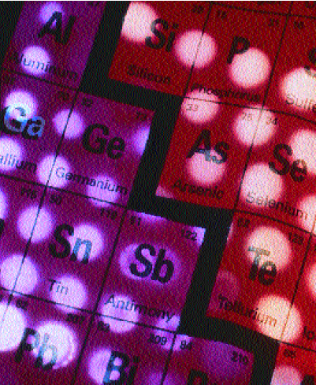
Manipulating the electronic structure and
magnetism of spin-orbit Mott insulator by
tailoring superlattices
Dawei Shen （沈大伟）
Shanghai Institute of Microsystem and Information
Technology (SIMIT), Chinese Academy of Sciences

Slide 2





Acknowledgements
SrIrO₃ growth and their electronic structure tuning through superlattices; transport, photoemission and XMCD measurements on films and superlattices
Hard X-ray photoemission, XAS and XMCD measurements on SrIrO₃ films and related super-
lattices at Spring-8
Scanning TEM and theoretical supports and helpful discussions
Congcong Fan, Dr. Zhengtai Liu, Wanling Liu, Dr. Jishan Liu, Prof. Mao Ye SIMIT, CAS;
Prof. Akio Kimura,
Hiroshima U; Dr. Yukiharu Takeda and
Yuji Saitoh, SPring-8;
Prof. Peng Wang and Prof. Xiangang Wan, Nanjing U; Prof. Yunhao Lu and Prof. Yang Liu, Zhejiang U; Dr. Arthur Ernst, MPI-MSP.
Grants: MOST, CAS and NSFC
Notes:
.

Slide 3
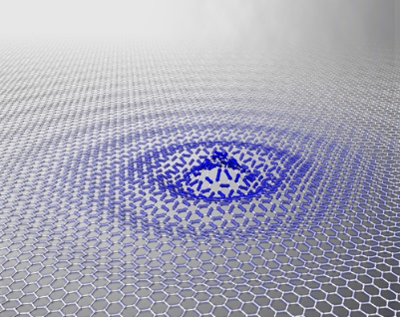
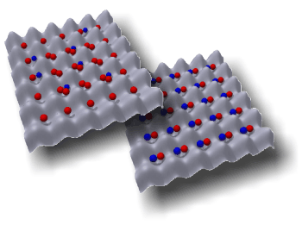
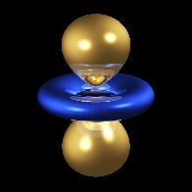
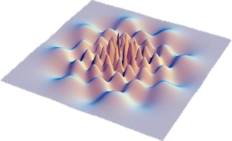
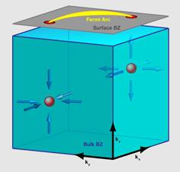
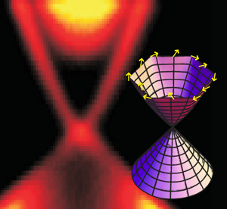
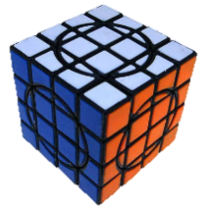
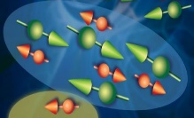
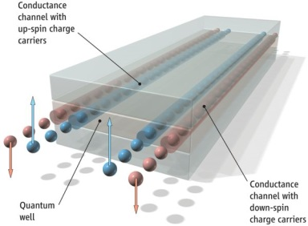
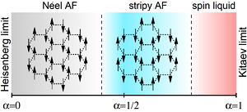
More competing degrees of freedom in 4d-/5d-electron system
Orbital
Spin liquid
Mott insulators, HTC?
5d-
electrons
Lattices
Weyl
Semi-
metals
Charge
3d-electrons
Spin
Topological insulators
Kitaev-model systems
Quantum spin Hall effects

Slide 4
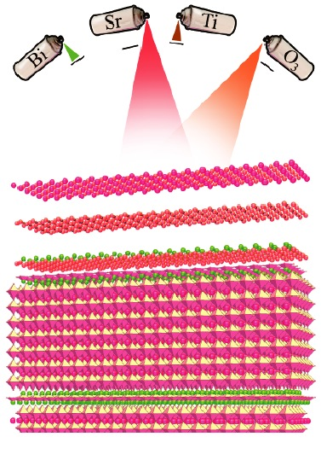
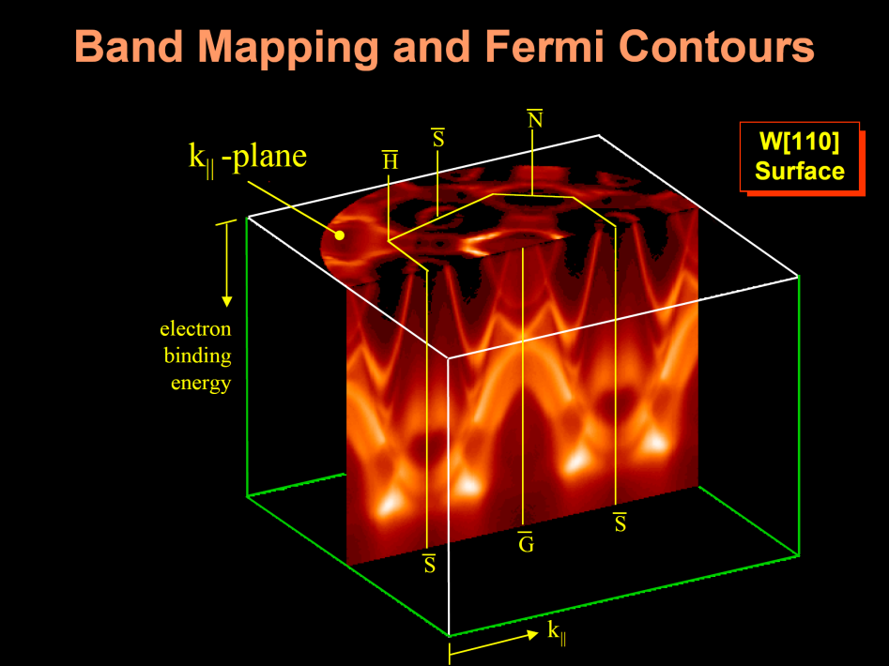
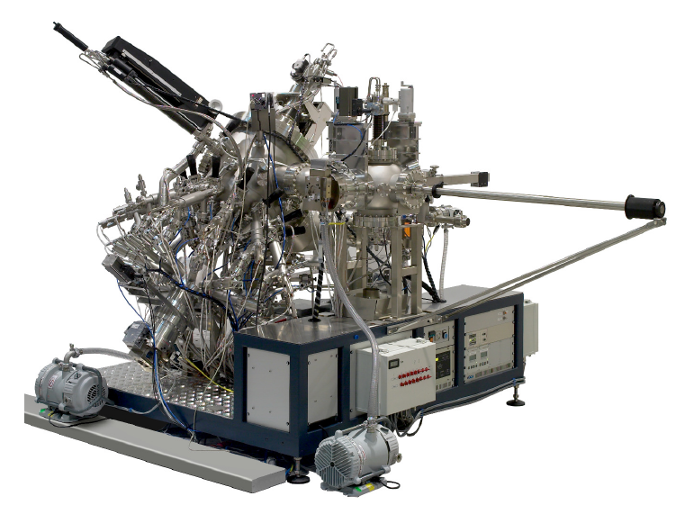
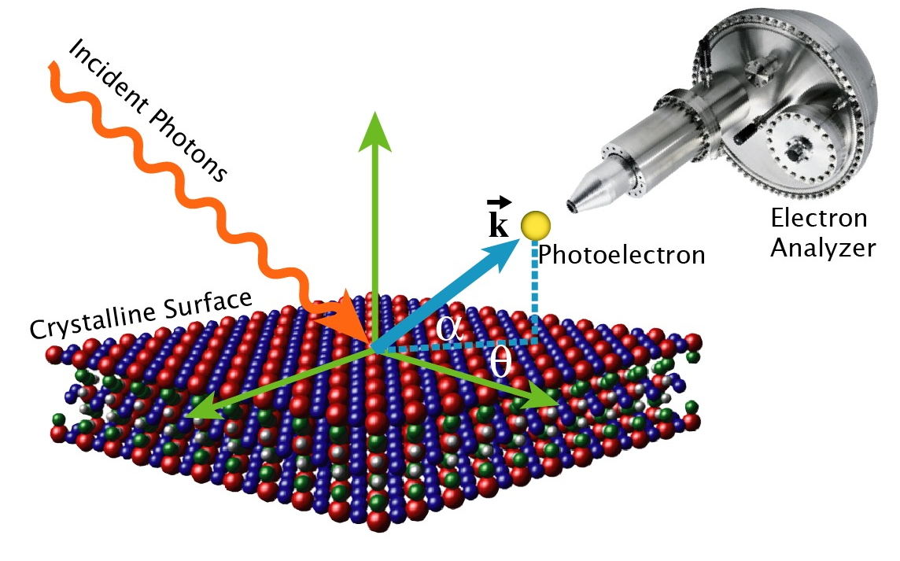
Outline
New tools for investigating and manipulating novel states of matters
Manipulating the electronic structure of topological crystalline semimetal perovskite SrIrO₃ by tailoring superlattices
Oxide Molecular Beam Epitaxy
Angle-Resolved Photoemission Spectroscopy
Notes:
In our case, we used the combo of oxide MBE, in-situ ARPES and XMCD to study 5d electron oxide systems.

Slide 5
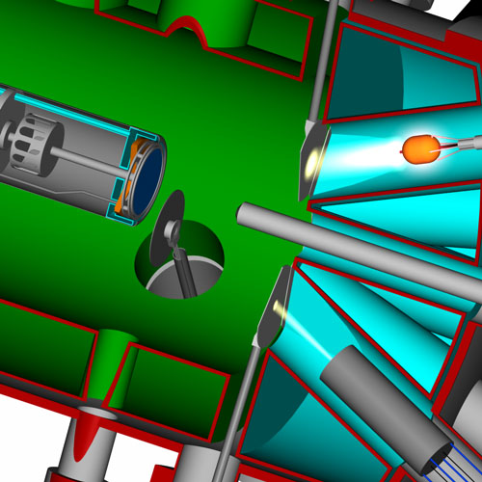

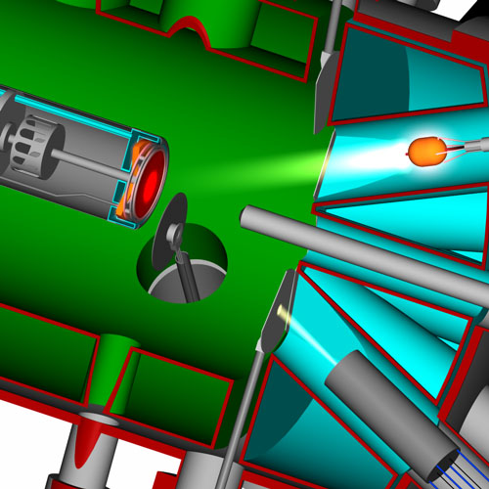
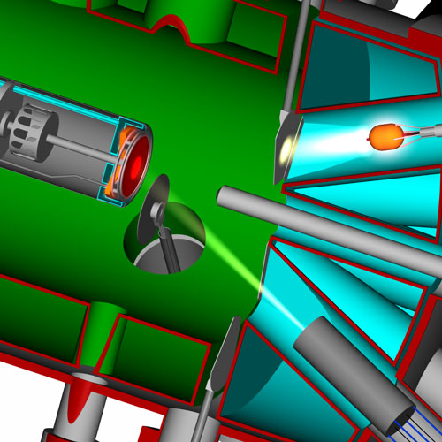
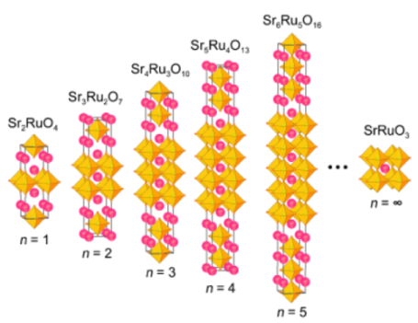
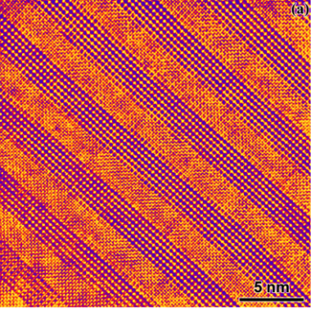
Oxide Molecular Beam Epitaxy : “Atomic Spray Painting”
RHEED oscillation (<1%)
O₂ or O₃
New Phase
Superlattice, Interface
Courtesy of Dr. Carolina Adamo

Slide 6
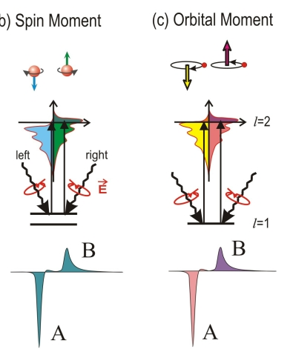
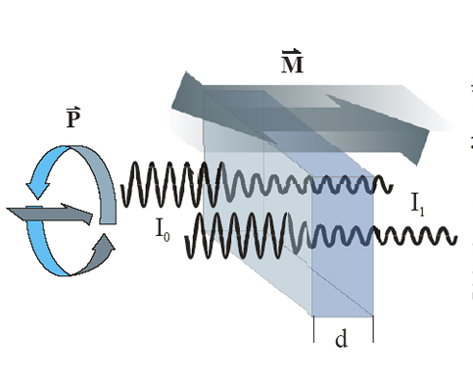
Complementary characterizations through ARPES and XMCD
X-ray Magnetic
Circular Dichroism （XMCD）
Angle-Resolved Photoemission
Spectroscopy
（ARPES）
1. Element specific magnetic properties

Slide 7
The necessity and possibility of synergistic collaborations
ARPES
Atomically clean surfaces
Restricted to cleavable samples
Not sensitive to magnetism
OMBE
Films grown under ultra-high vacuum conditions, not energetic deposition
Epitaxial growth allows for study of “uncleavable” materials
Artificial interfaces/super-
lattices
XMCD
Kind of bulk sensitive
High sensitivity to magnetism
Easy measurements on films/superlattices

Slide 8
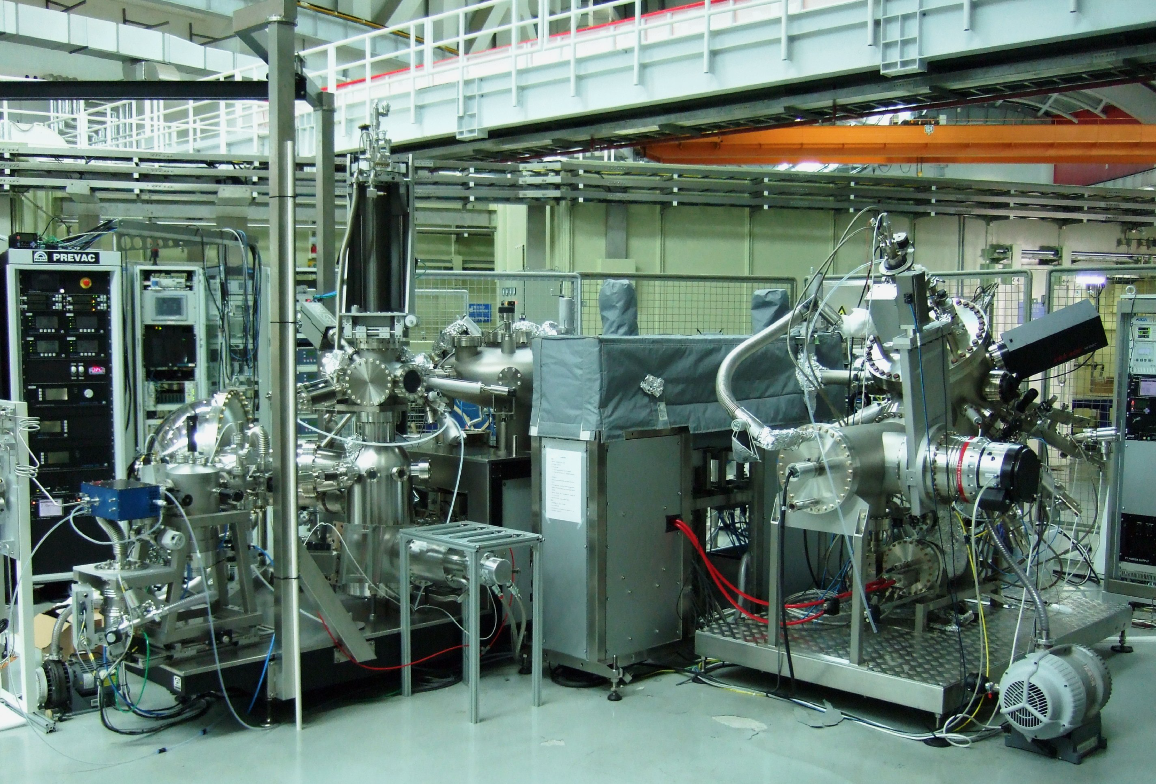
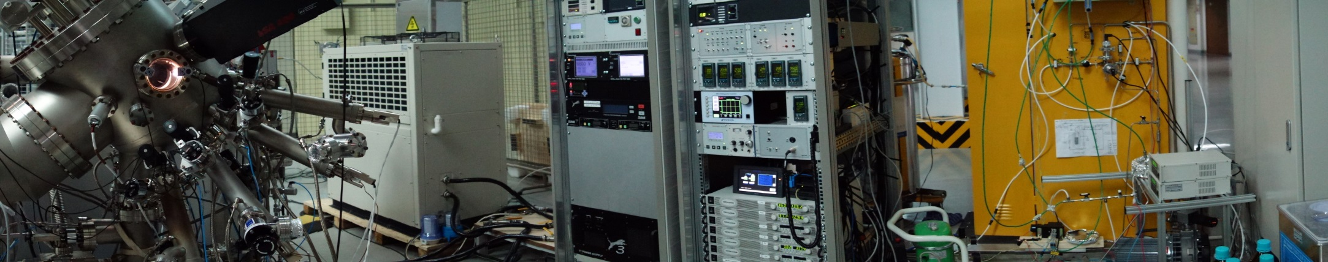
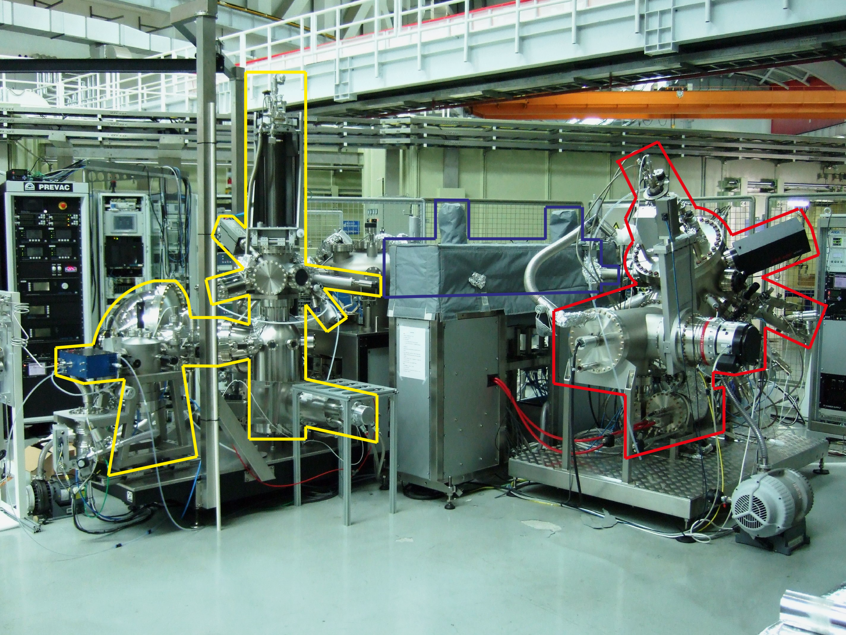
Integrated Oxide MBE + ARPES at SIMIT
Transfer chamber
ARPES System
Oxide MBE

Slide 9
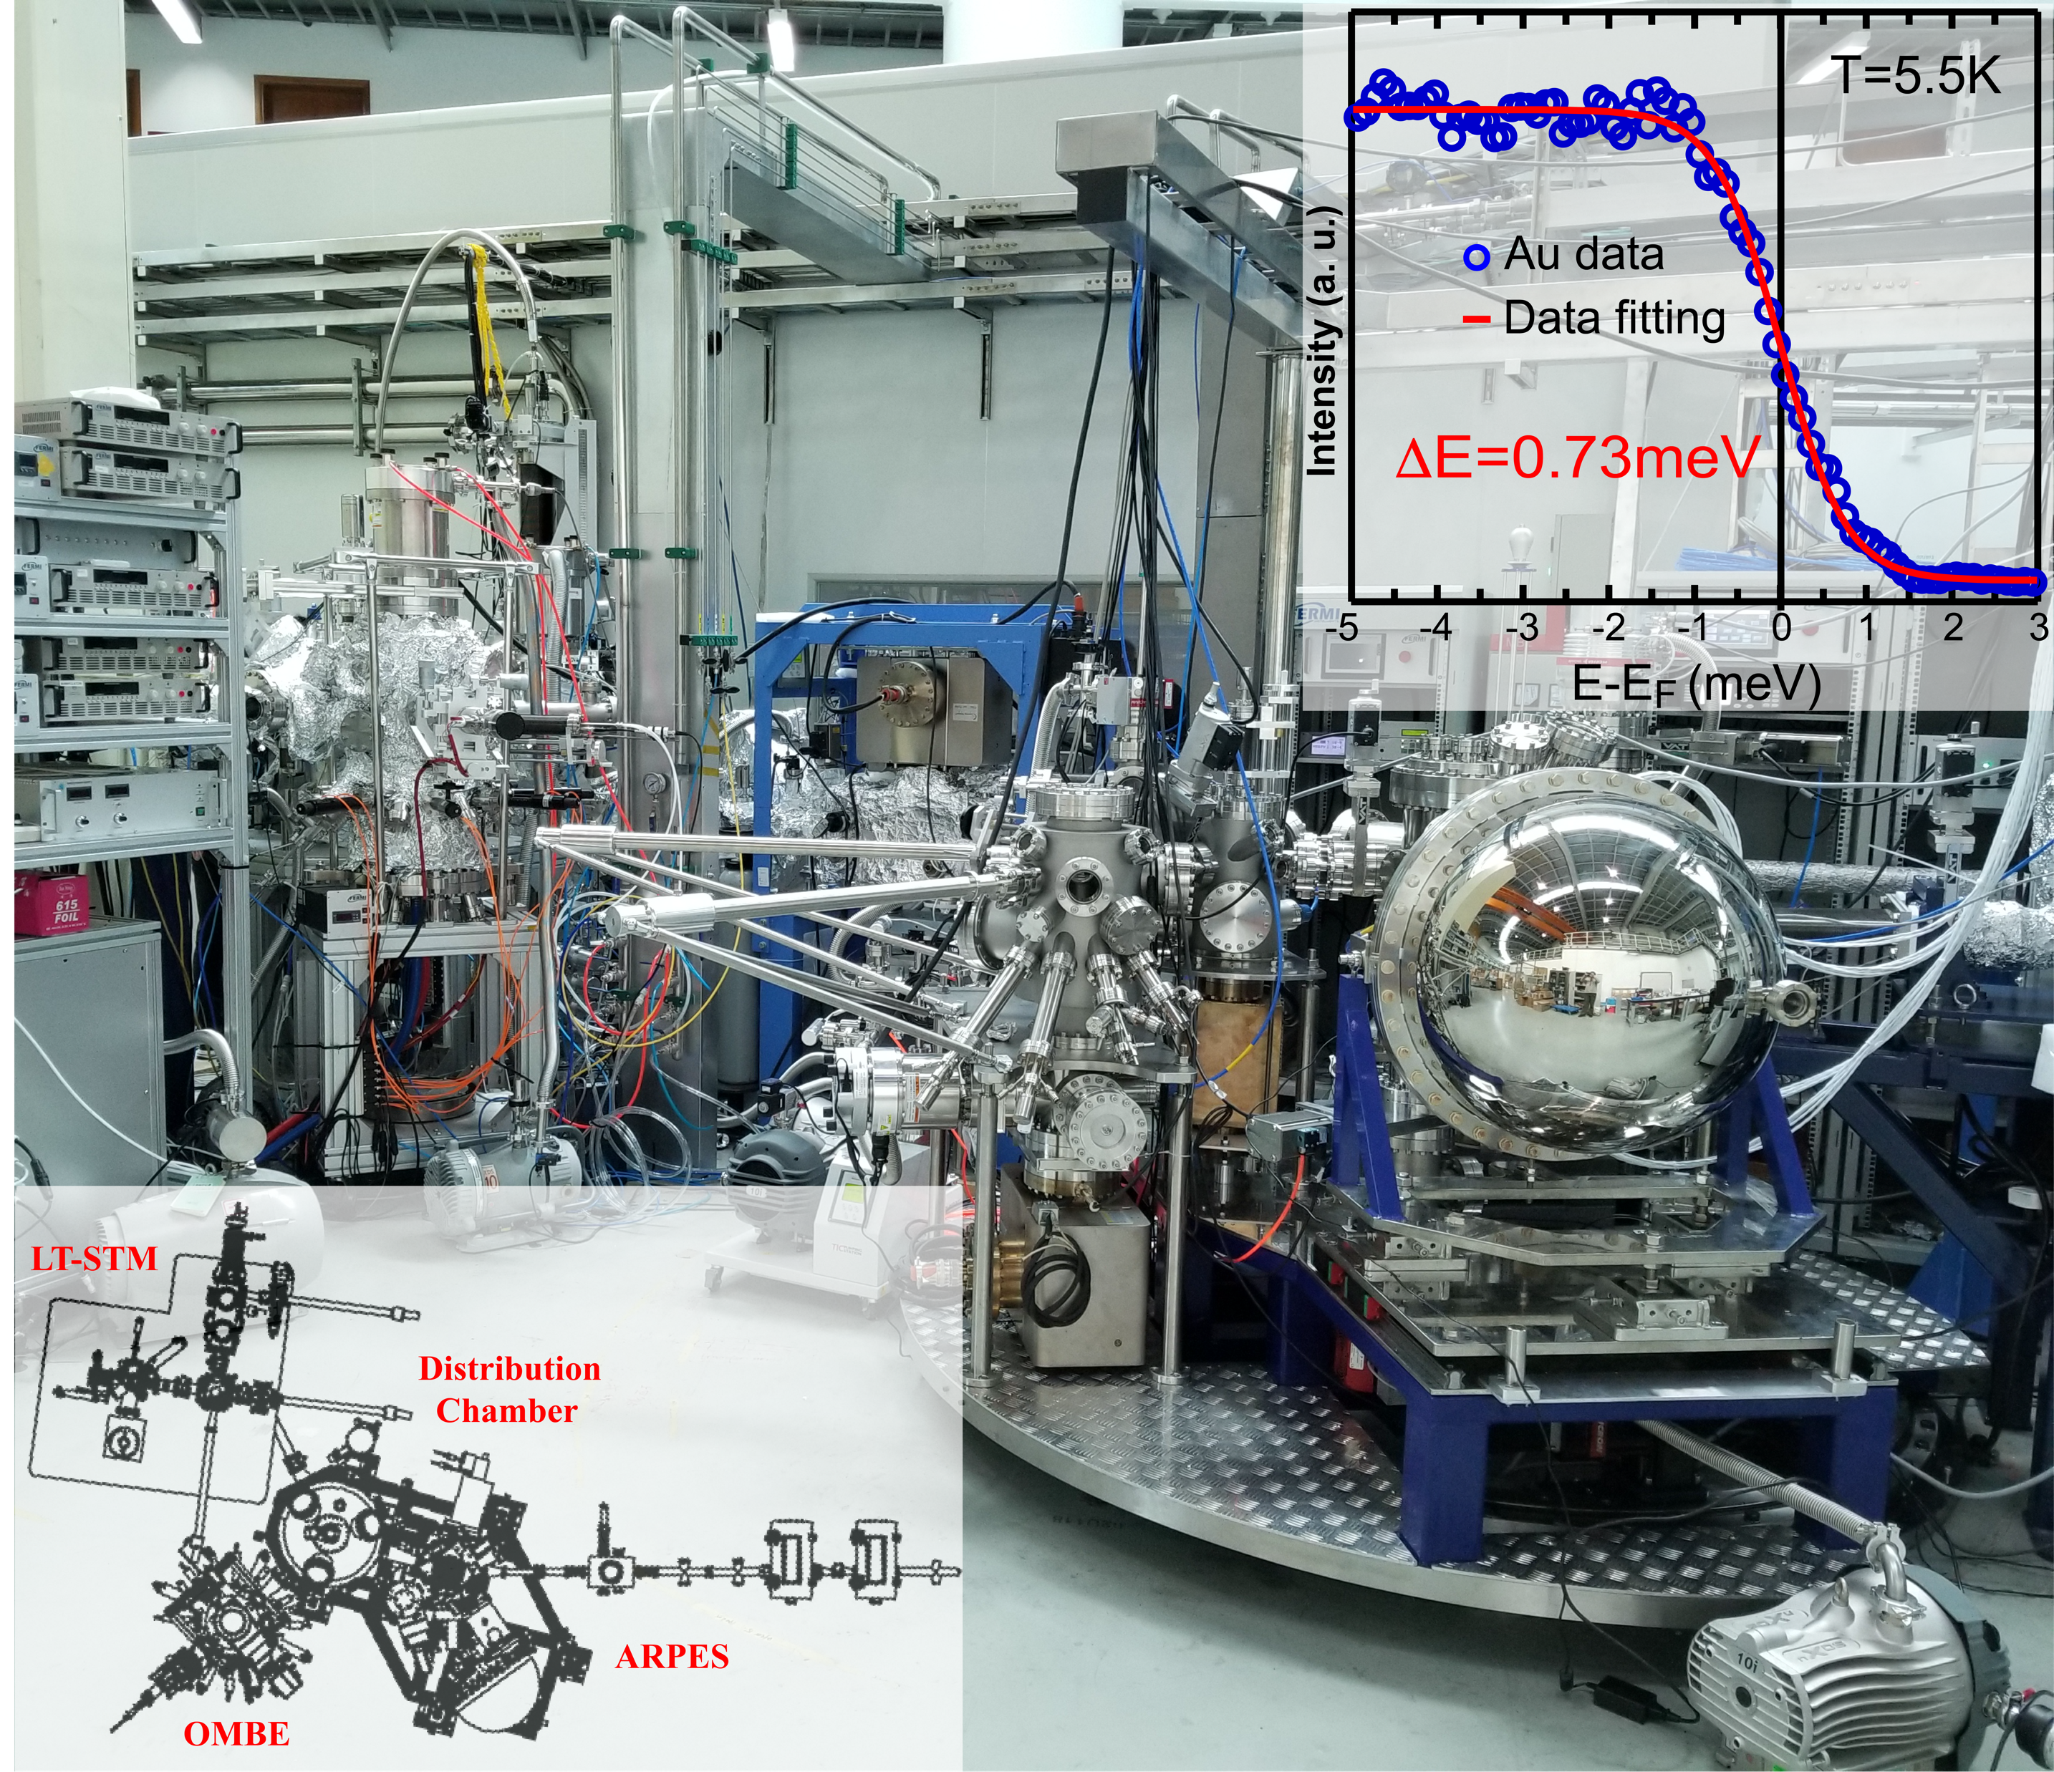
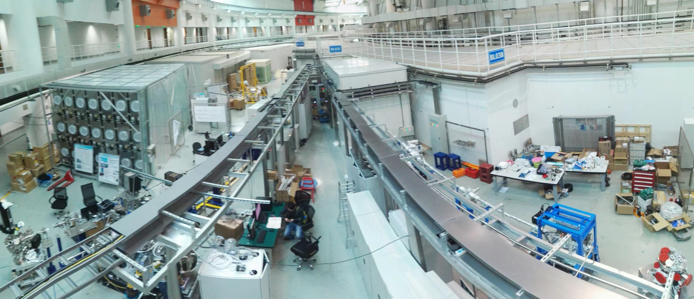
New generation of platform for in-situ electronic structure probing
Shanghai integrated Platform for Energy and
Environment-friendly Materials (SiP∙ME2)
03U Beamline
Endstation

Slide 10
Comparison with other beamlines
Beamlines | In-situ means | Light sources |  |  |  | ARPES
 |  | Flux Photon/s | Photon Energy eV | Resolu-tion E/∆E | Spot Size 𝛍m | Analy-zer | Resolu -tion meV | Temp K
SiP•ME² | OMBE /PLD | 1.3x10¹³ | 5.9-400 | 33000@21.6eV | ~80 | DA30 | 0.73 | 4.5-400
Elettra APE | Sputtering | 2x10¹¹ | 8-120 | 30000 | 50 | DA30 | 6 | 15~1000
ALS 7.0.2.1 | PLD | 3x10¹² | 20-1000 | 30000 | <10 | R4000 | 10 | 15-2500
ALS 10.0.1.1 | ╳ | 1x10¹³ | 17-350 | 35000 | 100 | R4000 | 10 | 20-1000
SLS SIS | PLD | 2x10¹³ | 10-800 | 100000 | 50 | R4000 | 5 | 15~400
Diamond I05 | ╳ | 5x10¹² | 18-240 | >20000 | 70 | R4000 | 5 | 10-300
SSRL 5-4 | MBE | 8x10¹¹ | 7-40 | 20000 | 100 | R4000 | 3 | 5~300
Notes:
.

Slide 11
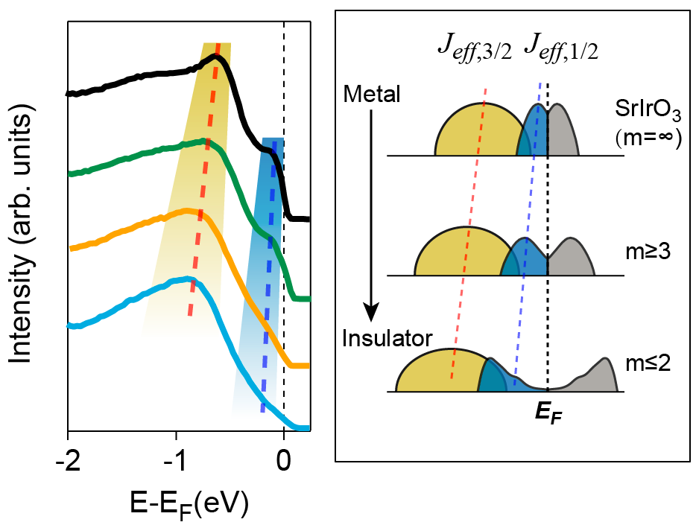
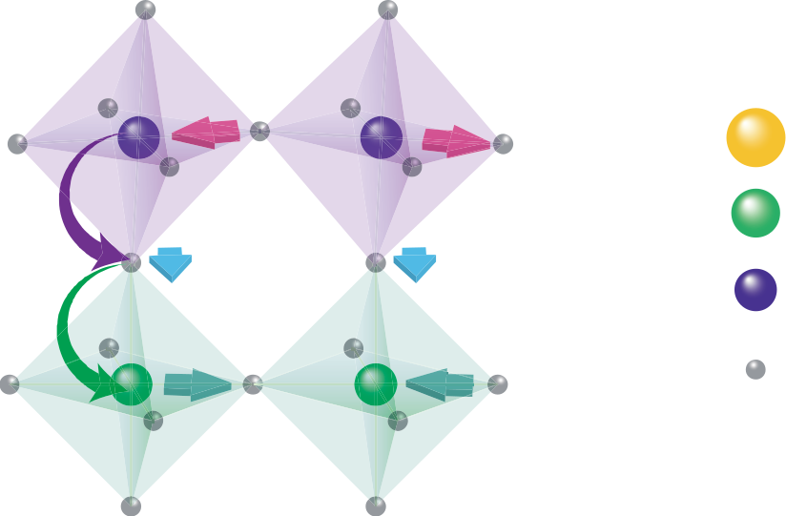
Outline
New tools for investigating and manipulating novel states of matters
Manipulating the electronic structure of topological crystalline semimetal perovskite SrIrO₃ by tailoring superlattices
Z. Liu and DWS, Sci. Rep (2016); C. C. Fan and DWS, AIP Adv. (2017);
W. L. Liu, DWS, in preparation

Slide 12
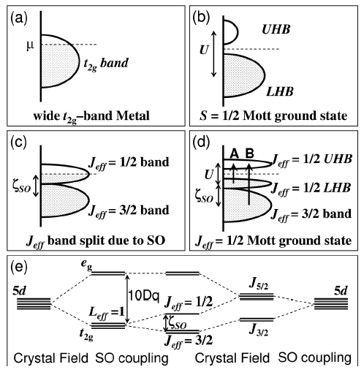
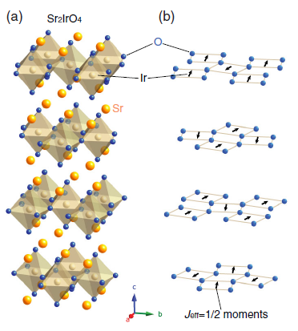
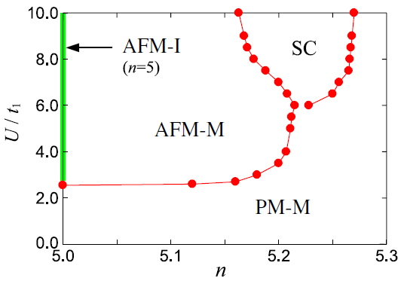
Sr₂IrO₄: spin-orbit Mott insulator high-Tc SC parent?
B. J. Kim, PRL, 2012
B. J. Kim, PRL, 2008
In remarkable analogy of (LaSr)₂CuO₄ in many aspects:
Share K₂NiF₄ crystal structure
Mott insulator before carrier doping
Pseudospin j = ½ maps to similar Hubbard model
Unconventianal SC
An ideal system for the comparison study of cuprates and I-M transition is desired!
F. Wang, PRL, 2011; H. Watanabi, PRL, 2013

Slide 13
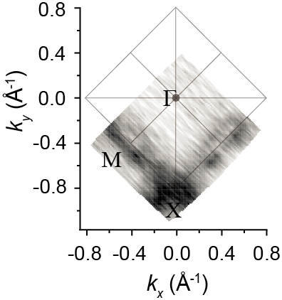
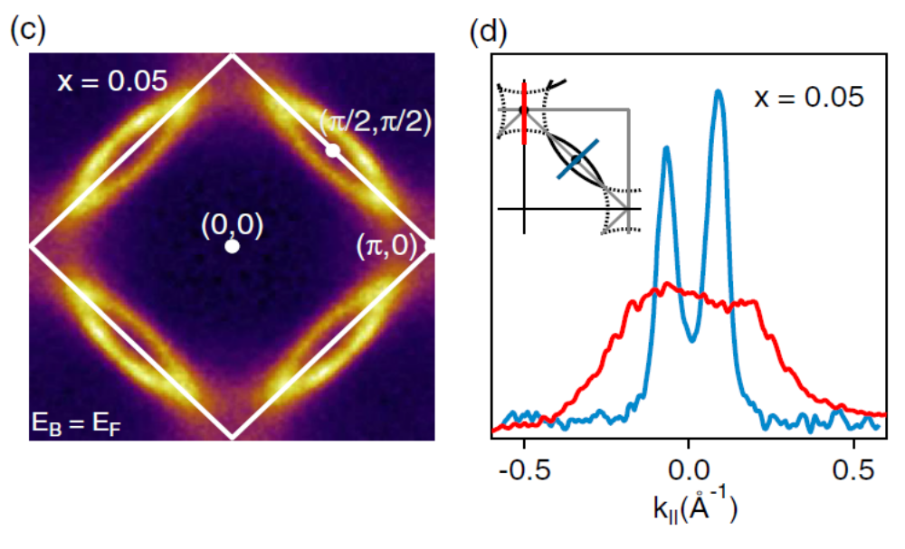
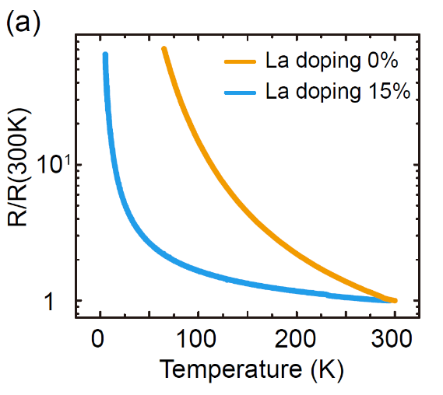
Electronic structure evolution of carrier-doped Sr₂IrO₄
M. Y. Li and DWS, CPL, 2015
A. Torre, PRL, 2015
Both MBE- and flux- grown lightly La doped Sr₂IrO₄ show evident Fermi arcs; Effective doping levels: MBE: x~0.046, Flux: x~0.05
Both samples exhibit insulating ground state, down to ∼50 K followed by an upturn at lower temperature, comparable to UD cuprates.
No signs of superconductivity.

Slide 14
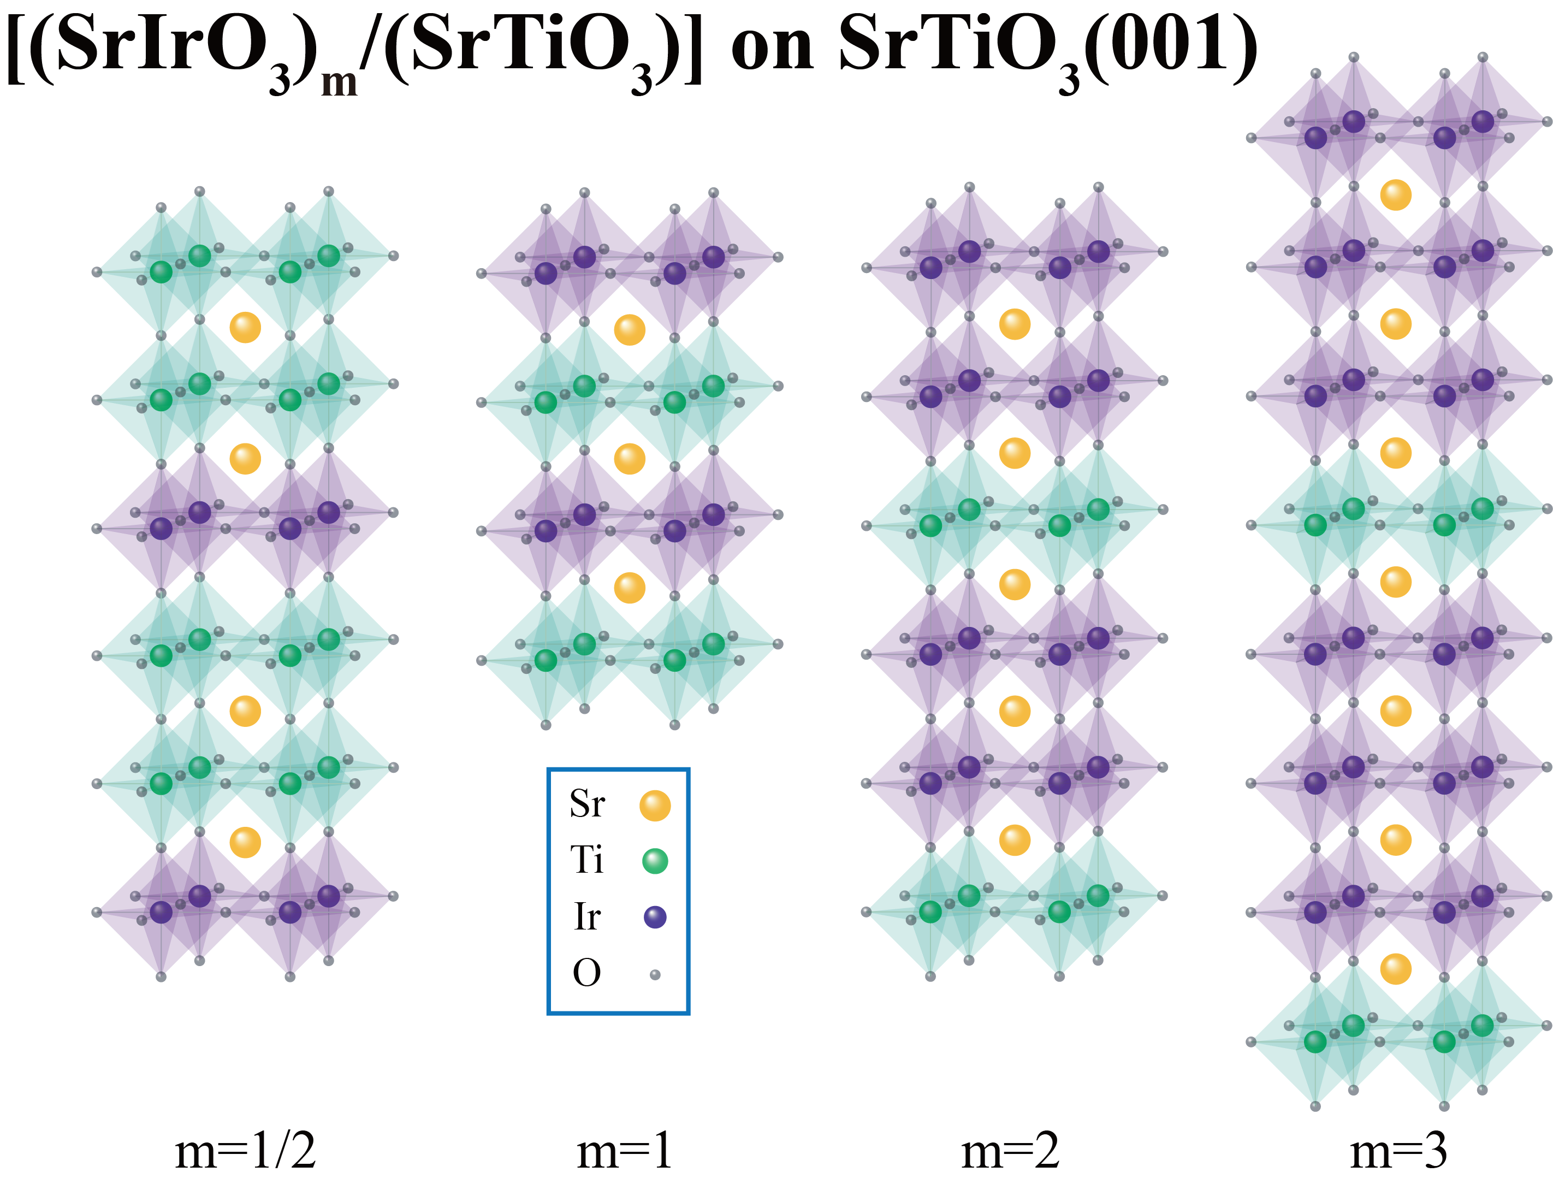
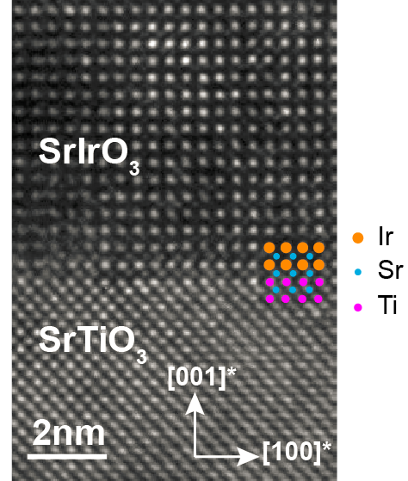
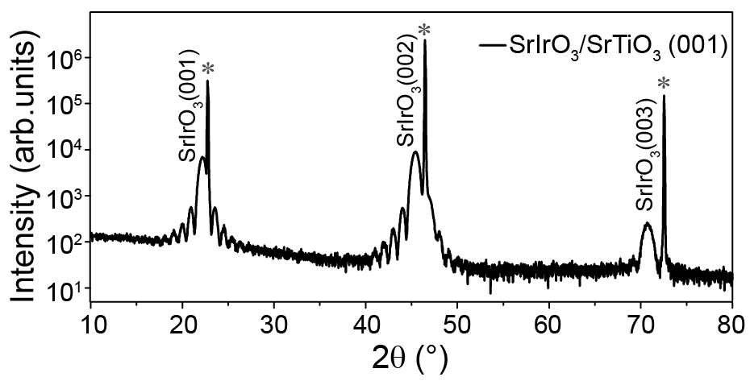
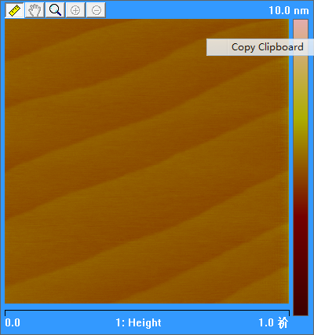
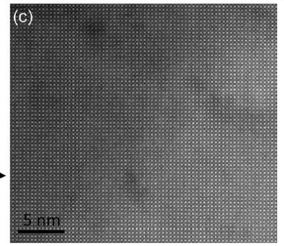
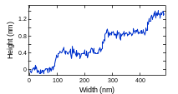
Manipulating iridates by tailoring superlattices
SrIrO₃ epitaxial superlattices
@620 ℃
O₃ 2x10⁻⁶Torr
SrTiO₃
SrIrO₃(100)/STO(100)
SrIrO₃
Time
1 loop
m loops
SrTiO₃(100)/STO(100)
SrIrO₃/SrTiO₃/SrIrO₃… (m=1)

Slide 15
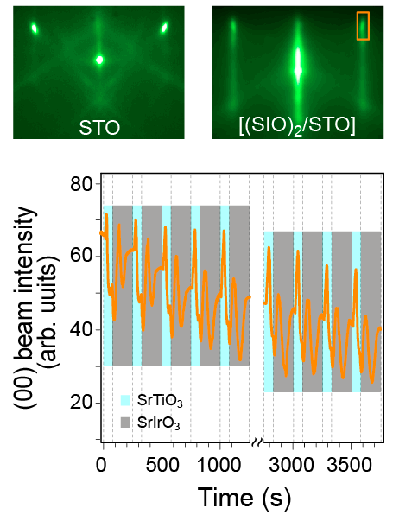
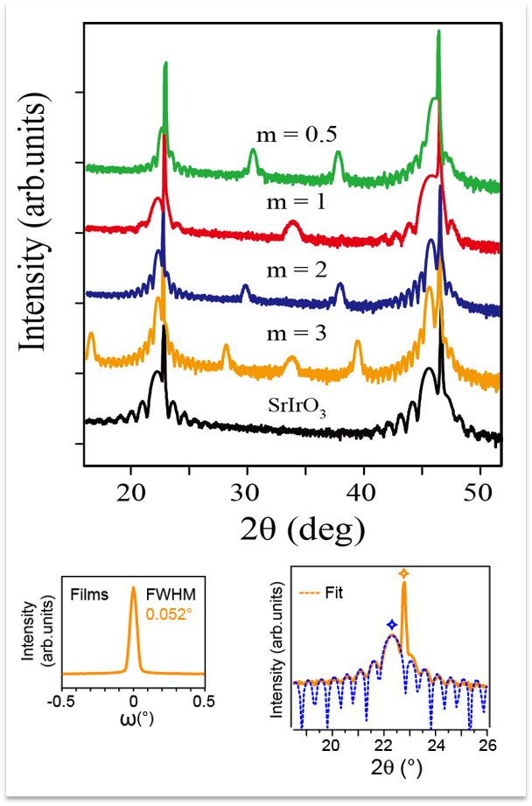
SrIrO₃ based superlattices
RHEED
X-Ray Diffraction
RHEED pattern & intensity oscillation

Slide 16
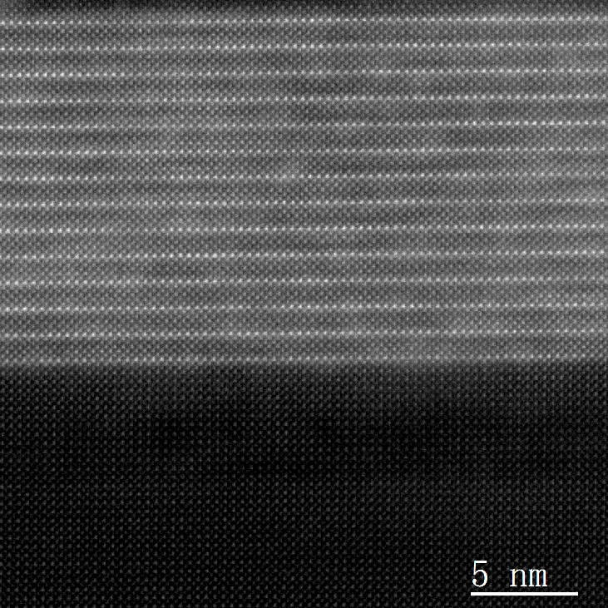
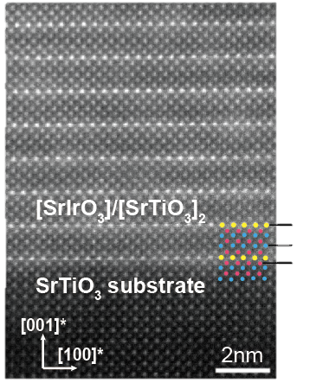
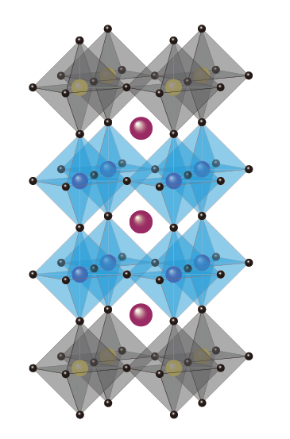
The HAADF TEM Pattern of the Superlattices
Superlattices
STO buffer
STO substrate
15 u. c. m=1/2 SLs on STO（001） substrates

Slide 17
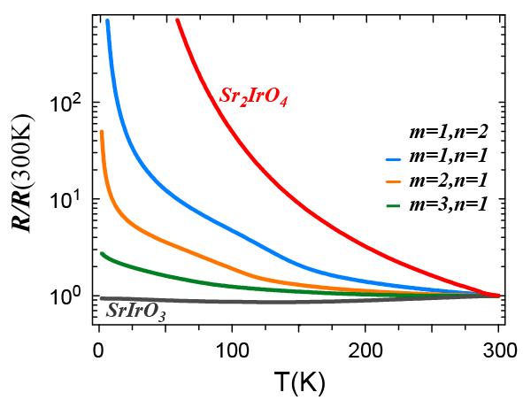
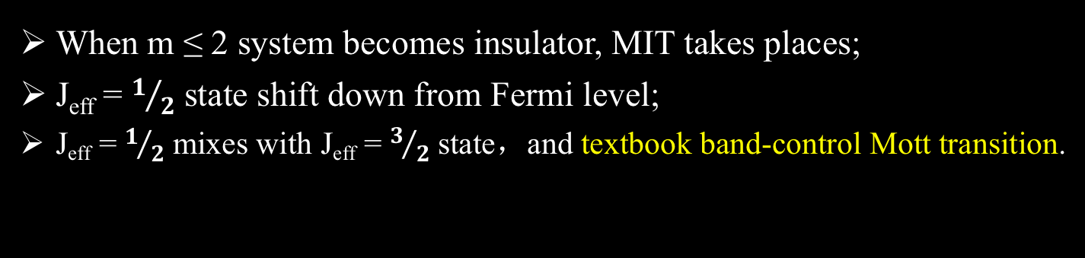
Superlattices: metal-insulator transition
R-T curves
Valence bands
When m ≤ 2 system becomes insulator, MIT takes places;
J_{eff} = $1/2$ state shift down from Fermi level;
J_{eff} = $1/2$ mixes with J_{eff} = $3/2$ state，and textbook band-control Mott transition.

Slide 18
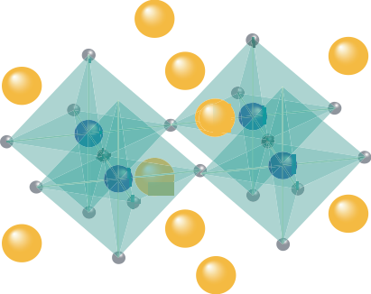
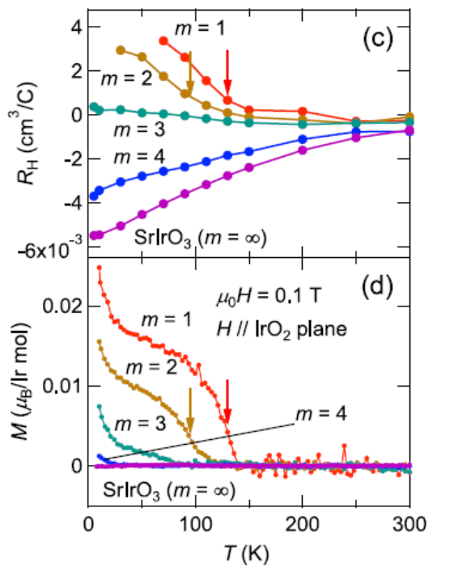


Emergent magnetism in the superlattices
PRL 114, 247209 (2015)
Emergent weak ferromagnetism
ground state
Even different from Sr₂IrO₄
SrTiO₃
Diamagnetic
SrIrO₃
Paramagnetic
SrTiO₃
Diamagnetic
A real quantum phase transition, and the origin?

Slide 19

X-ray absorption spectra of (SrIrO₃)_{m}/(SrTiO₃)
Ti L-edge
Increasing
intensity
at Ti edge
O K-edge
Increasing percentage of SrTiO₃
50%
33%
Ti signal from STO substrate?
0%

Slide 20







XAS and XMCD of (SrIrO₃)_{m}/(SrTiO₃) at oxygen K-edge
XAS at O K-edge of SLs
O_{2p} - ${Ir}_{{j_{eff}=1/2}_{}}$
Pre-edge states (529, 530.8eV): O_{2p} hybridized with Ir_{5d} and Ti_{3d}
Corresponding XMCD signals responsible for ferromagnetism
O_{2p} - Ti_{3d}
m=1/2
m=1
m=2
m=∞
$${Ir}_{{j_{eff}=1/2}_{}}$$
Ti_{3d}
Notes:
One

Slide 21





Emergence of magnetic ordering of Ir_{jeff=1/2} states
Dzyaloshinskii-Moriya
(DM) interaction
Rotation of the IrO6 octahedral due to
lattice mismatch
The m=1 SIO/STO develops a canted in-plane AFM (weak FM), in contrast to Sr2IrO4
Canted in-plane (low-dimensional) AFM ordering in monolayer IrO₆
SIO/STO (m=1)
Sr₂IrO₄ (H=0)
PRL 114, 247209 (2015); PNAS 113, 6397 (2016)

Slide 22



Circular-polarized-XAS and XMCD for m = 1 sample (T_{C}=130K)
No net Ti XMCD signals for superlattices !
Ti L₂₃ edges
According to this data, non-magnetic or just AFM for Ti! Plausibly Ti⁴⁺ would be non-magnetic!
Is this the truth?

Slide 23



No charge transfer at interfaces in m=1/2 SL No Ti_{3d} XMCD signal
HAADF-STEM
EELS based on STEM
m=1/2
Ti L-edge
O K-edge
Ti⁴⁺
STO
STO
Ti⁴⁺
SIO
STO
Ti⁴⁺
STO
SIO
Ti⁴⁺
STO Buff
Standard Ti⁴⁺ in buffer layers, no oxygen vacancies
Negligible change of valence for Ti atoms in m=1/2
No distinct XMCD signal around 530.8 eV (Ti_{3d} states)
XMCD
Collaborate with Prof. P. Wang @NJU, M. Ye @SIMIT

Slide 24







Pronounced charge transfer at interfaces in m=2
HAADF-STEM
EELS based on STEM
m=2
Ti L-edge
O K-edge
Ti³⁺
STO
SIO
Ti³⁺
SIO
STO
Ti⁴⁺
SIO
SIO
Ti⁴⁺
-2
STO Buff
Ti⁴⁺
Micron, 2012, 43(4): 532
Standard Ti⁴⁺ in buffer layers, no oxygen vacancies
Evident charge transfer at interfaces between IrO₆ and TiO₆ in m=2, Ti³⁺ states
XMCD signal around 530.8 eV (hybridized with Ti_{3d})
XMCD
Collaborate with Prof. P. Wang @NJU, M. Ye @SIMIT

Slide 25






Moderate charge transfer at interfaces in m=1
HAADF-STEM
EELS based on STEM
Ti L-edge
Ti^{4+~3+}
O K-edge
m=1
Ti^{4+~3+}
STO
SIO
Ti⁴⁺
STO
SIO
Ti⁴⁺
STO
SIO
Ti⁴⁺
STO Buff
Standard Ti⁴⁺ in buffer layers, no oxygen vacancies
Moderate valence change for Ti in m=1
Small XMCD signal around 530.8 eV (Ti_{3d})
XMCD
Collaborate with Prof. P. Wang @NJU, M. Ye @SIMIT

Slide 26


Charge transfer tuning by oxygen octahedral rotation manipulation
Rotation of the IrO6 octahedral due to
lattice mismatch
First-principles
simulation
The charge transfer across nonpolar interfaces;
Electrons transferring from Ir to Ti: for m=2, larger in-plane octahedral rotation
would result in more prominent charge transfer than for m=0.5.

Slide 27

Emergence of magnetic ordering at interfaces
O_{2p}-Ti_{3d} K-edge shows substantial XMCD signal, while Ti L_{2,3} doesn’t.
The observed XMCD signal at the O K-edge
(O_{2p}-Ti_{3d} hybridization) originates from the oxygen atoms at the interface due to the charge transfer between Ir and Ti.
SIO/STO (m=1)
No Ti net FM: less lattice constant
mismatch and smaller SOC render
the non-canted AFM, no net Ti L edge XMCD signal.
The oxygen atoms at interfaces (symmetry broken) exhibit emerging weak FM due to strong SOC and crystal field.

Slide 28
We conclude…
We fabricate a family of perovskite SrIrO₃ based superlattices by means of oxide MBE technique.
Through tuning the band width, we could manipulate the ground state of the superlattices (m=0.5/1, Mott insulators with canted AFM; m=∞, paramagnetic semimetal).
In-situ photoemission measurements confirm the Mott insulator-
metal transition in these superlattices.
XMCD findings clarify that the emergent ferromagnetic order at
interfaces, with Ir character in the J_{eff}=1/2 orbital and O character
between Ir and Ti, which originates from the interplay of electron
correlations, crystal field and spin-orbit coupling in the low
dimension.
The manipulation of electronic structure in SIO/STO SLs is not simply only due to the change of dimensionality, but also due to the interfaces.

Slide 29
Thank you!

Slide 30



Perovskite SrIrO₃: lattice symmetry protected line nodes?
Predicted robust node lines due to
combination of SOC and lattice symmetry
  Semimetal with no magnetism
  Low carrier density
A strong topological insulator
once the mirror symmetry is broken
PRB 86, 085149 (2012); arXiv:1504.07641; arXiv:1506.03449
Notes:
The simplest iridate is the perovskite SrIrO3, and it has long been predicted to be the candidate of the so-called topological crystalline semimetal. There exists the lattice symmetry protected line nodes in the band structure. However, the synthesis of bulk single-crystalline 113 is very difficult and so far no

Slide 31



High quality single crystal film of SrIrO₃
XRD patterns of SrIrO₃(100) films
with different stains
XRD results
Smooth and uniform Laue oscillation
The FWHM is identical to substrates
TEM results
Regular lattices
Sharp interface between SIO and STO
Notes:
However, high-quality single crystalline 113 films could be achieved by means of oxide MBE methods. Our group is among the first serval research groups who have successfully fabricate high quality 113 films by MBE. Actsaully, we have tried various films with different strains, and the resulting XRD patterns prove the superior quality of films. While, we found the 113 films deposited on STO substrates are superior to others. The clear laue oscillation and the narrow FWHM of rocking curve indicates the

Slide 32

Direct observation of the semi-metallicity caused by strong SOC
Simultaneous intersection of the Fermi level by hole- and electron-like bands;
The direct evidence that the perovskite SrIrO₃ has a semimetallic ground state.

Slide 33


Topological crystalline protected Dirac node lifting
Band dispersions around U point
DFT
Topological protected Dirac node is lifted!

Slide 34


Dirac node lifting
Symmetry operations of the Pbnm perovskite ABO₃
Dirac nodes with different symmetries
Strain effect: n-glide symmetry is broken
Gapped Dirac node due to absence of n-glide operation
PRB 93, 085118 (2016)
Epitaxial perovskite SrIrO₃ is a topological crystalline semimetal, but with the crystalline symmetry protected Dirac node lifted due to strain!

