Slide 1
Neutron scattering for restricted dimensionality in magnetism: interfaces, surfaces and more!
Kirrily Rule
Australian Centre for Neutron Scattering

Slide 2
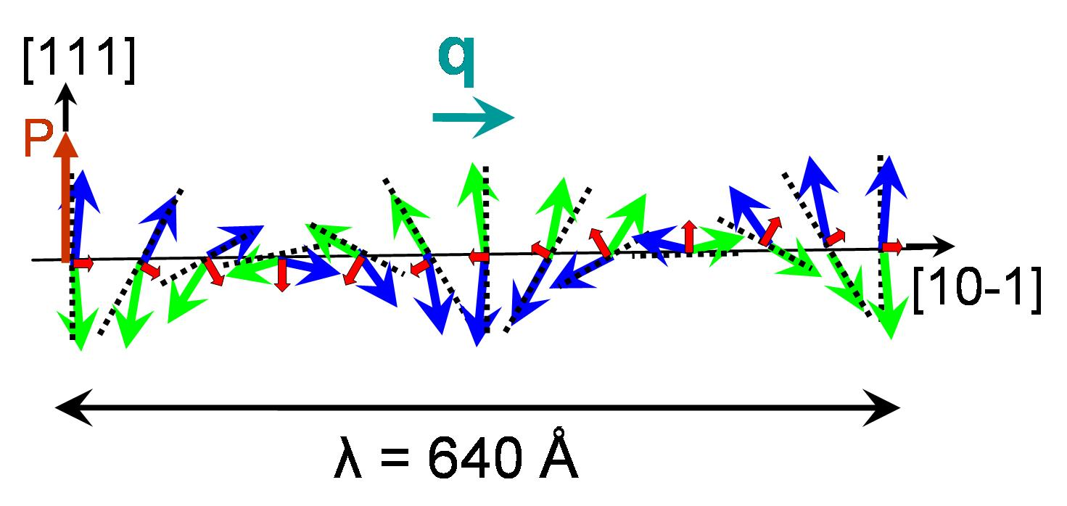


Outline
Neutrons for magnetic scattering
  Diffraction
  Inelastic neutron scattering
Thin films and interfaces
  FePt₃
  BiFeO₃
Magnetic nanoparticles
  Silver doped LaMnO₃
Frustrated magnetic chains
  Linarite
J₁ = FM
J₂ = AFM

Slide 3
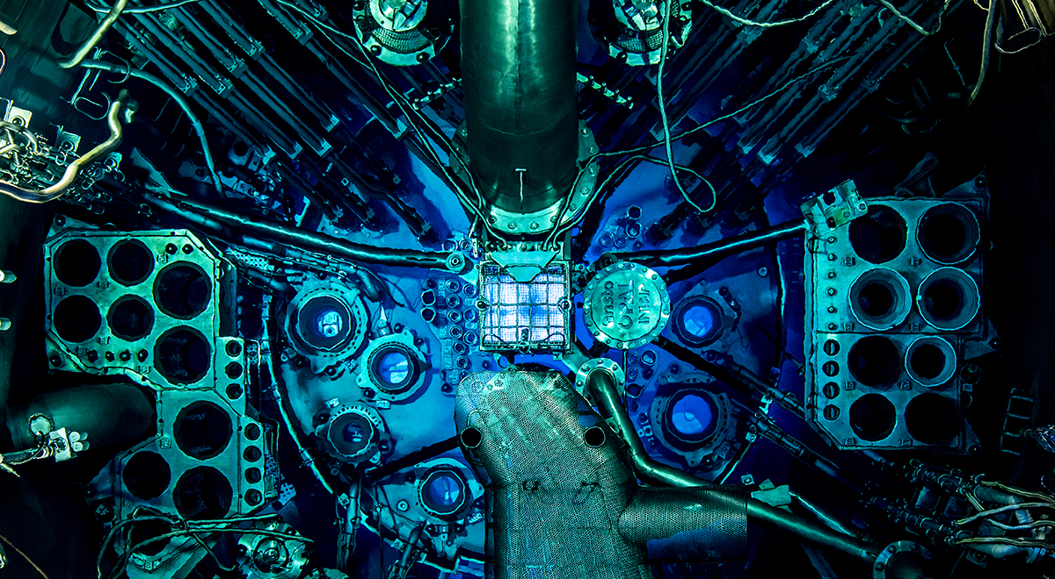
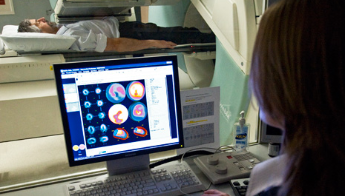
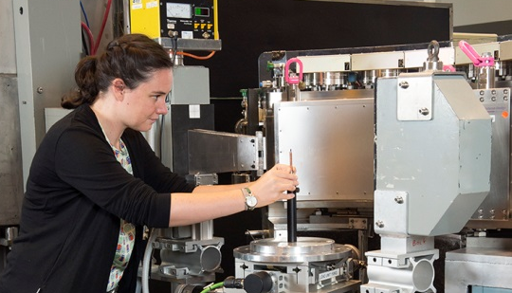
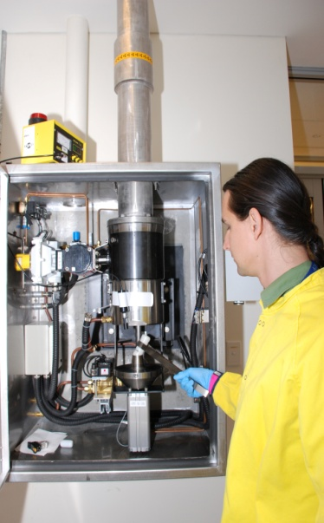
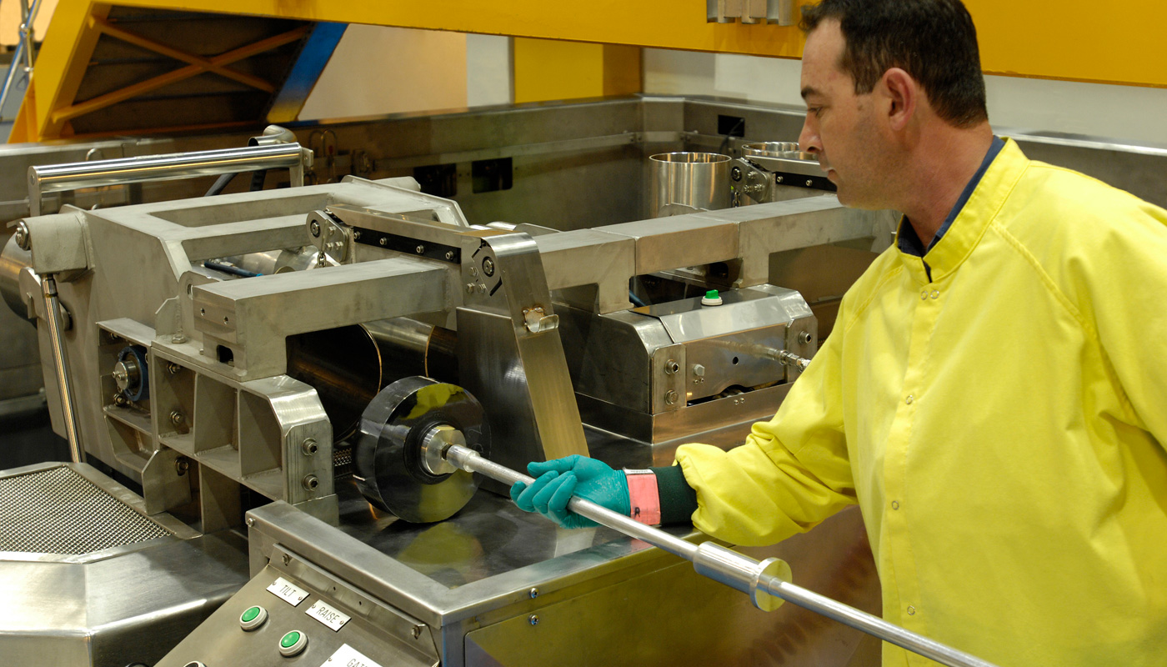
OPAL - multi-purpose reactor
Medical radioisotopes
Scientific research
Neutron activation
Silicon irradiation

Slide 4






Advantages of neutrons
Energy
Wavelength
Strong interaction
Highly penetrating
Magnetic moment
Non-destructive

Slide 5
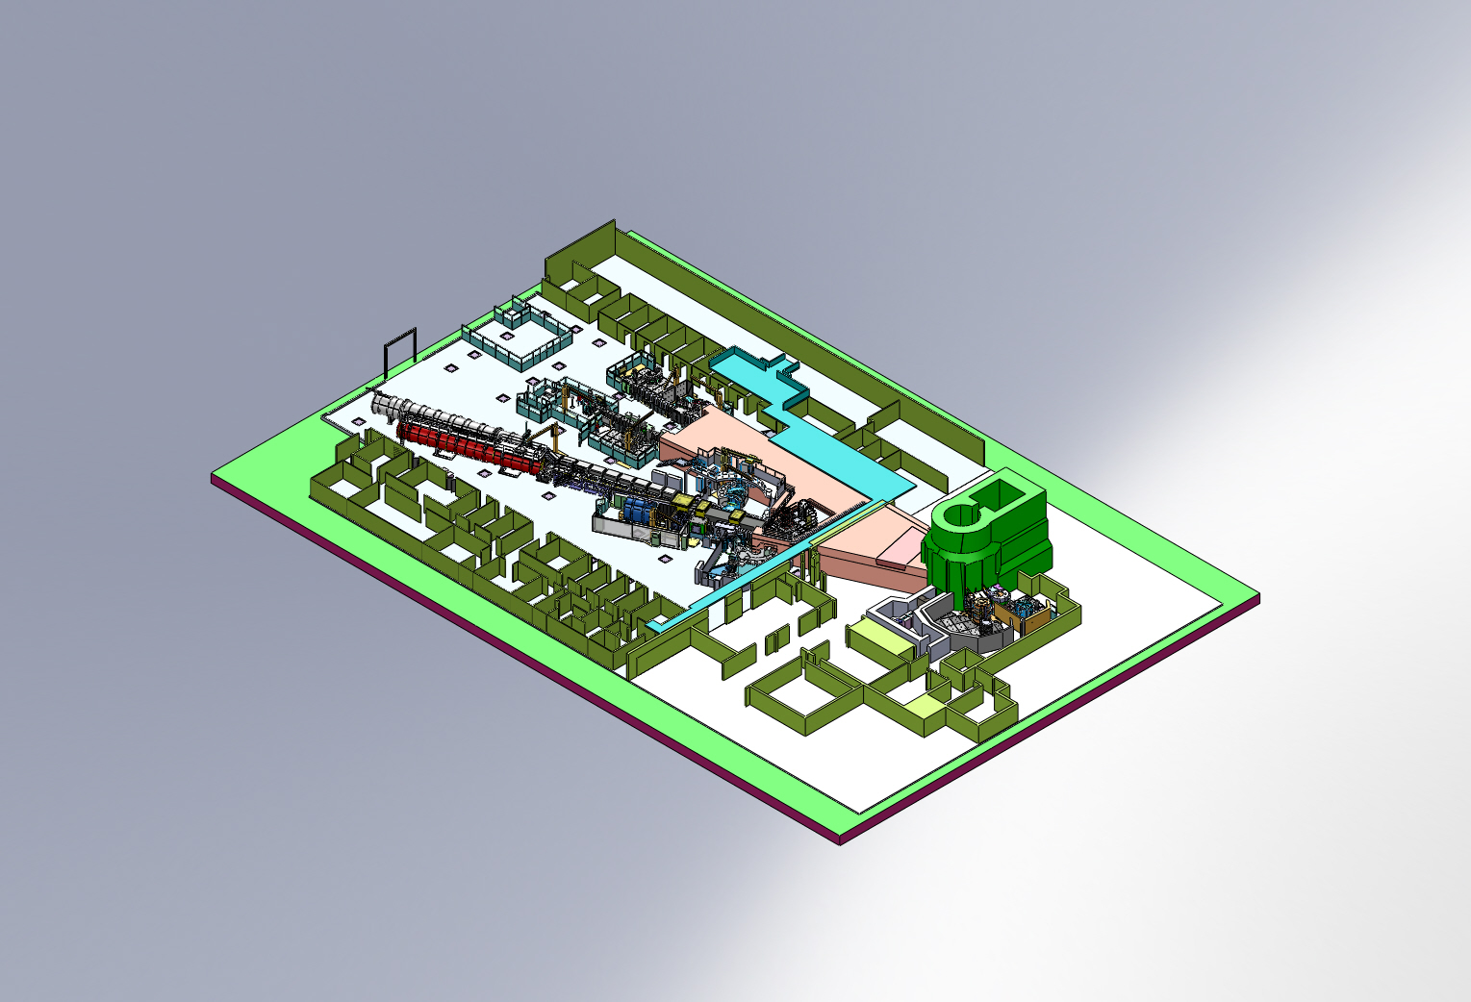
The Australian Centre for Neutron Scattering
JOEY
ECHIDNA
KOALA
QUOKKA
WOMBAT
KOWARI
BILBY
PELICAN
SPATZ
PLATYPUS
KOOKABURRA
EMU
TAIPAN
15 Neutron Beam Instruments
+ SAXS & X-ray Reflectometry + PPMS
DINGO
³He filling station
SIKA

Slide 6
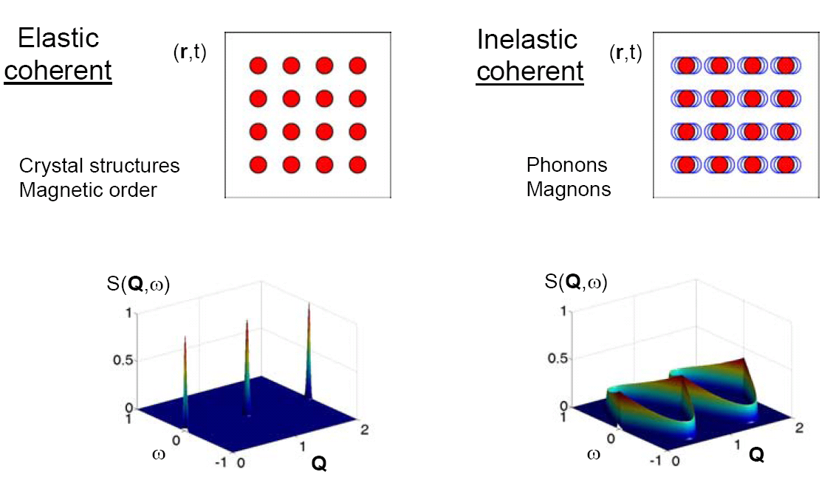
Elastic Neutron Scattering
No loss of energy
Examines the change in momentum or angle of the neutrons.
Inelastic Neutron Scattering
Examines both momentum and energy dependencies.
Uses these to characterize a systems vibrational, magnetic, and lattice excitations.

Slide 7
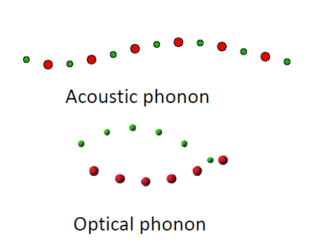
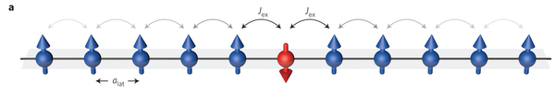
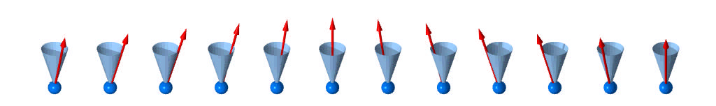
Excitations in materials
Nuclear excitations can tell us about
Interatomic potentials & bonding
Phase transitions & critical phenomena (soft modes)
Fluid dynamics
Diffusion processes
Momentum distributions & Superfluids ( eg. He)
Interactions (eg. electron-phonon coupling)
Magnetic inelastic scattering can tell us about
Exchange interactions
Single-ion and exchange anisotropy (determine the spin Hamiltonian)
Phase transitions and critical phenomena
Quantum critical scaling of magnetic fluctuations
Other electronic energy scales (eg CF and SO)
Interactions (eg spin-phonon coupling)

Slide 8
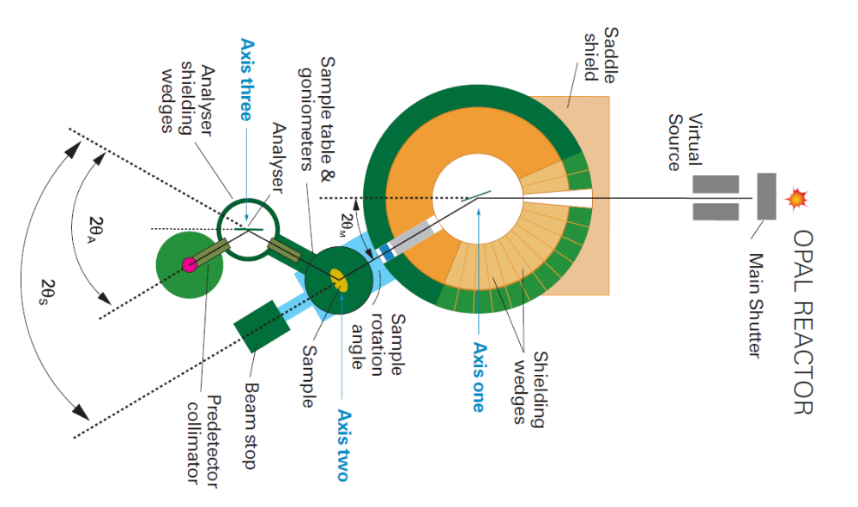
TAIPAN
Two different modes:
Inelastic scattering
  To measure excitations and dynamics in materials
  Energy range:
    ~5-90meV (PG), ~30-200meV (Cu)
  Energy resolution:
    ~ 1 meV (PG)
Elastic scattering
  To measure diffraction when a high signal to noise ratio is required
  Wavelength range:
    1-4 Å (PG) 0.6-2.5 Å (Cu)
Types of samples:
Single crystals
Powder
Multi-crystal arrays including thin films

Slide 9
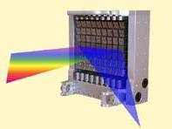
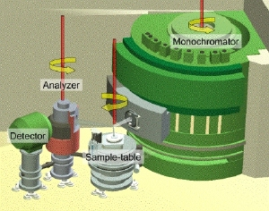
Triple Axis Spectrometer
Source
1
Monochromator (PG002)
2θ_{M}
3
Analyser (PG002)
Sample
2
2θ_{S}
2θ_{A}
Detector

Slide 10
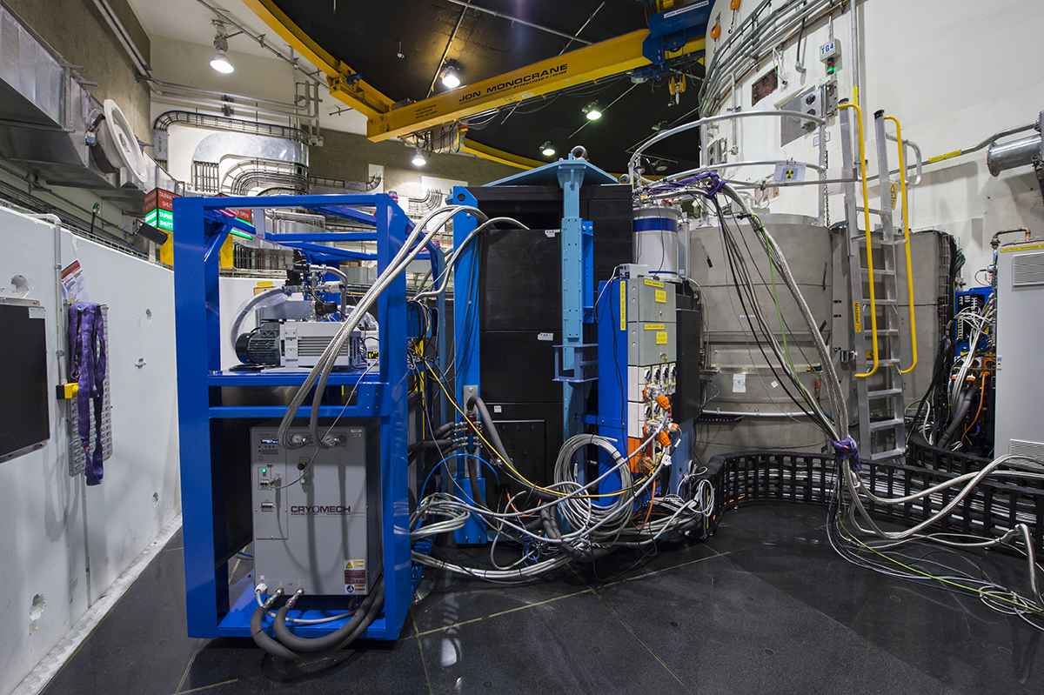
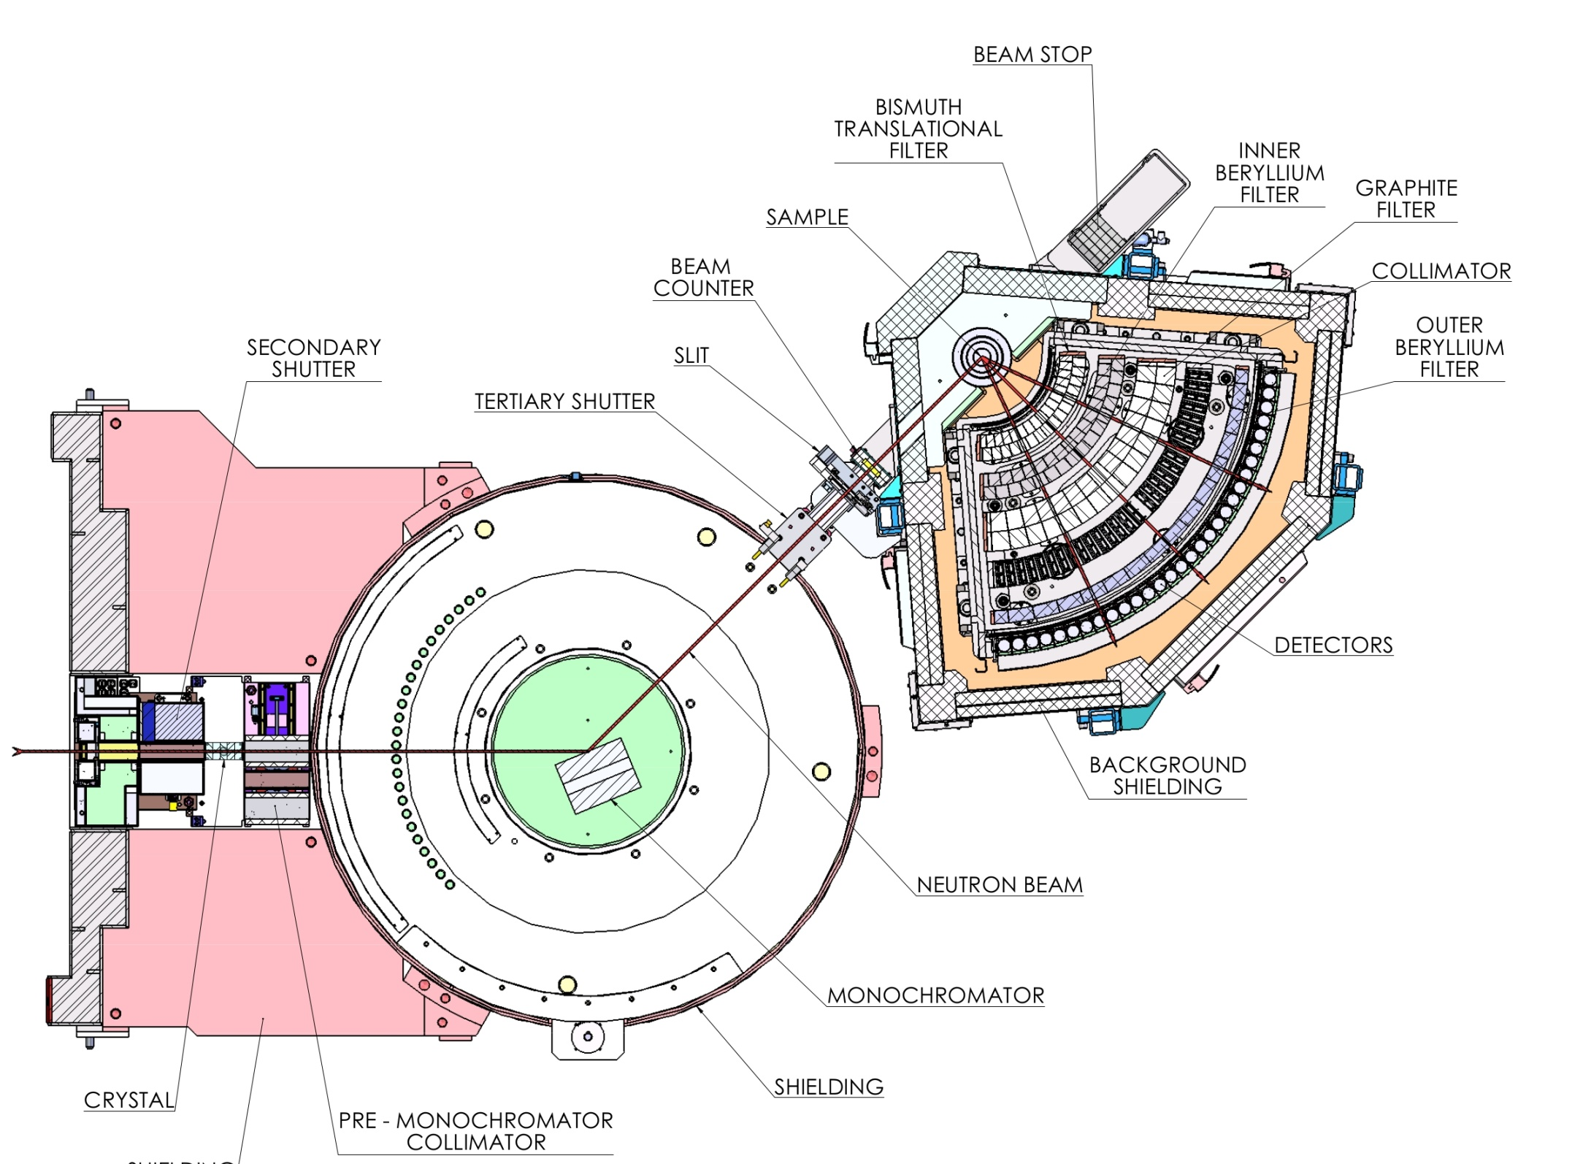
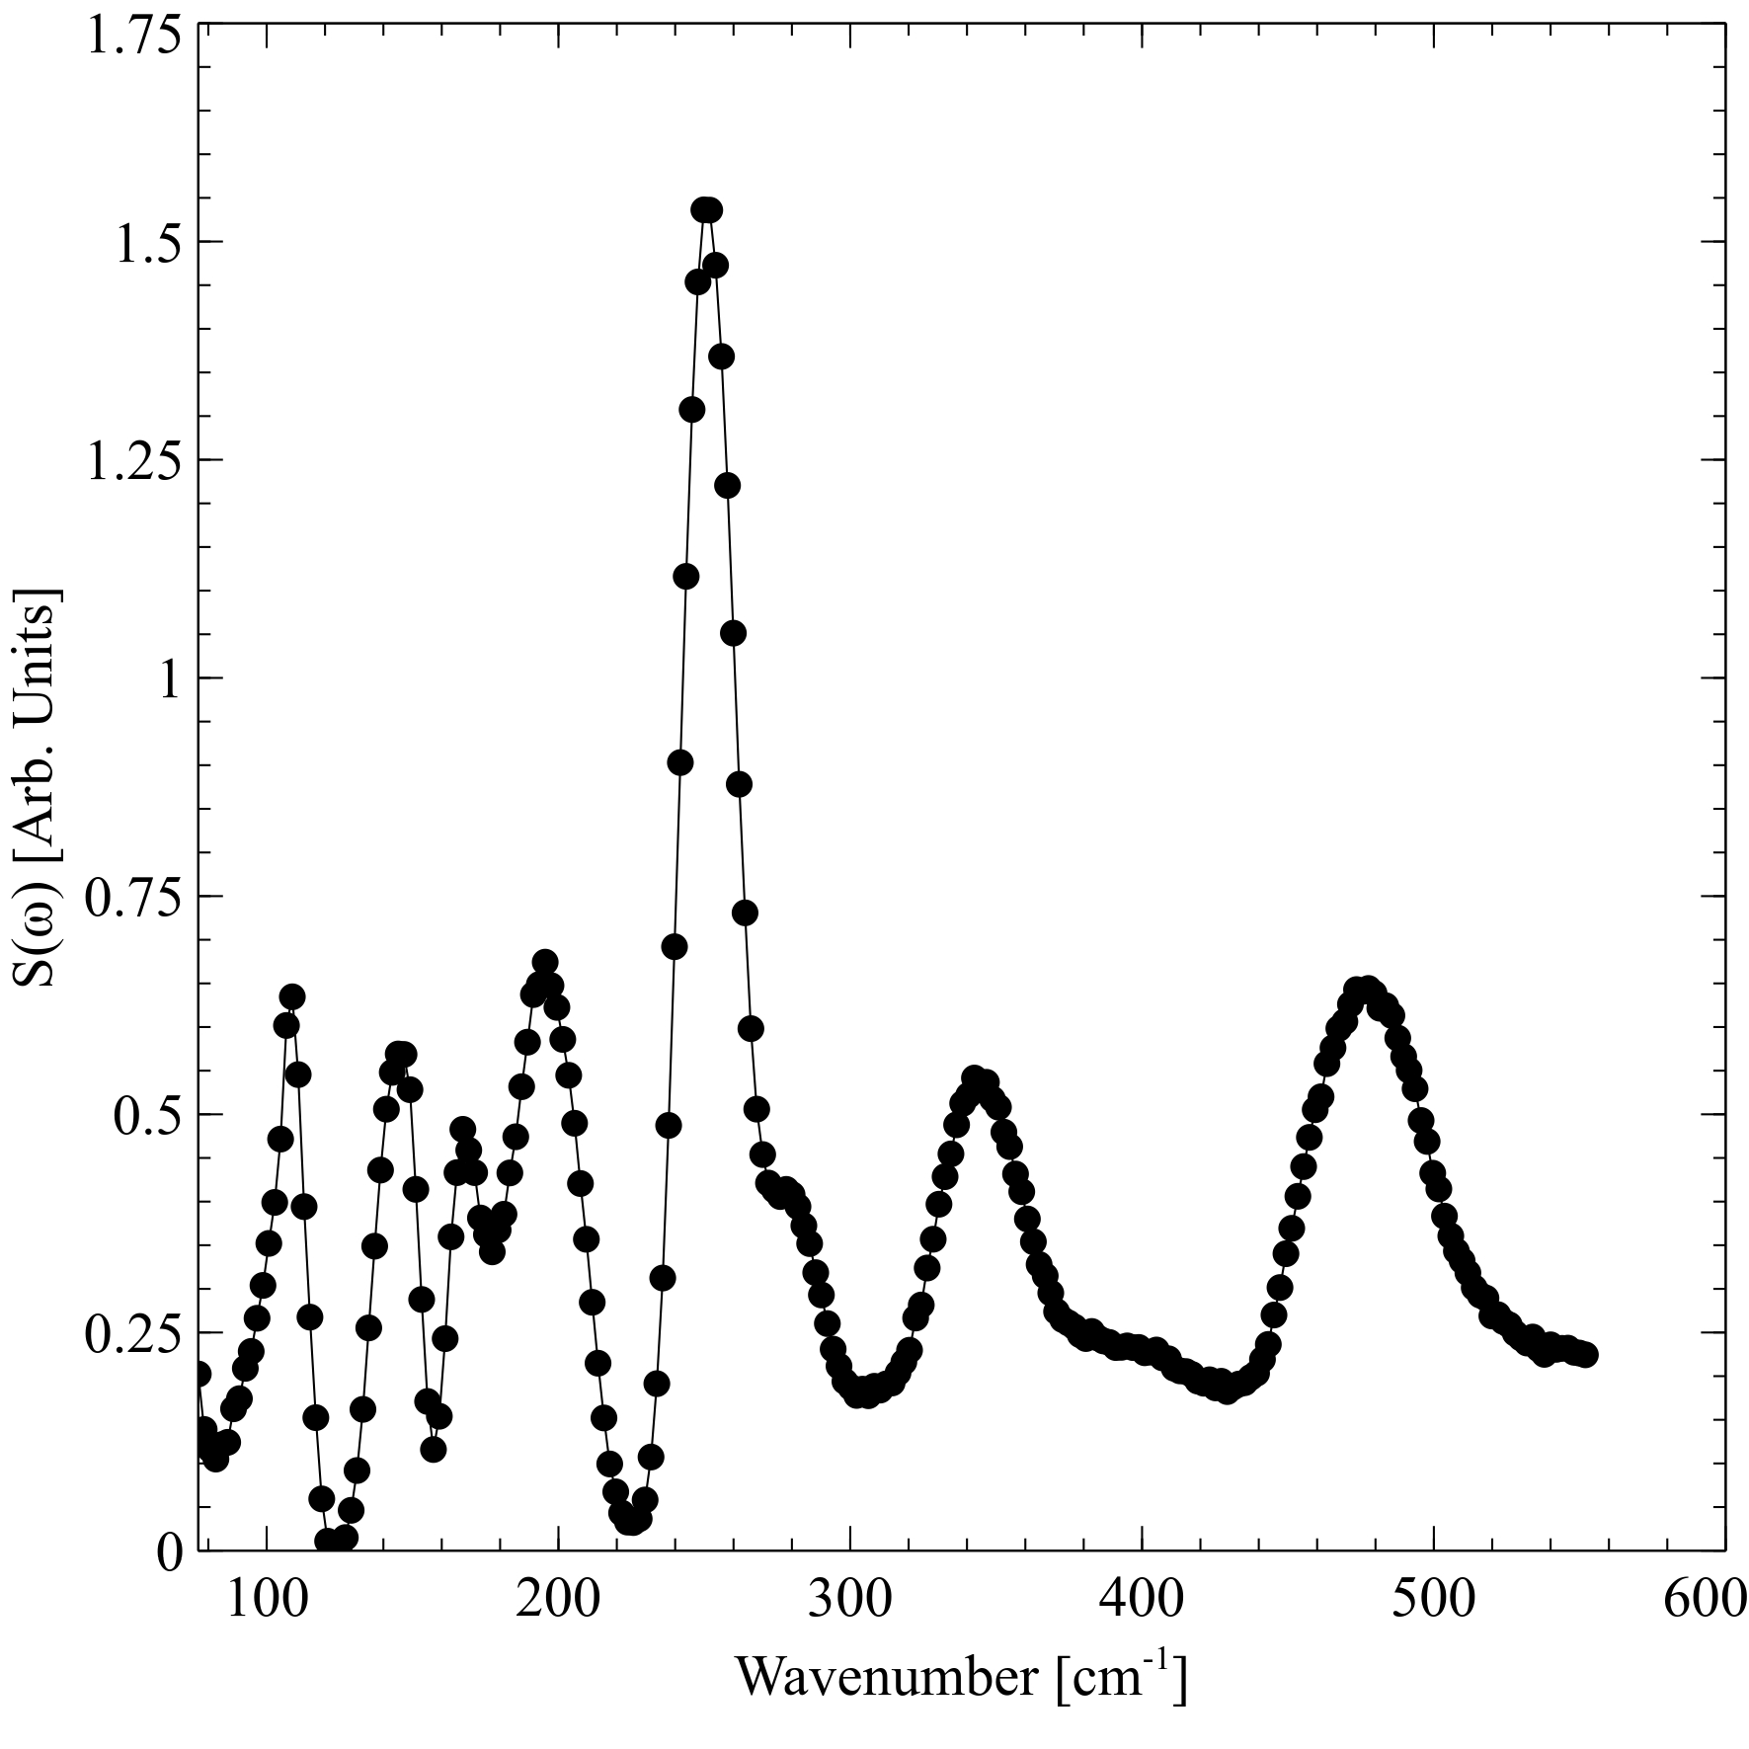
TAIPAN – Be-filter
  Lattice and molecular excitations in complex materials in the form of phonon density of states
  Molecular vibrations as “fingerprints” of surroundings
  Future energy storage (hydrides)
  Oil and chemical industry catalysts (zeolites)
  Nano-crystalline materials for industry
  Coal studies
  Nuclear Fuels

Slide 11

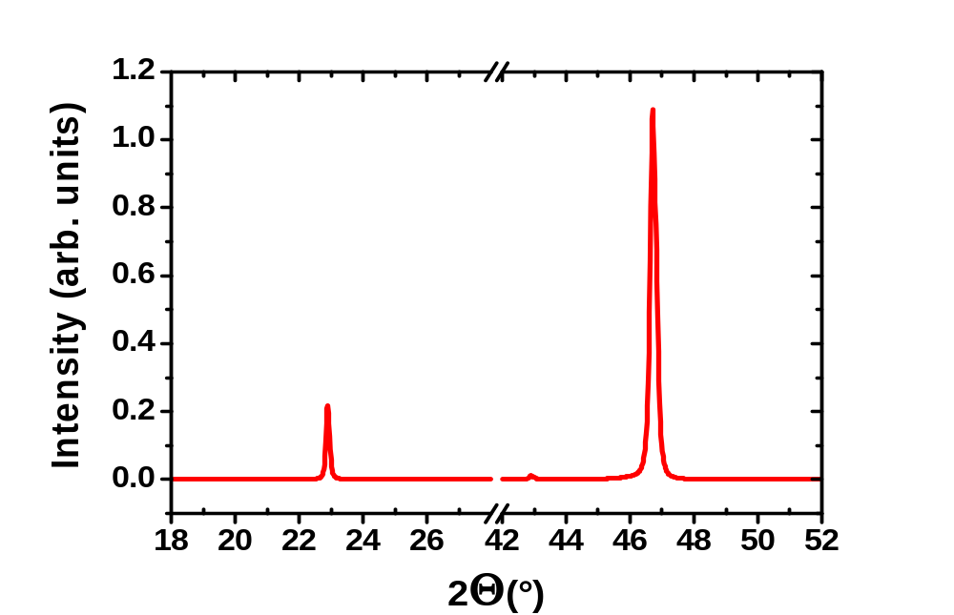
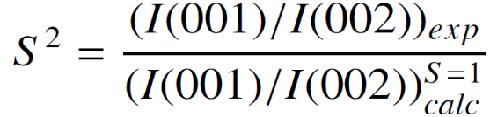

FePt₃: Chemical Order ⇔ Antiferromagnetism
Deposition at T_{dep} ~ 900 K
X – ray Diffraction
(002)
(001)
MgO
Fe Occupies Corners
Pt Occupies Faces
Saerbeck et al., PRB 82, 134409 (2010),
Saerbeck et al.,Procedia Engineering 36, 488 (2012)

Slide 12
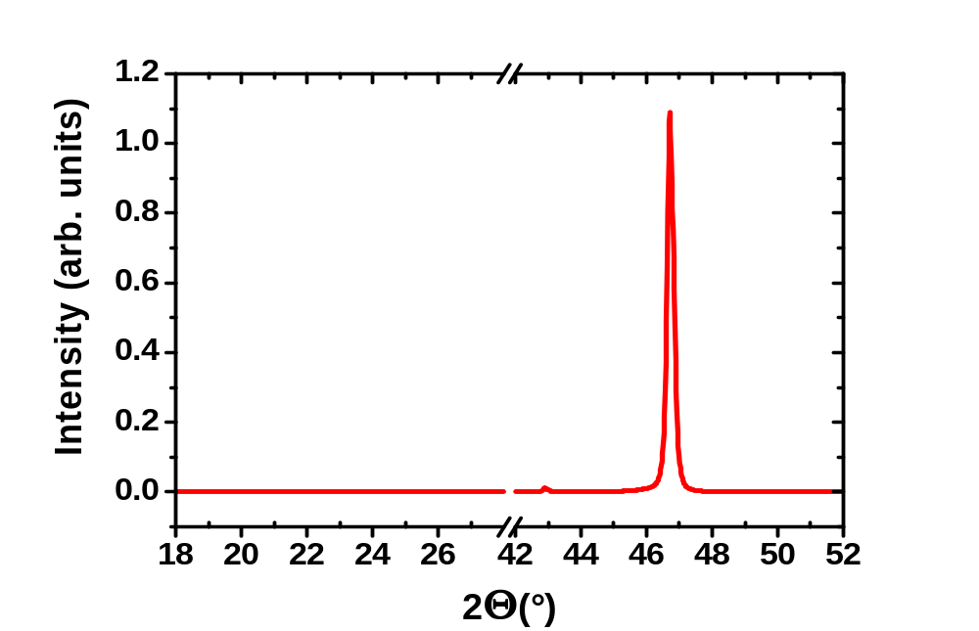

FePt₃: Chemical Disorder ⇔ Ferromagnetism
Deposition at T_{dep} = 800 K
X – ray
Diffraction
(002)
MgO
Random Distribution of Fe and Pt
Disorder
Saerbeck et al., PRB 82, 134409 (2010),
Saerbeck et al.,Procedia Engineering 36, 488 (2012)

Slide 13
Chemical order modulation
Modulation of Deposition Temperature
Chem. Order:
AFM
FM
AFM
Fe on Corners
⇒
FM
Pt on Faces
+
AFM
Chem. Disorder: FM
MgO(100)
Random Distribution
of Fe + Pt
…but only one material!
Disorder
Saerbeck et al., PRB 82, 134409 (2010),
Saerbeck et al.,Procedia Engineering 36, 488 (2012)

Slide 14
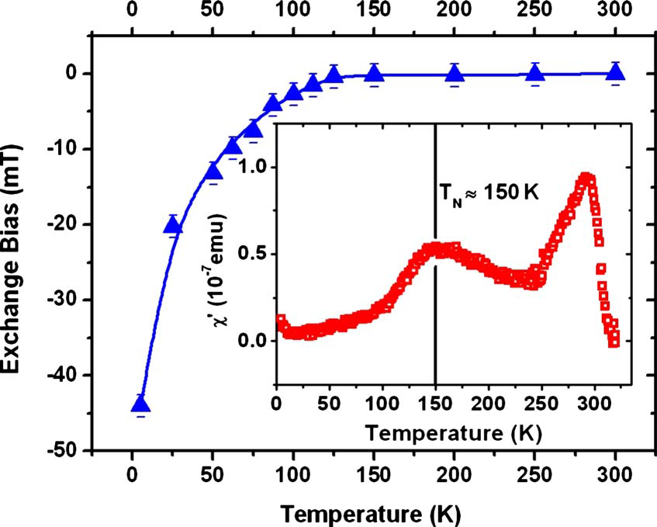
Chemical order modulation
Chem. Order:
AFM
Tc ~ 300K
Fe on Corners
Pt on Faces
+
Chem. Disorder: FM
Random Distribution
of Fe + Pt
Disorder
Saerbeck et al., PRB 82, 134409 (2010),
Saerbeck et al.,Procedia Engineering 36, 488 (2012)

Slide 15
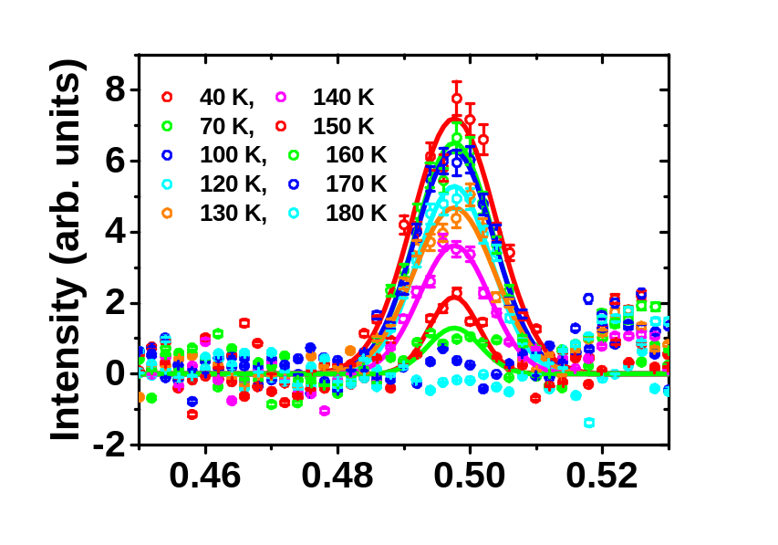
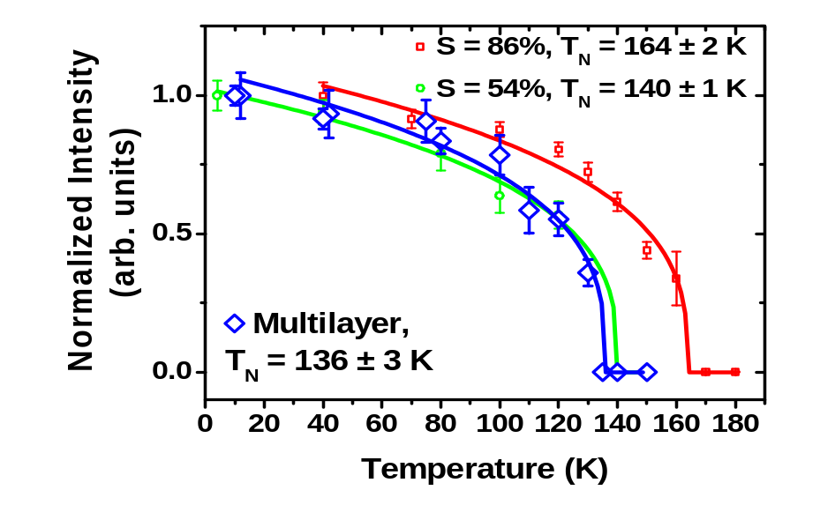
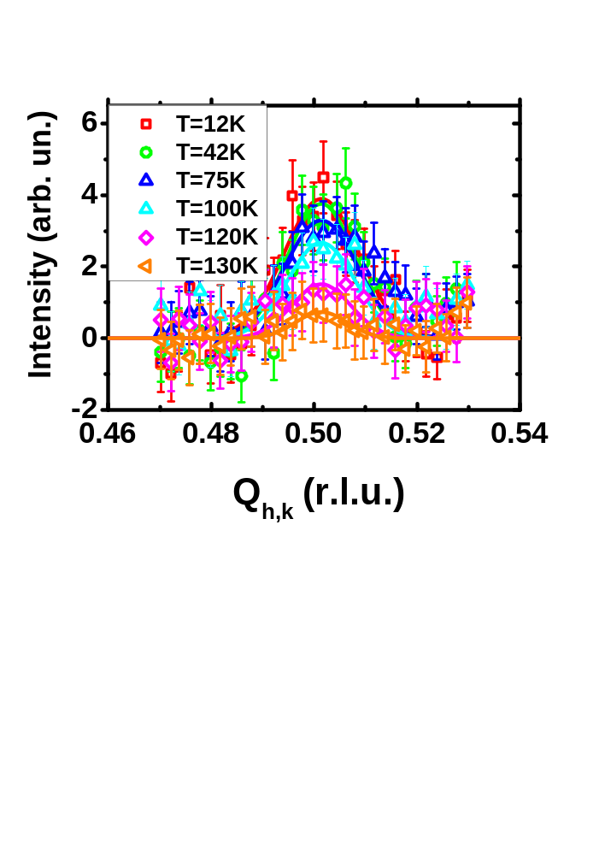
High Angle Neutron Diffraction
(0 ½ ½) AFM order
(0 ½ ½)
Thin Film
(S = 2800Å)
S = 86 %
(0 ½ ½)
5 x Multilayer
Ferromagnet
Interface (Frustration)
Antiferromagnet
Saerbeck et al.,Procedia Engineering 36, 488 (2012)

Slide 16

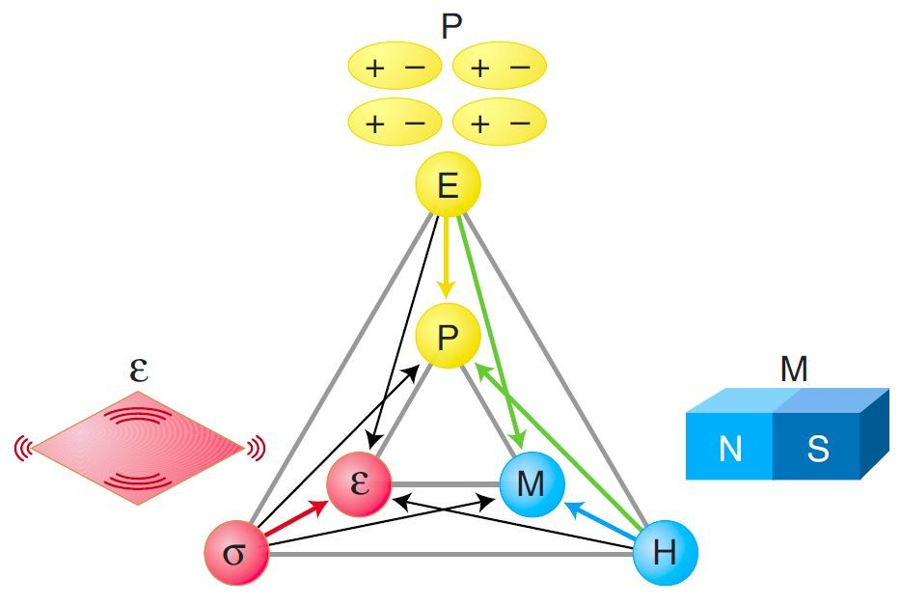
Multiferroic thin films
Multiferroics – materials which possess 2 or more of the following, with coupled order parameters:
(anti) ferromagnetism
(anti) ferroelectricity
(anti) ferroelasticity
BiFeO₃ is both magnetic and strongly ferroelectric at room temepraure.
BiFeO₃ has an incommensurate magnetic structure with a spin cycloid periodicity of ~62-64nm

Slide 17
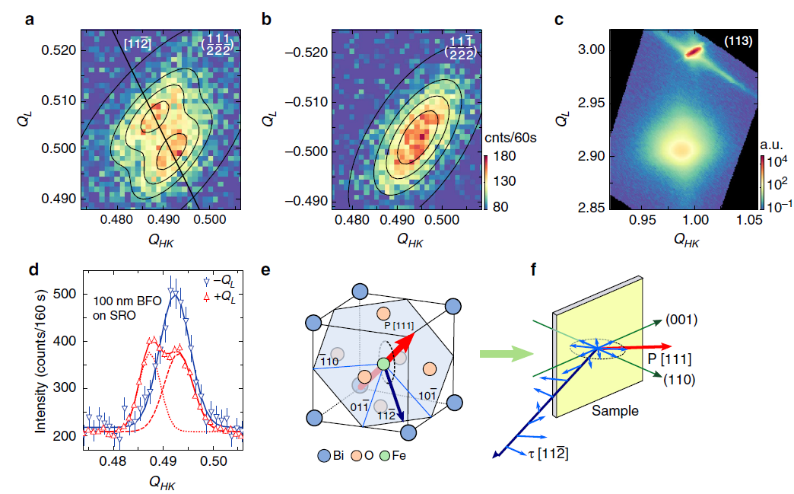
Spin cycloid in a 100nm BiFeO₃ film
Bulk: k|| [110]
100nm film: k|| [112] and
k┴ [11-2]
NATURE COMMUNICATIONS | 7:12664 | DOI: 10.1038/ncomms12664

Slide 18
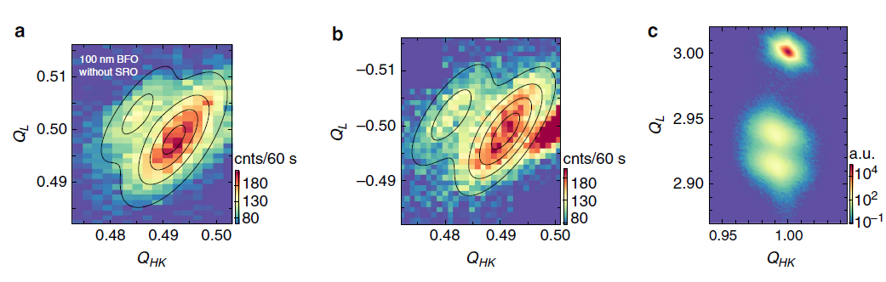
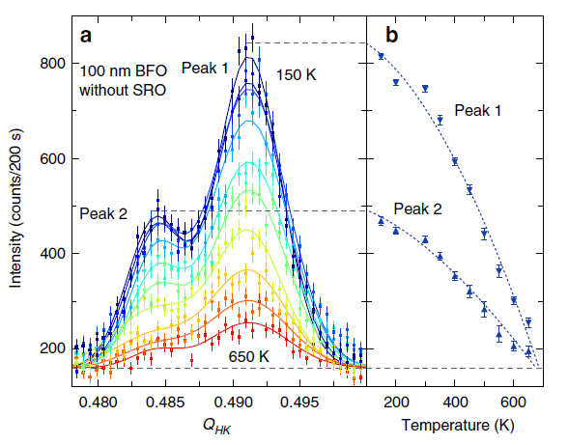
ICM magnetic satellite peaks
Cycloid propagation length = 64.7 nm, which is consistent with the bulk value.
NATURE COMMUNICATIONS | 7:12664 | DOI: 10.1038/ncomms12664

Slide 19

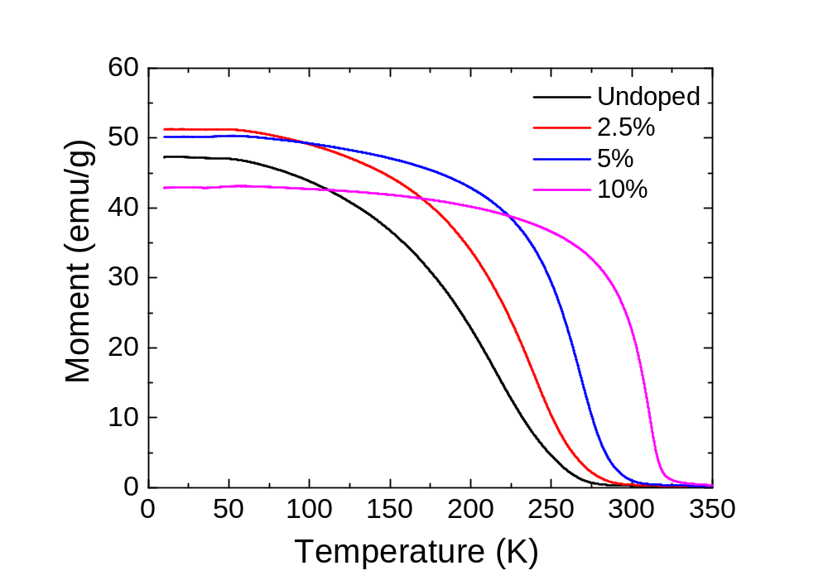
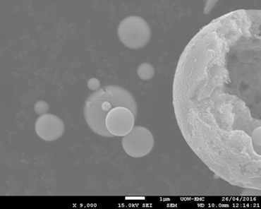
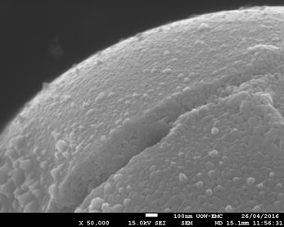
Ag doped nanoparticles of LaMnO₃
Hollow sphere aggregates made via the spray pyrolysis method – diameters ~ 70nm
Desired Ag Concentration | EDS Result
2.5% | 2.65%
5% | 4.78%
10% | 10.5%
Ag doping gave an O-rich phase
What role does the Ag play in: Magnetism, stoichiometry, Jahn-Teller distortions and phonon propagation?
How does this compare to the bulk?

Slide 20
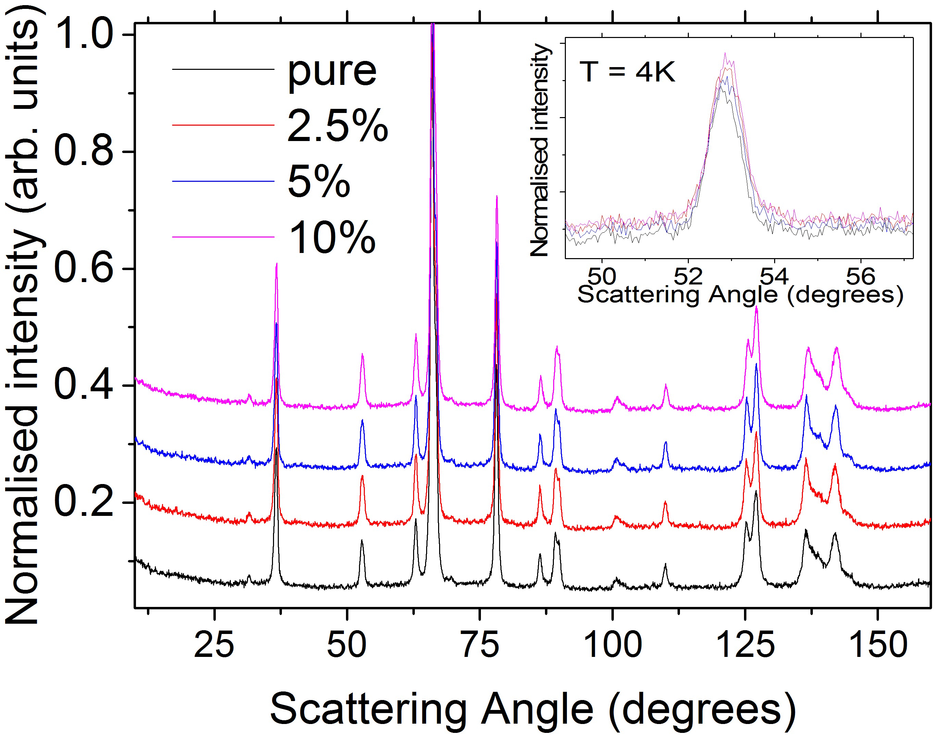
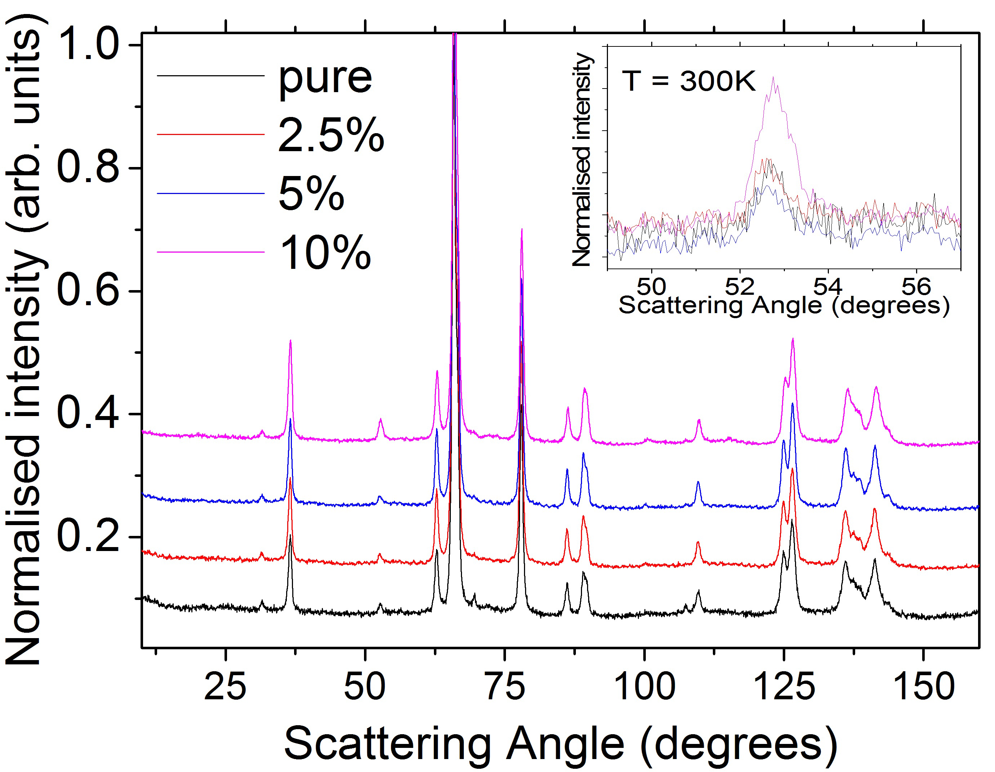
Neutron elastic scattering - TAIPAN
Bulk LaMnO₃ | Nano La_{1-x}Ag_{x}MnO_{3*} (x = 0, 0.025, 0.05, 0.1)
Stoichiometric | O-rich
J-T around 700K | J-T at RT due to Mn⁴⁺
Long range effects | Broadening of features due to finite size effects

Slide 21
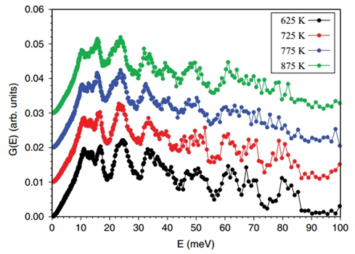
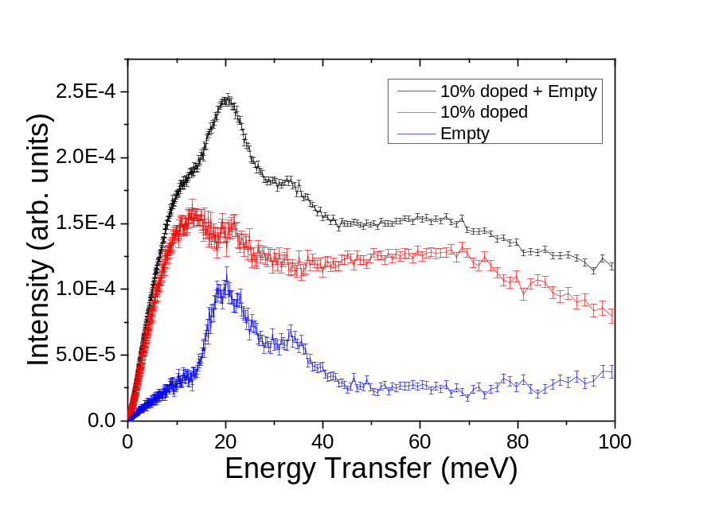
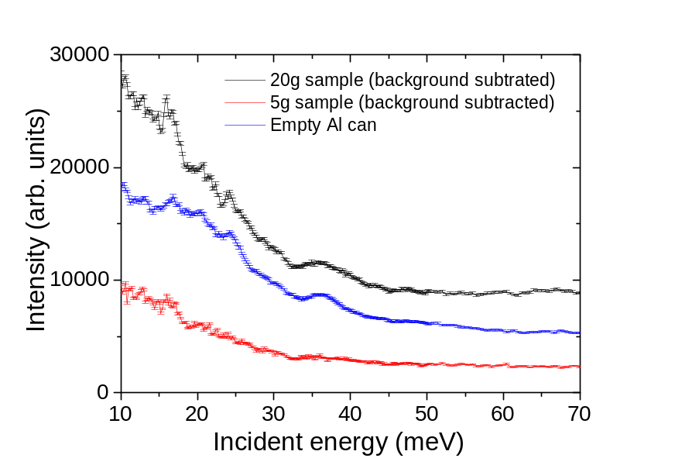
Dynamic properties – LaMnO₃
ToF neutron energy loss data
Bulk, stoichiometric LaMnO₃
~750K = Jahn-Teller transition
Wdowik et al., PRB 86, 174305 (2012)
10% Ag sample
300K
PELICAN
TAIPAN

Slide 22
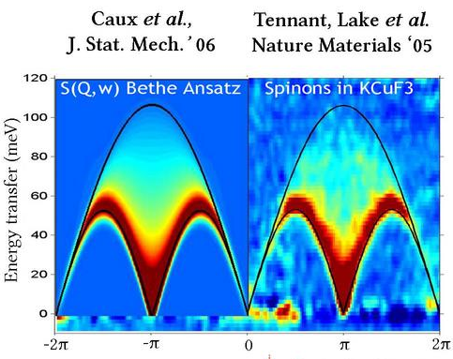
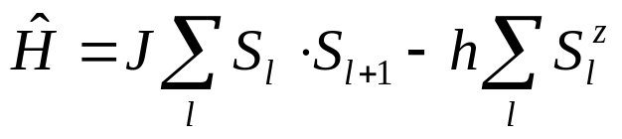
Low dimensional spin systems
One dimensional quantum magnets
Magnetic coupling in only 1 direction
Low spin state magnetic ions
S = ½ or 1 (typically Cu)
Interesting field induced phases
Bose-Einstein condensation (superfluid He)
1 or 2 magnon states
Multipolar phases
Spin nematic phases
Why?
• “easy“ to describe!
Comparison between experiment
and theory is possible with different models
which can help us understand the magnetic
interactions.
CuGeO₃
6K
Arai et al PRL 77 3649
22

Slide 23
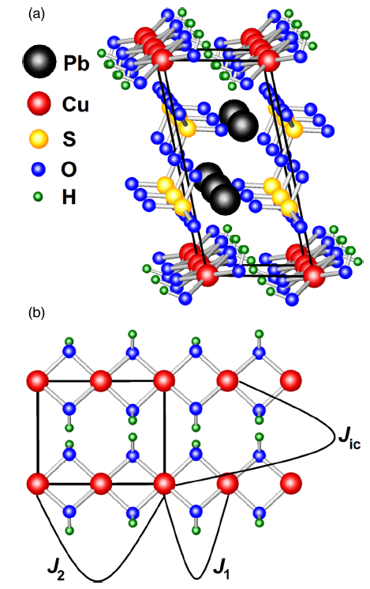
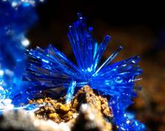
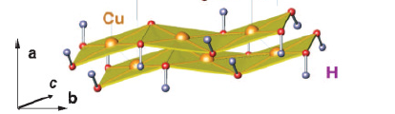
Linarite, PbCuSO₄(OH)₂
Monoclinic: P2₁/m
a = 9.682
b = 5.646
c = 4.683
β = 102.65°
T_{N} = 2.75K
|Θ_{CW}| = 27K
f = |Θ_{CW}|/T_{N}~10
Wolter et al., PRB 85, 014407 (2012)
Rule et al., PRB 95, 024430 (2017)
23

Slide 24
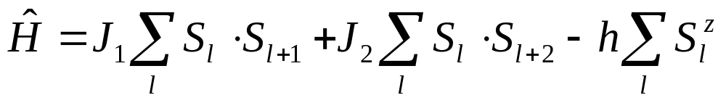

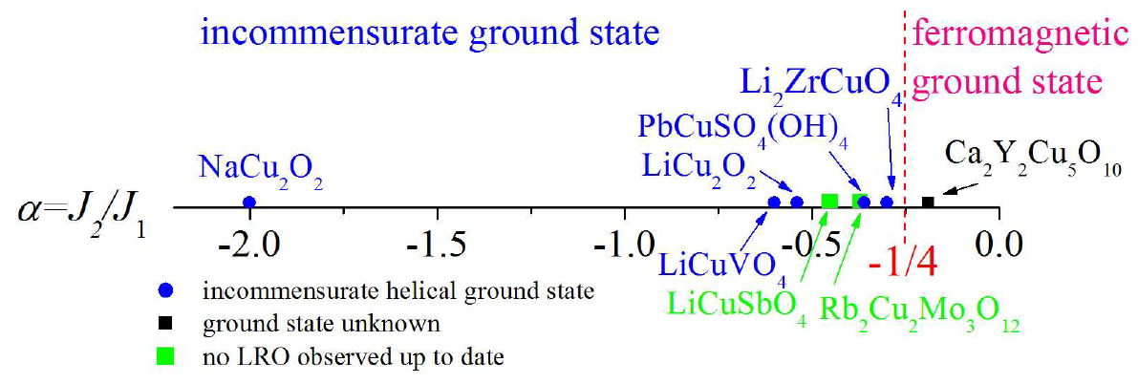
J₁-J₂ frustrated spin chain model (s = ½)
J₁ = FM
J₂ = AFM
from Furukawa et al. PRL 105 257205 (2010)

Slide 25
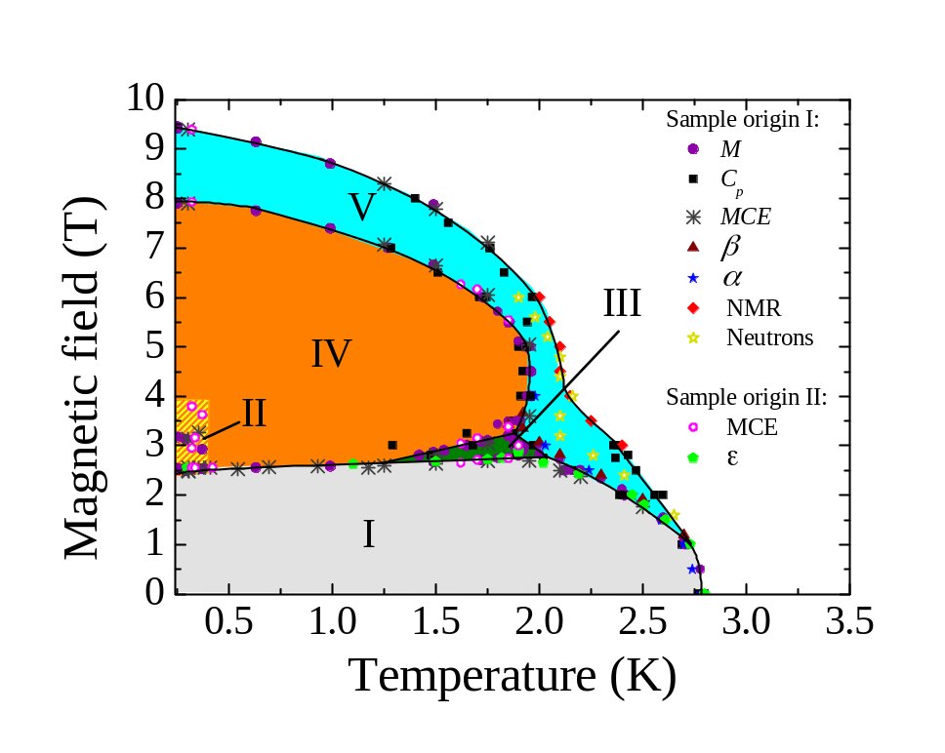
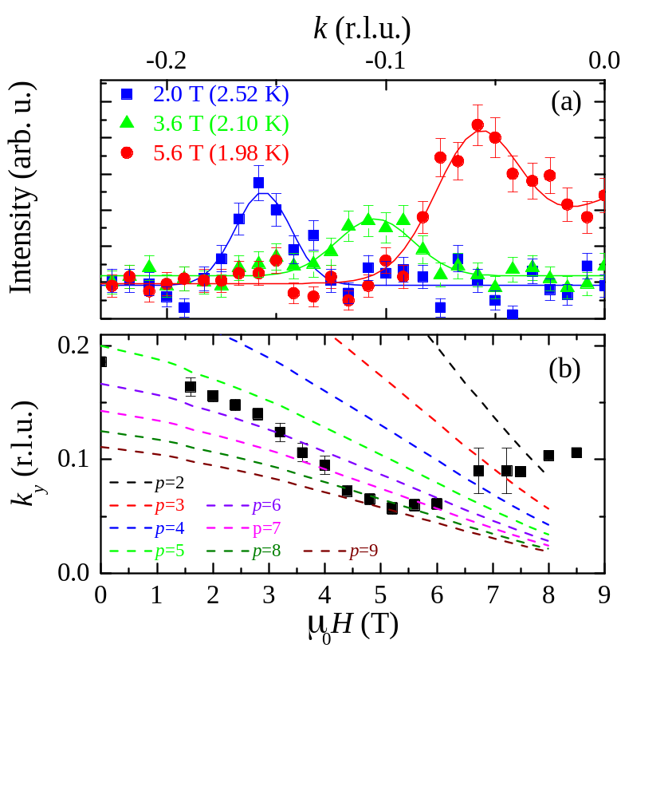
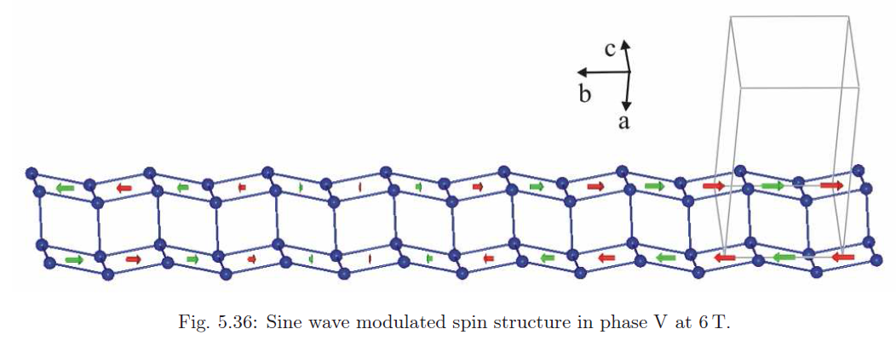
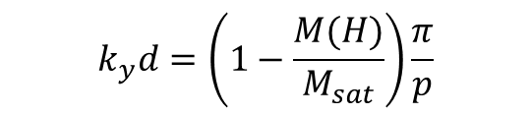
Elastic neutron scattering – high field B||b
Phase V
μ = 0.44 μ_{B}
$$k_{y}d=\left(1−\frac{M(H)}{M_{sat}}\right)\frac{π}{p}$$

Slide 26
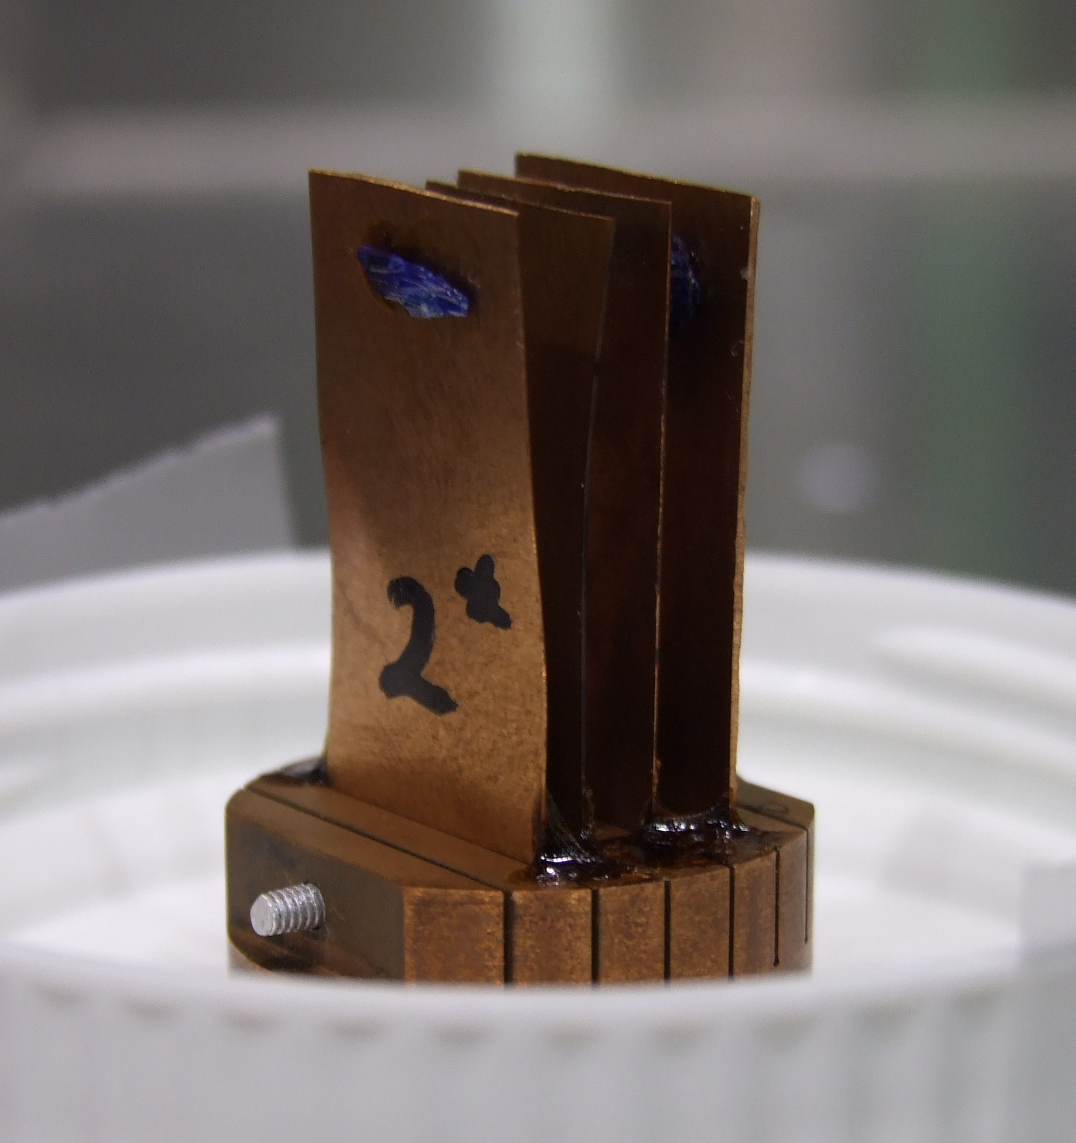
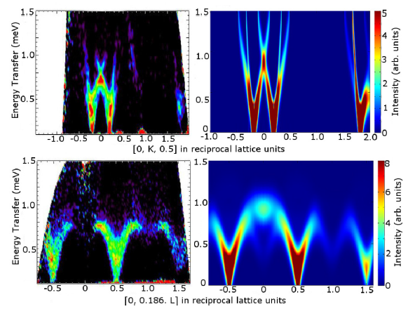
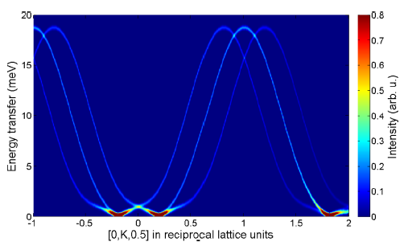
Inelastic Neutron scattering
K-direction
L-direction
From LSWT we estimate
J₁ = -114K,
J₂ = 37K and
J_{ic} = 4K
α ~ 0.32
Rule et al., PRB 95, 024430 (2017)

Slide 27
Conclusions
Neutron scattering is a particularly effective tool for understanding magnetic materials
While often considered a bulk probe, it can also be utilised for materials with reduced dimensionality
Thin films and interfaces
Magnetic nanoparticles
Low dimensional magnets
TAIPAN at ANSTO is a versatile and highly configurable neutron instrument which can be tuned for each scientific problem
Proposal now being accepted (deadline 15th September)
https://neutron.ansto.gov.au/

Slide 28
Thank you!
T. Searbeck, F. Klose
J. Bertinshaw, R Maran, S Callori, V Ramesh, J Cheung, S Danilkin, W-T Lee, S Hu, J Seidel, N Valanoor, C Ulrich
M. Westlake, M. Tehei, M. Lerch, J Horvat.
B. Willenberg, M Schaepers, L. Heinz, S. Suellow, A. Wolter-Giraud, G. Ehlers, R Mole, S. Nishimoto, S. Drechsler

