Slide 1
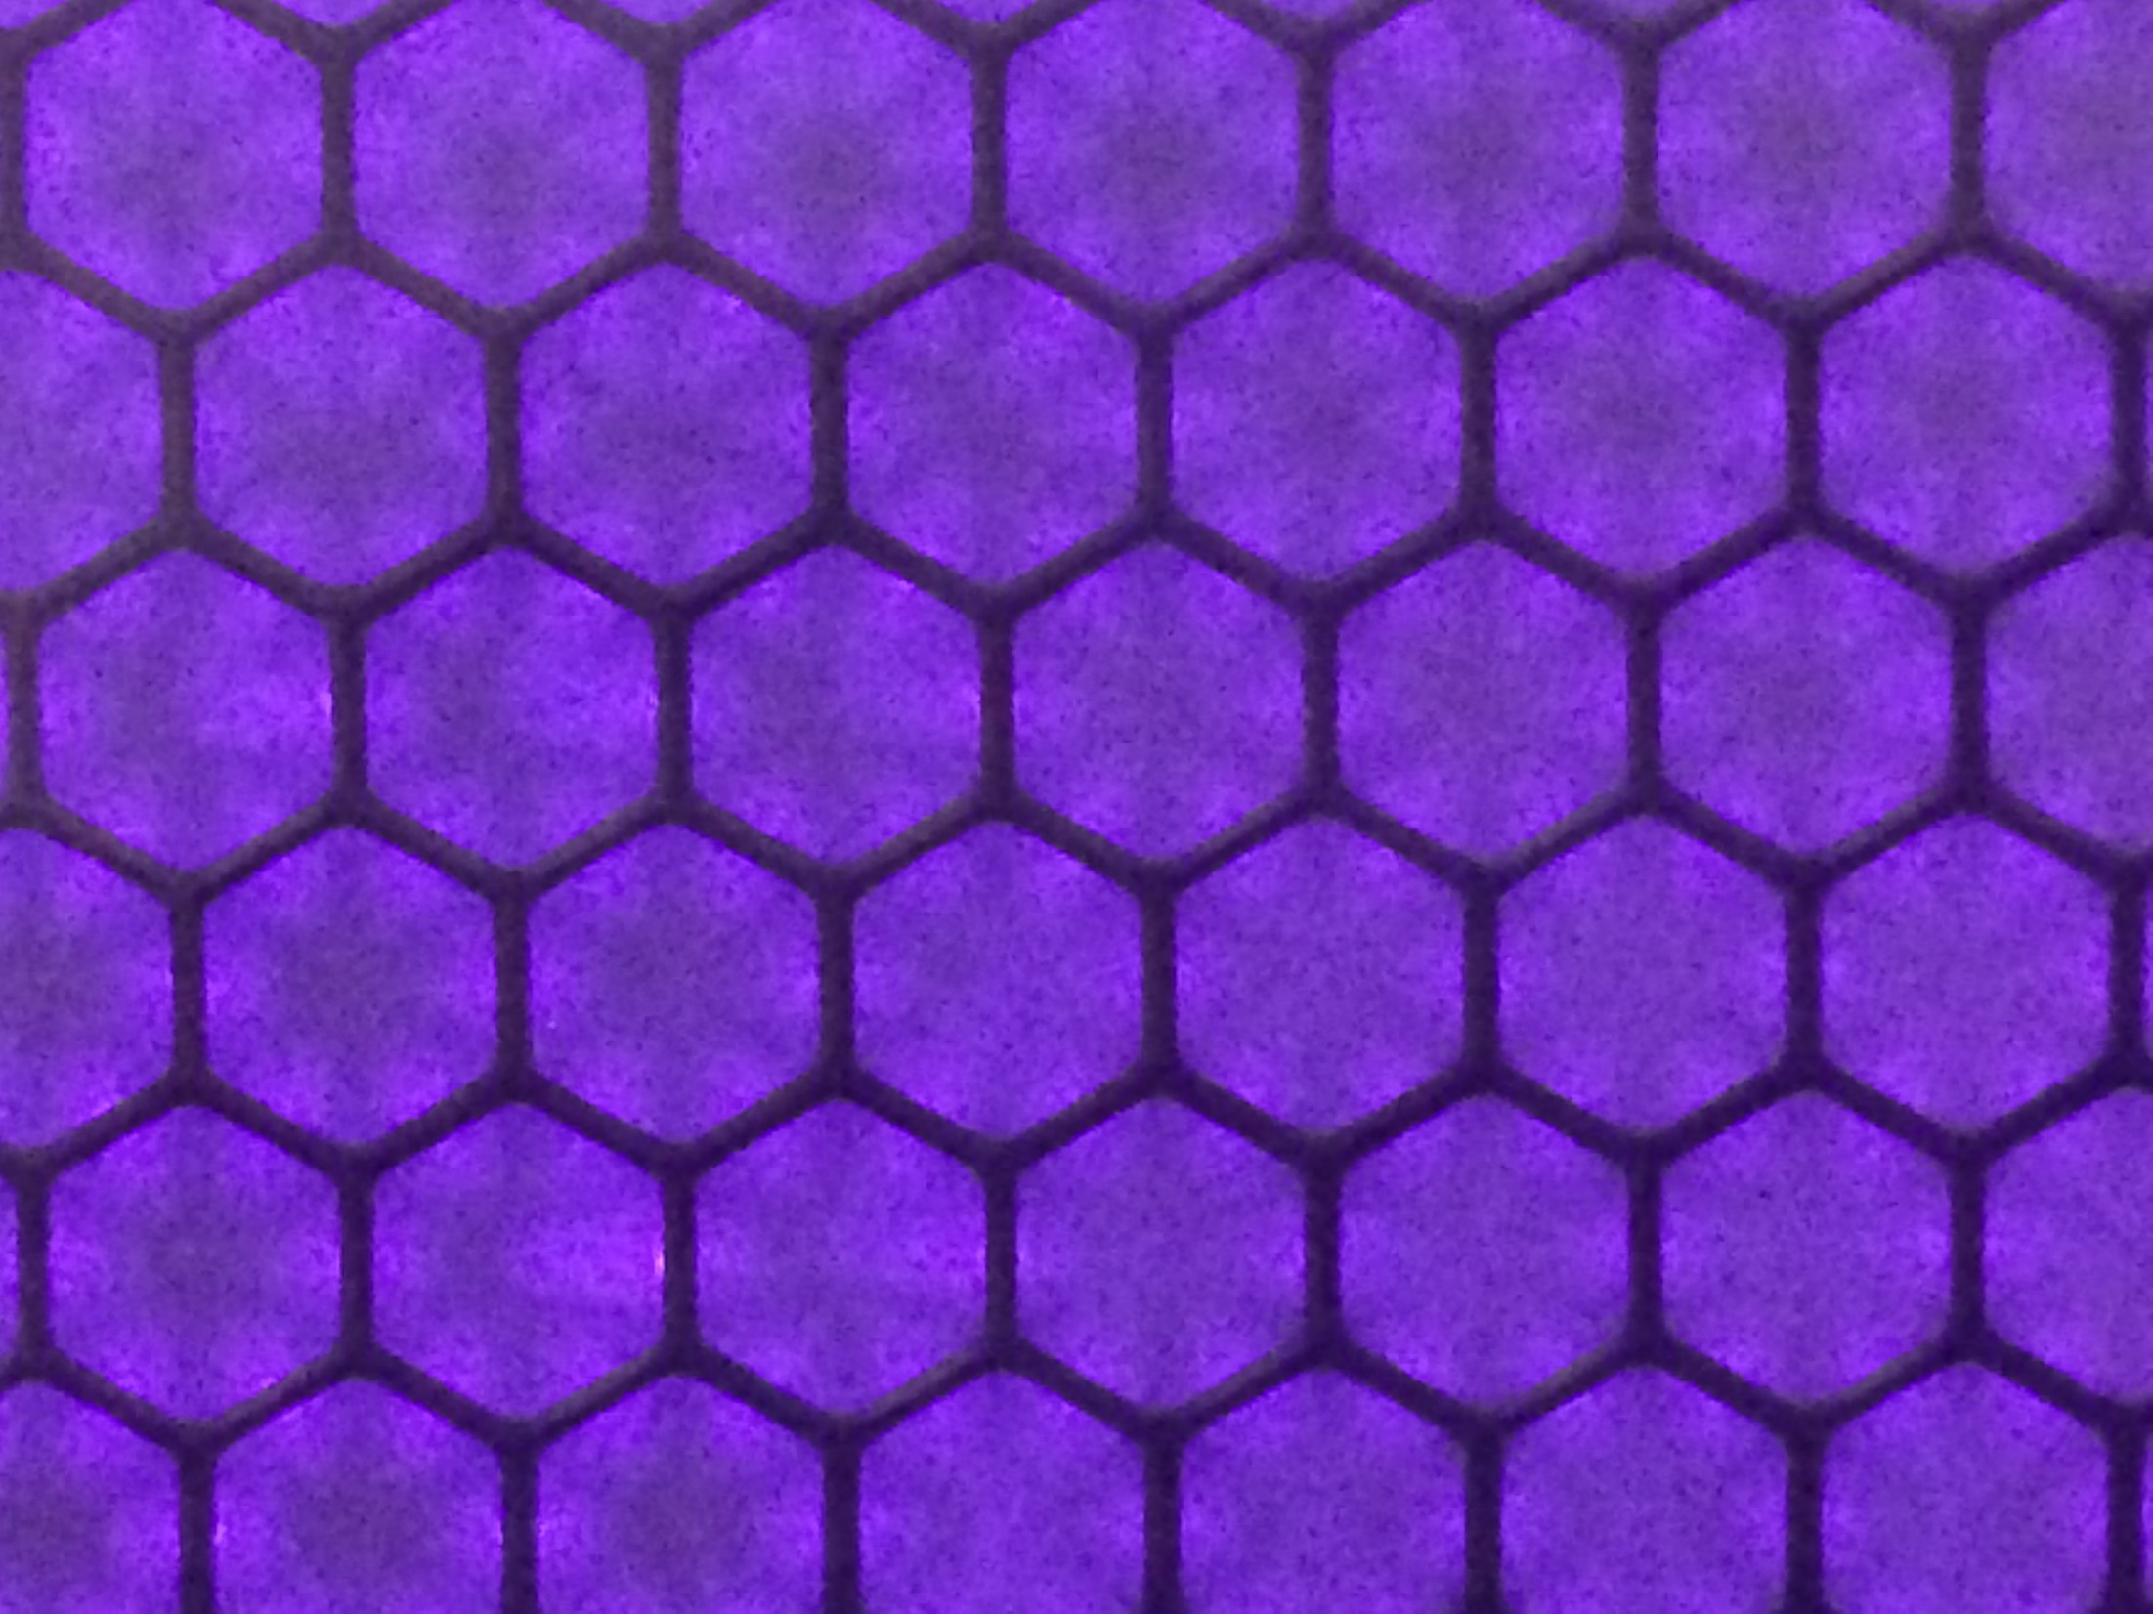
Development of scalable plasma polymerisation processes
Jason Whittle
School of Engineering, University of South Australia
Future Industries Institute, University of South Australia
Cell Therapy Manufacturing CRC

Slide 2
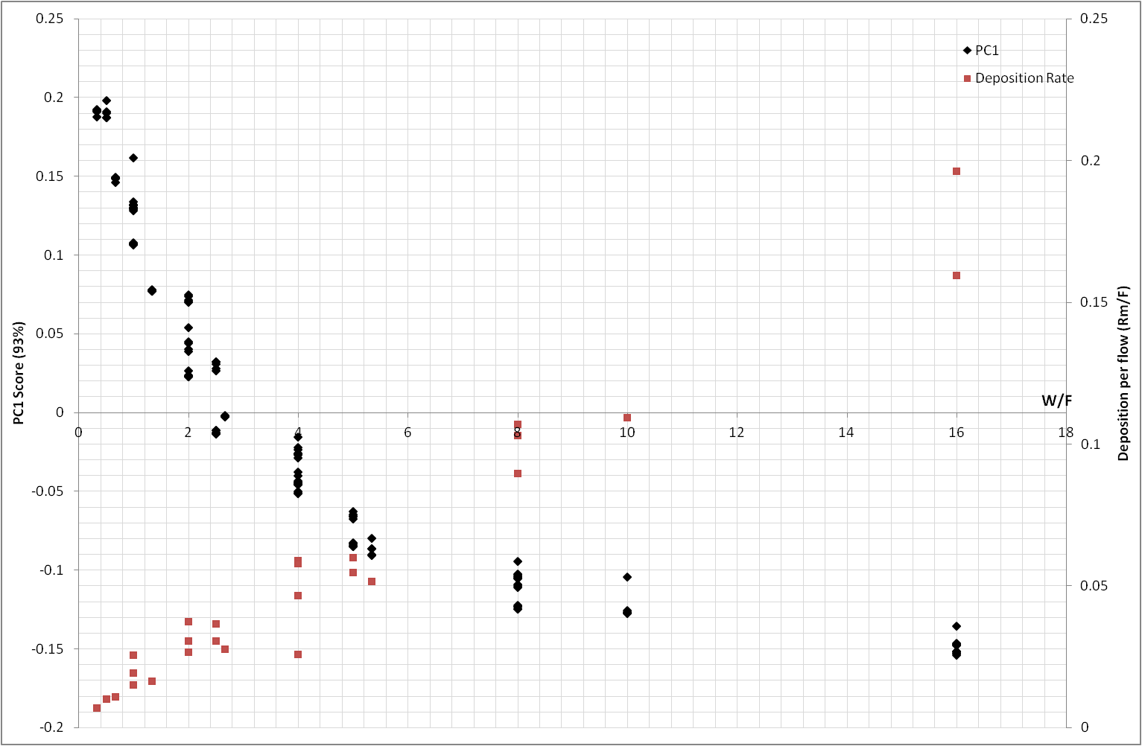
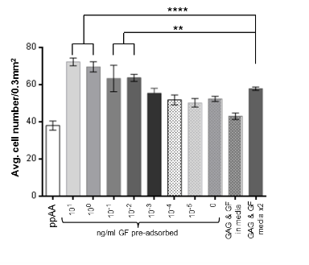
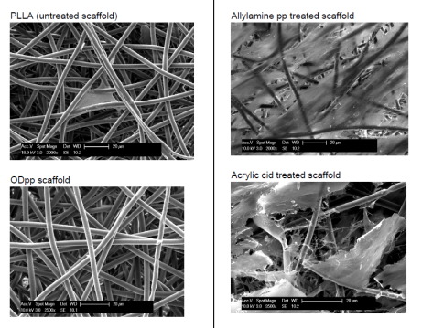
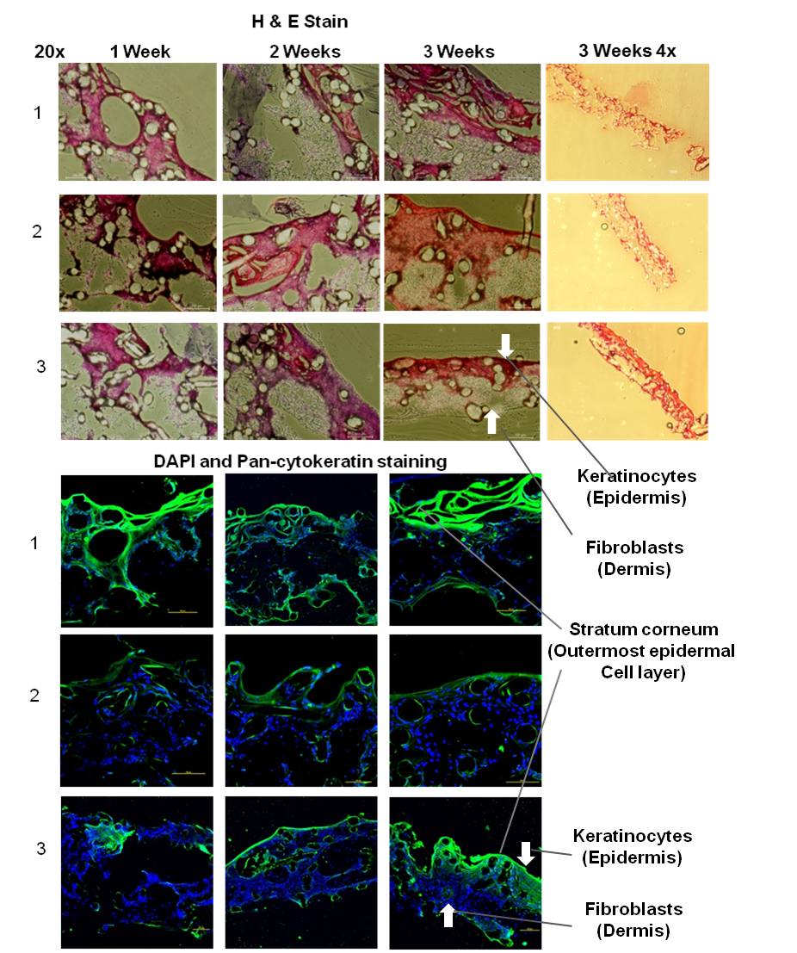
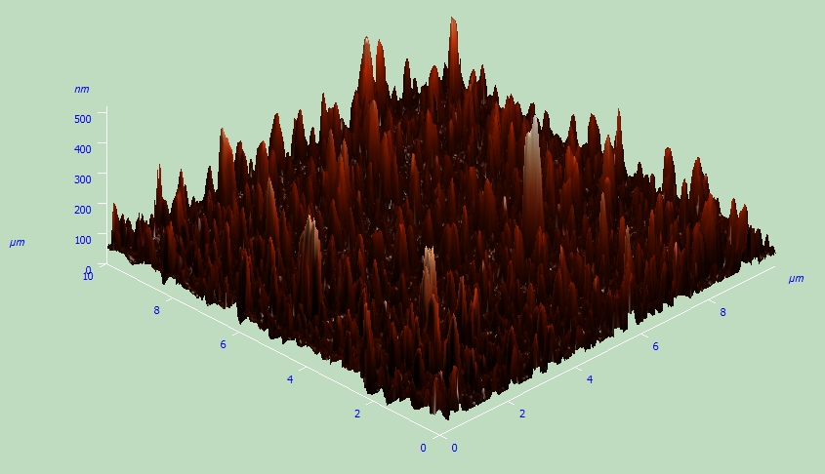
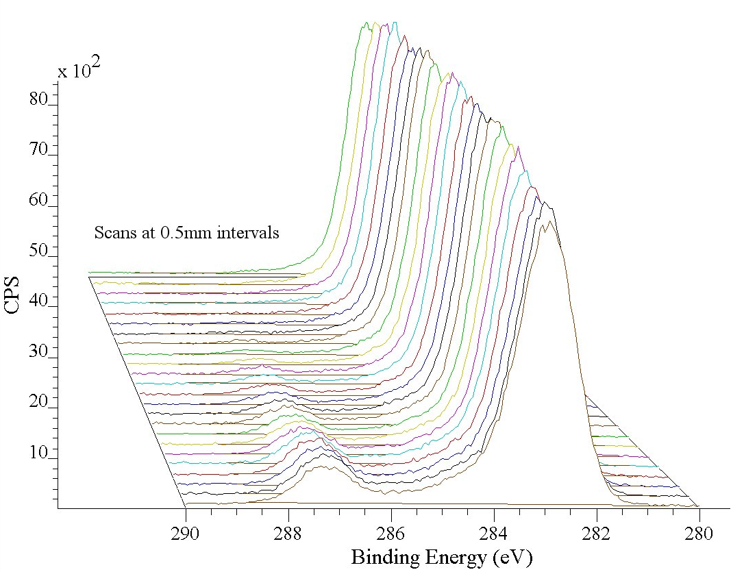
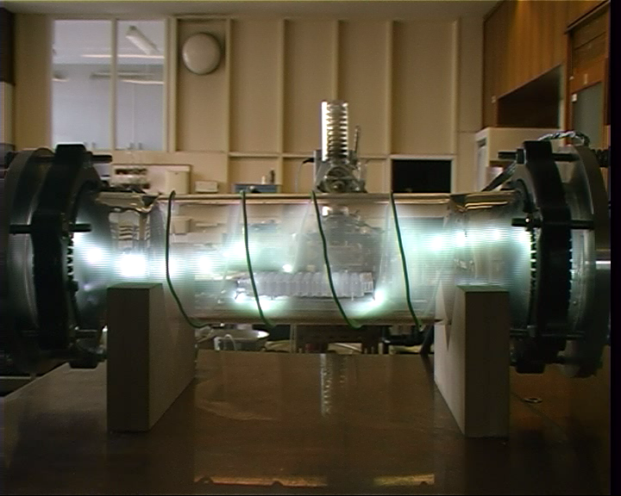
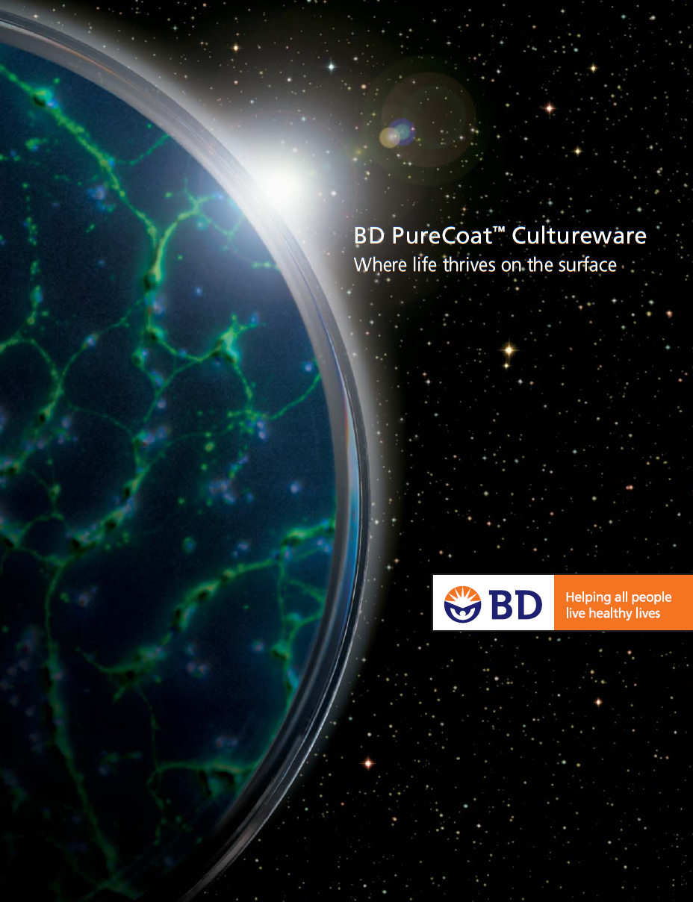
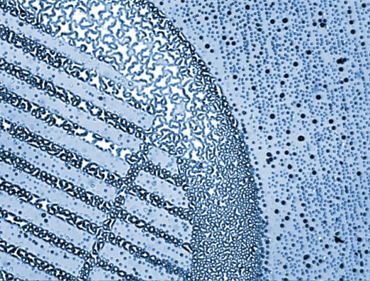
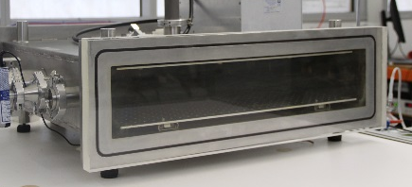
Applications
Mechanisms
Plasma Polymers
Properties
Translation

Slide 3
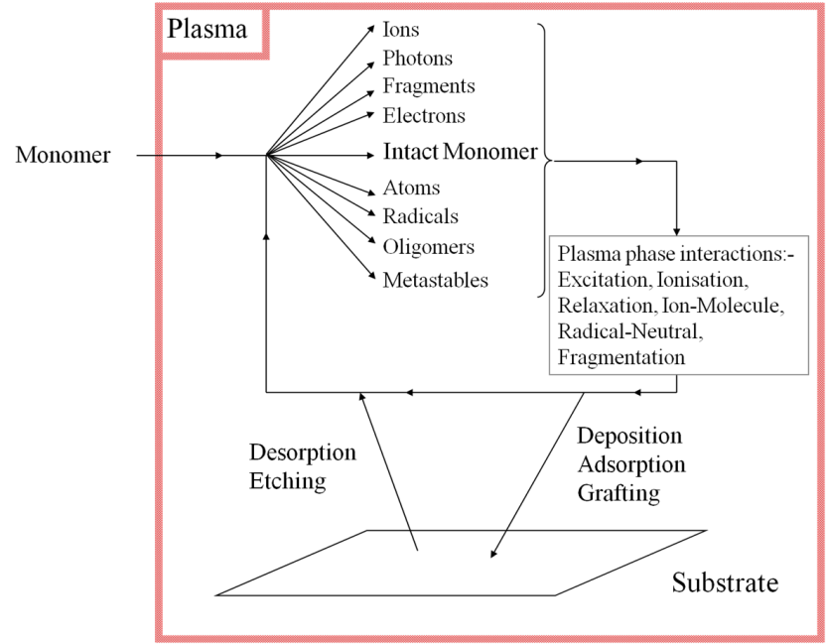
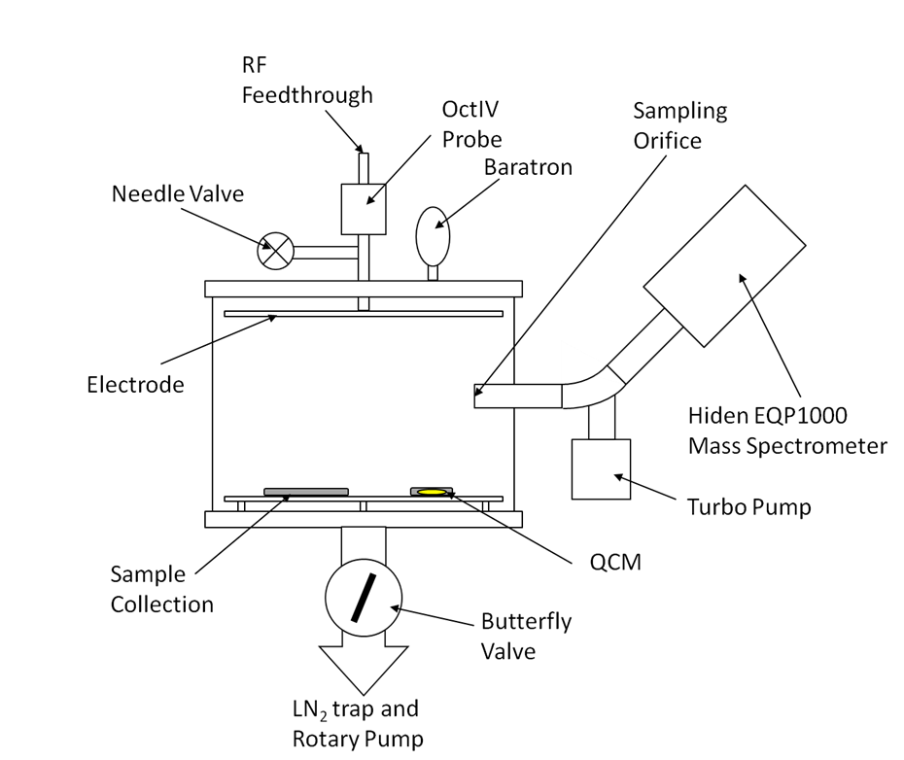
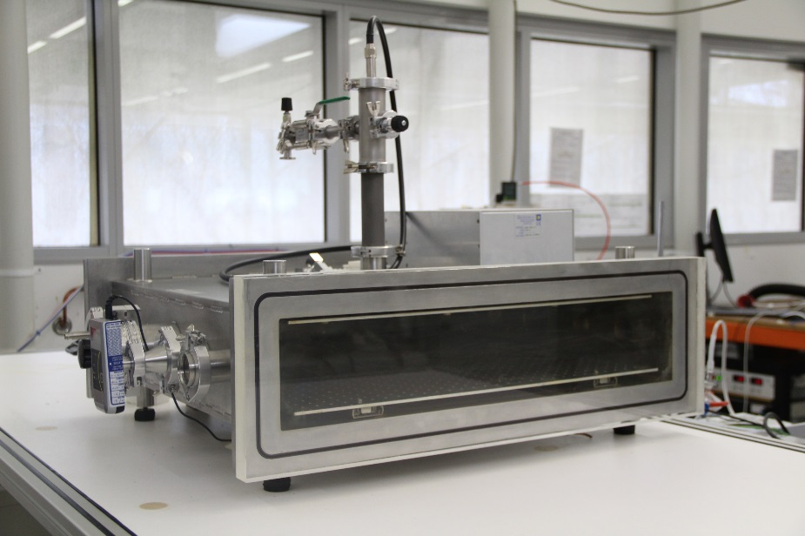
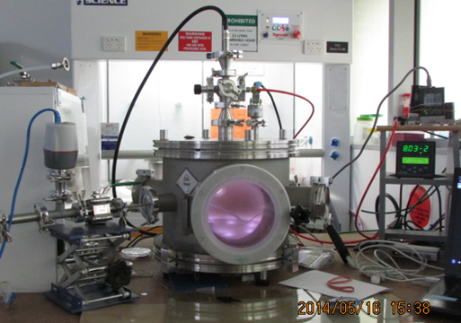
Plasma Polymerisation
Plasma Chamber (under vacuum)
Monomer Vapour
Flows into Chamber
Radiofrequency Power
Applied to System
Plasma
Substrate
Notes:
LT plasmas in biomedical materials. TCPS, Purecoat, Peptide etc.

Slide 4
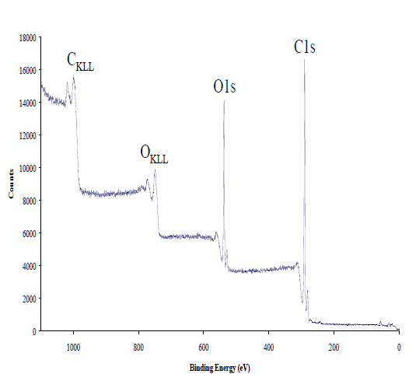
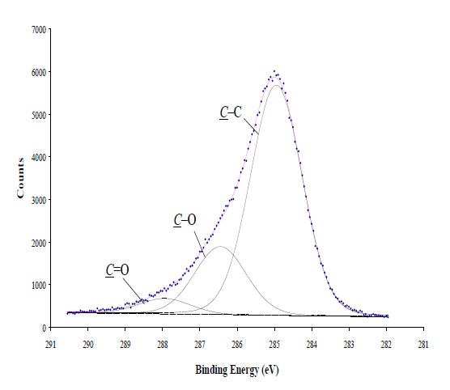
Plasma Polymerisation
Uniform
Reproducible
Substrate Independent
Stable
Pinhole Free
Scalable
W
FM
Yasuda Parameter

Slide 5
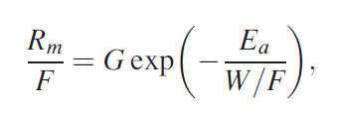

Slide 6
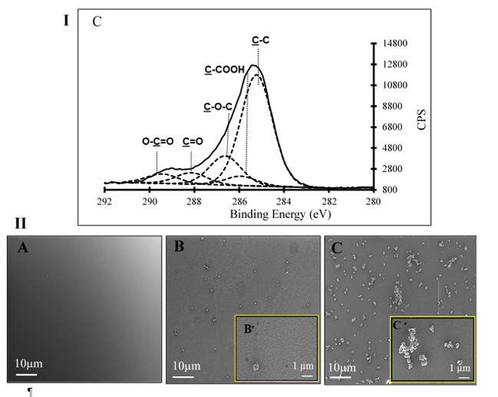
Uniform?
Shirazi et al. Colloids and Surfaces B: Biointerfaces 161, 261-268 (2018)
Notes:
Images along the bottom – 2W low flow, 4W normal flow, 10w normal flow. All 1min.
XPS shows no chemical difference.

Slide 7
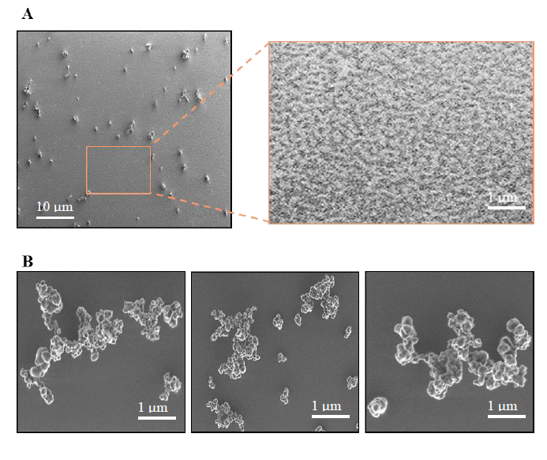
Uniform?
Notes:
2W, 1min, 4.9sccm – top. Bottom 4W, 10min, 4.9sccm bottom.

Slide 8
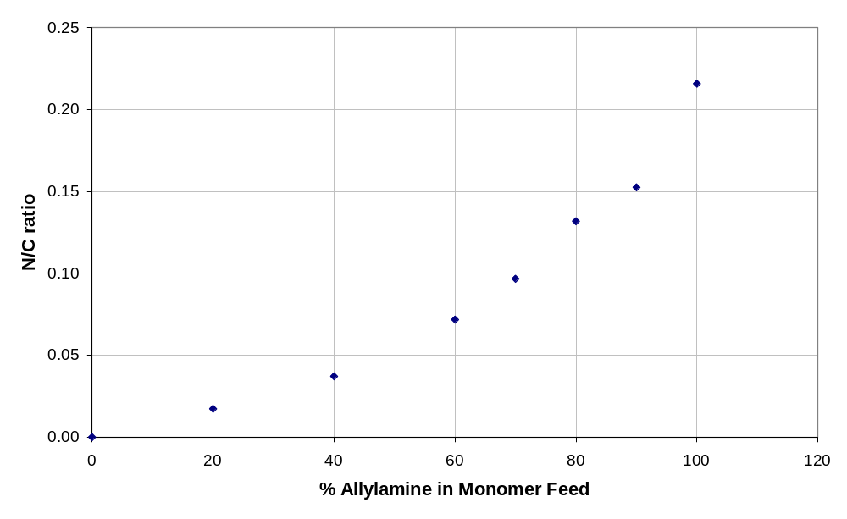
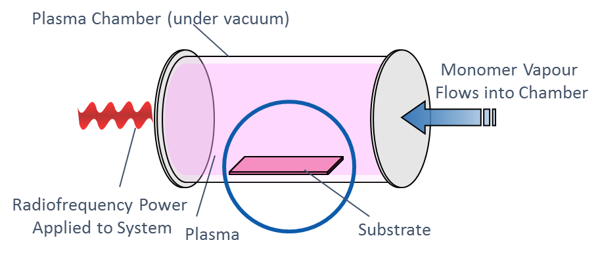
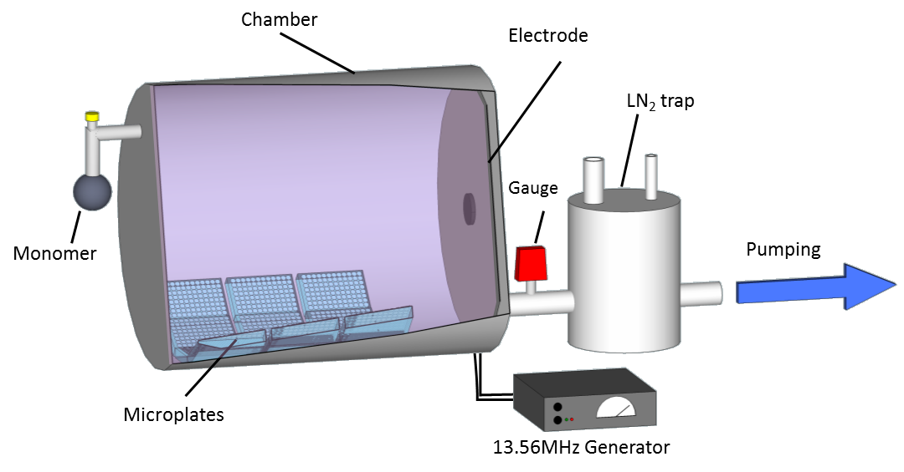
Reproducible?
Small Scale
Mean N/C 0.23 (n=10)
SD = 0.045
Medium Scale
Mean N/C 0.22 (n=11)
SD = 0.01

Slide 9
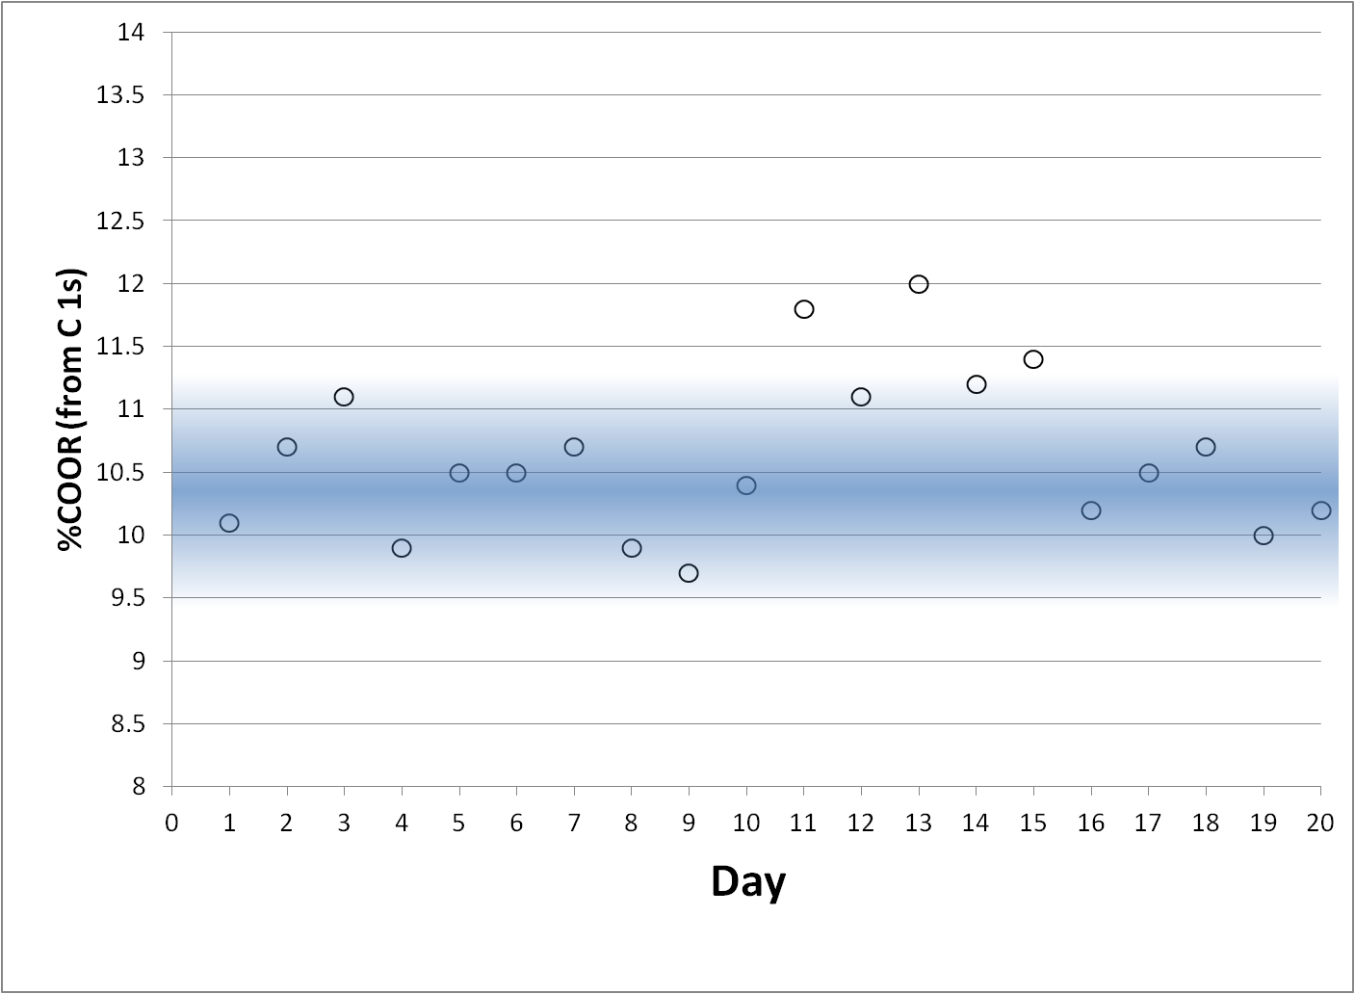
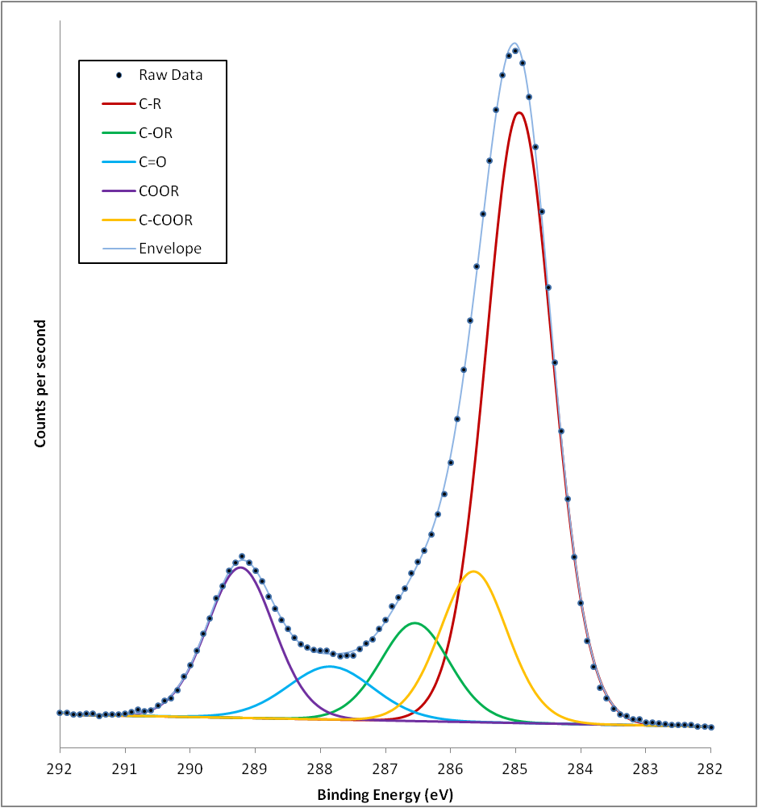
Reproducible?
Notes:
Anecdotally, within the university, people had often reported problems making their “usual” acrylic acid films. We started to see the same thing. And it was particularly at certain times of the year. So we set up an experiment to run the same process over and over to see what happened.
Since then (in adelaide) we have seen a similar effect with increased humidity. So the moral here is to have control of the environment outside the reactor too – its not enough to control whats going on inside the chamber. We think temperature affects monomer vp – but this is only 5 degree C or so. From this point on, we started measuring and logging the temperature and humidity in our lab.

Slide 10
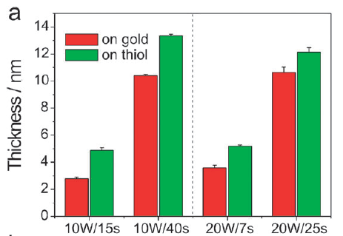
Substrate Independent
Vasilev et al. Chem. Comm. p3600-02 (2009)

Slide 11
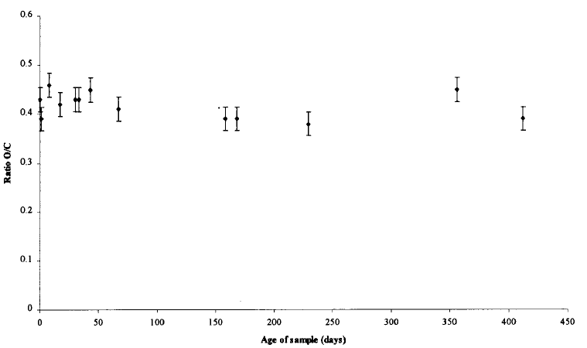
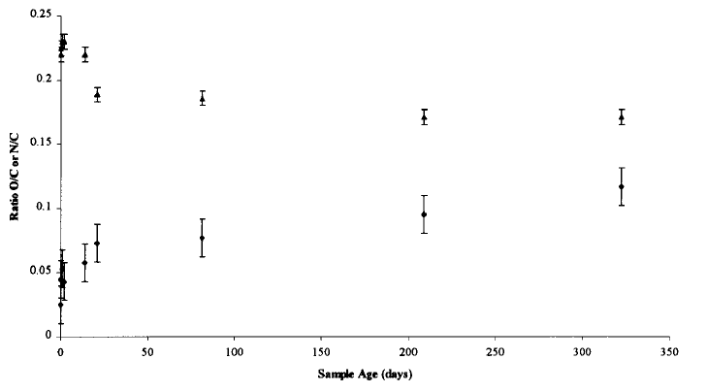
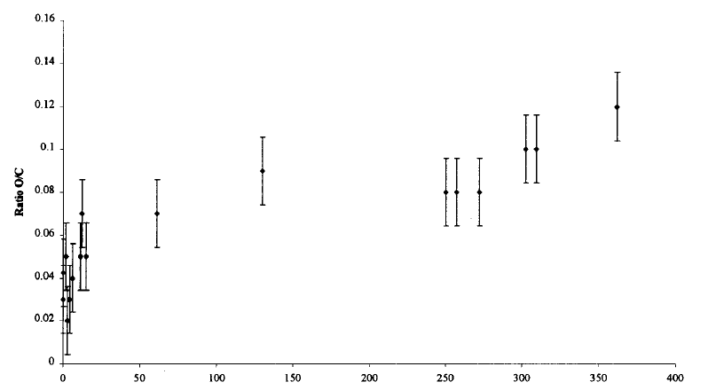
Stable?
Whittle et al. Chemistry of Materials 12 (9), 2664-2671 (2000)

Slide 12
Translatable?
Steel Cylinder (3)
Axial Symmetry
Internal Electrodes
Steel Barrel (2)
non-coaxial geometry
Internal Electrodes
Glass Cylinder (2)
Substrates perpendicular to flow
Insulating walls, Internal Electrodes
Glass Barrel (7)
Substrates parallel to flow
External Electrodes
Band (5) or Coil (2) Electrodes
Glass Cross-piece (2)
Substrates parallel to flow
External Coil electrodes
Whittle et al. Plasma Processes and Polymers, Vol.10, p767 (2013)

Slide 13
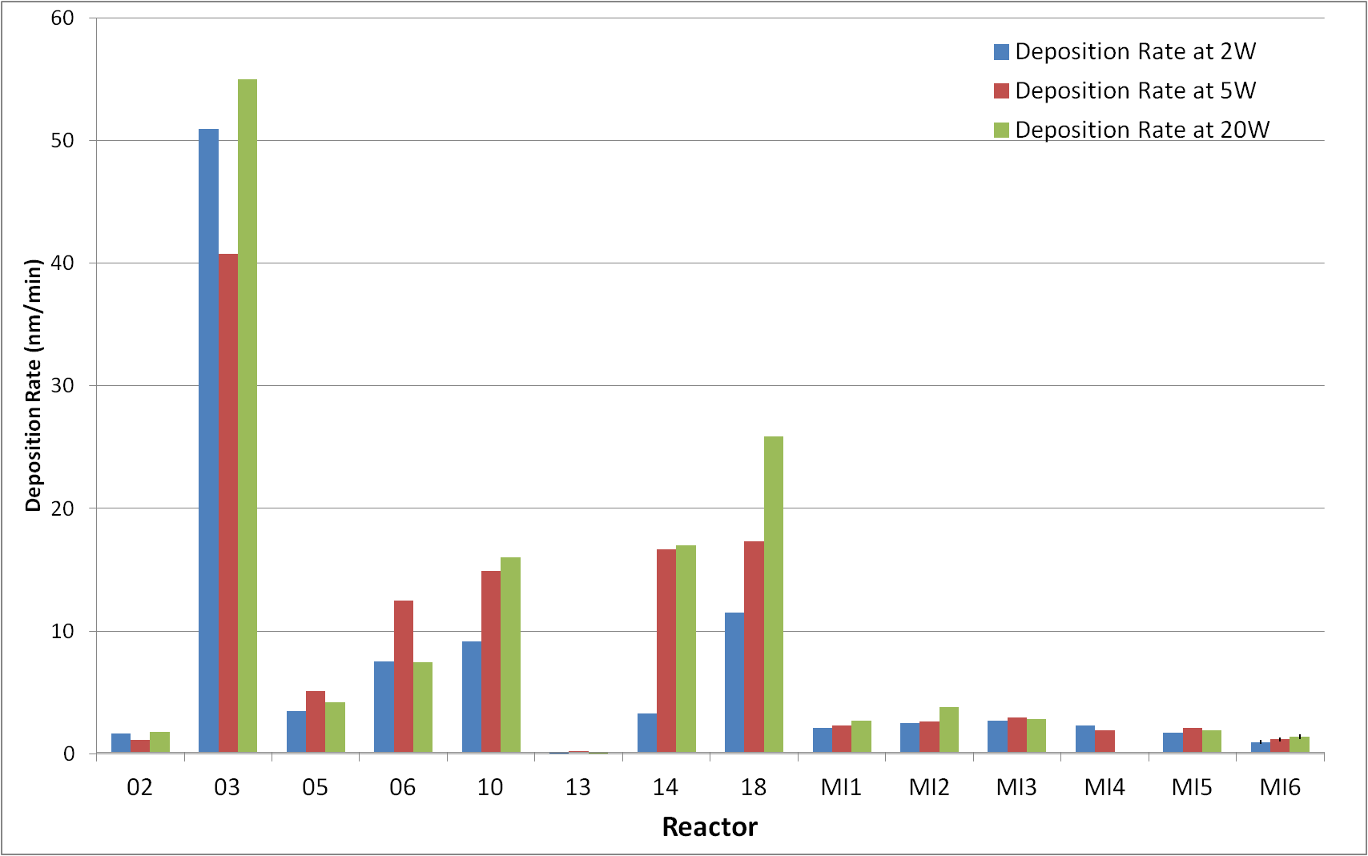
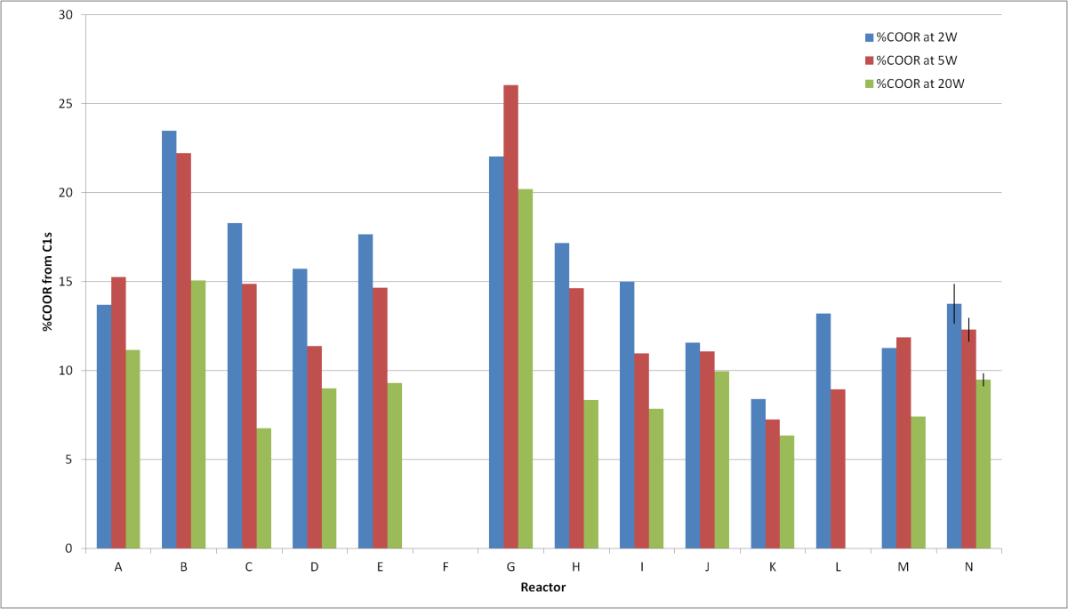
Translatable?
Whittle et al. Plasma Processes and Polymers, Vol.10, p767 (2013)

Slide 14
Translatable?
Whittle et al. Plasma Processes and Polymers, Vol.10, p767 (2013)
Notes:
Recolor
Build up or split into different graphs for different powers?
Explain error bars (earlier slide?)

Slide 15
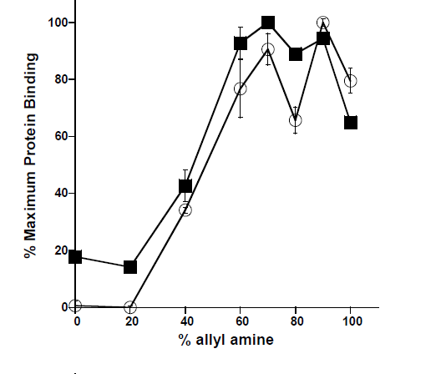
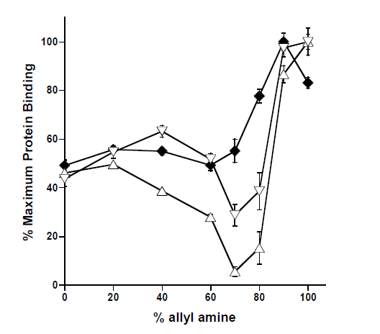
Unfractionated Heparin (4th Int. Std)
Low Molecular Weight Heparin
Chondroitin-4-Sulfate
Hyaluronan
Dermatan Sulfate

Slide 17
So where to look?
Mass Spectrum
Ion Flux
Ion Energy Distribution
Deposition Rate

Slide 18
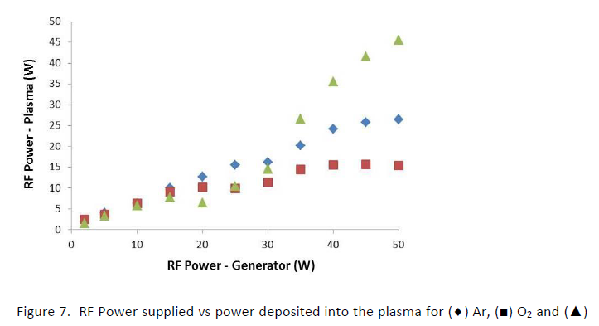
Power
Plasma Processes and Polymers Vol.11. p833-41 (2014).

Slide 19
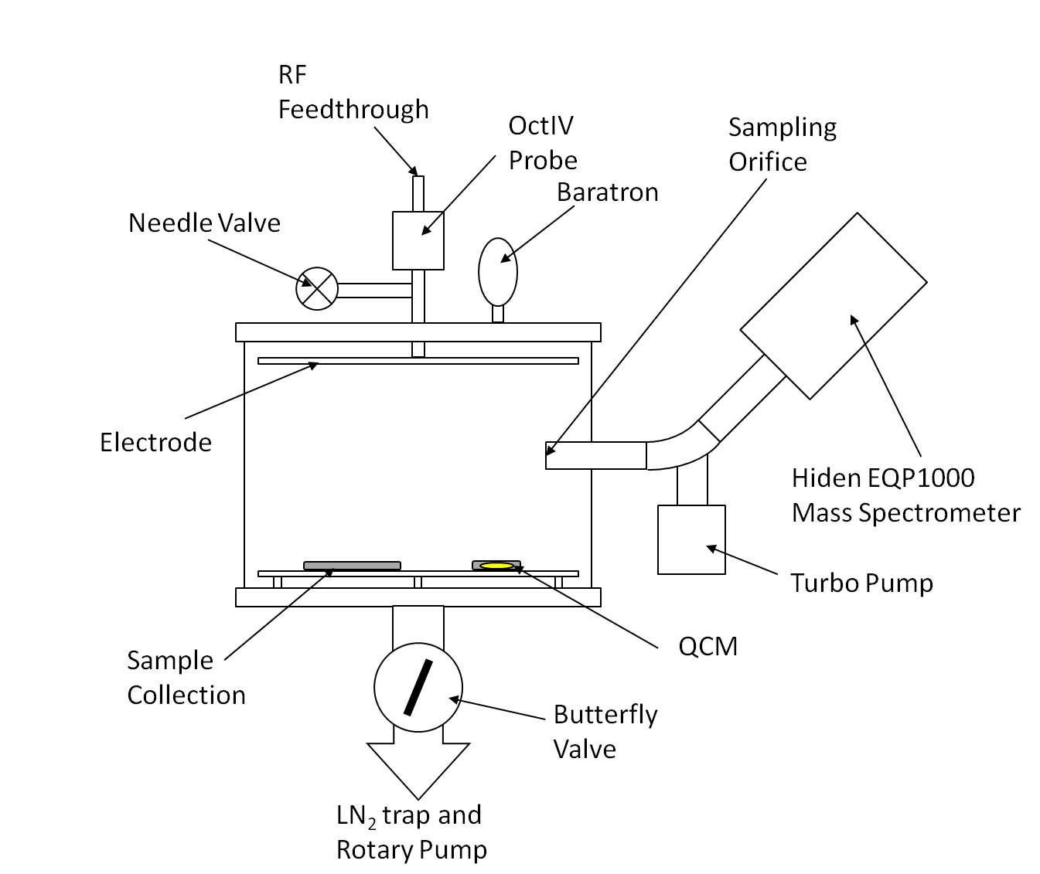
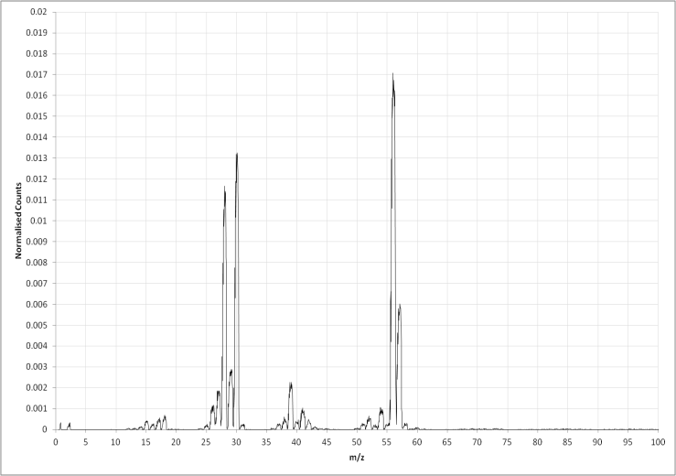
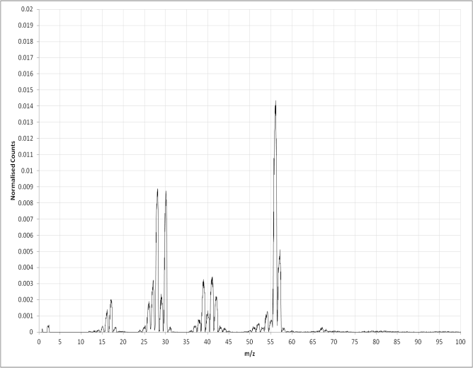
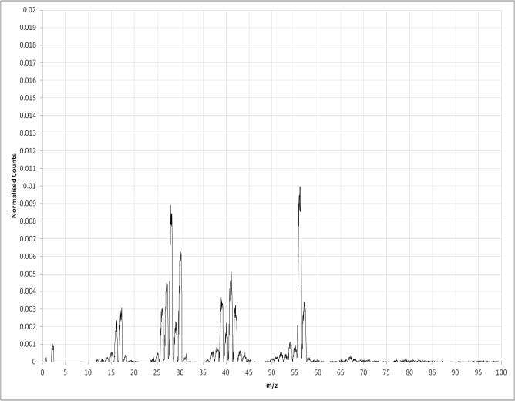

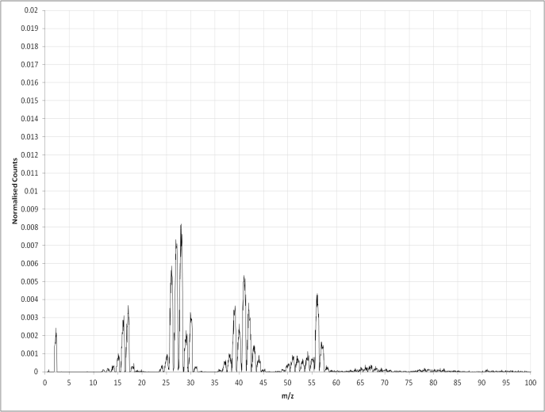
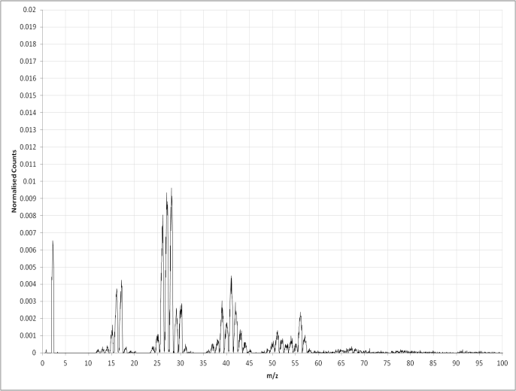
0W
2W
4W
8W
16W
32W
Notes:
Neutral high res at 2 sccm. Big picture is

Slide 20
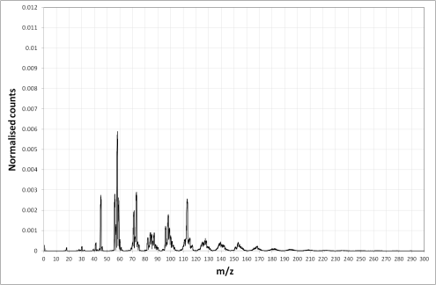
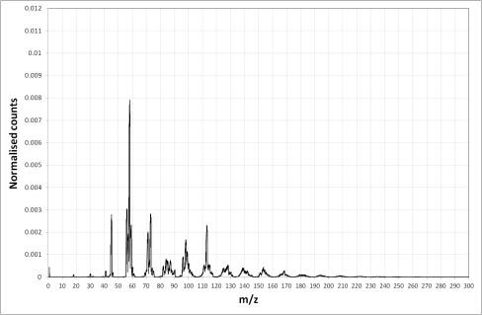


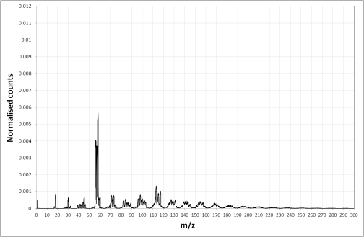


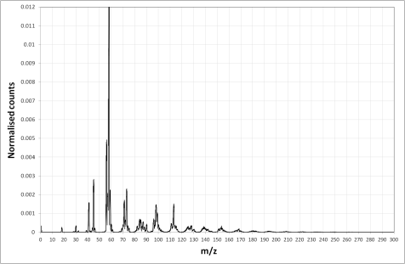
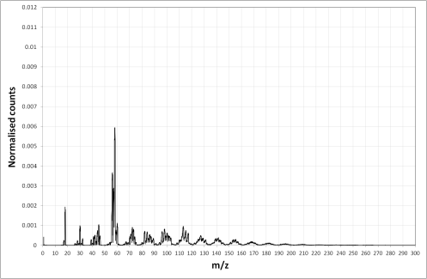
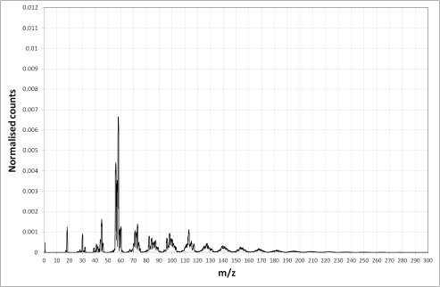

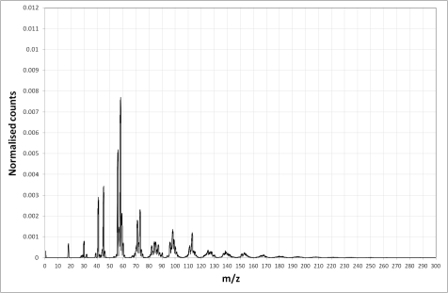
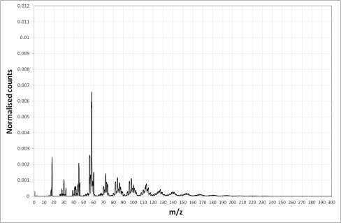
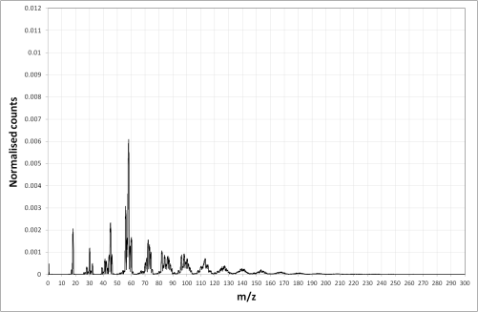
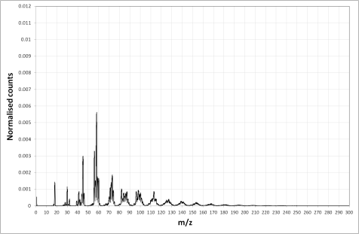

2 sccm
4 sccm
6 sccm
8 sccm
4W
8W
16W
32W
Notes:
Positive Ion Spectra by power and flow rate

Slide 21
Principal Component Analysis (PCA)
AVS Tampa 2012 PsThA8
Goals:
Reveal Underlying structure
Reduce Complexity
Take m spectra (around 140) each with n peaks (150-300)
Once we have a PCA model, we can project new data points into it.
Notes:
Right had side – add information about PCA generally, and the preparation for analysing my data.
Makes no assumptions about underlying patterns in the data
Reduces the dimensionality of the data by rotating the data along axes of maximum variance
Note – we aren’t selecting any peaks here, it’s a blind analysis that just takes in unit mass MS data.

Slide 22



EI Mass spectra of neutral species
2sccm
2sccm
4sccm
6sccm
8sccm
Notes:
PC1 loadings for neutral RGA

Slide 23

EI Mass spectra of neutral species
Notes:
PC1 vs W/F for neutral RGA data
SO in principle we can estimate W/F without measuring either of these properties. Or we can adjust the process to maintain a particular W/F value without having to worry about losses and errors in w/f. Since what we’re measuring here is essentially “fragmentation”, we should be able to translate this between reactor systems too.

Slide 24


Positive Ions

Slide 25

Ion Energy
Ion energy distributions (M+H)⁺ at 1.3Pa

Slide 26



Ion Flux
Michelmore et al., ACS Appl. Mater. Interf. Vol.5. 5387-91 (2013)

Slide 28
Black Box
Power (W)
Pressure (p)
Temperature (T)
Flow Rate (mols⁻¹)
Duration (s)
Geometry
Substrate
Film Chemistry
Crosslink Density
Deposition Rate
Optical Properties
Morphology
Plasma
External Parameters
Surface Properties
Internal Parameters
Electron Temperature (T_{e})
Ion Temperature (T_{i})
Ion Density (n_{i})
Electron Density (n_{e})
Plasma Potential (V_{p})
Sheath Potential (V_{s})
Mass Spectrum
Optical Emission

Slide 29




Large-scale
650 mm

Slide 30


Slide 31


Acknowledgements
UniSA
  Sameer Al-Bataineh
  Nick Rogers
  Solmaz Saboohi
  Giles Kirby
  Hanieh Safizadeh Shirazi
  Andrew Michelmore
  Louise Smith
  David Robinson
  Tara Fernandez
  Rob Short
Elsewhere
  Claire Homan, Josef Gecz (Uni. Adelaide)
  Tony Day, Andy Marson, David Mahoney (Oxford/Manchester)
  John Gallagher (Iduron Ltd.)
  Morgan Alexander, Cathy Merry (Manchester/Nottingham)
Notes:
Funding Bodies in here – EPSRC? Plasso, BD, UniSA, ARC, CTM-CRC. Check acknowledgemetns

