Slide 1
The 9th Vacuum and Surface Science Conference of Asia and Australia
VASSCAA-9 13-16 AUG 2018, Sydney
Mild Plasma Configuration
Yielding Efficient Doping on Graphene Surface
Goo-Hwan Jeong
Department of Materials Science and Engineering
Kangwon National University, Chuncheon 24341, Korea

Slide 2

Outline
1. Overview on graphene and doping
2. Graphene synthesis and plasma doping
3. Results and discussion
(1) Structural aspects
(2) Functional doping aspect
(3) Doping stability aspect
4. Summary

Slide 3
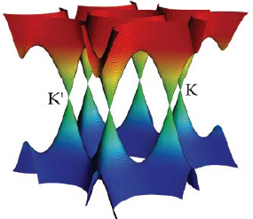
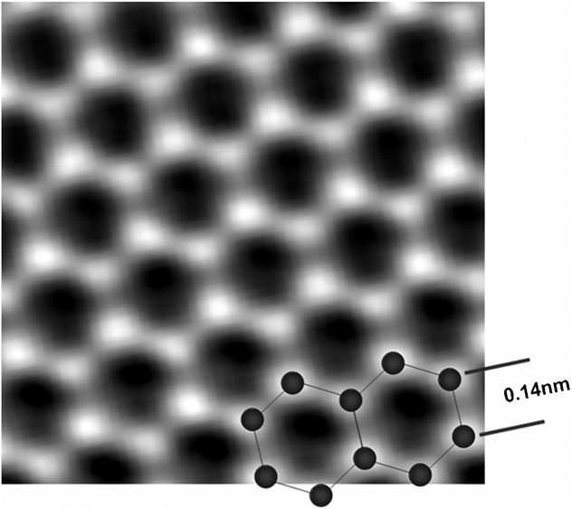
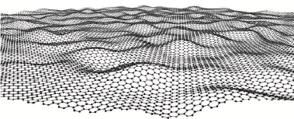
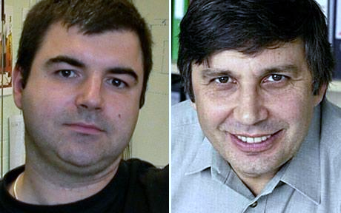
Graphene
- The thinnest material sheet, yet the strongest
(5 times stronger than steel and much lighter)
- Is a semimetal
(Electrical properties can be modulated)
- Has high electron mobility (>10000 cm²/Vs at RT) ballistic conduction
- Has very high current densities (10⁹A/cm2)
- Is a superb heat conductor
- Is a novel material for applications such as sensors, composites, transistors,
transparent conductive films, thermal transport media, batteries and solar cells
Nobel Prize in 2010

Slide 4
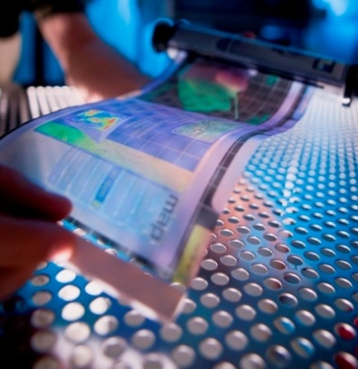
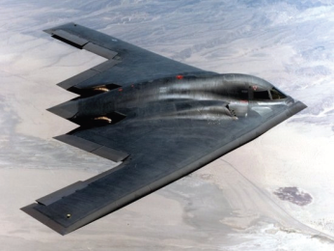
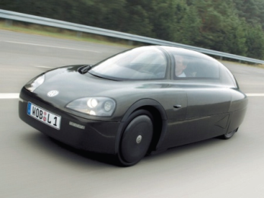
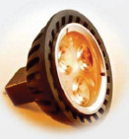
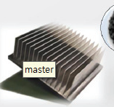
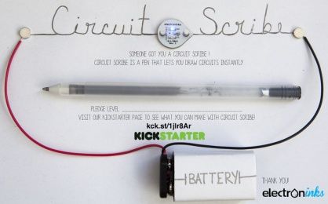
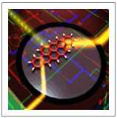
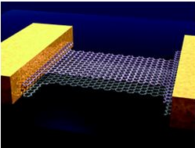
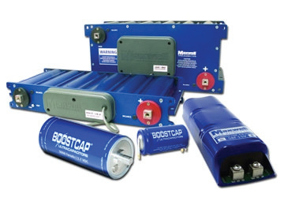
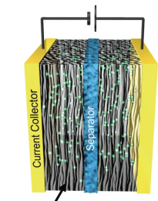
Application fields of graphene
4/36
Flexible display
Transparent devices
Smart window
Aerospace
Automobile
Transparent electrode
Conductive ink
EMI shielding
Printing electrode
Light &
High-strength
composite
Printing Electronics
Graphene
Heat dissipation
Energy
Devices
LED heat sink
Heat dissipation
Future
nanoelectronics
Solar cell
Secondary battery
Fuel cell
Super capacitor
Nanoelectronics
RFID, Sensors

Slide 5
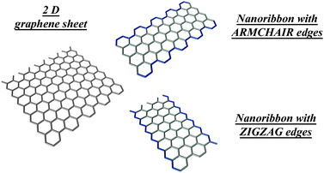
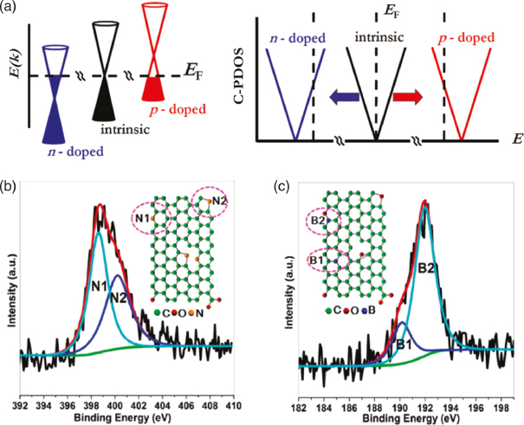
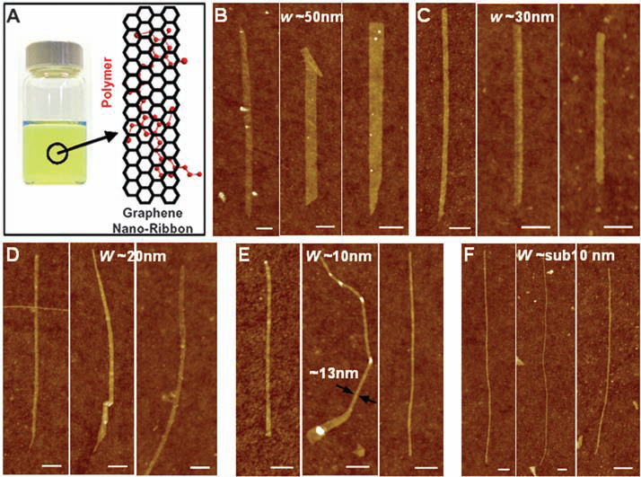
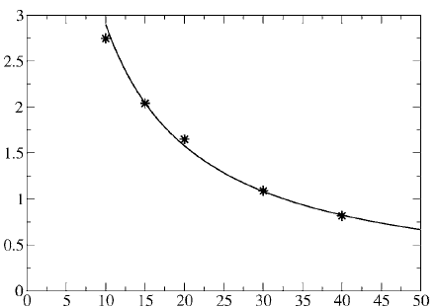
Tuning of electronic properties of graphene
Structure modification
Chemical doping
Graphene
sheet
Armchair edge
n-doping
p-doping
Nano-ribbon
Zigzag edge
N
B
Band gap (eV)
Width (nm)
Ref) X. Li et al., Science 319, 1229 (2008)
L. Pisani et al., Phys. Rev. B 75, 064418 (2007)
Ref) S. Park et al., Nat. Nanotechnol. 4, 217 (2009)
Y. J. Yu et al., Nano Lett. 9, 3430 (2009)
Methods for chemical doping of graphene
Thermal treatment
Plasma treatment
Simple method
High temperature
Time consuming process
Low temperature
Quick treatment
Plasma-induced damage

Slide 6
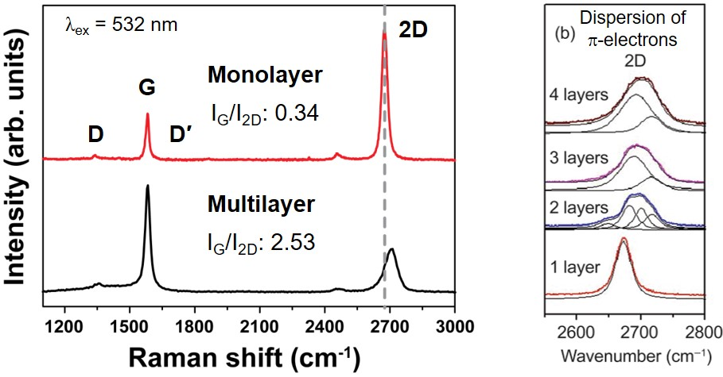
Raman spectrum of graphene
D- and Dʹ-band (1350, 1620 cm⁻¹): Defect-induced peaks
G-band (1580 cm⁻¹): Graphitic tangential vibration
2D-band (2700 cm⁻¹): Overtone of D-band
Intensity ratio of D- and G-band (I_{D}/I_{G}) → A mount of defect
Intensity ratio of G- and 2D-band (I_{G}/I_{2D}) → The number of layer
Monolayer graphene
I_{G}/I_{2D}: ~0.3
Profile of 2D: Single Lorentzian
Position of 2D < 2700 cm⁻¹
Ref) Z. Ni et al., Nano Res. 1, 273 (2008), A.C. Ferrari et al., Phys. Rev. Lett. 97, 187401 (2006)

Slide 7
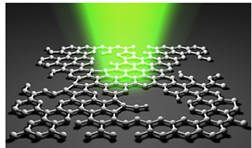
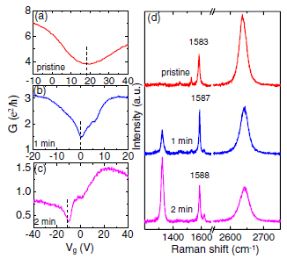
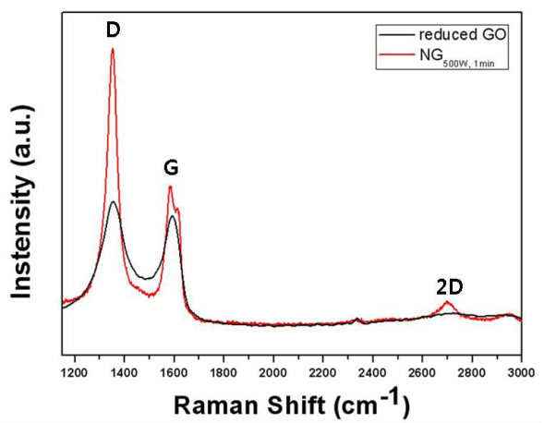
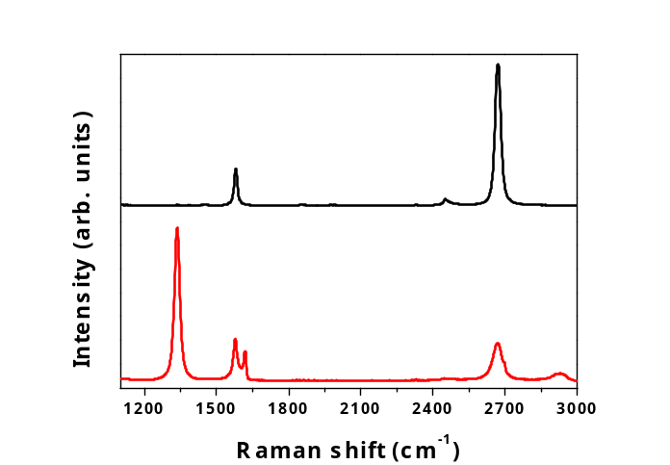
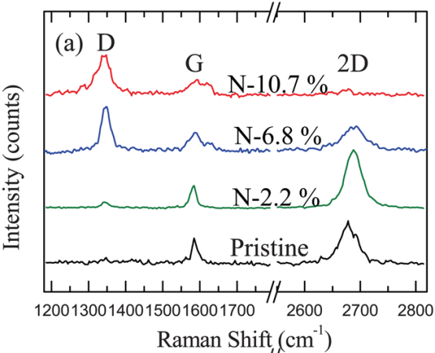
Doping by plasma process
● Structure degradation due to plasma-induced damage during doping
D
N-doping:
ICP, NH₃
N-doping:
ICP, N₂, 500 W
D
Before plasma treatment
2D
D
G
D
After plasma treatment
NH₃ plasma (0.4 W, 3 sec)
Dʹ
Suppression of defect formation & Optimization of efficient doping condition
Effect of plasma parameters toward defect-free doping on graphene
Plasma condition optimization for ‘efficient chemical doping’
Ref) Y. C. Lin et al., APL 96, 133110 (2010), H. M. Jeong et al., Nano Lett. 11, 2472 (2011), S. H. Park et al., J. Mater. Chem. C 2, 933 (2014)

Slide 8
Outline
1. Overview on graphene and doping
2. Graphene synthesis and plasma doping
3. Results and discussion
(1) Structural aspect
(2) Functional doping aspect
(3) Doping stability aspect
4. Summary

Slide 9
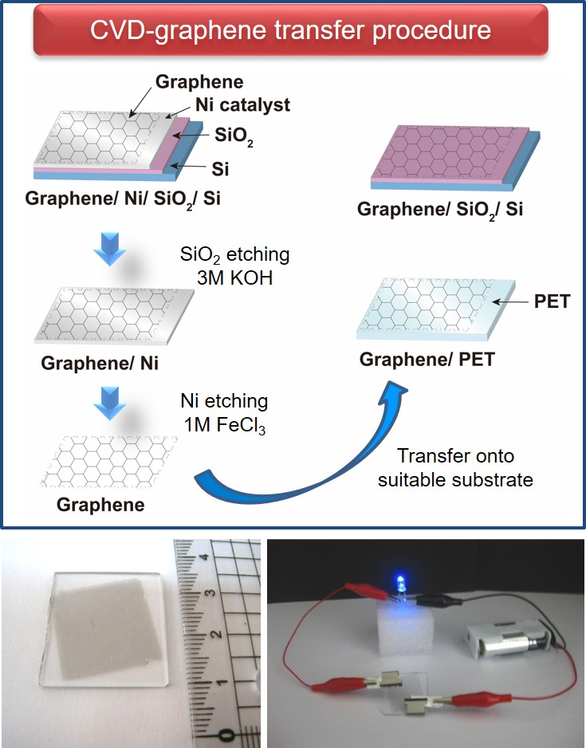
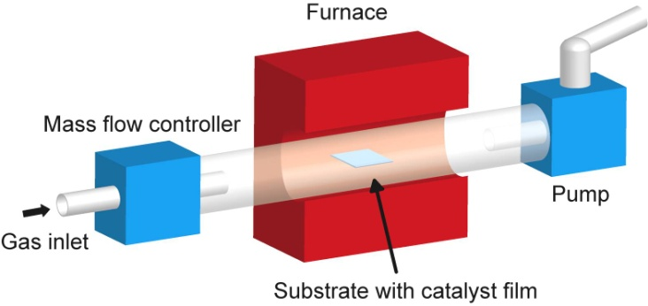
Graphene synthesis by CVD
< Thermal CVD system >
Substrates: 300 nm Ni/ SiO₂/ Si
200 nm Ni/ Mo sheet
Feedstock: Methane (CH₄)
Temperature: 1000˚C
Synthesis time: 5 min
Graphene synthesis on
Ni, Pt, Cu and Ni-Mo is possible.

Slide 10
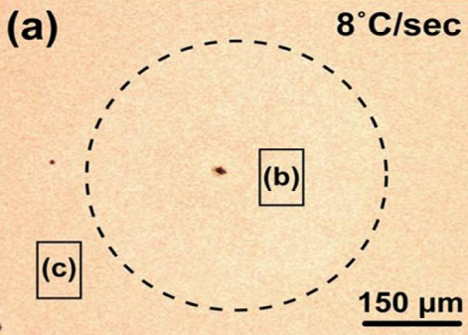
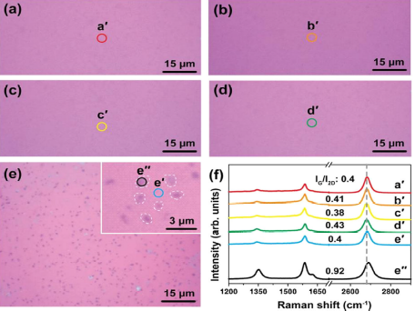
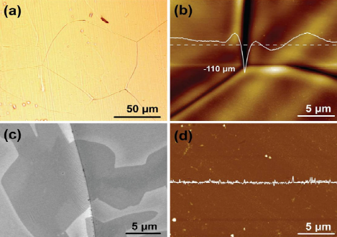
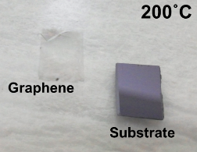

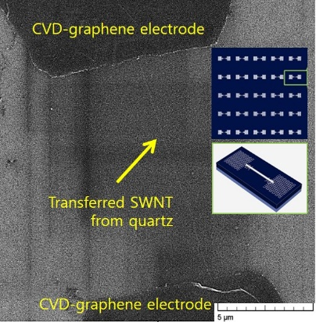
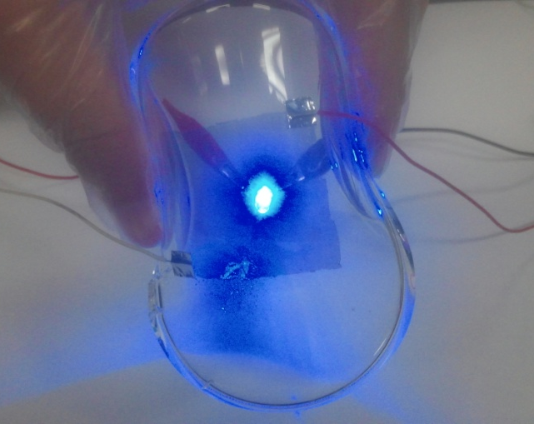
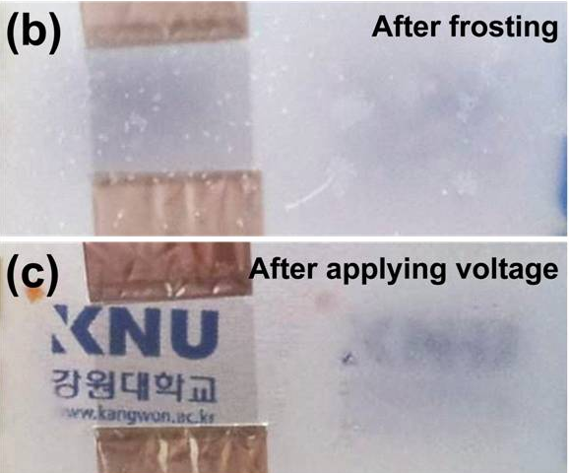
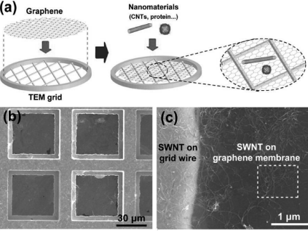
Other studies on graphene
10/36
● CVD-grown graphene on Ni, Cu, Ni/Mo and Pt substrates
Wafer-scale growth
Synthesis mechanism study
Low-Temp. synthesis
Ni : C-precipitation induced growth
Ni/Mo : Mixing of C-adsorption & precipitation
Cu and Pt : C-adsorption driven growth
● CVD-graphene application
PDMS
Flexible Transparent
Conductive Film
Flexible Transparent
Defrost Film
TEM membrane
‘Graphene-SWNT’
All-carbon device

Slide 11
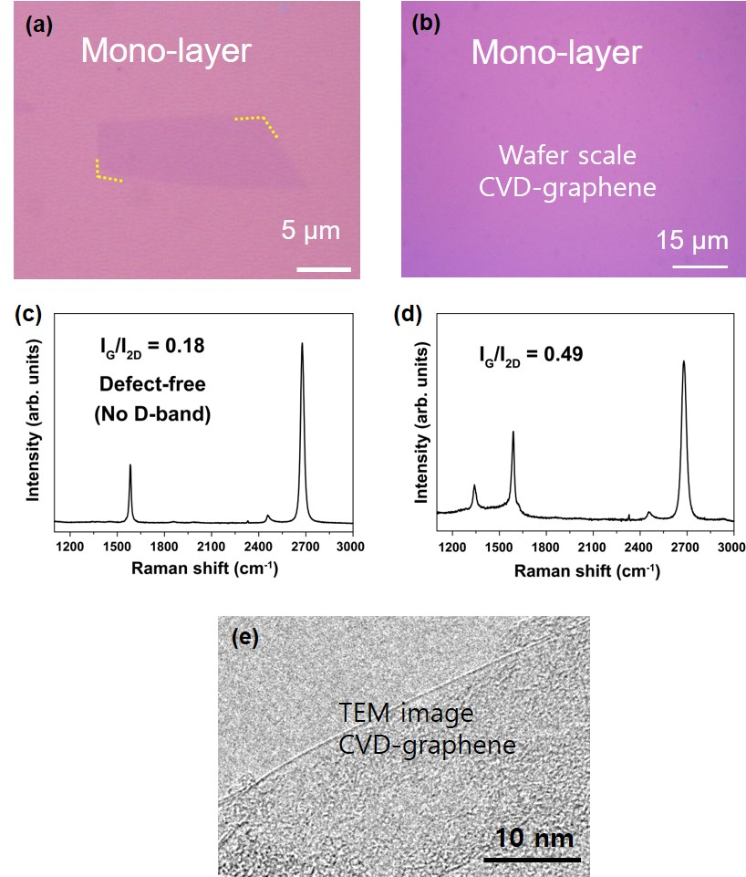
Graphene preparation for doping study
11/36
Mech-exfoliation
from graphite

Slide 12
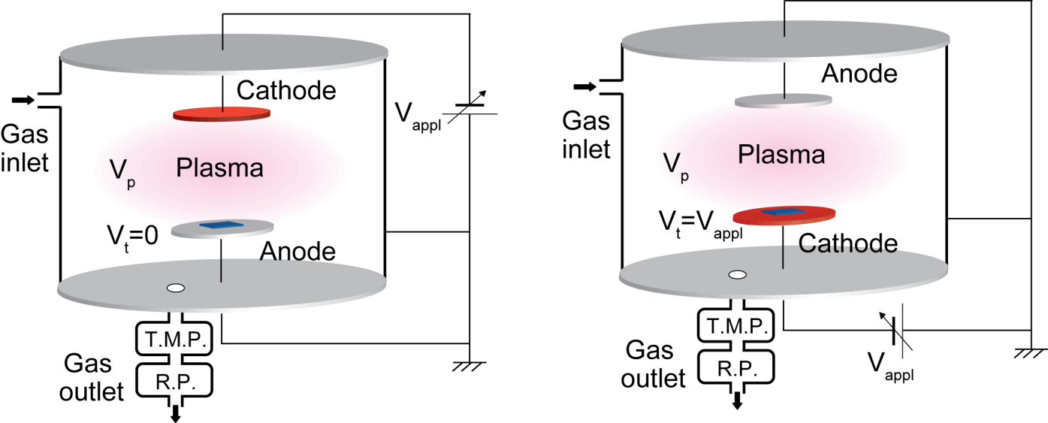
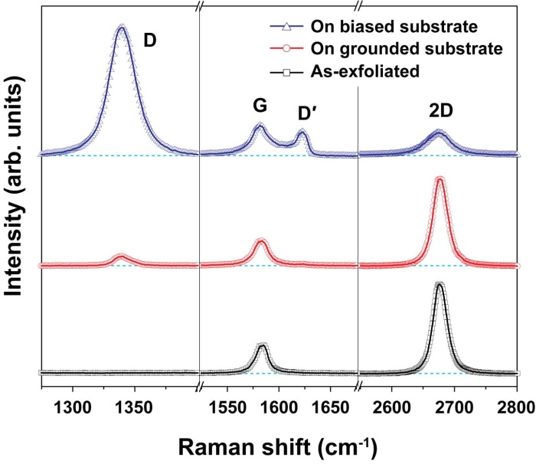
Comparative plasma configurations
Ion-bombardment type
Harsh plasma formation
Plasma-immersion type
Mild plasma formation
Biased substrate (Down-cathode)
Grounded substrate (Up-cathode)
Gas: NH3
Pressure: 0.3 Torr
Applied voltage: -450 ~ -700 V
Applied power: 0.45, 1, 1.3, 1.65, 2.4, 2.8 W
Time: 3 ~ 3600 sec

Slide 13
Parameters to investigate the plasma effects
Ion bombardment energy (E_{i})
E_{i} = e(V_{p}-V_{t})
e: electric charge
V_{p}: plasma potential
V_{t}: target potential
V_{t (down)} = - 450 V
V_{t (up)} = 0 V
E_{i (down)} > E_{i (up)}
Impinging ion flux (Γ_{i}) & ion dose (D_{i})
Γ_{i} = n_{i}(kT_{e}/M)^{1/2}
D_{i} = Γ_{i}t
n_{i}: ion density
k: Boltzmann’s constant
T_{e}: electron temperature
M: ion mass
t: ion irradiation time
High plasma power Higher ion energy & dose
Longer plasma treatment time Lager ion dose
Plasma power & treatment time ∝ (I_{D}/I_{G}) & (I_{D’}/I_{G})
Ref) M. A. Lieberman and A. J. Lichtenberg, Principle of Plasma Discharges and Materials Processing, John Wiley & Sons (1994)

Slide 14
Outline
1. Overview on graphene and doping
2. Graphene synthesis and plasma doping
3. Results and discussion
(1) Structural aspects
(2) Functional doping aspect
(3) Doping stability aspect
4. Summary

Slide 15
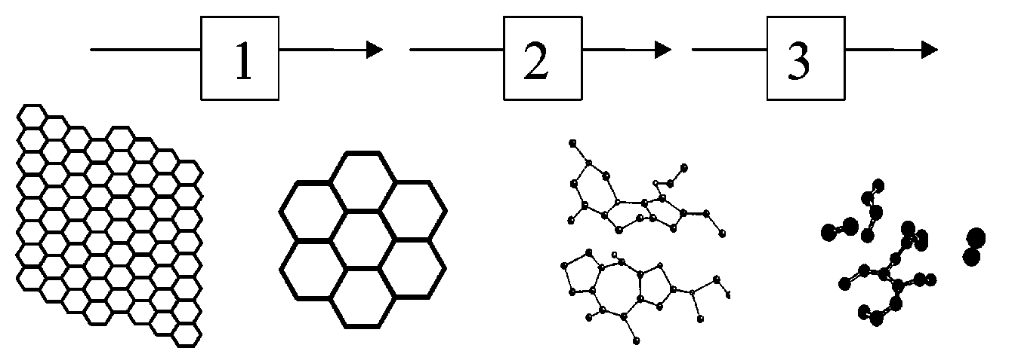
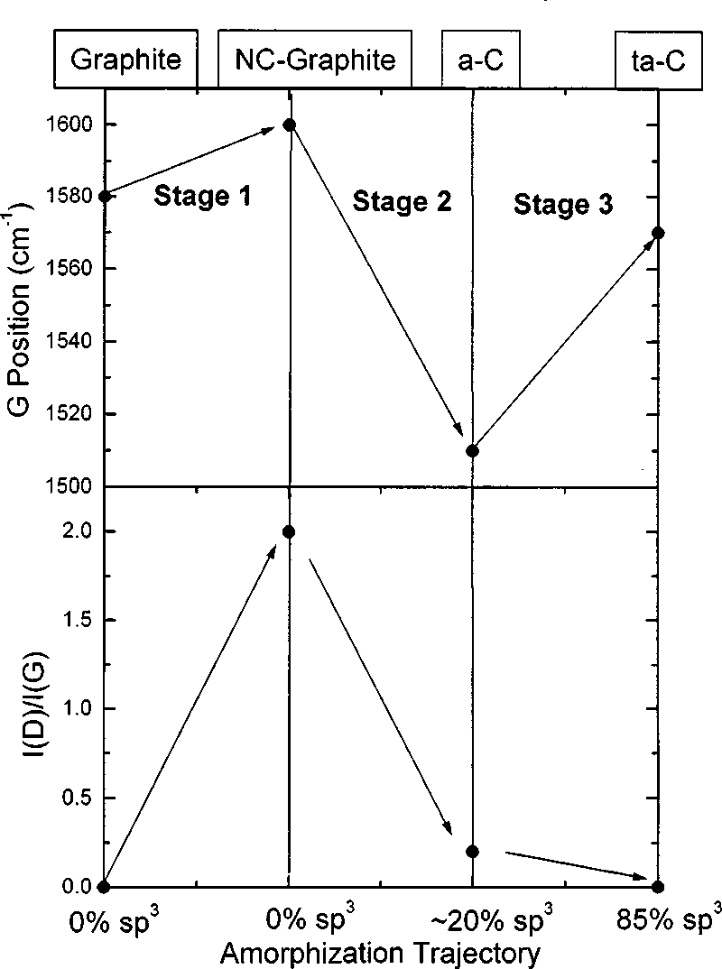
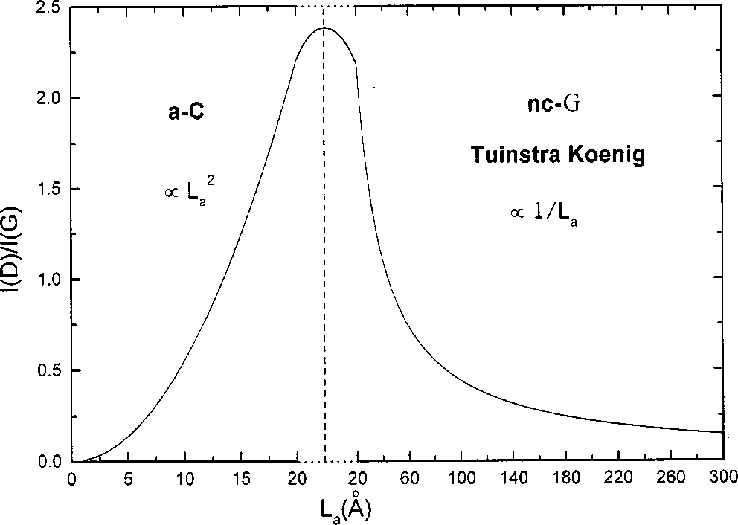
A three stage model for graphitic structure
● Structure change of graphite
(Ref) A. C. Ferrari et al., Phys. Rev. B 61, 14095 (2000)
Graphite
Nanocrystalline
graphite (NC-G)
Amorphous
carbon (a-C)
Tetrahedral
a-C (ta-C)
● Structure evaluation from Raman
Defect formation
Amorphization
ɷ̜_{G}
● Size of in-plane crystallites (L_{a})
Stage 2
(a-C)
I_{D}/I_{G} ∝ L_{a}²
Stage 1
(NC-G)
I_{D}/I_{G} ∝ 1/L_{a}
I_{D}/I_{G}
Tuinstra-Koenig

Slide 16
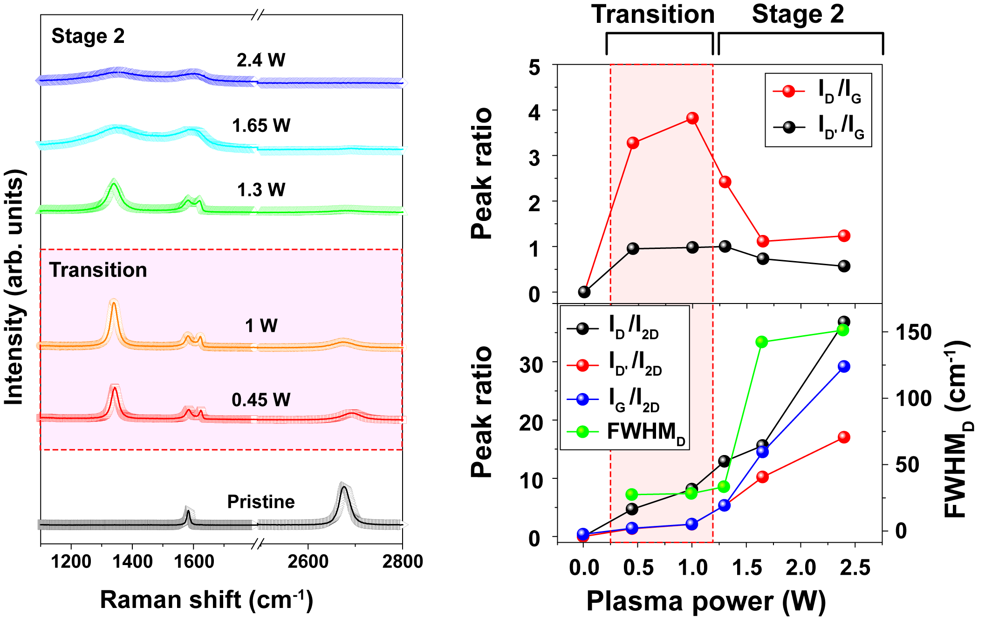
Effect of plasma power on graphene structure
Harsh plasma (Down-cathode)
D
G
Dʹ
2D
Formation of defects on graphene (Transition stage)
Structural degradation of graphene (Stage 2)

Slide 17
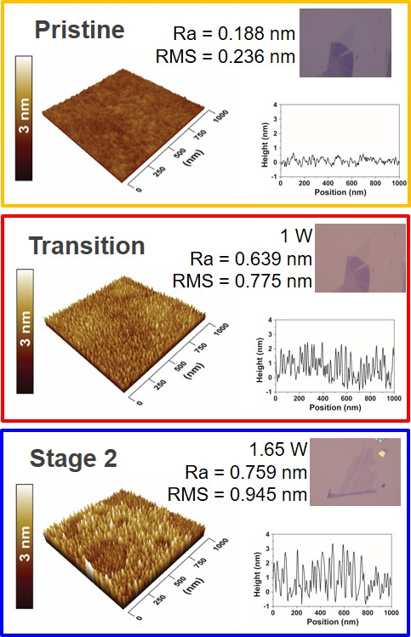
Effect of plasma power on graphene structure
Harsh plasma (Down-cathode)
NH₃ plasma: 0.3 Torr, 10 sec

Slide 18
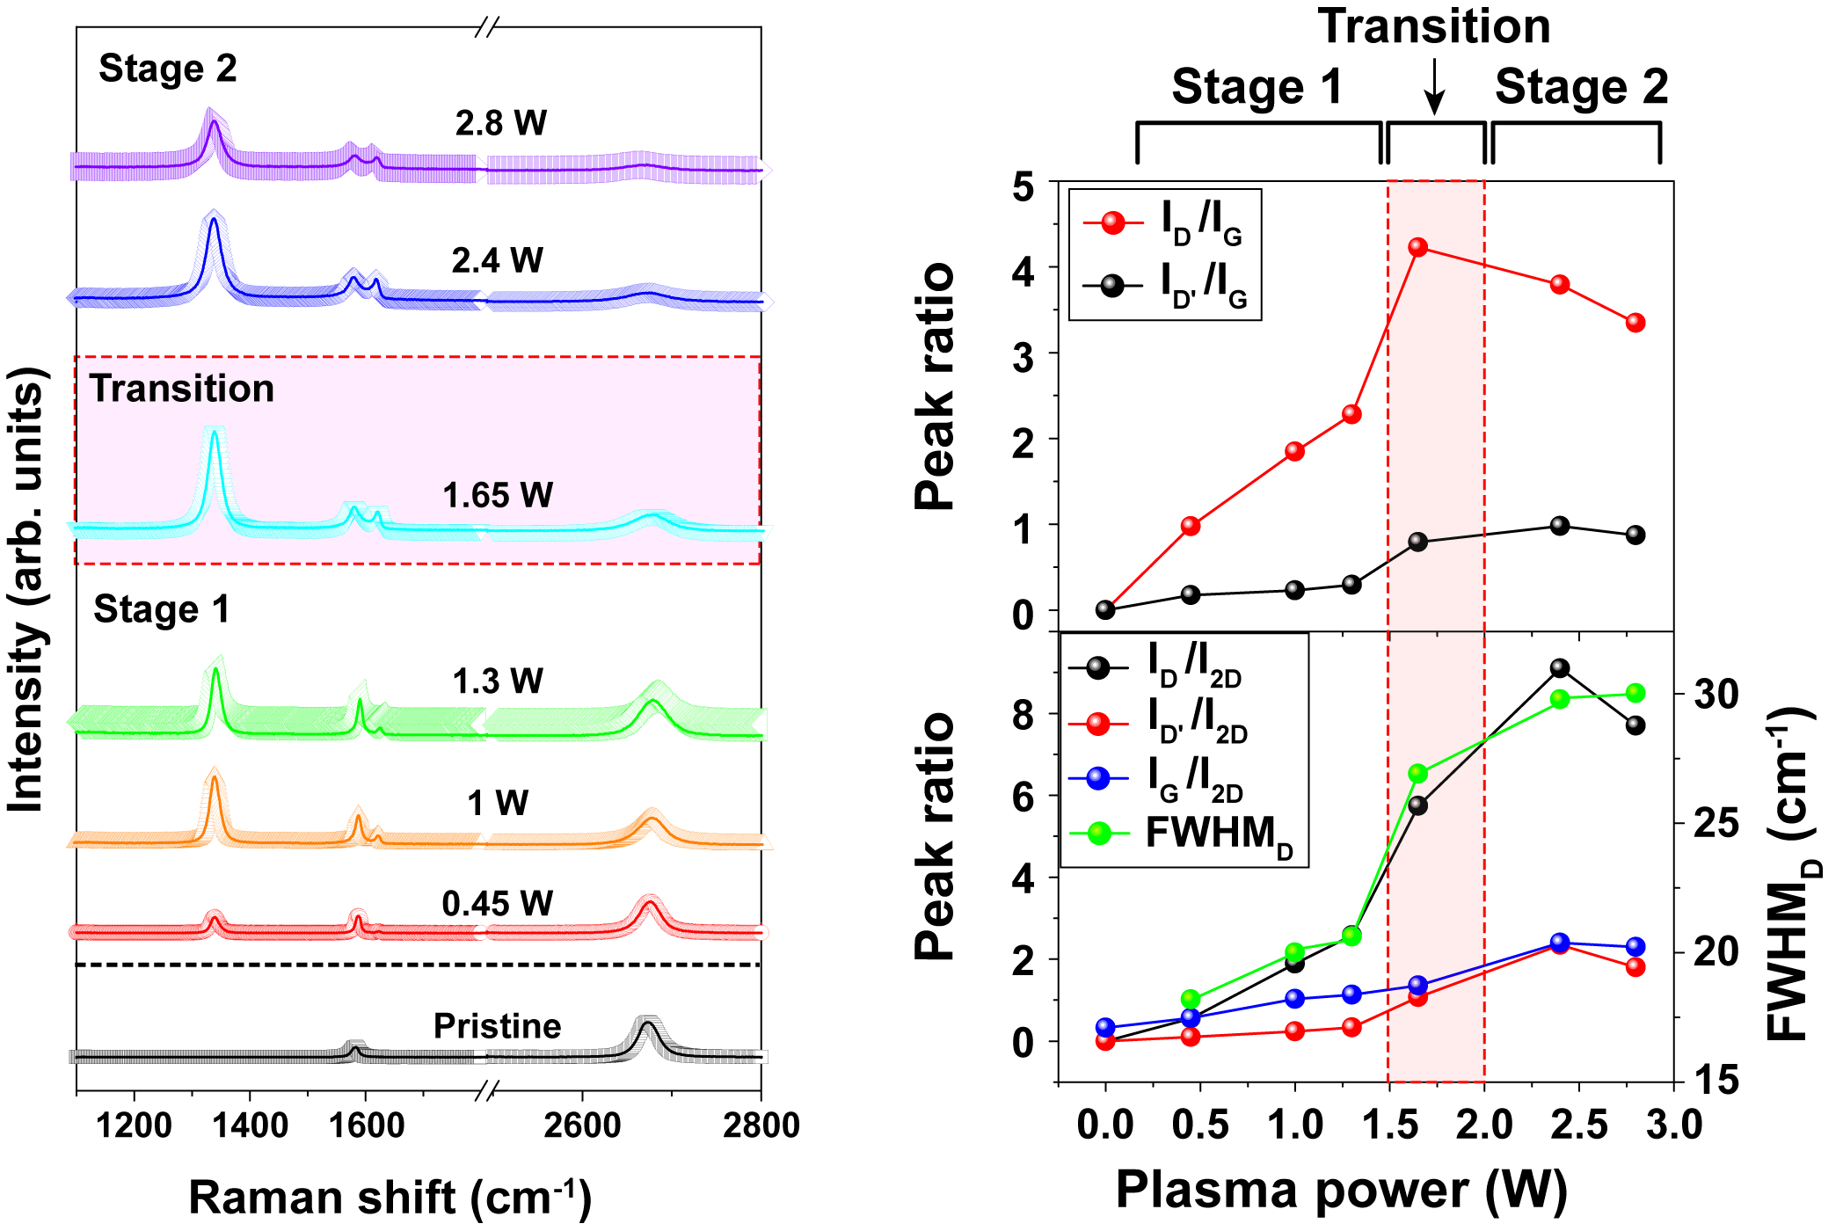
Effect of plasma power on graphene structure
Mild plasma (Up-cathode)
High plasma power → Higher ion energy & dose : Stage 1 → Transition → Stage 2
Low plasma power below 1.3 W (Stage 1) → Effective doping without structural damage

Slide 19
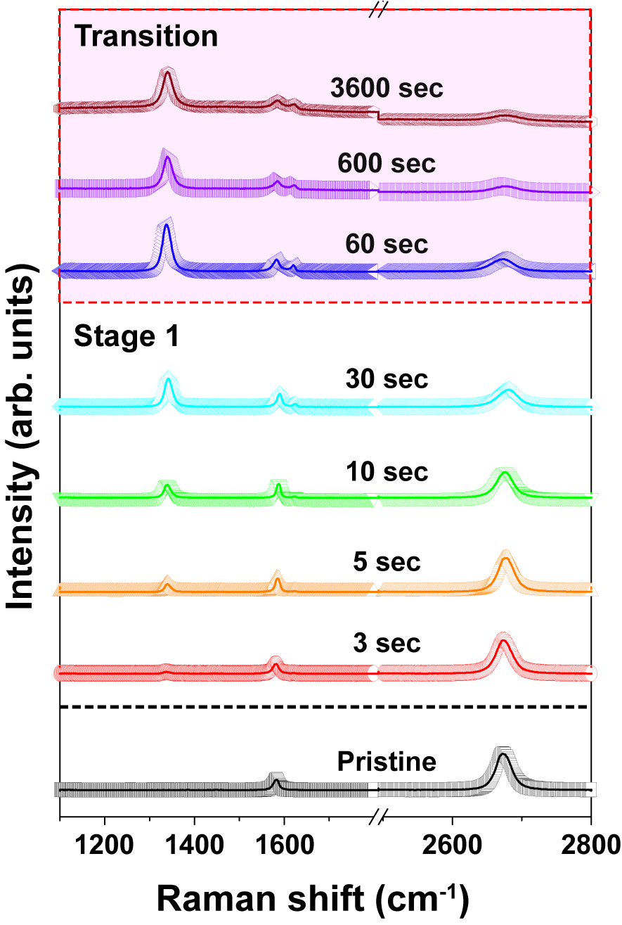
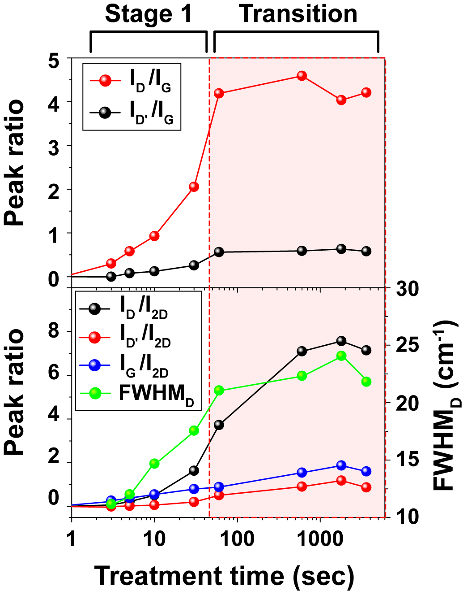
Effect of treatment-time on graphene structure
Mild plasma (Up-cathode)
Longer plasma treatment time → Higher ion dose : Stage 1 → Transition
Short treatment time below 30 sec → Effective doping without structural damage

Slide 20
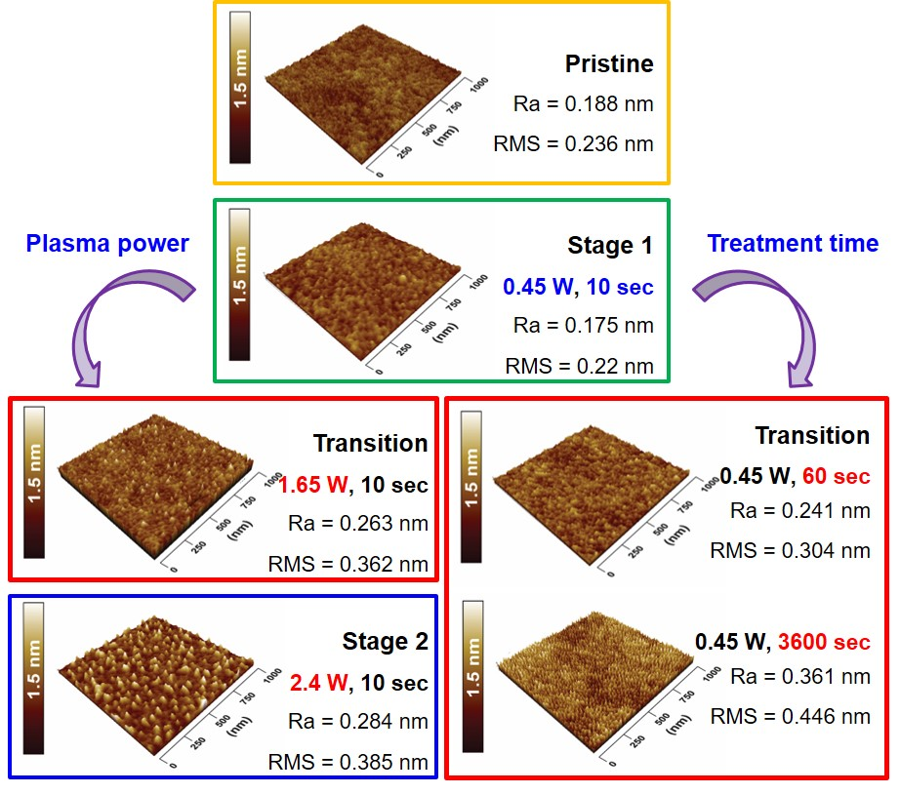
Structure evolution using mild plasma
Mild plasma (Up-cathode)

Slide 21
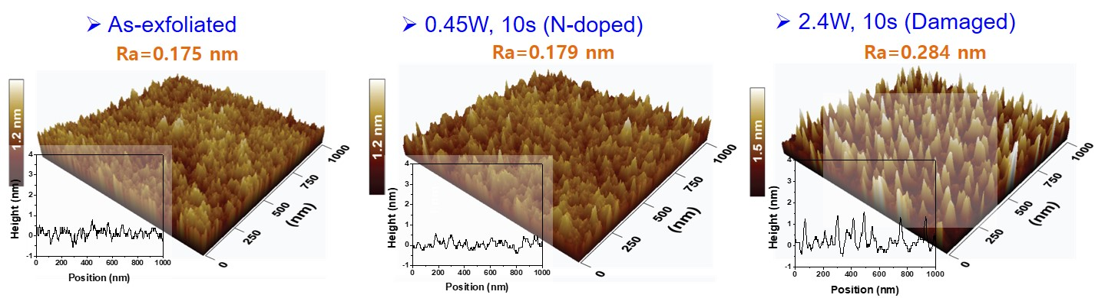
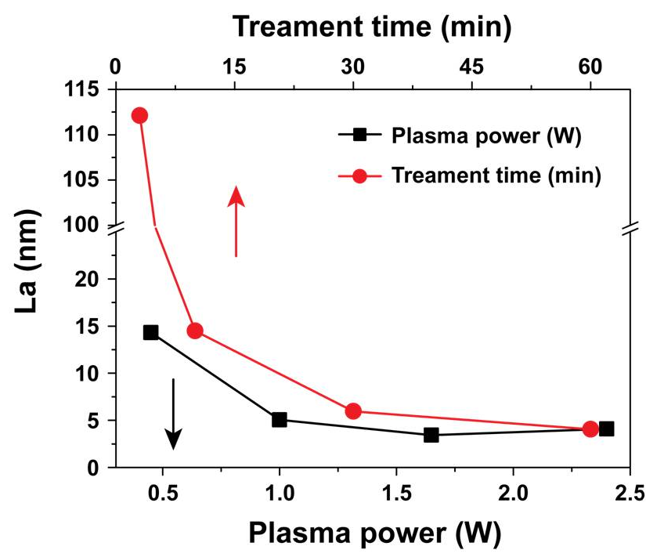

Size of in-plane crystallites (L_{a})
Size of in-plane crystallites (L_{a})
$$L_{a}=\left(2.4×{10}^{−10}\right)λ^{4}{({I_{D}}/{I_{G}})}^{−1}$$
L_{a}: size of in-plane crystallites
λ: laser excitation wavelength
I_{D}/I_{G}: intensity ratio of D- and G-band
Ref) B. Guo et al.; Nano Lett. 10 (2010) 4957
L. G. Cancado et al., Appl. Phys. Lett. 88 (2006) 163106

Slide 22
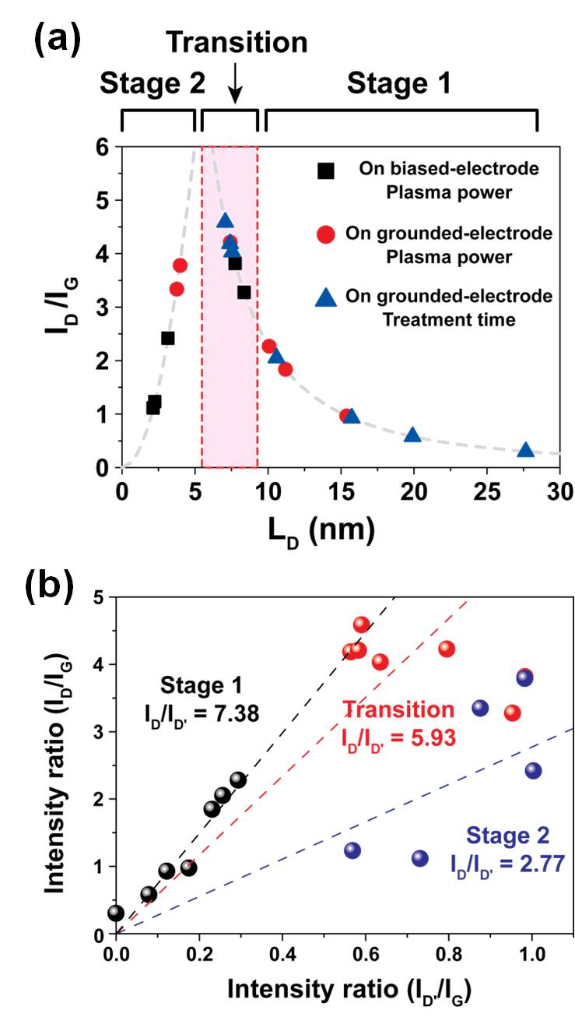


Crystallites & Type of defect
Size of in-plane crystallites (L_{D})
Stage 1: >8 nm & Transition: 5-8 nm
→ I_{D}/I_{G} ∝ 1/L_{D} (T-K relation)
Stage 2: < 5 nm
→ I_{D}/I_{G} ∝ L_{D}² (sp3 increase)
λ: laser wave length (532 nm), C, C': constants related λ
Ref) A. C. Ferrari et al., Phys. Rev. B 61, 14095 (2000)
M. M. Lucchese et al., Carbon 48, 1592 (2010)
Type of defect formed on graphene
I_{D}/I_{D'} (slope)
Stage 1 7.38: point defect
Transition 5.93: point defect → sp³ increase
Stage 2 2.77: sp³ increase
Ref) A. Eckmann et al., Nano Lett. 12, 3925 (2012)
P. Venezuela et al., Phys. Rev. B 84, 035433 (2011)

Slide 23
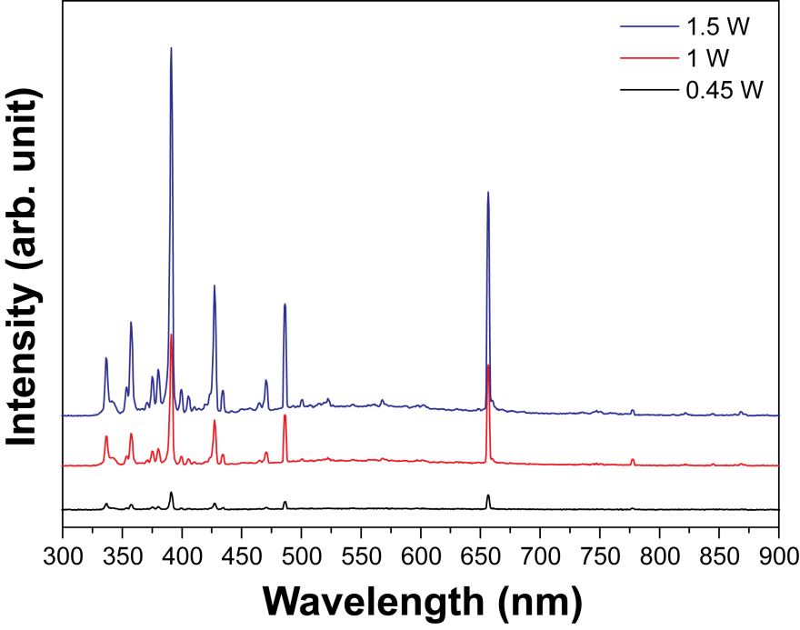

OES analysis results
Avantes, Ava Spec, ULS2048L-RS
- Integration time: 1 s
- Averages: 3 times
Harsh plasma (down-cathode)
Mild plasma (Up-cathode)
391.4 nm
(N₂⁺)
656.3 nm
(H_{α})
391.4 nm
(N₂⁺)
656.3 nm
(H_{α})
486.1 nm
(H_{β})
425.32 nm
(N)
425.32 nm
(N)
N₂
486.1 nm
(H_{β})
N₂
H₂
H₂
► In the mild plasma system,
peaks related with hydrogen (H_{α} and H_{β}) are stronger than those of nitrogen (N₂⁺ and N)
► Further study is necessary to clarify the effect of various active species.

Slide 24
Outline
1. Overview on graphene and doping
2. Graphene synthesis and plasma doping
3. Results and discussion
(1) Structural aspect
(2) Functional doping aspect
(3) Doping stability aspect
4. Summary

Slide 25




N-bonding configurations and Raman result
N-C bonding configuration
Plasma
n-doping
Doping evaluation from Raman spectrum
Change of Fermi level by extra charge carriers
Δω_{G} = 0.6 cm⁻¹ → Δn∼2.4 × 10¹¹ cm⁻².
Both electron and hole doping
Up-shift of G-band position (ω_{G})
Decrease of FWHM_{G}

Slide 26

Bonding characterization: XPS
NH₃ plasma: up-cathode, 10 sec
Samples | Intensity ratio (%)
 | N 1s /C 1s
Pristine | 0.26
0.45 W (Stage 1) | 3.34
2.4 W (Stage 2) | 10.34

Slide 27

Bonding characterization: XPS results
Stage 1: Increase of all components including amine bond
Stage 2: Increase of pyrrolic-N. Deacrease of pyridinic-N. Decrease of C=C

Slide 28

Effect of plasma power on functional doping
Harsh plasma (down-cathode)
Mild plasma (Up-cathode)
Stage 2
Transition
Stage 1
Doping
Doping

Slide 29
Effect of treatment time on functional doping
Mild plasma (Up-cathode)
Change of Fermi level by extra charge carriers
Stage 2
Δω_{G} = 0.6 cm⁻¹ → Δn∼2.4 × 10¹¹ cm⁻²
Transition
Stage 1
Doping level at optimum condition
Optimum condition: up-cathode, 0.45 W, 10 sec
n = 1.8 × 10¹² cm⁻²

Slide 30



Doping characterization using FET device
(a)
(b)
Charge density (n): 2.07 × 10¹² cm⁻²
n = C_{g}(V_{g}-V_{Dirac})/e
Electrode
Electrode
n: charge density
C_{g}: gate capacitance (11.6x10⁻⁹ F/cm²)
e: electric charge
Graphene
V_{g}: gate voltage
V_{Dirac}: gate voltage at Dirac point
15 μm
3 μm
Doping level from Raman: n = 1.8 × 10¹² cm⁻²
(c)
Plasma-treated
Vacuum-annealed
As-fabricated
Carrier mobility (n)
2.1 → 2.4 → 4.1 x 10³ cm²/Vs
$μ=\left[\left(\frac{∆ I_{ds}}{V_{ds}}\right)\left(\frac{L}{W}\right)\right]$ / C_{g}$∆$V_{g}
-29.6
-1.1
58.2
μ : carrier mobility
I_{ds}: drain-source current
V_{ds}: drain-source voltage
L, W: channel length, width
C_{g}: gate capacitance (11.6x10⁻⁹ F/cm²)
V_{g}: gate voltage
Similar doping level compare with Raman result is obtained
High carrier mobility is obtained owing to the n-doping w/o structure degradation

Slide 31
Outline
1. Overview on graphene and doping
2. Graphene synthesis and plasma doping
3. Results and discussion
(1) Structural aspect
(2) Functional doping aspect
(3) Doping stability aspect
4. Summary

Slide 32

Doping stability after vacuum annealing
● NH₃ plasma treatment
Equipment: DC-plasma system
Pressure: 0.3 Torr
Applied voltage: 450 V
Applied power: 0.45 W
Time: 10 s
● Vacuum annealing
Equipment: High vacuum chamber
Pressure: 10⁻⁶ Torr
Temperature: 100, 300, 500ºC
Time: 1 h
● Characterization
Raman, XPS, and Wettability

Slide 33





Effect of anneal temperature on doped graphene
100˚C
300˚C
500˚C
Plasma: 0.45 W, 10 sec
Annealing: 10⁻⁶ Torr, 1 h
Vacuum annealed
NH₃ plasma treated
As-fabricated
N = 35
N = 35
L_{a}= ~14.7 nm
L_{a}= ~29.1 nm
L_{a} (nm) = (2.4 X 10⁻¹⁰)λ⁴(I_{D}/I_{G})⁻¹
Higher temperature → Decreases of I_{D}/I_{G} & I_{G}/I_{2D} → Structural healing of doped graphene

Slide 34





Effect of anneal temperature on doped graphene
100˚C
G
300˚C
G
500˚C
G
Vacuum annealed
NH₃ plasma treated
As-fabricated
N = 35
N = 35
n = 1.2 × 10¹² cm⁻²
n = 1.2 × 10¹² cm⁻²
Small decreases of Δω_{G} & Increase of ΔFWHM_{G} → Recovery of doped graphene
High doping stability can be expected

Slide 35




Investigation of doping stability
XPS and wetting characterization
As synthesized
Contact angle : 71˚
After NH₃ plasma treatment
61˚
After vacuum annealing
60˚
Intensity ratio (N1s/C1s)
Pyrrolic N
Pyridinic N
As synthesized: 0.02 (2%)
Plasma treated: 0.06 (6%): Plasma-doped
Vacuum annealed: 0.05 (5%): Highly stable
Graphitic N
• Intensity decrease of pyrrolic-N component is observed → Structure healing
• Intensity of pyridinic-N component is similar → Stable doping
• High intensity ratio of N to C (N1s/C1s) → Stable doping of nitrogen on carbon networks

Slide 36
Summary
We demonstrated here the mild plasma configuration yielding efficient doping on graphene surface. To employ various ion bombardment energies and plasma doses, we changed the plasma input power and treatment time.
The up-cathode system, which provided a low-energy ion process, was more suitable for plasma doping than the down-cathode system because of its suppression of high-energy ion-induced damage.
For plasma doping, the optimum plasma conditions were obtained in Stage-1. The doping level estimated from Raman analysis was similar to that from FET device. The electron mobility of plasma-treated graphene increased due to the n-type doping on the graphene.
XPS indicated that graphitic-N and pyridinic-N contribute to the formation of C-N bonds in the doped graphene in Stage-1. On the other hand, pyrrolic component is responsible for structure degradation in Stage-2.
It is found that the crystallite size of the plasma-treated sample increases after vacuum annealing and the degree of the structure healing is enhanced with increase of annealing temperature.
The nitrogen doping level after the annealing shows similar value compare with the plasma-doped sample meaning high doping stability.
Notes:
The order is as follow.

Slide 37



Thank you
Collaboration with
FET: Prof. Sangwook Lee (Ewha Womans Univ. , Korea)
FET: Dr. Dong-Hoon Shin (Ewha Womans Univ., Korea)
Main experiment: Byeong-Joo Lee (Ph. D candidate)
Budget: National Research Foundation of Korea (2013-2015, 2016-2018)
Notes:
The order is as follow.

