Slide 1
2018/08/14
Adsorption and absorption of hydrogen
in Titanium dioxide
Institute of Industrial Science
The University of Tokyo
K. Fukutani
Co-workers:
Y. Ohashi, N. Nagatsuka, A. Sakurai
S. Ogura, S. Ashihara

Slide 2
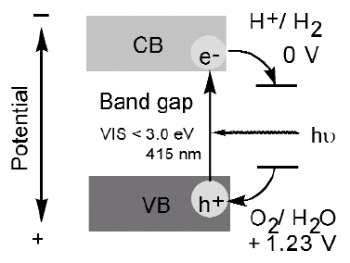
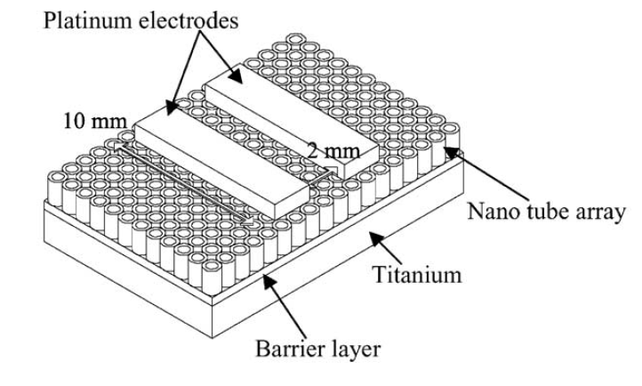
Interaction of H with TiO₂ surfaces
electron
Photocatalytic water splitting
and H₂ generation
H
proton
+
2H⁺ + 2e⁻ → H₂
Hydrogen sensor
H-induced conductivity
TiO₂
Behavior of proton and electron
at TiO₂ surfaces

Slide 3
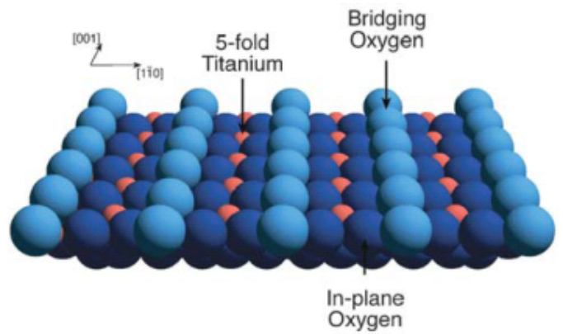
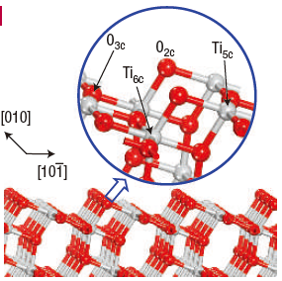
Electronic structure of TiO₂
Rutile TiO₂(110)
Ti⁴⁺(3d⁰)O²⁻(2p⁶)
e_{g}
anti-
bonding
t_{2g}
Ti3d
e_{g}
t_{2g}
Band gap
~3 eV
O2p
Anatase TiO₂(101)
t_{2g}
π
bonding
e_{g}
σ

Slide 4
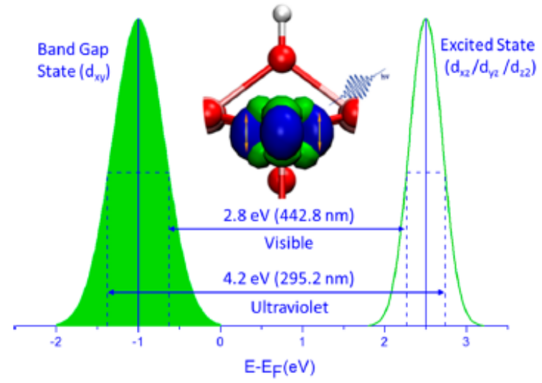
Background 1
H adsorption on rutile TiO₂(110):
OH formation
・Charge transfer
from H to Ti
H
e⁻
O
Ti
・Formation of in-gap state
X.Y. Lin et al., ChemPhysChem 9, 253 (2008)
K. Fukada et al., JPSJ 84, 064716 (2015).
・Electronic excited state
at ~2.5 eV above E_{F}
A. Argondizzo et al., PRB 91, 155429(2015)
Z. Wang et al., JACS 137, 9146 (2015).

Slide 5
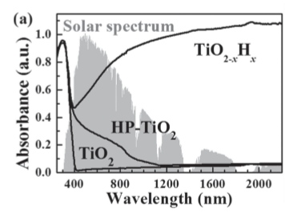
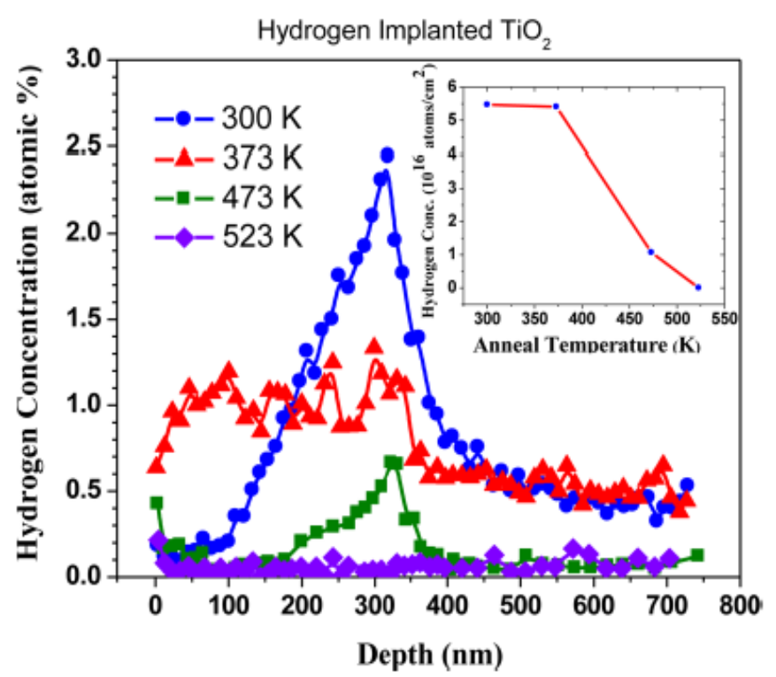
Background 2
Hydrogenation of TiO₂
H
Enhancement of solar absorption
High pressure
Plasma
Ion implantation
O
Ti
Importance of disorder
H implantation at 40 keV
Wang et al., Adv. Func. Mater. 23, 5444 (2013).
Nandasiri et al., JPCL 6, 4627 (2015)

Slide 6
Purpose of the present study
How much H is present at the surface / near-surface region?
What is the effect of H on the electronic structure?
How H behaves upon heating?
Sample:
rutile TiO₂(110) & anatase TiO₂(101)
H
O
Ti
Atomic H dose:
adsorption on the surface
H ion irradiation at 500 eV
incorporation of H into the near-surface region
SRIM: penetration depth ~8 nm
Notes:
nmat_5_665

Slide 7
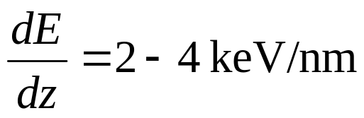
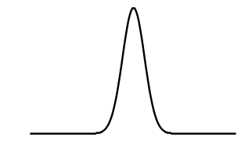
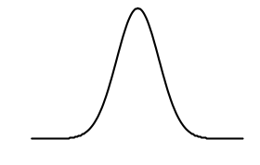
Experiment 1:Nuclear reaction analysis (NRA)
¹⁵N+¹H →¹²C+α+γ（4.43MeV）
Resonance energy(E_{R}) = 6.385 MeV
Resonance width = 1.8 keV
E_{R}
Stopping power
E_{R}+Δ E
Depth resolution< 5 nm
Lateral resolution< 30 μm
sensitivity < 10¹⁹/cm³
γ yield
E_{R}
E_{R}+Δ E
¹⁵N Energy (E₀)
M. Wilde & KF, Surf. Sci. Rep. 69 (2014) 196.
Notes:
Nuclear reaction we use

Slide 8
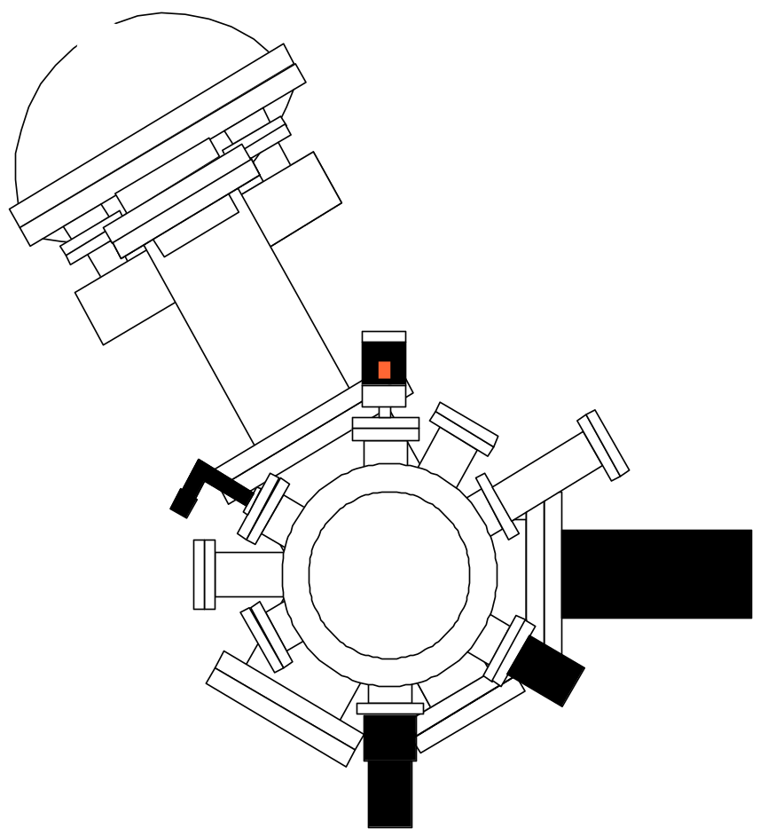
Experiment 2: photoemission
1.55 eV
Ti:Saphire
BBO (OPA)
0.55-
0.70 eV
Laser
（～100 fs）
0.85-
1.0 eV
He I
（21.22 eV）
BBO (4HG)
BBO (SHG)
3.4-4.0 eV
λ/2 plate
1.7-2.0 eV
e analyzer
・HeI：1-photon PES
occupied state
・Laser：2-photon PES
unoccupied state

Slide 9
Electronic structure of TiO₂
Ti⁴⁺(3d⁰)O²⁻(2p⁶)
Rutile TiO₂(110)
e_{g}
anti-
bonding
t_{2g}
Ti3d
e_{g}
t_{2g}
Band gap
~3 eV
O2p
Anatase TiO₂(101)
t_{2g}
π
bonding
e_{g}
σ

Slide 10
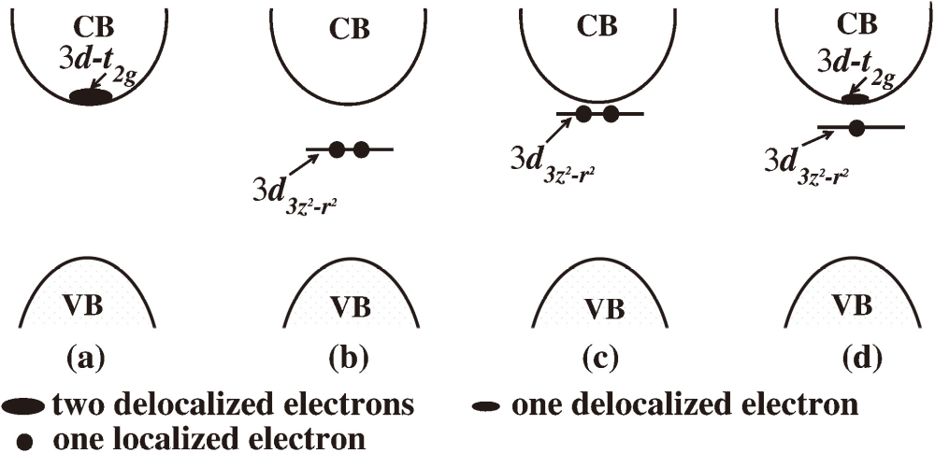
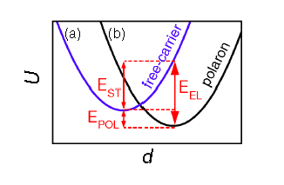
Electron doping & polaron formation
Hydrogen adsorption
H → H⁺ + e⁻
(H+ O²⁻ → H⁻ + O + e⁻)
U
delocalized
localized
Hou &Terakura,
JPSJ 79,114704 (2010)
polaron
-
d
+
-
+
e⁻
+
+
-
-
Excess e⁻
M. Setvin et al., PRL 113 (2014) 086402

Slide 11
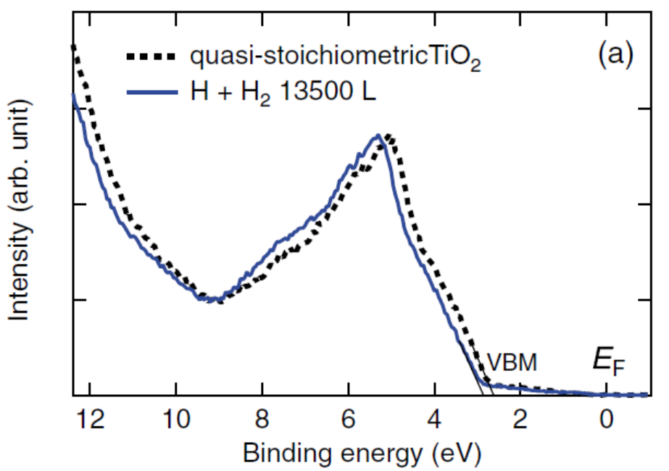
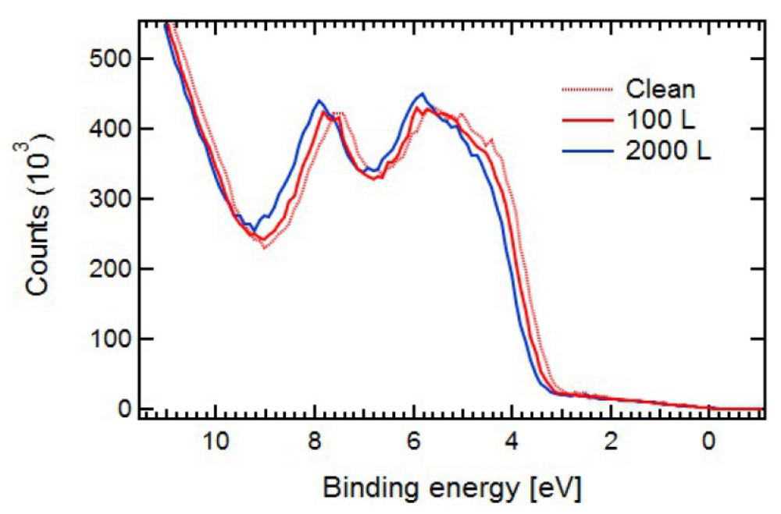
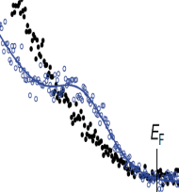
Hydrogen adsorption on r-TiO₂ & a-TiO₂
rutile-TiO₂ (110)
anatase-TiO₂ (101)
Downward shift of VBM
Presence of in-gap state
rutile:〇, anatase: ×
Decrease of work function

Slide 12
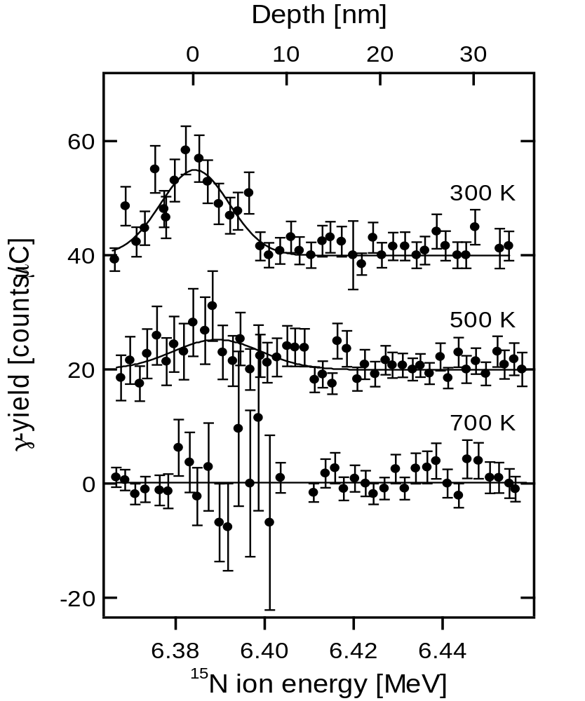
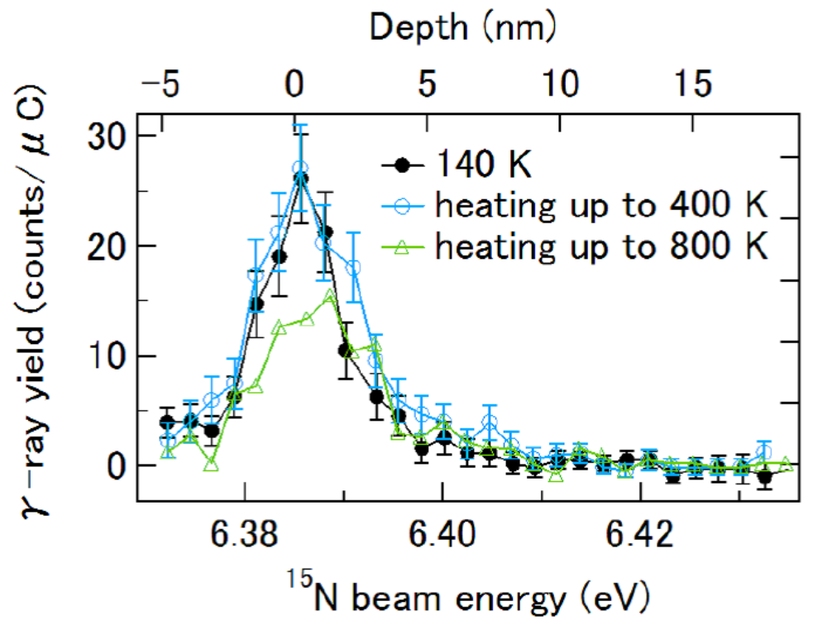


NRA: Hydrogen coverage
rutile-TiO₂ (110)
anatase-TiO₂ (101)
$$0.48±0.12 ML$$
$$0.47±0.1 ML$$
Notes:
(1ML =$5.17×{10}^{14}$cm⁻²)

Slide 13
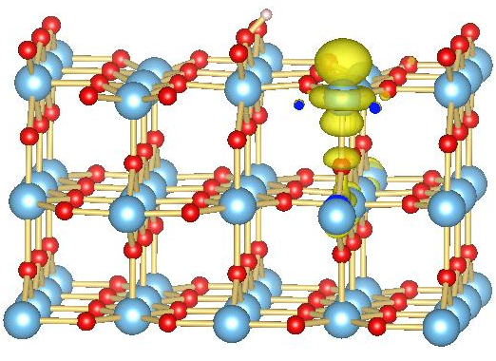

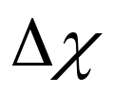
Band bending and surface dipole
rutileTiO₂(110)
H⁺
e⁻
CB
E_{F}
Surface
dipole
BB：band bending
VB
proton：on the surface
electron：subsurface & bulk
JPCC_115_7562 (2011)
JPCM 24, 435504 (2012)

Slide 14
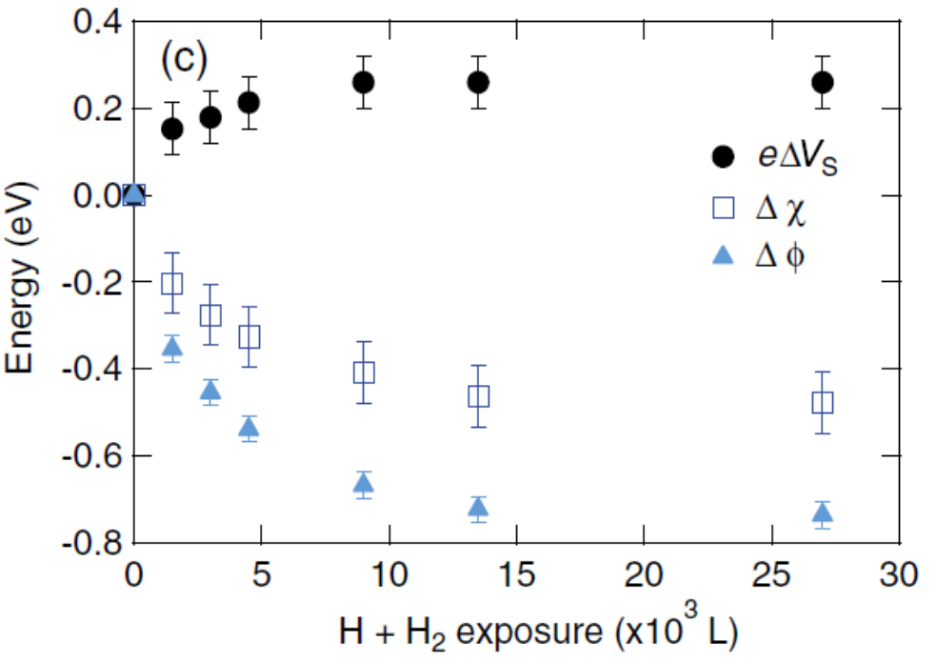
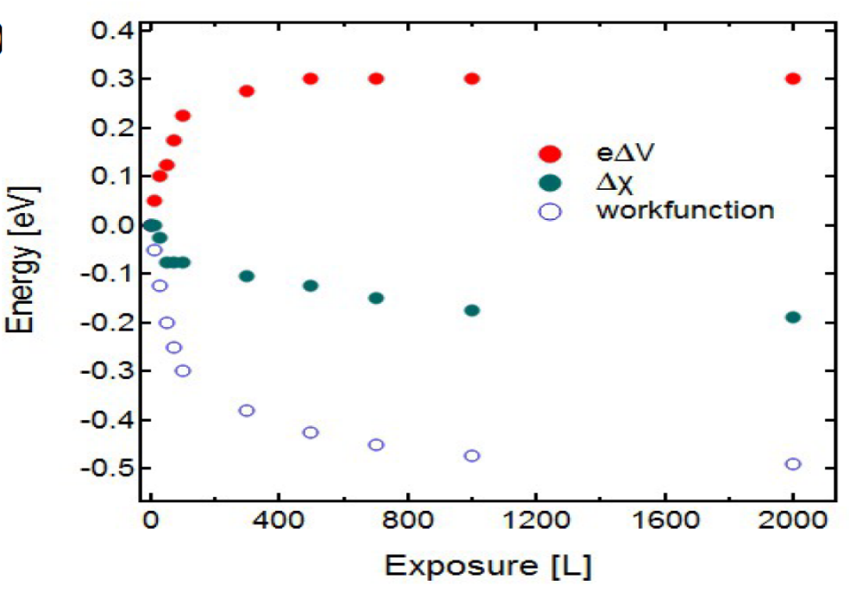



Band bending & electron affinity
Rutile TiO₂(110)
Anatase TiO₂(101)
K. Fukada et al., JPSJ 84 064716 (2015)
N. Nagatsuka et al. in prep.
CB
Rutile<Anatase
E_{F}
Rutile>Anatase
Surf.
dipole
BB
VB

Slide 15
Hydrogen on r-TiO₂ & a-TiO₂
Rutile
Anatase
CB
CB
E_{F}
E_{F}
IGS
VB
VB
CB
VB

Slide 16
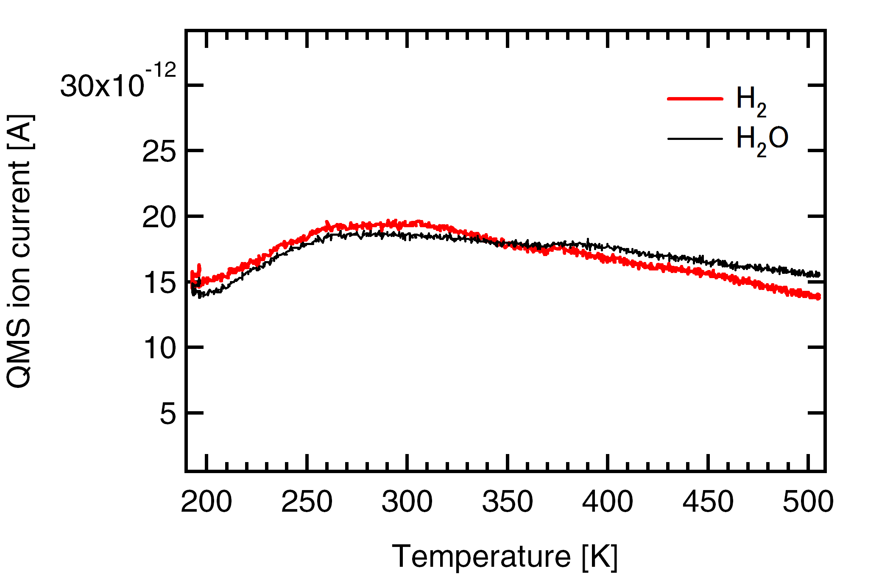

Diffusion of Hydrogen
UPS: disappearance of
surface dipole
Thermal desorption:
no significant signal < 10⁻³ ML
Diffusion into bulk
$$Diffusion barrier\sim 1.2 eV$$
Notes:
(1ML =$5.17×{10}^{14}$cm⁻²)

Slide 17
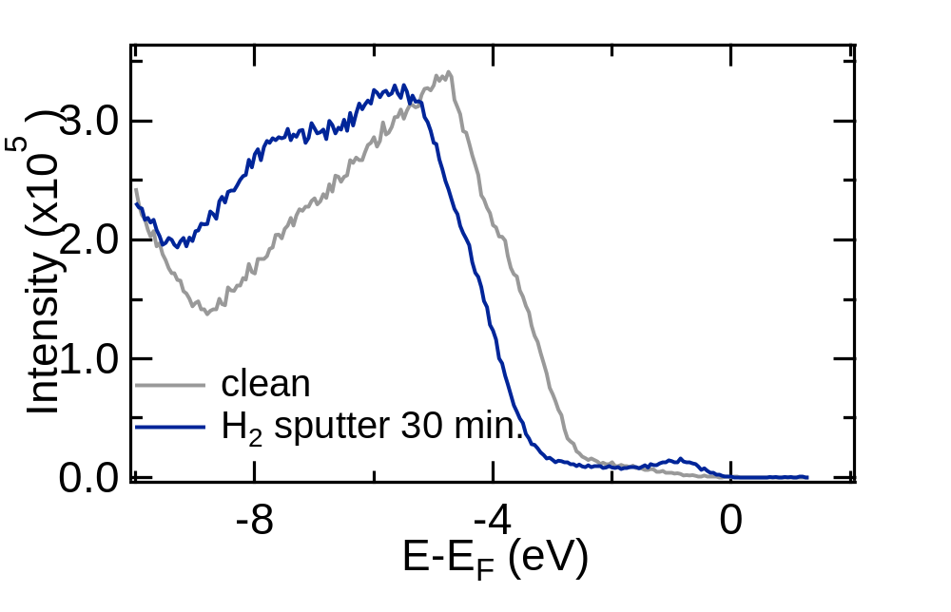
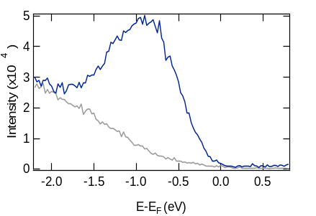
1P-PES：H-irradiated r-TiO₂(110)
CB
E_{F}
IGS
VB
・ Enhanced IGS intensity
~10 times larger than H-ads. surface
・ Downward band bending ~0.5 eV:
Surface gets metallic?
・ No change around VBM

Slide 18
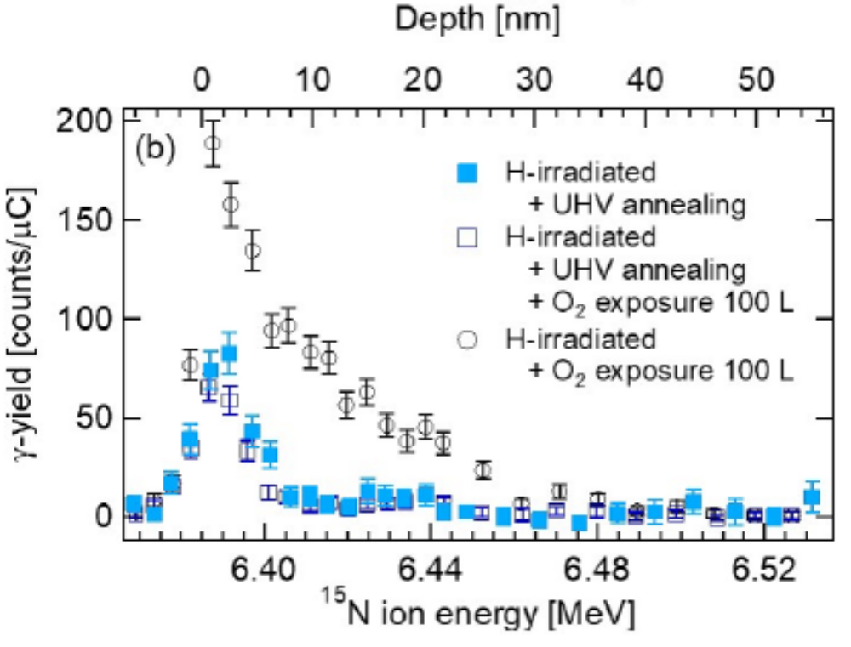
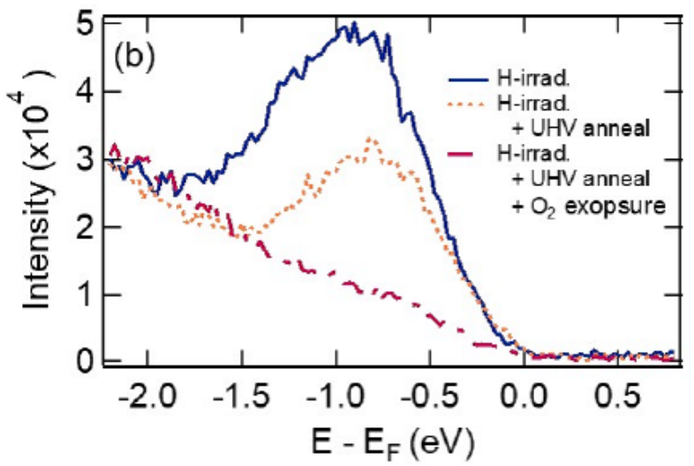
NRA：H-irradiated TiO₂(110)
8.2 ML at saturation
5.6 at. %
Cf. H adsorption
0.47 ML
UPS: in-gap state
Annealing at 673 K
Reduction of H: 8.2 → 1.4 ML
Reduction of IGS
Notes:
Most of H comes from a deeper region, the amount of H near the surface within 1 nm

Slide 19
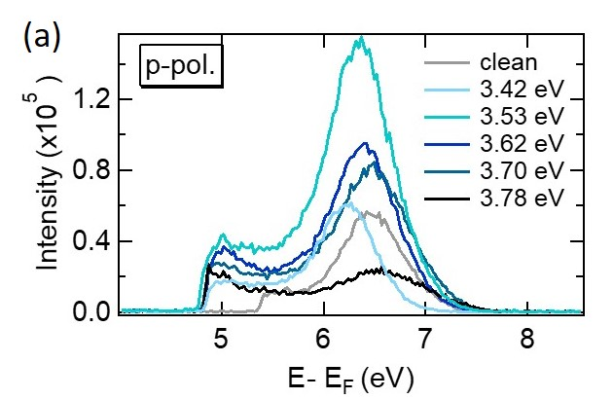
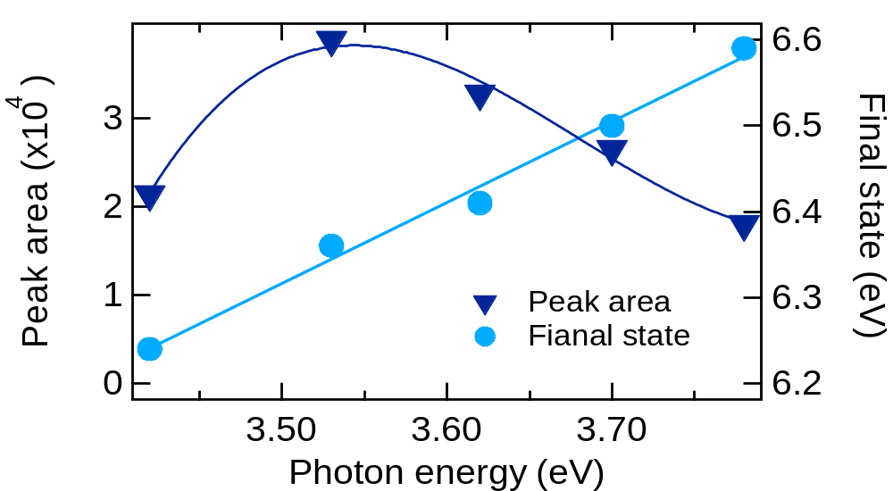
2P-PES：H/ rutile-TiO₂(110)
E-E_{F}
(eV)
CB
2.7
ExS
E_{F}
-0.8
IGS
-3
VB
Resonance at ~3.5 eV
No particular dispersion
傾き=0.94
Slope=0.94
localized

Slide 20
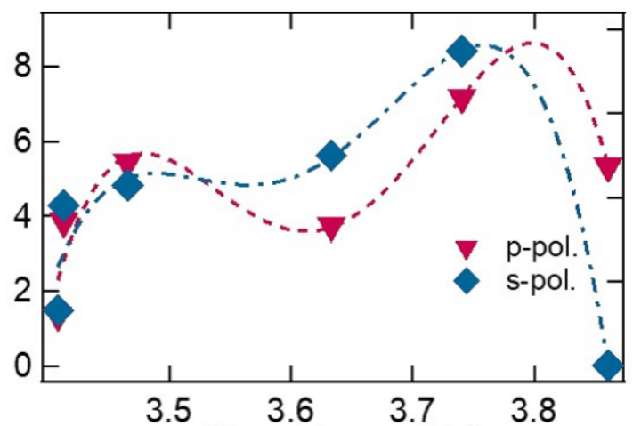
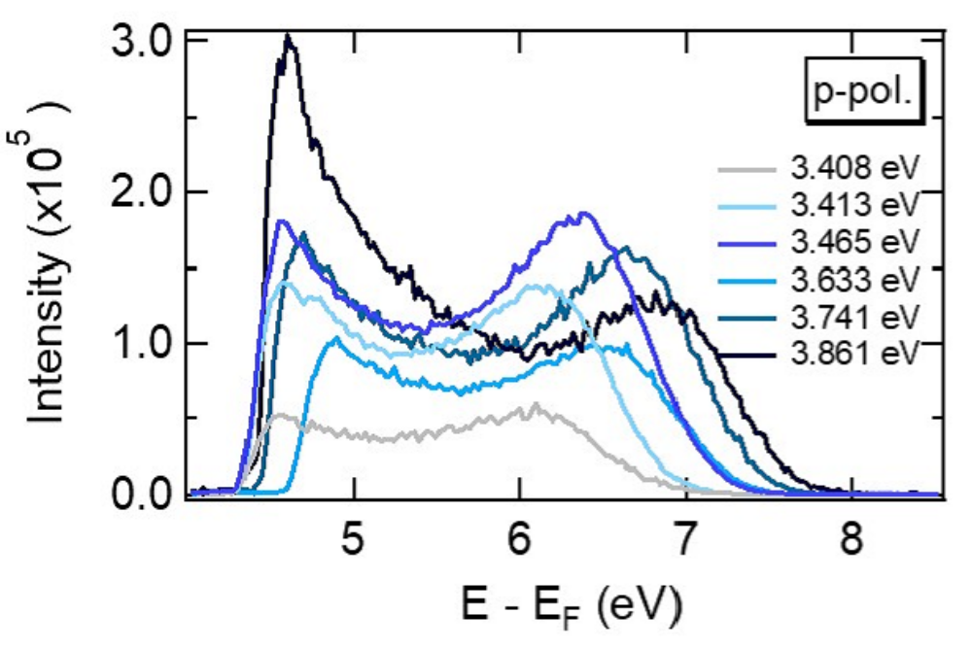
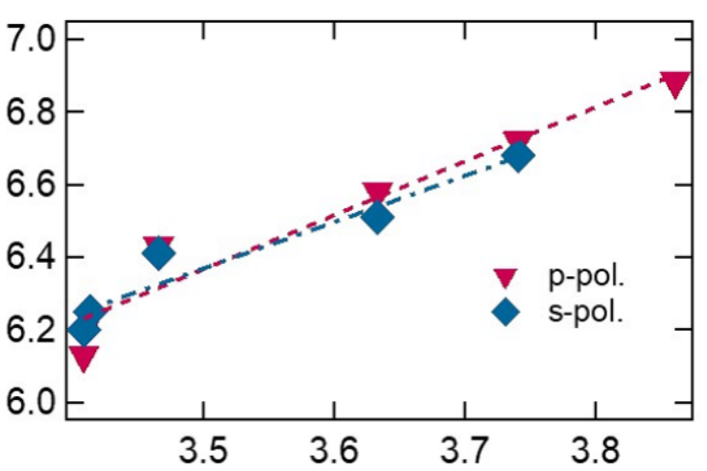
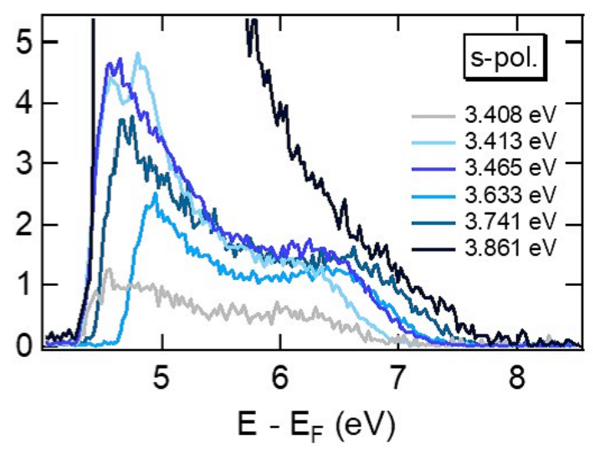
2P-PES：H-irradiated TiO₂(110)
Intensity (arb. u.)
Photon energy (eV)
Slope~1
Peak position (eV)
Resonance at ~3.5 & ~3.7 eV
Photon energy (eV)

Slide 21
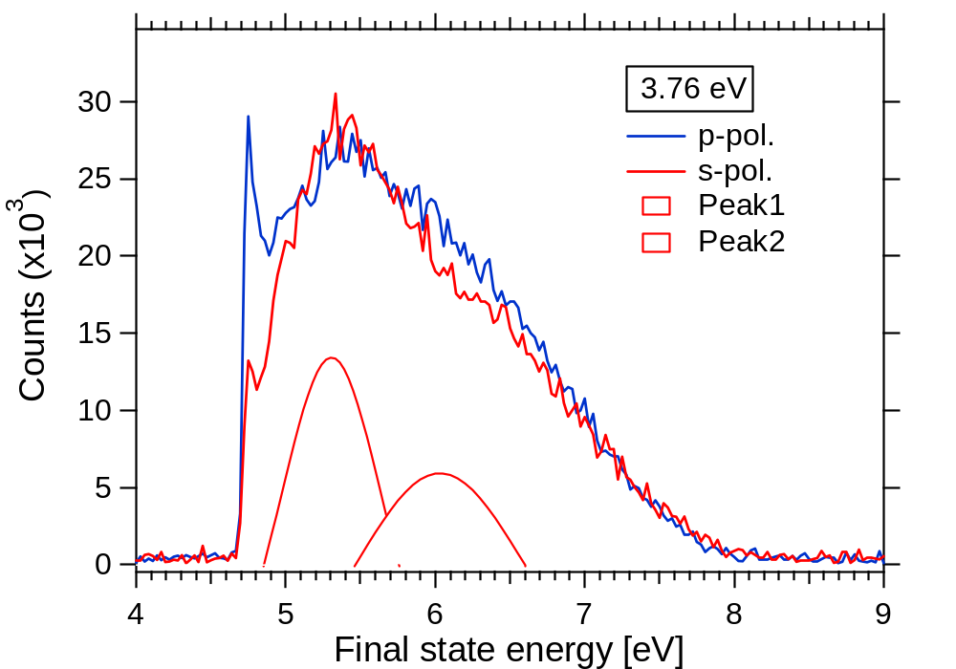
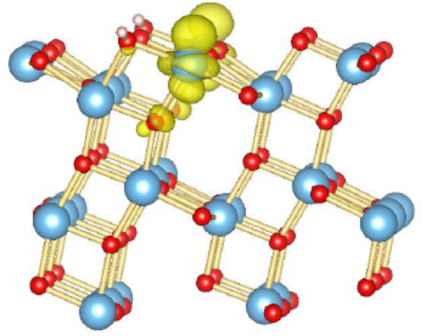
2P-PES：H/Anatase-TiO₂(101)
Peak 1
Peak3
Peak 2
Peak 3
E_{vac}
2.3 eV
CB
1.5 eV
Peak2
0 eV
E_{F}
Peak1
VB

Slide 22
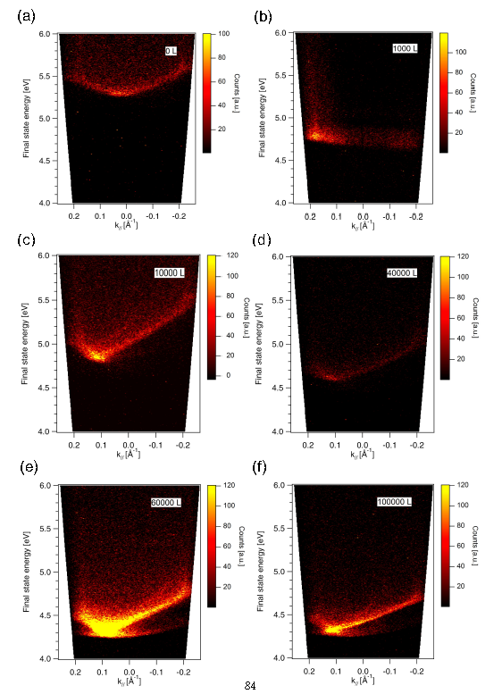
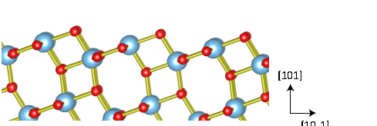
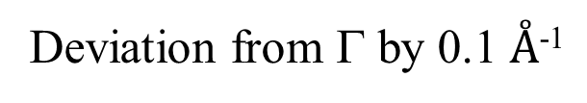
Dispersion：H/Anatase-TiO₂(101)
With increasing H coverage
･disappearance of
clean surface feature
･appearance of
H-induced feature
Large dispersion
delocalized
Deviation from Γ by 0.1 $Å$⁻¹
Cf. dispersion of SS on a vicinal surface：PRB 77, 085425 (2008)

Slide 23
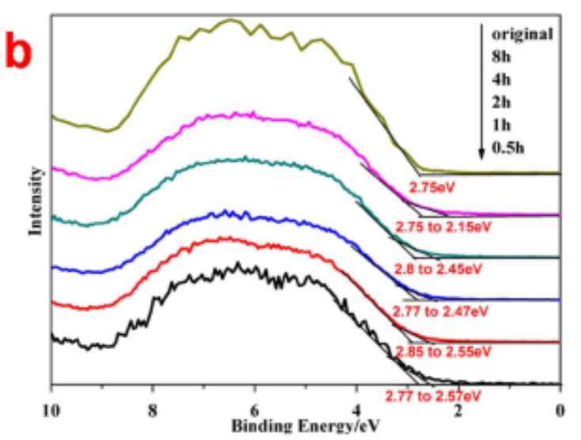
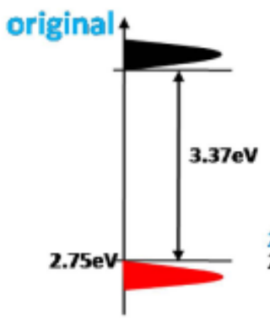
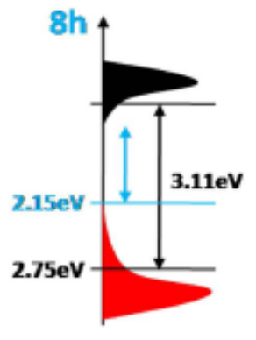
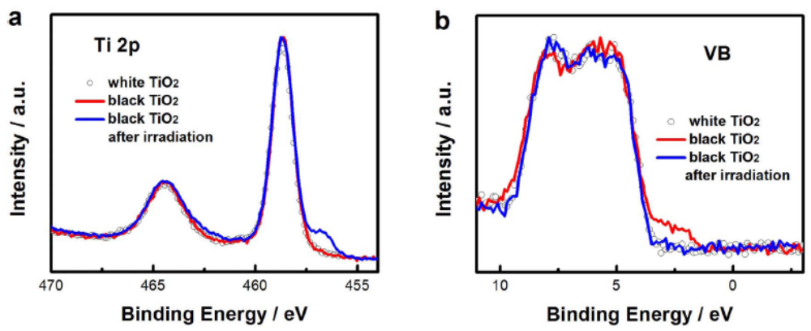
Comparison with black titania
Plasma-treated/ ultrasonic treated
Tailing of VB
C. Fan et al., Sci. Rep. 5, 11712 (2015)
High pressure H₂
X. Chen et al., Science 331, 746 (2011); Sci. Rep. 3, 1510 (2013)

Slide 24
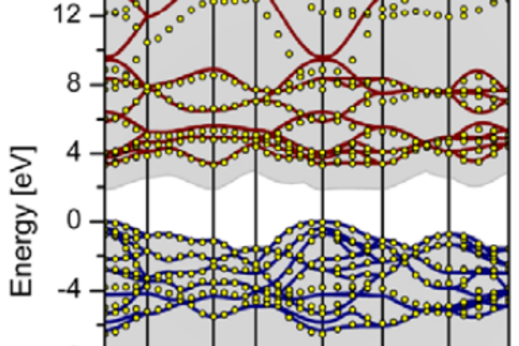
Rutile TiO₂
Anatase
H-ads.
H-irradiated
H-ads.
E-E_{F}
(eV)
CB
CB
CB
2.7
ExS
2.7
2.3
E_{F}
E_{F}
E_{F}
IGS
-0.8
-0.8
-3
-3
-3
VB
VB
VB
Theoretical calculations
Ti3d
No significant change in VB
e_{g}
t_{2g}
O2p
JPCM, 24, 195003(2012)

Slide 25
Summary
Hydrogen adsorption and absorption at
rutile TiO2(110) and anatase TiO2(101) surfaces
with NRA, 1P-PES and 2P-PES
H adsorption: saturation coverage=0.48 ML
el. ground state
rutile: in-gap state, anatase: no in-gap state (metallic)
el. excited state above E_{F}
rutile: ~2.7 eV (localized), anatase: ~2.3 eV (extended)
2. H irradiation at 500 eV
concentration: ~5 at. % within ~10 nm
enhancement of In-gap state (~10 times larger)
thermal diffusion of H

Slide 26
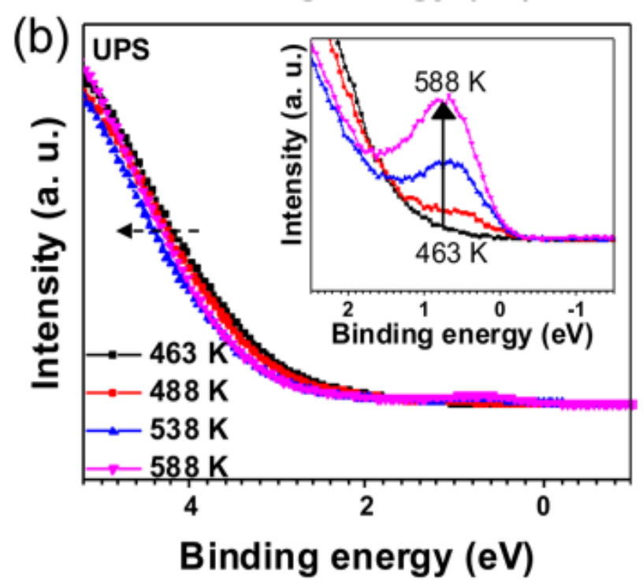
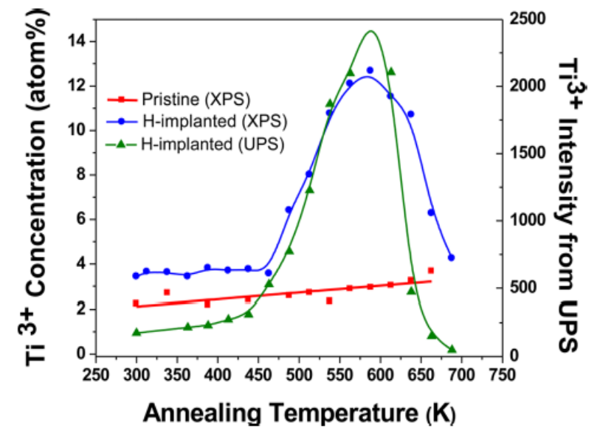
H implantation at 40 keV
followed by annealing
Nandasiri et al., JPCL 6, 4627 (2015)

Slide 27
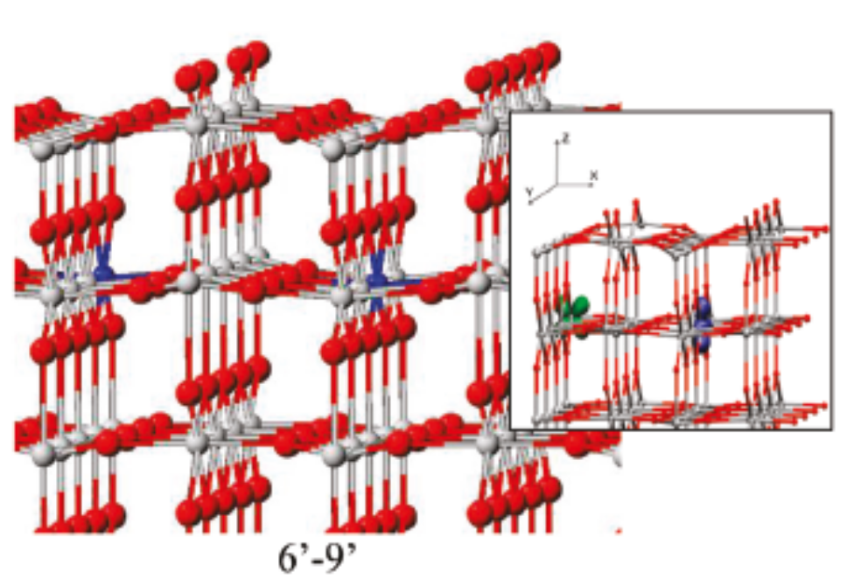
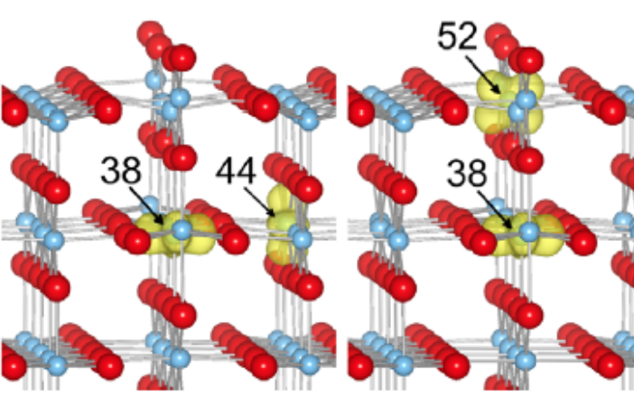
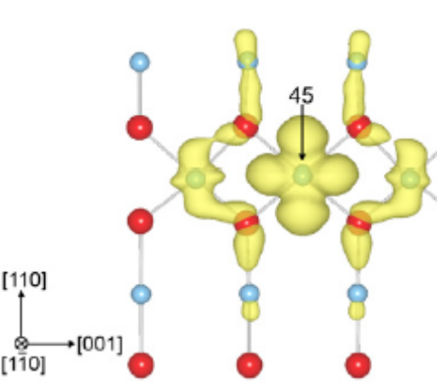
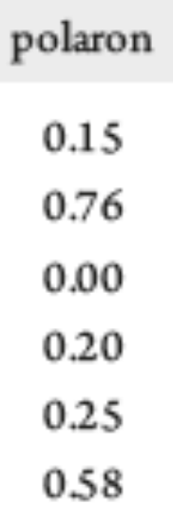
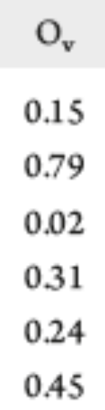

II: 1st layer Ti
JPCC_115_7562 (2011)
JPCM 24, 435504 (2012)
I: 1st layer Ti5c
z
x
III: 2nd layer Ti6c
84%(d_{z2}), 16(d_{x2-y2})
Ⅰ
Ⅱ
Ⅲ
Ⅳ
Ⅴ
Ⅵ
similar
Most stable
(from left)
Electron hopping barrier:<0.3 eV
(Adiabatic or non-adiabatic?)
Notes:
2 electrons
polaron stabilization
spin-spin interaction
polaron-Ov interaction

Slide 28





Coordinate transformation
(110) surface
The TiO₆ octahedron is alternately aligned in 90˚ different directions.

Slide 29












${d−p}_{}$混成による $pの$寄与
（平面波）
入射面 $\left(1\overline{1}0\right) \left(00\overline{1}\right)$
$$|\left.ψ_{f}\right\rangle$$
○ ×
$$|\left.ψ_{m}\right\rangle$$
$$|\left.ψ_{i}\right\rangle$$
p_{x}，p_{y}の縮退が解ける
→表面状態
Notes:
計算は加藤さん
Ｓ偏光で中間状態がｐxy軌道（ｍ＝＋１，－１）とするには，ｐｘに励起してｐｙから放出にしないといけない
縮退が解けるとこうならない

Slide 30









Polarization dep.
$\left(00\overline{1}\right)$ p
$\left(00\overline{1}\right)$ s
$\left(1\overline{1}0\right)$ p
$\left(1\overline{1}0\right)$ s
強度比
入射面$\left(00\overline{1}\right)$ |  | 入射面$\left(1\overline{1}0\right)$
P $$\left[110\right]+\left[1\overline{1}0\right]$$ | S $$\left[00\overline{1}\right]$$ | P $$\left[110\right]+\left[00\overline{1}\right]$$ | S $$\left[1\overline{1}0\right]$$
14.4 | 0 | 3.76 | 1
$$|\left.ψ_{f}\right\rangle$$
$$|\left.ψ_{m}\right\rangle$$
$$W∝{\left|\left\langle ψ_{m} | r | ψ_{i}\right\rangle \right|}^{2}$$
$r$ : $Y_{1m}$ : $m=0, ±1$
$$|\left.ψ_{i}\right\rangle$$

Slide 31



Electronic structure of TiO₂
Rutile TiO₂
unstable
Ti⁴⁺(3d⁰)O²⁻(2p⁶)
O²⁻
e_{g}
anti-
bonding
t_{2g}
Ti3d
Ti⁴⁺
Surf. Sci. Rep., 48, 53 (2003)
e_{g}
t_{2g}
Basic structure：
TiO₆
Band gap
~3 eV
O2p
t_{2g}
π
stable
bonding
e_{g}
σ
Notes:
Oh vs Td

Slide 32




1P-PES：H-adsorbed TiO₂(110)
CB
E_{F}
Surf.
dipole
BB
VB
Downward band bending
0.2 eV
H^{+δ}
+
Presence of In-gap state (IGS)
Charge transfer from H to Ti
－

Slide 33

H on rutileTiO₂(110)
H⁺
e⁻
Recovery of Δχ
→ Diffusion of H into the interior
Clean H ad. 550 K 620 K
Cf. X.Y. Lin et al., ChemPhysChem 9, 253 (2008)

Slide 34


2P-PES: Polarization dependence
H-ads.
$\left(00\overline{1}\right)$ p
No intensity at
s-pol. in inc.
$\left(00\overline{1}\right)$ s
$\left(1\overline{1}0\right)$ p
$\left(1\overline{1}0\right)$ s
Similar intensity in
s-pol. incidences
H-irrad.
Presence of two types of TiO₆

Slide 35


Comparison with black titania
Tailing of VB ultrasonic treated
L.-B. Mo et al., APL 105, 202114 (2014)
M. Mehta et al., J. Mater. Chem. A 4, 2670 (2016)

