Slide 1
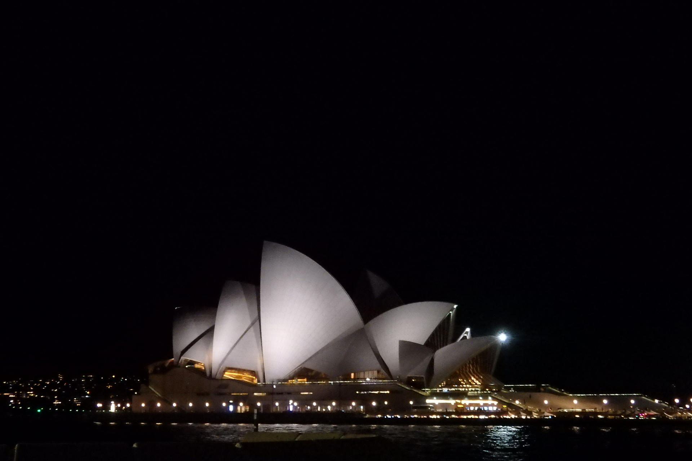
The 9-th Vacuum and Surface Science Conference of Asia and Australia (VASSCAA-9)
August 13-16, 2018, Sydney, Australia
X-ray dichroism studies of magnetic anisotropies in ferromagnetic thin films
Atsushi FUJIMORI
University of Tokyo

Slide 2
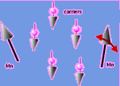
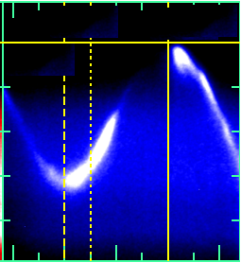
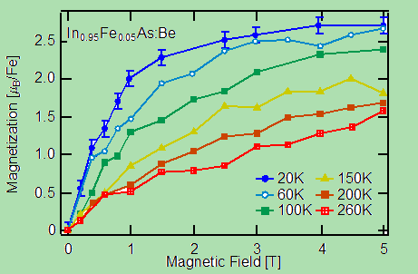
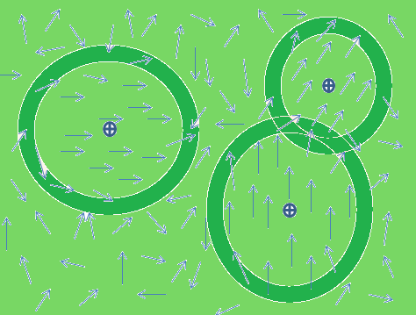
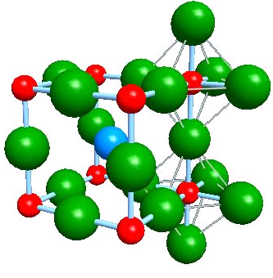
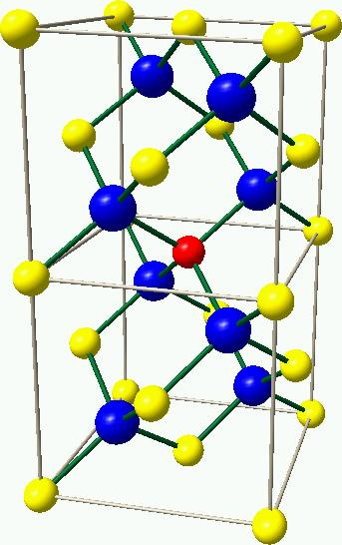
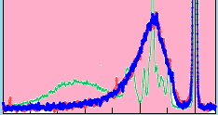
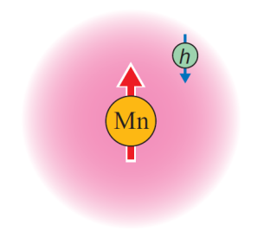
The 9-th Vacuum and Surface Science Conference of Asia and Australia (VASSCAA-9)
August 13-16, 2018, Sydney, Australia
X-ray dichroism studies of magnetic anisotropies in ferromagnetic thin films
Atsushi FUJIMORI
University of Tokyo
ARPES
XMCD
XMLD
e
SR-SX
Circular polarization
hν
hν
RIXS
Linear polarization

Slide 3
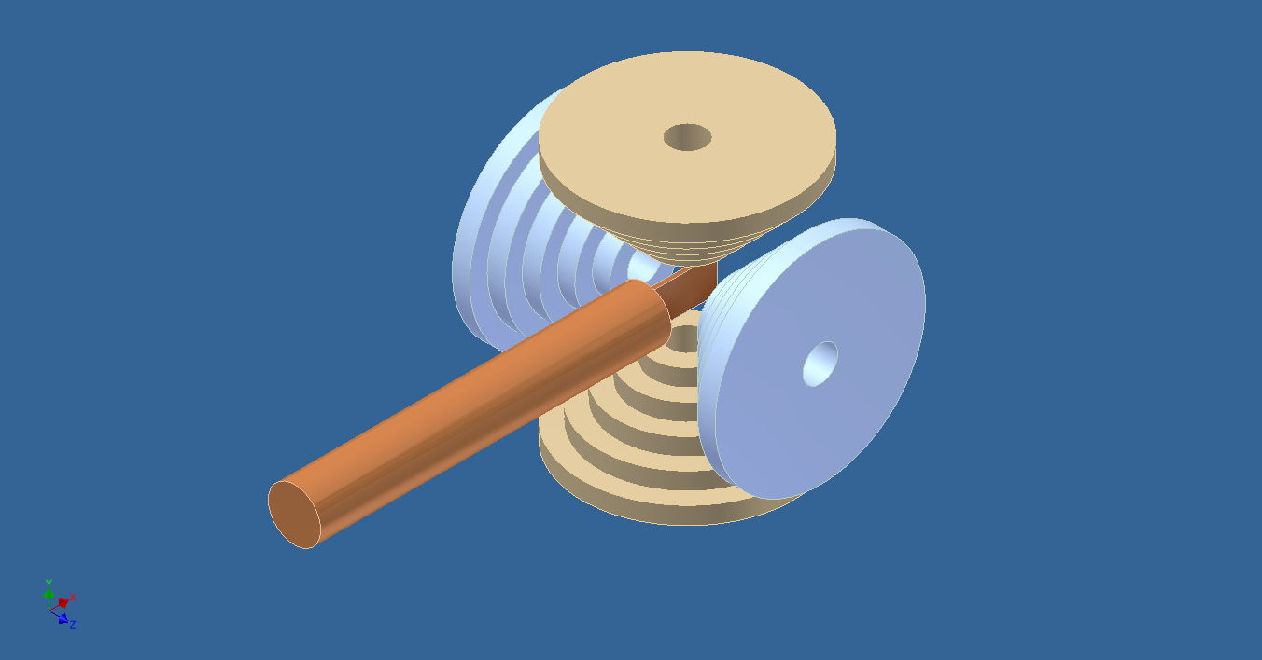
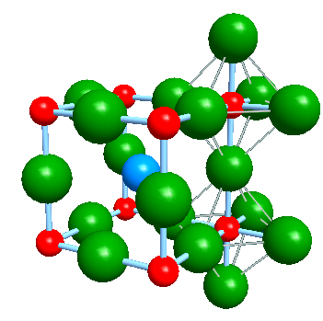
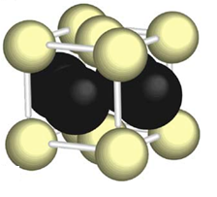
The 9-th Vacuum and Surface Science Conference of Asia and Australia (VASSCAA-9)
August 13-16, 2018, Sydney, Australia
X-ray dichroism studies of magnetic anisotropies in ferromagnetic thin films
Atsushi FUJIMORI
University of Tokyo
H
hν
SR
Sample rotation
La_{1-x}Sr_{x}MnO₃
L1₀-phase FePt

Slide 4
Acknowledgement
G. Shibata, K. Ikeda, Y. Takahashi, Y. Nonaka, K. Ishigami, Z. Chi, T. Harano, T. Kadono (UTokyo)
Soft x-ray MCD: T. Koide, K. Amemiya, M. Sakamaki (KEK-PF)
Y. Takeda (JAEA SPring-8)
Hard x-ray MCD: M. Suzuki, N. Kawamura (JASRI SPring-8)
La_{1-x}Sr_{x}MnO₃ thin film: M. Kitamura, M. Minohara, K. Yoshimatsu, H. Kumigashira (KEK-PF)
L1₀-ordered FePt thin film: K. Takanashi, T. Seki (IMR, Tohoku U)
Cluster-model calculation: A. Tanaka (Hiroshima U)
JSPS-KAKENHI Basic Research S (22224005, JSPS, 2010-2014) & A (15H02109, 2015-2018)
H
hν
SR
Sample rotation
La_{1-x}Sr_{x}MnO₃
L1₀-phase FePt

Slide 5
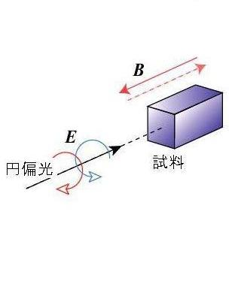
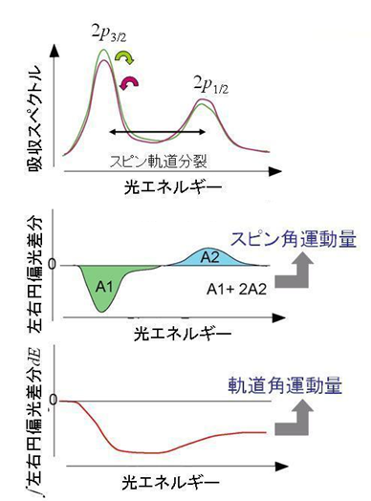
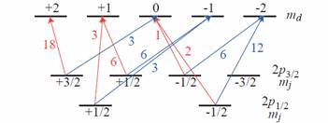
X-ray magnetic circular dichroism (XMCD)
X-ray absorption (XAS) spectra
σ ⁻
σ⁺
Circular
polarized light
Absorption
10~20 eV
Sample
σ ⁻
Spin-orbit splitting
σ⁺
Photon energy
XMCD
M_{spin}
M_{spin} + (7/2)M_{T}
Valence
level
XMCD =
I(σ⁺) – I(σ ⁻)
Spin
sum rule
σ⁺
σ ⁻
3
3
Photon energy
M_{T} = -μ_{B}T : Magnetic dipole
Core level
M_{orbital}
Spin-orbit
splitting
Orbital
sum rule
∫XMCD d(hν)
A3-A2
Element specific
Free from impurities, substrates, ..
Photon energy
B. T. Thole et al., PRL (1992), P. Carra et al., PRL (1993)

Slide 6
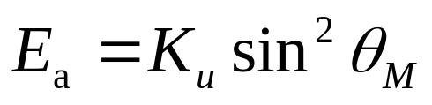
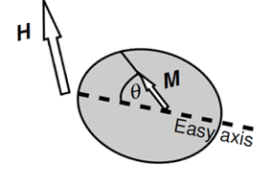
Magnetic anisotropy of ferromagnets
Coercivity of permanent magnets
Perpendicular magnetization for high-density information storage
Magnetic anisotropy energy (MAE)
Spin-orbit interaction is necessary.
for uniaxial cases
K_{u}: uniaxial MAE per volume
M: magnetization
H: applied magnetic field
α
θ_{M}
θ_{H}
Magnetic anisotropy →
θ_{H} ≠ θ_{M} (except for θ_{H} = θ_{M} = 0º or 90º)
M. J. D. Coey, Magnetism and Magnetic Materials (Cambridge, 2009)

Slide 7
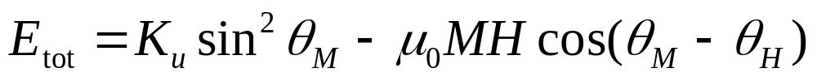
Magnetization hysteresis of a single-domain
ferromagnetic nanoparticle
Stoner-Wohlfarth model
α
θ_{M}
θ_{H}
MAE
Zeeman
M-H curves for different H angles
θ_{H} ＝
M. J. D. Coey, Magnetism and Magnetic Materials (Cambridge, 2009)

Slide 8
Magnetization hysteresis of a single-domain
ferromagnetic nanoparticle
Stoner-Wohlfarth model
α
θ_{M}
θ_{H}
MAE
Zeeman
M-H curve averaged over different H angles
M. J. D. Coey, Magnetism and Magnetic Materials (Cambridge, 2009)

Slide 9
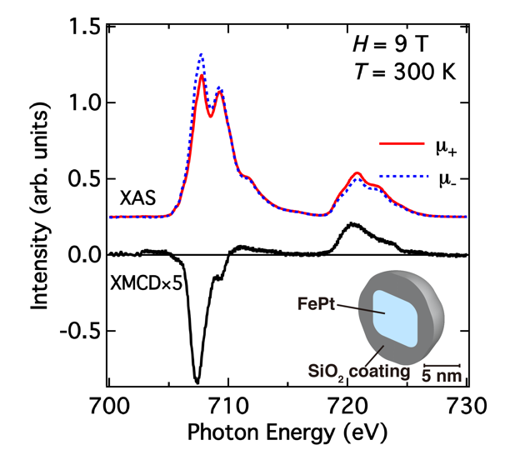
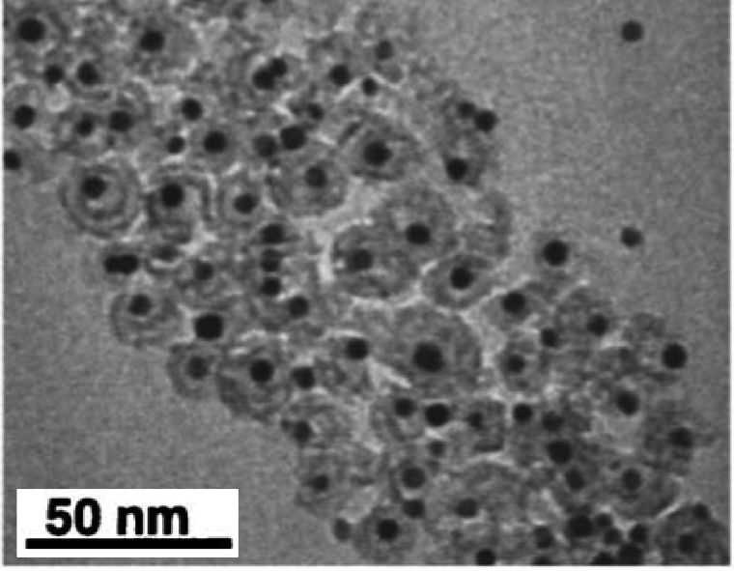
Fe L_{2,3} XMCD of L1₀-phase FePt single-domain nanoparticles
L1₀ (fct, a>c)
Fe
Pt
bare FePt
particles
oxidized Fe
FePt SiO₂
S. Yamamoto et al., APL (2005)
Y. Takahashi, AF et al., PRB (2014)

Slide 10
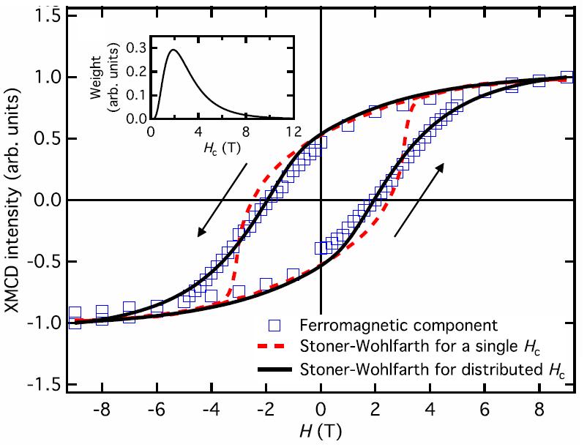
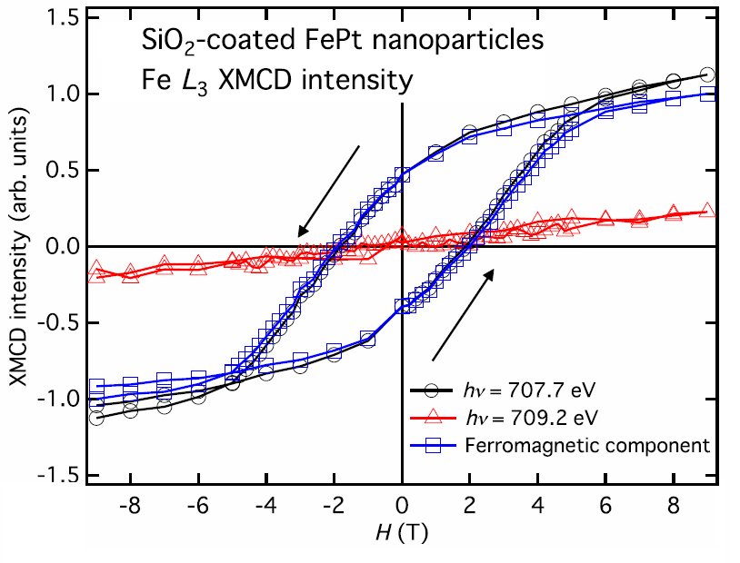
Fe L_{2,3} XMCD of L1₀-phase FePt single-domain nanoparticles
M-H curves deduced from XMCD intensities
Fit using the angle-averaged Stoner-Wohlfarth model
H_{c} distribution
Fe in FePt
Expt
oxidized Fe
Single H_{c}
Distributed H_{c}
→ MAE with K_{u} 〜 2.7 × 10⁶ J/m³
cf. K_{u} 〜 3×10⁶ J/m³ (thin film)
Y. Takahashi, AF et al., PRB (2014)
Y. Takahashi, AF et al., PRB (2014)

Slide 11
Magnetic anisotropy of nanoparticle
Stoner-Wohlfarth model
MAE
Zeeman
Magnetic anisotropy energy (MAE)
K_{u}: uniaxial MAE per volume
M: magnetization
H: applied magnetic field
α
θ_{M}
θ_{H}
Magnetic anisotropy →
θ_{H} ≠ θ_{M} (except for θ_{H} = θ_{M} = 0º or 90º)
M. J. D. Coey, Magnetism and Magnetic Materials (Cambridge, 2009)

Slide 12
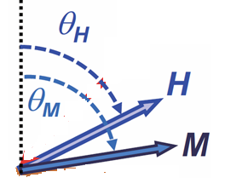
Magnetic anisotropy of thin film
Stoner-Wohlfarth model
MAE
Zeeman
Magnetic anisotropy energy (MAE)
axis
K_{u}: uniaxial MAE per volume
M: magnetization
H: applied magnetic field
Magnetic anisotropy →
θ_{H} ≠ θ_{M} (except for θ_{H} = θ_{M} = 0º or 90º)
H_{demag}
film
M. J. D. Coey, Magnetism and Magnetic Materials (Cambridge, 2009)

Slide 13
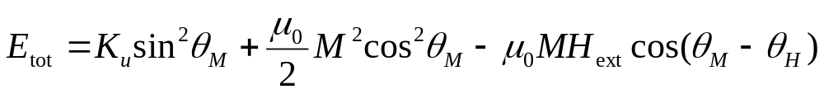
Magnetic anisotropy of thin film
Stoner-Wohlfarth model
MAE
SA
Zeeman
Shape anisotropy
caused by demagnetization field
K_{u} = E|| - E⊥ > 0 → Perpendicular magnetic anisotropy (PMA)
Magnetic anisotropy energy (MAE)
H⊥
axis
K_{u}: uniaxial MAE per volume
M: magnetization
H: applied magnetic field
H||
Magnetic anisotropy →
θ_{H} ≠ θ_{M} (except for θ_{H} = θ_{M} = 0º or 90º)
H_{demag}
film
M. J. D. Coey, Magnetism and Magnetic Materials (Cambridge, 2009)

Slide 14
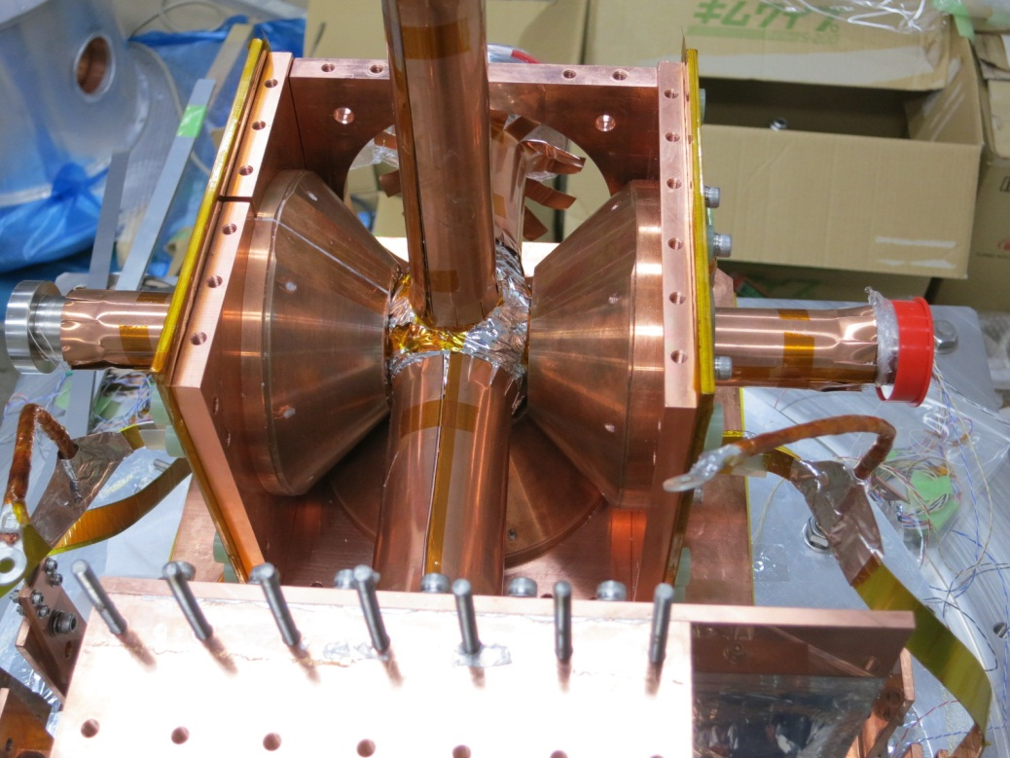
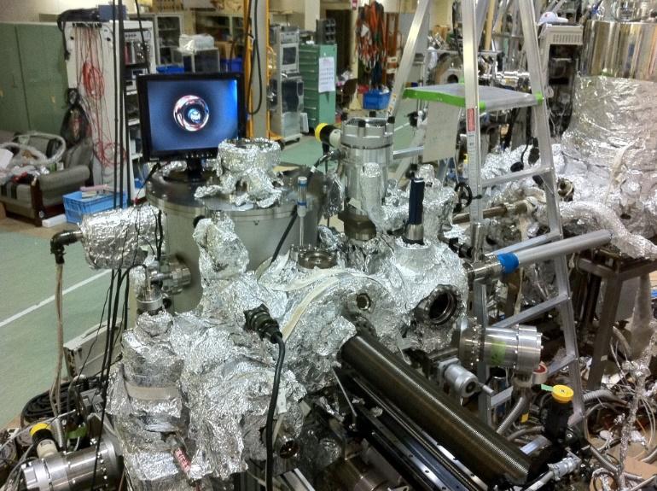
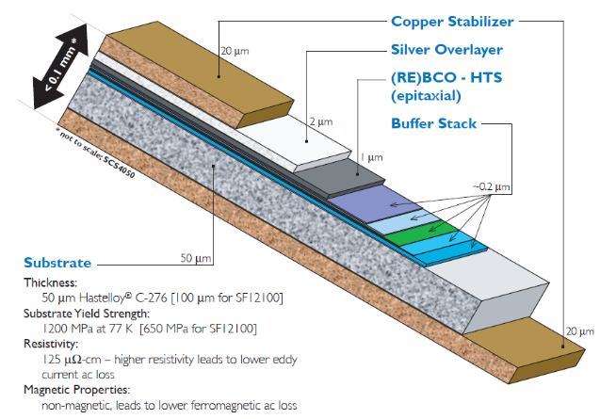
Vector-type superconducting magnet
Vertical coil
Horizontal coil
~16 cm
H
hν
SR
Sample rotation
M. Furuse et al., IEEE Trans. Appl. Supercond. (2012)
SuperPower®
YBCO wire

Slide 15
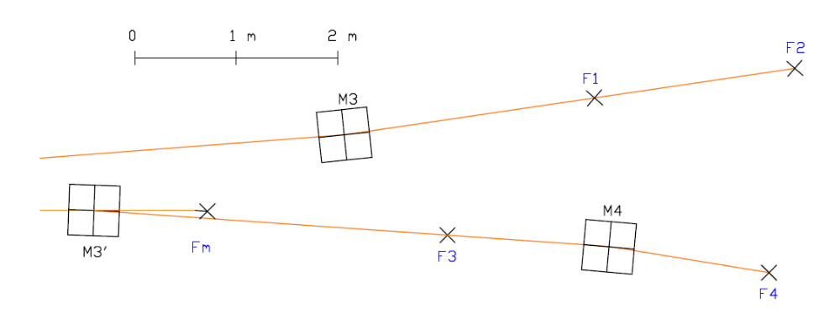
Fast polarization switching undulator at the soft x-ray beam line BL-16A of KEK-PF
Apple II-type undulators
Electron trajectory
To beamline
Undulator I
Undulator II
Kicker magnets
Fast
switching
~10 Hz
Vector-type SC
XMCD（1.4 T）
rom undulator →
SC magnet
XMCD (5T)
Electromagnet XMCD (1.2 T)
Depth resolved
XAFS/XMCD

Slide 16
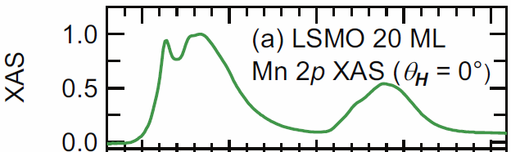
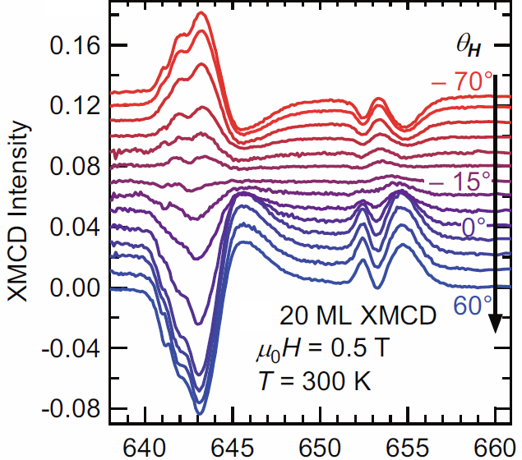

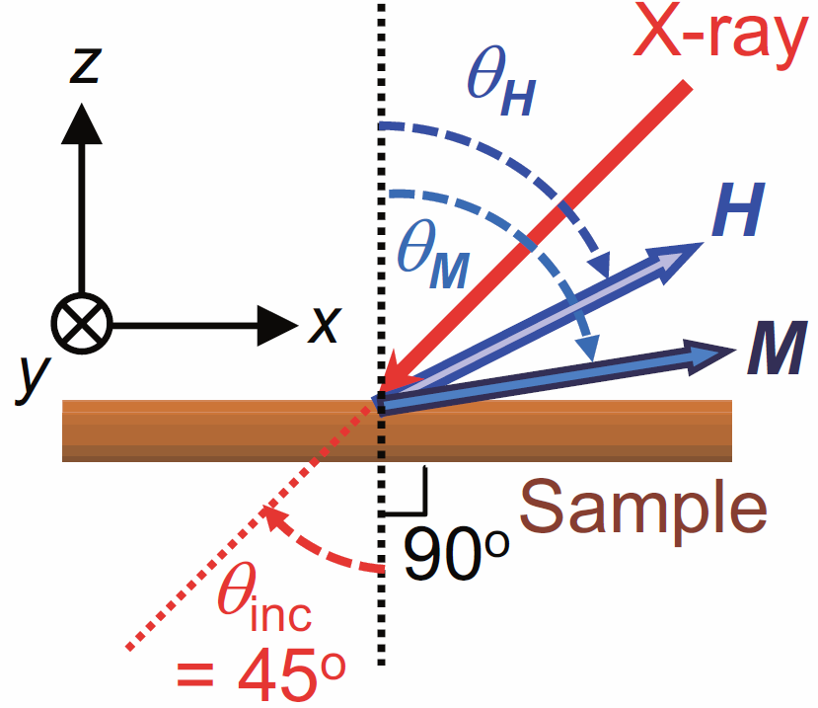

Angular-dependent XMCD of La_{0.6}Sr_{0.4}MnO₃ film on SrTiO₃(001)
Superconducting vector magnet
L_{2,3}
H
Mn L_{2,3} XMCD
Sample rotation
hν
@Apple II undulator BL-16, KEK-PF
hν
k
G. Shibata, AF et al., npj Quantum Mater. (2018)

Slide 17
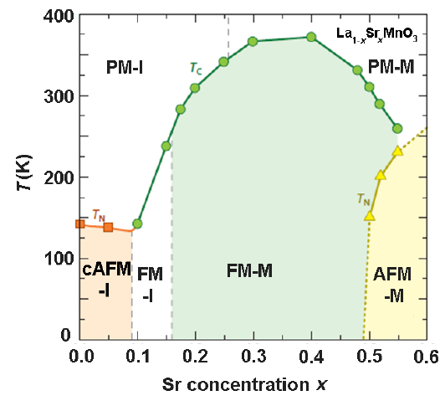
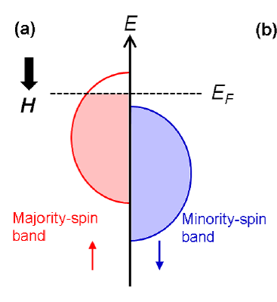
Phase diagram of hole-dope La_{1-x}Sr_{x}MnO₃
Half-metal
A. Urushibara, Y. Tokura et al. , PRB (1995)

Slide 18
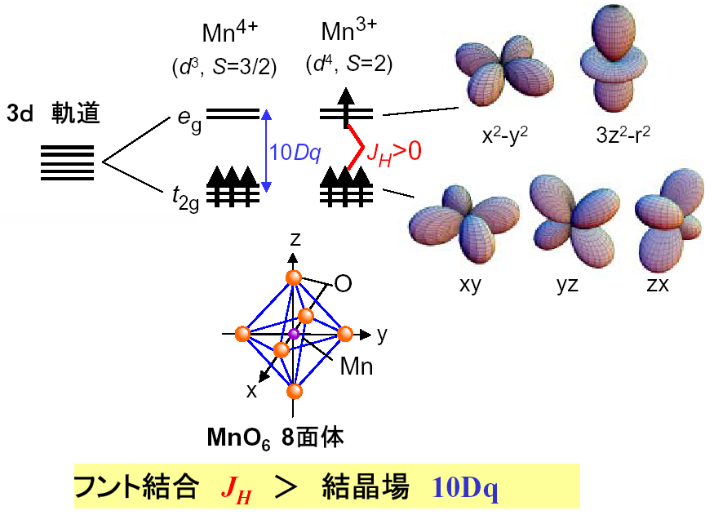
Giant magneto-resistive manganites
orbitals
ε
Mn
O
MnO₆ octahedron
Y. Tokura
3
→ High-spin state
Hund’s rule
> Crystal field

Slide 19
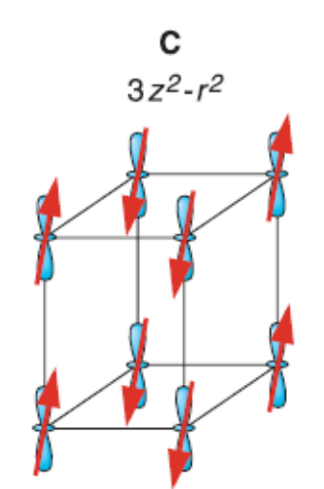
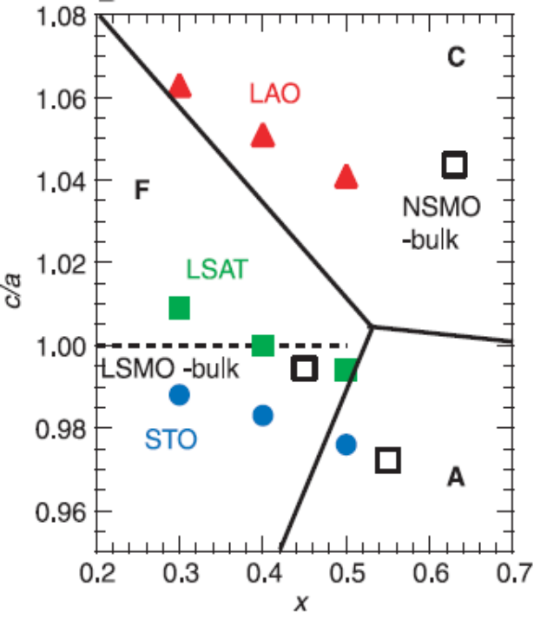
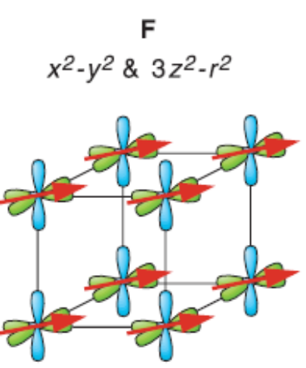
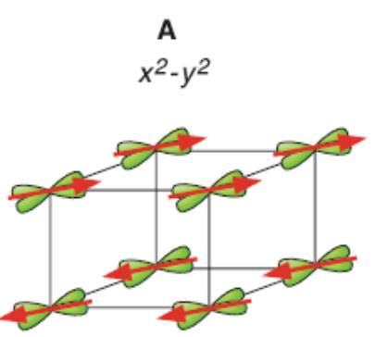
Electronic phase diagram of
La_{1-x}Sr_{x}MnO₃ under epitaxial strain
C-AFI
compressive
FM
C-AFI
FM
A-AFM
A-AFM
tensile
Y. Konishi et al., JPSJ (1999)

Slide 20
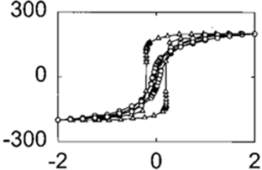

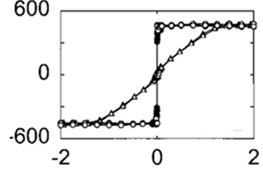

Magnetic anisotropy of strained La_{0.67}Sr_{0.33}MnO₃ films on SrTiO₃ and LaAlO₃ substrates
compressive
M
H⊥
LaAlO₃
H||
H||
H ⊥
tensile
M
SrTiO₃
F. Tsui et al., APL (2000)

Slide 21
Angular-dependent XMCD of La_{0.6}Sr_{0.4}MnO₃ film on SrTiO₃(001)
Superconducting vector magnet
L_{2,3}
H
Mn L_{2,3} XMCD
Sample rotation
hν
@Apple II undulator BL-16, KEK-PF
hν
k
G. Shibata, AF et al., npj Quantum Mater. (2018)

Slide 22
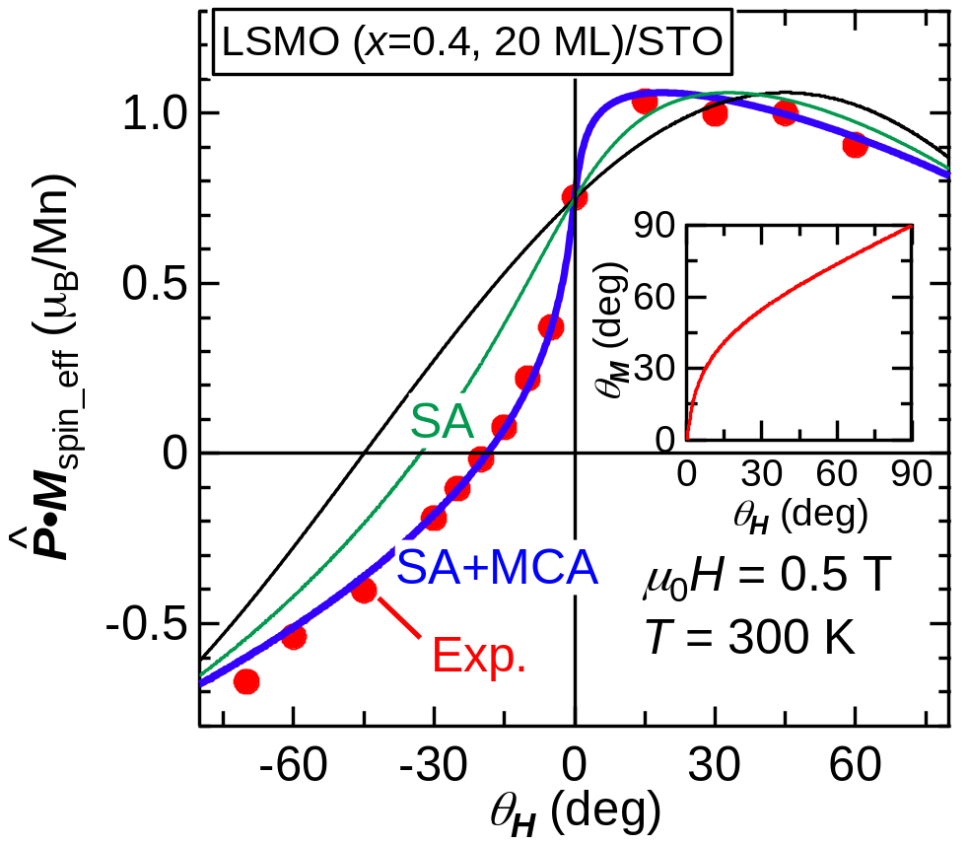
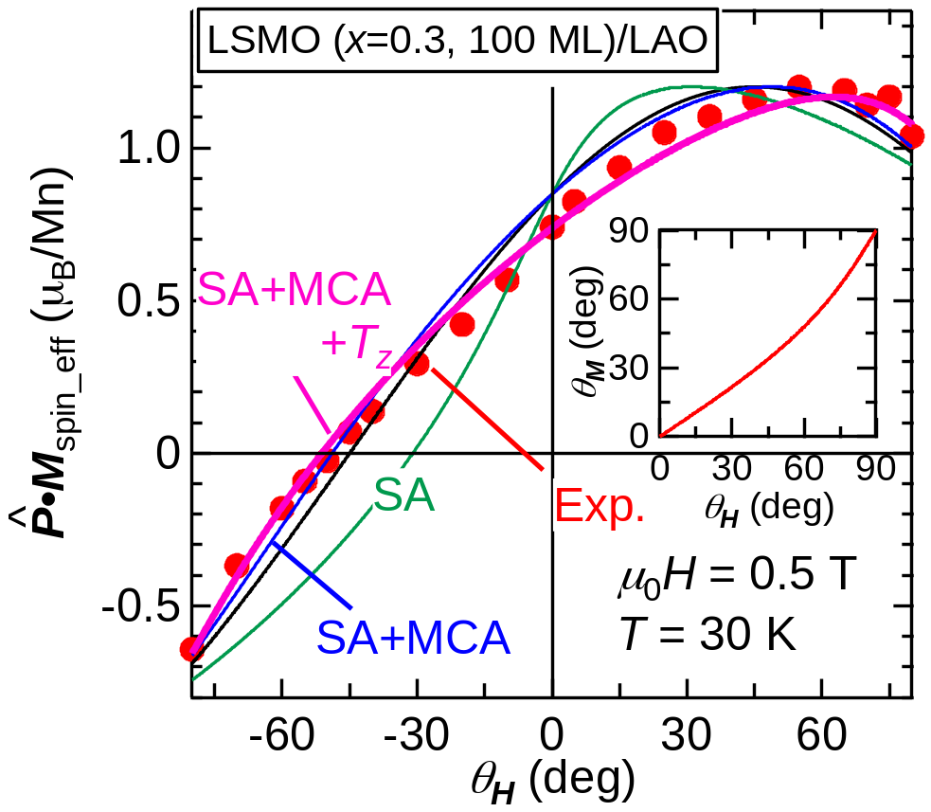
Angular-dependent XMCD of strained La_{1-x}Sr_{x}MnO₃ film on SrTiO₃ and LaAlO₃ substrates
La_{0.6}Sr_{0.4}MnO₃/SrTiO₃(001)
La_{0.7}Sr_{0.3}MnO₃/LaAlO₃(001)
M
M
compressive
tensile
MAE
Magnetic dipole
+
+
+
MAE
+
MAE
G. Shibata, AF et al., npj Quantum Mater. (2018)

Slide 23
Magnetic anisotropy of thin film
Stoner-Wohlfarth model
MAE
SA
Zeeman
Shape anisotropy
caused by demagnetization field
K_{u} = E|| - E⊥> 0 → Perpendicular magnetic anisotropy (PMA)
Magnetic anisotropy energy (MAE)
H⊥
axis
K_{u}: uniaxial MAE per volume
M: magnetization
H: applied magnetic field
H||
Magnetic anisotropy →
θ_{H} ≠ θ_{M} (except for θ_{H} = θ_{M} = 0º or 90º)
H_{demag}
film
M. J. D. Coey, Magnetism and Magnetic Materials (Cambridge, 2009)

Slide 24
Angular-dependent XMCD of strained La_{1-x}Sr_{x}MnO₃ film on SrTiO₃ and LaAlO₃ substrates
La_{0.6}Sr_{0.4}MnO₃/SrTiO₃(001)
La_{0.7}Sr_{0.3}MnO₃/LaAlO₃(001)
M
M
compressive
tensile
MAE
Magnetic dipole
+
+
+
MAE
+
MAE
K_{u} = - (1.9±0.1) x 10⁴ J/m³ < 0
in-plane easy axis
K_{u} = (4.0±0.4)×10⁴ J/m³ > 0
out-of-plane easy axis
G. Shibata, AF et al., npj Quantum Mater. (2018)

Slide 25
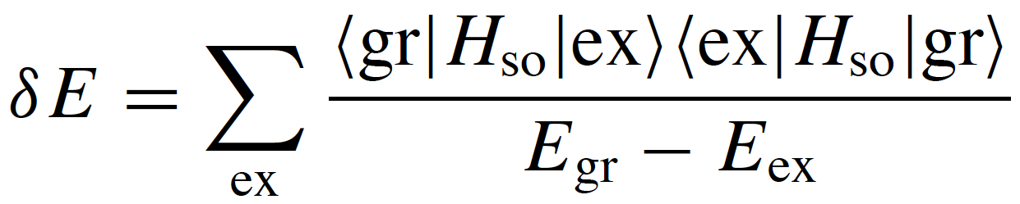

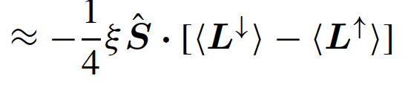

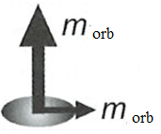
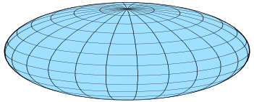
Microscopic theory of magnetic anisotropy
Magnetic anisotropy energy (MAE):
H⊥
K_{u} = E|| - E⊥
> 0 → Perpendicular magnetic anisotropy (PMA)
H||
||, ⊥
spin-conserved term
(Bruno term)
spin-flip term
ξ: spin-orbit coupling
L: orbital moment
S: spin moment
T: magnetic dipole
MAE
E_{a}
Easy axis
|
M
Bruno
relation
||
Hard
axis
G. van der Laan, JPCM (1998)
M
P. Bruno, PRB (1989).

Slide 26
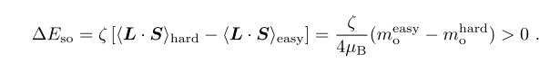
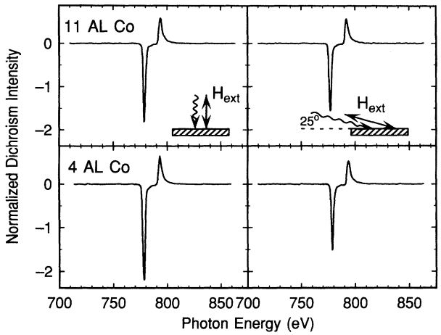
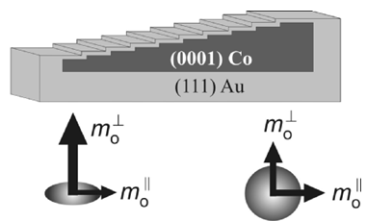
Bruno model: Magnetic anisotropy vs orbital-moment anisotropy
Magnetic anisotropy energy
M
M
a
orb
orb
ζ: spin-orbit coupling
P. Bruno, PRB (1989)
Co L_{2,3} XPCD of Au/Co multilayer
M
M
M
M
Perpendicular magnetic anisotropy (PMA)
D. Weller et al., PRL (1995), J. Stöhr, JMMM (1999)
Bruno model: Successful for Ni/Fe, Co/Fe, Co/Au, …. Interfaces, alloy thin films, …
Notes:
結晶磁気異方性 (MCA) と軌道磁気モーメントの関係としてBrunoの式が提唱されています。Bruno の関係によれば、
磁化容易軸方向の軌道磁気モーメントは困難軸方向より大きい
磁気異方性エネルギーは磁化容易軸方向と困難軸の軌道磁気モーメントの差に比例する
ということです。
つまり、Brunoの関係によれば、「結晶磁気異方性の増加、つまりL10規則度の増加に伴い、容易磁化軸方向と困難軸方向の軌道磁気モーメントの差が増加する」ことが期待されますが、以前我々が行ったFe L23端XMCDの実験ではそのような結果が得られませんでした。
加えて、オーダーしたFePt 合金の MCA の起源は Pt 5d 軌道の強いスピン軌道相互作用であり、ソロヴィエフ (Solovyev) らの第一原理計算によればオーダーしたFePt合金のPtはFeより15倍以上のMCAエネルギーもっているということが分かっています。
そこで今回我々はPtに注目して、L10規則度を変えたFePt薄膜の XMCDを面直及び面内磁場配置で測定し、まずはBrunoの関係を用いて、磁気異方性の度合いがPtの軌道角運動量の異方性の度合いによって発現しているかを調べることを目的に実験を行いました。
#----------------------------------------------------------------------------
加えて、オーダーしたFePt 合 金の MCA の起源は Pt 5d 軌道の強いスピン軌道相互作用であり [2]、スピン軌道相互作用の 2 次摂動を考慮し た第一原理計算によればオーダーした FePt 合金の Pt は Fe より 15 倍以上の MCA エネルギーを持っています [3]。これらは L10オーダーしたFePt 薄膜の MCA の起源も同様に Pt 5d 電子の軌道角運動量である可能性を示唆しています。実際、われわれの行ったFeL23端XMCDの実験では、L10 規則度の増加に伴う面直および面直磁場配置の軌道磁気モーメントの差の増加が見られませんでした。
#Bruno モデルがDOSの計算に使うハートリーフォックモデルでは平均場近似が仮定されているので、計算されたDOSはスピンの向きが異なる電子間の電子相関効果を考慮できない。
#----------------------------------------------------------------------------
電子配位子場モデルでは、結晶磁気異方性（MCA) のミクロな起源は図のように考えられている。
+z方向に外部磁場Hをかけて、スピン方向を揃えた原子のd電子を考える。
スピン方向の周りを回転運動するd電子の軌道モーメント<Lz> は-2 から +2 までの値を取る。
最も低いエネルギー準位はスピン方向が外部磁場Hと逆方向の Lz = -2 状態になる。
この原子が四隅に負または正の電荷をもつ原子の作る平面の中心にある状態を考える。
軌道上を運動する電子は負イオンの場合クーロン斥力、正イオンの場合クーロン引力をうける。
軌道上を運動する電子は2つの逆向きに進む定常波 +/-Lz の重ね合わせからなる定常波、図のような定常波をつくる。
(電子の面内軌道は分子軌道が形成されたことで消失した(図はdx2-y2とdxy)。ともいえる。)
ゆえに、軌道に付随する接合面に垂直な方向の軌道モーメントは消失する。
これに対して、近傍にイオンがいないために、電子は接合面に垂直な方向に動きにくくなる。
軌道に付随する面内軌道モーメントは消失しない。
図に示すような単純なモデルによれば、原子の軌道モーメントの異方性は結合環境の異方性に関係がある。
単層膜では、軌道モーメントL(morb=-muBL/h)は結合面内で大きく、結合面に垂直な方向で小さくなると予想できる。
多層膜の場合、これは逆になる場合がある。
#D. Weller らはCo(0001)の膜厚を変えながら図のような構造のAu(111)/Co(0001)/Au(111)薄膜を作成し、Co L3,2 XMCDを面直および面内磁場配置で測定した結果に基づき、Bruno の関係の正当性を実験的に検討しました。Coの膜厚を薄くすると結晶磁気異方性が強くなることがしられていましたが、面内と面直磁場配置で測定したXMCDから求めた軌道モーメントの差が大きくなったことから、Brunoの関係が実験的に確かめられました。

Slide 27
Giant magneto-resistive manganites
Very weak spin-orbit coupling in e_{g} orbitals.
Orbital moment M_{orb} is too weak to detect
by XMCD.
orbitals
ε
Mn
O
MnO₆ octahedron
Y. Tokura
3
→ High-spin state
Hund’s rule
> Crystal field

Slide 28
X-ray magnetic circular dichroism (XMCD)
X-ray absorption (XAS) spectra
σ ⁻
σ⁺
Circular
polarized light
Absorption
10~20 eV
Sample
σ ⁻
Spin-orbit splitting
σ⁺
Photon energy
XMCD
M_{spin}
M_{spin} + (7/2)M_{T}
Valence
level
XMCD =
I(σ⁺) – I(σ ⁻)
Spin
sum rule
σ⁺
σ ⁻
3
3
Photon energy
M_{T} = -μ_{B}T : Magnetic dipole
Core level
M_{orbital}
Spin-orbit
splitting
Orbital
sum rule
∫XMCD d(hν)
A3-A2
Element specific
Free from impurities, substrates, ..
Photon energy
B. T. Thole et al., PRL (1992), P. Carra et al., PRL (1993)

Slide 29
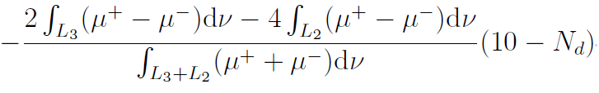





XMCD sum rules in conventional (longitudinal) geometry
Spin sum rule
≈
hν
: Magnetic dipole
M_{T}
M_{spin}
M_{orb}
≈ 0 for cubic symmetry
Sample
Orbital sum rule
H
: Unit vector || photon helocity

Slide 30

XMCD in transverse geometry (T-XMCD)
Spin sum rule
H
hν
M_{spin}
M_{T}
X
M_{orb}
Sample
: Magnetic dipole
|
Orbital sum rule
||
: Unit vector || photon helicity
H. A. Dürr and G. van der Laan, PRB (1995)

Slide 31




XMCD in transverse geometry (T-XMCD)
M_{T}
hν
Orbital sum rule →
M||_{orb} - M⊥_{orb} changes sign between tensile and
compressive strain.
k
According to Bruno model, K_{u} ≡ E|| - E⊥ should
also change sign, consistent with MAE.
However, the sign of M||_{orb} - M⊥_{orb} cannot be
determined with sufficient accuracy.
G. Shibata, AF et al., npj Quantum Mater. (2018)

Slide 32
Beyond the Bruno model – Magnetic dipole
Magnetic anisotropy energy (MAE):
H⊥
K_{u} = E|| - E⊥
> 0 → Perpendicular magnetic anisotropy (PMA)
H||
||, ⊥
small
spin-conserved term
(Bruno term)
spin-flip term
ξ: spin-orbit coupling
L: orbital moment
S: spin moment
T: magnetic dipole
MAE
E_{a}
Easy axis
|
M
Bruno
relation
||
Hard
axis
M
P. Bruno, PRB (1989).
G. van der Laan, JPCM (1998)

Slide 33

XMCD in transverse geometry (T-XMCD)
Spin sum rule
H
hν
X
M_{spin}
M_{T}
X
≈
M_{orb}
Sample
: Magnetic dipole
|
Orbital sum rule
||
: Unit vector || photon helicity
H. A. Dürr and G. van der Laan, PRB (1995)

Slide 34






Magnetic dipole M_{T} reflecting the spin-density anisotropy
where
: position operator of electron,
Q_{xx}
Q_{yy}
Q_{zz}
Q: Quadrupole tensor
defines the anisotropic distribution of spin density ρ_{spin}(r)
〈S〉
〈T〉
x²-y²
Q_{zz}>0
〈S⋅T〉 > 0
〈S⋅T〉 ~ 0
〈S⋅T〉 < 0
〈S〉
〈T〉
3z²-r²
Q_{zz}<0
〈S⋅T〉 < 0
〈S⋅T〉 ~ 0
〈S⋅T〉 > 0
J. Stöhr and H. König, PRL (1995), H. A. Dürr and G. van der Laan, PRB (1996)

Slide 35
XMCD in transverse geometry (T-XMCD)
〈S⋅T〉 > 0
〈S⋅T〉 < 0
M_{T}
hν
Spin sum rule →
T (M_{T}) changes sign between tensile and
compressive strain.
k
G. Shibata, AF et al., npj Quantum Mater. (2018)

Slide 36
Magnetic dipole M_{T} reflecting the spin-density anisotropy
where
: position operator of electron,
Q_{xx}
Q_{yy}
Q_{zz}
Q: Quadrupole tensor
defines the anisotropic distribution of spin density ρ_{spin}(r)
〈S〉
〈T〉
x²-y²
Q_{zz}>0
LSMO/STO
〈S⋅T〉 ~ 0
〈S⋅T〉 < 0
〈S⋅T〉 > 0
〈S〉
〈T〉
3z²-r²
Q_{zz}<0
〈S⋅T〉 < 0
LSMO/LAO
〈S⋅T〉 > 0
〈S⋅T〉 ~ 0
J. Stöhr and H. König, PRL (1995), H. A. Dürr and G. van der Laan, PRB (1996)

Slide 37
Beyond the Bruno model – Magnetic dipole
Magnetic anisotropy energy (MAE):
H⊥
K_{u} = E|| - E⊥
> 0 → Perpendicular magnetic anisotropy (PMA)
H||
||, ⊥
small
spin-conserved term
(Bruno term)
spin-flip term
ξ: spin-orbit coupling
L: orbital moment
S: spin moment
T: magnetic dipole
MAE
E_{a}
Easy axis
|
M
Bruno
relation
||
Hard
axis
M
P. Bruno, PRB (1989).
G. van der Laan, JPCM (1998)

Slide 38
Angular-dependent XMCD of strained La_{1-x}Sr_{x}MnO₃ film on SrTiO₃ and LaAlO₃ substrates
La_{0.6}Sr_{0.4}MnO₃/SrTiO₃(001)
La_{0.7}Sr_{0.3}MnO₃/LaAlO₃(001)
M
M
compressive
tensile
MAE
Magnetic dipole
+
+
+
MAE
+
MAE
K_{u} = - (1.9±0.1) x 10⁴ J/m³ < 0
in-plane easy axis
K_{u} = (4.0±0.4)×10⁴ J/m³ > 0
out-of-plane easy axis
G. Shibata, AF et al., npj Quantum Mater. (2018)

Slide 39
Magnetic dipole as the origin of magnetic anisotropy?
Magnetic anisotropy
Orbital anisotropy
M
M
Orbital polarization induced by H
Magnetization induced by H
?
H

Slide 40

Observation of anisotropic charge density induced by H by x-ray magnetic linear dichroism (XMLD)
H
V
hν
L₃
L₂
H-pol
XMLD
V-pol
Integral of
XMLD
z
〈Q_{zz}〉
M_{spin}
y
XMLD sum rule
^
^
H || z
x
Q_{ij} ≡ δ_{ij} – 3r_{i}r_{j}
〈Q_{zz}〉 = 〈1 – 3z²/r²〉
∝ ∫_{L3+L2} (XMLD) d(hv)
B. Thole et al., PRL 55 (1985)

Slide 41


Mn L_{2,3} XMLD of La_{0.6}Sr_{0.4}MnO₃/SrTiO₃(001)
XMLD
intensity
∝ M²
G. Shibata, AF et al., submitted to JPSJ

Slide 42
Magnetic dipole as the origin of magnetic anisotropy?
Magnetic anisotropy
Orbital anisotropy
M
M
Orbital polarization induced by H
Magnetiztion induced by H
?
H
G. Shibata, AF et al., submitted to JPSJ

Slide 43



L1₀-ordered FePt thin film with strong perpendicular anisotropy
L1₀ (fct, a>c)
Fe
anneal
Pt
H⊥
M-H curves
H||
S = 0.8
S = 0.5
S = 0.4
S: Degree of L1₀ order
T. Seki, K. Takanashi et al., J. Phys. D (2011)

Slide 44

Fe L_{2,3} XMCD of L1₀-ordered FePt thin film
L1₀ (fct, a>c)
FePt Fe L_{2,3} XMCD
Fe
Pt
H⊥
M_{spin}(Fe) ~ 2 μ_{B}
H||
MAE
E_{a}
Easy axis
M
Bruno
relation
Hard
axis
M
K. Ikeda, AF et al., APL (2017)

Slide 45



Pt L_{2,3} XMCD of L1₀-ordered FePt thin film
L1₀ (fct, a>c)
FePt Pt L₃ XMCD
Pt L₂ XMCD
Fe
Pt
H⊥
M_{spin}(Pt) ~ 0.3 μ_{B}
H||
MAE
E_{a}
Easy axis
M
Bruno relation
violated !
M
Hard
axis
K. Ikeda, AF et al., APL (2017)

Slide 46
Comparison with first-principles calculations:
Roles of Fe 3d and Pt 5d electrons in MAE
 |  | Fe |  | Pt
 |  | M_{spin} (μ_{B}) | M_{orb} (μ_{B}) | M_{spin} (μ_{B}) | M_{orb} (μ_{B})
Experiment XMCD M-H | out-of-plane | 2.00 | 0.20 | 0.30 | 0.036
 | in-plane | 1.80 | 0.15 | 0.29 | 0.041
 | M_{orb} (⊥-||) | - | 0.05 | - | -0.005
 | MAE (||-⊥) = K_{u} (MJ/m³) | 4.7
First-principles calculation | out-of-plane | 2.77 | 0.0802 | 0.35 | 0.0486
 | in-plane |  | 0.0690 |  | 0.0616
 | m_{orb} (out - in) | - | 0.0112 | - | -0.0130
 | MAE (in - out) = K_{u} (MJ/m³) | -0.887 |  | 14.28
“Bruno”
Non-Bruno
Non-Bruno
Non-Bruno
Notes:
有効数字
Solovyev 、Fe L edge 等の結果をまとめtる => MAE mainly comes from Pt sites ちゃんと oral で
Solovyev. 産総研 contact …? absolute valueの解析を進める。

Slide 47
Comparison with first-principles calculations:
Roles of Fe 3d and Pt 5d electrons in MAE
 |  | Fe |  | Pt
 |  | M_{spin} (μ_{B}) | M_{orb} (μ_{B}) | M_{spin} (μ_{B}) | M_{orb} (μ_{B})
Experiment XMCD M-H | out-of-plane | 2.00 | 0.20 | 0.30 | 0.036
 | in-plane | 1.80 | 0.15 | 0.29 | 0.041
 | M_{orb} (⊥-||) | - | 0.05 | - | -0.005
 | MAE (||-⊥) = K_{u} (MJ/m³) | 4.7
First-principles calculation | out-of-plane | 2.77 | 0.0802 | 0.35 | 0.0486
 | in-plane |  | 0.0690 |  | 0.0616
 | M_{orb} (⊥-||) | - | 0.0112 | - | -0.0130
 | MAE (||-⊥) = K_{u} (MJ/m³) | -0.887 |  | 14.28
“Bruno”
Non-Bruno
<<
Non-Bruno
Non-Bruno
Pt dominates MAE and hence PMA!
First-principles calculation by I. V. Solovyev et al., PRB (1995)
Notes:
有効数字
Solovyev 、Fe L edge 等の結果をまとめtる => MAE mainly comes from Pt sites ちゃんと oral で
Solovyev. 産総研 contact …? absolute valueの解析を進める。

Slide 48
MAE of L1₀-ordered FePt thin film
 | Bruno | Magnetic dipole M_{T}
Fe
Pt
×
×

Slide 49
Beyond the Bruno model – Magnetic dipole
Magnetic anisotropy energy (MAE):
H⊥
K_{u} = E|| - E⊥
> 0 → Perpendicular magnetic anisotropy (PMA)
H||
||, ⊥
spin-conserved term
(Bruno term)
spin-flip term
ξ: spin-orbit coupling
L: orbital moment
S: spin moment
T: magnetic dipole
MAE
E_{a}
Easy axis
|
M
Bruno
relation
||
Hard
axis
M
P. Bruno, PRB (1989).
G. van der Laan, JPCM (1998)

Slide 50


Angular-dependent XMCD
Superconducting vector magnet
XAS and XMCD spectra of
L1₀-ordered FePt thin film
S = 0.4
H
Sample rotation
hν
@Apple II undulator BL-16, KEK-PF
hν
k
G. Shibata, AF et al., npj Quantum Mater. (2018)
K. Ikeda, G. Shibata, AF et al.

Slide 51


Magnetic dipole M_{T} reflecting the anisotropic spatial distribution of spin density
where
: position operator of electron,
Q_{xx}
Q_{yy}
Q_{zz}
Q: Quadrupole tensor
Defines the anisotropic distribution of spin density ρ_{spin}(r)
〈S〉
〈T〉
Q_{zz}>0
〈S⋅T〉 > 0
〈S⋅T〉 ~ 0
〈S⋅T〉 < 0
〈S〉
〈T〉
Q_{zz}<0
〈S⋅T〉 < 0
〈S⋅T〉 ~ 0
〈S⋅T〉 > 0
J. Stöhr and H. König, PRL (1995), H. A. Dürr and G. van der Laan, PRB (1996)

Slide 52

Magnetic anisotropy measured by angular-dependent XMCD
Stoner-Wohlfarth model
MAE
SA
Zeeman
K_{u} = 0.38 MJ/m³
Fe L_{2,3}-edge XMCD intensity
+ T: Magnetic dipole
-MH + SA + MAE + T
hν
-MH + SA + MAE
-MH + SA
k
Expt
-MH + SA
k
-MH + SA + MAE
-MH + SA + MAE + T
θ_{H} (deg)
G. Shibata, AF et al., npj Quantum Mater. (2018)
K. Ikeda, G. Shibata, AF et al.

Slide 53
Beyond the Bruno model – Magnetic dipole
Magnetic anisotropy energy (MAE):
H⊥
K_{u} = E|| - E⊥
> 0 → Perpendicular magnetic anisotropy (PMA)
H||
||, ⊥
spin-conserved term
(Bruno term)
spin-flip term
〈S⋅T〉 < 0
ξ: spin-orbit coupling
L: orbital moment
S: spin moment
T: magnetic dipole
MAE
E_{a}
Easy axis
Does not explain the PMA
|
M
Bruno
relation
||
Hard
axis
M
P. Bruno, PRB (1989).
G. van der Laan, JPCM (1998)

Slide 54
MAE of L1₀-ordered FePt thin film
 | Bruno | Magnetic dipole M_{T}
Fe
Pt
×
×
×
√ ?
  May be explained by the anisotropic spin distribution of Pt 5d electrons?
  → Further angular-dependent XMCD studies at the Pt L edge are needed.

Slide 55
Beyond the Bruno model – Magnetic dipole
Magnetic anisotropy energy (MAE):
H⊥
K_{u} = E|| - E⊥
> 0 → Perpendicular magnetic anisotropy (PMA)
H||
||, ⊥
large
small
↑
4d, 5d TM
spin-conserved term
(Bruno term)
spin-flip term
ξ: spin-orbit coupling
L: orbital moment
S: spin moment
T: magnetic dipole
MAE
E_{a}
Easy axis
|
M
Bruno
relation
||
Hard
axis
M
P. Bruno, PRB (1989).
G. van der Laan, JPCM (1998)

Slide 56
Conclusion
MA of 3d transition-metal and alloy thin films can be explained by M_{orb} anisotropy (the Bruno model).
Weak MA of LSMO thin films driven by epitaxial strain is difficult to explain by the Bruno model because of too small M_{orb} and too small M_{orb} anisotropy. On the other hand, the MA can explained by the spin-density anisotropy M_{T}.
Strong PMA of L1₀-ordered FePt thin film cannot be explained by the Bruno model. The M_{T} of Pt 5d electrons should play the major role owing to their very strong spin-orbit interaction.
Outlook
Further angular-dependent XMCD studies at the heavy-metal L_{2,3} edges (in the hard x-ray region).
Temperature dependence of MAE, M_{orb} anisotropy, and M_{T} .
Origin of MAE in cubic systems (CoFe₂O₄, Fe₃O₄ etc).
H
hν
SR
Sample rotation
La_{1-x}Sr_{x}MnO₃
L1₀-phase FePt

Slide 58

Core levels for x-ray absorption for XMCD
2p
3d
4d
4f
5d
5f
VUV
Light
elements
Soft x ray
Energy
← N_{4,5} edge
3d transition
elements
← N_{2,3} edge
4d transition
elements
← M_{4,5} edge
Hard x ray
← M_{2,3} edge
Lanthanides
5d transition
elements
← L_{2,3} edge
Actindes
O
Mn,Fe
La
Pt
← K edge
Atomic number
菅野暁，藤森淳，吉田博編：
新しい放射光科学（講談社，2000）

Slide 59






Magnetic anisotropy of ferromagnet with cubic symmetry
Magnetic anisotropy energy
[001]
M-H curves
Anisotropy energy surface
[111]
Easy axis: [001]
Easy axis: [111]
M. J. D. Coey, Magnetism and Magnetic Materials (Cambridge, 2009)

Slide 60

XMCD apparatus with the vector-type superconducting magnet
hν
hν
⊗

Slide 61


Temperature dependence of MAE in La_{0.6}Sr_{0.4}MnO₃/SrTiO₃(001)
Angle dependence of Mn L_{2,3} XMCD
intensity
Temperature dependences of
M_{sat} and K_{u}
(<0)
T_{C}
LSMO (20 ML)/STO
G. Shibata et al., unpublished

Slide 62


Temperature dependence of MAE in manganite thin films
MAE of La_{0.67}Ca_{0.33}MnO₃
Magnetization of La_{0.6}Sr_{0.4}MnO₃
∝ K_{u}
J. O’Donnell et al., APL (1998)
K. Yoshimatsu et al., APL (2009)

