Slide 1

Present Status of
Siam Photon Source &
Soft X-ray Beamline
Pat Photongkam
Beamline Scientist (BL3.2Ub) & Acting Chief of Beamline Design and Support Division
Research Facility Division
Synchrotron Light Research Institute
pat@slri.or.th

Slide 2
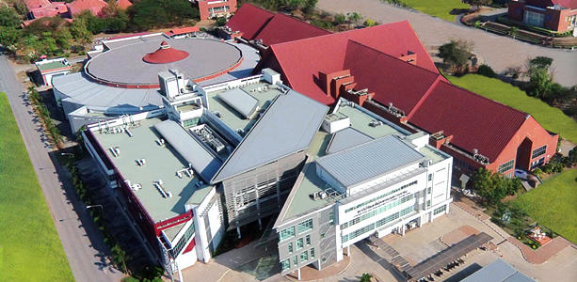

About us
Synchrotron Light Research Institute
Nakhon-Ratchasima
Bangkok
Thailand synchrotron research center under supervision of the Ministry of Science and Technology.
Located in the area of Suranaree University of Technology, approx. 265 km from Suvarnabhumi international airport

Slide 3
About us
Vision
Target Groups
International Help & Support
Be a national research center with high efficiency in performing and promoting synchrotron research and development for sustainable development of Thailand
Local
SRA
SATI
Workshops
Training
South East Asia
SR2A
ASEAN Synchrotron Science Camp
ASEAN Workshop
International
Spring-8
NSRRC
CERN
DESY
ESRF
Daresbury Laboratory
Diamond
Australian Synchrotron
etc.

Slide 4
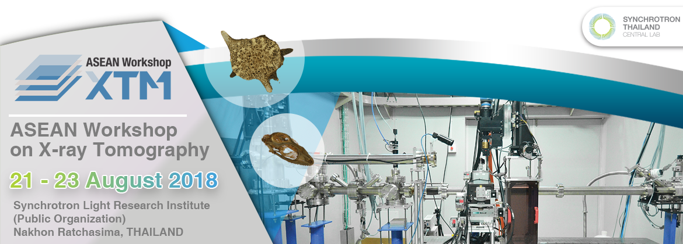
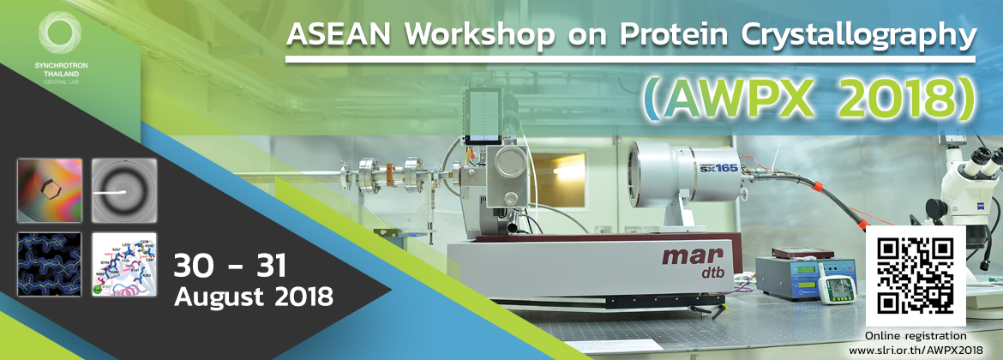


Slide 5
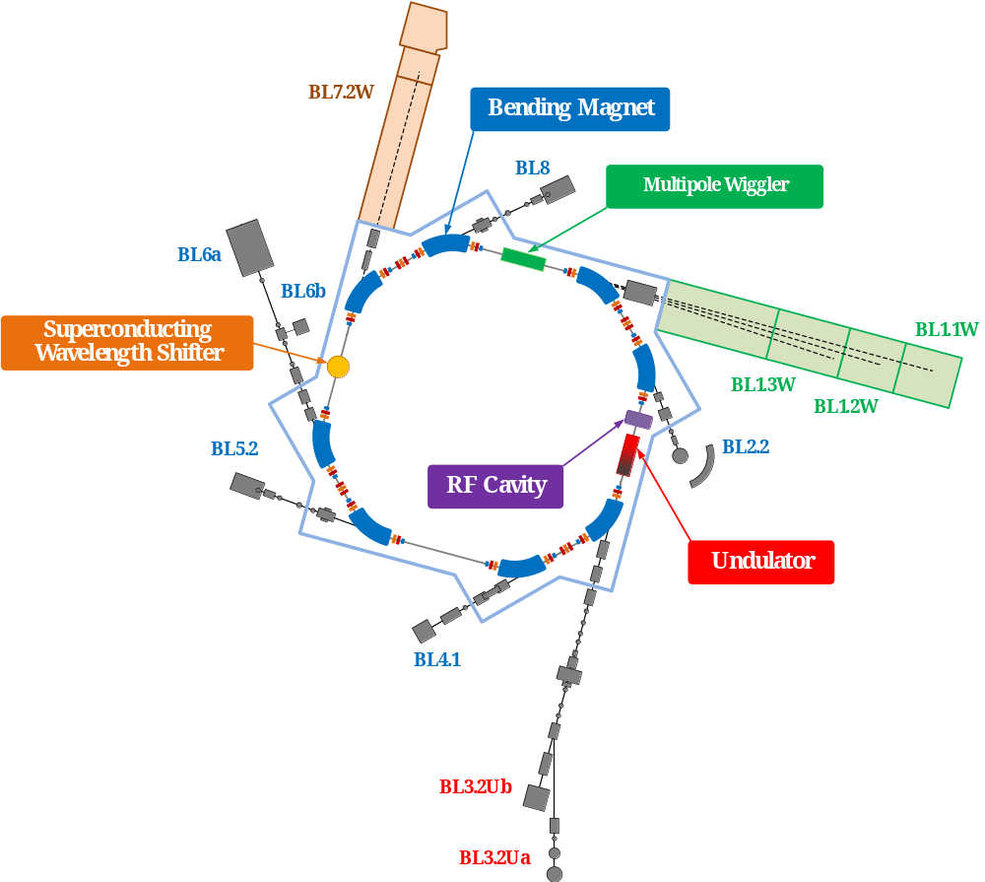
Siam Photon Source
Present Status (May 2018)
Storage ring
Decay mode
Electron energy = 1.2 GeV
I_{max} = 150 mA
Emittance = 61 nm.rad
Beamlines and End stations
10 beamlines with total of 12 end stations

Slide 6
Siam Photon Source
Beam Service and Machine Shutdown
Holiday
Round-2
Round-1
11 hrs / shift
JAN - MAY
Holiday
SEP - DEC
JUN - AUG
8.00 am – 9:00 am
Beam Injection
8.00 am – 9:00 am
Shutdown

Slide 7
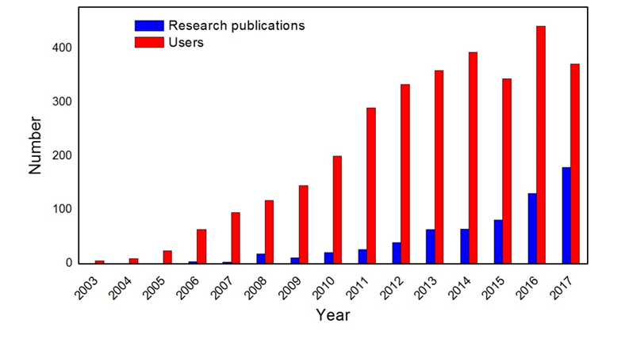
Siam Photon Source
Number of annual Siam Photon Source users and publication during 2003-2017

Slide 8
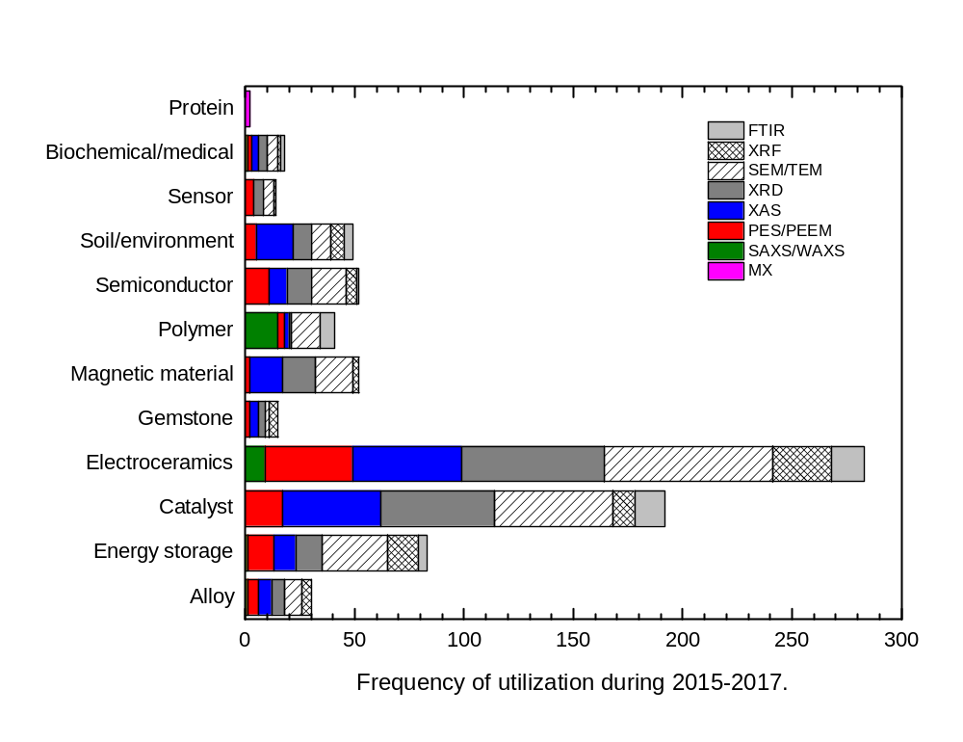
Siam Photon Source
Frequency of utilization on different classes of materials in published research during 2015-2017.

Slide 9
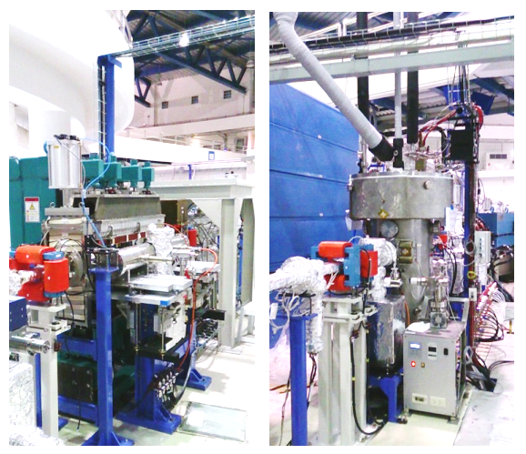
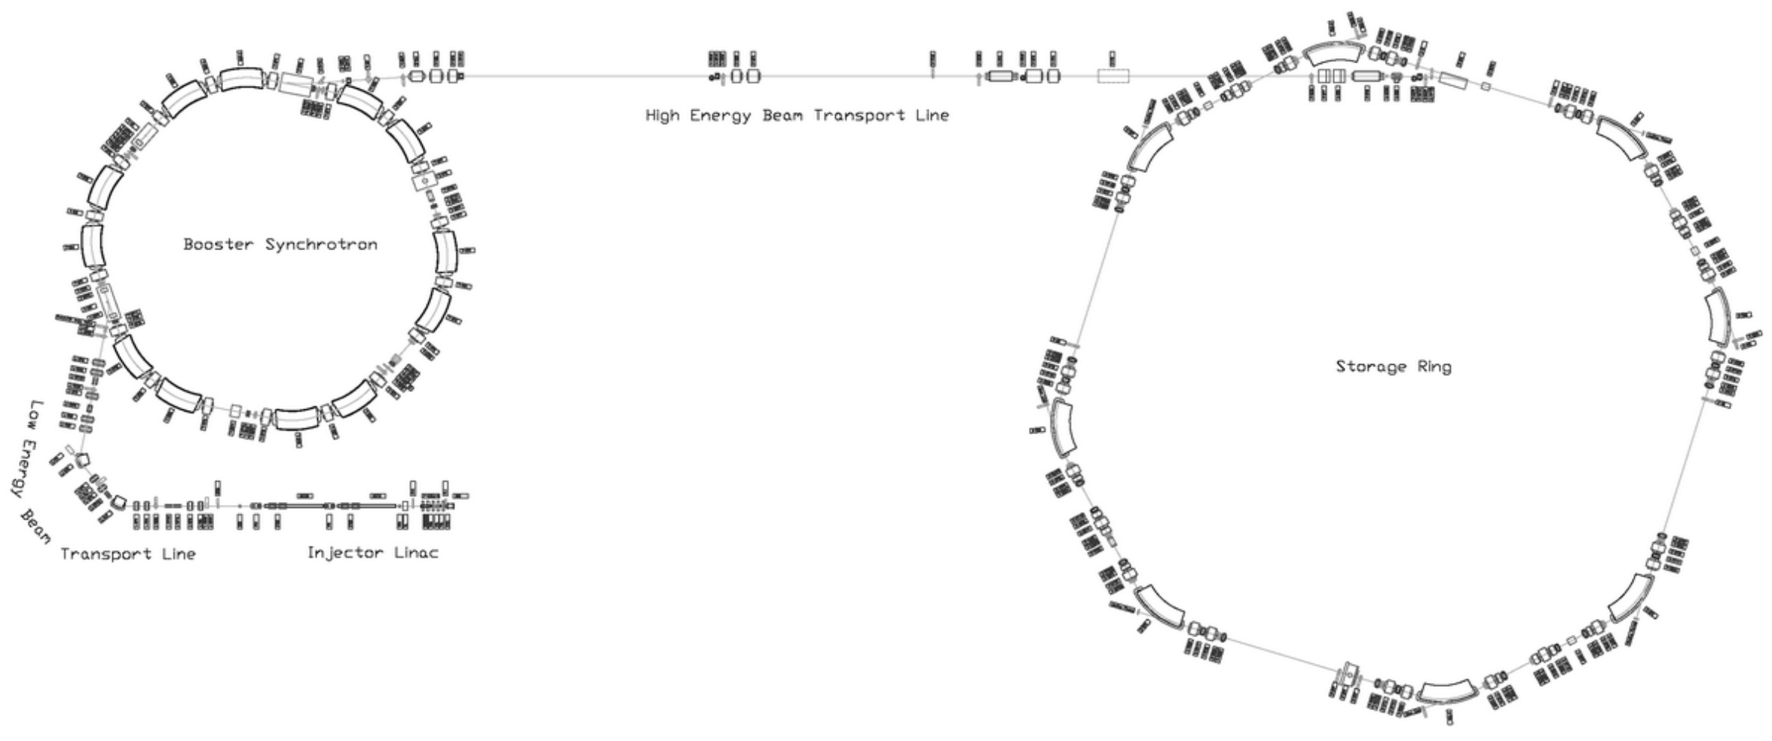
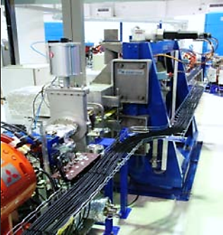
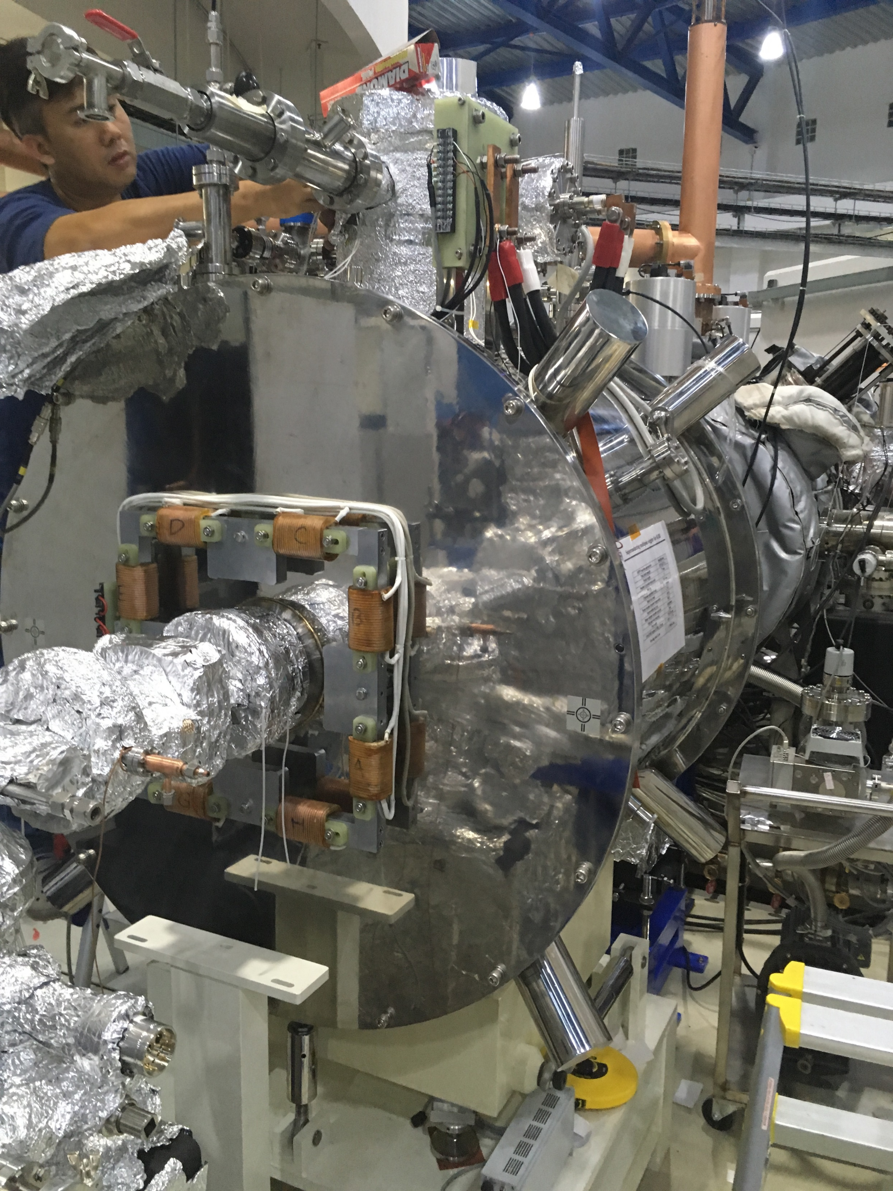
Siam Photon Source
2.4T Hybrid MPW
ASTeC, Daresbury
1.2 GeV
Booster
Synchrotron
1.2 GeV Storage Ring
81.3m Circumference
24 BPM
40 MeV Linac
Planar U60 PMM
Danfysik Co., Ltd
6.5T SWLS
NSRRC
New SMPW
August 2018

Slide 10
Development of Siam Photon Source
New 3 GeV Light Source
BL ASEAN
XAS (BL5.2)
MXT, XMCT & IR
PES, PEEM, SAXS & µ-XRF
MX
2019
2018
TRXAS
2016
Full Energy Injection
& SMPW
2015
XAS (BL8) & DXL
2014
RF Cavity upgrade
2012
2011
1.2 GeV Booster upgrade
2010
Open service
2009
2008
MPW 2.4T & SWLS 6.5T
Install the 1st beamline: photoemission
2005
Fault Tolerant Control
2003
NSRC to SLRI
2002
U60 Installation
2001
1.2 GeV STR upgrade
1998
1.0 GeV storage ring, the first SR light
1996
Installation, major parts from SORTEC
NSRC Project Approved

Slide 11
Full Energy Injection
1.0 GeV
U60 undulator
1.2 GeV booster
Full Energy Injection
2001
2005
2010
2014
2015
2016
2018
1 GeV Booster
1.2 GeV STR
2.4T MPW
6.5T SWLS
RF cavity upgraded
Problem of 1.0 to 1.2 GeV Ramp Up
High Load on machine components
Beam instability
Beam dump required for filling electron
More difficult for increasing # machine component
High level of adjustment required
Benefit of Full Energy Injection
Filling electron without dumping beam
Requiring short time to stabilize
Low level of adjustment

Slide 12
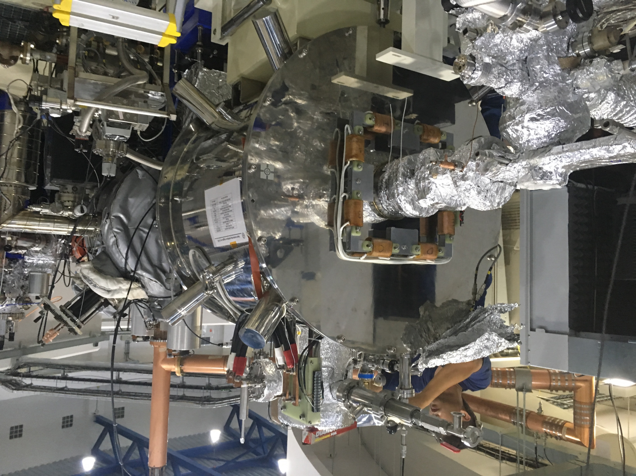
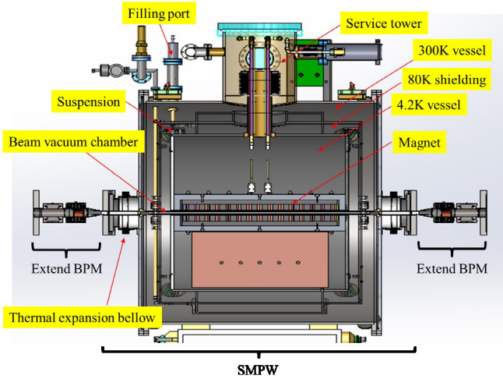
ASEAN Beamline
BL6b shutting down in May 2019
End Station Installation & Commission
New Bending Magnet Installed
2016
2017
2018
2019
2020
SMPW Design and Produce at NSRRC
Installation
SMPW & Beamline
Officially Open
Photon Energy:
4-30 keV
Spot size ~ 20 micron
Proposed technique:
Micro XAS
Micro XRF & Imaging

Slide 13


Study New Electron Reference Orbit
Setting Reference Orbit
Change vertical orbit in sextupole
Change the horizontal orbit in MPW
Reduce coupling
Reduce vertical beam size
Location | Upstream BPM | Downstream BPM
MPW | BPM1 | BPM2
BL1 | BPM3 | BPM4
BL2 | BPM6 | BPM7
U60 | BPM7 | BPM8
BL3 | BPM8 | BPM9
BL4 | BPM11 | BPM12
BL5 | BPM13 | BPM14
BL6 | BPM16 | BPM17
SWLS | BPM18 | BPM19
BL7 | BPM20 | BPM21
BL8 | BPM23 | BPM24
Increase Brightness
Reduce beam lifetime

Slide 14
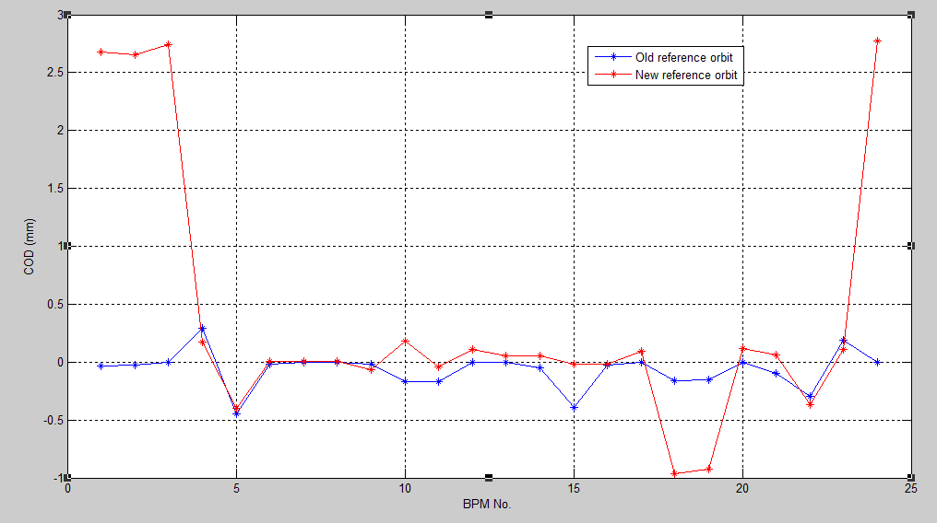
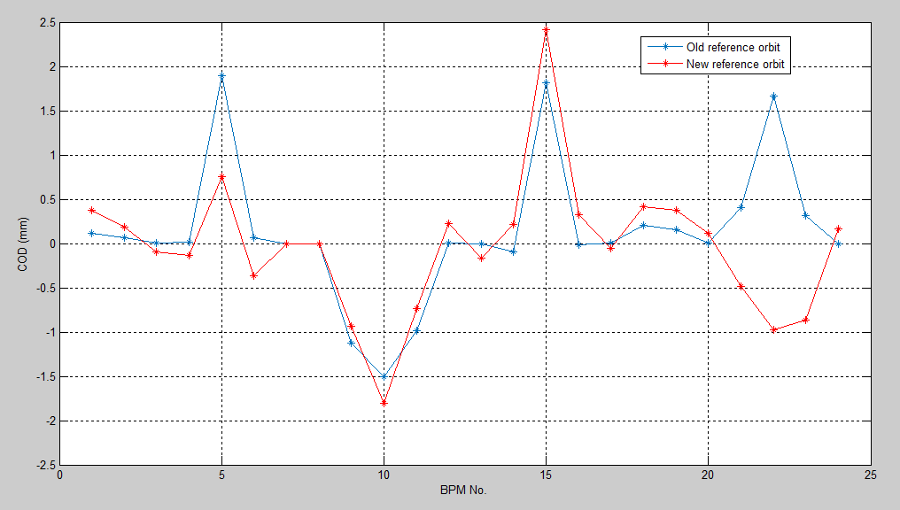
Study New Electron Reference Orbit
BPM no. | Hor. Diff (mm) | Ver. Diff (mm)
BPM1 | 2.7115 | 0.2588
BPM2 | 2.6804 | 0.1246
BPM3 | 2.7382 | -0.0960
BPM4 | -0.1204 | -0.1569
BPM5 | 0.0499 | -1.1389
BPM6 | 0.0249 | -0.4248
BPM7 | 0.0063 | -0.0006
BPM8 | 0.0065 | 0.0001
BPM8 | -0.0484 | 0.1921
BPM10 | 0.3491 | -0.3057
BPM11 | 0.1296 | 0.2540
BPM12 | 0.1106 | 0.2190
BPM13 | 0.0533 | -0.1680
BPM14 | 0.1070 | 0.3139
BPM15 | 0.3735 | 0.5970
BPM16 | 0.0091 | 0.3383
BPM17 | 0.0918 | -0.0562
BPM18 | -0.8000 | 0.2109
BPM19 | -0.7726 | 0.2118
BPM20 | 0.1151 | 0.1191
BPM21 | 0.1607 | -0.8943
BPM22 | -0.0758 | -2.6322
BPM23 | -0.0793 | -1.1740
BPM24 | 2.7756 | 0.1678
Horizontal direction
Vertical direction

Slide 15
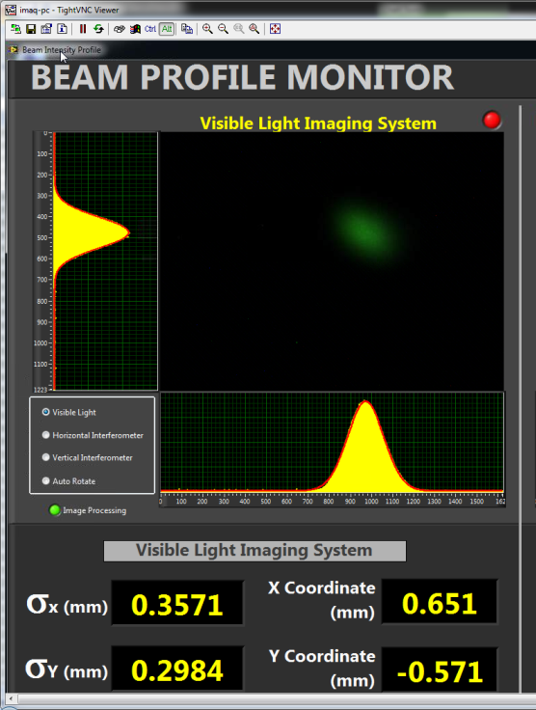
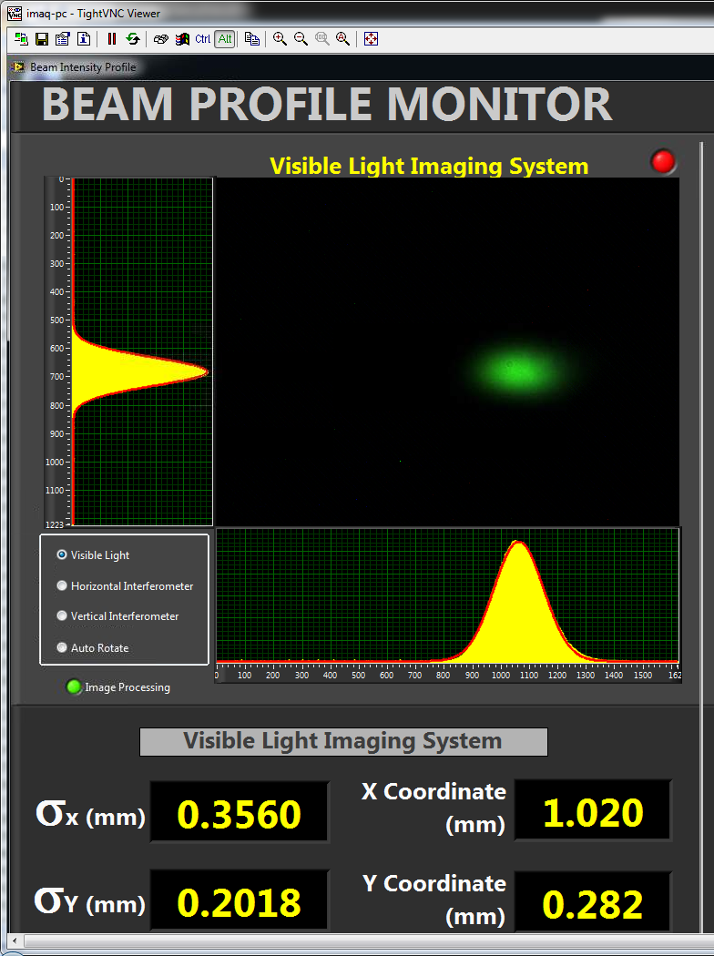
Study New Electron Reference Orbit
Old Reference Orbit
New Reference Orbit
Optimize orbit in sextupole magnet
Bump orbit in MPW
Coupling 5.5%
Beam product 69,000 mA.min
Coupling 11.7%
Beam product 90,000 mA.min
Vertical beam size reduce by 30%

Slide 16
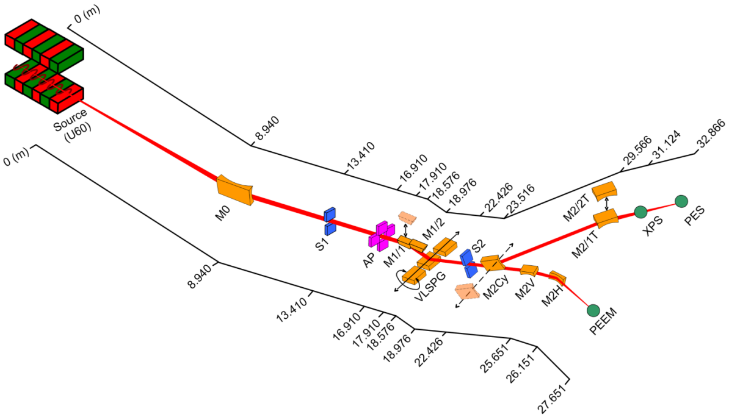
Soft X-ray Beamline
1.0 GeV
Bending Magnet
New post-focusing mirror for BL3.2Ua
U60 undulator
2001
2005
2010
2011
2013
2017
1.2 GeV STR upgrade
BL3.2Ua: PES
BL3.2Ub: PEEM
Harmonic Rejection for BL3.2Ua
Technical specification
Photon energy: 40-160, 220-1040 eV
Energy resolution: 1x10⁻⁴
Flux: 1x10¹⁰ phs/s
Beam size: < 1 mm²

Slide 17
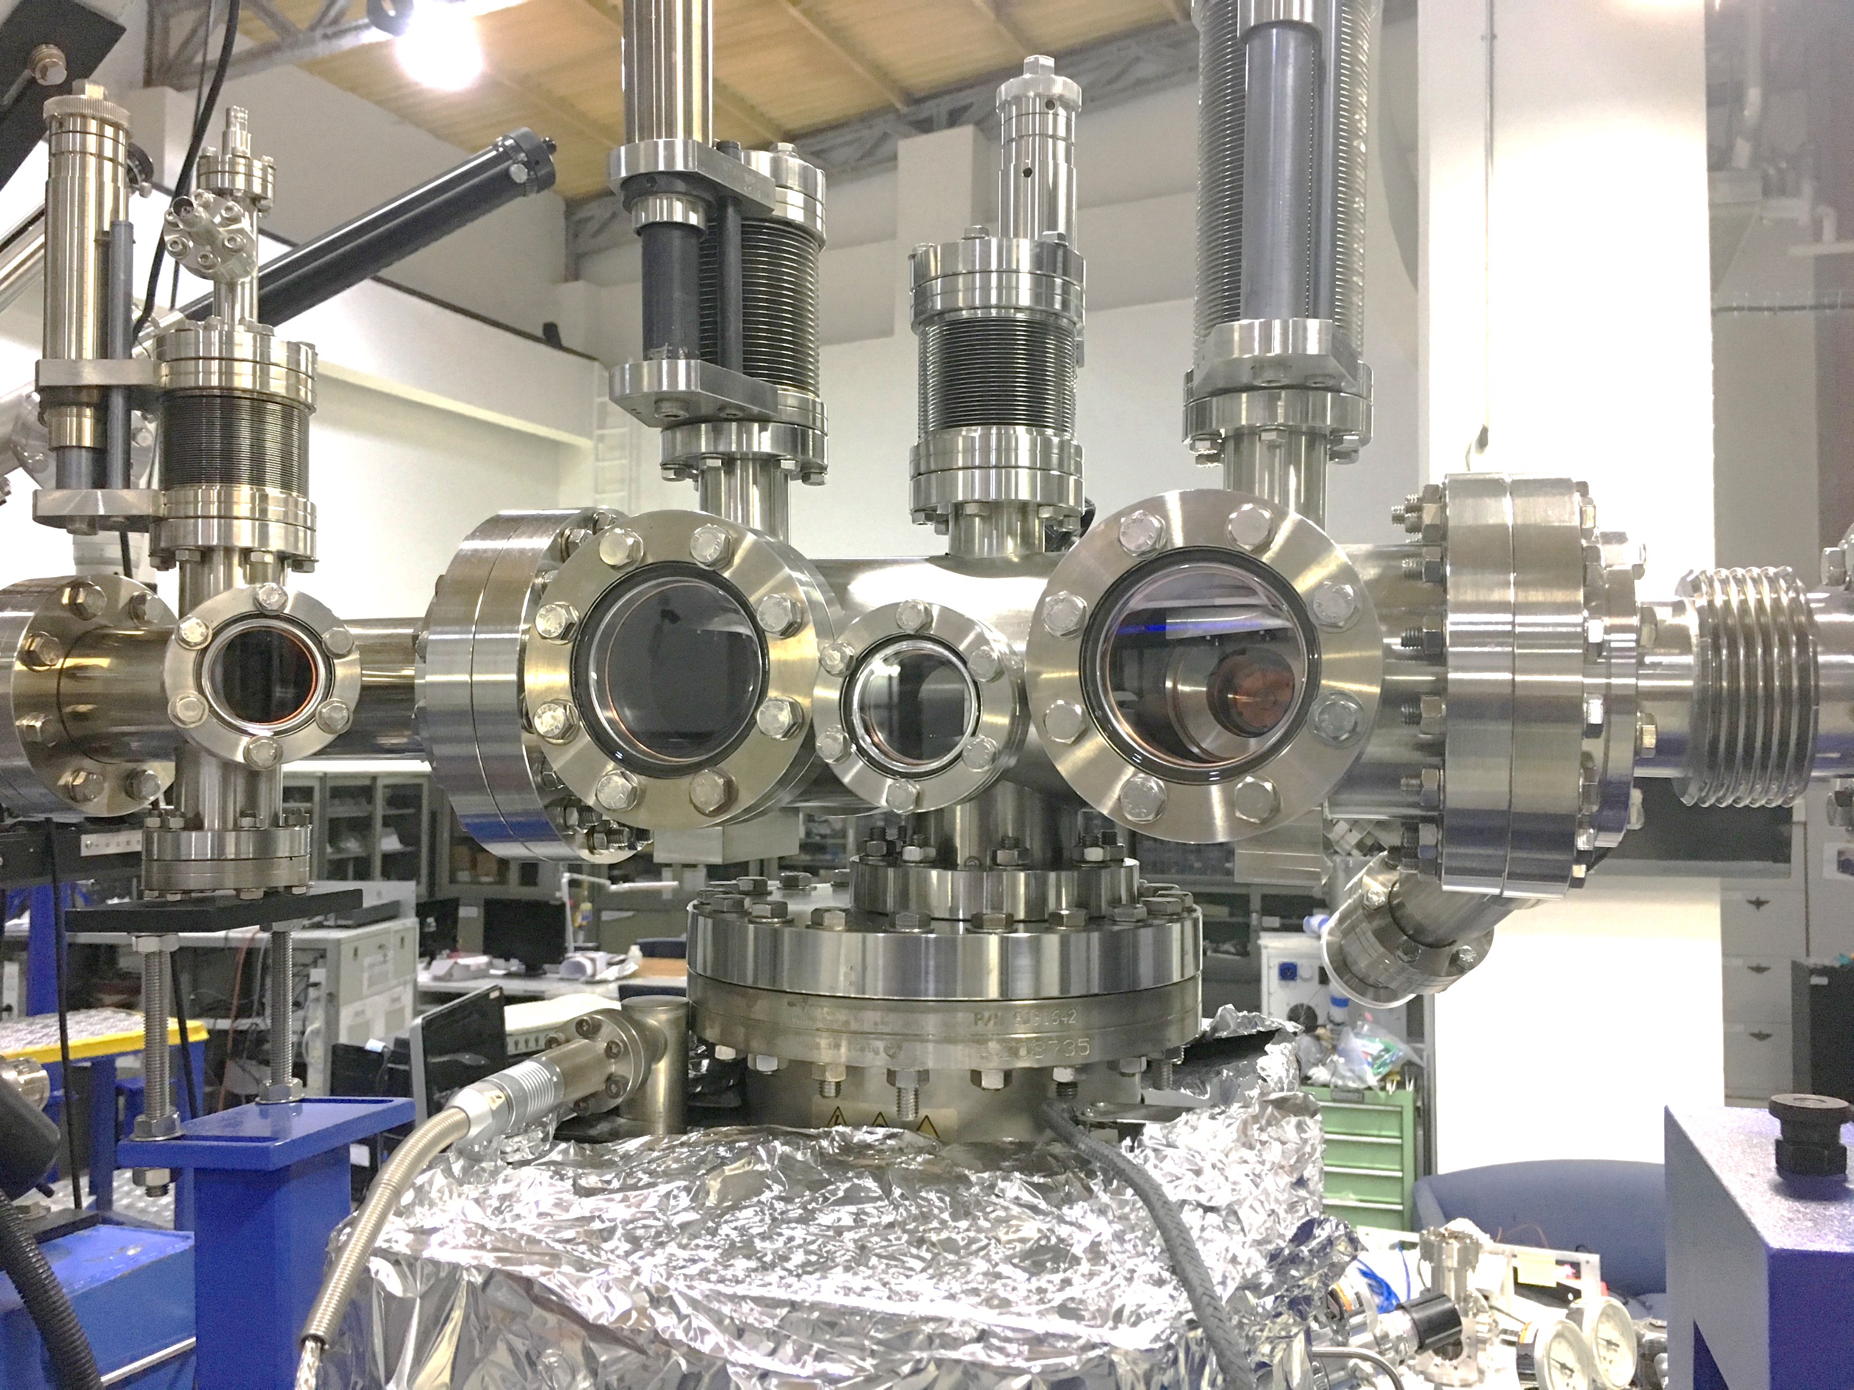
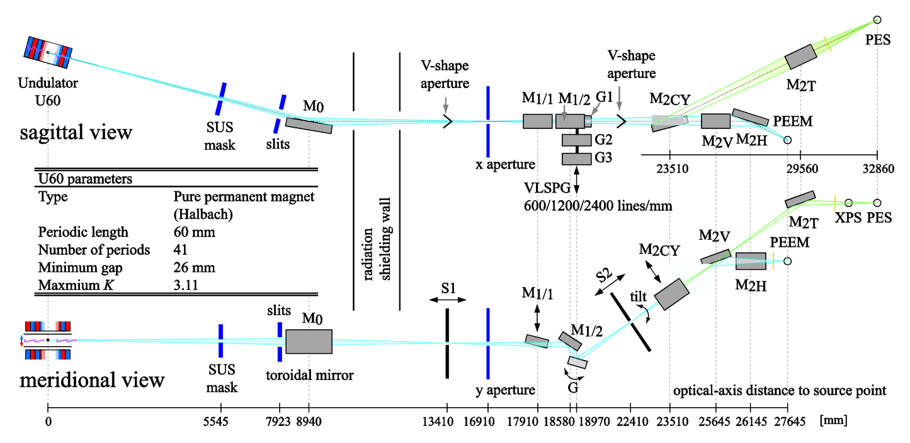
Soft X-ray Beamline
Three-bounce Harmonic Rejection Mirrors Chamber

Slide 18
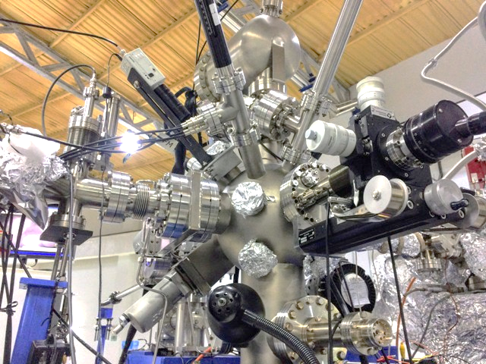
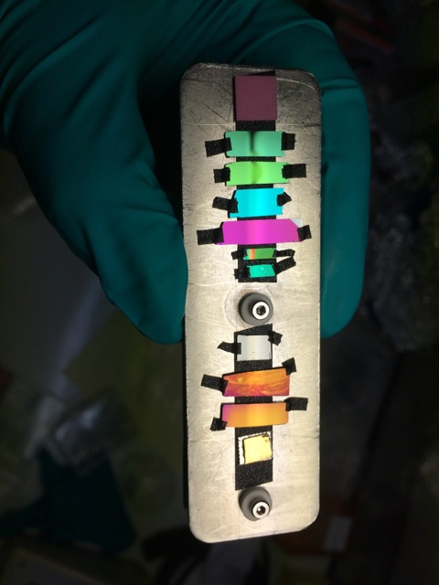
BL3.2Ua:PES
a) XPS Station
Technique: XPS, EY-XAS, FY-XAS
CLAM2 hemispherical analyzer
(Thermo VG Scientific/VG Microtech)
SSD/MCP
Pico-ammeters
Current linear amplifier
Ion sputtering gun

Slide 19
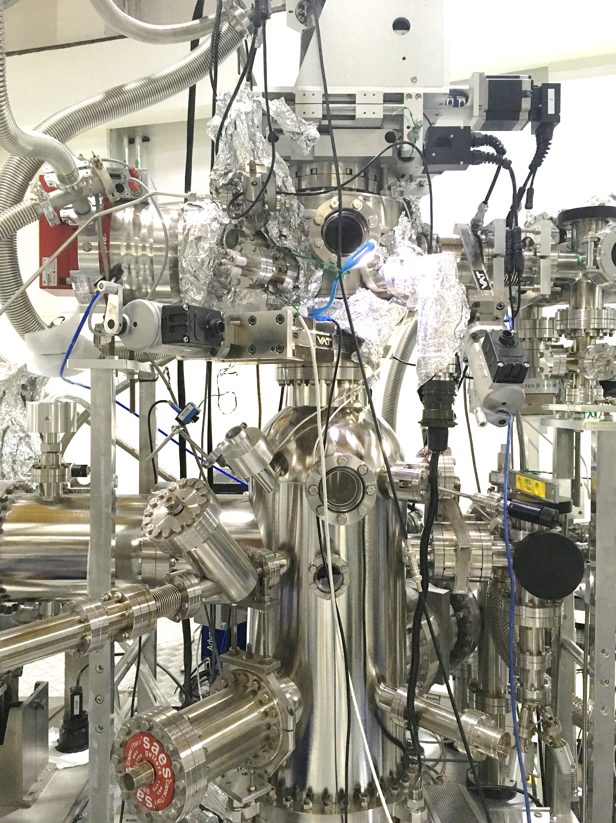
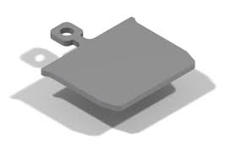
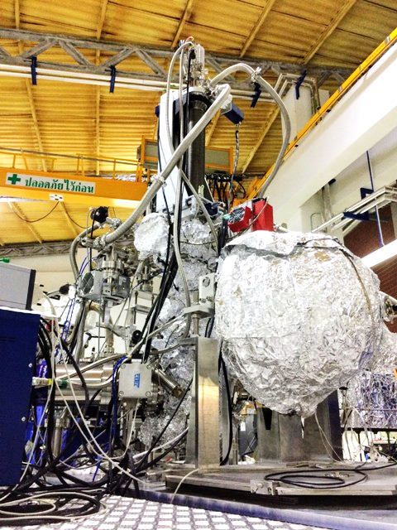
BL3.2Ua:PES
b) ARPES Station
Technique: ARPES
VG Scienta R4000 hemispherical analyzer
(replaced Thermo VF Scientific ARUPS10 in 2014)
20K 6-axis sample manipulator
Ion sputtering gun
Sample heating capability
Sample Holder
SHOM type

Slide 20
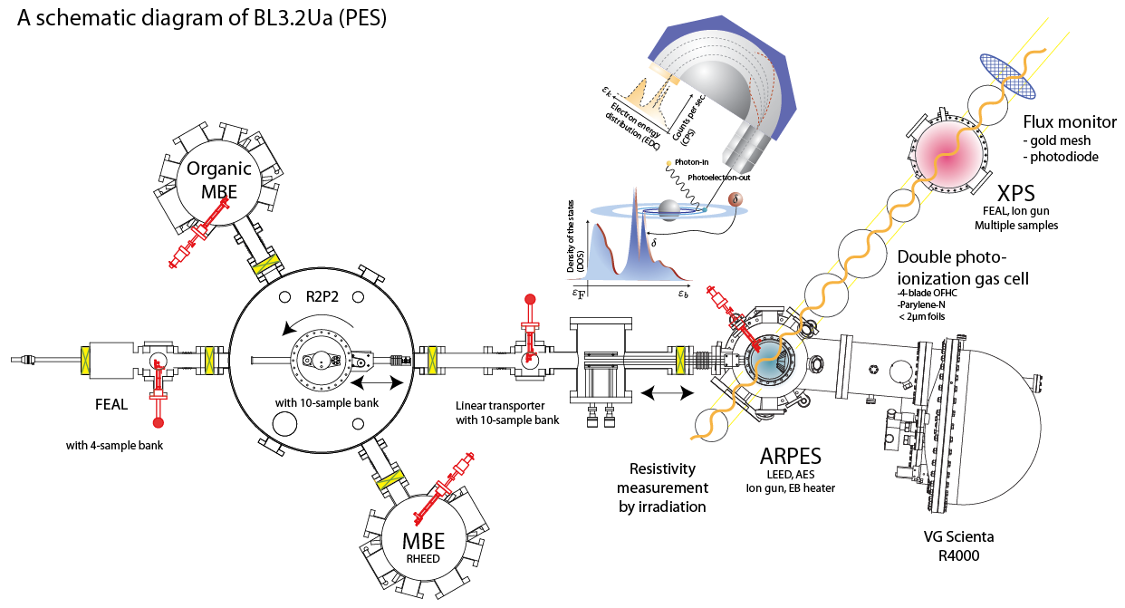
BL3.2Ua:PES
Currently not Available

Slide 21
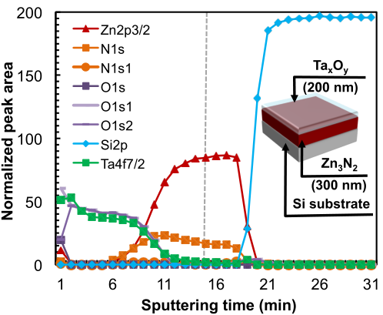
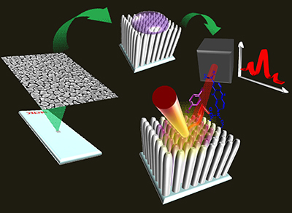
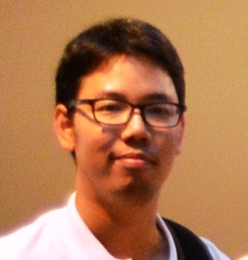
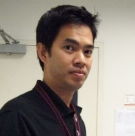

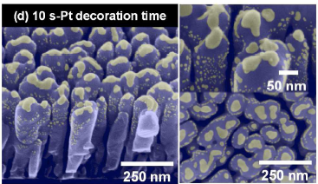
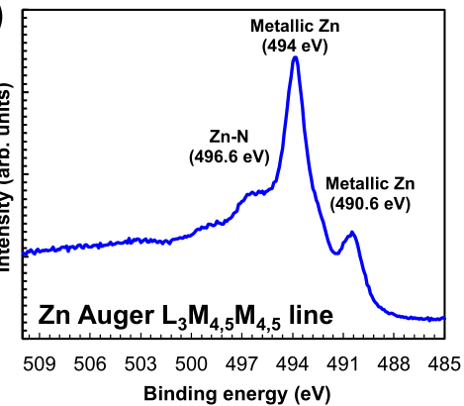


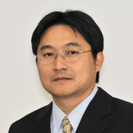

Metal oxide thin films, Nano-rods by OAD, Gas-timing dopes, SERS
SERS chips (Ag NRs)
H gas sensor (Pt/WOx)
White LED (ZnONx)
http://dx.doi.org/10.1039/C6RA09972F
http://dx.doi.org/10.1021/am505127g

Slide 22

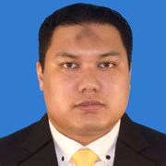
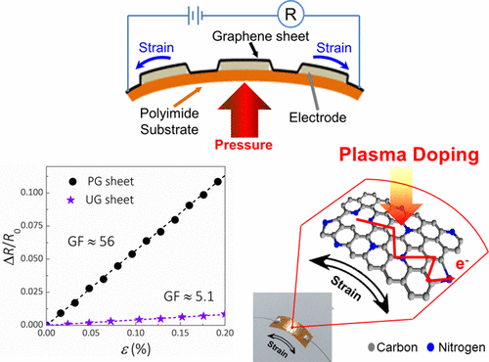
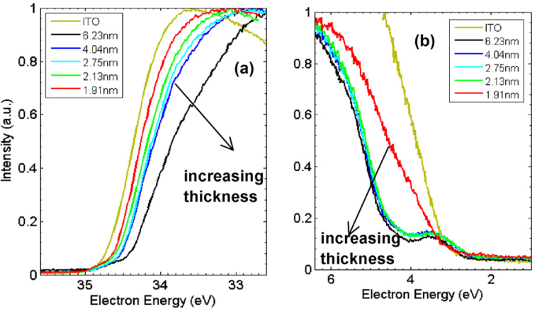
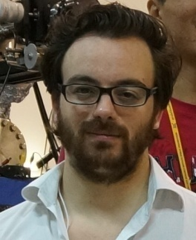

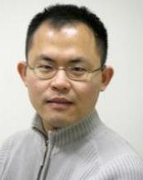
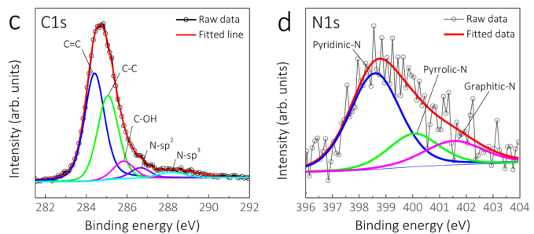
Dr. S. M. Hafiz (UPM)
Dr. Thomas
(NUS)
Dr. K. L. Woon
(UM)
J. Phys. D: Appl. Phys. 47 055109 (2014).
ACS Appl. Mater. Interfaces, 2017, 9 (17), pp 15192–15201.

Slide 23

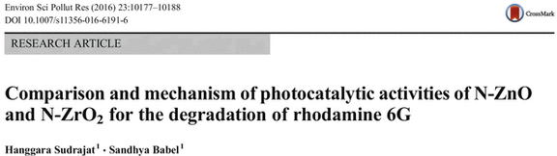


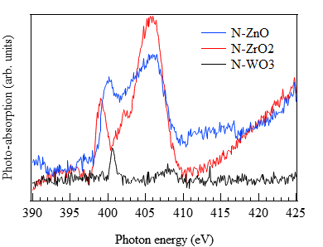
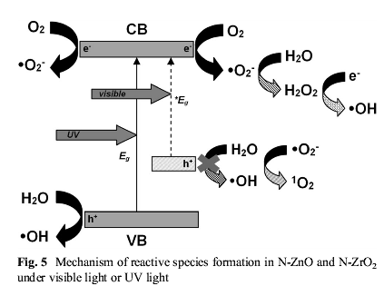
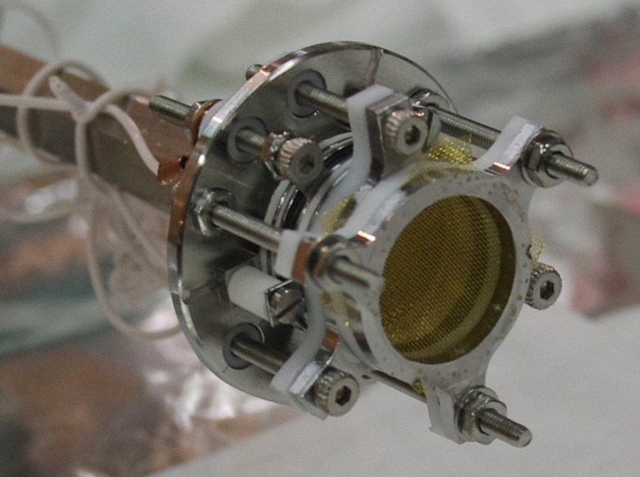
N K-edges
MCP with CsI: CF4655S144
Total fluorescence yield detector - first results on bulk-sensitive & non-conductive samples

Slide 24



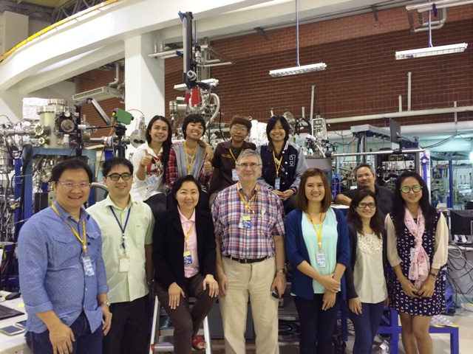
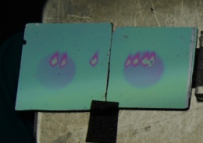
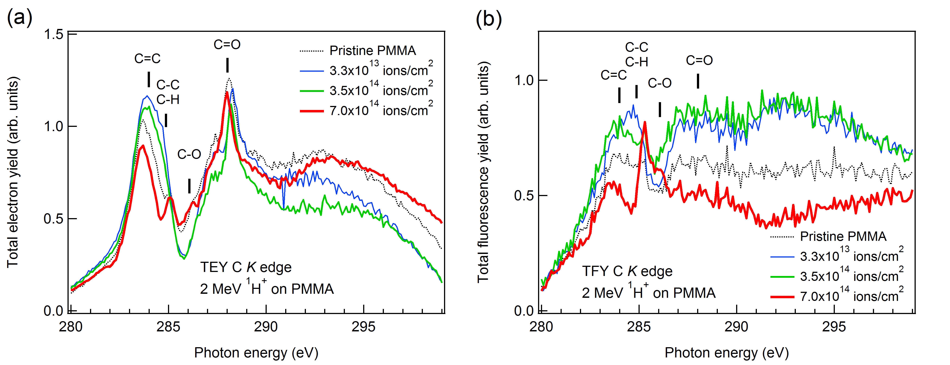
Norarat, R., Jainontee, K., Thianthaisong, W., Sriwang, S., Nakajima, H., Chienthavorn, O., ... & Whitlow, H. J. (2017).
MeV ion exposure behaviour of PMMA resist polymer studied by synchrotron light spectroscopies.
Nuclear Instruments and Methods in Physics Research Section B:
Beam Interactions with Materials and Atoms, 404, 238-242.

Slide 25
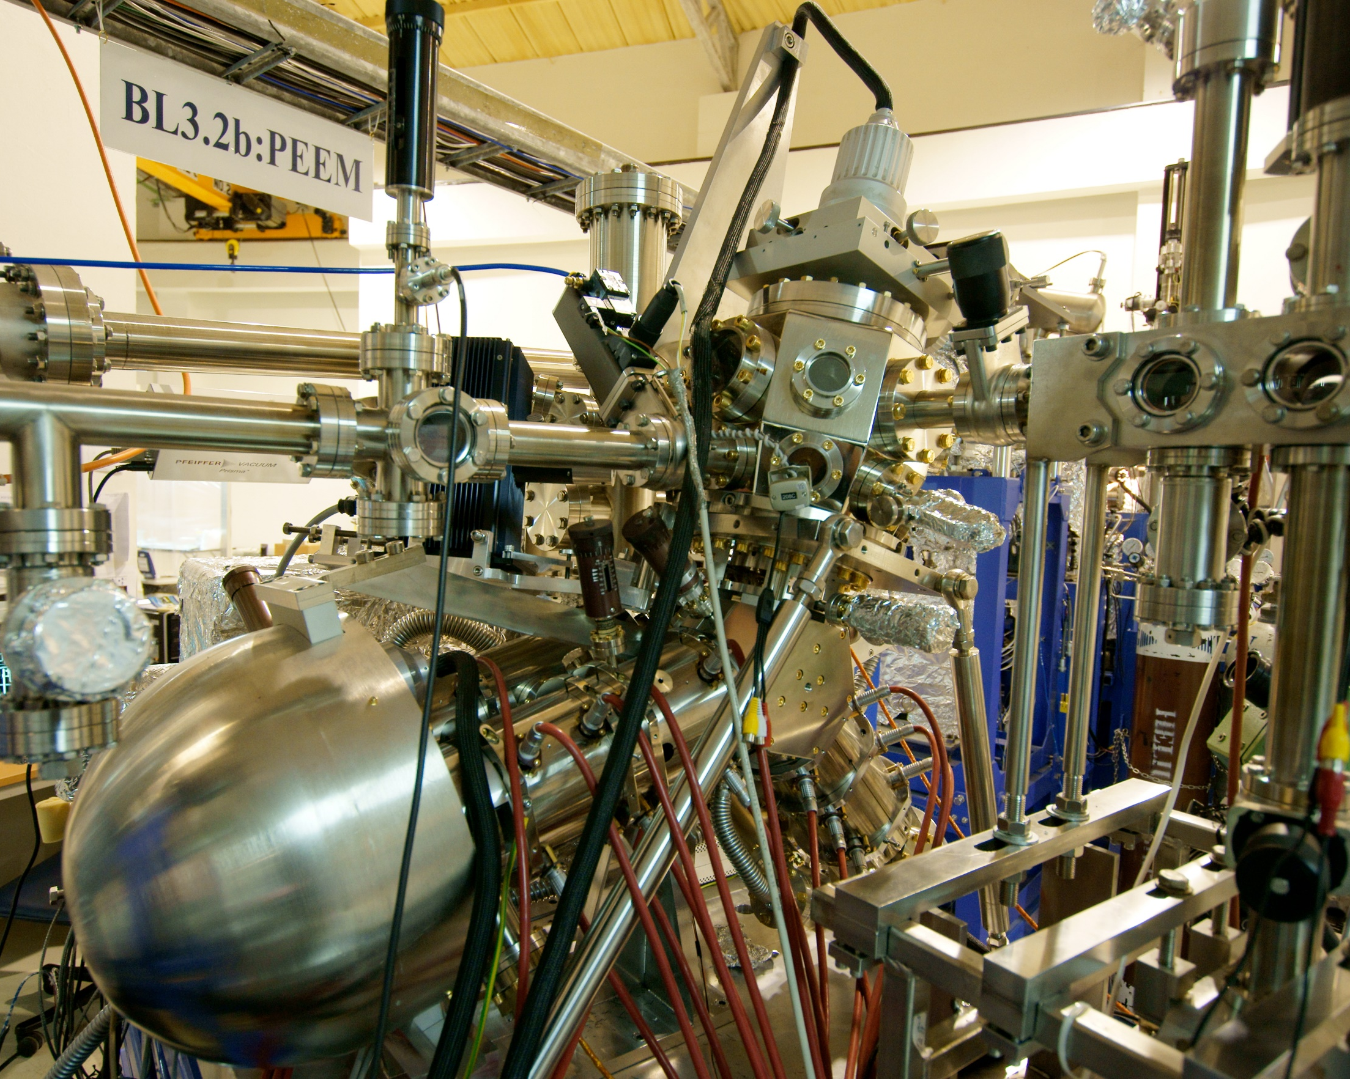
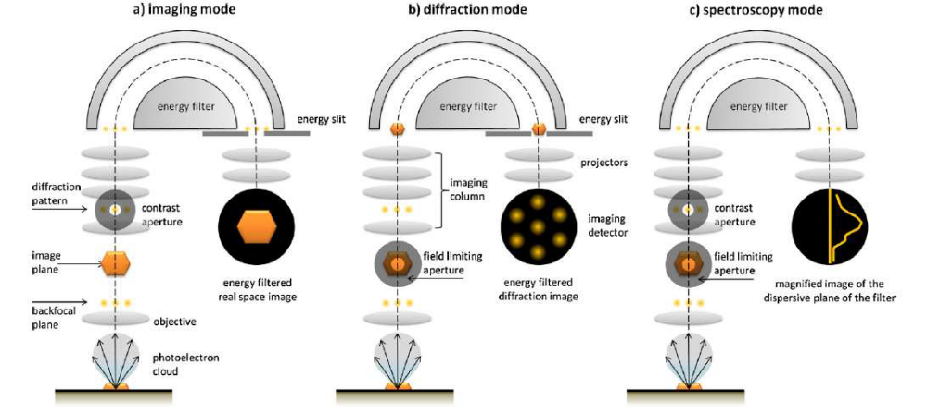
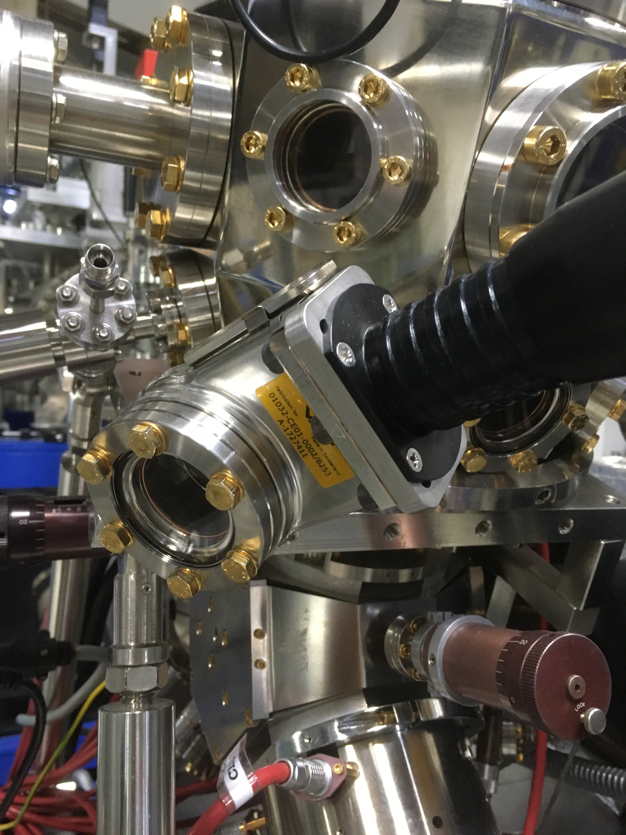
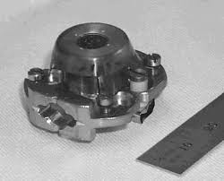
BL3.2Ub:PEEM
ELMITEC SPELEEM
Technique: PEEM, LEEM
Ion sputtering gun
0-100amu quadrupole mass spectrometers
X-PEEM, EF-PEEM
PED / µ-ARPES
µ-XPS
Heatable Sample Holder
from RT to > 1400°C
Locatelli, A., & Menteş, T. O. (2015). Chemical and Magnetic Imaging with X-Ray Photoemission Electron Microscopy. In Synchrotron Radiation (pp. 571-591). Springer, Berlin, Heidelberg.

Slide 26
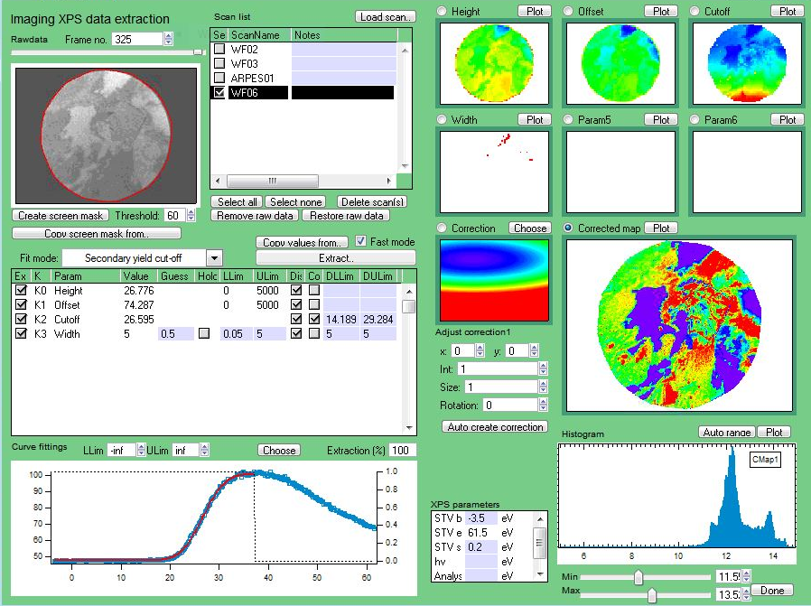


SLRI LEEM PEEM imaging analysis package
(made by Dr. Chanan Euaruksakul)

Slide 27


Supruangnet, R., Morawe, C., Peffen, J. C., Nakajima, H., Rattanasuporn, S., Photongkam, P., ... & Busayaporn, W. (2016).
Chemical modification of B₄C cap layers on Pd/B₄C multilayers.
Applied Surface Science, 367, 347-353.

Slide 28


Tunmee, S., Photongkam, P., Euaruksakul, C., Takamatsu, H., Zhou, X., Wongpanya, P., ... & Saitoh, H. (2016).
Investigation of pitting corrosion of diamond-like carbon films using synchrotron-based spectromicroscopy.
Journal of Applied Physics, 120(19), 195303.

Slide 29






Kanjanachuchai, S., & Photongkam, P. (2017). Planar Self-Assembly of Submicron and Nanoscale Wires and Grooves on III–V (110) Surfaces.
Crystal Growth & Design, 17(8), 4413-4421.
Kanjanachuchai, S., & Euaruksakul, C. (2013). Directions and breakup of self-running in droplets on low-index InP surfaces.
Crystal Growth & Design, 14(2), 830-834.
InP(001)
InP(111)A
InP(111)B

Slide 30





Mg map on AlSi₃ alloy
Surface of AlSi based alloy at high temperature

Slide 31

Surface treatment for CuAgZr alloy
326C
342C
360C
370C
373C
379C
388C
402C
415C

Slide 32



Ag 3d XPS intensity vs. annealing temperature
CuAgZr
Surface treatment for CuAgZr alloy
Cold-rolled CuAgZr
(w/ a lot of dislocations)

Slide 33





Graphene on SiC(0001)
75 micron field of view
5 micron field of view
1-layer
graphene
2-layer graphene
3-layer
graphene

Slide 34


Polycrystalline surface of Fe 99.9%
during 600C annealing
Pentacene Growth on Si wafer

Slide 35

Fabrication of boron nitride flakes from iron alloy by annealing

Slide 36




Beamline at SPS
BL1.1W: Multi X-ray Technique
XAS, XRF, WAXS and XRD
Contact: Dr Prae Chirawatkul (prae@slri.or.th)
BL1.2W: XTM
XMCT
Contact: Dr Catleya Rojviriya (catleya@slri.or.th)
BL1.3W: SAXS
SAXS and WAXS
Contact Dr Siriwat Soontaranon (siriwat@slri.or.th)
BL2.2: Multi X-ray Technique
Time resolved XAS
Contact Dr Yingyot Pooarporn (yingyot@slri.or.th)

Slide 37




Beamline at SPS
BL3.2Ua: PES
XPS, USP, ARPES and soft-XAS
Contact: Dr Hideki Nakajima (hideki@slri.or.th)
BL3.2Ub: PEEM
PEEM, LEEM
Contact Dr Chanan Euaruksakun (chanan@slri.or.th)
BL4.1: IR Spectroscopy and Imaging
IR Spectromicroscopy
Contact Dr Kanjana Thamanu (kanjanat@slri.or.th)
BL5.2: XAS (SUT-NANOTEC-SLRI)
XAS and XRF
Contact Dr Pinit Kidkhunthod (pinit@slri.or.th)

Slide 38




Beamline at SPS
BL6a: DXL
X-ray Lithography
Contact: Dr Rungruang Phatthanakun (rungruang@slri.or.th)
BL6b: XRF
micro-XRF and XRF imaging
Contact Dr Jitrin Chaiprapa (jitrin@slri.ro.th)
BL7.2W: MX
Macromolecule X-ray crystallography
Contact Dr Nuttawan Pramanpol (nuttawan@slri.or.th)
BL8: XAS
XAS and XRF
Contact Dr Wantana Klysubun (wantana@slri.or.th)

Slide 39

BL1.1W: Multi X-ray Technique (MXT)
Source | 2.4T Hybrid Magnet MPW
Monochromator type | DCM with Si(111)
Photon energy | 4 – 18keV
Energy resolution | 10⁻⁴
Photon flux | 10⁷-10¹⁰ phs/s
Beam size (HxV) | 6 x 3 mm²
Technique | XAS, XRF, WAXS and XRD
19 element Ge detector
Ionization chamber
XRD setup is installing during shutdown 2018
Image plate detector

Slide 40



BL1.2W: X-ray Tomography Microscopy
Source | 2.4T Hybrid Magnet MPW
Monochromator Type | Pink & Whitebeam
Photon Energy Range | 5 – 20keV
Photon flux | 4.6x10¹¹ phs/s at 15keV
Beam size (HxV) | 10 × 4 mm²
Spatial Resolution | 1-5 micron
Plan to install monochromator in 2019-2020

Slide 41



BL1.3W: SAXS
Source | 2.4T Hybrid Magnet MPW
Monochromator type | DMM with W/B4C
Photon energy | 6 – 9keV
Energy resolution | 10⁻⁴
Photon flux | 3x10⁹ phs/s
Beam size (HxV) | 2 x 1 mm², 0.4 mrad divergence
Technique | SAXS and WAXS
Sample to detector | 4.5 m maximum (SAXS)
RAYONIX LX170HS
MARS SX165

Slide 42




BL2.2: Time resolved XAS
Source | Bending magnet
Monochromator type | Energy dispersive bend crystal with Si (111) and Si(220)
Photon energy | 4.2 – 12 keV
Energy resolution | 10⁻³ - 10⁻²
Beam size (HxV) | 2 x 1 mm²
Technique | XAS (transmission)
Sample Environment | 0-600°C heating cell O₂, N₂, He, Ar and H₂,

Slide 43
BL4.1: IR Spectroscopy and Imaging
Source | Bending magnet
Photon energy | 0.01 - 0.5eV
Beam size (HxV) | 10 x 10 µm²
Technique | IR microspectroscopy
Spectrometer: | Vertex 70 spectrometer
Microscope: | Hyperion 2000 microscope
Detector | 250 micron MCT
Mode of measurement | Reflection, Transmission and Transfection

Slide 44


BL5.2: XAS (SUT-NANOTEC-SLRI)
Source | Bending magnet
Monochromator type | DCM with KTP(011), IsSb(111) Ge(220)
Photon energy | 1.24 – 12.1 keV
Energy resolution | 2x10⁻⁴
Beam size (HxV) | 13 x 1 mm² (transmission) 20 x 1 mm² (fluorescence)
Technique | XAS & XRF
Sample Environment | In-situ heating cell O₂, N₂, He, Ar and H² max. flow rate 100 ml/min (N₂)
Only 1/3 of beamtime is managed by SLRI

Slide 45


BL6a: DXL
Radiation (UV/X-ray)
Mask
Source | Bending magnet
Monochromator type | White beam
Beam size (HxV) | 6 × 2 mm²
Technique | X-ray Lithography
Photosensitive materials
Substrate (e.g. Si, glass)
Photosensitive materials
Change only when exposed to radiation
Spray substrate with
developer solution
Good sensitivity
Exposed area absorb
developer (distortion)
Positive resist, developer-
solution removes exposed area
b) Negative resist, developer-
solution removes unexposed area

Slide 46








BL6a: DXL
Supporting Facilities
Class 100 clean room - e-beam lithography
Class 1,000 clean room - UV lithography
Class 10,000 clean room – thin film deposition
Flexible humidity sensor on PET substrate
Flexible microhotplate on PET substrate
Sensitivity of 0.027 pF/%RH
(wearable device and packaging)

Slide 47


BL6b: µ-XRF
Source | Bending magnet
Monochromator type | White beam
Photon energy | 2 - 10 keV
Beam size (HxV) | 100 × 100 µm2
Technique | µ-XRF and Imaging
Detector | Si(PIN) detector with energy resolution of 160 eV

Slide 48

BL7.2W:MX
Source | 6.4T SWLS
Monochromator type | DCM
Photon energy | 7-18 keV
Flux | 1 x 10⁹ phs/s at 8keV
Beam size (HxV) | 2.5 × 1.5 mm²
Technique | MacromolecularX-ray Crystallography
Detector | marCCD SX165
Sample Environment | 100K with Oxford Cryosystems: 700 series cryostream nitrogen cooler
Supporting Facilities
Protien Crytalization Lab

Slide 49

BL8: XAS
Source | Bending magnet
Monochromator type | DCM with KTP(011), IsSb(111), Si(111) and Ge(220)
Photon energy | 1.2 - 13 keV
Energy resolution | 1x10⁻⁴ to 3x10⁻⁴
Flux | 1x10⁸ - 1x10¹⁰ phs/s/100mA
Beam size (HxV) | 13 × 2 mm²
Technique | XAS & XRF
Supporting Facilities
Ionization Chamber
Si drift detector (4 channel)
13 element Ge detector

Slide 50

BL5.3: XPS (SUT-NANOTEC-SLRI)
The end station for coming up beamline
PHI 5000 VersaProbe II Scanning XPS Microprobe
Contact: Dr Narong Chanlek (narong@slri.or.th)

Slide 51


Thailand 3.0 GeV Synchrotron Light Source
The project is during submission for drafting the 13th national economic and social development plan (2022-2026)
The detail design reports have deadline on Sep 2019
7 beamlines will be construct in the 1st phase

Slide 52


Thailand 3.0 GeV Synchrotron Light Source
Candidate Location
Storage Ring
Beam emittance < 1.0 nm•rad at beam current of 300 mA
Storage ring circumstance 321.3m by 14 cells of DTBA lattice
Beamline in 1st Phase
High Resolution Soft X-ray Spectroscopy
Tender X-ray absorption spectroscopy
Hard X-ray absorption spectroscopy
Small and Wide Angle X-ray scattering
High resolution X-ray diffraction
Macromolecular crystallography
X-ray microtomography
Nakhon-Ratchasima
Rayong

Slide 53
THANK YOU FOR YOUR ATTENTION

