Slide 1

Confinement-Induced Giant Spin-Orbital-Coupled Magnetic Moment of Co Nanoclusters in TiO₂ Films
Jiabao Yi
Global Innovative Center for Advanced Nanomaterials, School of Engineering, University of Newcastle, Callaghan, 2308, Australia
VASSCAA-9 Sydney, 13-16, Aug, 2018

Slide 2


Acknowledgement

Slide 3
Introduction to GICAN

Slide 4
Introduction to GICAN

Slide 5

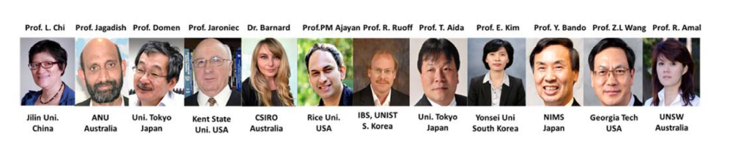
Introduction to GICAN

Slide 6

Introduction to GICAN

Slide 7
OUTLINE
Introduction to Spintronics and diluted magnetic semiconductors
Motivations
Results and Discussion
Conclusion

Slide 8
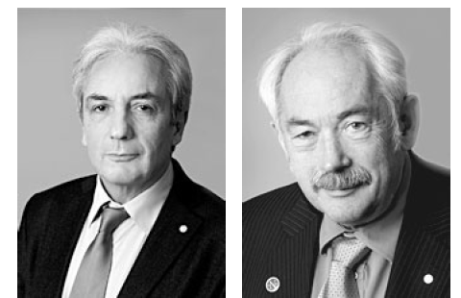
Spintronics
2007 Nobel Prize in Physics
Albert Fert Peter Grünberg
Discovery of giant magnetoresistance (GMR) in Fe/Cr multilayer in 1988, when the Spintronics start.
http://www.nobelprize.org/nobel_prizes/physics/laureates/2007/

Slide 9
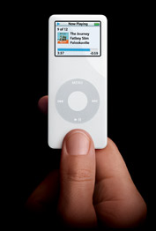
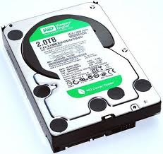
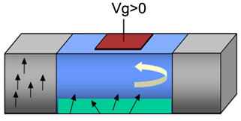
Spintronics
Charge of electron…
Integrated circuits, capacitors,
Resistance and transistors realize semiconductor device functions
Spins of electron…
Having been used
as reading head for magnetic recording media.
Spintronics-spin transistors
-Combine logic, storage and communications on a single chip.
-non volatile memory.
-smaller devices, faster speed.
-without release of heat
Sarma, S. D. Am. Sci. 89, 516 (2001)

Slide 10
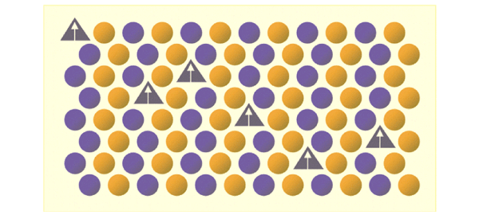
Introduction:
Diluted magnetic semiconductor (DMS)
Why DMS?
DMS materials can fulfil both spin function and be integrated into current semiconductor technology.
Pearton, S. J. et al. Mater. Sci. Eng. R40, 137(2003).

Slide 11
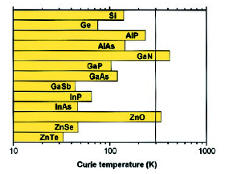
Introduction-diluted magnetic
semiconductor (DMS)
The original idea for DMS is to dope magnetic ions into semiconductor host.
Mn doped GaAs is the most successful DMS. However, the low Curie temperature (190 K) limits its applications.
Mean field theory based Zener model predicted GaN and ZnO are two possible candidates for the host materials of DMS, which Curie temperature is possible higher than room temperature.
Deitl et al. , Sciene, 2000.

Slide 12
Introduction: Diluted magnetic semiconductor
(DMS) and Motivations
Introduction-DMS
DMS fabricated from wide gap semiconductors doped with magnetic element, such as Fe, Co, and Ni.
Ferromagnetism has been widely found in magnetic element doped oxide.
The ferromagnetism sometimes is difficult to reproduce.
Ferromagnetism can only be observed when the samples are prepared under oxygen poor environment.

Slide 13
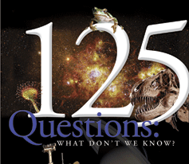
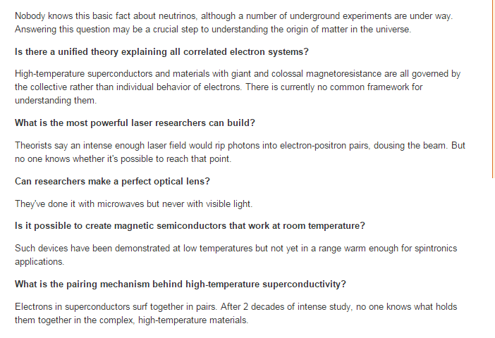
Introduction:diluted magnetic semiconductor
(DMS) and Motivations
Notes:
Enter speaker notes here.

Slide 14
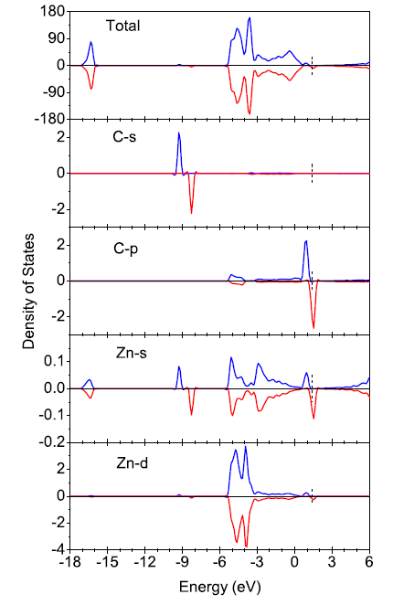
Nonmagnetic element doping induced ferromagnetism-C doped ZnO by PLD
C replacing O induces holes in the O2p states, which coupled with C2p with p-p interaction. The coupling induces spin alignment of C atoms
Pan et al. Phys. Rev. Lett., 99, 127201 (2007)
Notes:
Enter speaker notes here.

Slide 15
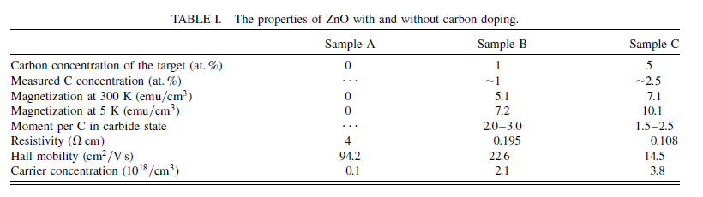
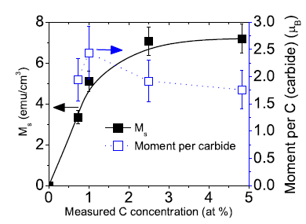
C doped ZnO induced ferromagnetism
Pan et al. Phys. Rev. Lett. 99, 127201 (2007)
Notes:
Enter speaker notes here.

Slide 16
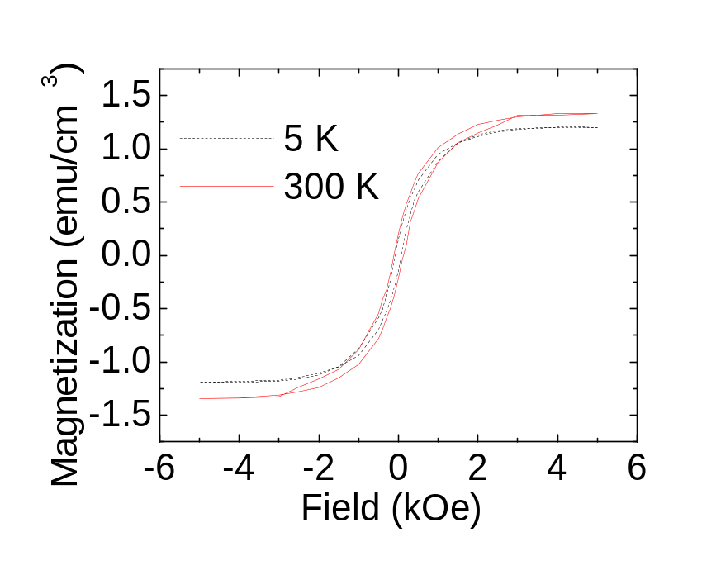
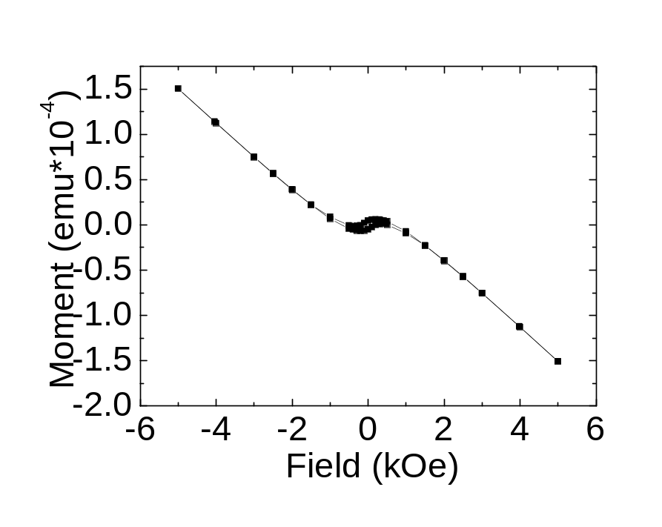
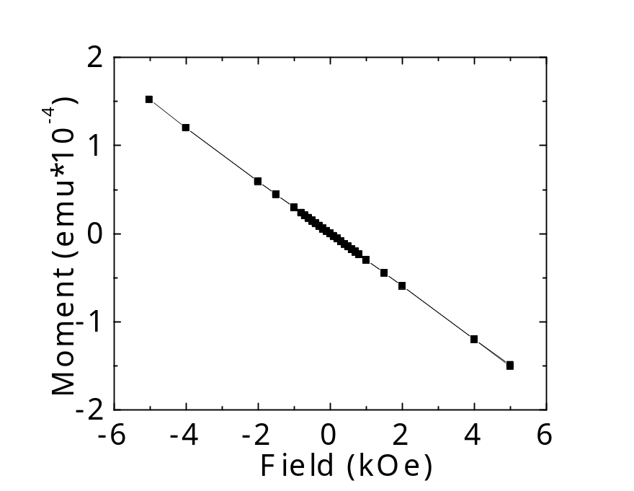
Nonmagnetic element doping
-Li doped ZnO
300 K
6% Li:ZnO, 10⁻⁴ torr O₂
6% Li:ZnO, 10⁻⁴ torr O₂
6% Li:ZnO, 10⁻⁶ torr O₂
The high oxygen partial pressure favoring ferromagnetism excludes the contamination or impurities effect.
Yi et al. Phys. Rev. Lett. ,104, 137201, 2010
Notes:
Enter speaker notes here.

Slide 17
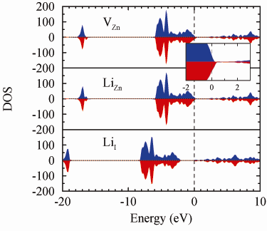
Vacancy induced ferromagnetism:
Li-ZnO
3×3×2 supercell
Only Zn vacancy is magnetic.
Yi et al. Phys. Rev. Lett.,104, 137201, 2010
Notes:
Enter speaker notes here.

Slide 18
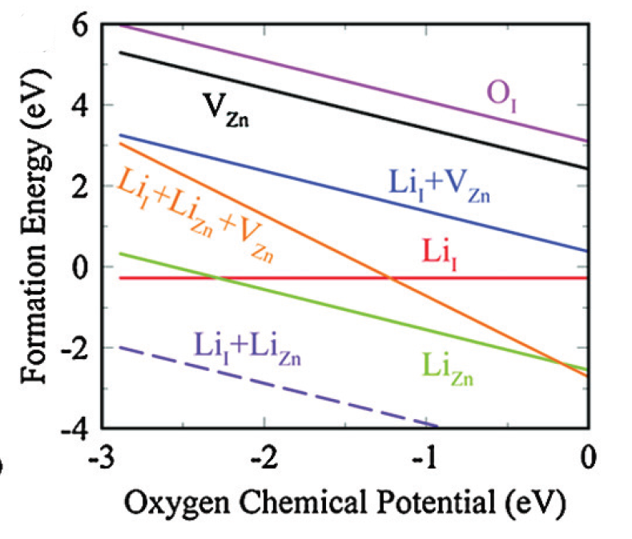
Vacancy induced ferromagnetism:
Li-ZnO
High oxygen partial pressure helps to form Zn vacancies.
Li doping reduce formation energy of Zn vacancy
Notes:
Enter speaker notes here.

Slide 19
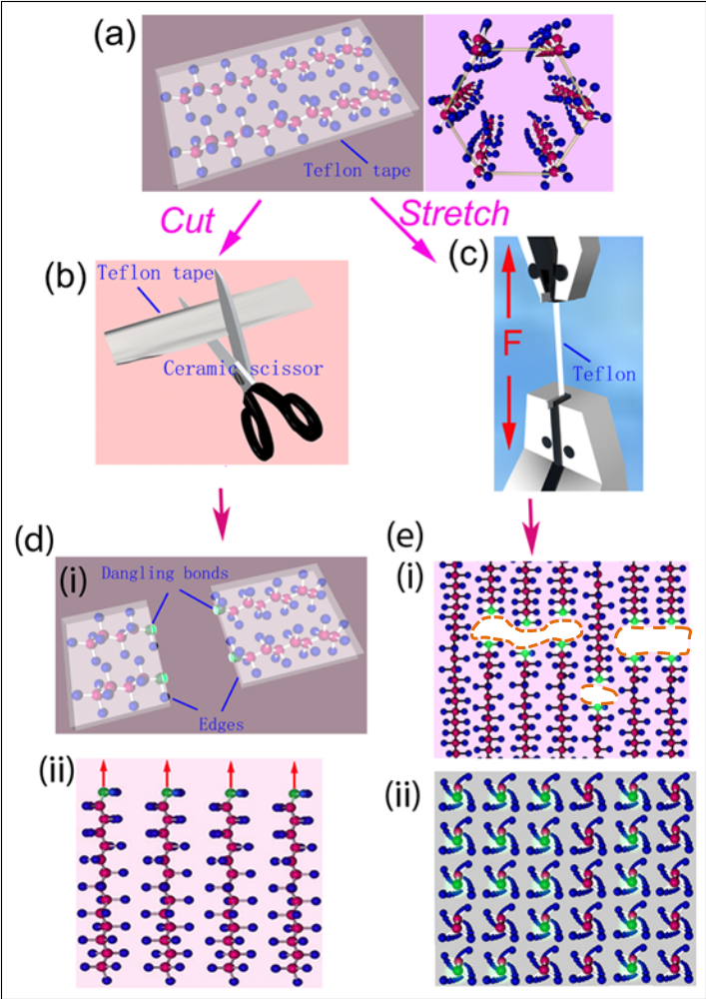
Ferromagnetism in Teflon
Cutting and stretching both induce room temperature ferromagnetism.
The ferromagnetism is due to the carbon dangle bonds.
Y,W. Ma et al. Nature Communications, 3.727, 2012
Notes:
Enter speaker notes here.

Slide 20
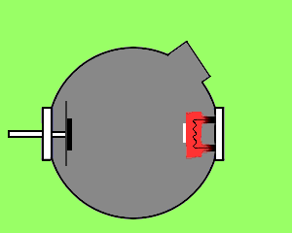
Magnetic uniformity examined by
Muon spin relaxation (μSR)-Co-TiO₂
H. Saadaoui, et al. Phys. Rev. Lett. 227, 227202 ,2016
Notes:
Enter speaker notes here.

Slide 21
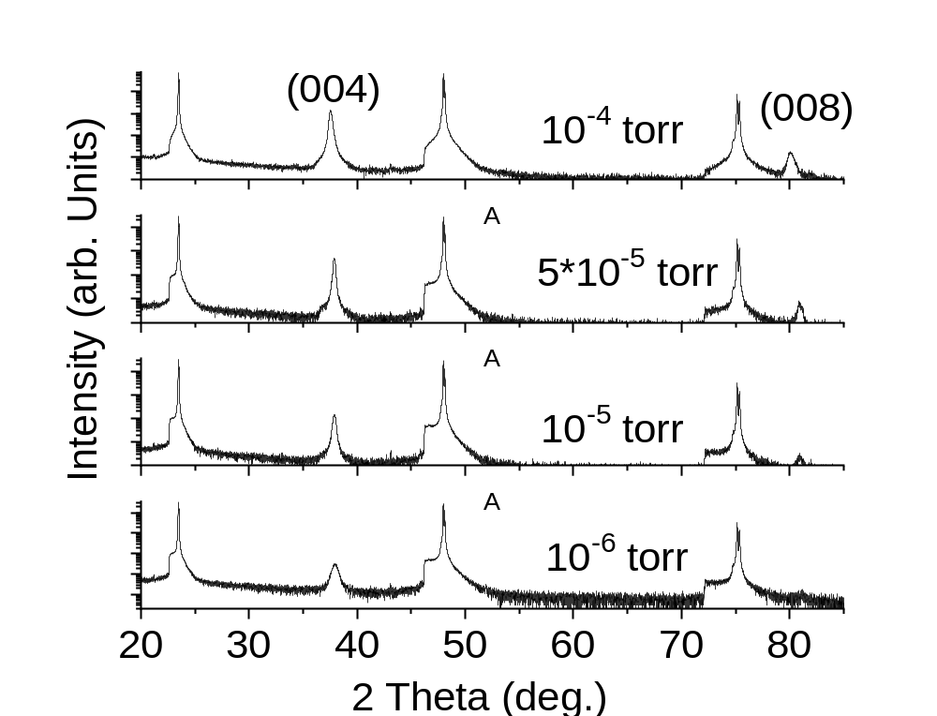
Magnetic uniformity examined by
Muon spin relaxation (μSR)-Co-TiO₂
H. Saadaoui, et al. Phys. Rev. Lett. 227, 227202 ,2016
Notes:
Enter speaker notes here.

Slide 22
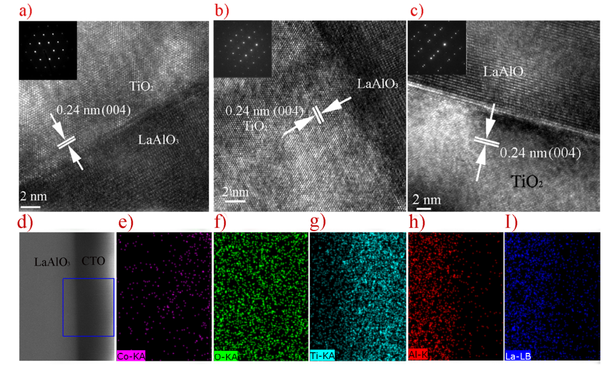
Magnetic uniformity examined by
Muon spin relaxation (μSR)-Co-TiO₂
H. Saadaoui, et al. Phys. Rev. Lett. 227, 227202 ,2016
Notes:
Enter speaker notes here.

Slide 23
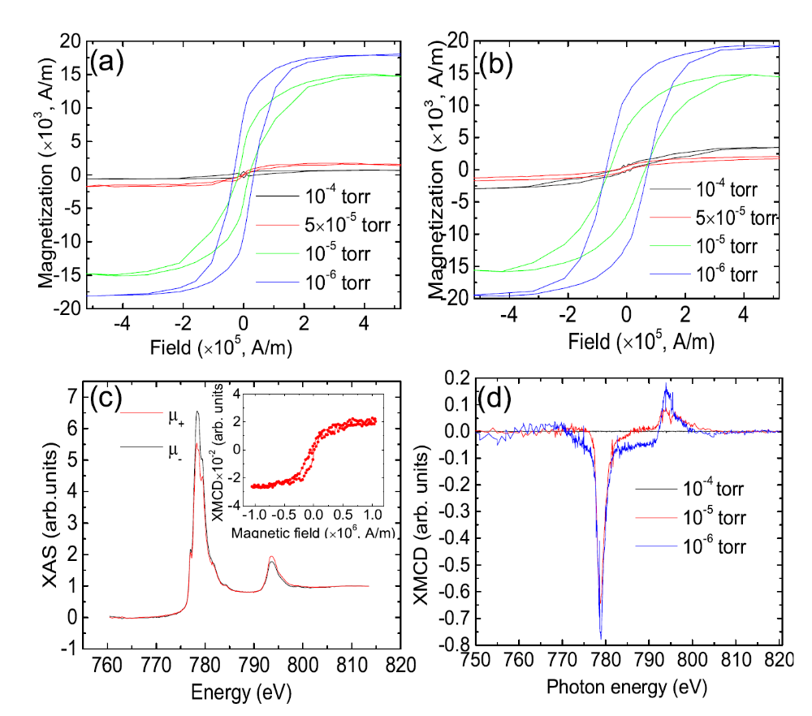
Magnetic uniformity examined by
Muon spin relaxation (μSR)-Co-TiO₂
H. Saadaoui, et al. Phys. Rev. Lett. 227, 227202 ,2016
(a) and (b) are M-H loops at 300 and 5 K; (c) XAS measurement of P₂=10⁻⁶ torr; The inset of the loop XMCD; (d) XMCD spectra.
Notes:
Enter speaker notes here.

Slide 24
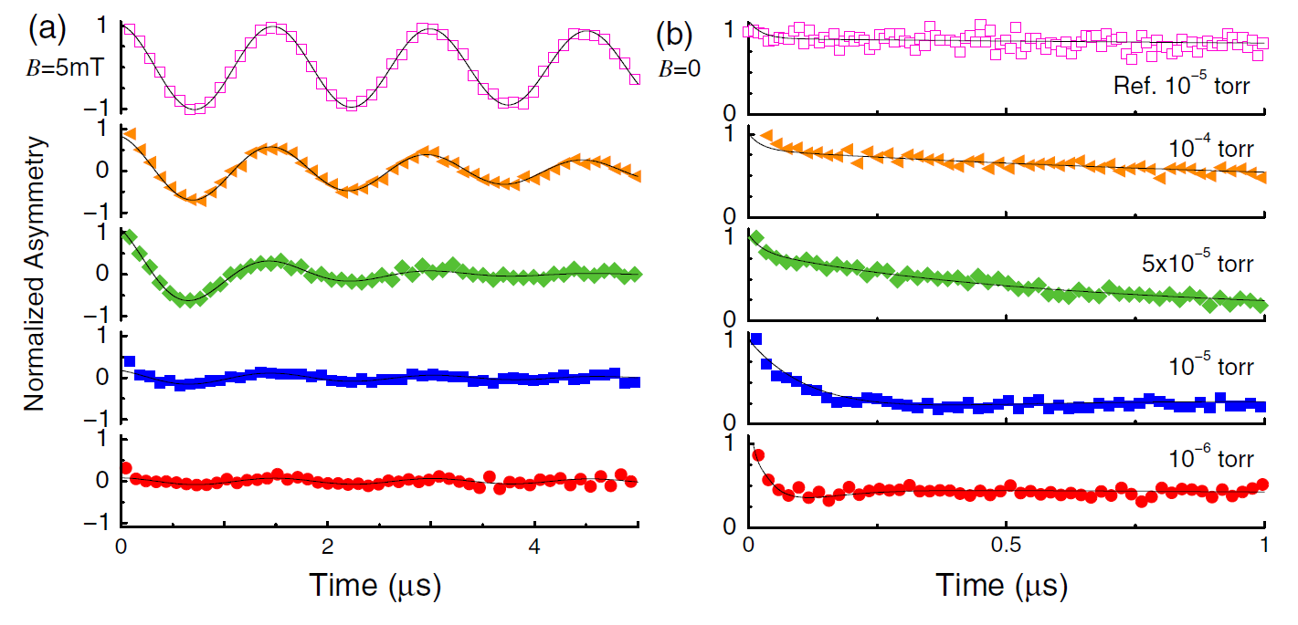
Magnetic uniformity examined by
Muon spin relaxation (μSR)-Co-TiO₂
Both zero field and transverse field measurement shows that reference sample is nonmagnetic and 10⁻⁶ sample has the strongest magnetism.
H. Saadaoui, et al. Phys. Rev. Lett. 227, 227202 ,2016
Notes:
Enter speaker notes here.

Slide 25
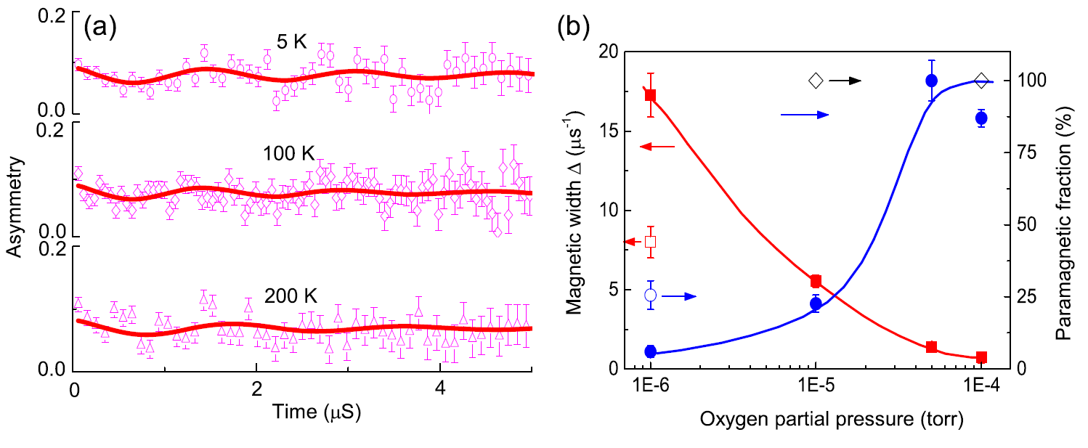
Muon spin relaxation (μSR)
Temperature dependence indicates that the ferromagnetism is not from clusters.
PO₂=10⁻⁶ torr sample has 100 % volume fraction of ferromagnetic phase, indicating magnetic uniformity in this sample.
H. Saadaoui, et al. Phys. Rev. Lett. 227, 227202 ,2016
Notes:
Enter speaker notes here.

Slide 26
High magnetic moment of
Co in Co doped TiO₂
(a), (b) and (c) are illustrations of three possible states of Co atoms (substitution, cluster+ substitution and cluster, respectively) in TiO₂ matrix. (d) Description of the effects of parameters on the formation of clusters or substitution defects in Co doped TiO₂.
Notes:
Enter speaker notes here.

Slide 27
High magnetic moment of
Co in Co doped TiO₂
(a) XRD pattern of 5 at% Co-doped TiO₂ film. (b) High-resolution TEM image of the sample. The inset is the selecting area electron diffraction (SAED) pattern of the film. (c), (d) and (e) is EDS mapping of Co, O and Ti element, respectively.
Notes:
Enter speaker notes here.

Slide 28
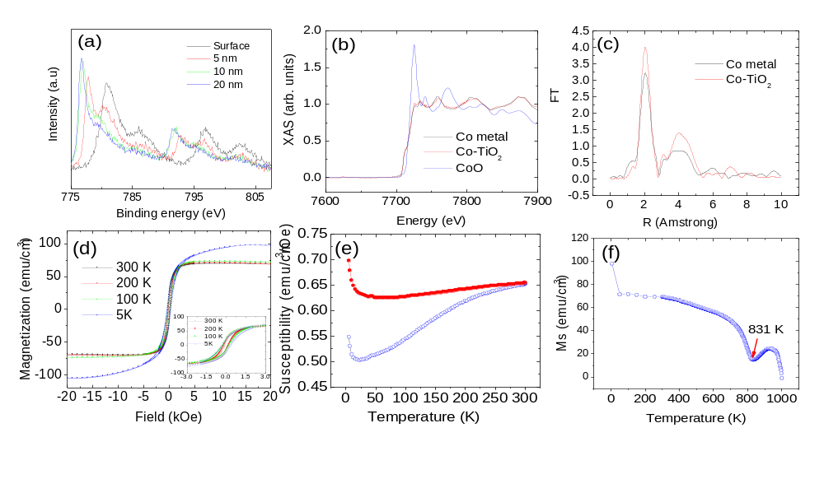
High magnetic moment of
Co in Co doped TiO₂
(a) XPS spectra of Co edge from surface to inside the film with distance to the surface of 5 nm, 10 nm and 20 nm, respectively. (b) NEXAS of Co K edge in Co doped TiO₂ and reference samples of metallic Co and CoO. (c) Fourier transformation of reference Co sample and Co in Co dped TiO₂. (d) Hysteresis loops of Co-TiO₂ at different temperatures. (e) Zero field cooling (ZFC) and field cooling (FC) curves with an applied field of 500 Oe. (f) Temperature dependence of magnetization, showing the Curie temperature.
Notes:
Enter speaker notes here.

Slide 29
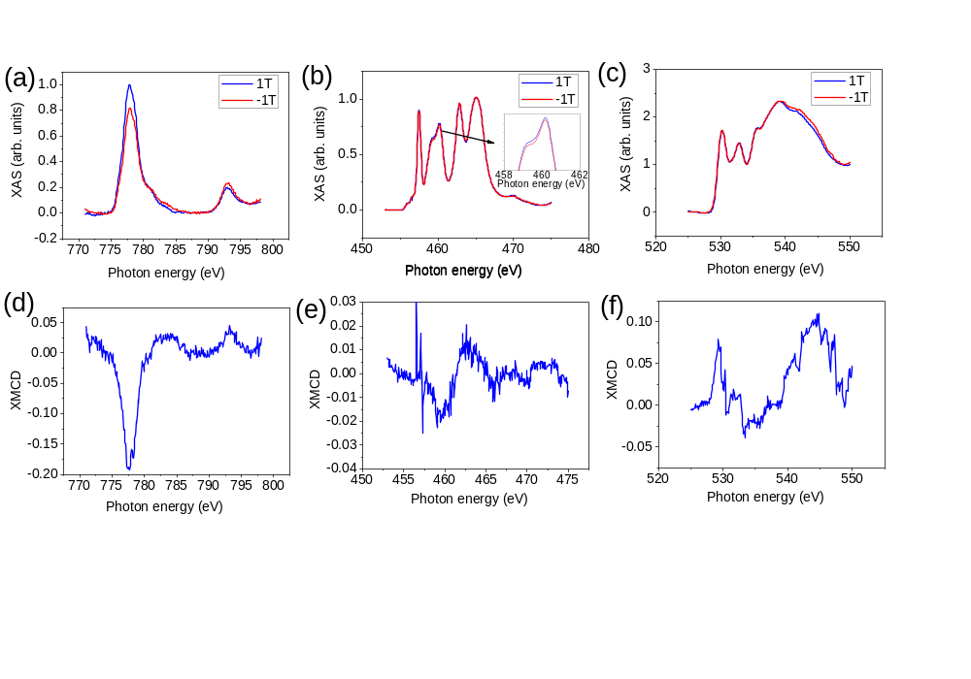
High magnetic moment of
Co in Co doped TiO₂
XAS and XMCD spectra of Co, Ti and O: (a) XAS of Co L edge. (b) XAS of Ti L edge. The inset is th enlarged part as shown by the arrow. (c) XAS of O K edge. (d) XMCD of Co L edge. (b) XMCD of Ti L edge. (c) XMCD of O K edge. The XAS is collected by the total yield mode.
Notes:
Enter speaker notes here.

Slide 30
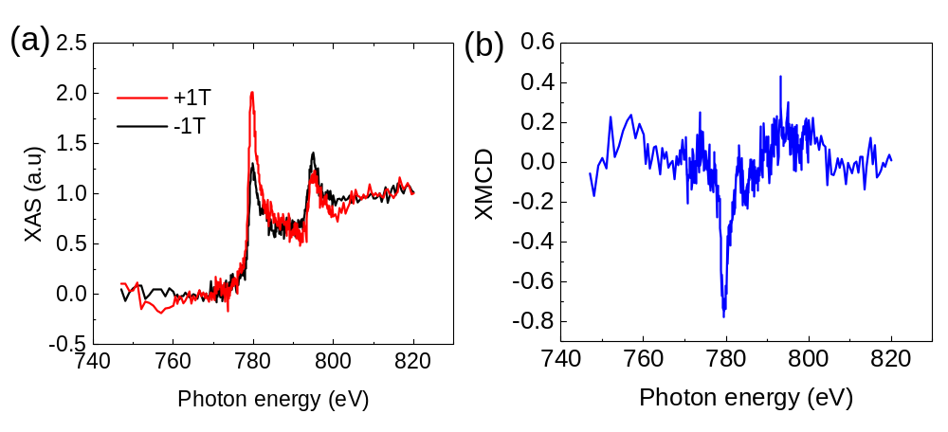
High magnetic moment of
Co in Co doped TiO₂
(a) XAS of Co edge collected by Florence mode. (b) XMCD of Co K edge collected by Florence mode.
Notes:
Enter speaker notes here.

Slide 31
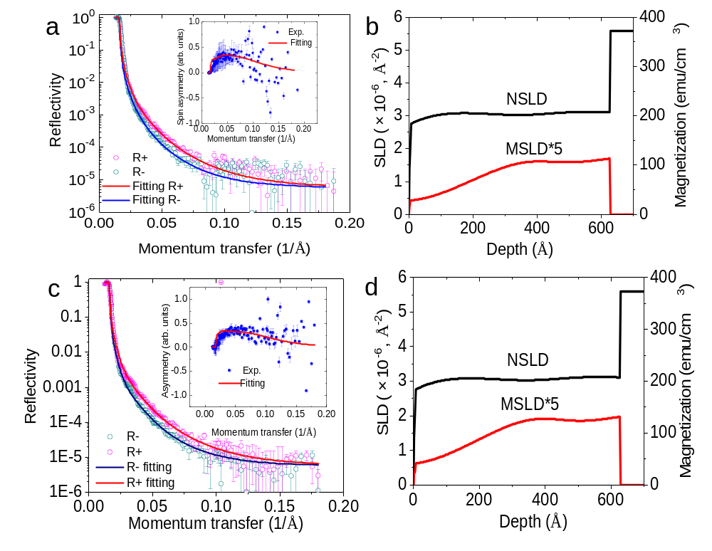
High magnetic moment of
Co in Co doped TiO₂
PNR spectra of Co doped TiO₂ film. (a) Reflectivity versus moment transfer at 300 K; (b) SLD curves at 300 K; (c) Reflectivity versus moment transfer at 5 K. (d) SLD curves at 5 K.
Notes:
Enter speaker notes here.

Slide 32
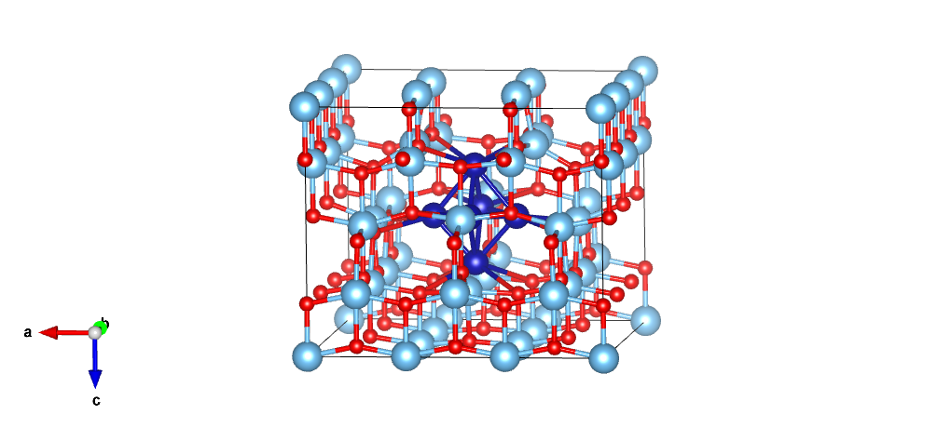
DFT calculations
Notes:
Enter speaker notes here.

Slide 33
DFT Calulations
Table 1: Calculated average spin and orbital moments in μ_{B}/atom along the easy spin axis [001], as well as along [100] and [010] direction (in brackets).
systems | GGA-SOC |  | GGA+U-SOC |  | HSE-SOC
 | Spin moment (μ_{B}) | Orbital moment (μ_{B}) | Spin moment (μ_{B}) | Orbital moment (μ_{B}) | Spin moment (μ_{B}) | Orbital moment (μ_{B})
6Co | 1.21 | 0.14 | 2.24 | 0.21 | 1.89 | 0.17
7Co | 1.21 | 0.16 | 2.29 | 0.25 | 1.94 | 0.21
11Co | 1.41 | 0.19 | 2.48 | 0.27 | - | -
14Co | 1.70 | 0.20 | 2.62 | 0.25 | 2.42 | 0.24
15Co | 1.94 | 0.19 | 2.61 | 0.22 | 2.44 | 0.22
Notes:
Enter speaker notes here.

Slide 34
DFT calculations
(a)
(b)
(c)
(a) Calculated spin density plots for 14 Co nanoclusters embedded in TiO₂ matrix along the easy spin axis [001]. Calculated spin density in the gas-phase of (b) free relaxed and (c) fixed structure at the HSE-SOC level. Yellow (blue) isosurfaces denote positive (negative) spin polarization.
Notes:
Enter speaker notes here.

Slide 35
Conclusions
Both uniform and clustered Co dopants in TiO₂ can be formed dependent on the fabrication parameters.
Uniformly distributed Co shows relatively low magnetic moment. However, clustered Co shows large magnetic moment.
Detail studies indicate that Co shows a magnetic moment of 3.5 µ_{B}/Co and the rest of the magnetic moment is contributed from Ti and O.
Notes:
Enter speaker notes here.

Slide 36
Acknowledgement
Thanks for your attention!
Notes:
Enter speaker notes here.

