Slide 1
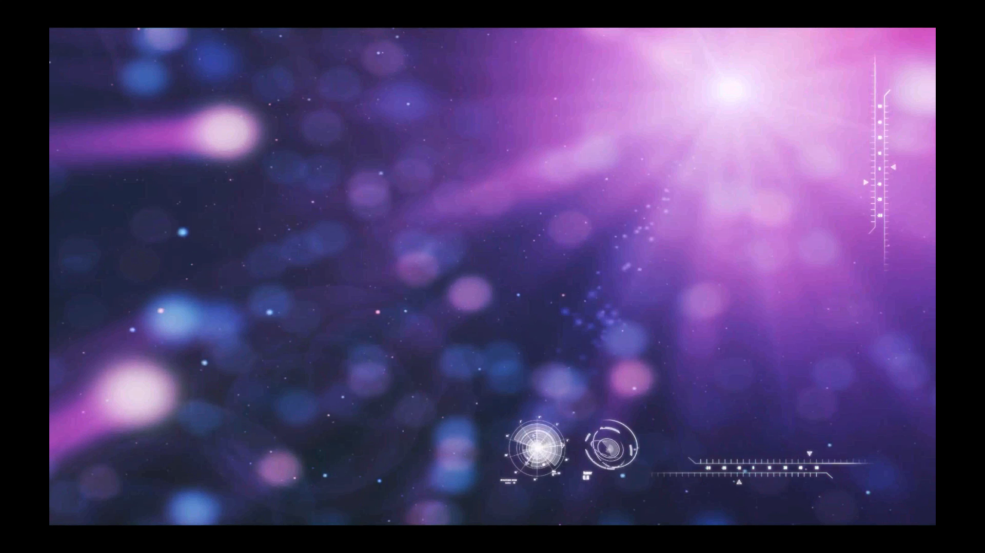


Professor Ewa Goldys,
Deputy Director, ARC Centre of Excellence
for Nanoscale Biophotonics, UNSW
Using light, high energy radiation and theranostic nanomaterials to engineer interactions with biological systems

Slide 2
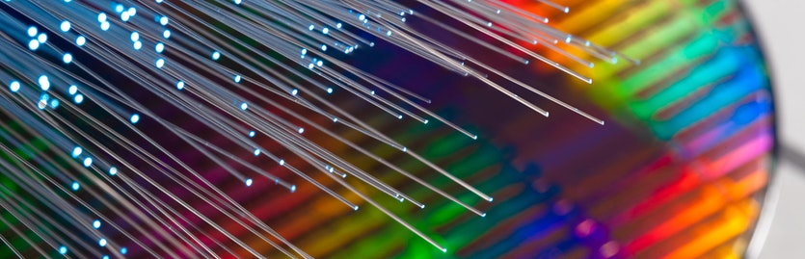

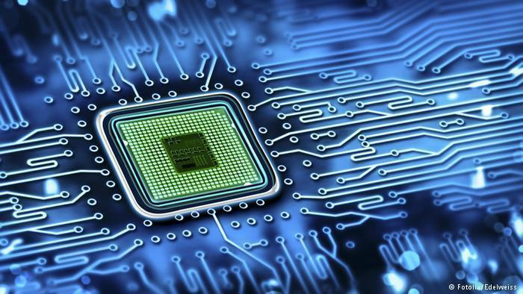

Slide 3
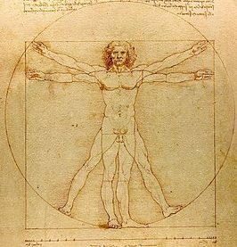

Slide 4

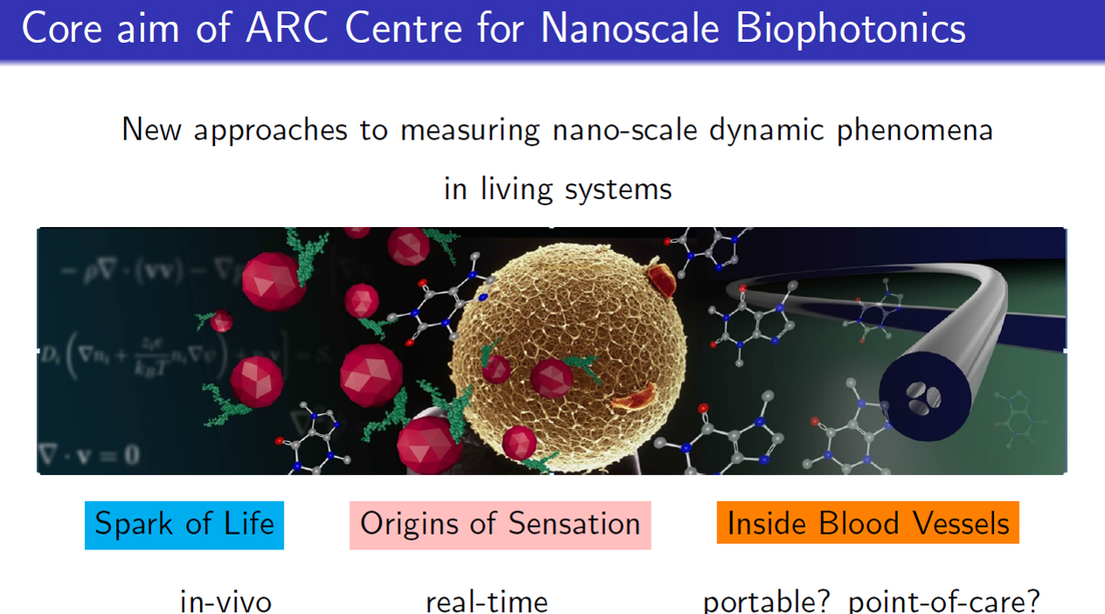

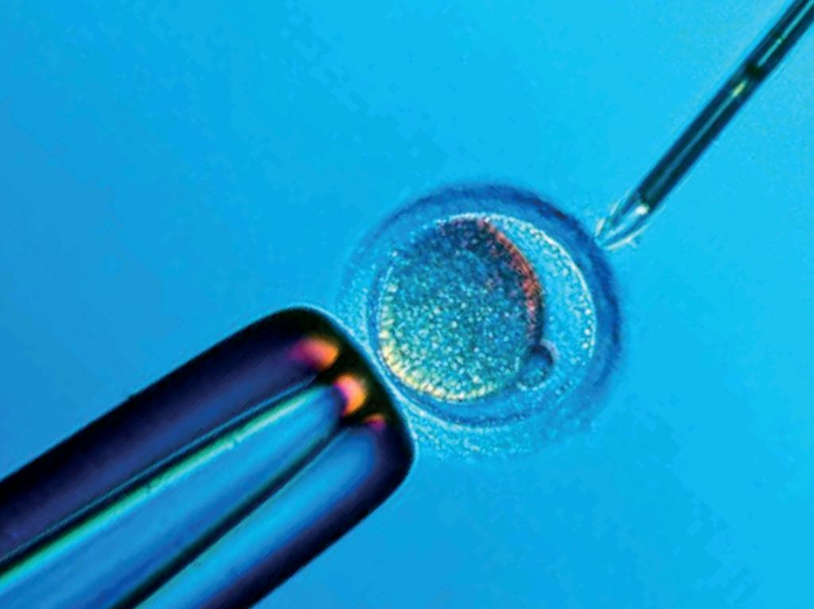

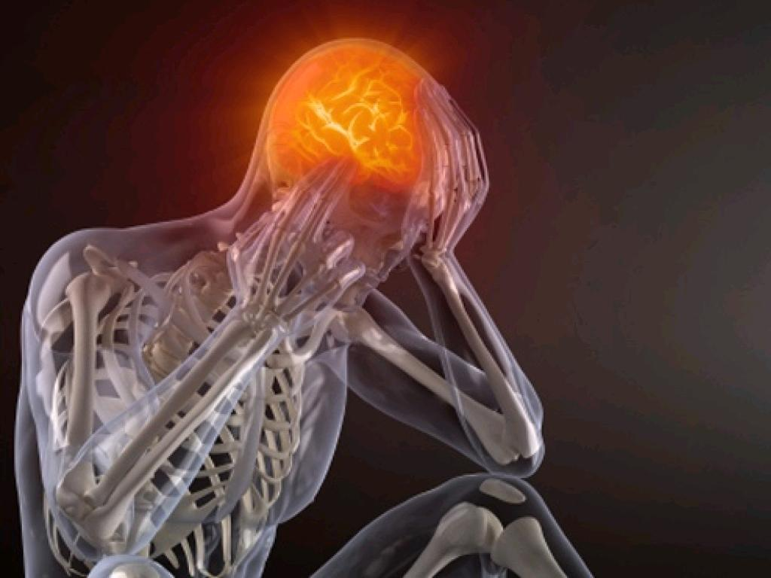

Slide 5
Notes:
Approaches = sensing and imaging approaches

Slide 8
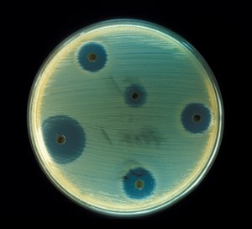
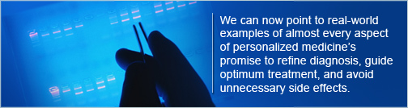
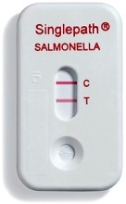
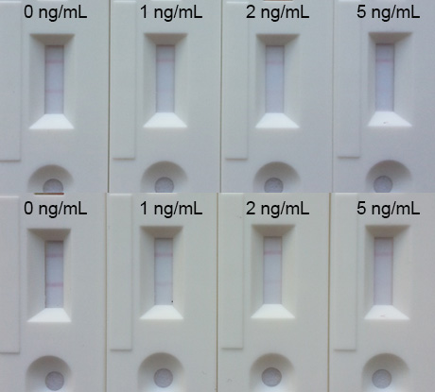
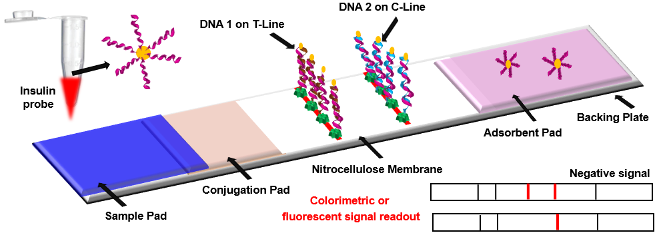
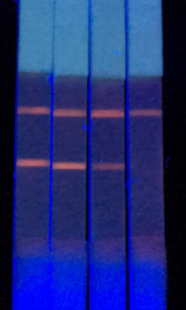
Amplified assay technologies provide
effective molecular diagnostic tools for medicine
Complex body fluids
Simple rapid detection at low concentration (single 1 µm microbe in 100 µl of blood
Personalised genetic analysis for individuals
Therapies targeted to disease type and individual drug response
Improved infectious disease diagnostics
Targeted therapies against antibiotic resistant pathogens
Rapid pathogen detection in health and industry
Notes:
Focus on fluorescence only

Slide 9
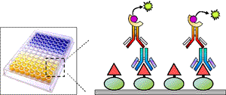
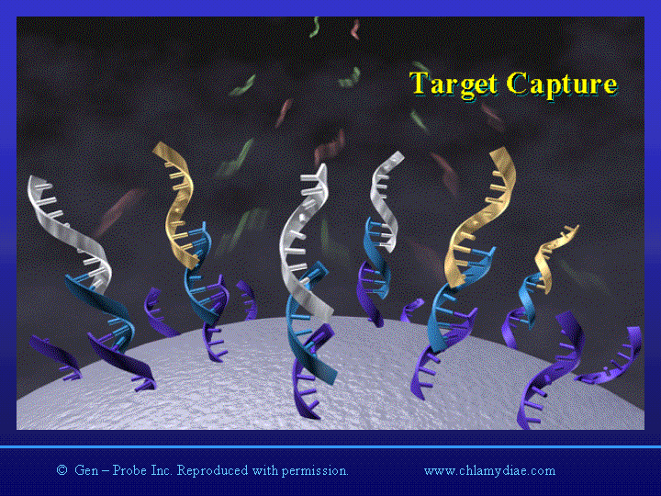
Molecular recognition enables molecularly specific assays
Immunoassays –
extremely specific bio-chemical reactions between antibody and antigen proteins
Complementary nucleic acid sequences –
strong binding between corresponding
base pairs

Slide 10
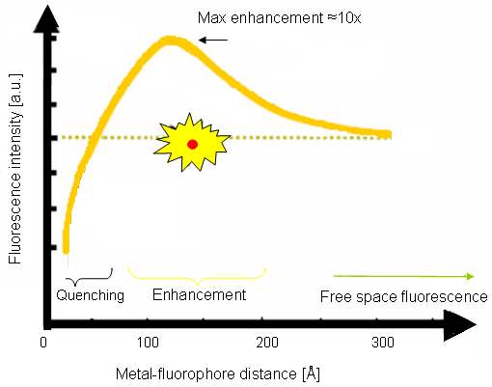
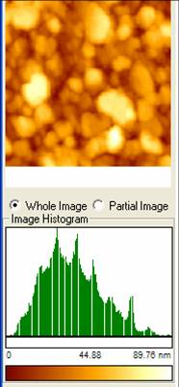
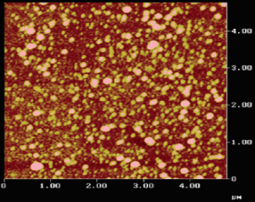
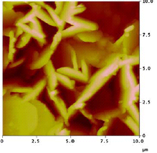

Plasmonics - enhanced biosensing
The effect of distance between metal surface and the fluorophore on MIFE:
0 – 5 nm, quenching;
5-20 nm, enhancement;
> 20 nm, free space fluorescence.
Metal structure design can optimise radiative scattering of fluorescence
Effect of metal on fluorescence signal
as a function of fluorophore-metal distance
Lakowicz et al. Analytical Biochemistry 301, 261–277 (2002)
Ag Island Films:
Malicka J. et al, Anal. Biochem. 315 (2003)
Ag Colloids:
Geddes C. et al, J. Phys. Chem. A 2003, 107
Ag Nanorods:
Kadir A. et al, J. Phys. Chem. B 2005, 109
Notes:
Less than 50 A from surface have metal quenching of fluorophore due to damping of dipole oscillations
We have been trying to use metal ampliciation for fluorescent detection of proteins

Slide 11
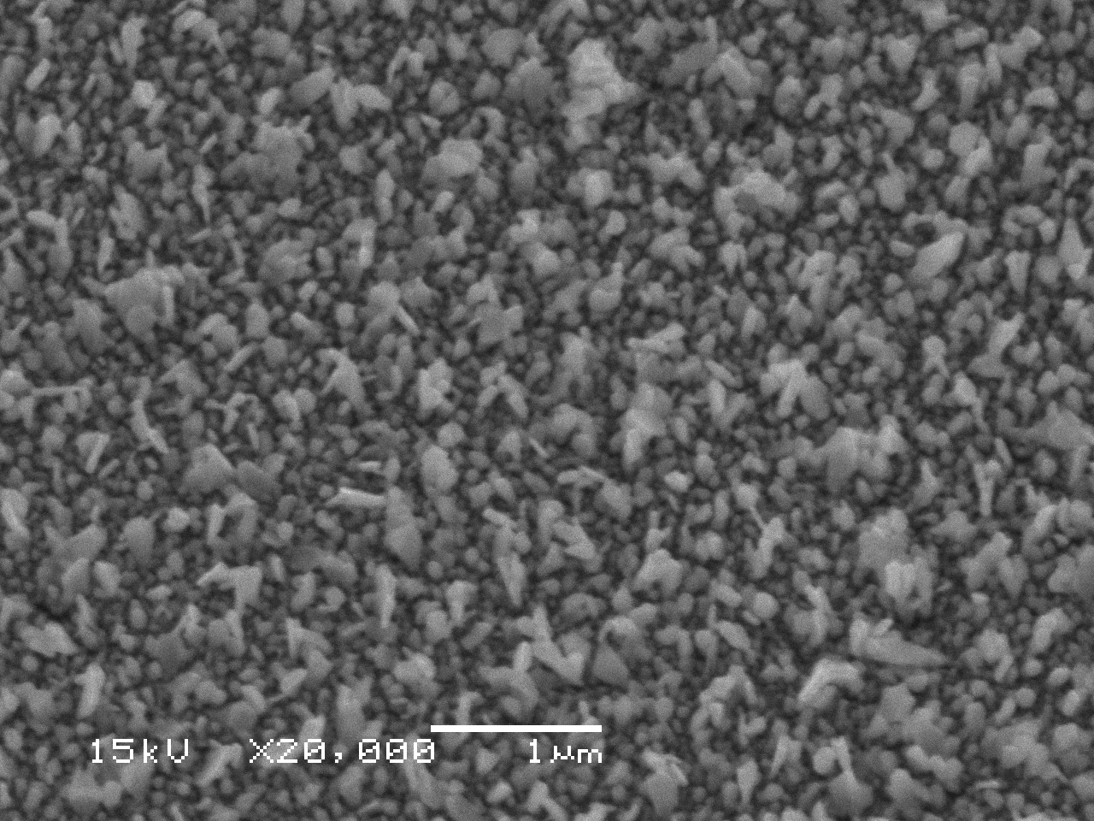
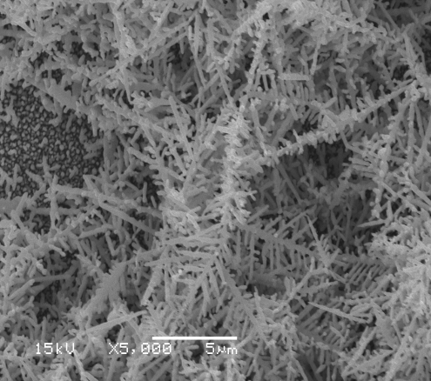
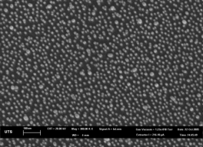
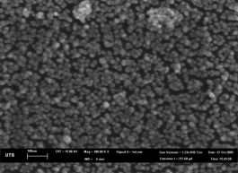
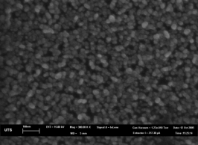



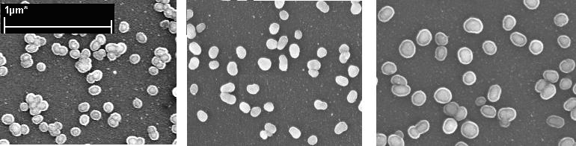
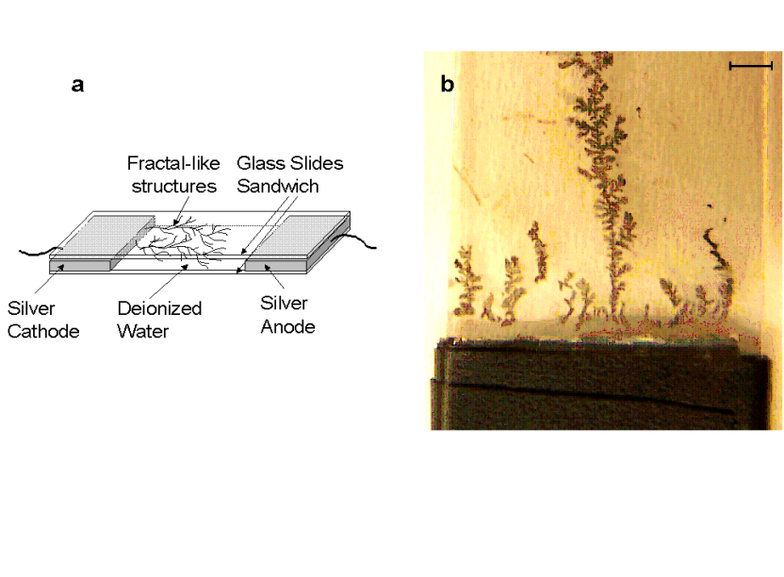
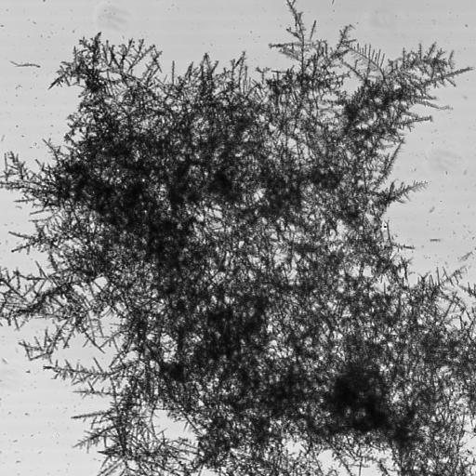
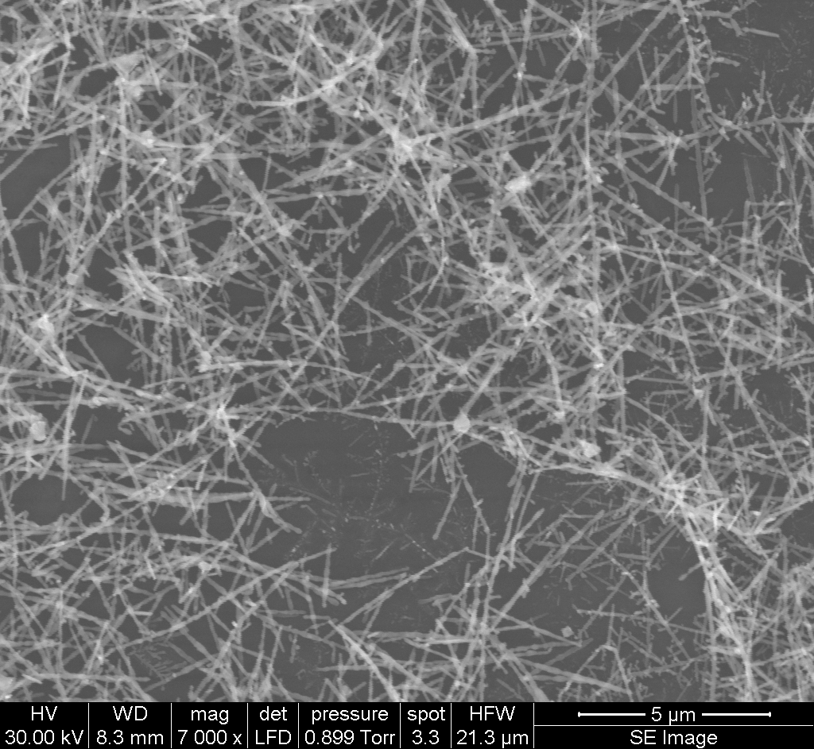
Fluorescence Amplifying Substrates
Ag
Au
A
B
C
Metals: silver, gold, or both; Wet chemistry
Achieved amplification factor x70
Journal of the American Chemical Society
(2007), 129(40), 12117-12122.

Slide 12
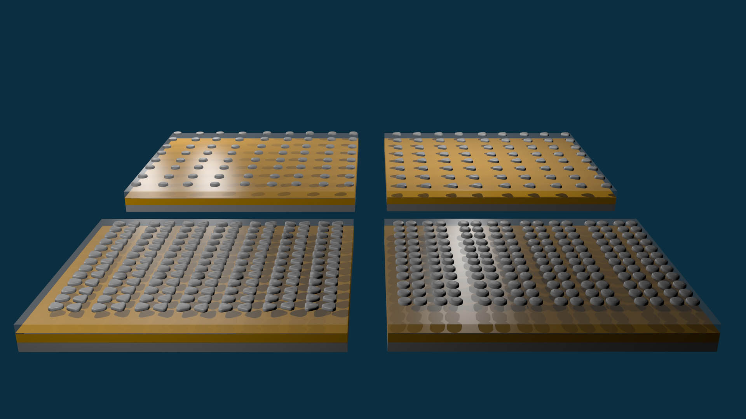

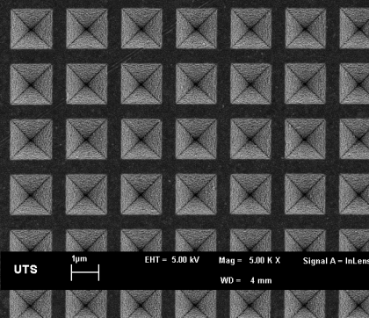
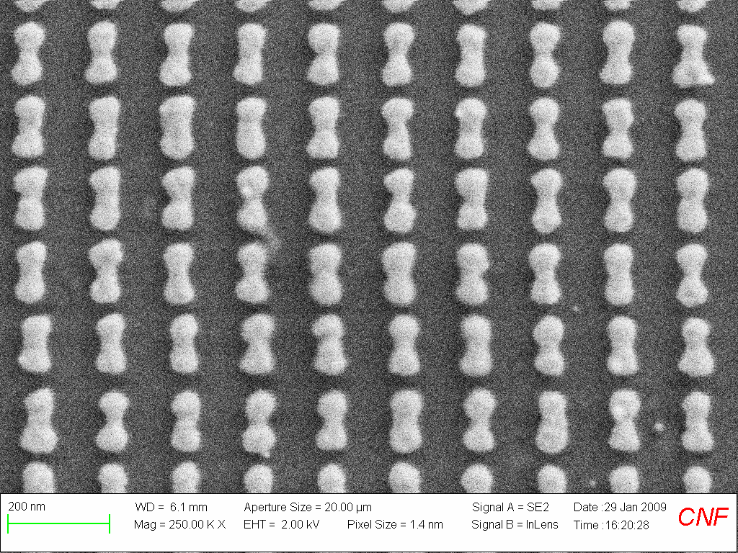
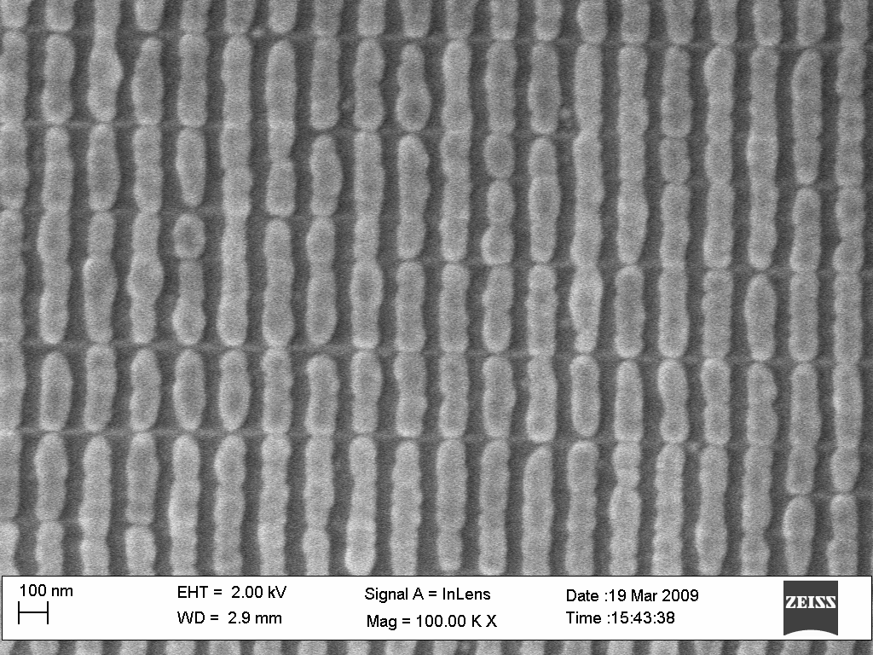
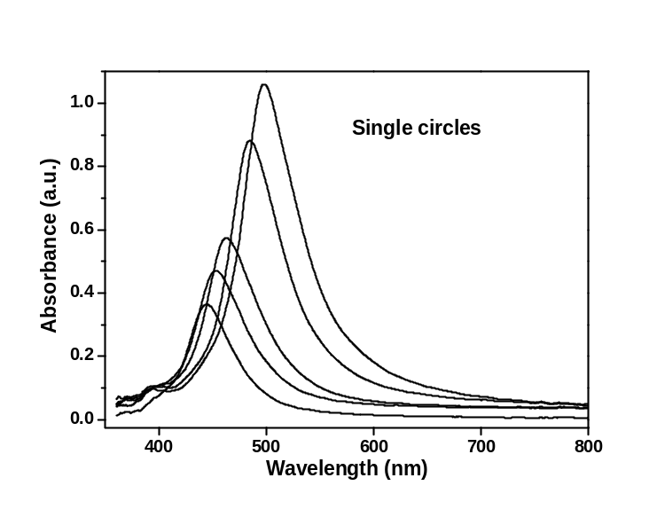
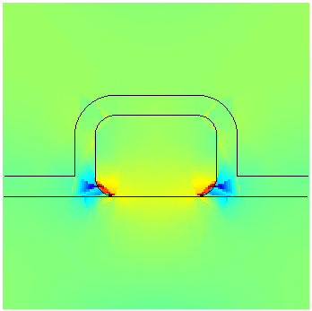
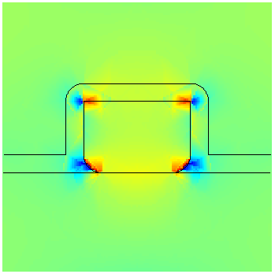
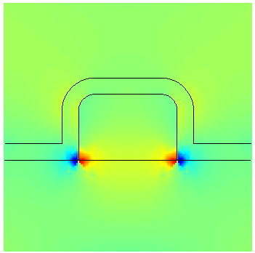

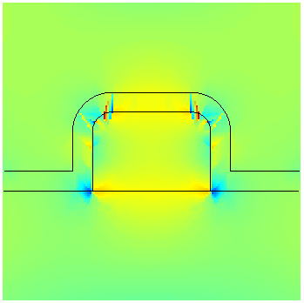
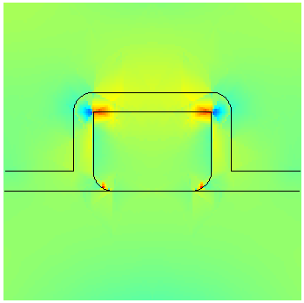
Fluorescence amplifying substrates
E-beam nanostructures: rational design of plasmonic properties, optimise enhancement
Ag on quartz
Klarite
both rounded
bottom rounded
right peak
top rounded
right peak
8
0.3
Absorbance log₁₀(T₀/T₁)
both rounded →
0
0.2
–8
0.1
← bottom rounded
top rounded
left peak
bottom rounded
left peak
5
← top rounded
0.0
0
300
400
500
600
700
–5
λ (nm)
Langmuir 28 (24), 9071-9081 (2012)

Slide 13
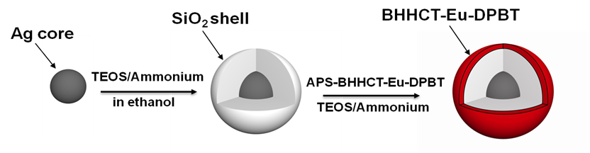
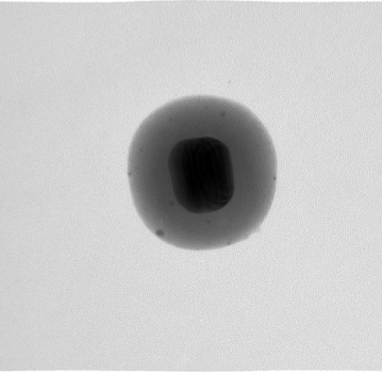
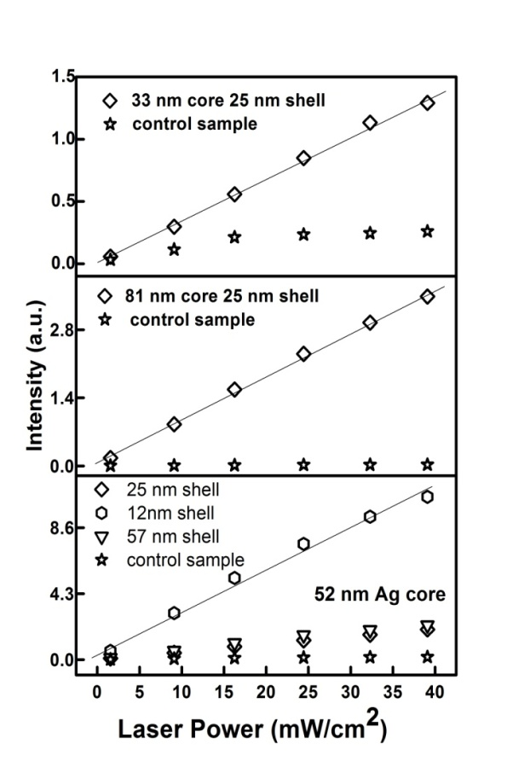
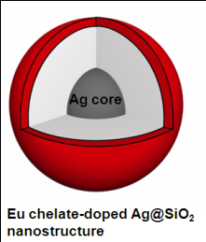
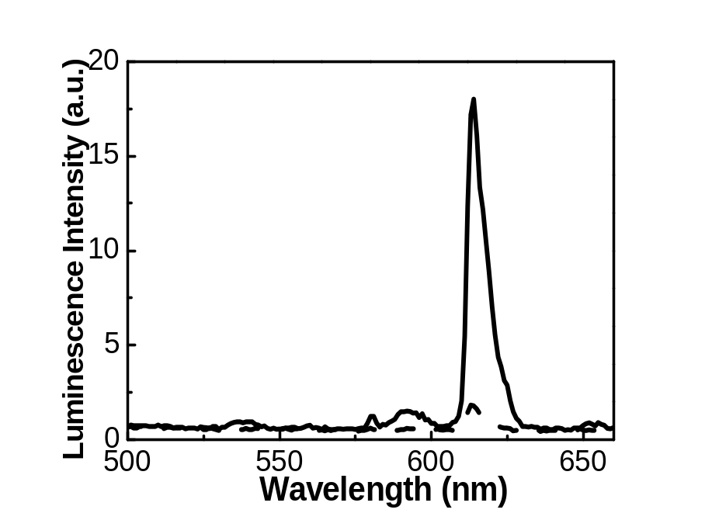
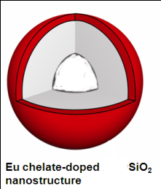
Ultrabright Eu-doped plasmonic labels
100 nm
X 10.7 plasmonic fluorescence enhancement
Controls
Advanced Materials 23 (40), 469-4654 (2011)
Notes:
100 nm
b

Slide 14
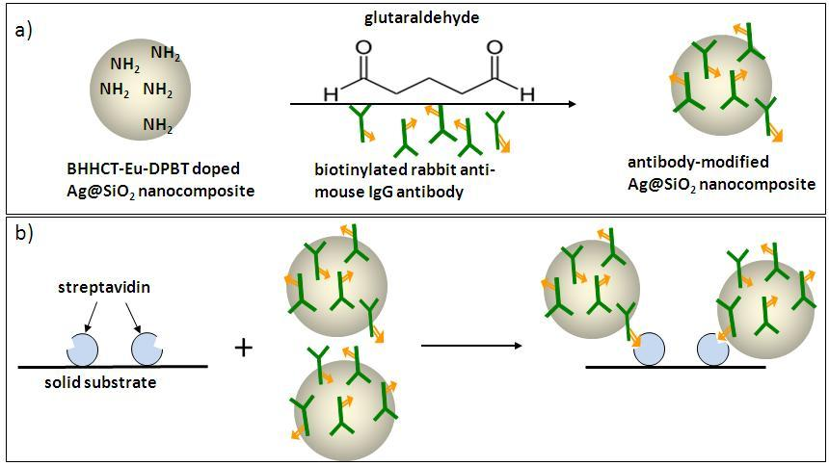
Amplified model assay
X 120 enhancement
Advanced Materials 23 (40), 469-4654 (2011)

Slide 15


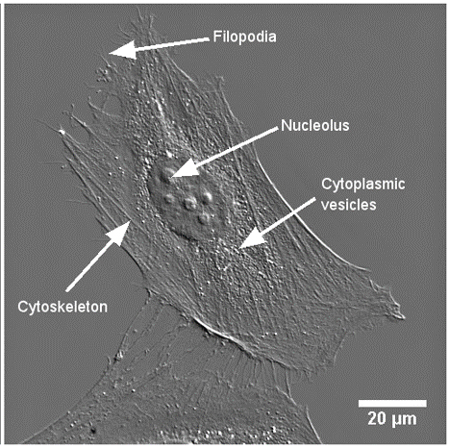
Motivation: visualise molecular events
Lindsay Parker, Macquarie
Antibody molecules enable very specific attachment of fluorescent labels to their target

Slide 16


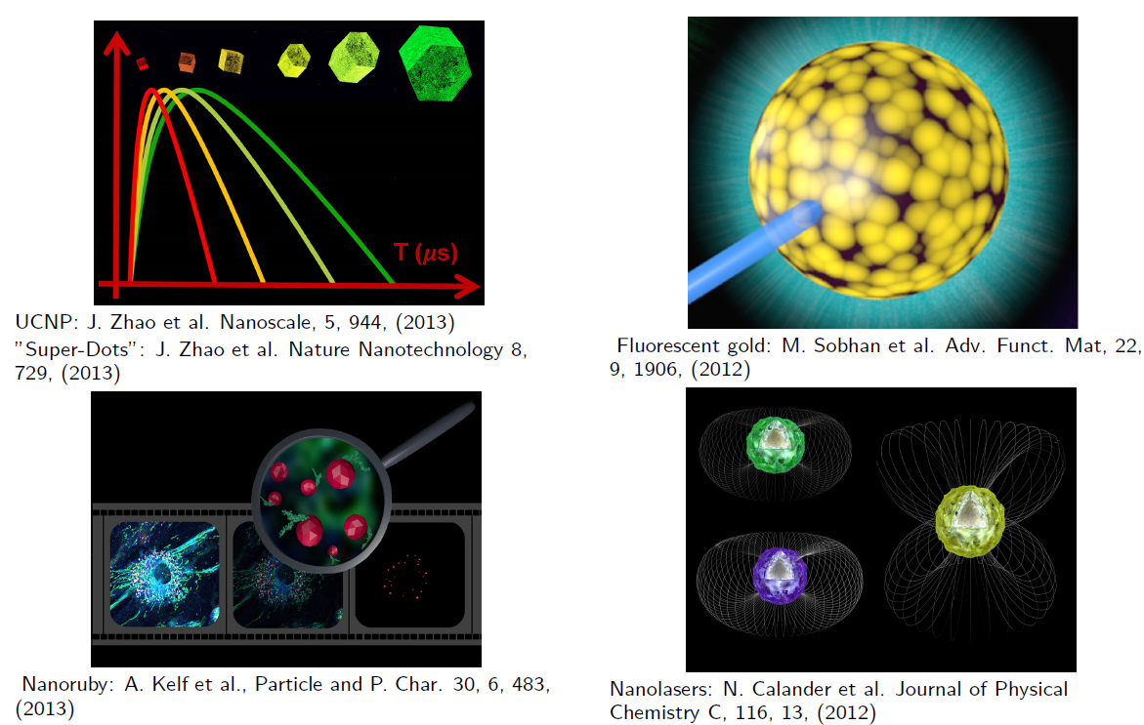

Slide 17

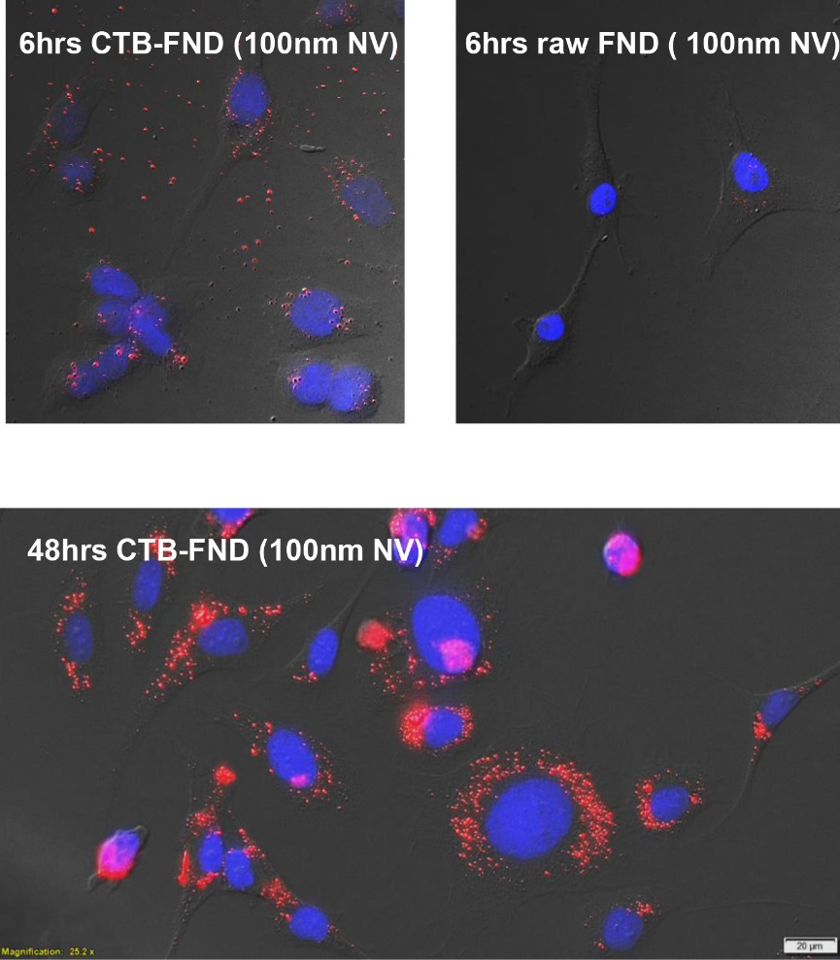
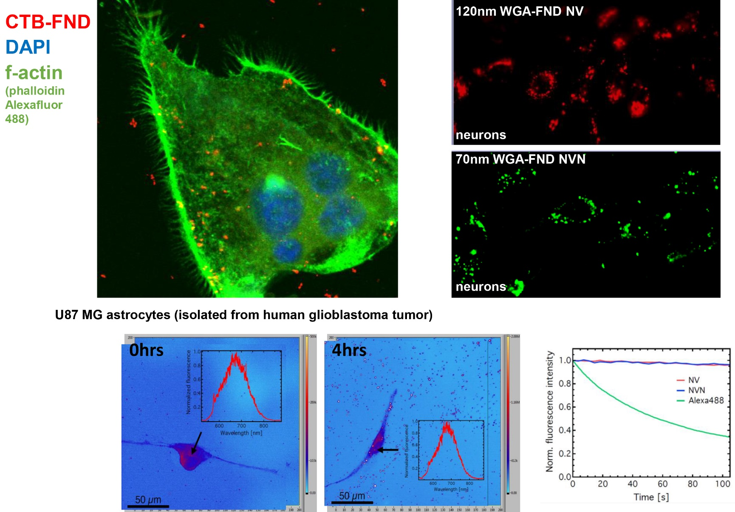
Lindsay Parker, Macquarie

Slide 18

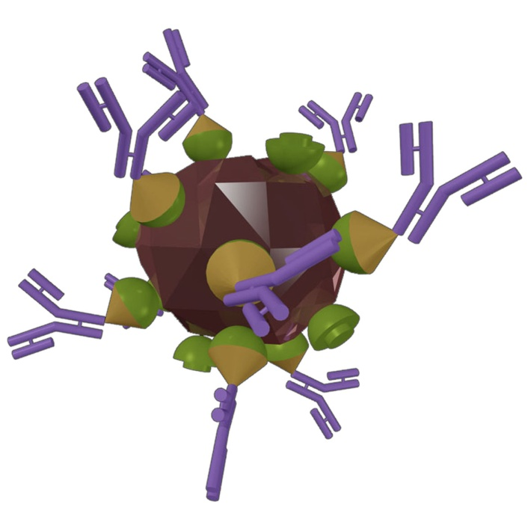


Nanoprobes can be targeted to molecules of interest
Quantum
dots
Biotin-streptavidin pairs
Antibody-antigen
pairs
F
Various nanoparticle-molecule conjugates (e.g. with specific peptides, nucleic acids etc)

Slide 19




NR:
nanoruby
SNP:
Silica
nano
particle
ACS Appl. Mater Interfaces, 2017, 9(45) 39197-39208.
Qdot=
Quantum Dot
(inorganic
nanoparticle
ZnSe, CdSe etc )
Algae and microorganisms in puddle water. Image: Russell Connally
Biotin
= molecule
not nano-
particle
In each quadrant: Top : fixed cells, bottom: live cells

Slide 20



Algae and microorganisms in water from a pond. Image: Russell Connally

Slide 21


Label targets
with long-lived label (here:Eu)
2. Excite sample
with a light pulse
3. Wait until short-lived autofluorecence decays
4. Collect signal from the label
5. Keep repeating steps 2-4
Data: Russell Connally

Slide 22



Slide 23



Sreenivasan et al. ACS Appl. Mater Interfaces, 2017, 9(45):39197-39208. doi: 10.1021/acsami.7b12665.

Slide 24


Lindsay Parker, Macquarie

Slide 25

Lindsay Parker, Macquarie

Slide 26

Er or Tm
Yb

Slide 27



NaYF₄,Yb,Tm
Size ~30 nm
Silica coated
λ_{ex} = 980 nm
UCNPs + antibody against Her2neu receptor over-expressed on SK-BR-3 cells show higher labelling vs control CHO-K1 cells (Grebenik , Nadort et al. JBO 2013)
UCNPs labelling of mRNA – Lindsay Parker, unpublished

Slide 28



Anna Guller,
Andrei Zvyagin,
Annemarie Nadort,
Ekaterina Ivukina
Live mouse, post 1-hour intravenous injection of PA -UNCPs (polyacrolein microbeads with UNCPs inside). Beads accumulate in cancer regions due to enhanced permeability and retention effect (EPR).

Slide 29


Upconversion luminescence with tunable lifetime in NaYF4:Yb,Er nanocrystals: role of nanocrystal size, J. Zhao et al.
Nanoscale, 5, 3, 944-952, (2013)
Amplified stimulated emission in upconversion nanoparticles for super-resolution nanoscopy, Y. Liu et al. Nature 543, 229–233 (2017)

Slide 30



Multiplexing: distinguishable labeling for multiple types of molecules

Slide 31




Lifetime variations are independent of spectral properties
Yiqing Lu, Macquarie

Slide 32


Slide 33


Time-multiplexed in vivo imaging
New paper by Lu
Nature Nanotechnology (2018)
doi: 10.1038/s41565-018-0221-0

Slide 34

A Matter of Scale...

Slide 35


Slide 36


Spatial ELISA sensor
Modified optical fibre
G. Liu, E. Goldys, et al., ACS Sens., 2017, 2(2), 218-226,
Zoom 1x (FOV 1500 x 1500 micrometer), 10 stacks
Catheter with holes
Optical fibre

Slide 37





“sandwich immunoassay”,
canula
K. Zhang, Guozhen Liu
Macquarie U
Mike Baratta, U Colorado
Living brain (hippocampus)
Brain Behav Immun. 2018 Jul;71:18-22.
doi: 10.1016/j.bbi.2018.04.011

Slide 38



NIR II
nm
1700 nm
Deng ZM et al NANOSCALE (2018), 10,19, 9393-9400
Xue, ZL et al BIOMATERIALS (2018) ,171,153-163

Slide 39




Slide 40




Photodynamic therapy with light and PLGA polymers incorporating verterporfin and gold nanoparticles
PLGA polymer incorporating verteporfin and gold nanoparticles
Wei Deng
PLGA polymer
405nm laser
Zofia Kautzka
RSC Advances 6, 112393-112402, (2016).
PANC-1 cell
Notes:
Enhanced cancer cell-killing efficacy was demonstrated by our PLGA polymers incorporating verteporfin and gold nanoparticles under light illumination

Slide 41




X-ray activated PDT with Nanoparticle-Photosensitizer combinations
Why use X-rays in Photodynamic Therapy ?
Limited penetration depth of UV and visible light
Sandhya Clement
Absorption band of protoporphyrin IX(PpIX)²
Tissue transparency window¹
Why use Nanoparticles in X-ray Photodynamic Therapy ?
Disadvantages of photosensitiser drugs: poor selectivity, hydrophobic nature, aggregation property in physiological environment and limited therapeutic effect.
Scintillating Nanoparticles (CeF₃) as energy transducers
Metal nanoparticles (Au) as singlet oxygen (¹O₂ ) amplifiers
Polymer nanoparticles (PLGA) as Drug carrier for X-ray PDT
C.H. Quek and K. W. Leong. Near-infrared fluorescent nanoprobes for in vivo optical imaging. Nanomaterials 2(2), 92 (2012)
2. R. M. Valentine, S. H. Ibbotson, K. Wood, C. T. A. Brown, and H. Moseley. Modelling fluorescence in clinical photodynamic therapy.
Photochemical&Photobiological Sciences 12(1), 203 (2013).

Slide 42






Scintillating Nanoparticles (CeF₃) as energy transducers
PDT Mechanism in CeF3 nanoparticles
Clement, S.; Deng, W.; Drozdowicz-Tomsia, K.; Liu, D.; Zachreson, C.; Goldys, E. M. Bright, water-soluble CeF3 photo-, cathodo-, and X-ray luminescent nanoparticles. J Nanopart Res 2015, 17, 1-9
Clement, S. et al. X-ray induced singlet oxygen generation by nanoparticle-photosensitizer conjugates for photodynamic therapy: determination of singlet oxygen quantum yield. Sci. Rep. 6, 19954; doi: 10.1038/srep19954 (2016).
Absorption spectra of verteporfin
Emission of CeF₃ nanoparticles
X-ray luminescence
Singlet oxygen generation
 | CeF3 | Conjugate sample A | Conjugate sample B | Conjugate sample C
¹O₂ molecules per absorbed 8 keV X-ray | 1000 ± 170 | 2100 ± 280 | 3900 ± 470 | 6300 ± 380
X-ray singlet oxygen quantum yield (η) | 0.13±.02 | 0.26 ± 0.04 | 0.49 ± 0.06 | 0.79 ± 0.05
Dose partition
Energy | 30 keV | 6 MeV
CeF₃ | 89% | 28%
Tissue | 11% | 72%
Based on experimental and theoretical calculations, the number of singlet oxygen generated per cell for 6MeV X-ray energy is (2±0.7)×10⁸ . This is comparable with Neidre dose (5 )×10⁷
Cell level PDT Demonstration:
Cancer cell: Panc 1
Radiation source: Elekta XiO planning system (Elekta AB, Sweden) (6 MV photons)
Cell viability: MTS assay

Slide 43




Metal nanoparticles (Gold-Au) as singlet oxygen (¹O₂ ) amplifiers
X-ray and 690 nm PDT mechanism
Clement, S., Chen, W., Anwer, A. G., & Goldys, E. M. (2017). Verteprofin conjugated to gold nanoparticles for fluorescent cellular bioimaging and X-ray mediated photodynamic therapy. Microchimica Acta, 1-7.
Singlet oxygen generation
Conjugates
We show a proof-of-principle that PDT can be carried out with therapeutic X-rays both with molecular photosensitizer VP and with AuNP-VP conjugates. The conjugates synthesized in this work were less effective than the VP alone but they were also less cytotoxic in the absence of sensitizing radiation.
PDT effect in Panc 1 cancer cell line

Slide 44





PDT Mechanism
Polymer nanoparticles (PLGA) as a drug carrier for X-ray PDT
Cell line : HCT 116 , colorectal cancer cell line
Singlet oxygen generation
In vitro PDT assays suggest that the conjugates effectively kill HCT116 cells in the presence 6 MeV radiation. In X-ray radiation, the 6 MeV radiation from linear accelerator produces energetic secondary electrons and Cerenkov radiation in the samples, which, in turn excite the VP molecules.

Slide 45




Beyond PDT: drug/gene release from X-ray triggered liposomes incorporating verteporfin (VP) and gold nanoparticles
4 Gy
In vitro cell-killing effect in HCT116 cell line)
Wei Deng
In vivo therapeutic effect in a mouse model with colorectal cancer
Nature Communications
volume 9, Article number: 2713 (2018)

Slide 46

Wrapyp 2 slides

Slide 47


Slide 48


Increase sensitivity of end-user assays
by several orders of magnitude
(5 orders – single molecules sensitivity)
Molecularly sensitive imaging in vivo
Develop simple and low cost methods of nanostructure synthesis
Engineering
Develop simple and low costs assays and devices
Chemistry
Biotechnology
Design and demonstrate plasmonic and dielectric structures for optimised enhancement (fluorescence, SERS, absorption)
Physics
Industry
Medical therapies and diagnostics
Overcome the R&D gap and take the inventions to the market
Clinical adoption of technologies

Slide 49




Slide 50



Collaborators - presented work:
Sutton-McDowall ML, Gosnell M, Anwer AG, White M, Purdey M, Abell AD, Thompson JM, Nadort A, Hutchinson MR, Y.Q. Lu, J.B. Zhao, R.C. Leif, J.A. Piper, J.P. Robinson, D.Y. Jin, Zhang, K., Ma, K., Care, A. Mahbub, S. B, Cassano, J. C. Sue, C. M., Perinchery, S. M., Inglis, D. W., Adhikary, P. P. Jazayeri, J. A., Cahill, M. A., Saad, S., Pollock C.A., Chandra Bala, D. Rowe, G. Vesey, Razali, W. A. W., Sreenivasan, V. K. A., Bradac, C., Connor, M., Zvyagin, A. V, Dawes, J. M, Purdey, M, RB Gilchrist, DK Gardner, A. Habbibalahi, V. Staikopoulos, M. Baratta, S.Mustafa, B.Gibson and others.

Slide 51

THANK YOU

Slide 52
Spare slides

Slide 53
Publications on fluorescence amplification, substrates
“Extreme sensitivity of optical properties of metal nanostructures to minor variations in geometry is due to highly localised electromagnetic field modes”, Ewa M. Goldys , Nils Calander, and Krystyna Drozdowicz-Tomsia, accepted Journal of Physical Chemistry C (2010).
“Deposition of Silver Dentritic Nanostructures on Silicon for Enhanced Fluorescence”, Drozdowicz-Tomsia, Krystyna; Xie, Fang; Goldys, Ewa M., Journal of Physical Chemistry C (2010), 114(3), 1562-1569.
“Metalllic nanomaterrials for sensitivity enhancement of fluorescence detection”, Fang Xie, EM. Goldys , Sensors (2008), 8, 886-896,
“Enhanced Fluorescence Detection on Homogeneous Gold Colloid Self-Assembled Monolayer Substrates”, Xie, Fang; Baker, Mark S.; Goldys, Ewa M. Chemistry of Materials (2008), 20(5), 1788-1797.
“Fluorescence Amplification by Electrochemically Deposited Silver Nanowires with Fractal Architecture”, Goldys, Ewa M.; Drozdowicz-Tomsia, Krystyna; Xie, Fang; Shtoyko, Tanya; Matveeva, Eva; Gryczynski, Ignacy; Gryczynski, Zygmunt”, Journal of the American Chemical Society (2007), 129(40), 12117-12122.
“Preparation of Homogeneous Silver-Coated Nanoparticles and their Application for Fluorescence Enhancement”, Fang Xie, Mark Baker, Ewa Goldys, J. Phys. Chem. B. 110 (46), 23085-23091, (2006)
SPR enhancement
“ Modeling of the SPR resolution enhancement for a nanoparticle inclusive sensor by using statistical hypothesis testing” Anne Barnett, Ewa M Goldys; Optics Express (2010), Volume 18, Issue 9, Pages: 9384-9397
Notes:
Sensitive protein detection

Slide 54









Smart particles …
… SHINERS
Novel SERS enhancement,
by 'dusting-on' a powder of plasmonic nanoparticles …
Our own Ag/ SiO₂ SHINs

Slide 55



Plasmonic core-shell
Nano
Ruby
Upconverting nanoparticles
Quantum
dots
F
Gold
nanoparticles
Nano
diamonds

Slide 56


Slide 57

Calander et al, J. Phys. Chem. C, 2012

Slide 58

Photonic and Laser Technologies and Applications
David Spence
Helen Pask
Richard Mildren
Judith Dawes
Brian Orr

Slide 59
Applications
Fibre sensing: single particles
Biolabelling
Rare cell detection
Document security

Slide 60

1. Fluorescent nanoprobes
Motivation: Visualise molecular events
Bright labels Reduced autofluorescence
( high signal) (low background)
Lanthanides or
transition metals
Time-gated methods
ms lifetimes
Low photon cycling rates
Not bright enough

Slide 61





Slide 62









outside cell
inside cell
“sandwich immunoassay”, Y shapes = antibodies
Guozhen Liu,
Macquarie

Slide 63





