Slide 1


Neutron studies of iron-based superconductors
The 9th Vacuum and Surface Science Conference
of
Asia and Australia
Jie-Yu (Shirley) Yang
Advisor: Prof. Maw. Kuen. Wu, and Prof. Chih-Hao Lee
Taiwan-National Tsing Hua University/Academia Sinica
Aug. 13, 2018

Slide 2
Outline
Motivation
Structural and magnetic model
Experimental
  Sample synthesis
  Magnetic susceptibility
  Neutron measurements
Analysis and results
Summary

Slide 3
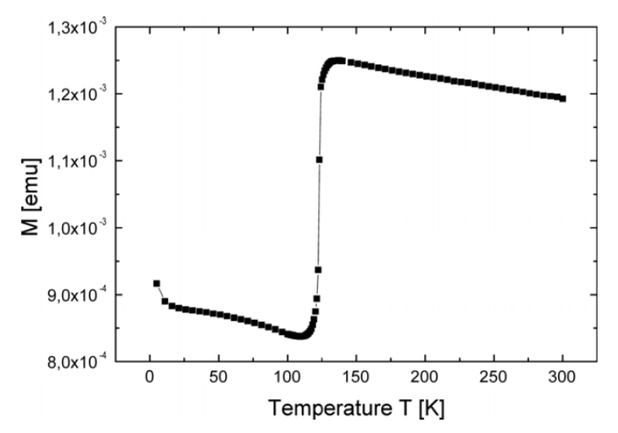
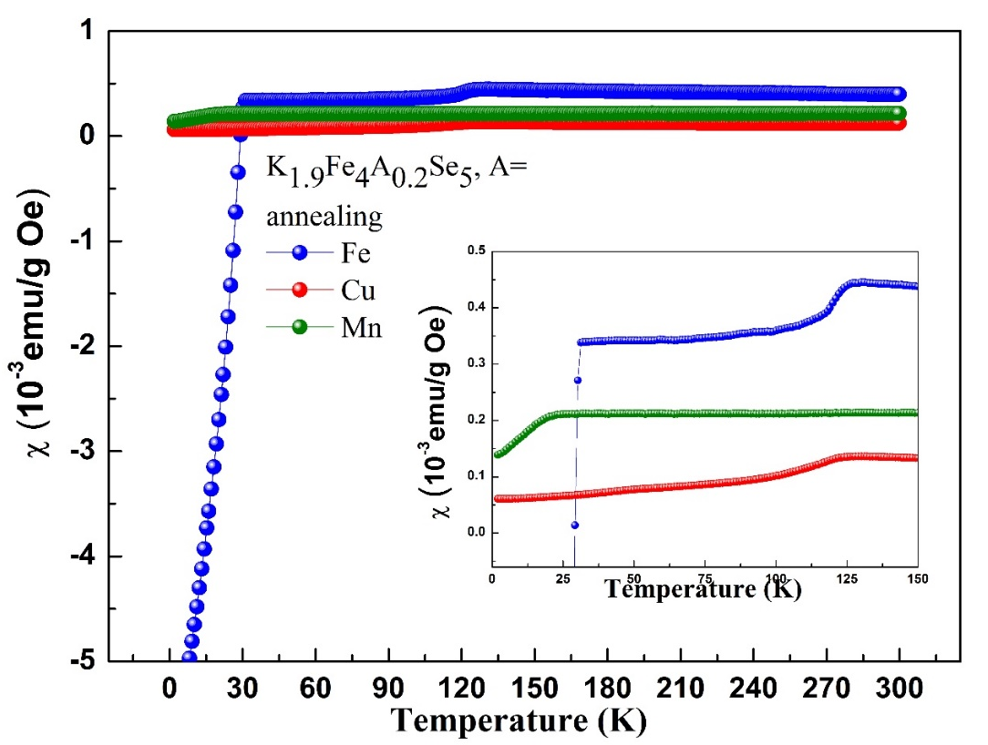
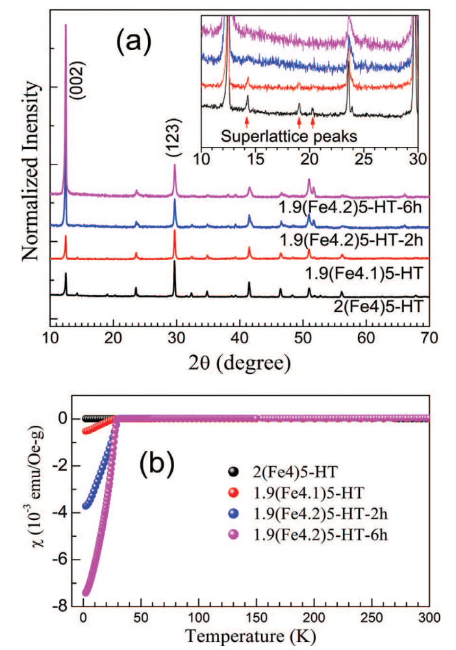
Motivation
Fe₃O₄
125 K
FIG. 1.(a) XRD (b) magnetic susceptibility for K_{2-x}Fe_{4+y}Se₅ polycrystalline.
FIG. 2. Magnetic susceptibility measurement for K_{1.9}Fe₄A_{0.5}Se₅, A=Cu/Mn.
To study the correlation between magnetic structure and superconductivity.
To identify whether the magnetic transitions observed at 125 K in the stoichiometric K_{2-x}Fe_{4+y}Se₅, related to Verwey transition (as that observed in Fe₃O₄).
EPL, 111 (2015) 27004
J. Phys.: Condens. Matter 20 (2008) 142201

Slide 4
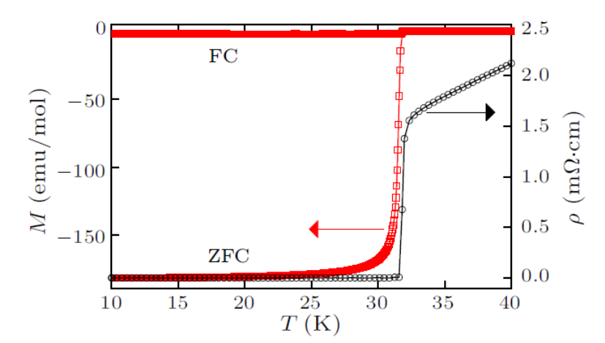
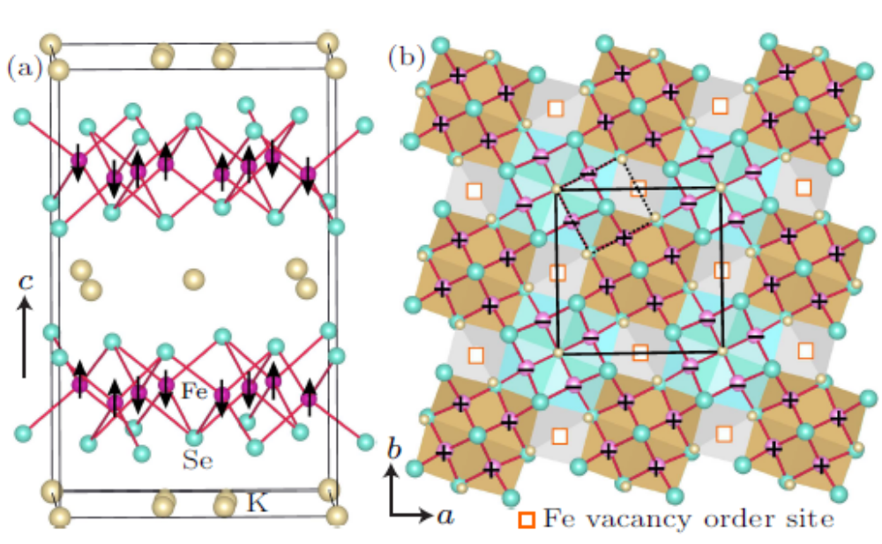
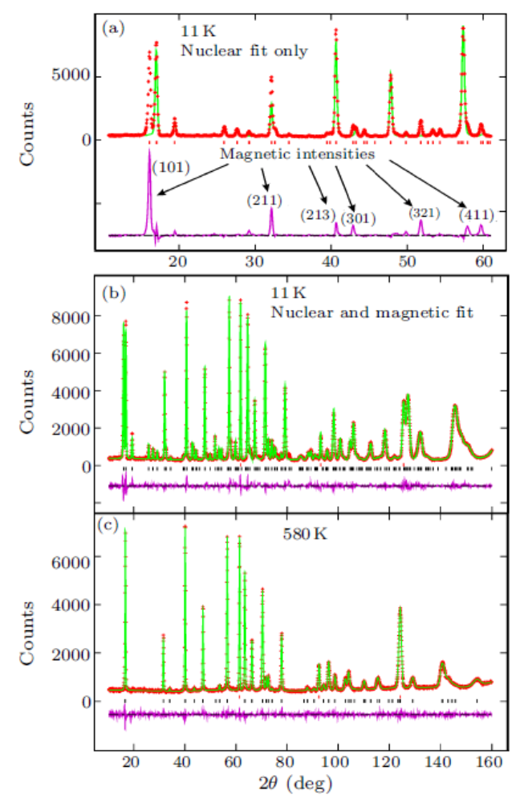
Structure model-experiment: Tetragonal I 4/m K_{0.8}Fe_{1.6}Se₂
Fig. 1. Magnetic susceptibility and resistivity for bulk K_{0.8}Fe_{1.6}Se₂.
Fig. 3. Crystal and magnetic structure of K_{0.8}Fe_{1.6}Se₂ in the low-temperature I 4/m unit cell.
Fig. 2. Neutron powder diffraction patterns of the K_{0.83(2)}Fe_{1.64(1)}Se₂ superconductor.
CHIN. PHYS. LETT. Vol. 28, No. 8 (2011) 086104

Slide 5
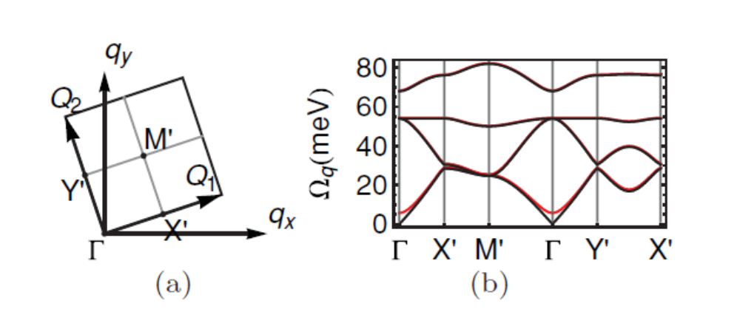
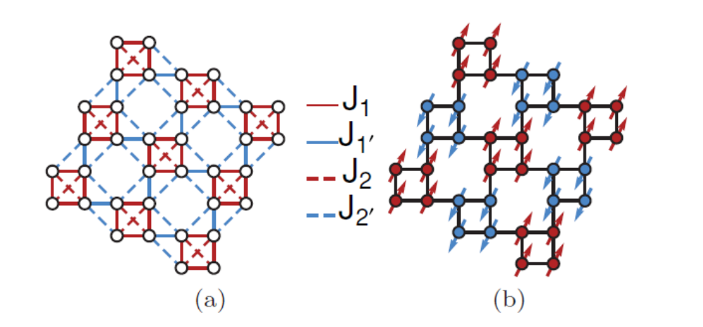
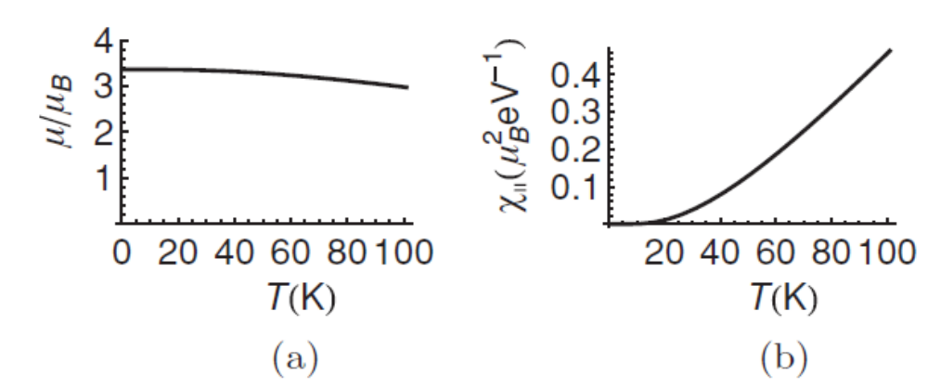
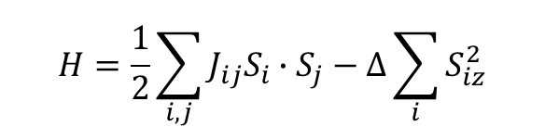
Spin wave model-theory
70 meV
55 meV
K_{0.8}Fe_{1.6}Se₂
30 meV
FIG. 2.(a) The magnetic Brillouin zone. (b) The spin-wave spectrum.
The correlation between anti-ferromagnetism (AFM) and superconductivity remains unknown.
$$H=\frac{1}{2}\sum_{i,j}{J_{ij}S_{i}∙S_{j}}−∆\sum_{i}{S_{iz}^{2}}$$
FIG. 1.(a) The schematic representation of the vacancy ordered √5 ×√5 lattice structure in each iron plane. (b) The ordered spin configuration.
FIG. 3. Temperature dependence of (a) the per-iron magnetic moment and (b) the longitudinal uniform susceptibility.
PHYSICAL REVIEW B 84, 020406(R) (2011)

Slide 6
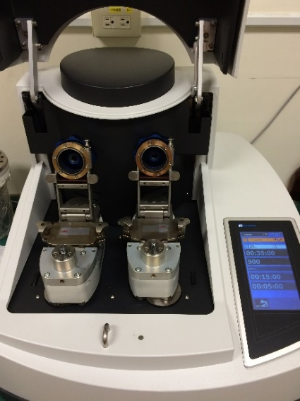
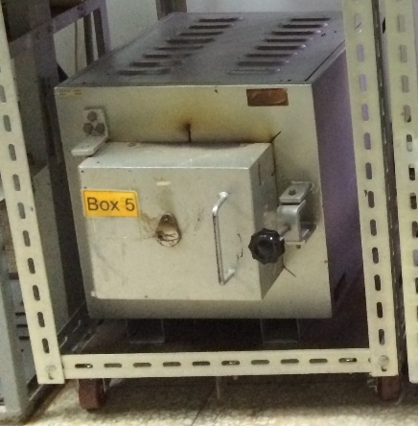
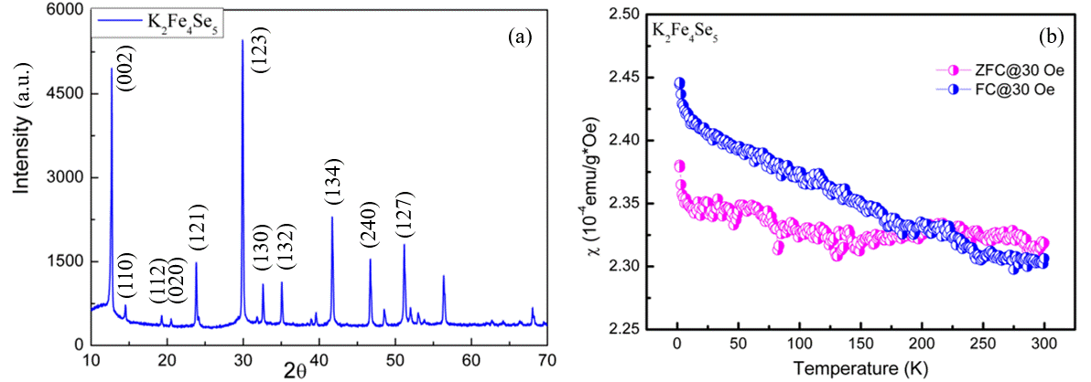
Sample synthesis
quartz
K+Fe+Se
Furnace
Ball milling box
Ball milling machine
Samples K_{2-x}Fe_{4+y}Se₅
#1 K₂Fe₄Se₅_annealing
K₂Fe₄Se₅
#2 K_{1.9}Fe_{4.2}Se₅ (SC)
K_{1.9}Fe_{4.2}Se₅_annealing
#3 K_{1.9}Fe₄Cu_{0.2}Se₅
K_{1.9}Fe₄Cu_{0.2}Se₅_annealing
#4 K_{1.9}Fe₄Mn_{0.2}Se₅
K_{1.9}Fe₄Mn_{0.2}Se₅_annealing
Fe vacancy order

Slide 7
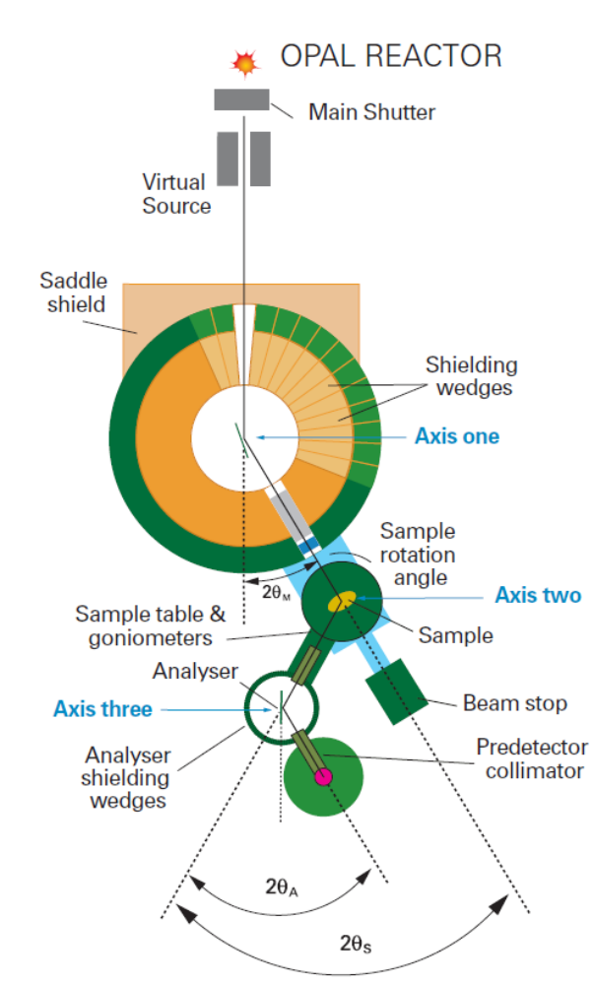

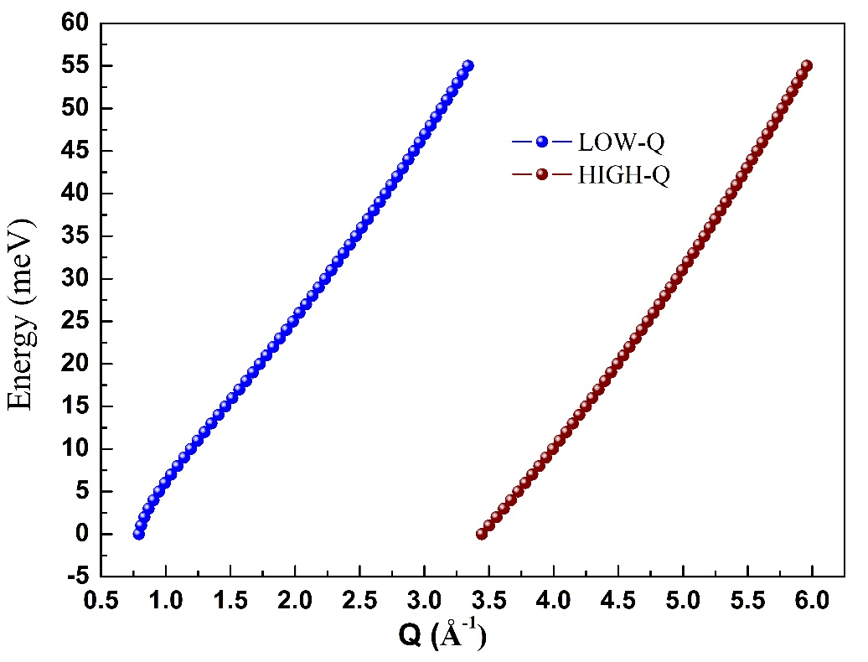


TAIPAN experiment:
Thermal 3-Axis Spectrometer
ECHIDNA experiment:
High-resolution powder diffractometer
Energy transfer E=ℏω=E_{i}-E_{f}
E_{f}: fixed at 14.87 meV
Ge(331)
λ=2.4395 Å
$$\left|Q\right|=\sqrt{k_{i}^{2}+k_{f}^{2}−2k_{i}k_{f}cos2θ }$$

Slide 8
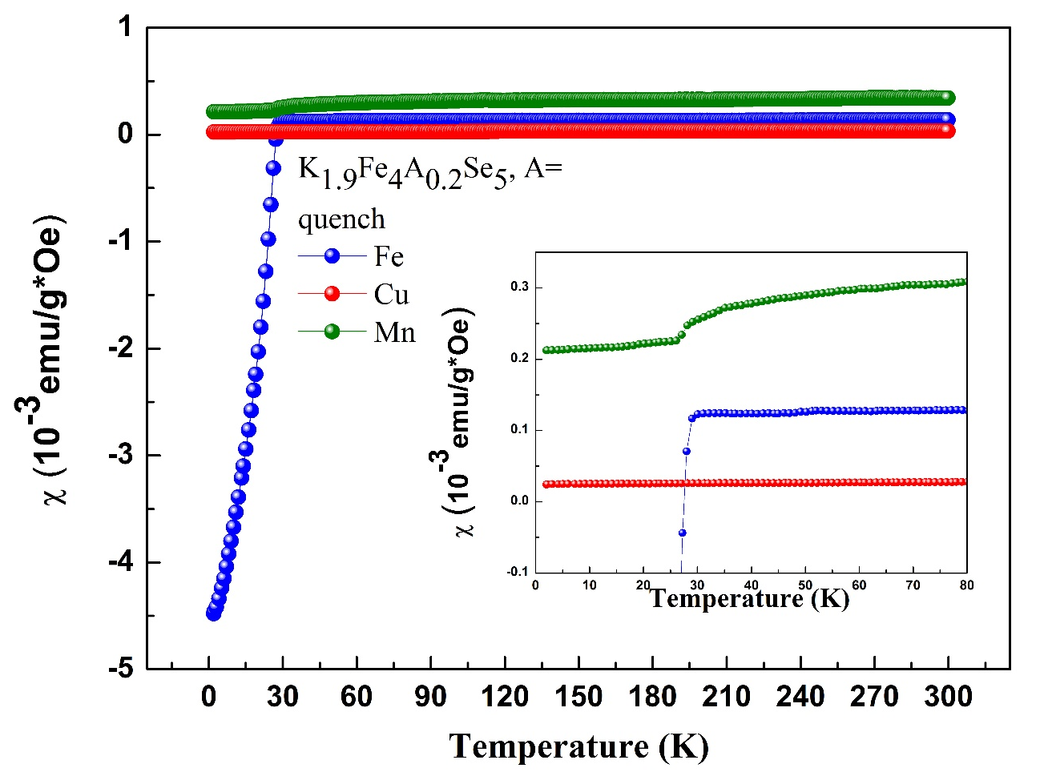

  Magnetic susceptibility
A= Fe: Superconducting T_{c}=30 K
A= Cu: totally suppress superconductivity
A= Mn: T_{c} shift to lower temperature~28 K.
A= Fe: Superconducting with 125 K transition
A= Cu: 125 K transition
A= Mn: T_{c} shift to lower temperature~20 K.

Slide 9
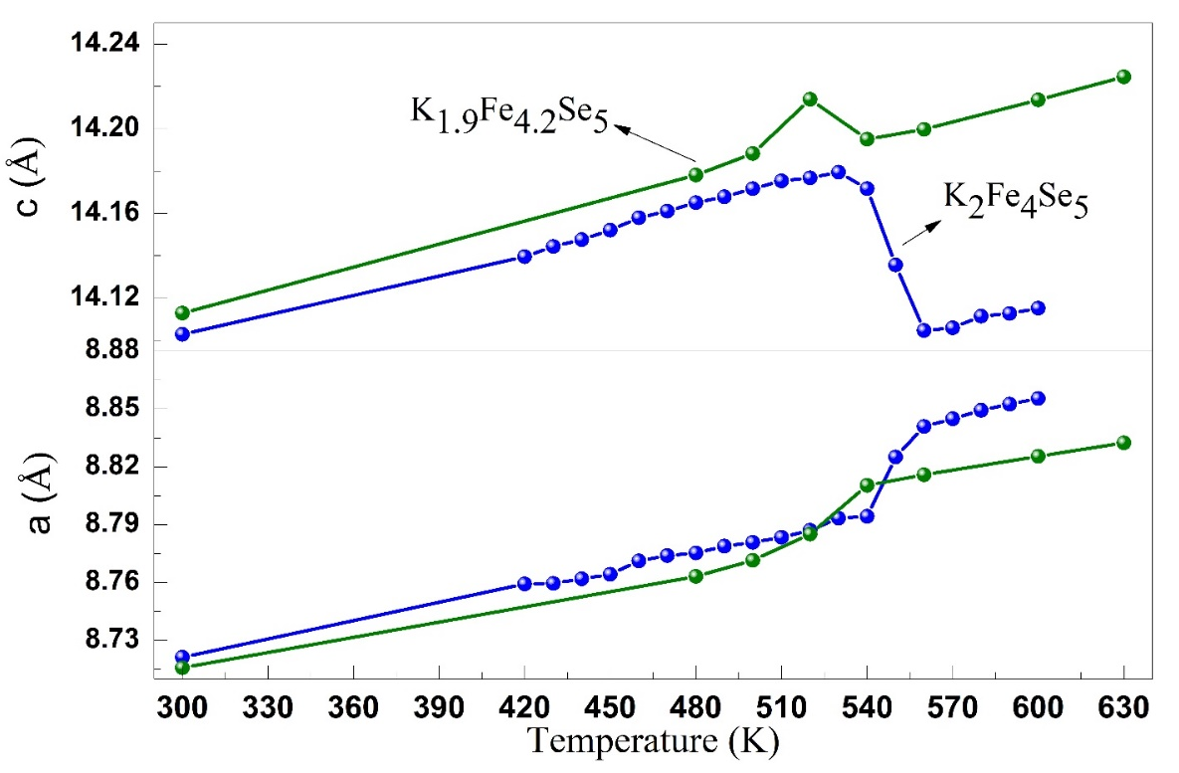
Neutron measurements:
ECHIDNA experiment: High-resolution diffractometer
Lattice constant
At 300 K
Samples | Magnetic moment (μ_{B}) | a=b (Å) | c (Å)
#1 K₂Fe₄Se₅ | 2.817(23) | 8.72126(54) | 14.10288(15)
#2 K_{1.9}Fe_{4.2}Se₅ | 2.683(54) | 8.71535(23) | 14.11369(65)
#2-annealing | 3.007(45) | 8.71739(16) | 14.10608(46)
#3 K_{1.9}Fe₄Cu_{0.2}Se₅ | 2.478(33) | 8.71701(81) | 14.13734(23)
#3-annealing | 2.871(33) | 8.72172(83) | 14.12850(23)
#4 K_{1.9}Fe₄Mn_{0.2}Se₅ | 2.663(41) | 8.73086(15) | 14.10628(41)
#4-annealing | 3.208(39) | 8.72525(22) | 14.10379(44)
Extra irons doped sample with smaller a-axis and larger c-axis.
The magnitude of magnetic moment increases after annealing.

Slide 10
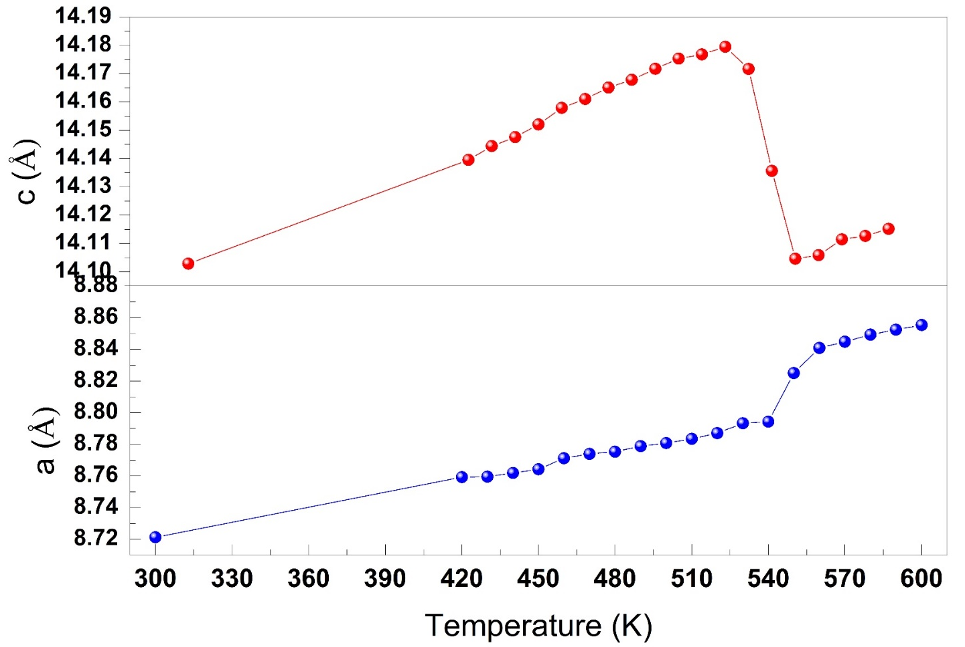
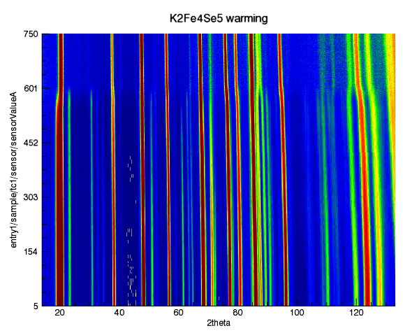
ECHIDNA experiment
Transitions of magnetic order and structure
Magnetic peak
K₂Fe₄Se₅_annealing
T_{S}~560 K
Fe-vacancy order
K₂Fe₄Se₅
T_{N}~530 K
Temperature(K)
T_{N} < T_{S}
T_{N}: magnetic order-disorder transition temperature
T_{S}: structure transition temperature

Slide 11
Summary of neutron powder diffraction
The magnetic order-disorder transition temperature is at 530 K, and the structure transition temperature is at 560 K.
K_{1.9}Fe₄A_{0.2}Se₅, A=Fe, Cu, annealing samples display Verwey-like transition in χ-T. No structural or magnetic transition is detected in the NPD patterns collected below and above 125 K.
Superconducting sample has larger c-axis and smaller a-axis, compared to the parent compound.
Quenched sample has smaller a-axis, which increases after annealing.

Slide 12
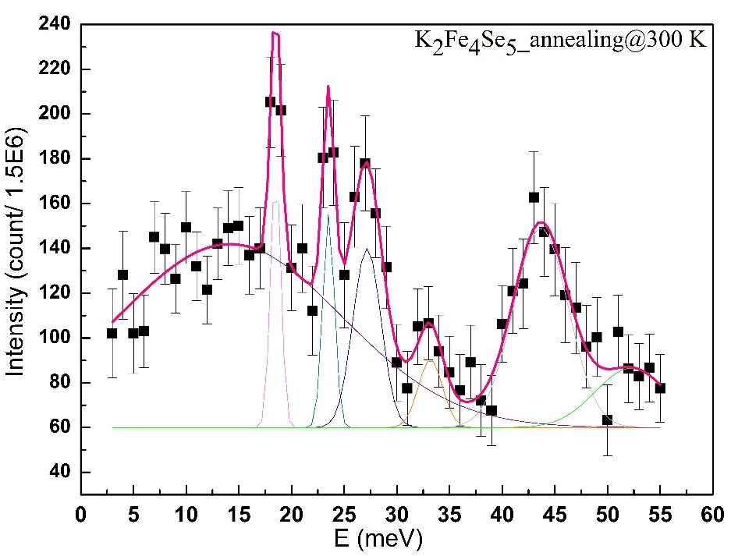
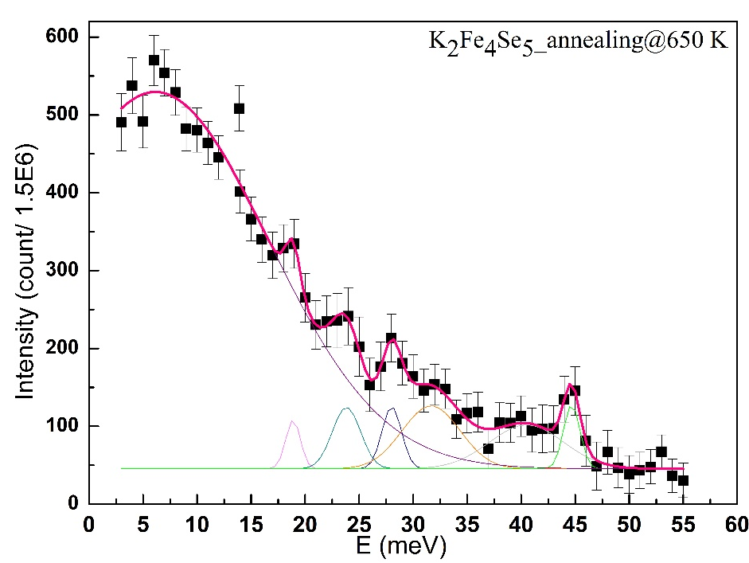
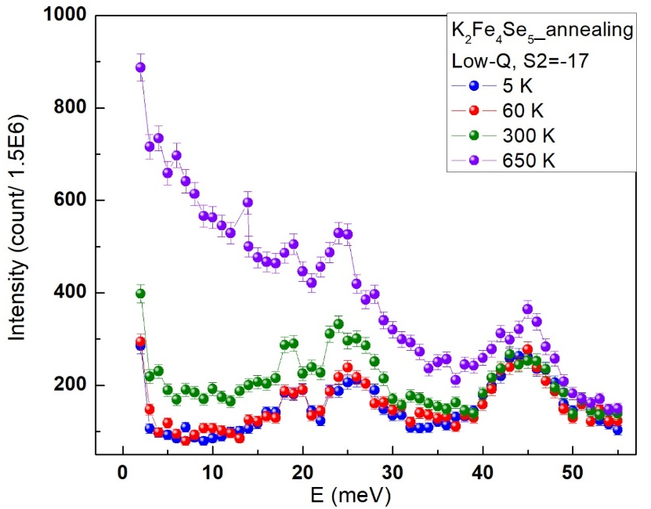
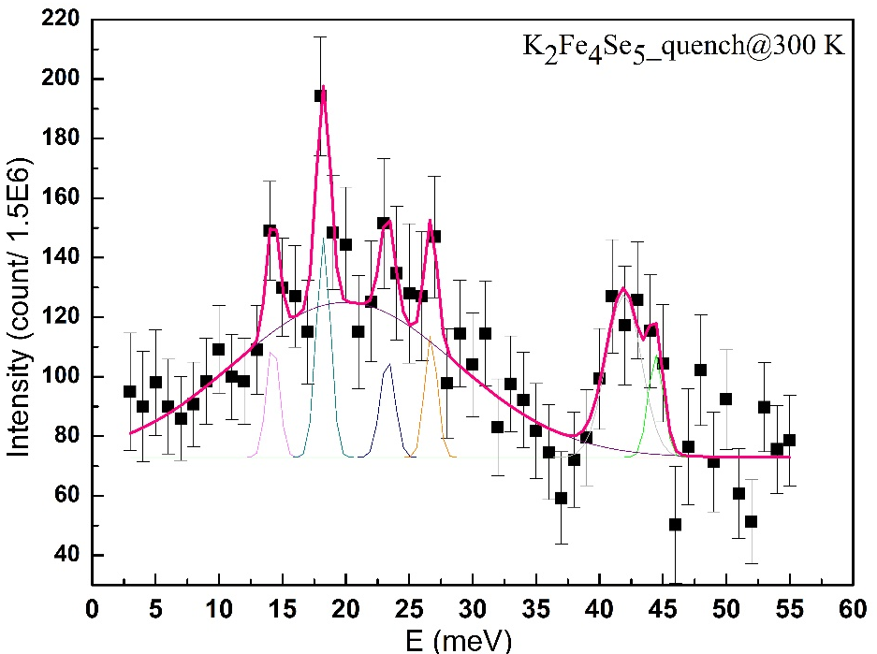
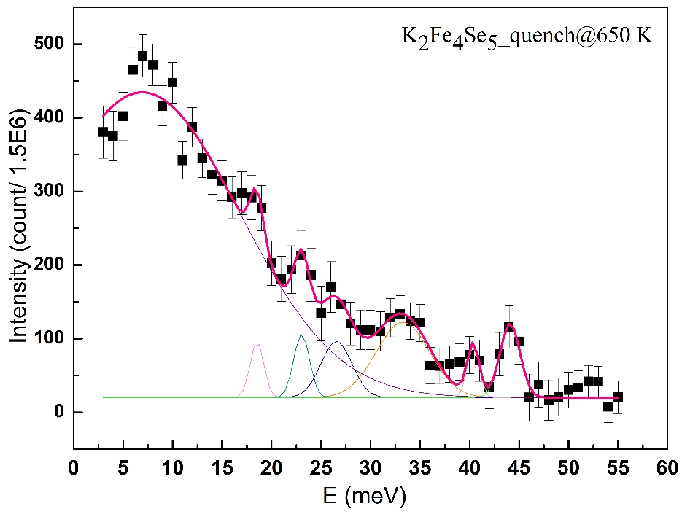
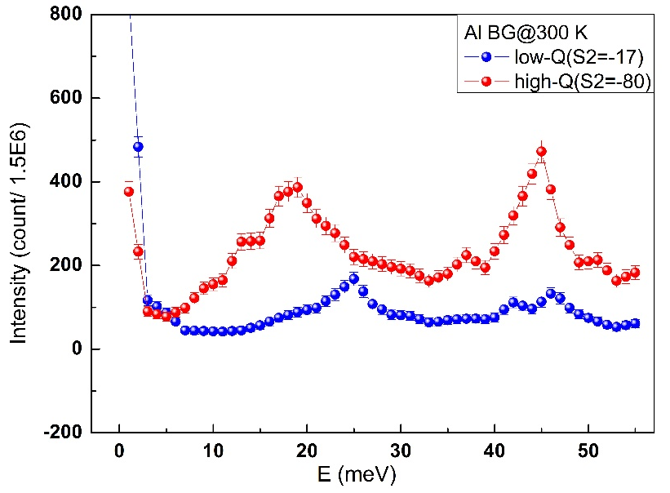
TAIPAN experiment: thermal 3-aixs spectrometer
T_{N}<650 K

Slide 13
Summary of inelastic neutron scattering
The magnetic order becomes disorder above 650 K, and the coherent vibrations merge into the background.
The magnon excitation seems different for the annealing and quenched K₂Fe₄Se₅.
Thank you for your attention!
Acknowledgement
ANSTO
Institute of Physics, Academia Sinica, Taiwan
Helpful discussion: Anton Stampfl, Chin-Wei Wang

Slide 14
K2Fe4Se5_annealing | 5 K | 60 K | 300 K | 650 K
Peak position 1 (meV) / error | 18.50 / 0.324 | 18.80 / 0.357 | 18.50 / 0.071 | 18.89 / 0.402
2 | 23.33 / 0.439 | 24.46 / 0.994 | 23.52 / 0.116 | 23.83 / 0.546
3 | 27.21 / 0.377 | 27.22 / 0.715 | 27.17 / 0.237 | 28.02 / 0.375
4 | 33 / 0 | 33.44 / 0.408 | 33.19 / 0.447 | 31.66 / 1.309
5 | 43.08 / 0.653 | 42.55 / 1.907 | 43.66 / 0.571 | 40.51 / 2.080
6 | 45.56 / 0.815 | 44.49 / 0.433 | 52.25 / 1.661 | 44.68 / 0.307
7 (Background) | 7.17 / 1.072 | 14.41 / 0.386 | 14.16 / 1.134 | 6.14 / 0.921
K2Fe4Se5_quench | 5 K | 60 K | 300 K | 650 K
Peak position 1 (meV) / error | 10.36 / 0.191 | 13.84 / 1.543 | 14.26 / 0.247 | 18.53 / 0.265
2 | 18.64 / 0.168 | 18.64 / 0.253 | 18.23 / 0.163 | 23.04 / 0.338
3 | 23.68 / 2.601 | 28.03 / 4.643 | 23.30 / 0.495 | 26.56 / 0.536
4 | 26.53 / 0.225 | 25.94 / 2.752 | 26.71 / 0.290 | 33.27 / 0.400
5 | 39.72 / 0.357 | 41.10 / 1.565 | 41.91 / 0.449 | 40.38 / 0.232
6 | 43.60 / 0.308 | 44.43 / 0.677 | 44.45 / 0.239 | 44.09 / 0.263
7 (Background) | 38.84 / 2.797 | 33.11 / 2.117 | 19.95 / 0 | 6.95 / 0.672

Slide 15
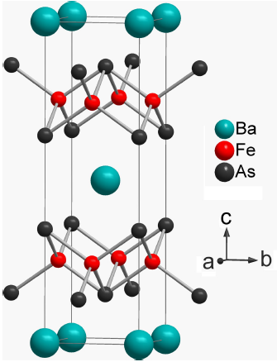
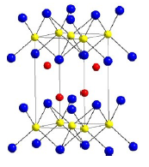
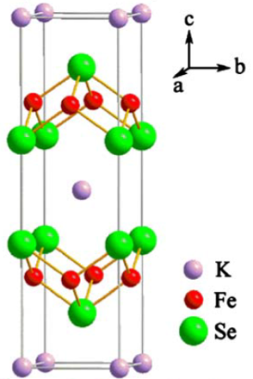
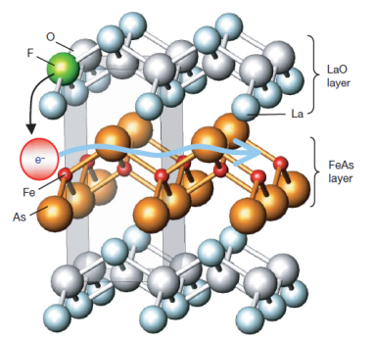
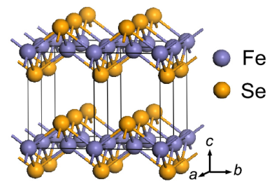
Introduction to iron-based superconductors
LaFeAsO | BaFe₂As₂ | LiFeAs | FeSe | KFe₂Se₂
Tc ~ 28 K (55 K for Sm) | Tc ~ 38 K K Co | Tc ~ 18 K | Tc ~ 10 K Pressure (37K) Lattice distorts 1 UC Interface (53K onset) | Tc ~ 32 K Pressure Tc ~ 48K at 12.5 Gpa 245 & 122 phases co-exist
Takahashi et al. Nature 453, 376 (2008) | Rotter et al. PRL 101, 107006 (2008) | Wang et al. Sol. St. Comm 148, 538 (2008) | Hsu et al. PNAS 105, 14262 (2008) | Guo et al., PR B82, 180520 (2010) Sun et al. Nature 10813 (2012)

Slide 16
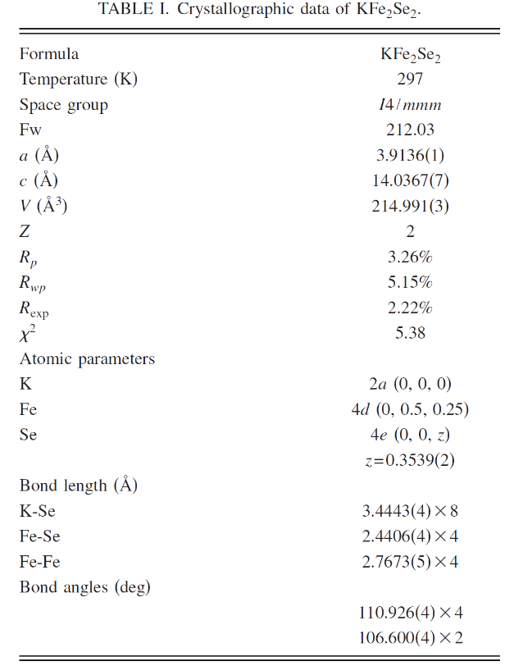
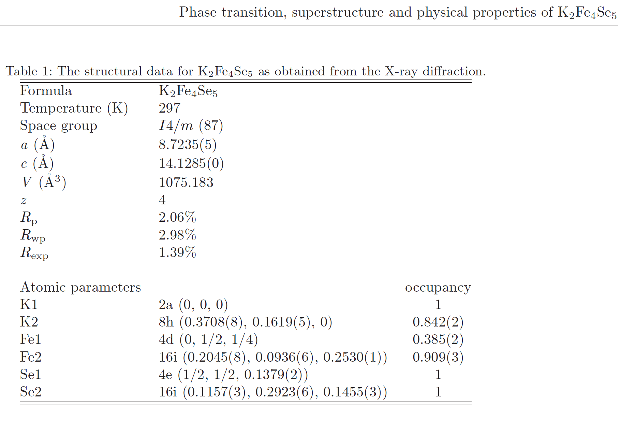
EPL, 95 (2011) 37007
PHYSICAL REVIEW B 82, 180520R (2010)

Slide 17
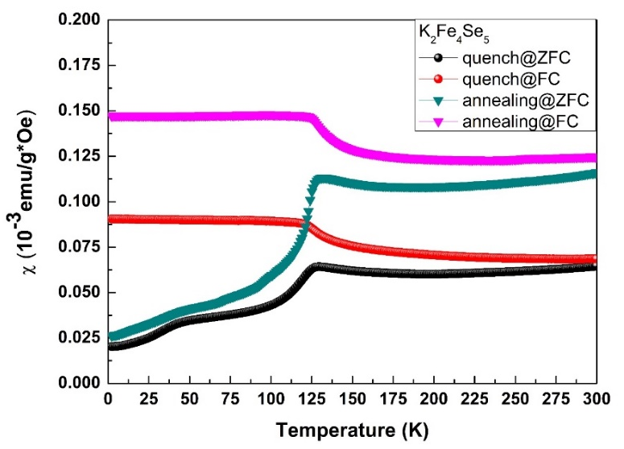
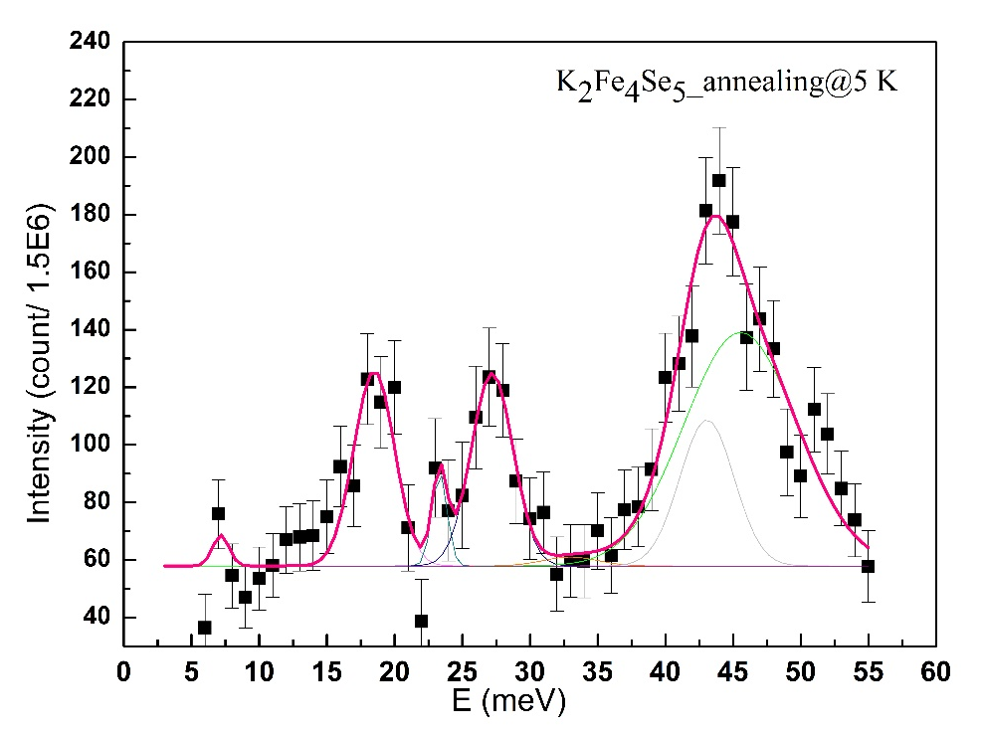
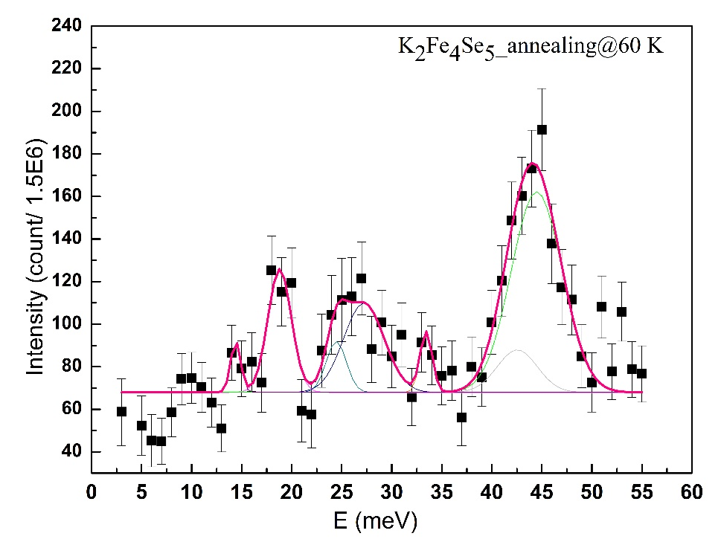
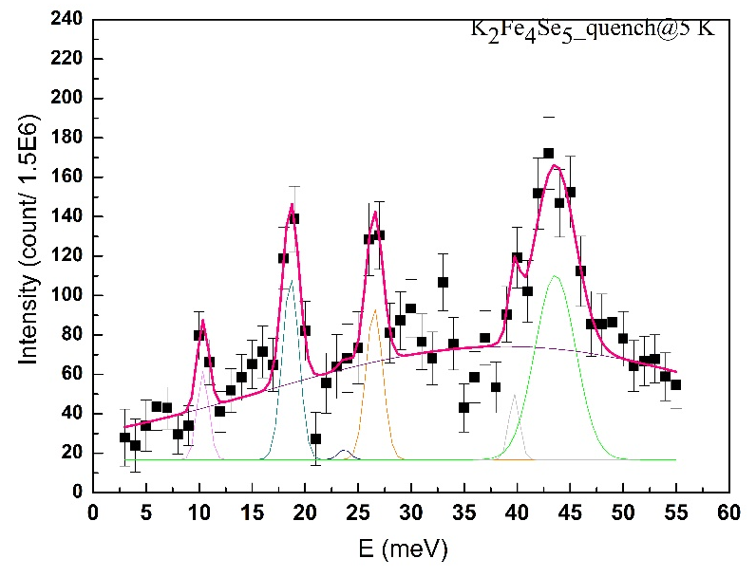
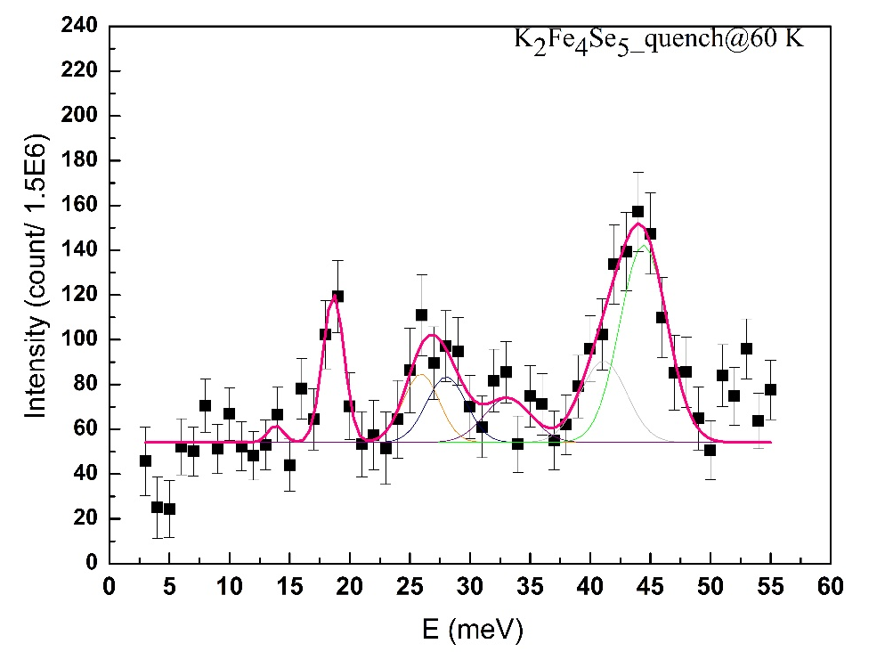

Slide 18
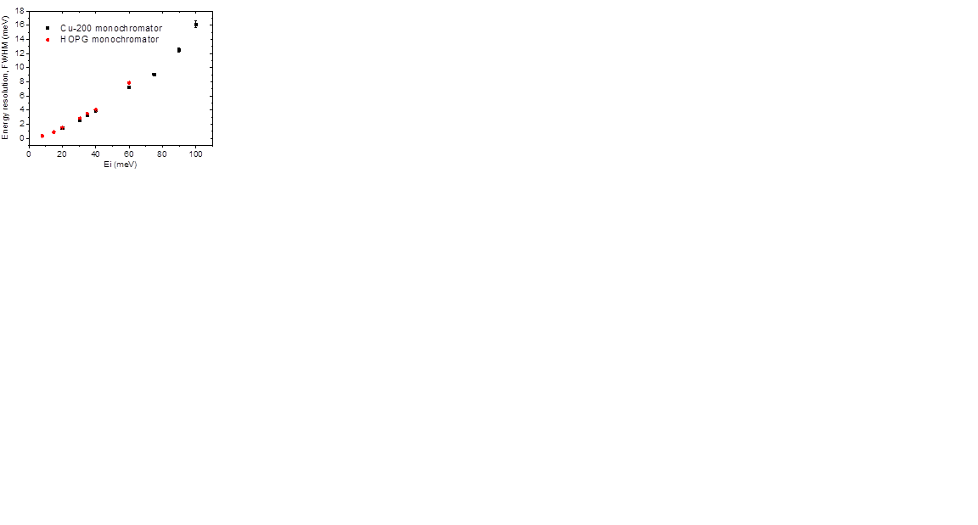
Ei | 9 meV | 15 | 20 | 30 | 35 | 40
FWHM | 0.4 | 0.9 | 1.5 | 2.9 | 3.5 | 4
K2Fe4Se5_annealing | 18 | 23 | 27 | 33 | 43 | 45
Ref | 1.3 | 1.8 | 2.6 | 3.3 | 4.3 | 4.5
K2Fe4Se5_annealing@5 K | 3.53 | 1.3 | 3.64 | 4.7 | 4.7 | 9.8
K2Fe4Se5_annealing@60 K | 2.76 | 2.35 | 4.77 | 1.41 | 4.7 | 6.0
K2Fe4Se5_annealing@300 K | 1.13 | 1.3 | 3.13 | 2.7 | 6.13 | 8
K2Fe4Se5_annealing@650 K | 1.6 | 3.1 | 2.12 | 6.32 | 8.2 | 1.8
K2Fe4Se5_quench | 10@5K/14/33@650K | 18 | 26@60K/23 | 28@60K/27 | 40@5K/42 | 45
Ref | 0.5/0.8 | 1.3 | 2.5/1.8 | 2.7/2.6 | 4.2 | 4.5
K2Fe4Se5_quench@5 K | 1.3 | 1.8 | 1.3 | 1.9 | 1.2 | 4.5
K2Fe4Se5_quench@60 K | 1.5 | 2.1 | 3.5 | 3.9 | 4.5 | 4.6
K2Fe4Se5_quench@300 K | 1.18 | 1.3 | 1.37 | 1.18 | 3.25 | 1.41
K2Fe4Se5_quench@650 K | 6.3 | 1.6 | 1.9 | 3.7 | 1.4 | 2.4

