Slide 1
Overview of the Neutron Scattering Capabilities at the OPAL Research Reactor
Jamie Schulz
Australian Centre for Neutron Scattering

Slide 2
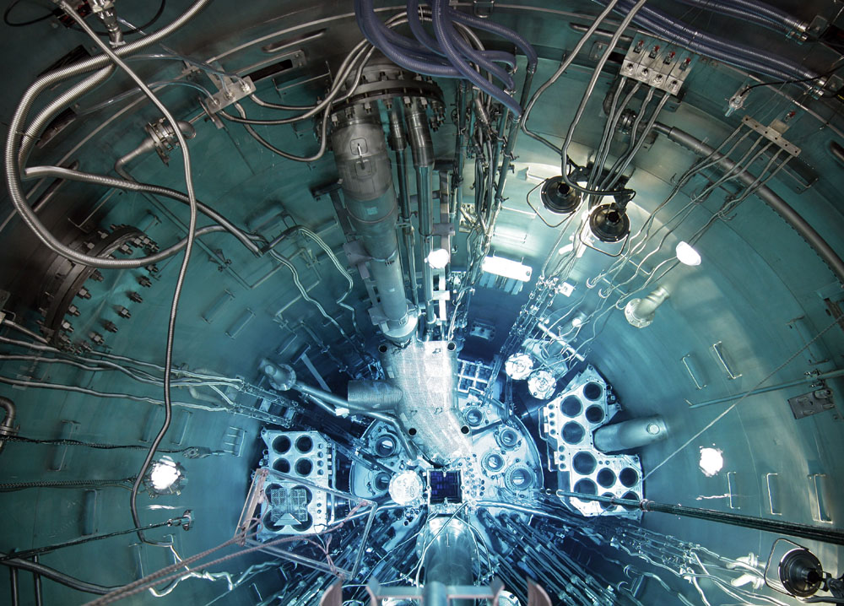
10 Years of Neutron Beams
100 Operating Cycles of OPAL
1000 Scientific Research Papers
Notes:
10 years of neutron beams and user service. Commenced neutron beam operations July 2008.
We will commence the 100th reactor operating cycle on Friday
In June we passed the 100 paper milestone

Slide 3
Outline
1 | Introduction to ANSTO
2 | OPAL Reactor & Neutron Beam Facilities
3 | Australian Centre for Neutron Scattering
4 | Why Neutrons?
5 | Selected Case Studies
6 | Closing Remarks

Slide 4
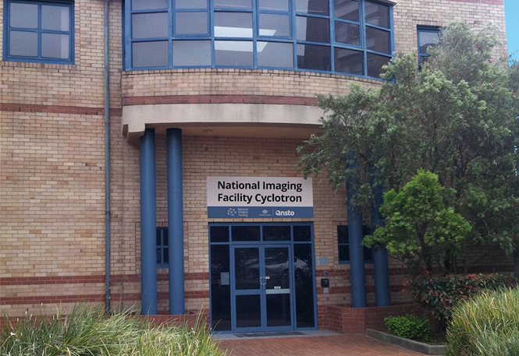
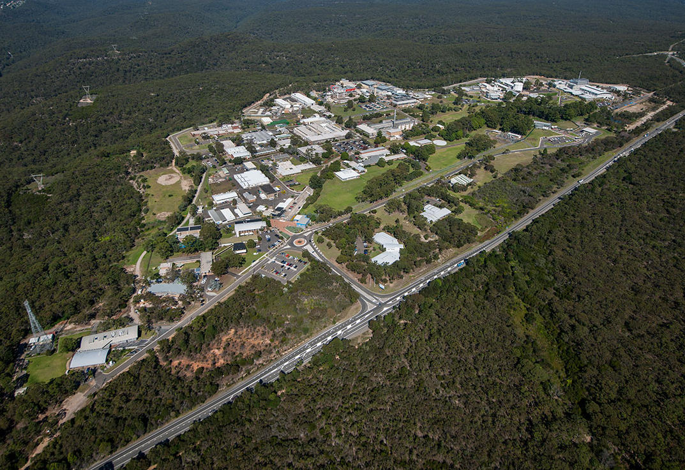
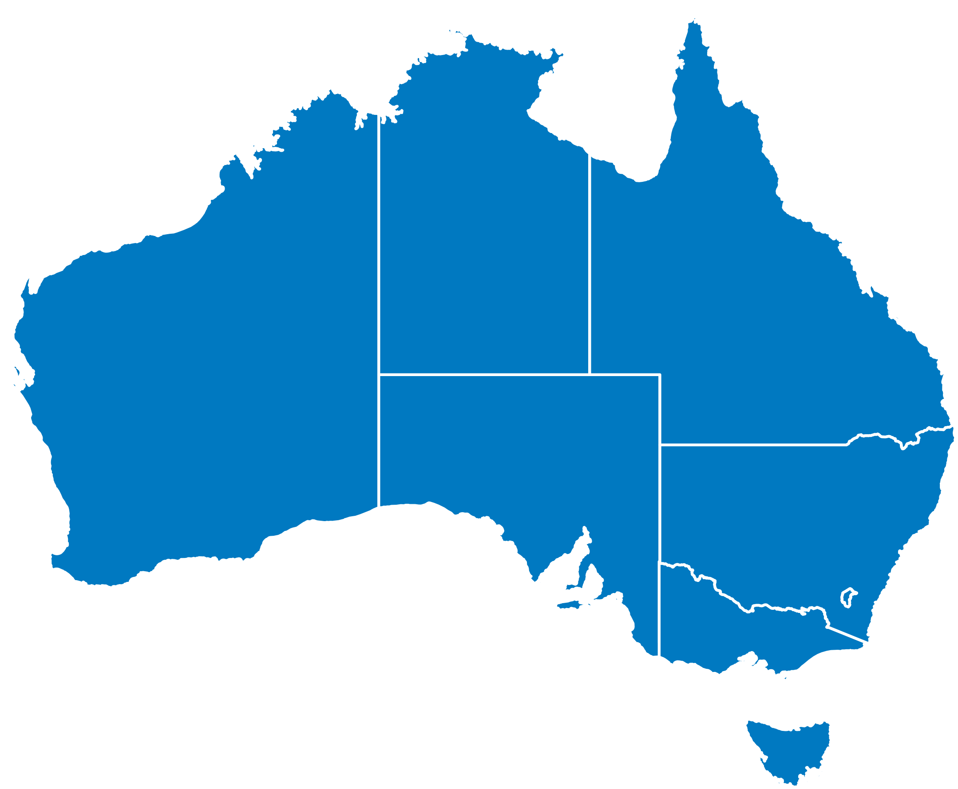
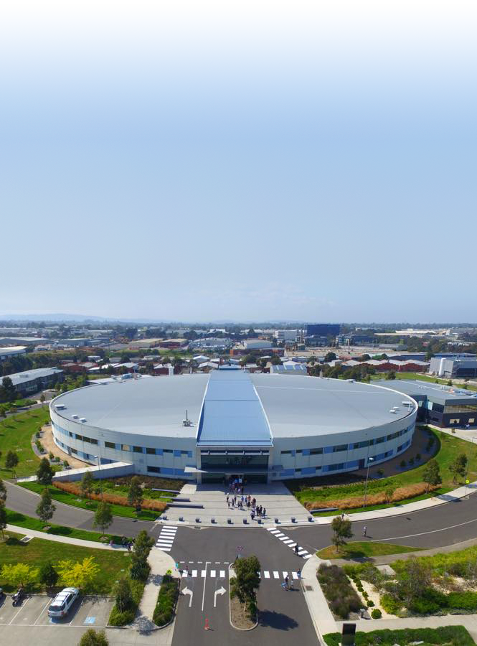
Australian Nuclear Science & Technology Organisation
Public research organisation
Formed in 1953
Manages >$1 billion of assets
Camperdown
Cyclotron
NSW
Main site
Lucas Heights
NSW
Clayton
Australian Synchrotron
VIC
Notes:
ANSTO is one of the country’s largest public research organisations and custodian of much of the country’s national research infrastructure.
Three campuses:
Lucas Heights (Sydney) – OPAL Multipurpose Reactor, ACNS, CAS, …
Camperdown (Sydney) – National Imaging Facility Research Cyclotron
Clayton – Australian Synchrotron.

Slide 5



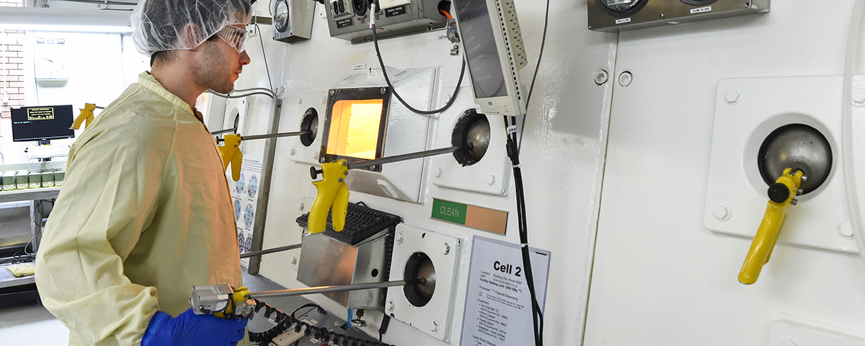
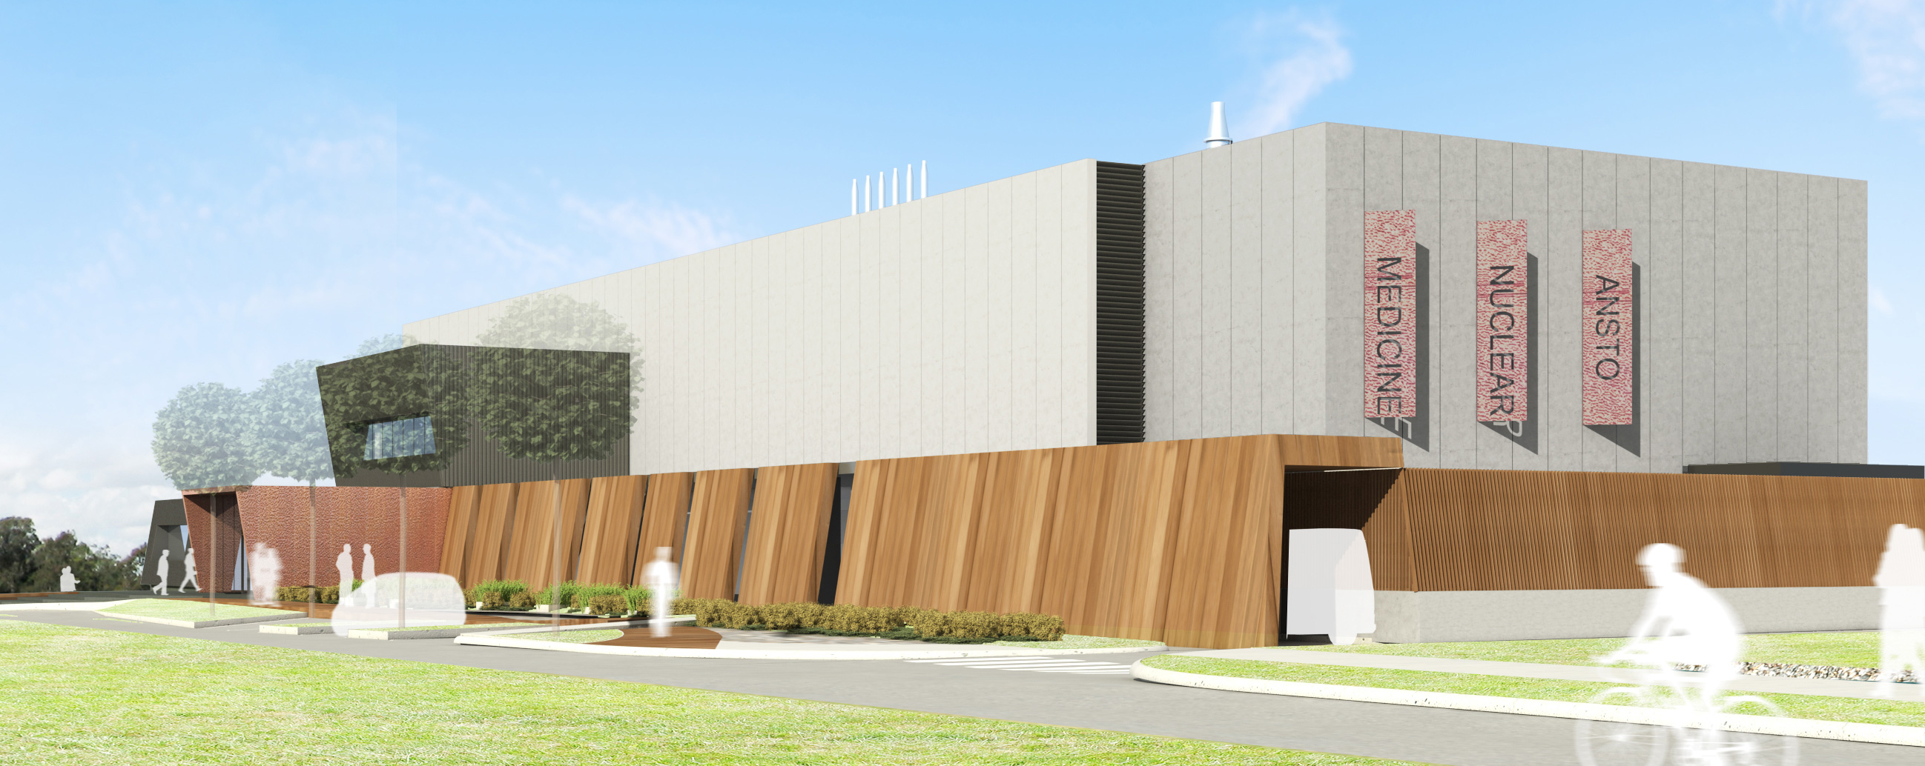
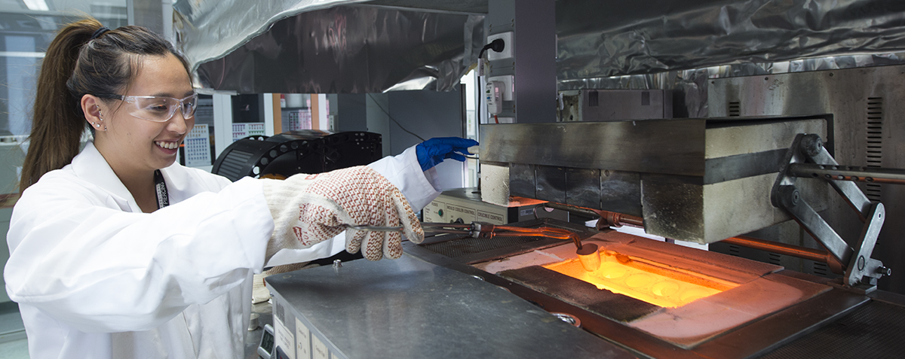



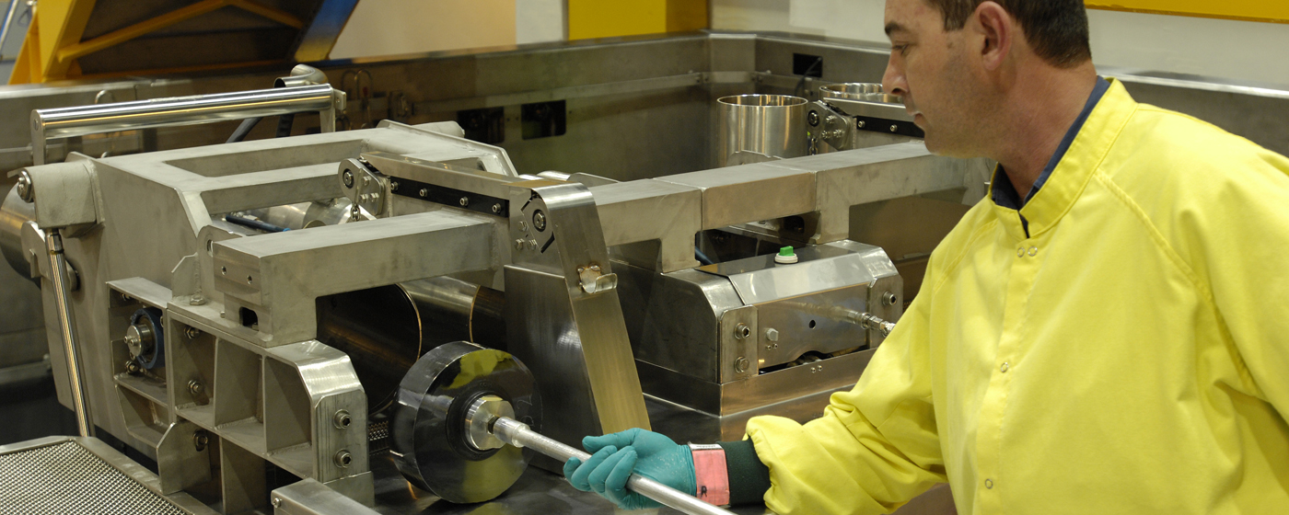
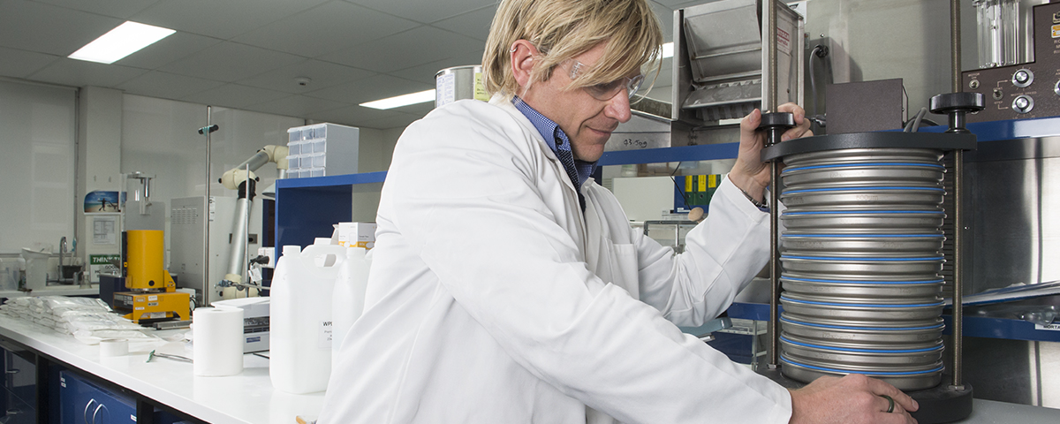
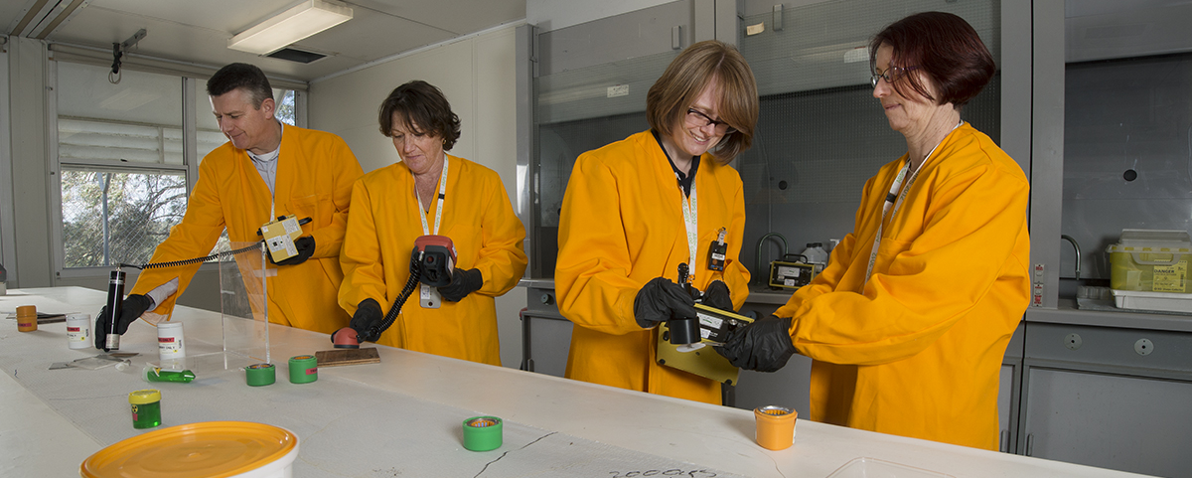


ANSTO businesses

Slide 6

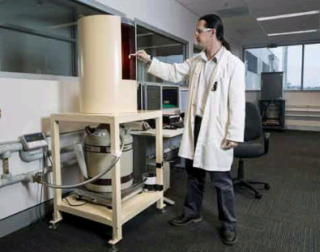
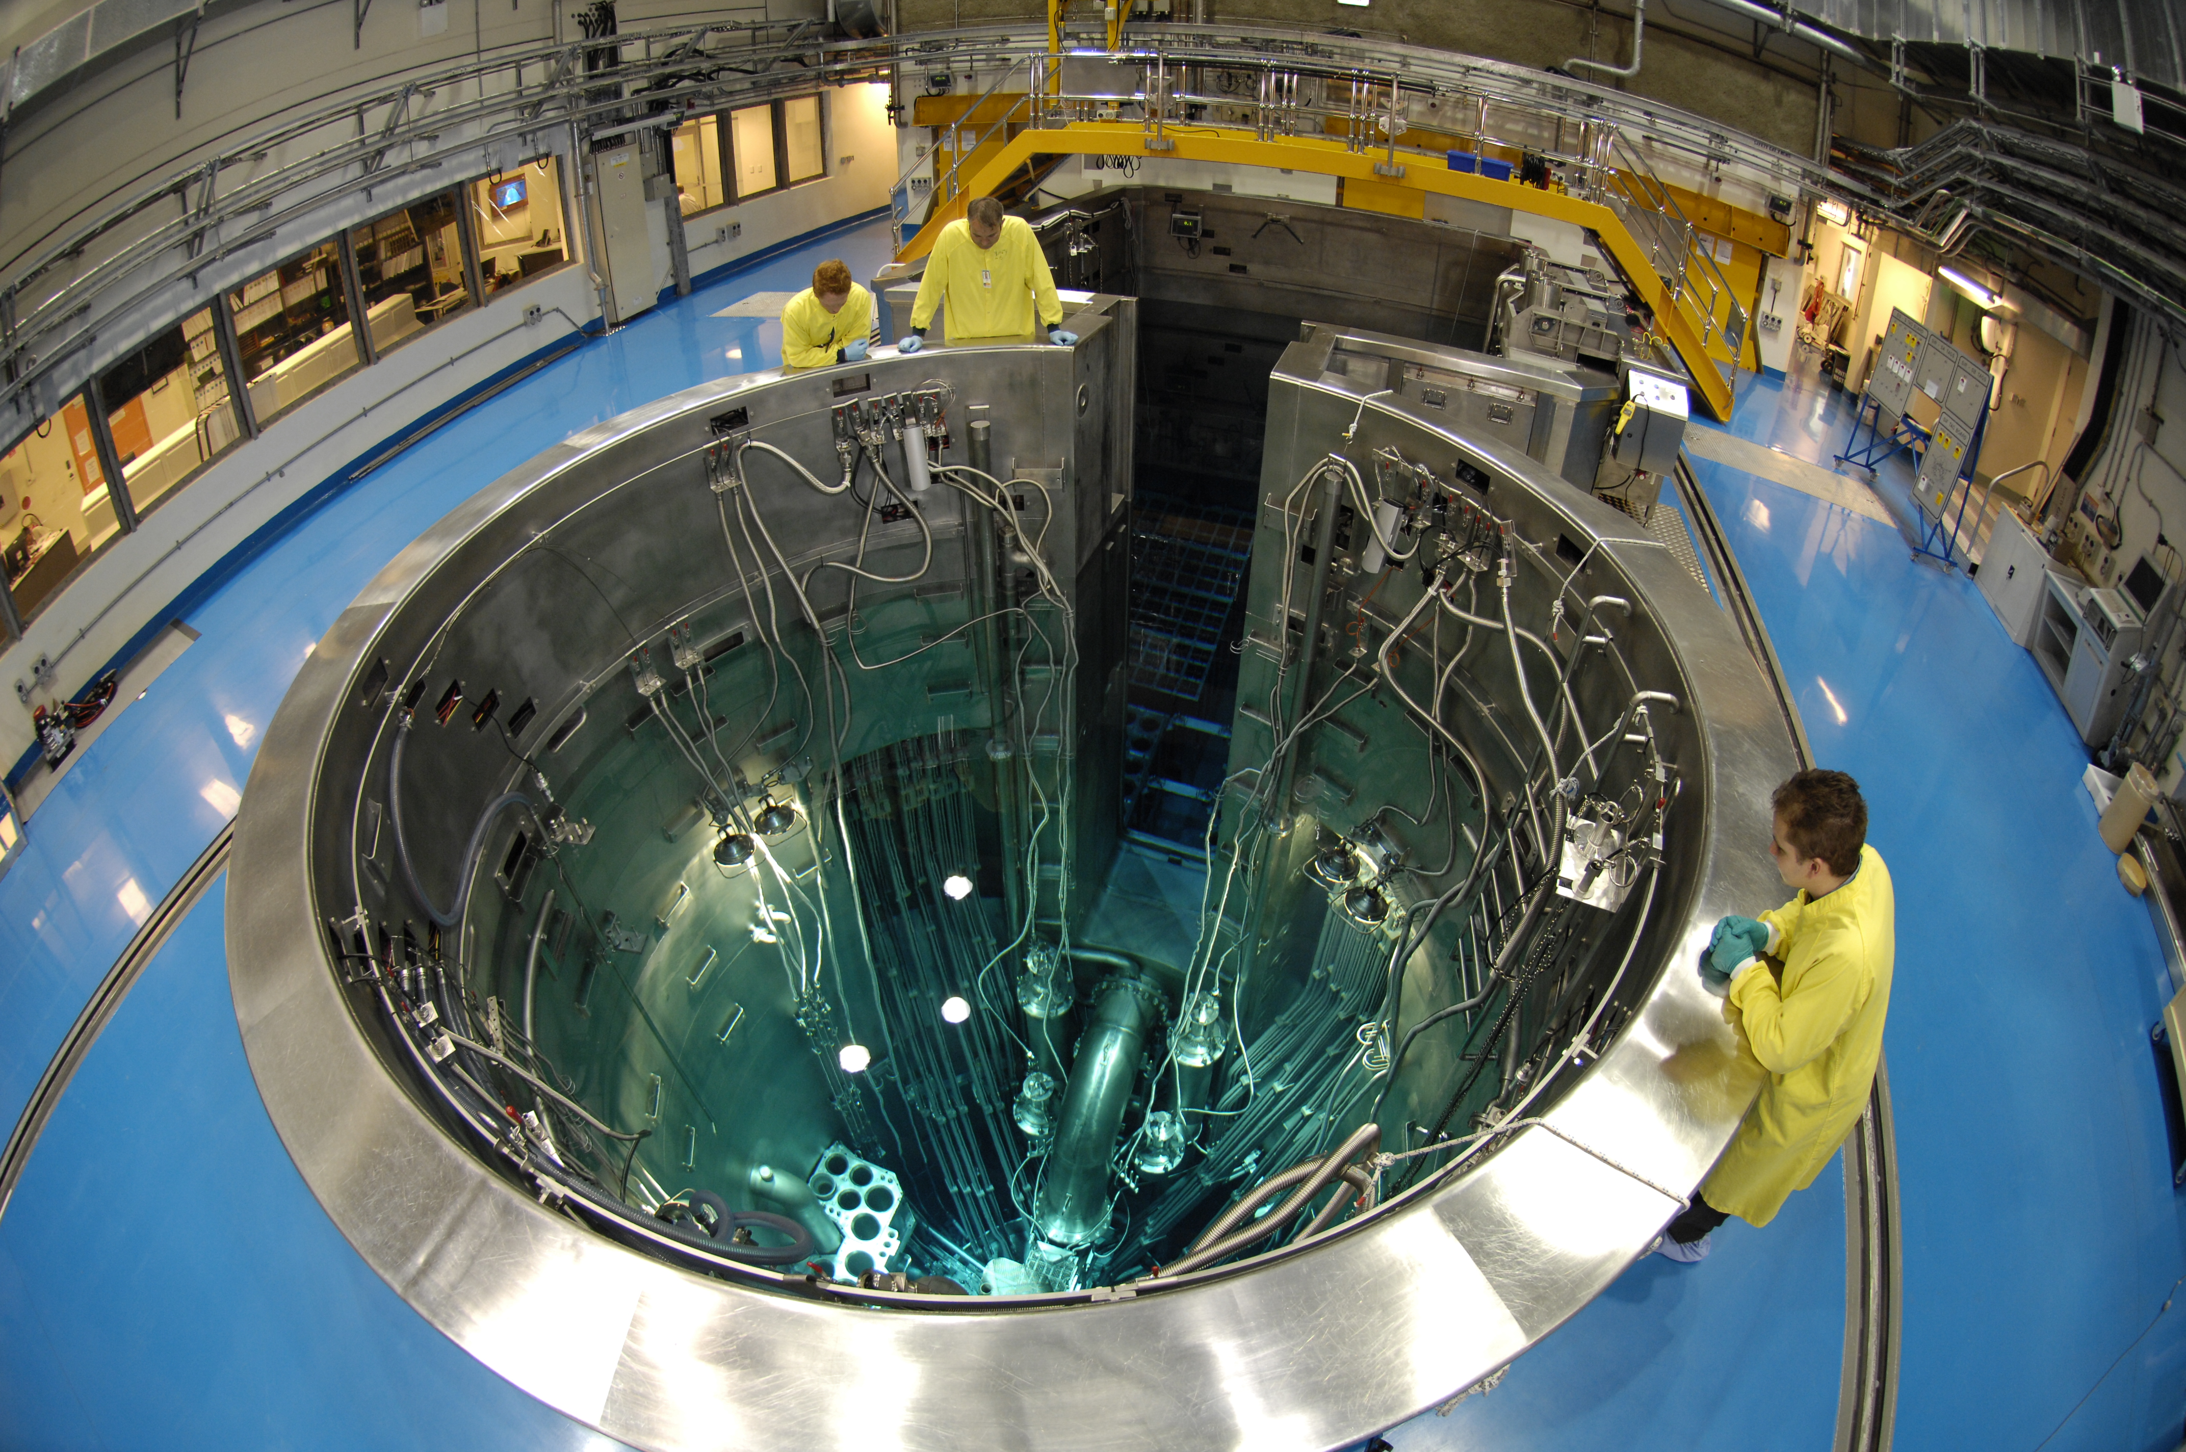
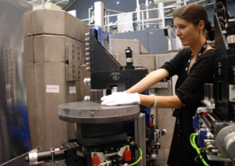
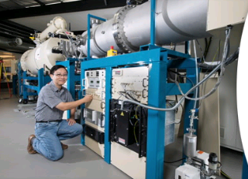
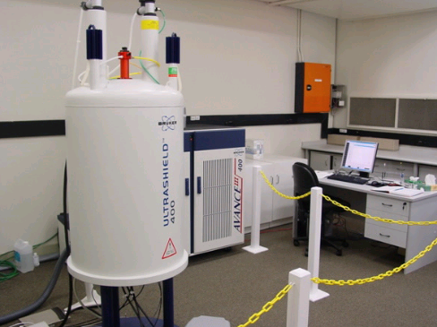
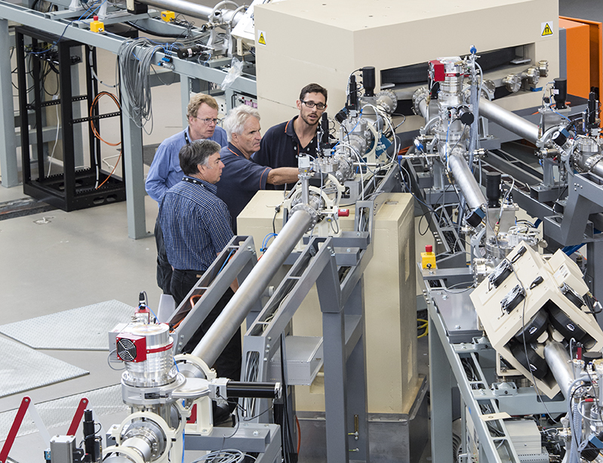
ANSTO Research Infrastructure for Users and Industry
Landmark
National
Institutional
Local with national impact
OPAL Multipurpose Reactor
Australian Centre for Neutron Scattering
Australian Synchrotron
National Deuteration Facility
Centre for Accelerator Science
Medical Research Cyclotron
Isotope Tracing and Dating
Nuclear Forensics
Activity Standards
Neutron Activation and Irradiations
Radiotracers and Bioimaging
Materials Characterisation
Notes:
ACNS:
Neutron & X-ray scattering and specialised sample environment.
Structure-function investigations for Industry, Health, Environment, Biotechnology, Nanotechnology, Energy, Advanced Materials, Engineering, Food and Heritage / Archaeology sectors.
CAS
High sensitivity trace element analysis and 2D mapping (environmental quality ~ soil/air/biota)
Heavy ion irradiations and ion beam interactions with matter (material damage & modification)
Surface characterisation with monolayer resolution (materials characterisation)
Ultrasensitive isotope dating (for climate change, geomorphology, forensics, safeguards)
NMDC
Materials synthesis, characterisation, modelling, and testing for ANSTO and industrial clients. Includes product development (e.g.,HIPing, PI³ surface modification)
Range of outputs: consulting, internal and commercial reports, patents, publications.
ITNS
High sensitivity measurements of radioisotopes and stable isotopes in water, soil and air for:
Sediment dating, tracing and analysis & soil erosion measurement
Groundwater dating and tracing
Atmospheric transport modelling
Ecosystem analysis using stable isotopes.

Slide 7
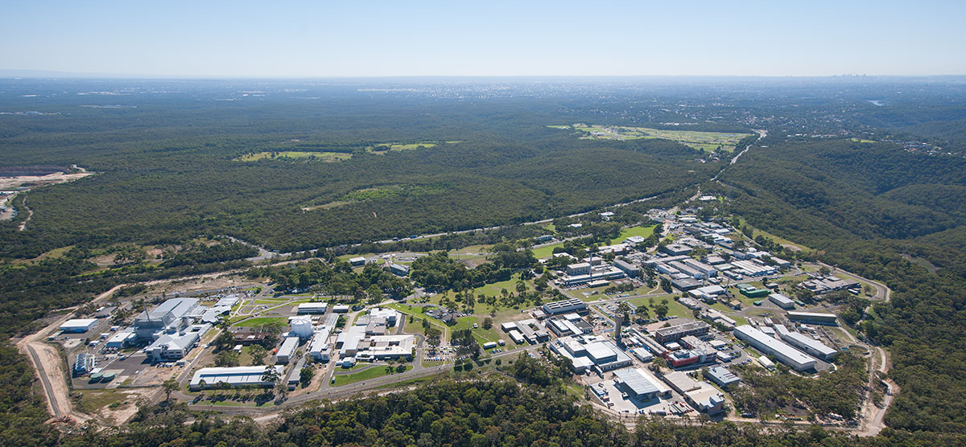

ANSTO Lucas Heights Campus & OPAL Reactor
Sydney CBD
30km
20 MW
Open pool
Compact core
D₂O reflector
Plate type Low Enriched Uranium fuel
Commenced operation 2006
OPAL
HIFAR
MOATA
Notes:
Australia has operated research reactors since 1958:
HIFAR 10MW DIDO Reactor (1958 - 2007)
UAlx, HEU (primarily 80%)
Different geometrical designs
Conversion to LEU fuel from August 2006
MOATA 100KW Argonaut Reactor (1961 – 1995)
HEU UAlx
Fully decommissioned in 2010
OPAL 20MW (2006 - present)
LEU uranium silicide fuel

Slide 8
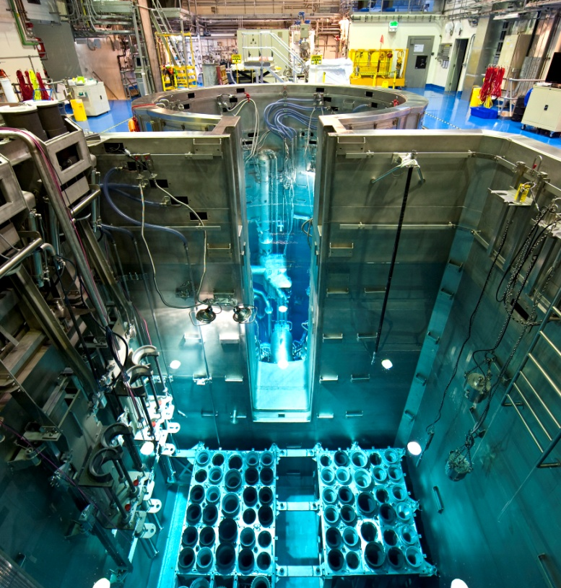
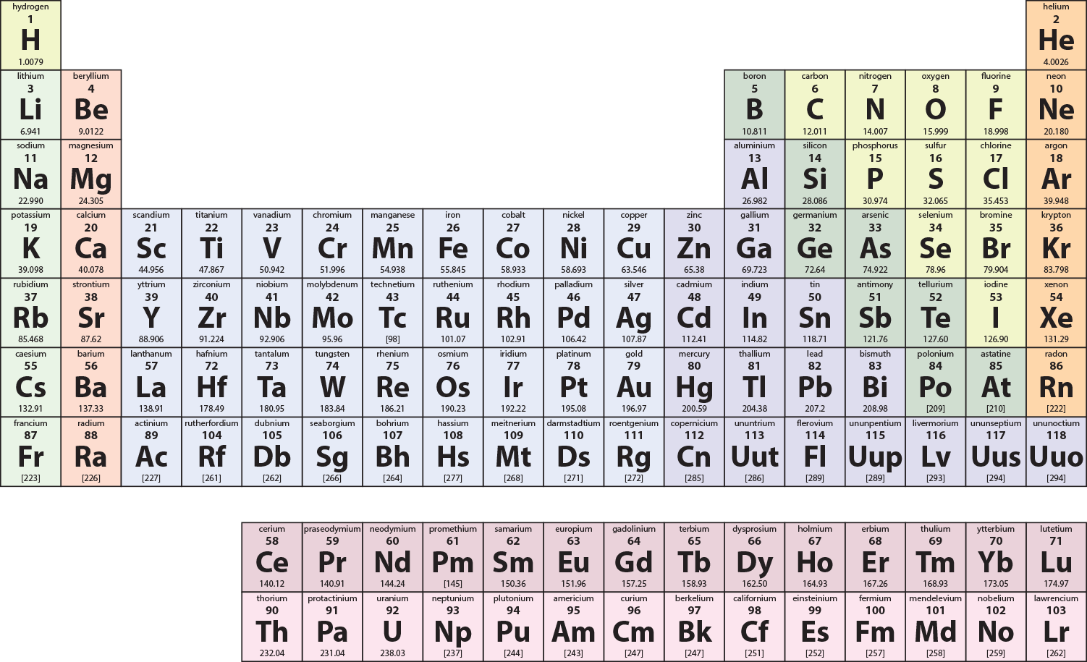
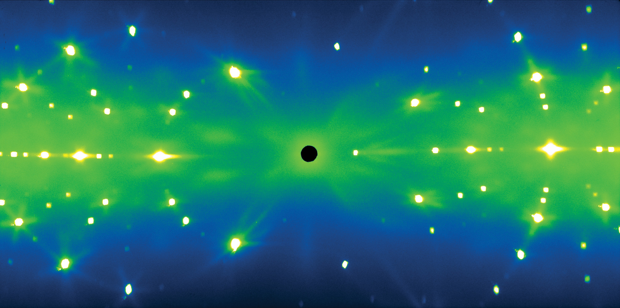
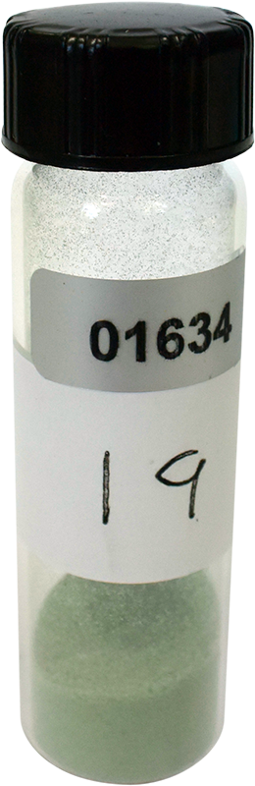
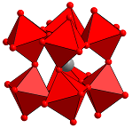

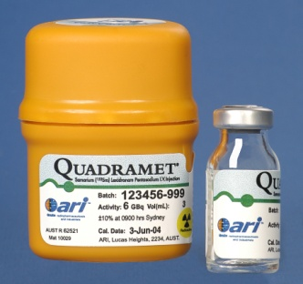
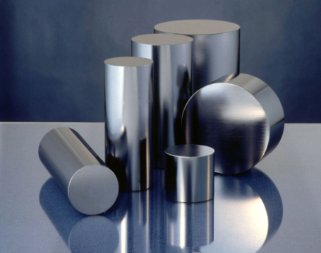
OPAL (multi-purpose reactor)
Neutron Activation
Neutron Scattering
Notes:
NAA – high sensitivity for trace elements – sensitivity of 2 teaspoons of sugar in Sydney harbour.
10,000 patient doses every week.
Changing silicon atoms into phosphorous with neutron absorption. 40% worlds transmutation silicon. – 45 tonnes of silicon each year.
http://www.ansto.gov.au/cs/groups/corporate/documents/document/mdaw/mde5/~edisp/acs046215.pdf
99 Mo
131 I
153 Sm
67 Ga
123 I
51 Cr

Slide 9
OPAL Operating Days
296
300
304
302
300
300
286
282
290
270
275
248
128
94
39
2006 | 2007 | 2008 | 2009 | 2010 | 2011 | 2012 | 2013 | 2014 | 2015 | 2016 | 2017 | 2018 | 2019 | 2020
Notes:
2017 – 300
2018 – 300
2019 – 270
2020 – 300
Lubi to speak
Speaking points:
The increased reliability in the operation of the OPAL reactor is illustrated.
The target of 300 + days has been reached in CY 2015 and is on target to be reached again in CY 2016.
The 300 days of operation is complemented by high reliability (98%).
Major increases in reliability are due to a combination of gained expertise and effective maintenance strategies, including reliability engineering and management of single point failures and electrical system resilience upgrades. Minimising susceptibility to disruptions in external electricity supply is a current focus.

Slide 10
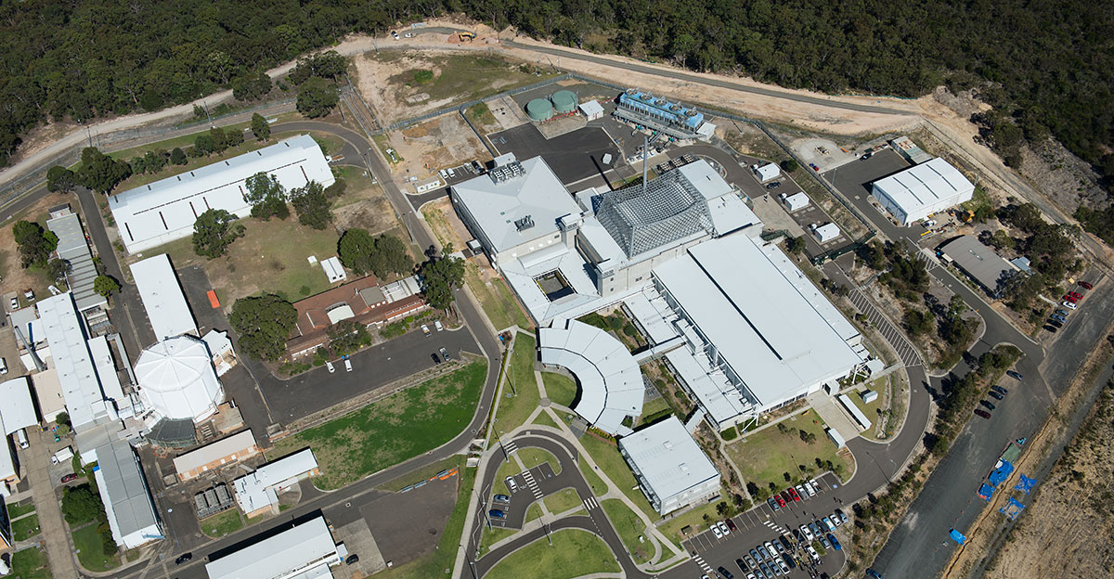
OPAL Facility
Reactor
Offices
Offices
Neutron Guide Hall
HIFAR
OPAL Visitor Centre
Offices
Notes:
2nd NGH

Slide 11
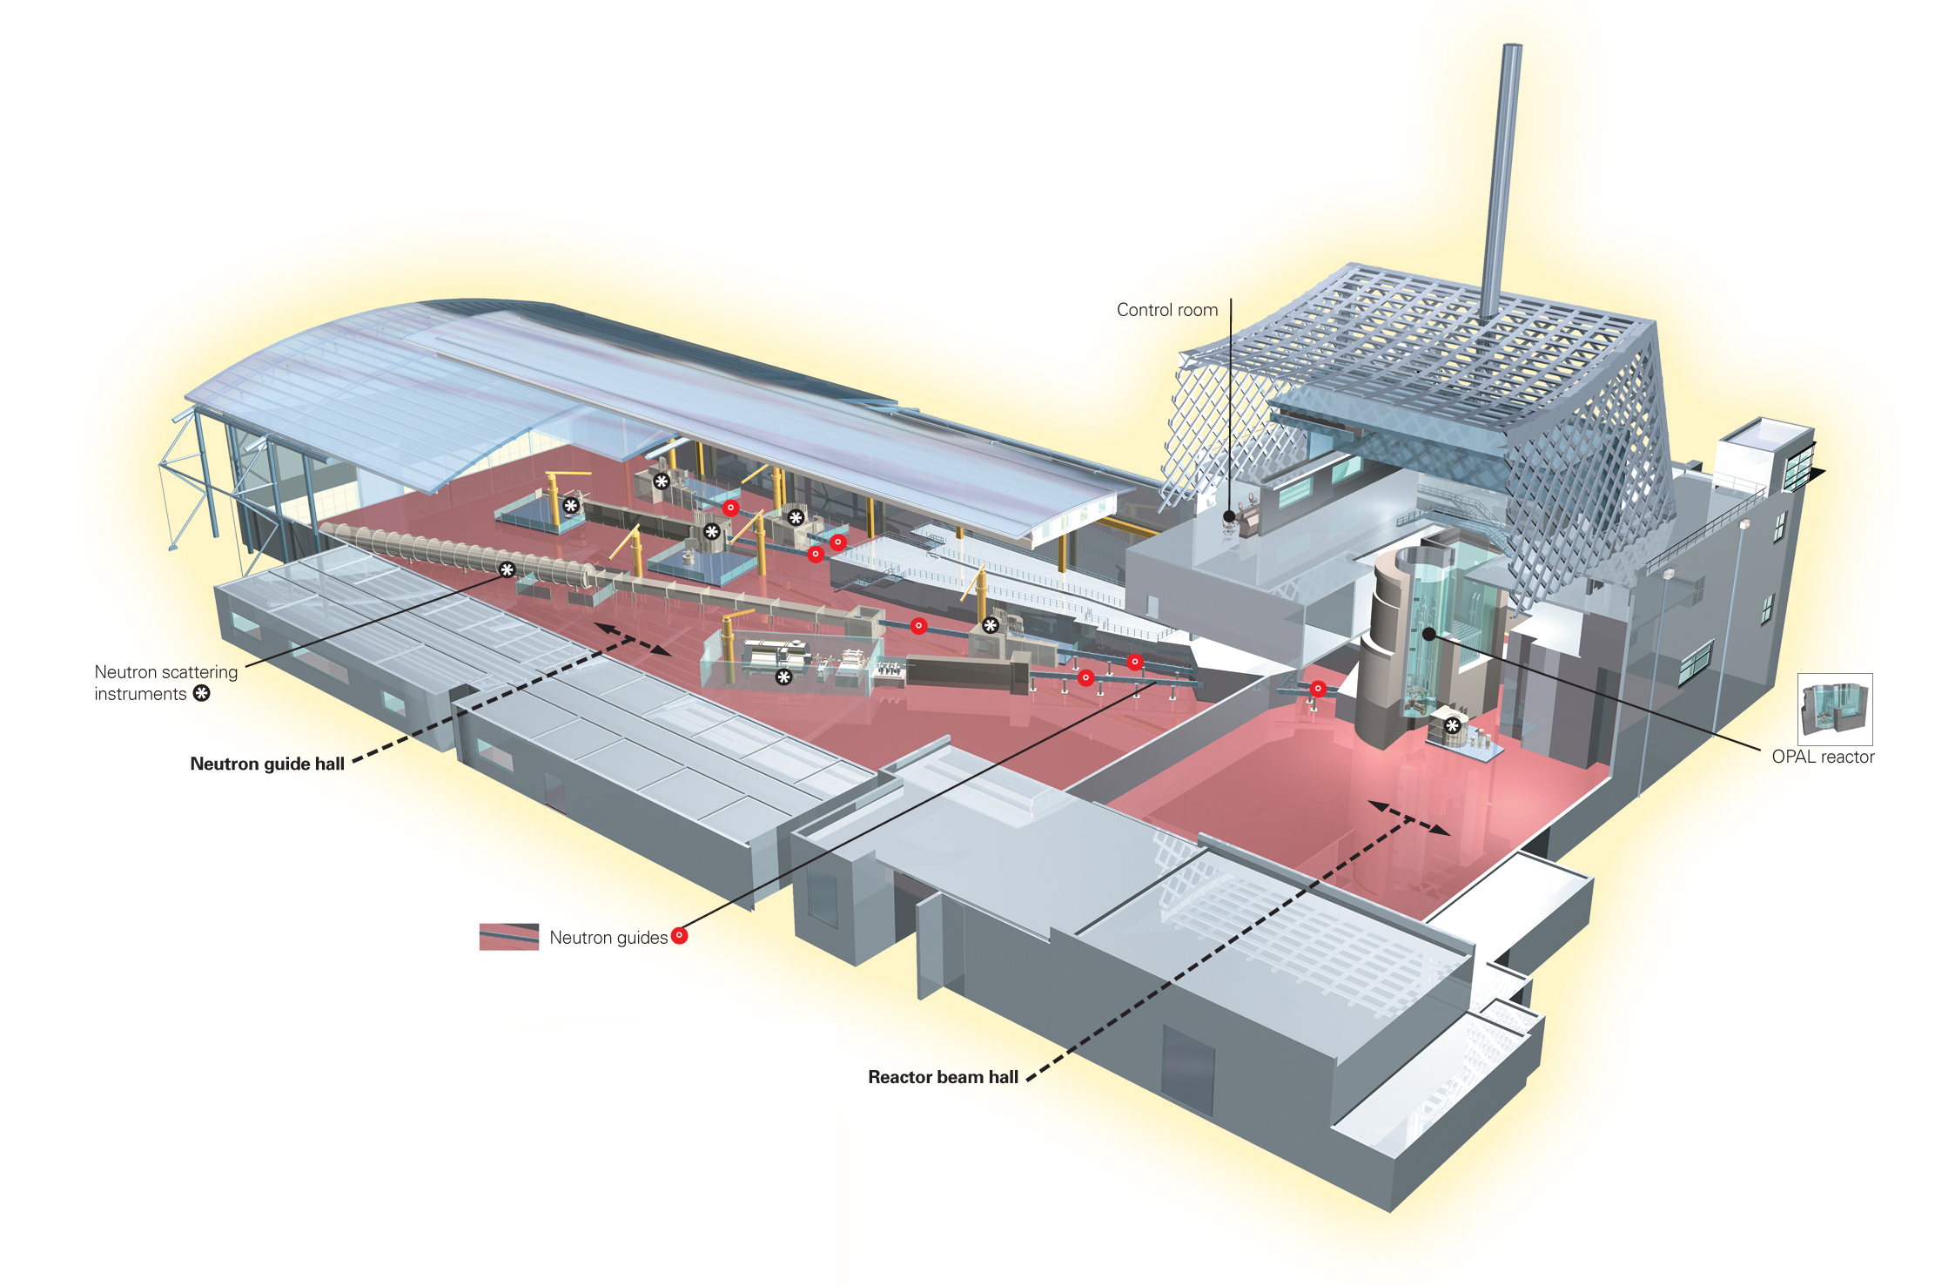
Beams for Neutron Scattering Science

Slide 12
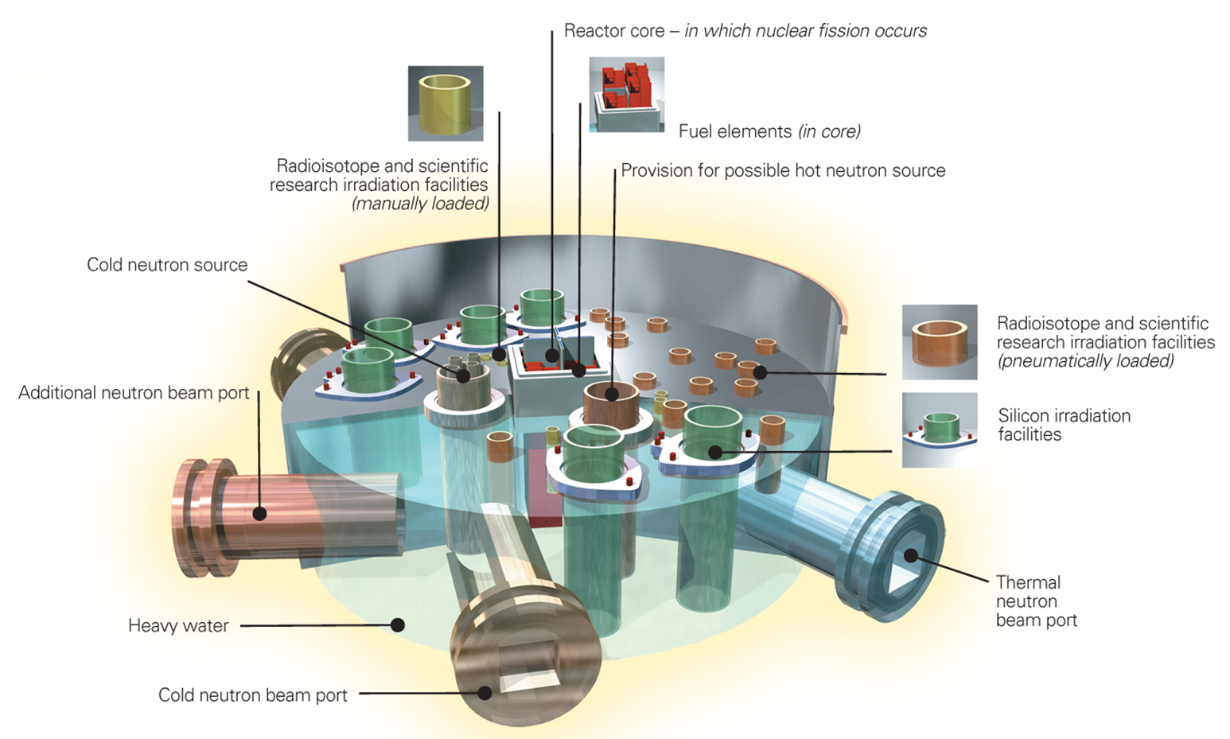
OPAL Utilisation/Experimental Facilities

Slide 13
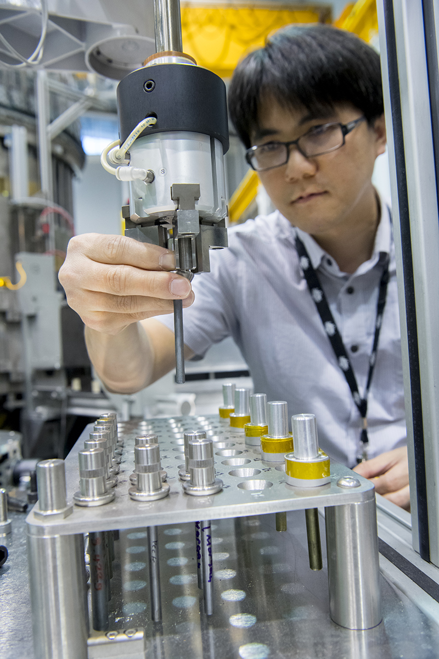
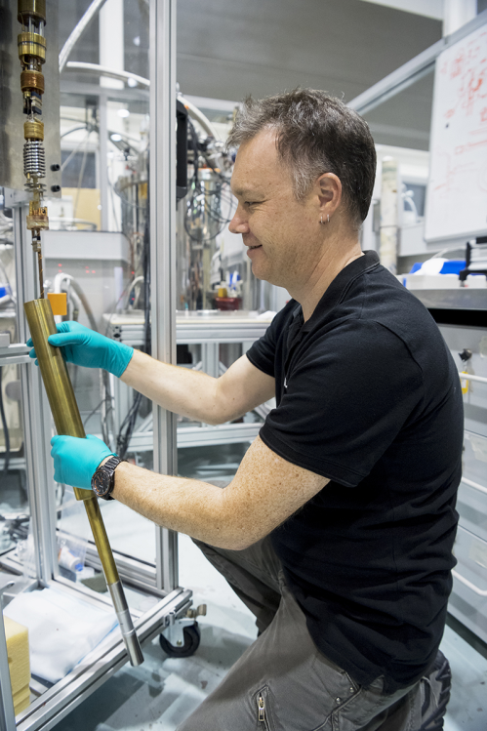
Australian Centre for Neutron Scattering
80 staff support 300 reactor days
  225 days to user service
14 (+1) neutron beam instruments
4,300 registered users
450 user experiments per year
500 individual users visit per year
  1,400 user visits per year
1014 journal publications with neutron data from users & staff (2007-2018)
  183 in 2017
  86 in 2018

Slide 14
Australian Centre for Neutron Scattering
ECHIDNA
WOMBAT
JOEY
KOWARI
KOALA
PELICAN
QUOKKA
³He Filling Station
BILBY
TAIPAN
SPATZ
PLATYPUS
KOOKABURRA
DINGO
EMU
SIKA
15 Neutron Beam Instruments
SAXS & X-ray Reflectometry
PPMS & Ellipsometry

Slide 15
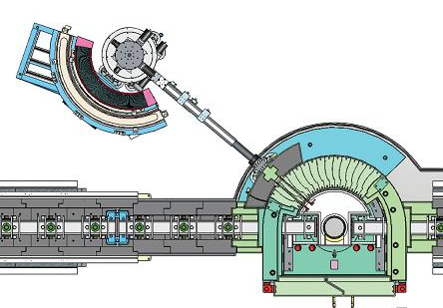
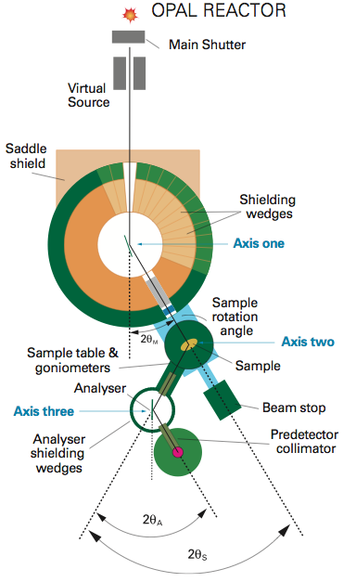
ACNS Instruments
Diffractometers:
ECHIDNA | high-resolution powder diffractometer
WOMBAT | high-intensity diffractometer
KOALA | single-crystal Laue diffractometer
KOWARI | strain scanner
JOEY | crystal-alignment Laue diffractometer
Small-angle Spectrometers:
QUOKKA | monochromatic SANS
BILBY | time-of-flight SANS
KOOKABURRA | ultra-SANS
Imaging & Reflectometry:
DINGO | radiography/tomography/imaging station
PLATYPUS | reflectometer
SPATZ | reflectometer (under construction)
Inelastic Spectrometers:
TAIPAN | thermal-neutron three-axis spectrometer, with Be-filter option
SIKA | cold-neutron three-axis spectrometer
PELICAN | cold-neutron time-of-flight spectrometer
EMU | high-resolution back-scattering spectrometer
WOMBAT
TAIPAN
Notes:
Here a list of all the operating instruments, and those under construction, grouped by the scattering technique. The first set of instruments were essentially copies of successful designs elsewhere, but usually updated in some way.
ECHIDNA which is used for high-resolution powder diffraction
KOWARI which is generally used for determination of strain tensors in quite bulky engineering objects, such as sections of gas pipes, from point-by-point measurement of lattice parameters, but can also be used be used for other forms of powder and single-crystal diffraction
WOMBAT which is frequently used to measure powder patterns rapidly as a function of external influence, e.g. temperature, pressure, often in quite complicated sample environments, e.g. real batteries. WOMBAT is also suited to analysis of texture in engineering materials and rocks, and to various single-crystal studies, particularly diffuse scattering
The wide-angle detectors or detector arrays are notable features of ECHIDNA and WOMBAT. In fact detectors are generally the key element of most neutron instruments, with considerable effort put into optimising the form of the detector for the particular application.
http://www.ansto.gov.au/research/bragg_institute/facilities/instruments/echidna
http://www.ansto.gov.au/research/bragg_institute/facilities/instruments/kowari
http://www.ansto.gov.au/research/bragg_institute/facilities/instruments/wombat

Slide 16
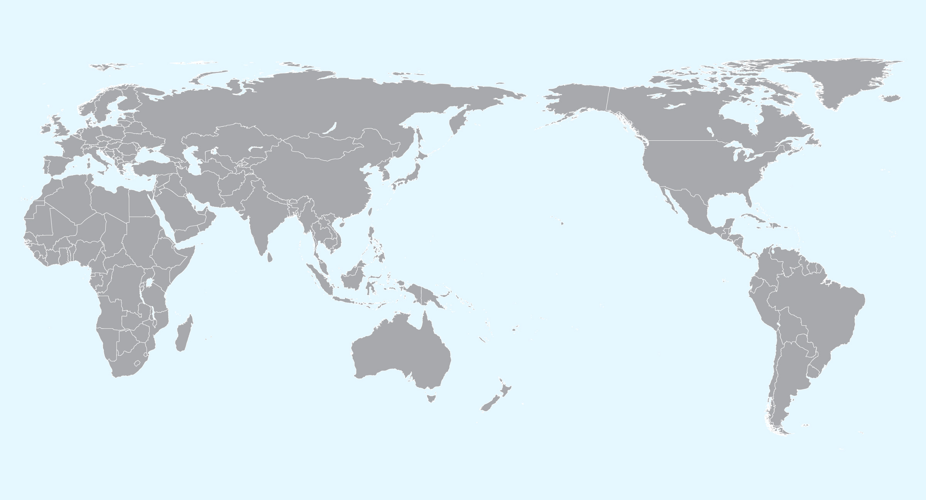




Where do the users come from?
ANSTO
2008 – 2018

Slide 17
Demand from 2018-2 Round - 270 Proposals

Slide 18
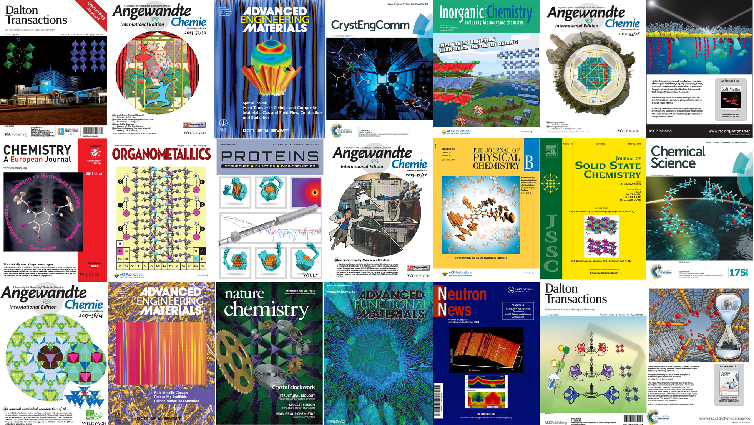
Science
Notes:
All areas of science:
Physics
Chemistry
Material Science
Excellence in science enables us to translate into industry

Slide 19
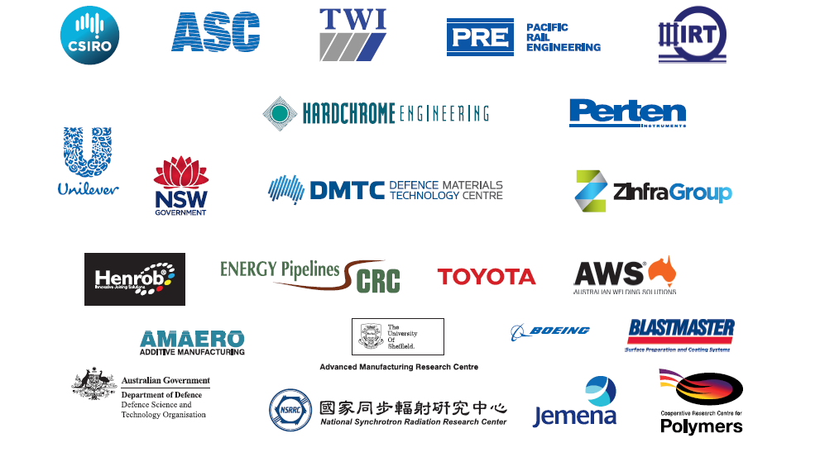



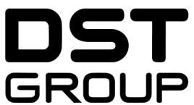











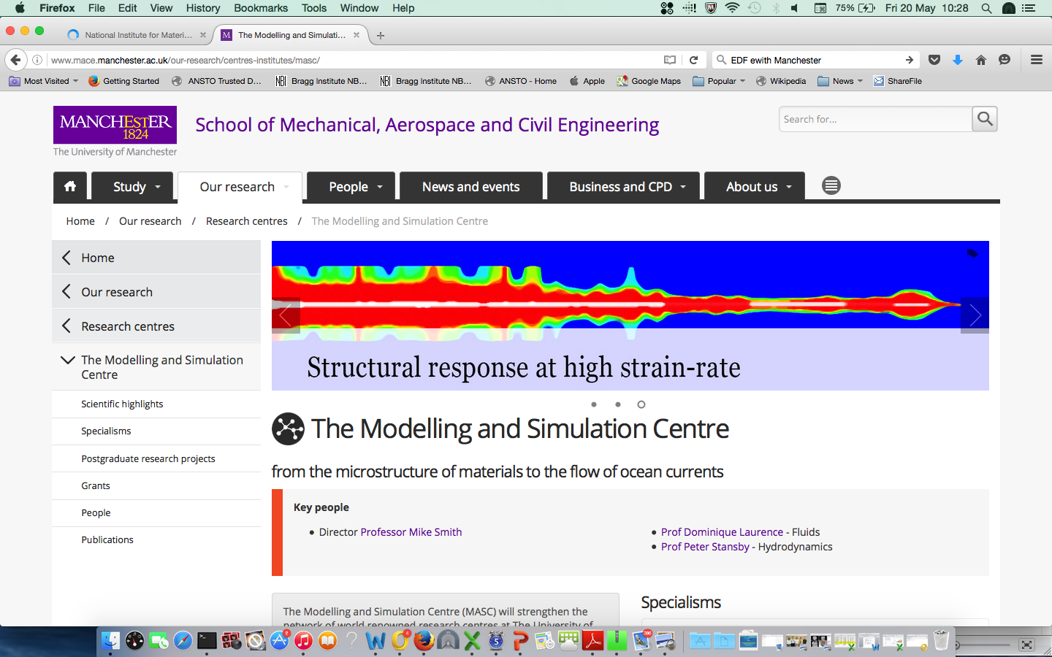




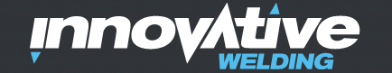
Commercial Clients
Notes:
Companies let us use their logo
Engineering
Aerospace
Defence - armoured vehicles
Food multinational
Big mining companies in Australia
Government - Sydney harbour bridge

Slide 20
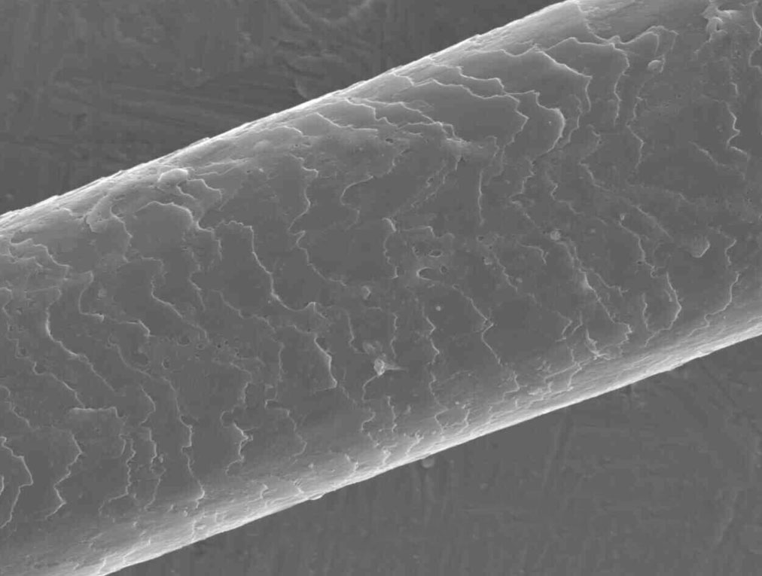
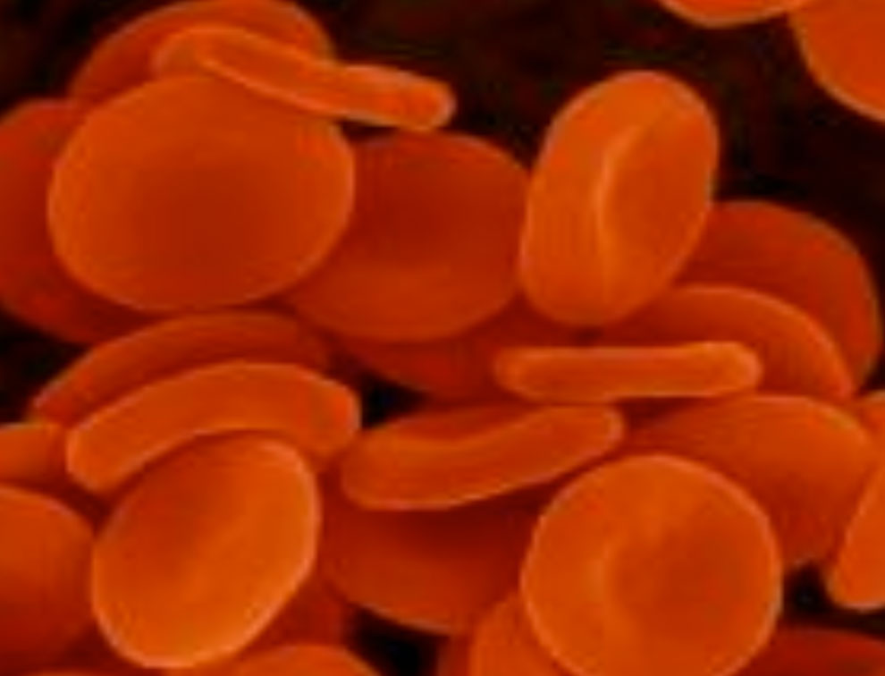
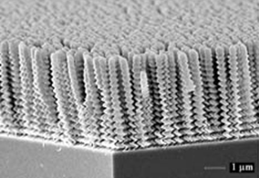
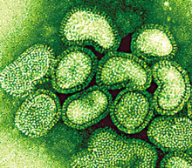
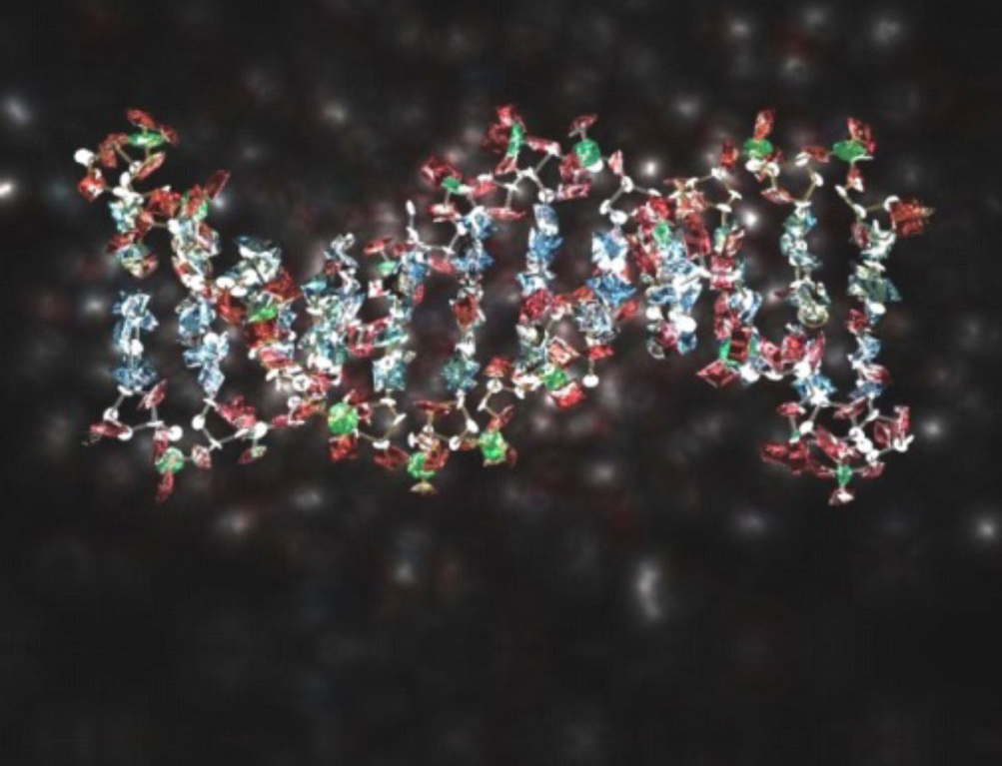
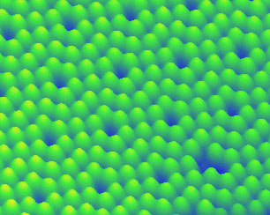
Neutrons as a Probe of Atomic and Nanoscale Structures
Have the right (tunable) wavelength
Human hair
~100,000 nm
Red blood cells
~7,000 nm
Deposited nanostructures
~500 nm
Influenza virus
~100 nm
DNA
~2 nm
Silicon atoms
~100,000 nm

Slide 21
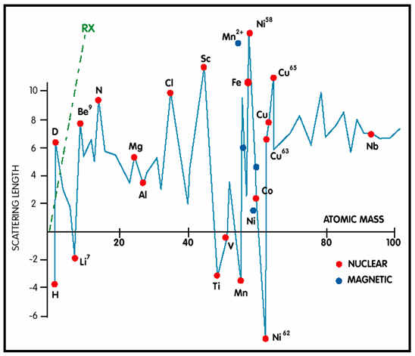
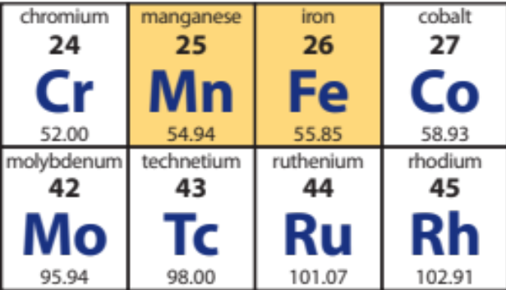
Neutrons as a Probe of Atomic and Nanoscale Structures
Scatter from the nucleus
  See light atoms next to heavy ones
  Distinguish neighbouring atoms in periodic table

Slide 22
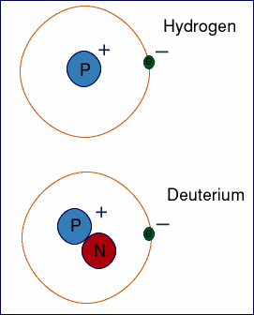
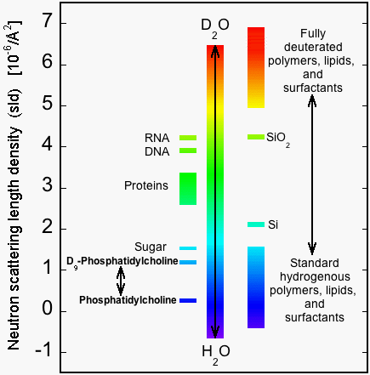
Neutrons as a Probe of Atomic and Nanoscale Structures
Scatter from the nucleus: isotopic sensitivity
  isotopic sensitivity - contrast between H and D
Scattering Length / (10⁻¹² cm)
 | n | X-ray
H | -0.374 | 0.28
D | 0.667 | 0.28

Slide 23
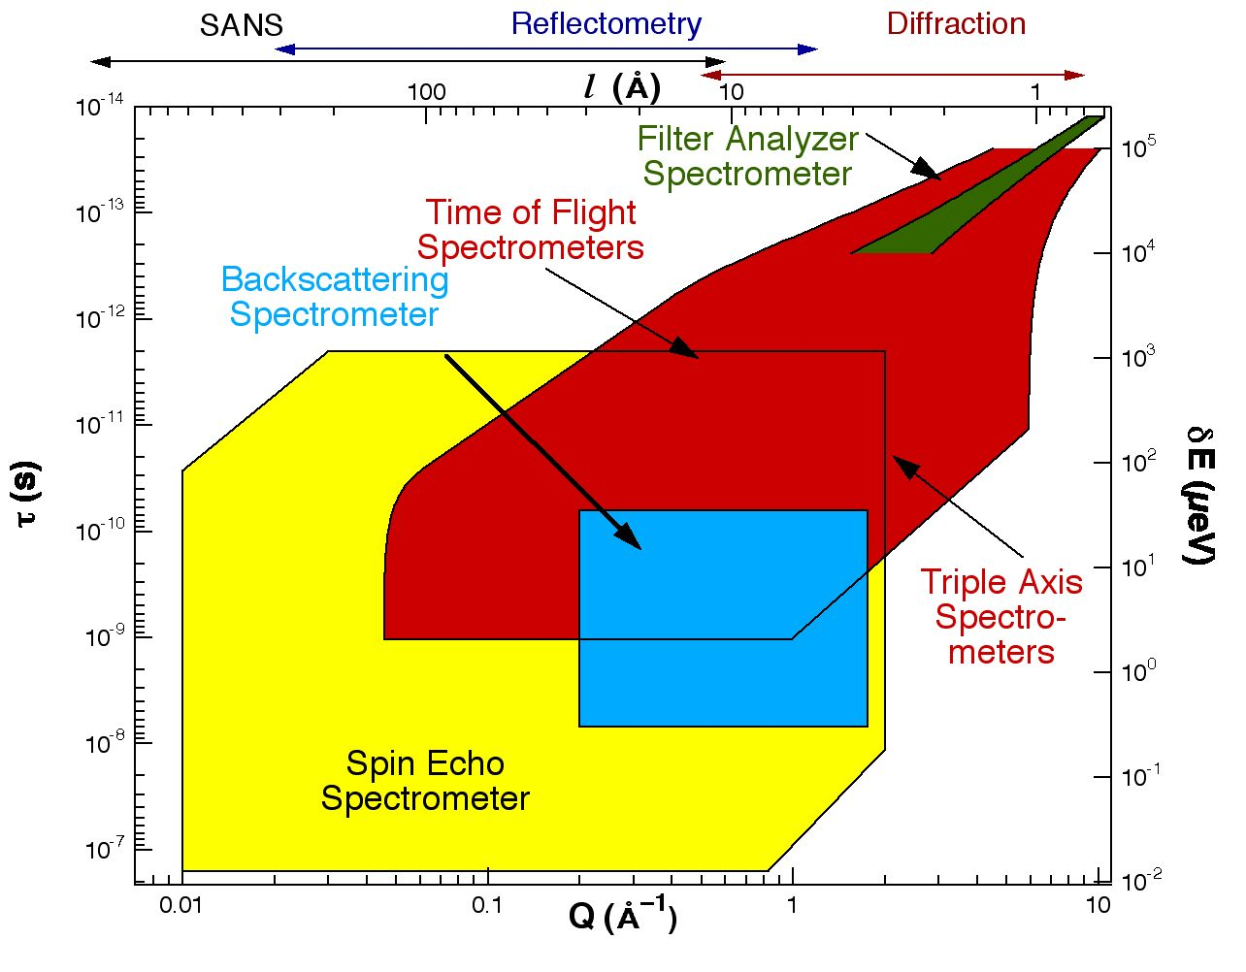
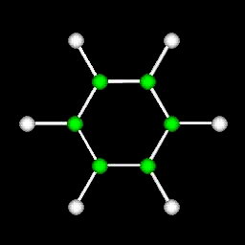


Neutrons as a Probe of Atomic and Nanoscale Structures
Energy comparable to atomic and molecular motion and dynamics

Slide 24



Neutrons as a Probe of Atomic and Nanoscale Structures
Penetrate deeply (bulk information; sample environments)
Neutrons have spin – study magnetism at the atomic level
Neutrons act like a tiny magnet
630 kg gas-pipeline section
Large sample environments

Slide 25





Target Leading Energy Technologies
Energy generation
Separations
Separation and capture
Energy extraction
Energy storage
Notes:
Key message:
The ultimate goal is to provide information that will lead to new technologies

Slide 26










Wombat – Lithium-ion Batteries – New Material
TYPICAL OPERATION
1.5 – 4.2 V
REDUCED WINDOW
2.0 – 4.0 V
25%
Better long-term performance

Slide 27



ECHIDNA – Solid Porous Sorbents
H₂
CH₄
CO₂
CO₂
Remove
CO₂
CH₄
CO₂
CH₄
H₂
H₂
CO₂
H₂
H₂
CH₄
CH₄
Notes:
A promising class of storage materials are the porous coordination framework materials, known better these days as MOFs, These materials lend themselves well to chemical modification, a method by which functional groups can be introduced and the hydrogen interaction with the material can be tuned. These are one of the leading options for the storage of hydrogen, but also importantly, for other gases of importance in the energy area, such as CO2, and gases that hydrogen needs to be separated from after its production.
Many of these materials are available commercially, and both the US DOE and Australian funding agencies have invested significantly to pursue the development of these materials for CO2 and hydrogen storage and separation.
Tuneable property & target application

Slide 28



SANS Applications Large scale structures (1 to > 100nm)
Colloids/emulsions/micelles
Polymers
Nanoparticles / Drug Release
Biomineralisation & biomimetics
Biomembrane physics
Type-II Superconductors - magnetic vortices
J. Colloid Interface Sci. 449 (2015) 160-166
Langmuir 30 (2014) 7296-7303
Notes:
Triglyceride digestion:
Triglycerides represent about 60% of the caloric intake of the typical western diet. We use SAS to understand the influence of pH on the shape of the carrier vehicles for the final products of digestion, namely fatty acids and monoglycerides. We used SANS, selective deuteration of the fatty acid (NDF) and synchrotron SAXS together to observe changes from elongated to spherical morphology with increasing pH mimicking conditions in the stomach and intestine.

Slide 29




Durability of Organic Light Emitting Diodes (OLED)
Electron Transport Layer
Emissive Layer
Hole Transport Layer
Cathode (+)
Anode (-)
Notes:
OLED vs LCD - Their thinness, greater brightness, and better colour reproduction make them significantly better.
Light produced when potential voltage placed across the layered structure.
Electrons move from cathode through the electron transport layer – holes move from the anode. Holes and electrons combine in the emmissive layer producing light.

Slide 30

Diffusion – The hidden menace in Organic Light Emitting Diodes (OLED)
Deuterated layer 1
Deuterated layer 3
Deuterated
layer 1
Deuterated
layer 3
Cathode
Electron Transport Layer
Emissive Layer
Hole Transport Layer
Anode
Protonated
layer 2
90°C
100°C - Intermediate
100°C - Equilibrium
Protonated layer 2
Notes:
Performance is much better than LCD technology – however longevity is a challenge due to diffusion between the various layers. Heating from joule heating.
Mass density within the sample. 90C perfect OLED stack
Joule heating

Slide 31
Low Tg Hole/Electron Transport Systems
d-NPB (98 °C)
HTL
EL
ETL
TCTA:Ir(ppy)₃ (151 °C)
d-Alq₃ (175 °C)
Silicon
d-NAD (207 °C)
HTL
EL
ETL
J. A. McEwan et al,
ACS Appl. Mat. Interfaces,
2017, 9, 14151
TCTA:Ir(ppy)₃ (151 °C)
d-TPBi (127 °C)
Silicon
Notes:
To ensure longevity and efficiency of OLED systems must avoid temperature driven diffusion
High T_{g} compounds

Slide 32
Access to ANSTO
1. Merit
2. User Pays
Sample preparation, experiment, analysis and reporting conducted by a team of specialist scientists
Timely access, minimal waiting period
IP conditions that support commercial use
Normal & Program (3 years) proposal rounds - 15th March & 15th September.
Mail-in for Powder Diffraction measurements on ECHIDNA
No charge but expectation to publish

Slide 33

Concluding Remarks
Neutron scattering provides unique opportunities for both researchers and industry
ANSTO’s neutron scattering capabilities are open for business!
Proposal deadlines
  15th March
  15th September
neutron.ansto.gov.au

Slide 34


Thank you.

