Slide 1
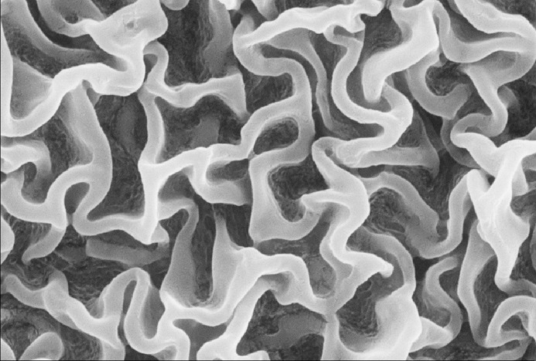
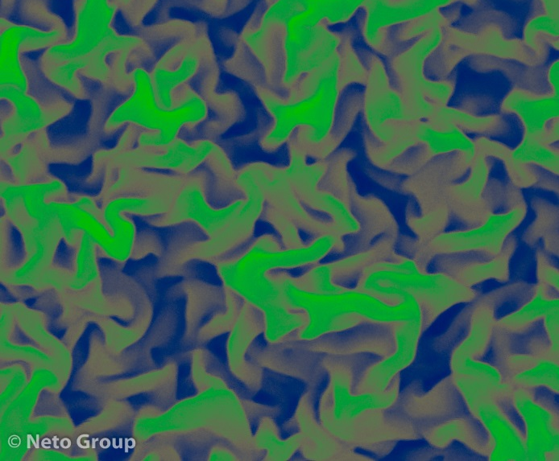
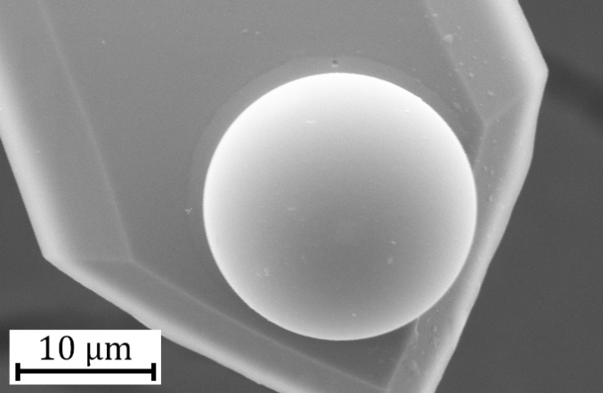


14th August 2018, VASSCAA
Anti-fouling and Slippery Properties of Lubricant-Infused Surfaces
Chiara Neto
School of Chemistry
University of Sydney Nano Institute The University of Sydney
NSW 2006
@netogroup
@ChiaraOz

Slide 2
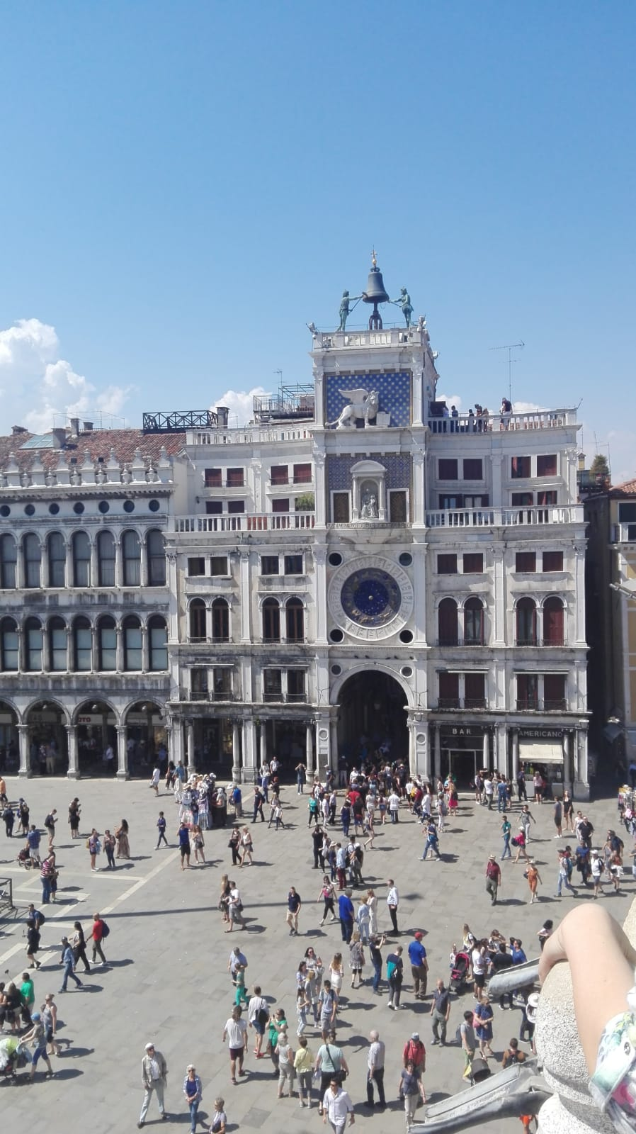
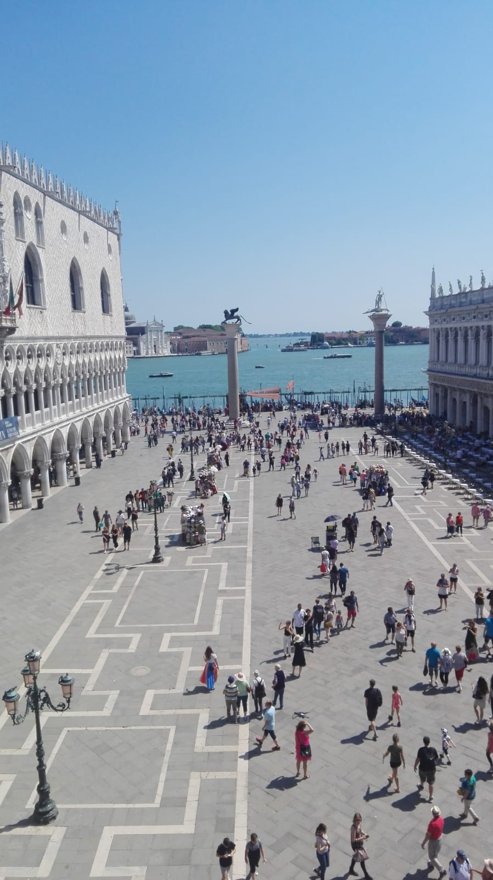
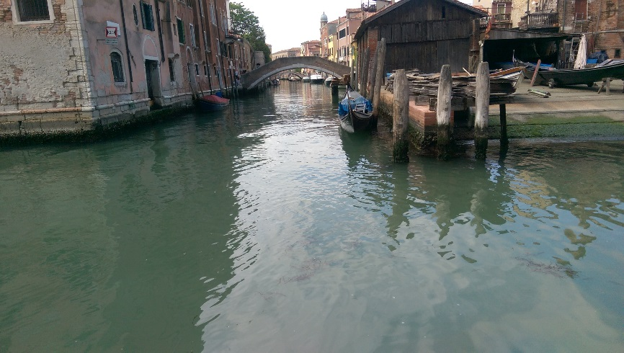
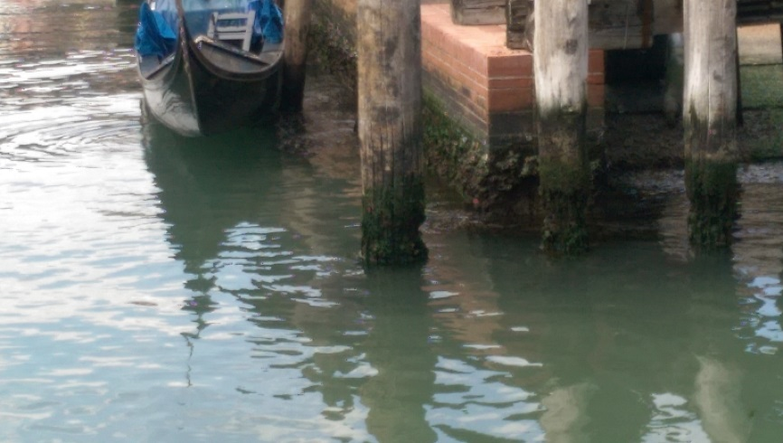

Slide 3
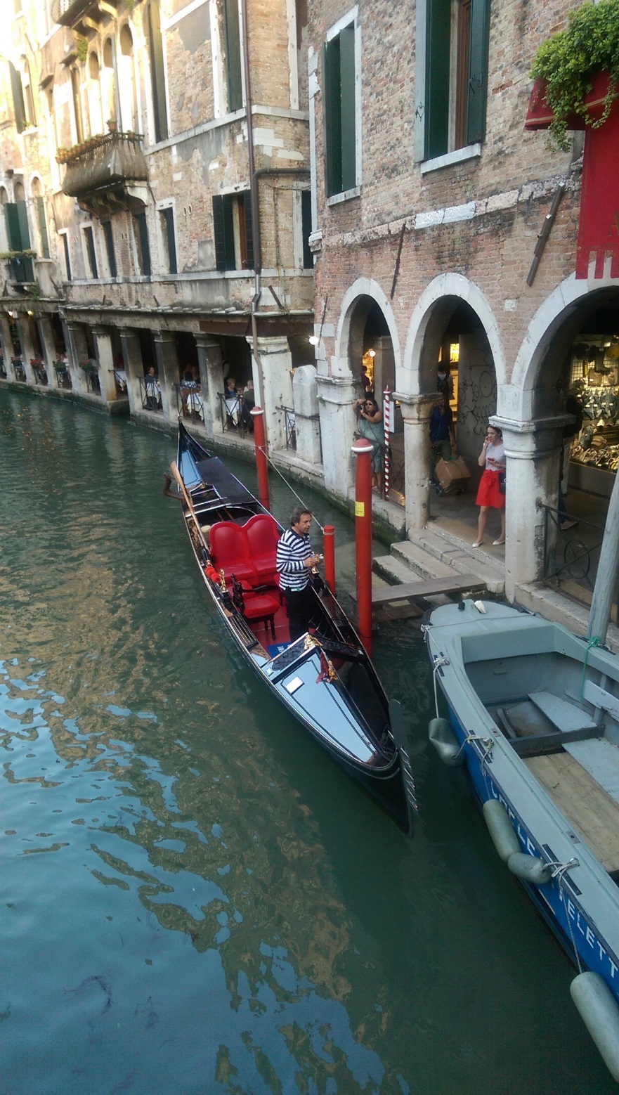



Slide 4
14th August 2018, VASSCAA
Anti-fouling and Slippery Properties of Lubricant-Infused Surfaces
Chiara Neto
School of Chemistry
University of Sydney Nano Institute The University of Sydney
NSW 2006
@netogroup
@ChiaraOz

Slide 5
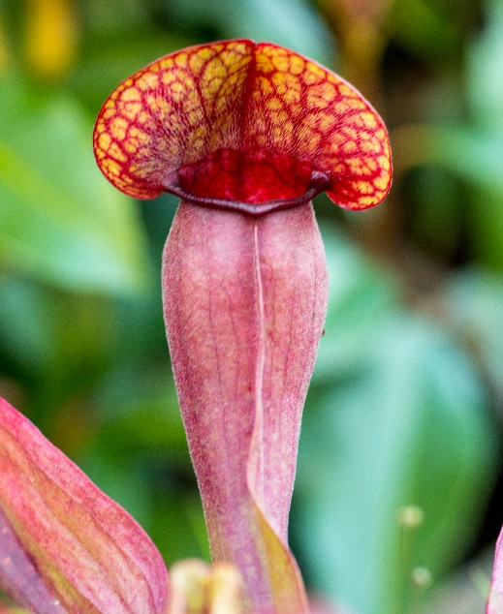
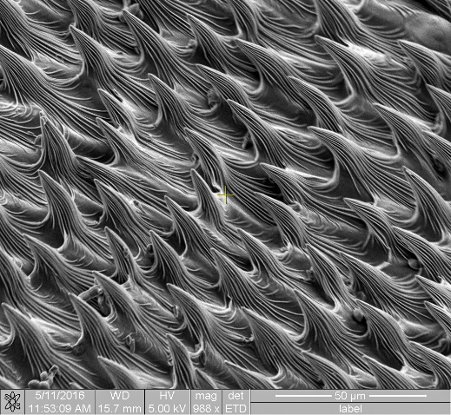

Slippery Liquid-infused Surfaces (SLIPS)
Surfaces inspired by the pitcher plant
The microstructure traps a lubricant layer, which makes a smooth slippery surface.
Trumpet Pitcher Plant
Trumpet Pitcher Plant SEM

Slide 6
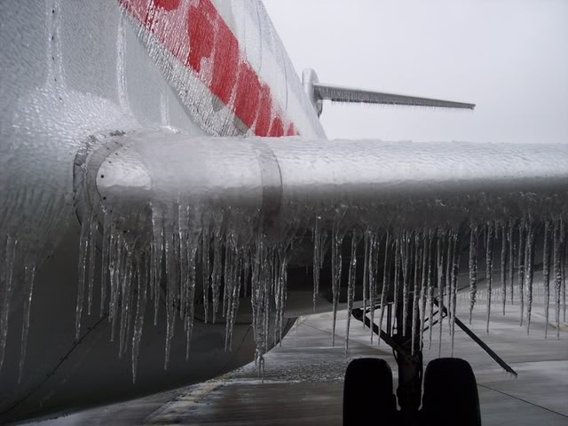
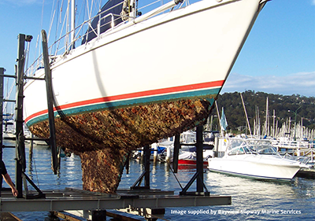
Slippery liquid-infused surfaces (SLIPS)
Omniphobic¹
Anti-icing
Anti-fouling
Potentially anti-drag²
http://bit.ly/2lA71f6
http://bit.ly/2z0IMJP
[1] Wong, Kang, Tang, Smythe, Hatton, Grinthal, J. Aizenberg, Nature 2011, 477, 443-447.
[2] Van Buren, T.; Smits, A. J., J. Fluid Mech. 2017, 827, 448-456.

Slide 7
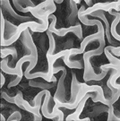
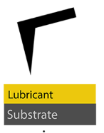
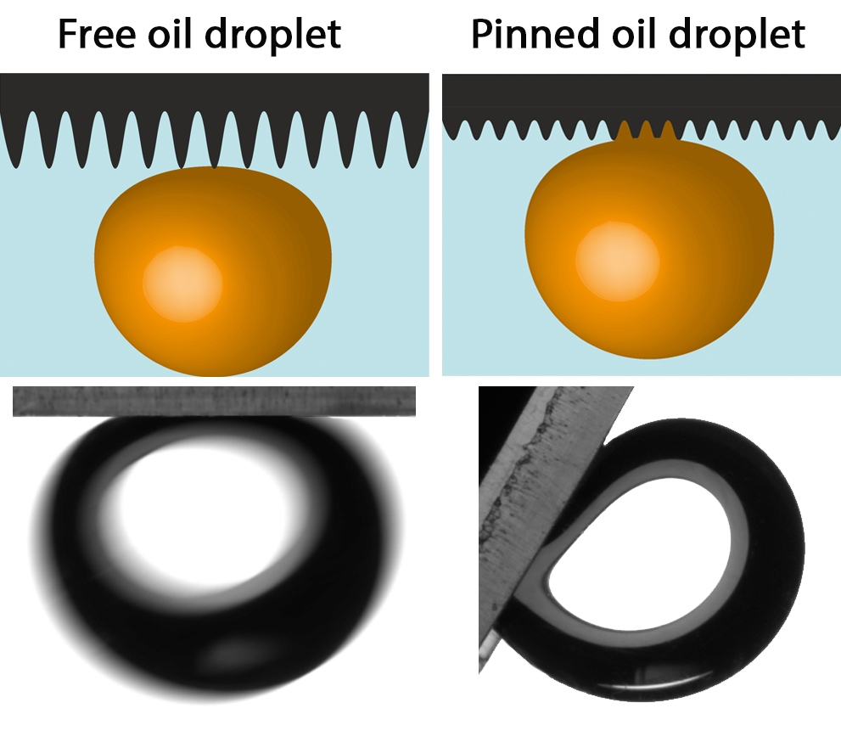
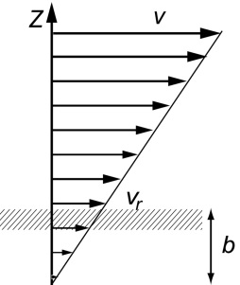
Outline
1. Anti-fouling wrinkled polymer surfaces
2. Mapping lubricant film thickness
3. Under water superoleophobic surfaces
4. Quantifying drag-reduction
liquid
solid

Slide 8
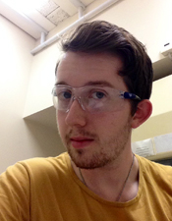
1. Teflon Wrinkles
Teflon wrinkles spontaneously upon shrinking of shrinkable substrates.
The wrinkled substrates are superhydrophobic and resistant to wear.
Liam Scarratt
Shrinks to 30% of its original size
λ wrinkle wavelength
h layer thickness
E_{f} , E_{s}Young’s modulus of the top film and soft substr.
λ≈ 2πh(E_{s}/3E_{f}) ^{1/3}
Scarratt, et al; ACS Appl. Mater. Interfaces 8, 6743−6750 (2016)

Slide 9

Infusion of Silicone Oil in Teflon Wrinkles
λ = 150± 20 nm
Height 290 ± 30 nm
On shrinkwrap
λ = 390 nm
Height 380 nm
Cameron Ware
Θ_{os(a)} >θ_{c}
0<Θ_{os(a)} <θ_{c}
Teflon wrinkles trap silicone oil well.
0 < Θ_{os(a)} < Θc in air (Θc = 80°)
Θ_{os(w)} = 0 in water
P4VP wrinkles are superoleophobic under water.
Θ_{os(w)} = 156º
PS wrinkles do not work.
Our best infused Teflon wrinkles
have:
low roll-off angles
Cannot be marked
with markers
P4VP
PS
Θ_{os(w)} >θ_{c}
44°
0<Θ_{os(w)} <θ_{c}
Bico, Thiele, Quéré Colloids Surf. 2002, 206 (1-3), 41. Smith et al., Soft Matter 2013, 9 (6), 1772.

Slide 10
Roll-Off Angle on Infused Teflon Surfaces
Droplet roll-off angle ≈ adhesion
Reduced roll off for all infused Teflon wrinkles compared to dry surfaces is a measure of ‘slippery’ surfaces.
Substrate | Wrinkle λ (nm) | Dry Roll Off Angle | Infused Roll Off Angle
Silicone | Flat | 22 ± 1º | N/A
Polyshrink™ | 80 | 12 ± 1º | 4 ± 1º
 | 150 | 9 ± 1º | 4 ± 1º
 | 1190 | 17 ± 6º | 9 ± 1º
Shrink Wrap | 150 | 10 ± 6º | 3 ± 1º
 | 160 500 | 28 ± 6º | 4 ± 1º
 | 390 | 10 ± 3º | 4 ± 1º
 | 300 1600 | 20 ± 5º | 16 ± 2º
infused wrinkles
Dry wrinkles
Ware, et al, ACS Applied Materials Interfaces 10, 4173−4182, 2018.

Slide 11


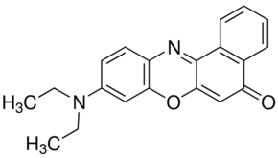
Quantifying Silicone Oil
Fluorescence
Fluorescence spectra for varying volumes (0−1.00 μL) of 1.00 μM Nile red in 10 cSt silicone oil;
Drained 2.5h
Truis
Smith-Palmer
Sam
Peppou-Chapman
Spun 1 min
Nile Red
Silicon oil is extracted from the surface and fluorescence compared to the calibration curve
Spun 5 min
Ware et al, ACS Applied Materials Interfaces 10, 4173−4182, 2018.

Slide 12
Bacterial inhibition
Drainage Treatment | Volume silicone Oil / µL cm⁻² | Water Contact angle / ° | Roll-off angle / ° | % Inhibitionª
Drained 1 h | 0.9 ± 0.2 | 99 ± 2 | 5 ± 1 | 99 ± 1
Spun at 8000 rpm, 1 min | 0.4 ± 0.2 | 111 ± 2 | 7 ± 1 | 86 ± 9
Spun at 8000 rpm, 5 min | 0.3 ± 0.2 | 113 ± 3 | 9 ± 1 | 84 ± 10
Drained 1 h, 2 weeks shear | 0.04 ± 0.01 | 113 ± 1 | 6 ± 3 | 73 ± 13
Spun at 8000 rpm, 1 min, 2 weeks shear | 0.02 ± 0.01 | 122 ± 6 | 8 ± 4 | 76 ± 16
Inhibition measured by absorbance of crystal violet extracted from
the surfaces exposed to bacteria
^{a)} The % inhibition is relative to dry Teflon wrinkles, non-infused with silicone oil.
Surface were exposed to marine bacteria Psuedoalteromonas spp for 24 hours.
Only small volumes of oil (0.2 mL/m²) are required for anti-fouling behavior .
Able to be molded
dry drained spun,
teflon sheared 2 weeks

Slide 13
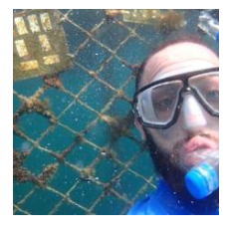
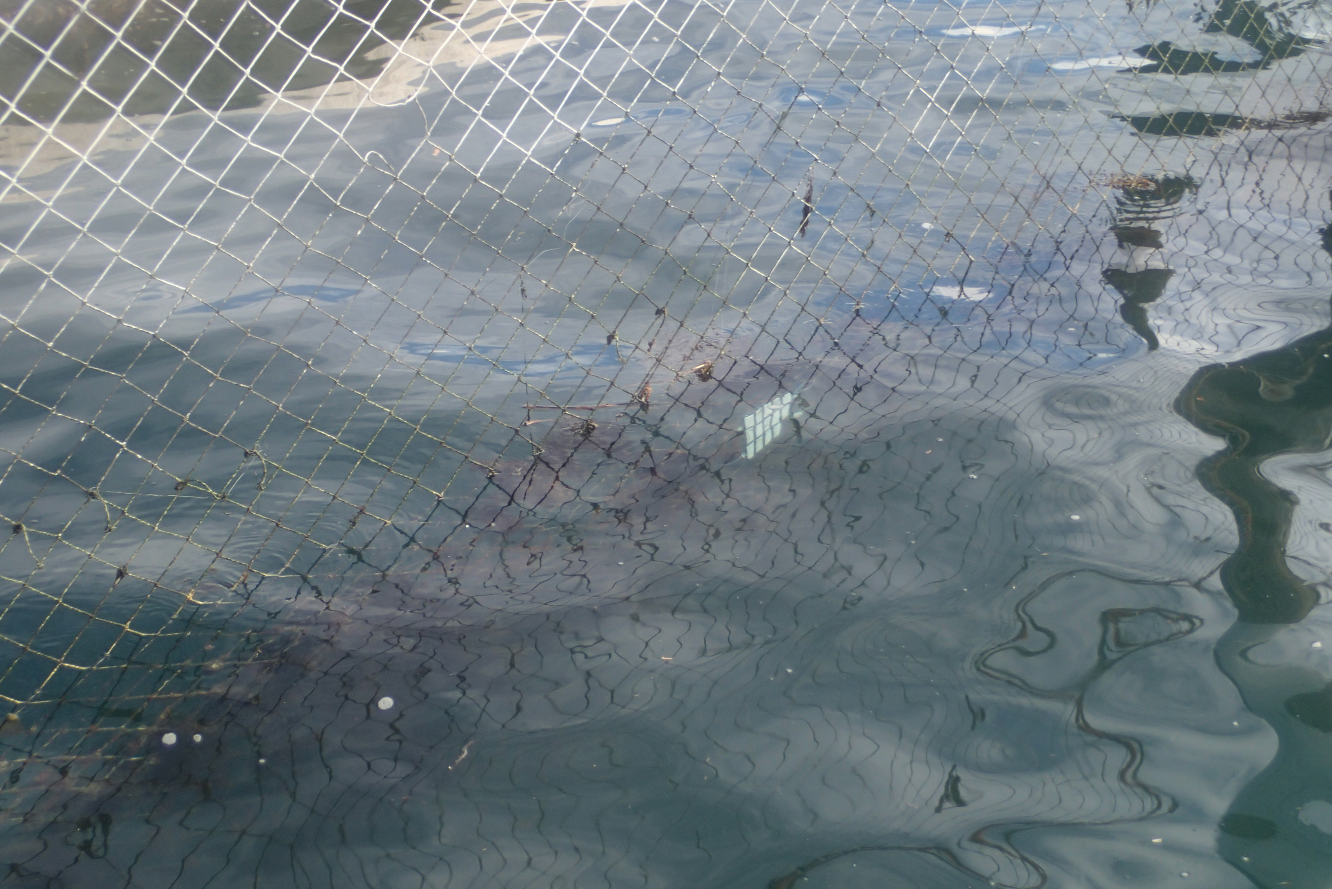
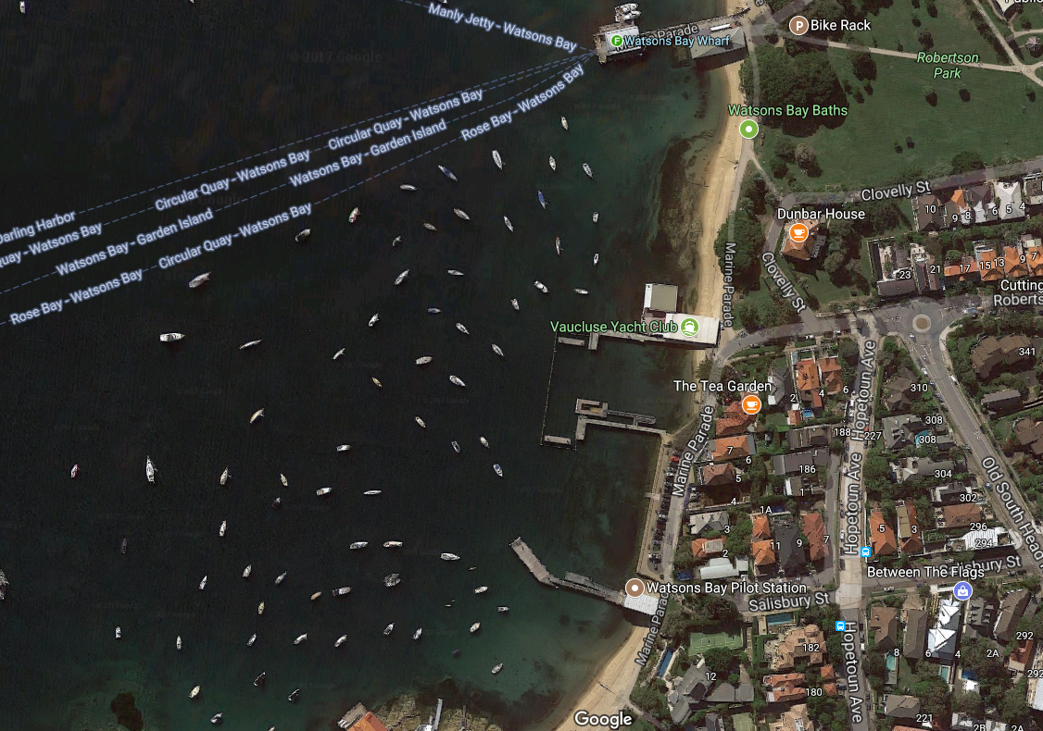
Test of anti-fouling in the ocean
Surfaces immersed in Sydney Harbour for seven weeks to test for real-world fouling.

Slide 14
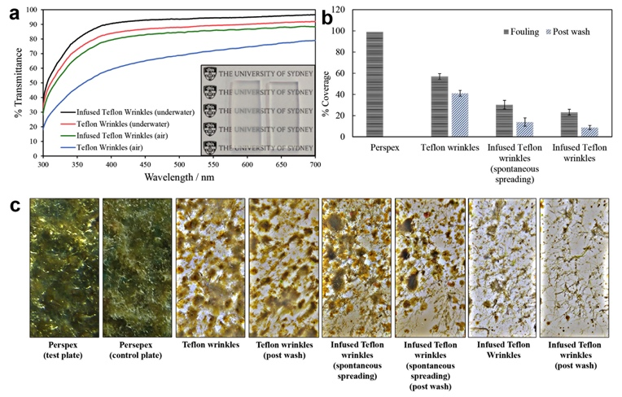
Inhibition of marine fouling
Surfaces immersed in Sydney Harbour for seven weeks to test for real-world fouling.
Silicon oil is non-toxic but inhibits fouling and is foul-release.
% Surface coverage by marine fouling
30% of fouling
released
65% of fouling
released
99 %
57 %
30 %
23 %
Ware, et al, ACS Applied Materials Interfaces 10, 4173−4182, 2018.

Slide 15
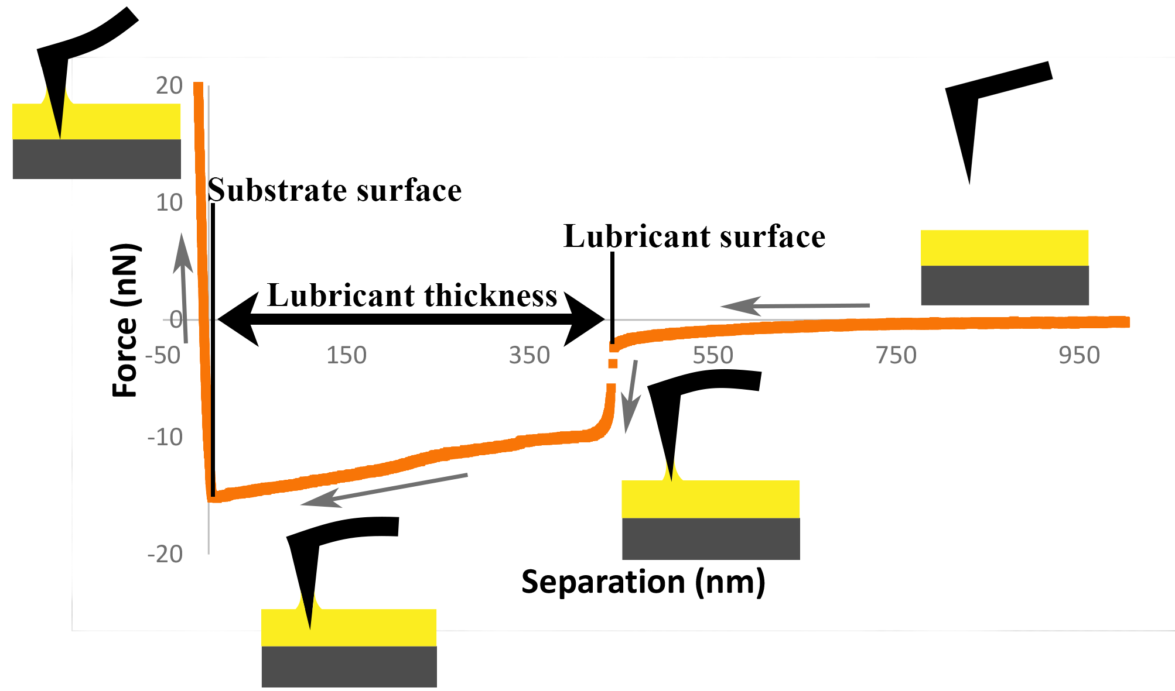
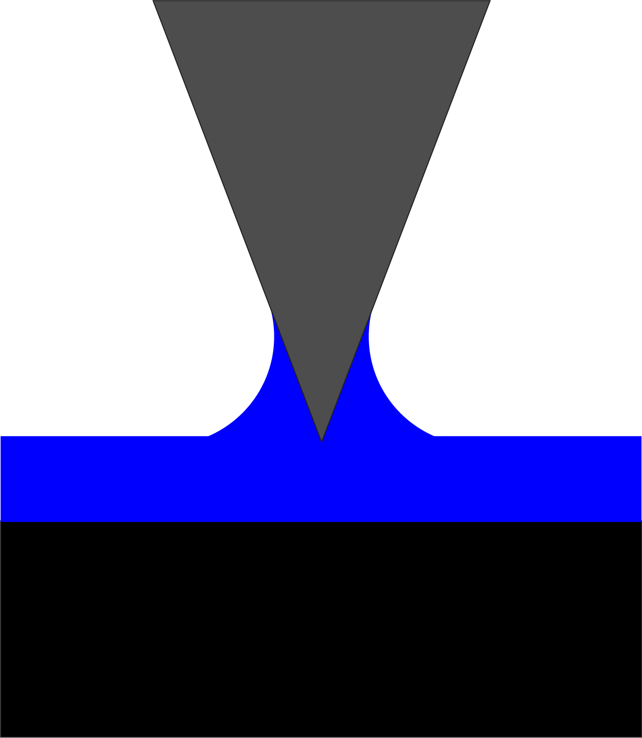
2. Mapping lubricant film thickness
Sam
Peppou-Chapman
AFM Meniscus Force Measurements
Jump-in separation indicates thickness of liquid film
Position of hard substrate
Mate et al. J. Chem. Phys. 1989 and 1991
Thickness reproduces ellipsometric results.
Peppou-Chapman & Neto, submitted, 2018.

Slide 16
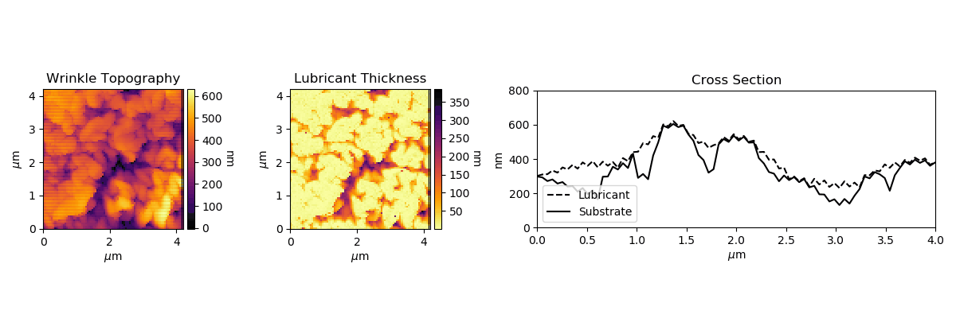
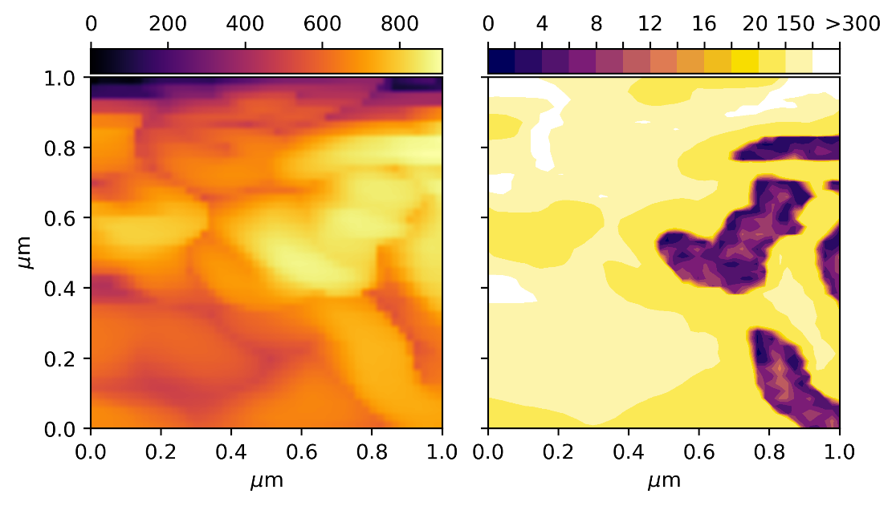
Mapping of lubricant thickness
Lubricant
Substrate
Contour map of film thickness
shows areas of thick film and areas that are depleted with nanoscale accuracy.
Notes:
Add histogram

Slide 17
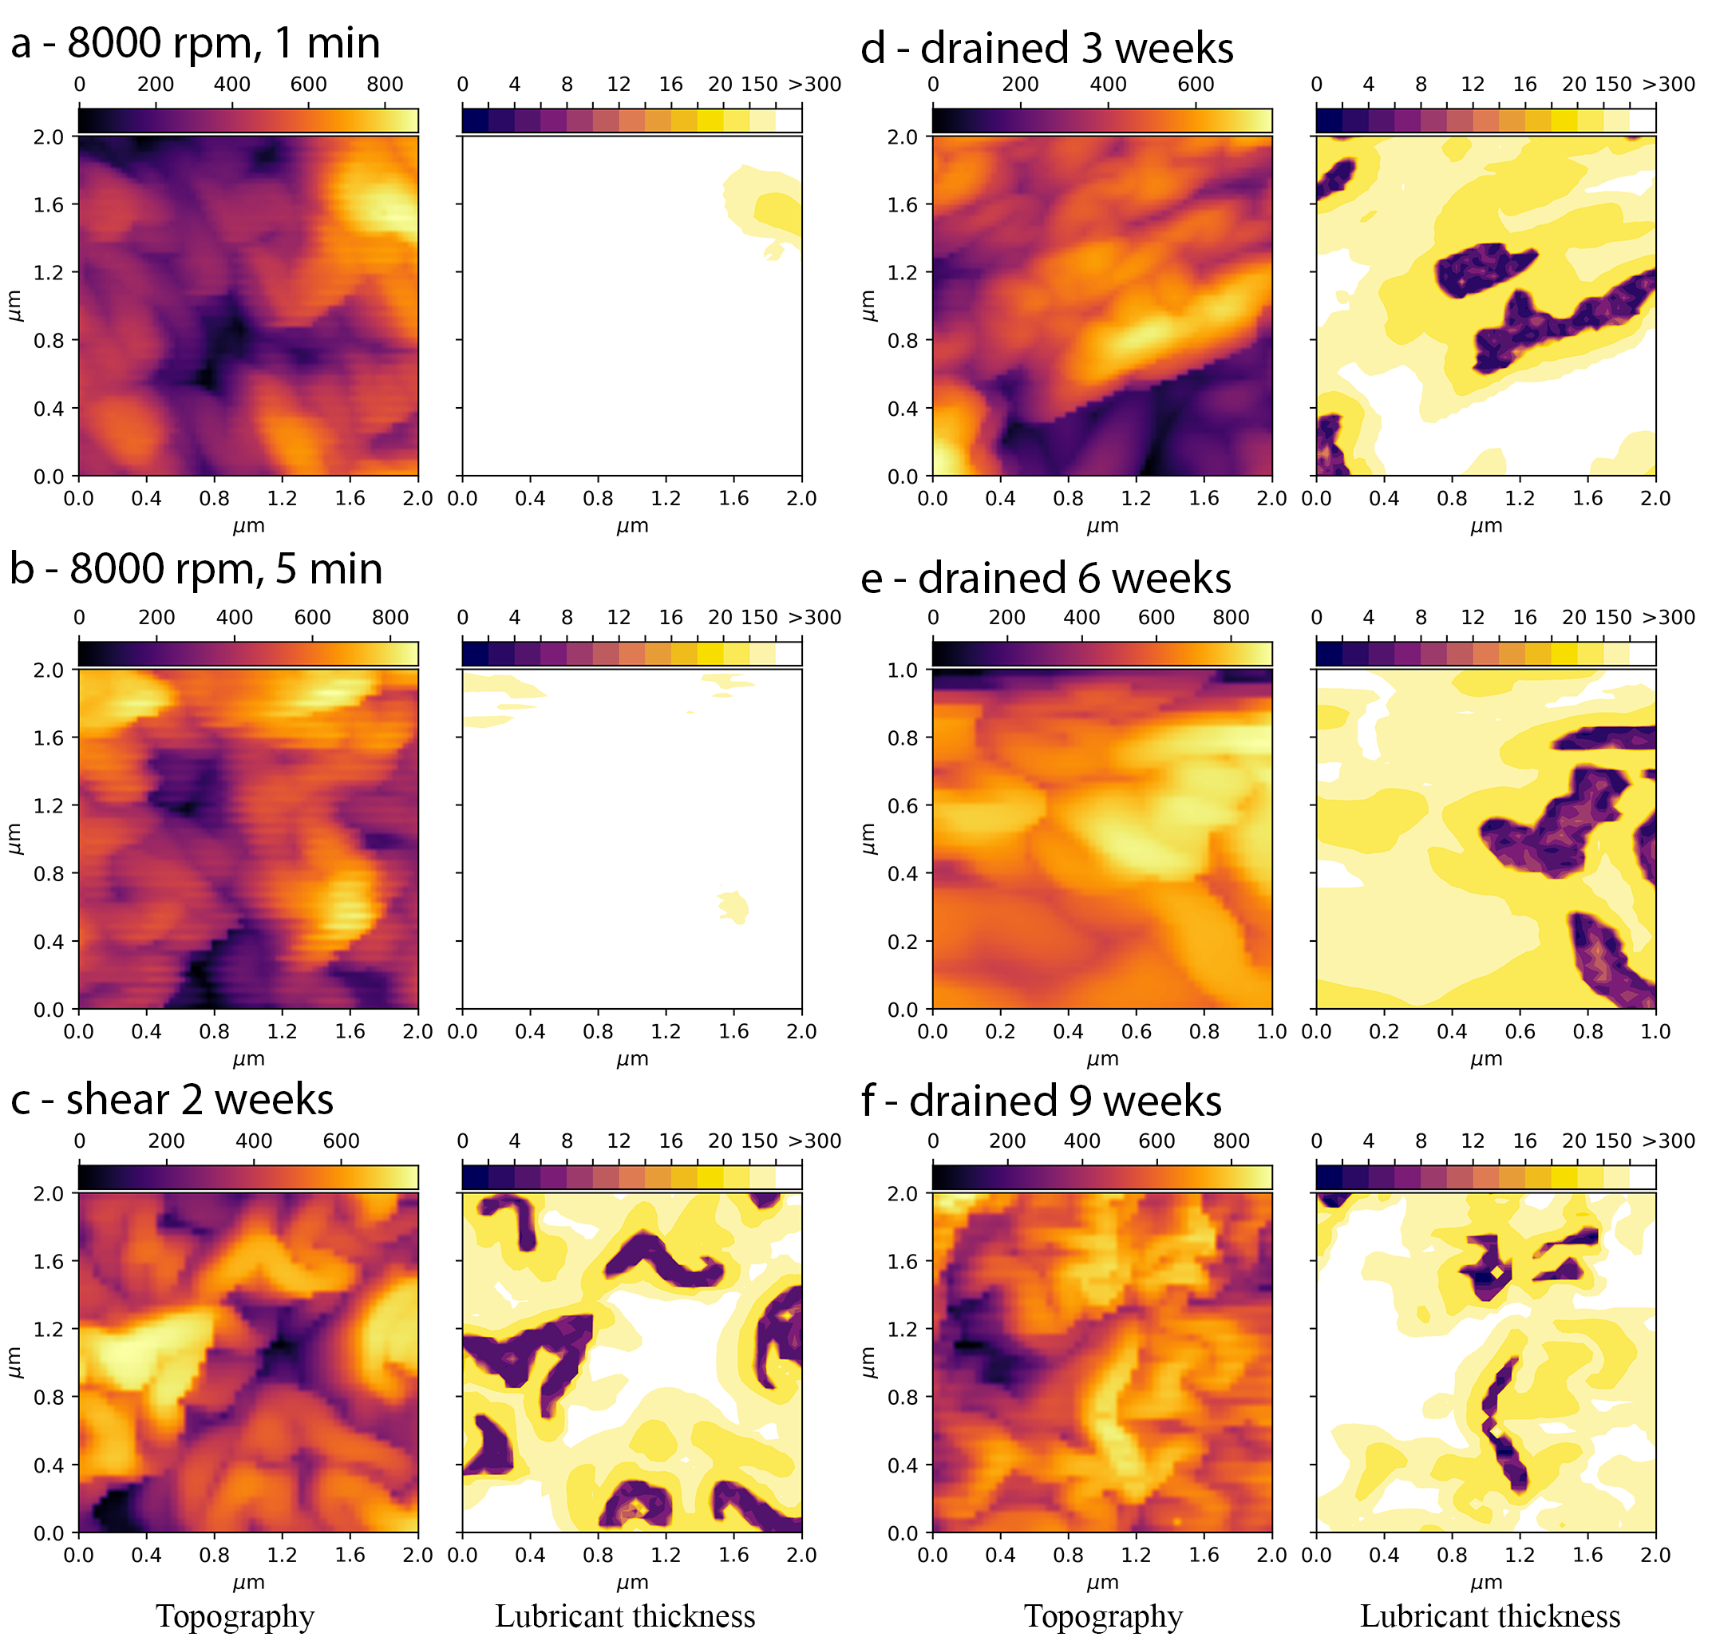
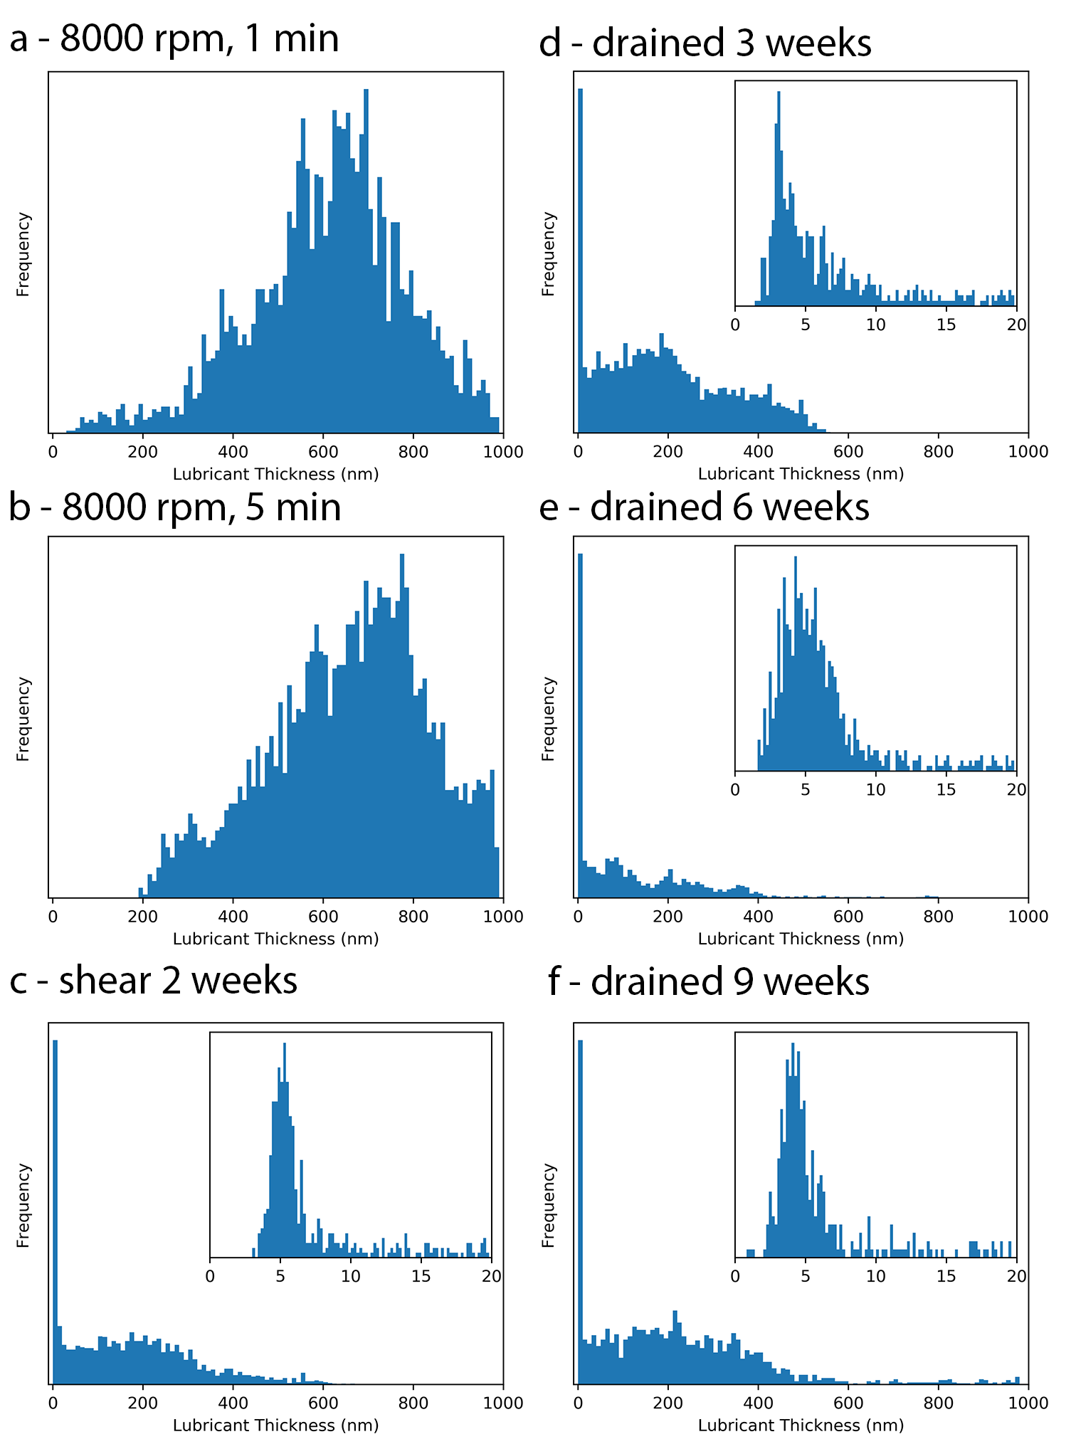
Film depletion leads to two distinct regions
wrinkle tops
0.09 ± 0.03 µL cm⁻²
0.02 ± 0.01 µL cm⁻²
Thick film
wrinkle tops
0.09 ± 0.02 µL cm⁻²
0.02 ± 0.01 µL cm⁻²
Thick film
wrinkle tops
wrinkle tops
0.02 ± 0.002 µL cm⁻²
0.02 ± 0.01 µL cm⁻²
Infusion of hydrophobic Teflon leads to two populations of film thickness: one thick and one thin; the thin film population is ~ 5 nm.

Slide 18
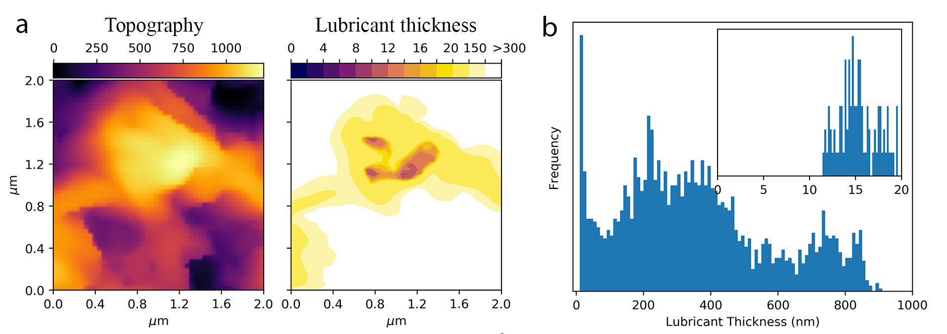
Infusion of P4VP with silicon oil
Silicone oil spreads on and poly(4-vinylpyridine) (P4VP) in air.
Wrinkle tops
Thick film
Infusion of hydrophilic P4VP also leads to two populations of film thickness:
thick and thin; the thin population is ~ 15 nm. The volume of silicone oil infused is higher (0.037 ± 0.004 µL cm⁻²).

Slide 19


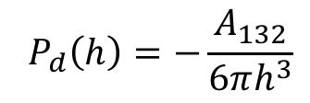
Interface potential of a thin liquid film
1
3
2
Lubricant
thin film
h
Silicon oil
Teflon/P4VP
Disjoining pressure
- van der Waals forces
$$P_{d}\left(h\right)=−\frac{A_{132}}{6πh^{3}}$$
$A_{132}$ = Hamaker constant
Thin film unstable on Teflon
Thin film stable on P4VP
Seemann, et al.; J. Phys.: Condens. Matter 17, S267-S290 (2005).

Slide 20
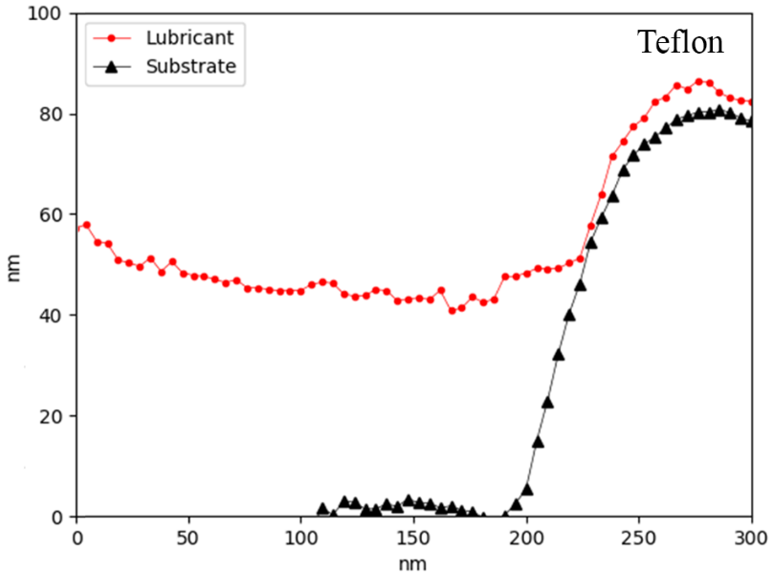
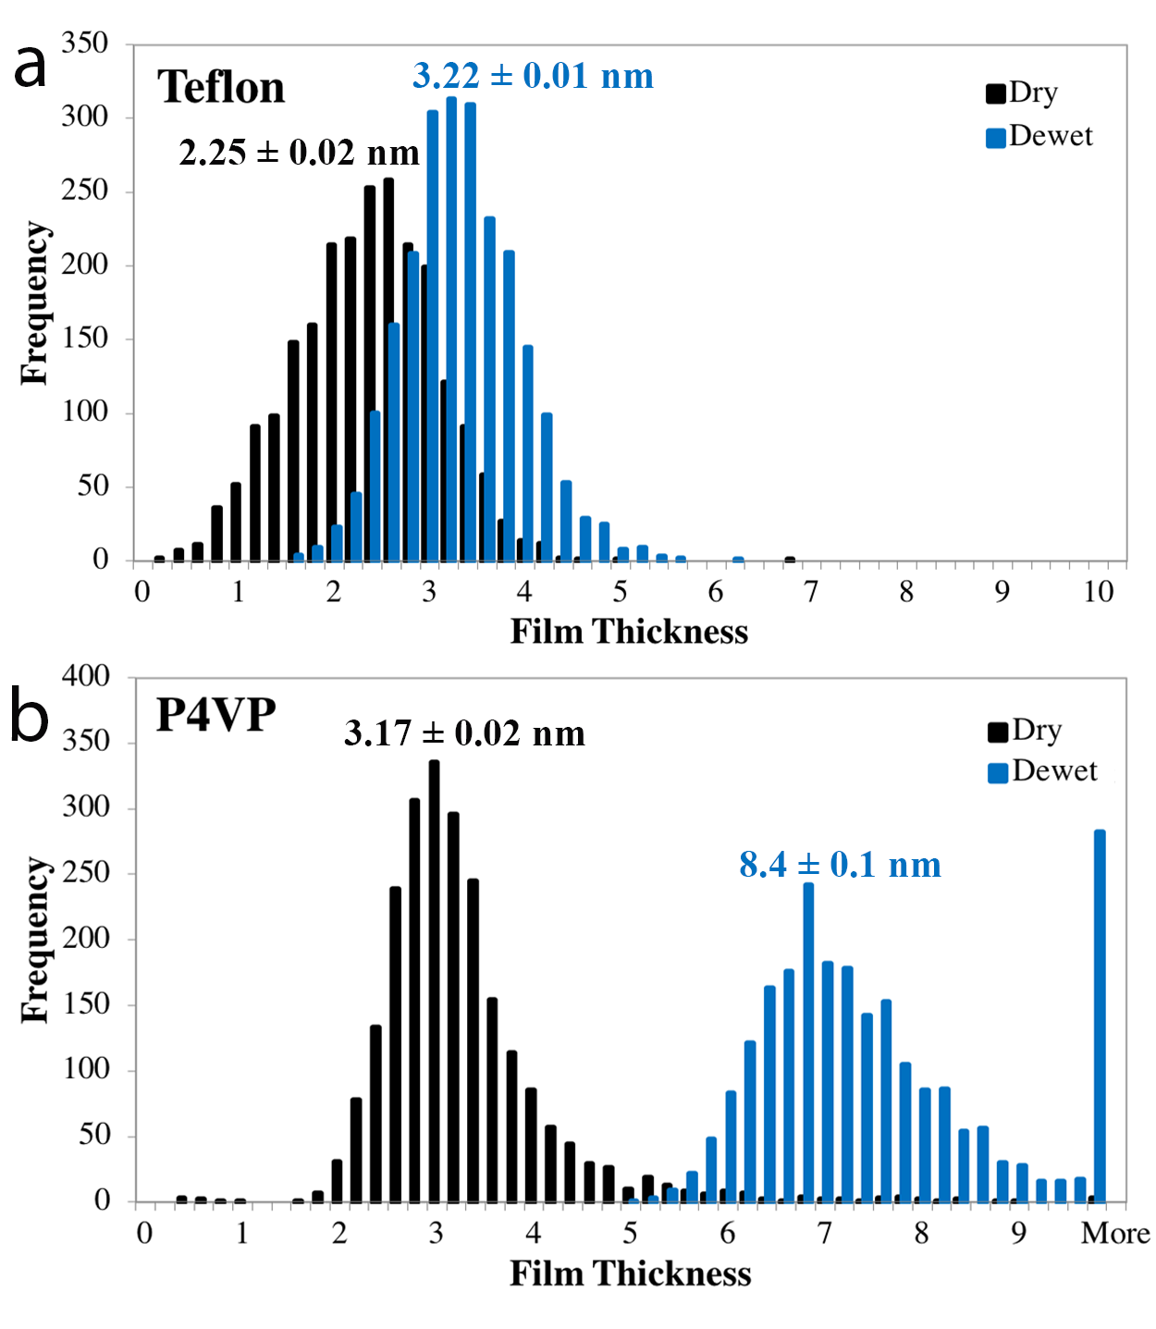


Film thickness on the wrinkle tops
Silicon oil on Teflon wrinkles
60º
Silicon oil on P4VP wrinkles
Minimum measurable thickness of liquid varies depending on interface potential and wettability.
Peppou-Chapman & Neto, submitted, 2018.

Slide 21

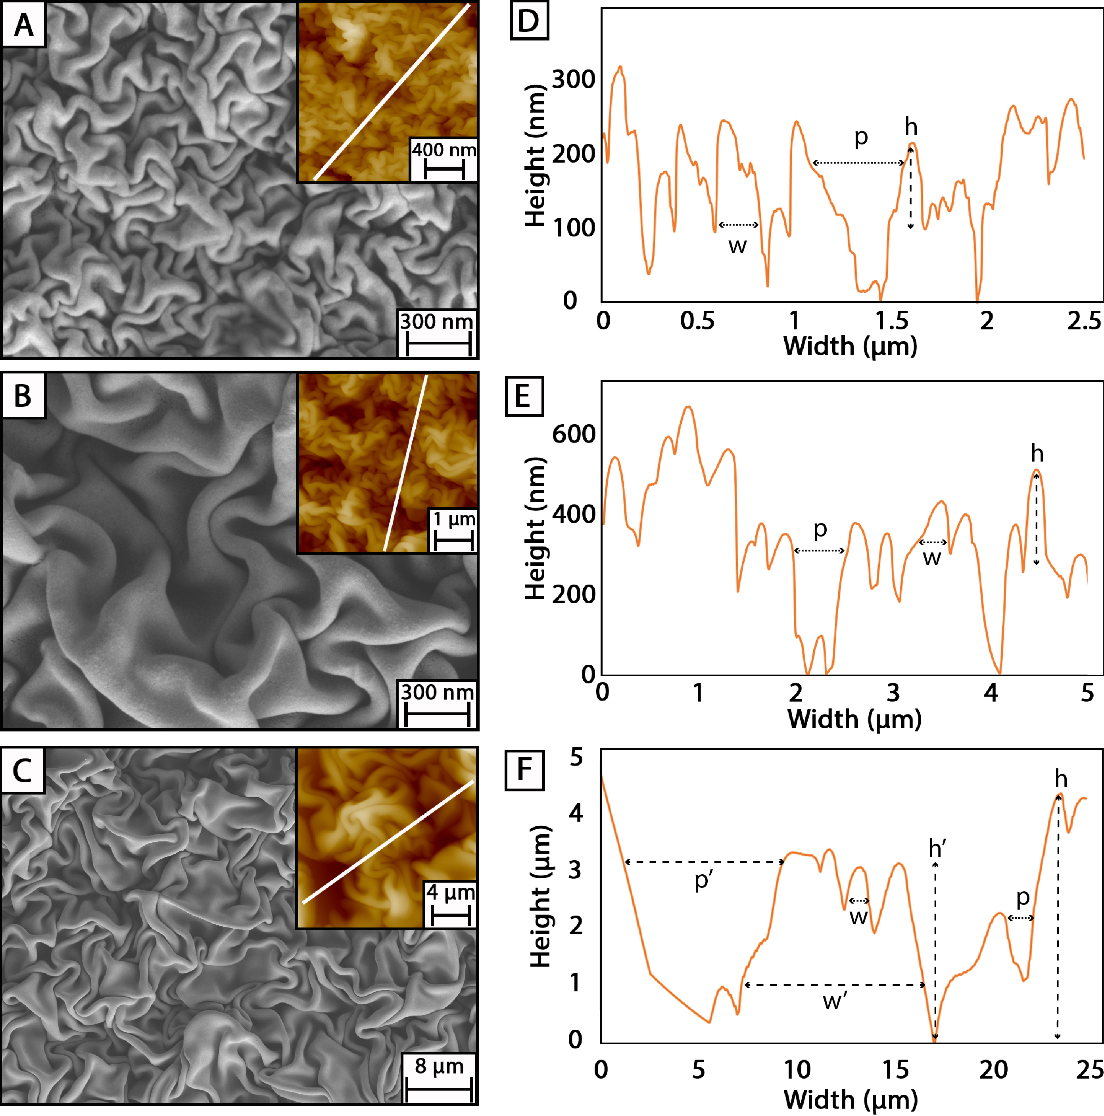
3. Under water superoleophobic surfaces
16 nm thick
Ahmed Owais
poly(4-vinylpyridine) P4VP films
36 nm thick
Coating thickness (nm) | wrinkle width (w, nm) | wrinkle heights (h, nm) | pitch width (p, nm) | Roughness (R_{RMS}, nm)
16 | 90 ± 18 | 120 ± 45 | 176 ± 128 | 80 ± 20
36 | 200 ± 55 | 175 ± 68 | 279 ± 226 | 230 ± 50
241 | Sm. 1280 ± 535 Lg. 8800 ± 4000 | Sm. 1050 ± 510 Lg. 3450 ± 1200 | Sm. 1600 ± 950 Lg. 4500 ± 3450 | 970 ± 380
241 nm thick
Hydrophilic P4VP films wrinkle similarly to Teflon films.

Slide 22
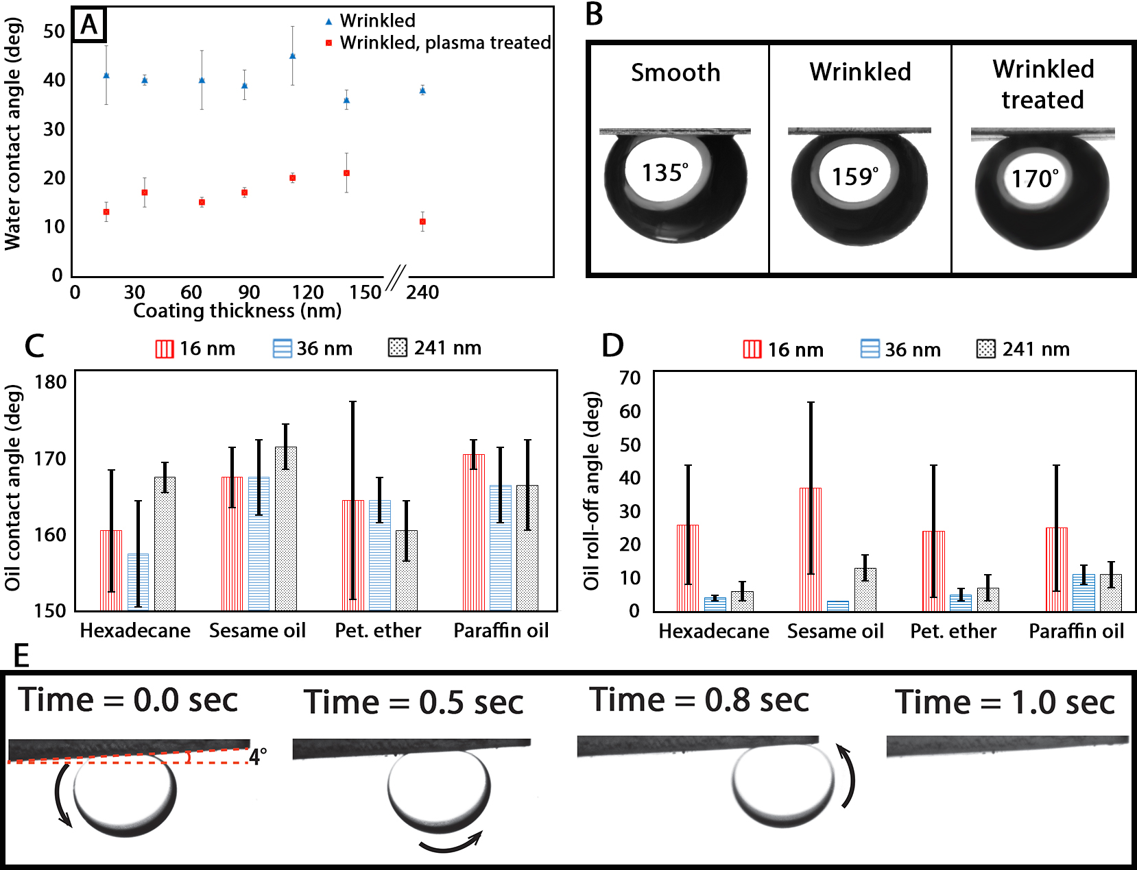
Underwater oil repellency of P4VP wrinkles
P4VP wrinkles are highly wettable by water, especially after plasma treatment
Wrinkled surfaces are superoleophobic underwater
The thickest coatings showed the best performance
petroleum spirit
A. Owais, T. Smith-Palmer, A. Gentle, C. Neto; Soft Matter, 2018, in press

Slide 23
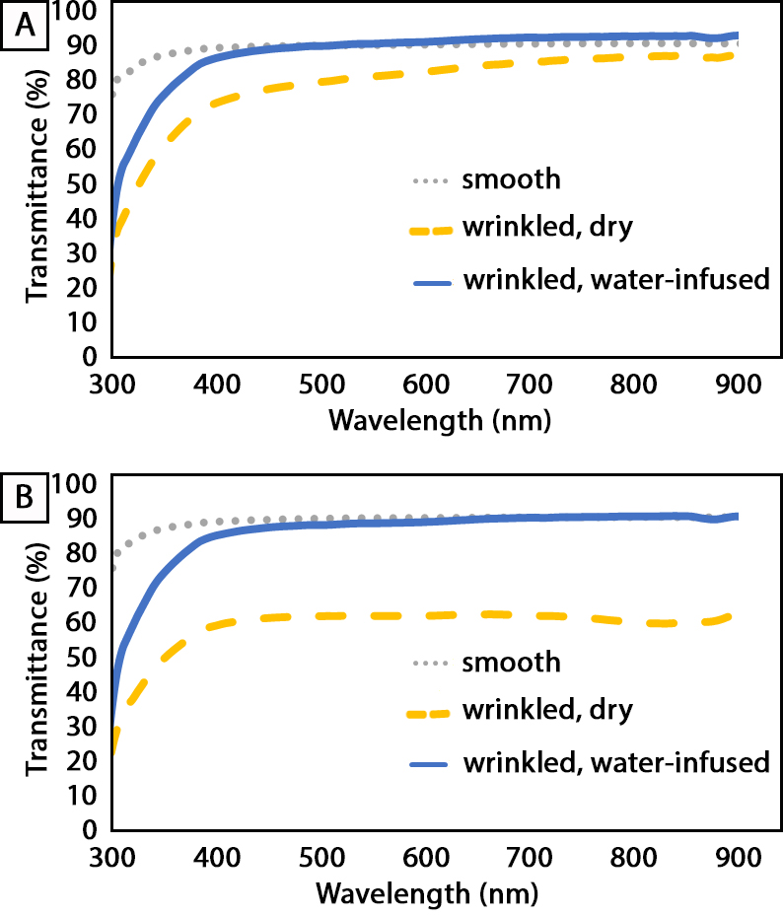
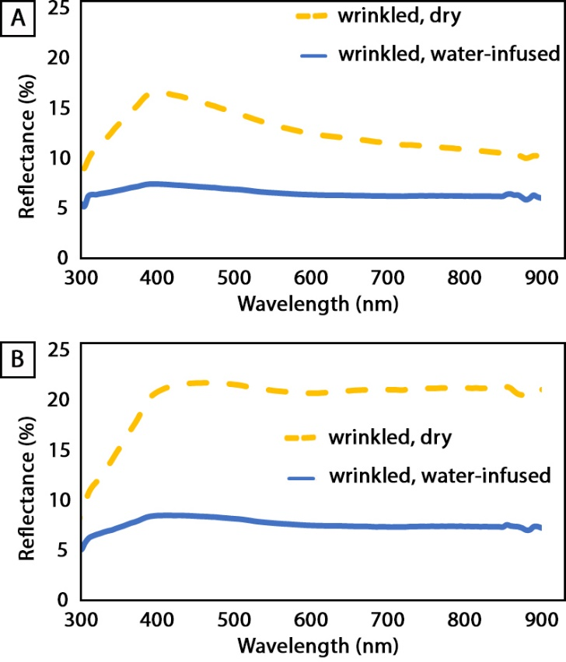
Optical transmittance
Surface | Reflectance
 | Dry | water-infused
Glass | 8%
P4VP 36 nm-thick, dry | 13% | 7%
P4VP 241 nm-thick, dry | 20% | 8%
Transmittance
Reflectance
C
36 nm-thick P4VP
36 nm-thick P4VP
D
241 nm-thick P4VP
241 nm-thick P4VP
Water-infused wrinkled P4VP surfaces are transparent and as reflective as glass.

Slide 24
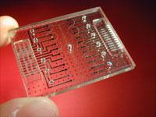

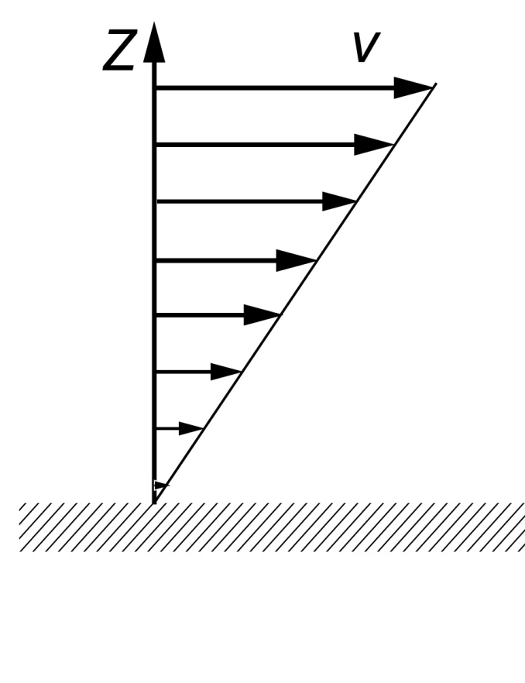
4. Quantifying drag-reduction
NO SLIP
PARTIAL SLIP
liquid
liquid
solid
solid
Universally employed.
Ok for macroscopic experiments.
No microscopic explanation.
Commonly accepted for gases
and polymers.
b, slip length, quantifies slip
Craig, Neto, Williams, Phys. Rev. Lett. 87, 054504 (2001).

Slide 25
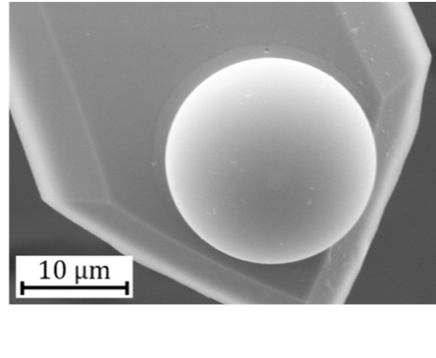
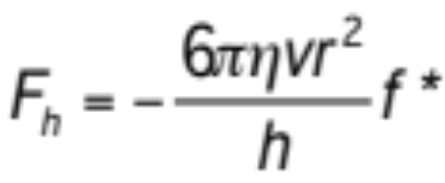
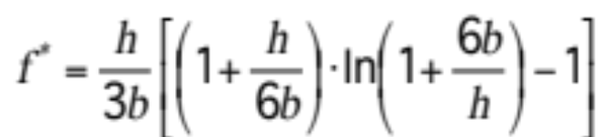
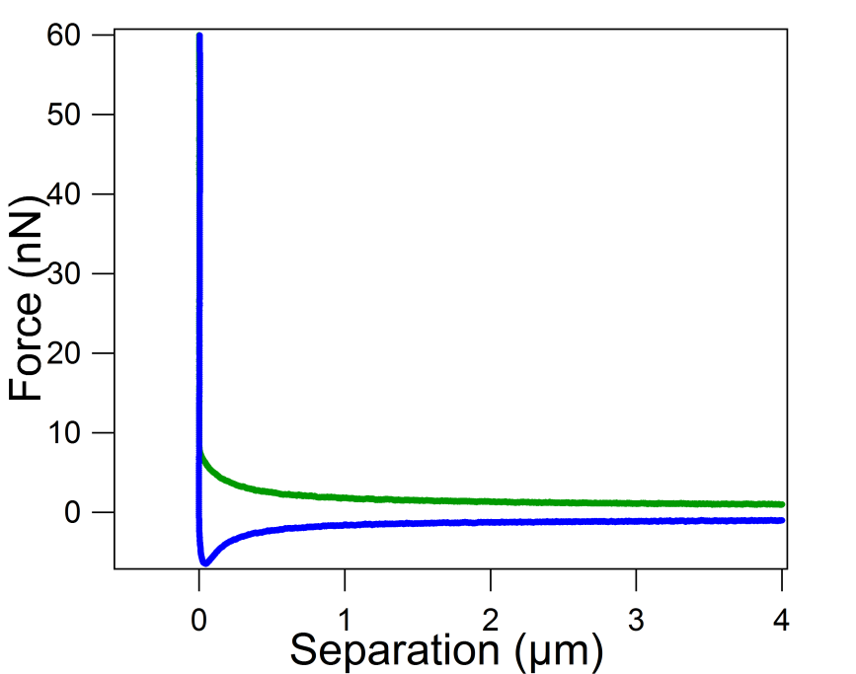
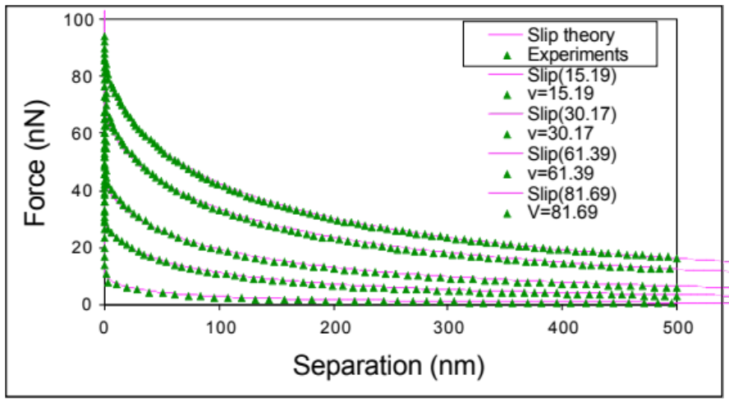
AFM colloid probe – hydrodynamic force measurements
approach
withdraw
increasing
rate
No Slip
Slip
F_{total}(t) = k x
= F_{h}(t)+ F_{d}(t)+ F_{v}(t)

Slide 26
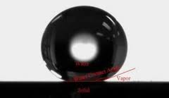
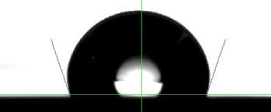
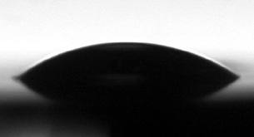
Effect of wettability on slip on solid surfaces
θ > 150°
Super-hydrophobic surface (θ > 150°)
Slip length b ~ the order of micrometers
Solvophobic surface (θ > 90°)
Slip length ~ 20 - 100 nm
θ > 90°
Solvophilic surface (θ < 90°)
Slip length ~ 0 - 10 nm
θ < 90°
Zhu, Attard, Neto; Langmuir 2011, 27, 6701-6711;
Langmuir 2011, 27, 6712-6719; Langmuir 2012, 28, 3465-3473;
Langmuir 2012, 28, 7768-7774

Slide 27
Flat surfaces can also trap lubricant
Flat self-assembled monolayers have been shown to trap lubricant and prevent thrombosis.¹
Liam Scarratt
Lubricant
Blood
Plastic
Rough self-assembled monolayer
Ɵ
Roll off angle Ɵ
We have used SAMs of octadecyl tricholoro silane (OTS) to trap the lubricant.
1. Leslie, Waterhouse et al Nat Biotech 2014, 32, (11), 1134-1140.

Slide 28
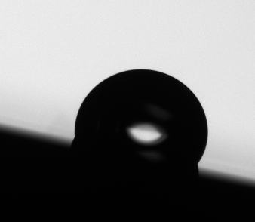
Effect of lubricant thickness on sliding angle
Roll-off angle of 10 µl water droplets is often used to define how ‘slippery’ a surface is.
Roll off angle
Silicon oil layer
silicon
OTS SAM
As measured by ellipsometry
Notes:
Include some text.

Slide 29



Silicone oil film dewets under water
Disjoining pressure
- van der Waals
Silicone oil film is stable is air
h
$$P_{d}\left(h\right)=−\frac{A_{132}}{6πh^{3}}$$
Submerge in Water/Sucrose
$h_{eq}$?
Silicone oil film
dewets under water
$A_{132}$ = Hamaker constant
Initial film thickness = 300 nm
Initial film thickness = 150 nm

Slide 30

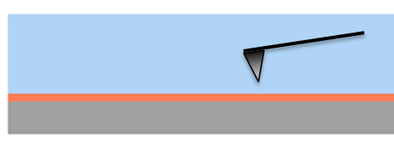

AFM meniscus forces on silicon oil film
Approach
Withdraw
≈ 3 N/m spring constant
Clean OTS in Air
30 nm Oil OTS in Air
Clean OTS in Sucrose 60%
Oil OTS in Sucrose 60%

Slide 31

Drag reduction by 4 nm thin silicone oil film
Sucrose 60 %
η = 40 mPa.s
0.18 – 0.9 N/m spring constant
b
@ 40 µm/s
b
On dry OTS surface (not infused)
On infused OTS surface
No slip boundary
No slip boundary
Slip boundary
Slip boundary
○○○
Experimental
○○○
Experimental
Force (nN)
b = 24 nm
b = 29 nm
Separation (nm)

Slide 32
Conclusions
The function of SLIPS is strongly dependent on film thickness.
The use of lubricant in wrinkled SLIPS is highly efficient.
Anti-fouling behaviour is retained overall, even if some regions are exposed, down to nanoscale films.
Sliding angles are not necessarily able to predict the local depletion.
AFM can be used to quantify regions of depletion.

Slide 33
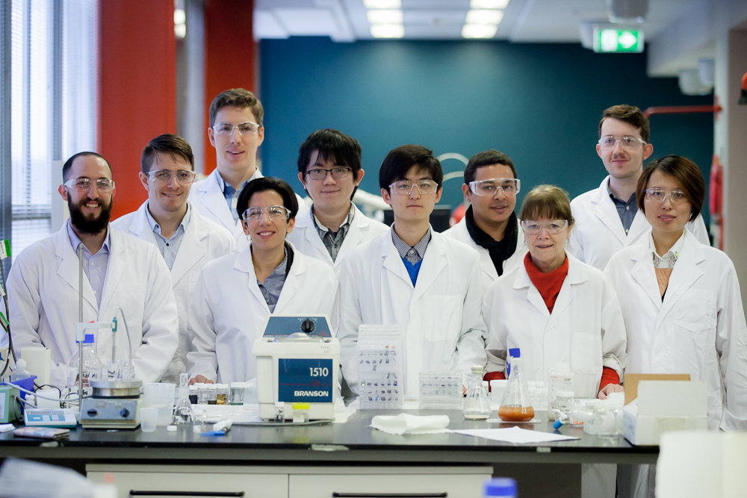

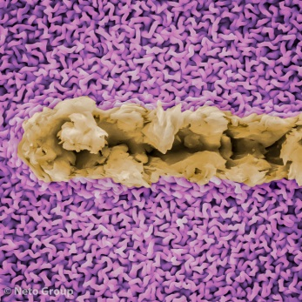




Acknowledgements
Liam Scarratt
Cameron Ware
Sam Peppou-Chapman
Ahmed Owais
Dr Liwen Zhu
A/Prof Truis Smith-Palmer, St. Francis Xavier University
@netogroup
@ChiaraOz
The Neto group, June 2017
FUNDING

Slide 34

acis2019.info
Abstract deadline: September 3rd, 2018

Slide 35



Interface potential of a thin liquid film
e
Silicon oil
Teflon/P4VP
PS
Lubricant
thin films
d
100 µm
Metastable film dewetting
$$Φ(e)=\frac{c}{e^{8}}−\frac{A_{234}}{12πe^{2}}+\frac{\left.{\left(A\right.}_{234}−A_{132}\right)}{12π{\left(e+d\right)}^{2}}$$
c strength of the short-range interaction
Van der Waals term < 0 for Teflon
Van der Waals term > 0 for P4VP
h*
Seemann, et al.; J. Phys.: Condens. Matter 17, S267-S290 (2005).

Slide 36




Qualitative validation of the method
Light Tapping
Hard Tapping
Tapping mode AFM
Reconstructed from force curves
TM AFM and force curves provide qualitatively similar information.

Slide 37

Fitting force curves to obtain slip length
System: dioctyl phthalate between a hydrophobised silicon substrate (contact angle ≈ 45°) and a silica colloid probe (contact angle ≈ 21°)
Fitted slip length b = 60 nm
Hundreds of force curves performed in different positions on each substrate at 10 - 80 μm/s approach rates.
Experimental force
No- Slip theoretical force
Slip theoretical force
Zhu, Attard, Neto; Langmuir 2011, 27, 6712-6719

Slide 38
Slip measurements
Over the past 15 years there has been a lot of evidence for slip.
Colloid probe AFM remains one of the best techniques to measure slip.^{1,2,3,4}
Reproducible average slip length 11 nm in wettable systems (21º)⁴ and 45 nm in partially wettable systems (45º)²
1.Zhu, Attard, Neto; Langmuir 2011, 27, 6701-6711
2. Zhu, Attard, Neto; Langmuir 2011, 27, 6712-6719
3. Zhu, Attard, Neto; Langmuir 2012, 28, 3465-3473
4. Zhu, Attard, Neto; Langmuir 2012, 28, 7768-7774

Slide 39



Effective slip - grafted polymer brushes
Dr Eric Charrault
Dynamic force curves captured at 40 um/s and in viscous sucrose solution
no-slip
slip
b=26 nm
± 3 nm
Charrault, Lee, Neto, Soft Matter 12, 1906-1914 (2016).

Slide 40


Interpreting ‘Slip’ on Polymer Brushes
Short chain PEG1k
b = 16 ± 4 nm
L ≈ 3 nm
r_{max} ≈ 10 nm
400 nm
Slip of similar magnitude to the roughness: flow within the surface features
Long chain PEG30k
b = 25 ± 3 nm
L ≈ 50 nm
Penetration length
Stagnation length
Charrault, Lee, Neto, Soft Matter 12, 1906-1914 (2016).

Slide 41



Our Approach
Fit algorithm & drag component
Best practice experimental protocol
Zhu, Attard, Neto; Langmuir 2011, 27, 6701-6711
Zhu, Attard, Neto; Langmuir 2011, 27, 6712-6719
OLD
NEW
Elimination of the virtual deflection
Care to recognise nanoparticles
Repeated measurements
  A “blind test” reveals error of 2 nm in b and 3 % in k; non-constant drag force on cantilever
Shear-rate dependence
Symmetric and asymmetric systems
Zhu, Attard, Neto; Langmuir 2012, 28, 3465-3473
Zhu, Attard, Neto; Langmuir 2012, 28, 7768-7774

Slide 42
Quantification of intermolecular interactions
Capillary forces enhance surface efficiency
System | Hamaker constant (× 10⁻²⁰ j) | Force type | Stability of the sandwiched layer
Hexadecane/water/P4VP | 1.21 | Attraction | Metastable
Hexadecane/water/Au | -3.23 | Repulsion | Stable
WCA on gold is 73º ± 1
No need to have a superhydrophilic coating to achieve underwater superoleophobicity

Slide 43


Soft Interfaces: Polymer Brushes
Dr Eric Charrault
cloud
point
Polymer chains tethered at one end - densely
‘Grafting-to’ keeps the synthesis simple
No salt high salt conc.
lower temp higher temp
Poly(ethylene)glycol (PEG):
M_{w} = 1000 g/mol
M_{w} = 30000 g/mol,
Cloud Point (CP) conditions:
Increase T°C and ionic strength
65ºC, [K₂SO₄] = 2.9 M for PEG1k
40ºC, [K₂SO₄] = 1.8 M for PEG30k
Grafted onto gold substrates through thiols
(gold not entirely smooth)
Charrault, Lee, Neto, Soft Matter 12, 1906-1914 (2016).

