Slide 1
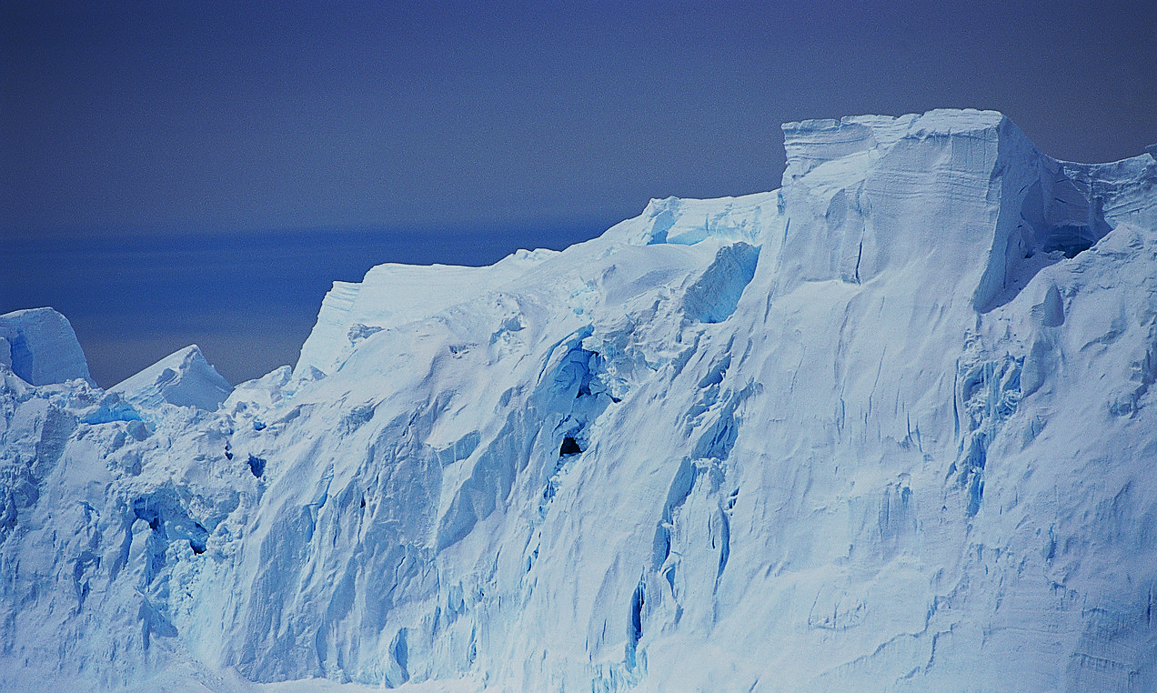
Entropy-Driven Spontaneous Dissociation of Weak Acids in Ice
VASSCAA-9 (Sydney, 2018. 08. 13-16)
Youngwook Park, Sunghwan Shin, Heon Kang*
Department of Chemistry, Seoul National University, South Korea
Notes:
Today I am going to say that certain reactions (such dissociation of weak acids) occur more efficiently in ice than in liquid water.

Slide 2
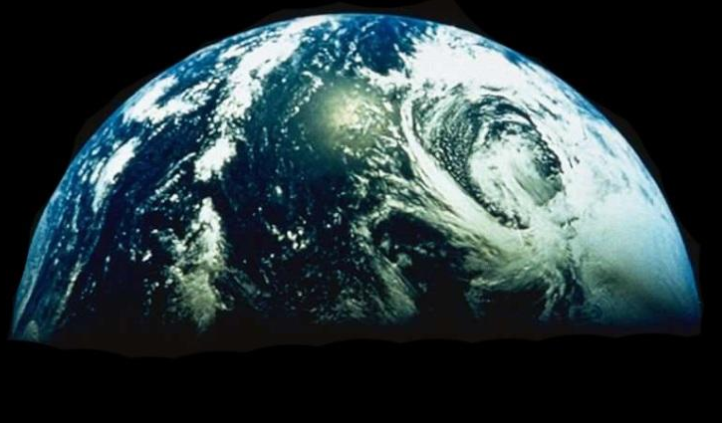
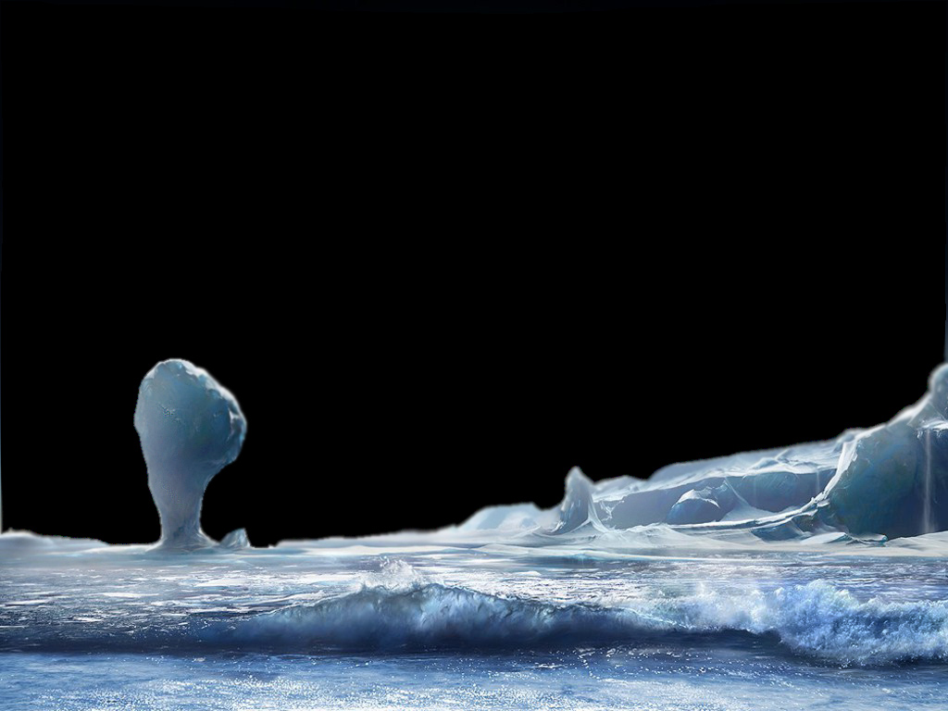

In the whole universe …
A very strange planet !
Chemistry in liquid water ??
Notes:
Let me start with brief introduction about why we study ice?
Ice is everywhere (ubiquitous).
If we move our viewpoint further into the space. In the universe as a whole, the most abundant form of water is solid ice.
Therefore, if an alien would find the Earth, he would naturally think it is a very strange planet, full of liquid water, instead of ice. In fact, it is very difficult to find a planet that has liquid water like Earth in the universe.
So, in the whole universe, chemistry of ice should be a lot more important than chemistry of liquid water.
Indeed, many scientists believe that ice has played an important role to generate various molecules in outer space, such as interstellar medium.
(I hope that this introduction has helped you to move your standpoint a bit from a liquid water side to solid ice.)
(Key message) Nevertheless, little is known about the chemistry of ice, compared with the vast amount of knowledge about aqueous solution chemistry accumulated from studies in the last two centuries.
……
The chemical processes in ice have been studied in the fields of environmental science, geochemistry, and astrochemistry. In these previous works, empirical observation was more important than seeking for fundamental understanding of the observed chemical phenomena. The chemical processes in ice have never been studied as rigorously as solution chemistry.

Slide 3
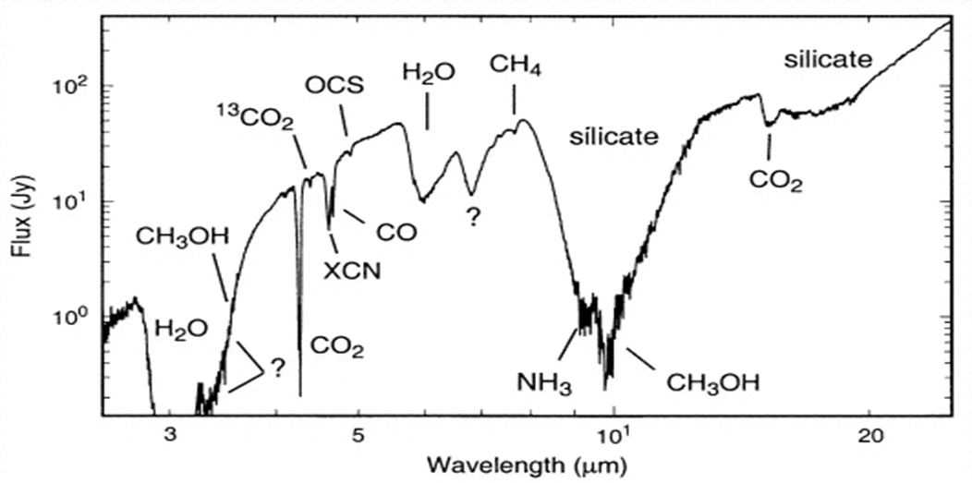
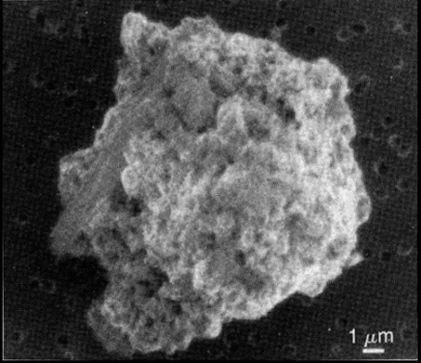
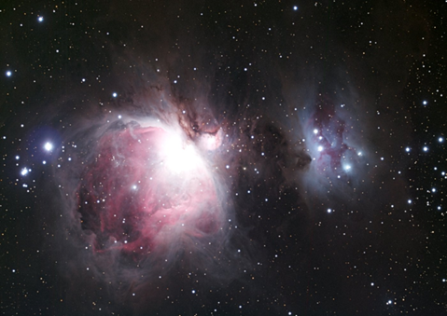
Observation of Molecules in Interstellar Medium
Infrared spectrum of the dust around the embedded protostar W33A (Gibb et al., Astrophys. J., 2000).
Notes:
IR spectrum of interstellar dust cloud regions, called protostar W33A.
Many types of molecules are observed in space. Infrared telescope observations.
Similar spectra have been obtained from many other dust clouds and protostar regions.
These molecules are believed to form on ice particles in interstellar medium, shown in the figure, , and stored and carried in the ice particles in space.
Chemistry in outer space is mostly ice chemistry.

Slide 4
Can Reactions Occur in Cold Ice?
Reaction energy barrier
Molecule diffusion in solid
Rate of thermal reaction at low temperature
k(T) = A e^{−Ea/RT}
Eg.) For reactions with a typical barrier height (E_{a}) ~ 20 kJ mol⁻¹,
k(T)
~ 10⁻⁷ at T~100 K (ice inside a vacuum chamber)
k(300 K)
~ 10⁻⁴⁹ at T~20 K (ice in interstellar cloud)
Notes:
Now, come back to a subject of fundamental chemistry of ice.
Can Reactions Occur in Cold Ice?
Two aspects to consider the occurrence of reactions in the condensed phase.
Reaction energy barrier
Molecule diffusion in solid
(When a reaction occurs on an ice surface, it occurs very slowly and its speed can be substantially varied by controlling the temperature of the ice. This gives us the opportunity to observe the progress of the reaction in real time, and sometimes, to even halt the reaction at an intermediate stage and identify the intermediate species using spectroscopic methods.)

Slide 5
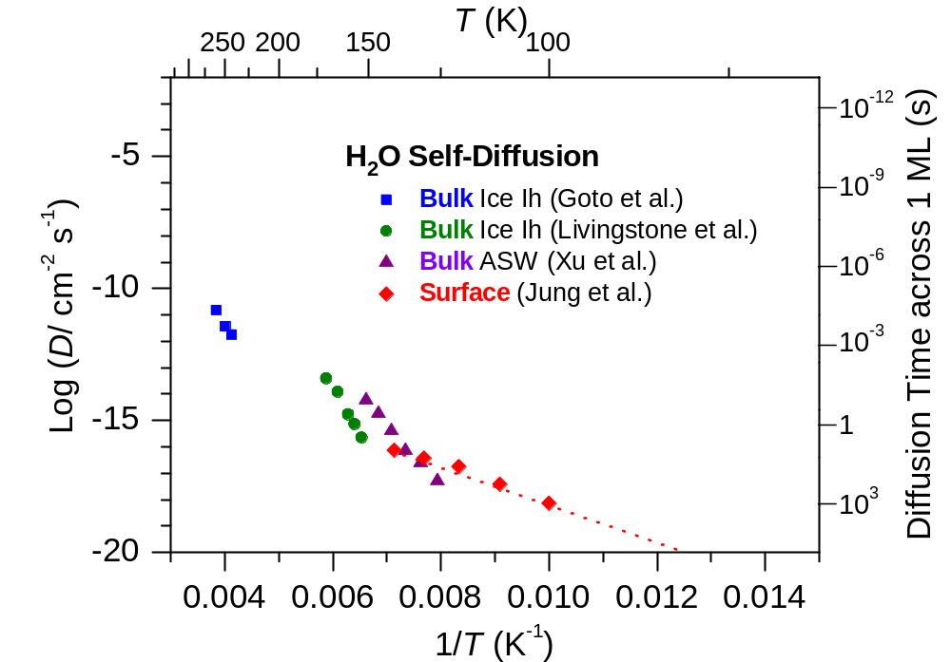
Self-Diffusion Rate of Ice
Stratosphere
Hot cores
Interstellar clouds
D(T) = D_{o}e^{−Ed/RT}
K. Goto et al., Jpn. J. Appl. Phys. 1985, 25, 351-357. F. E. Livingstone et al., J. Phys. Chem. B 1997, 101, 6127-6131.
Y. Xu et al., PNAS, 2016, 113, 14921. K.-H. Jung et al., J. Chem. Phys. 2004, 121, 2758.
Notes:
Kinetic aspect.
……
It seems impossible that chemical reactions occur at very low temperature.
Nevertheless, I am going to show some results that reactions do occur in ice at cryogenic temperature.
Refs.)
Itay Presiado, Jyotsana Lal, Eugene Mamontov, Alexander I. Kolesnikov, and Dan Huppert, Fast Proton Hopping Detection in Ice Ih by Quasi-Elastic Neutron Scattering. J. Phys. Chem. C 2011, 115, 10245–10251.
K. Goto, T. Hondoh, A. Higashi, Determination of diffusion coefficients of self-interstitials in ice with a new method of observing climb of dislocations by x-ray topography. Jpn. J. Appl. Phys. 1985, 25, 351-357.
F. E. Livingston, G. C. Whipple, and S. M. George, Diffusion of HDO into Single-Crystal H₂¹⁶O Ice multilayers: Comparison with H₂¹⁸O. J. Phys. Chem. B 1997, 101, 6127-6131.
Yuntao Xu, Nikolay G. Petrik, R. Scott Smith, Bruce D. Kay, and Greg A. Kimmel, Growth rate of crystalline ice and the diffusivity of supercooled water from 126 to 262 K. PNAS, 2016, 113, 14921.
K.-H. Jung, S.-C. Park, J.-H. Kim, H. Kang, Vertical diffusion of water molecules near the surface of ice. J. Chem. Phys. 2004, 121, 2758.

Slide 6
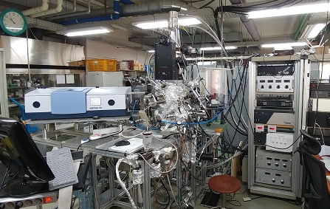
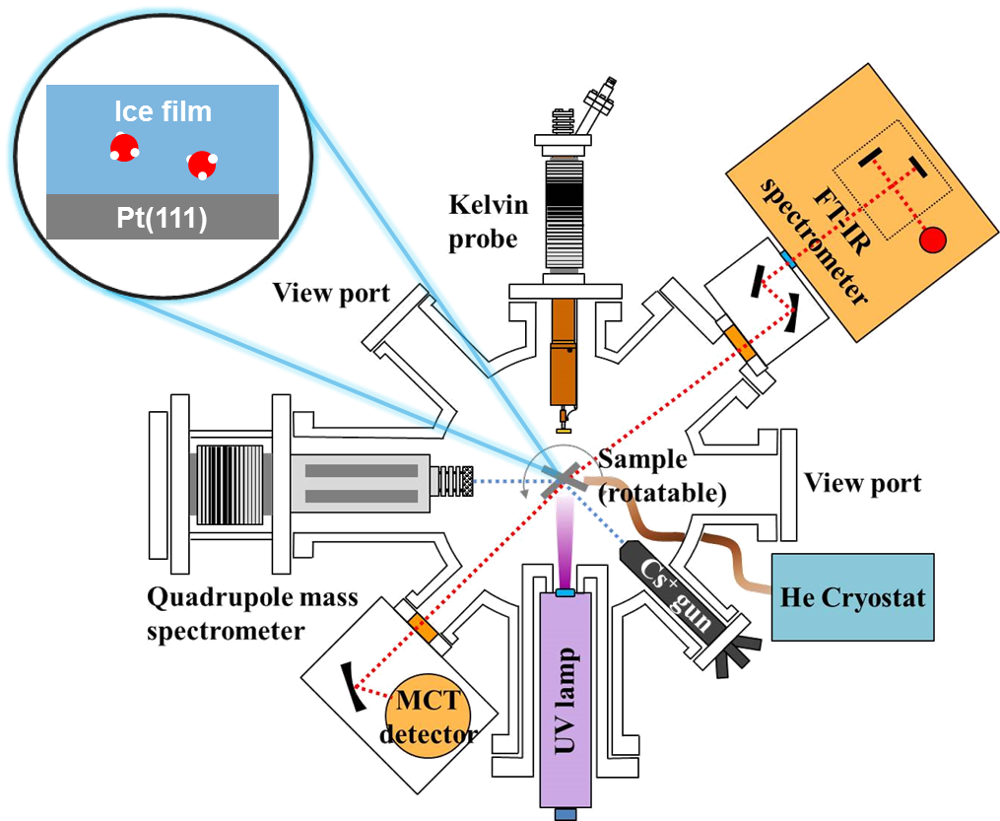
Experimental Apparatus
  Spectroscopic tools
Reactive ion scattering (RIS) and low energy sputtering (LES)
Reflection absorption IR spectroscopy (RAIRS)
Kelvin work function probe
Temperature-programmed desorption (TPD)
Notes:
The spectroscopic methods used to study the chemical processes of ice must have the following characteristics. They must have molecular detection ability, and they must be nondestructive.
Ice reactions often produce metastable products trapped in ice or adsorbed on the surface. These species can easily be damaged by high energy radiations. So, the spectroscopic methods based on high energy radiations (X-ray, electrons, ions, etc.) cannot used.
There are only a few suitable methods among the currently available techniques. They include infrared spectroscopy, and Kelvin work-function probe.

Slide 7
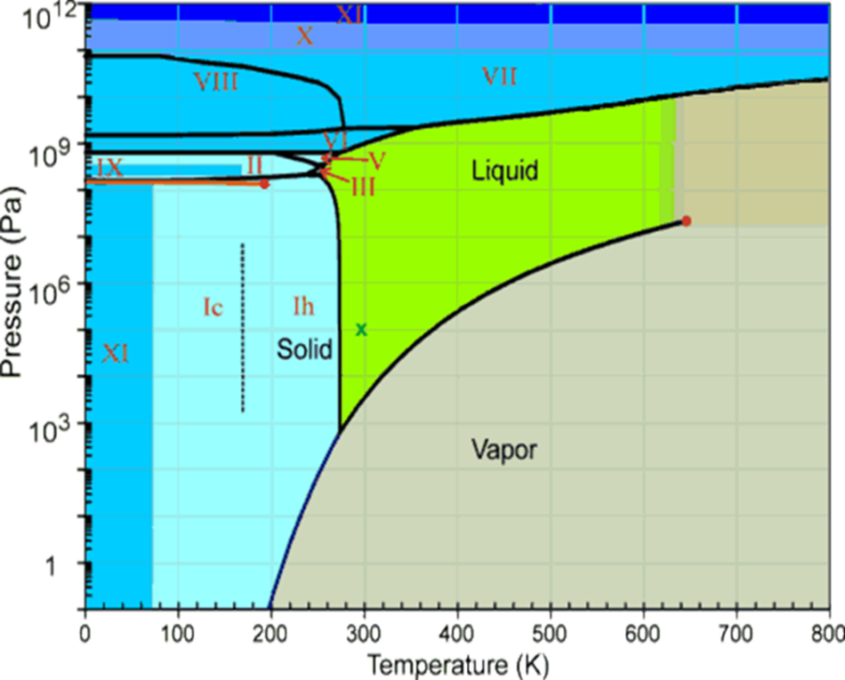
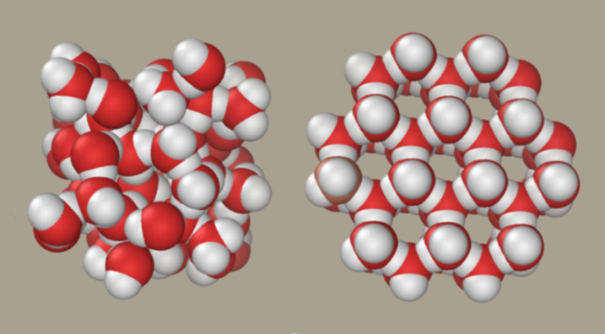
Water, Ice, and Amorphous Solid Water
Crystalline Ice (‘ordinary’ ice Ih) – “Ice Rule”
Tetrahedral network (O atom in each water molecule forms two H-bonds).
Only one H atom between each pair of O atoms.
All configurations are equally probable.
Amorphous Solid Water (ASW)
A solid form of water without long-range order in O arrangement.
Produced by vapor deposition onto a very cold substrate.
Notes:
Brief introduction about various forms of condensed water.
Amorphous solid water (ASW) is a metastable glassy phase form of water that can be created in the laboratory by vapor deposition onto a cold substrate (T<130 K).
The properties of ASW are of interest: its use as a model for liquid and supercooled liquid water [1–5], its use as a model for studying the properties of amorphous solids, and because it is believed to be the predominant form of water in astrophysical and planetary environments
In the experimental aspect, the techniques available for growing thin films in ultrahigh vacuum (UHV) can be used to control the sample composition and structure at the molecular scale, which is clear advantage over the experiment with liquid samples.
Here, I will often use “ice” as a generic name for all forms of solid water, without specific structural distinctions made here.

Slide 8
Thermodynamic Data for Dissociation of Carboxylic Acids in Aqueous Solution
Acid | pK_{aq}⁰ | ΔG⁰ kJ/mol | ΔH⁰ kJ/mol | ΔS⁰ J/mol K
Acetic acid (AA) | 4.76 | 27.2 | −0.41 | −92
Formic acid (FA) | 3.75 | 21.4 | 0 | −72
Monofluoro-AA | 2.82 | 16.1
Dichloro-AA | 1.35 | 7.8 | −0.42 | −25
Difluoro-AA | 1.34 | 7.7
Trifluoro-AA | 0.50 | 2.9 | +1.7 | −4.2
(pK_{aq} = −log₁₀K_{aq})
Ross Stewart, “The Proton: Applications to Organic Chemistry”, Academic Press (1985).
Notes:
We used AA and its fluoro and chloro-substituted acids to study acid dissociation in ASW.

Slide 9
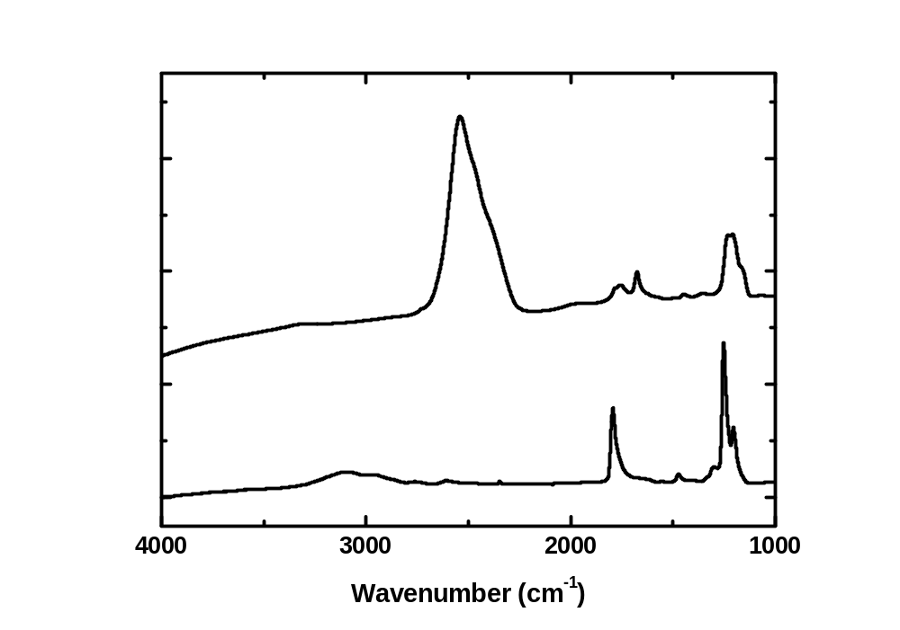
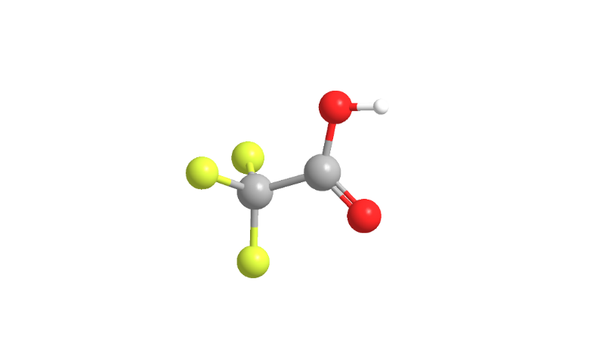
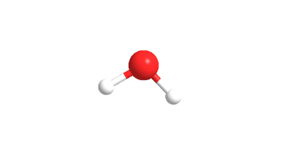
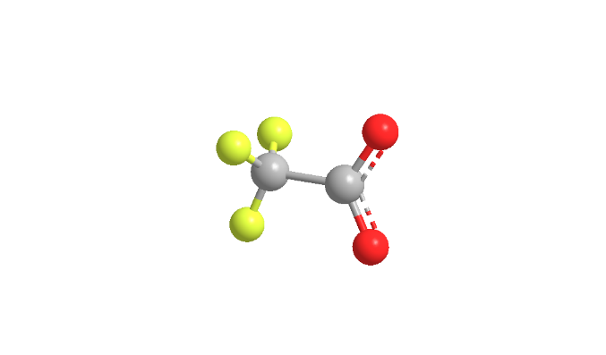
Ionic Dissociation of Trifluoroacetic Acid in ASW
RAIR spectrum
TFA(4%)-D₂O mixture, T = 60 K
Pure TFA film
TFA in D₂O film
ν(OD) of D₂O
ν(C=O) of carboxylate ion
no
ν(OH) of TFA
ν(C=O)
ν(C=O) of TFA
ν(OH)
ν(OH) of TFA
TFA film
Pt(111)
CF₃COOH + D₂O → CF₃COO⁻ + HD₂O⁺ (or D₃O⁺)
Complete dissociation (α > 0.9) of TFA in ASW.
Observed for different (1−10 M) acid concentrations.
Notes:
I am going to show an example of trifluoro-acetic acid (TFA) in ASW
The samples were prepared in a sandwich structure, in which the acid−D2O mixture layer (80 ML) was trapped between two pure D2O layers (30 ML) at the bottom and top.
Result: ν(O-H) and ν(C=O) bands of TFA disappeared.
We estimated the dissociation yield (α) of acid from the change of ν(O–H) intensity of acid at ~3050 cm⁻¹. This band does not exist for carboxylate anion. The absence of the ν(O–H) intensity in spectra (a)–(c) straightforwardly indicated almost complete dissociation (α>0.9) of the acids.
The lower limit of α was determined solely by the background noise level of the spectrum.

Slide 10
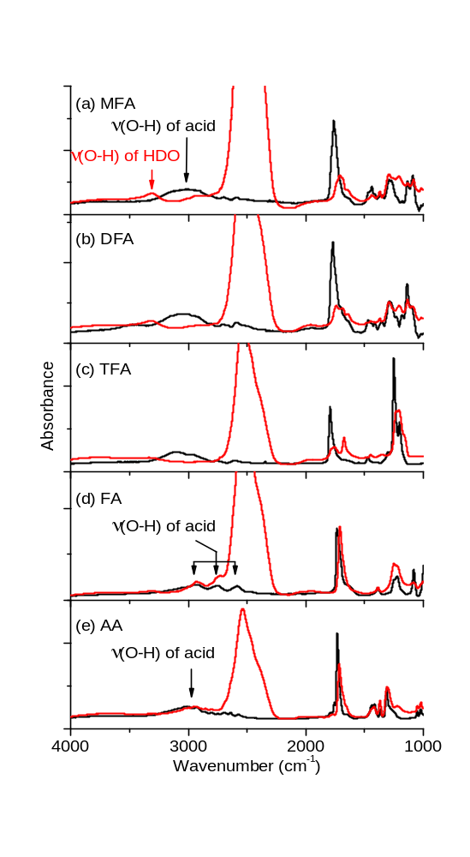
Various Weak Acids
T = 70- 80 K
─ pure acids
─ acids (4-6%) in D₂O-ASW
monofluoroacetic acid: dissociation (α > 0.9)
in ASW
difluoroacetic acid: dissociation
trifluoroacetic acid: dissociation
formic acid: no dissociation (α < 0.1)
acetic acid: no dissociation
Notes:
Carboxylic acid series에서 OH peak이 갈라져 나오는 이유:
정확한 이유는 모르겠지만, 이전 연구들에서 제시된 가능성으로 위 두 가지 정도 찾아볼 수 있었습니다. 정리하면,
가능성 1) FA dimer (or larger cluster) 에 의한 feature이다. 그래서 FA-water mixture에서도 FA dimer가 많이 있어서 분명한 feature가 나온다.
가능성 2) low freq mode들의 combination band이다.

Slide 11
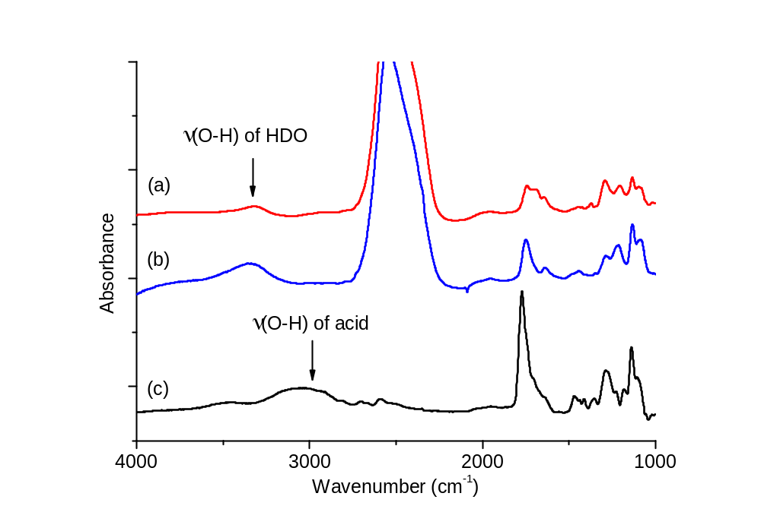
Different Temperatures: DFA at 8 and 70 K
T = 70 K
DFA(6%)-D₂O mixture
T = 8 K
DFA(10%)-D₂O mixture
pure DFA
Full dissociation of MFA, DFA, and TFA observed at T = 8–140 K.
Acid dissociation is unaffected by the temperature of ASW.

Slide 12
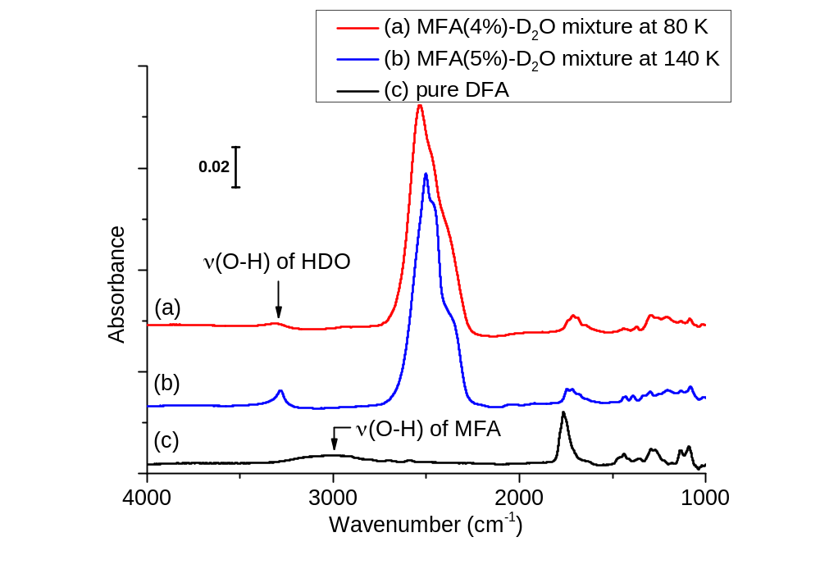
Temperature Effect: MFA in ASW at 80 and 140 K
Dissociation of acids was unaffected by temperature changes between 8 – 140 K (full dissociation of MFA, DFA, and TFA).

Slide 13
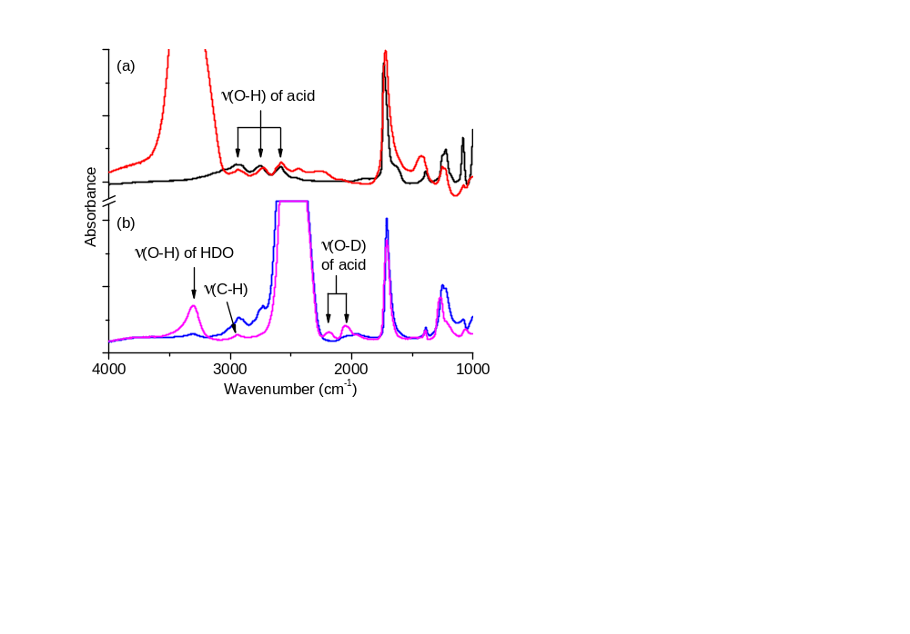
Formic Acid: H/D Exchange without Dissociation
▬▬ Pure FA at 80 K
▬▬ FA(6%)–H₂O mixture (prepared at 80 K and heated at 140 K)
No dissociation of FA in ASW
(no change for ν(O–H) peaks of molecular FA)
▬▬ FA(6%)–D₂O mixture prepared at 80 K
▬▬ FA(6%)–D₂O mixture heated at 140 K (prepared at 80 K)
HCOOD formation at 140 K
(acid ν(O–D) peaks appeared.)
HCOOH + D₂O ↔ HCOOD + HDO (proton transfer equilibrium w/o acid dissociation)
Notes:
Proton transfer equilibrium with ice, just like weak acid equilibrium in aqueous solution.
As long as P-T is concerned, FA is in quasi-equilibrium with ice.

Slide 14
Summary of Observations
Acid | Dissociation in ASW? | Aqueous solution parameters*
 |  | pK_{aq}⁰ | ΔG⁰ kJ/mol | ΔH⁰ kJ/mol | ΔS⁰ J/mol K
Acetic acid (AA) | No | 4.76 | 27.2 | −0.41 | −92
Formic acid (FA) | No (α < 0.1, but (PT equilibrium) | 3.75 | 21.4 | 0 | −72
Monofluoro-AA | Yes (α > 0.9) | 2.82 (α ≈ 0.03) | 16.1
Dichloro-AA | Yes | 1.35 | 7.8 | −0.42 | −25
Difluoro-AA | Yes | 1.34 | 7.7
Trifluoro-AA | Yes | 0.50 | 2.9 | +1.7 | −4.2
Y. Park, S. Shin, and H. Kang, J. Phys. Chem. Lett. (2018)
Notes:
Dissociation of weak acids in ice – a surprising result !!
But, we could not explain why it is so, for a while.
One day, it came to my mind, well, I might explain it.
I would like to share this idea with you today and discuss it. (I am going to tell you the story.)

Slide 15
What Makes Acids Dissociate in Cryogenic Ice?
Energy factor
Dielectric screening of charged ions: ε_{r}~2 for ASW vs ε_{r}~80 for liquid water
ΔH for acid dissociation (ion solvation energy) will be less exothermic in ASW.
Kinetic aspect
Water molecules are immobile at T < 100 K.
Excess protons are uniquely mobile species in ice (Grotthuss hopping mechanism).
Entropy
In liquid water, ΔSº < 0 for these acid dissociation reactions.
In ice, mobile protons can increase the configurational entropy of system: ΔS_{conf} = k lnW
Notes:
Why more acidic in ice? Molecules are all frozen in place in ice at low temperature.
This is an outstanding question.
Better solvation of dissociated ions in ice than in water? Unlikely!
We need to consider other reasons.
We think that it is related to high mobility of excess protons in ice. ……

Slide 16
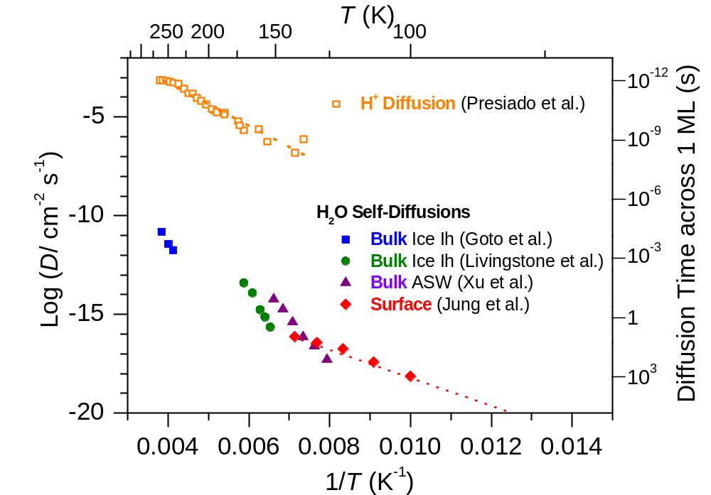
Diffusion Coefficients of H⁺ and H₂O in Ice
Stratosphere
Hot cores
Interstellar clouds
I. Presiado et al., J. Phys. Chem. C 2011, 115, 10245–10251. K. Goto et al., Jpn. J. Appl. Phys. 1985, 25, 351-357.F. E. Livingstone et al., J. Phys. Chem. B 1997, 101, 6127-6131. Y. Xu et al., PNAS, 2016, 113, 14921.
K.-H. Jung et al., J. Chem. Phys. 2004, 121, 2758.
Notes:
Itay Presiado, Jyotsana Lal, Eugene Mamontov, Alexander I. Kolesnikov, and Dan Huppert, J. Phys. Chem. C 2011, 115, 10245–10251.
K. Goto, T. Hondoh, A. Higashi, Jpn. J. Appl. Phys. 1985, 25, 351-357.
F. E. Livingston, G. C. Whipple, and S. M. George, J. Phys. Chem. B 1997, 101, 6127-6131.
Yuntao Xu, Nikolay G. Petrik, R. Scott Smith, Bruce D. Kay, and Greg A. Kimmel, PNAS, 2016, 113, 14921.
K.-H. Jung, S.-C. Park, J.-H. Kim, H. Kang, J. Chem. Phys. 2004, 121, 2758.
Itay Presiado, Jyotsana Lal, Eugene Mamontov, Alexander I. Kolesnikov, and Dan Huppert, Fast Proton Hopping Detection in Ice Ih by Quasi-Elastic Neutron Scattering. J. Phys. Chem. C 2011, 115, 10245–10251.
K. Goto, T. Hondoh, A. Higashi, Determination of diffusion coefficients of self-interstitials in ice with a new method of observing climb of dislocations by x-ray topography. Jpn. J. Appl. Phys. 1985, 25, 351-357.
F. E. Livingston, G. C. Whipple, and S. M. George, Diffusion of HDO into Single-Crystal H₂¹⁶O Ice multilayers: Comparison with H₂¹⁸O. J. Phys. Chem. B 1997, 101, 6127-6131.
Yuntao Xu, Nikolay G. Petrik, R. Scott Smith, Bruce D. Kay, and Greg A. Kimmel, Growth rate of crystalline ice and the diffusivity of supercooled water from 126 to 262 K. PNAS, 2016, 113, 14921.
K.-H. Jung, S.-C. Park, J.-H. Kim, H. Kang, Vertical diffusion of water molecules near the surface of ice. J. Chem. Phys. 2004, 121, 2758.
Itay Presiado, Jyotsana Lal, Eugene Mamontov, Alexander I. Kolesnikov, and Dan Huppert, Fast Proton Hopping Detection in Ice Ih by Quasi-Elastic Neutron Scattering. J. Phys. Chem. C 2011, 115, 10245–10251.

Slide 17
High Mobility of Excess Protons in Ice
Proton hopping (Grotthuss) mechanism in ice
Concerted proton hopping along the H-bonded network of ice (resonant tunneling, no significant change in the lattice structure).
Excess protons may be considered “dynamically delocalized” in ice.
(i)
H₃O⁺
molecular dipole
(ii)
H₃O⁺
M. Eigen, L. De Maeyer, Proceedings of the Royal Society of London. Series A. Mathematical and Physical Sciences 247, 505-533 (1958).
C. Kobayashi, S. J. Saito, I. Ohmine, J. Chem. Phys. 113, 9090-9100 (2000).
E. S. Moon, C. W. Lee, H. Kang, Phys. Chem. Chem. Phys. 10, 4814-4816 (2008).
Notes:
Explain:
Excess proton in ice lattice is not stabilized.
Proton hopping relay.
An excess proton is not trapped in localized sites in ice but “delocalized” in the ice network by fast movement, generating the so called “charge-delocalized hydronium state”.

Slide 18
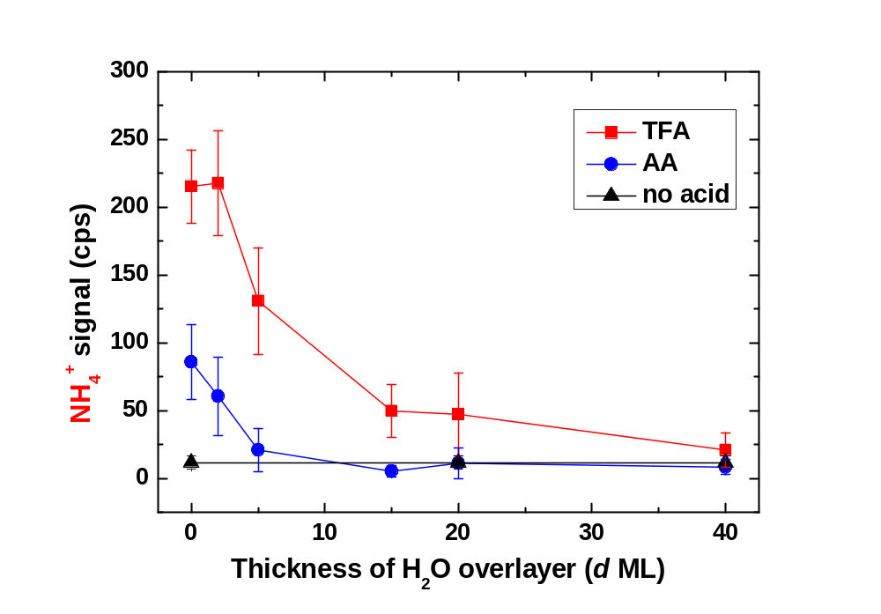

Proton Migration Distance in ASW
LES detection of proton migration to ice surface: H⁺ + NH₃ → NH₄⁺
NH₃
NH₃
NH₄⁺
NH₄⁺
x
H⁺
H⁺
H₂O-ASW film
(~70 K)
Pt(111)
Protons move through ASW overlayer (thickness ≤ 20 ML) to change NH₃ into NH₄⁺.
→ Proton commuting distance in ASW ≤ 20 ML at ~70 K.
S. Shin et al., J. Phys. Chem. C (2017)
Notes:
How far does an excess proton go in ASW?
So, we measured the proton migration distance……
Proton commuting distance in ASW ≤ 20 ML at ~70 K (range of rapid proton transfer without reorientation of water).

Slide 19
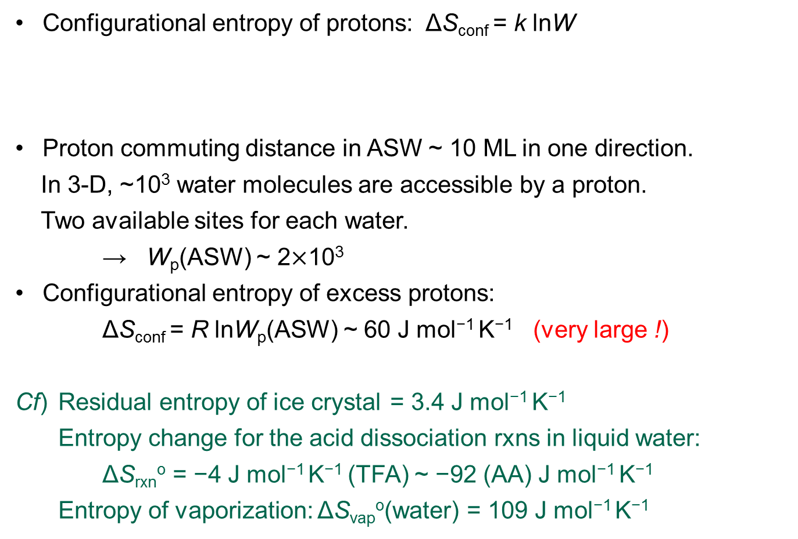
Configurational Entropy of Excess Proton
Configurational entropy of protons: ΔS_{conf} = k lnW
Proton commuting distance in ASW ~ 10 ML in one direction.
In 3-D, ~10³ water molecules are accessible by a proton.
Two available sites for each water.
→ W_{p}(ASW) ~ 2$×$10³
Configurational entropy of excess protons:
ΔS_{conf} = R lnW_{p}(ASW) ~ 60 J mol⁻¹ K⁻¹ (very large !)
Cf) Residual entropy of ice crystal = 3.4 J mol⁻¹ K⁻¹
Entropy change for the acid dissociation rxns in liquid water:
ΔS_{rxn}º = −4 J mol⁻¹ K⁻¹ (TFA) ~ −92 (AA) J mol⁻¹ K⁻¹
Entropy of vaporization: ΔS_{vap}º(water) = 109 J mol⁻¹ K⁻¹
H₃O⁺
Notes:
Now that we know that excess protons are very mobile and we know how far they can go in ASW,
we can estimate the magnitude of configurational entropy of protons in ASW.
……
Configurational entropy of excess protons is very large.
So, it can be a very effective thermodynamic driving force for ice reacions.

Slide 20
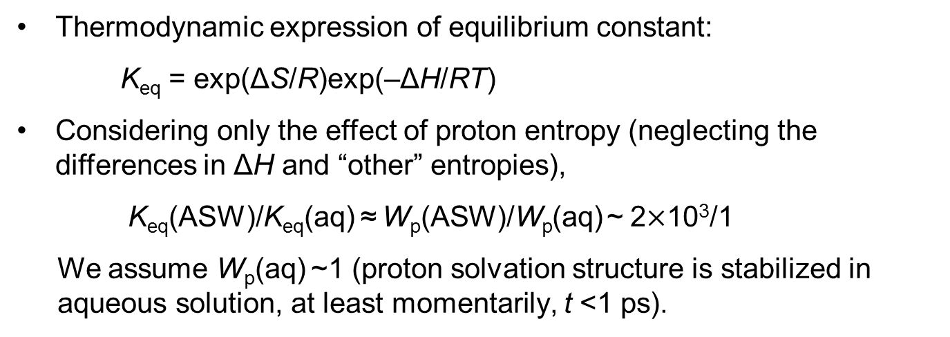
Proton Entropy and Acid Dissociation Constant
Thermodynamic expression of equilibrium constant:
K_{eq} = exp(ΔS/R)exp(–ΔH/RT)
Considering only the effect of proton entropy (neglecting the differences in ΔH and “other” entropies),
K_{eq}(ASW)/K_{eq}(aq) ≈ W_{p}(ASW)/W_{p}(aq) ~ 2$×$10³/1
We assume W_{p}(aq) ~1 (proton solvation structure is stabilized in aqueous solution, at least momentarily, t <1 ps).
Acid | pK_{aq}⁰ | Dissociation in ASW?
AA | 4.76 | No
FA | 3.75 | No
MFA | 2.82 | Yes
DCA | 1.35 | Yes
DFA | 1.34 | Yes
TFA | 0.50 | Yes
K_{eq}(ASW)/K_{eq}(aq) ~10³
↔ Agrees with experimental observation.
Configurational entropy of protons increases acid dissociation in ice !!
Notes:
The story is : ”Configurational entropy of protons enhances acid dissociation in ice.”
Contrary to general behavior that reactions are suppressed in ice at low temperature.

Slide 21
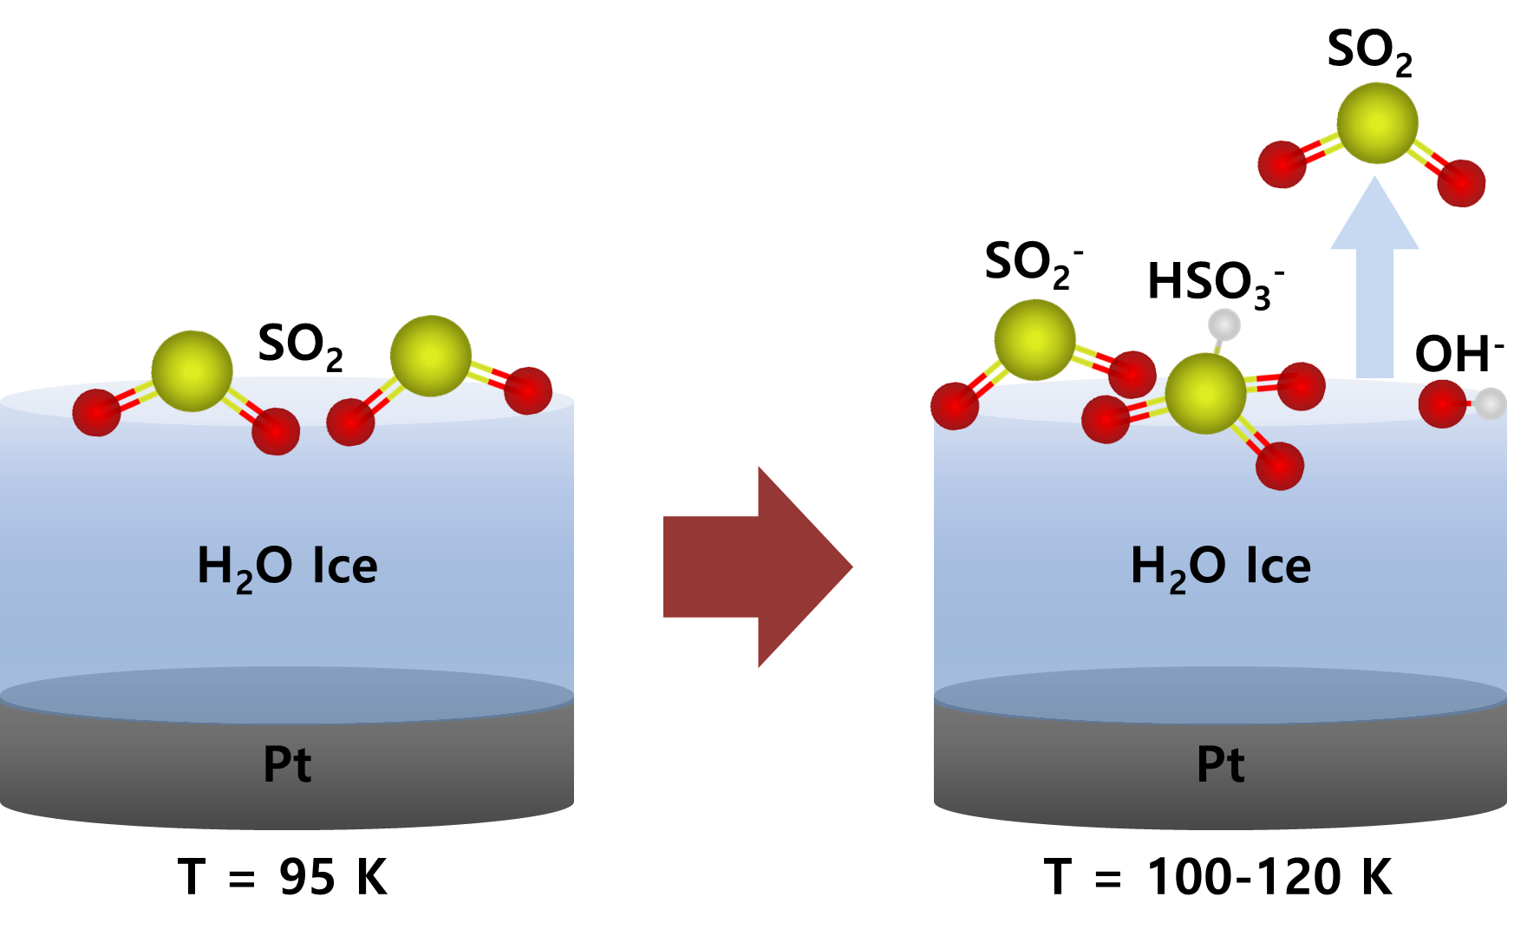
There are more examples
SO₂(ASW surface and interior) → HSO₃– + H₃O⁺ (T = 100–130 K) ^{[1]}
NO₂(ASW surface) → NO₃⁻(s) + H₃O⁺(s) (>100 K) ^{[2]}
→ HONO(s) → HONO(g) (>140 K)
HF(ASW surface and interior) → H₃O⁺ + F– (40–50 K) ^{[3]}
H⁺-promoted crystallization of ASW (137–150 K) ^{[4]}
All these spontaneous reactions seem to have a common feature of proton transfer in ice.
[1] Jagoda-Cwiklik et al., Phys. Chem. Chem. Phys. (2008); Loeffler et al., Geophys. Res. Lett. (2010); Bang et al., ACS Earth Space Chem. (2017).
[2] Kim et al., J. Phys. Chem. Lett. (2010); Bang et al., J. Phys. Chem. (2015);
[3] Ayotte et al., J. Chem. Phys. (2005); Ayotte et al., J. Chem. Phys. (2009).
[4] D. H. Lee et al., J. Phys. Chem. C, to be published.
Notes:
Over the years, several research groups have studied ice surface reactions and observed some spontaneous reactions. For example, …
These ice surface reactions are interesting and charming.
But we did not really try to understand why they can occur at such low temperatures.
These reactions have a substantial barrier, according to QM calculations.

Slide 22
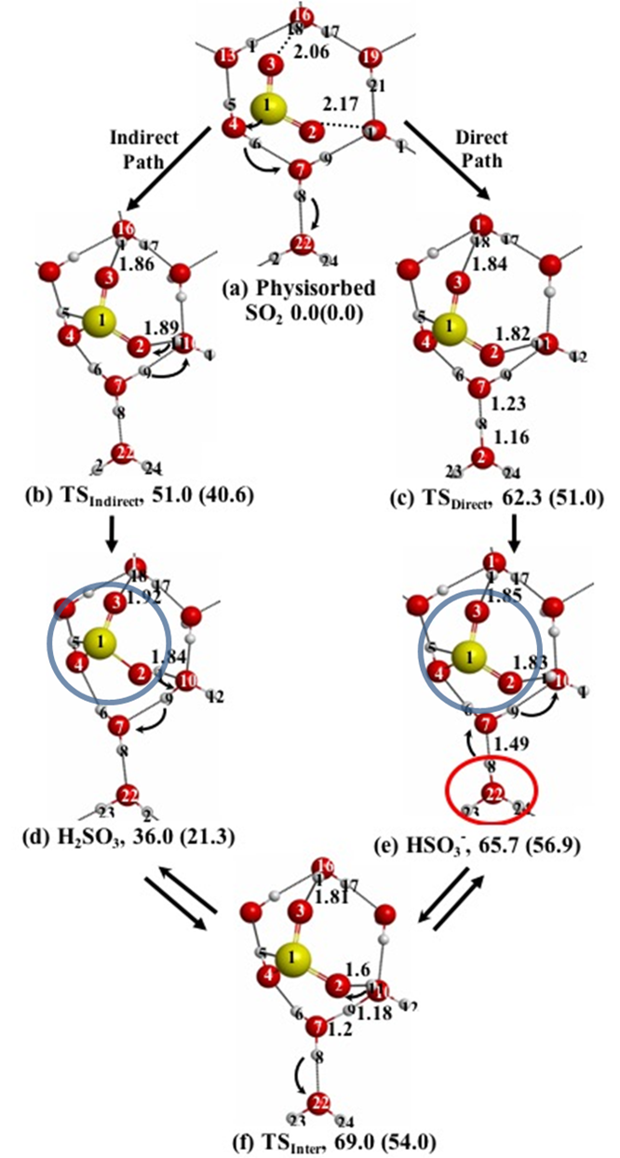
QM Study of Interaction of SO₂ with Ice Surface
Physisorbed SO₂
SO₂ + ice → H₂SO₃ → HSO₃– + H₃O⁺ (indirect path)
SO₂ + ice → HSO₃– + H₃O⁺ (direct path)
The reaction may be assisted by the entropy of excess protons (H₃O⁺) released into ice.
H₂SO₃
HSO₃–
Energy (kJ/mol) of each structure represents the MP2-calculated value relative to physisorbed SO₂.
(B3LYP-calculated values are in the parentheses.)
Binding energy of physisorbed SO₂ structure = 97.9 kJ/mol (MP2).
H₃O⁺
Bang et al., ACS Earth Space Chem. (2017)
Notes:
Let’s discuss the case of SO2 reaction on ice.
The reaction releases excess protons into ice.
The entropy of proton migration could be an extra driving force for the reaction.

Slide 23
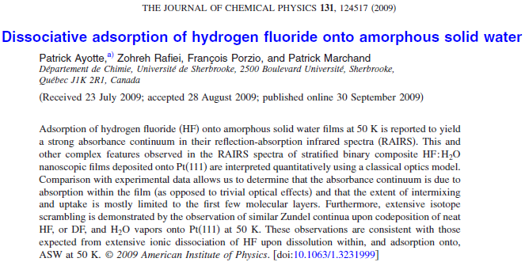
Weak acidity (pK_{a} = 3.2) of HF in aqueous solution is due to large negative entropy of F⁻ hydration.
Observation in ASW: increased dissociation of HF at 40-50 K.
“Thus, the entropic inhibition which renders HF aqueous solutions weak acids at STP appears to be suppressed at cryogenic temperatures.”
ΔS_{conf} of excess protons may reduce the amount of negative entropy change for dissociation of HF in ice, thereby making HF more acidic in ASW.
Notes:
In fact, we are not the first to observed spontaneous acid dissociation in ice. P. Ayotte observed that HF dissociates in ASW.
which was strange at that time.
In one of these conferences, he gave a presentation about the observation of ionization of HF in ice.
HF is a weak acid, but surprisingly it dissociates upon dissolution in ice or adsorption on the ice surface.
I am going to show that the increased acidity in ice is not unique to HF, but more general phenomena that can occur for other acids also.

Slide 24
Summary
Observation
Fluoro- and chloro-acetic acids dissociate spontaneously and more efficiently in cold (8-140 K) ice than in aqueous solution at room temperature.
The enhanced acid dissociation is a thermodynamic effect, rather than a kinetic effect (i.e., proton transfer equilibrium with ice).
Interpretation
ΔS_{conf} of excess protons shifts the acid dissociation equilibrium forward, while other atoms and molecules are frozen in position in the lattice.
This story may also apply to other proton-transfer reactions in ice (eg., hydrolysis of NO₂, SO₂, HF, etc.) and QLL/ice interface.
Implication
Spontaneous reactions, without external excitation, may also be important for the chemistry of ice in outer space.
Spontaneous reactions to spoil foods in the freezer?
Notes:
Spontaneous reactions, without external excitation, may occur in various cryogenic ice environments in nature (eg., outer planets of the solar system, interstellar dust clouds, etc.)
Well, this story may not be limited to chemistry in far out space only. It may also apply to your daily life also. For example, we may ask …
Spontaneous acid-base reactions inside a deep freezer?
The protonic entropy effect for cryogenic reactions is a new concept.
Any objections or counter arguments against this story are welcomed.

Slide 25
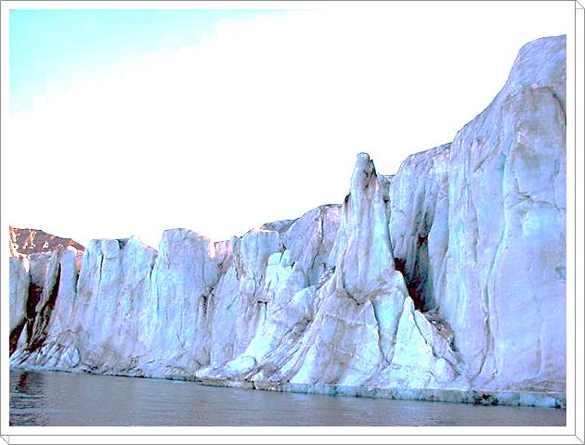
Acknowledgements
Students
Youngwook Park (PhD student)
Jaehyeock Bang (PhD student)
Hani Kang (PhD student)
Former students
Du Hyeong Lee (PhD, 2018)
Sunghwan Shin (PhD, 2017)
Youngsoon Kim (PhD, 2017)
Eui-Sung Moon (PhD)
Eunhee Park (MSc)
Sooyeon Lee (MSc)
Sun-Kyung Kim (MSc)
Young-Kwang Kim (MSc)
Jung-Hwan Kim (PhD)
Chang-Woo Lee (PhD)
Coworkers
Prof. Cheol Ho Choi (Kyungpook Nat. Univ.)
Prof. Sangyeob Lee (SNU)
Prof. Jin Yong Lee (Sungkyunkwan Univ.)
Prof. Tae Hoon Choi (Chungnam Nat. Univ.)
Prof. Bong June Sung (Sogang Univ.)
Prof. Jun Soo Kim (Ewha Womans Univ.)
Prof. Taek Dong Chung (SNU)
Funding:
Samsung Science and Technology Foundation

Slide 26
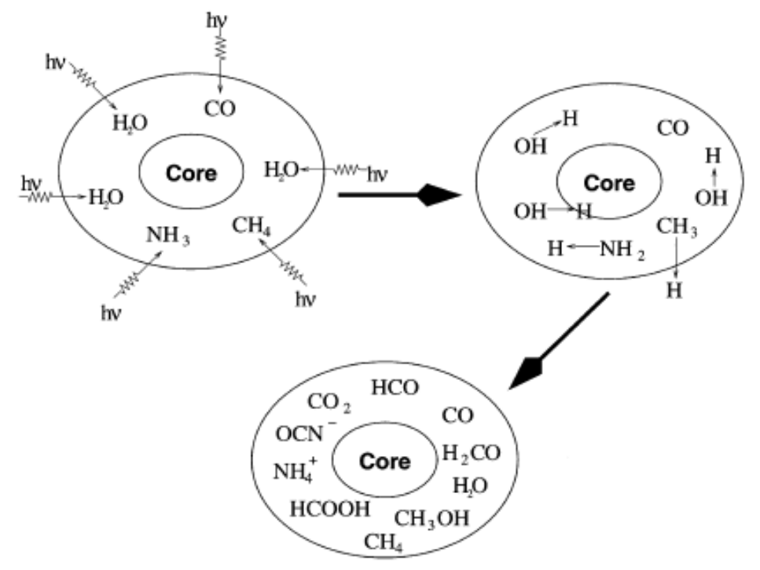
A Brief History of Interstellar Grain
Star formation
Comet
Small solid particles (<10 A) ejected from cooling stars
molecular cloud (accretion, reaction, photo-processing)
star formation portions of the cloud into surrounding
(diffuse cloud) regions
A single cycle ~ 10⁸ yr, average lifetime of a grain ~ 10⁹ yr
[J. M. Greenberg, Surface Sci. 500 (2002) 793]

Slide 27
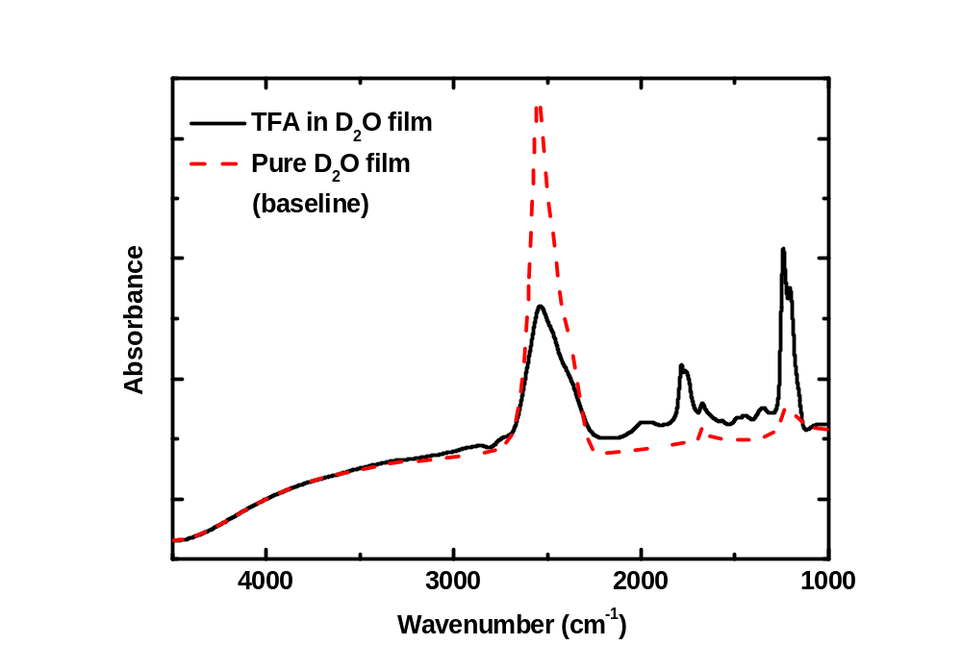
TFA in ASW: Zundel Continuum and v(O-D) of D₂O
TFA:D₂O molar ratio
= 1:5
Decrease of v(O-D) band intensity of D₂O
Spectral baseline (a pure D₂O film or a solid Xe film with the same optical thickness.
Zundel continuum absorption
A large decrease of v(O-D) band: ≥4 times larger than that expected for 1:1 stoichiometric reaction (H⁺ + D₂O → HD₂O⁺) → One excess proton is shared by many water molecules.
Appearance of a broad absorption (Zundel continuum) band at 1000−3000 cm⁻¹
Notes:
Some other features are also noticeable in the ionization of TFA in ice.
……
The spectral baseline was also checked with a solid Xe film, which did not show any molecular absorption band, and a pure D2O film with the same optical thickness.
I will talk more about Zundel continuum later.

Slide 28
Energy barrier for various transport processes in ice or on its surface
Process | Barrier (kJ mol^{–1}) | Onset temperature | Observation Method
H⁺ hopping in crystalline ice (Cf. H⁺ hopping in liq. water) | 0-8 ^{[1]} (~2) | (<< 80 K)^{[2]} | Theory (QM/MM),^{[1]} LES^{[2]} (QM/EFP-MD)^{[3]}
H atom diffusion on the surface of ASW | 2-5 | < 10 K | TPD,^{[4]} PSD^{[5]}
Bjerrum defect motion in ice | 51 ± 3 | ~135 K | FTIR^{[6]}
Water self-diffusion in ice | 71 ± 4 | ~150 K | LITD^{[7]}
^{[1]} Kobayashi et al., J. Chem. Phys., 113, 9090 (2000).
^{[2]} Moon et al., Phys. Rev. Lett., 108, 226103 (2012).
^{[3]} Uddin et al., J. Phys. Chem. B, 118, 13671 (2014).
^{[4]} Perets et al., Astrophys. J., 627, 850 (2005).
^{[5]} Hama et al., Astrophys. J., 757, 185 (2012).
^{[6]} P. J. Wooldridge et al., J. Chem. Phys., 88, 3086 (1988).
^{[7]} F. E. Livingston et al., J. Phys. Chem. B, 101, 6127 (1997).
Notes:
Barrier for H⁺ hopping in crystalline ice is very low.
Barrier ~ 0 for resonant proton transfer between adjacent water molecules in an ice crystal.
Barrier < 8 kJ mol^{–1} if the Coulombic interactions with the second and larger solvation shells are included.
Here I am talking about proton hopping only, without water reorientation.
(Without the trace effect, the potential energies of all the proton locations must be same. As the excess proton yields the different potential due to its trace, it may be said that the excess proton feels an effect from ‘‘its past movement.’’)
Probably, only other species that have mobility comparable to H+ is H atom.
Other motions, …, require overcoming much higher barriers and difficult to occur at low temperature.

Slide 29
Transport Mechanisms of H₃O⁺ and OH⁻ in ASW
H₃O⁺ : proton hopping relay (“hop-and-turn”)
H₃O⁺
H₃O⁺
H₃O⁺
Jaccard, Helv. Phys. Acta. (1959); Collier et al., J. Phys. Chem. (1984)
OH⁻ : molecular hydroxide migration
OH⁻
OD⁻
X
“Proton hole” migration
(“mirror image” of H⁺ transport)
OH⁻
Molecular hydroxide migration
D. H. Lee et al., J. Phys. Chem. Lett. (2014)
Notes:
Fundamentally different transport mechanisms for two species. Not the mirror images of each other.
These transport mechanisms may well be expected apply to liquid water as well, according to QM/MD calculation study of collaborators.

Slide 30
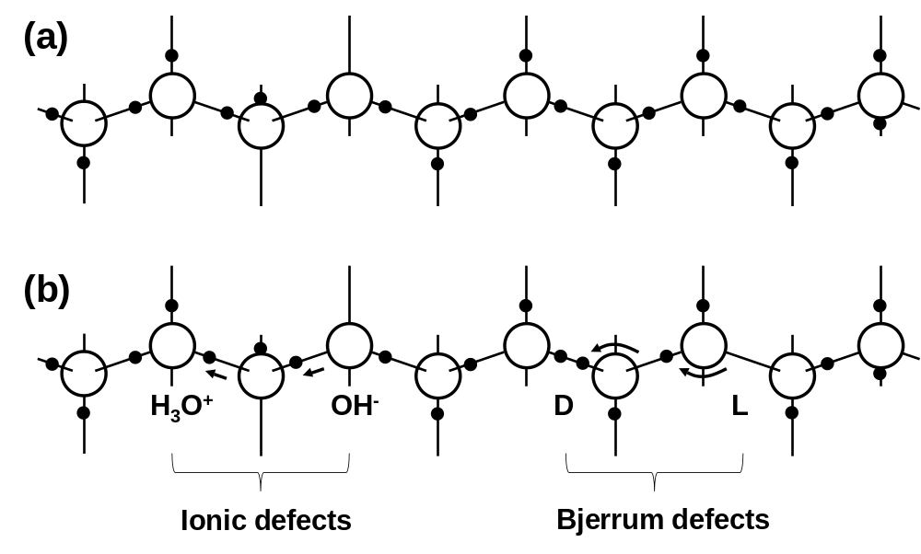

Slide 31
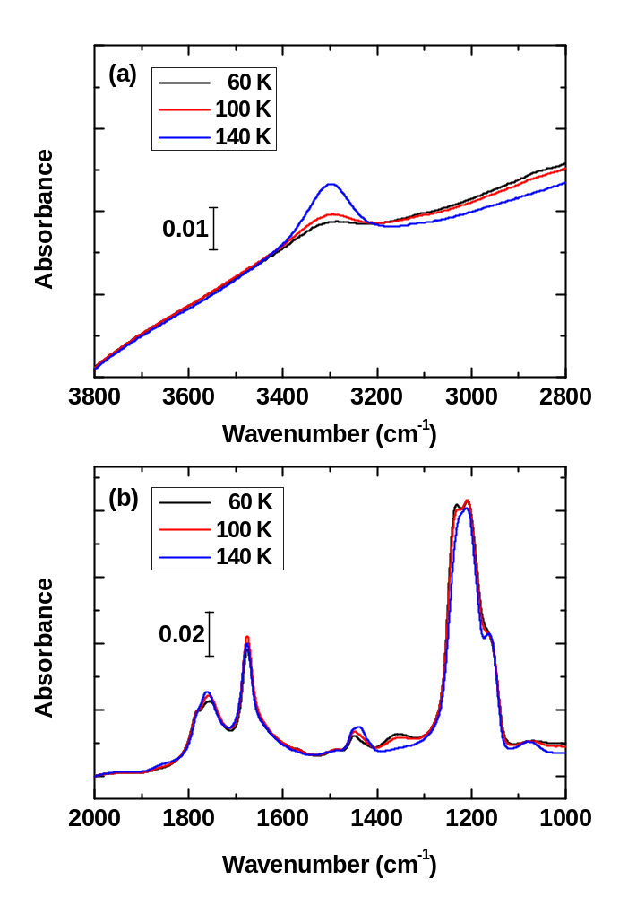
Variation of ν(O–H) stretching band intensity of vibrationally decoupled HDO species produced in a TFA(4 %)-D₂O(96%) mixture sample after heating at 60, 100, and 140 K.

Slide 32
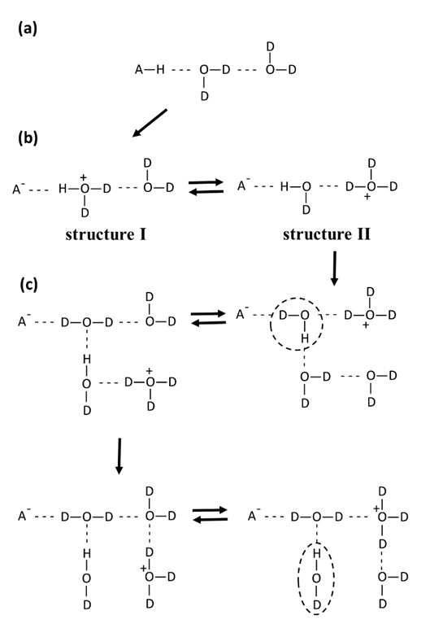
Illustration of the dissociation path of TFA in ASW.
(a) Molecular acid (HA) and water (D₂O) connected with hydrogen bond.
(b) The acid releases a proton to the adjacent D₂O to form HD₂O⁺ (structure I). The excess proton migrates along the water chain via D⁺ hopping and forms, for example, structure II. Structures I and II are rapidly interconvertible via the concerted hopping motion of protons (D⁺ or H⁺) in the water chain, i.e., the charge of excess proton is dynamically delocalized in the extended network structure.
(c) Thermal reorientation of water (HDO marked by a dotted circle) is necessary for H⁺ to escape from the proton-shuttling water chain. This leads to the formation of isolated HDO species (marked by a dotted ellipse).

Slide 33
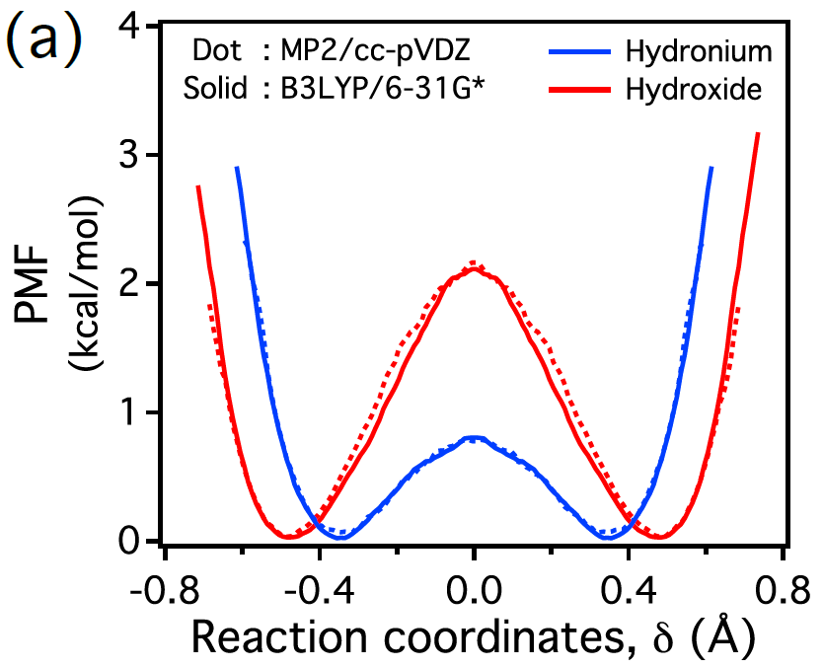
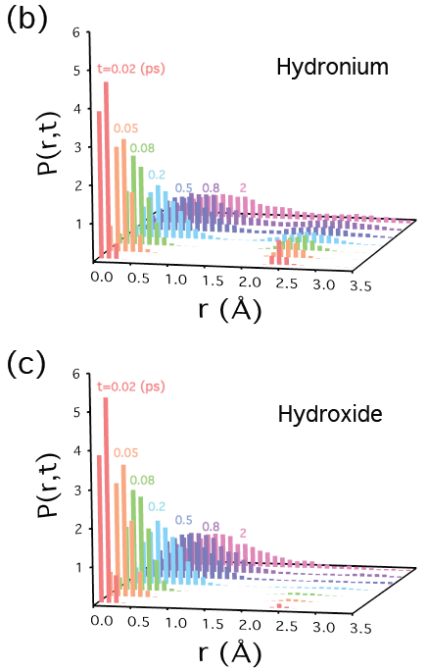
Dynamics of H₃O⁺ and OH⁻ Diffusion in Water
Proton transfer transition state
Proton hopping
(a) Free energy (potential of mean force; PMF) surface for hydronium (blue) and hydroxide (red).
Hydronium has a lower barrier (by ~1.3 kcal/mol) for proton transfer than hydroxide, and also its barrier width is wider (by ~0.2 Å).
Brownian molecular diffusion
Simulation results for space-time correlation function, P(r, t), of oxygen atoms of (b) hydroniums and (c) hydroxides as a function of r at various times, t, at 300 K.
Notes:
Explain P(r,t) …
The gradual broadening of the distribution function shows diffusion via Brownian motion.
On the other hand, there appears a hydronium population at distance ~2.5 A from the original position even at a very early stage of diffusion. This indicates proton tunneling to neighbor water to produce a hydronium ion.

Slide 34
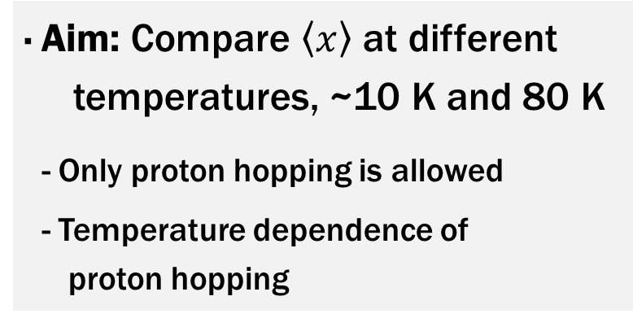
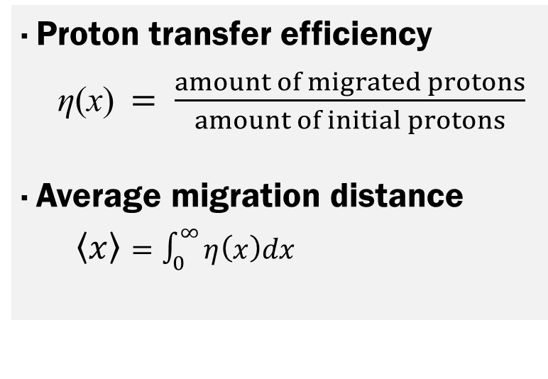
Chapter 4: Scheme
· Proton transfer efficiency
η(x)$= \frac{amount of migrated protons}{amount of initial protons}$
· Average migration distance
$\left\langle x\right\rangle =\int_{0}^{∞}{η\left(x\right)dx}$
Proton Acceptor
x ML
Proton Donor
· Aim: Compare $\left\langle x\right\rangle$ at different temperatures, ~10 K and 80 K
- Only proton hopping is allowed
- Temperature dependence of
proton hopping
Pt(111)
Notes:
4장에서는 저온에서 양성자의 이동에 관해 연구하였습니다.
대략적인 연구 계획을 소개하면, 10K와 80 K에서 거리에 따른 양성자 이동 정도를 측정하여 비교하였습니다.
이렇게 양성자 주개와 받개 사이의 거리를 조절하여 (click) 양성자가 어느 정도 이동하는지를 거리와 온도에 따라 측정한 후, 평균 이동 거리를 온도에 따라 측정하였습니다.
10K와 80 K는 둘 다 양성자 이동이 호핑만으로 이루어지는 낮은 온도이므로, 양성자 호핑 거리를 비교해, 온도 의존성을 확인하는 것이 연구의 목표가 되겠습니다.

Slide 35
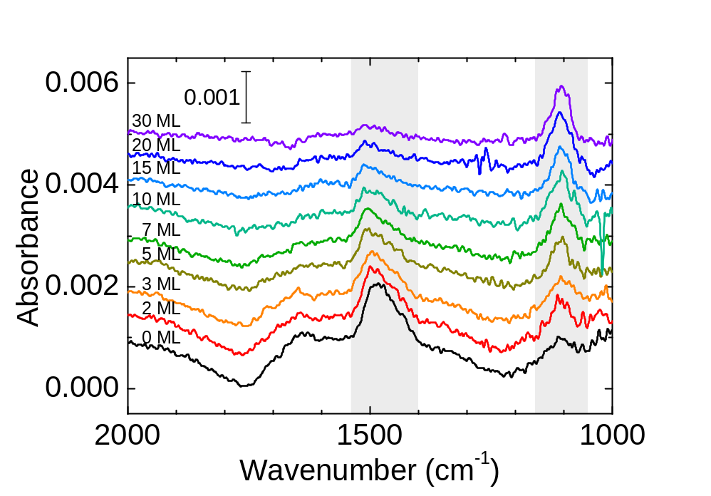
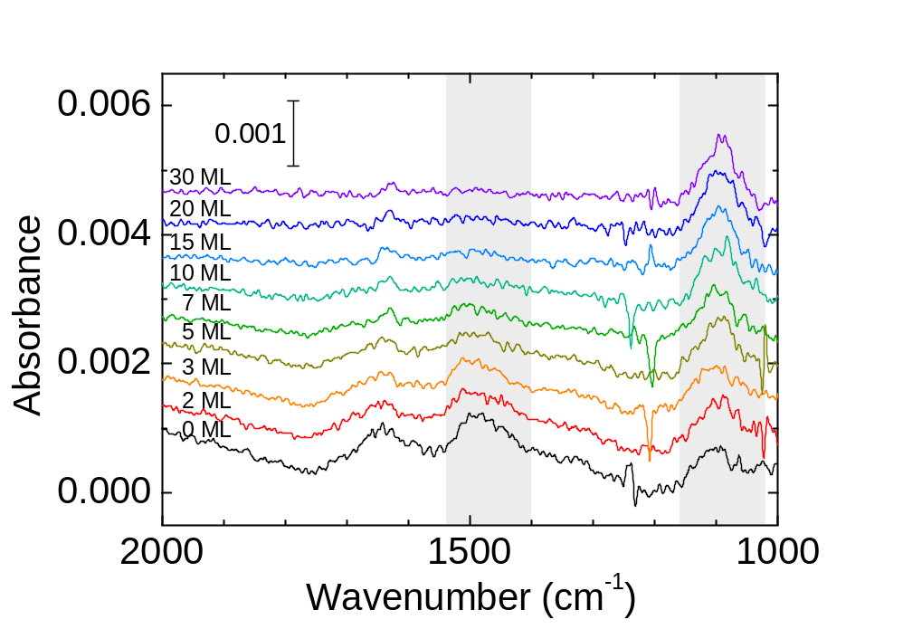
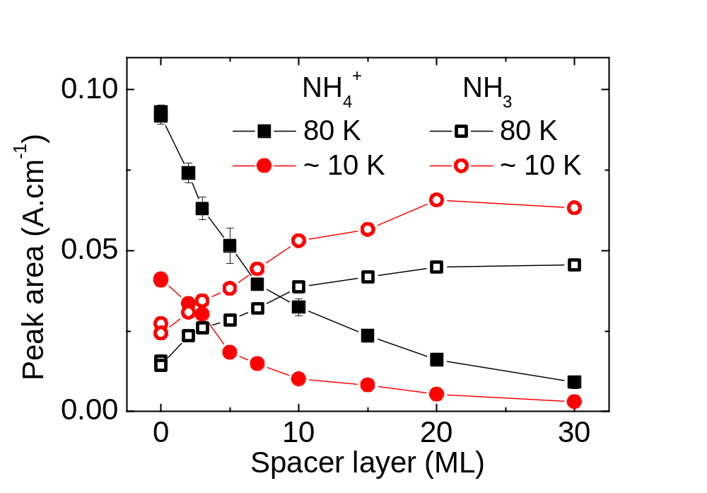
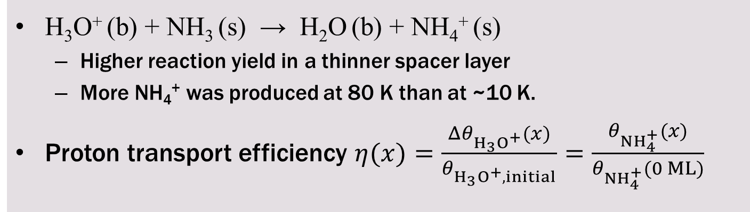
Thickness-Dependent Proton Transfer
80 K
~10 K
H₃O⁺ (b) + NH₃ (s) → H₂O (b) + NH₄⁺ (s)
  Higher reaction yield in a thinner spacer layer
  More NH₄⁺ was produced at 80 K than at ~10 K.
Proton transport efficiency $η(x)=\frac{Δθ_{H_{3}O^{+}}(x)}{θ_{H_{3}O^{+}, initial}}=\frac{θ_{NH_{4}^{+}}(x)}{θ_{NH_{4}^{+}}(0 ML)}$
Notes:
이런 실험을 온도와 두께를 바꾸어 가며 측정하여 proton transfer이 얼마나 일어났는가를 측정하면, 이런 spectrum set을 얻을 수 있습니다.
여기서 ammonium과 ammonia peak 면적을 적분하면 (click) spacer layer의 두께가 증가할 수록 암모늄 이온이 적게 생성되는것과,
10K보다는 80K에서 암모늄 이온이 많이 생성되는 것을 확인할 수 있습니다.
여기서 proton transfer efficiency를 이렇게 정의할 수 있습니다.

Slide 36
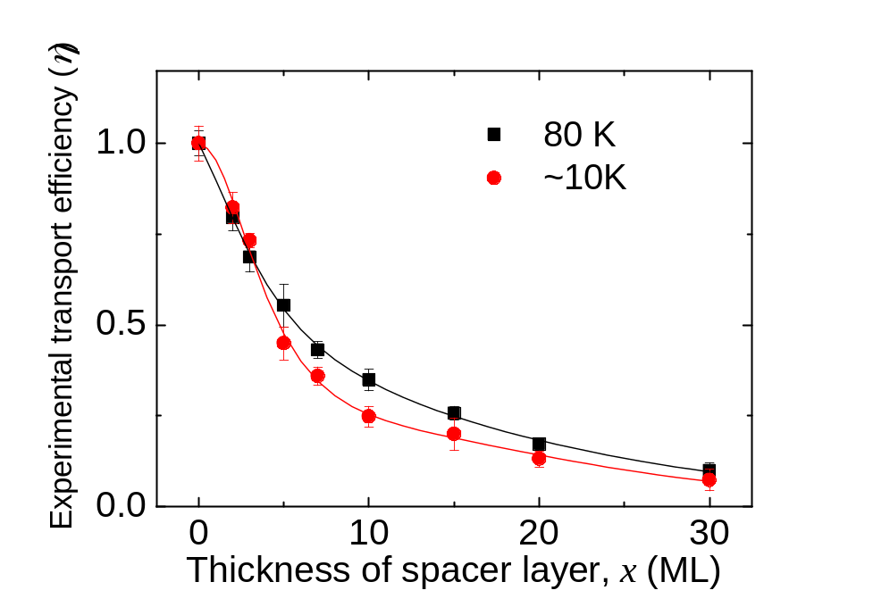
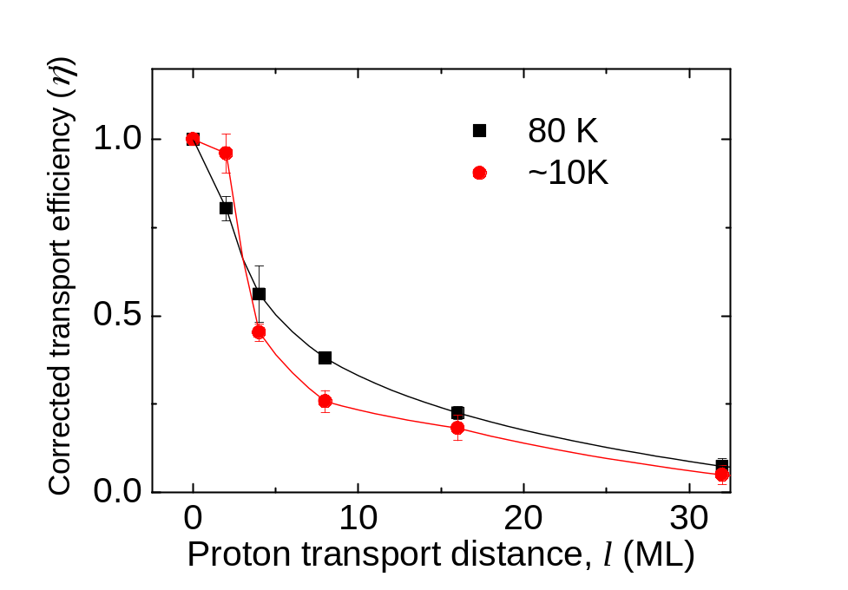

Proton Transfer in Bulk ASW
η’(l) was fitted using
Average proton migration distance
  At 80 K: 11.2 ± 1.1 ML
  At ~10 K: 9.4 ± 1.4 ML
Difference: 1.8 ± 1.8 ML
Notes:
보정을 해 주면 이런 그래프를 얻을 수 있고, 이 그래프를 적분하여 각 온도에서 평균 이동 거리를 결정할 수 있습니다.
양성자의 도약에 의한 평균 이동 거리는 80 K에서는 11.2 ML, 10 K에서는 9.4 ML로 차이는 1.8 플러스마이너스 1.8 ML이었습니다.
이 차이는 온도 차이를 고려하면 거의 차이가 없으며, 양성자 이동에 온도 영향이 거의 없음을 보여줍니다.

