Slide 1

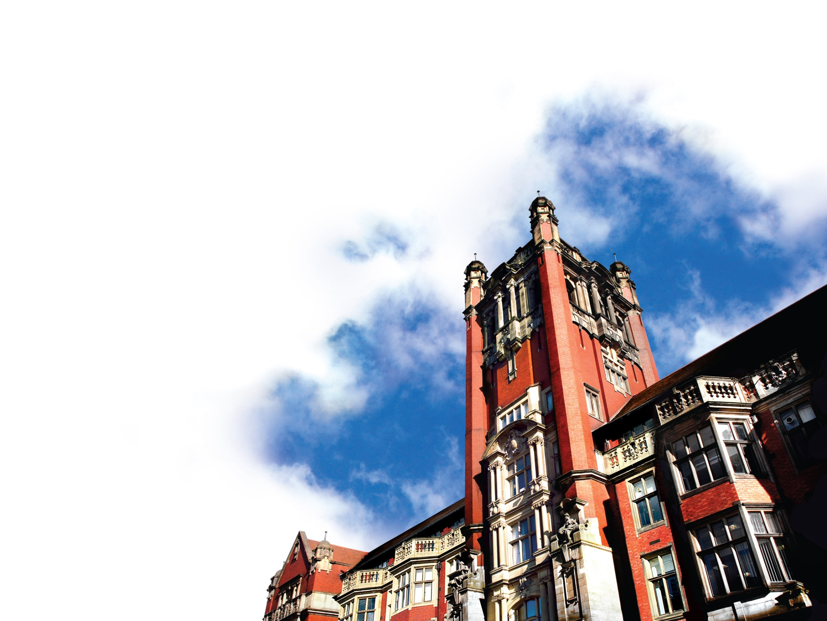
High mass‐resolution 3D ToF‐SIMS:
PCA and visualization in seconds using Graphical Processor Units (GPUs)
Peter Cumpson, James Hood, Ian Fletcher, Naoko Sano, Anders Barlow,
Newcastle University, UK
VASSCAA-9, Aug 2018
Notes:
All copy must be typed over existing copy in the appropriate template. Copy and pasting text will result in changing the style of the typography.
The palette of designated colours can be found in the font toolbox under ‘More Font Colours’.
If you need to insert a new slide while on a slide with similar content, then select ‘Duplicate Slide’.
Images must be scaled to 25% in size after inserting picture ‘From File’. Then ‘Arrange’ > ‘Send To Back’.
The images click to the guidelines for positioning. Use an existing slide as a guide, then remove the pervious images.
All images must be cropped without distortion to maintain original proportions.
Template Style Notes
Image sizes are as follows:
Full page image: 2894 pixels wide x 2173 high
1 side image: 679 pixels wide x 1813 high
2 side images: 679 pixels wide x 895 high (both images)
3 side images: 679 pixels wide x 590 high (1st & 2nd image), 679 pixels wide x 600 high (3rd image)

Slide 2
High mass‐resolution 3D ToF‐SIMS:
PCA and visualization in seconds using Graphical Processor Units (GPUs)
Peter Cumpson, James Hood, Ian Fletcher, Naoko Sano, Anders Barlow,
Newcastle University, UK
Present address;
Mark Wainwright Analytical Centre,
University of New South Wales
VASSCAA-9, Aug 2018
Notes:
All copy must be typed over existing copy in the appropriate template. Copy and pasting text will result in changing the style of the typography.
The palette of designated colours can be found in the font toolbox under ‘More Font Colours’.
If you need to insert a new slide while on a slide with similar content, then select ‘Duplicate Slide’.
Images must be scaled to 25% in size after inserting picture ‘From File’. Then ‘Arrange’ > ‘Send To Back’.
The images click to the guidelines for positioning. Use an existing slide as a guide, then remove the pervious images.
All images must be cropped without distortion to maintain original proportions.
Template Style Notes
Image sizes are as follows:
Full page image: 2894 pixels wide x 2173 high
1 side image: 679 pixels wide x 1813 high
2 side images: 679 pixels wide x 895 high (both images)
3 side images: 679 pixels wide x 590 high (1st & 2nd image), 679 pixels wide x 600 high (3rd image)

Slide 3
Imaging Mass Spectrometry
MALDI – matrix assisted. Large molecular fragment ions, limited spatial resolution
SIMS: secondary Ion Mass Spectrometry – higher spatial resolution, possibility to “depth-profile”.
In both cases spectra can be extremely complex – practically one needs help in interpretation, often by using multivariate analysis methods.
This is a problem – Modern SIMS instruments generate Tb of data differentiated by
  Precise fragment mass
  Spatial origin on the sample

Slide 4
Agenda
New PCA algorithm for dealing with terabyte 3D datasets.
  Every mass channel in every spectrum in every voxel goes into the PCA.
  No “out of memory errors”. No peak-picking.
  Everything is PCA’d.
Faster PCA at better mass resolution:
  Two reasons why we must choose samples intelligently from all among the voxels available
    GPU memory limits
    Quadro Logarithmic Trap Analyser (slow but very high mass resolution)
Biomimetic (or Biokleptic?) solution
  Human Retina
Conclusions

Slide 5
Agenda
New PCA algorithm for dealing with terabyte 3D datasets.
  Every mass channel in every spectrum in every voxel goes into the PCA.
  No “out of memory errors”. No peak-picking.
  Everything is PCA’d.
Faster PCA at better mass resolution:
  Two reasons why we must choose samples intelligently from all among the voxels available
    GPU memory limits
    Quadro Logarithmic Trap Analyser (slow but very high mass resolution)
Biomimetic (or Biokleptic?) solution
  Human Retina
Conclusions

Slide 6
Agenda
New PCA algorithm for dealing with terabyte 3D datasets.
  Every mass channel in every spectrum in every voxel goes into the PCA.
  No “out of memory errors”. No peak-picking.
  Everything is PCA’d.
Faster PCA at better mass resolution:
  Two reasons why we must choose samples intelligently from all among the voxels available
    GPU memory limits
    Quadro Logarithmic Trap Analyser (slow but very high mass resolution)
Biomimetic (or Biokleptic?) solution
  Human Retina
Conclusions

Slide 7
Agenda
New PCA algorithm for dealing with terabyte 3D datasets.
  Every mass channel in every spectrum in every voxel goes into the PCA.
  No “out of memory errors”. No peak-picking.
  Everything is PCA’d.
Faster PCA at better mass resolution:
  Two reasons why we must choose samples intelligently from all among the voxels available
    GPU memory limits
    Quadro Logarithmic Trap Analyser (slow but very high mass resolution)
Biomimetic (or Biokleptic?) solution
  Human Retina
Conclusions

Slide 8
Agenda
New PCA algorithm for dealing with terabyte 3D datasets.
  Every mass channel in every spectrum in every voxel goes into the PCA.
  No “out of memory errors”. No peak-picking.
  Everything is PCA’d.
Faster PCA at better mass resolution:
  Two reasons why we must choose samples intelligently from all among the voxels available
    GPU memory limits
    Quadro Logarithmic Trap Analyser (slow but very high mass resolution)
Biomimetic (or Biokleptic?) solution
  Human Retina
Conclusions

Slide 9
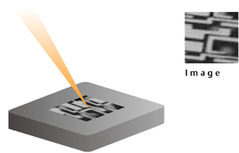

Slide 10
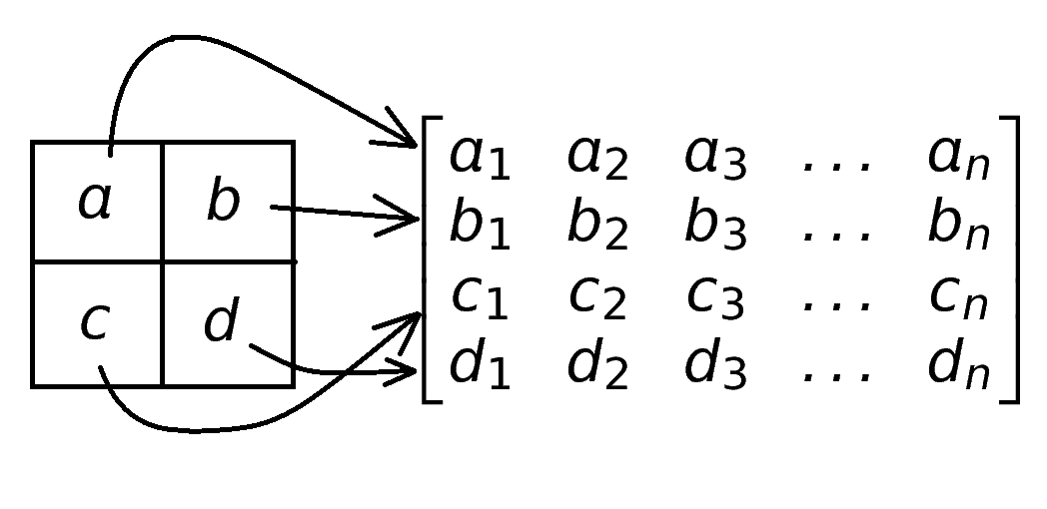
Mapping Pixels

Slide 11
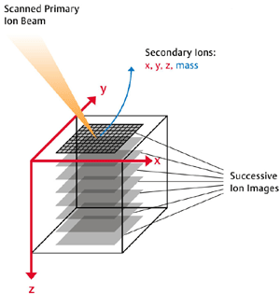
Mapping Pixels

Slide 12
Mapping Pixels
Modern instruments generate huge 3D datasets of pixels (or voxels) each of which have a huge SIMS spectrum associated with that pixel (or voxel).
Navigating and interpreting these datasets is effectively impossible manually, and a challenge computationally.

Slide 13
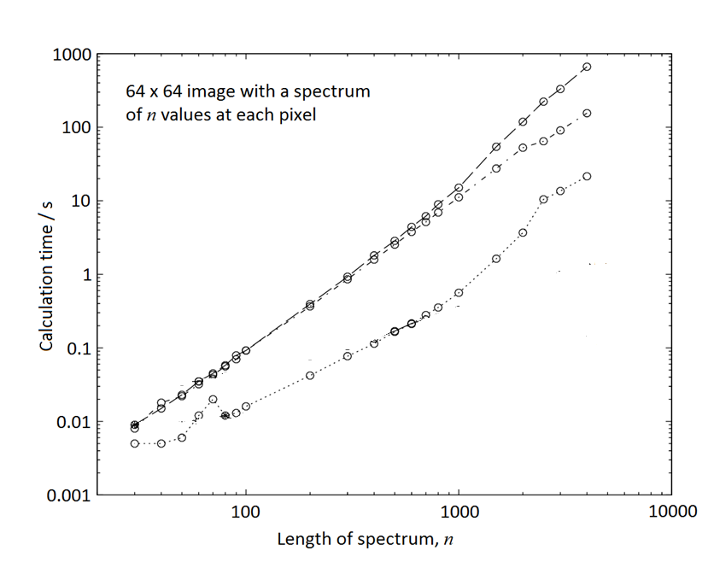
“Built in” PCA algorithms
(e.g. MATLAB etc)

Slide 14
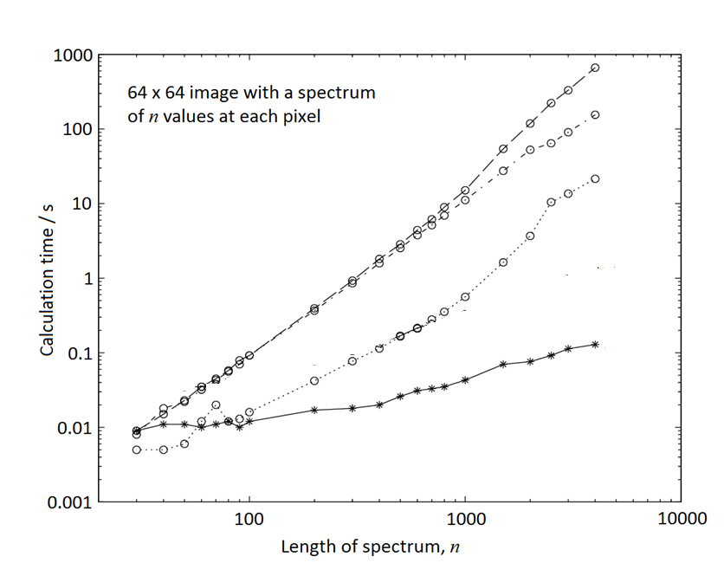
Random Vectors algorithm due to Halko et al
Random Vectors (RV1)
P J Cumpson et al, Surface and Interface Analysis 47 (2015) 986.

Slide 15
We applied this to some datasets from our J105 SIMS instrument
Citrate crystal – lots of topography
Basalt rock. Very large dataset, 512x512 image
Rat’s brain – data from John Fletcher (Gothenburg)

Slide 16
Sodium citrate crystal
(approx 1x0.7mm)
P J Cumpson et al, Surface and Interface Analysis 47 (2015) 986.

Slide 17
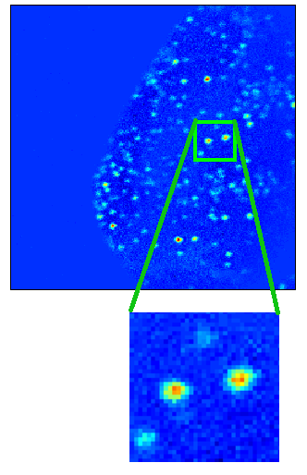
Sodium citrate crystal
(approx 1x0.7mm)
PCA analysis of the entire sodium citrate ToFSIMS image using the RV2 algorithm shows (in the 11th component) small chemically-distinct regions at the surface of the otherwise relatively homogeneous sodium citrate crystal. The field of view is 1mmx1mm
P J Cumpson et al, Surface and Interface Analysis 47 (2015) 986.

Slide 18
Basalt rock sample
1.6mm by 1.6mm,
512x512 pixels
N Sano et al,
JVST A 34, 041405 (2016)

Slide 19
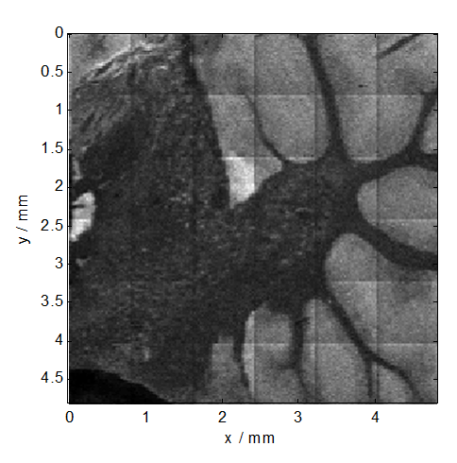
PCA of a complex image
Total ion image
Rat brain data – Courtesy of John Fletcher @ Swedish National IMS Centre, Gothenburg

Slide 20
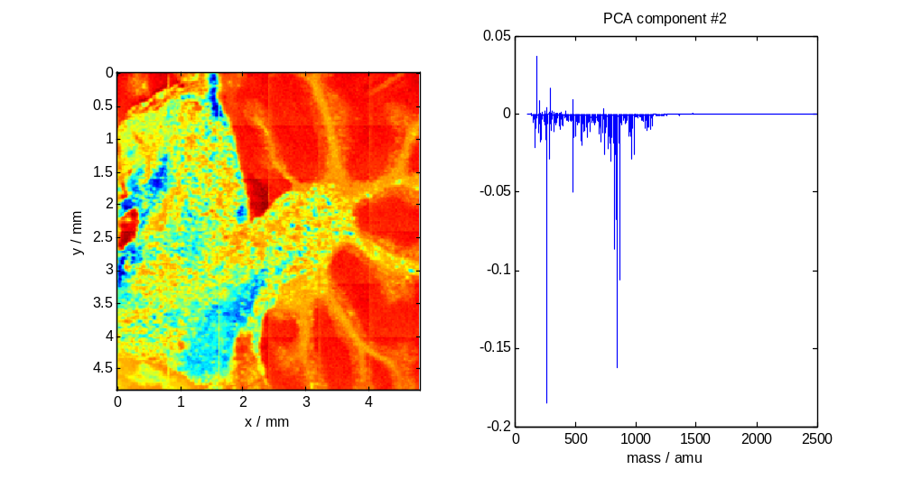
PCA of a complex image
Rat brain data – Courtesy of John Fletcher @ Swedish National IMS Centre, Gothenburg

Slide 21
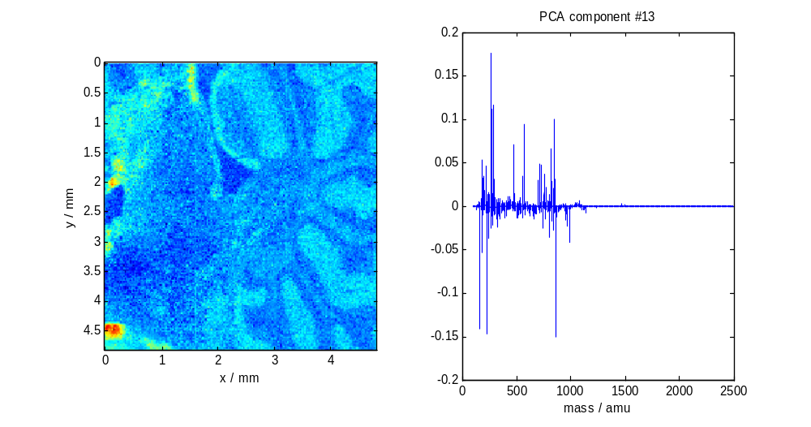
PCA of a complex image
Rat brain data – Courtesy of John Fletcher @ Swedish National IMS Centre, Gothenburg

Slide 22
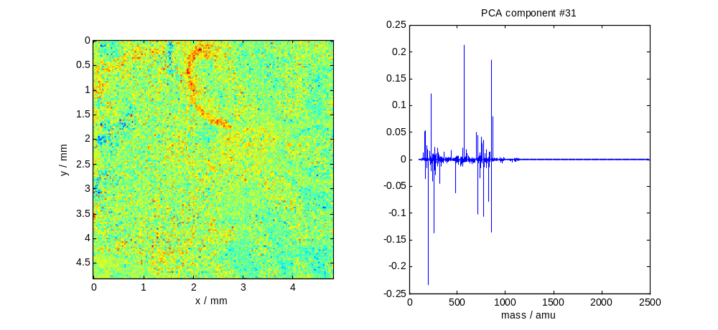
PCA of a complex image
Rat brain data – Courtesy of John Fletcher @ Swedish National IMS Centre, Gothenburg

Slide 23

20kV, C60 imaging depth profile from a Yucca plant leaf
256x256um, 128x128 pixels, 120 levels
70,000 mass spectrum at each voxel
Just under 2 million voxels
Dataset just over 1Tb uncompressed, 30Gb compressed.

Slide 24
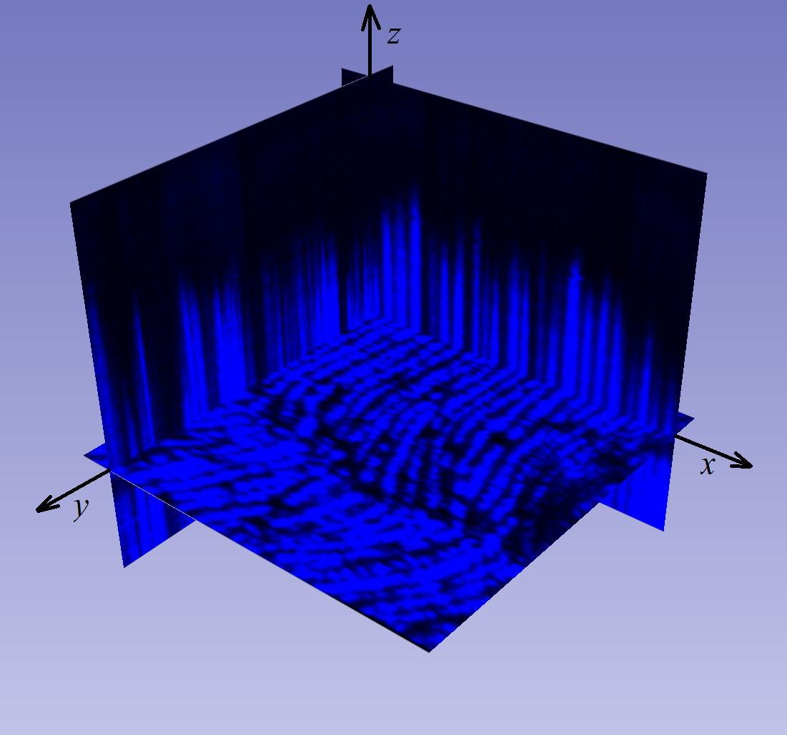
PC1

Slide 25
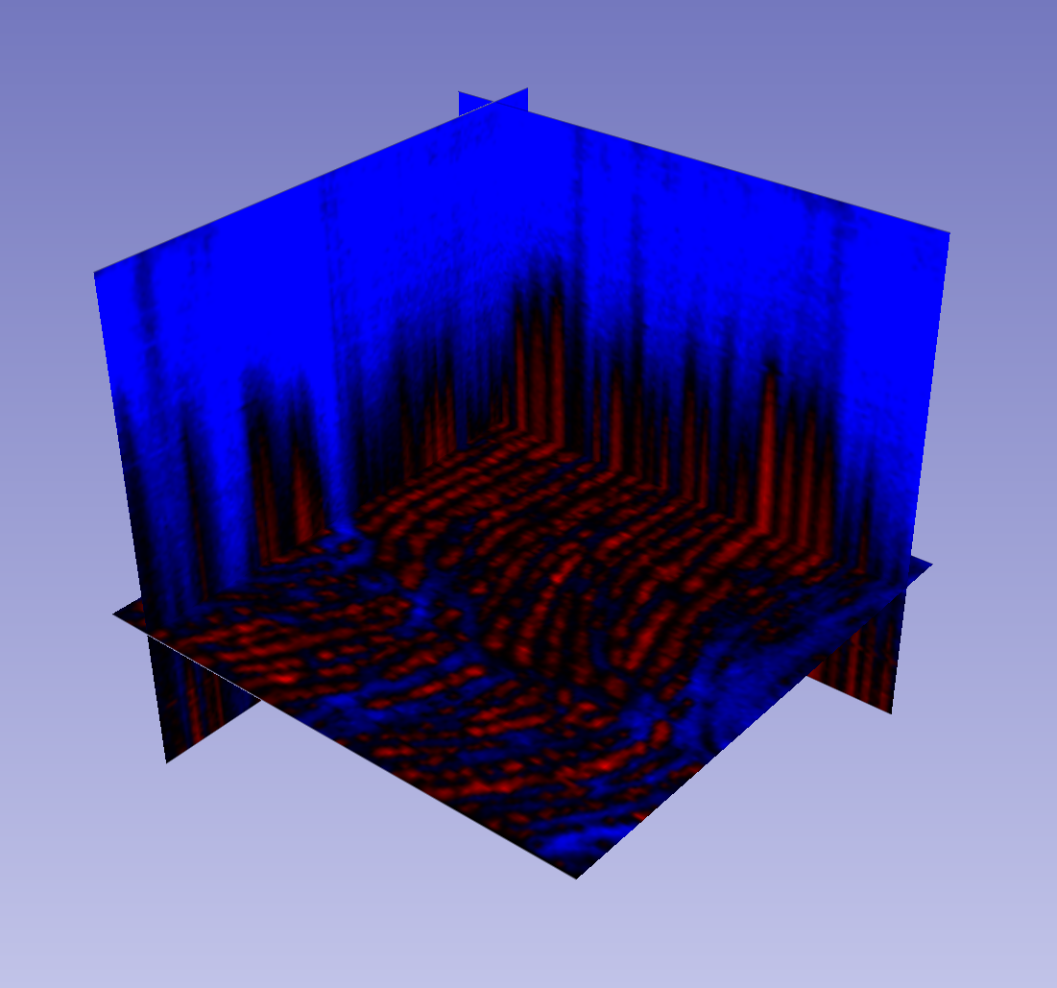
PC2

Slide 26
PC2
Full mass resolution, entire mass range

Slide 28
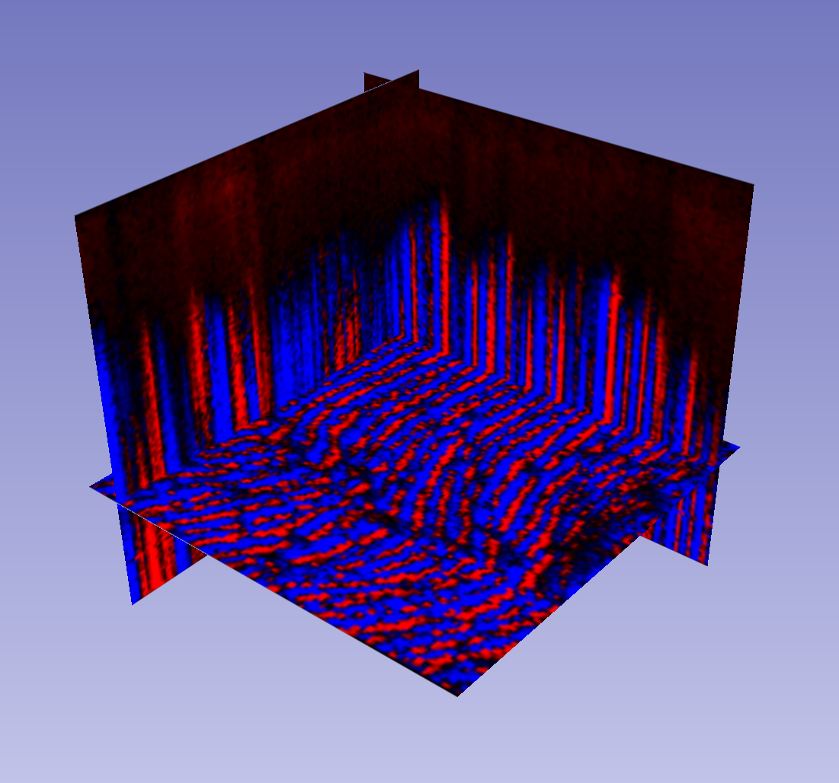
PC3

Slide 29
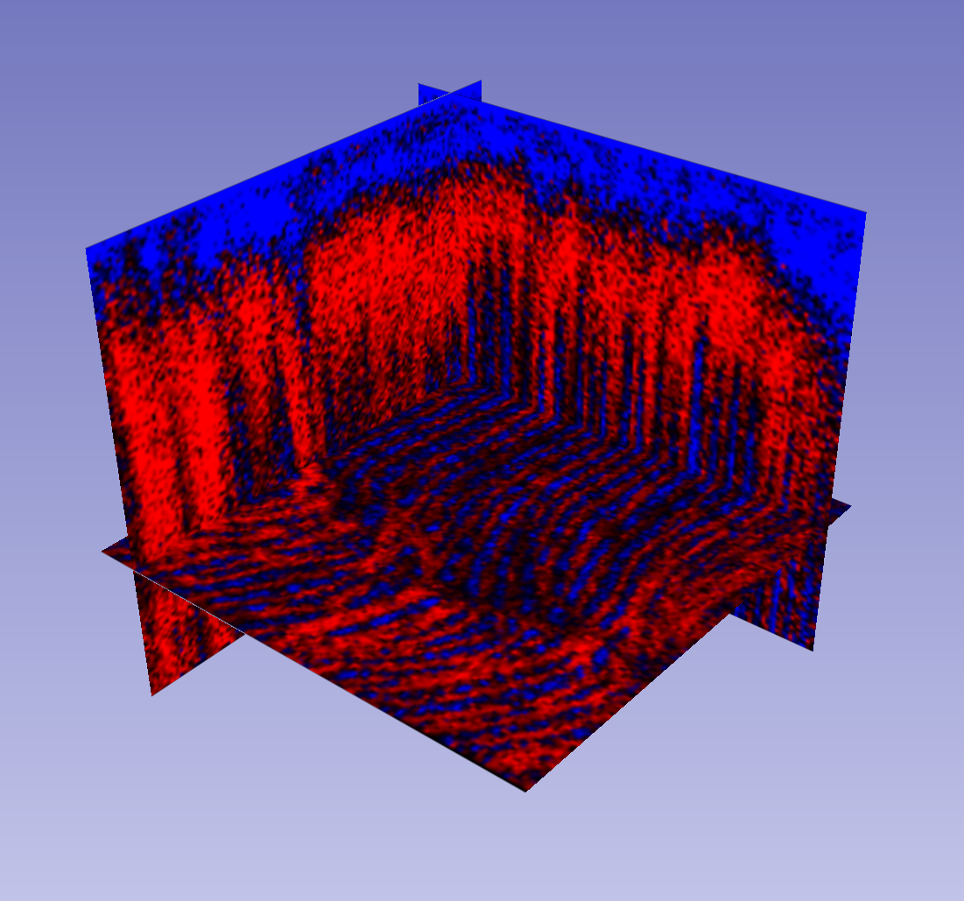
PC4

Slide 30
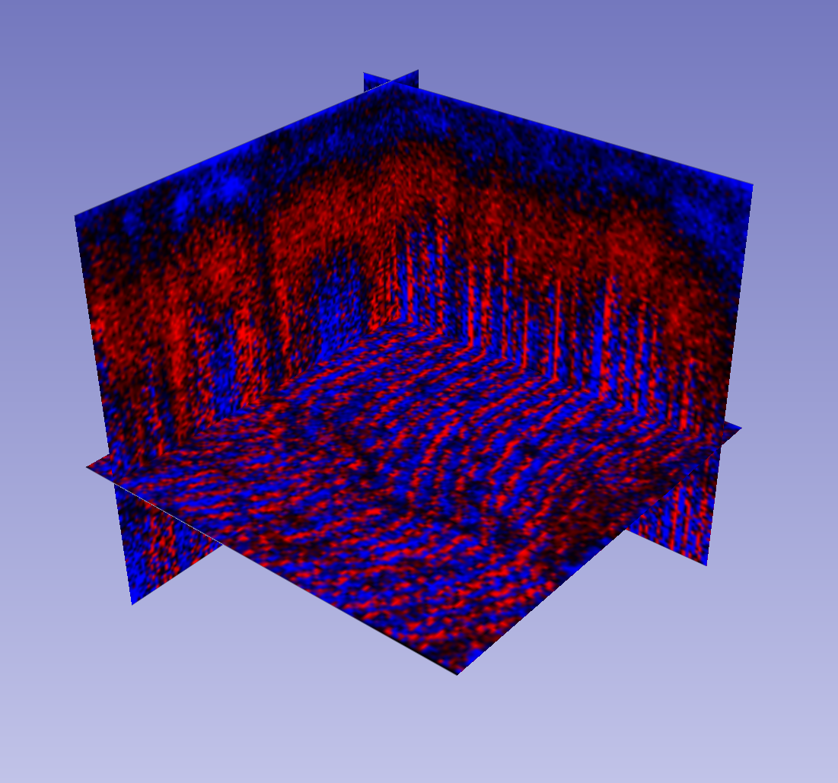
PC5

Slide 31


Slide 32
Agenda
New PCA algorithm for dealing with terabyte 3D datasets.
  Every mass channel in every spectrum in every voxel goes into the PCA.
  No “out of memory errors”. No peak-picking.
  Everything is PCA’d.
Faster PCA at better mass resolution:
  Two reasons why we must choose samples intelligently from all among the voxels available
    GPU memory limits
    Quadro Logarithmic Trap Analyser (slow but very high mass resolution)
Biomimetic (or Biokleptic?) solution
  Human Retina
Conclusions

Slide 33
Agenda
New PCA algorithm for dealing with terabyte 3D datasets.
  Every mass channel in every spectrum in every voxel goes into the PCA.
  No “out of memory errors”. No peak-picking.
  Everything is PCA’d.
Faster PCA at better mass resolution:
  Two reasons why we must choose samples intelligently from all among the voxels available
    GPU memory limits
    Quadro Logarithmic Trap Analyser (slow but very high mass resolution)
Biomimetic (or Biokleptic?) solution
  Human Retina
Conclusions

Slide 34
Agenda
New PCA algorithm for dealing with terabyte 3D datasets.
  Every mass channel in every spectrum in every voxel goes into the PCA.
  No “out of memory errors”. No peak-picking.
  Everything is PCA’d.
Faster PCA at better mass resolution:
  Two reasons why we must choose samples intelligently from all among the voxels available
    GPU memory limits
    Quadro Logarithmic Trap Analyser (slow but very high mass resolution)
Biomimetic (or Biokleptic?) solution
  Human Retina
Conclusions

Slide 35
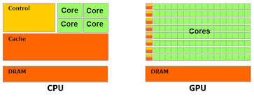
P J Cumpson et al, Surface and Interface Analysis, DOI: 10.1002/sia.6042
A Graphical Processor Unit – “GPU” has many more processors, potentially doing the PCA calculation more rapidly.
GPU cards cost perhaps $3,000 or so, and fit in desktop PCs.

Slide 36
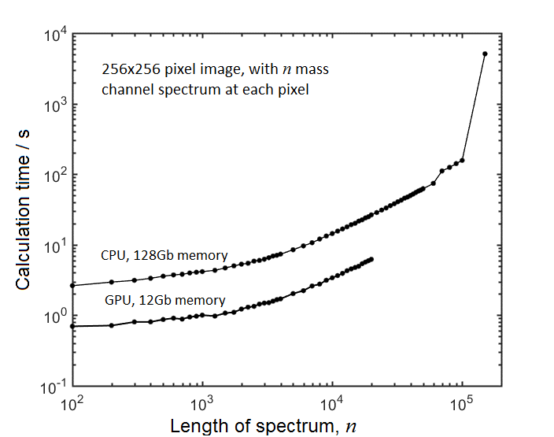
P J Cumpson et al, Surface and Interface Analysis, DOI: 10.1002/sia.6042
Nvidia GPU with 2,880 processor cores

Slide 37
P J Cumpson et al, Surface and Interface Analysis, DOI: 10.1002/sia.6042
Nvidia GPU with 2,880 processor cores

Slide 38
P J Cumpson et al, Surface and Interface Analysis, DOI: 10.1002/sia.6042
No more local GPU memory
Nvidia GPU with 2,880 processor cores

Slide 39
Agenda
New PCA algorithm for dealing with terabyte 3D datasets.
  Every mass channel in every spectrum in every voxel goes into the PCA.
  No “out of memory errors”. No peak-picking.
  Everything is PCA’d.
Faster PCA at better mass resolution:
  Two reasons why we must choose samples intelligently from all among the voxels available
    GPU memory limits
    Quadro Logarithmic Trap Analyser (slow but very high mass resolution)
Biomimetic (or Biokleptic?) solution
  Human Retina
Conclusions

Slide 40
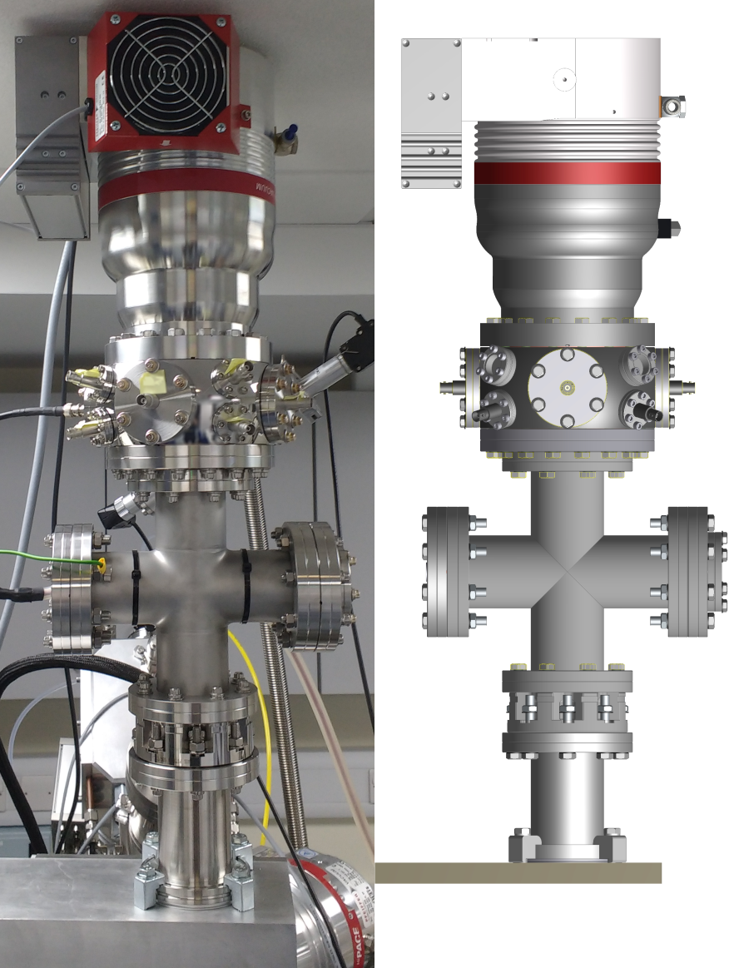
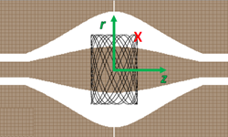
Quadro-logarithmic trap
A. Makarov, Anal. Chem. 72 (2000) 1156

Slide 41
Quadro-logarithmic trap

Slide 42
J C Hood and P J Cumpson, IJMER 6 (Oct 2016) p76-83.
Quadro-logarithmic trap

Slide 43
J C Hood and P J Cumpson, IJMER 6 (Oct 2016) p76-83.
Quadro-logarithmic trap
(QLT)

Slide 44
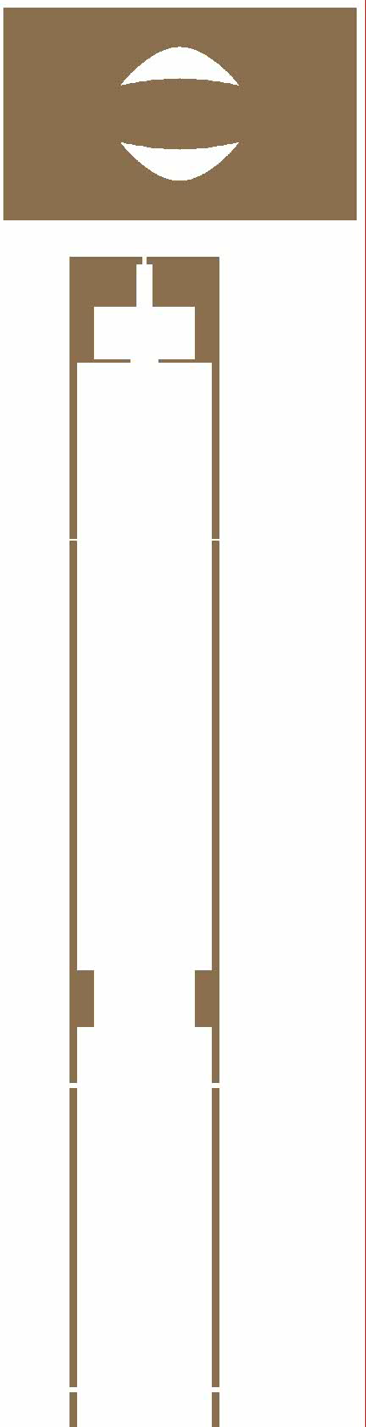

J C Hood and P J Cumpson, IJMER 6 (Oct 2016) p76-83.
SIMION model

Slide 45
J C Hood and P J Cumpson, IJMER 6 (Oct 2016) p76-83.
SIMION model

Slide 46
J C Hood and P J Cumpson, IJMER 6 (Oct 2016) p76-83.

Slide 47
J C Hood and P J Cumpson, IJMER 6 (Oct 2016) p76-83.

Slide 48
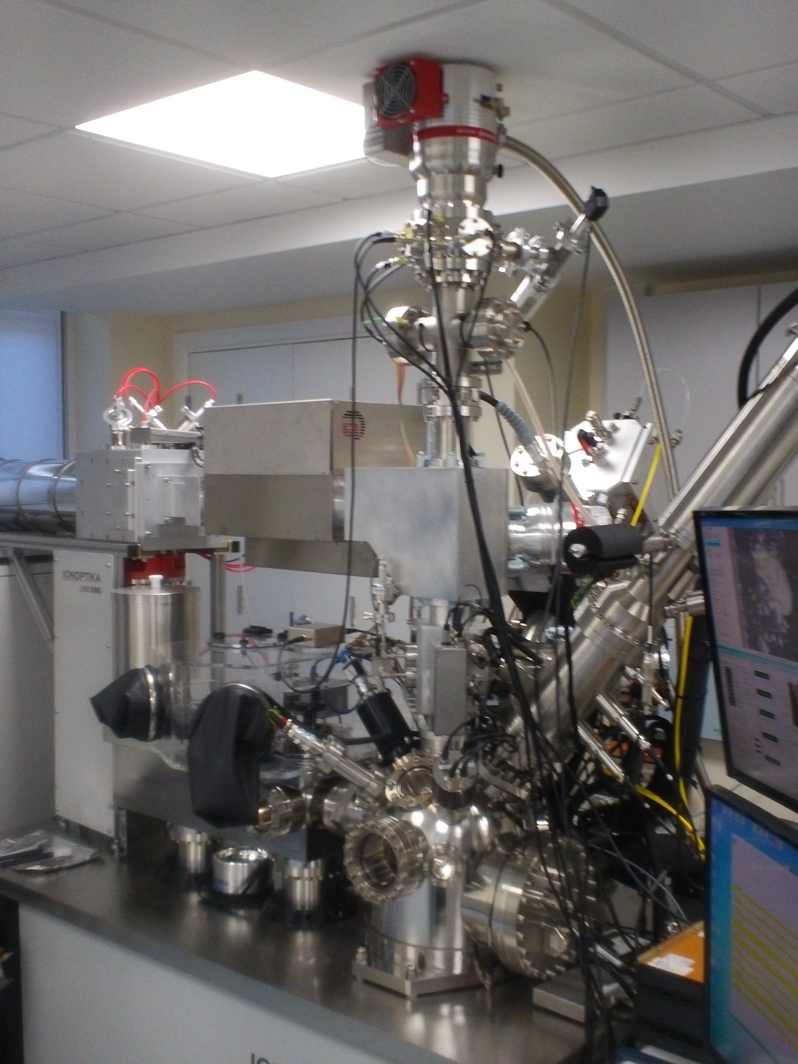
J C Hood and P J Cumpson, IJMER 6 (Oct 2016) p76-83.

Slide 49
J C Hood and P J Cumpson, IJMER 6 (Oct 2016) p76-83.

Slide 50
J C Hood and P J Cumpson, IJMER 6 (Oct 2016) p76-83.

Slide 51
J C Hood and P J Cumpson, IJMER 6 (Oct 2016) p76-83.

Slide 52
ToF
J C Hood and P J Cumpson, IJMER 6 (Oct 2016) p76-83.

Slide 53
QLT
J C Hood and P J Cumpson, IJMER 6 (Oct 2016) p76-83.

Slide 54
40kV Ar clusters
40kV C60
J C Hood and P J Cumpson, IJMER 6 (Oct 2016) p76-83.

Slide 55
J C Hood and P J Cumpson, IJMER 6 (Oct 2016) p76-83.

Slide 56
ToF
≈5ms / pixel

Slide 57
QLT
>100ms / pixel

Slide 58
Two different reasons to process a subset of pixels (or voxels)
Long acquisition time of FTMS methods
  can we ever hope to do PCA on 3D datasets when acquisition is 20 to 200 times slower than the ToF?
Memory limit of GPU card.
  If we want PCA in seconds or minutes we need GPU cards that can hold the entire data-cube.
  Maybe in the future GPU cards will have 20, 40 or 100Gb, but unlikely to be 10Tb!
Therefore we must sample. Don’t take an entire spectrum from each pixel (or voxel).
  Choose instead a subset of pixels (or voxels).
  But which to choose?!?!?

Slide 59
Two different reasons to process a subset of pixels (or voxels)
Long acquisition time of FTMS methods
  can we ever hope to do PCA on 3D datasets when acquisition is 20 to 200 times slower than the ToF?
Memory limit of GPU card.
  If we want PCA in seconds or minutes we need GPU cards that can hold the entire data-cube.
  Maybe in the future GPU cards will have 20, 40 or 100Gb, but unlikely to be 10Tb!
Therefore we must sample. Don’t take an entire spectrum from each pixel (or voxel).
  Choose instead a subset of pixels (or voxels).
  But which to choose?!?!?

Slide 60
Two different reasons to process a subset of pixels (or voxels)
Long acquisition time of FTMS methods
  can we ever hope to do PCA on 3D datasets when acquisition is 20 to 200 times slower than the ToF?
Memory limit of GPU card.
  If we want PCA in seconds or minutes we need GPU cards that can hold the entire data-cube.
  Maybe in the future GPU cards will have 20, 40 or 100Gb, but unlikely to be 10Tb!
Therefore we must sample. Don’t take an entire spectrum from each pixel (or voxel).
  Choose instead a subset of pixels (or voxels).
  But which to choose?!?!?

Slide 61
Two different reasons to process a subset of pixels (or voxels)
Long acquisition time of FTMS methods
  can we ever hope to do PCA on 3D datasets when acquisition is 20 to 200 times slower than the ToF?
Memory limit of GPU card.
  If we want PCA in seconds or minutes we need GPU cards that can hold the entire data-cube.
  Maybe in the future GPU cards will have 20, 40 or 100Gb, but unlikely to be 10Tb!
Therefore we must sample. Don’t take an entire spectrum from each pixel (or voxel).
  Choose instead a subset of pixels (or voxels).
  But which to choose?!?!?

Slide 62
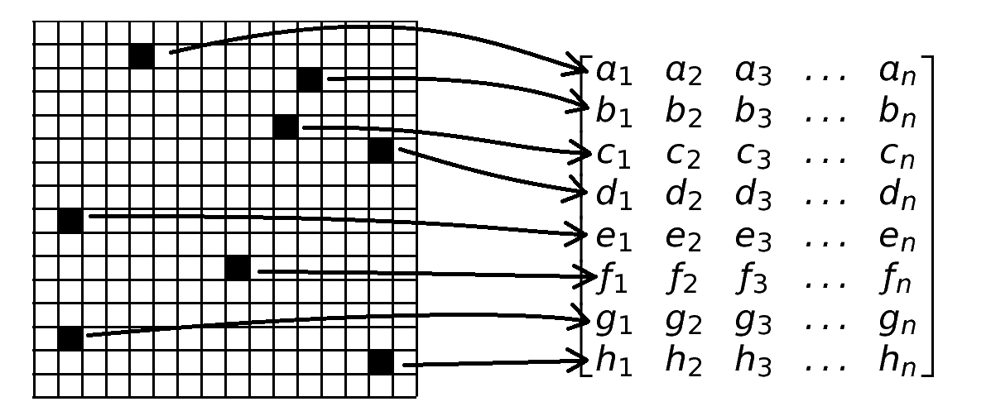
When the 2D or 3D dataset becomes too large we are forced to sample!

Slide 63
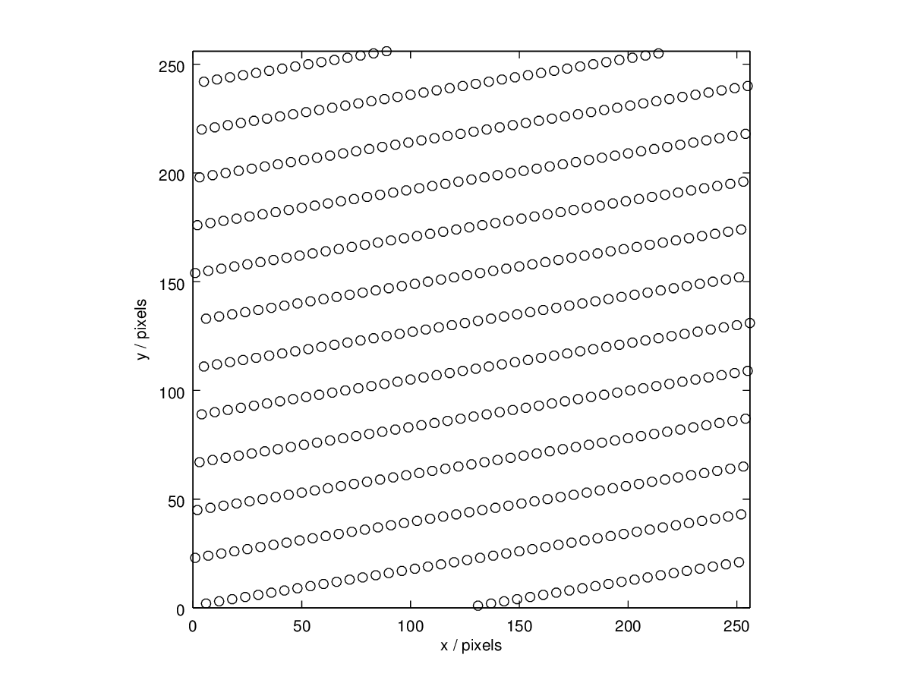
e.g. take every 130th pixel

Slide 64
e.g. take every 130th pixel

Slide 65
e.g. take every 130th pixel

Slide 66
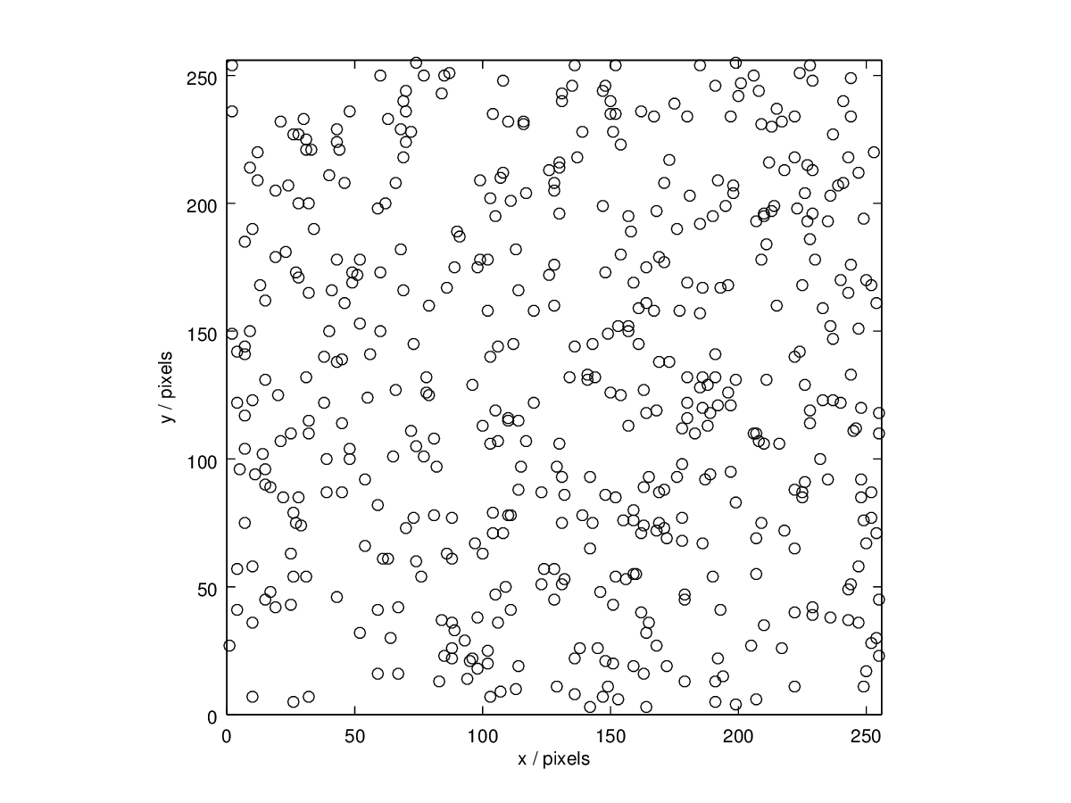
Sampling pixels at random

Slide 67
Sampling pixels at random

Slide 68
Sampling pixels at random

Slide 69
Agenda
New PCA algorithm for dealing with terabyte 3D datasets.
  Every mass channel in every spectrum in every voxel goes into the PCA.
  No “out of memory errors”. No peak-picking.
  Everything is PCA’d.
Faster PCA at better mass resolution:
  Two reasons why we must choose samples intelligently from all among the voxels available
    GPU memory limits
    Quadro Logarithmic Trap Analyser (slow but very high mass resolution)
Biomimetic (or Biokleptic?) solution
  Human Retina
Conclusions

Slide 70

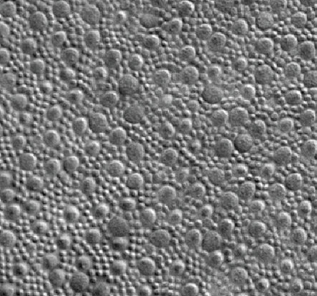
Biomimetic (biokleptic?) solution
Human Retina
Cones –
expensive high-wavelength-resol’n spectra
Rods – cheap but low-wavelength- resolution spectra
J C Horton et al, Sci. Rep. 5 (2015) 12364

Slide 71
Biomimetic (biokleptic?) solution
Cone distribution
J C Horton et al, Sci. Rep. 5 (2015) 12364

Slide 72
Biomimetic (biokleptic?) solution
Human Retina

Slide 73
Biomimetic (biokleptic?) solution
Human Retina

Slide 74
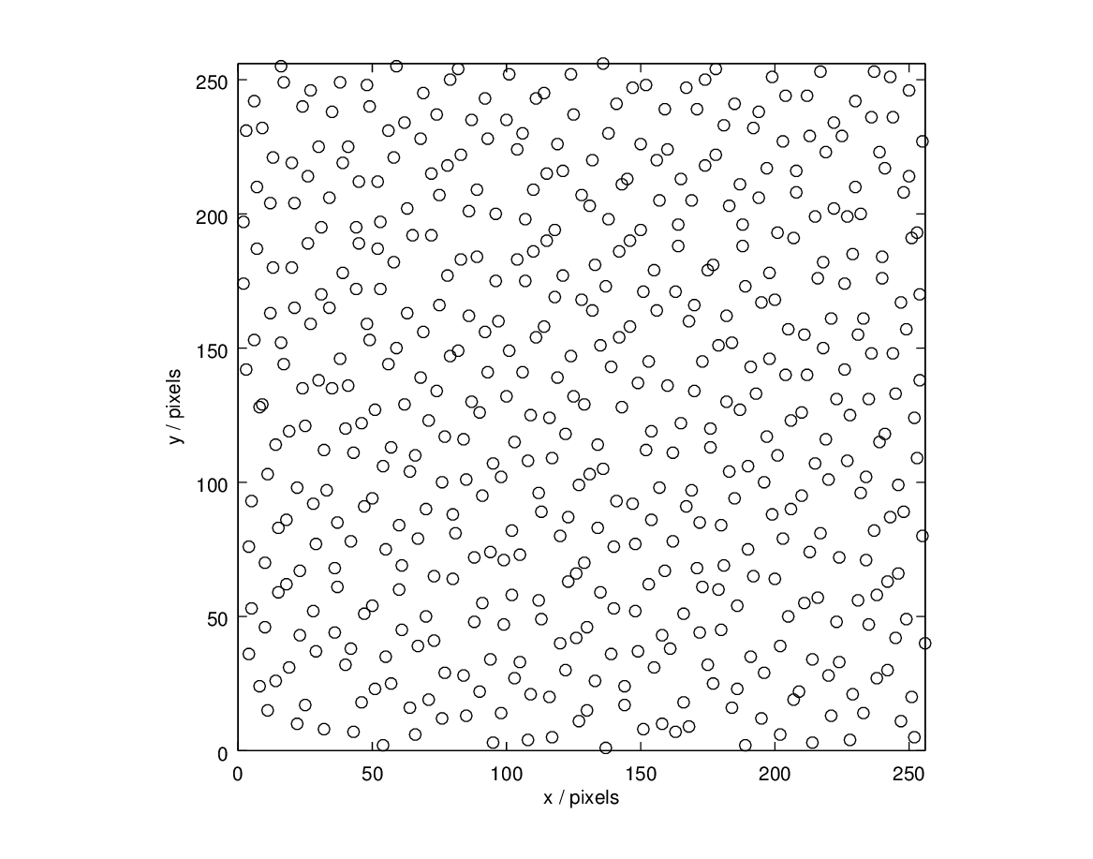
Biomimetic (biokleptic?) solution
Human Retina
Sobol

Slide 75
Sobol sequences
One example of Low-discrepancy or “sub-random” sequences found to assist in rapid convergence of MC integration problems.
Sobol, I. M. The distribution of points in a cube and the approximate evaluation of integrals, USSR Comput. Math. Math.
Phys. 7, 4, 86-112, 1967

Slide 76
Sobol sequences

Slide 77
Sobol sequences

Slide 78
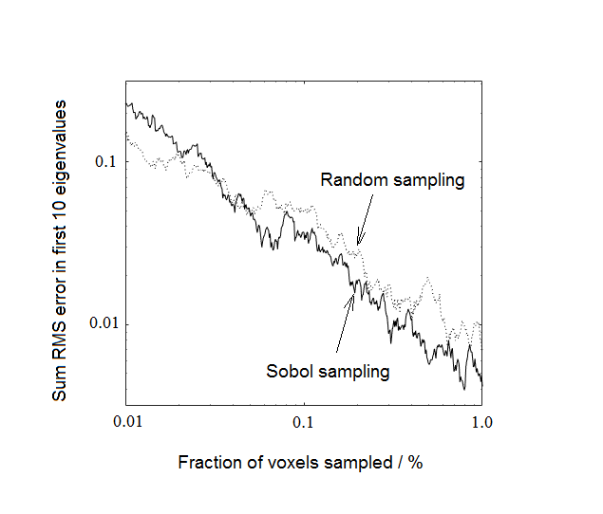
Compare performance of Sobol vs. Random sampling from basalt rock sample
512x512 pixel ToFSIMS image of rock sample, 67,111 mass values in each spectrum in each pixel

Slide 79
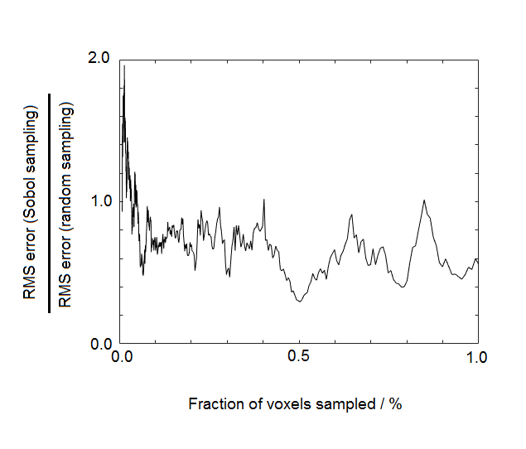
Compare performance of Sobol vs. Random sampling from basalt rock sample
512x512 pixel ToFSIMS image of rock sample, 67,111 mass values in each spectrum in each pixel

Slide 80
Compare performance of Sobol vs. Random sampling from basalt rock sample
512x512 pixel ToFSIMS image of rock sample, 67,111 mass values in each spectrum in each pixel
On-average about 40% better than random sampling

Slide 81
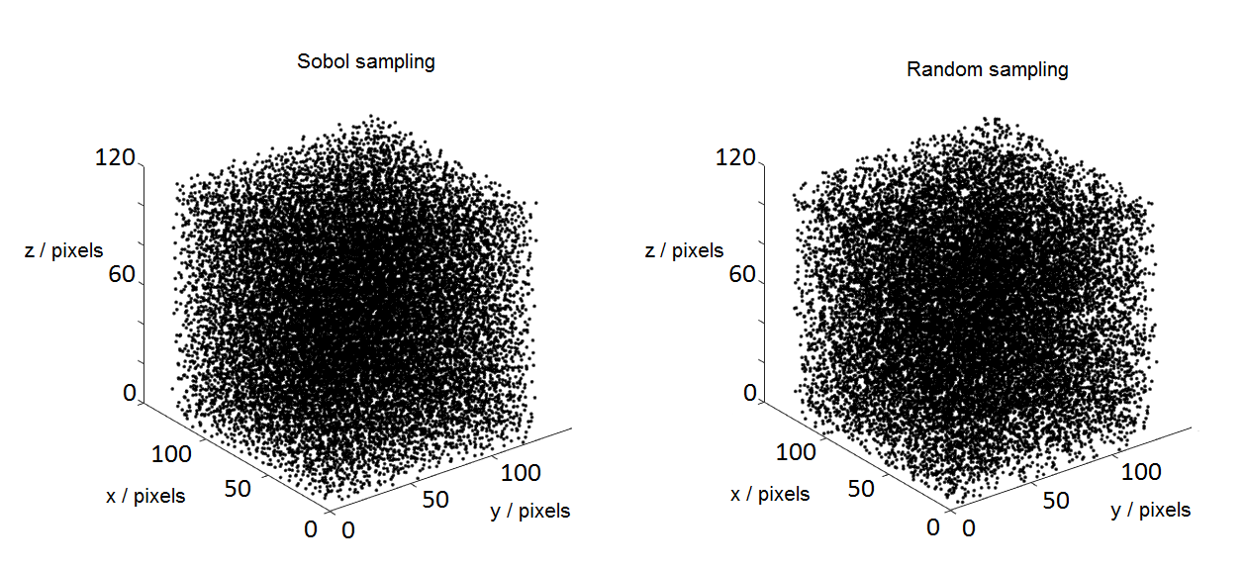
Extends naturally to 3D

Slide 82
CONCLUSIONS
Random Vectors/Low Discrepancy PCA
PCA by GPU is fast (<10s) provided you don’t exceed the 12Gb memory on the GPU card
This memory limit, and the ponderous QLT will force us to do PCA on only a sample of pixels (voxels)
“Not very random” methods of sampling, such as Sobol series, are best.

Slide 83
Thanks to
Chiefly yourselves for your attention!
Ionoptika & John Fletcher @ Swedish National IMS Centre, “go-IMS!”, Gothenburg for J105 imaging data
EPSRC for 2013 “Great 8” equipment grant that bought the J105
Nicholas Burn, Jack Calder, Joseph Ford, Andrew Kiang, Lisa Li, Joe Midgley, Jonathan Rhodes, Grant Saunby and Siyao Xu for design, simulation and precision machining & assembly.
Stuart Baker, Mike Foster and Jamie Hodgson of the CNC workshop in the School of Mechanical Engineering
Barry Gallacher and Richard Burnett at Newcastle for electronics design and fabrication.

Slide 84
Slope set by CPU/GPU speed
Set by how much you can tolerate
Slope set by disc read speed
Physical memory in PC

Slide 85
PCA of four Pixels

