Slide 1
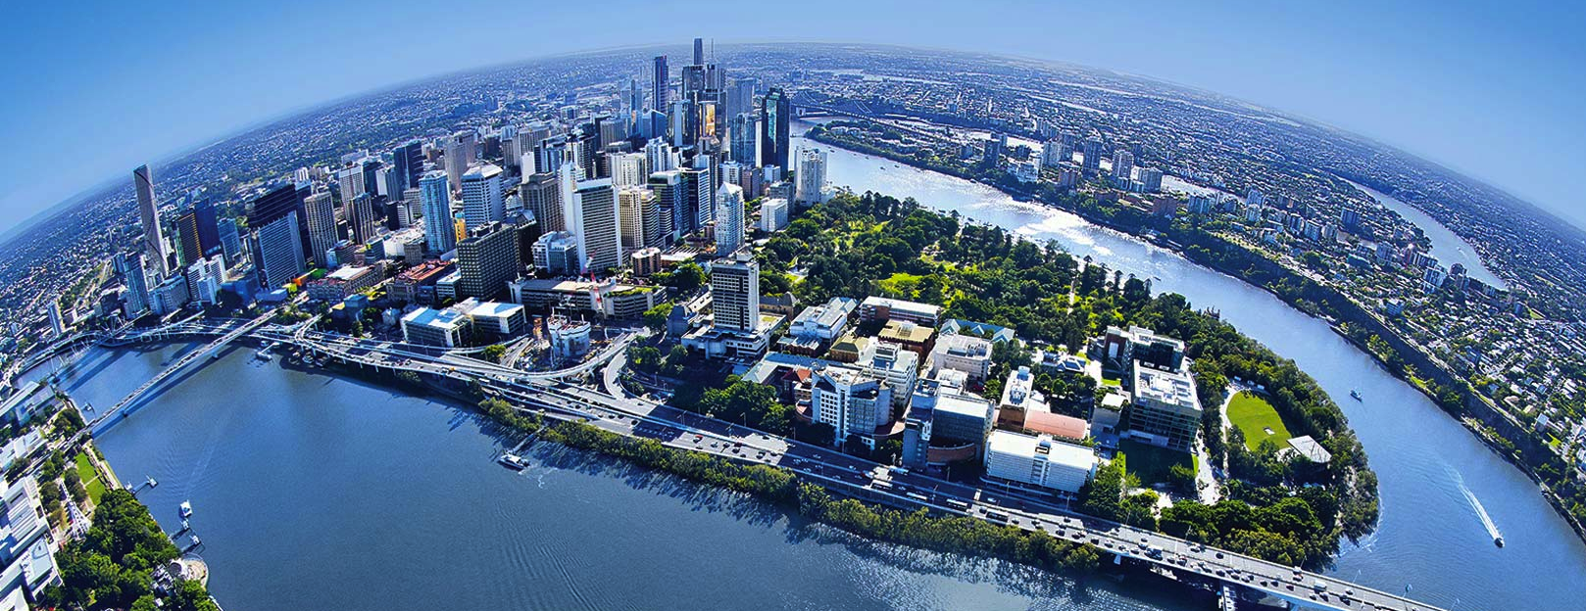

Graphene Heterostructures on SiC: 2D materials towards applications
Nunzio Motta, Mojtaba Amjadipour, Jonathan Bradford, Jennifer Macleod, Josh Lipton-Duffin, Francesca Iacopi*
School of Chemistry, Physics and Mechanical Engineering
Queensland University of Technology - Brisbane - Australia
*University Of Technology Sydney - Australia

Slide 2
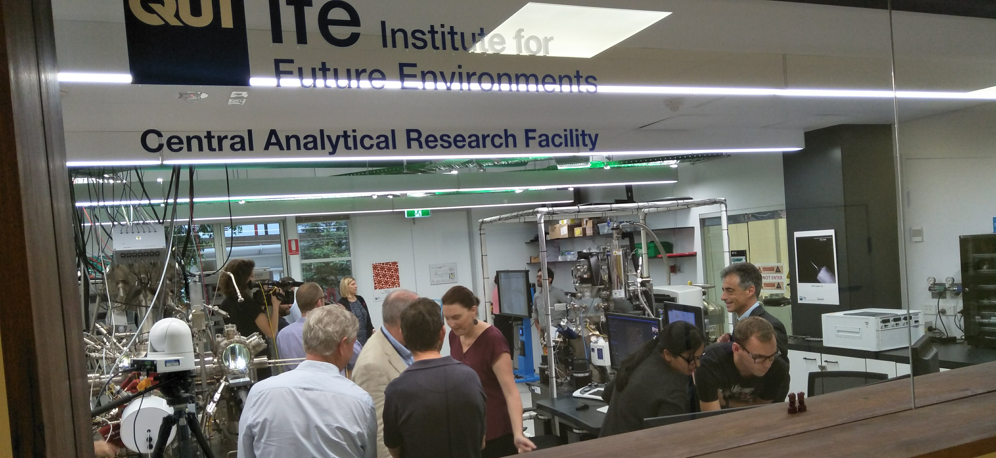
Nanoscale Imaging Lab - Queensland University of Technology
UHV Multiprobe System (2011)
Helium Ion Microscope (2014)
Xe- Plasma FIB (2019)
Opening, 24 April 2018

Slide 3
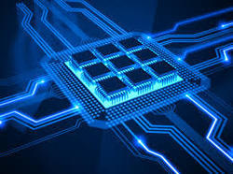
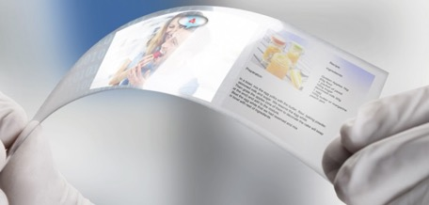
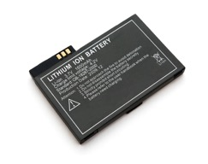
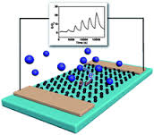
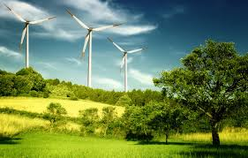
Why 2D Materials?
Electronics
  High speed electronics
  Low power consumption
Energy
  Supercapacitors
  Lithium batteries
Sensing
  Gas sensors
  Environmental monitoring
High surface to volume ratio

Slide 4
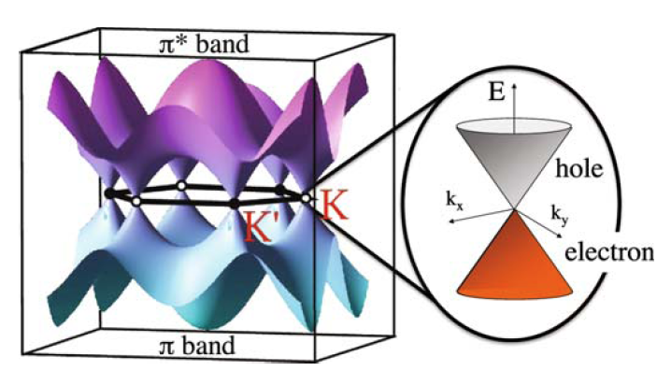
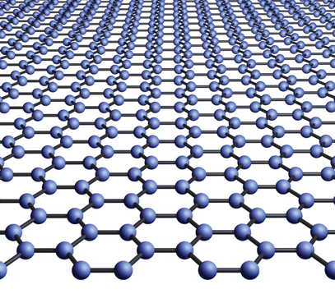



Graphene
One layer of graphite
First example of atomic 2D crystal.
The world’s strongest material
Extremely high electron mobility
Very elastic
Impermeable to any molecule
Graphene structure
Graphene electronic structure
Discovered 2004
Nobel prize (Geim – Novoselov) 2010
$$a_{1}=\frac{a}{2}\left(1, \sqrt{3}\right)$$
$$a_{2}=\frac{a}{2}\left(−1, \sqrt{3}\right)$$
Problem:
Semimetal (no electronic gap)
No digital electronics
$$a=\left|a_{1}\right|= \left|a_{2}\right|=0.246 nm$$

Slide 5
Summary
Epitaxial growth of Graphene
Opening a gap in graphene by nano-patterning
Making graphene free-standing
Graphene heterostructures
  2D in-plane heterostructures Graphene - h-BN
  2D Van der Waals heterostructures: Graphene - MoS₂ (WS₂)

Slide 6
Graphene from SiC
By high Temperature annealing

Slide 7
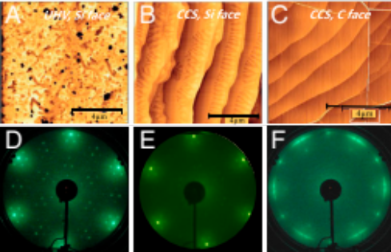
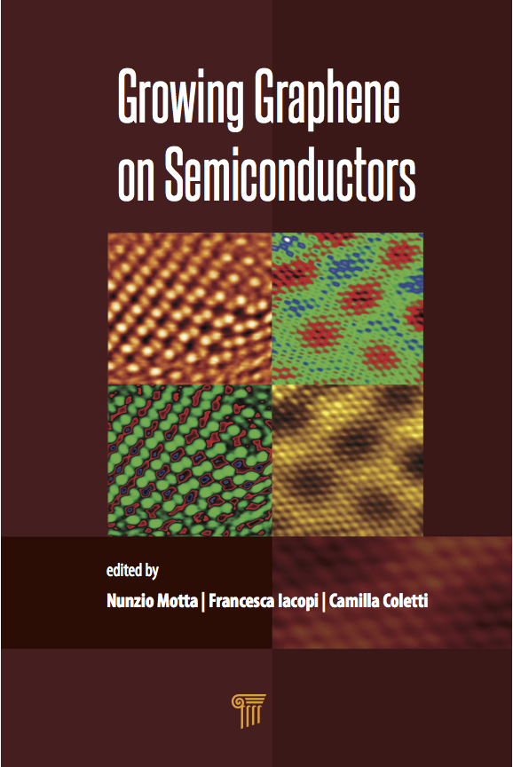
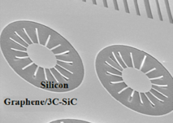
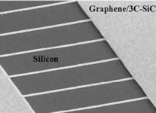
Graphene growth on SiC by Si sublimation
  Direct growth on semiconductor
  Compatibility with the semiconductor industry
  Clean process
  Potential combination with other 2D materials
  de Heer – Berger et al PNAS 108, 16900 (2011)
Si
Graphene
Si
Si
    Problem: Bulk SiC: very expensive
    Solution: 3C-SiC(111)/Si(111)
SiC
SiC
SiC
SiC
Motta, Iacopi, Coletti - Growing Graphene on Semiconductors - Pan Stanford - 2017
Cunning et al. Nanotechnology, 25, 325301 (2014)

Slide 8
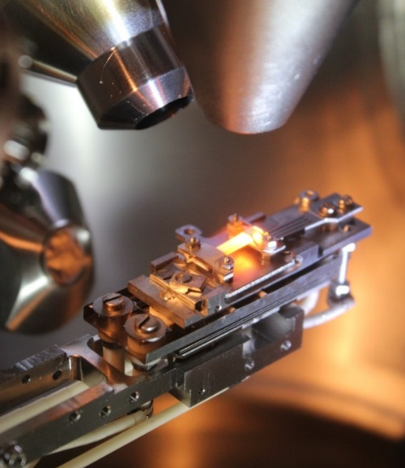
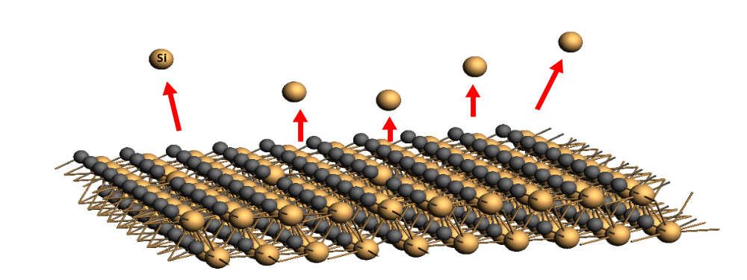
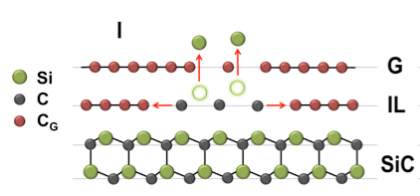
How does graphene grow on SiC?
Si leaving SiC as a result of high temperature annealing (~1200 ˚C)
Si
SiC/Si during annealing by direct current heating in UHV
F.Zarotti, B.Gupta. et al. Carbon 98 - (2016) 307-312

Slide 9
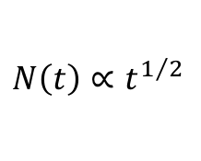
How does graphene grow on SiC?
Si leaving SiC as a result of high temperature annealing (~1200 ˚C)
Graphene XPS peak intensity
$$N\left(t\right)∝t^{1/2}$$
12
10
8
N of Graphene layers
6
4
2
SiC/Si during annealing by direct current heating in UHV
F.Zarotti, B.Gupta. et al. Carbon 98 - (2016) 307-312

Slide 10


Improving quality of graphene on SiC
Un-treated
H+ etched
Degassing
P= 1 10⁻⁹ mbar
T_{SiC}=950˚C 10’
Annealing
P= 5 10⁻¹⁰ mbar
T=1250˚C 10’
H⁺ treatment
P_{H}= 7.5 10⁻⁶ mbar
T_{SiC}=1000˚C 15’
Annealing
P= 5 10⁻¹⁰ mbar
T=1250˚C 10’
P.Mondelli, et al. Nanotechnology 28 (2017) 115601

Slide 11
Opening a gap
Quantum confinement

Slide 12
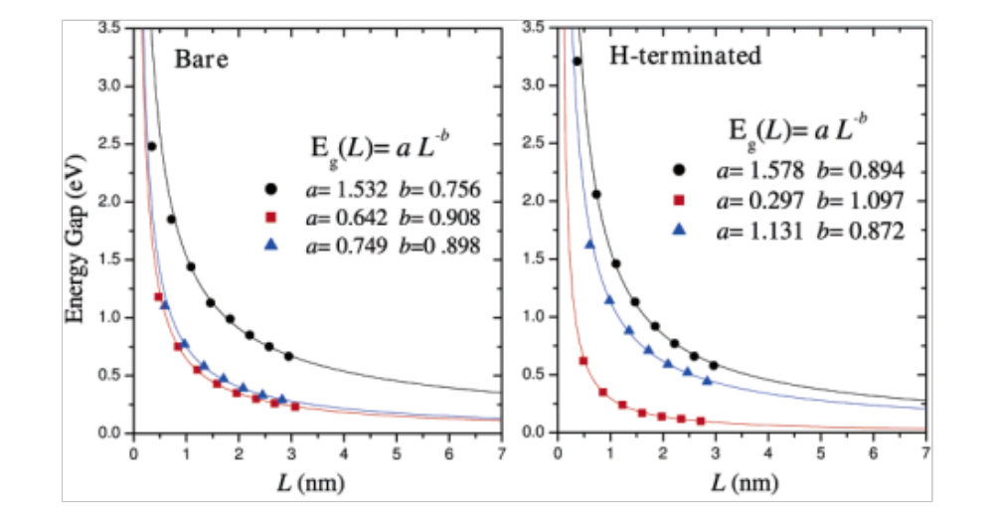
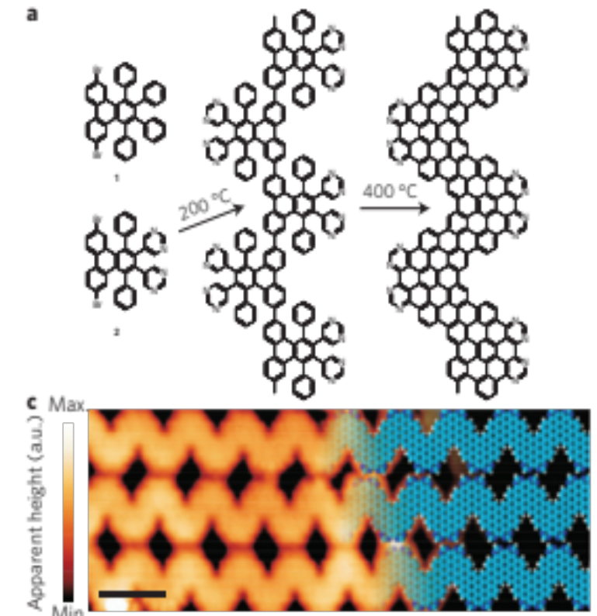
How to open a gap
Quantum confinement on the plane
  Graphene nanoribbons
Graphene NR on Au
    Barone et al Nano Letters, 2006. 6: p. 2748
    (Theory)
    Cai et al Nature Nanotech, 2014. 9 p. 896
    (Experiment)
Notes:
[1] Barone, V., O. Hod, and G.E. Scuseria, Electronic Structure and Stability of Semiconducting Graphene Nanoribbons. Nano Letters, 2006. 6(12): p. 2748-2754.
[2] Cai, J., C.A. Pignedoli, L. Talirz, P. Ruffieux, H. Söde, L. Liang, V. Meunier, R. Berger, R. Li, X. Feng, K. Müllen, and R. Fasel, Graphene nanoribbon heterojunctions. Nat Nano, 2014. 9(11): p. 896-900.

Slide 13
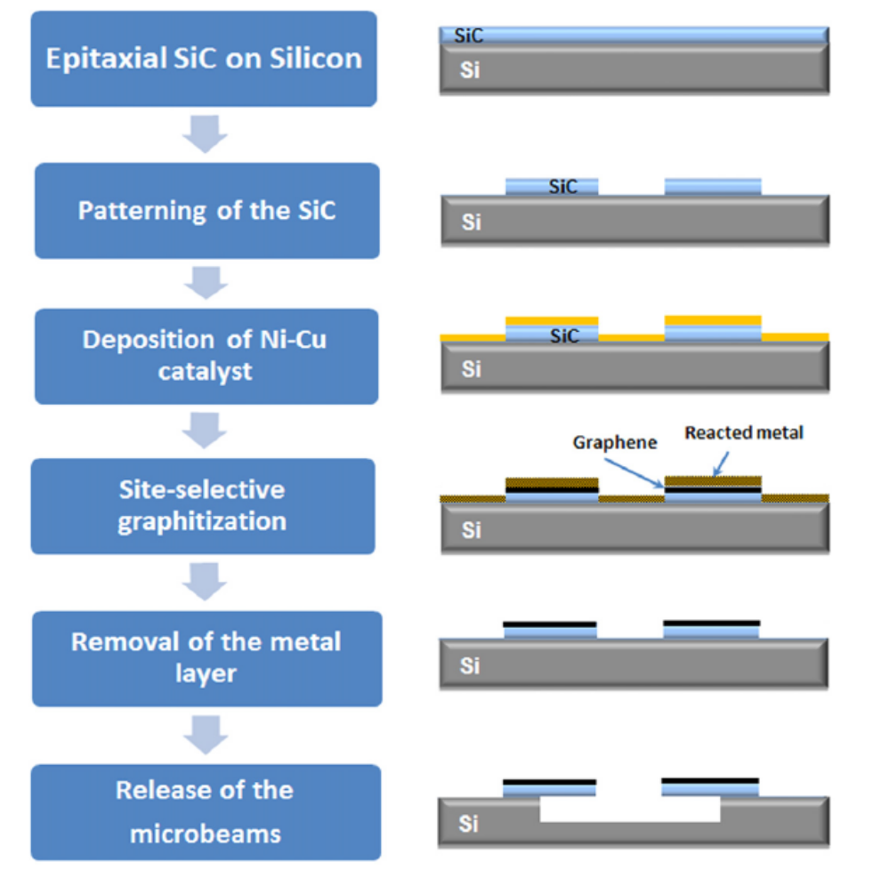
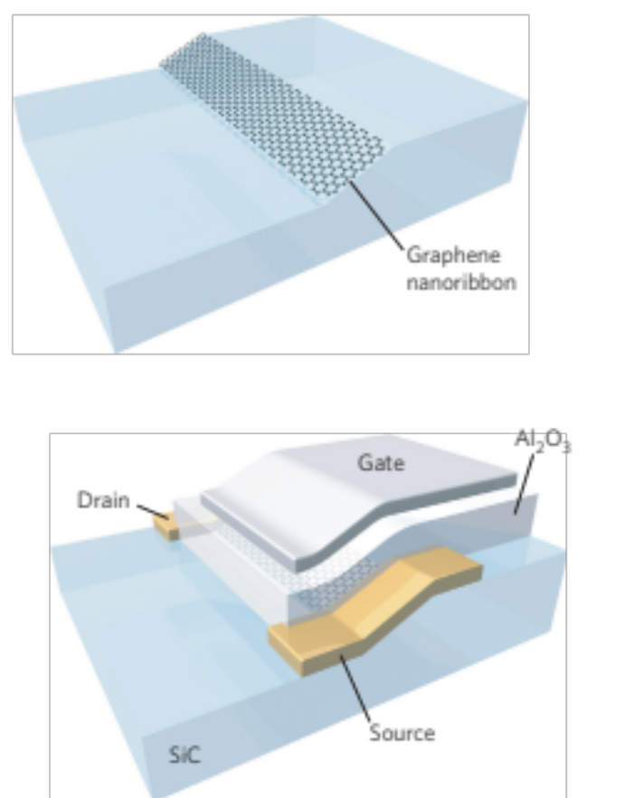

Nanoscale Graphene Fabrication on SiC
Graphene on SiC facets
Patterning 4H/6H-SiC by photolithography
Graphene on micro-scale structures
M. Sprinkle et al, Nature Nanotechnology, 2010. 5(10): p. 727-731.
B. V. Cunning et al, Nanotechnology, 2014. 25(32): p. 325301.
Notes:
graphene on SiC facets
Field Effect Transistor
More recently, Cunning et al [23] reported a pathway for fabricating SiC micro-structures at the wafer-level through photolithography, on which they achieved metal catalyst aided graphitisation

Slide 14
Our goal
Employing a combination of FIB (Ga⁺ ions) and HIM (Helium ions) to fabricate nanoscale structures
Fabricate a transistor using this approach

Slide 15
Ga⁺ FIB patterning
No Damage
Using Si Layer
Surface protection
required!
HIM Image
E-beam Si evaporation
M. Amjadipour et al. Nanotechnology 28.34 (2017): 345602.
Talk Surf Sci 6 Mojtaba Amjadipour
Notes:
In this study we showed the effect Ga ion poisoning on the graphene nanoribbon fabrication, and also we propose a procedure how to overcome the damage and produce high quality grapherne on FIB patterned nanostructures of SiC.

Slide 16
Effect of the protective layer
After
H-etching
Si Deposition
H-Etching
Graphene Growth
M. Amjadipour et al. Nanotechnology 28.34 (2017): 345602.
Notes:
Figure ‎4‑9. XPS spectrum of Si 2p: (a) after atomic hydrogen etching, (b) silicon deposition, (c) milling by FIB and second atomic hydrogen etching, (d) final graphene growth.

Slide 17
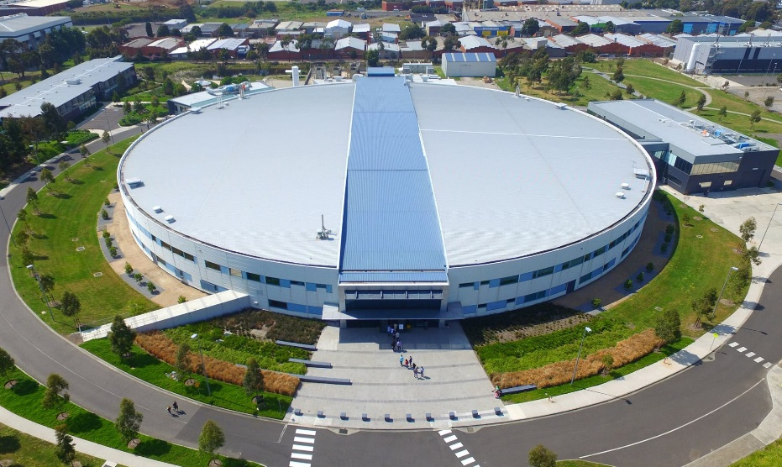

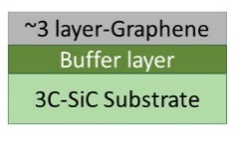
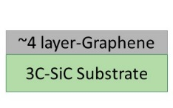
Free-Standing Graphene on 3C-SiC/Si(111)
Photoelectron Spectroscopy (PES) Measurement C 1s 330 eV
As Grown Graphene
Free-Standing
Graphene
Graphene
Buffer Layer
Graphene
H-intercalation
C 1s
C 1s
Buffer
H-intercalation improves flatness
600 ˚C, 30 mins
SiC
SiC
M. Amjadipour et al. Nanotechnology 29 (2018): 145601.
Notes:
The comparison of the peak intensity further confirms this, as the ratio of graphene-related spectral weight to silicon carbide spectral weight, $R=\frac{I_{gr}+I_{S1}+I_{S2}}{I_{SiC}}≅12$ , remains constant through the intercalation. In this expression

Slide 18
Opening a gap
2D Materials – Graphene heterostructures

Slide 19
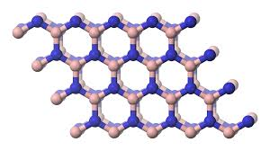
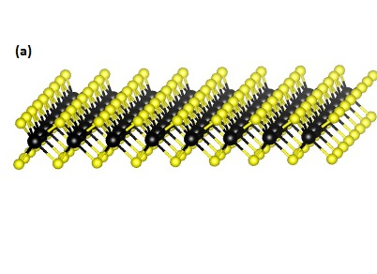
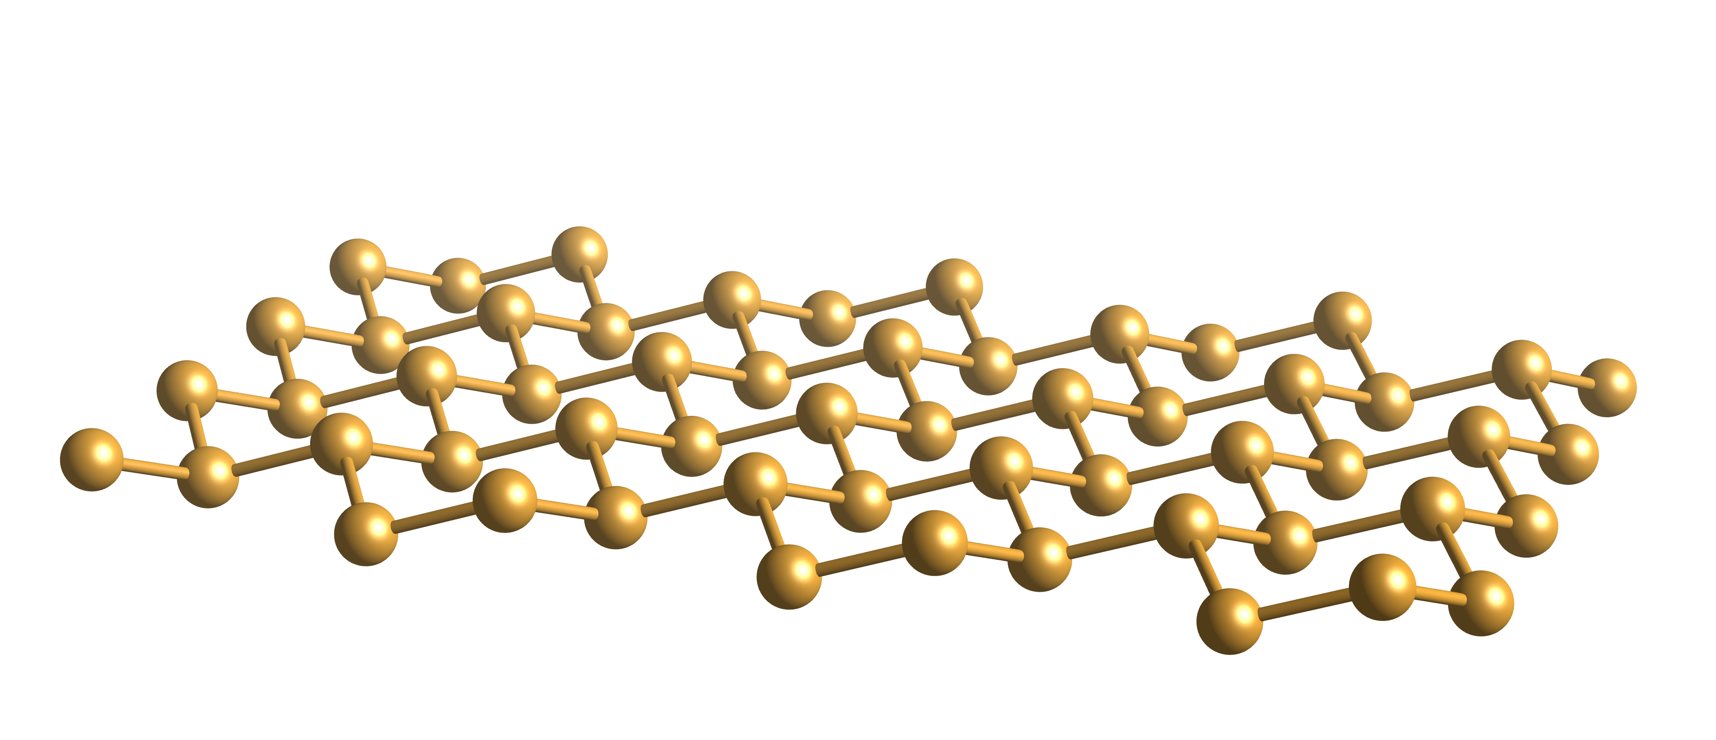
Other 2D Materials
Boron Nitride - BN
Transition metal Dichalcogenides
MXenes
Group IV materials:
Silicene
Germanene
Stannene
Silicene
h-BN E_{g}=5.2 eV
TMDC | E_{g} (ev)
MoS₂ | 1.78
MoSe₂ | 1.50
MoTe₂
WS₂ | 1.84
WSe₂ | 1.52
Insulator
Semiconductors
Semimetals
(gap opening by electric field or doping)

Slide 20
Epitaxial graphene heterostructures
2D materials Heterostructures
2D materials: building blocks
  Engineer heterostructures with new properties
  Tailor properties to suit applications
Geim, A.K., et al. Nature 499(7459) 419 (2013)

Slide 21
Graphene heterostructures on SiC
Lateral heterostructure of graphene and
h-BN on a SiC substrate
TMD/graphene/SiC van der Waals
heterostructure

Slide 22
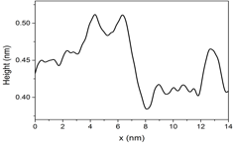
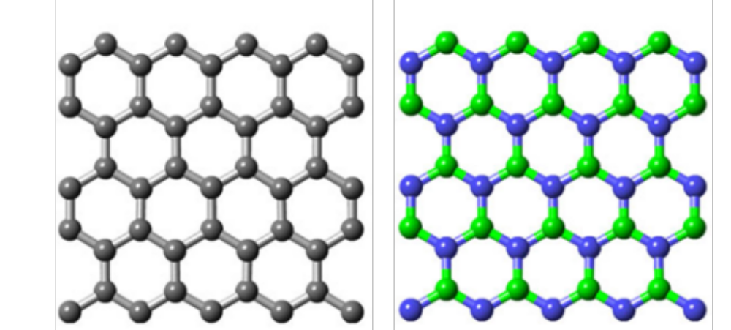
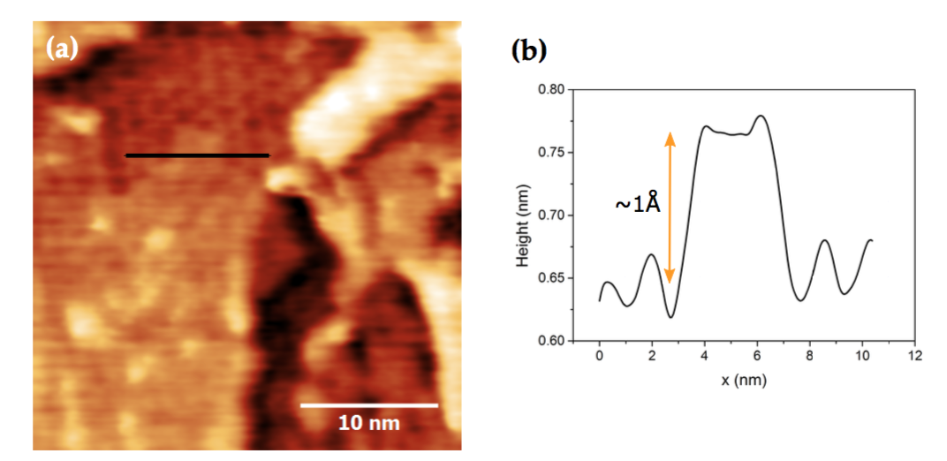
Graphene – h-BN in plane heterostructure
Following Talk: Jonathan Bradford
graphene
h-BN
6H-SiC substrate
Gr
1 Å
h-BN
h-BN
6x6 Gr
a=2.46 Å
a=2.505 Å
Gr
Very similar lattice constant (difference 1.8%)
Very different Energy gap (Gr=0, h-BN= 6.4 eV)
h-BN
Gap opening by surface alloying
h-BN /Gr STM images
J.Bradford, J.Macleod, J.Lipton-Duffin, M.Shafiei, N.Motta In preparation

Slide 23
TMD/Graphene van der Waals Heterostructures
High carrier mobility of graphene complements direct optical bandgap of monolayer TMDs (e.g. MoS₂, WS₂).
Ideal for optoelectronic devices
Photoresponsivity improved by a factor of 10⁴ compared to MoS₂.
Other applications in gas sensing, energy storage, electronics.
TMD/graphene/SiC van der Waals heterostructure
Pierucci, D. et. al. Sci. Rep. 6 (2016)
Photoresponse of a MoS₂/graphene photodetector

Slide 24
CVD Growth of TMDs on Graphene
MoS₂ grown by CVD from MoO₃ and S powders.
Tube pumped down to 85 Torr under Ar
MoO₃ evaporated at 800˚C and S evaporated at 300˚C.
Films characterised by AFM, XPS, STM and Raman spectroscopy.

Slide 25
MoS₂/Graphene/SiC - XPS

Slide 26
Multilayer MoS₂/Graphene/SiC
AFM image of low density multilayer
MoS₂ flakes grown under 200 sccm Ar flow.
STM image of an individual MoS₂ flake
(V = 1:6 V; I = 0:6 nA).

Slide 27
MoS₂ spirals on Graphene/SiC
AFM image of high density multilayer
MoS₂ flakes grown under 300 sccm Ar flow.
STM image of an MoS₂ spiral
(V = 2.0 V; I = 0.4 nA).

Slide 28
MoS₂/Graphene/SiC – Raman spectroscopy
Raman spectrum of MoS₂/gr/SiC. Inset: Raman spectrum of gr/SiC.

Slide 29
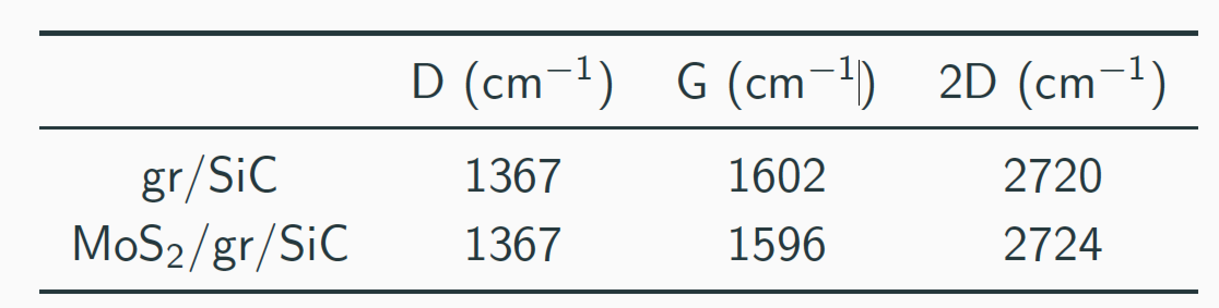
MoS₂/Graphene/SiC – Raman spectroscopy
Graphene Raman peak positions:
6 cm⁻¹ redshift of G peak and 4 cm⁻¹ blueshift of 2D peak
Graphene is hole doped under laser illumination
Electron-hole pairs generated in MoS₂ and separated at the interface

Slide 30

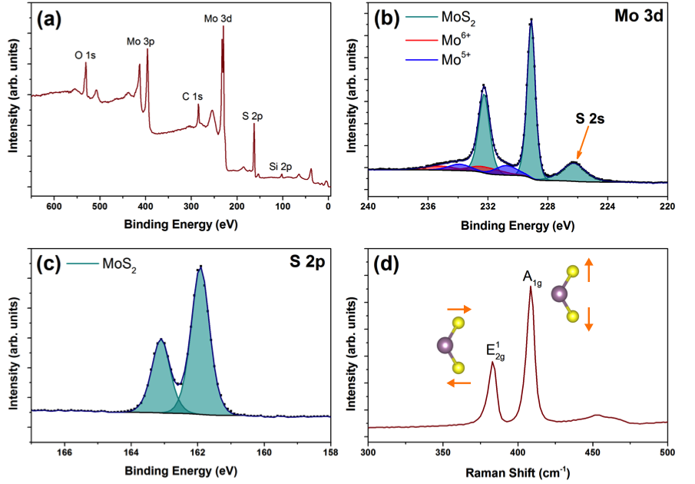
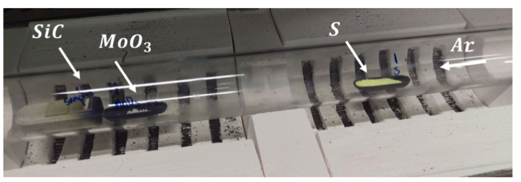
Growth of MoS₂ on 4H-SiC
MoS₂ grown by CVD on 4H-SiC substrates.
T=750 ˚C
P= 80 Torr
Ar flux: 300 sccm
X-ray photoemission spectroscopy (XPS) and Raman spectroscopy identify the growth of MoS2 with minimal residual oxide.
12
Notes:
Enhancement of the A_{1g} lattice vibration (out-of-plane) is due to high density of exposed edges.
Need to understand the growth mechanism

Slide 31
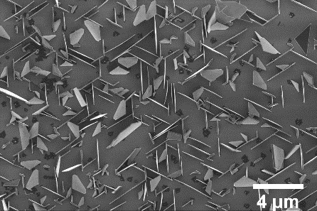
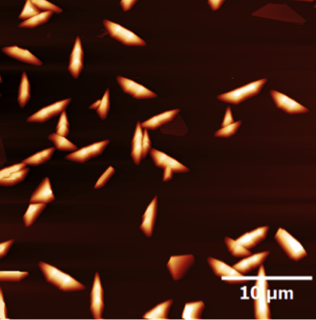
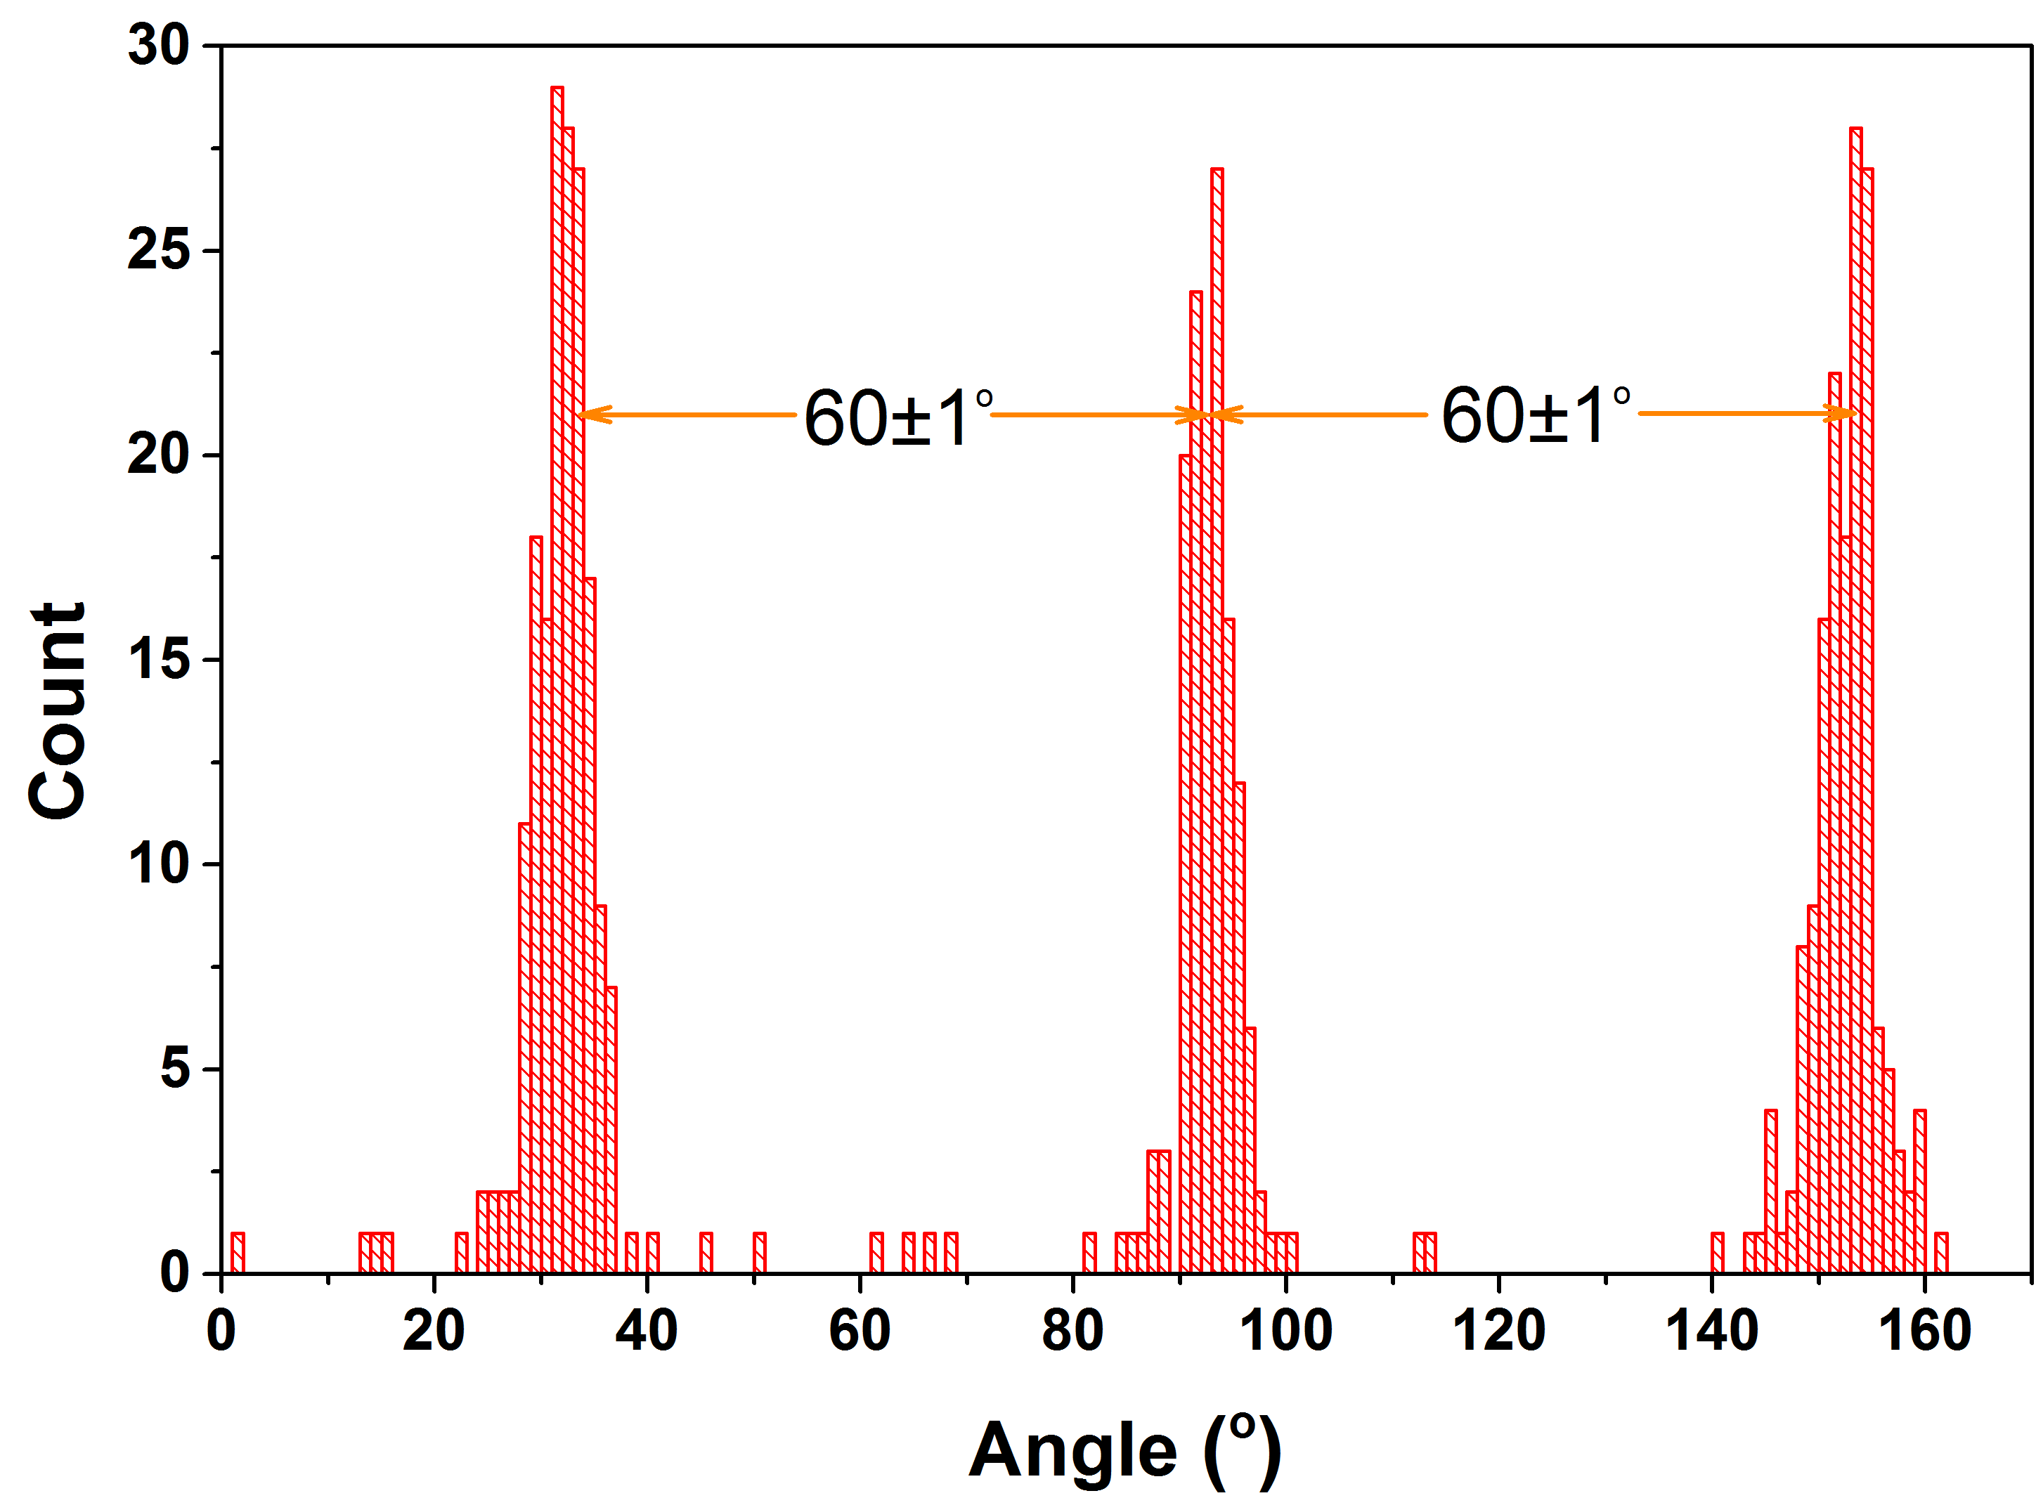
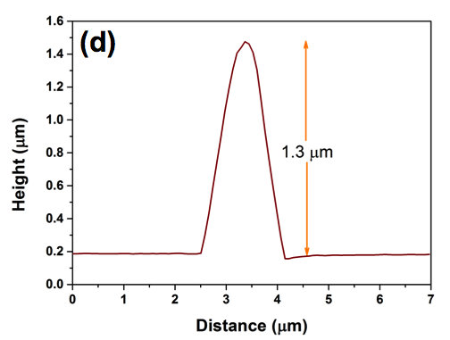
Vertical MoS₂ Flakes on SiC!
SEM
AFM
Flakes are vertically standing with three preferred orientations.
Flakes grow preferentially at the step edges
High edge density of vertically standing flakes ideal for applications in gas sensing, field emission, etc.
12
Notes:
Three preferred orientations are 60 degrees apart from one another, suggesting that they are aligned to the three high symmetry directions of the hexagonal SiC lattice
Need to understand the growth mechanism

Slide 32
Conclusions
Epitaxial Graphene growth on SiC
High temperature annealing in UHV
FIB nanopatterning to open a gap
H intercalation to isolate graphene
Heterostructures of 2D materials on epitaxial graphene
Growth of in-plane graphene/h-BN heterostructures on SiC.
Spiral and multilayer growth modes of MoS₂ on epitaxial graphene/SiC
Vertical flakes of MoS₂ on SiC

Slide 33
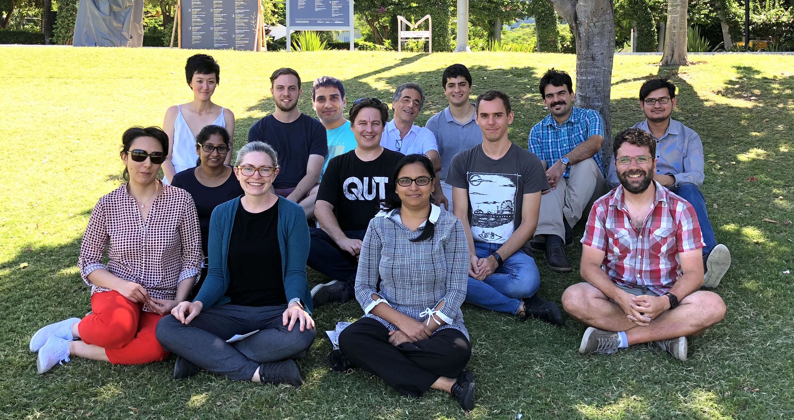






Acknowledgements
QUT Surface science group
Jennifer MacLeod
Josh Lipton Duffin
Bharati Gupta
Jonathan Bradford
Mojtaba Amjadi Pour
Nima Khoshsirat
Muhammad Imran
Michael Horn
Maryam Abyasizami
Collaborators
Francesca Iacopi (UTS)
Mahnaz Shafiei (Swinburne)
Sgarlata, Tomellini, Placidi, De Crescenzi (Tor Vergata)
Mariani, Betti, Di Bernardo, Mondelli (Sapienza)
Jinzhang Liu (Beihang)
Isabelle Berbezier (IM2NP)
Luca Camilli (DTU)

Slide 34
Silicene
Work in progress…
Silicene on AG(111)
Silicene on graphene

Slide 35
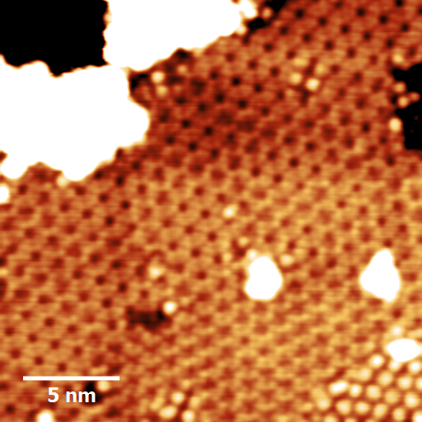
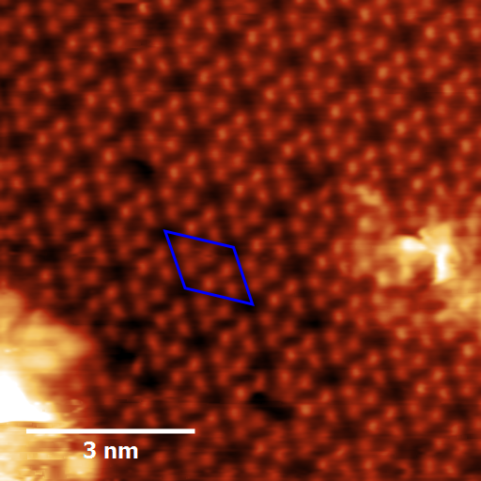
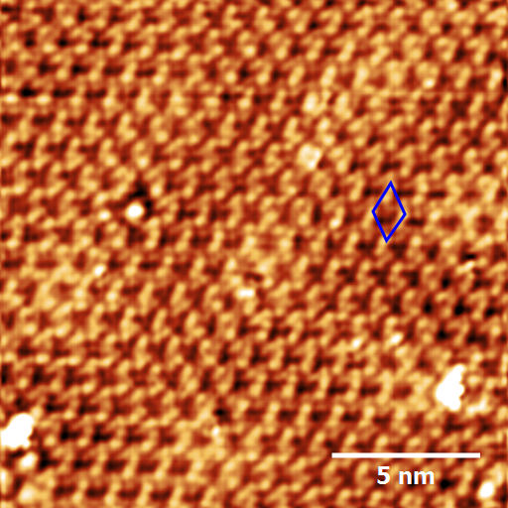
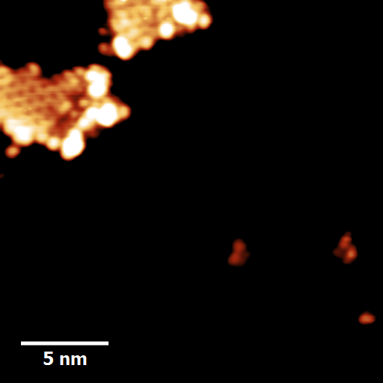
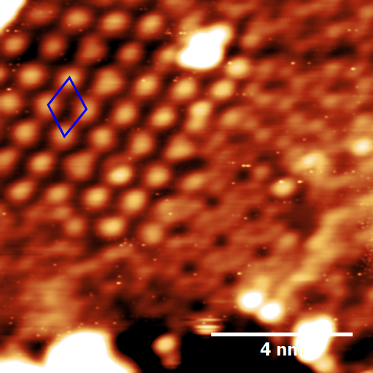
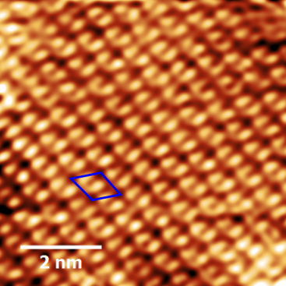
Silicene on Ag(111)/Mica
STM image of the silicon monolayer/Ag
(V = -1.0 V, I = 1.0 nA).

Slide 36
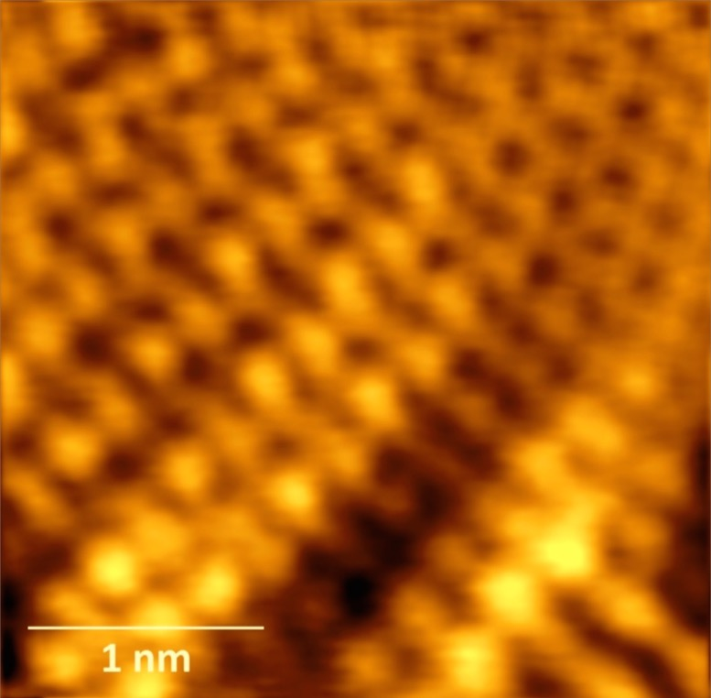

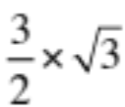

Surface – Transition: SiC to graphene
Graphene
4.9
4.6 Å
2x2
5.2 Å
SiC (3/2x√3)
4.9
200 nm 3C SiC (111)/Si(111) T = 1250˚C
5.2
5.3 Å
Collaboration
4.6
5.3 Å
STM image V_{b}=60 mV I=80 pA
STM image (20mV; I=80pA)
3.6 nm
3 nm
B. Gupta, E. Placidi, C. Hogan, et al., Carbon, 91, 378 (2015)

Slide 37
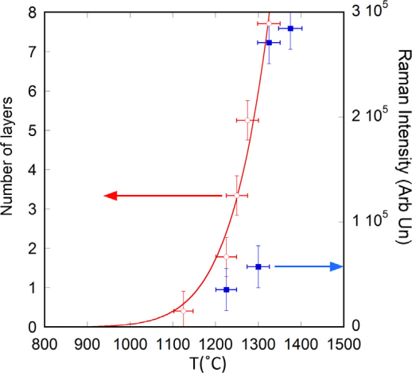
XPS: Number of graphene layers vs T
10’ annealing
Arrhenius formula
N(T) = A e^{-Ea/KT}
Activation energy
E_{a} = 2.46 eV
A = 4.74 x 10⁸
2D
B.Gupta. et al. Carbon 68 ( 2014 ) 563 –572
Notes:
By annealing for 10’ we found an increase in the number of layers with temperature described by the Arrhenius formula

Slide 38
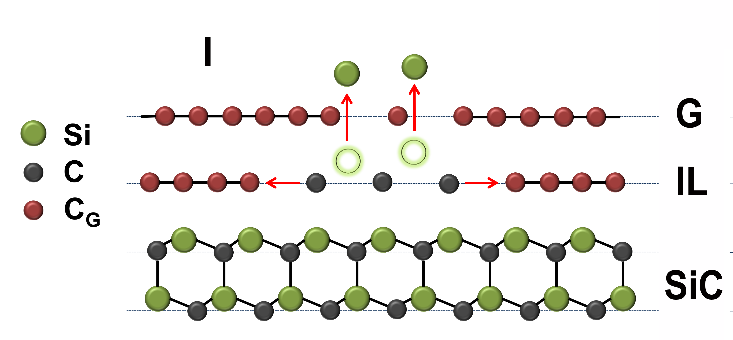
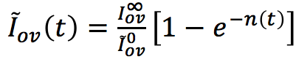
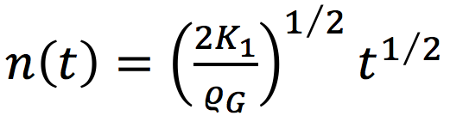
Graphene thickness vs annealing time
graphene
SiC
Si out-diffusion
F.Zarotti, B.Gupta. et al. Carbon 98 - (2016) 307-312

Slide 39





Growth law of the graphene layer
X-ray
e⁻
hν
Overlayer signal
G + I
Exponential rise
graphene
SiC
h(t)
Intensity of the normalised overlayer signal
(λ=e⁻ mean free path)
The overall best fitting is obtained with the function
$$∝Number oflayers$$
(growth law)
$$N\left(t\right)∝t^{1/2}$$
F.Zarotti, B.Gupta. et al. Carbon 98 - (2016) 307-312
Notes:
The intensity of the overlayer signal, normalised to the substrate signal can be fitted with an exponential rising function as a function of time.
This can be obtained by a simple argument considering the contribution of the signal coming from the different layers and the attenuation of the electron flux due to the layer thickness.
Eq. 1 of our Carbon paper (Zarotti et al)

Slide 40







Arrhenius plot – activation energy
So we fit all the temperatures with
Experimental kinetics
The slope = provides the activation energy
and obtain β for each T.
From diffusion theory:
Where:
Activation energy
K₁=diffusion constant
U_{d}*=diffusion energy
E_{si}= Si bond energy
F.Zarotti, B.Gupta. et al. Carbon 98 - (2016) 307-312
Notes:
Our experimental fit of the beta coefficient provides an evaluation of the activation energy
The slope provides in fact an “apparent” activation energy.
The real activation energy is Ud* + Esi/2 =~ 5 eV, which is matching the theoretical value of energy

Slide 41


How to produce free-Standing Graphene
Buffer layer
ML graphene + Buffer layer
PES Measurement
H-intercalation
by molecular hydrogen
on bulk SiC
Free-standing ML graphene
Free-standing BL graphene
Free-standing
S1 and S2 disappear after H-intercalation
C. Riedl et al, Physical Review Letters, 2009. 103(24): p. 246804.

Slide 42
Energy storage
Use of graphene and Graphene oxide for improving supercapacitors energy storage

Slide 43



Supercapacitors
High power density
Fast charge and discharge rate

Slide 44






Supercapacitors
    Energy storage is electrostatic
      no chemical reactions
      physical phenomenon
    highly reversible

Slide 45


1. Exfoliated graphene
Vacuum filtration
optical
Graphene dispersion
Porous alumina
membrane
SEM
AFM
Vacuum pumping
SEM cross section
AFM results
supercapacitor
Glass or PET
PVA+H3PO4
Gelled electrolyte
Glass or PET
C=0.9 mF/cm²
C=0.7 mF/cm²
J. Liu et al, Langmuir, 2013, Vol. 29,p13307

Slide 46






2. Graphene + Carbon Nanotubes film
SEM
G
CNT
HIM image
SEM
graphene films as electrodes
CNT films as current collectors
G
CNT
CNT film
Low R graphene film
C=2.2 mF/cm²

Slide 47






3. Graphene/MWNT mixture
Making electrodes out of graphene-MWCNT mixture films with high roughness.
Repeat process:
Grinding + suspension + filtration
2 μm
C=10 mF/cm²
200 nm
J.Liu, et al. Journal of Power Sources，274, p823 (2015)

Slide 48




Scaling up the production
Reduced graphene oxide
Reduced Graphene oxide( rGO) solution
  1: Blade-coating : dense paste
  2: Spray coating : liquid solution
1
AFM of
rGO on
mica
2
rGO

Slide 49

4. Blade coating - spray coating
Fabrication process of flexible solid-state supercapacitors
(polyimide)

Slide 50



4. Blade vs spray: SEM analysis
Blade-coated film
Spray-coated film
Blade coating:
0.23 mg/cm²
(C= 250 F/g)
C=57.5 mF/cm²
B.Wang,et al. ACS Applied materials and interfaces 34, 22316, 2016

Slide 51

5. Hybrid Graphene Oxide/NaCl/Urea Films
Record capacitance: 425 F/g
@ 1A/g
Y. Zhao, et al. ACS Applied materials and interfaces (2017) (10.1021/acsami.7b05965)

Slide 52
5. Hybrid Graphene Oxide/NaCl/Urea Films
Y. Zhao, et al. ACS Applied materials and interfaces (2017) (10.1021/acsami.7b05965)
Capacitance improvement:
>100!

Slide 53



Graphene sponge for Li Batteries
Study Li adsorption on graphene sponge by XPS
Collaboration
I. Di Bernardo, M.C. Asensio, C. Chen, J. Avila, Y. Ito , J.L.Duffin, P. Hines , L.Rintoul N.Motta C. Mariani, M.G.Betti, to be submitted

Slide 54

2D Materials for gas sensing
Graphene Oxide
SEM
Collaboration
Brescia University
AFM
Sensing NH₃
AFM
1 μm

Slide 55
Capacitance measurements
Note: the way in which capacitance is measured is very important!
Weight capacitance: Farad/g
  If the active material is very light how much space you need to get enough capacitance?
Volume capacitance: Farad/cm³
  if the active material is thin, what happens to thick layer?
Surface capacitance: Farad/cm²
  surface does not take into account thickness!

