Slide 1
Two-dimensional and wide dynamic range profile monitor using OTR/fluorescence screens for diagnosing beam halo of intense proton beam
Y. Hashimoto, T. Toyama,
T. Mitsuhashi and M. Tejima
KEK

Slide 2
In The J-PARC,
We want to see beam profile of proton beam (like in the electron machine).
We want to see halo profile.
What is effect of beam collimator?

Slide 3
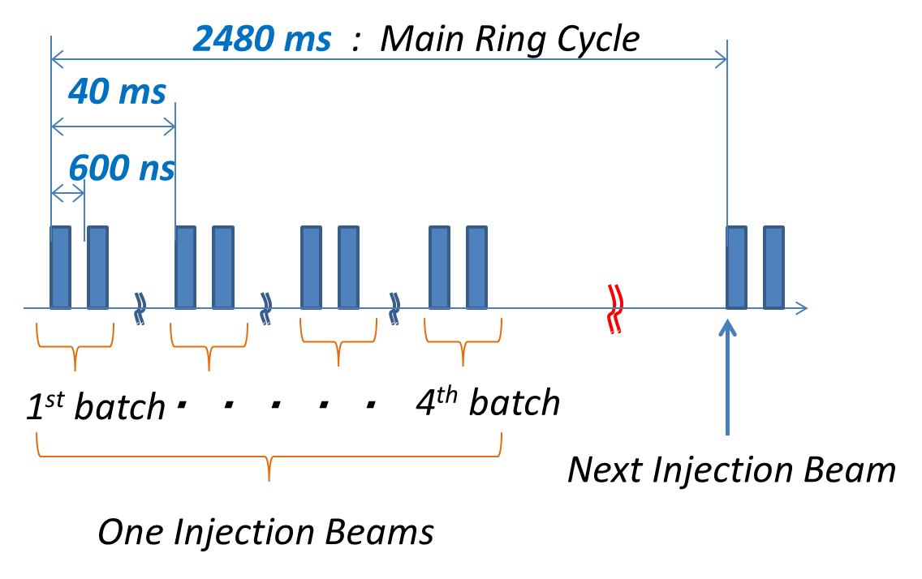
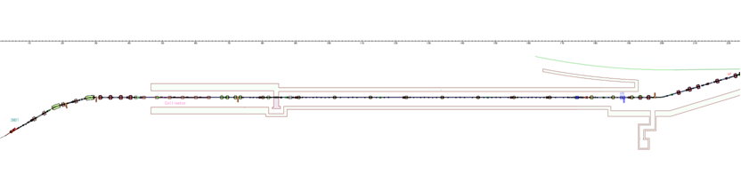
J-PARC
3-50 beam transportline
~ 122m
Beam collimator
Location of the monitor

Slide 4
Optical design for OTR profile monitor in beam transportline between 3.5GeV Rapid Cycle Synchrotron and 50GeV main ring
The beam size of
proton beam is 5cm!
*2 dimensional charge distribution
*3 dimensional charge distribution
Tomographyc observation
*2 dimensional halo distribution
Light source is OTR and
fluorescence screen
5cm

Slide 5
OTR screen for beam core observation!
Beam core
Beam halo

Slide 6
Beam halo observation by screen with hole
OTR from beam halo only!
Beam core
screen with hole
Beam halo

Slide 7
Fluorescence screen for observation of beam halo in outside
Beam core

Slide 8
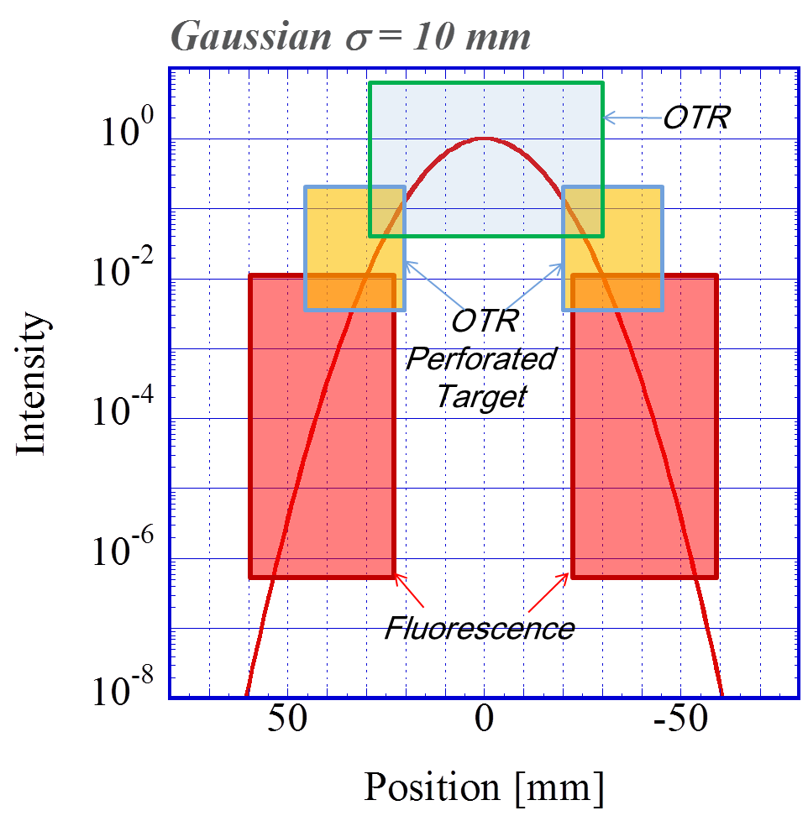

Slide 9
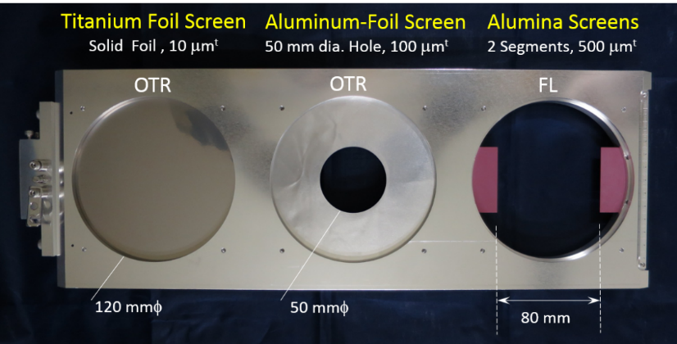
Target assembly

Slide 10
OTR : 3GeV Proton Beam (Low γ）
2.5×10¹⁰ photons/10¹³ protons
30GeV
3GeV
Intensity : Emitted photon number in a light band (ω₂-ω₁)

Slide 11
Angular distribution of OTR from 3.5GeV Al foil target and proton beam
RCS 3GeV
Peak is in 350mrad!
PS 12GeV

Slide 12
Typical OTR profile monitor at electron machine
OTR screen 45º
few mrad
lens
Imaging device

Slide 13
Typical OTR profile monitor at electron machine
OTR screen 45º
Large field depth by large object
few mrad
lens
Imaging device

Slide 14
Toyoda, Mitsuhashi 2009 for slow extraction line at J-PARC
OTR screen 45º
Large field depth by large object
6000mm
50 mrad
Imaging device
300mm

Slide 15
Large field depth by large object
45degree set up of target will impossible!
Too long
field depth!
500mm
500mrad

Slide 16
Foil target must be normal to the beam!
500mm
beam
500mrad

Slide 17
Offner relay system
Proton beam
500 mrad
Spherical 2ed mirror
D=200mm
R=250mm
Spherical 1st mirror
D=600mm
R=500mm
D=300mm２枚

Slide 18
Application of Offner relay system to reflective input optics for the Streak camera (2002)

Slide 19
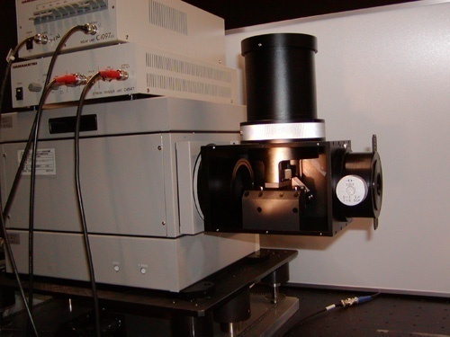

Slide 20
Design of Offner relay system
Object size: 50mm
General aperture
300mm

Slide 21
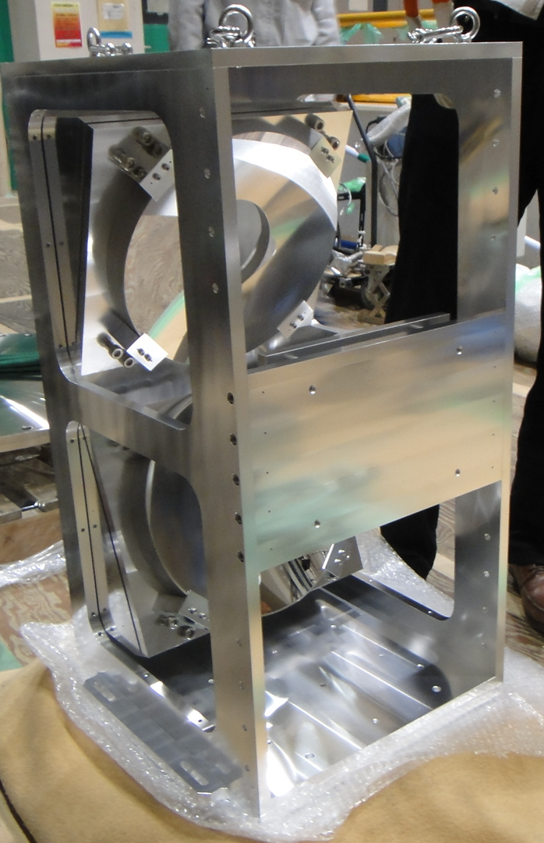
First mirror
Spherical concave 300mm in diameter
f=500mm
Second mirror
Spherical convex
200mm in diameter
f=250mm
Third mirror
Spherical concave 300mm in diameter
f=500mm

Slide 22
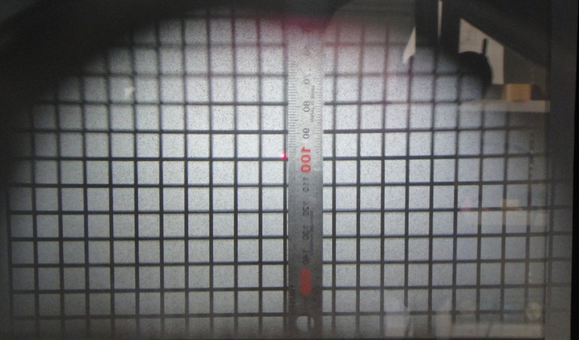
Grid chart test
Clear region
+/-45mm in vertical
+/-100mm in horizontal

Slide 23
Direct observation of beam image by reduction system
Design of reduction system
How to reduce image filed (100mm x 100mm) into CCD aria (10mm x 10mm)?
Magnification of Offner system is 1:1, so image field is 10cmx10cm.
A reduction system having magnification factor less than 0.1 will necessary.

Slide 24
We cannot realize large reduction ratio with simple configurations.
Often focus point is in the lens！
We must design long backfocus.
Apply a retro-focus design
Configuration of retro-focus
H₁
H₂
f
f

Slide 25
Large reduction optics system with retro-focus design
Acceptance 300mrad
Lens material: B270 (a kind of white crown glass)
Long working distance is necessary for observing image in vacuum chamber

Slide 26
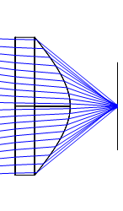
Large reduction ratio is impossible!

Slide 27
Aperture of next optics

Slide 28
Proton beam
diffuser screen

Slide 29
Angular opening of OTR is shacking by PSF of diffuser
Diffuser screen

Slide 30
Lens aperture
Diffuser screen

Slide 31
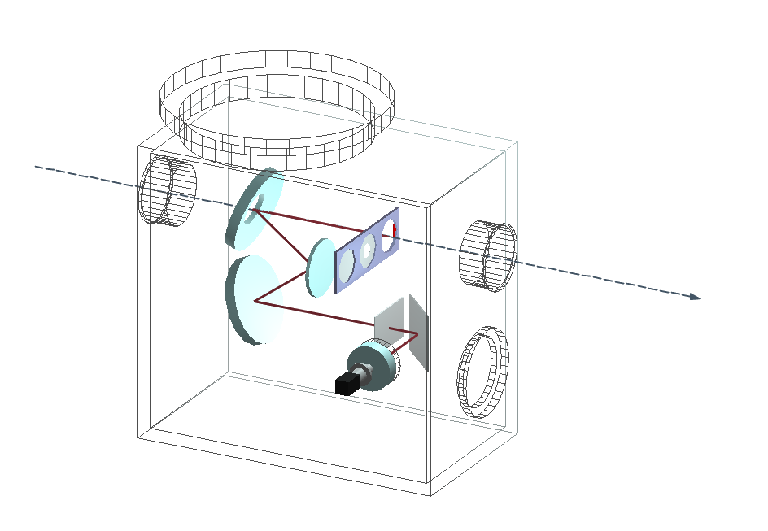

Slide 32
Alumina fluorescence screen
+OTR screen

Slide 33
Alumina fluorescence screen
+OTR screen
Offner relay optical system

Slide 34
Alumina fluorescence screen
+OTR screen
Offner relay optical system
Diffuser screen

Slide 35
Alumina fluorescence screen
+OTR screen
Offner relay optical system
Diffuser screen
Image intensifier+ CID camera

Slide 37
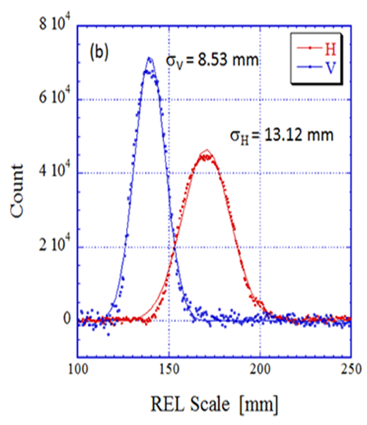
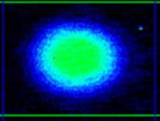
Beam core image
(OTR)

Slide 38
Beam core image (OTR) and beam halo (FL)

Slide 39
  For the scaling of different images,
  1. Gain ratio G_{R} of image intensifier
  G_{R}=G₁₀₀₀/G_{SET}
  G₁₀₀₀ : Gain at MCP1000V
  G_{SET} : Gain at each observation
  2. Ratio between fluorescence and
  OTR in the same region

Slide 42
Adding vertical fluorescence screen

Slide 43
Four fluorescence screen are set in vertical and horizontal arrangement in front of OTR screen
Titanium foil target for beam core observation
Movable fluorescence
Screen for beam halo observation
fluorescence
fluorescence
Beam Profile
(Projection )
OTR

Slide 44
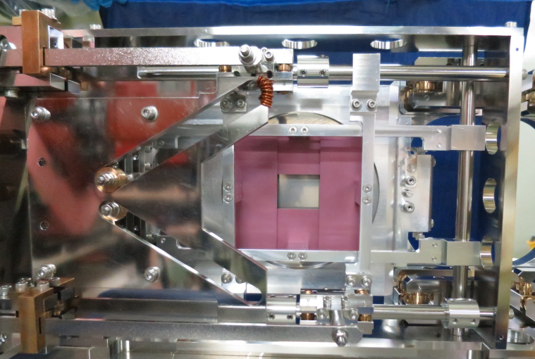

Slide 45
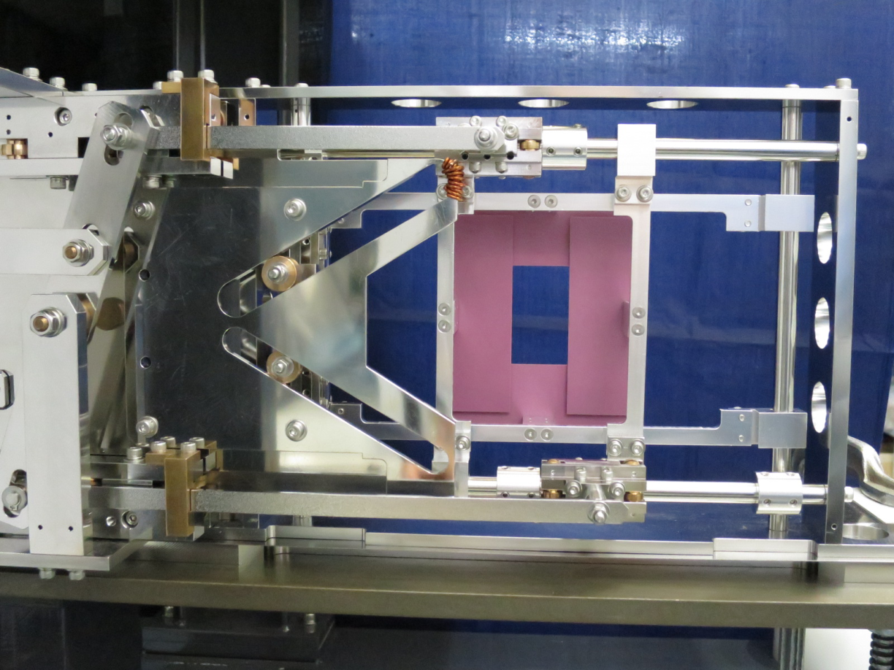

Slide 46
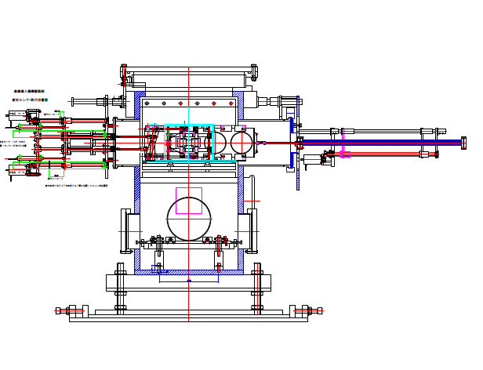

Slide 47
Observation of effect of beam collimator for beam halo

Slide 48
Superimposed image of beam core (OTR), one image of beam halo near by core (OTR) and
Beam halo in far from core (fluorescence)

Slide 49
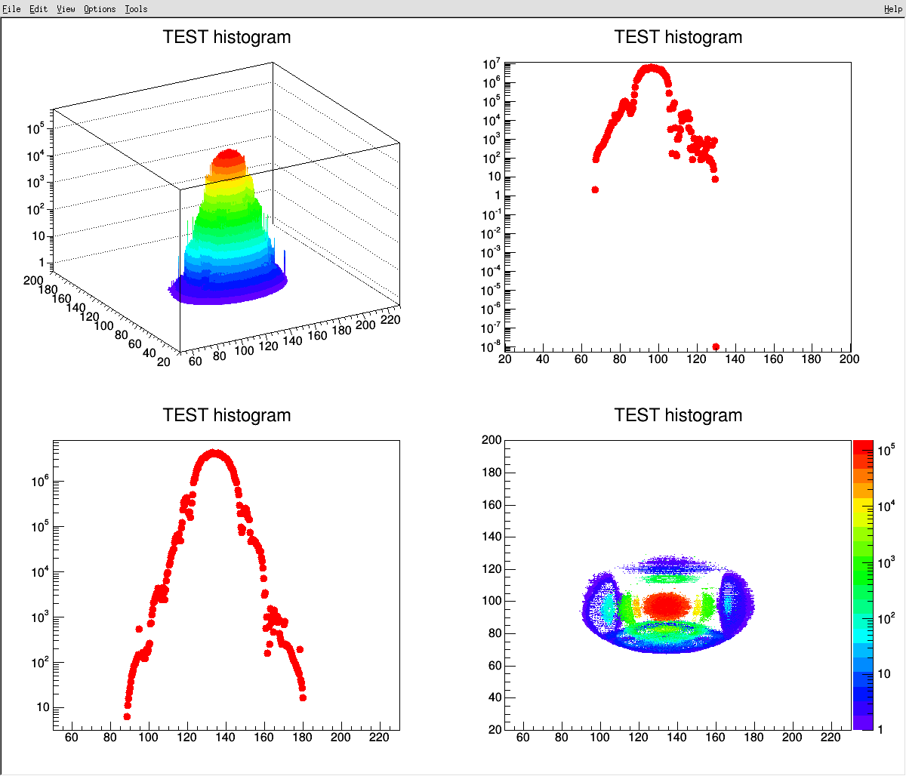
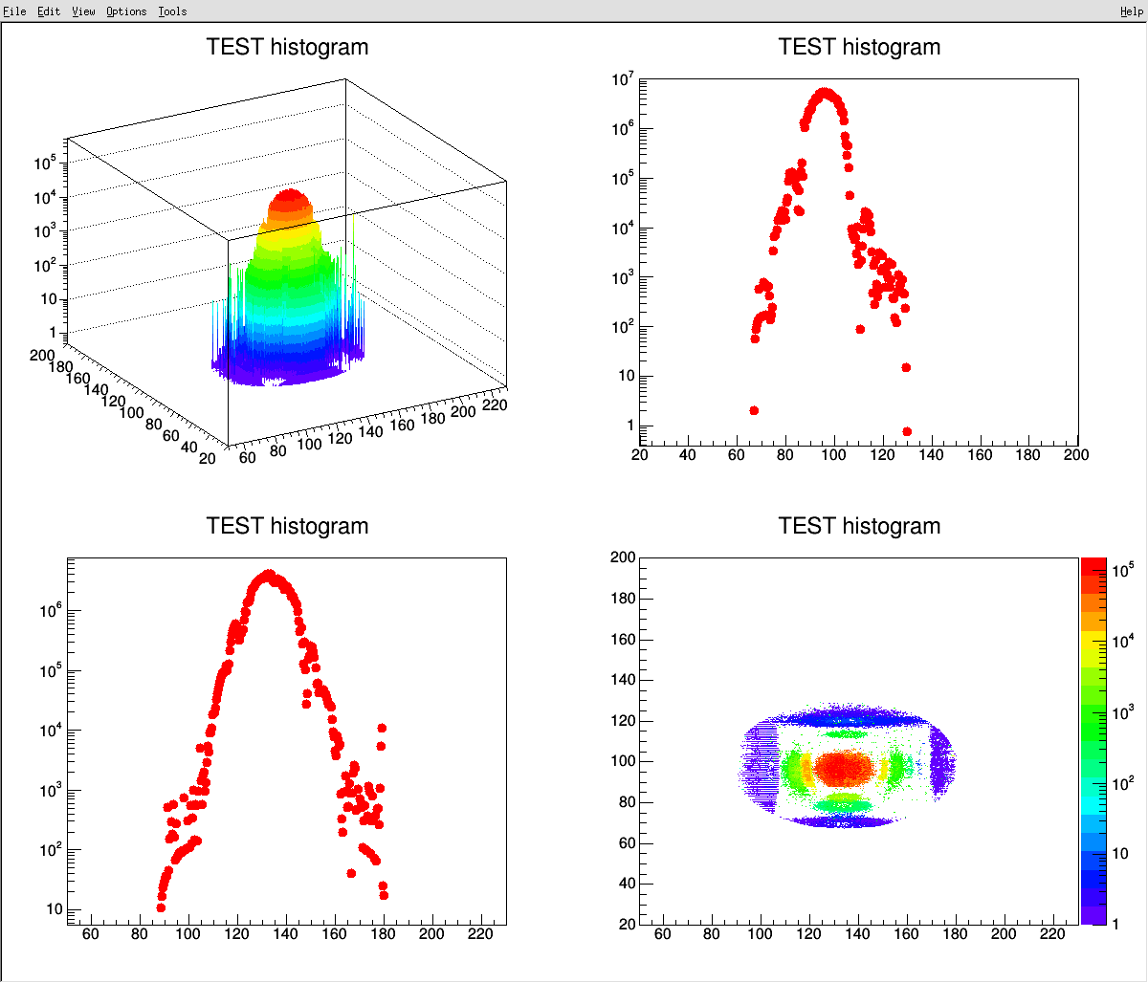
Difference in order of 10⁻⁴ to 10⁻⁵
Collimator off
Collimator on

Slide 50
Horizontal collimator
Collimator OFF
Collimator ON

Slide 51
Vertical collimator
Collimator OFF
Collimator ON

Slide 52
A Simultaneous observation of beam core with OTR
and
fluorescence screen

Slide 53
OTR
About 200nsec)
1ms (1/10)
Fluorescence

Slide 54
Change the exposure time of I.I. Gate to get a nice contrast between beam core and halo
Choose exposure time
OTR
About 200nsec)
1ms (1/10)
Fluorescence

Slide 56
100π Painting
50π Painting
60mm
54mm
Horizontal
vertical

Slide 57
Tomographic observation
By using high speed gated camera
Observe sliced images (minimum temporal width 3nsec) along longitudinal axis.
About 100nsec

Slide 58
Thank you very much for your attention!

