Slide 1
Collaboration Proposals
Hermann Schmickler, Melbourne 18.3.2015

Slide 2
Possibilities to collaborate with CERN
mutual interest, share work , “just do it”
apply commonly for (European) funds, define matching funds
Collaboration co-financed 50%/50% between CERN/Partner Institute,
CERN brings money, Partner brings people or other value (beamtime, workshops…)
Partner employs people and send them to CERN as “project associate”.
Limited to three years per person.

Slide 3
List of medium/long terms CERN developments
(no further explanation of grey shaded projects)
New LHC bunch to bunch BPM acquisition system :
4 GS/s sampling for bunch signal integration; RF front-end, timing
High bandwidth/sampling rate digitisers with 10GHz analog bandwidth, 20GSa/s, digital signal processing and data reduction in FPGA:
LHC application: Instability monitor
X-ray Synchrotron radiation in the framework of HL-LHC or FCC with possibly synergy with the light source community (imaging or measurement of divergence)…
“Home made” moderately radiation hard digital cameras, Open HW design, production by industry, radiation qualification by institutes.
radiation hard cameras; vidicon tube replacement
Gas jet wire scanner/Gas sheet fluorescence monitor
fibre BLMS for CLIC & FCC

Slide 4
1) LHC BPM Read-out Electronics
Present schema: Wideband Normalizer
  Self-triggered, bunch-by-bunch analog signal processing
  Utilizes broadband analog technologies, e.g.
    fast analog dual-comparator
    rad-tolerant fiber for PWM signal transmission
    analog integrator
  Optimized for 50 and 25 ns bunch spacing
    Gaussian-like low-pass roll-off ~70 MHz
    “Frozen” integration time (~15 ns), hard-linked to internal cable delays, filters and analog electronics components

Slide 5
Amplitude to Time Normalizer schematics
LP
Filter
Position encoded
in pulse width
of AND output
Delay=0
C =A+B (T₁)
Zero
crossing
detector
A
Delay= T₁
E
G
F
AND
Delay= T₁
B
LP
Filter
D =B+A (T₁)
Zero
crossing
detector
Delay = T₂
A
C
E
G
B
F
ΔT
D(T₂)

Slide 6
LHC BPM Read-out Electronics (cont.)
Requirements
  Read-out of ~1000 button and strip-line BPM pickups
    in the given LHC infrastructure
  Large proton / ion bunch intensity range to be covered
    few 1e9 to >1.5e11 p/b
  Exotic beam formatting for scrubbing runs, MD, etc.
    E.g. doublet proton bunches with 5 ns spacing
  A few BPMs are currently part of the technical interlock
    To be reviewed
Maintenance issues with the present BPM electronics
  Large quantity of (~1000) 4-ch BPM analog electronics
  Calibration, adjustment and compensation of non-linear effects are time elaborate
  Stocking of spare parts and components of analog electronics tends to become more difficult

Slide 7
LHC BPM Upgrade R&D
Minimalistic analog front-end
  Time-domain band-pass filter
  Single channel processing by analog time multiplexing of two electrode signals (12 ns delay)
    To minimize aging and “electronic offsets”
“Brute-force” digitalization of the (almost) raw bunch signals
  E.g. AD9625 (2.5 GSPS, 12-bit), ADCJ4000 (4 GSPS, 12-bit)
  We can squeeze out ~60 dB dynamic range at our base-band frequency (400 MHz)
FPGA-based DDC, filter and decimation
  Demodulation by convolution with the analog BP filter response
  CIC-FIR low-pass and decimator, e.g. to 25 ns words.
Flexible signal processing by FPGA reprogramming or register mods
  Adapt BPM signal processing to different LHC beam types and formats
LHC specific BPM R&D with spin-off potential for other accelerators
  Tailored to the LHC infrastructure and requirements

Slide 8
4) New digital cameras
BE-BI has some 100 analog video cameras installed, which need regular replacement.
CERN is looking to create a new “standard” camera with the following qualities:
- digital readout
- moderately radiation tolerant (needs to be specified)
Problem when buying from consumer market: : Short lifetime of products…every new procurement needs a new integration into the controls infrastructure.
No radiation tolerance (or no information on this)
Proposal: Design our own camera based on long term available camera chips, define interface to control system, have cameras designed by CERN/ collaboration partner and have the first 100 produced by industry.
Detailed specifications available

Slide 9
5) Vidicon replacement (1/2)
Replacement of the rad-hard video systems needed:
Vidicon tubes are no longer produced
CERN has still a stock for some time, but action is needed now.
So far no (European) industrial supplier found that offers a replacement tube (at a reasonable price).
Recent contacts to a Russian provider; contact through Samara Space University. This Russian industry partner has similar products, but the size of the tube is different (30% smaller) ,the electrical interface is different and the scanning of the beam in the tube is based on a different principle….hence a new camera design is needed.
There is an American provider with some rest stock of vidicon tubes

Slide 10
Vidicon replacement (2/2)
Options and actions:
CERN will buy some stock of remaining tubes (keeps us going for a few years)
CERN continues to search for available industrial products
(Co)-development CERN/partner based on new tubes. Radiation qualification of new systems….

Slide 11

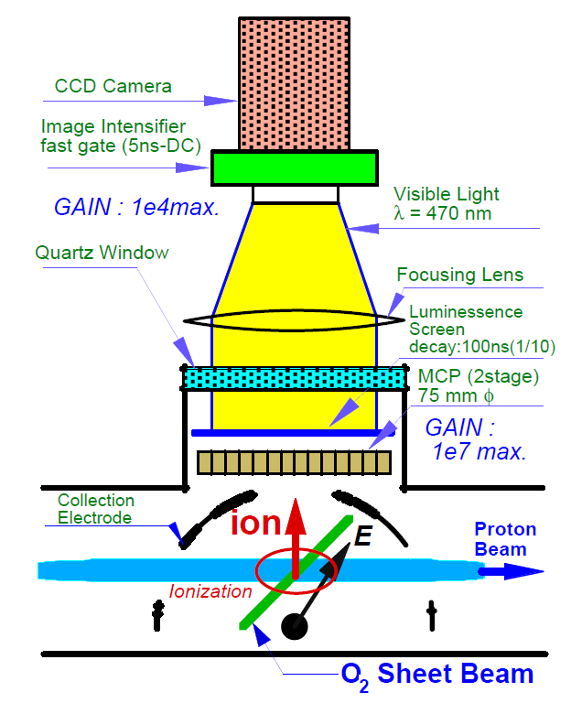

6) Gas jet beam generation
Generate thin atom gas curtain,
Ionize atoms with primary particle beam,
Extract ions via electric field,
Monitor on MCP, P screen.
adam.jeff@cern.ch Principle of the gas jet monitor 2 / 17
Y. Hashimoto et al., Proc. Part. Acc. Conf., Chicago (2001)

Slide 12
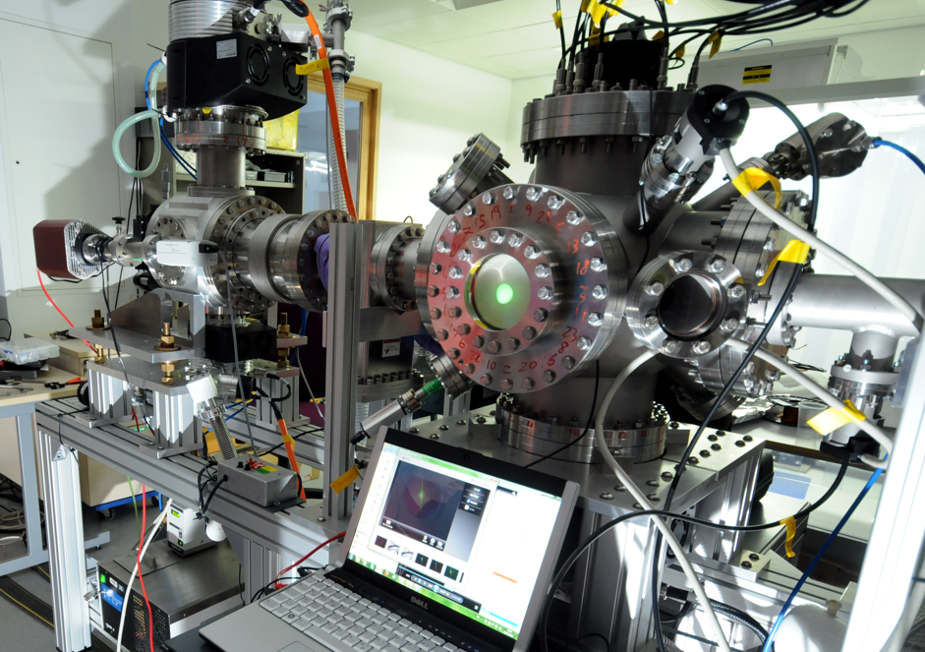
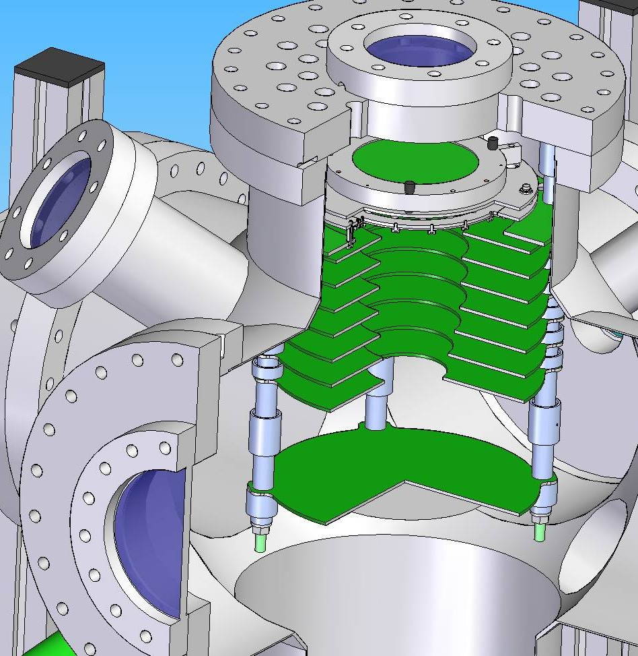
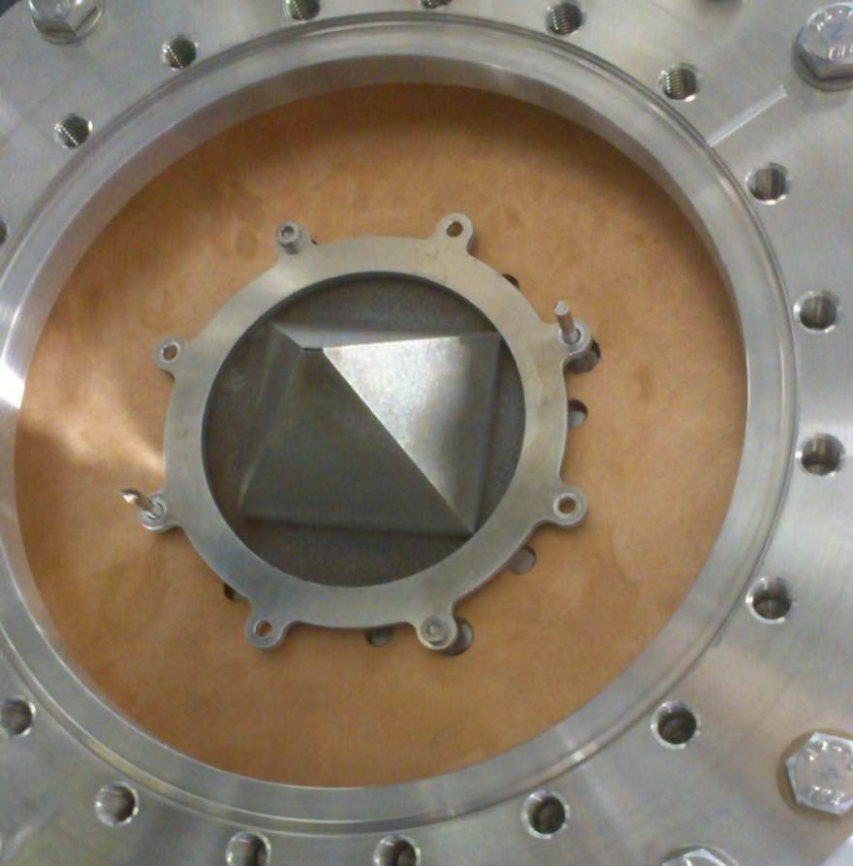
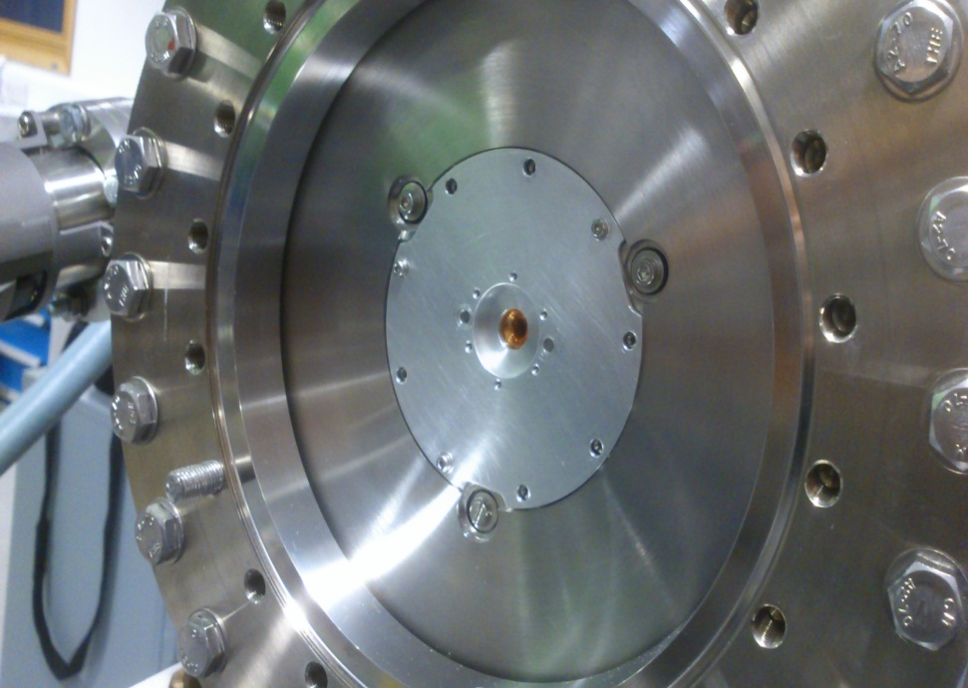
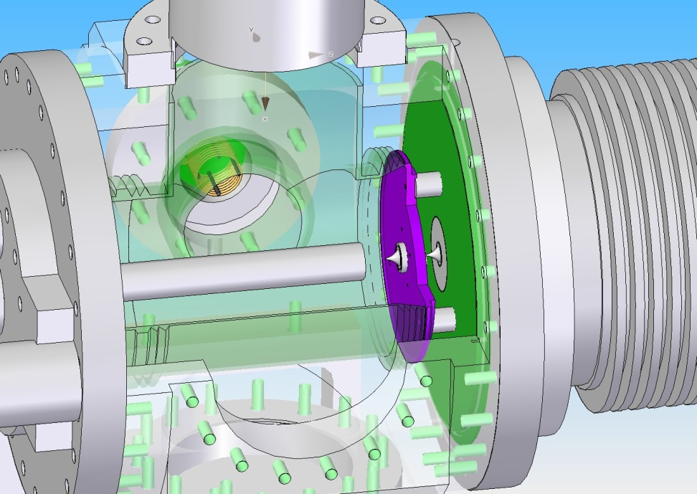
Gas Sheet injection system developed by Cockcroft Institute in the technical development framework for the CLIC drive beam generation
adam.jeff@cern.ch Test Setup @ Cockcroft Institute 3 / 17

Slide 13
Applications
Will keep the design as paper study for CLIC drive beams profile measurements
Investigate usage of system in strong magnetic fields (preventing the use of ionization) by collecting photons from gas fluorescence.
Further develop gas jet production in the shape of a pencil beam…replacement of wire scanners.
Observable signal: Secondary particles (as most present systems) or ion current measured on a large collection surface.

