Slide 1
AS Diagnostic Collaboration
Mark Boland
2015-03-18

Slide 2
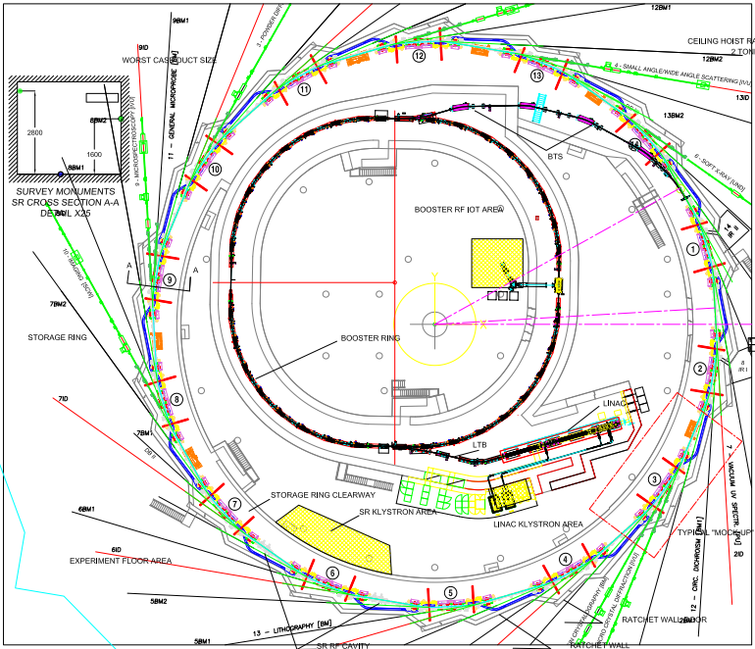
REBAS – Relativistic Electron Beams at the Australian Synchrotron
3 GeV, 1 Hz, ~3 nC
3 GeV, 1 Hz, ~5 nC

Slide 3
Test Beam Facility Motivation
Improve operation of the Australian Synchrotron through accelerator diagnostic R&D.
Contribute to international accelerator R&D for existing collaborations: CLIC (CERN), ATF2 (KEK), SPEAR3 (SLAC), PSI.
Pilot studies for particle and x-ray detector test beam facility.

Slide 4
Test Beam Options 100 MeV
Extract 100 MeV at the end of the linac.
Bunch structure 1-75 bunches, 2 ns spacing plus 0.667 ns microbunches.
Repetition rate 1 Hz.
Bunch charge 0.02-1 nC single bunch, 0.02-5 nC multi bunch.

Slide 5
Test Beam Options 3 GeV
Extract 3 GeV at the start of the booster transport line.
Bunch structure 1-75 bunches, 2 ns spacing.
Repetition rate 1 Hz.
Bunch charge 0.02-1 nC single bunch, 0.02-5 nC multi bunch.
Power supply
Control and DAQ
magnets
Bench
Vacuum chamber

Slide 6
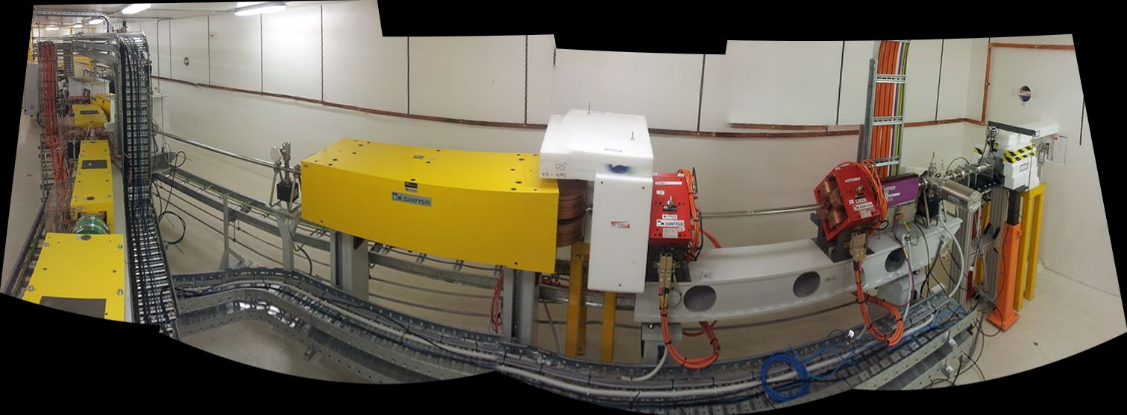
BTS in Booster Tunnel Photos

Slide 7
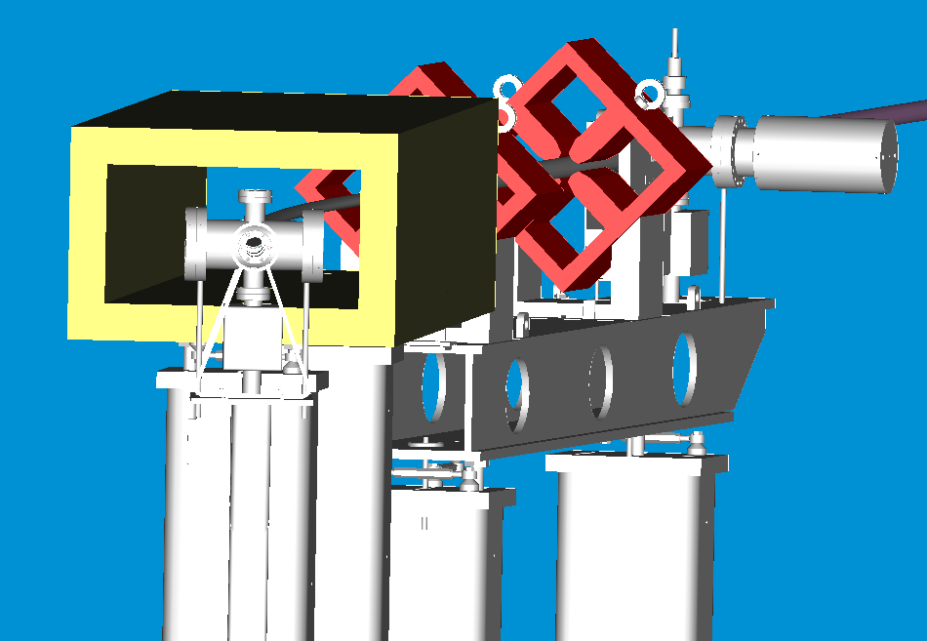
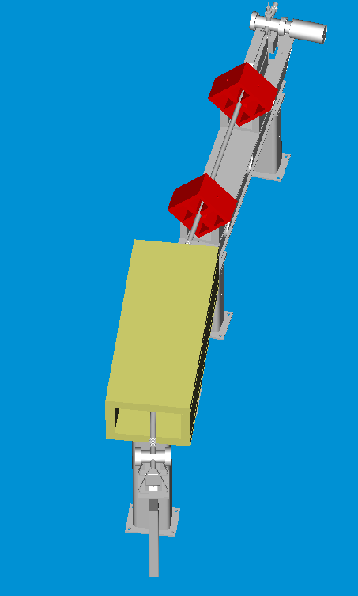
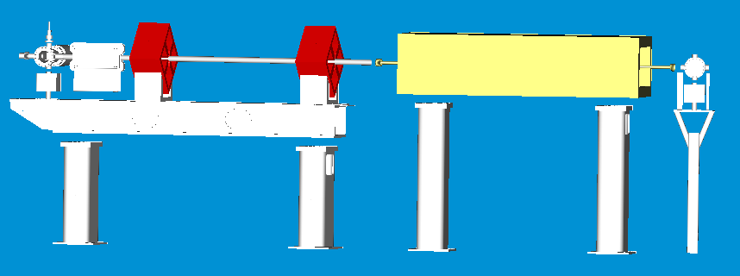
BTS in Booster Tunnel Drawings

Slide 8
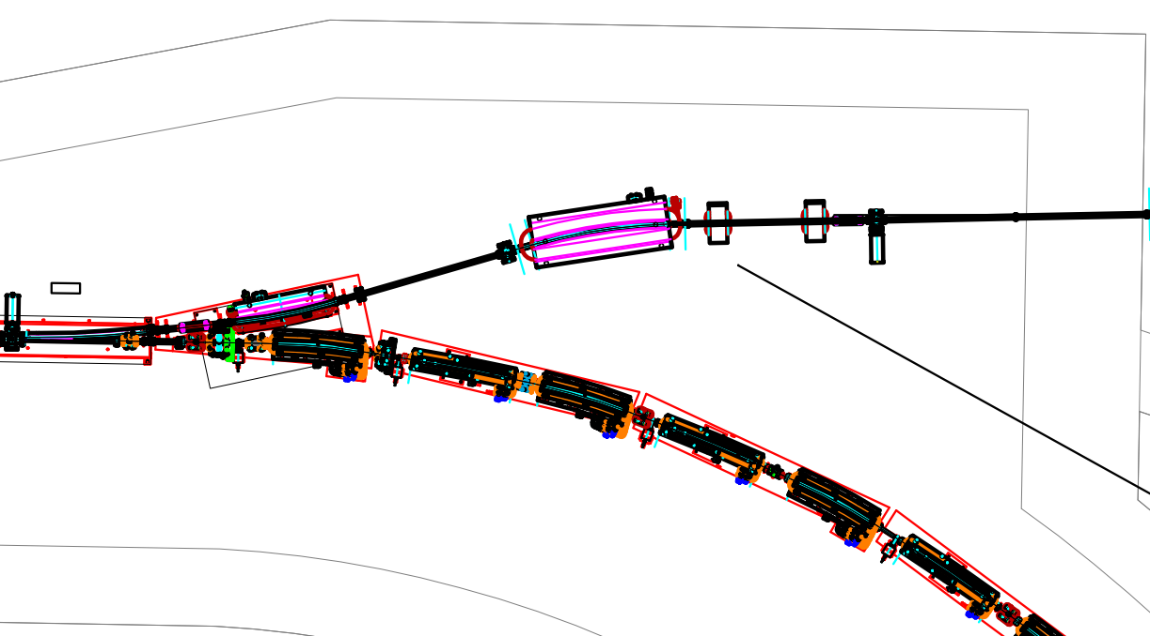
Present layout

Slide 9
Straight through extraction

Slide 10
Valves and FCT

Slide 11
Pulsed Multipole extraction

Slide 12
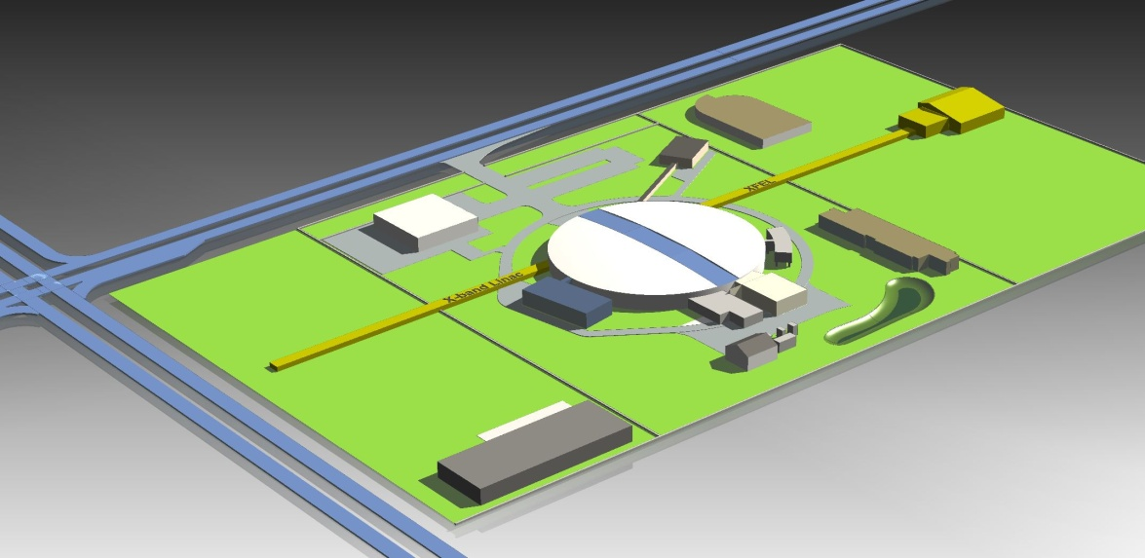
AXXS – Australian X-band X-Ray Source
“SAC recognises the need to begin planning for the first major upgrade of the storage ring, which typically happens after about 10-15 years of operation. This should be viewed as a high priority research project for the team.”
– SAC Report 2014

Slide 13
Lightsouce Strategy
Estimated Beamline Capacity at AS:
In use: 9 (6 ID, 3 BM1, 0 BM2)
Capacity: ID 12 total, 50% usage (BM1 11, 27% usage)
Build up the existing storage ring beamlines to full capacity (presently ~50%).
Upgrade the storage ring with an MBA lattice with ε < 1 nm rad, in the existing tunnel with the same source points.
Build a 3 GeV x-band linac to inject a low emittance beam into the storage ring.
Use a second x-band linac to generate a 6 GeV beam for an XFEL.
Capitalise on local HEP support for a linear collider.
Leverage international collaboration through the CLIC collaboration.

Slide 14
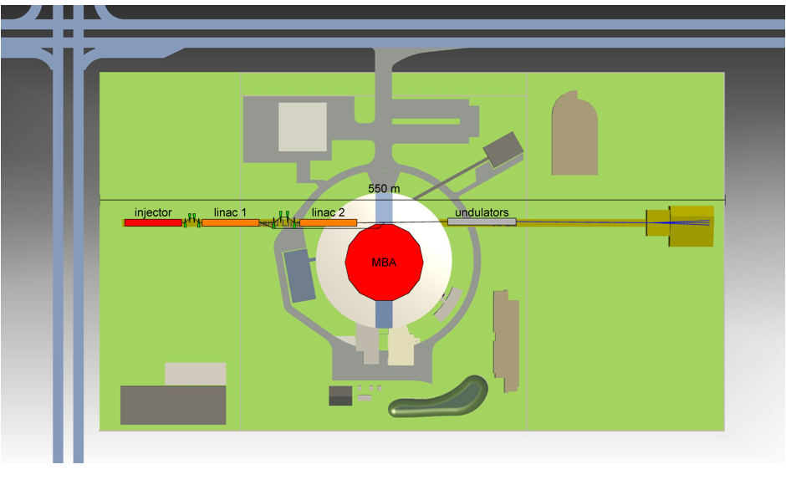
Potential Layout

Slide 15
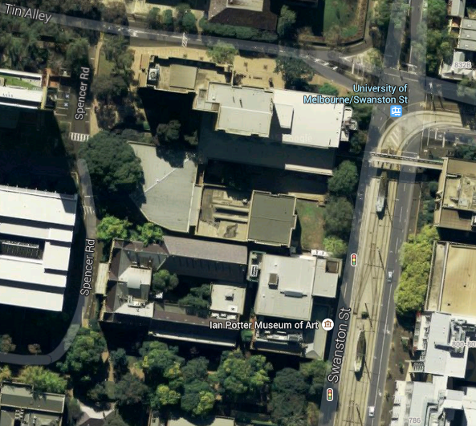
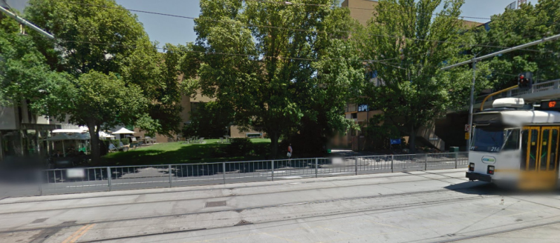
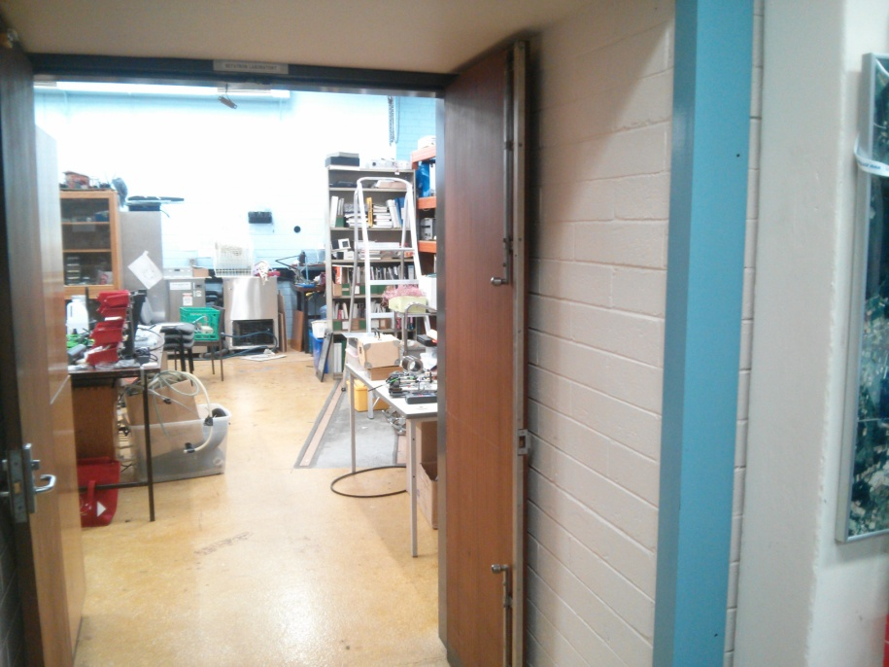
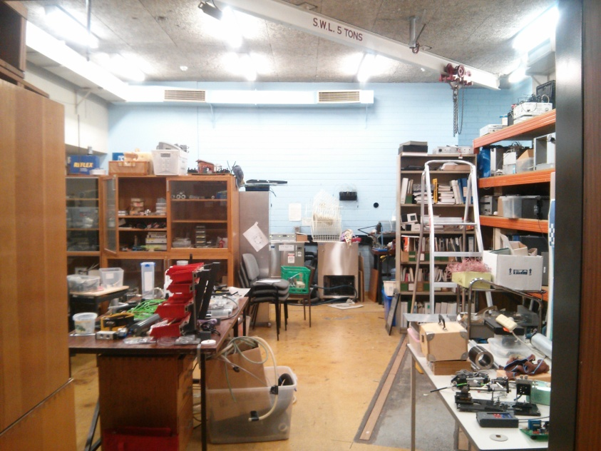
Advanced Accelerator R&D at Melbourne Uni
Propose new X-band RF structure lab in the old 35 MeV betatron lab
Initial investment $100,000 for low power, shielding in place
Further $2M for high power
Future RF photocathode development
Steel/Pb
Vault door
5 T crane

Slide 16
Motivation for new lab
spread knowledge and ownership of accelerator development back into the universities
attract students
physically and psychologically remove R&D from operations, unlimited vault access
increase the accelerators available for testing

Slide 17
Other interests
CCD cameras (x-ray rad hard)
BPM electronics for booster synchrotron, 500 MHz
Visible optical diagnostics (Open Hardware designs?)
Vertical undulator emittance measurement, x-ray slits and CCD
High-end “Red Pitaya” 1 GHz, 2 Gsa, 4 channel, instrument applications, EPICS and other controls integration

