Slide 1
LANSCE Beam Diagnostics R&D
Presented by James Sedillo
on behalf of AOT-IC Beam Diagnostics Team
IBIC 2015 Collaboration Meeting
March 18, 2015

Slide 2
Presentation Outline
LANSCE Facility Overview.
2011+: Deployment of wire scanners
2014: Lujan Center Target harp diagnostic
2014: Instrumentation Technologies Libera Single-Pass H for beam energy measurement
2015: New emittance data acquisition system
2015: New beam position and phase measurement system
LANSCE diagnostics system architectures
The Future of LANSCE: MaRIE

Slide 3
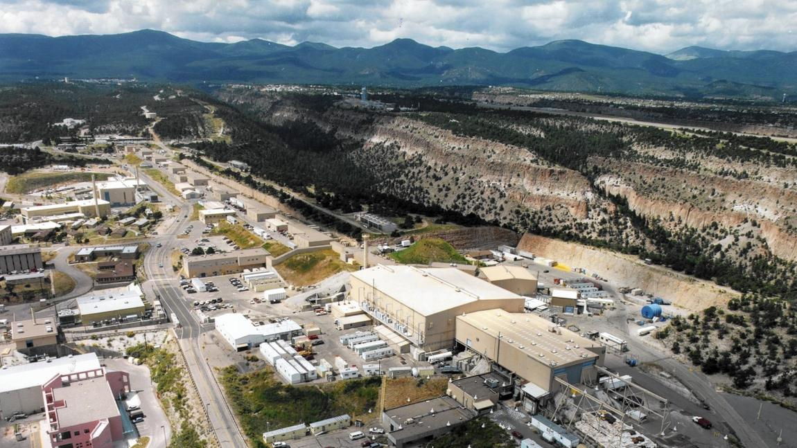
LANSCE Facility

Slide 4
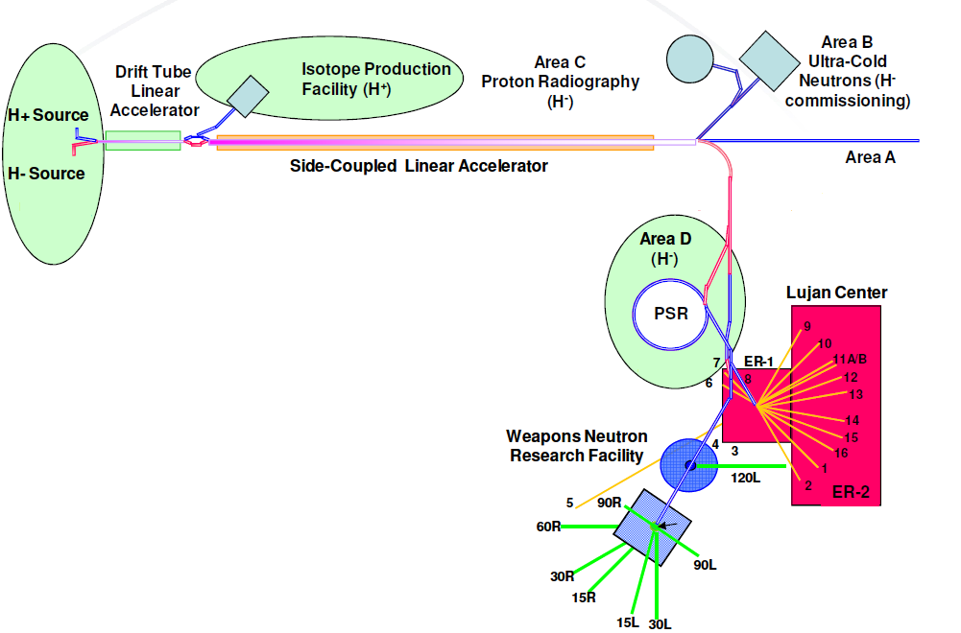
LANSCE Facility

Slide 5
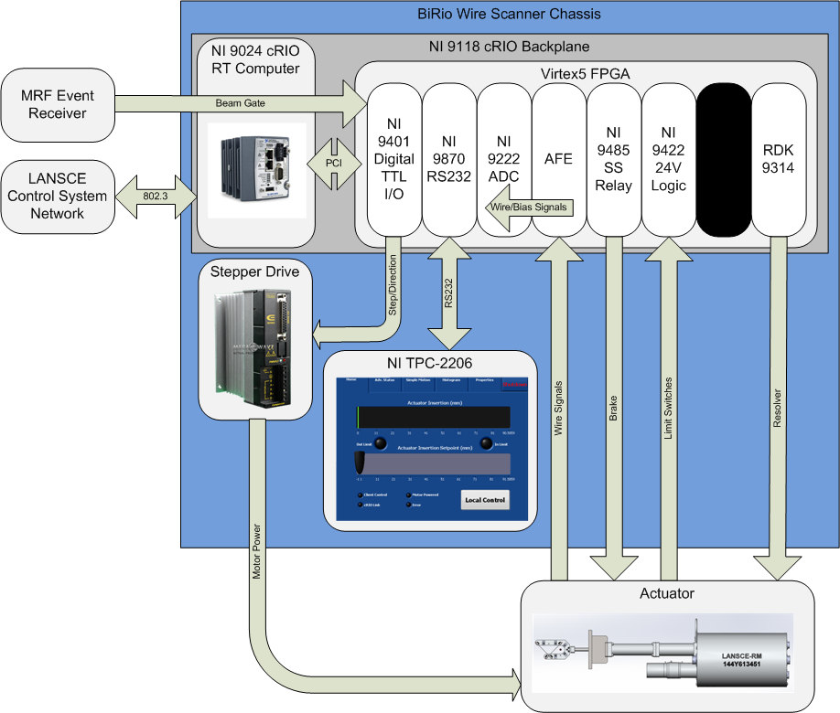
2011+: Deployment of New Wire Scanners
National Instruments (NI) cRIO-based
Nine systems have been deployed
Will deploy three new systems this year
Planning for eight more systems next year
A total 54 system are planned for deployment using a graded approach

Slide 6
2011+: Deployment of New Wire Scanners

Slide 7
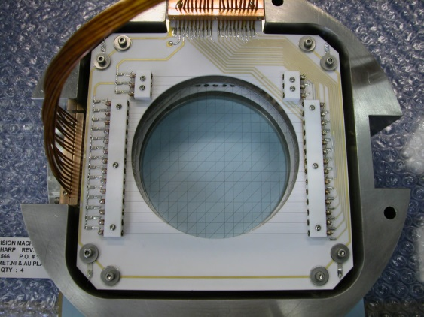
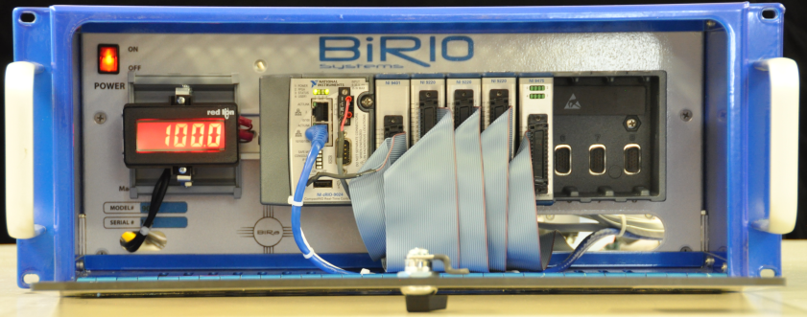
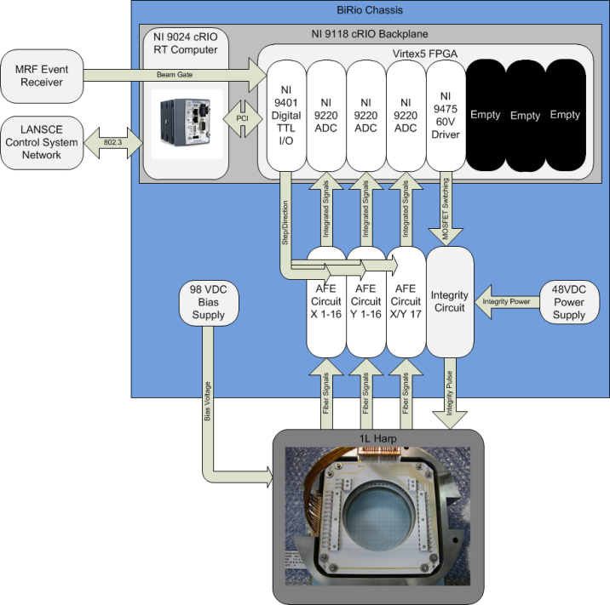
2014: 1L Harp Diagnostic
Stationary sensor
Three planes: bias, vertical, horizontal.
17-wires per plane
Beam energy: 800 MeV
Beam Particles: Protons
Particle Bunch Pulse Rate: 20Hz
Beam Pulse Duration: 300 ns
34-channel, 10S/channel simultaneous 100kS/s acquisition rate
ACF2101 analog integrators
Wire integrity verification

Slide 8
2014: Recent completion of 1L harp diagnostic electronics.

Slide 9
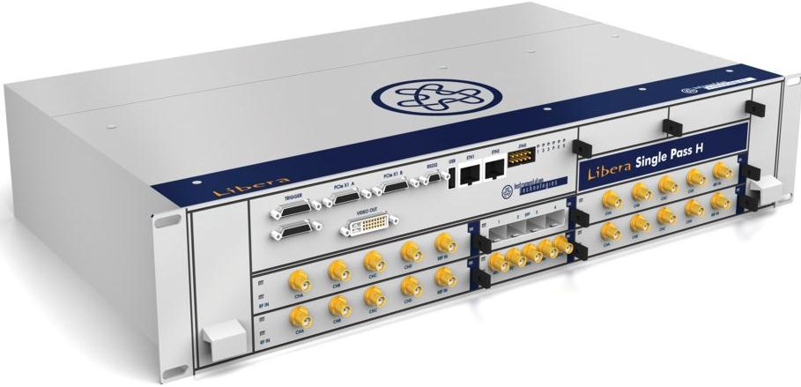
2014: Libera Beam Energy Measurement
One chassis digitizes I/Q BPM sensor signals from two BPMs
Libera processor calculates reference-relative phase for each BPM
Using the phase for each BPM, known BPM separation and bunch frequency; an energy measurement can be obtained

Slide 10
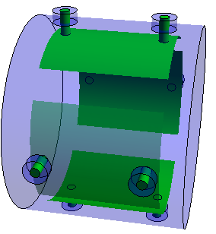
2014: Libera Beam Energy Measurement
How many micropulses between BPMs. (N=21 for IPF)
Coarse time
Fine timing at BPM2
Fine timing at BPM1

Slide 11
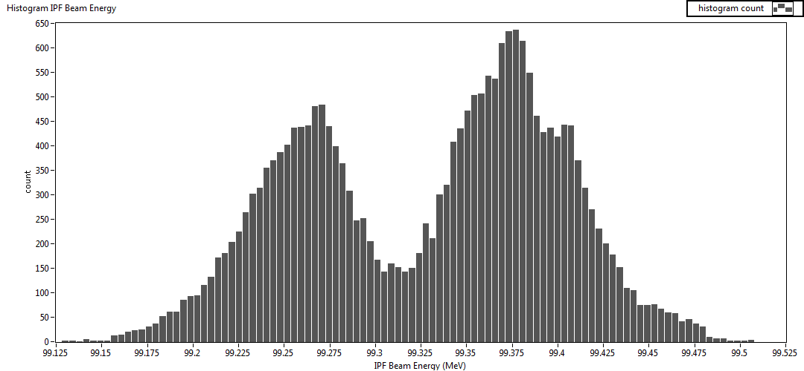
2014: Libera beam energy measurement
Energy measurement over 1-week timeframe
Expected beam energy: 100 MeV

Slide 12
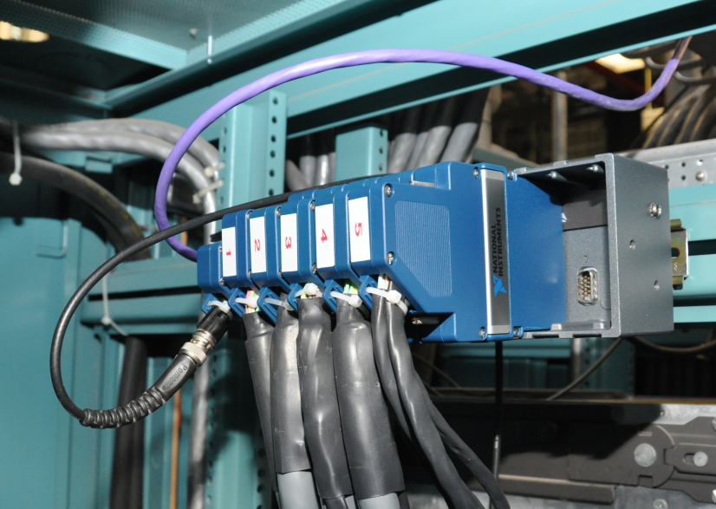
2015: New Emittance Data Acquisition System
Intended to replace aging RICE system.
NI compactRIO
Signals read from existing analog processor that incorporates sample & hold capability.
76 channels per system.
70-samples per channel acquisition @ 100kS/s sampling rate
Waveforms obtained at 4Hz rate, synced to beam pulse

Slide 13
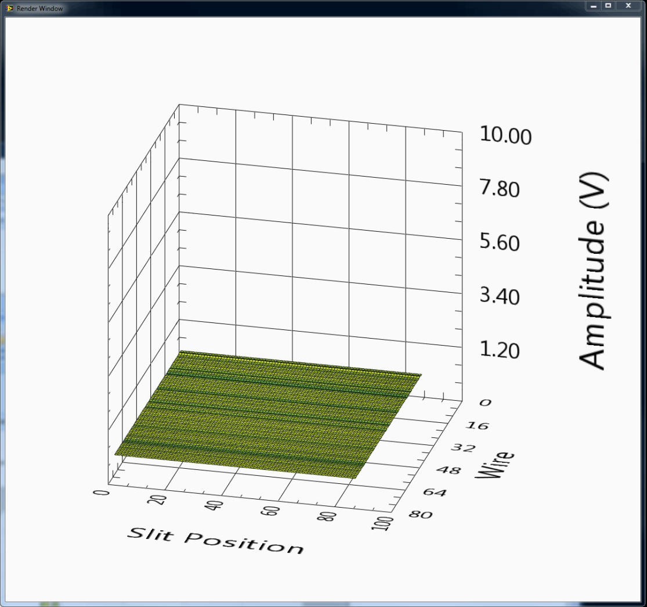
2015: New Emittance Data Acquisition System.

Slide 14
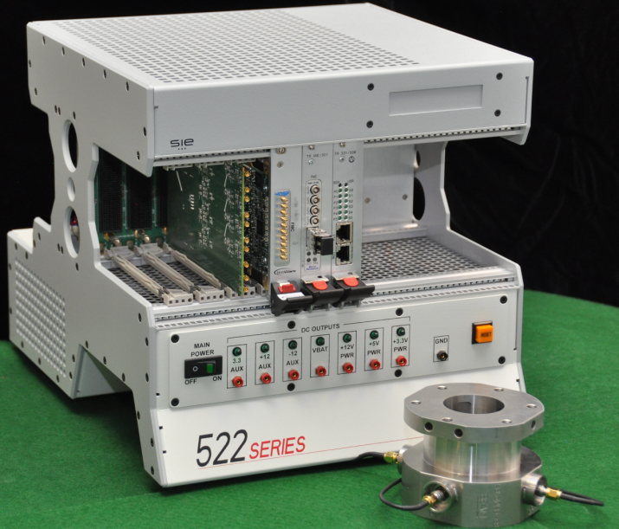
2015: New Beam Position and Phase Measurement System
I/Q undersampling of 201.25 MHz component & comparison to the master reference oscillator for phase
500kS possible per beam pulse
Beam energy measurement capability

Slide 15
2015: New Beam Position and Phase Measurement System
Analog
Signal
conditioning
Digitizers
240 MS / s
FPGA
Software to cull data
EPICS
Timed
&
flavored
201.25 MHz reference
Filter
Amplifiers
Ringing filter (MPEG)
Cal. & diagnostics
Sinusoids
→H, V, φ, etc.
10k / gate
Raw samples
Time mode
Successive mode
Gate-stacked mode
Undersampled
500kS / gate

Slide 16
LANSCE Diagnostics System Architectures
NI compactRIOs for <1MHz data acquisition
  Deployed as EPICS IOCs on VxWorks OS
  Harps (100 kS/s, multichannel ADCs)
  Emittance (100 kS/s, multichannel ADCs)
  Wire Scanners (closed-loop actuator control)
VPX systems for >1MHZ data acquisition
  Large FPGA with ADC mezzanine card
  FPGA ARM or soft-core processors running EPICS IOC on RTEMS OS
  New BPPM System (under development)

Slide 17
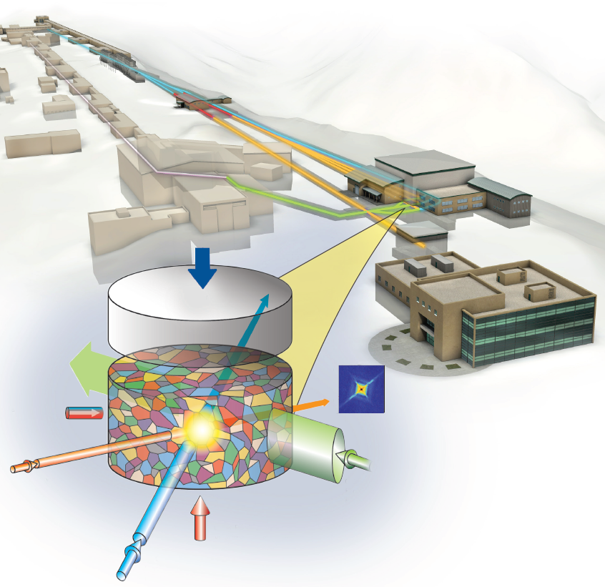
The Future of LANSCE: MaRIE
MaRIE: Matter-Radiation Interactions in Extremes
Combines existing LANSCE linac with a new XFEL linac for materials analysis at the mesoscale
In conceptual design phase

