Slide 1
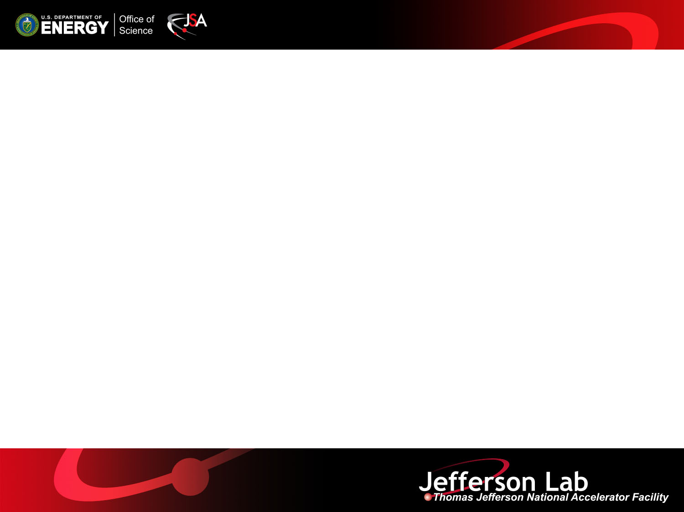
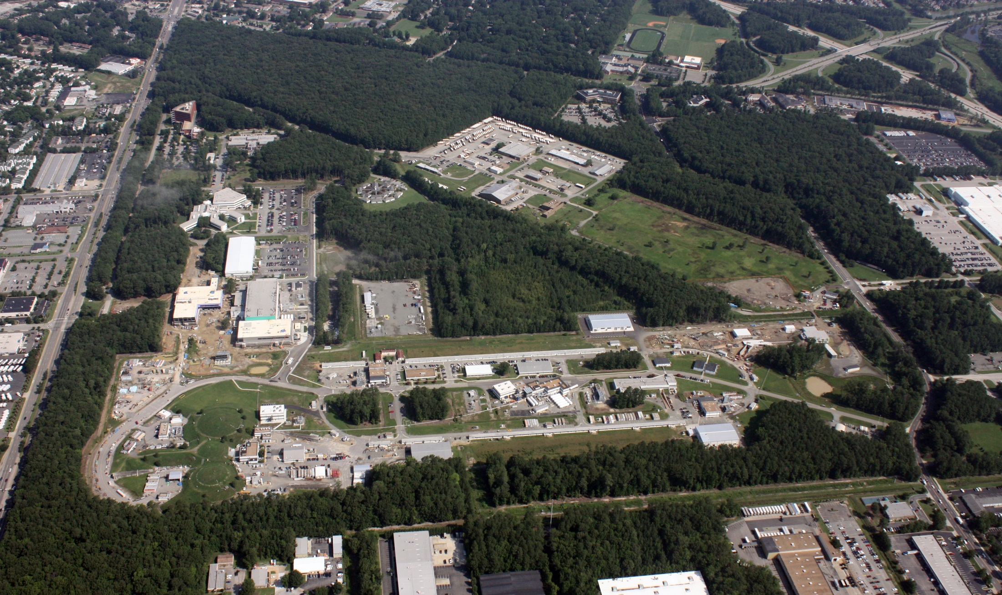
MEIC Design Overview
Kevin Jordan
Beam Diagnostics Collaboration Meeting 3/18/15

Slide 2
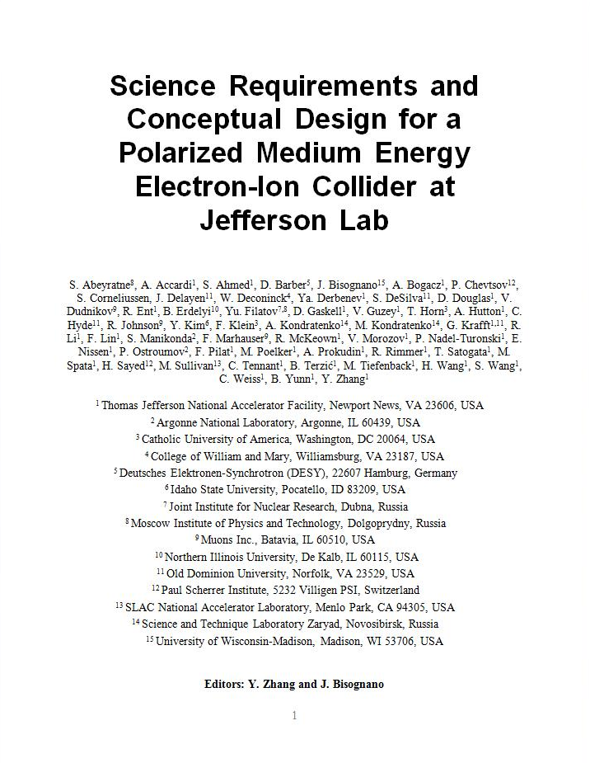
MEIC Design Goals
Energy
  Full coverage of √s from 15 to 65 GeV
  Electrons 3-10 GeV, protons 20-100 GeV, ions 12-40 GeV/u
Ion species
  Polarized light ions: p, d, ³He, and possibly Li
  Un-polarized light to heavy ions up to A above 200 (Au, Pb)
Space for at least 2 detectors
Full acceptance is critical for the primary detector
Luminosity
  10³³ to 10³⁴cm⁻²s⁻¹ per IP in a broad CM energy range
Polarization
  At IP: longitudinal for both beams, transverse for ions only
  All polarizations >70%
Upgrade to higher energies and luminosity possible
  20 GeV electron, 250 GeV proton, and 100 GeV/u ion
  Design goals consistent with the White Paper requirements

Slide 3
Design strategy: High Polarization
All rings are figure-8 → critical advantages for both ion and electron beam
  Spin precessions in the left & right parts of the ring are exactly cancelled
  Net spin precession (spin tune) is zero, thus energy independent
  Spin is easily controlled and stabilized by small solenoids or other compact spin rotators
  Advantage 1: Ion spin preservation during acceleration
  Ensures spin preservation
  Avoids energy-dependent spin sensitivity for all species of ions
  Allows a high polarization for all light ion beams
  Advantage 2: Ease of spin manipulation
    Delivers desired polarization at the collision points
  Advantage 3: The only practical way to accommodate polarized deuterons
  (given the ultra small g-2)
  Advantage 4: Strong reduction of quantum depolarization thanks to the energy independent spin tune.

Slide 4
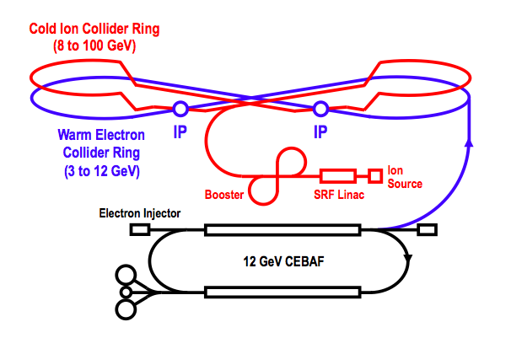
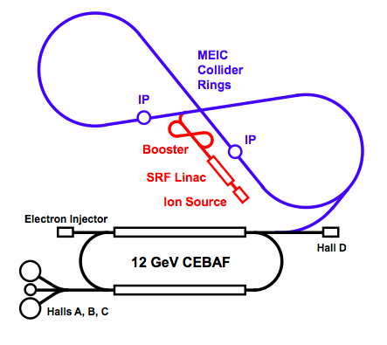
Baseline Layout
Booster
Warm Electron
Collider Ring
(3 to 10 GeV)
Linac
Ion Source
Booster
Linac
Ion Source
CEBAF is a full energy injector.
Only minor gun modification is needed
MEIC Cost Review December 18 2014

Slide 5
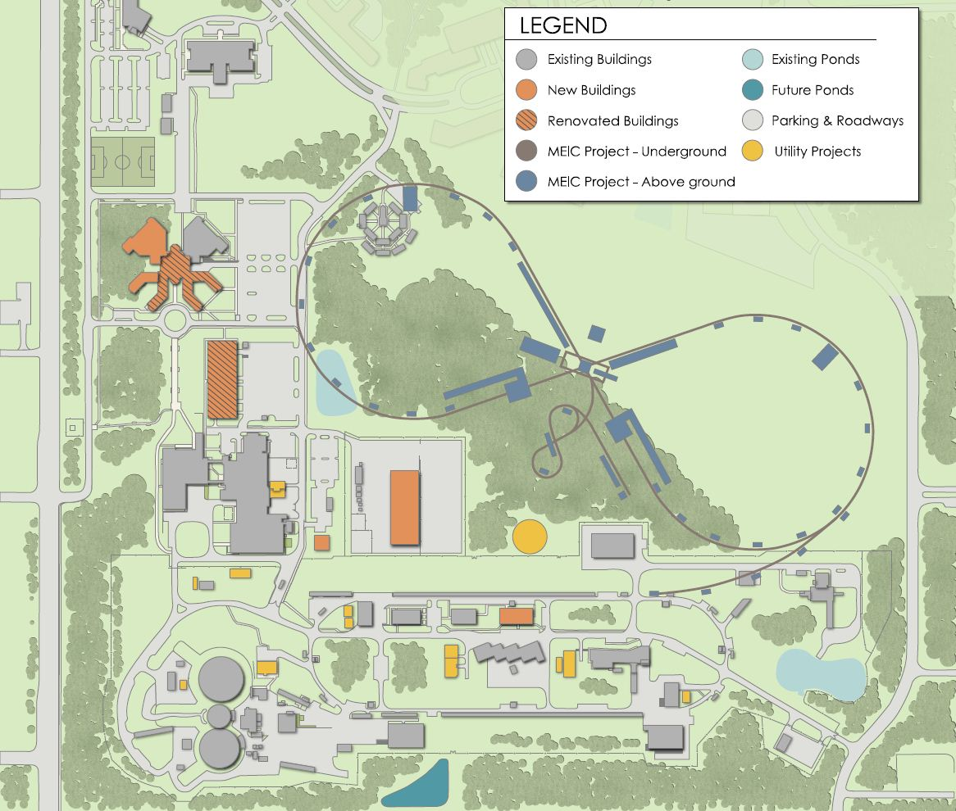
Campus Layout
~2.2 km circumference
E-ring from PEP-II
Ion-ring with super-ferric magnets
Tunnel consistent
with a 250+ GeV upgrade

Slide 6
MEIC Baseline
Baseline for the cost estimate
Collider ring circumference: ~2200 m
Electron collider ring and transfer lines : PEP-II magnets, RF (476 MHz) and vacuum chambers
Ion collider ring: super-ferric magnets
Booster ring: super-ferric magnets
SRF ion linac
Energy range
Electron: 3 to 10 GeV
Proton: 20 to 100 GeV
Lead ions: up to 40 GeV
Design point | p energy (GeV) | e- energy (GeV) | Main luminosity limitation
low | 30 | 4 | space charge
medium | 100 | 5 | beam beam
high | 100 | 10 | synchrotron radiation

Slide 7
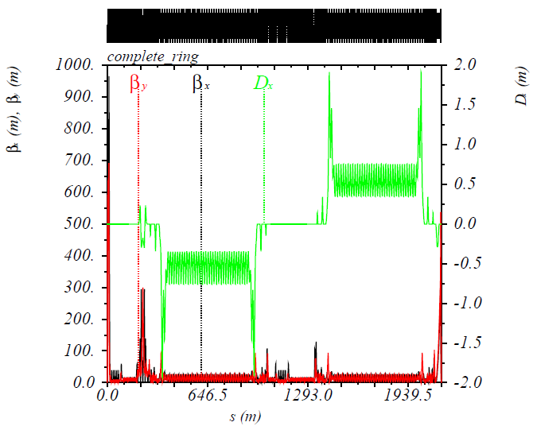
MEIC Electron Complex
CEBAF provides up to 12 GeV, high repetition rate and high polarization (>85%) electron beams, no further upgrade needed beyond the 12 GeV CEBAF upgrade.
Electron collider ring design
  circumference of 2154.28 m = 2 x 754.84 m arcs + 2 x 322.3 m straights
  Meets design requirements
  Provides longitudinal electron polarization at IP(s)
  incorporates forward electron detection
  accommodates up to two detectors
  includes non-linear beam dynamics
  reuses PEP-II magnets, vacuum chambers and RF
Beam characteristics
  3A beam current at 6.95 GeV
  Normalized emittance 1093 μm @ 10 GeV
  Synchrotron radiation power density 10kW/m
  total power 10 MW @ 10 GeV
CEBAF and the electron collider provide
the required electron beams for the EIC.
IP
Electron Collider Ring Optics
D_{x}(m)
β_{x}(m), β_{y}(m)

Slide 8
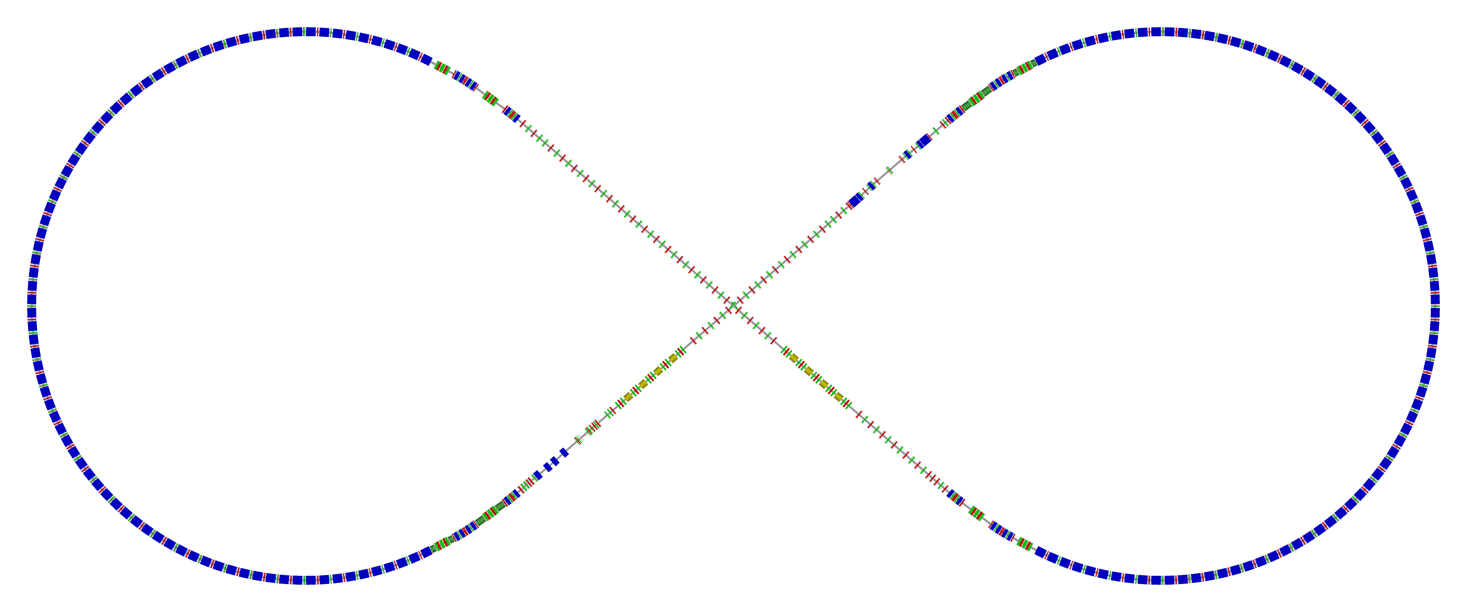
Electron Collider Ring Layout
  Circumference of 2154.28 m = 2 x 754.84 m arcs + 2 x 322.3 m straights
Figure-8, crossing angle 81.7°
  Electron collider ring w/ major machine components
Spin rotator
Spin rotator
CCB
Tune trombone & Straight FODOs
R=155m
81.7°
e⁻
Arc, 261.7°
Future 2nd IP
RF
RF
Spin rotator
IP
Spin rotator
Forward e⁻ detection

Slide 9
Electron Ring Optics Parameters
Electron beam momentum | GeV/c | 10
Circumference | m | 2154.28
Arc net bend | deg | 261.7
Straights’ crossing angle | deg | 81.7
Arc/straight length | m | 754.84/322.3
Beta stars at IP β*_{x,y} | cm | 10/2
Detector space | m | -3 / 3.2
Maximum horizontal / vertical β functions β_{x,y} | m | 949/692
Maximum horizontal / vertical dispersion D_{x,y} | m | 1.9 / 0
Horizontal / vertical betatron tunes ν_{x,y} |  | 45.(89) / 43.(61)
Horizontal / vertical chromaticities ξ_{x,y} |  | -149 / -123
Momentum compaction factor α |  | 2.2 ×10⁻³
Transition energy γ_{tr} |  | 21.6
Horizontal / vertical normalized emittance ε_{x,y} | µm rad | 1093 / 378
Maximum horizontal / vertical rms beam size σ_{x,y} | mm | 7.3 / 2.1

Slide 10
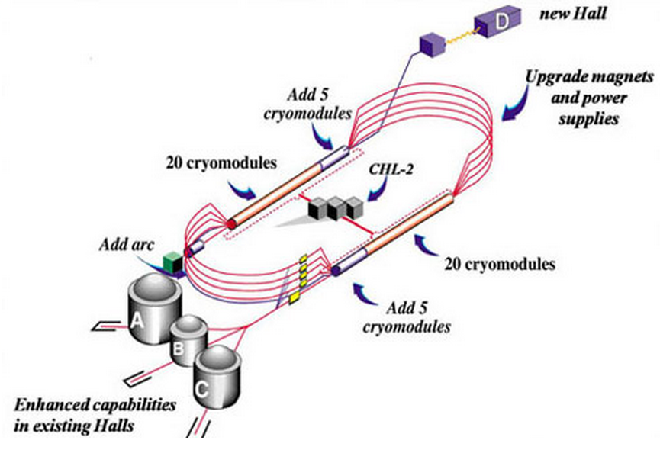
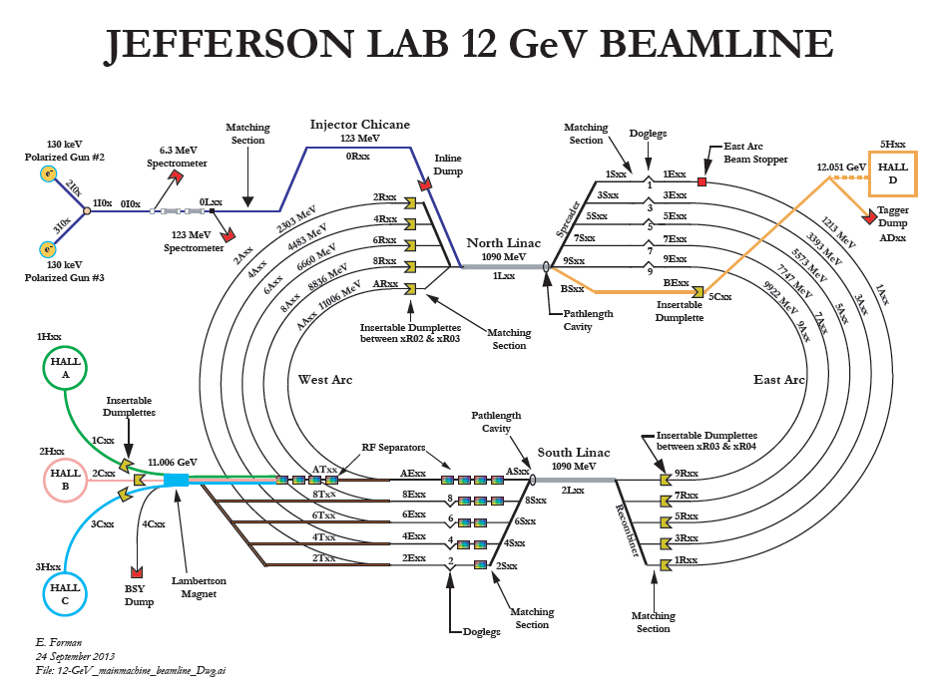
CEBAF - Full Energy Injector
CEBAF fixed target program
  5-pass recirculating SRF linac
  Exciting science program beyond 2025
  Can be operated concurrently with the MEIC
CEBAF will provide for MEIC
  Up to 12 GeV electron beam
  High repetition rate (up to 1497 MHz)
  High polarization (>85%)
  Good beam quality up to the mA level

Slide 11
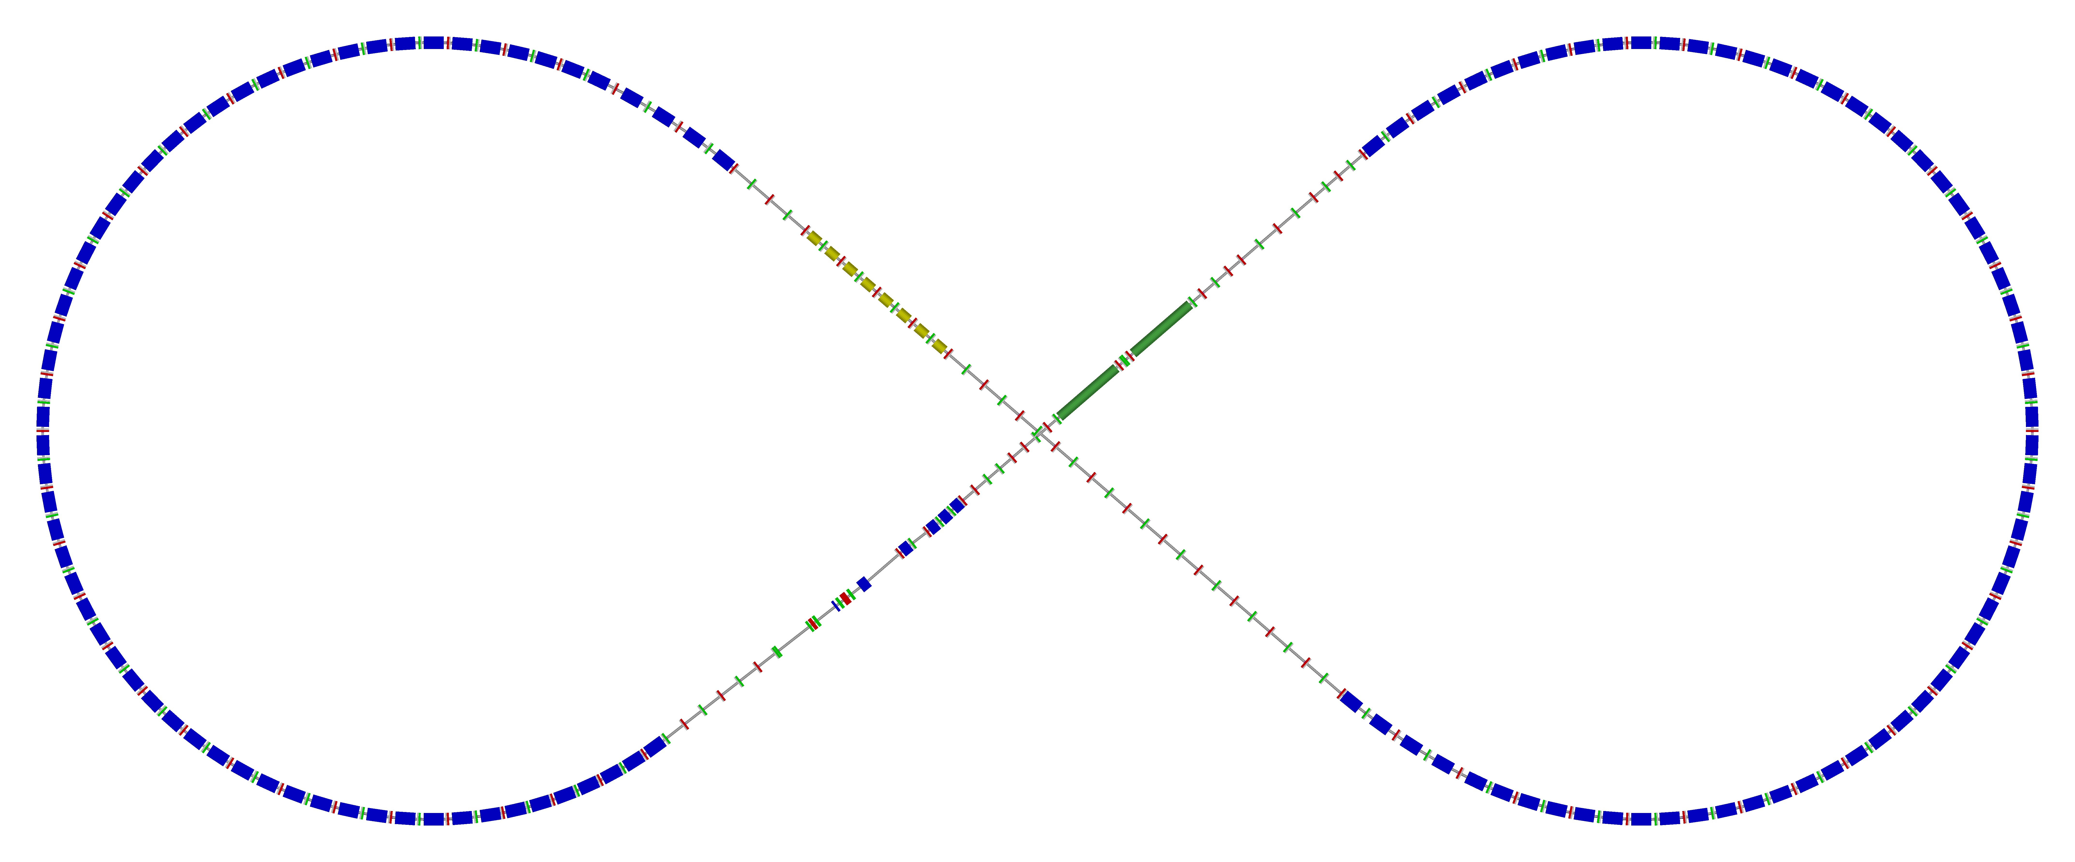
Ion Collider Ring
Figure-8 ring with a circumference of 2153.9 m
Two 261.7° arcs connected by two straights crossing at 81.7°
disp. supp./
geom. match #3
disp. supp./
geom. match #2
norm.+
SRF
Arc, 261.7°
elec. cool.
tune
tromb.+
match
81.7°
R = 155.5 m
future 2nd IP
det. elem.
disp. supp.
ions
beam exp./
match
IP
disp. supp./
geom. match #3
disp. supp./
geom. match #1

Slide 12
Ion Collider Ring Parameters
All design goals achieved
Resulting collider ring parameters
Proton energy range | GeV | 20(8)-100
Polarization | % | > 70
Detector space | m | -4.6 / +7
Luminosity | cm⁻²s⁻¹ | > 10³³
Circumference | m | 2153.89
Straights’ crossing angle | deg | 81.7
Horizontal / vertical beta functions at IP β*_{x,y} | cm | 10 / 2
Maximum horizontal / vertical beta functions β_{x,y} _{max} | m | ~2500
Maximum horizontal dispersion D_{x} | m | 3.28
Horizontal / vertical betatron tunes ν_{x,y} |  | 24(.38) / 24(.28)
Horizontal / vertical natural chromaticities ξ_{x,y} |  | -101 / -112
Momentum compaction factor α |  | 6.45 × 10⁻³
Transition energy γ_{tr} |  | 12.46
Normalized horizontal / vertical emittance ε_{x,y} | µm rad | 0.35 / 0.07
Horizontal / vertical rms beam size at IP σ*_{x,y} | µm | ~20 / ~4
Maximum horizontal / vertical rms beam size σ_{x,y} | mm | 2.8 / 1.3

Slide 13
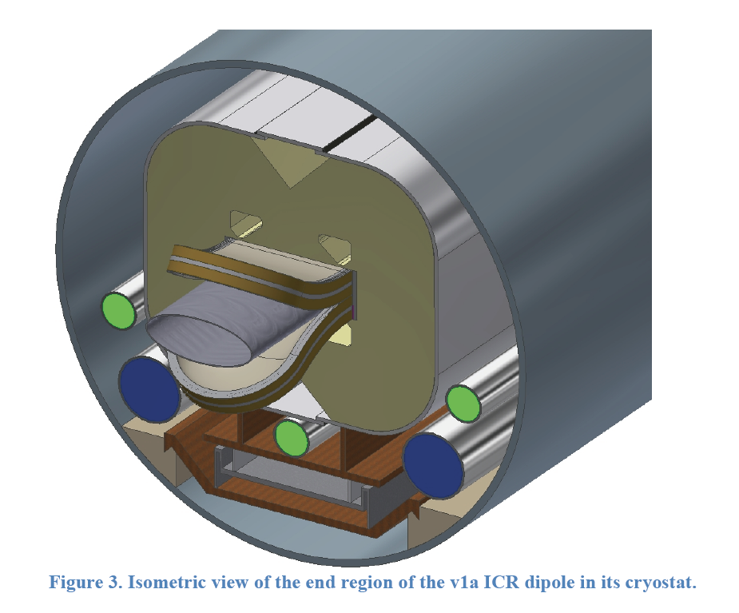
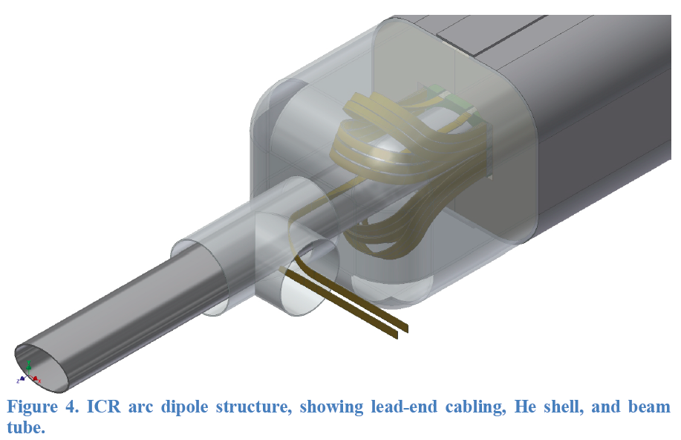
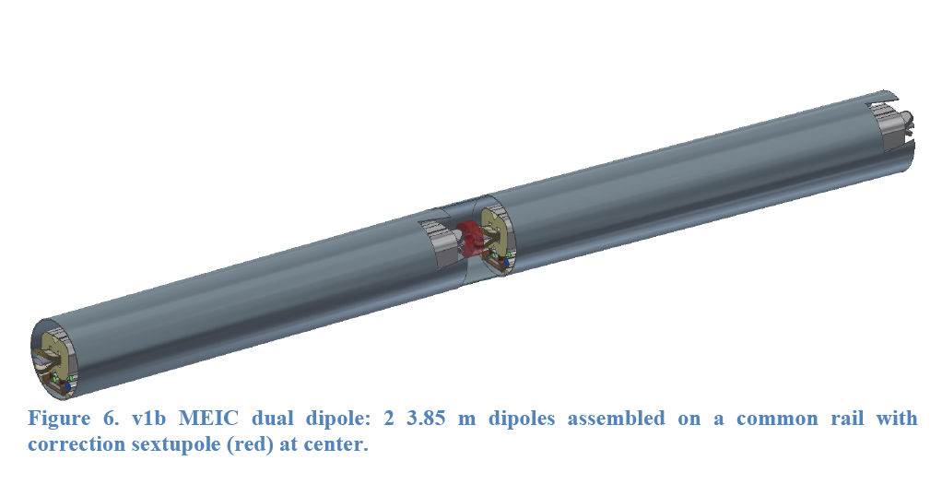
MEIC super-ferric dipole
2 X 4m long dipole
NbTi cable
3 T
Correction sextupole
Common cryostat
Collaboration with
Peter McIntyre
Texas A&M Univ.

Slide 14
Ion Injector Complex − Overview
Booster (8 GeV)
(accumulation)
DC e-cooling
Ion Sources
SRF Linac (285 MeV)
Status of the ion injector complex:
Relies on demonstrated technology for injectors and sources
Design for an SRF linac exists
8 GeV Booster design to avoid transition for all ion species and based on
super-ferric magnet technology
Injection/extraction lines to/from Booster are designed

Slide 15
Ion Linac − Parameters and Layout
RFQ
QWR
QWR
HWR
Ion Sources
IH
4 cryostats
2
10 cryostats
4 cryos
2 cryos
10 cryos
MEBT
Optimum stripping energy: 13 MeV/u
Linac design based on the ANL linac for FRIB
Pulsed linac capable of accelerating multiple
charge ion species (H⁻ to Pb ⁶⁷⁺)
Warm Linac Sections: (115 MHz)
RFQ (3m)
MEBT (3m)
IH structure (9m)
Cold linac sections:
QWR + QWR (24m + 12 m) 115 MHz
Stripper, chicane (10m) 115 MHz
HWR section (60m) 230 MHz
Ion species: p to Pb
Ion species for the reference design | ²⁰⁸Pb
Kinetic energy (p, Pb) | 285 MeV 100 MeV/u
Maximum pulse current: Light ions (A/Q<3) Heavy ions (A/Q>3) | 2 mA 0.5 mA
Pulse repetition rate | up to 10 Hz
Pulse length: Light ions (A/Q<3) Heavy ions (A/Q>3) | 0.50 ms 0.25 ms
Maximum beam pulsed power | 680 kW
Fundamental frequency | 115 MHz
Total length | 121 m

Slide 16
Booster (8 GeV, γ_{t} = 10)
Ring circumference: 273 m
(≈ 2200/8)
E_{kin} = 285 MeV – 8 GeV
Injection: multi-turn 6D painting
  0.22-0.25 ms long pulses ~180 turns
  Proton single pulse charge stripping at 285 MeV
  Ion 28-pulse drag-and-cool stacking at ~100 MeV/u
  Ion energies scaled by mas-to-charge ratio to preserve magnetic rigidity
Crossing angle:
75 deg.
injection
RF cavity
extraction
70
7
BETA_X&Y[m]
DISP_X&Y[m]
0
-7
0
BETA_X
BETA_Y
DISP_X
DISP_Y
272.306
Inj. Arc (255⁰)
Straight
Arc (255⁰)
Straight (RF + extraction)

Slide 17
MEIC Multi-Step Cooling Scheme
ion sources
BB cooler
ion linac
DC cooler
Booster
(0.285 to 8 GeV)
collider ring
(8 to 100 GeV)
Ring | Cooler | Function | Ion energy | Electron energy
 |  |  | GeV/u | MeV
Booster ring | DC | Injection/accumulation of positive ions | 0.11 ~ 0.19 (injection) | 0.062 ~ 0.1
 |  | Emittance reduction | 2 | 1.1
Collider ring | Bunched Beam Cooling (BBC) | Maintain emittance during stacking | 7.9 (injection) | 4.3
 |  | Maintain emittance | Up to 100 | Up to 55
DC cooling for emittance reduction
BBC cooling for emittance preservation

Slide 18
MEIC Bunched Beam Electron Cooler
Baseline cooling requirements and solution
Emittance 0.5 to 1 mm mrad → reduced IBS effect
Magnetized beam, up to 55 MeV energy, and 200 mA current
Need linac for acceleration
Must utilize energy-recovery-linac (beam power is 11 MW)
Cooling by a bunched electron beam
ion bunch
Electron energy | MeV | up to 55
Current and bunch charge | A / nC | 0.2 / 0.42
Bunch repetition | MHz | 476
Cooling section length | m | 60
RMS Bunch length | cm | 3
Electron energy spread | 10⁻⁴ | 3
Cooling section solenoid field | T | 2
Beam radius in solenoid/cathode | mm | ~1 / 3
Solenoid field at cathode | KG | 2
Cooling section
solenoid
electron bunch
energy recovery
SRF Linac
injector
dump
Notes:
18

Slide 19
Performance MEIC baseline
Achieved with a single pass ERL cooler
For a full acceptance detector
CM energy | GeV | 21.9 (low) |  | 44.7 (medium) |  | 63.3 (high)
 |  | p | e | p | E | p | e
Beam energy | GeV | 30 | 4 | 100 | 5 | 100 | 10
Collision frequency | MHz | 476 |  | 476 |  | 159
Particles per bunch | 10¹⁰ | 0.66 | 3.9 | 0.66 | 3.9 | 2.0 | 2.8
Beam current | A | 0.5 | 3 | 0.5 | 3 | 0.5 | 0.72
Polarization | % | >70% | >70% | >70% | >70% | >70% | >70%
Bunch length, RMS | cm | 2.5 | 1.2 | 1 | 1.2 | 2.5 | 1.2
Norm. emitt., vert./horz. | μm | 0.5/0.5 | 74/74 | 1/0.5 | 144/72 | 1.2/0.6 | 1152/576
Horizontal and vertical β* | cm | 3 | 5 | 2/4 | 2.6/1.3 | 5/2.5 | 2.4/1.2
Vert. beam-beam param. |  | 0.01 | 0.02 | 0.006 | 0.014 | 0.002 | 0.013
Laslett tune-shift |  | 0.054 | small | 0.01 | small | 0.01 | small
Detector space, up/down | m | 7/3.6 | 3.2 / 3 | 7/3.6 | 3.2 / 3 | 7/3.6 | 3.2 / 3 (3)
Hour-glass (HG) reduction |  | 0.89 |  | 0.88 |  | 0.73
Lumi./IP, w/HG, 10³³ | cm⁻²s¹ | 1.9 |  | 4.6 |  | 1.0
For a high(er) luminosity detector
Horizontal and vertical β* | cm | 1.2 | 2 | 1.6 / 0.8 | 1.6 / 0.8 | 2 /1 | 1.6 / 0.8
Vert. beam-beam param. |  | 0.01 | 0.02 | 0.004 | 0.021 | 0.001 | 0.021
Detector space, up/down | m | ±4.5 | 3 | ±4.5 | 3 | ±4.5 | 3
Hour-glass (HG) reduction |  | 0.67 |  | 0.74 |  | 0.58
Lumi./IP, w/HG, 10³³ | cm⁻²s¹ | 3.5 |  | 7.5 |  | 1.4

Slide 20
Conclusions and Outlook
The MEIC baseline based on a ring-ring design is mature
and can deliver luminosity from a few 10³³ to a few 10³⁴
and polarization over 70% in the 15-65 GeV range with low
technical risks.
The MEIC baseline fulfills the requirements of the white paper.
We continue to optimize the present design for cost and performance.
The design is upgradeable in energy and luminosity.
Many thanks to Fulvia Pilat & Yuhong Zhang for the slides

