Slide 1
Beam Diagnostics Collaboration Meeting
March 18th 2015
at Australian Synchrotron
Mario Ferianis – Elettra

Slide 2
A meeting to discuss in the field of beam diagnostics
including the current status of labs, upcoming
research programs, potential collaborations and
potential personal exchanges
Do you have beam measurement requirements
that are similar to other facilities?
Would you like to collaborate on developing an instrument through mutual contribution of funding and effort?

Slide 3
Possible ways of doing it…
Create a interest group with associated database with mailing list
Upload current activities or near future ideas /needs
Have one site manager; rotation per one or two years
Create Collabs events, associated to Community conferences

Slide 4
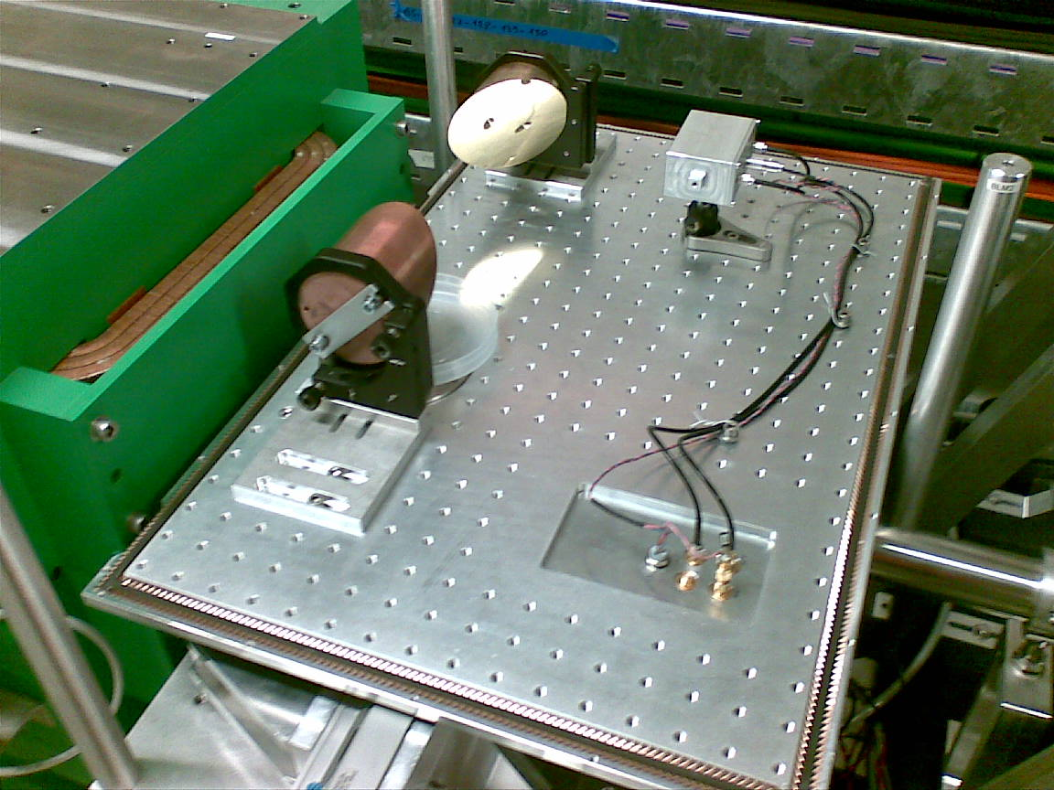
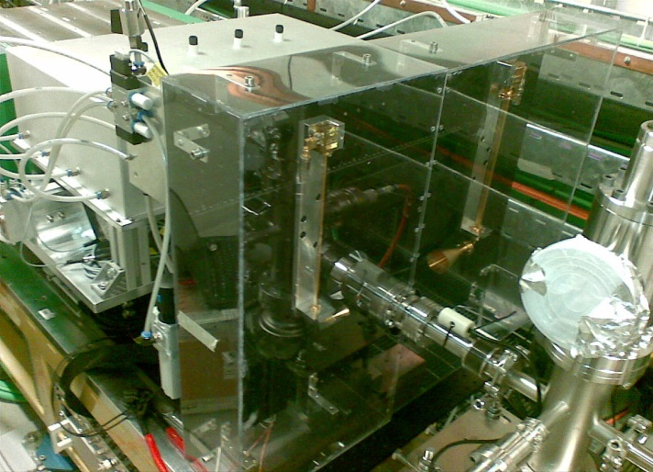
Advanced diagnostics topics of interest for international collaborations
Bunch Length monitors
Operational experience
(rep. rate 10Hz , 800pC, 0,5-10 ps)
A) CER/CSR detection with pyrodetectors
B) Coherent GAP radiation detection with RF diodes
+ absolute measurements (PRL 110, 074802 (2013))
Near future developments and middle term interests:
Operational with low charge (few pC) and ultra short electron bunches ( < 10fs)
Large dynamic range pyro-detectors
ref. M Veronese
Pyro
4th DIPOLE
off axis
Parabolic
mirror

Slide 5
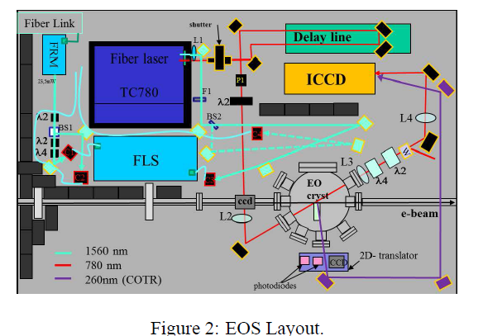
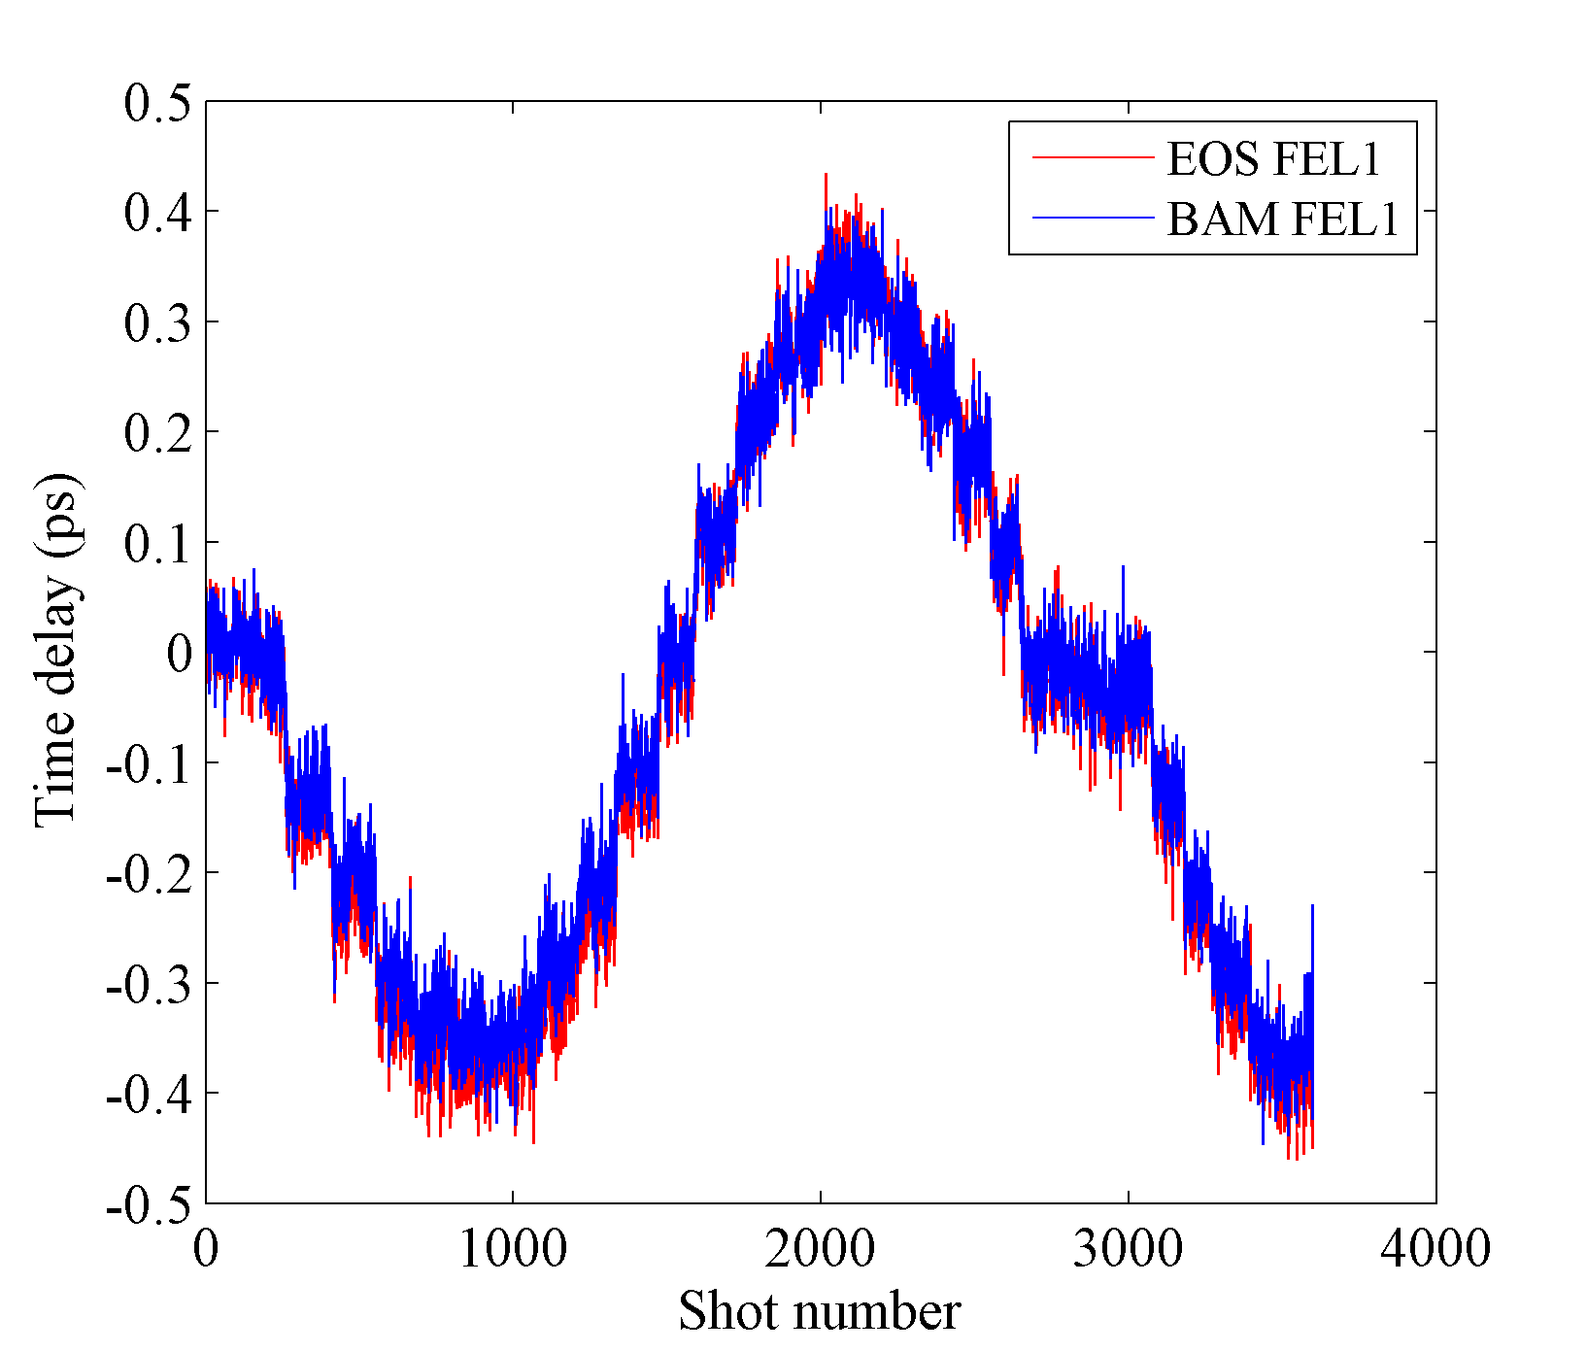
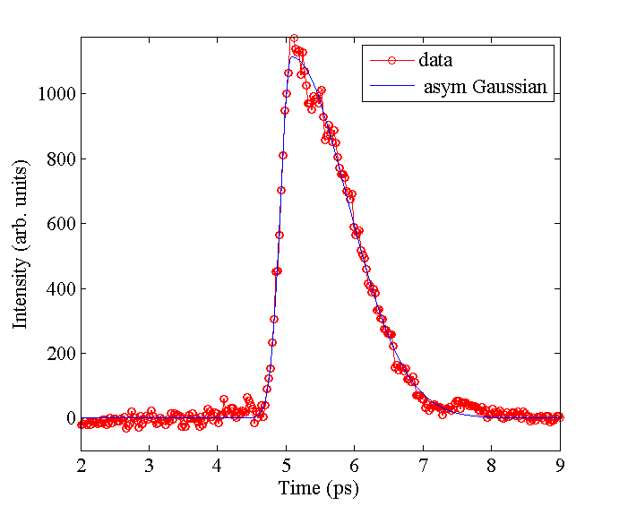
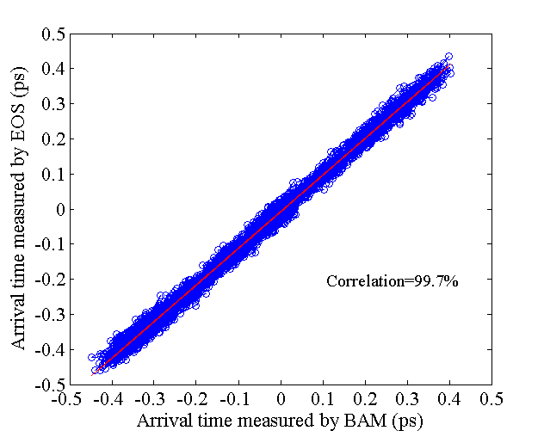
Advanced diagnostics topics of interest for international collaborations
Electro optical sampling
Operational experience
A) EOS Spatial encoding with fiber laser 1560@78MHz in the tunnel for FEL 1 line.
Time jitter comparable to BAM, Temp. profile resolution < 150fs.
B) Coarse temporal alignment of electron beam and seed laser
Near future developments and middle term interests:
EOS with seed lasers (FEL2 + possible upgrade of FEL1)
EOS of e-beams after seeding process (geometries and resolution )
EOS based on magneto-optics effect instead of electro optic effect (bulk vs surface)
ref. M Veronese
GaP
0.1mm

Slide 6
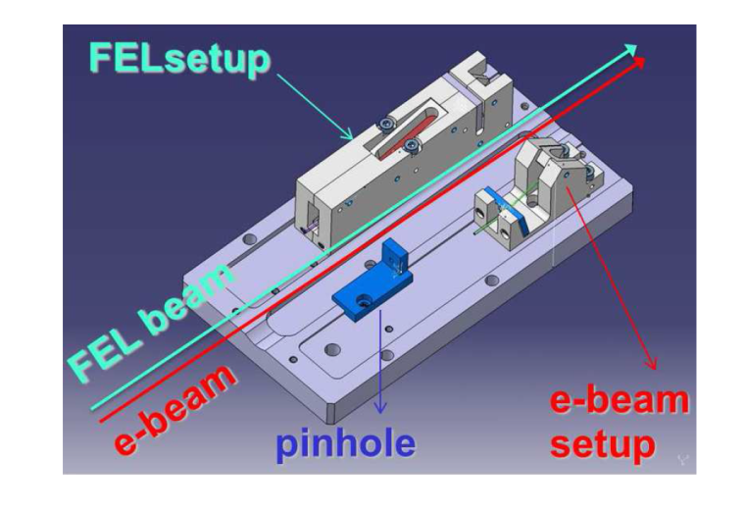
Advanced diagnostics topics of interest for international collaborations
Screen systems (intra undulator)
Operational experience
29 standard screens + 15 intra-undulator screens
COTR mitigation geometry with scintillators for intra undulator screens + high. resolution
Intra-undulator screen can measure also FEL profile.
Near future developments and middle term interests:
Advanced scintillator based screen designs with high resolution and overcoming COTR
Improvement of screen designs in mixed beams (i.e. e-beam + FEL)
Damage of scintillators and coatings by FEL radiation (share exp. and knowledge)
Performance of scintillators with FELs (is YAG:Ce the best choice ?)
ref. M Veronese
FEL 43nm
e-beam
σ=15μm

Slide 7
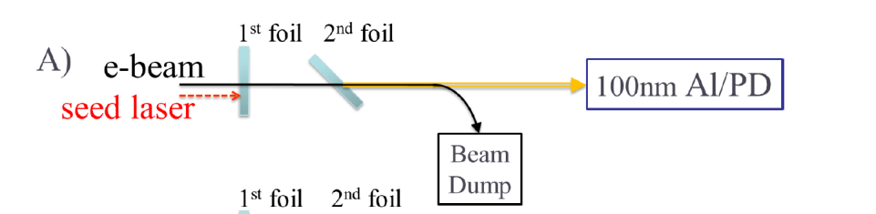
Advanced diagnostics topics of interest for international collaborations
Micro-bunching
Operational experience
A) Measured the seed laser induced bunching in the UV and for higher harmonics (VUV).
Near future developments and middle term interests:
1) Microbunching measurements in the IR
Non invasive beam size and emittance diagnostics
In collaboration with R.B. Fiorito, S. Di Mitri et al (PRSTAB 17, 122803 (2014))
ref. M Veronese

