Slide 1


Recent activities and achievements of the
Munich Neutron Imaging Group
Michael Schulz, Alexander Backs, Dominik Bausenwein, Thomas Bücherl, Michael Lerche, Malgorzata Makowska, Martin Mühlbauer, Tobias Neuwirth, Burkhard Schillinger, Rudolf Schütz, Marc Seifert, Samantha Zimnik

Slide 2
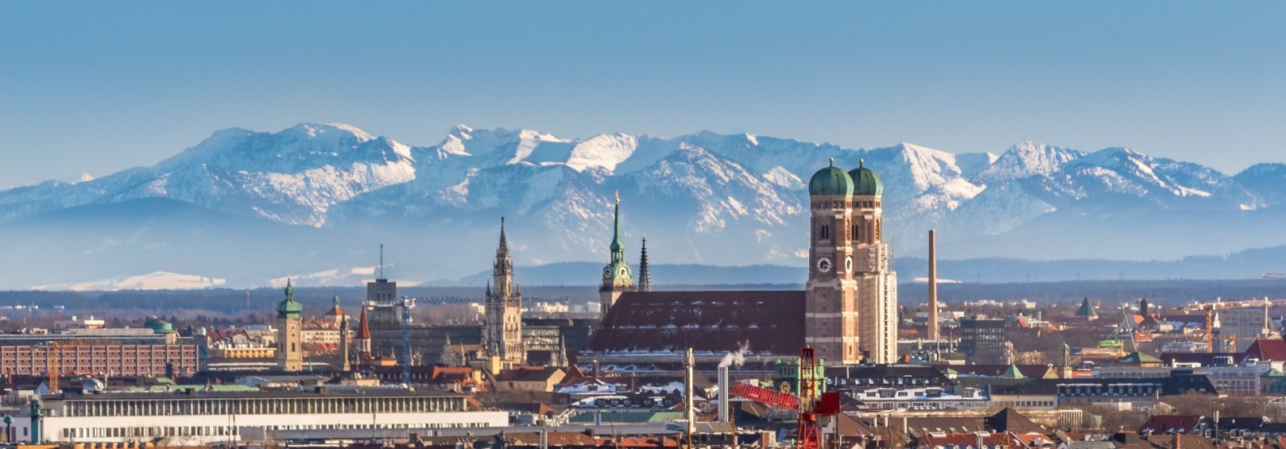

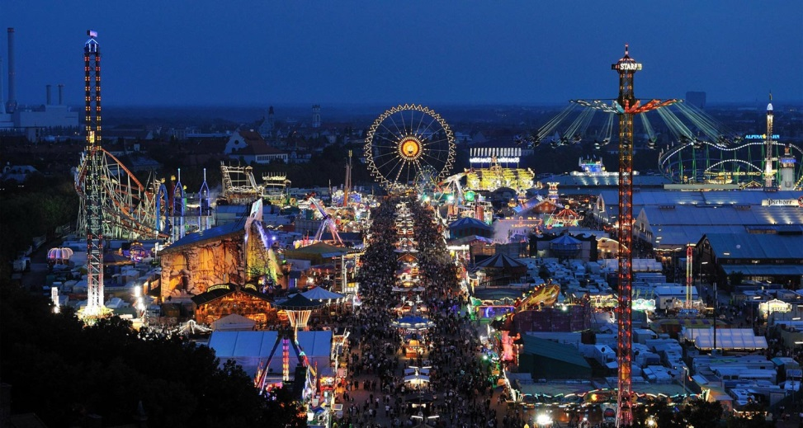

Munich

Slide 3
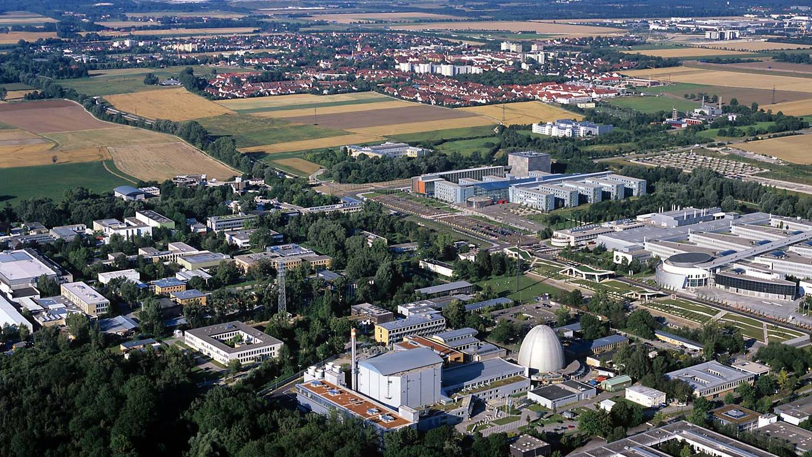
20km north: FRM II, Garching

Slide 4
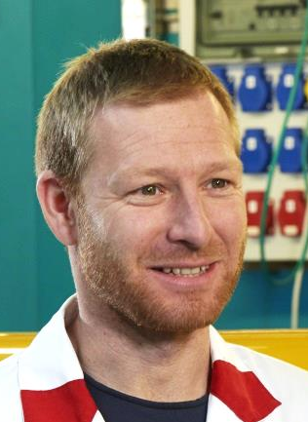
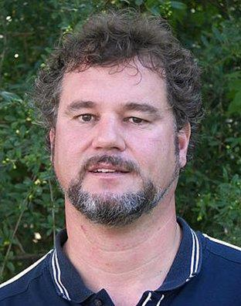
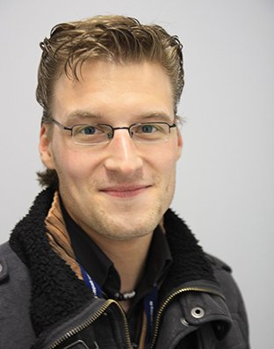

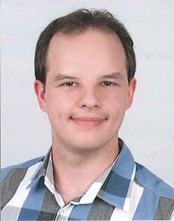
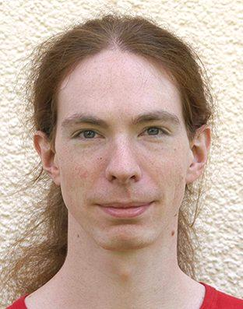
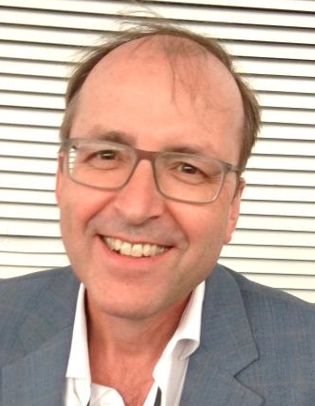
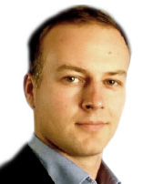
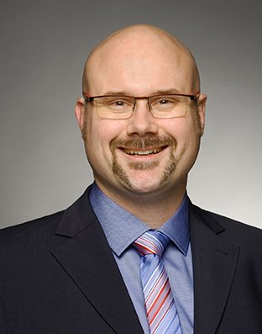
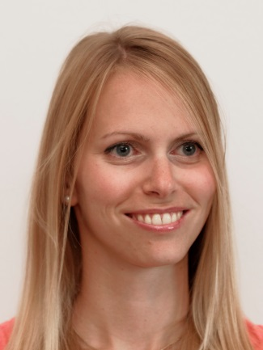
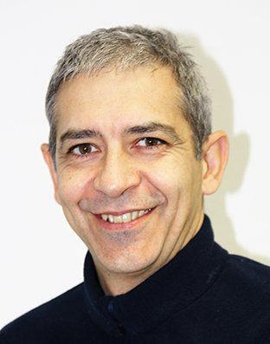
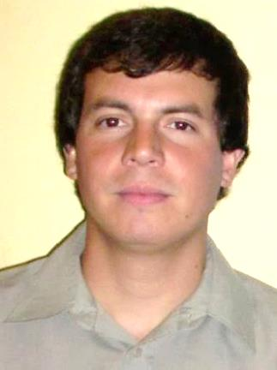
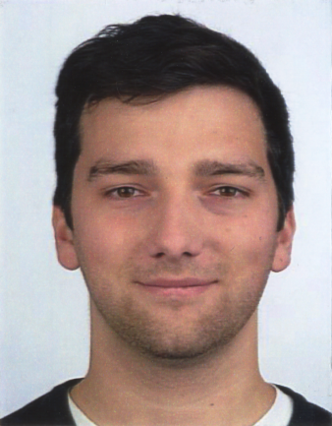

Munich Neutron Imaging Group (MUNIG)
ANTARES
M.Schulz
B. Schillinger
D. Bausenwein
M. Seifert
T. Neuwirth
A. Backs
NECTAR
ODIN@ESS
T. Bücherl
A. Losko
R. Schütz
S. Zimnik
M. Lerche
E. Calzada
Guests & Students
S. Soria
S. Sebold
T. Duong

Slide 5
Outline
ODIN@ESS
ANTARES – cold neutrons
  instrument overview + typical applications
  recent instrumentation highlight: nGI upgrade
NECTAR – fast neutrons
  instrument overview + typical applications
  recent instrumentation highlight: thermal beam option

Slide 6
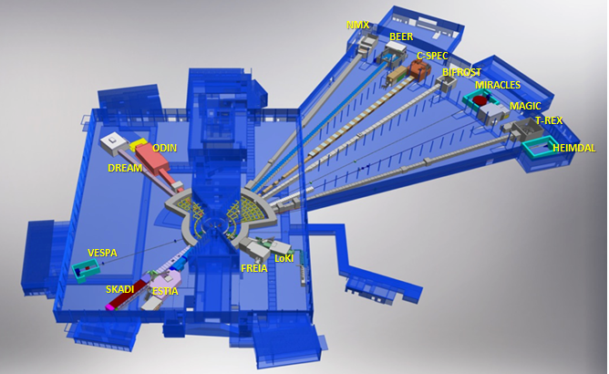










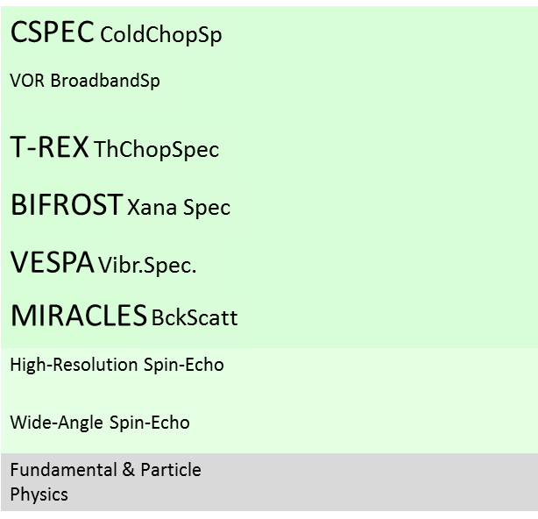











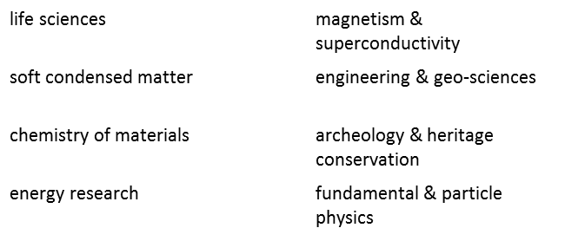
Optical and Diffraction Imaging with Neutrons (ODIN)
Large-Scale Structures
Spectroscopy
Diffraction

Slide 7
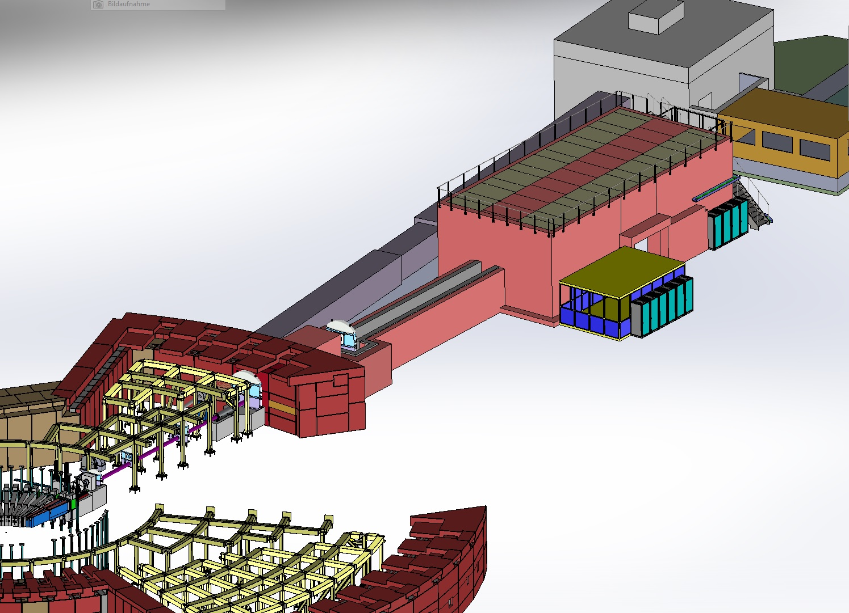
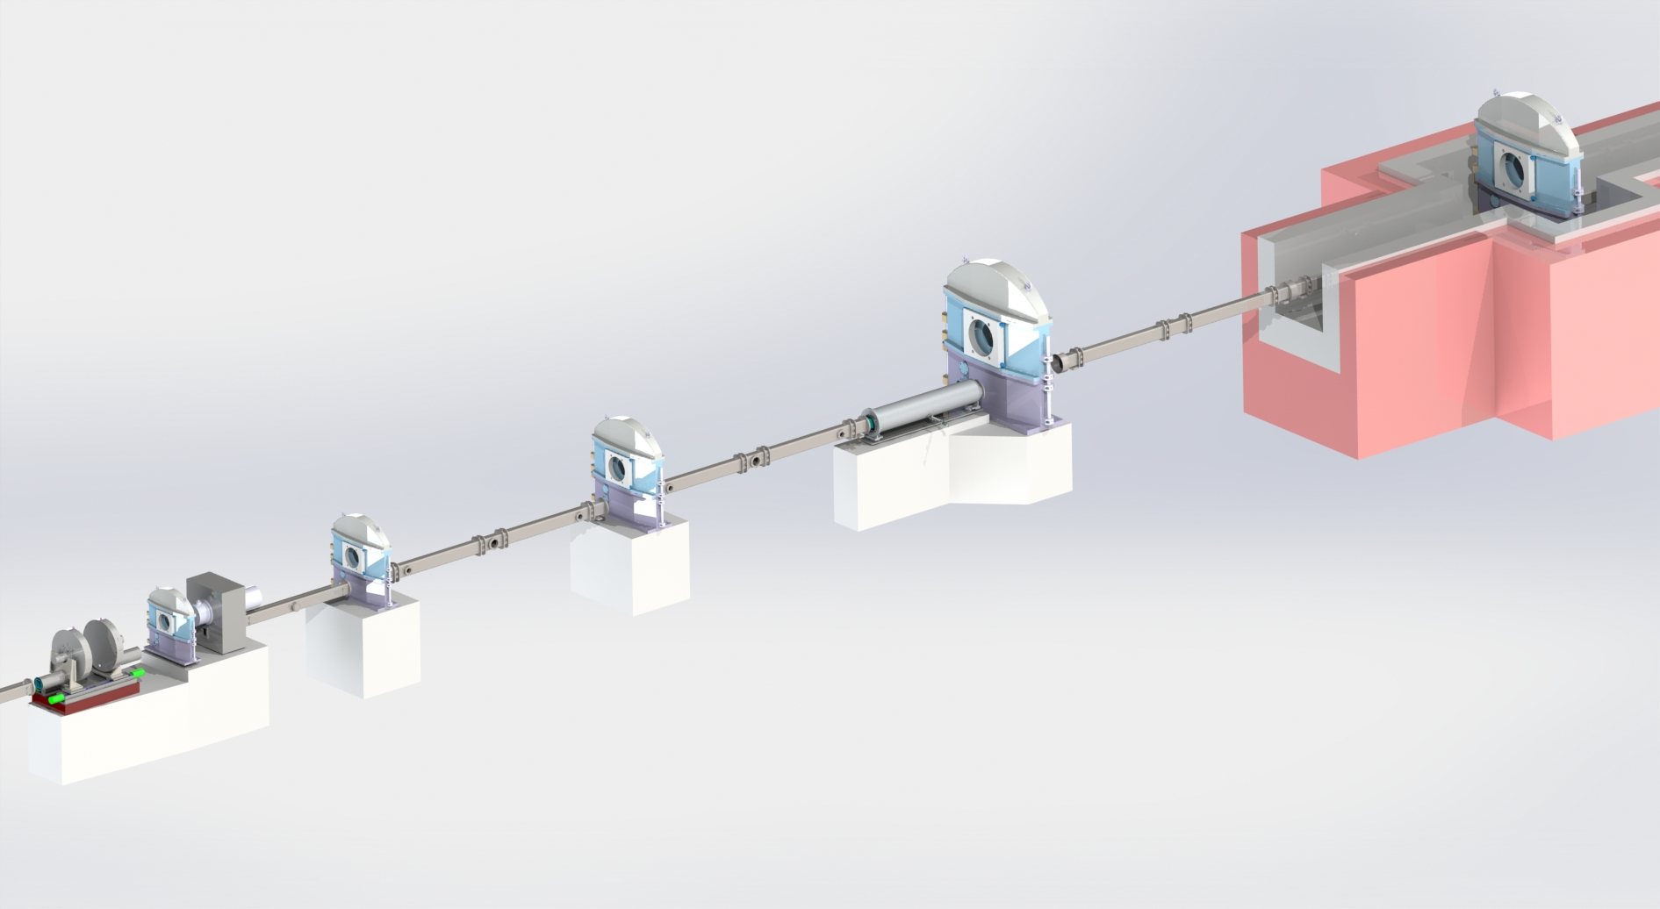
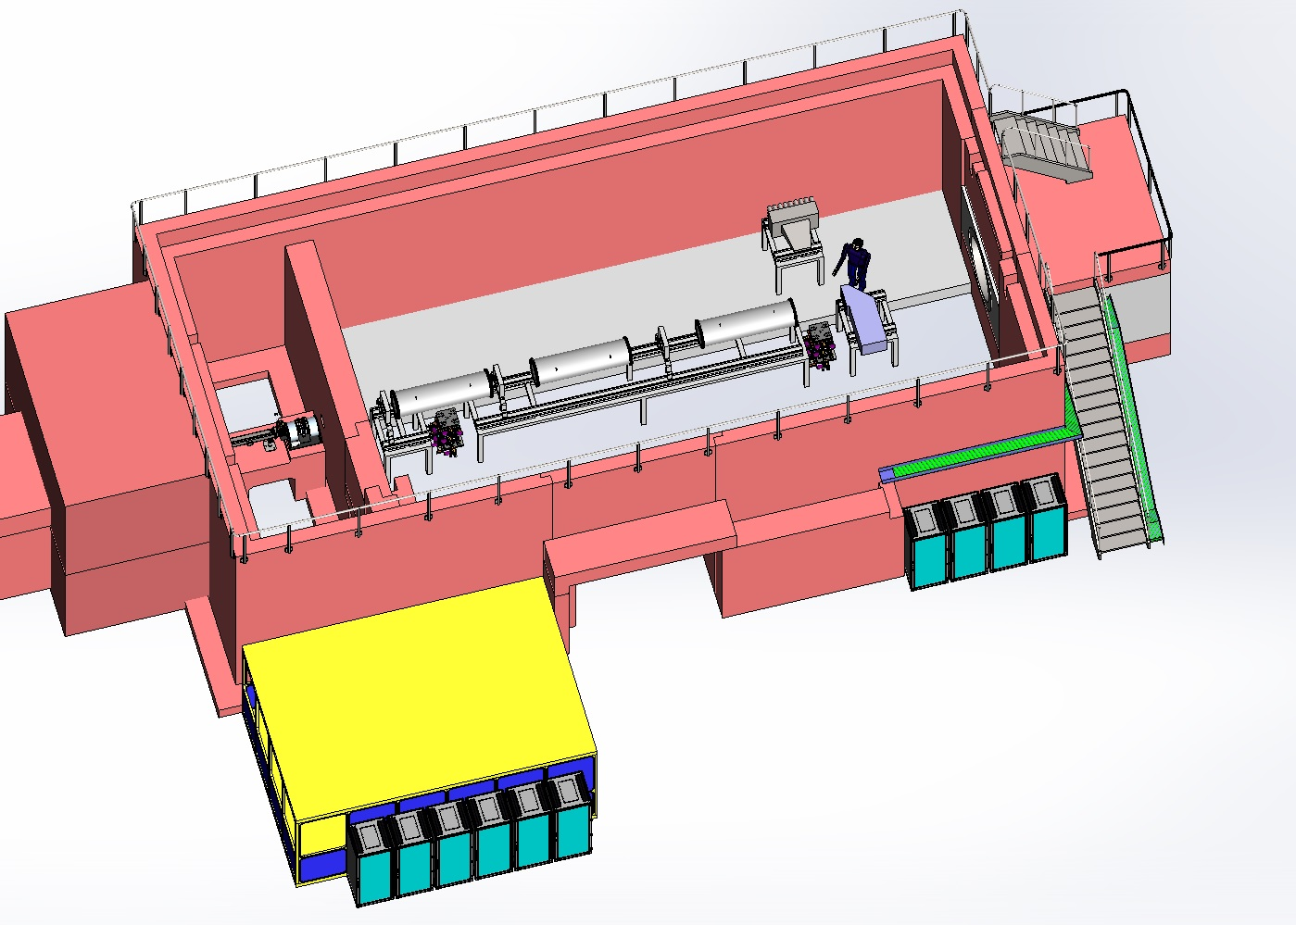
Overview Chopper Cascade
FOC 5
FOC 4
Frame Overlap Chopper 1
FOC 3
T0
FOC 2 + Band Pass
Wavelength Frame Multiplication Chopper 1+2
Detectors
Diffraction - Imaging
ODIN Overview
Cave
optical
experimental
Beam
Stop
User
(for scale)
60m
A complex chopper system will provide wavelength resolution of 0.3-1%, the source-sample distance of 60m will give a natural resolution of 10%, together with a large experimental station this will offer unprecedented versatility.
Collimator
Door
Control Racks
Control Hutch
Control Racks
More by Michael Lerche: today 13:15

Slide 8
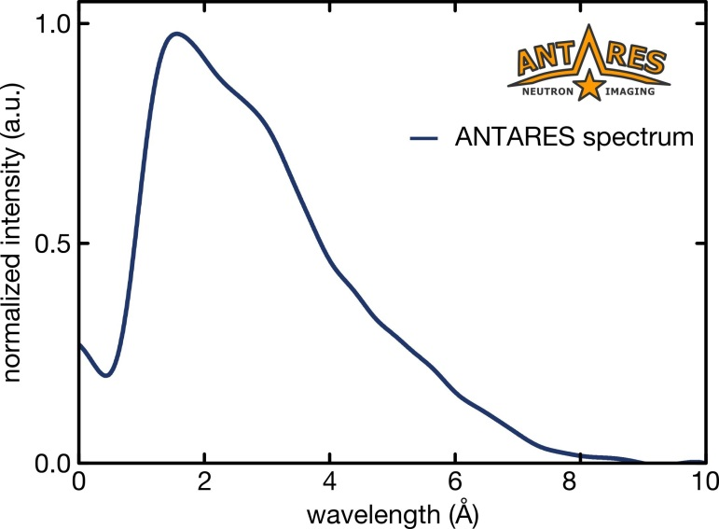
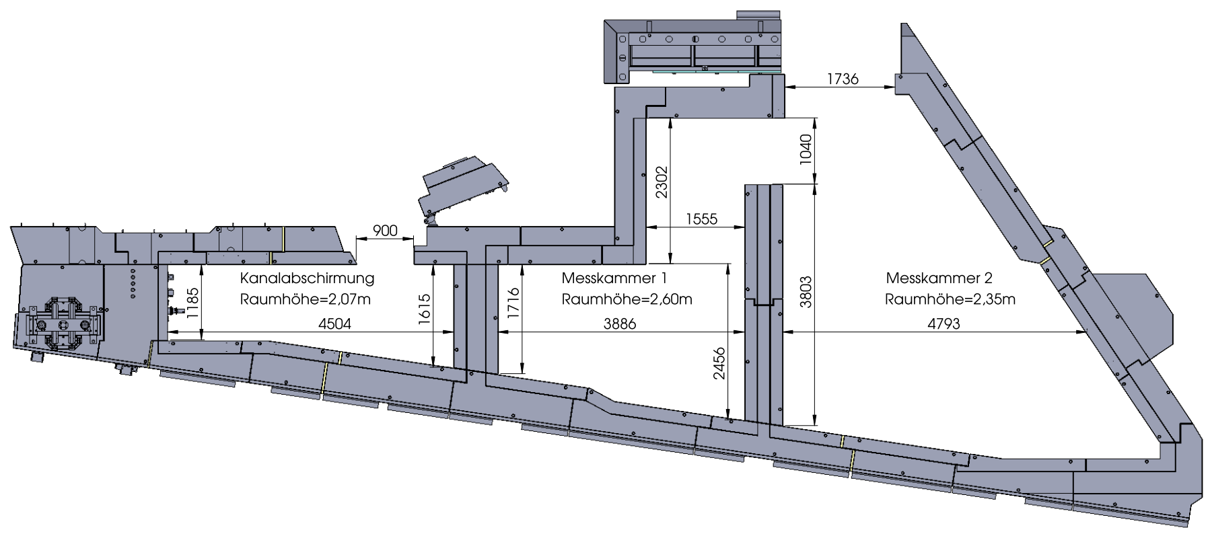
ANTARES – cold neutrons
3 chambers
Beam accessible along flight path -> high flexibility
L/D = 200 ... 7200
Flux: 10⁸ n/cm²/s @ L/D=400
Cold neutron spectrum
Velocity selector + Double crystal monochromator
Polarized neutron imaging
Neutron grating interferometry

Slide 9
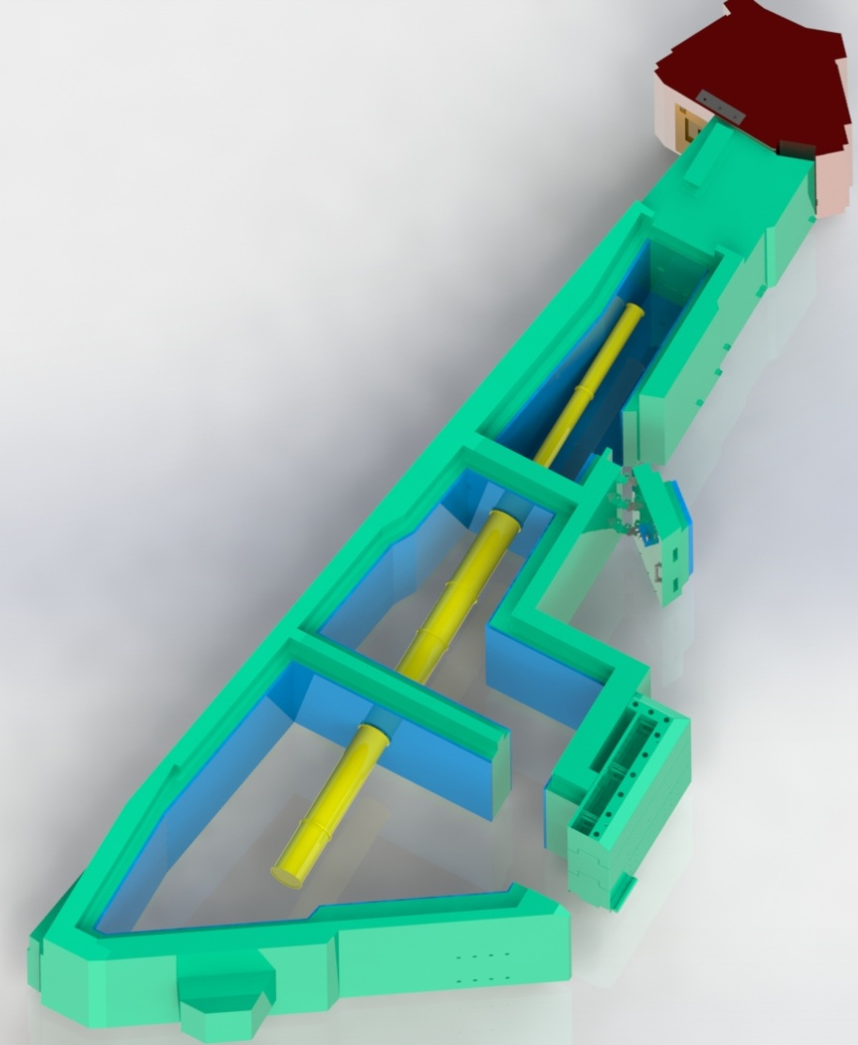
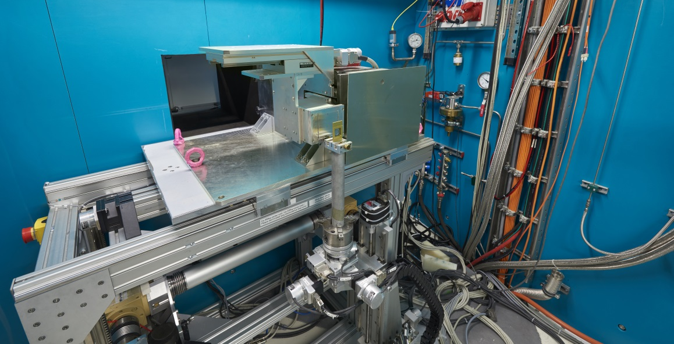
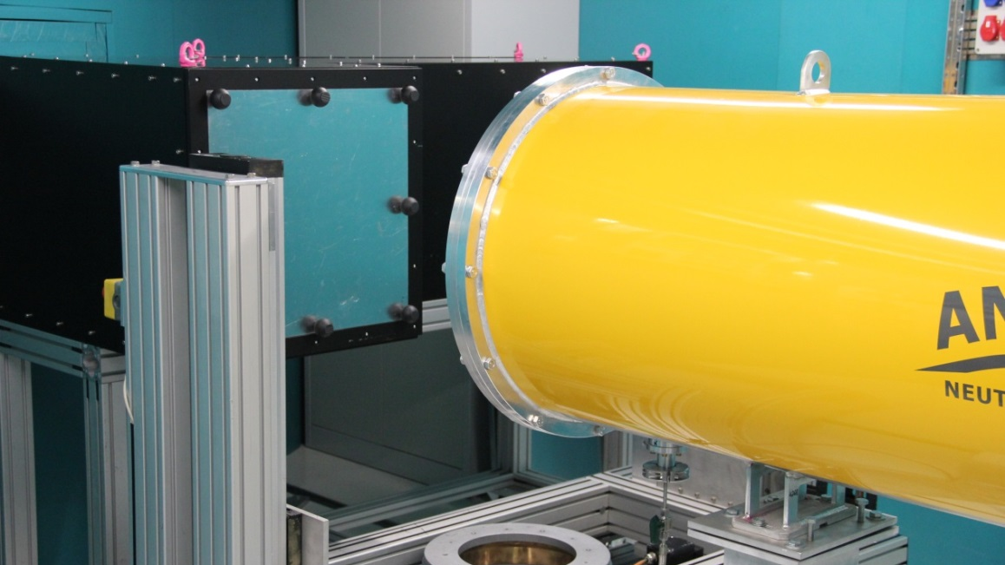
ANTARES – cold neutrons
15m

Slide 10
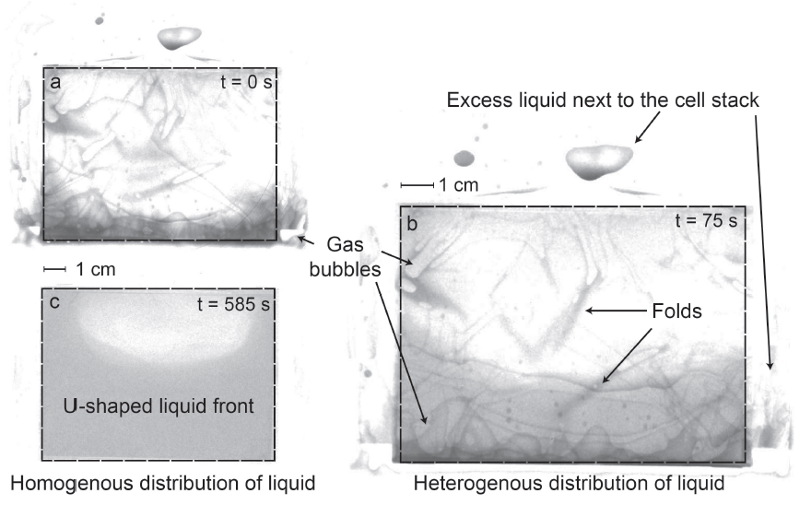
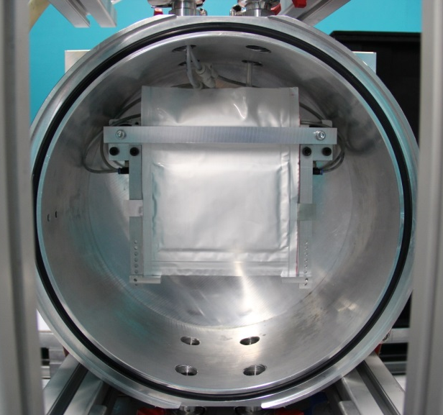
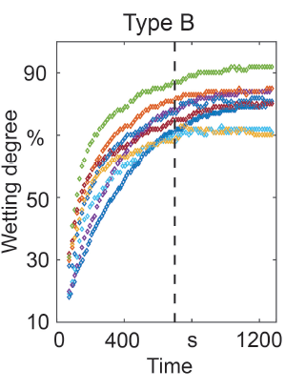
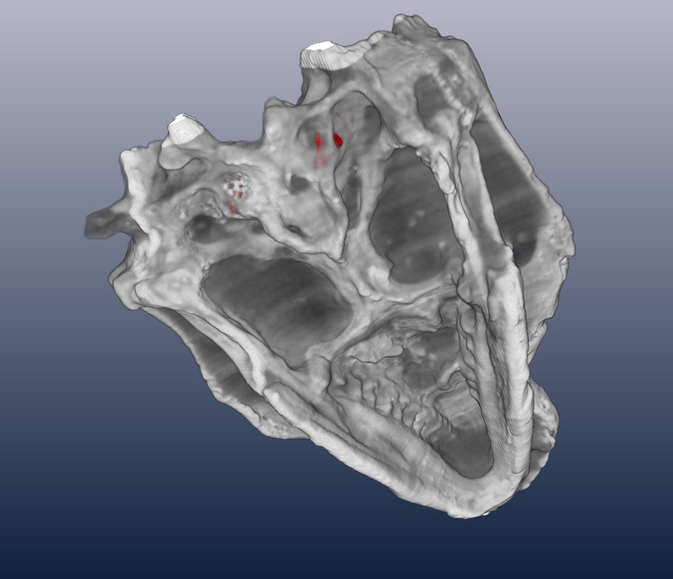
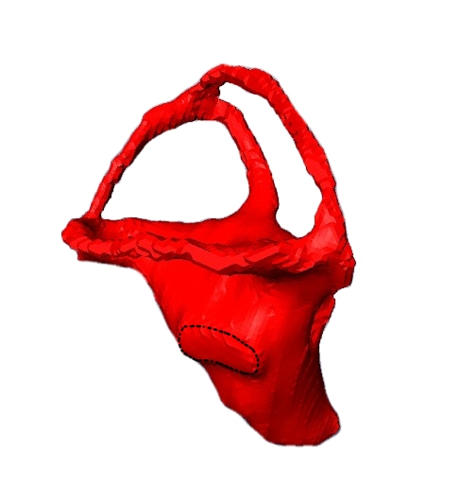
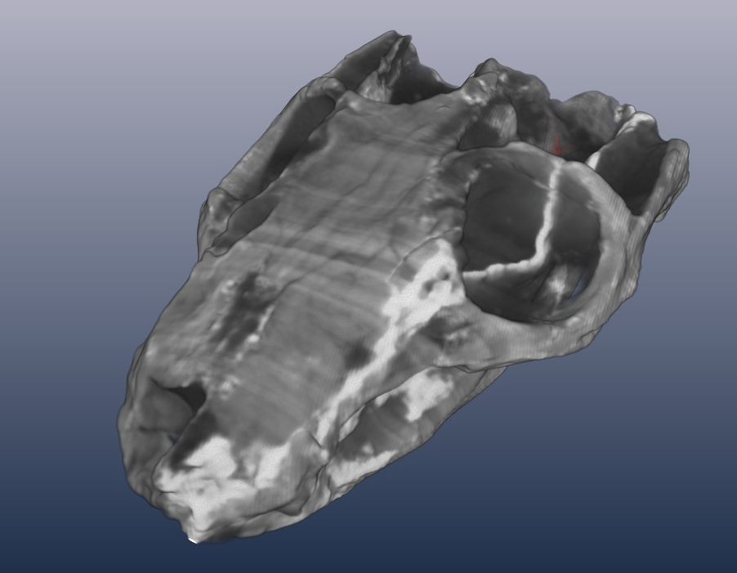
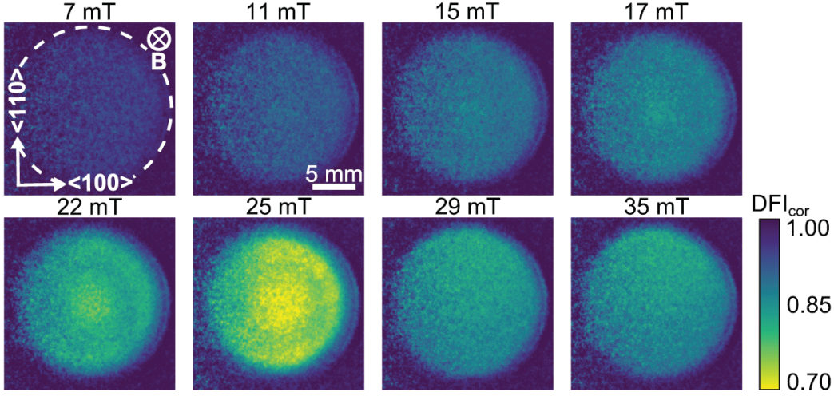
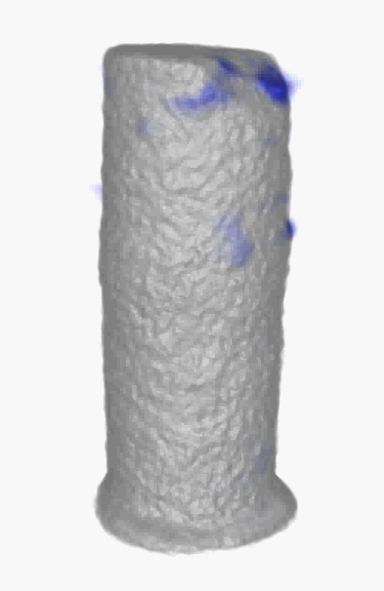
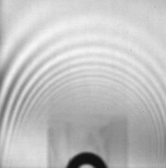
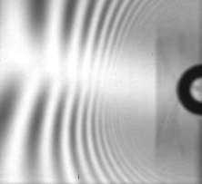
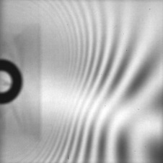
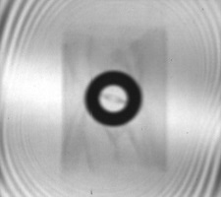
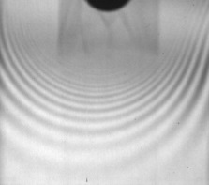
ANTARES – typical applications
T. Knoche, et al., J. Power Sources, 331, 267 (2016)
semicircular canals
(balance)
oval window
(stapes)
cochlea
(hearing organ)
inner ear of 230 My Massetognathus
T. Reimann, et al., Phys. Rev. B, 96, 144506 (2017)
M. Schulz, et al., J. Physics,
211, 012025 (2010)

Slide 11
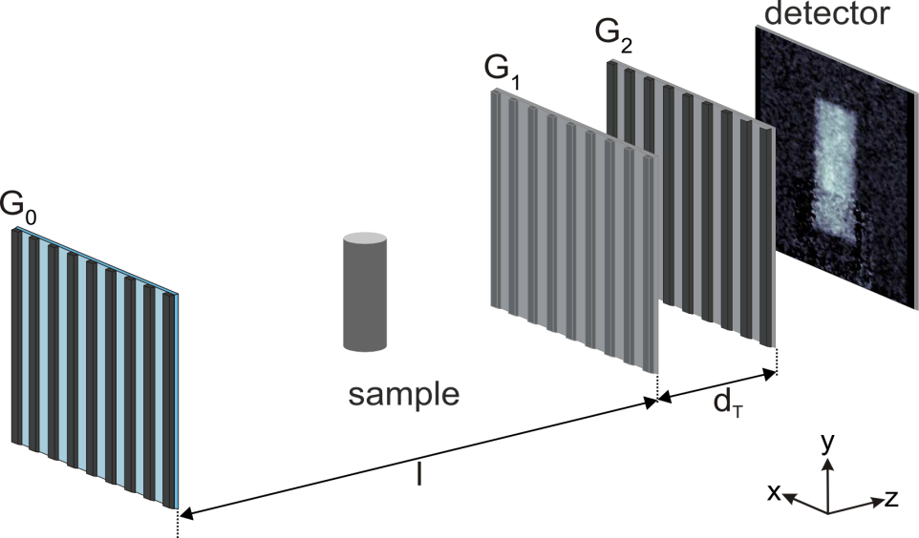
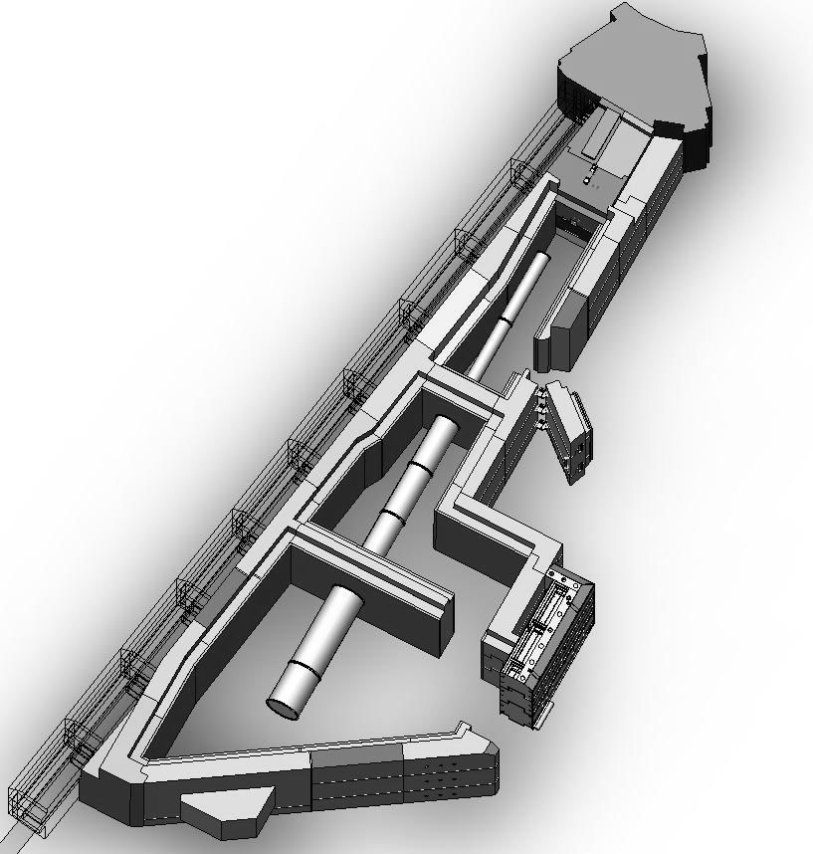
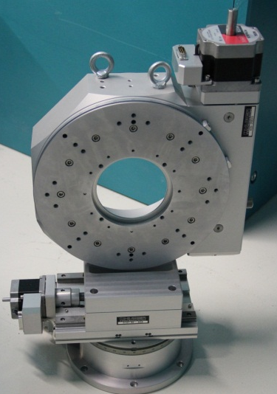
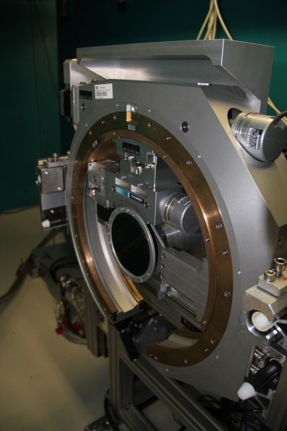
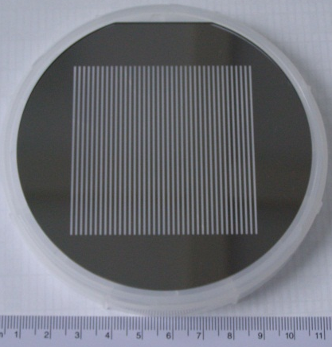
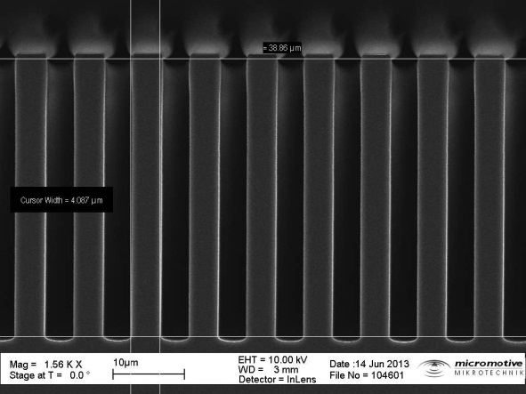
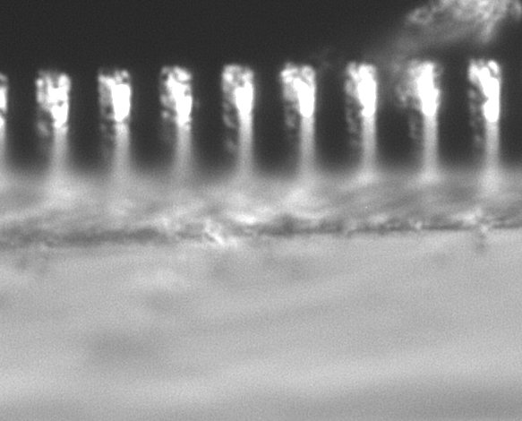
neutron grating interferometry (nGI)
p₀=1.6 mm
p₁=7.98 µm
p₂=4.0 µm

Slide 12
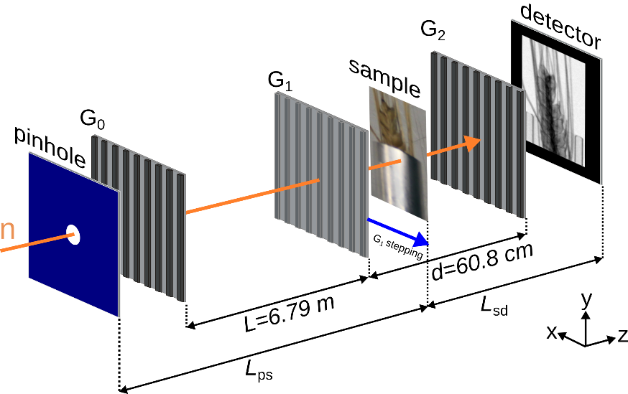
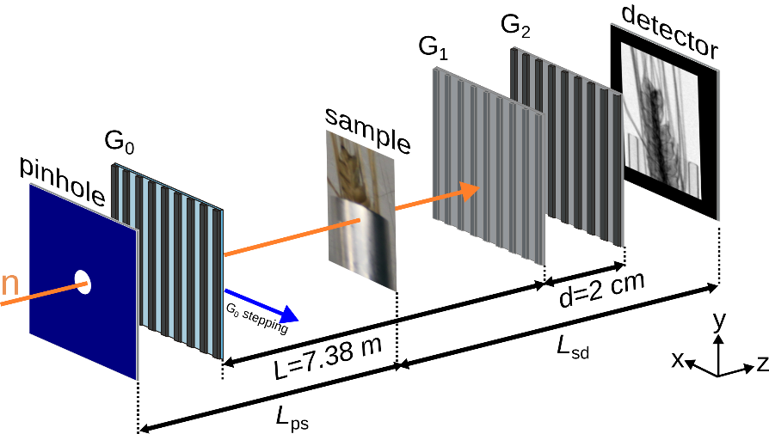
nGI upgrade
 | G₀ | G₁ | G₂
Period | 1596µm -> 150µm | 7.98µm -> 24.4µm | 4µm -> 13.3µm
Depth | 20µm -> 185µm | 37.7µm | ~10µm -> 80µm

Slide 13
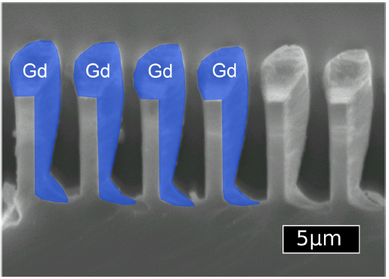
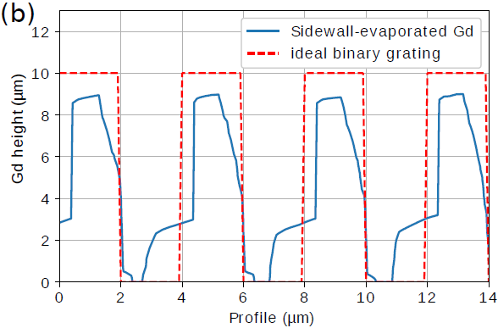


Fabrication of improved G₂ gratings
Conventional inclined sputtering
Gd powder deposition in Si wafer
+80µm
A. Gustschin, E17, Physics Derpartment TUM

Slide 14


Performance of new setup
DC = 0.2 λ = 4Å
Visibility: V = 0.75
Maximum visibility nearly 4x previous setup
Extension of effective measurement range λ = 1.6Å ... 6Å
Improved SNR at shorter exposure times
Variable DC G₀-gratings → Adjustment of flux vs. visibility
More by Tobias Neuwirth: Friday 10:00

Slide 15



NECTAR – fission neutrons

Slide 16

NECTAR – fission neutrons
  Fast (MeV) spectrum
L/D ≈ 200
Flux: 6.4•10⁷ n / (cm² s)
Exposure time: ~1min
Resolution: ~0.5mm - 1mm
Samples max.
  80cm x 80 cm x 80 cm
  400kg

Slide 17







NECTAR – typical applications
100 mm
Fe

Slide 18



NECTAR – thermal beam option
project no: 05K16VK3
ANTARES
NECTAR
NECTAR
Remote switching between fast and thermal beam
Moveable 10mm B₄C filter
L/D 200 … 800
Resolution: <<100µm
Φ_{th} = 8·10⁶n / (cm² s)

Slide 19




NECTAR – thermal beam option
collimator
beam limiter
detector upgrade
More by Samantha Zimnik: Thursday 15:30
flight tube

Slide 20
Conclusions
ODIN will be a next generation neutron imaging instrument at ESS
NECTAR and ANTARES are available for all kinds of user experiements
Next proposal deadline is 28.9.2018
nGI Upgrade at ANTARES delivers highly improved performance
Thermal upgrade at NECTAR provides an additional modality for improved contrast

Slide 21
Thank you!

Slide 22


neutron grating interferometry (nGI)
Setup generates neutron interference pattern at detector:
Scattering at µm structures locally degrades interference pattern
Degradation of interference pattern mapped in the DFI
→ DFI = spatially resolved USANS scattering map

