Slide 1
Large area MCP-based neutron imagers
Serge Duarte Pinto
WCNR 2018, Sydney

Slide 2
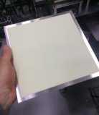
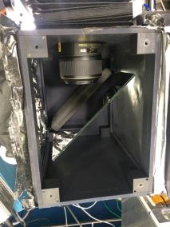
Neutron Imaging challenges
The higher the desired resolution, the thinner the scintillator needs to be, thus the lower the efficiency → Efficiency ~1% is common
Intensity limits final resolution for reasonable exposure time
Scintillator
Camera
Moderator
(thermal or cold)
Neutron source
Collimator
Sample
?
?
?
Mirror
D
L
ℓ
In practice only a handful of reactor/spallation sources worldwide is bright enough
for tomography with reasonable exposure times and high resolution.

Slide 3
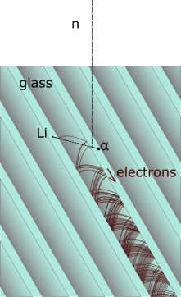
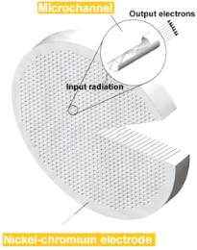
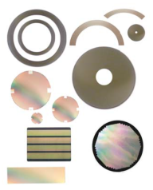
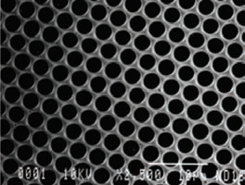

Microchannel Plates loaded with ¹⁰B and Gd
Glass capillary structures with millions of microscopic pores, each of which acts as an electron multiplier
Can be made in almost any size and shape
If the glass is doped with ¹⁰B and Gd, it becomes neutron sensitive
Detection efficiency ~50% for thermal neutrons (~70% cold)
PHOTONIS CONFIDENTIAL

Slide 4
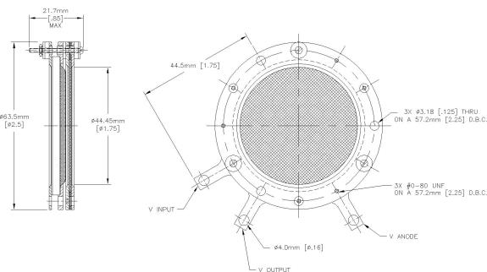
Neutron-sensitive phosphor screen imager
An assembly of one or more MCPs with a phosphor screen
Mounted in a vacuum enclosure, screen observed through a viewport by a camera
2 MCPs high gain, wider PSF
1 MCP lower gain, best resolution
First tests with 40 mm round FoV
100x100 mm² unit now available

Slide 5
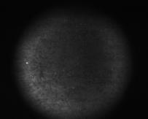
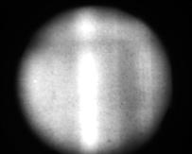
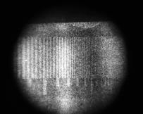
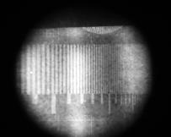
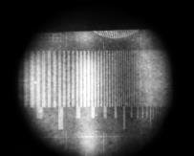
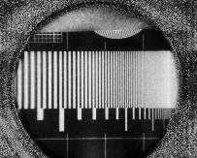
Taking Images and processing them
Raw images are taken until sufficient exposure
Background subtracted from the average raw image
Normalization with open beam image
Background
Open beam
Raw images (x200)
Average
Bkg subtracted
Normalized image

Slide 6
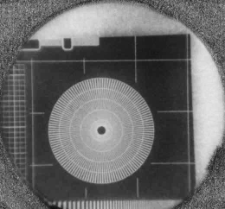
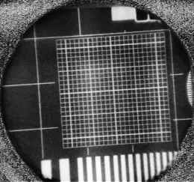
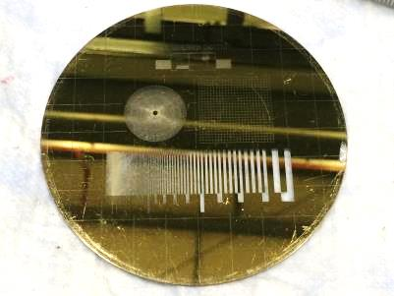
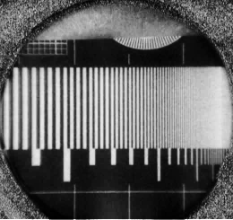
Gadolinium test mask
Made at PSI: C. Grünzweig et al., Rev. Sci. Instrum., vol. 78, no. 5, p. 53708, May 2007.

Slide 7

Gadolinium test mask
Resolution line grid can be used to calculate modulation transfer function (MTF) curve
Limiting resolution is often defined @ 10% or 5% MTF
This means 6-10 lp/mm, or 100-170 µm for our imager
Resolution (μm) 400 300 200 150

Slide 8
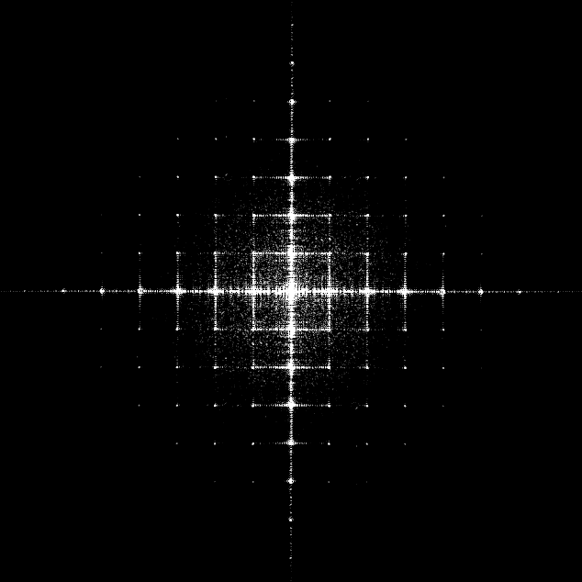
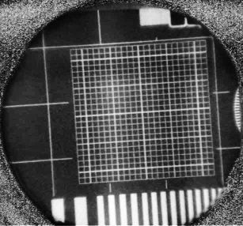
Gadolinium test mask
The square line grid can reveal pincushion or barrel distortions. A 2D Fourier transform is particularly sensitive to such distortion.
2D FFT

Slide 9
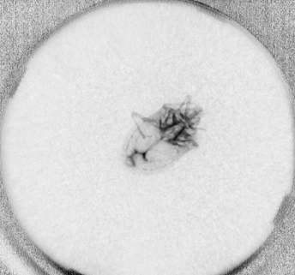
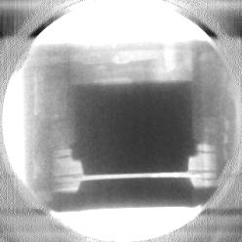
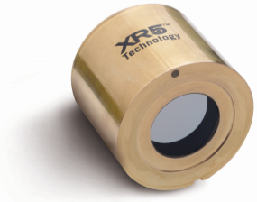
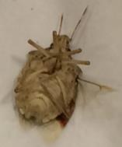
Some more images

Slide 10
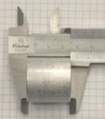
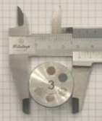
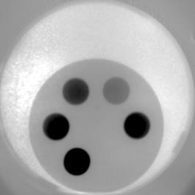
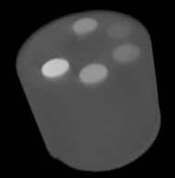
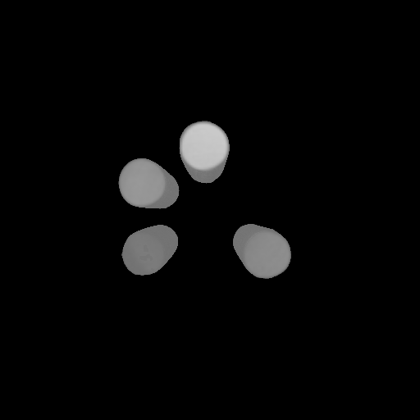
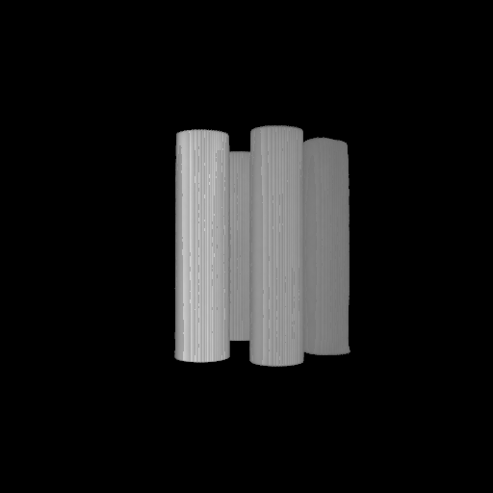
Tomography
Test sample from: A.P. Kaestner et al., Phys. Proc. 43 (2013) 128–137.
Tomography of multi-metal sample
900 projections in <2 hours
By adjusting the attenuation coefficient threshold metals can be in- or excluded
Pb
Ti
Cu
Fe
Al
Ni
Threshold: 0.5 cm¯¹

Slide 11
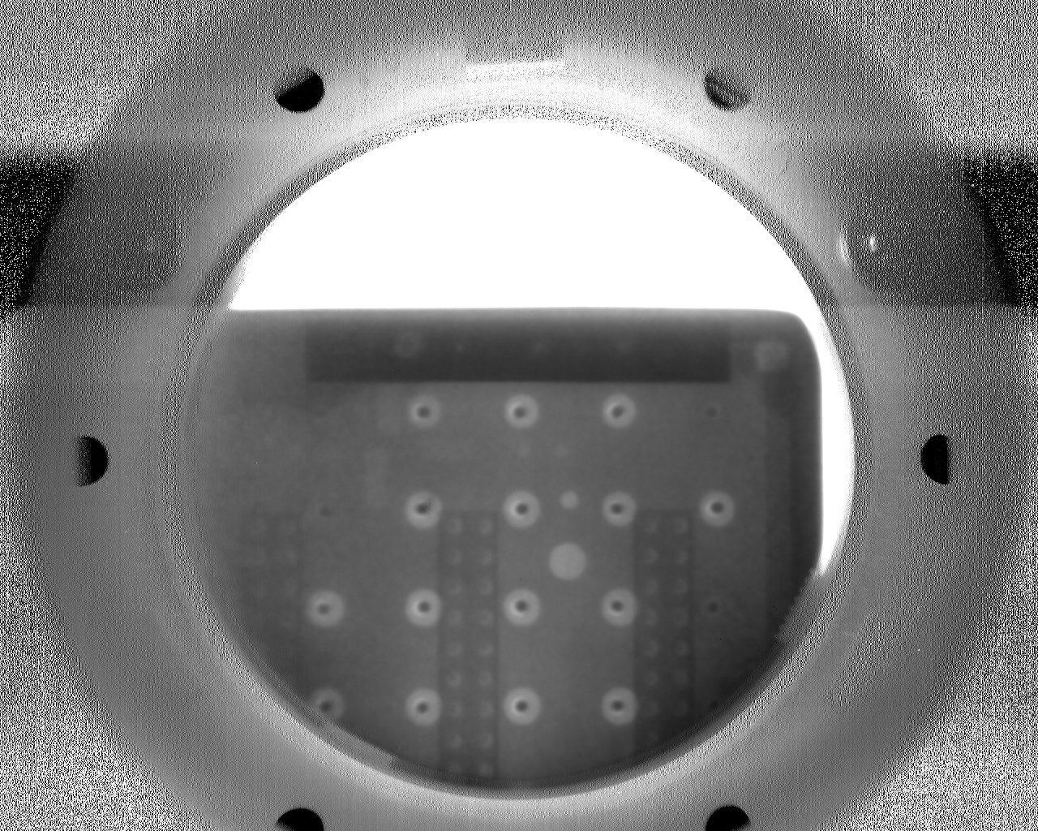
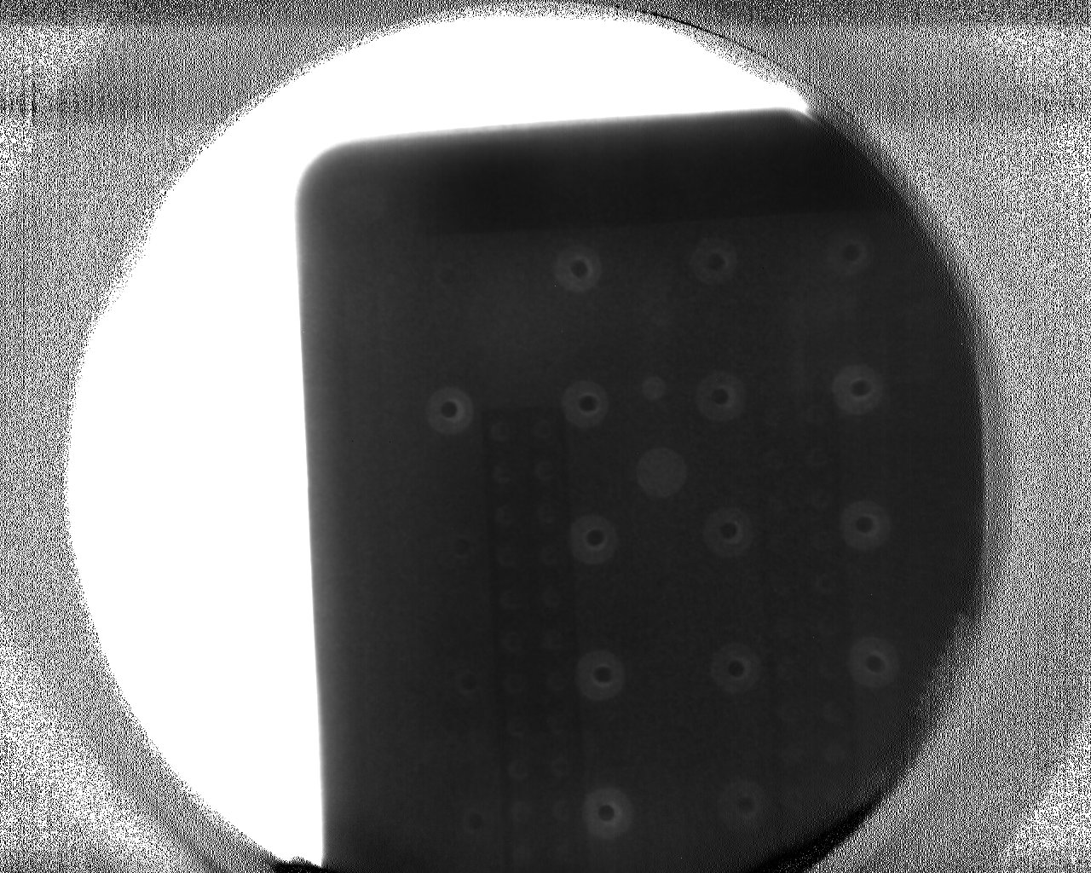
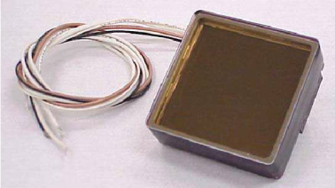
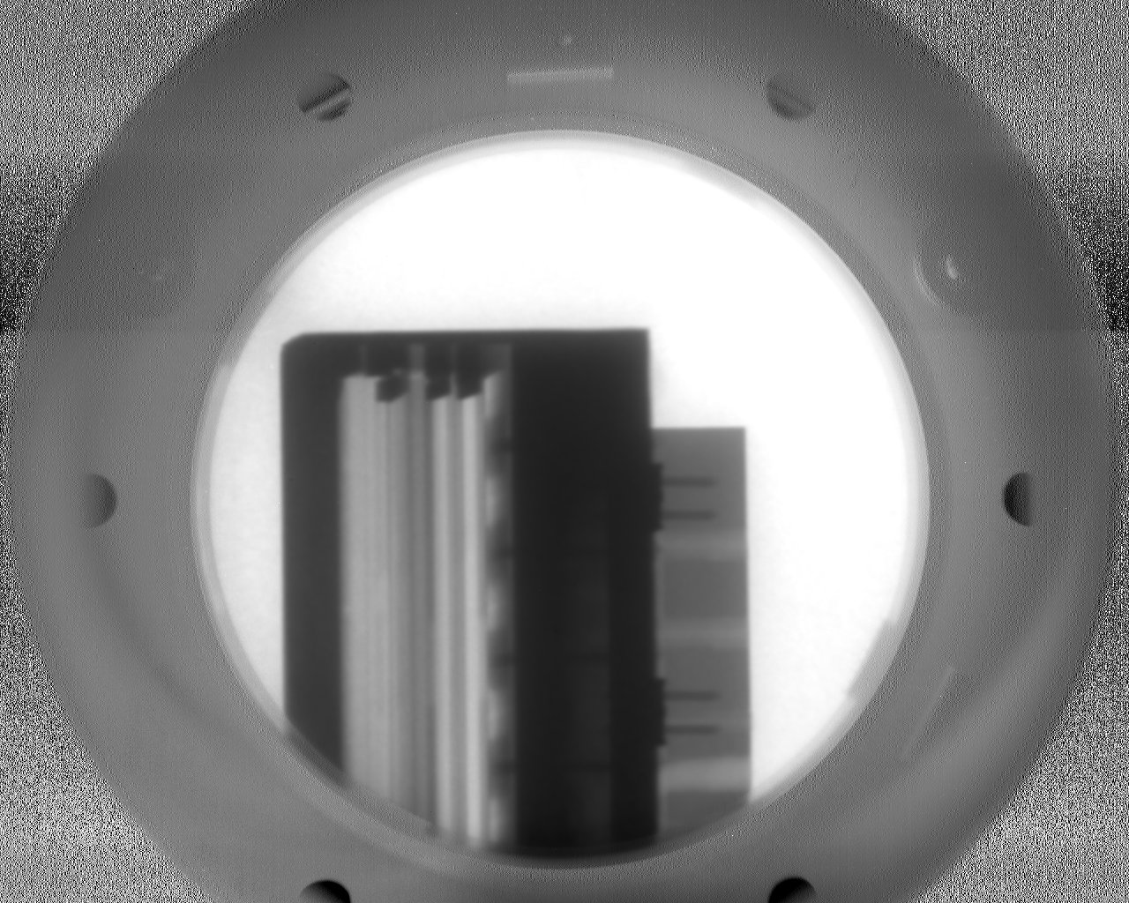
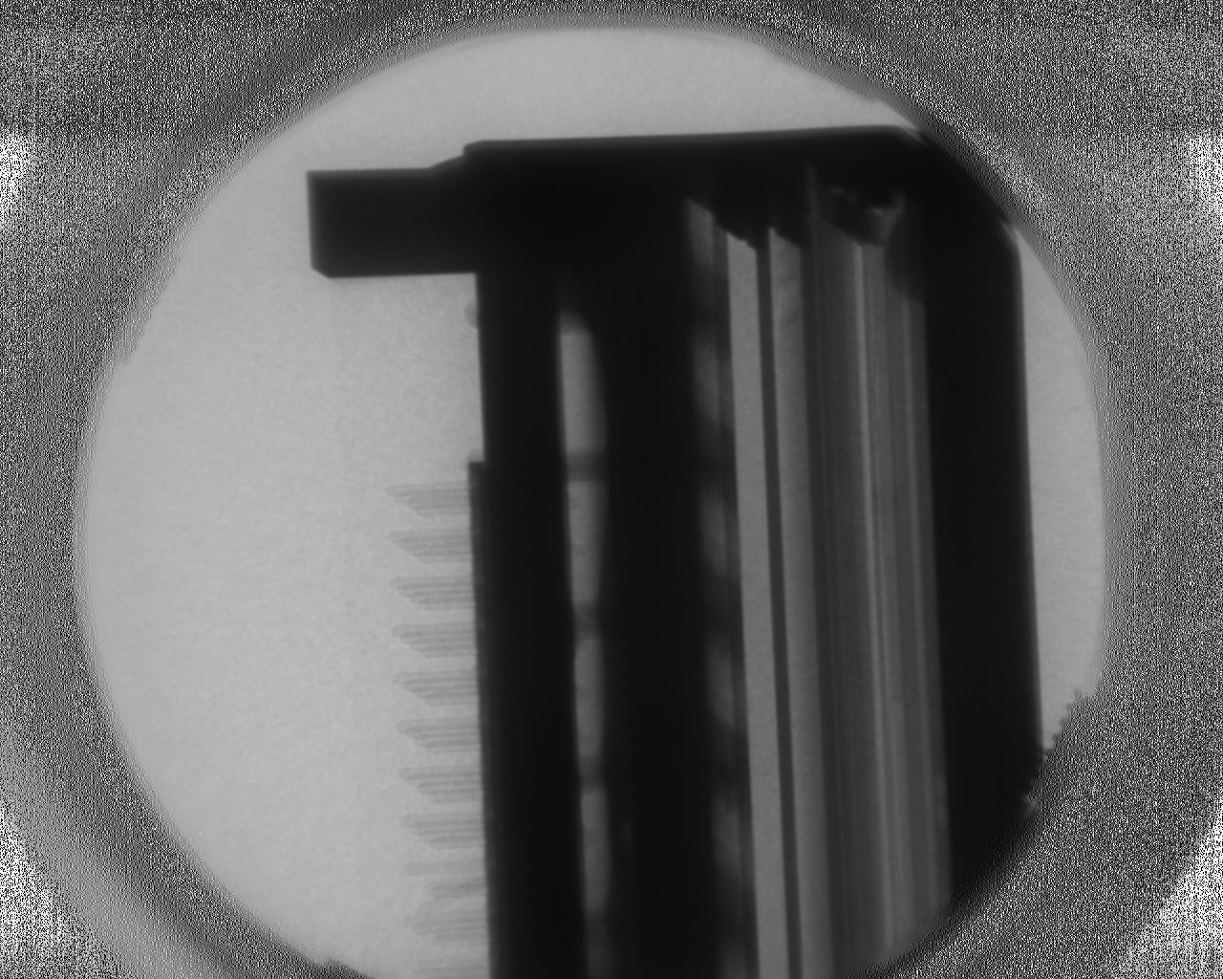
Thermal vs cold neutrons
Thermal Cold
Thermal neutrons: more penetration
Cold neutrons: more contrast
Images of a Planacon MCP-PMT made in Delft (thermal) and ORNL (cold).

Slide 12
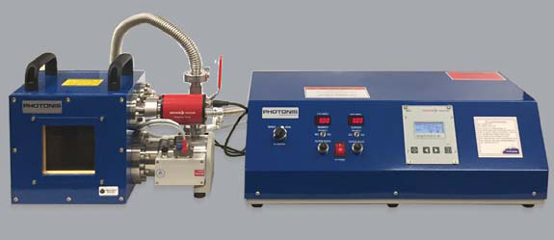
Improved design
Turbo pump control
And pressure gauge readout
High voltage supply
(also controllable remotely)
Backing pump inside
100x100 mm²

Slide 13
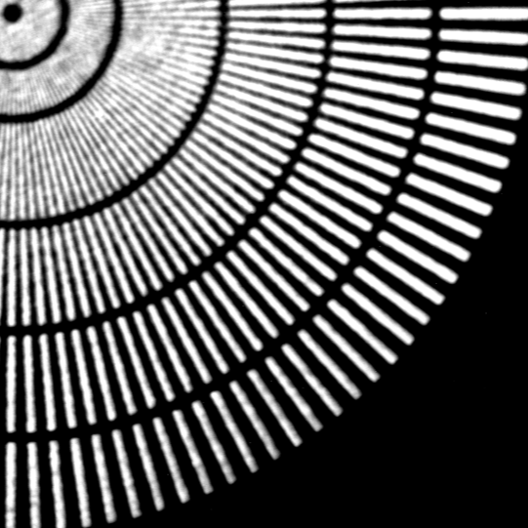
Improved design
400 µm
Attains about 70 µm spatial resolution
Over the full 100x100 mm² active area. And room for improvement …
300 µm
200 µm
100 µm
50 µm

Slide 14
Improved design
400 µm
Attains about 70 µm spatial resolution
Over the full 100x100 mm² active area.
And room for improvement …
300 µm
Resolution (µm) 200
100
50
200 µm
100 µm
50 µm

Slide 15
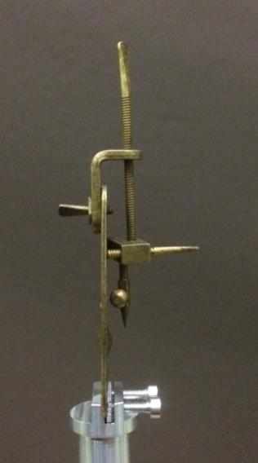
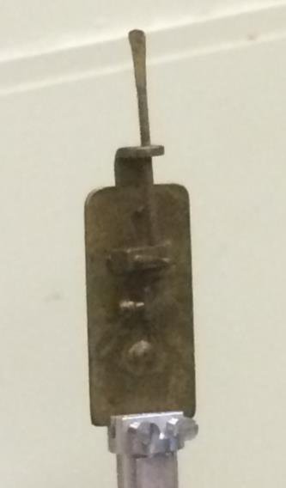
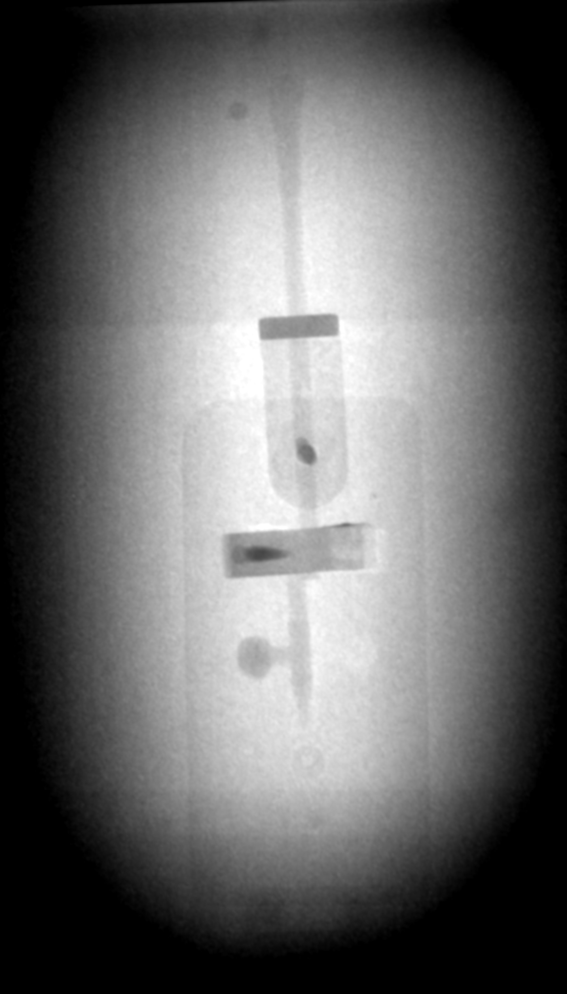
Imaging in the old days: know what this is…?

Slide 16
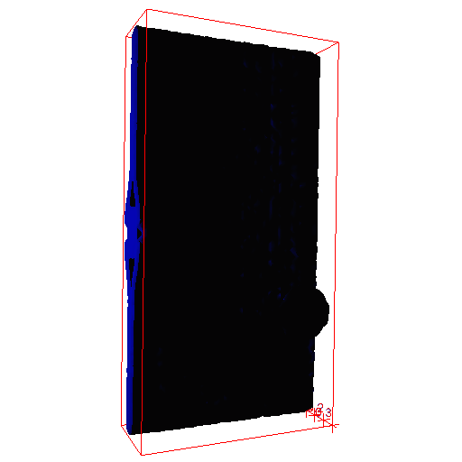
Tomography of AvL microscope
Samples made available by
Rijksmuseum Amsterdam,
Rijksmuseum Boerhaave Leiden

Slide 17
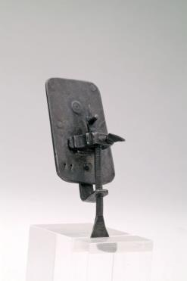
Conclusions
Tested in Delft and Oak Ridge NL
Results from the 40 mm imager published: 2017 Jinst 12 C12006
Still improving performance of the 100x100 mm² unit
Outlook
High efficiency makes better use of precious beam time
Enables fast tomography and neutron video
Neutron imaging can be done on lower flux sources (like Delft), even becomes feasible with neutron generators or alternative sources (laser driven, accelerator driven)
Museum pieces and rare artefacts can be imaged with lower flux, so they don’t stay in radioactive quarantine forever

Slide 18

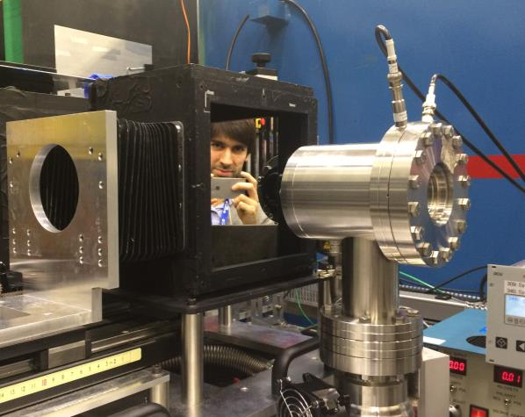

Thanks:
Jeroen Plomp, Zhou Zhou,
Lambert van Eijck,
Hassina Bilheux,
Indu Dhiman,
Steve Ritzau,
Dave Pasquale, Bruce Laprade
PHOTONIS Technologies S.A.S.
18 Avenue de Pythagore
CS 70019
33693 MERIGNAC Cedex
France
T +33 (0)556 16 40 50
F +33 (0)556 16 40 62
www.photonis.com

