Slide 1

Development of Neutron Imaging Facility at DHRUVA research reactor, India
Dr. Tushar Roy
Bhabha Atomic Research Centre, INDIA
Co-authors: Yogesh Kashyap, Shefali Shukla, Mayank Shukla, Prashant Singh, Ravi Baribadalla, S.C.Gadkari

Slide 2
Overview
Neutron imaging activities in BARC – historical perspective
DHRUVA Research Reactor
Neutron Imaging Beamline at DHRUVA reactor
Imaging Modalities
Some Applications…

Slide 3
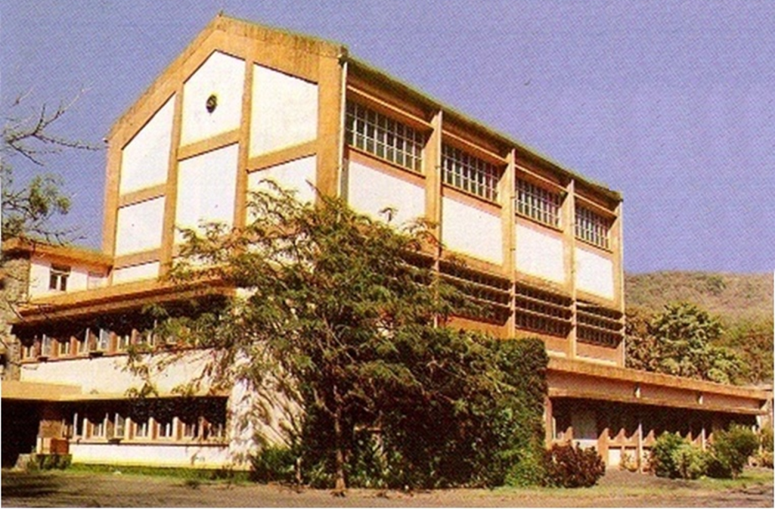
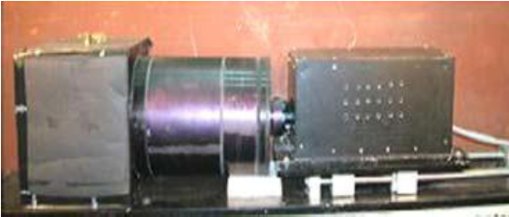
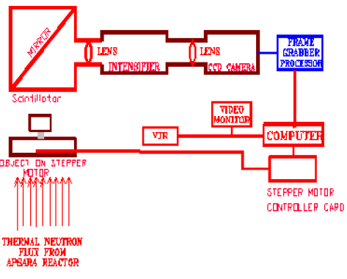
Overview of Neutron Imaging activities in BARC
Neutron imaging at APSARA Research Reactor (1995 - 2001)
APSARA Reactor
1 MWt
Swimming pool type
Neutron Radiography
Neutron Tomography - feasibility
Two-phase flow
Neutron detector
Thermal neutron flux ~ 1 x 10⁶ n/(s-cm²)

Slide 4
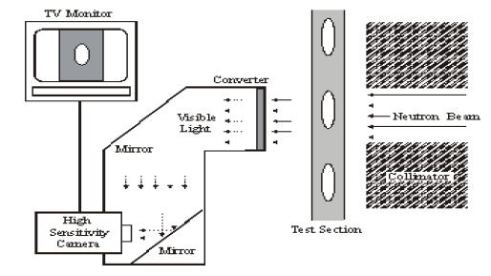
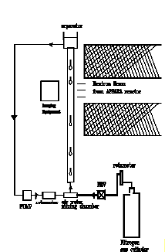
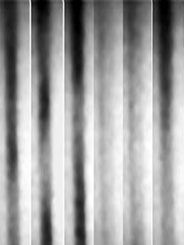

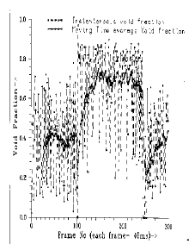
Some Results from APSARA
Two-phase flow : Thermal hydraulics study
Schematic of imaging set-up
Experimental set-up
Neutron radiograph of water flow inside SS tube at different time
Real-time flow visualization
Online void-fraction calculation
Void-fraction

Slide 5
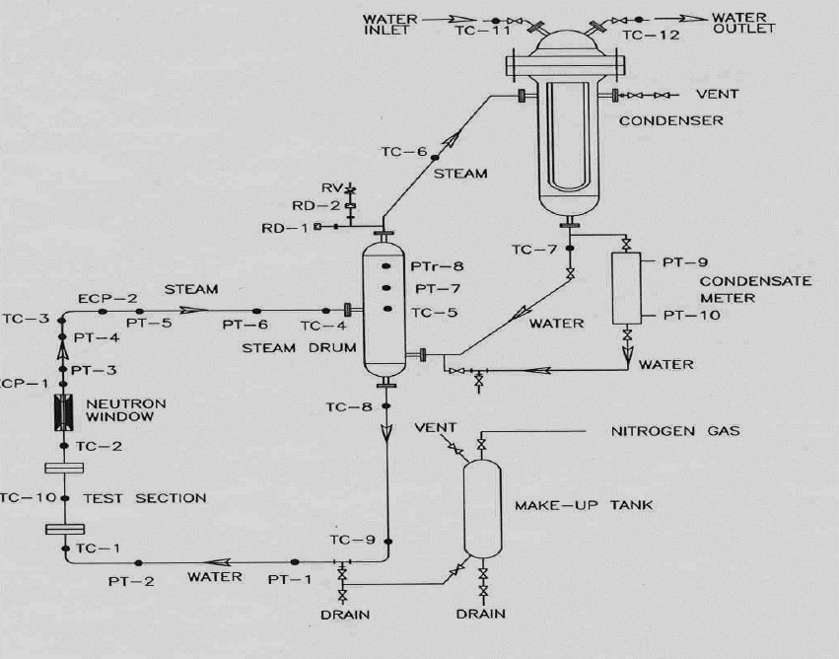
Some Results from APSARA
Schematic diagram of a simulated loop for natural convection-driven circulation

Slide 6
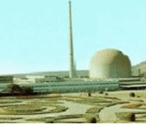
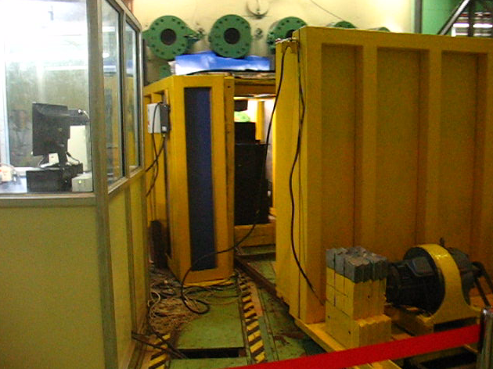
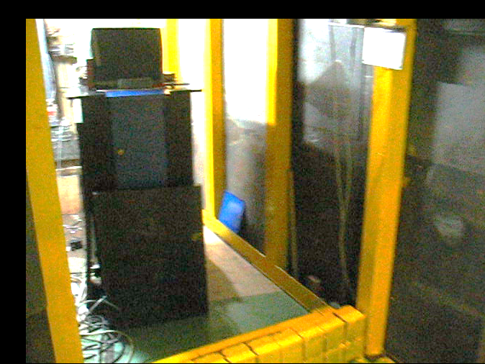
Overview of Neutron Imaging activities in BARC
Neutron imaging at CIRUS Research Reactor (2010)
CIRUS Reactor
40 MWt
Vertical tank type
Neutron Radiography
Neutron Tomography
Neutron Imaging Beamline at CIRUS
Thermal neutron flux ~ 1 x 10⁶ n/(s-cm²)

Slide 7
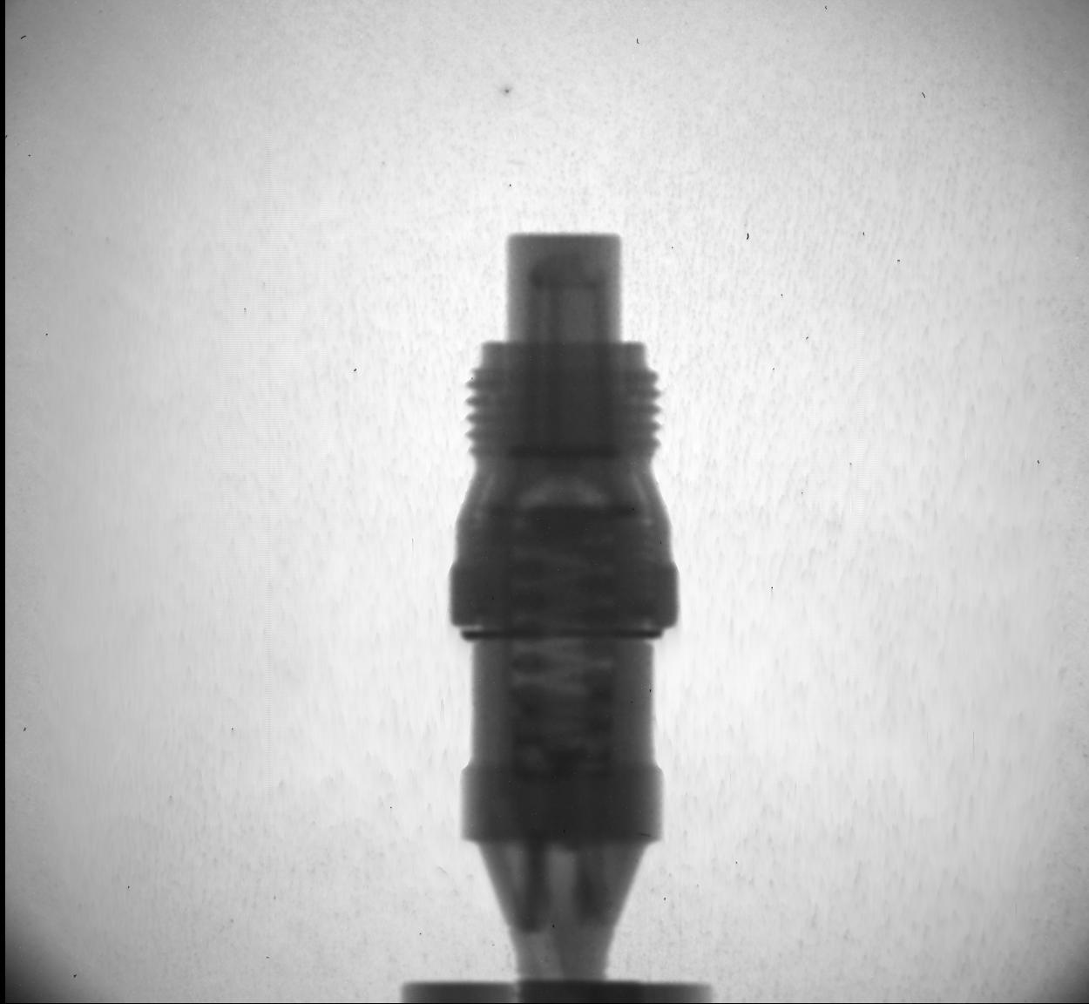
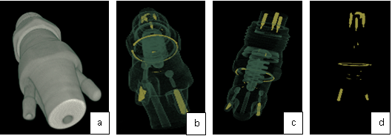
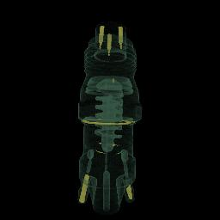
Some Results from CIRUS
Fuel injector of automobile
Radiograph
Tomograph – 3D view
7

Slide 8
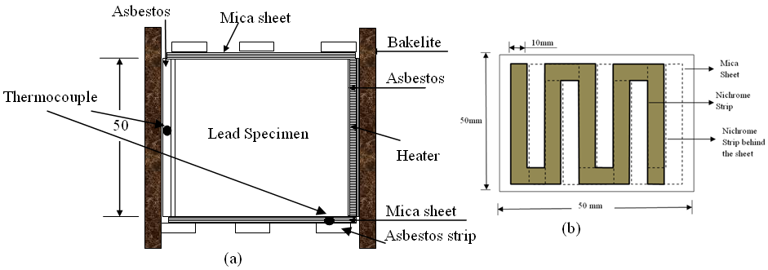
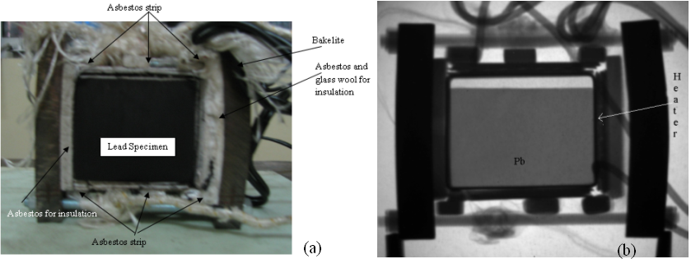
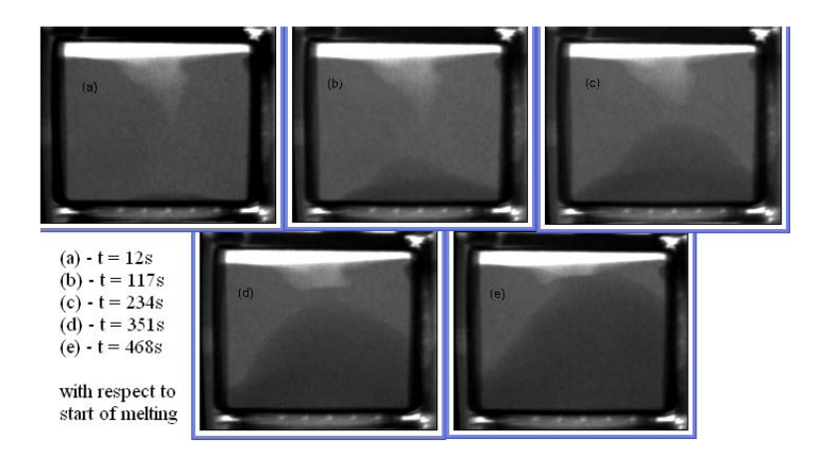
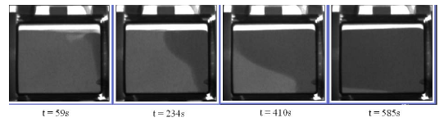
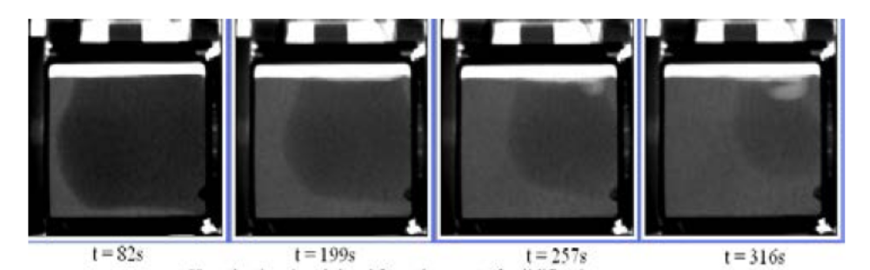
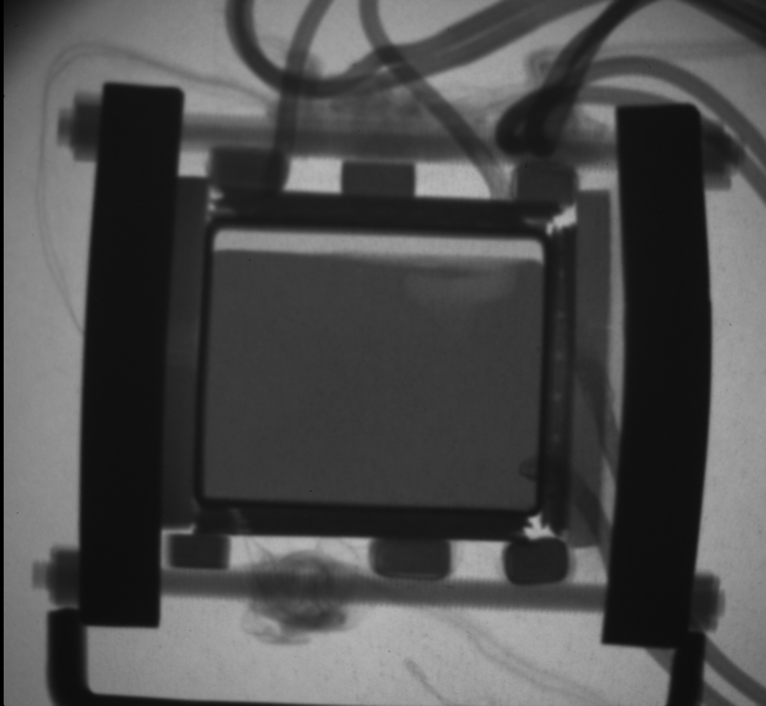
Some Results from CIRUS
Visualization of melting and solidification of Lead
Schematic of heating chamber
Solid-liquid interface of lead during melting
Melting of lead after 1 cycle of melting - cooling
Solid-liquid interface of lead during solidification

Slide 9
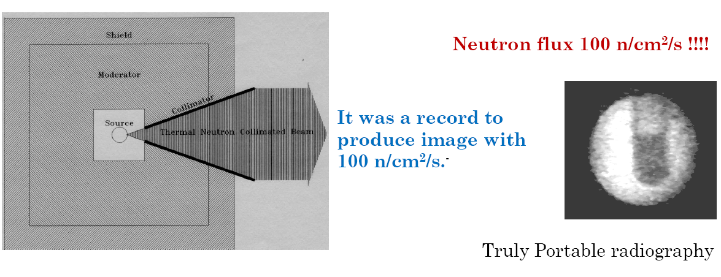
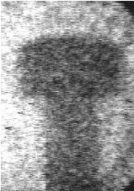
Non-Reactor based Neutron Imaging
Neutron radiography with isotopic source (Pu-Be) (1993)
Radiograph of water in test-tube
Radiograph of plastic bolt
Thermal neutron flux ~ 1 x 10² n/(s-cm²) with 6 Ci Pu-Be source
Feasibility study
Intensifier + CCD for digital imaging
The idea was used to design a neutron radiography system with D-T neutron source

Slide 10
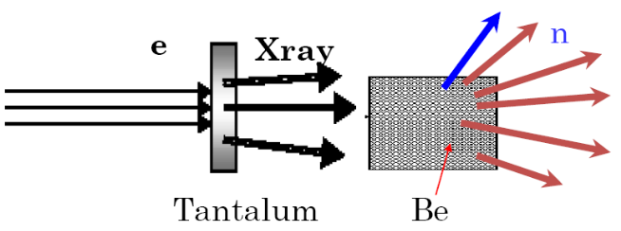
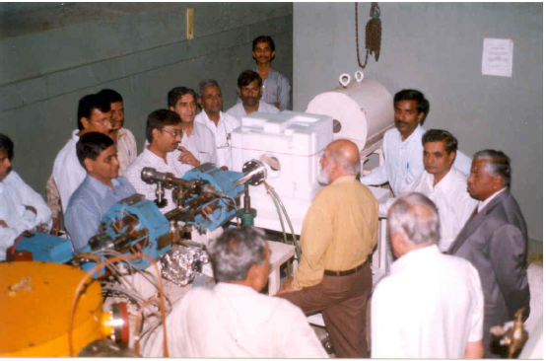
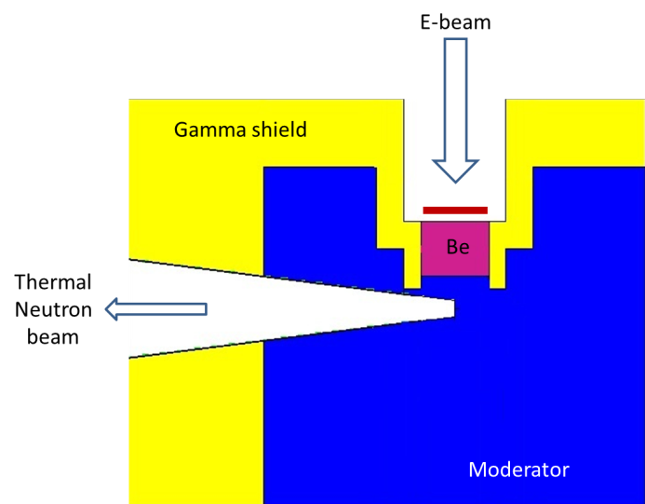
Non-Reactor based Neutron Imaging
Neutron radiography with Electron accelerator (2005)
9 MeV electron beam (Microtron)
Beam power ~ 1kW
Thermal Neutron flux ~ 1 x 10⁴ n/(s-cm²)
Schematic of Neutron radiography assembly
Neutron Radiography set-up with microtron source at Mangalore University

Slide 11
Neutron Imaging Facility at
DHRUVA Research Reactor

Slide 12
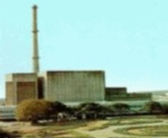
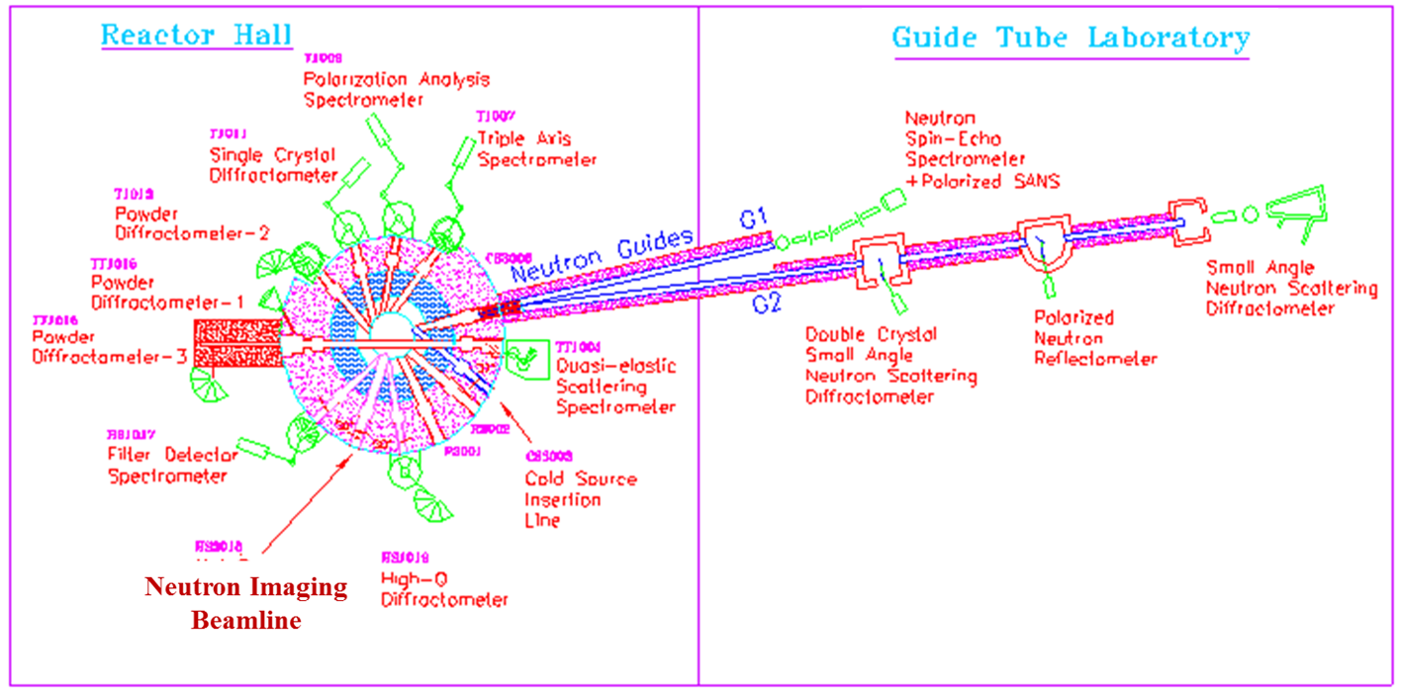
DHRUVA Research Reactor
Nat. uranium – heavy water
Vertical tank type
100 MWt
Layout of various beamlines

Slide 13
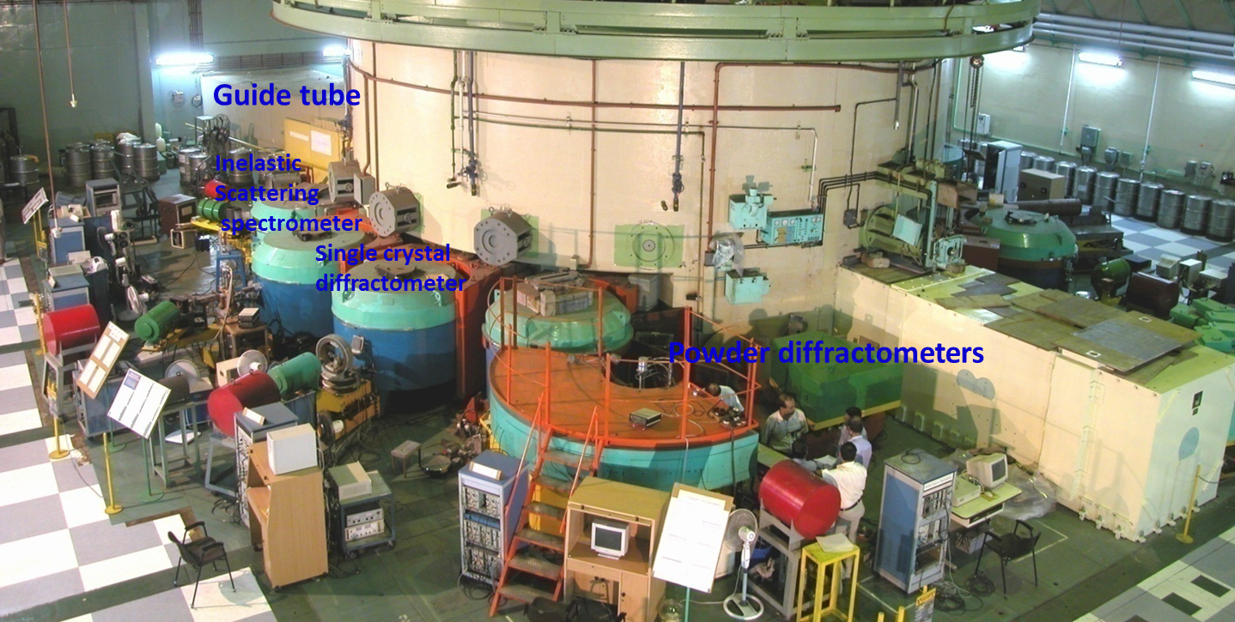
Layout of beamlines at DHRUVA reactor
Neutron Imaging beamline
DHRUVA Reactor Hall

Slide 14
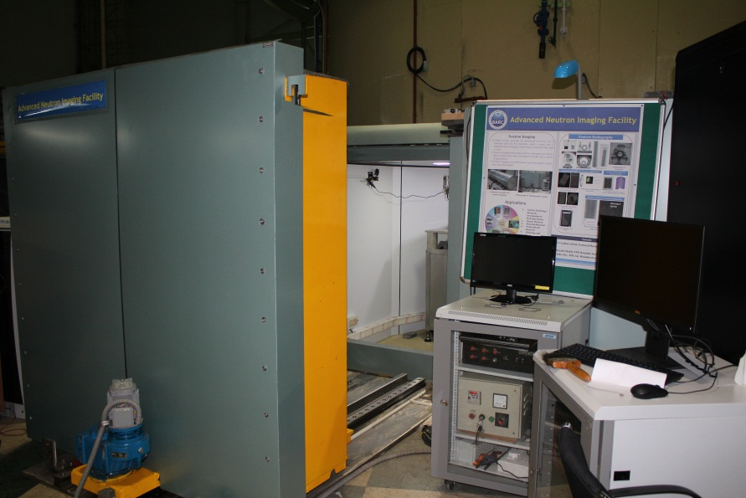
Neutron Imaging Beamline

Slide 15
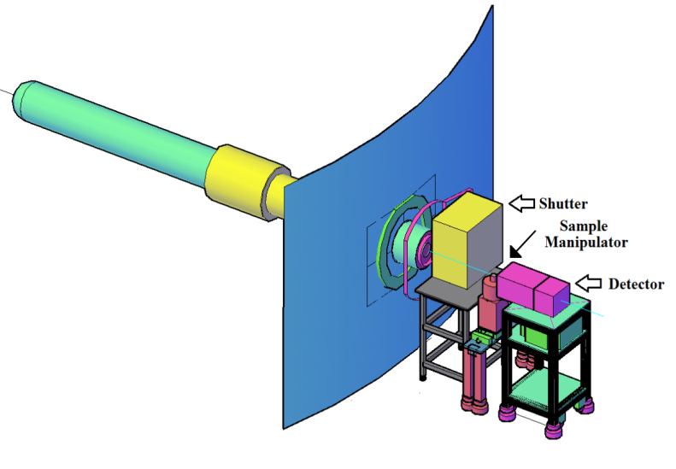
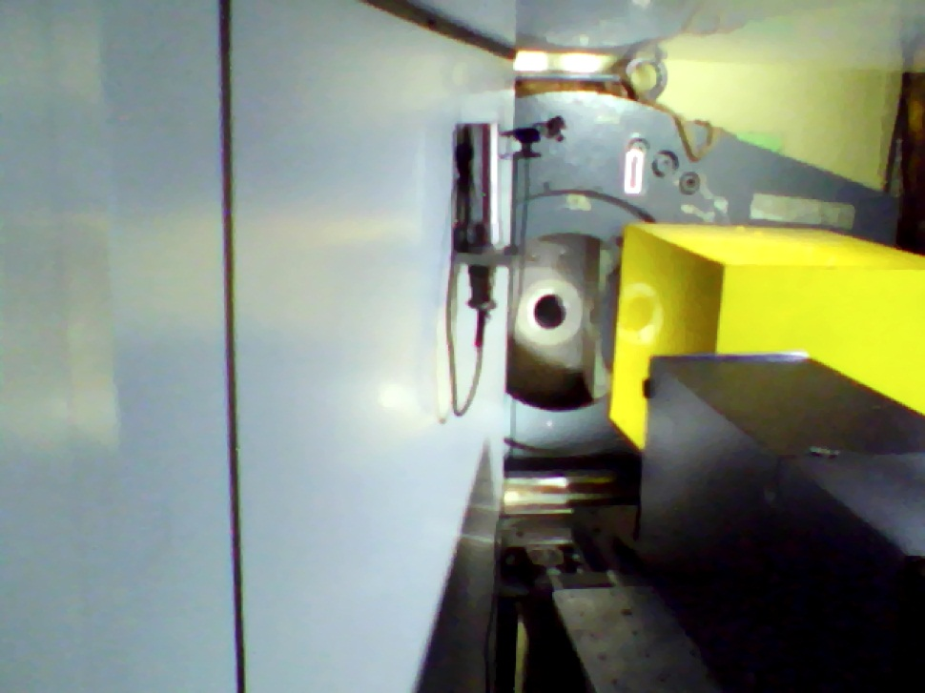
Neutron Imaging Beamline
Beam shutter
Sample manipulator (X, Z, Theta)
Detector (Scintillator +Mirror +CCD)

Slide 16
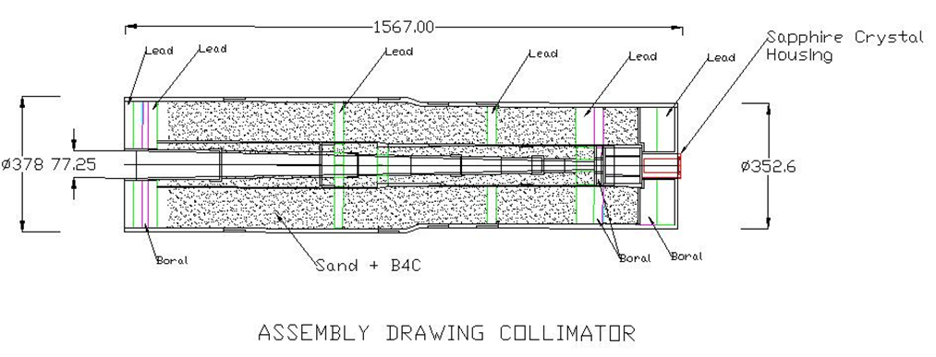
Collimator
Sapphire single crystal (001)
Bismuth single crystal (111)
Gd aperture: 16mm
B₄C and lead rings in the periphery to stop scattered neutrons and gamma

Slide 17
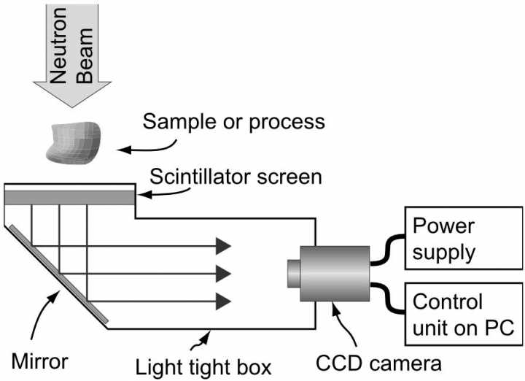
Detector
Scintillator : ⁶LiF:ZnS(Ag) - 100 micron

Slide 18
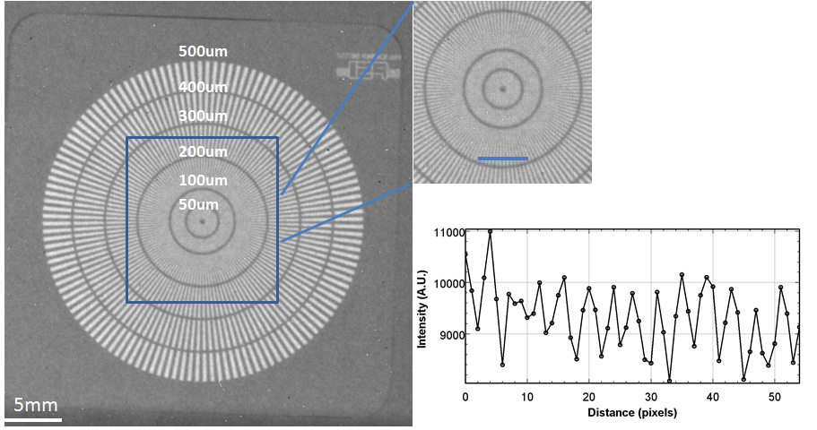
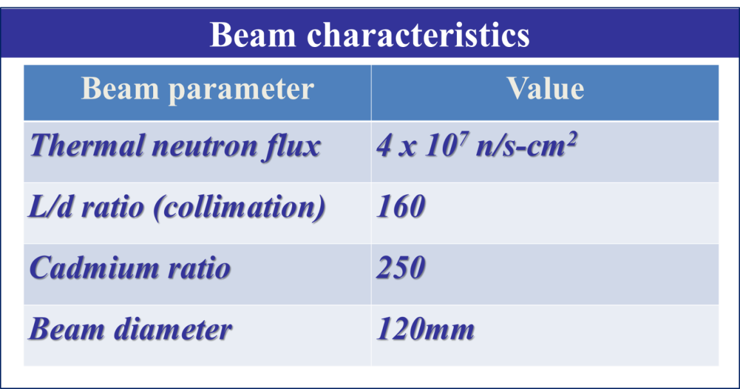
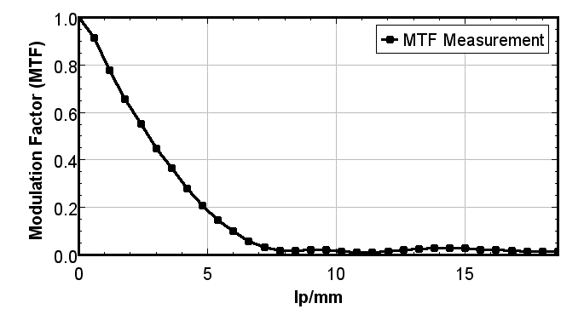
Beam characterization
Spatial resolution ~ 170 micron

Slide 19
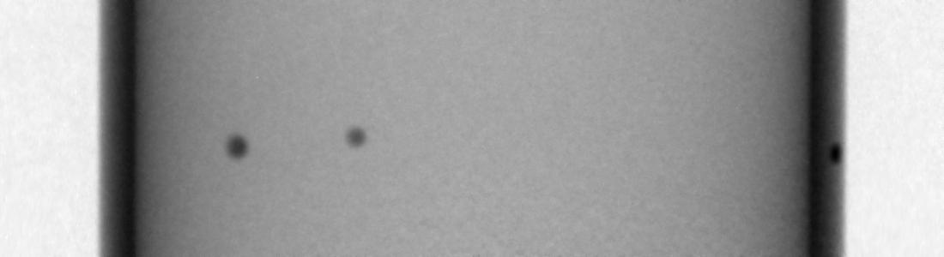
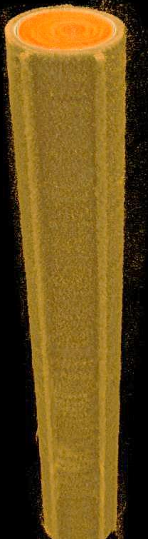
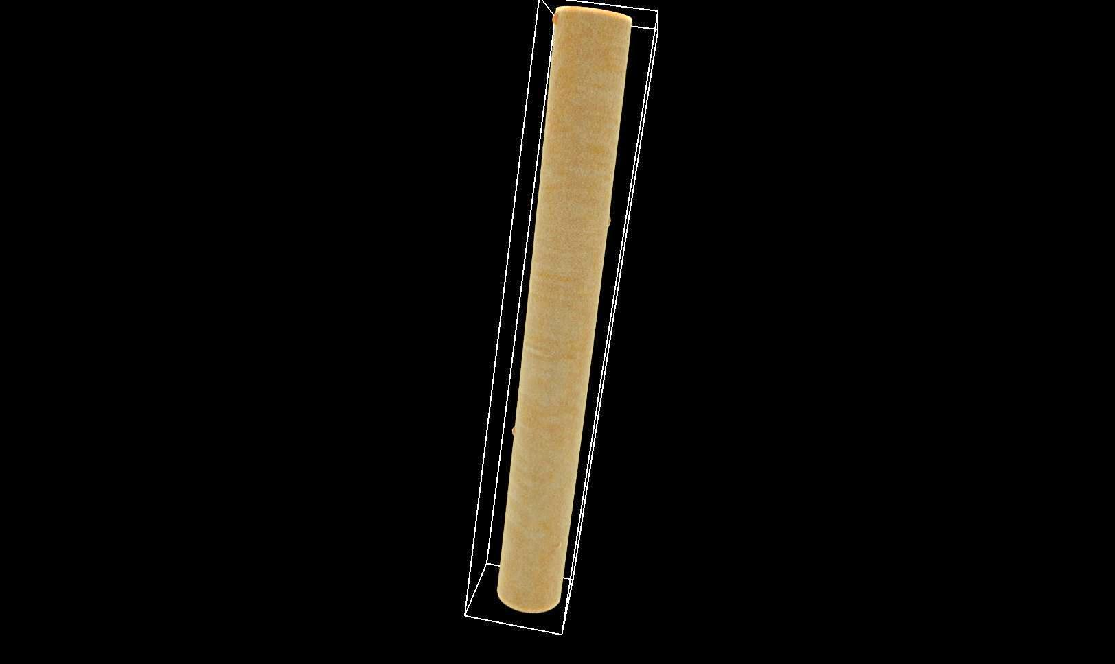
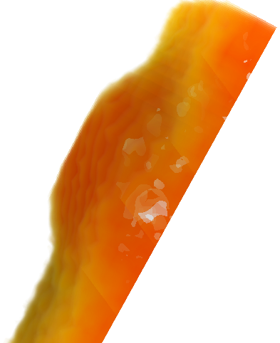
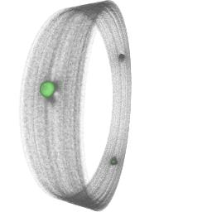
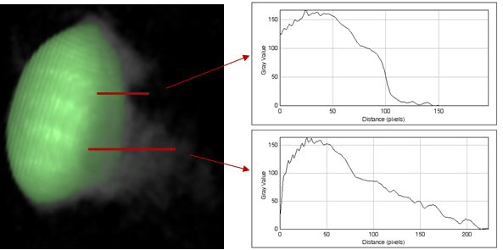

Applications: Reactor Engineering
Hydride blisters in Zircalloy Pressure tube
Hydride blisters in PHWR fuel pin
Blister
Fuel pin

Slide 20
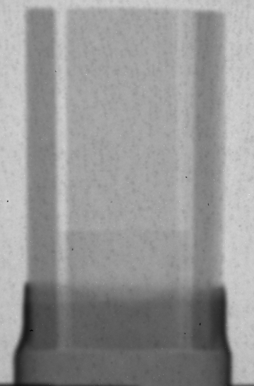
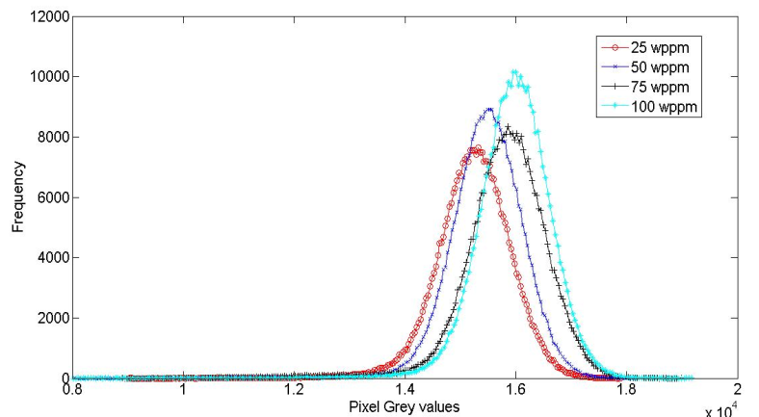
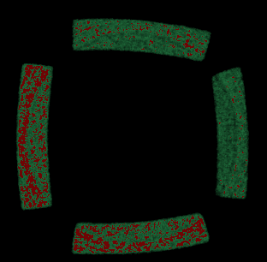
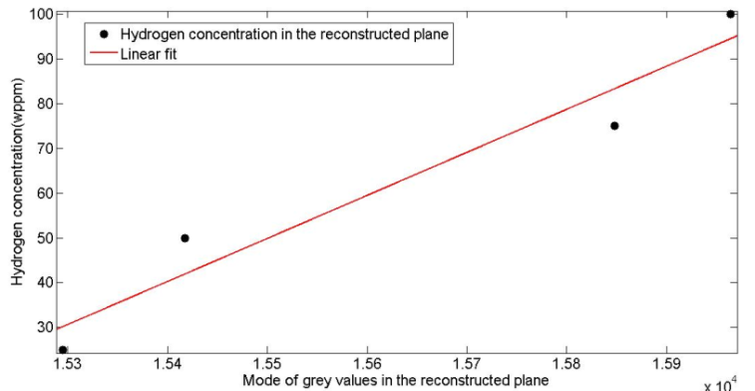
Applications: Reactor Engineering
Hydrogen ingress in Zircalloy
50 ppm
75 ppm
25ppm
100 ppm
Neutron tomographic reconstruction of homogenized hydrogen distribution in zircalloy. Each of the four samples have been charged with different amounts of hydrogen

Slide 21
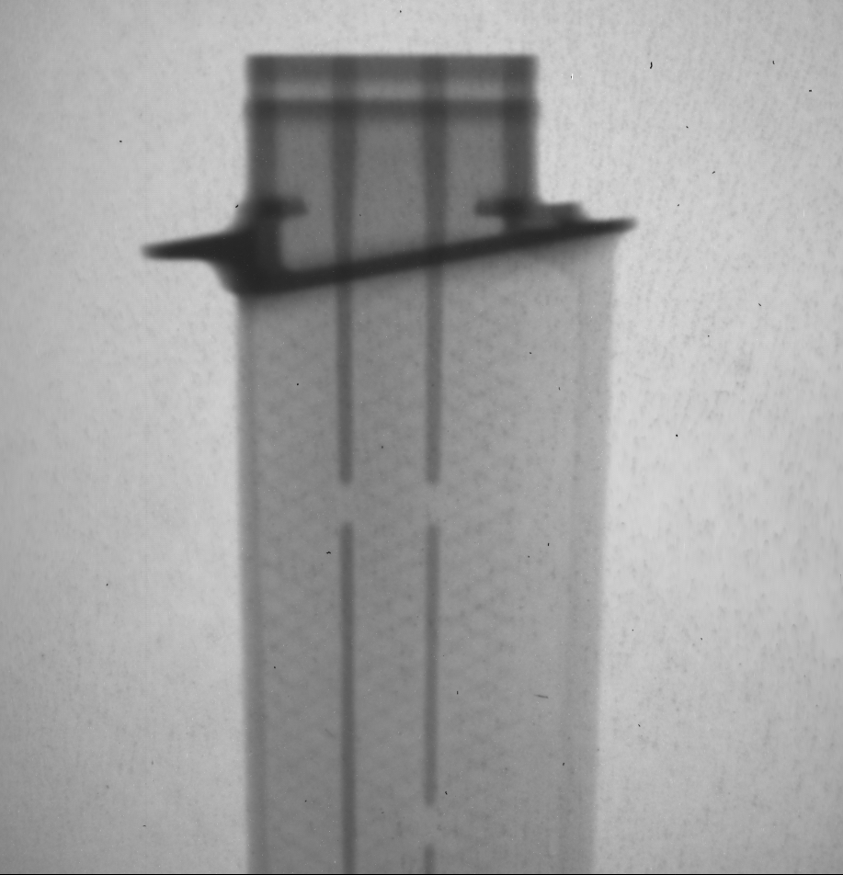

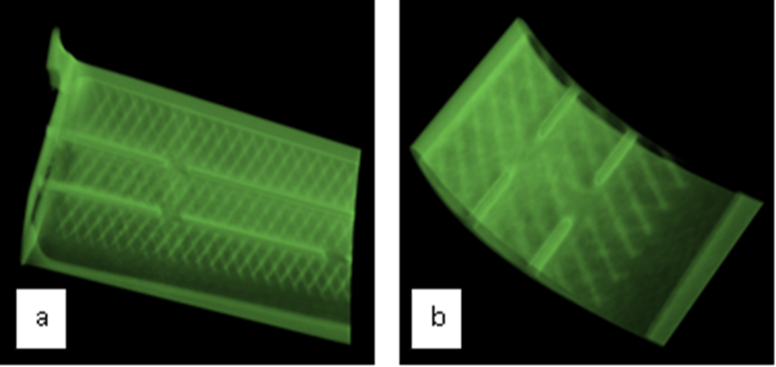
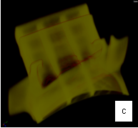
Applications: Material Engineering
Turbine blade

Slide 22
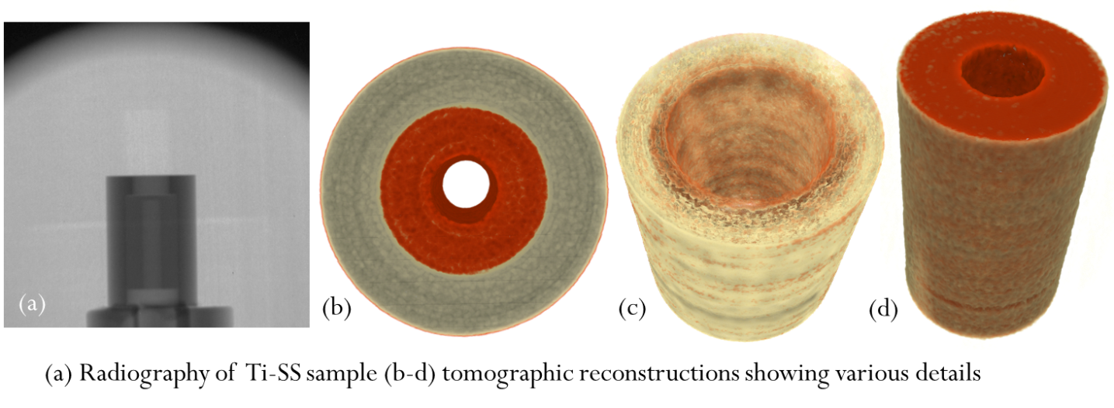

Applications: Material Engineering
Diffusion Bonding of Dis-similar Metals
Bonding of Ceramic-to-Metal Joints

Slide 23


Applications: Material Science
Aluminium foam
Study of porosity and wall thickness distribution of metallic foam;
Parameters to be used for FEM analysis to model mechanical properties

Slide 24



Applications: Geological
Geological sample from Jaisalmer river bed (Bandah Formation of middle Eocene age)
The samples analyzed are bundles of boring produced by the xylophagous (organisms that live on woody substrates) bivalves, also called shipworms, belonging to the family Teredinidae. They have been observed within present and fossilized substrate of accumulated woods as well as in individual allochthones fossilized logs that were transported as detrital sediments in water. Distribution of modern Teredinidae are controlled by the factors such as temperature, salinity, and presence of xylic substrate. The availability of wood fragment as substrate also plays an important role and is directly related to the cyclic relative sea-level fluctuations. Studies on Bandah Formation will reveal the transgressive-regressive relative sea-level cycles of the ancient seaway that existed in western Rajasthan and the relation of these wood-boring organisms with respect to the changing sea.
Radiograph
3D volume

Slide 25



Applications: Archaeology & cultural heritage
Photograph of
Bronze Buddha statue
Neutron radiographs

Slide 26


Applications: Archaeology & cultural heritage
Neutron tomography of Buddha statue
(Right) Wax remnants on surface due to bronze casting process are detected

Slide 27

Neutron Phase Contrast Imaging
Conventional neutron radiography is based on only attenuation (removal) of neutrons in the beam path while phase sensitive techniques is based on detecting neutrons through ultra-small angles due to refraction or diffraction of coherent neutron wavefield.
For a large class of materials phase shift term dominates over the absorption term and hence the techniques which can reveal/retrieve the phase would help in increasing the sensitivity of conventional neutron imaging.

Slide 28

Propagation based Phase Contrast
Requires spatially coherent neutron source, high resolution neutron detector and propagation of wavefield behind the object

Slide 29

Neutron Phase Contrast Imaging

Slide 30



Neutron Phase Contrast: Results

Slide 31

Neutron Phase Contrast: Results
Neutron radiograph of 1mm iron syringes (a) absorption image (b) phase contrast image alongwith the profile across the marked line

Slide 32


Applications: Pyrotechnic devices
Neutron radiography with D-T neutron source (2016)
Imaging of pyrotechnic devices
Indigenously developed Non-Reactor based Neutron Radiography System
Spin-Off
Neutron radiograph at reactor source
Neutron Radiography System
Thermal neutron flux ~ 1 x 10⁴ n/(s-cm²) with D-T neutron source of strength 1 X 10¹⁰ n/s and L/d ~25

Slide 33
Future direction
Bragg-edge imaging
Residual stress
Laminography
Phase retrieval and Phase tomography

Slide 34

Acknowledgements
Dr. Amar Sinha
Dr.Yogesh Kashyap
Dr. Mayank Shukla
Shefali Shukla
Prashant Singh
Ravi B
Dr.S.C.Gadkari
Thank you

