Slide 1
Qualification and development of fast neutron imaging scintillator screens
R. Zboray¹, R. Adams², M.Morgano³, Z. Kis⁴
¹Department of Mechanical and Nuclear Engineering, The Pennsylvania State University, University Park, PA, 16802, USA
²Swiss Federal Institute of Technology Zurich, Department of Mechanical and Process Engineering, Sonnegstrasse 3, CH-8092, Zurich, Switzerland
³Neutron Imaging and Activation Group, Laboratory for Neutron Scattering and Imaging, Paul Scherrer Institut, 5232 Villigen PSI, Switzerland
⁴Hungarian Academy of Science, Centre for Energy Research, 29-33 Konkoly Thege Miklos street, 1121 Budapest, Hungary
11th World Conference on Neutron Radiography, 2-7 September 2018, Sydney, Australia

Slide 2
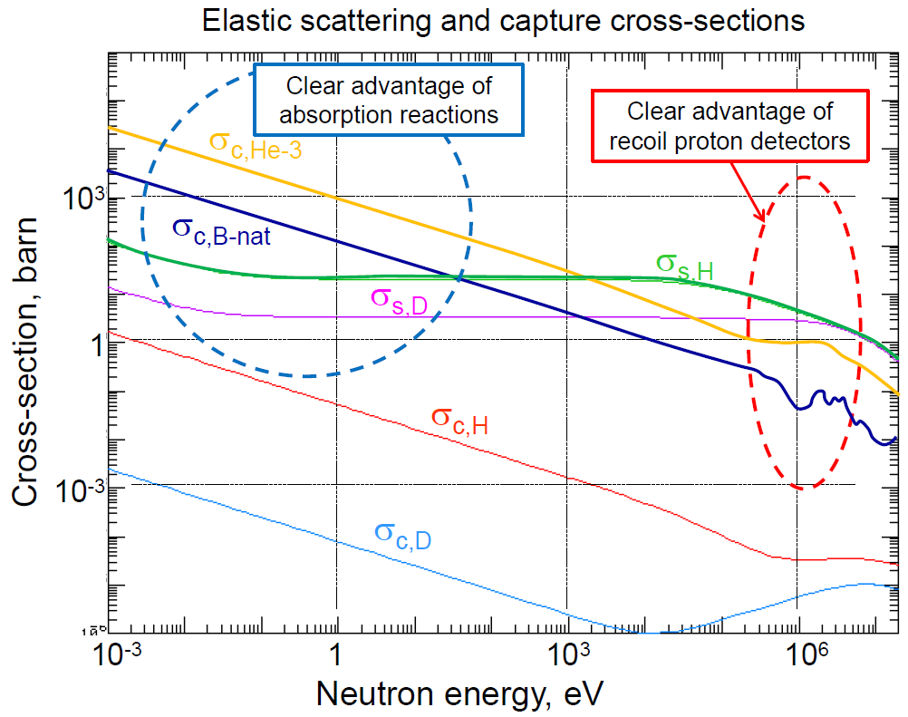
Fast neutron detection for imaging
In the ≥ 1 MeV energy range XS are generally low.
Elastic scatter conversion process to produce recoil protons is the most interesting detection option!
Two common solutions:
Hydrogen-rich plastic (organic) scintillators
Hydrogen-rich converter matrix mixed with high luminosity phosphor (ZnS)

Slide 3
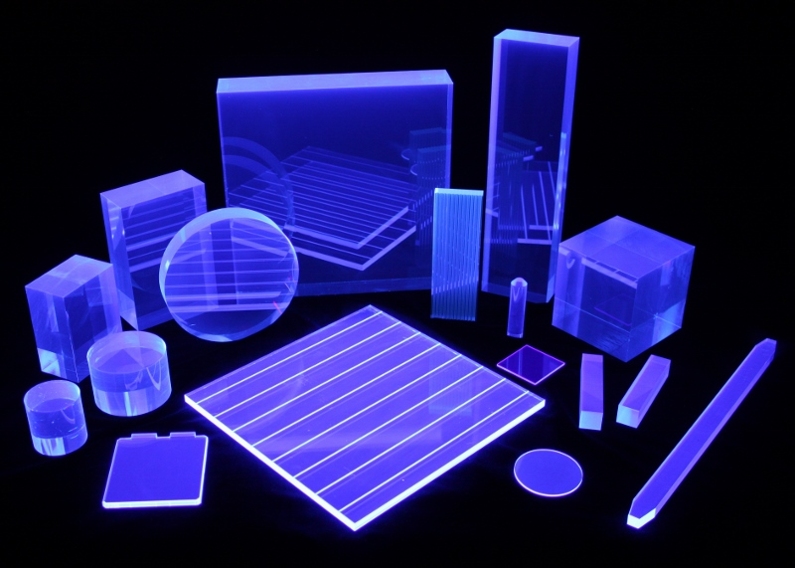
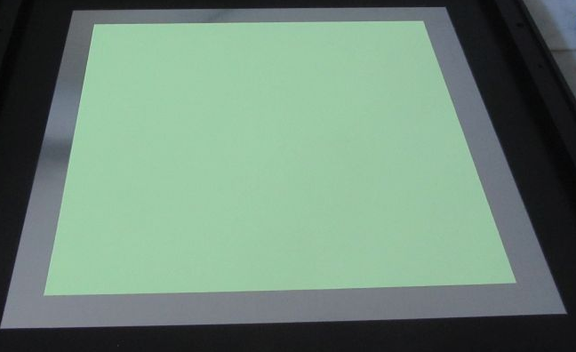
Plastic scintillators vs. Organic converter/inorganic scintillator
Plastic scintillators:
Transparent to own light (thicker screens could work) ☺ ☺
very fast scintillation response ☺
typically high H content ☺
easily shaped and relatively cheap ☺
low light yield ☹ ☹
Radiation damage ☹
Non-linear response (Birk’s law) ☹
Easier to prepare structured (fiber) screen (thickness/resolution decoupling)
typically emitting in blue ☹
Organic matrix mixed with ZnS (or similar):
Very high light yield ☺ ☺
slower scintillation response ☺
Low transparency (polycrystalline, granular) ☹ ☹
Linear response ☺
Green emission of ZnS(Cu) matches well CCD/CMOS sensitivity ☺

Slide 4
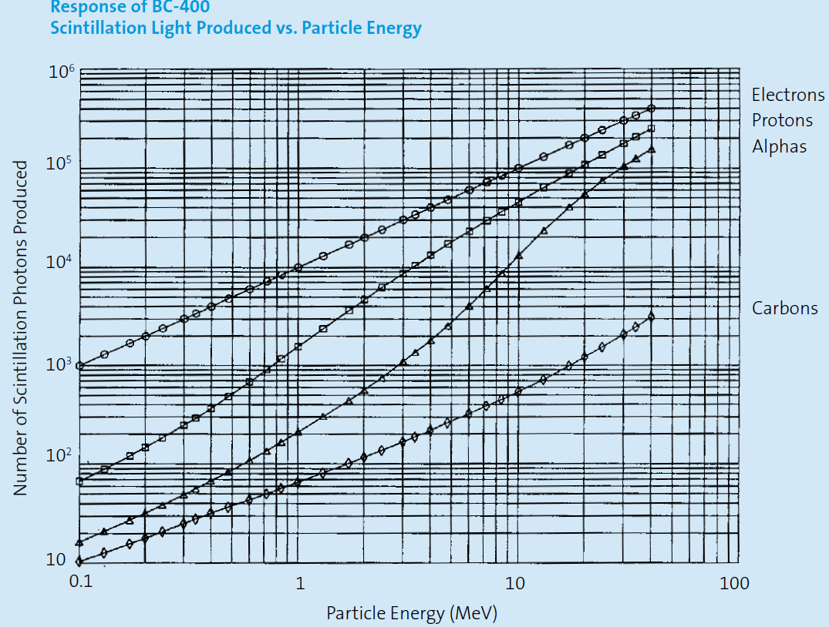
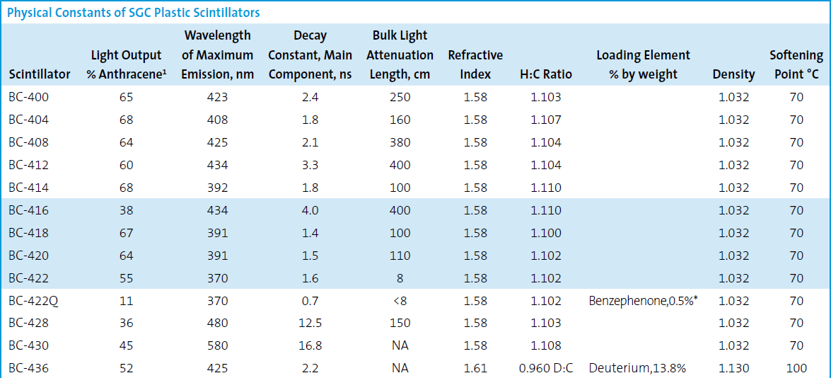
What is available commercially/in-house?
St.Gobain
Plastic scintillators:
ELJEN, St. Gobain, Crytur etc.:
Slab/fiber screens
Different thicknesses
Organic matrix mixed with ZnS (or similar):
RC Tritec AG, Teufen, Switzerland:
PP/ZnS:Ag (30%), PP/ZnS:Cu (30%), thicknesses typically from 1.5-3 mm
In-house varieties:
Many tried it working with different materials, just as we did (see below)

Slide 5
Overview of testing fast neuron scintillation screens
Test beam lines:
NEUTRA, SINQ, PSI, Switzerland
RAD beam line at the 10-MW research reactor at the Budapest Neutron Center, Hungary
Cameras:
ANDOR DV434 sCCD
TS14 CCD
ANDOR Neo 5.5 sCMOS
Screens (commercial):
PP/ZnS:Ag (30%), PP/ZnS:Cu (30%), RC Tritec AG, Teufen, Switzerland
BC400, St. Gobain
Screens (in-house):
EJ500(optical epoxy)/ZnS:Ag, EJ500/ZnS:Cu
Glycerol/ ZnS:Ag

Slide 6
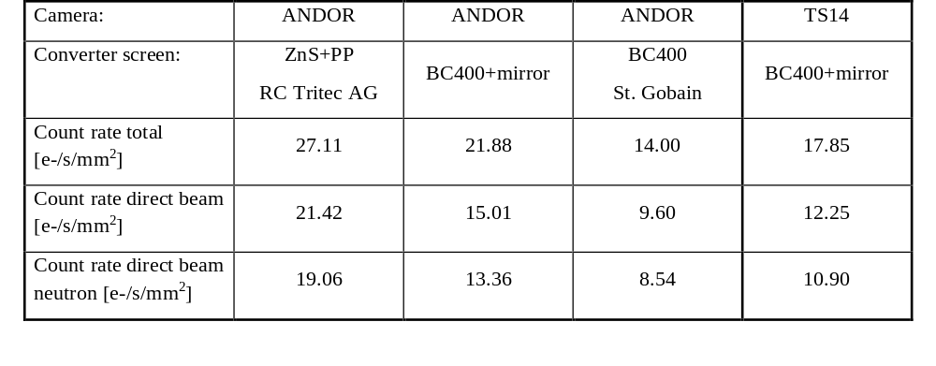
Tests at the NEUTRA beam line at PSI, Switzerland 1.
Utilized the high E tail of the beam spectrum, thermal contribution blocked by B₄C and Cd plates, fast flux around ~5e5 n/cm²/s, L/D=550
Used different combinations of different screens and cameras:
- 8 mm thick, slab plastic BC400 scintillator (St.Gobain)
- 2.4 mm PP/ZnS:Cu (30%) RC Tritec AG screen
BC400 was in some cases backed by a highly reflective mirror to increase light collection efficiency
direct+scattered
direct n+g
direct n
PP/ZnS screen has 7.4x higher efficiency/mm as BC400!

Slide 7
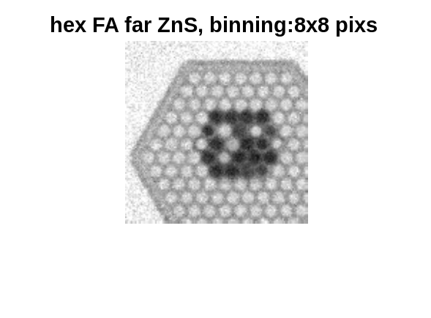
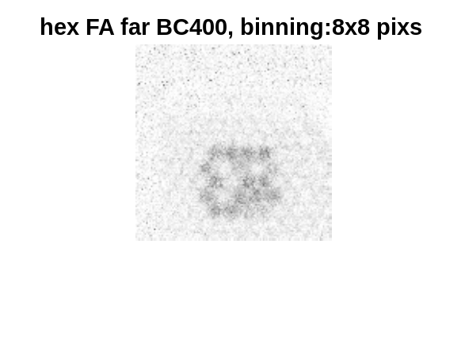
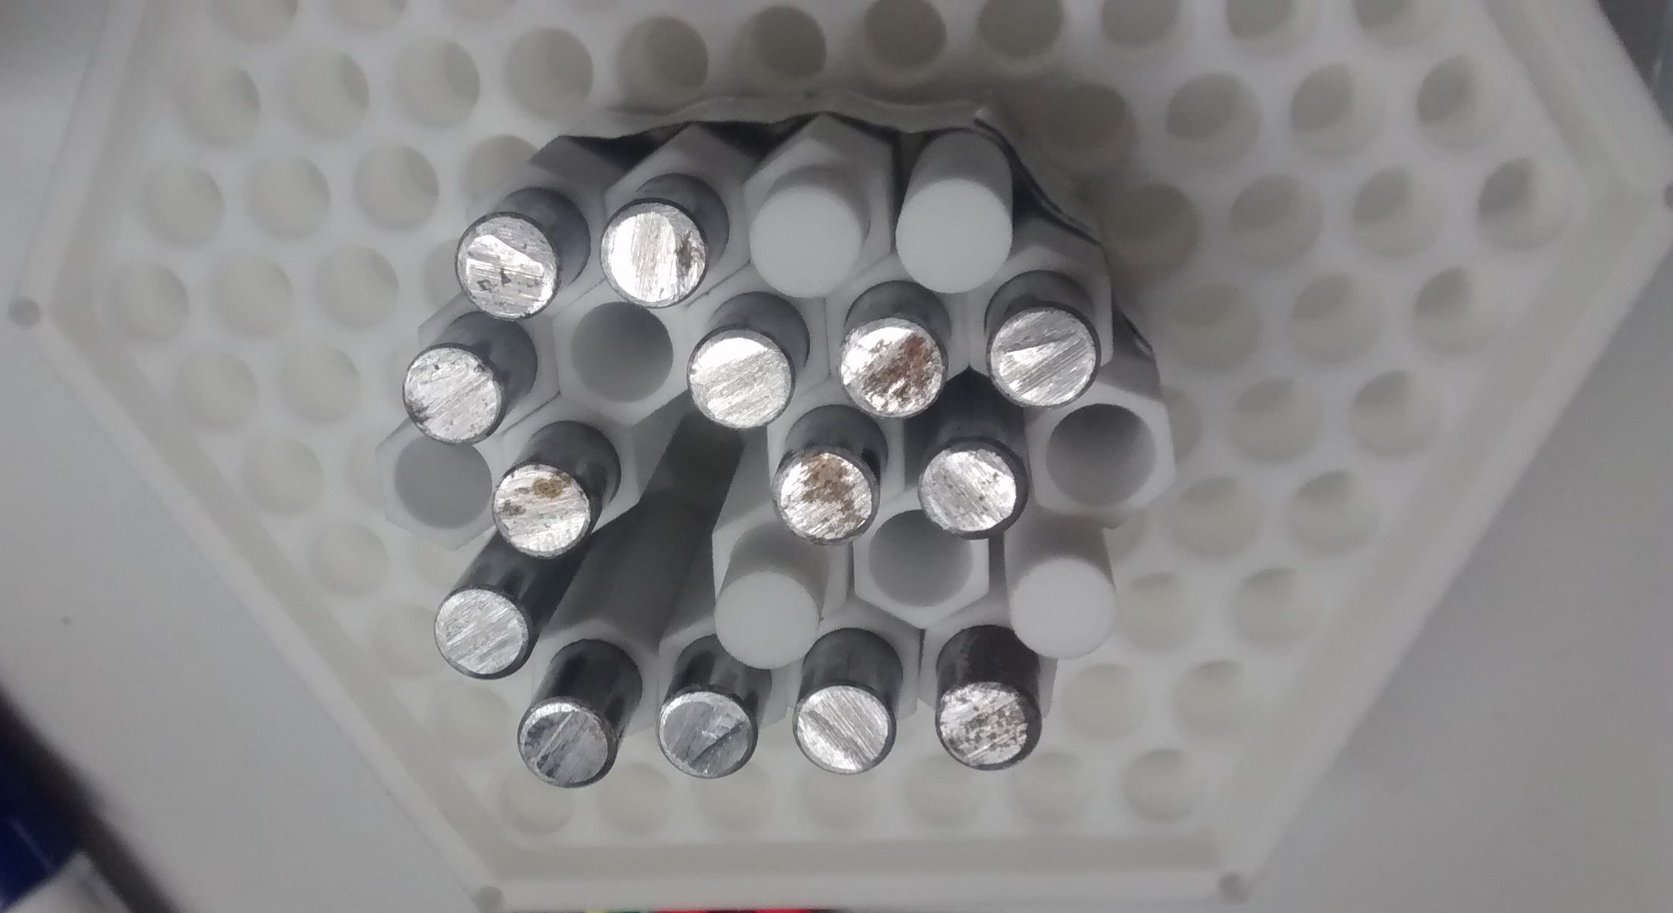
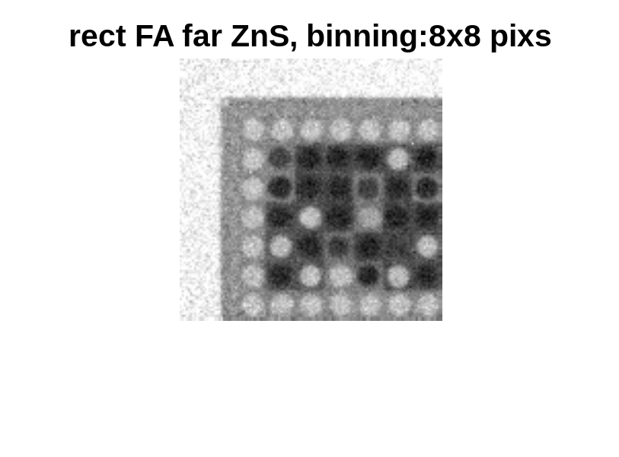
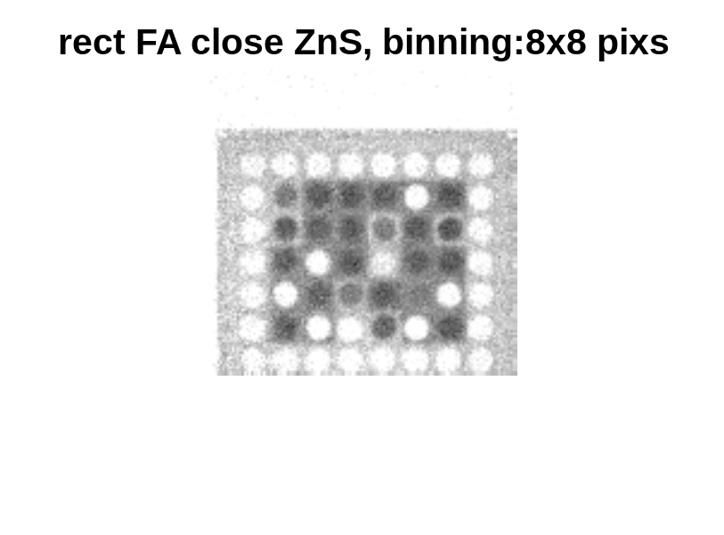
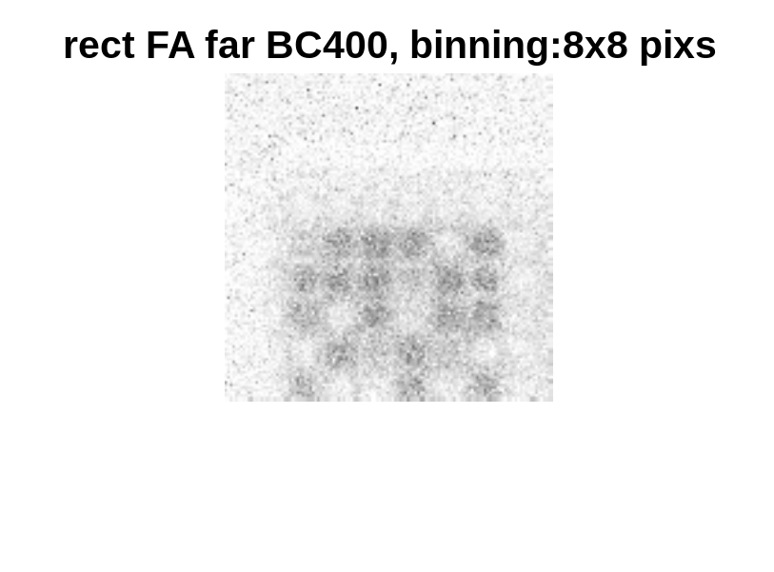
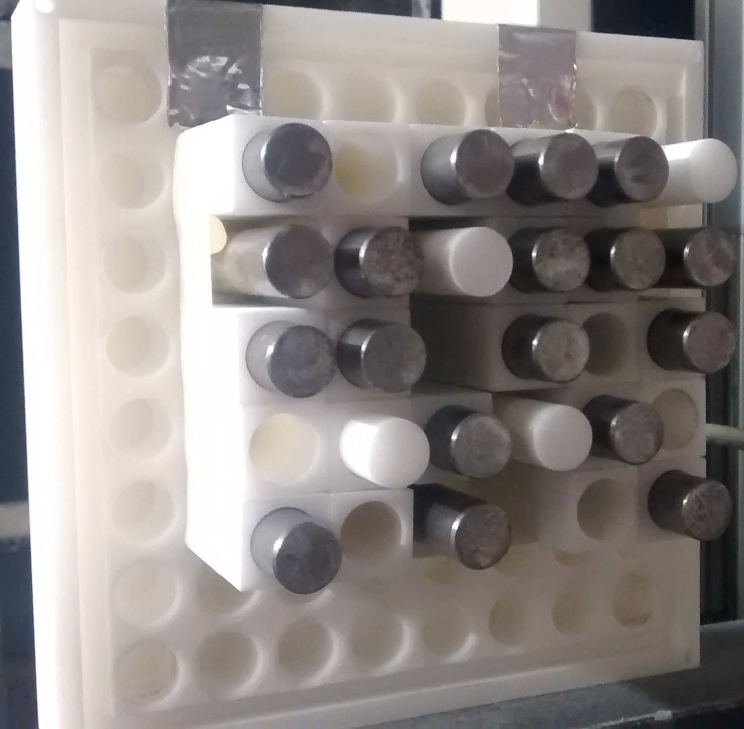
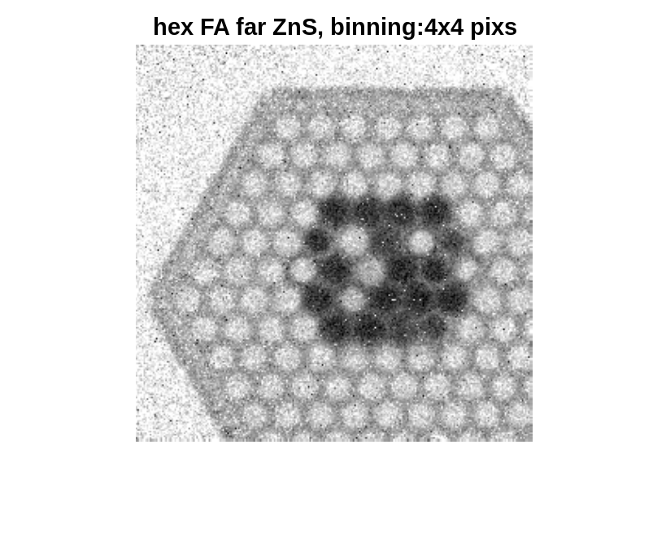
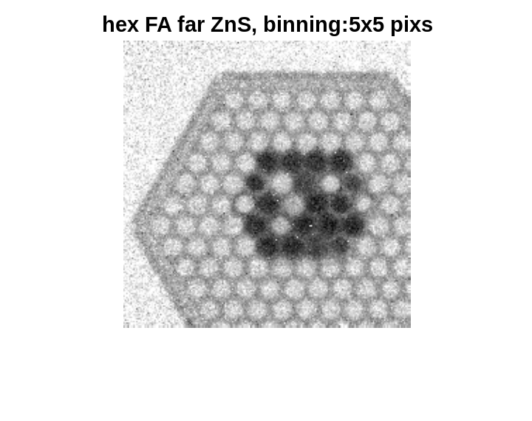
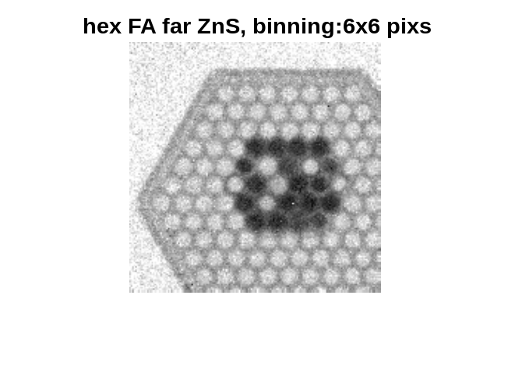
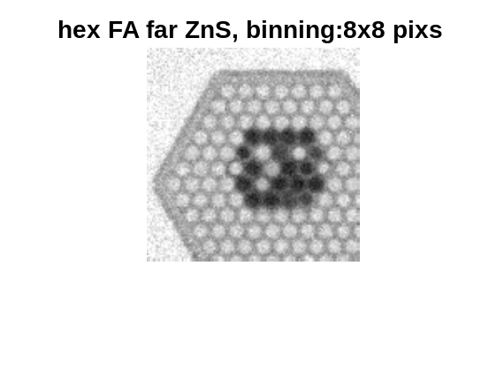
Tests at the NEUTRA beam line at PSI, Switzerland 2.
A few radiographs taken by the different detector configurations:
PP/ZnS screen
BC400 screen
a.
b.
c.
a.
b.
c.
d.
PP/ZnS screen
PP/ZnS screen
BC400 screen
4x4
Effect of pixel binning
5x5
6x6
8x8

Slide 8
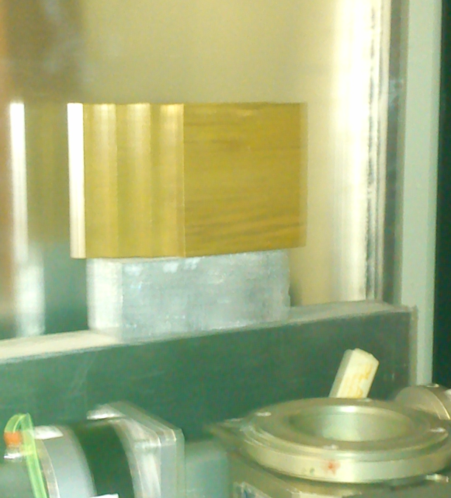
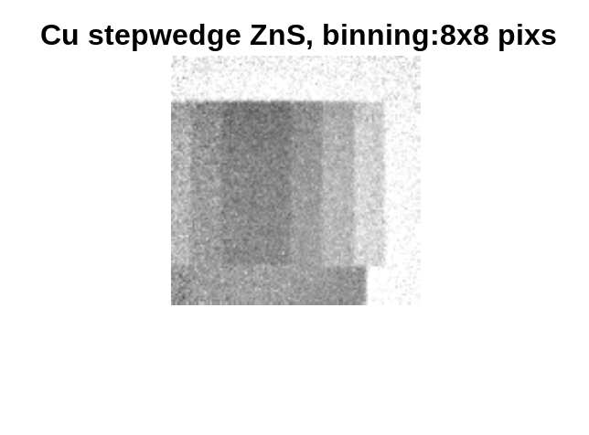
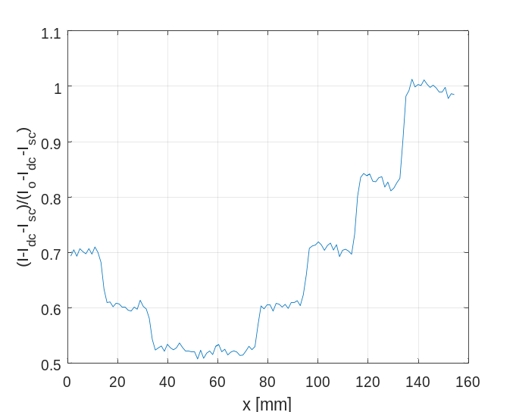
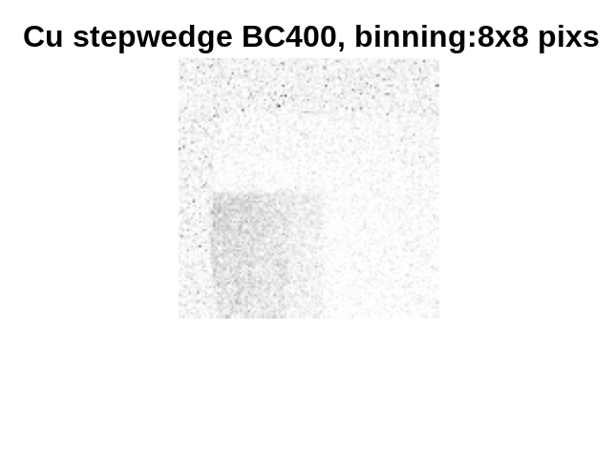
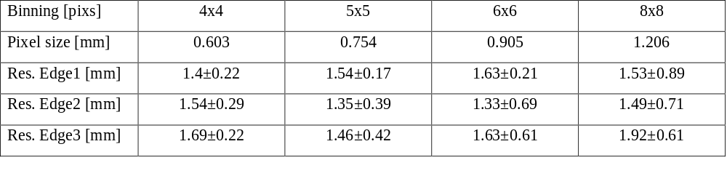
Tests at the NEUTRA beam line at PSI, Switzerland 3.
A few radiographs taken by the different detector configurations:
a.
b.
d.
Cu step wedge
edge1
edge2
c.
edge3
Effect of pixel binning on resolution:

Slide 9
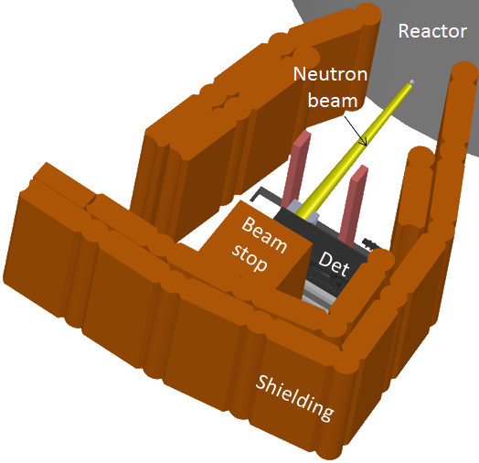
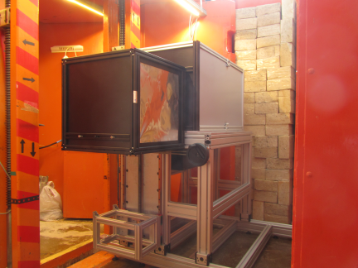
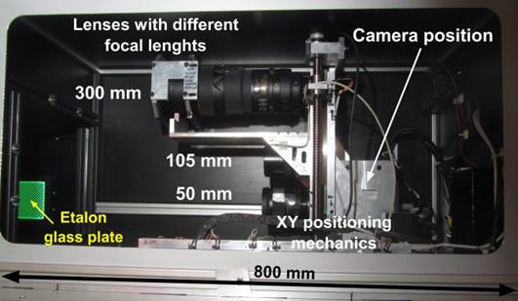
Tests at the 10 MW reactor RAD beam line at the BNC, Hungary
Thermal flux 4e7 n/cm²/s
Fast flux 2e7 n/cm²/s (E≥2.5 MeV)
1cm Mirrobor (thermal n)+200mm Pb filter (g) -> fast flux 3e5 n/cm²/s
Screens used: 8 mm thick BC400 slab
3.8 mm thick PP/ZnS:Cu (30%) from RC Titec AG
different in-house screens (see below)
scintillator
Optics and camera box
beam
b.
Mirror
c.

Slide 10
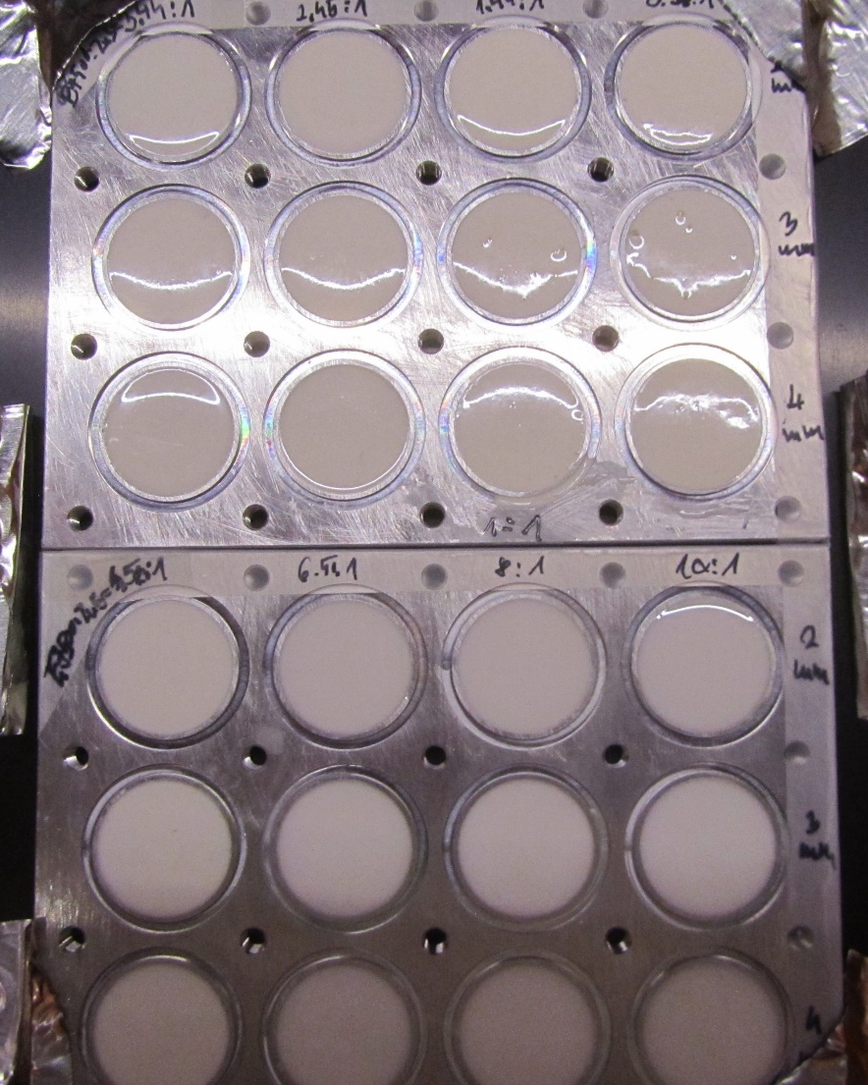
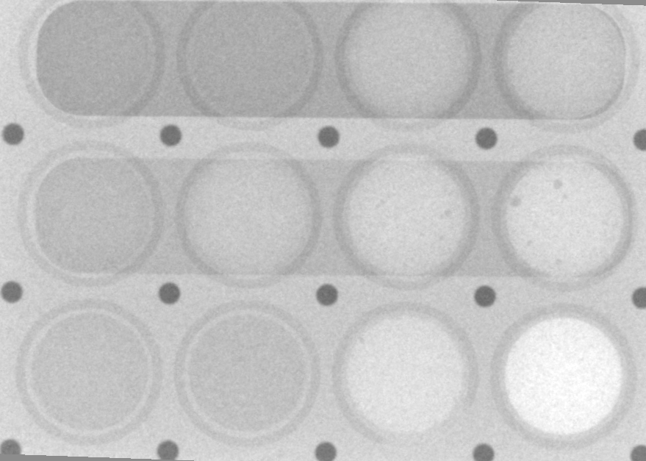
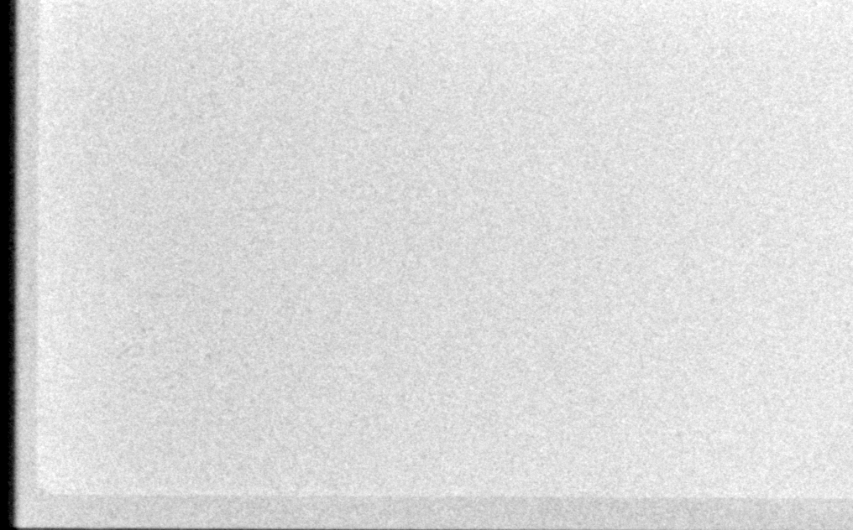
In-house scintillator screens
Test screen samples with various thickness and ZnS concentration have been prepared by molding EJ500 optical epoxy with EJ600 ZnS:Ag powder (mean Ø 8 um) both from ELJEN, deaerating and letting cure:
X-ray attenuation of the test screen
3.5:1
2.5:1
1.44:1
0.96:1
2 mm
Note that the back
side of the test samples
is thinned down to
1mm aluminum below
each sample
3 mm
4 mm
epoxy:ZnS
4.5:1
6.5:1
8:1
10:1
2 mm
3 mm
Thickness
4 mm
Epoxy:ZnS mass ratio
X-ray attenuation of the final screen
Good homogeneity

Slide 11
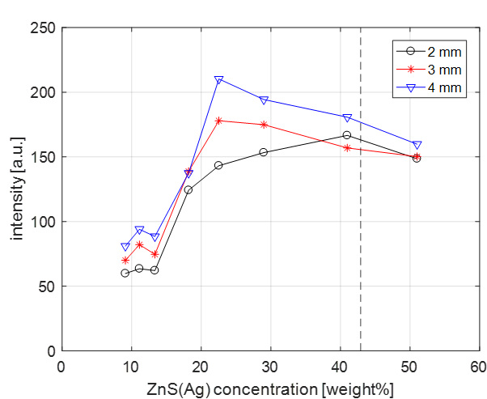
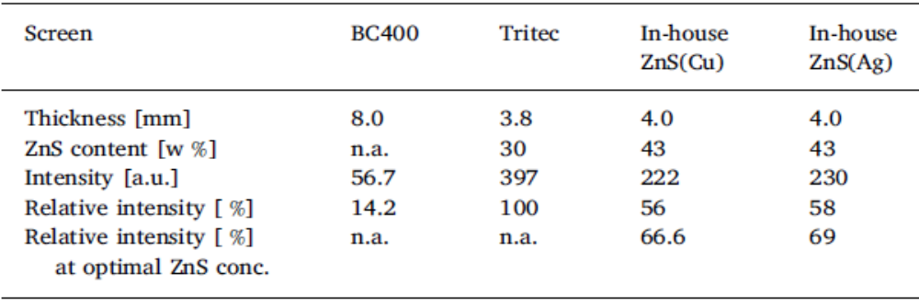
Tests results at the RAD beam line using the in-house screen
Light yield of the round screen samples:
Lower transparency due to ZnS conc +
Lower conversion efficiency
More light ↑ZnS conc
41% ZnS
Optimum ↑with thickness
Actual imaging screens are prepared with this ZnS:Cu and ZnS:Ag concentration!
22.5% ZnS
ZnS:Cu powder is from Phosphor Technologies (mean Ø 4um)
Note that the ratio of H atomic density of EJ500:PP ≈ 0.61!
There is room for improvement

Slide 12
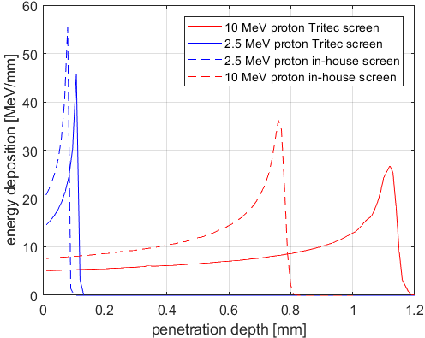
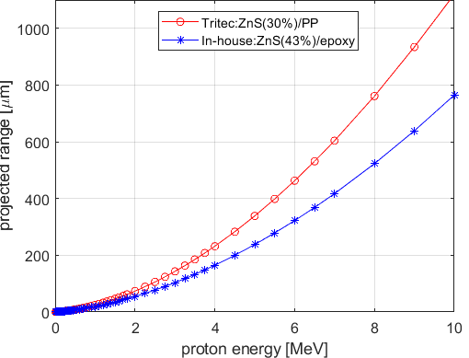
Why a thicker screen can bring extra detection efficiency?
There is no real consensus in the community about the useful thickness of ZnS containing screens above which it starts to be strongly self attenuating. 2mm? 3mm? or even more?
Similar debate for thermal neutron imaging and LiF/ZnS screens: 250um? 300um? 350um?
The idea:
the first layer from which practically no light would come thru acts as a proton radiator for the layer behind it from which light can escape
Forward scatter protons: high E -> long range
Bragg peak of E deposition of a high E proton in matter
Note: increased thickness -> higher blur!
~1mm
2-3mm
Range of recoil protons in PP/ZnS and epoxy/ZnS mixtures
n beam
p
Screen
No light comes thru from here
Transparent, some light comes thru

Slide 13
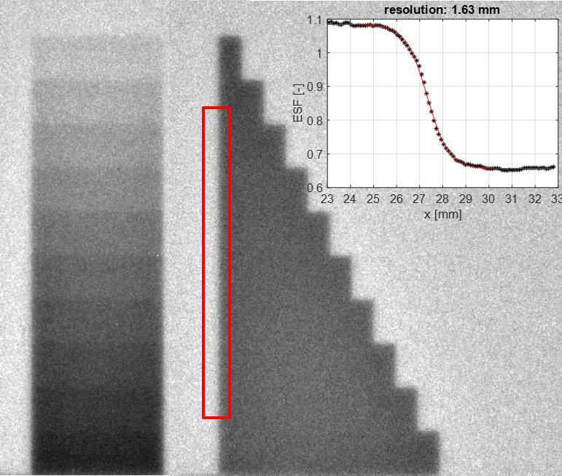
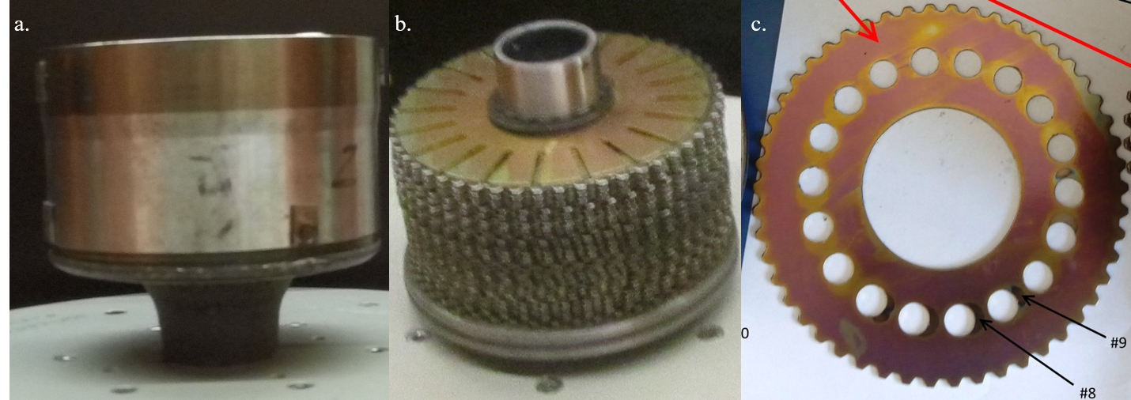
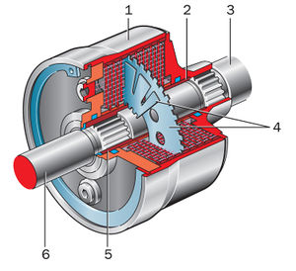
Test results at the 10 MW reactor RAD beam line at the BNC 1.
Iron step wedge imaged using the Tritec screen:
Resolution: 1.63 mm
t_{exp}=9 min
t_{exp}=6 min mm
We imaged two scrapped viscous(hydraulic)-coupling of a helicopter:
150 mm
With housing
Housing is made of steel
Without housing
One disc removed
Discs are made of Ni-Fe permalloy (Ni70%-Fe19%)

Slide 14
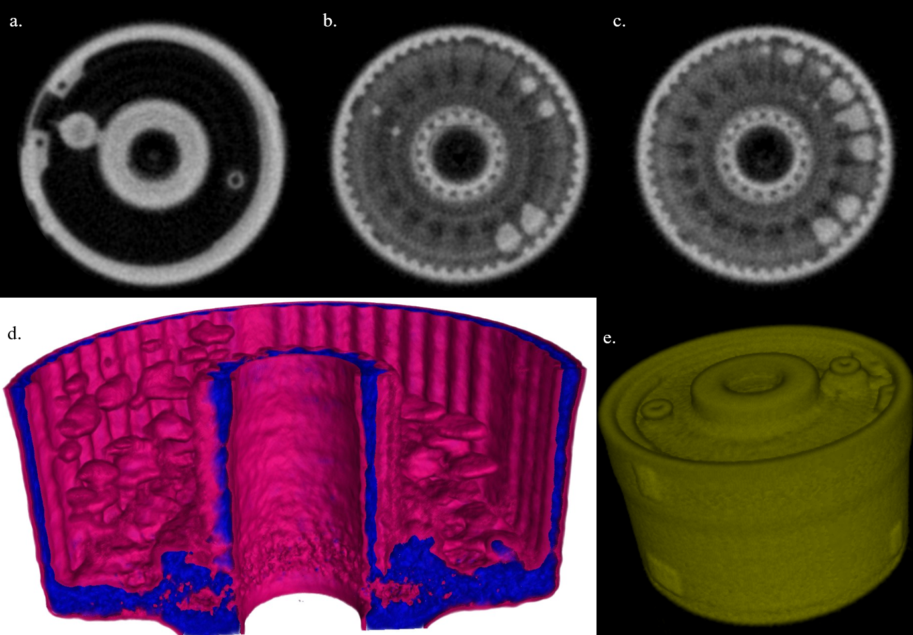
Test results at the 10 MW reactor RAD beam line at the BNC 2.
Tomographic imaging and rendering of the full coupling obtained using the TRITEC screen:
Oil droplets

Slide 15
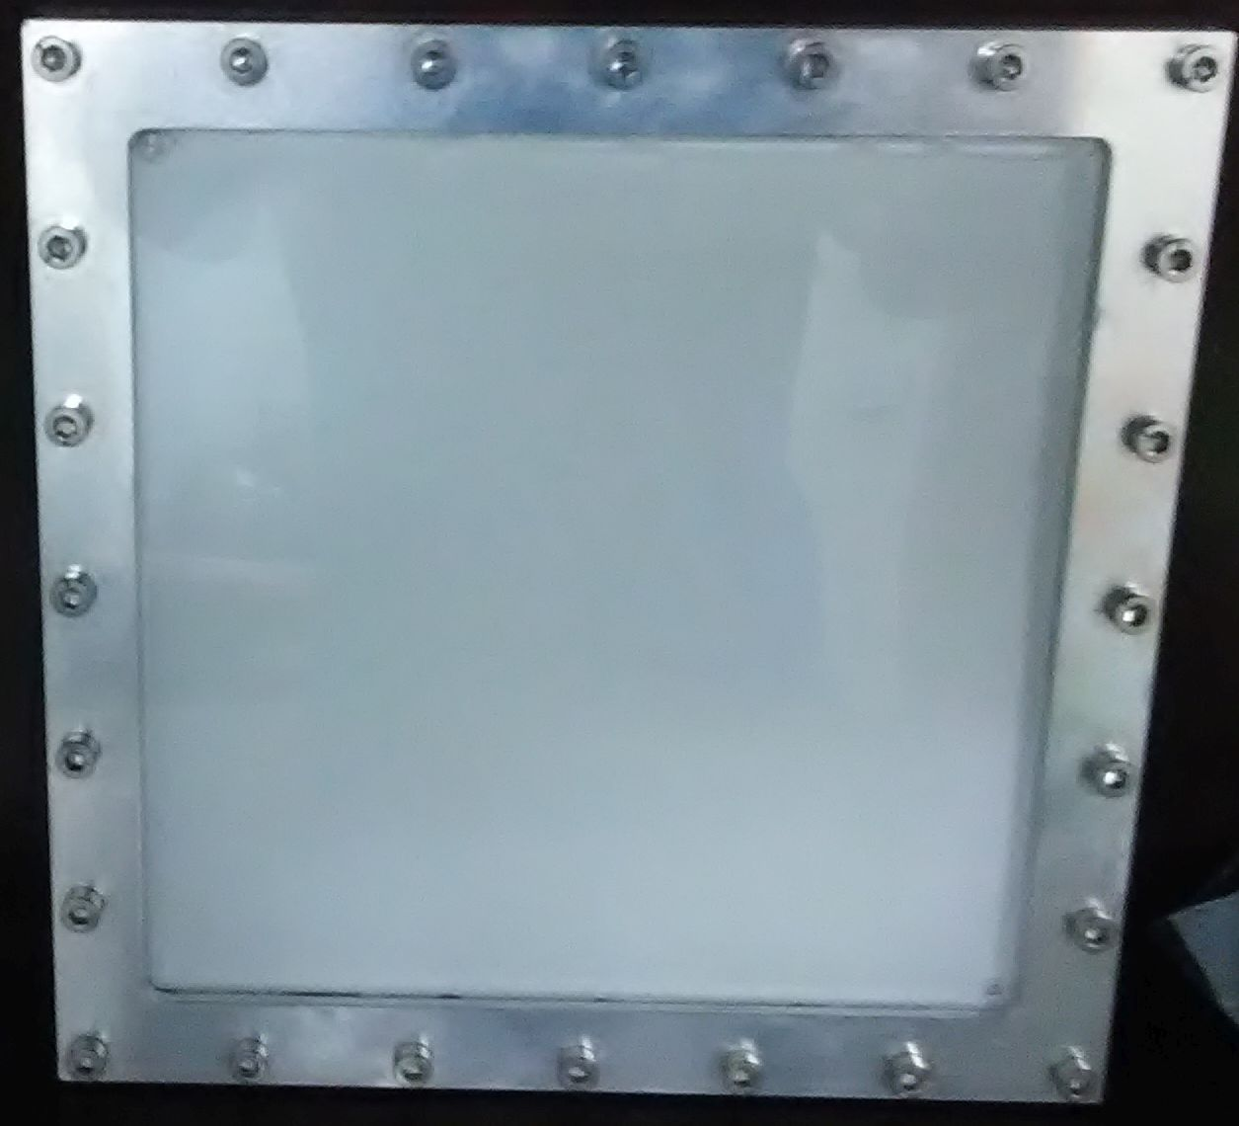

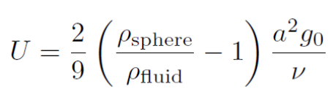
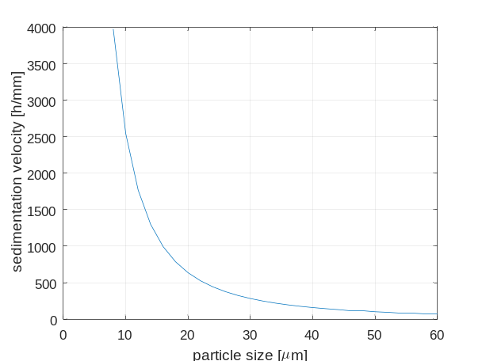
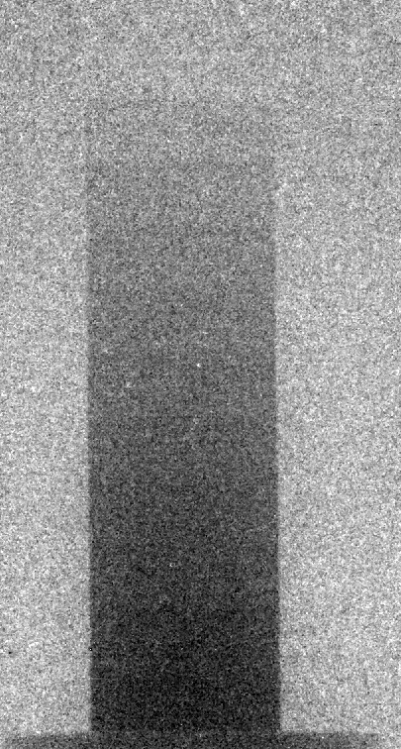
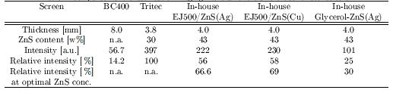
A less successful experiment: glycerol+ZnS screen
Glycerol has relatively high H density (~86% of PP), very transparent and very viscous
Mixing EJ600 ZnS:Ag powder (mean Ø 8 um) with glycerol
Fluid dynamics meets neutron imaging:
Stokes Flow - viscosity dominated
Drag and terminal (sedimentation) velocity of a spherical particle:
Unfortunately inferior result in terms of light yield ☹
Possibly wetting problems (ZnS separates from Glycerol over time)???
Aluminum backside
Transparent plexi cover towards camera
One might have to stir up the screen in between 2 experiments!
t_{exp}=6 min
Radiography of the iron step wedge

Slide 16
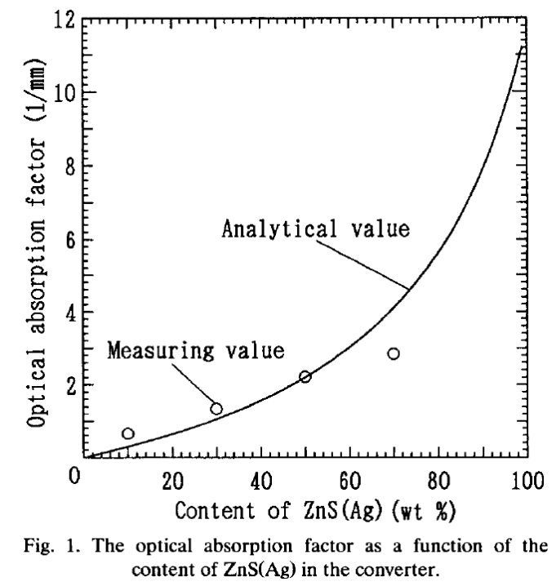
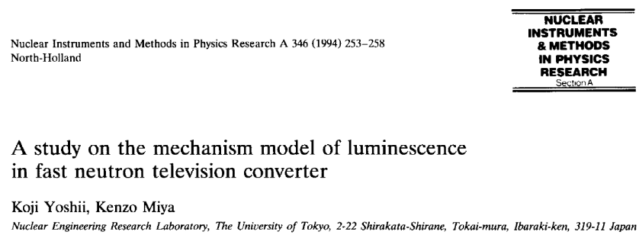
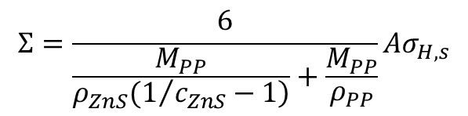

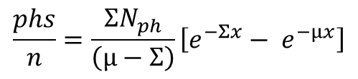
Modelling PP/ZnS and epoxy/ZNS scintillator screen behavior 1.
There is no real data on light yield by p⁺ in ZnS.
We use the 160’000 phs/Li reaction value known for LiF/ZnS (Q=4.78MeV)-> 33400 phs/MeV. This has to be corrected based on TRIM simulation with for the average fraction of total proton E actually deposited in ZnS. Further is has to be multiplied by the eff. QE of the chip and the solid angle factor describing the light collection efficiency from the screen via the lens to the chip (N_{ph,o}).
~1.4/mm
One has also to account for the light attenuation by ZnS (μ), which increases with both screen thickness and ZnS content. The simple model gives the nr. of photons detected on chip/neutron (Σ is the neutron scatter XS in the screen):
$$Σ=\frac{6}{\frac{M_{PP}}{\left.ρ_{ZnS}(1/{c_{ZnS}}−1\right)}+\frac{M_{PP}}{ρ_{PP}}}Aσ_{H,s}$$
$$\frac{phs}{n}=\frac{{ΣN}_{ph}}{\left(μ−Σ\right)}\left[{e^{−Σx}− e}^{−μx}\right]$$
$$N_{ph}=N_{ph,o}N_{ZnS}σ_{\left(p,ZnS\right)}$$

Slide 17
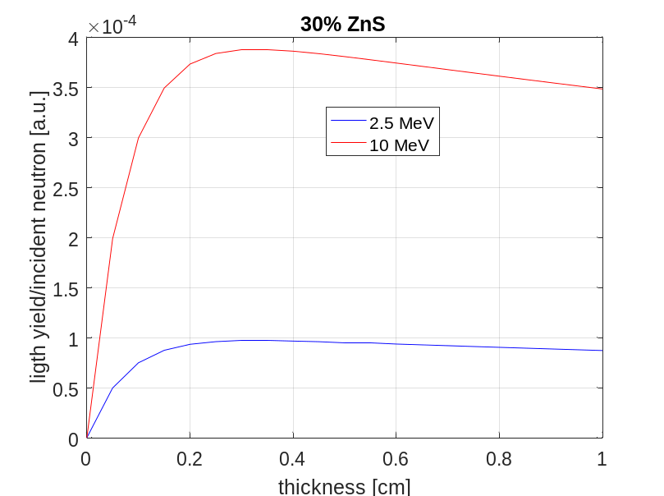
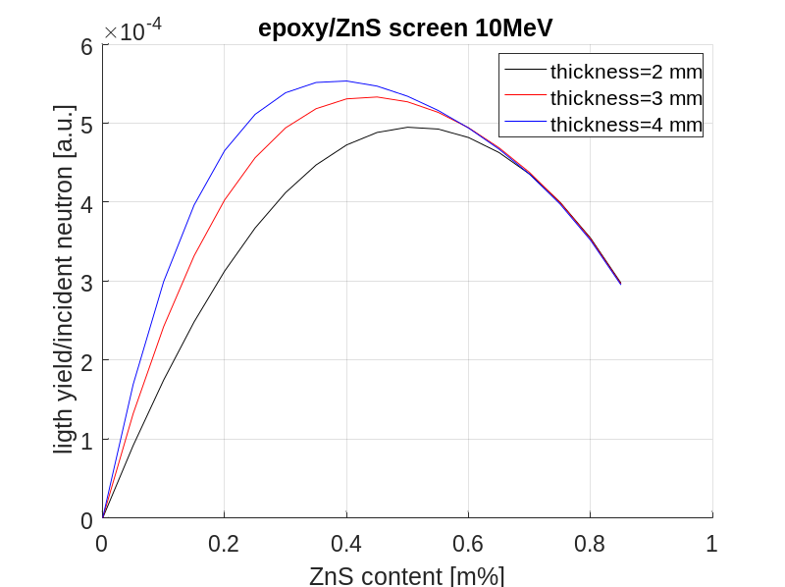
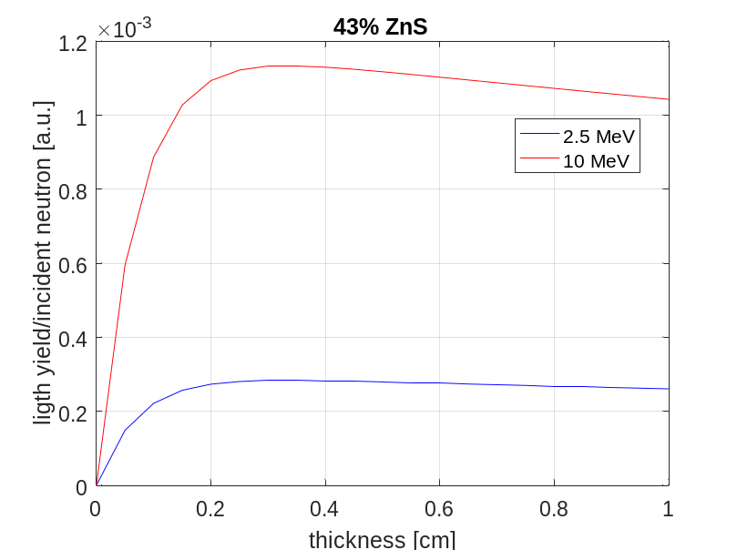
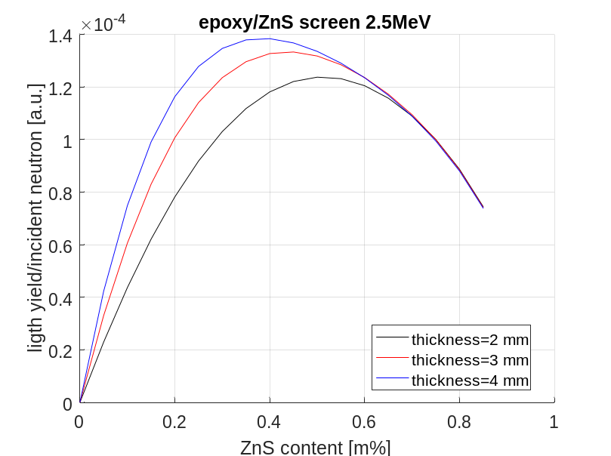
Modelling PP/ZnS and epoxy/ZNS scintillator screen behavior 2.
Qualitative behavior is well reflected by the model

Slide 18

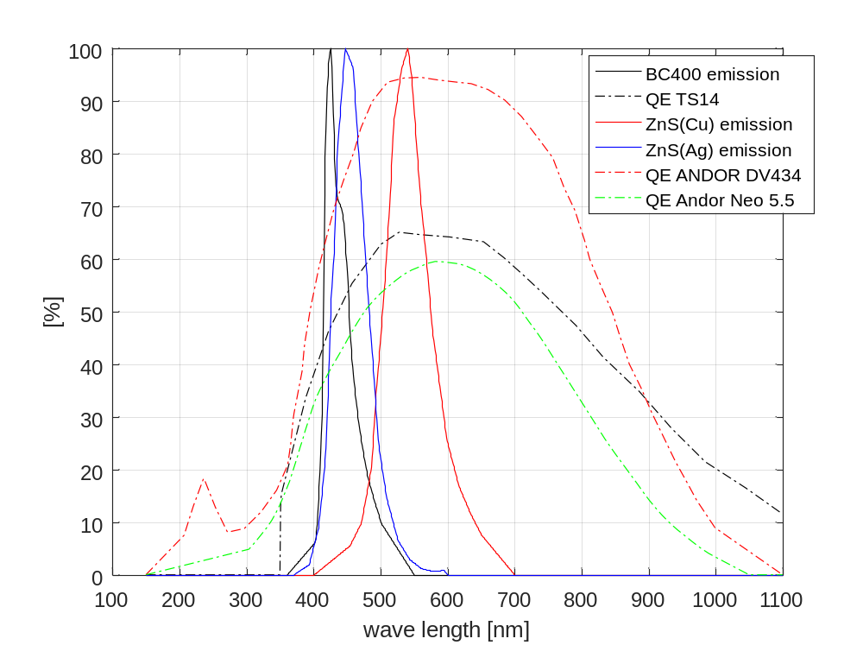
Modelling PP/ZnS and epoxy/ZNS scintillator screen behavior 3.
We have found practically the same light output of our inhouse epoxy/ZnS screen irrespective of the doping of ZnS with Cu or Ag. Based on the emission spectra of the 2 varieties and the wavelength dependent QE of the ANDOR Neo 5.5 we should have 46% (ZnS:Ag) vs. 56.5% (ZnS:Cu) effective QE. This alone would indicate 20% higher detected light for ZnS:Cu.

Slide 19


Modelling PP/ZnS and epoxy/ZNS scintillator screen behavior 4.
TRIM simulation using a simplified 1D model of the scintillator screen assuming uniform distribution of the ZnS particles in the converter matrix. Two parameters: particle size, pitch.
2.5 MeV proton in epoxy/ZnS (22% ),
Particle size=40 um
2.5 MeV proton in PP/ZnS (22% ), particle size=5 um
ZnS particle
PP/epoxy matrix
Pitch
It is very difficult to control particle agglomeration of fine powders in the size range of 5-10 um (coat or treat) and they tend to stick to grain sizes up to 40-50 um or higher. TRIM calculations show that depending on ZnS concentration, the E deposition into ZnS and thus the light yield can increase by up to 20% from 5 um to 40 um grain size!!
On average 85% vs 65% of the E of proton is turned into light for inhouse/Tritec!

Slide 20
Conclusions and Outlook
We have tested a wide range of fast neutron imaging screen in fission and spallation spectra including commercial plastic scintillators and a commercial mixed plastic/inorganic scintillator (Tritec)
We have also developed and optimized inexpensive, in-house fast neutron imaging screens by mixing optical epoxy or glycerol as neutron converter with ZnS:Ag and ZnS:Cu as phosphor
Result show that for screen thicknesses above 3mm ~22.5% is an at 2mm ~41% are the optimal ZnS concentrations, respectively.
Best performance in terms of light intensity is obtained by the Tritec PP/ZnS:Cu screen. Compared to the in-house ones (100% vs 60%) is mainly due to the higher H content of PP compared to optical epoxy. The plastic scintillator (BC400) performed worst for our camera-based setup.
A viscous, fluid screen made with glycerol lags behind expected performance.
A simple analytical model of the screen behavior have been setup that reflects the observed trends like: qualitative shape of the light yield vs ZnS cc curve, the ever-increasing light yield with thickness up to 4mm, shift to lower optimal ZnS cc for increasing height,
TRIM simulation of the granular structure of the scintillator show that a good control of the particle size is important as it has a significant effect on light output amount on average to 20% more light for large (40um) vs. small (5 um) particles.

Slide 21
Auxiliary slides

Slide 22


Gamma sensitivity, Gamma spectra of NEUTRA and RAD
Direct measurement of the screen γ sensitivity -> difficult using (Co60,Cs-137) as one needs at least a few Ci for reasonable exposure times.
Low-cost, in-house LYSO-based gamma detector, less sensitive and almost no loss on failure -> could be placed into direct beam!
Gamma spectrum at NEUTRA
1.25e4 photons/s/cm2
Estimated gamma contribution in BC400 detector ~11-13%!
n/γ~1
There is also a scattered γ baseline (pedestal) contribution from fats neutrons being moderated in the surrounding and activating: typically 10% can be compensated for in imaging.
Gamma spectrum at RAD
Behind 200 mm Pb filter!
Estimated gamma contribution in imaging detector <1%!
1.7e3 photons/s/cm2
n/γ~1
Makoswska et al (2017) found n/γ~ 1.1 for PP/ZnS:Cu and n/γ ~2 for PP/ZnS:Ag (depending on thickness)

Slide 23

Tests results at the 10 MW reactor RAD beam line at the BNC 3.
Tomographic imaging and rendering of the coupling without housing obtained using the in-house epoxy/Zns:AG screen:
Oil droplets

