Slide 1
Development of event-type neutron imaging detectors at the energy-resolved neutron imaging system RADEN at J-PARC
Joe Parker
CROSS/BL22 Group
WCNR-11 Australian National Maritime Museum, Sydney, Australia 4 September 2018
Notes:
Good morning. My name is Joe Parker.
Thank you very much for having me here today and thank you for allowing me speak to you about my research on ‘A new micro-pattern detector for high-rate, time-resolved neutron imaging and its applications’.

Slide 2




RADEN and µNID development members
WCNR-11 4 Sep 2018 J. Parker
JAEA/J-PARC Center Takenao Shinohara
Tetsuya Kai
Kenichi Oikawa (BL10)
Masahide Harada (BL10)
Takeshi Nakatani
Mariko Segawa
Kosuke Hiroi (BL15)
Yuhua Su (SE Group)
CROSS Hirotoshi Hayashida
Joe Parker (µNID Lead Developer)
Yoshihiro Matsumoto
Nagoya University Yoshiaki Kiyanagi
Kyoto University Toru Tanimori
Atsushi Takada

Slide 3

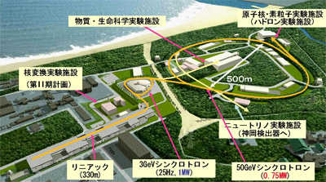
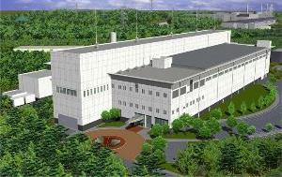
J-PARC (Japan Proton Accelerator Research Complex)
WCNR-11 4 Sep 2018 J. Parker
Materials and Life science experimental Facility (MLF)
Hadron experimental facility
Nuclear transmutation facility
Neutrino facility
(to Kamiokande)
LINAC
(330m)
3GeV Synchrotron
(25Hz,1MW)
50GeV main ring
(0.75MW)
J-PARC
MLF is currently operating at 500kW
(successful test at 1 MW in June 2018)
Tokyo
Materials and Life science experimental Facility (MLF)
100 km from Narita international airport
Notes:
1 day by walk, 2 or 3 hours by a bus or train

Slide 4
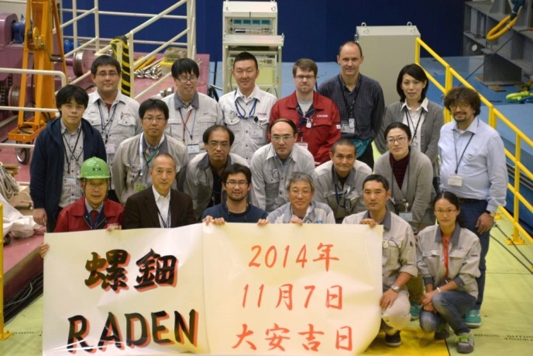
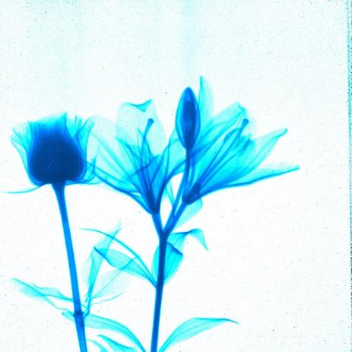

RADEN/BL22 – Neutron imaging instrument at the MLF
WCNR-11 4 Sep 2018 J. Parker
World’s first instrument dedicated to energy-resolved neutron imaging using pulsed neutrons
World-class, pioneering instrument for pulsed-neutron imaging
Leading facility for conventional radiography in Japan
Commissioning from Nov. 2014, user program from April 2015
First images from RADEN (7 Nov 2014)

Slide 5
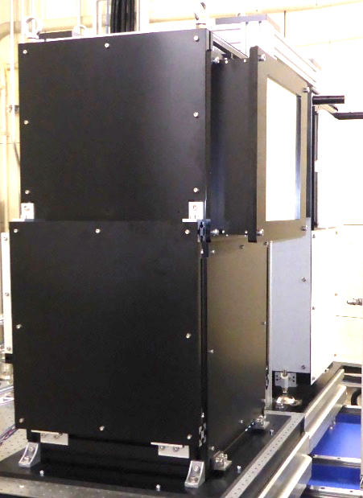
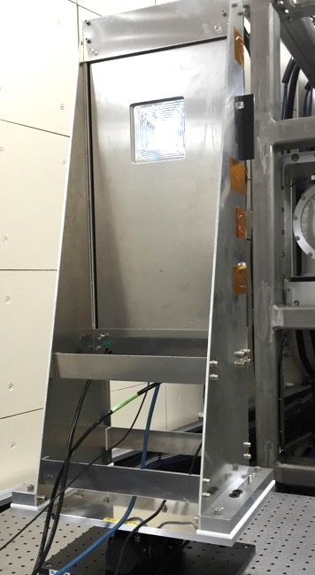
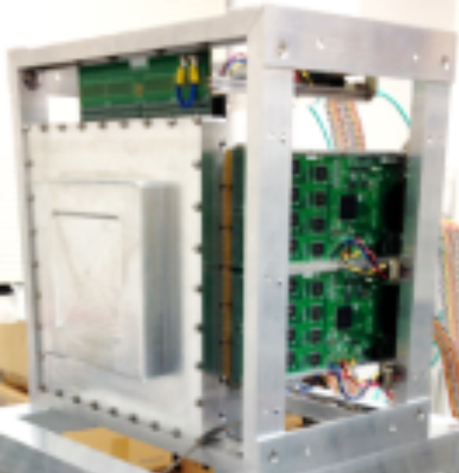
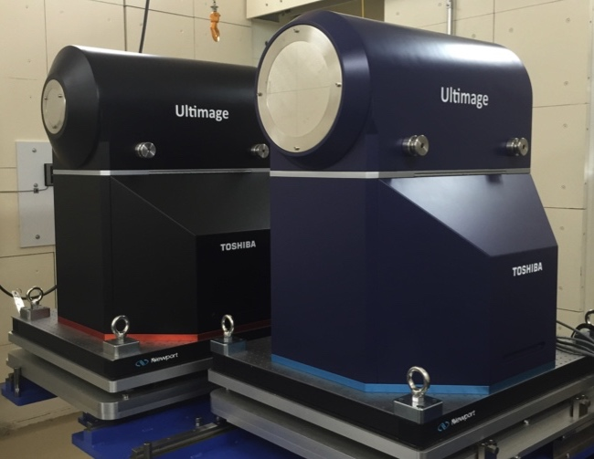
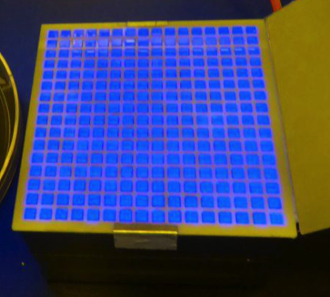
Neutron imaging detectors at RADEN
WCNR-11 4 Sep 2018 J. Parker
Camera type
Event type
Mirror
Single-mirror CCD system (Andor iKon-L, EMCCD)
Neutron color I.I. (high-res,high-speed)
nGEM
µNID
Scintillator
CCD
camera
micropattern
micropattern
Li-glass scintillator
Micropattern detectors (nGEM, µNID)
Li-glass pixel scintillator (LiTA12)
Neutron color I.I.
LiTA12

Slide 6
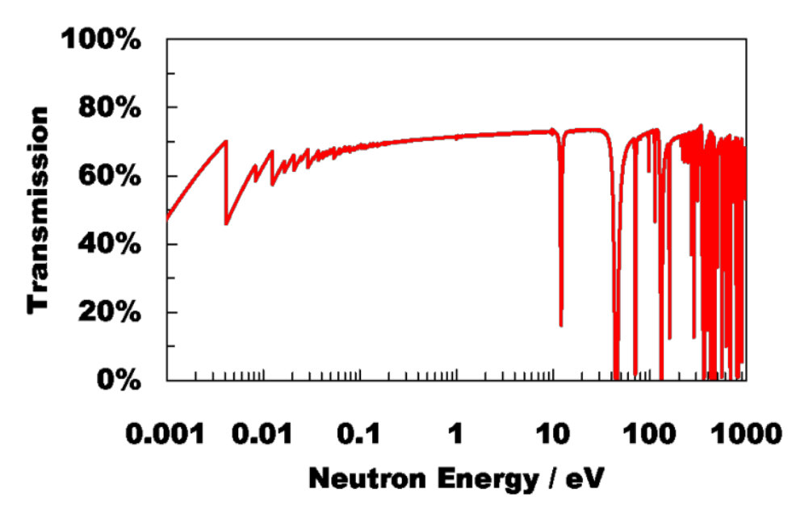
ERNI with event-type detectors
WCNR-11 4 Sep 2018 J. Parker
Energy-dependent neutron transmission
Energy-dependence → quantitative information on macroscopic distribution of microscopic quantities
Pulsed neutrons → wide energy range, accurate energy determination by time-of-flight
Requires detector with:
  Sub-mm spatial resolution
  Sub-µs time resolution
  Mcps count rate
  Strong background rejection
Resonance absorption
Bragg-edge,
Magnetic imaging
Energy
1 meV
1 keV
Wavelength
10 Å
10⁻² Å

Slide 7
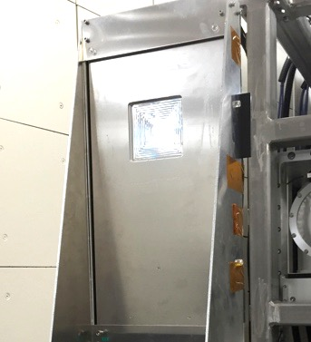
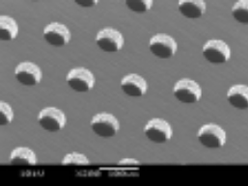
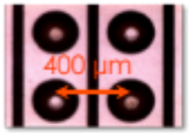
Event-type detectors at RADEN
WCNR-11 4 Sep 2018 J. Parker
nGEM
µNID
LiTA12
170 µm
10 cm
10 cm
GEM surface
Anode
structure
5 cm
 | nGEM | µNID | LiTA12
Detector type | Micropattern | Micropattern | Scintillator
Converter material | ¹⁰B | ³He | ⁶Li
Active area | 10 cm x 10 cm | 10 cm x 10 cm | 5 cm x 5 cm
Spatial resolution | 1 mm | 0.1 mm | 3 mm
Time resolution | 10 ns | 250 ns | 40 ns
Efficiency (thermal) | 10% | 26% | 23%
Count rate | 0.2 Mcps | 1 Mcps | 6 Mcps
Gamma sensitivity | 10⁻⁴ | < 10⁻¹² | low
Notes:
30 sec

Slide 8
Current detector performance
WCNR-11 4 Sep 2018 J. Parker
Count rate and spatial resolution should be considered together
G O A L
LiTA12
µNID
nGEM

Slide 9
Development of event-type detectors
WCNR-11 4 Sep 2018 J. Parker
For energy-resolved neutron imaging, we need:
  Improved rate performance (10 Mcps order or higher)
  Improved spatial resolution (µNID <100µm, LiTA12 <1mm)
  Full integration into RADEN experiment control system
  Fast, easy-to-use data processing software
Ongoing development of µNID and LiTA12
  Optimization of existing detector components, development of new components
  Optimization of analysis algorithms, measurement methods
  Development of new control and processing software
Notes:
Benefits
Drastically reduced measurement times
Complicated measurement techniques
Combine with CT, real time measurements

Slide 10
µNID development at RADEN
WCNR-11 4 Sep 2018 J. Parker
Optimization of filling gas, analysis algorithms
Full integration into RADEN control system
Web-based analysis GUI

Slide 11
µNID development at RADEN
WCNR-11 4 Sep 2018 J. Parker
G O A L
LiTA12
µNID
µNID
(ca. 2014)
nGEM

Slide 12
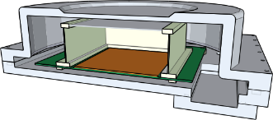
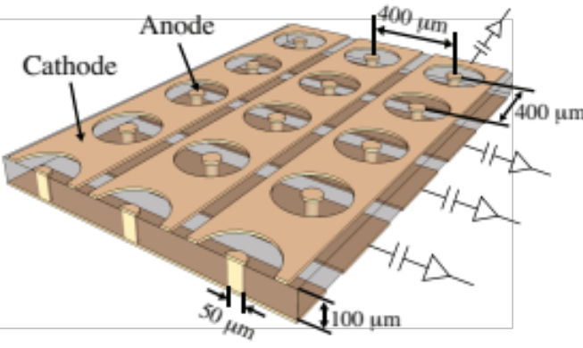
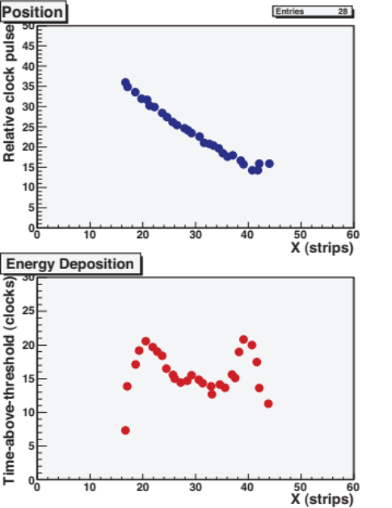
µNID: µPIC-based neutron imaging detector
WCNR-11 4 Sep 2018 J. Parker
Developed at Kyoto University
Gaseous time-projection-chamber
  CF₄-iC₄H₁₀-³He (45:5:50) at 2 atm
  µPIC micropattern readout
  Compact ASIC+FPGA data encoder front-end
3-dimensional tracking of decay pattern + time-over-threshold
  Accurate position reconstruction
  Strong gamma rejection
Neutron detection via ³He
Track length ~5 mm in gas
E
33 cm
µPIC readout
10 cm x 10 cm area,
400 µm pitch x,y strips
Digital encoder with time-over-threshold (TOT)
µPIC
TOT for proton-triton track
Threshold
Neutron
Proton
Discriminator
Triton
Polyimide substrate
Time-over-threshold
(∝ energy dep.)
Notes:
Our µPIC-based neutron imaging detector, or µNID, shown here, consists simply of a µPIC, which is just a printed circuit board, and drift cage contained in an aluminum pressure vessel. As stated previously, we achieve neutron detection by adding He3 to the gas of the detector, and we measure both the detailed 3-dimensional track and energy deposition of the resultant proton-triton pairs.
The energy deposition is estimated using the time-over-threshold technique. As illustrated here, it is simply the time for which an analog signal exceeds the threshold of the discriminator. This measurement is accomplished digitally, without the need for ADCs, allowing us to maintain maximal counting rates. In this way, we can measure approximately the energy deposition at each hit point, as illustrated by this sample event.
By observing this TOT distribution, we are able to cleanly separate the proton and triton tracks, leading to a much better estimate of the neutron interaction position, as compared to say taking the midpoint of the track as one would be forced to do in the absence of the TOT information.
This characteristic shape is also what allows us to reject essentially all backgrounds.

Slide 13
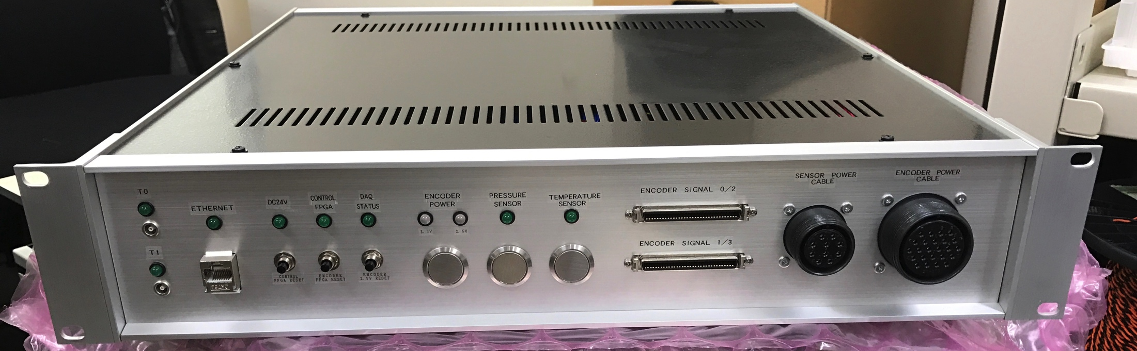
µNID DAQ/control system layout
WCNR-11 4 Sep 2018 J. Parker
DAQ PC
Data encoders
Ethernet
~50 cm
External timing signals
SiTCP
GbE × 4
µPIC
Control box
・DAQ control
・system monitor
・DC power
Encoders
±2.5V, +3.3V
FPGA-based data encoders and DAQ controller
Data transfer via Gigabit Ethernet
Full integration into RADEN experiment control system
Sensor power
Vessel pressure
Ambient temperature
Network
Monitoring
DAQ control
Power

Slide 14
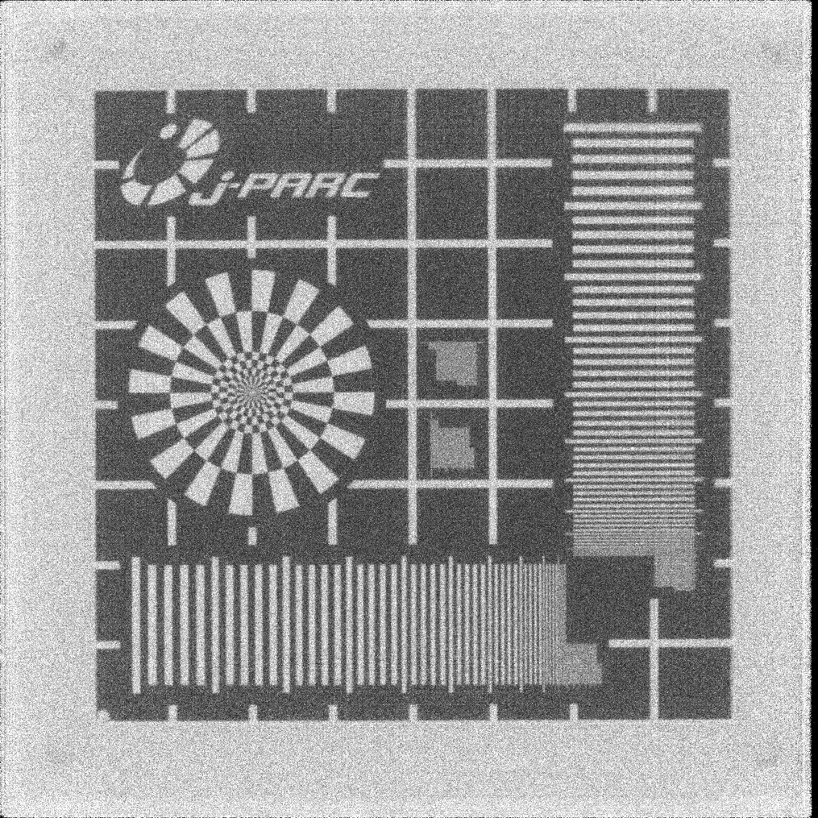
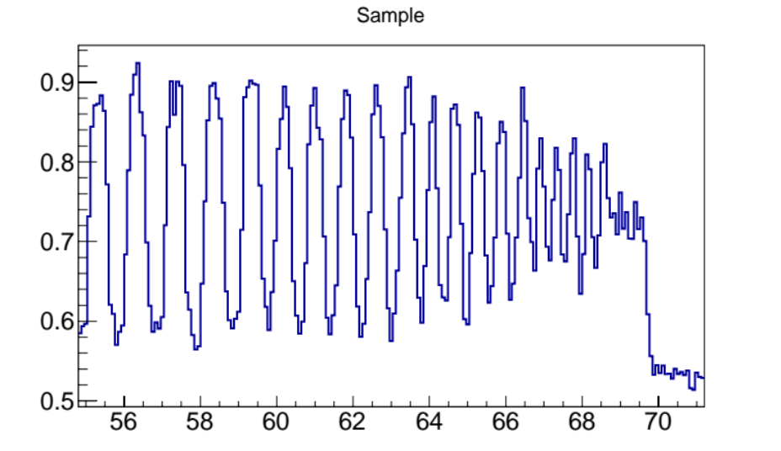
Spatial resolution at RADEN
WCNR-11 4 Sep 2018 J. Parker
Optimized gas mixture and refined neutron position reconstruction algorithm
Image of Gd test pattern
  L/D: 5000, Exposure: 1.5 hours
  10% contrast at 5 lp/mm (100µm line width)
Image of Gd test target
8 cm
Transmission
0.1 mm
Bin size: 40 x 40 µm²
0.5 mm
0.4 mm
0.3
mm
0.2
mm
Distance from top (mm)

Slide 15
Hardware rate performance
WCNR-11 4 Sep 2018 J. Parker
Revised data encoder hardware (100BASE-T → Gigabit Ethernet)
  About 7 times increase in rate capacity
Changed from Ar to CF₄ based gas mixture
  About 2 times increase due to smaller track size
Total increase in global peak rate capacity from 0.6 to 8 Mcps
Usable rate limited by offline analysis

Slide 16
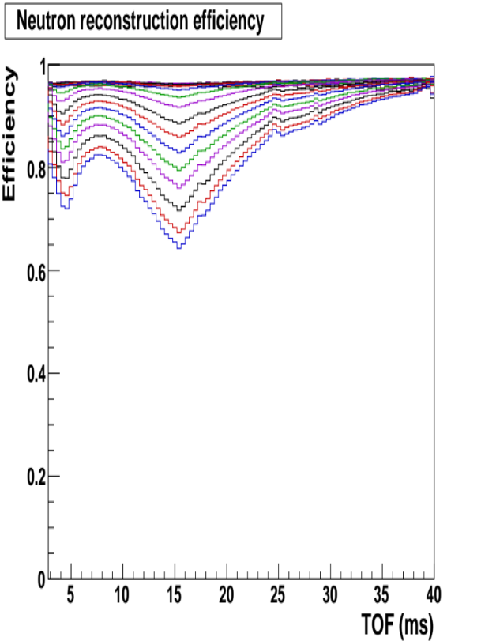
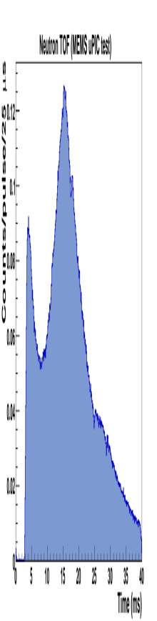
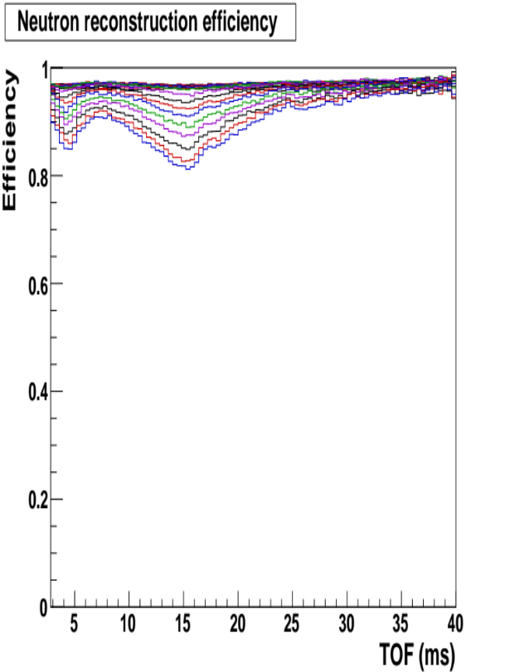
Offline hit clustering algorithm
WCNR-11 4 Sep 2018 J. Parker
Event reconstruction efficiency
Raw hits are clustered into neutron events (~14 hits/event with current gas mixture)
  Data taken with fixed area and increasing flux
  Efficiency determined by comparing numbers of raw hits and reconstructed neutron events
Change from single-linkage algorithm to DBSCAN-based algorithm with explicit event pile-up resolution
Event loss improved from 2% at 400 kcps to 2% at 1 Mcps global peak rate
Efficiency
<0.4 Mcps
2.5 Mcps
5.6 Mcps
Single-linkage clustering (original)
Typical neutron TOF
Efficiency
<1 Mcps
2.5 Mcps
5.6 Mcps
DBSCAN-based clustering (new)
Neutron TOF (ms)

Slide 17
µNID control software/analysis GUI
WCNR-11 4 Sep 2018 J. Parker
New control software
  In use since March 2018
  Based on DAQ middleware
  Full integration into beam line control system
New browser-based UI for offline analysis
  In use since April 2018
  Now preparing first update (simplified interface, better data visualization, etc.)
Software frameworks at the MLF
IROHA2 – Experimental device control system with web-based UI (MLF)
DAQ Middleware – Detector control and data collection (KEK)
µNID analysis GUI

Slide 18
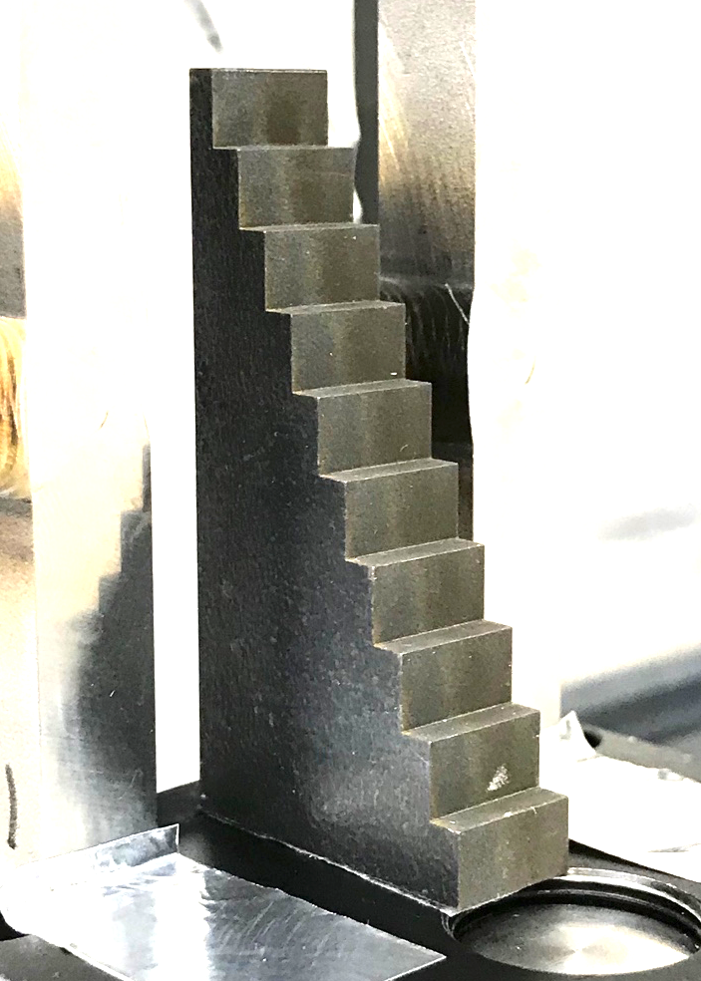
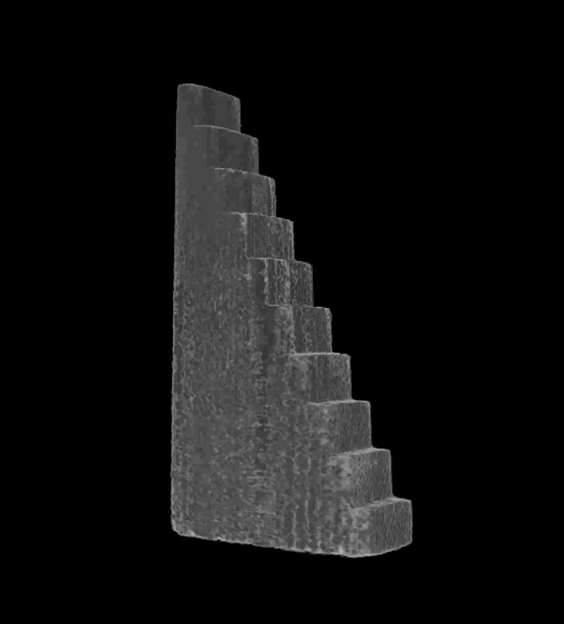
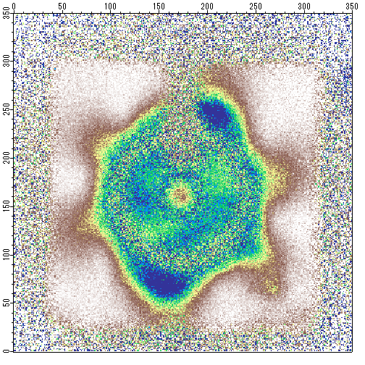
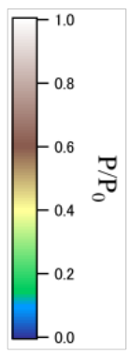
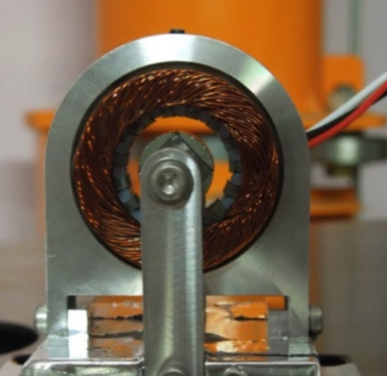
Demonstration measurements
WCNR-11 4 Sep 2018 J. Parker
Computed tomography
Increased rate and integrated control
  Perform complex measurements more easily
Computed tomography with TOF
  Help quantify effects of multiple scattering, beam hardening, etc.
Dynamic samples
  Fold TOF info with motion/process frequency
  Currently limited to cyclical processes
Fe step wedge
2°/step 91 images
5 cm
Magnetic imaging of running motor
Model electric motor (provided by Hitachi)
Polarization image
4 cm
4 cm
K. Hiroi et al., J. Phys.: Conf. Series 862 (2017) 012008

Slide 19
Other µNID development
WCNR-11 4 Sep 2018 J. Parker
Small-pitch MEMS µPIC
µNID with Boron converter

Slide 20
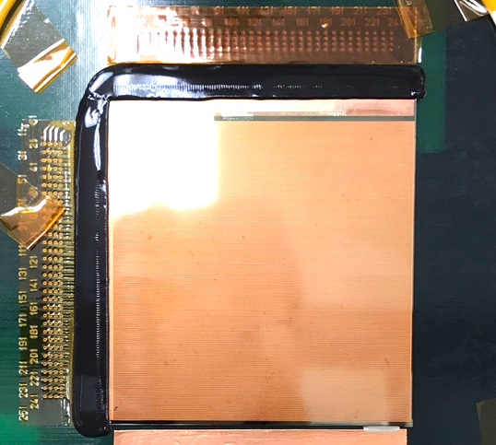
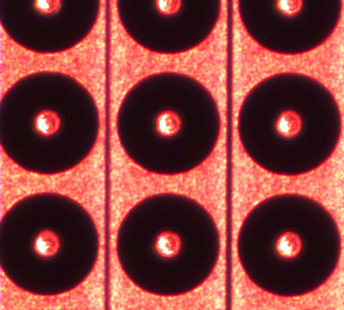
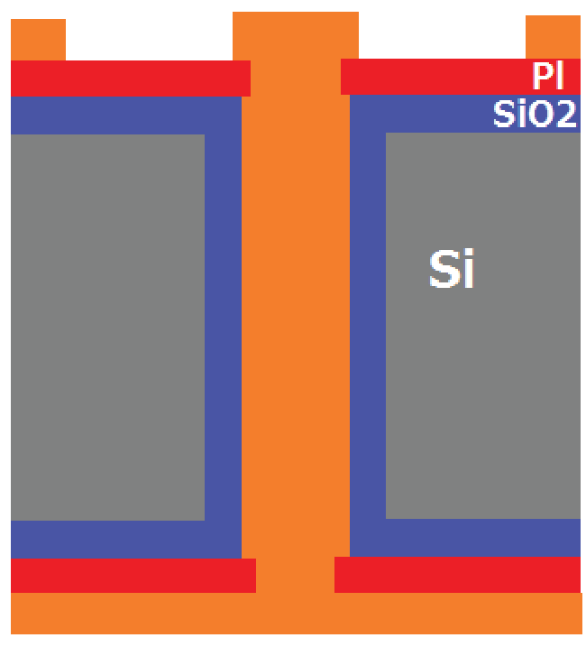
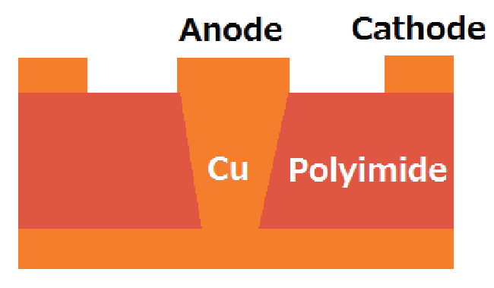
Small-pitch MEMS µPIC
WCNR-11 4 Sep 2018 J. Parker
Surface of MEMS µPIC
(digital microscope)
Improve spatial resolution with reduced strip pitch
Develop small-pitch µPIC
  Manufacture using MEMS on silicon substrate (by DaiNippon Printing Company, Ltd.) → uniform structures down to 10 µm
  Successfully produced 215 µm pitch µPIC (down from 400 µm)
  Small (14 x 14 mm²) and larger area MEMS µPICs (55 x 55 mm²) tested at RADEN
215µm MEMS µPIC
215 µm
55 mm
Current PCB µPIC
(400 µm pitch)
MEMS µPIC
Cu
100µm
400µm
10~15µm
4~11µm
15µm

Slide 21
MEMS µPIC tests at RADEN
WCNR-11 4 Sep 2018 J. Parker
Sufficient gain confirmed for small-pitch geometry
Imaging confirmed but spatial resolution not improved as expected
Gain instability under neutron exposure → improved by grounding substrate but not eliminated
Image taken with 215µm pitch MEMS µPIC at BL22
55 mm
MEMS µPIC gain vs time
0V
+HV
0V
Gain stability: new MEMS µPIC with glass substrate prepared
Spatial resolution: optimize gas for shorter tracks
More testing this winter
Cu
Gain depends on anode/cathode geometry

Slide 22
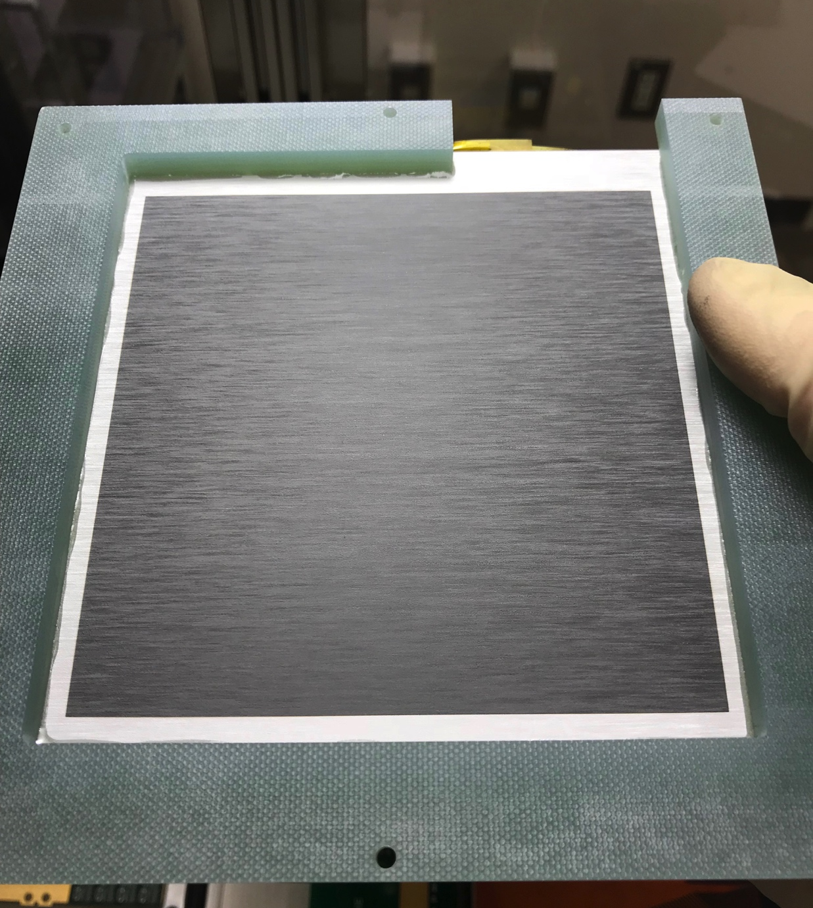
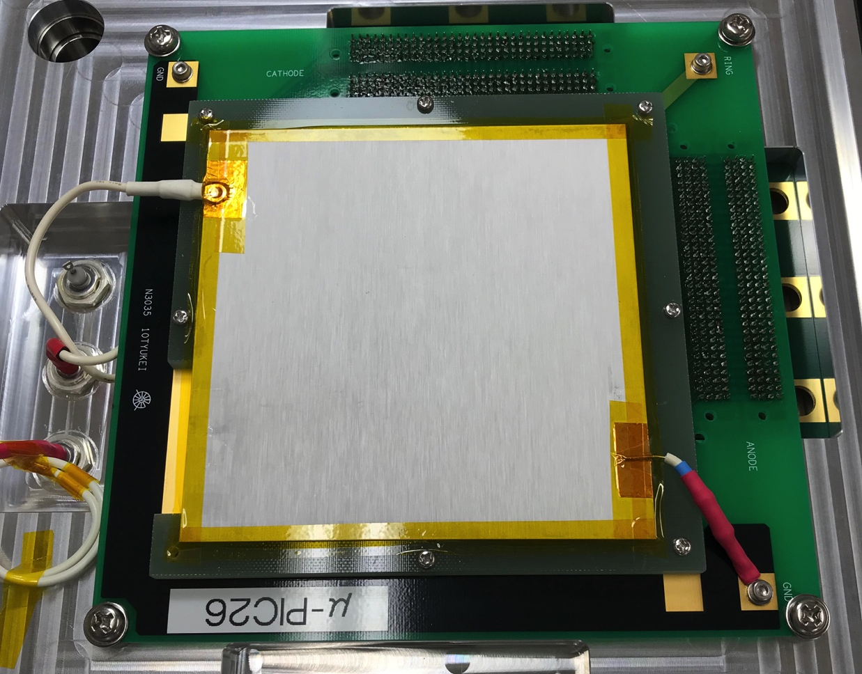
µNID with boron converter (B-µNID)
WCNR-11 4 Sep 2018 J. Parker
Increase count rate capacity by reducing event size
  ¹⁰B (α,Li) for 3x smaller event size than ³He (p,t)
  Trade-off in spatial resolution
µNID with flat boron converter (for initial testing)
  Thin, 1.2µm ¹⁰B layer → low efficiency (3~5%)
Need to consider ways to improve detection efficiency
Underside of drift plane
Boron converter installed in µNID
¹⁰B
(t = 1.2µm)
10cm
Al drift cathode (t=1mm)
~5 mm
¹⁰B coating (t=1.2µm)
µPIC readout
Expect 20~25 Mcps count rate
and 0.4 ~ 0.5 mm spatial resolution

Slide 23
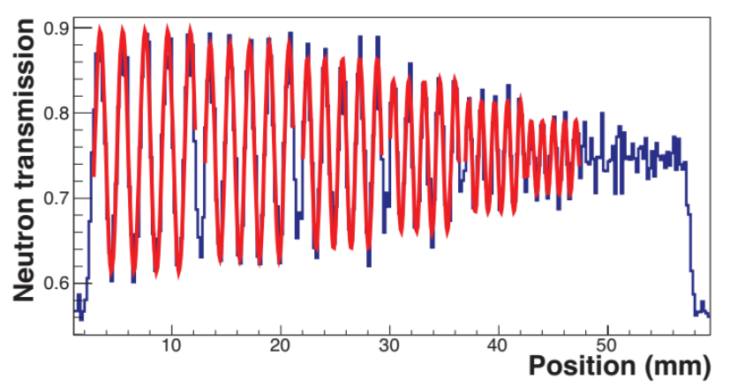
Spatial resolution study at RADEN
WCNR-11 4 Sep 2018 J. Parker
Study of spatial resolution, event size vs. gas pressure (1.2 ~ 1.6 atm)
L/D:1000, Exposure time: 15 mins
Spatial resolution estimated from contrast of line-pairs (MTF)
Maximum count rate at hardware limit: 22 Mcps @1.6 atm
Gas pressure: 1.4 atm
Bin size: 200 x 200 µm²
Pressure (atm) | 1.2 | 1.4 | 1.6
Average hits/event | 5.86 | 5.42 | 4.82
MTF @0.6mm | 27% | 36% | 41%
Spatial resolution @10% MTF (mm) | 0.50 | 0.48 | 0.45
Contrast (MTF) from
fit of sine curves
0.5
0.4
0.6
1.0
0.9
0.8
0.7
Line-width (mm)

Slide 24
Current and expected detector performance
WCNR-11 4 Sep 2018 J. Parker
Boron µNID
G O A L
Li-glass
MEMS µPIC
µNID
µNID
(current)
nGEM

Slide 25
Li-glass pixel detector
WCNR-11 4 Sep 2018 J. Parker
Improvement of spatial resolution using centroiding, image stepping

Slide 26
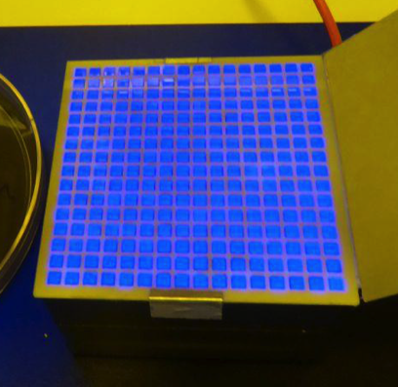
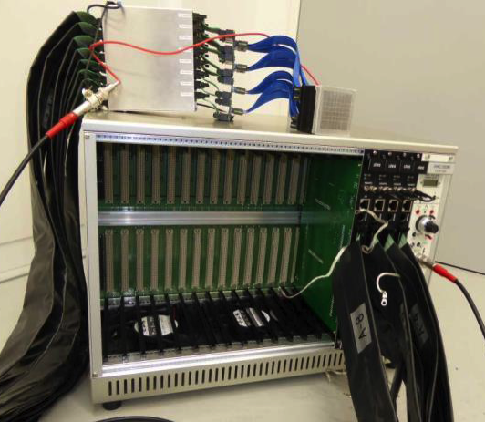
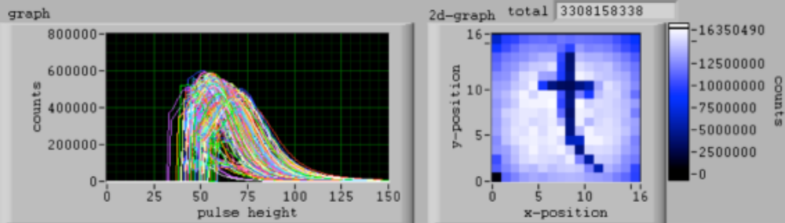
⁶Li Time Analyzer, model 2012 (LiTA12)
WCNR-11 4 Sep 2018 J. Parker
Developed at KEK, Japan
Li-glass scintillator (GS20) pixels on Hamamatsu H9500 multi-anode PMT
3 mm anode pitch limits spatial resolution
Improve spatial resolution using super resolution
  Single, flat scintillator with centroiding
  Image stepping with sub-pixel shifts
Li-glass
Amp
VME DAQ modules
5 cm
Li-glass detector parameters
Area | 5cm x 5cm
Spatial res. | 3 mm
Time res. | 40 ns ~
Eff. (thermal) | 22%
Count rate | 6 Mcps
Image taken at RADEN of cadmium ‘t’

Slide 27
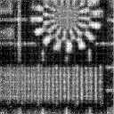
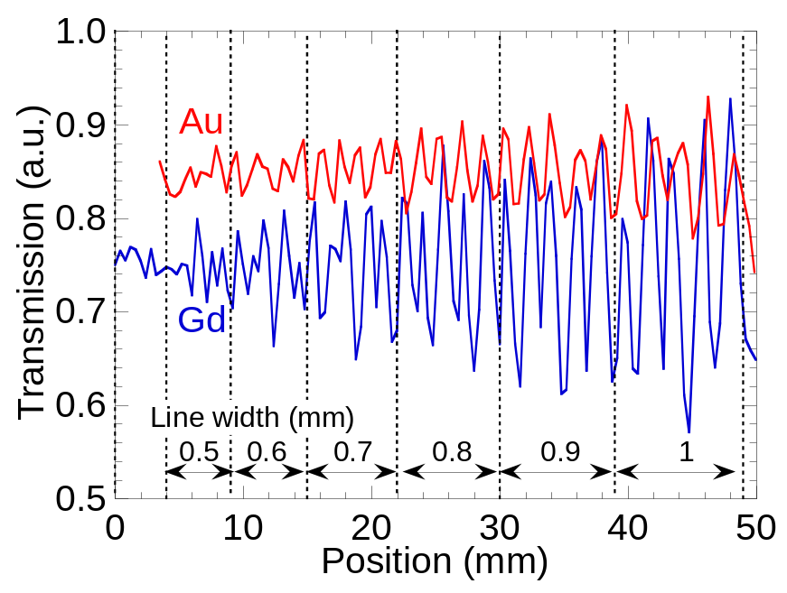
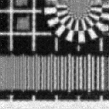
Centroiding with single scintillator
WCNR-11 4 Sep 2018 J. Parker
Replace pixels with 1mm thick plate
Spatial resolution improved with centroid computation
  ~0.7 mm for Au and Gd
Au indicator (4.9eV)
Gd indicator (<0.1eV)
T. Kai et al., Physica B, 2017

Slide 28

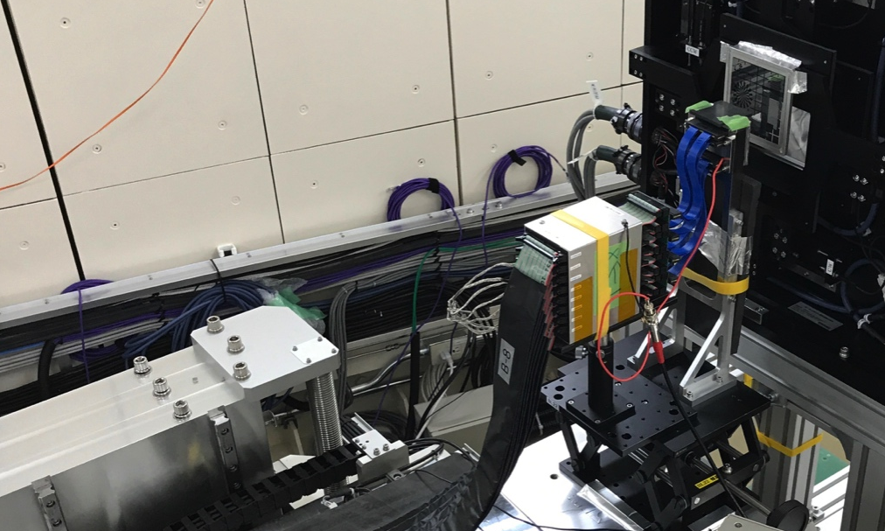
Image stepping (multi-image compositing)
WCNR-11 4 Sep 2018 J. Parker
LiTA12 (pixel detector) on remote-controlled stage
x,y scan of Gd test chart on 6 x 6 grid
  0.5 mm step size, 36 images
Low resolution image
Simple reconstruction

Slide 29
Current and expected detector performance
WCNR-11 4 Sep 2018 J. Parker
Boron µNID
G O A L
Li-glass
MEMS µPIC
µNID
µNID
(current)
LiTA12
(centroiding)
nGEM

Slide 30
Summary
WCNR-11 4 Sep 2018 J. Parker
Development of detectors to meet the needs of conventional and energy-resolved neutron imaging at RADEN is ongoing
Standard µNID
  Optimized detector components and refined analysis for improved spatial resolution/image quality and improved rate performance
  New analysis GUI and control software for improved ease-of-use
Continuing µNID development
  Basic operation of small-pitch MEMS µPIC confirmed; testing of new glass-substrate MEMS µPIC this winter
  Characterized µNID with boron converter; need to improve efficiency
Optimization of Li-glass detector
  Demonstrated improved spatial resolution with centroiding and sub-pixel image stepping
Notes:
And in summary, we have successfully developed a new, powerful detector system for time-resolved neutron imaging which combines 3-dimensional tracking and energy measurement by time-over-threshold to provide excellent overall operating characteristics.
Two µNID systems are already in service at J-PARC, with a third to be installed at the new imaging beamline.
I have also studied new time-of-flight based techniques and analysis methods, which have applications over a broad range of materials science, and I would like to use such new techniques to open up new science.
I have also developed good working relationships with members of J-PARC and Hokkaido University, and staff at DNP.
I am ready to continue and expand my research at the new imaging beamline, and use the skills I’ve acquired over my varied career to help develop a unique, world class beamline.
Thank you.

Slide 31
Thank you for your attention!

Slide 32
Extra slides

Slide 33
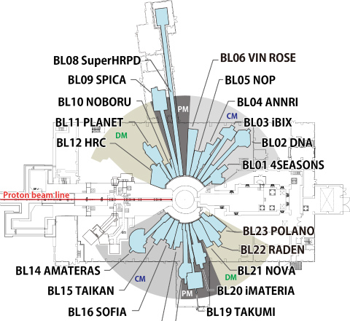
Public beamlines at the MLF
WCNR-11 4 Sep 2018 J. Parker
Mercury spallation target, 25 Hz repetition rate, beam power up to 1 MW
23 beam ports, 6 public beam lines currently in operation
BL11: PLANET
BL02: DNA
Dedicated imaging beamline at BL22 (RADEN)
BL01: 4 SEASONS
BL22: RADEN
BL15: TAIKAN
BL17: SHARAKU
BL18: SENJU

Slide 34
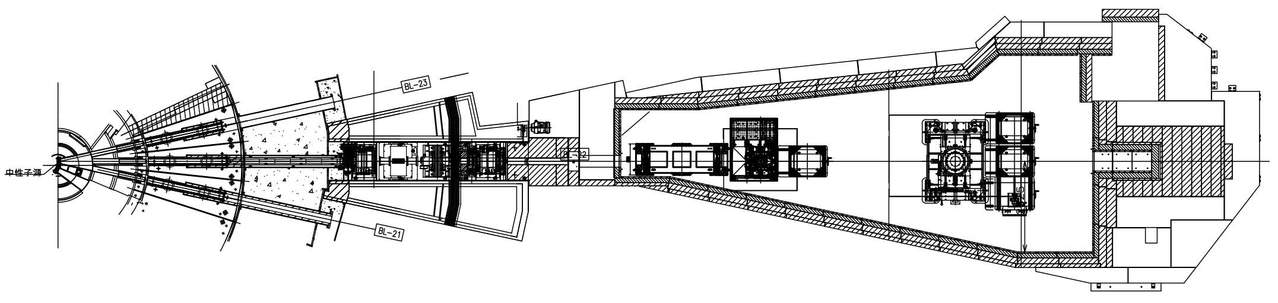
RADEN/BL22 – Neutron imaging instrument at the MLF
WCNR-11 4 Sep 2018 J. Parker
Experimental Space
13m
Bulk shield
Medium sample stage
Optical bench
5m
Moderator
1st Detector
position
Optical Devices
Large load
sample stage
Shutter
2nd Detector position
0m
8m
14m
18m
23m
27m
31m
Properties of RADEN
Conventional/pulsed-neutron imaging | Large beam size (up to 30x30 cm²)
High flux (2.6x10⁷ n/s/cm² @ <0.5eV) | Variable L/D (up to 7500)
Wide bandwidth (~9Å, Δλ/λ < 0.2%) | Large experimental area
Optional sample environments | Automated measurements

Slide 35
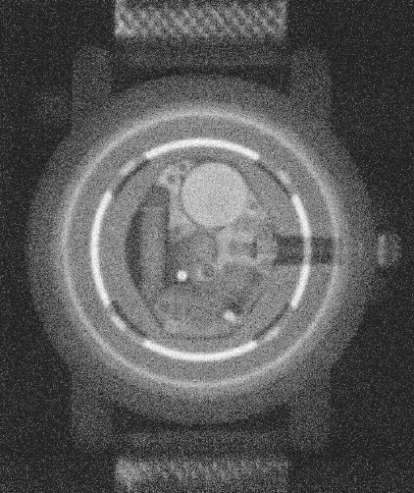
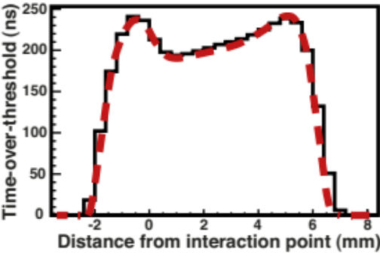
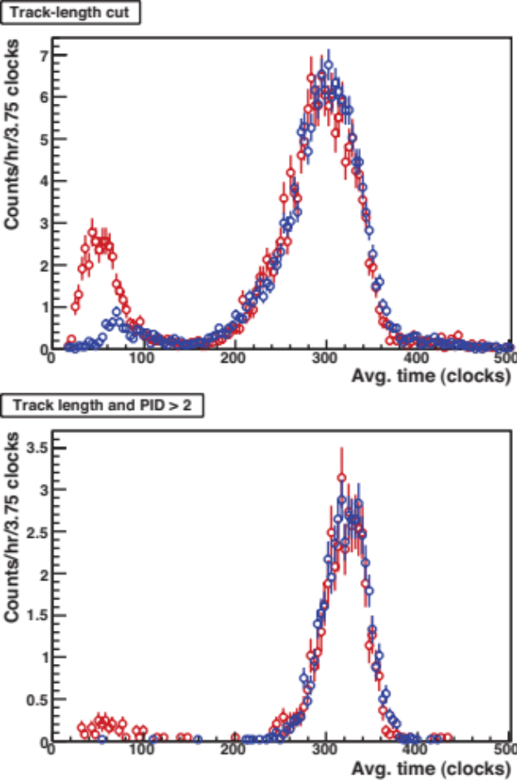
Performance of standard µNID
WCNR-11 4 Sep 2018 J. Parker
Measured TOT distribution
Strong gamma rejection using sum of TOT
Triton
Proton
Neutrons
¹³⁷Cs
No source
Template for fit
γ’s
Fine spatial resolution from fit to TOT distribution
‘Energy’ cut
Image taken at NOBORU (2011)
Total TOT (clocks)
Performance characteristics
Active area | Spatial resolution | Time resolution | γ-sensitivity | Efficiency @25.3meV | Rate capacity | Effective max. rate
10 x 10 cm² | 0.1 mm | 0.25 µs | < 10⁻¹² | 26% | 8 Mcps | 1 Mcps
Notes:
The next few slides demonstrate the basic performance of the µNID.
Here are a series of images to show the good spatial resolution we’ve achieved with our detector.
For comparison, the left-most image was constructed by ignoring the TOT information and selecting the mid-point of each track, resulting in a spatial resolution of about 1 mm.
I initially developed a simple algorithm which used the shape of the TOT distribution to determine the proton direction and then apply a correction relative to the mid-point of the track, resulting in the middle image. This method achieves a spatial resolution of about 150 µm but with poor overall image quality.
The final method which I developed uses a template-based fit, with templates generated by a simulation of the detector system. This method achieves a spatial resolution as low as 100 µm with good image uniformity as shown on the right.
The plot in the lower left shows the distribution of total time-over-threshold, summed event-by-event, where we can see a clear separation of the neutron and gamma peaks. By also considering the characteristic track length and TOT distribution for He3 decay events and optimizing the gas gain, we could achieve an effective gamma sensitivity of < 10⁻¹².

Slide 36
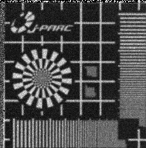
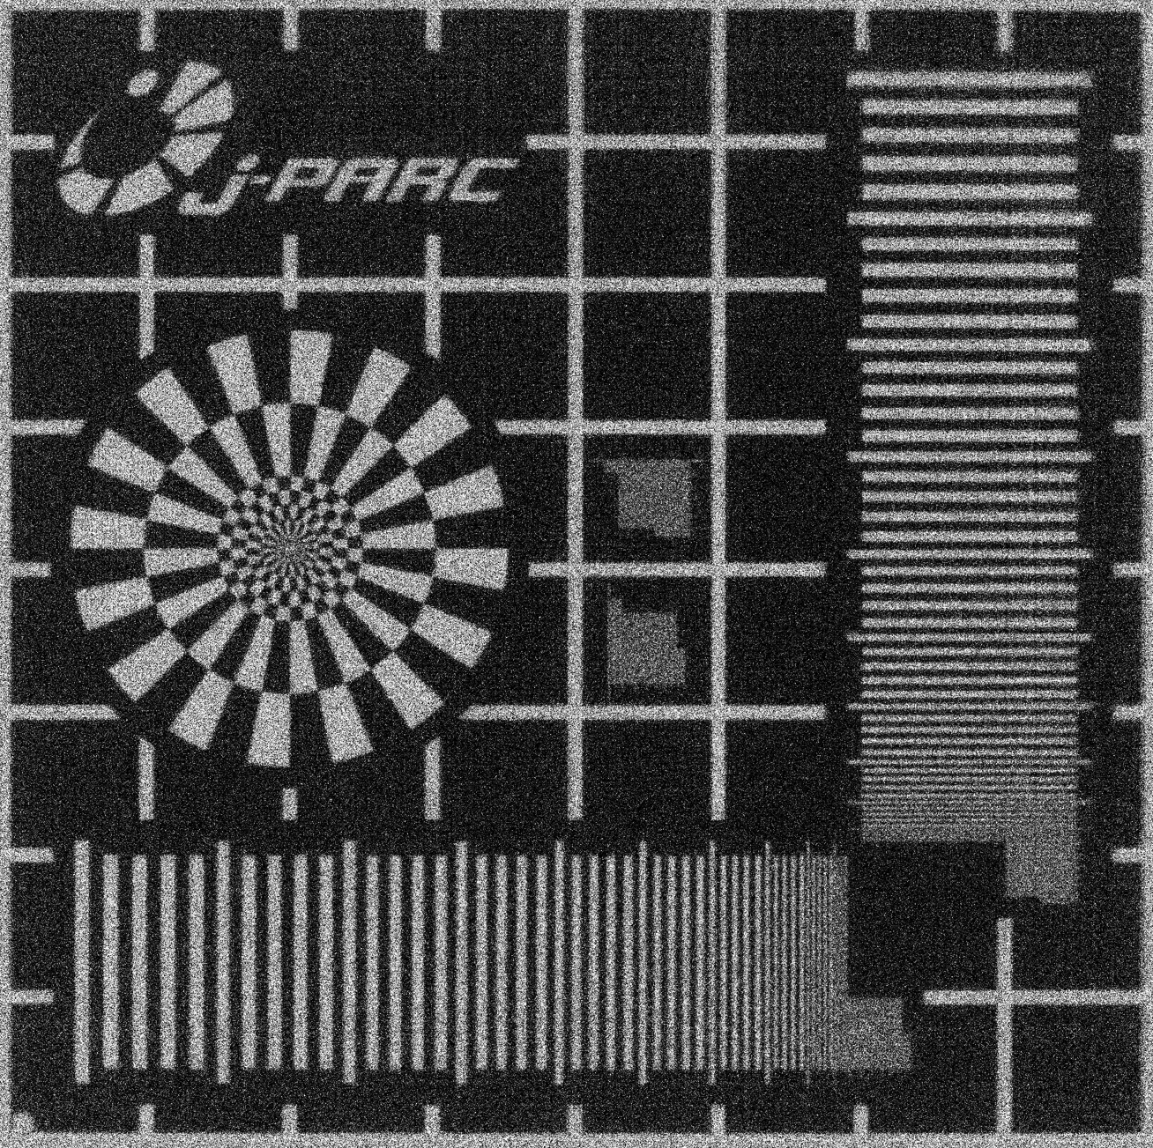
B-µNID and µNID
WCNR-11 4 Sep 2018 J. Parker
µNID: ³He converter
Larger event size but better position reconstruction
B-µNID (1.6atm)
Spatial resolution: 0.45 mm
µNID
Spatial resolution: 0.1 mm

Slide 37
B-µNID and nGEM
WCNR-11 4 Sep 2018 J. Parker
nGEM: similar boron-coating
Ar:CO₂ (90:10) at 1 atm
128 x 128 strips, 0.8 mm pitch
Spatial resolution about 1 mm
B-µNID (1.6atm)
Spatial resolution: 0.45 mm
nGEM
Spatial resolution: 1 mm

