Slide 1
Energy-resolved Neutron Imaging of Materials for Nuclear Energy
Kristian Myhre, Yuxuan Zhang, Hassina Bilheux, Jean-Christophe Bilheux, Jared Johnson, Andrew Miskowiec, and Rodney Hunt
Oak Ridge National Laboratory, USA
11th World Conference on Neutron Radiography
Sydney, Australia
September 3rd, 2018

Slide 2
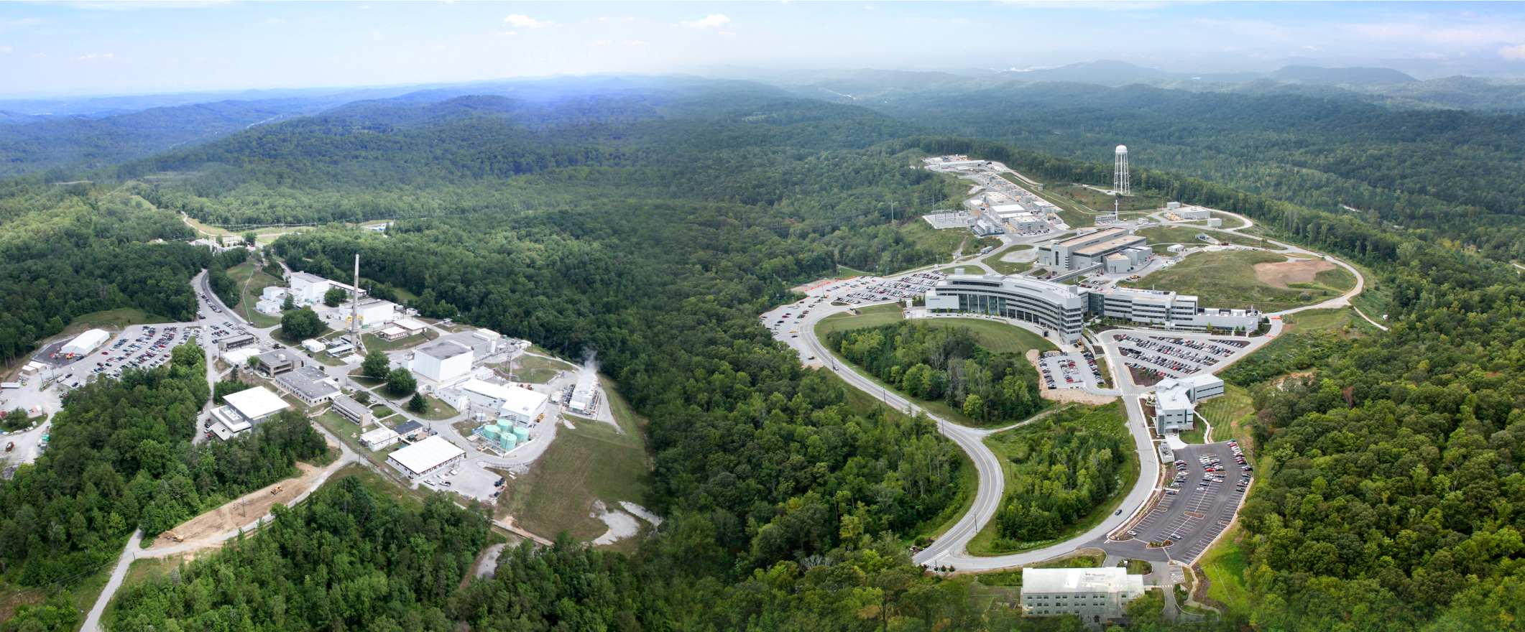
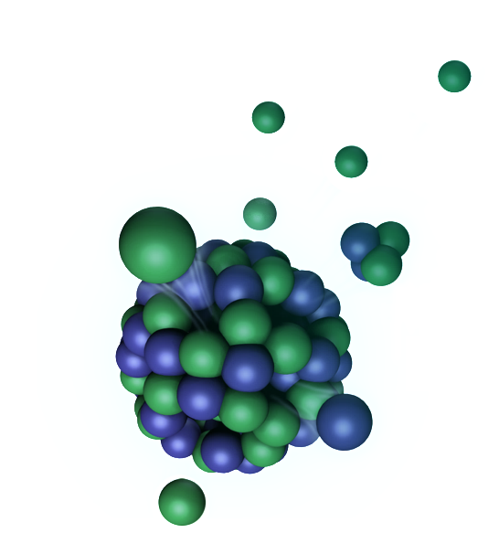
ORNL currently has two complimentary neutron sources with multiple imaging beamlines
High Flux Isotope Reactor
Spallation Neutron Source
CG-1D IMAGING (dedicated)
BL-3 SNAP (shared)
BL-10 VENUS (in planning)

Slide 3
The nuclear power industry faces significant material challenges for continued and increased use
Challenge areas include…
Structural materials
  Resistance to corrosion, radiation, high temperatures, and thermal cycling
  Qualification of repair procedures (i.e. welding) and new manufacturing methods (i.e. 3D printing)
Fuel materials
  Accident tolerance, high temperature, mixed oxide
Waste materials
  Long-term geological storage
Separation materials
  Mechanism, capacity, dynamics
Gross Global Electricity Production by Source
Information from the International Energy Association’s (www.iea.org) 2017 Electricity Information: Overview report.

Slide 4
Goal: Leverage ORNL’s key strengths to establish a unique characterization capability for nuclear science
Neutron sciences
Nuclear materials
Radiochemistry
Big data analysis
Accelerated development and deployment of nuclear technologies
Fuels and targets
Reactor materials
Waste
forms
Neutron sources
Radiological facilities
Computing resources

Slide 5
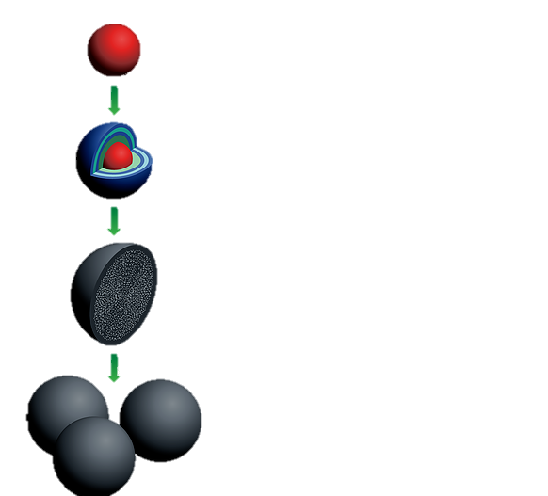
Understanding the production of uranium ceramic kernels for advanced nuclear fuels has been the focus of initial studies
Sol-gel production of UO₃ + C spheres
Conversion to UO₂ + UC₂
  Option secondary conversion (i.e. nitride)
Kernel selection
Fluidized bed CVD to deposit buffer, PyC, and SiC layers
TRISO particle selection
Embedment of TRISO particles in graphite
Pebble selection
Uranium ceramic kernel
~500 micron Ø
Uranium ceramic kernel
~1000 micron Ø
Graphite pebble
~6 cm Ø
~25,000 TRISO particles/pebble
Pebble bed
~100,000 to 200,000 pebbles/reactor
Image from: https://www.nextbigfuture.com/2017/03/startup-x-energy-has-started-design-of.html

Slide 6
Understanding the production of uranium ceramic kernels for advanced nuclear fuels has been the focus of initial studies
Sol-gel production of UO₃ + C spheres
Conversion to UO₂ + UC₂
  Option secondary conversion (i.e. nitride)
Kernel selection
Fluidized bed CVD to deposit buffer, PyC, and SiC layers
TRISO particle selection
Embedment of TRISO particles in graphite
Pebble selection
Uranium ceramic kernel
~500 micron Ø
Uranium ceramic kernel
~1000 micron Ø
Graphite pebble
~6 cm Ø
~25,000 TRISO particles/pebble
Pebble bed
~100,000 to 200,000 pebbles/reactor
Image from: https://www.nextbigfuture.com/2017/03/startup-x-energy-has-started-design-of.html

Slide 7
Understanding the production of uranium ceramic kernels for advanced nuclear fuels has been the focus of initial studies (continued)
Important characteristics neutron imaging could provide
Morphology/Structure
  Layer thickness, voids, cracks, kernel sphericity and displacement
Concentrations
  Elemental, isotopic, phase
Density
Crystal phases
OPyC
SiC
IPyC
buffer
kernel
Illustration of the layer structure of a TRISO particle.

Slide 8
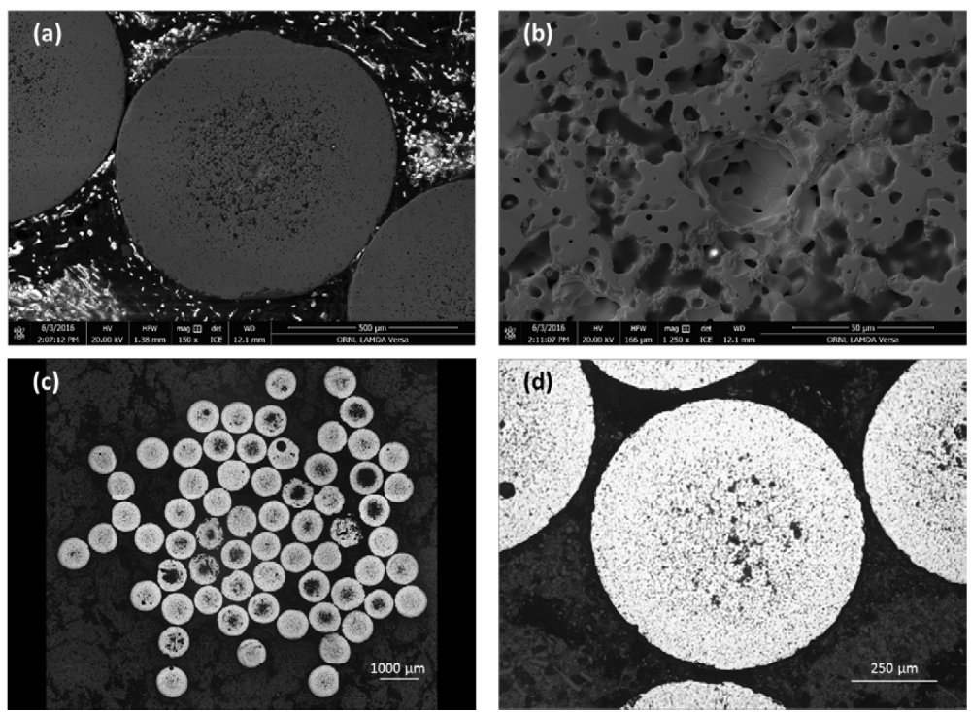
Electron and optical microscopy techniques have traditionally been used for characterization
Key difficulties with these techniques include
Only provide 2D slice
  No profiling throughout sphere
Destructive and damaging sample preparation required
  Difficulties identifying real and unreal defects/features
Images from ORNL report ORNL/SR-2016/268 by J. McMurray et al. 2016

Slide 9
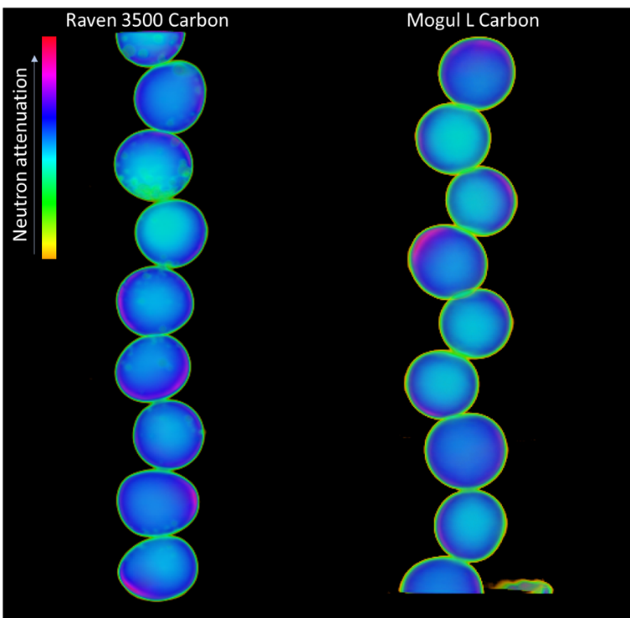

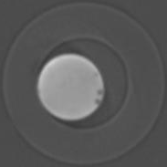
Total attenuation based CT measurements show defects due to different carbon feedstocks
Mogul L Carbon
Raven 3500 Carbon
Defects are clearly seen as dark spots
1 mm
1 mm
2D still images looking at the XZ plane
2D slices moving down the Z axis
Measurements were performed at the HFIR CG-1D beamline

Slide 10
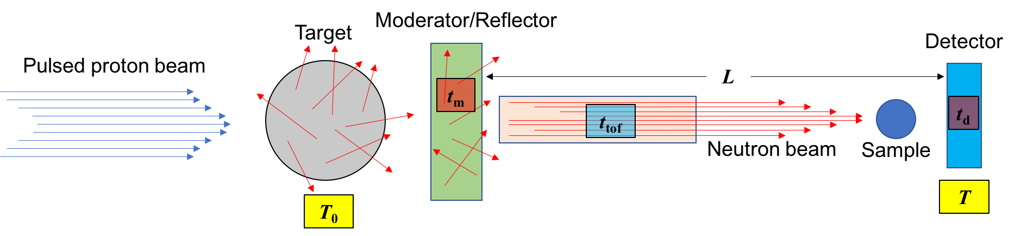
Energy-resolved neutron imaging (ERNI) at a pulsed neutron source can obtain a wealth of spatially resolved information
Cold spectrum
Epithermal spectrum
Bragg edge imaging
Energy resonance imaging
Crystal phases, strain, stress
Isotopics
What we measure
I_{T} (x, y)

Slide 11
The workflow for ERNI measurements is being streamlined and automated
Plan Experiment
Data Acquisition
Post-processing
Calibration
Peak Indexing
Peak fwhm fitting by Gaussian or Lorentzian
Reconstruction
Visualization
Use ImagingReso to predict resonance signal
Angle steps (5°)
Acquisition time per angle (2hr)
Angular coverage (180°)
Use projections for reconstruction of each element using iMars3D or Octopus
Sum images for open beam
Dragonfly
Seg3D
Sum peak images for each element

Slide 12
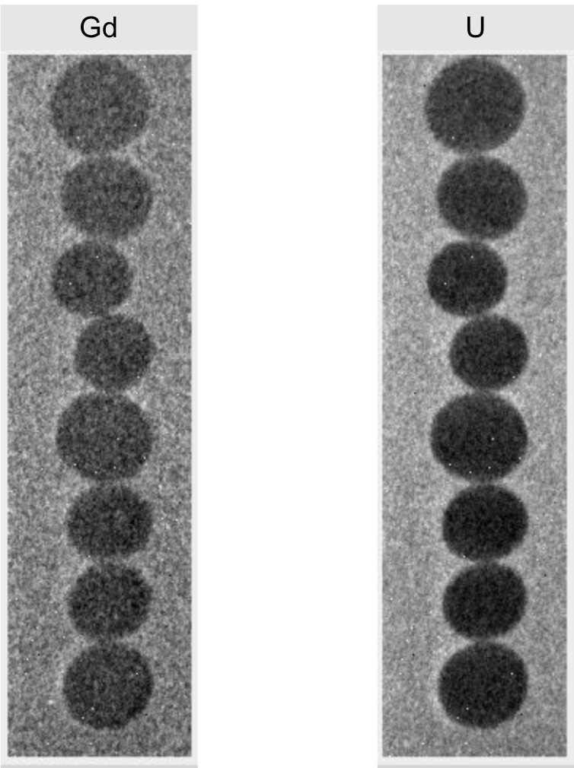
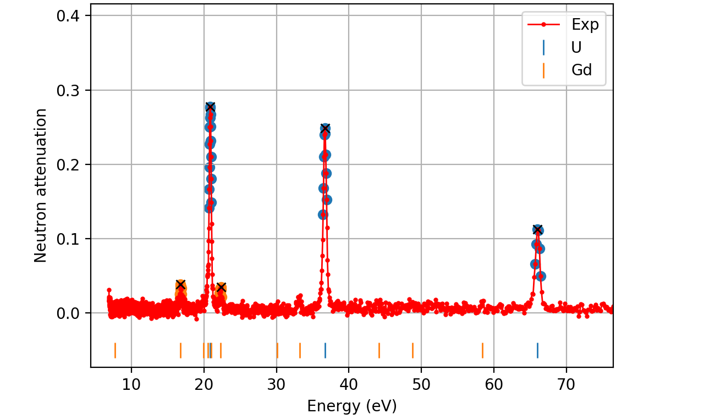
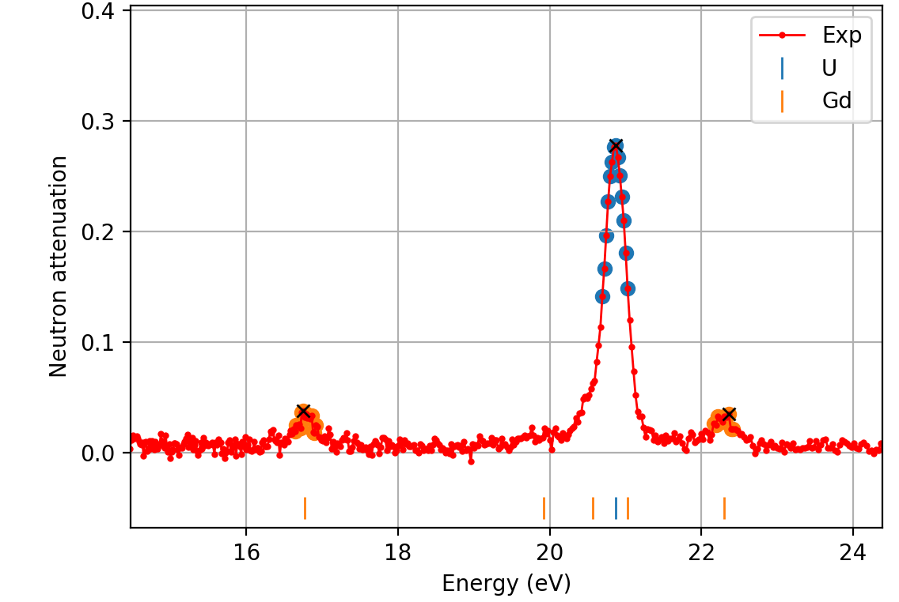
ERNI was used to map the Gd and U distribution in 3D
Left: Radiographs produced by summing peaks for Gd and U
Bottom: Resonance spectra from the whole sample region from (A) 5 to 75 eV and (B) 15 to 24 eV
Gd
U
A
B
Measurements were performed at the SNS SNAP (BL-3) beamline

Slide 13
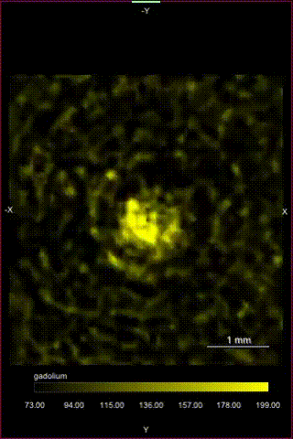
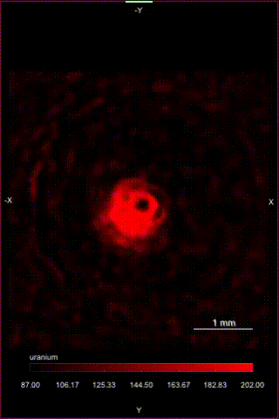
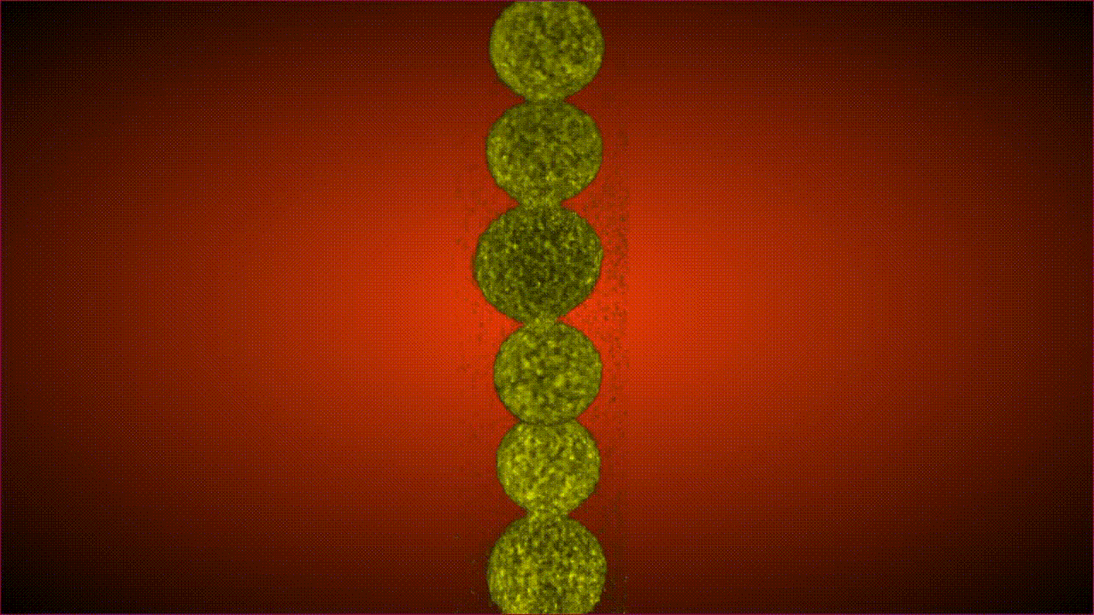
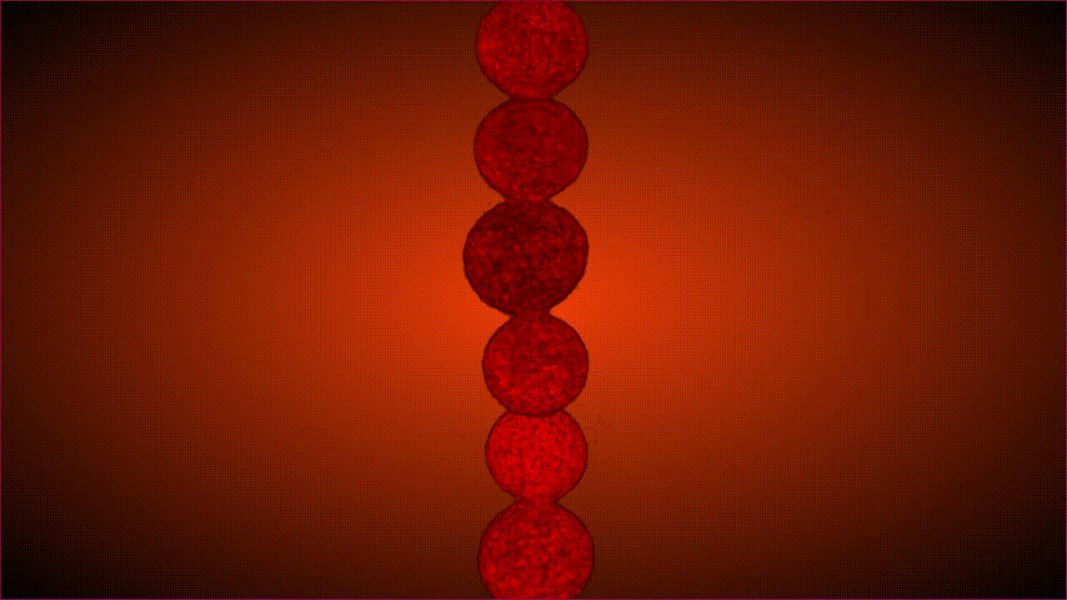
ERNI was used to map the Gd and U distribution in 3D (continued)
Gd
U

Slide 14
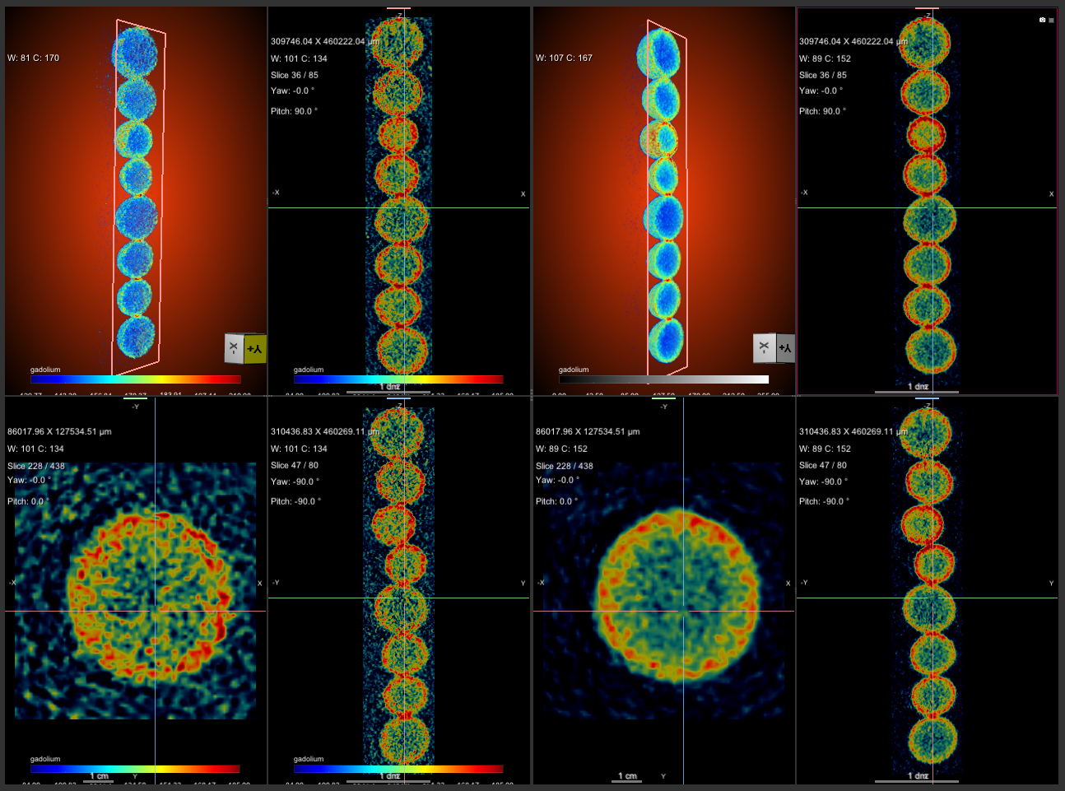
ERNI was used to map the Gd and U distribution in 3D (continued)
Gadolinium
Uranium
Tomographic reconstructions of the gadolinium (left) and uranium (right) content throughout imaged UO₃-Gd₂O₃ spheres. Advanced reconstruction methods are currently being explored for improved signal-to-noise.

Slide 15
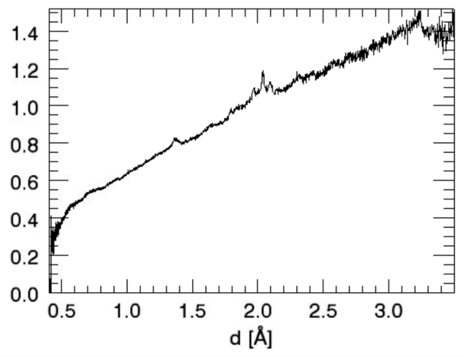
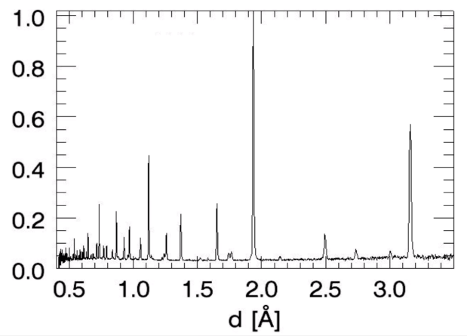
The conversion of kernels from oxide to carbide has been measured by Bragg-edge imaging
UO₃-C
UO₂-UC₂
UO₃-C
UO₂-UC₂
UO₂ (111)
A
B
UO₂ (220)
UO₃ (122)
Neutron diffraction data of uranium kernels before (A) and after (B) conversion from oxide to carbide.
Bragg edge spectra from 2D measurements of uranium kernels before (blue line) and after (red line) conversion from oxide to carbide.

Slide 16
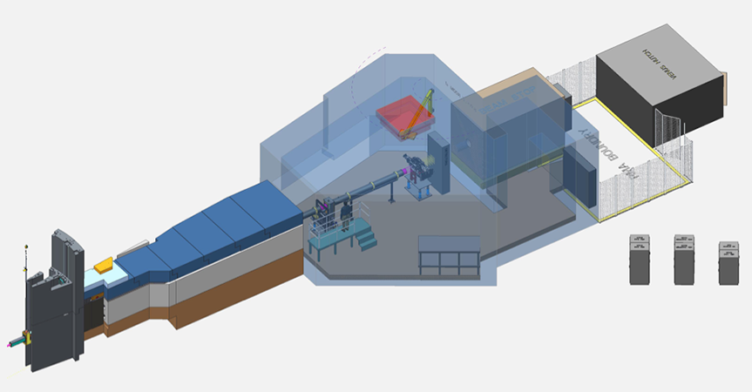
Future: a new neutron imaging beamline is currently being built at the SNS called VENUS
Estimated Beam Characteristics
Beam Spectrum | Epithermal, Thermal, Cold
Moderator | H2 decoupled poisoned (sharpest pulse at the SNS)
Wavelength bandwidth | ~ 2.4 Å (Time-of-Flight mode)
Spatial resolution | < 15 microns (a few microns with magnification)
Resolution Δd/d | 0.12%
Source-to-detector distance | 25 meters
Sample-to-detector distance | A few mm to tens of cm
Detection system | Camera and Micro-Channel Plate TOF detector
Flux on sample (n/s/cm²) | 1 x 10⁷ in TOF mode 1 x 10⁸ in white beam mode
Field of view | Up to 20 cm by 20 cm
Schematic representation of the Versatile Neutron Imaging Instrument (VENUS) currently planned for construction at the SNS first target station.

Slide 17
Acknowledgements
Anton Tremsin
Louis Santodonado
Jake McMurray
Tyler Reif
Jamie Molaison
Funding
Research sponsored by the Laboratory Directed Research and Development Program of Oak Ridge National Laboratory, managed by UT-Battelle, LLC, for the U. S. Department of Energy.
Beam time
This research used resources at the High Flux Isotope Reactor and the Spallation Neutron Source, a DOE Office of Science User Facility operated by the Oak Ridge National Laboratory.

Slide 18
Thank you!
Questions?

