Slide 1
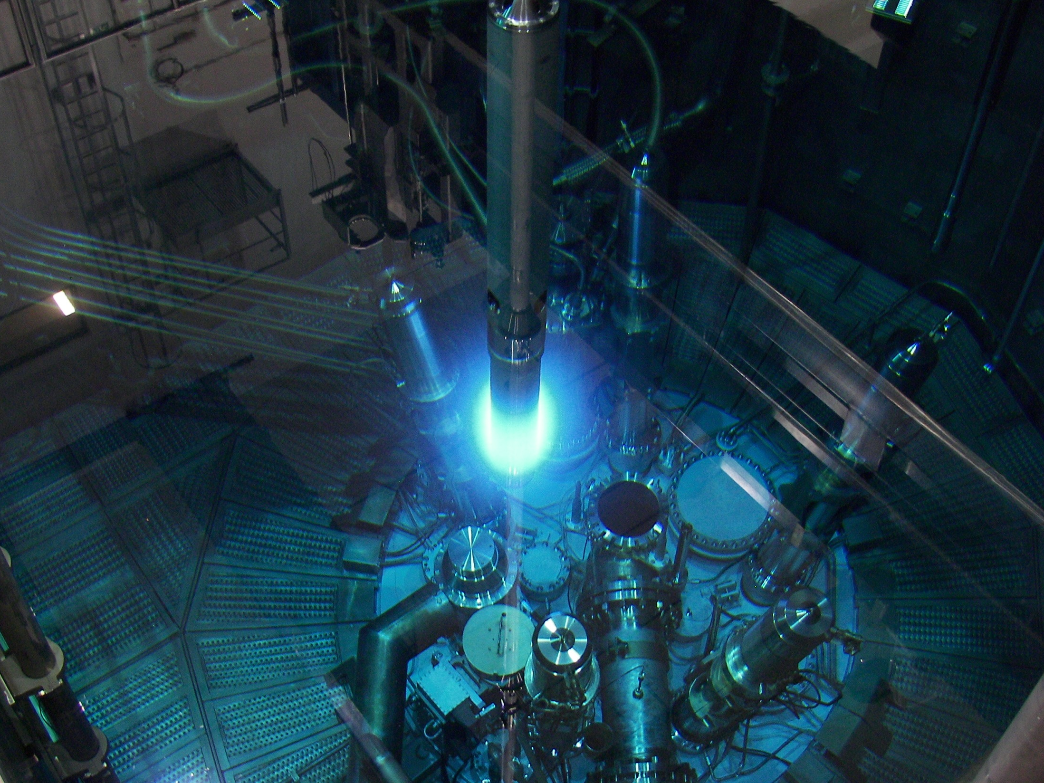
Epithermal neutron radiography and tomography on large and strongly scattering samples
Burkhard Schillinger
Heinz Maier-Leibnitz-Zentrum, Technische Universität München, Germany
Aaron Craft
Idaho National Laboratory, USA
B.Schillinger
1
Notes:
1

Slide 2
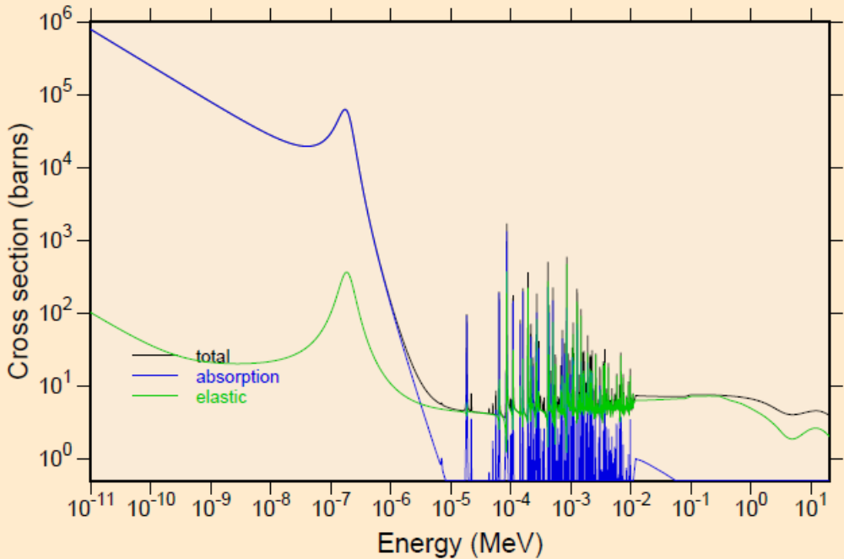
Standard neutron imaging is performed with a thermal or cold spectrum.
Sometimes, penetration of thermal/cold neutrons is not enough for thick samples.
It is worth trying the higher energy end of the spectrum.
1-2 mm cadmium cuts off all
energies lower than 0.4 eV .
Transparent for higher
energies, epithermal neutrons.
¹¹³Cd
B.Schillinger, A. Craft
2
Notes:
2

Slide 3
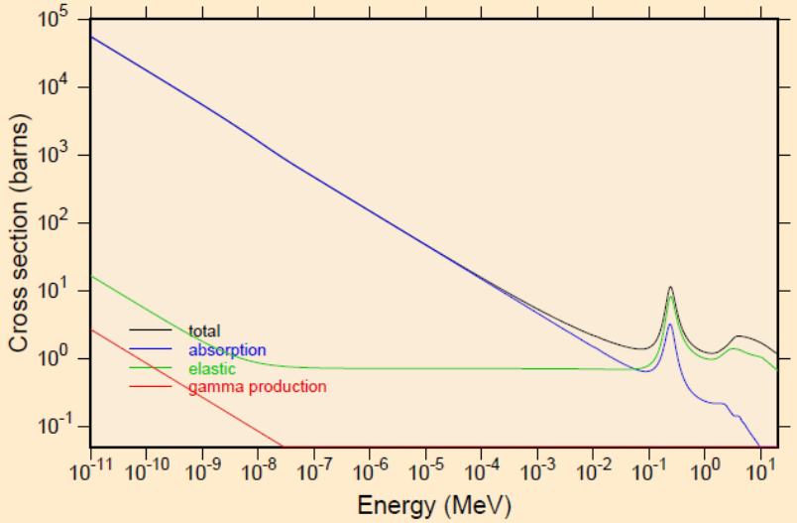
Epithermal neutrons:
Definitions vary, depicting energies beyond the Cd edge at 0.4 eV to a few hundred eV or up to tens of keV.
Since most times, a standard ⁶LiF+ZnS neutron screen is used, and the Li cross section follows 1/v, the visible neutron energies may be in the range 0.4...100eV - rather lower than higher.
Epithermal neutron energies
produce no wonders, but show
improvement in penetration.
⁶Li
B.Schillinger, A. Craft
3
Notes:
3

Slide 4
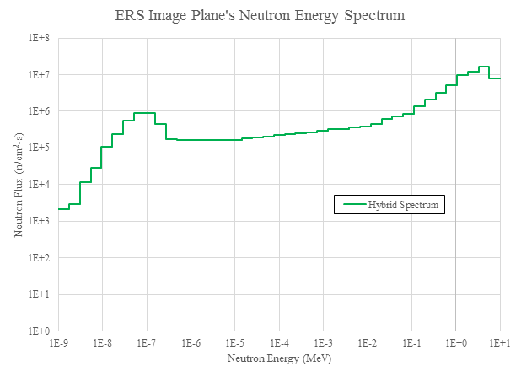
¹¹³Cd
neutron energy spectrum from reactor
full energy spectrum neutron beam
from reactor
cadmium foil
filters out
thermal neutrons
epithermal
and fast
neutron beam
detector
object
B.Schillinger, A. Craft
Notes:
4
Could be an introductory slide for topic

Slide 5
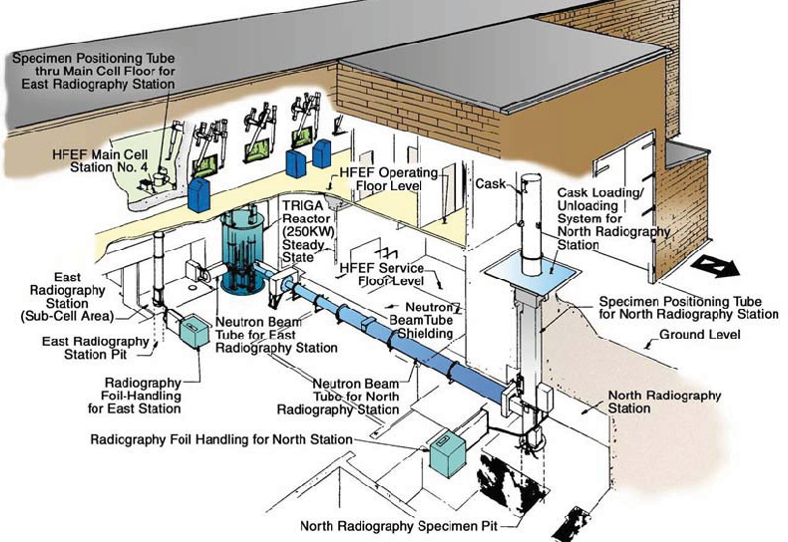
INL Facilities (250 kW core)
Radial beam directly on the core to maximize epithermal flux.
B.Schillinger, A. Craft
Notes:
5
Layout of INL‘s NRAD Reactor.

Slide 6
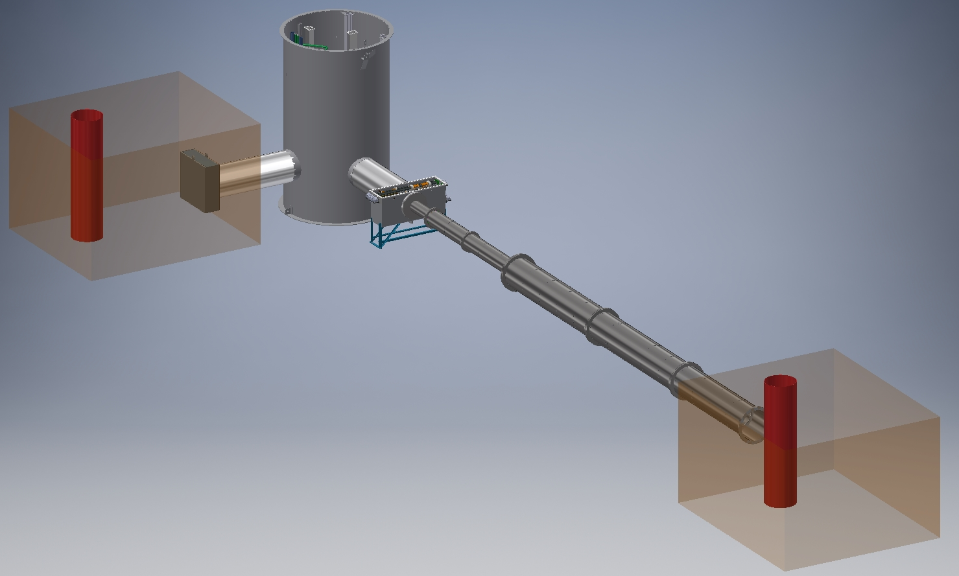
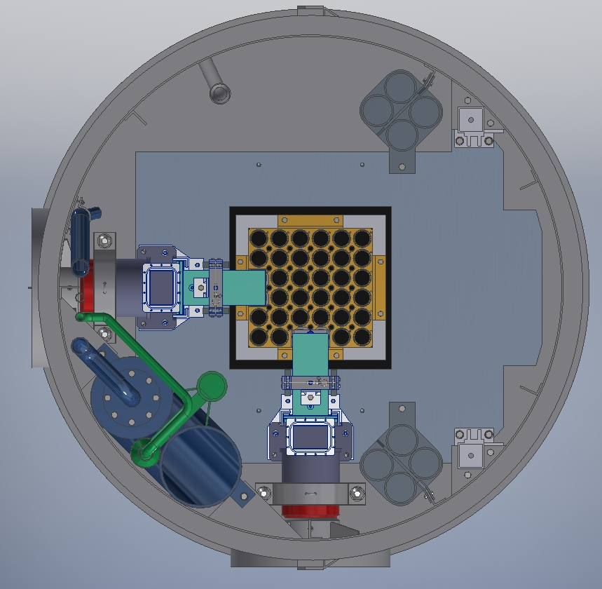

INL Facilities (250 kW core)
Hot
Cell
NRAD Reactor
East
Radiography Station
North
Radiography Station
Radial beam directly on the core to maximize epithermal flux.
Notes:
6
Layout of NRAD beams.

Slide 7
Energy Range | Neutron Flux [n/cm²s]
thermal (0–0.025 eV) | 1.8×10⁶
epithermal (0.025–25 eV) | 2.9×10⁶
intermediate (25 eV–1 MeV) | 1.74×10⁷
fast (1–10 MeV) | 4.85×10⁷
total: | 7.06×10⁷
B.Schillinger, A. Craft
Notes:
7
Energy spectrum of INL‘s east neutron beam

Slide 8
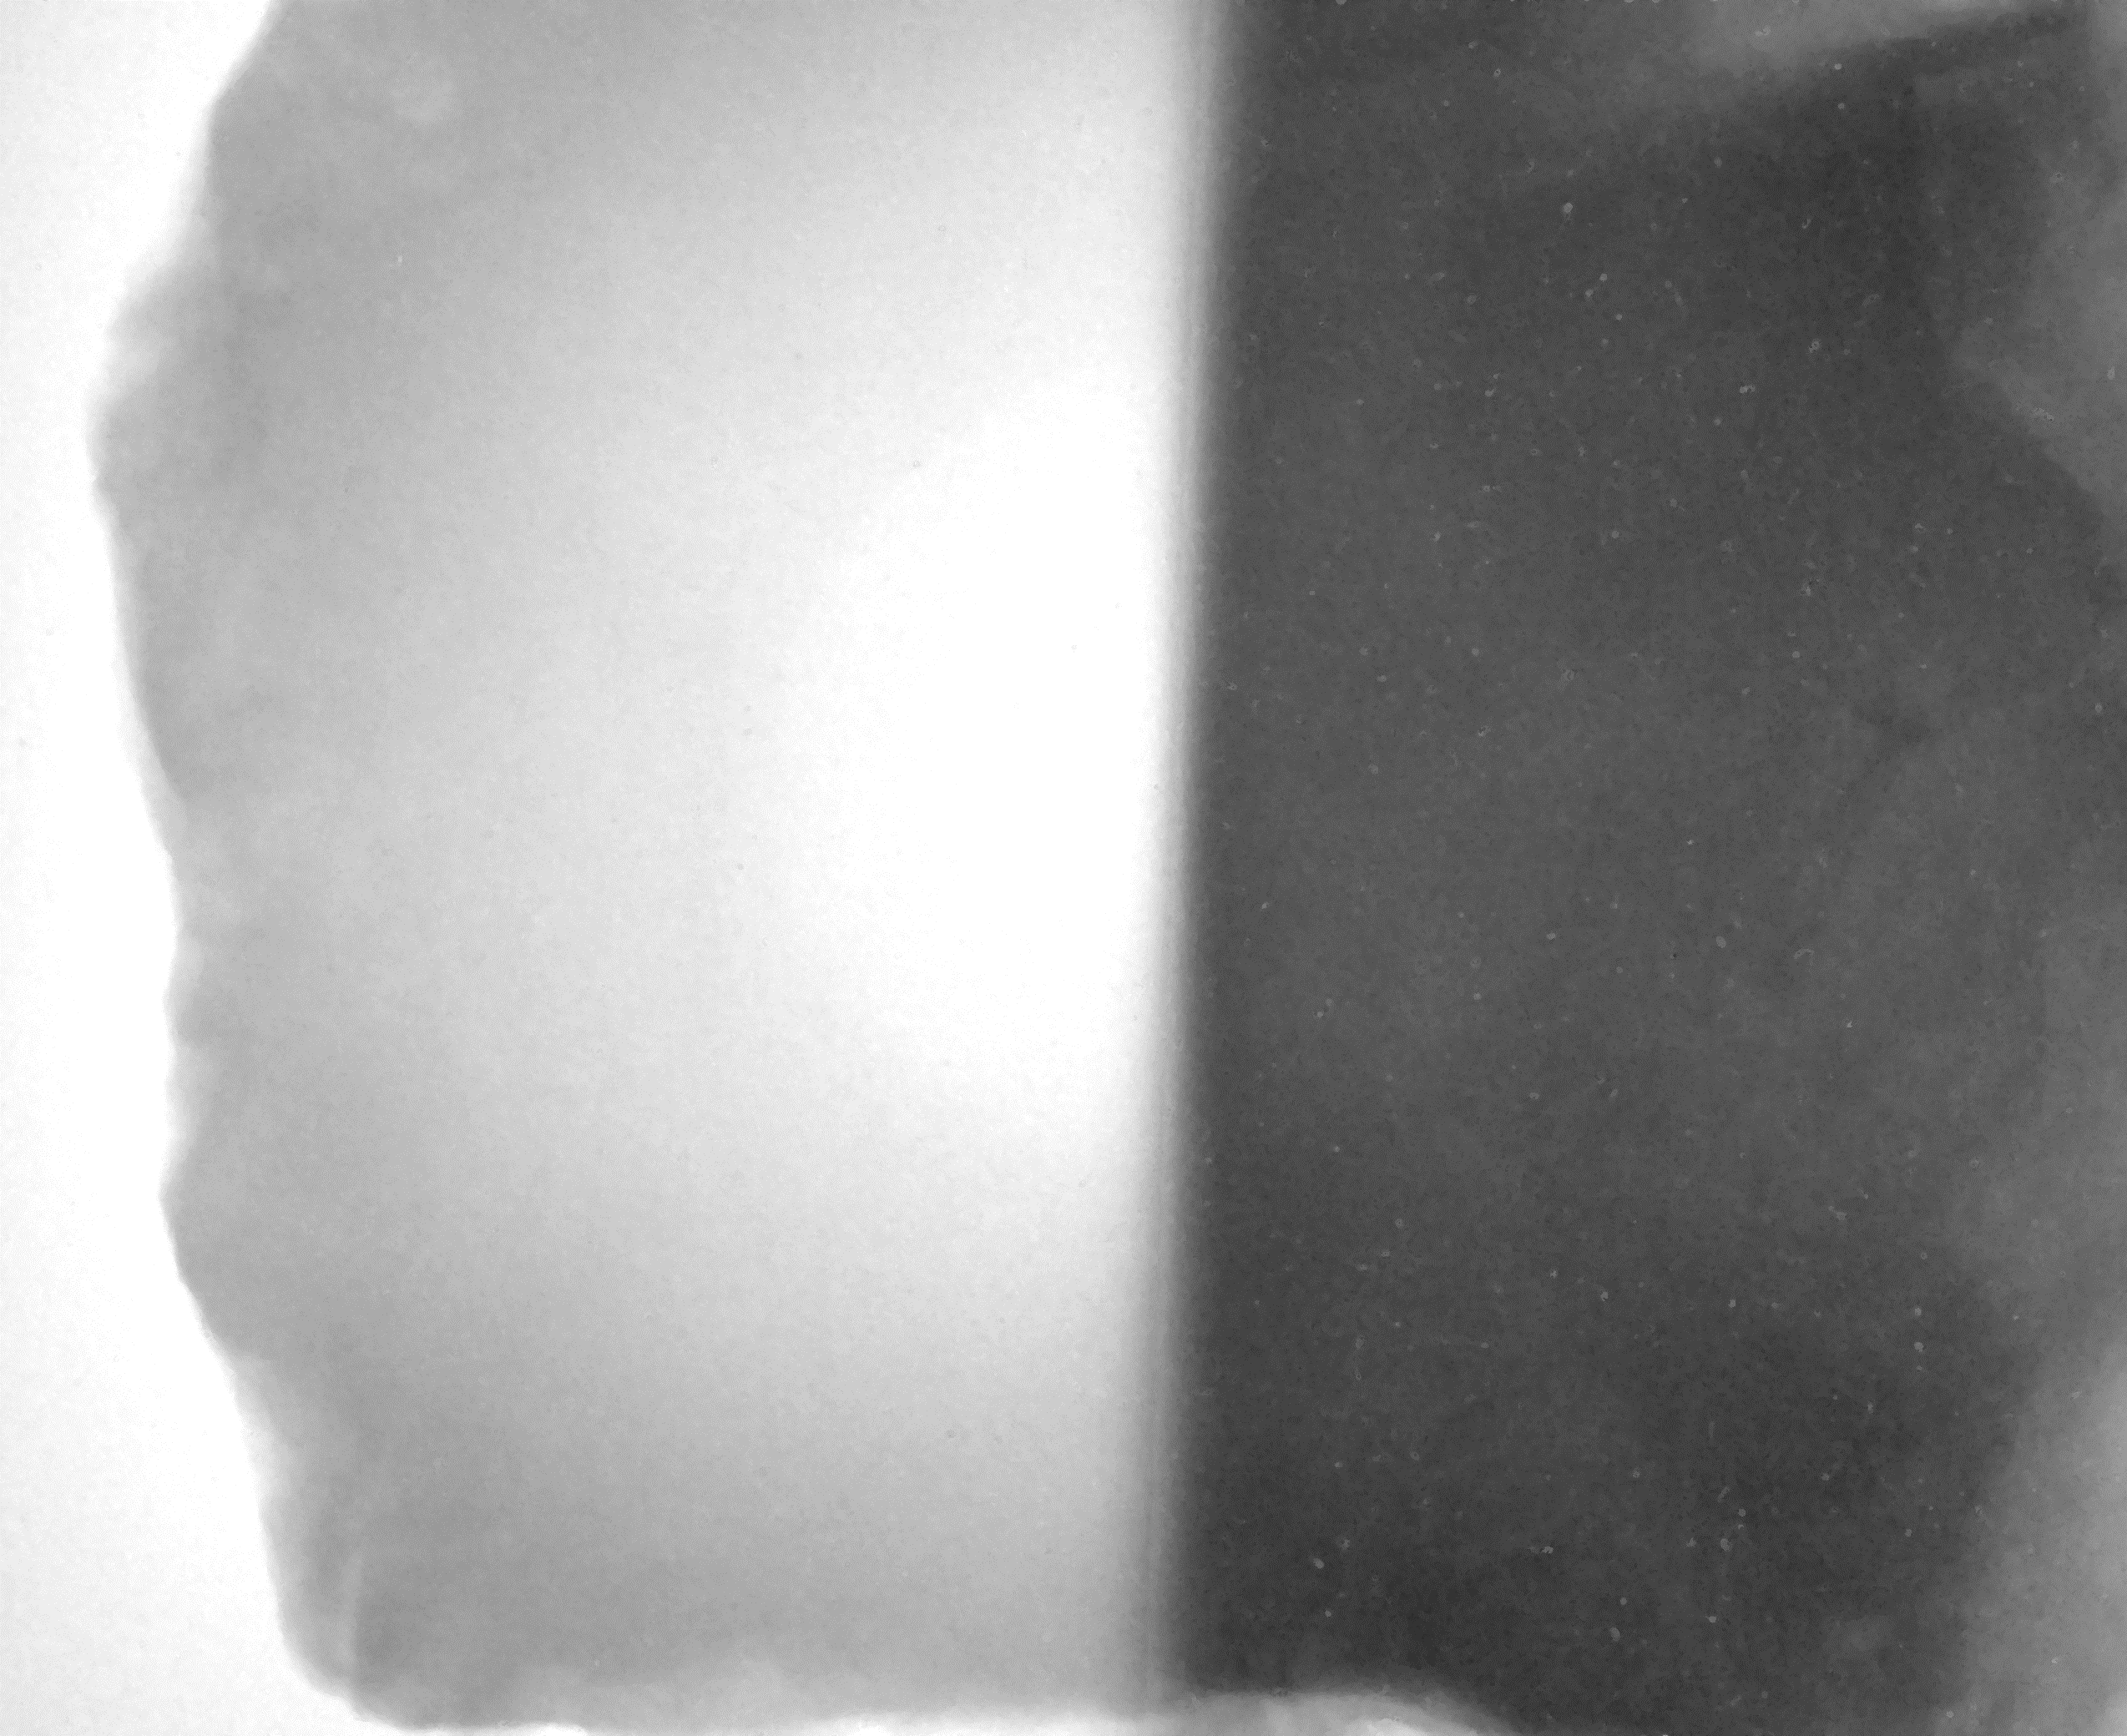
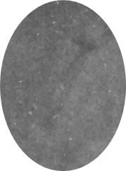
Initial tests were promising
Measurements at INL North Station
Thermal neutron radiographs of this same rock had too much scatter and too little penetration to provide a useful neutron radiograph.
This rock sample contains crystal water, which scatters and thermalizes neutrons.
Exposure time = 10 minutes
A brass screw behind the rock becomes visible, though faint.
Double Cd-filter offers some improvement.
Cd-filtered beam
Cd-filtered beam
AND
Cd on detector
B.Schillinger, A. Craft

Slide 9
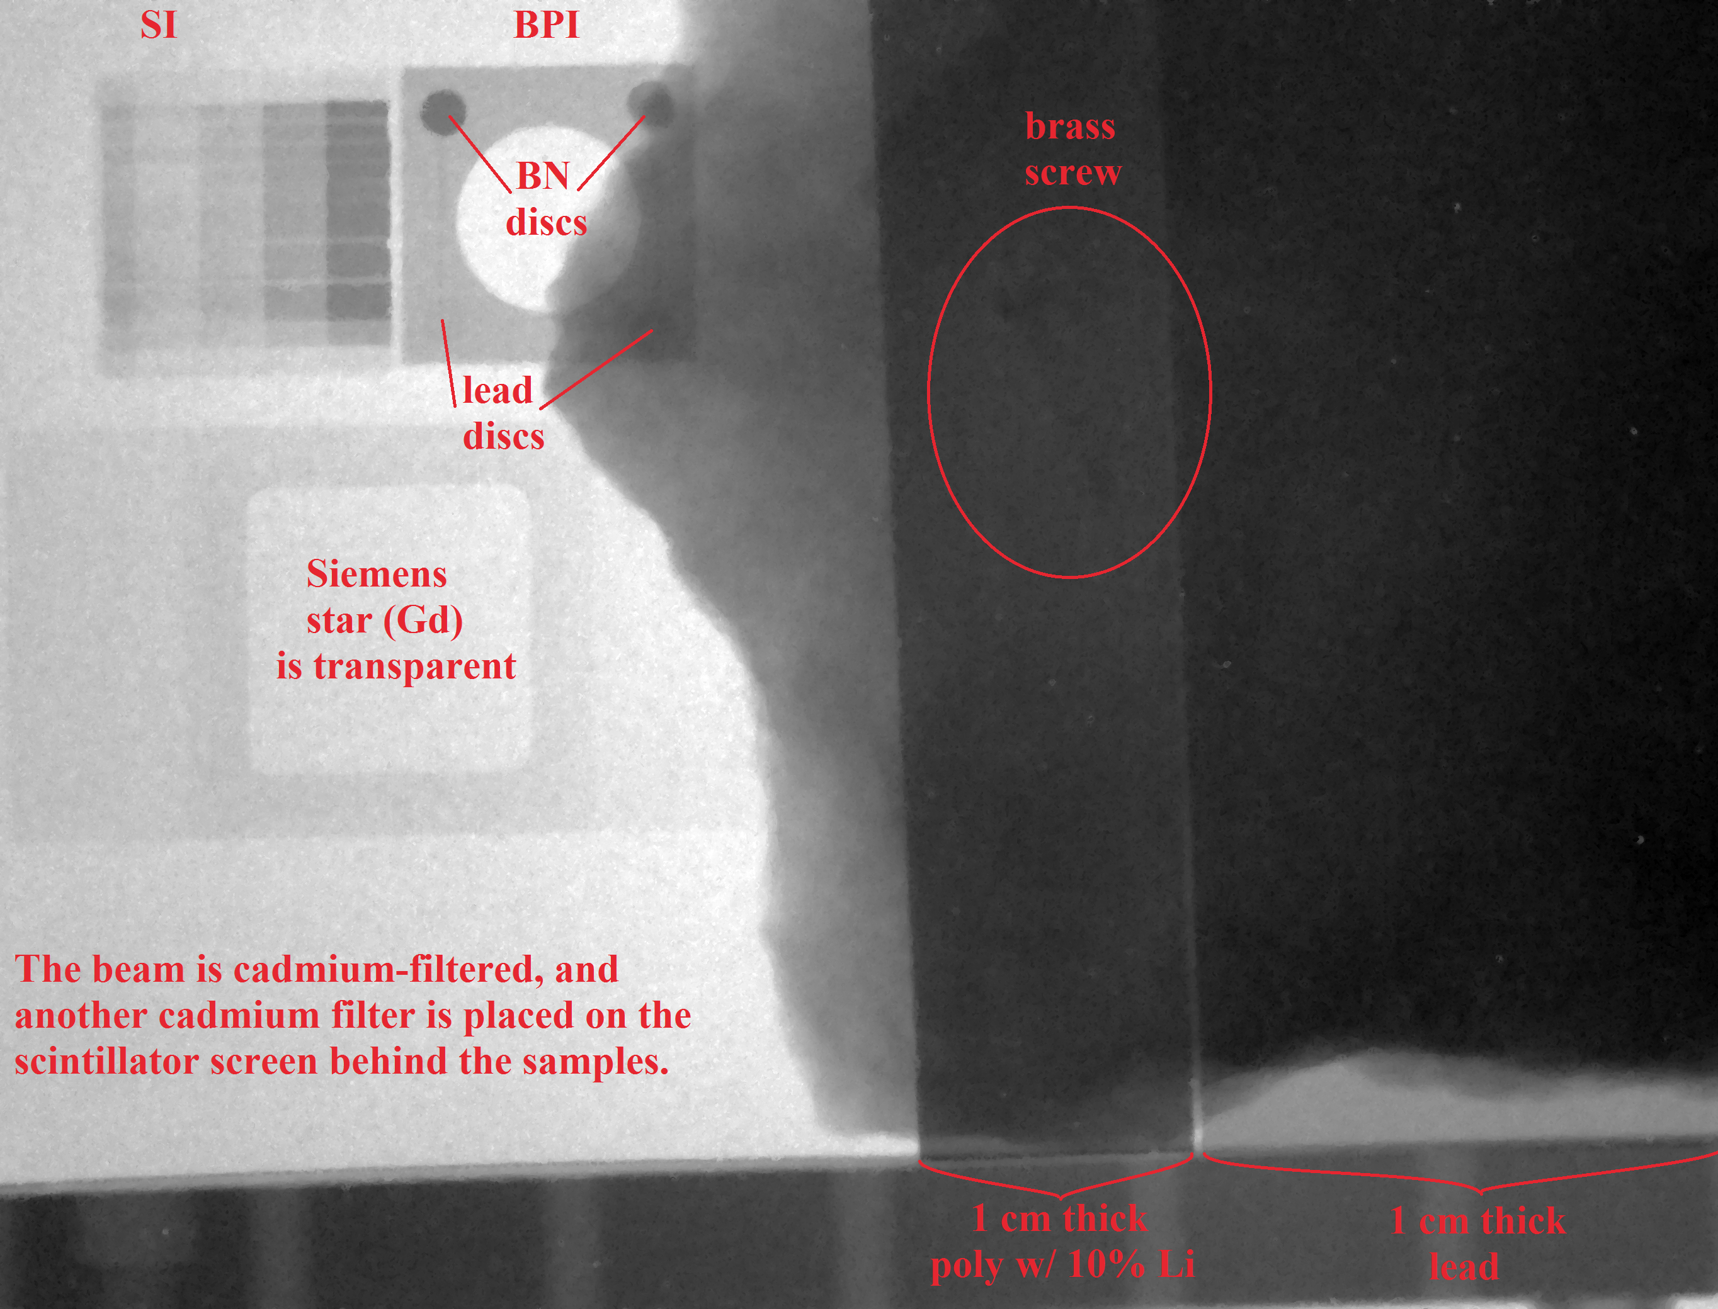
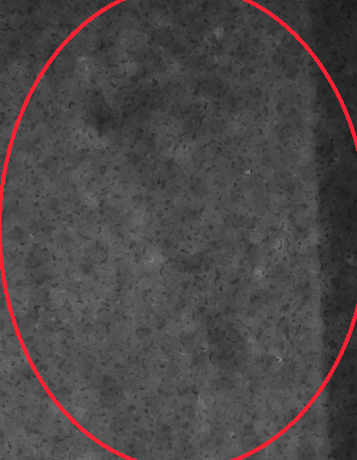
Initial tests were promising
Exposure time = 10 minutes
Cadmium-filtered beam AND on detector
The lithiated poly attenuates more strongly than lead, and the boron nitride discs in the BPI are clearly visible while the lead discs are not
  Indicates that this is primarily a neutron image, not a gamma image.
A brass screw behind the rock and lithiated poly are visible, though faint.
B.Schillinger, A. Craft

Slide 10
Initial tests were promising
Potential applications include:
  Large fuel bundles.
  Large fossils that are simply too thick for thermal neutrons to penetrate.
  Smaller fossils in rock containing highly-attenuating minerals for thermal neutrons such as crystal water content and high iron concentration.
  Study water migration through large soil or rock specimens.
    Experiments need to be large enough to be meaningful, which is often too thick for thermal neutrons.
    Potentially applicable for studies related to Yucca Mountain.
Initial efforts have also shown fast neutron imaging to be feasible at NRAD.
B.Schillinger, A. Craft

Slide 11
Epithermal neutrons at FRM II:
The FRM II ANTARES beam tube sits directly on the cold source, filled with liquid D₂
The FRM II NECTAR beam tube sits directly on the 80 kW uranium converter plate for fast neutrons, or has a near-radial view to the reactor core when the converter is removed.
For epithermal imaging, a 1 mm Cd sheet is used as a filter, and a standard ⁶LiF+ZnS screen is employed
B.Schillinger, A. Craft
11
Notes:
11

Slide 12
Cross section of the FRM II reactor block
Cold source
cold neutrons (Radiography)
Positrons
thermal neutrons
Cold neutrons
ultra cold neutrons
Neutron guides
Converter plate
Fast neutrons
Tumor therapy
Radiography
Reactor core
hot neutrons
B.Schillinger
12
Notes:
12

Slide 13
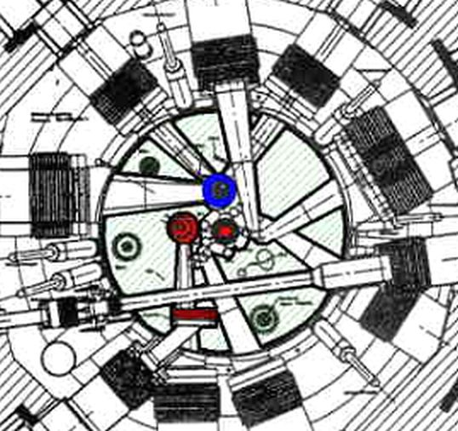
Cross section of the FRM II reactor block
Cold source
cold neutrons (Radiography):
tangential
Converter plate
Reactor core
Fast and/or thermal neutrons
(Radiography):
Radial view to converter plate
near-radial view to core
B.Schillinger
13
Notes:
13

Slide 14
Epithermal neutrons:
The cold source of FRM II is undermoderated – not fully thermalized
Optimized for maximum cold neutron output
Some remaining epithermal neutron flux is transmitted even through the cold source
Through the cold source, ANTARES has a tangential view past the core
B.Schillinger
14
Notes:
14

Slide 15
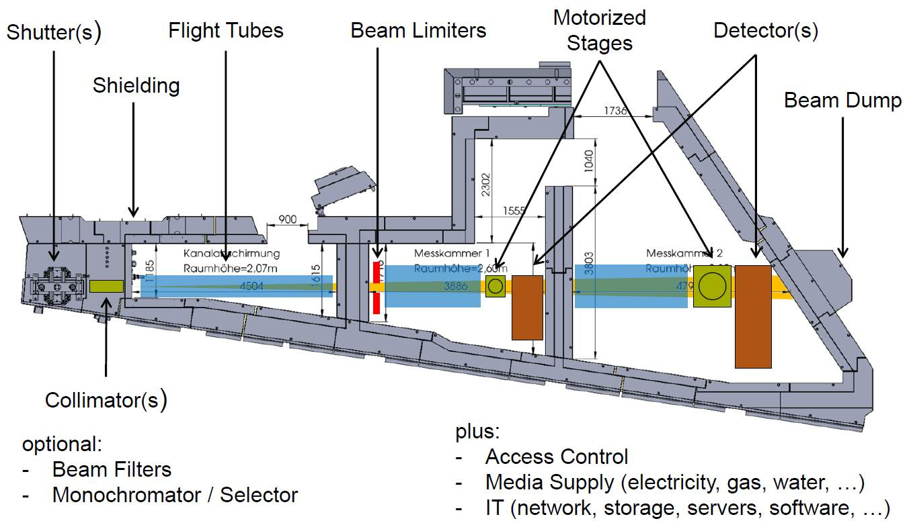
The ANTARES facility for neutron imaging at FRM II
Wenn eine neue Folie
NINMACH 2017, Budapest, Oct 11-13, 2017 Burkhard Schillinger
15

Slide 16
Epithermal neutrons:
The NECTAR facility can have a converter plate inserted at the beam tube end that produces fission neutrons (80 kW thermal power)
High penetration, but low resolution with plastic scintillator
LiF+ZnS scintillator does not work for fast neutrons.
With the converter plate removed, a thermal beam is available for imaging
With 1 mm Cd filter, the resulting image on a ZnS+LiF screen shows PE transparent, and lead opaque, even with 7.5 cm lead filter – so the beam has a huge gamma content.
A bismuth filter will be added in the future
B.Schillinger
16
Notes:
16

Slide 17
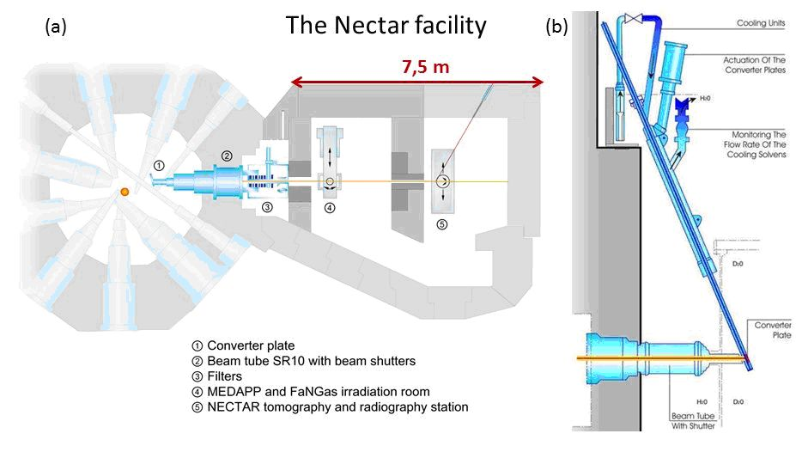
The NECTAR facility for fission neutrons, (a) a sketch of the beamline, (b) the enriched uranium converter plate position
B.Schillinger
17
Notes:
17
Neutron radiography and tomography facility Antares consist principally of:

Slide 18
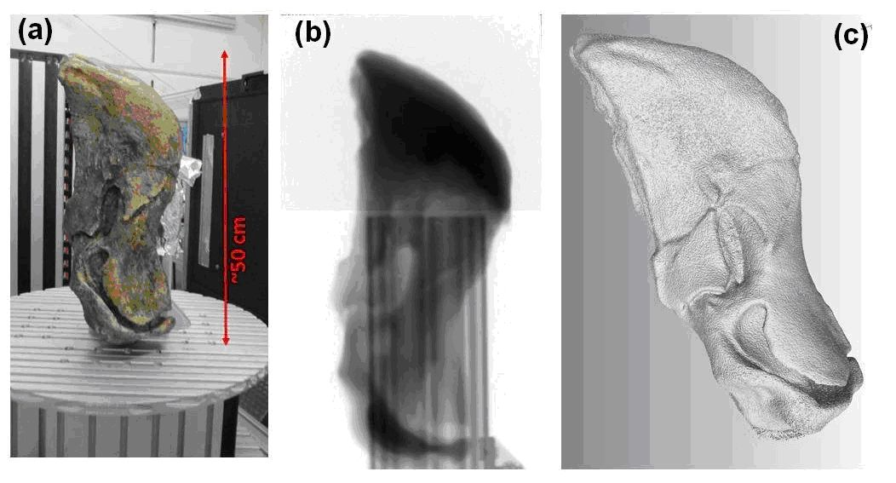
Fast fission neutron tomography at NECTAR of the lower jaw of Stahleckeria potens (a), photograph; (b), a single projection (stitched two normalized radiographs); (c), 3D visualization of the reconstructed object
B.Schillinger, A. Craft
18
Notes:
18
Neutron radiography and tomography facility Antares consist principally of:

Slide 19
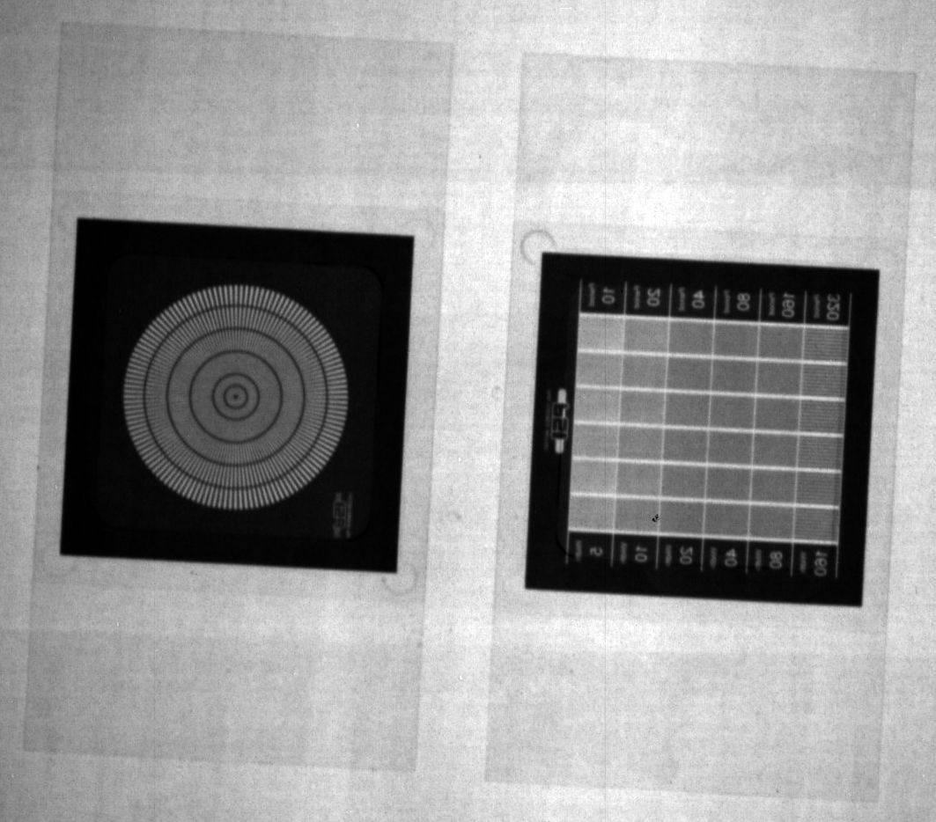
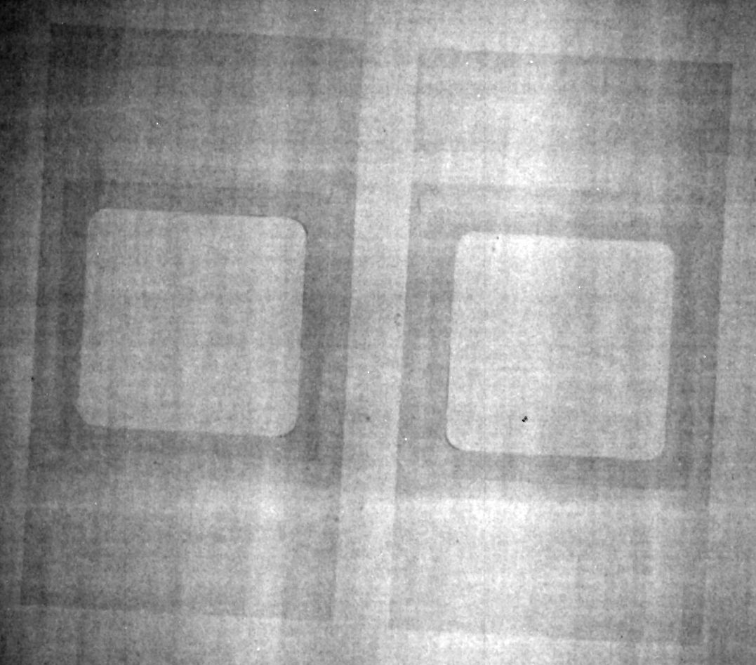
Measurements at ANTARES
Cold radiography
Epithermal radiography
Gd test pattern in holder –
Gd is transparent for epithermal neutrons.
B.Schillinger, A. Craft

Slide 20
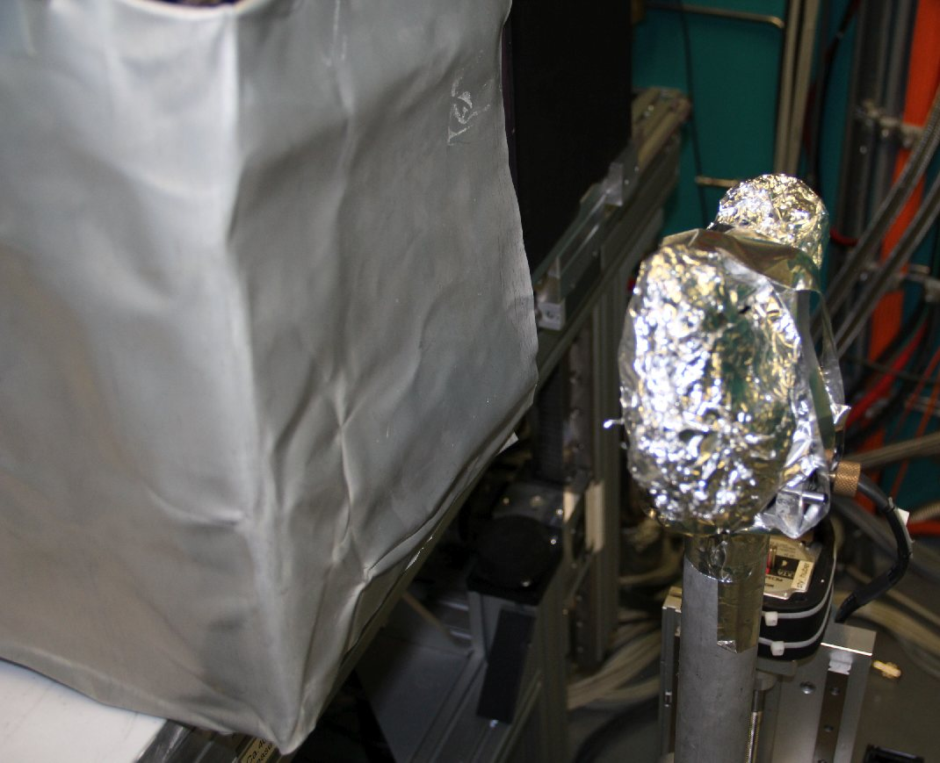
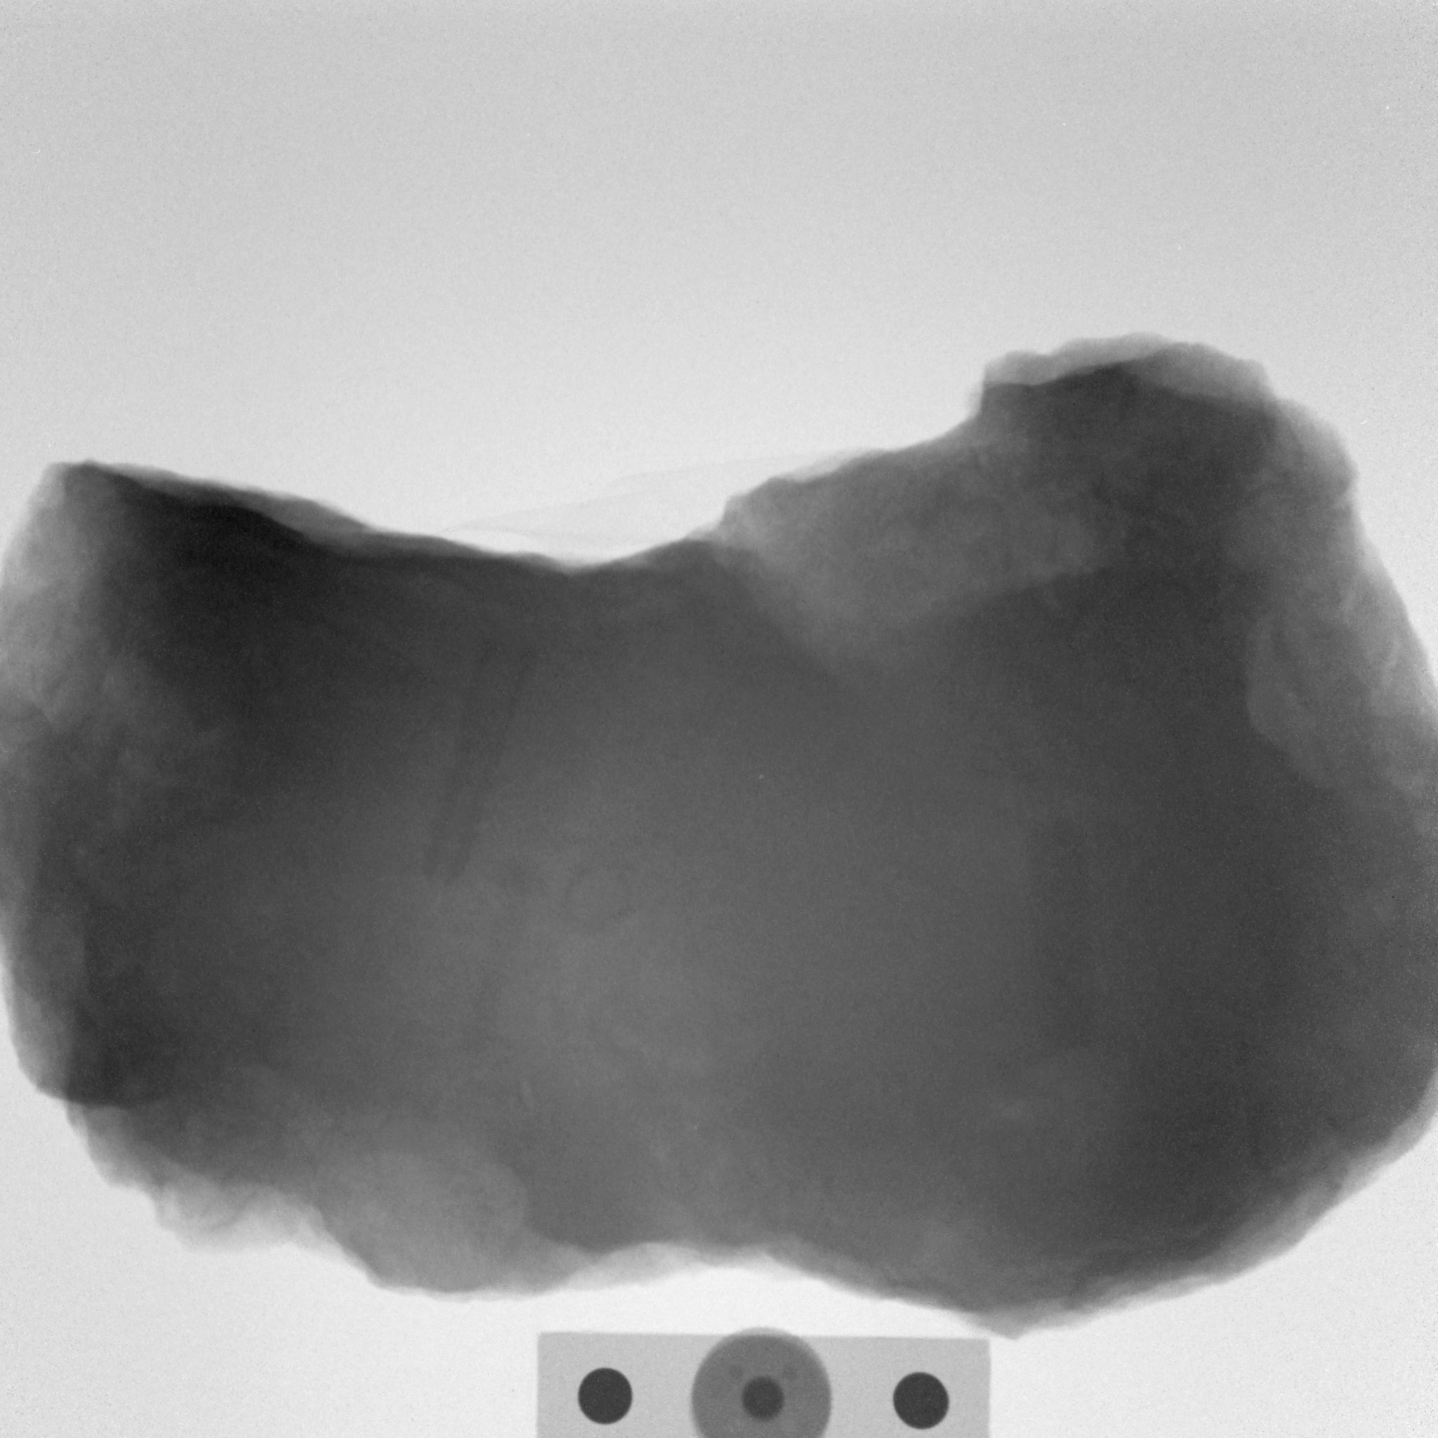
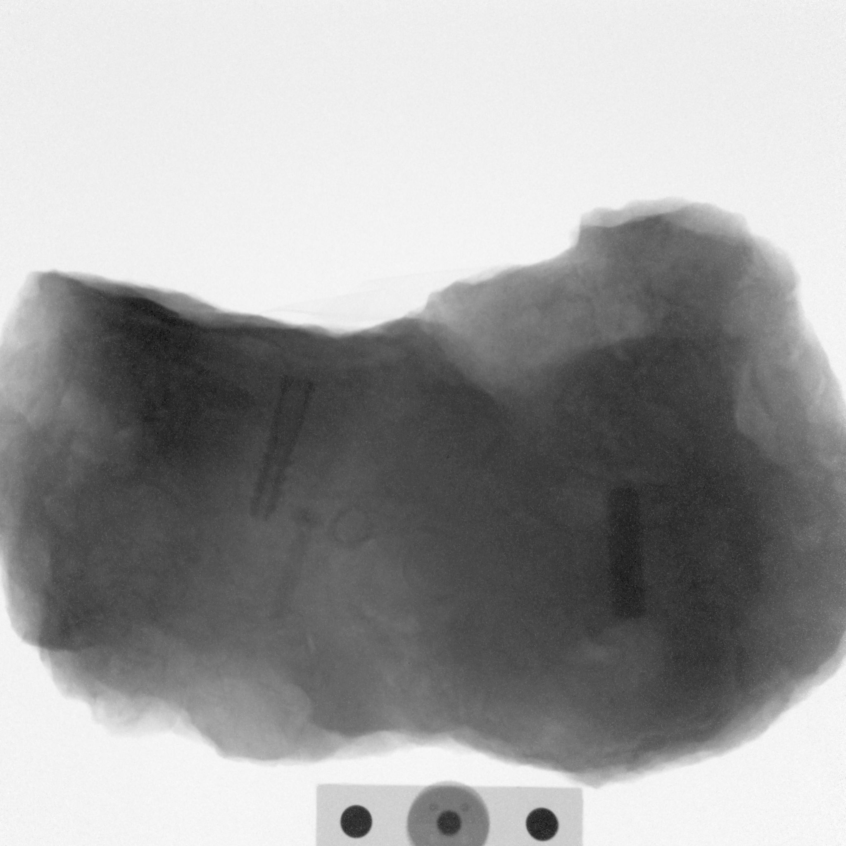
Epithermal radiography
1 mm Cd filter before sample
1 mm Cd filters before sample and before detector
Ferrous rock with plastic sleeve, brass screw and bolt
30 mm distance to detector
B.Schillinger, A. Craft

Slide 21
The ferrous rock contains a lot of crystal water that causes moderation of the epithermal neutrons.
Moderated thermal neutrons are scattered on the hydrogen and blur the image.
A second Cd filter between sample and detector eliminates the moderated thermal neutrons and increases contrast in the remaining epithermal image.
Since scattering of the thermal neutrons is isotropic into 4π, the effect decreases with increasing sample-detector distance, as less scattered neutrons reach the detector.
B.Schillinger, A. Craft

Slide 22
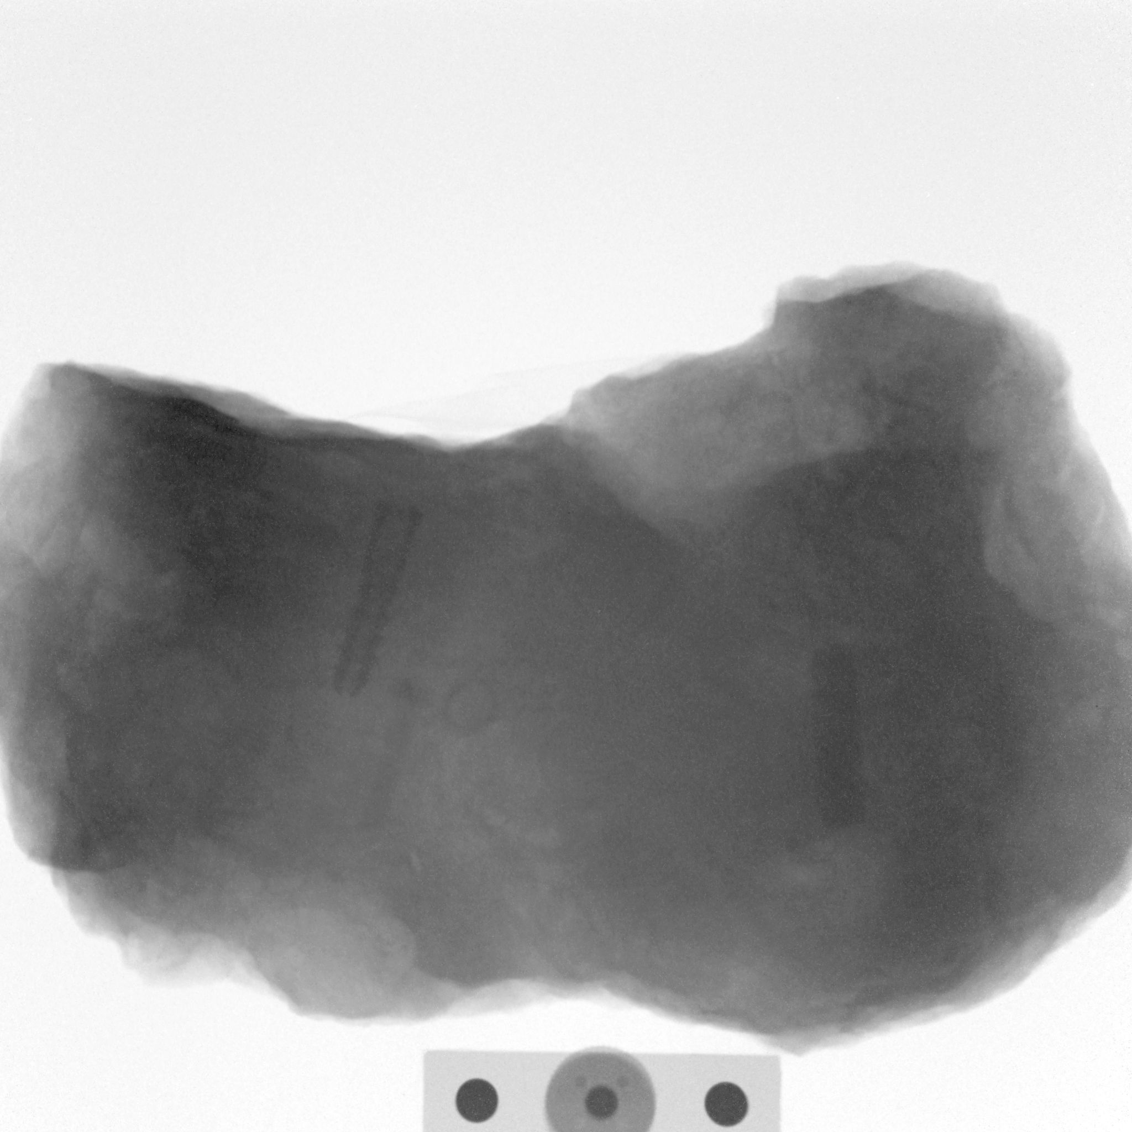
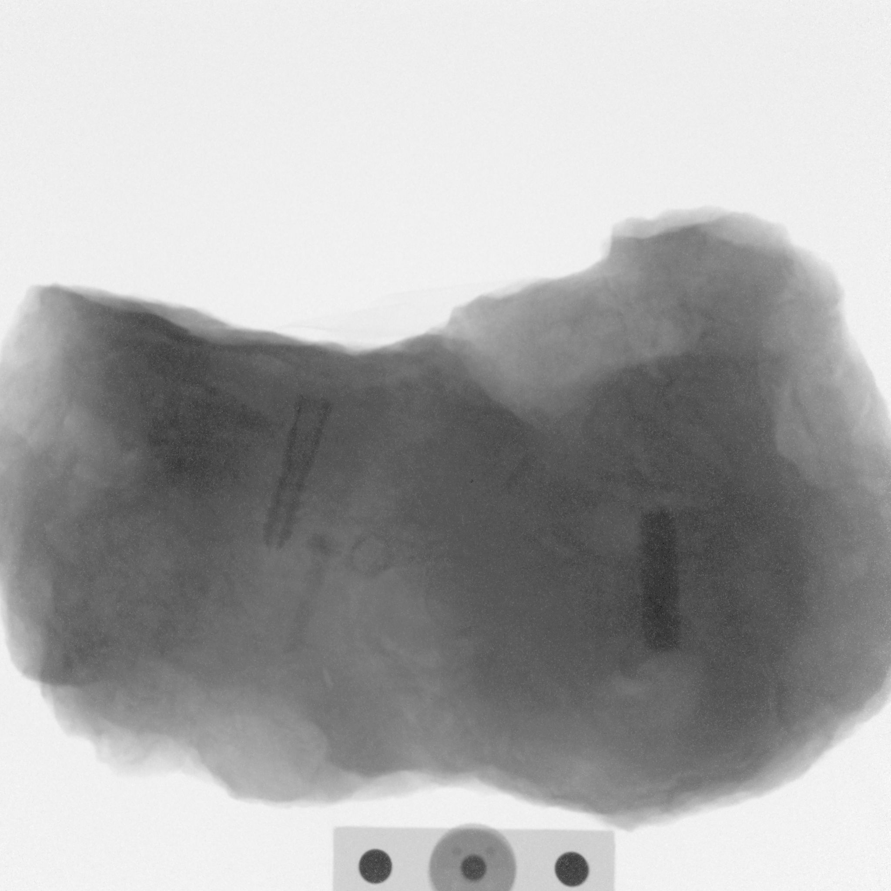
Epithermal radiography
1 mm Cd filters before sample and before detector
1 mm Cd filters before sample and before detector
1 mm Cd filter before sample
Ferrous rock with plastic sleeve, brass screw and bolt
60 mm distance to detector
B.Schillinger, A. Craft

Slide 23
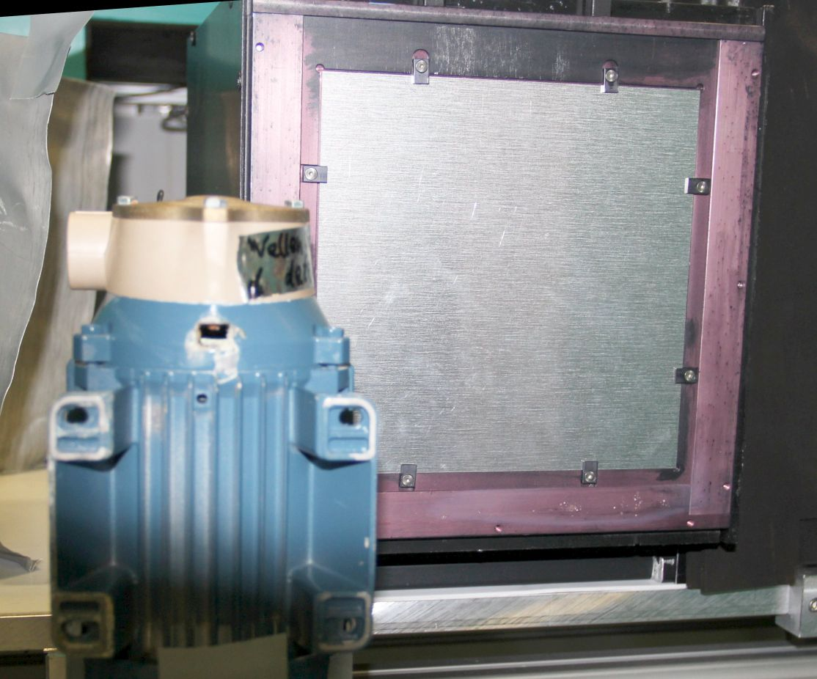
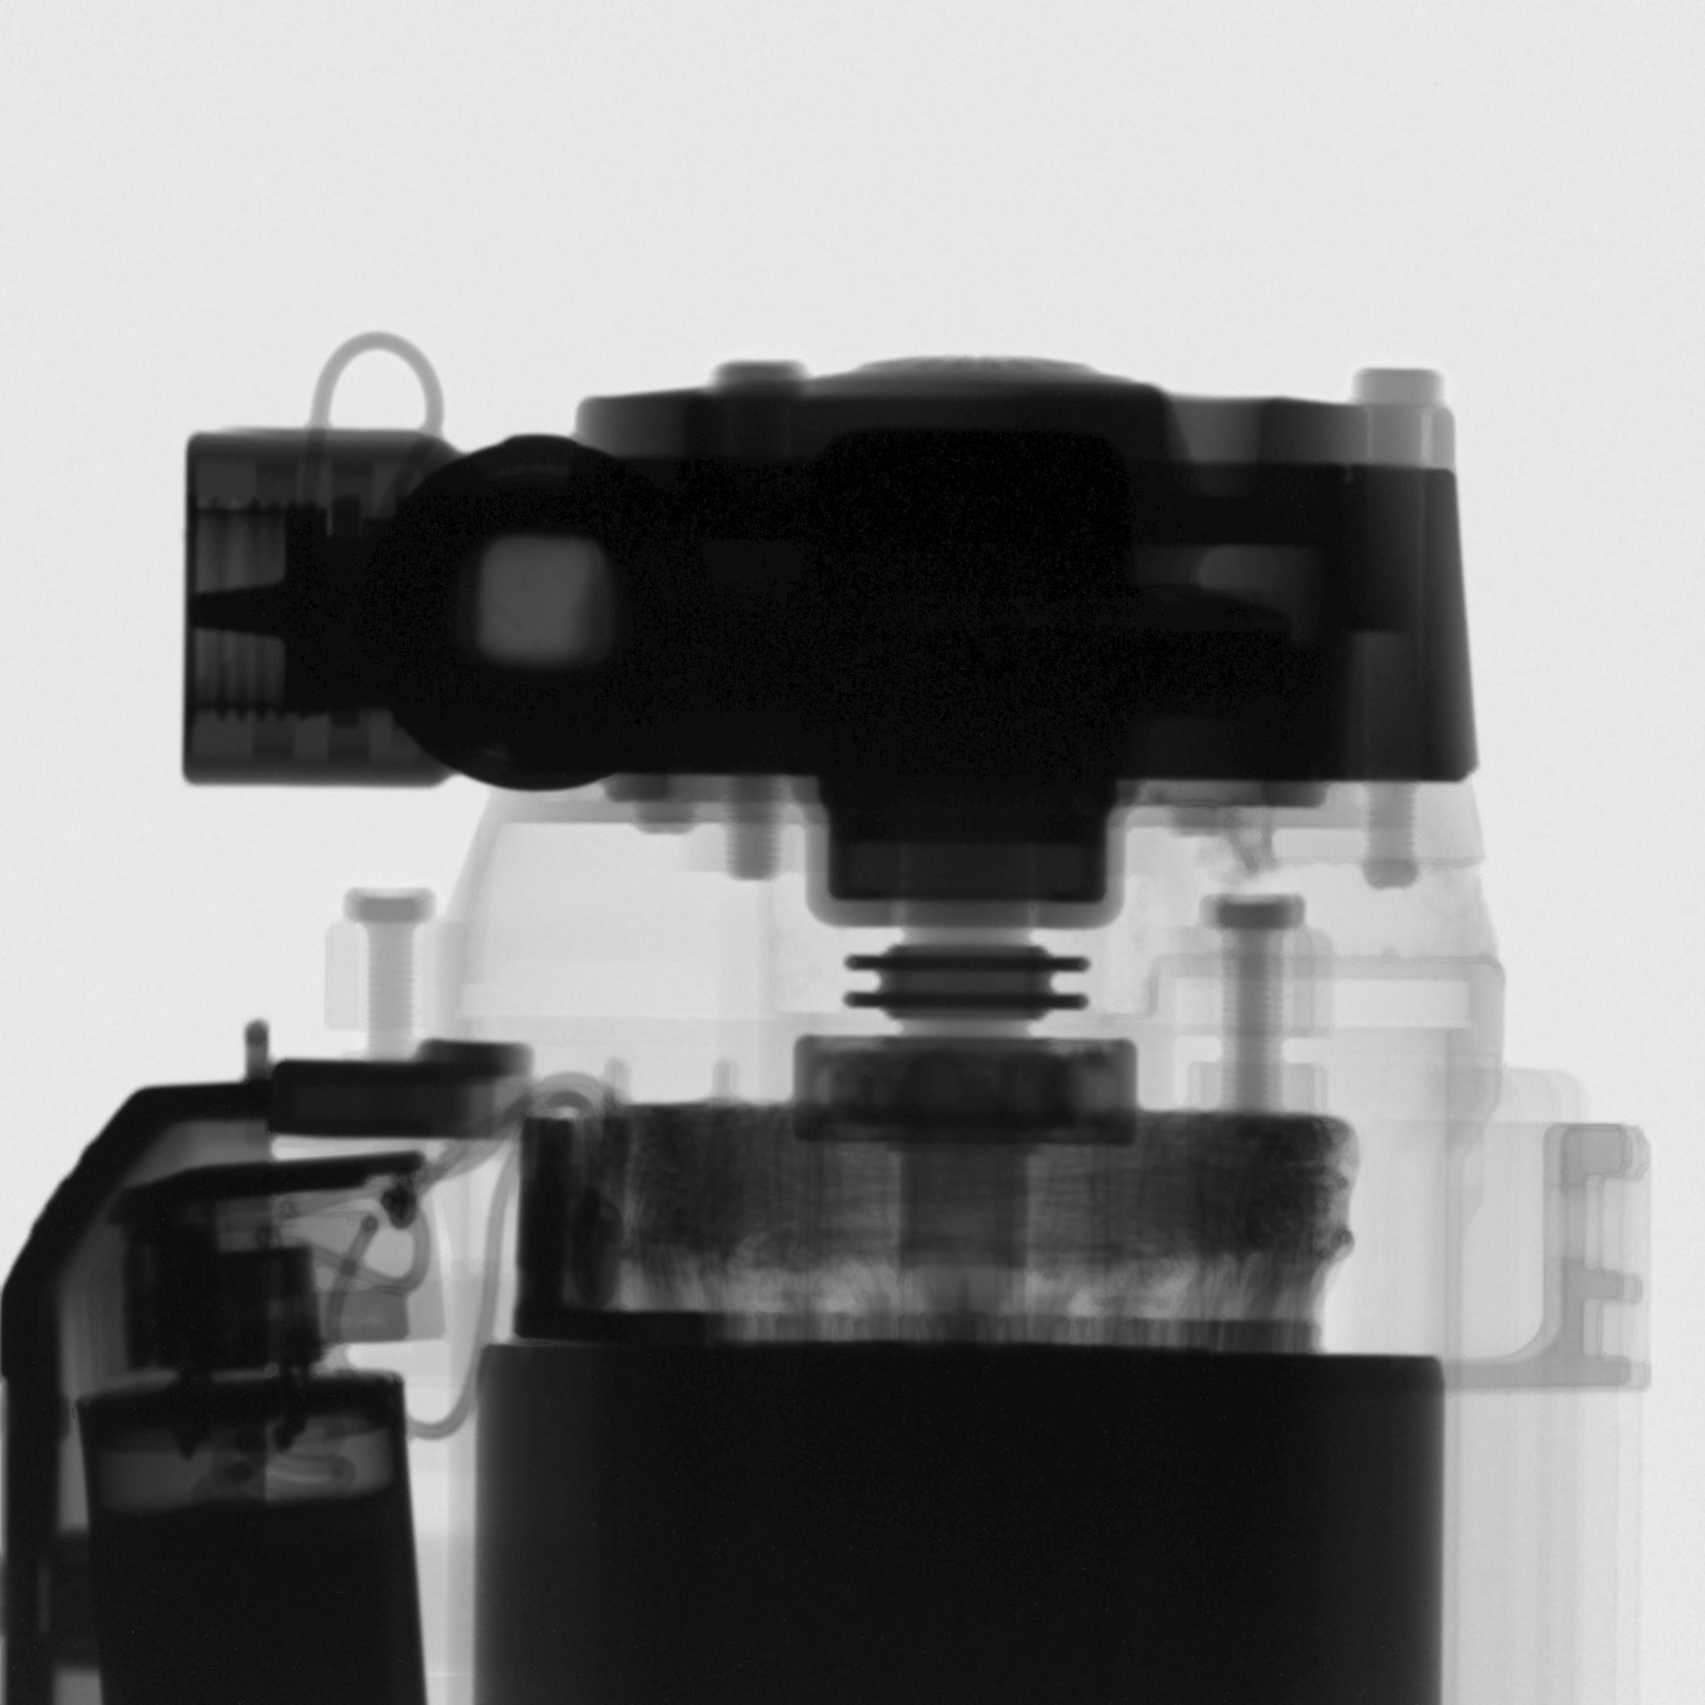
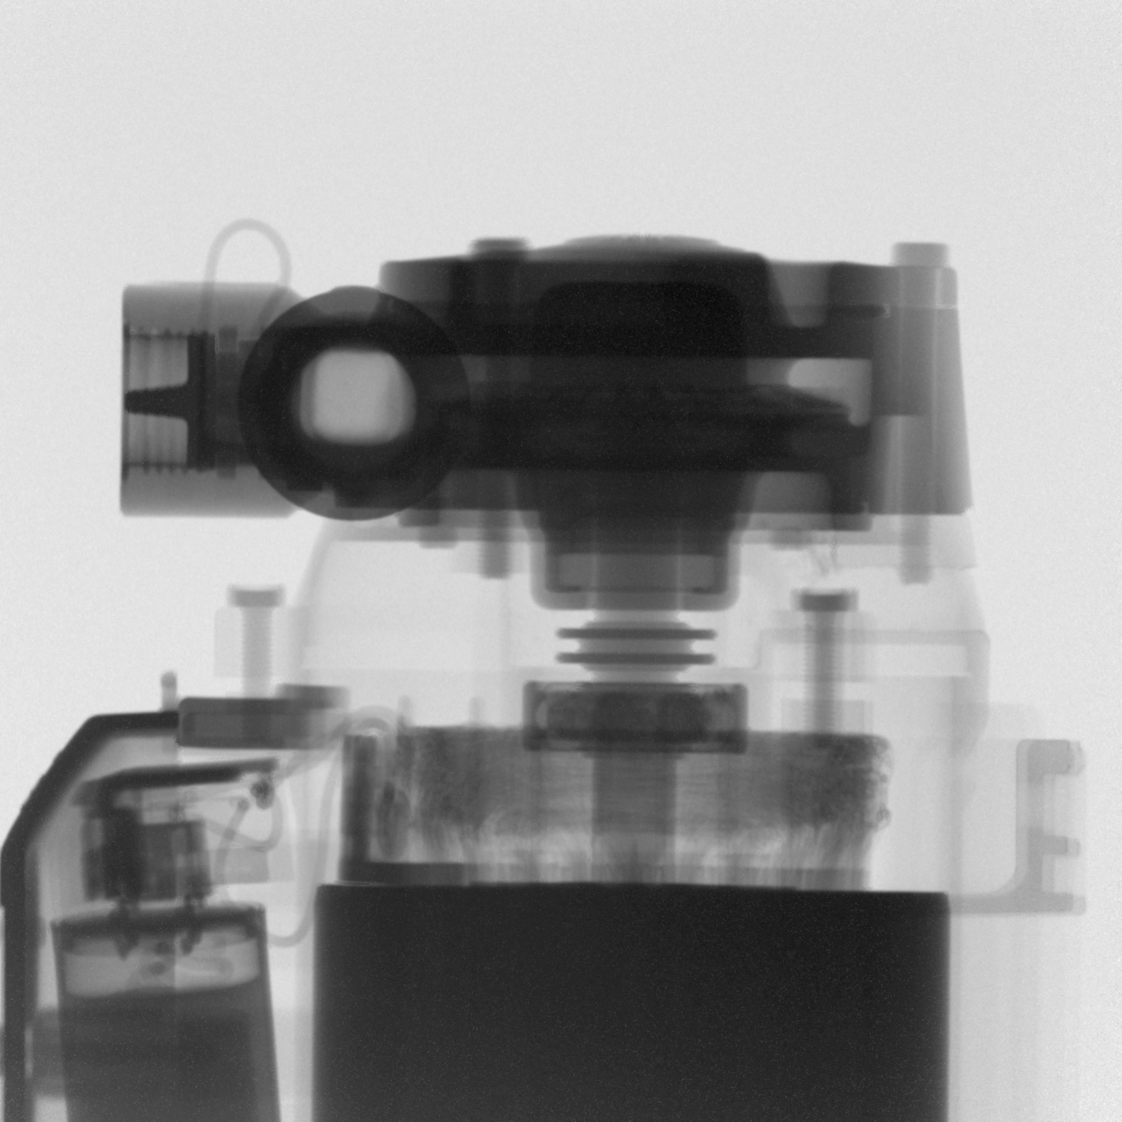
Cold radiography
4 sec exposure
Epithermal radiography
60 sec exposure
Electric pump and motor
B.Schillinger, A. Craft

Slide 24
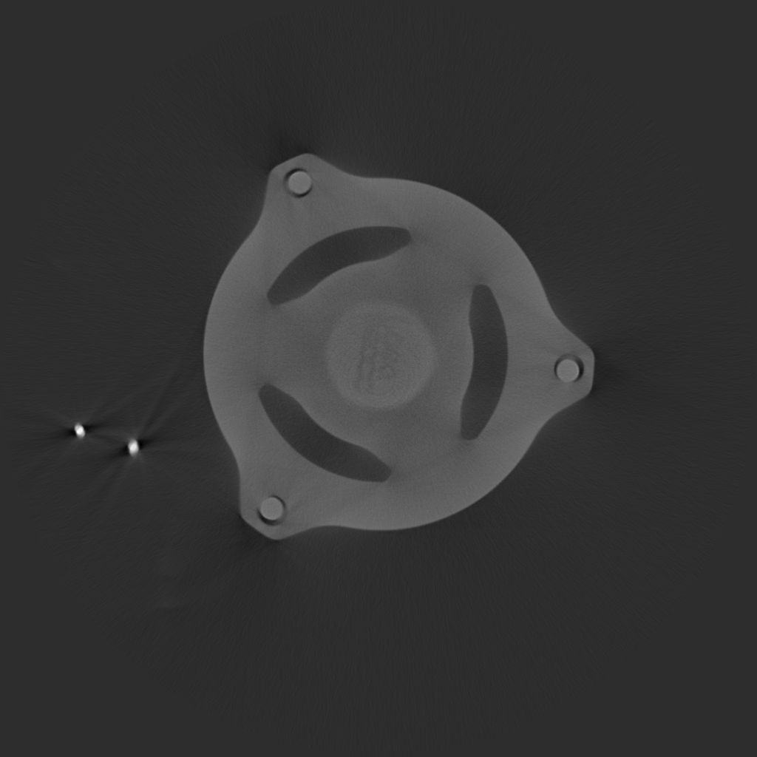
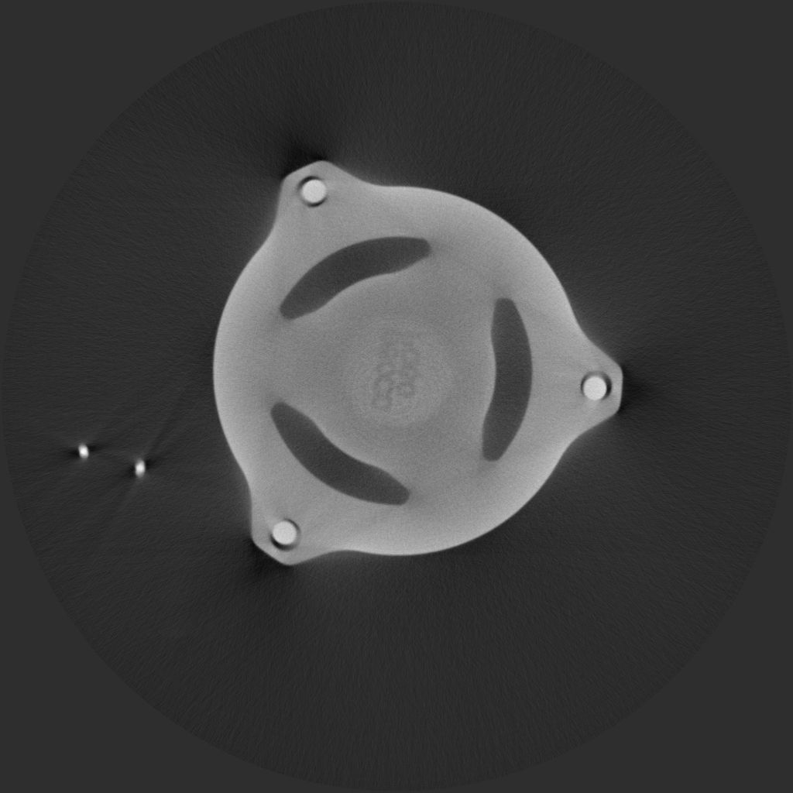
Cold CT layer
Epithermal CT layer
For moderate thickness, quality is similar
Electric pump and motor
B.Schillinger, A. Craft

Slide 25
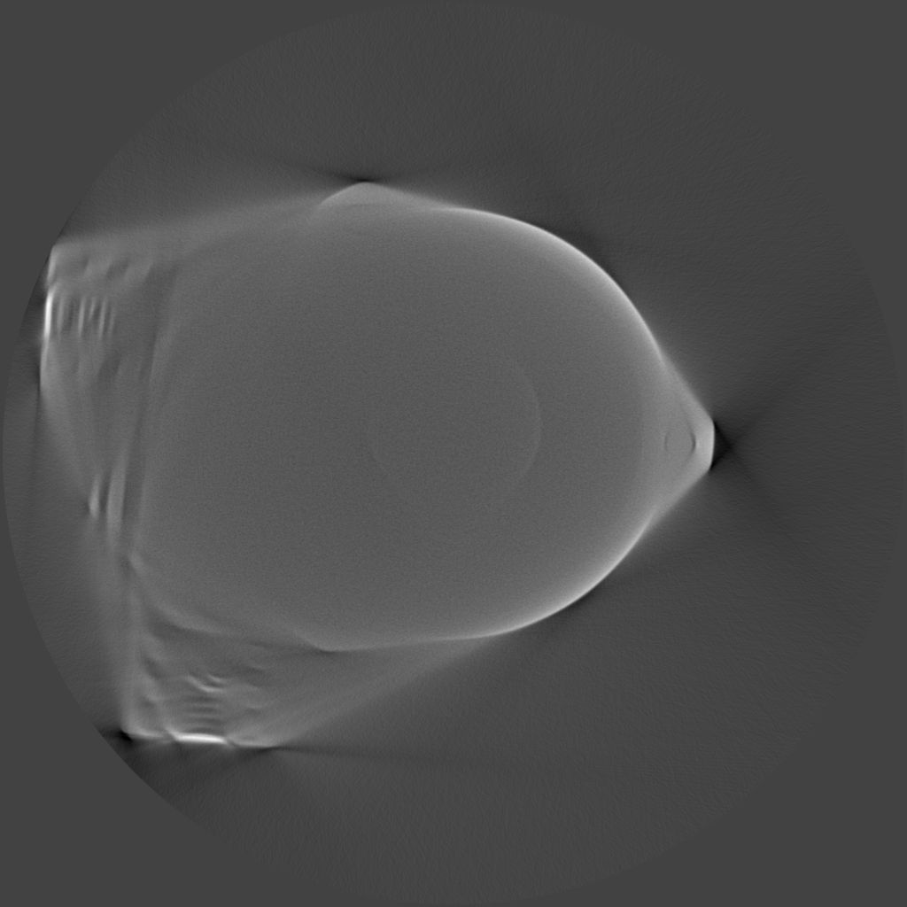
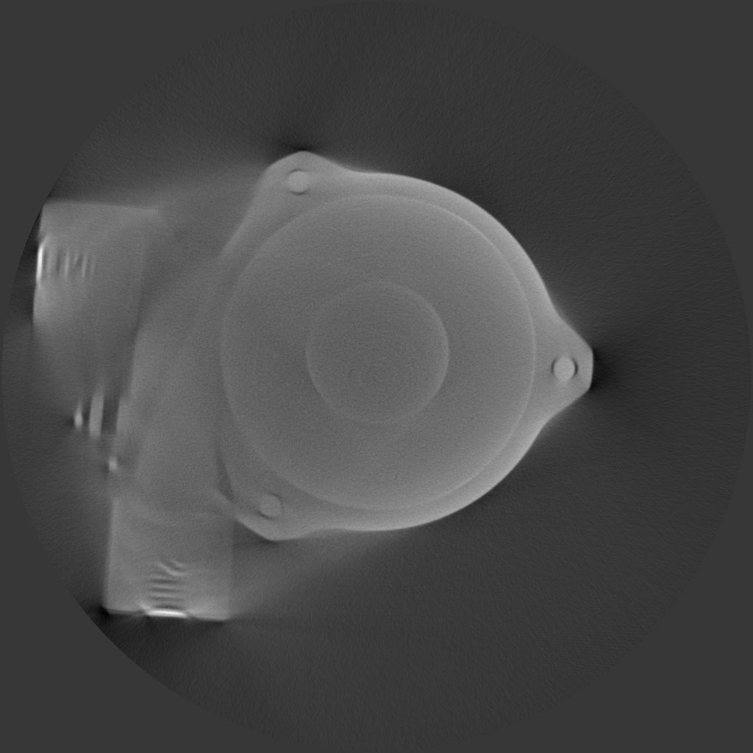
Cold CT layer
Epithermal CT layer
For extensive thickness, cold neutron CT fails, and epithermal reconstruction is also incomplete, but still shows more details.
B.Schillinger, A. Craft

Slide 26
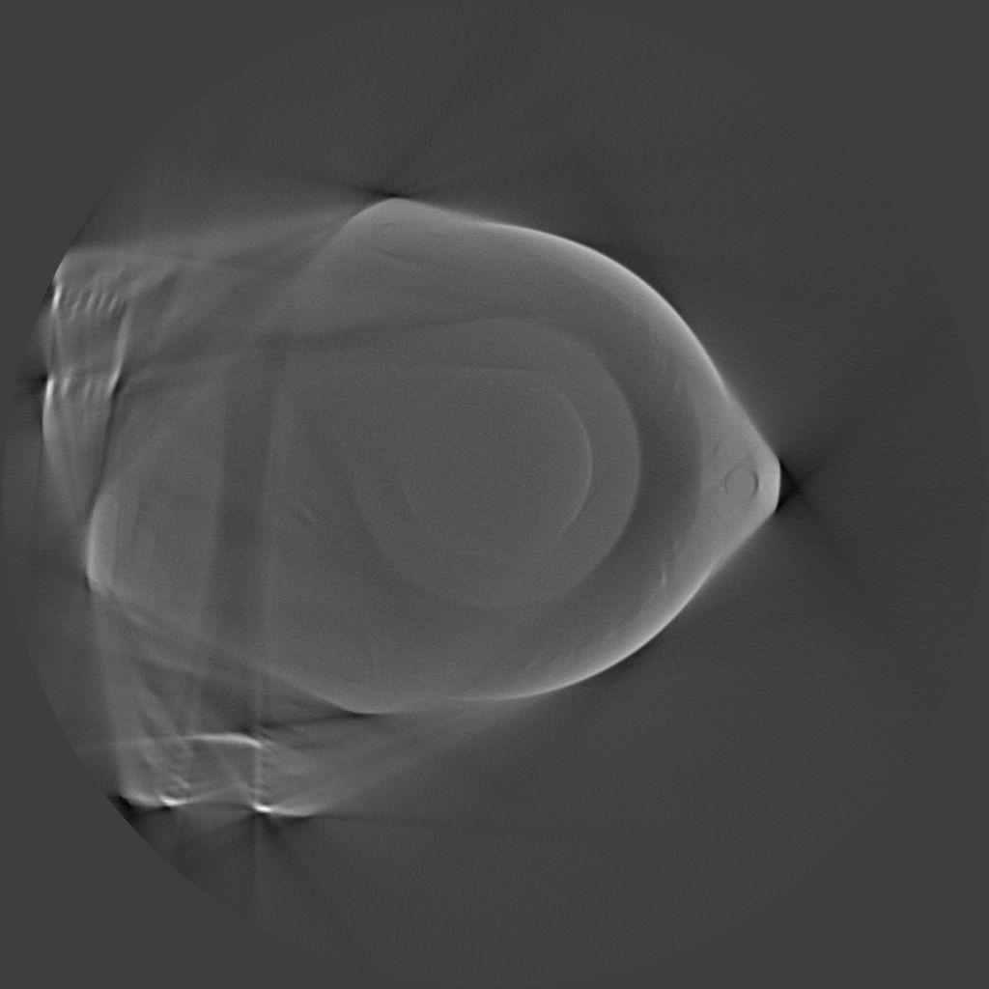
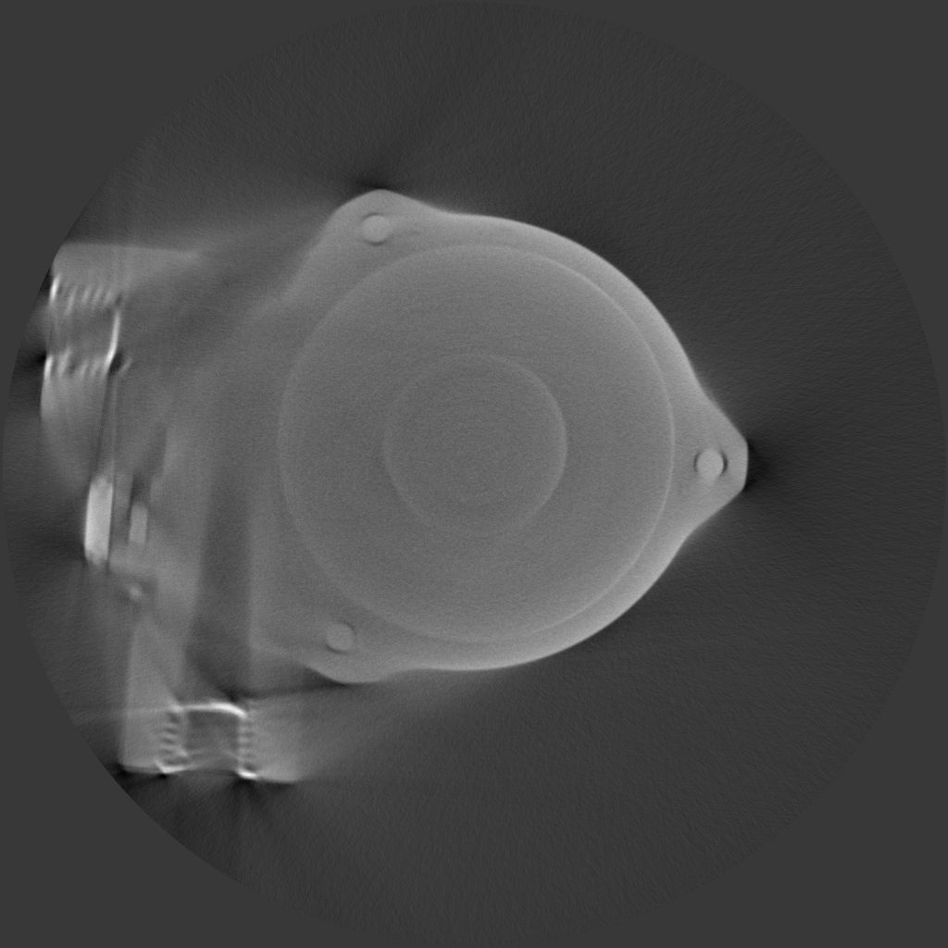
Cold CT layer
Epithermal CT layer
Electric pump and motor
B.Schillinger, A. Craft

Slide 27
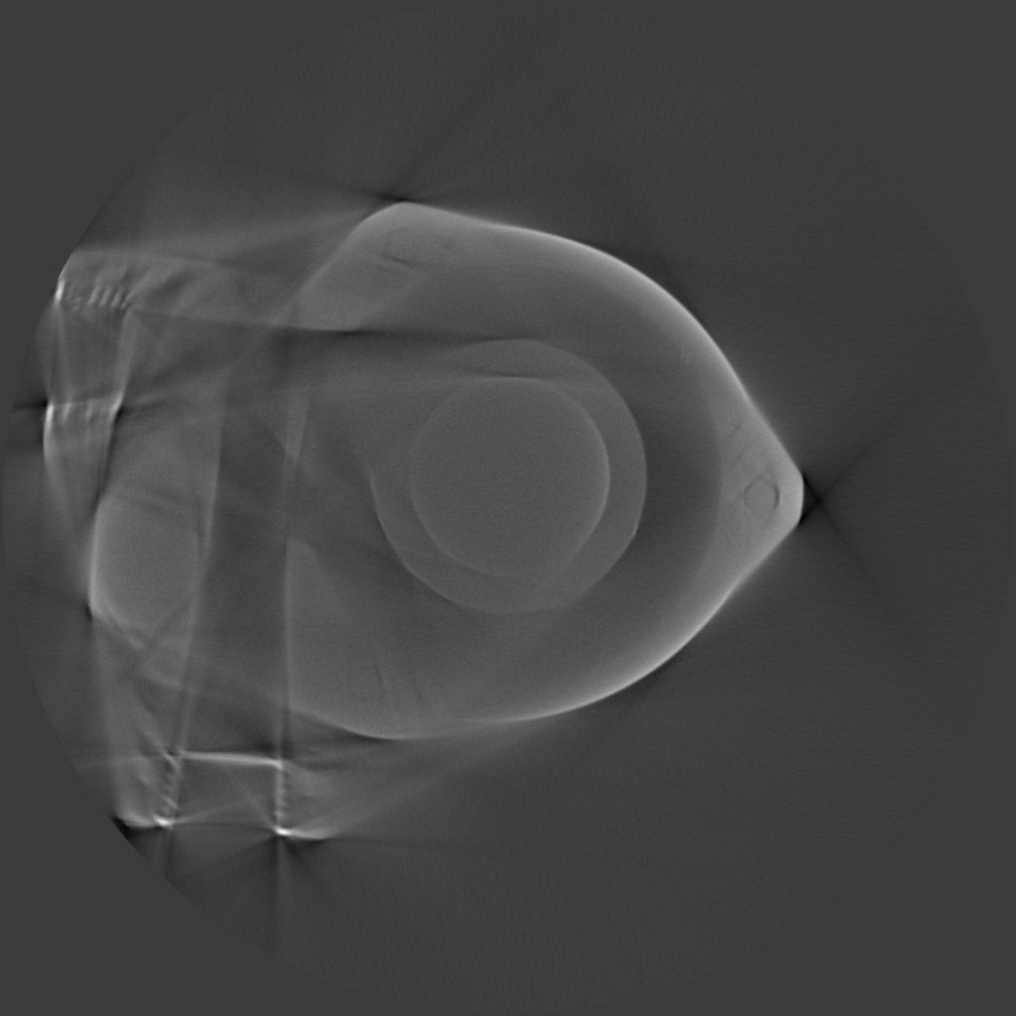
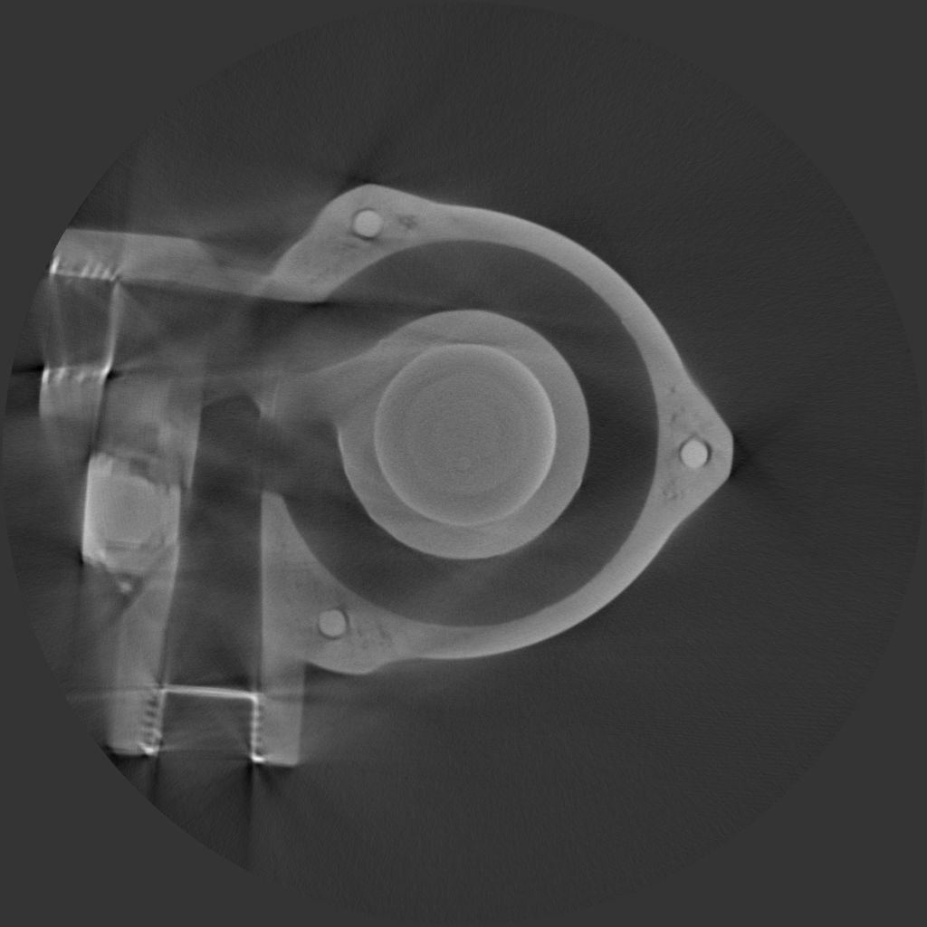
Cold CT layer
Epithermal CT layer
Electric pump and motor
B.Schillinger, A. Craft

Slide 28
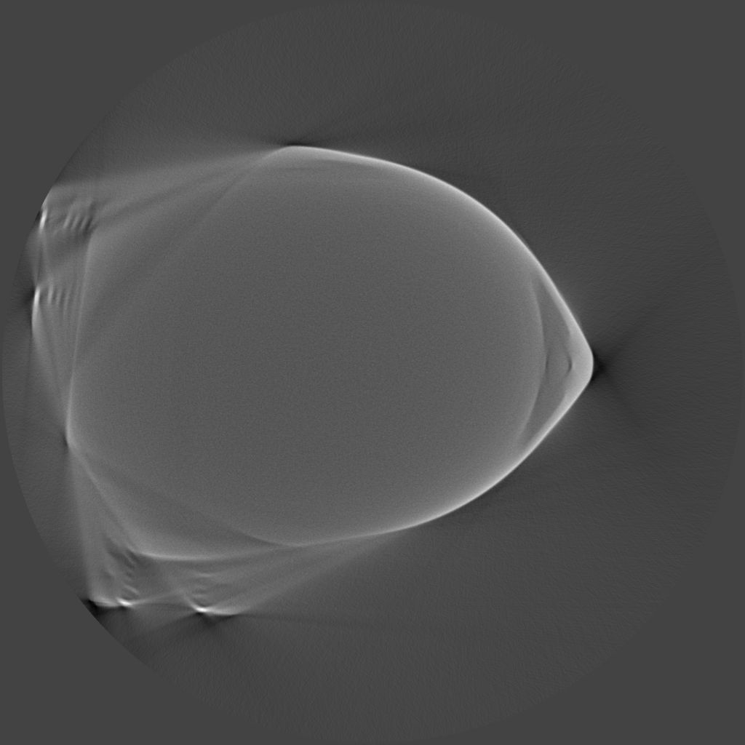
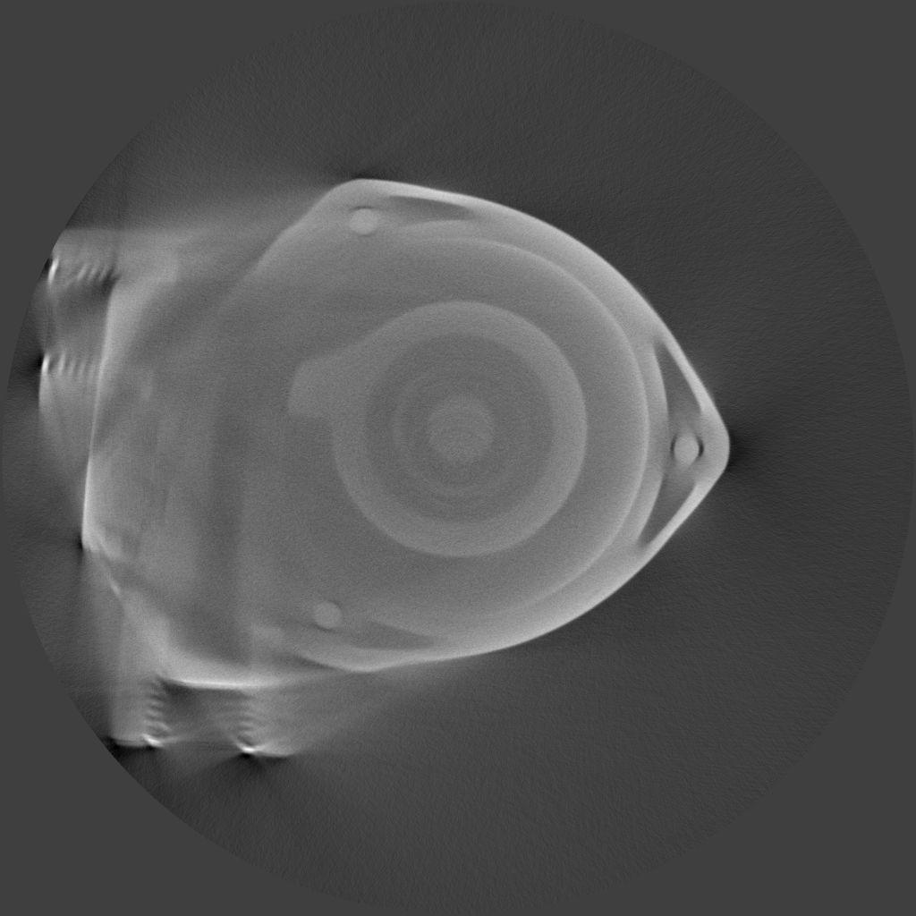
Cold CT layer
Epithermal CT layer
Electric pump and motor
B.Schillinger, A. Craft

Slide 29
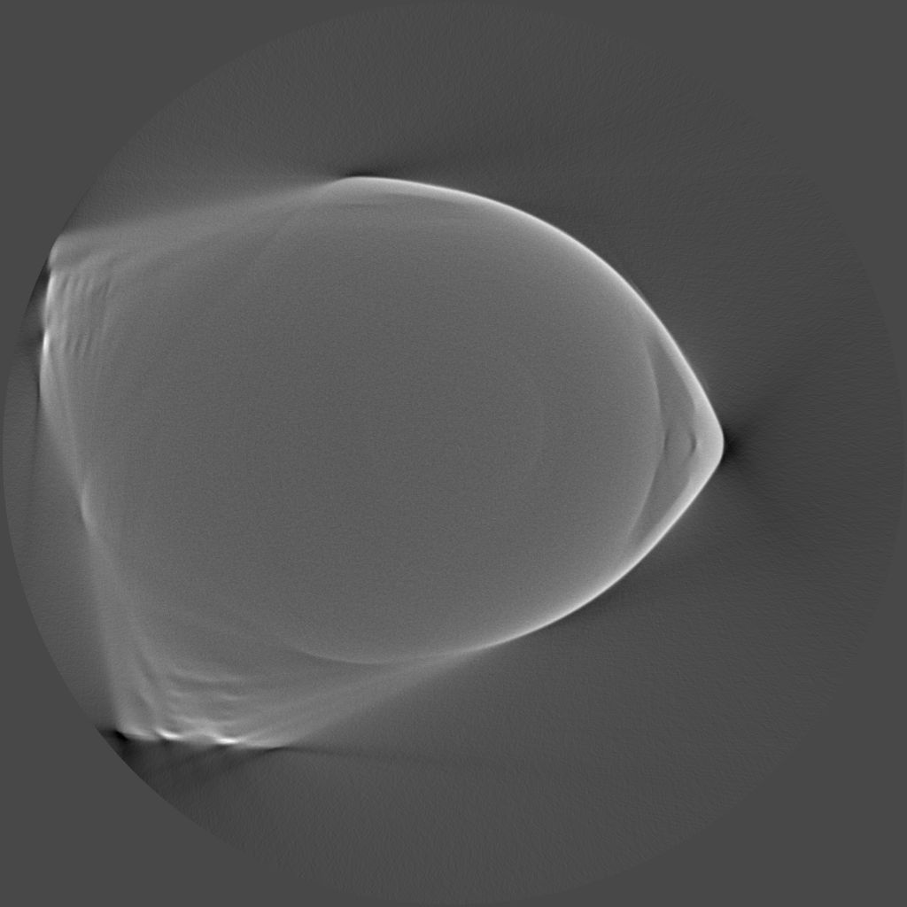
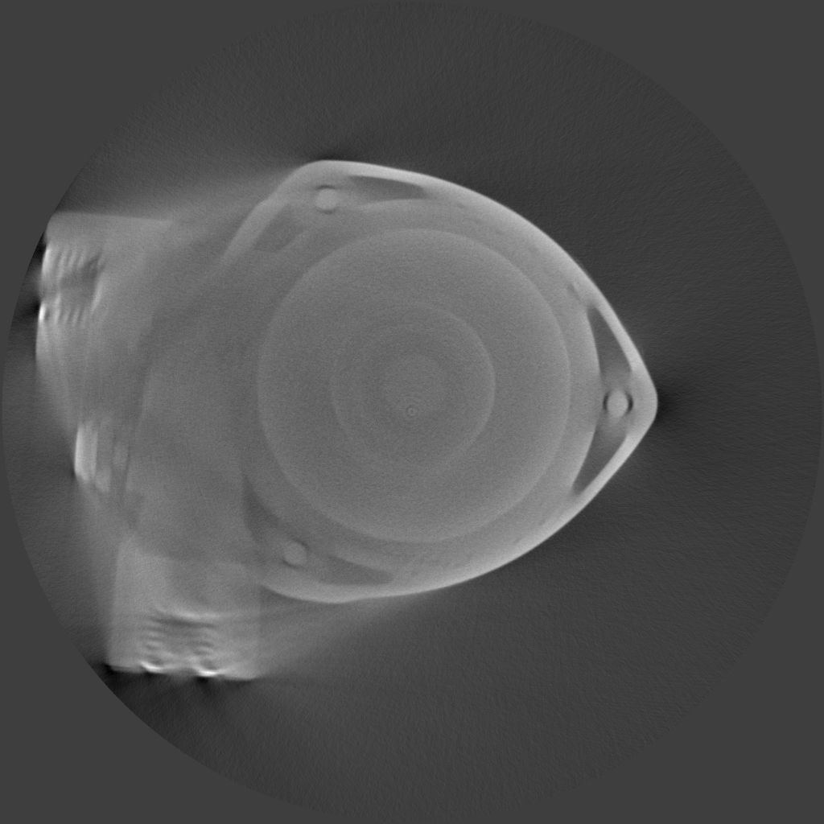
Cold CT layer
Epithermal CT layer
Electric pump and motor
B.Schillinger, A. Craft

Slide 30
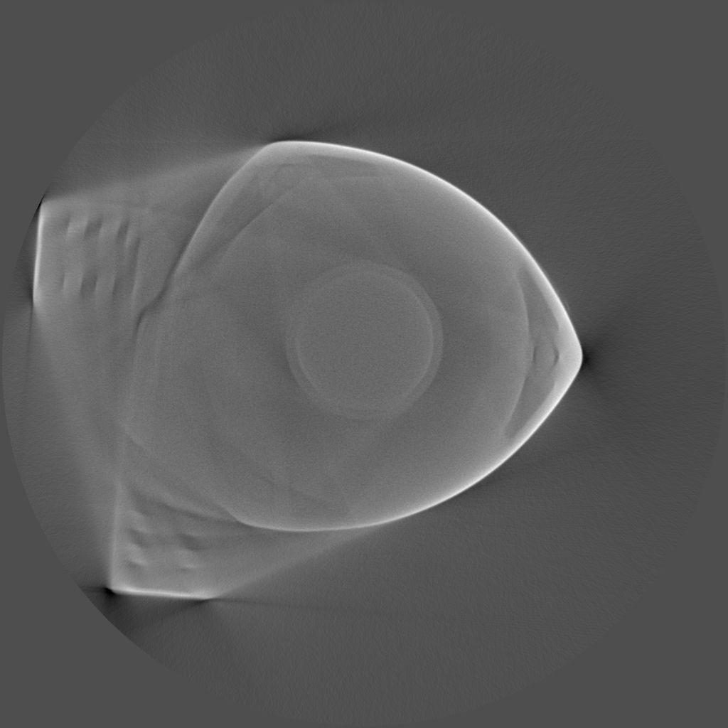
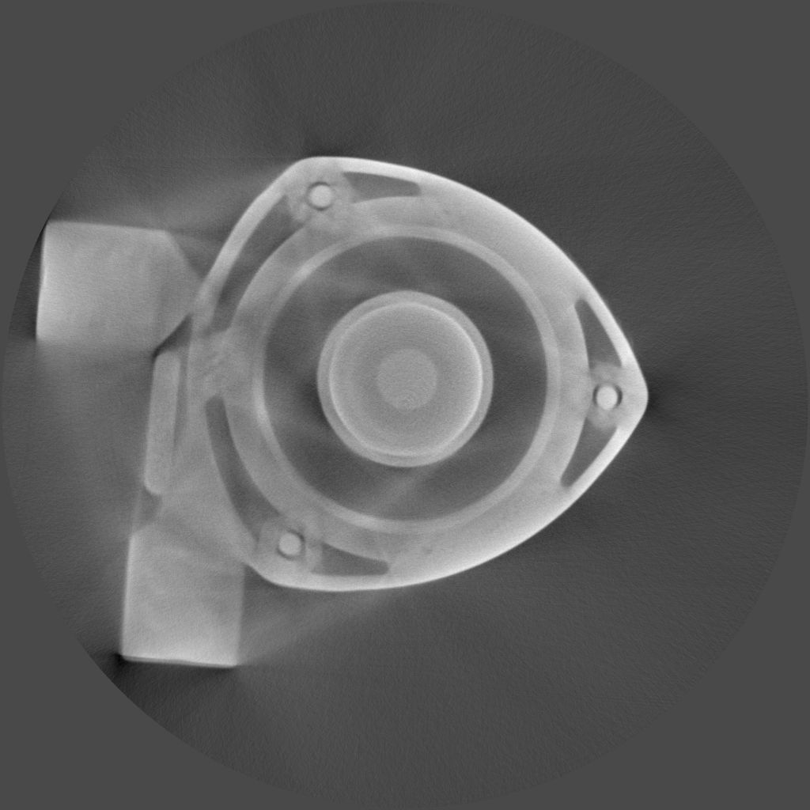
Cold CT layer
Epithermal CT layer
Electric pump and motor
B.Schillinger, A. Craft

Slide 31
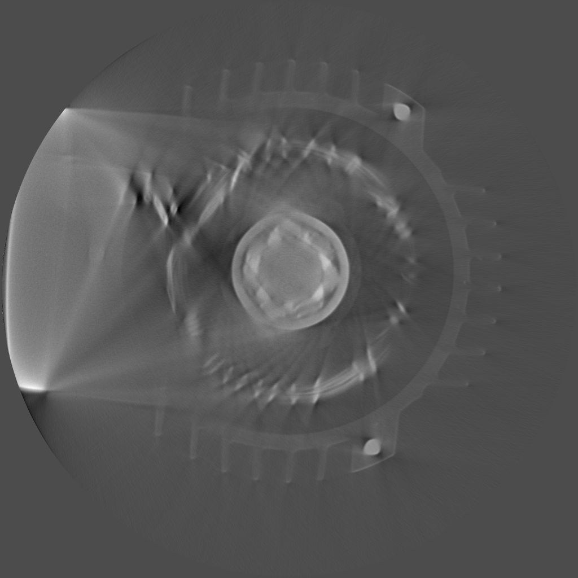
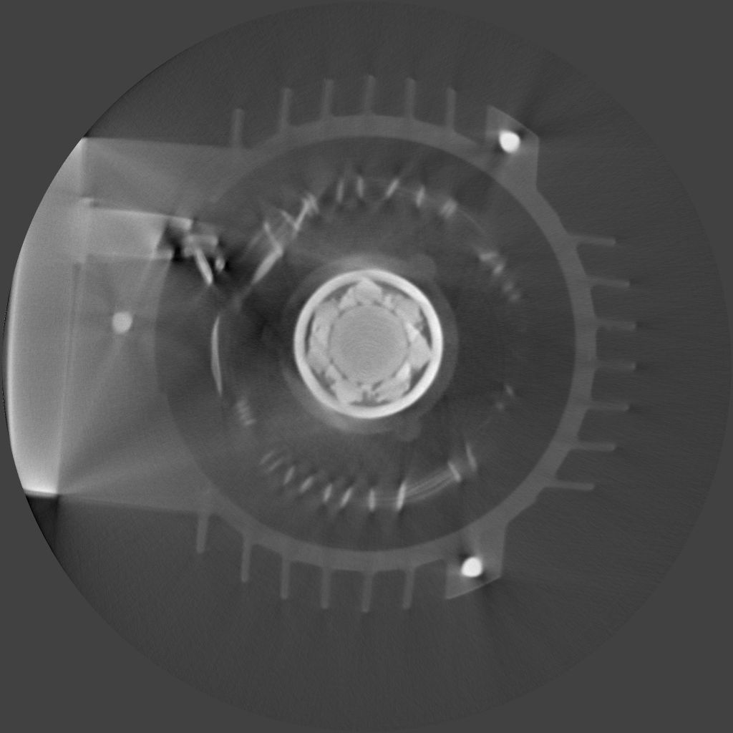
Cold CT layer
Epithermal CT layer
Electric pump and motor
B.Schillinger, A. Craft

Slide 32
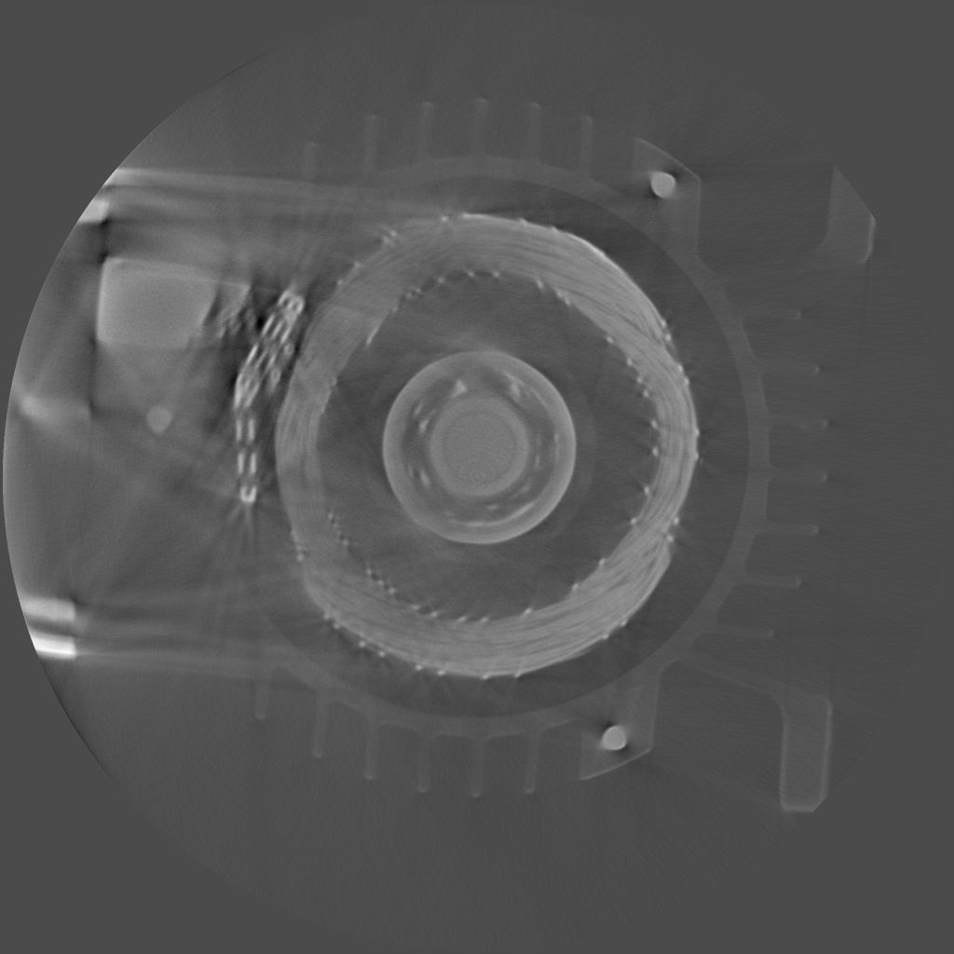
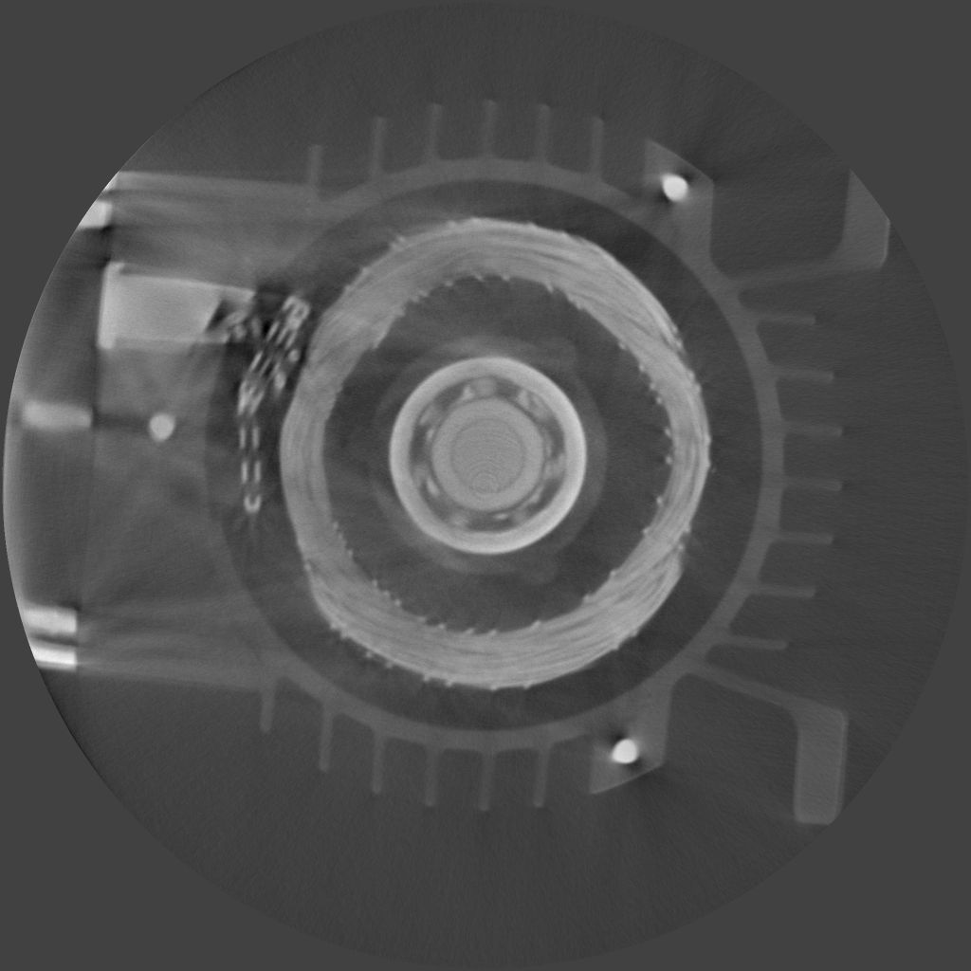
Cold CT layer
Epithermal CT layer
Electric pump and motor
B.Schillinger, A. Craft

Slide 33
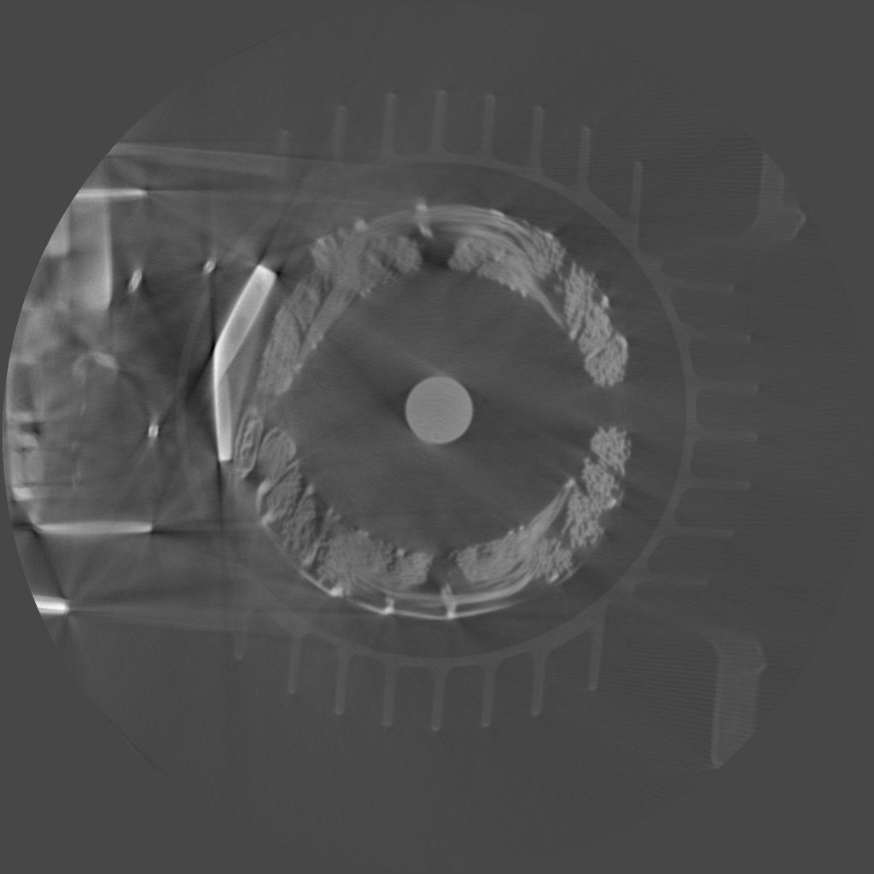
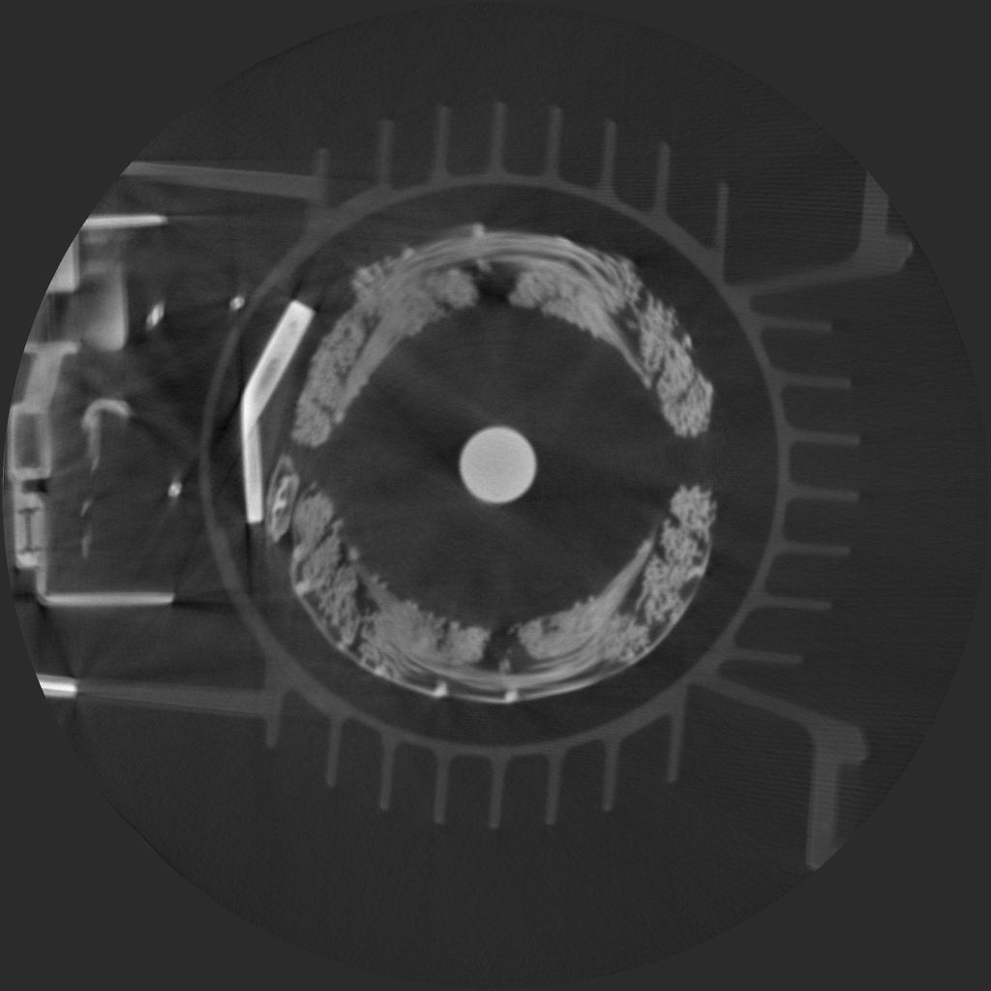
Cold CT layer
Epithermal CT layer
Electric pump and motor
B.Schillinger, A. Craft

Slide 34
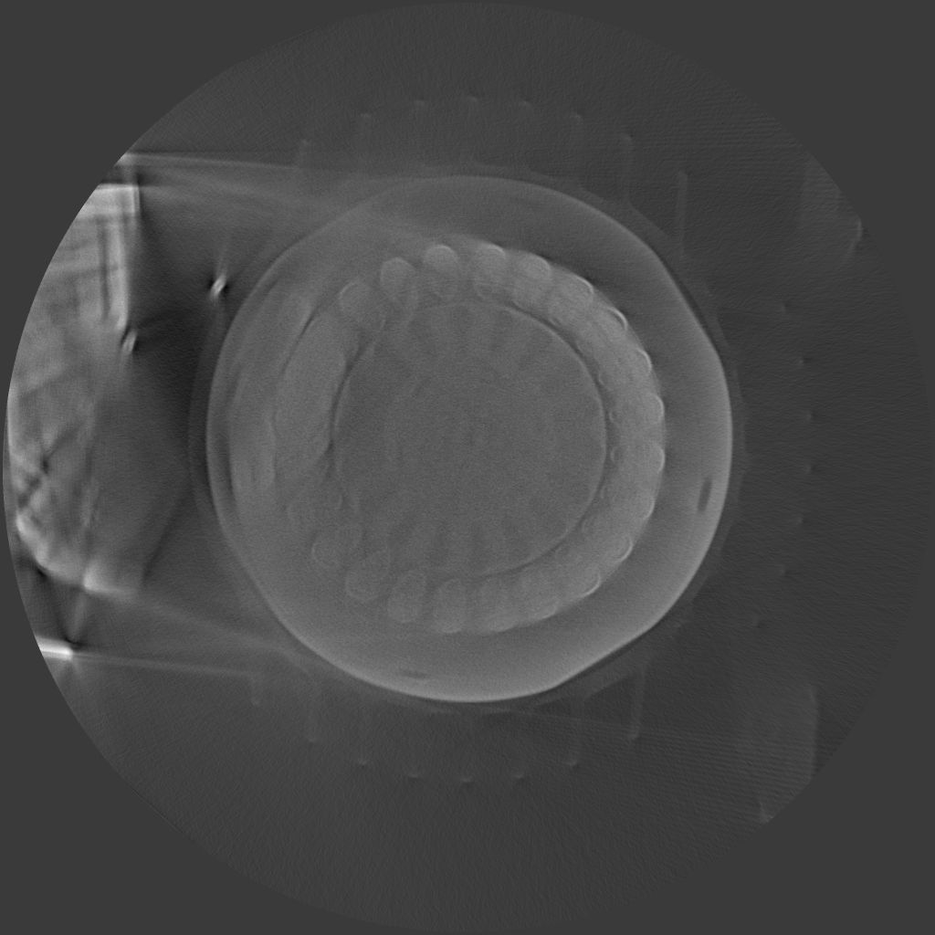
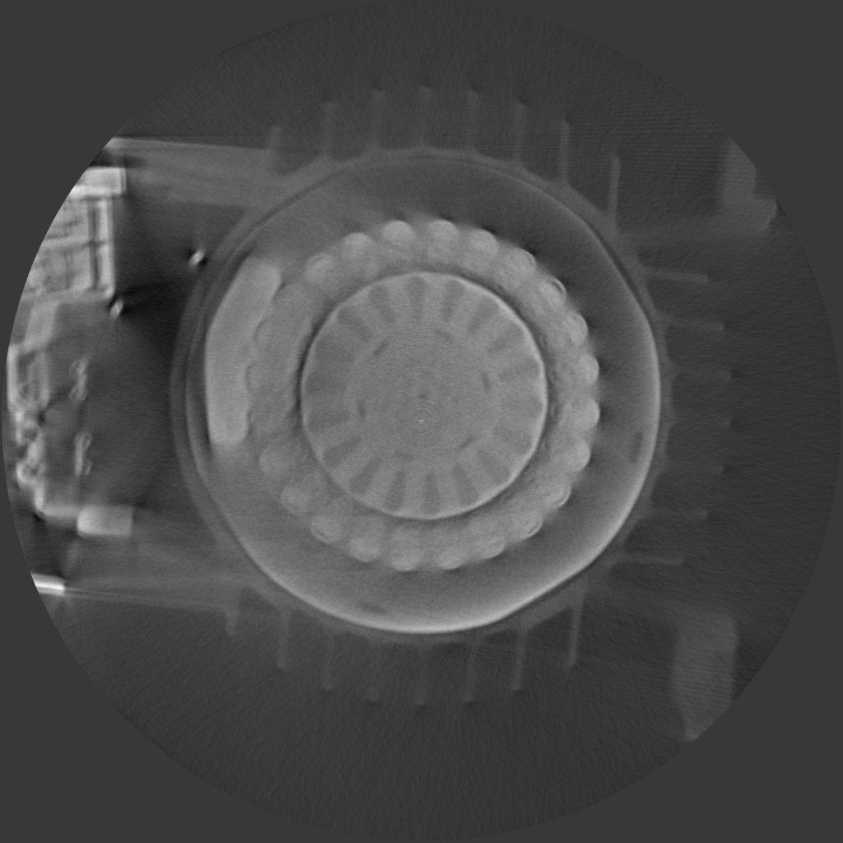
Cold CT layer
Epithermal CT layer
Electric pump and motor
B.Schillinger, A. Craft

Slide 35
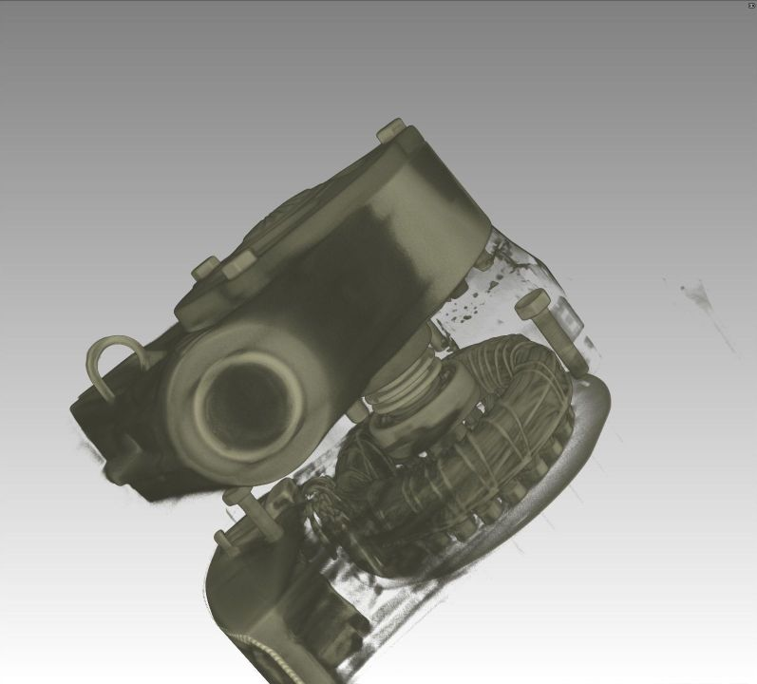
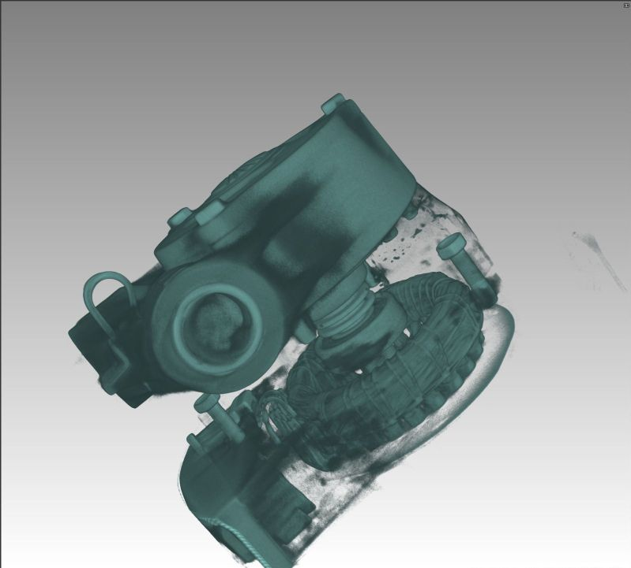
Cold 3D CT
Epithermal 3D CT
Electric pump and motor
B.Schillinger, A. Craft

Slide 36
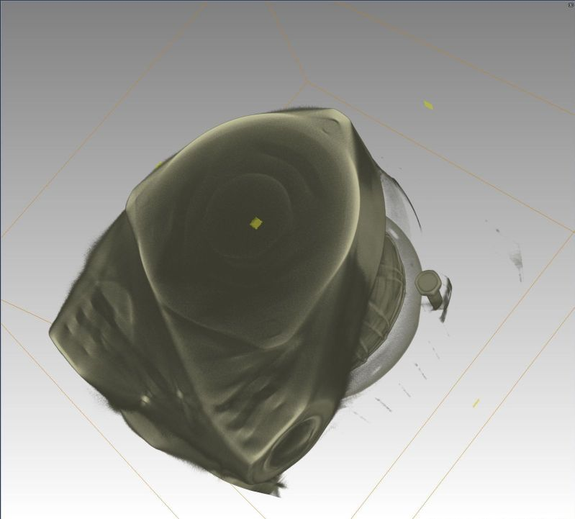

Cold 3D CT
Epithermal 3D CT
Electric pump and motor
B.Schillinger, A. Craft

Slide 37

Cold 3D CT
Epithermal 3D CT
Electric pump and motor
B.Schillinger, A. Craft

Slide 38
Conclusions:
Where cold and thermal neutron CT fail, epithermal neutrons can provide better penetration.
The effect is not overly large as long as a LiF+ZnS screen is used – its sensitivity quickly decreases with rising neutron energy, so energies only up to a few ten eV are really used
Using the remaining epithermal part of the spectrum requires good gamma filtering of the beam with lead or bismuth
In a strong gamma field, even a relatively gamma insensitive ZnS-screen will deliver a gamma image
B.Schillinger, A. Craft
38
Notes:
38

Slide 39

Conclusions:
New screens have to be developed with better sensitivity in the epithermal range, e.g. using ¹⁰B, others
B.Schillinger, A. Craft
39
Notes:
39

Slide 40
Conclusions:
Where available, fast fission neutrons can be used, e.g at the NECTAR facility with its 80 kW converter plate.
This is even more promising on a radial beam with direct contact to the core as at the INL reactor with 250 kW
New tests with a fast neutron screen will be conducted at INL soon
A fast neutron screen works with recoil protons – due to high energies, resolution is limited to about 0.5 mm, with detection efficiency of a few percent
B.Schillinger, A. Craft
40
Notes:
40

Slide 41

T/h/a/n/k/s
f/o/r
l/i/s/t/e/n/i/n/g !

