Slide 1
Experimental Validation of the Model Connecting Time, Contrast, Wavelength and Spatial Resolution
M. Grosse, P. Trtik, B. Schillinger

Slide 2
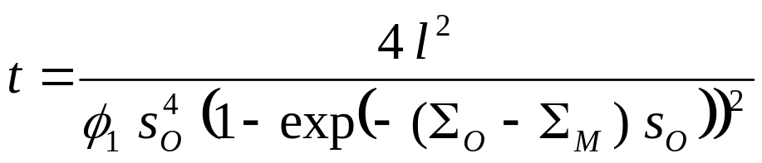
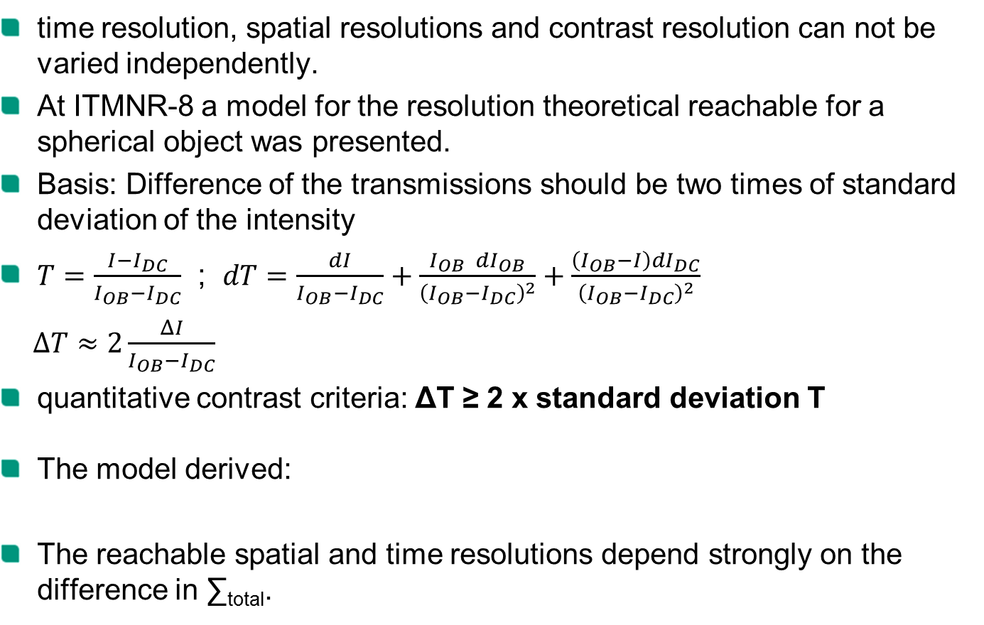
Introduction
time resolution, spatial resolutions and contrast resolution can not be varied independently.
At ITMNR-8 a model for the resolution theoretical reachable for a spherical object was presented.
Basis: Difference of the transmissions should be two times of standard deviation of the intensity
$T=\frac{I−I_{DC}}{I_{OB}−I_{DC}}$ ; $dT=\frac{dI}{I_{OB}−I_{DC}}+\frac{I_{OB} dI_{OB}}{{\left(I_{OB}−I_{DC}\right)}^{2}}+\frac{\left(I_{OB}−I\right)dI_{DC}}{{\left(I_{OB}−I_{DC}\right)}^{2}}$
$ΔT≈2\frac{ΔI}{I_{OB}−I_{DC}}$
quantitative contrast criteria: ΔT ≥ 2 x standard deviation T
The model derived:
The reachable spatial and time resolutions depend strongly on the difference in ∑_{total}.
very small

Slide 3
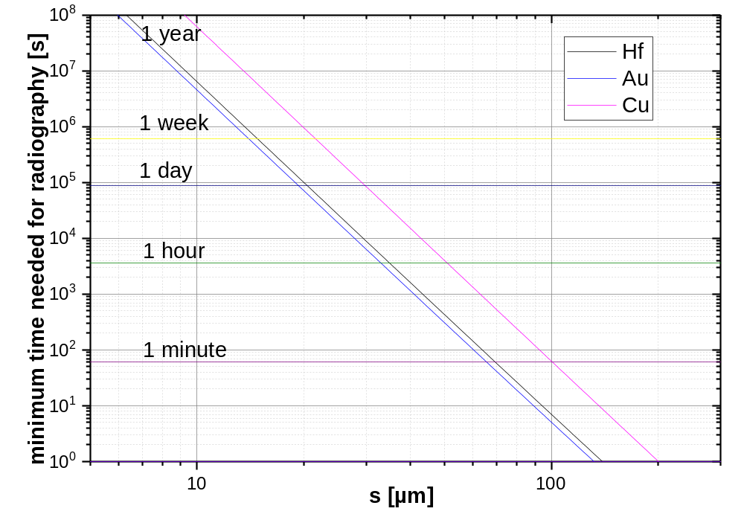
Introduction
Neutron Illumination time theoretical needed for a spherical object of size s_{O} (flux parameter valid for BOA @ SINQ)

Slide 4
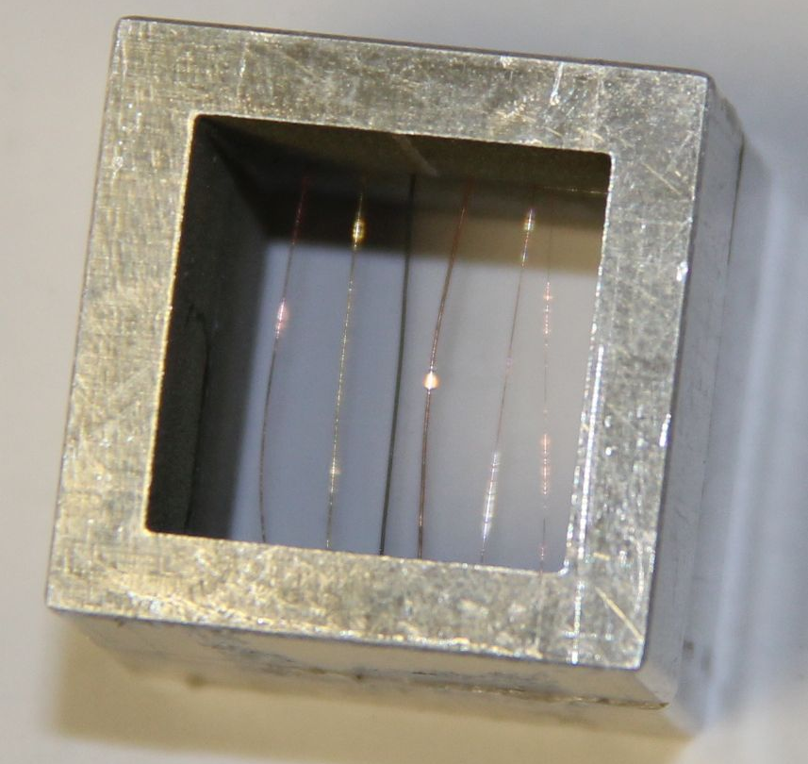
Validation tests
Wire sensibility tests are used in industrial X-ray inspections for material defect analysis (for instance standards ASTM E1647
DIN EN ISO 19232:1:2013).
The test principle was applied but material and thicknesses of the wires were fitted to neutron imaging.
wire sample consists of
  material Σ_{total} thickness
  Hf 5.12 cm⁻¹ 125 µm
  Au 6.28 cm⁻¹ 75 µm
  Cu 1.00 cm⁻¹ 125 µm
  75 µm
  50 µm
  20 µm

Slide 5
Validation tests
Measurements for validation of the model measurements were performed at BOA and POLDI @ SINQ as well as at ANTARES @ FRM-2.
 | BOA | POLDI | ANTARES
S-D distance | 10 mm | 1 mm | 15 mm
L/d | 300 | 220 | 560, 1120
Pixel size | 14 µm | 2.7 µm | 22.6 µm
Illumination times | 100 x 60 s | 389 X 60 s | 400, 450 X 60 s
mean ob-dc counts | 34.3 s⁻¹ | ~11 s⁻¹ | 630 s⁻¹ 106 s⁻¹
Accumulation methods:
3 – 120 s: addition
> 120 s: median (ANTARES)
averaged intensity
(POLDI, BOA)
Limits of the tests:
No continuous fitting of L/d on the resolution needed.
  Stepwise varying of the aperture slit size
No continuous fitting of the pixel size
  Rebining of pixels

Slide 6
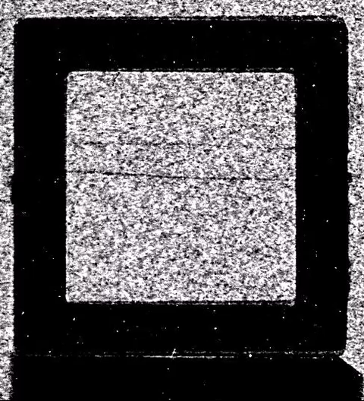
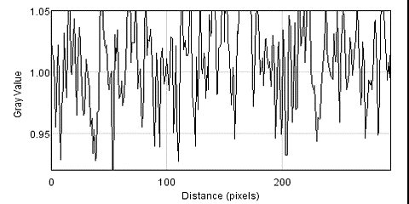
Results
ANTARES L/d = 560; 1 .. 20 s

Slide 7
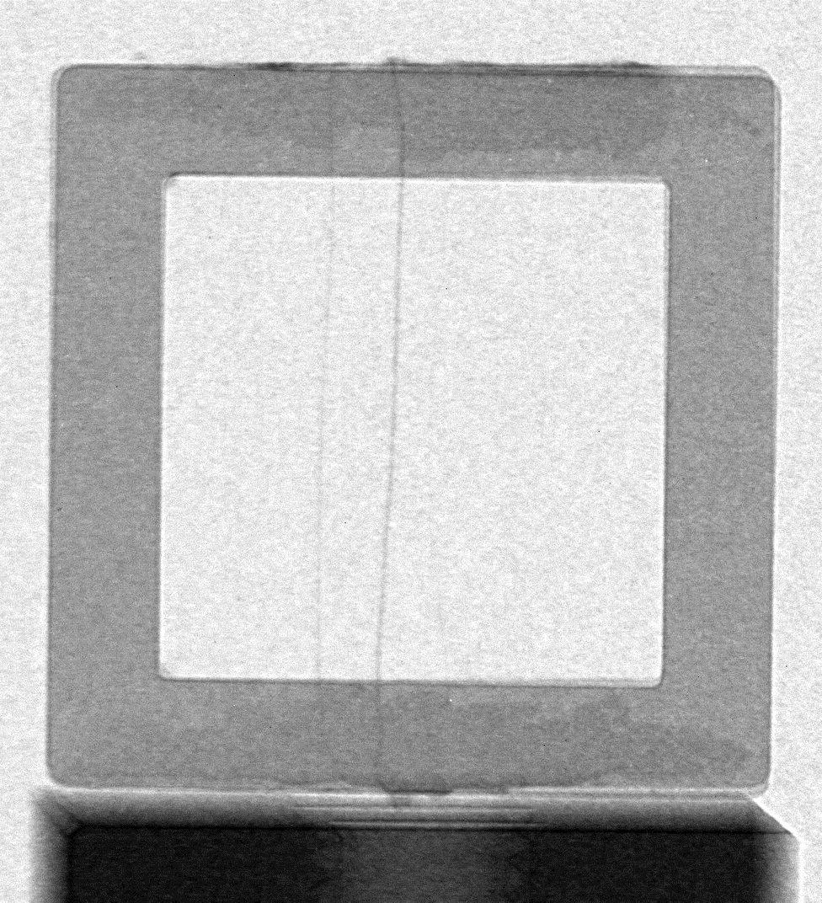
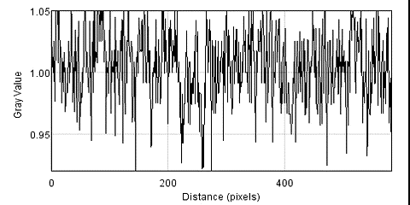
Results
ANTARES
L/d = 1120
120 s .. 5 h

Slide 8
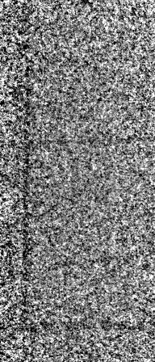
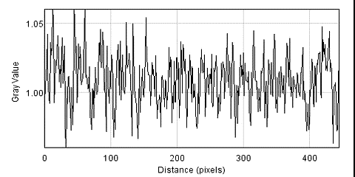
Results
Neutronen Microscopy at POLDI
L/d = 220
sample – detector: ~ 1mm
Pixel size 2.7 µm
389 x 60 s
All wires becomes visible earlier than theoretic expected
All wires show similar transmissions
(T ≠ f(wire thickness)
Main contrast is caused by scattering and total reflection

Slide 9
Results
 |  | Au 75 µm | Hf 125 µm | Cu 125 µm | Cu 75 µm | Cu 50 µm | Cu 20 µm
ANTARES | theoretic | 3 s | 12 s | 75 s | 450 s | 4100 s | 43.4 h
 | visible | 1 s | 1 s | 7 s | 20 s | 680 s | visible
 | quantit. | 7 s | 15 s | 1200 s | detected
BOA | theoretic | 55 s | 220 s | 1370 s | measured
 | visible | 60 s | 60 s | 60 s
 | quantit. | 180 s | 360 s | detect.
POLDI | theoretic | measured |  | 4280 s | 7.3 h | 65.2 h | 406 h
 | visible |  |  | 60 s | 60 s | 60 s | 720 s
 | quantit. |  |  | 900 s | 3180 s | 9950 s | 4500 s

Slide 10
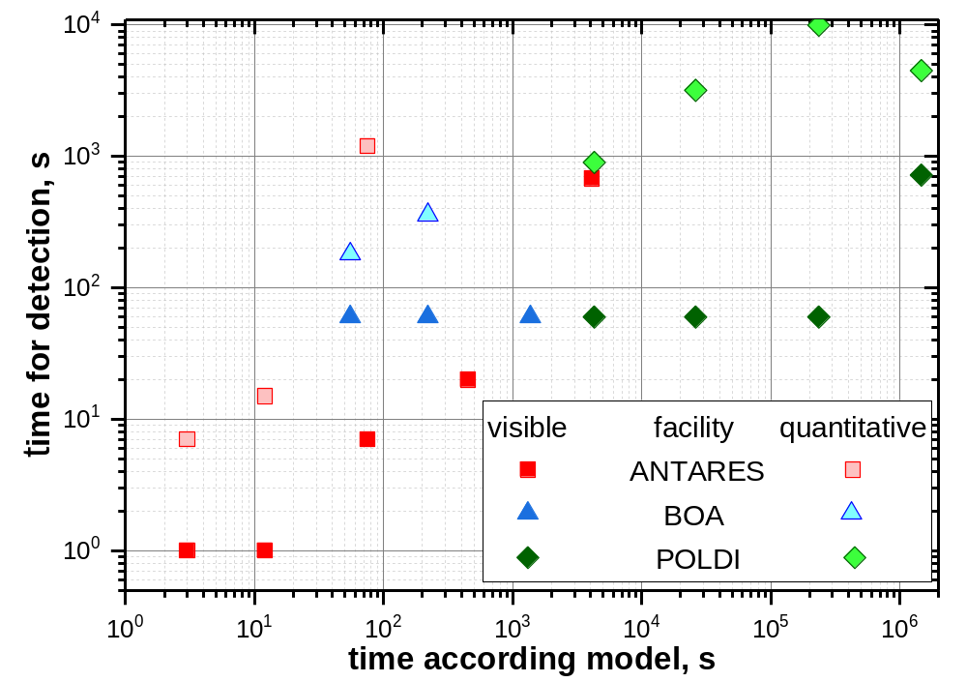
Discussion
Comparison experiment - model
BOA and ANTARES:
model predicts too low illumination times for the quantitative contrast criteria.
(factor 2 .. 3)
reasons: additional noise (incomplete white spot corrections, fluctuations in I₀
DC noise

Slide 11
Discussion
Comparison experiment - model
POLDI:
The contrast criteria is much earlier fulfilled than predicted by the model.
Obviously, the contrast is increased due processes like scattering, total refection, refraction.
reason:
thermal neutron spectrum
low L/d

Slide 12
Discussion
Comparison experiment - model
The wires becomes visible much earlier than the contrast criteria.
Is the criteria too strong?
A factor of 2 .. 4 cannot explain it completely.
Pattern recognition due to 1D extension.

Slide 13
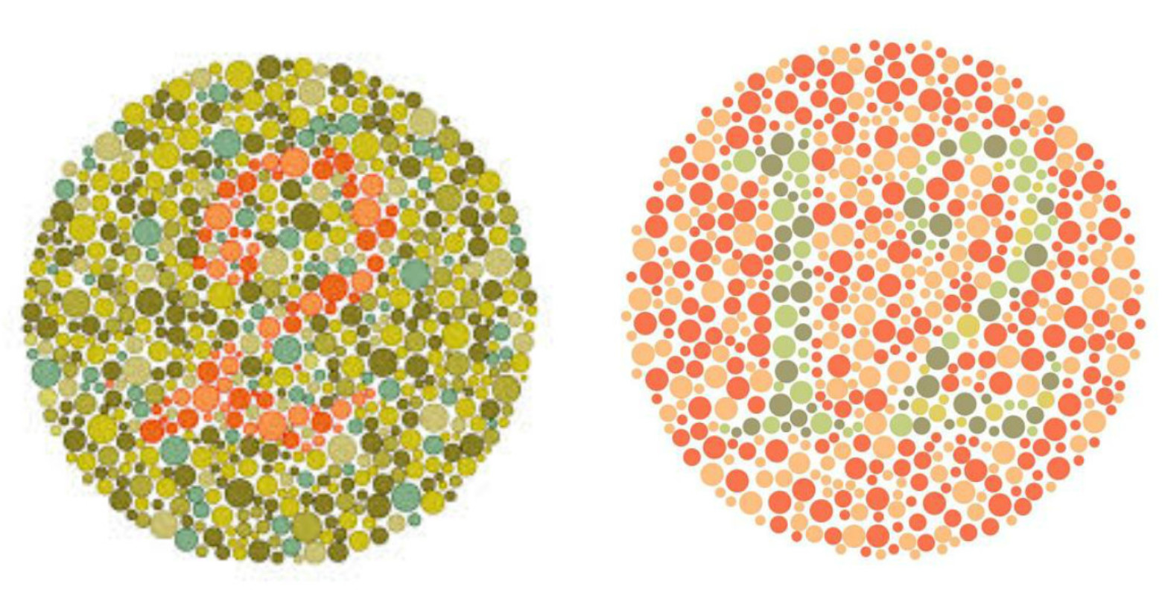
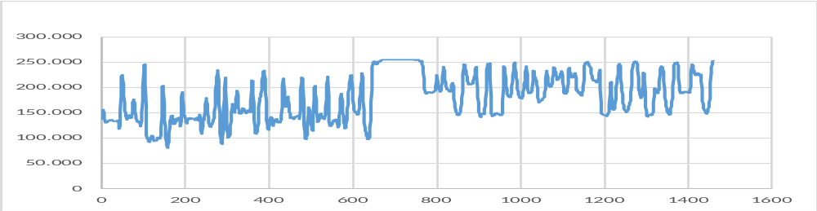
Discussion
Human brain is dedicated for pattern recognition.

Slide 14
Summary and Conclusions
The model was qualitatively validated by the experiments.
However, it does not allow to calculate exactly the illumination time needed.
The time needed to reach the contrast criteria is higher than predicted by the model if mainly attenuation occur by absorption. The reason are additional noise sources.
Additional effects increasing the beam attenuation like total reflection, refraction … can reduce significantly the illumination time needed below the value predicted.
The wires become visible much earlier than the contrast criteria is reached due to pattern recognition.

Slide 15
Thanks
The measurements were performed at ANTARES @FRM-2 as well as at BOA and POLDI @ SINQ. The authors thank for providing beamtime.
Than you for your kind attention
What are your questions?

