Slide 1


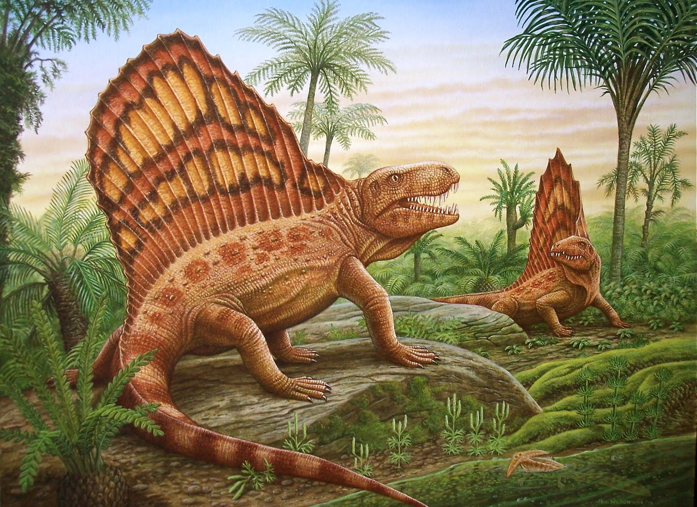
WCNR 11
11th World Conference on Neutron Radiography, Sydney, Australia
New insights into the tooth structure of pelycosaurs by means of neutron tomography
Michael Laaß¹ &
Burkhard Schillinger²
¹University of Duisburg-Essen, Department of General Zoology, Faculty of Biology, Universitätsstr. 5, D–45117 Essen, Germany
²Technical University of Munich, Heinz Maier-Leibnitz Centre and Faculty of Physics E21, Lichtenbergstraße 1, D-85747 Garching, Germany

Slide 2
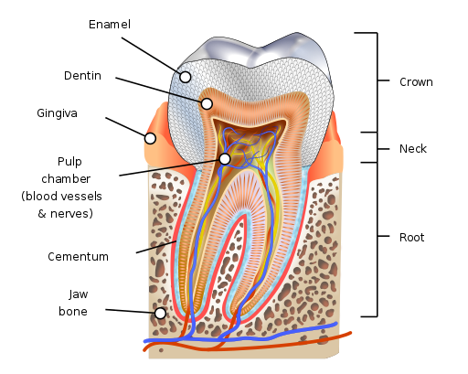
What is Plicidentine?
Tooth structure
Hard tissue:
Cap of enamel
Dentin body
cementum
https://en.wikipedia.org/wiki/Human_tooth

Slide 3
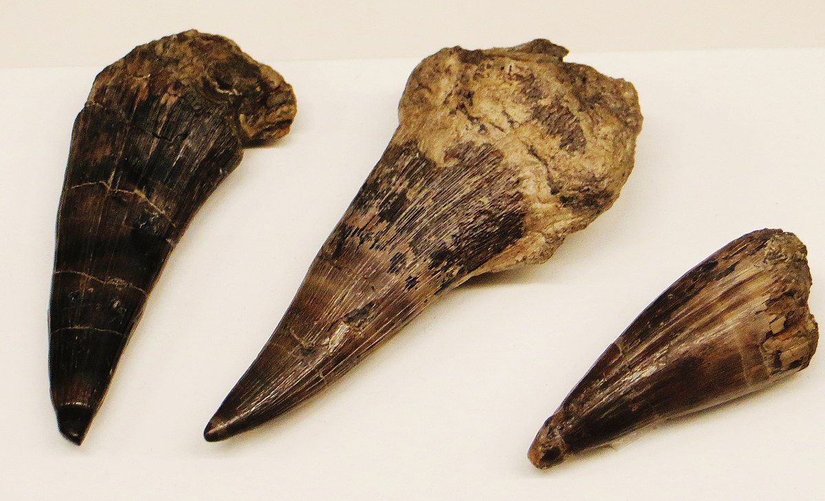
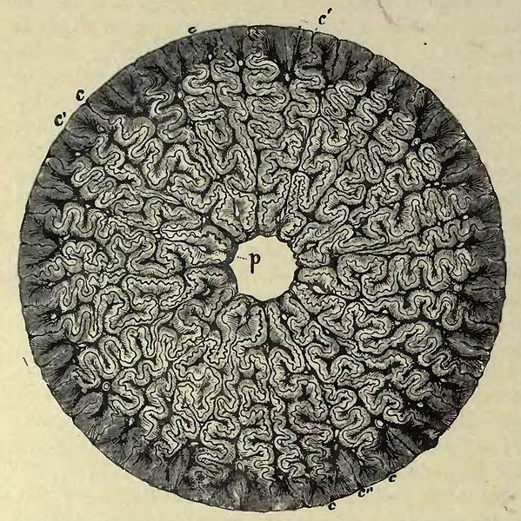
What is Plicidentine?
https://commons.wikimedia.org/wiki/File:Mastodonsaurus_giganteus_fangs_45.jpg
section through a tooth of Mastodonsaurus
Plicidentine =
Infolded dentine layer at the level of the tooth roots

Slide 4
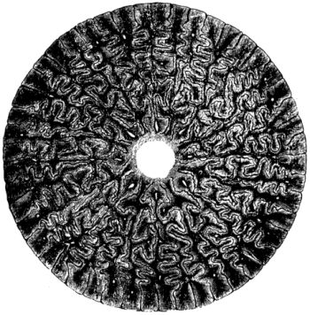
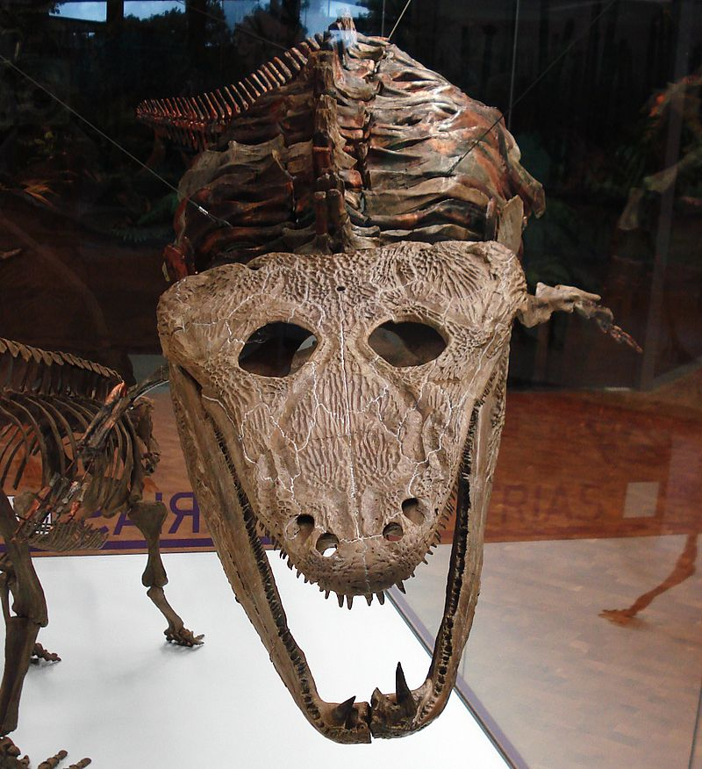
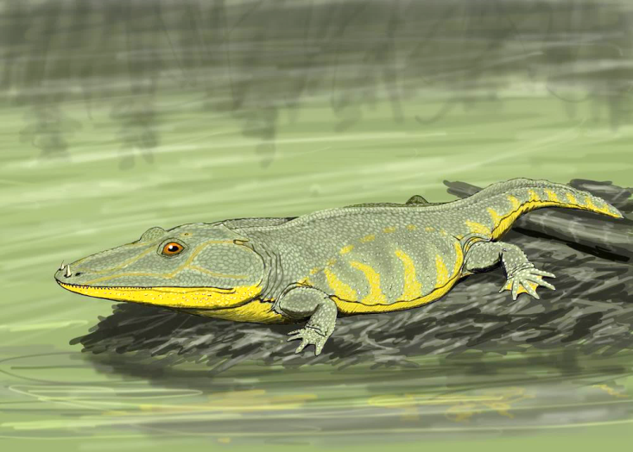
„Labyrinthodontia“
= invalid former group of early amphibians (Late Devonian – Early Cretaceous) named after their tooth structure („labyrinthodont teeth“)
→ Plicidentine present in several groups of basal tetrapods (amphibians, parareptiles, ichthyosaurs,…)
http://dinosimulator.wikia.com/wiki/File:Mastodonsaurus.jpg
Mastodonsaurus giganteus (Late Triassic, Keuper of Germany)
= one of the largest amphibians ever existed on earth
https://commons.wikimedia.org/wiki/Category:Mastodonsaurus_skulls#/media/File:Mastodonsaurus_giganteus.JPG

Slide 5
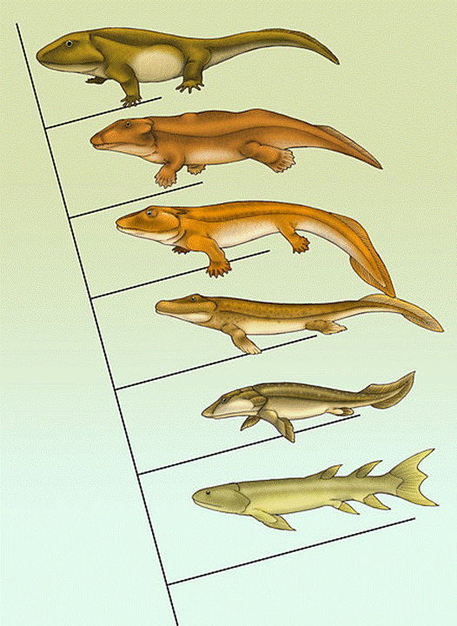
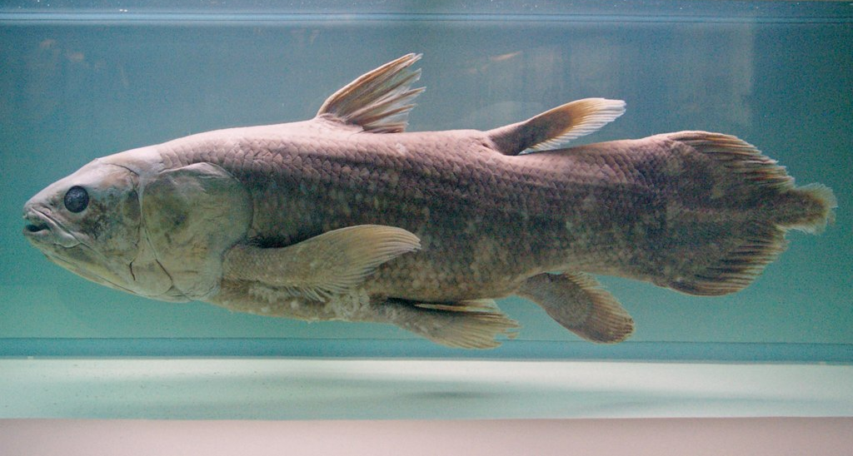
Tooth structure of Sarcopterygii
= ancestral group of land-living tetrapods
Extant coelacanth Latimeria chalumnae
https://en.wikipedia.org/wiki/Latimeria#/media/File:Latimeria_Paris.jpg

Slide 6
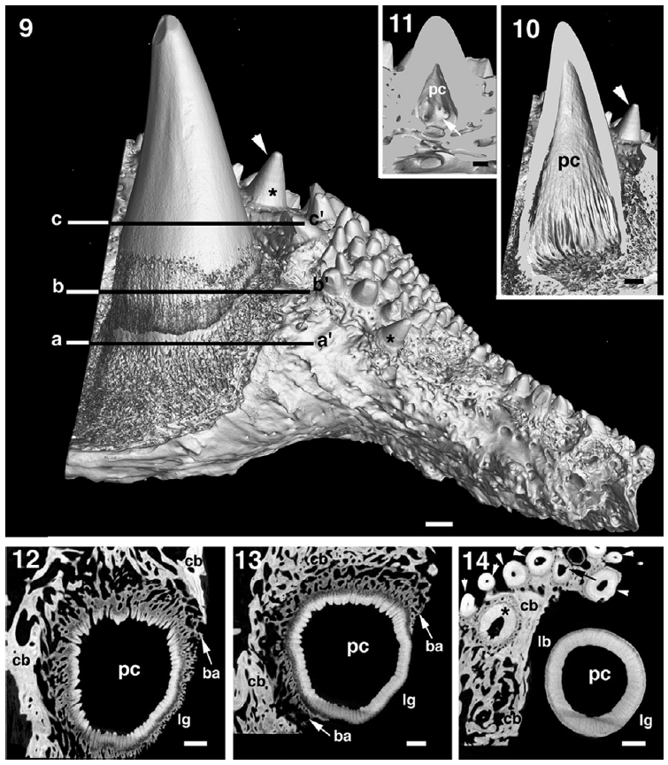
Plicidentine in the coelacanth Latimeria chalumnae
infolded dentine at the level of the tooth roots of Latimeria chalumnae
Plicidentine = ancient feature of early tetrapods inherited from aquatic ancestors
Meunier et al. 2015

Slide 7
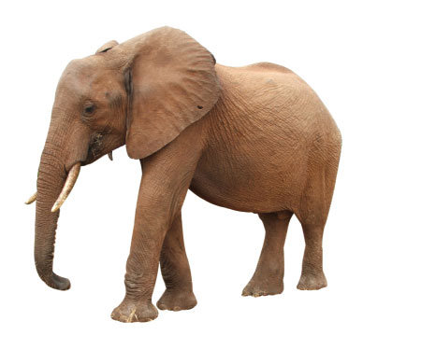
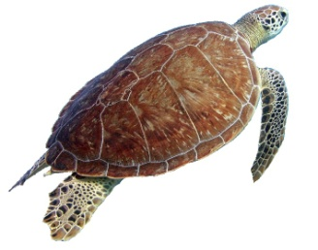
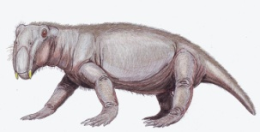
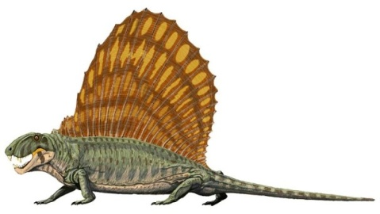
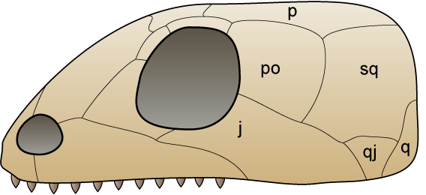
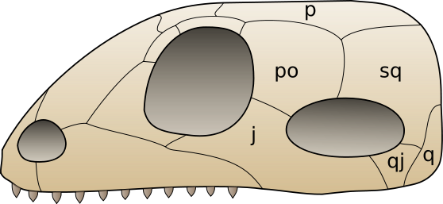
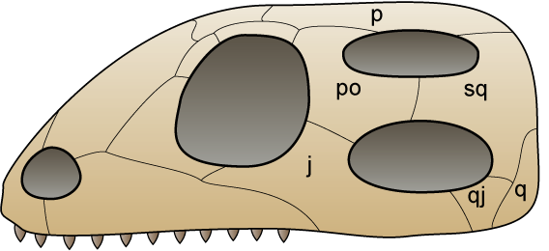
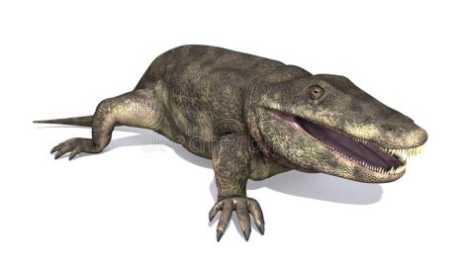
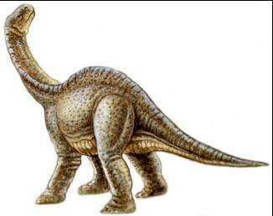
Up to 2014 plicidentine was unknown in synapsids!
2014: discovery of plicidentine in one group of pelycosaurs
Mammalia
Therapsida
Pelycosauria
Anapsida
(without fenestra)
Synapsida
(only infratemporal fenestra)
Diapsida
(Infra- and supratemporal fenestra, e.g. crocodiles, lepidosaurs, dinosaurs, birds)
Amphibia
Amniota
(tetrapods laying eggs with solid shell)
Tetrapoda
(land-living vertebrates with 4 legs)

Slide 8
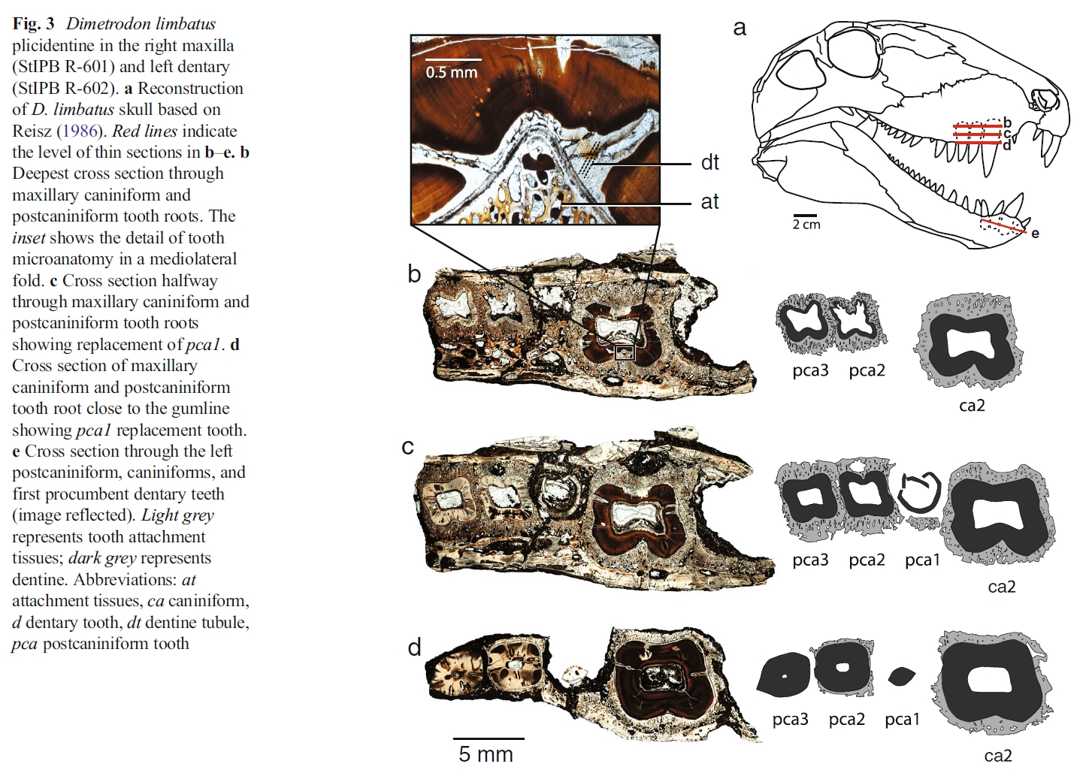
2014: The first record of plicidentine in synapsids
Brink et al. 2014

Slide 9
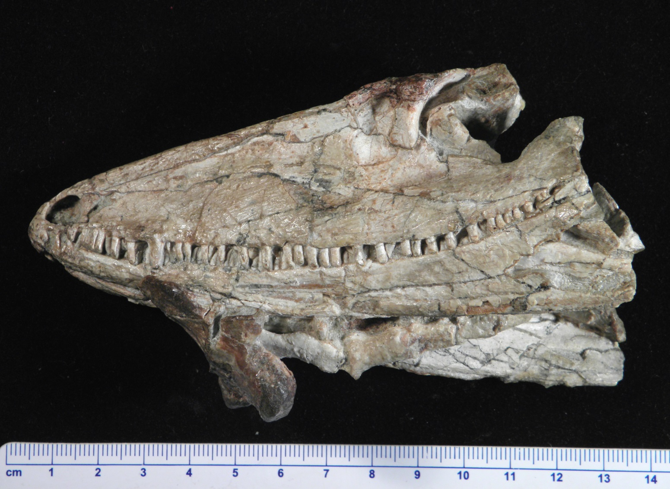
Tooth structure of early synapsids
Investigation of a skull of the pelycosaur Varanosaurus acustirostris at the facility ANTARES at FRM II in Munich
member of the primitive pelycosaur group Varanopseidae
Specimen from the collection of the Bayerische Staatssammlung in Munich
early Permian of Texas

Slide 10
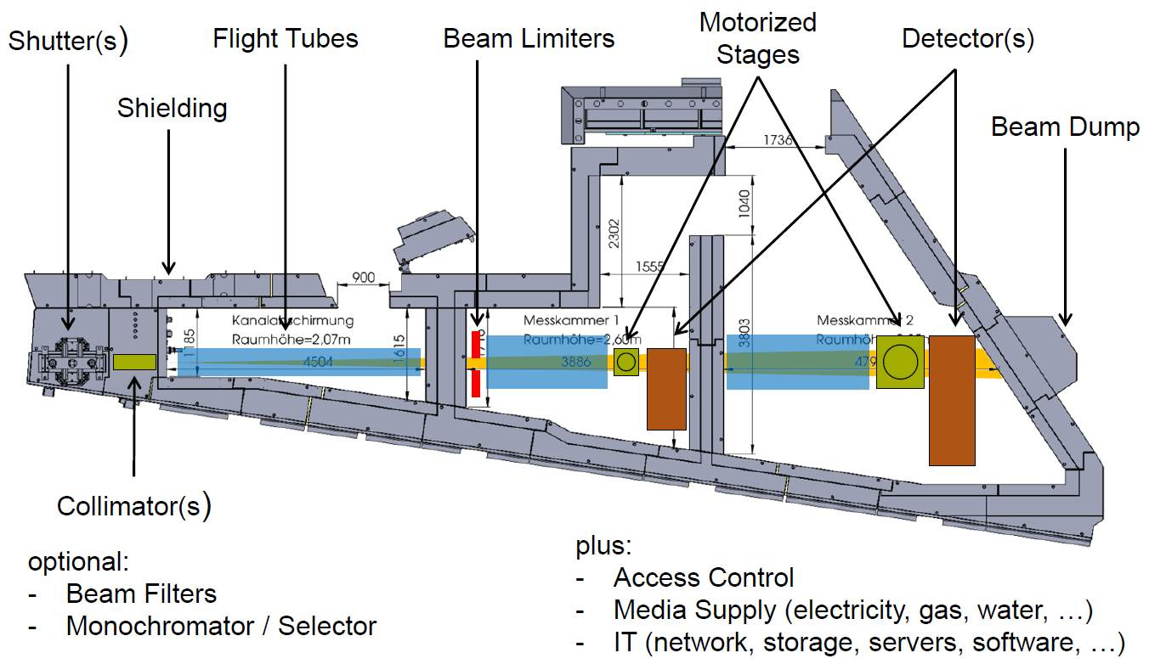
The ANTARES facility for neutron imaging at FRM II
Wenn eine neue Folie

Slide 11
ANTARES – Technical Data
Collimation and flux at the sample position in chamber 2
L/D = 200, 4·10⁸ n cm⁻² s⁻¹
L/D = 400, 1·10⁸ n cm⁻² s⁻¹
L/D = 800, 2.6·10⁷ n cm⁻² s⁻¹
L/D = 1600, 6.5·10⁶ n cm⁻² s⁻¹
L/D = 7000, 2.6·10⁵ n cm⁻² s⁻¹
Beam size up to 35 × 35 cm²
Energy selection
Double crystal monochromator:
  1.4 Å ≤ λ ≤ 6.0 Å (1% < Δλ/λ < 3%)
Neutron velocity selector:
  3.0 Å ≤ λ ≤ 8 Å (Δλ/λ = 10%)
Neutron grating interferometer:
  Sensitive to length scales 500nm – 10 µm
Beam Filters:
  Cd filter for epithermal imaging
  Be filter to suppress wavelengths λ < 4 Å
  Sapphire filter to suppress fast neutrons
Wenn eine neue Folie

Slide 12
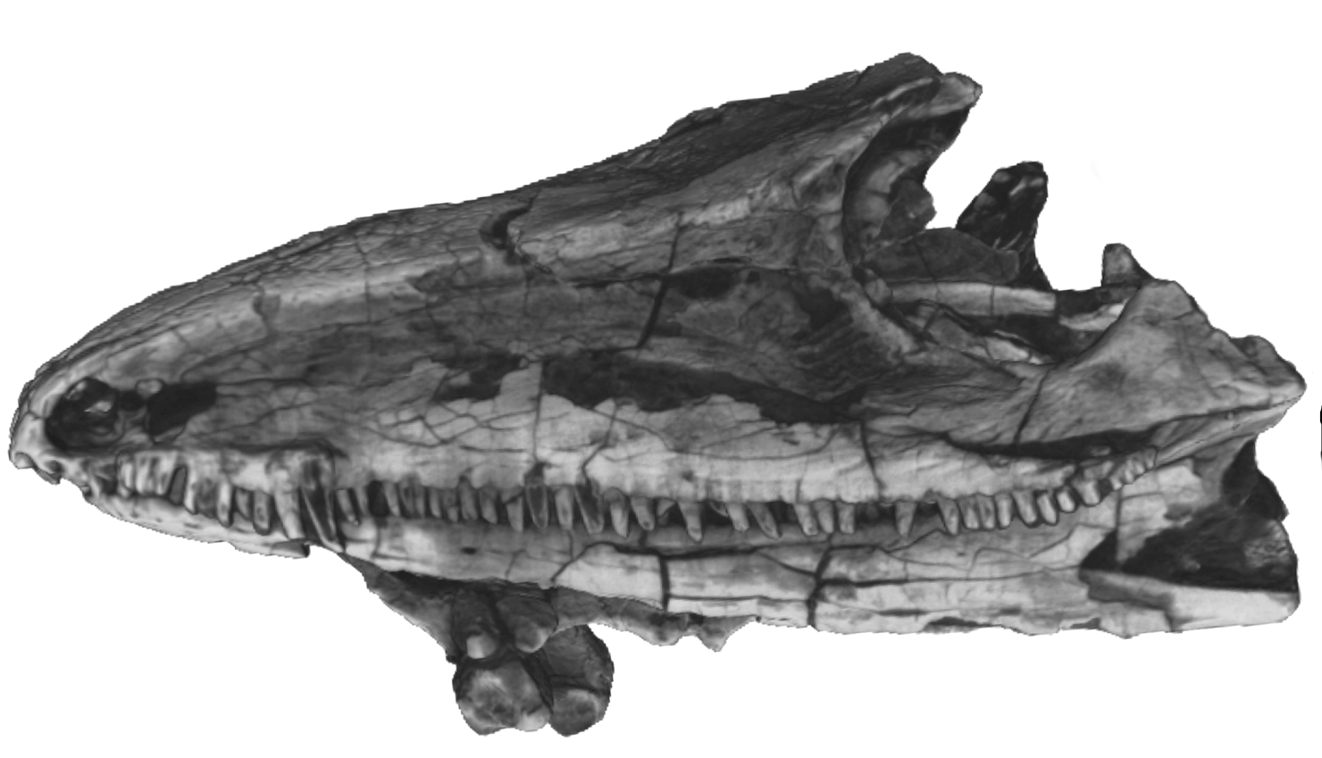
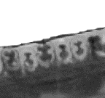
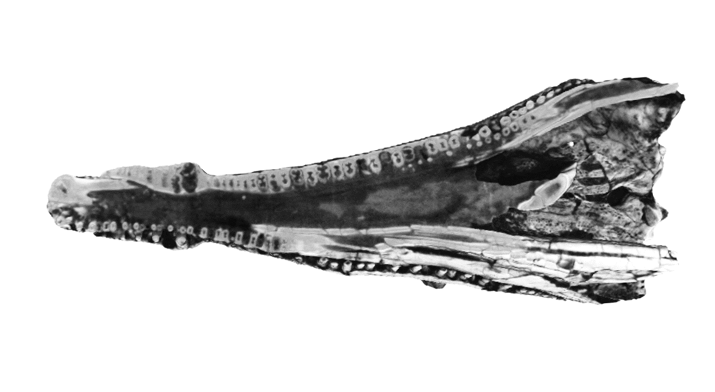
Results
Plicidentine

Slide 13
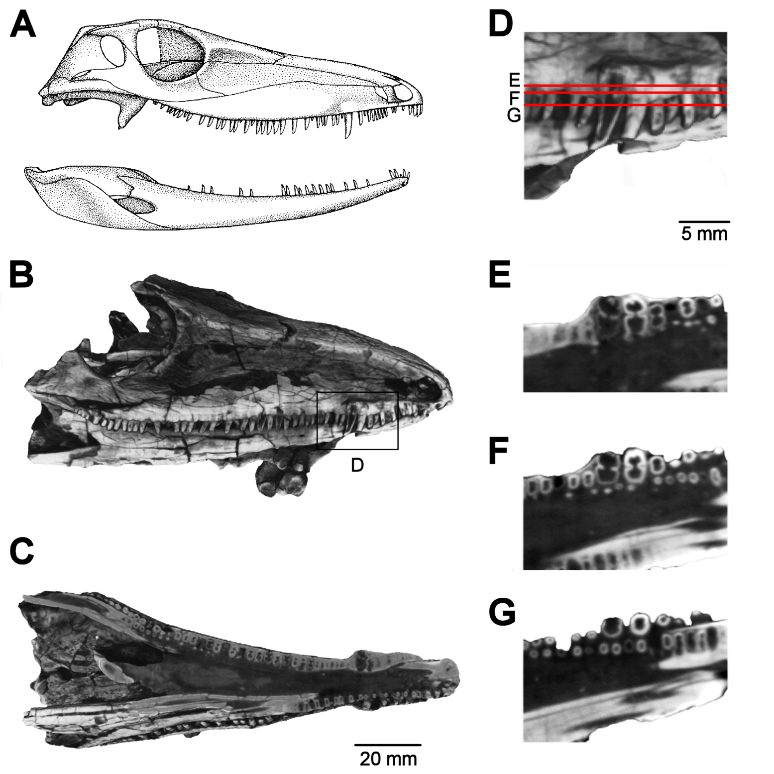
Results

Slide 14
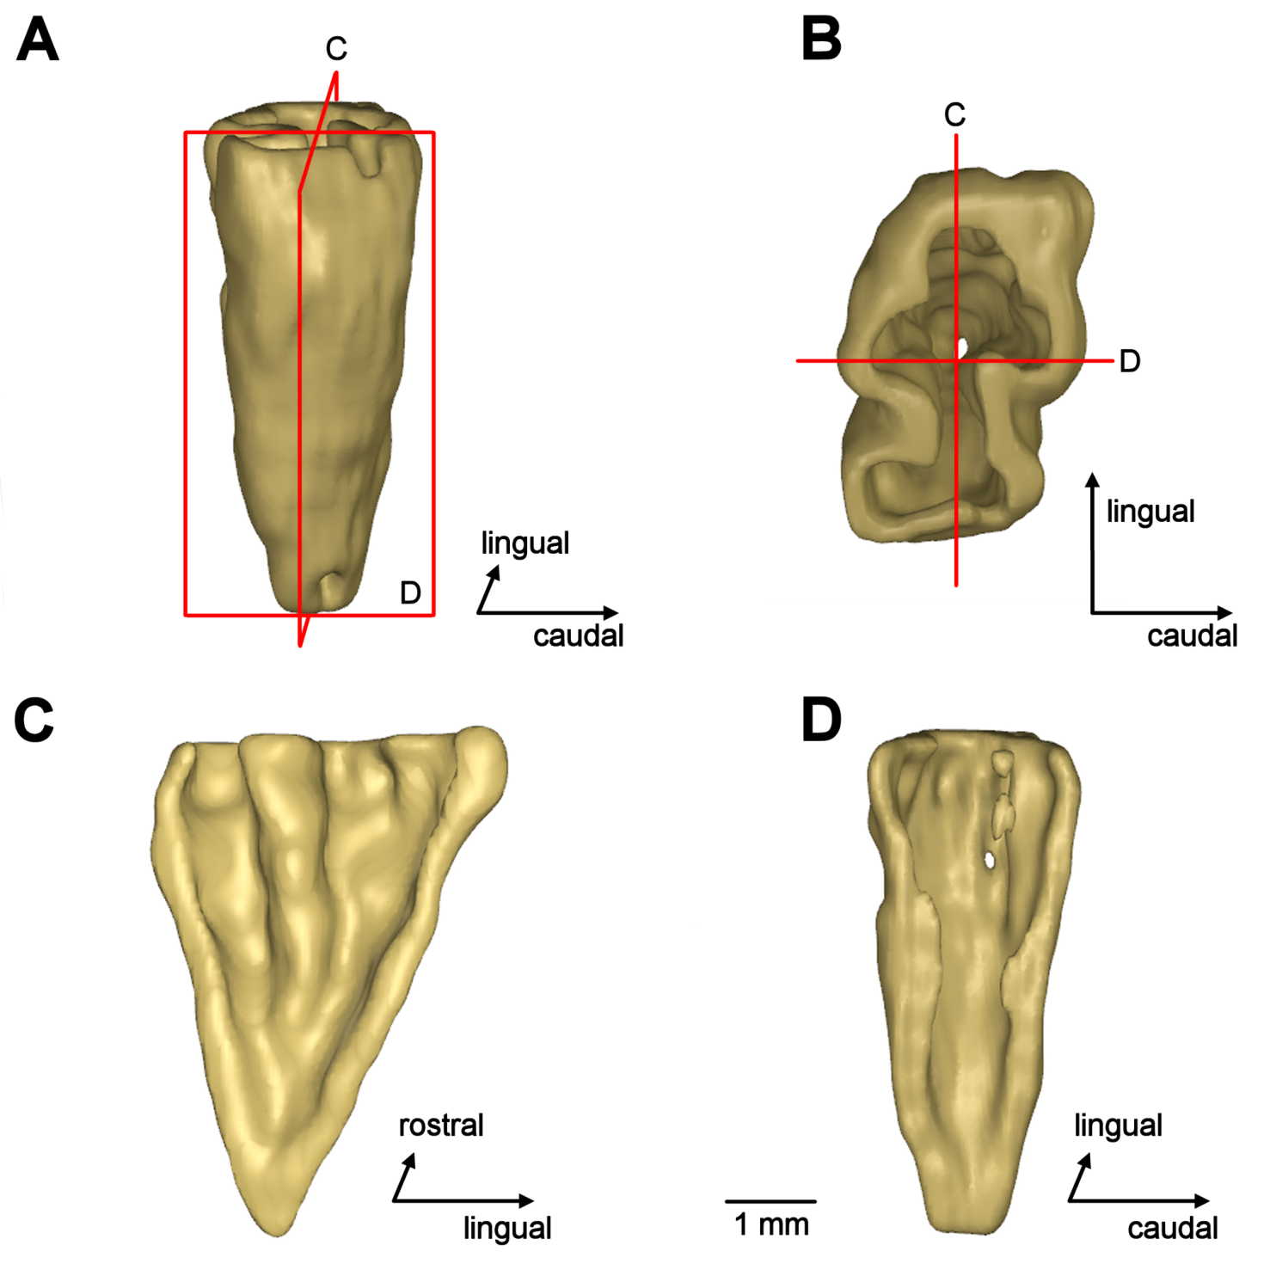
3D reconstruction of a tooth of Varanosaurus acustirostris

Slide 15
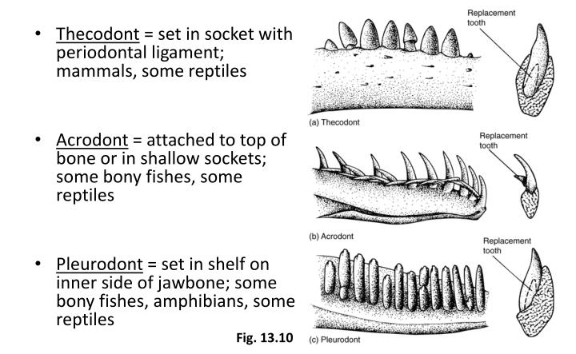
Function of plicidentine
Plicidentine increases the area for attachment of the tooth roots to the tooth bearing element

Slide 16
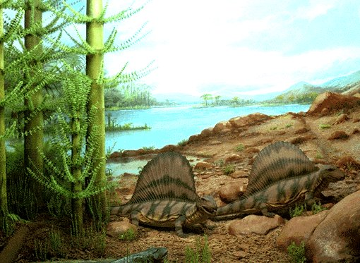
Conclusions
First record of plicidentine in Varanopsidae, a group of basal pelycosaurs
plicidentine obviously more widespread among basal synapsids than previously thought
hitherto, plicidentine was often overlooked, because the tooth roots were usually hidden by the jaw bones
functionally, the infolded dentine layer provides an increased area for attachment for the shallow tooth roots in the jaw
neutron tomography allows non-destructive investigation of the tooth structure of these valuable fossils

Slide 17
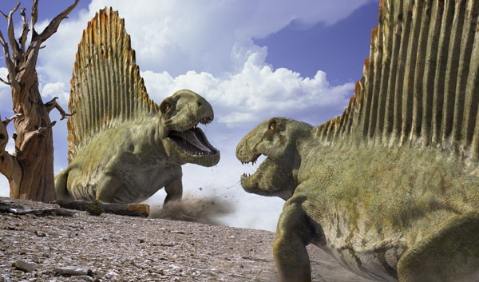
Thank you for your attention!
Many thanks to the following persons and institutions:
Oliver Rauhut, Bayerische Staatssammlung, Munich, Heinz-Maier Leibnitz Centre, TU Munich

