Slide 1

Pareto Optimal Solutions for a Neutron Radiography Collimator
Robert Nshimirimana
Research and Technology Development Division, Necsa SOC Limited, Pretoria, South Africa
robert.nshimirimana@necsa.co.za
Prof Andries Engelbrecht, Dr Gawie Nothnagel
WCNR-11, Sydney, Australia, 2 – 7 Sept 2018

Slide 2



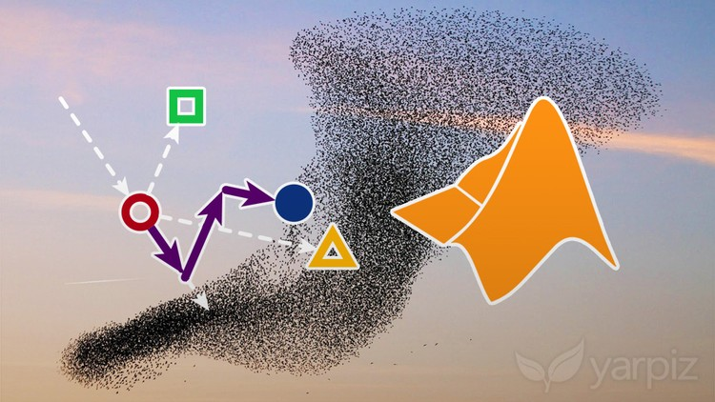
AIM
Present a collimator optimizer based on:
Ray-tracing technique: Ray tracing is a global illumination technique used in computer graphic to generate realistic images by simulating the path of light rays and the interaction of the light rays with virtual object.
Particle swarm optimization technique: Computational swarm intelligence technique that uses an innovative distributed intelligent paradigm for solving optimization problems that originally took its inspiration from the biological examples by swarming, flocking such as birds.

Slide 3
CONTENT
INTRODUCTION
NEUTRON COLLIMATOR OPTIMIZATION
PARETO OPTIMAL SOLUTIONS/FRONT
TECHNIQUES AND SOFTWARE INTERFACE
RAY-TRACING
IMAGE EVALUATION
PARTICLE SWARM OPTIMIZATION
EXAMPLE COLLIMATOR OPTIMIZATION: NRAD
CONCLUSION AND FINDINGS

Slide 4
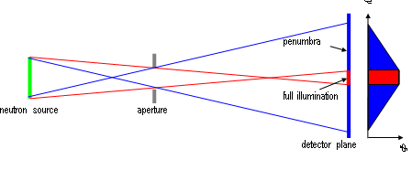
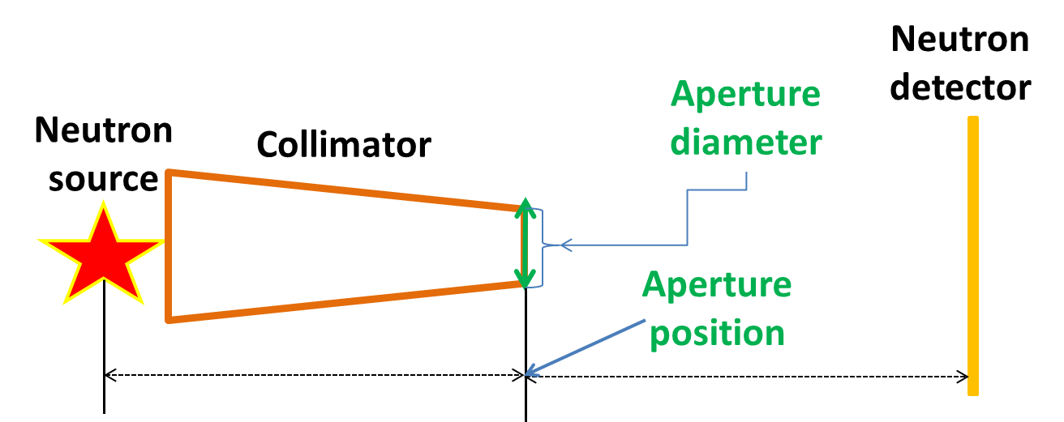
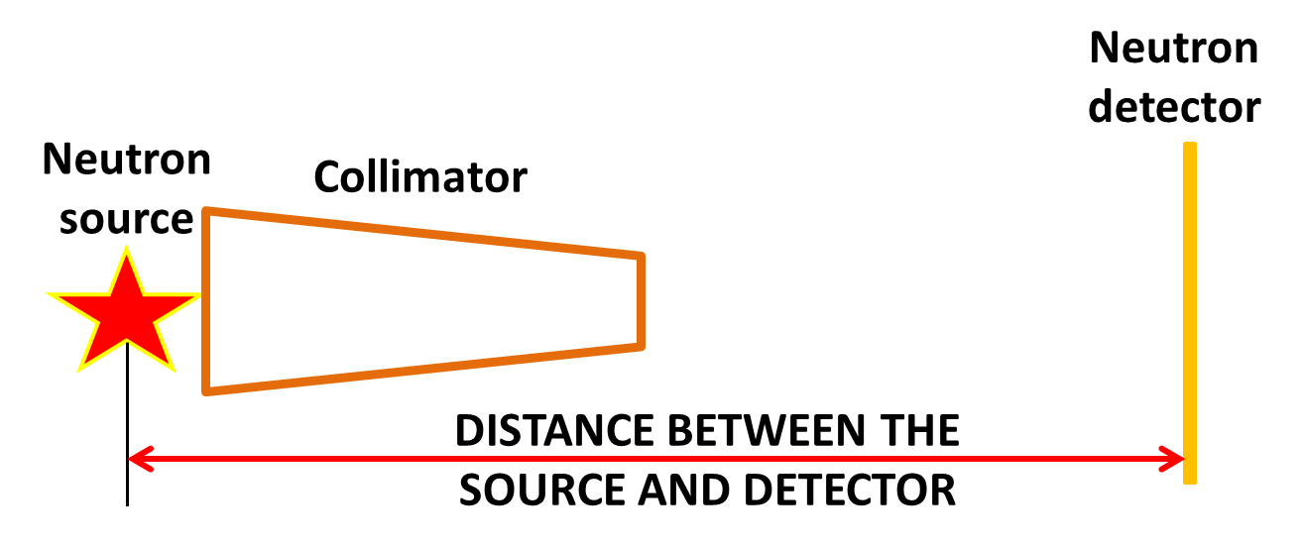
INTRODUCTION
NEUTRON COLLIMATOR OPTIMIZATION
CONFLICTING OBJECTIVES
Geometric(large homogeneous FOV)
Beam (high neutron flux)
Resolution
PARAMETERS
Aperture size
Aperture position
CONSTRAINT
Space
Cost
Material

Slide 5
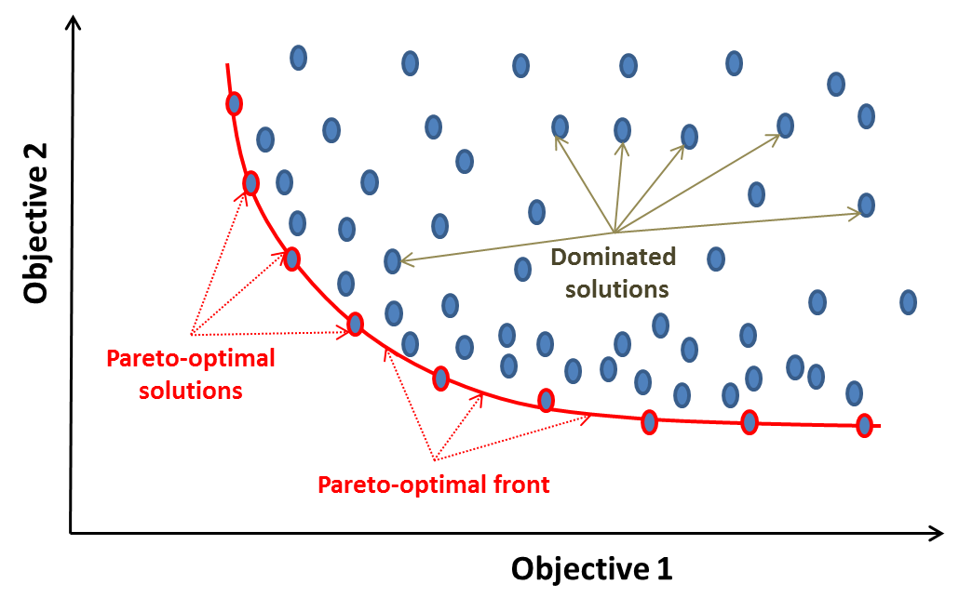
INTRODUCTION
SOLUTIONS FOR MULTI-OBJECTIVES OPTIMIZATION
Definition
2 or more conflicting objectives
PARETO OPTIMAL SOLUTIONS
MANY SOLUTIONS = MANY CHOICES

Slide 6
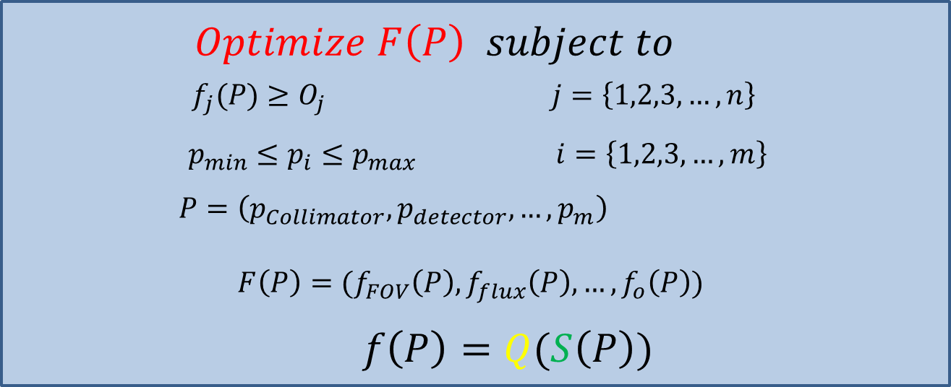
TECHNIQUES
SOLVING COLLIMATOR OPTIMIZATION PROBLEM
OBJECTIVE FUNCTION

Slide 7
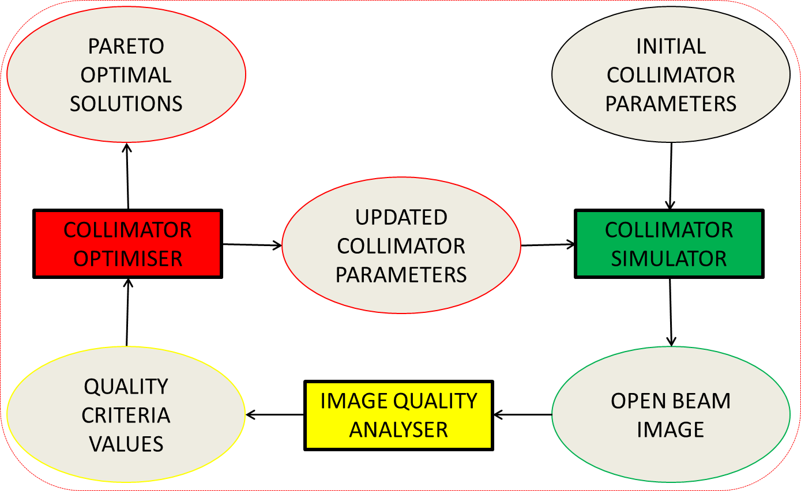
TECHNIQUES
COLLIMATOR OPTIMIZATION SYSTEM

Slide 8
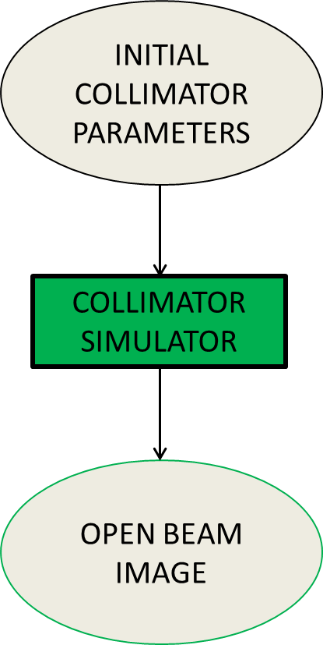
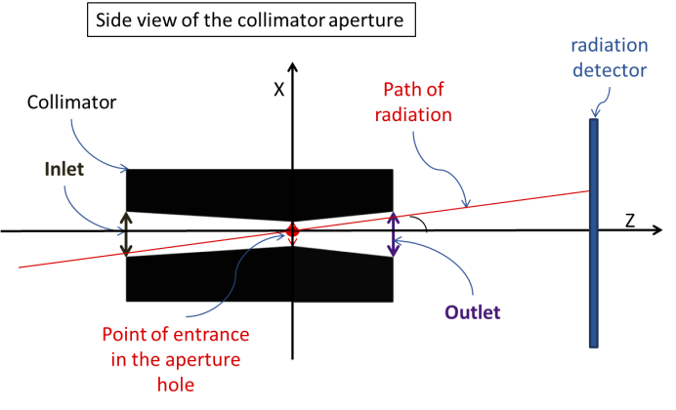
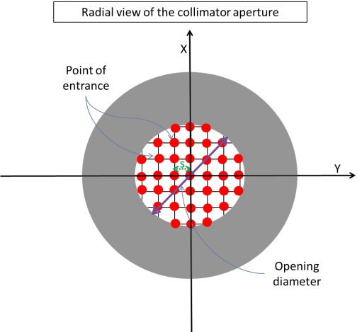

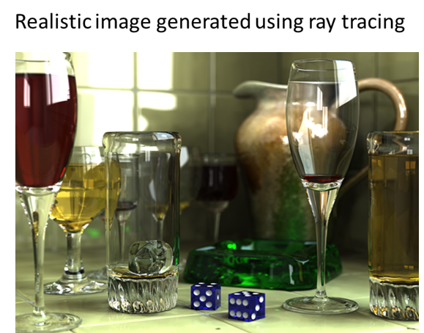
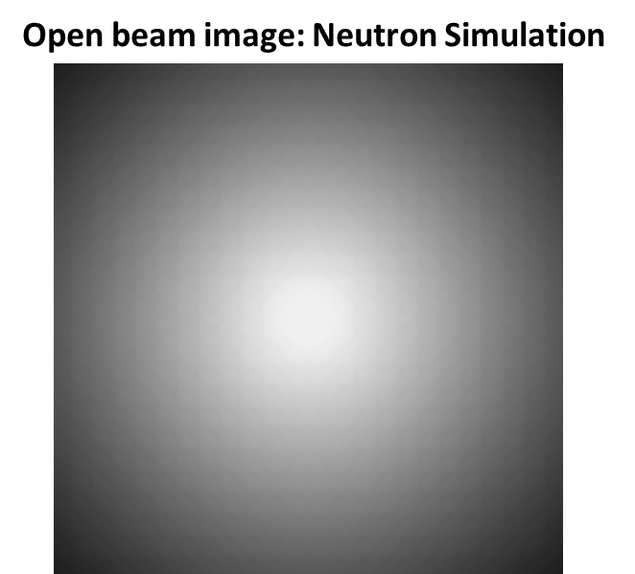
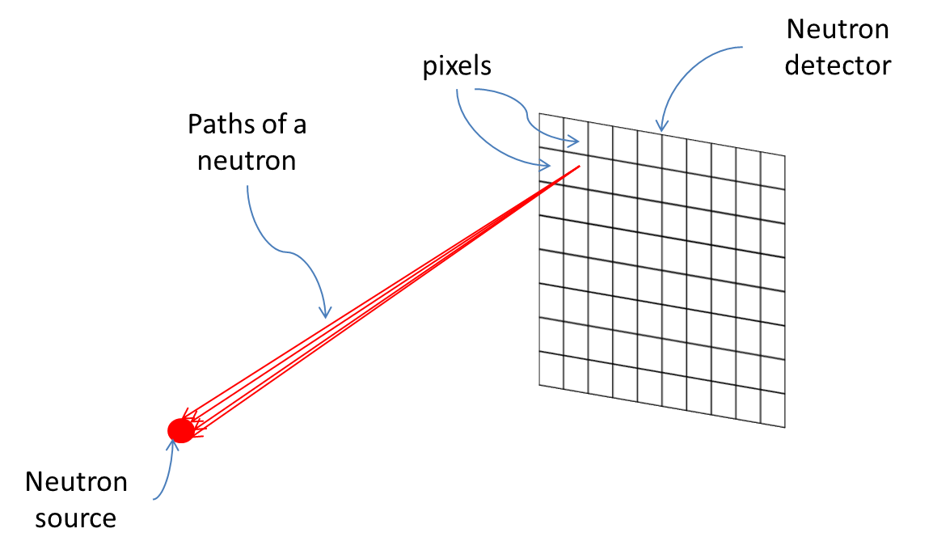
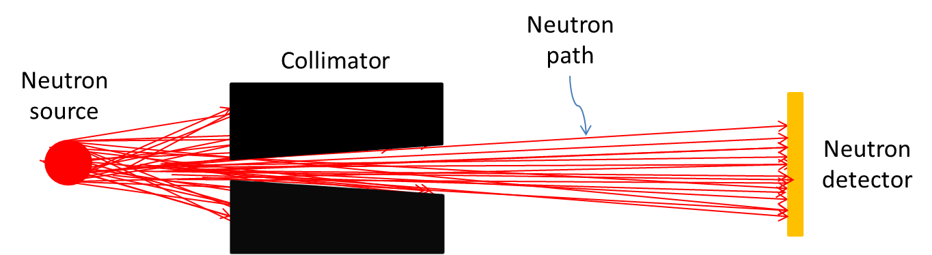
TECHNIQUES
SIMULATION: RAY-TRACING

Slide 9
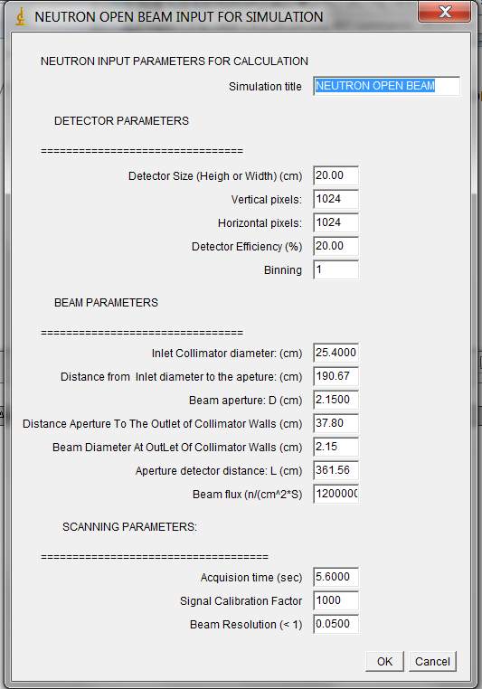
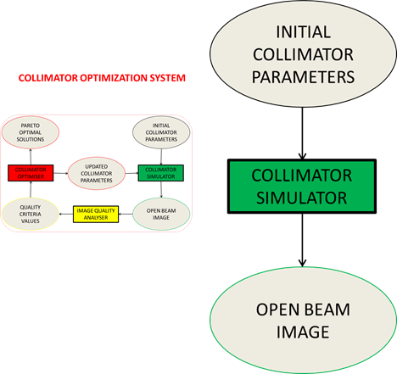
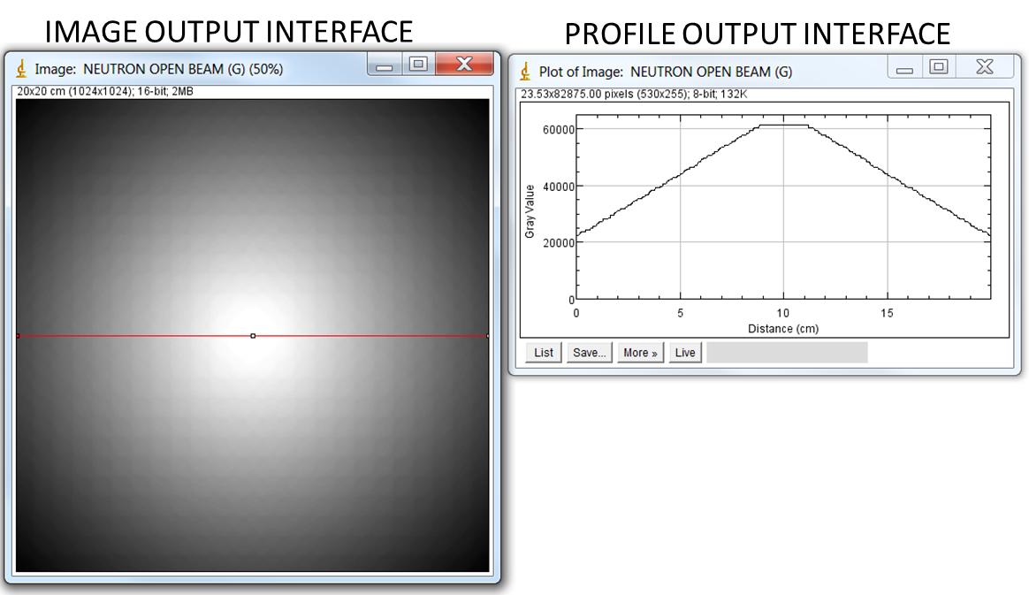
TECHNIQUES
SIMULATION: SOFTWARE INTERFACE

Slide 10
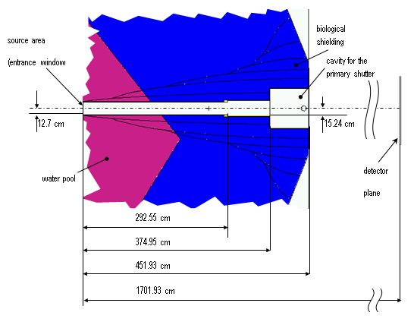
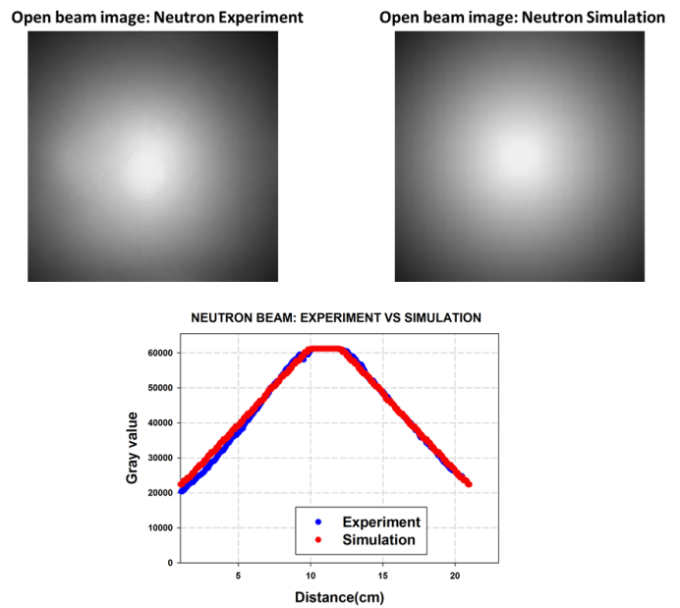
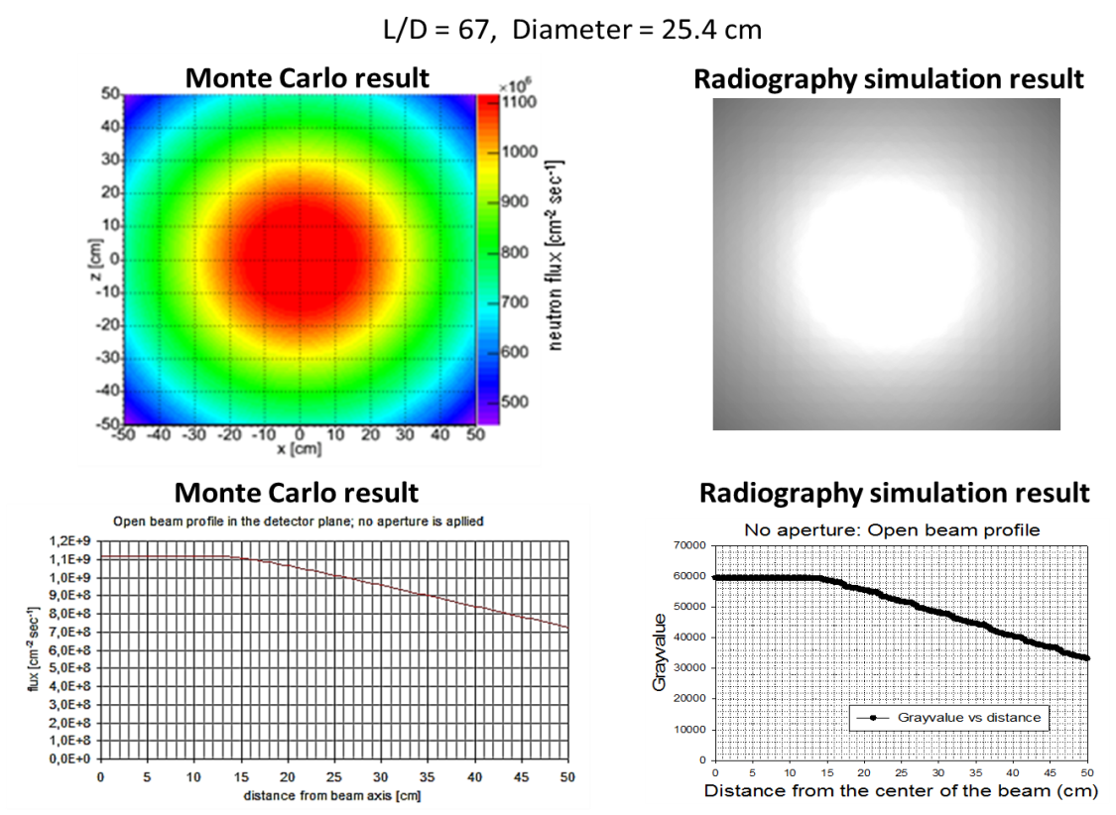
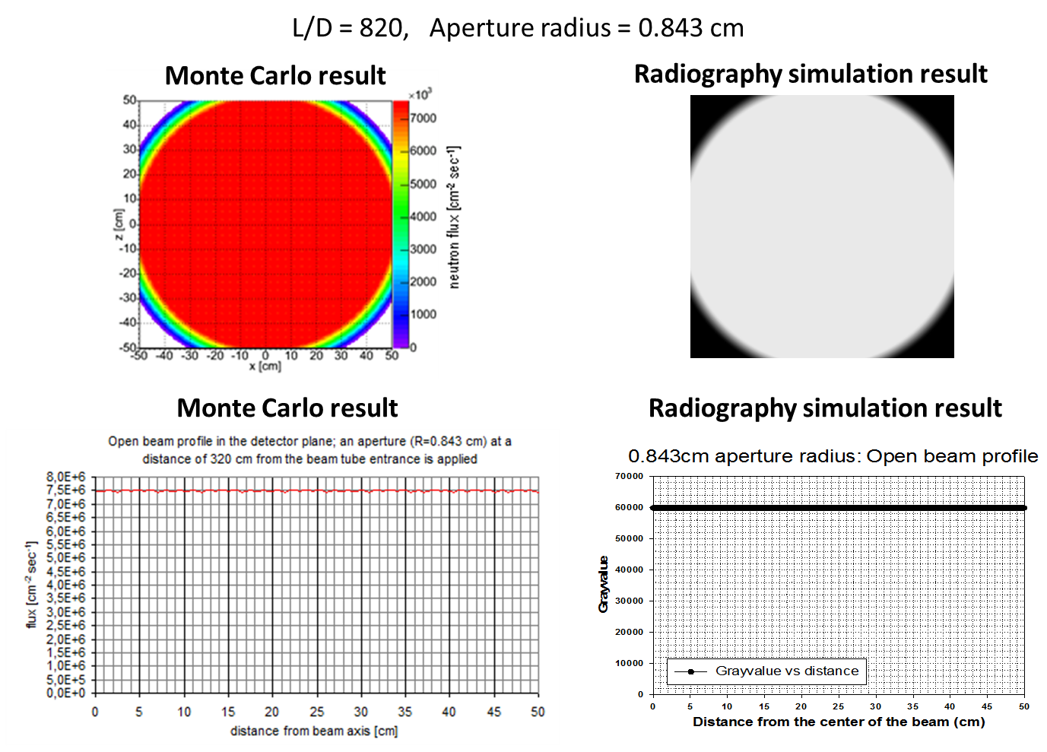
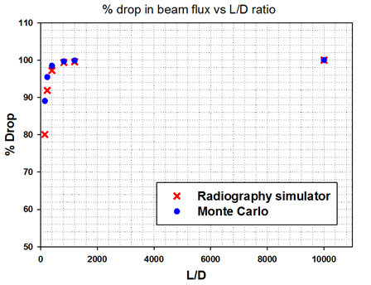
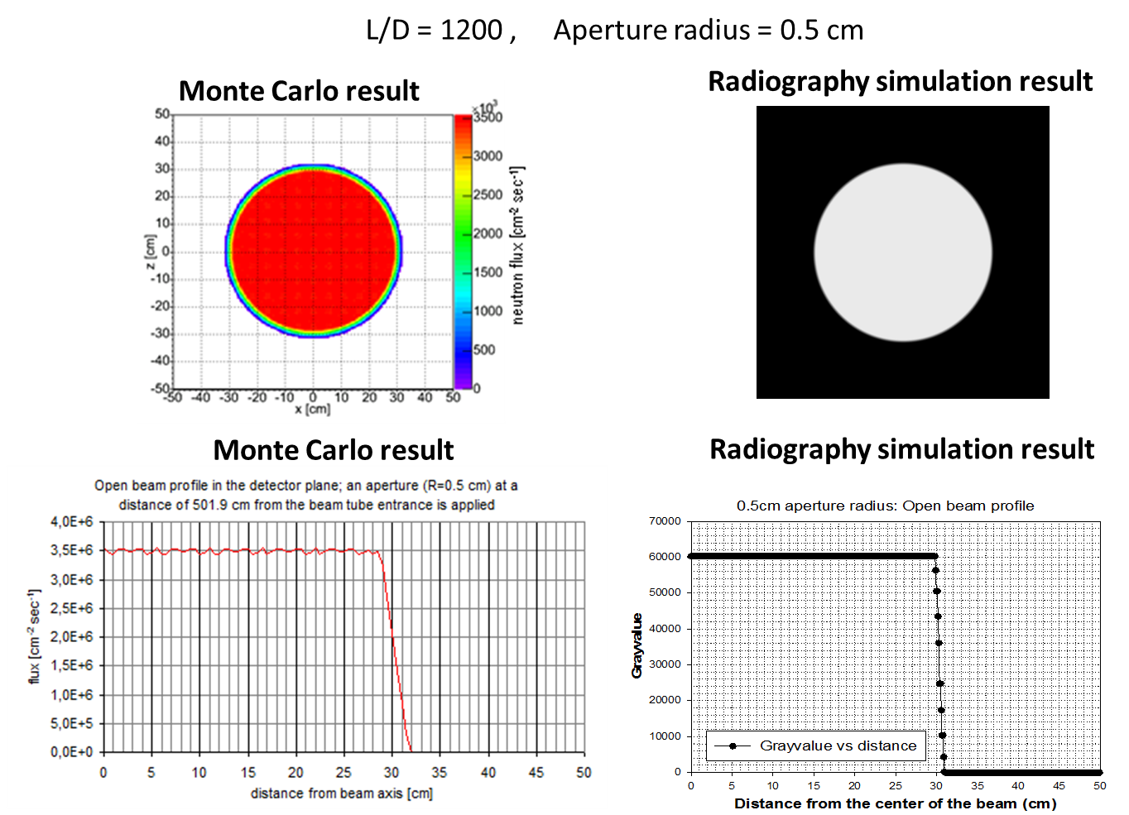
TECHNIQUES
SIMULATION: SOFTWARE BENCHMARKING
BENCHMARK WITH MCNP RESULTS

Slide 11
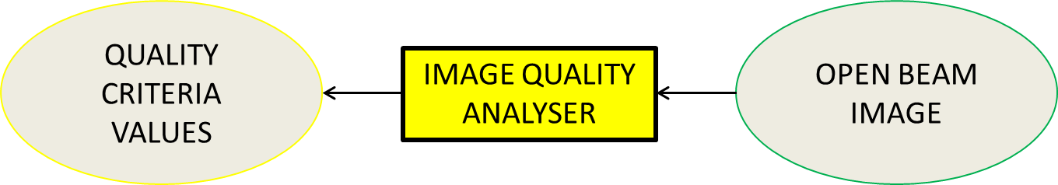
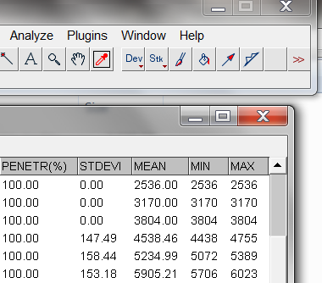
TECHNIQUES
IMAGE ANALYSER: HOMOGENEITY AND FOV

Slide 12
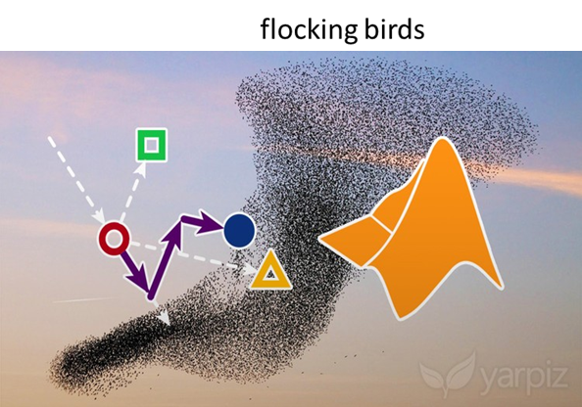
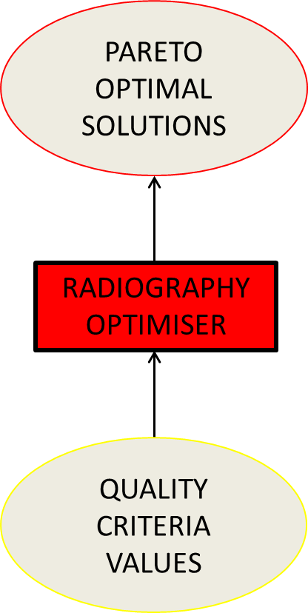
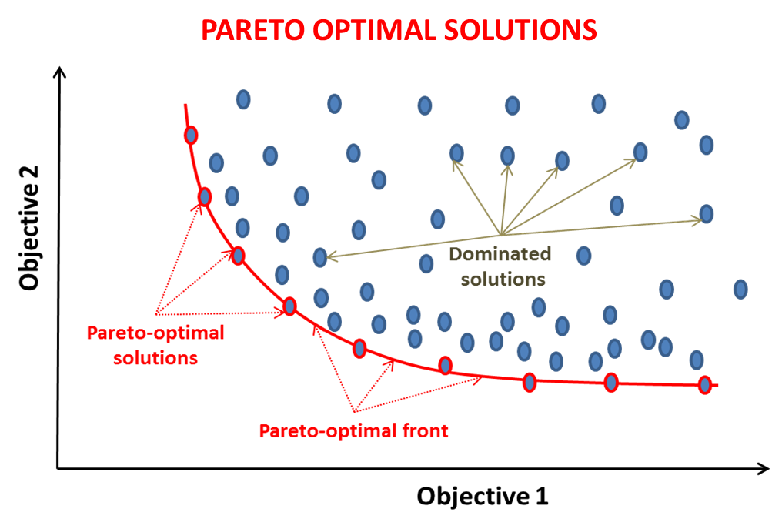
TECHNIQUES
OPTIMIZATION: PARTICLE SWARM OPTIMIZATION
NO FINE-TUNING MULTI-OBJECTIVES PARTICLE SWARM OPTIMISATION ALGORITHM (NF-MOPSO)
CAPABLE OF FINDING PARETO OPTIMAL SOLUTIONS FOR A MULTI-OBJECTIVES OPTIMIZATION

Slide 13
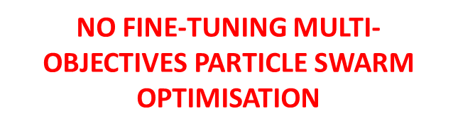
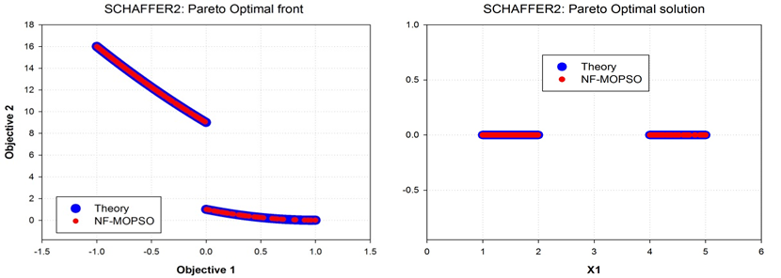
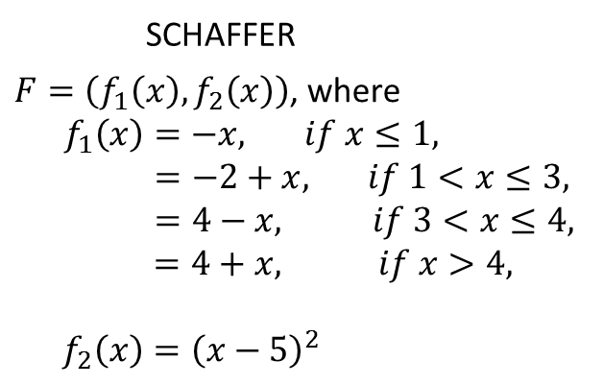
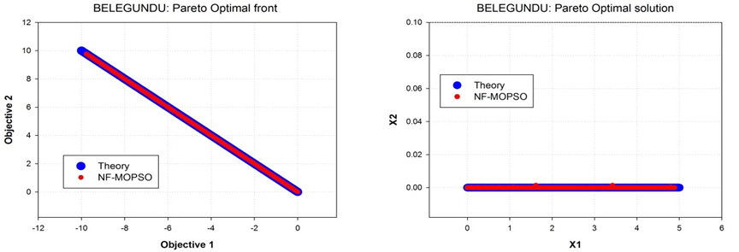
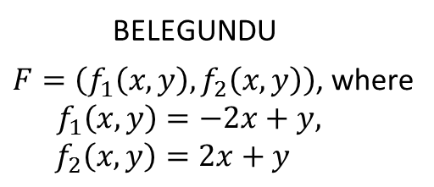
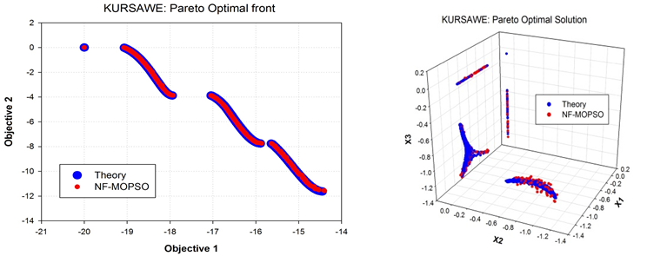

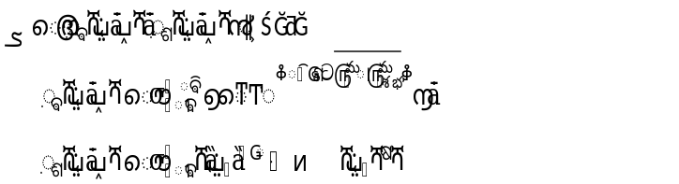
TECHNIQUES
OPTIMIZATION: ALGORITHM BENCHMARKING
TESTED ON 48 MATHEMATICAL TEST FUNCTIONS

Slide 14

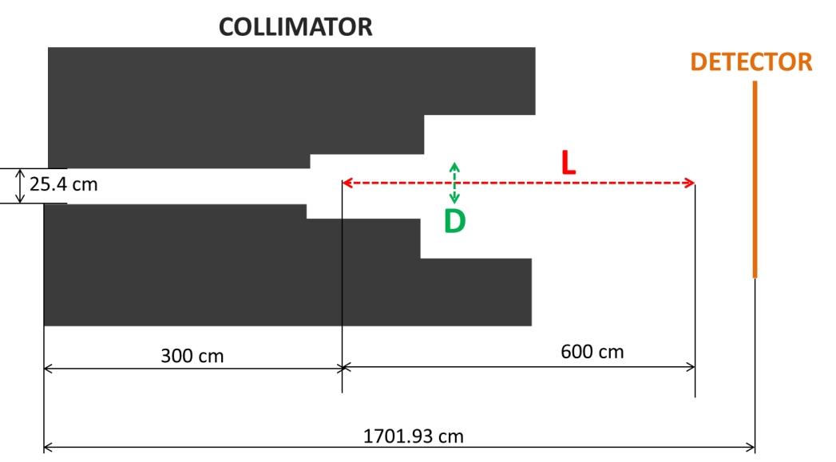
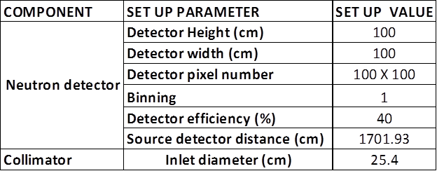
OPTIMISATION
EXAMPLE OF COLLIMATOR OPTIMISATION: NRAD
PROBLEM: The goal is to find the best values of L and D that produce a good geometry of the neutron beam
CONSTRAINT SPACE:
QUALITY FACTOR:
Full radius of illumination (cm) VS. Maximum gray value (square root)
Standard deviation (grayvalue) VS. Maximum gray value (square root)

Slide 15
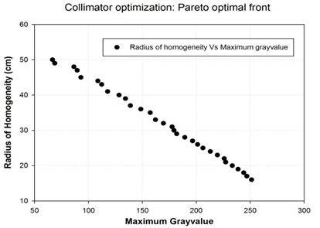
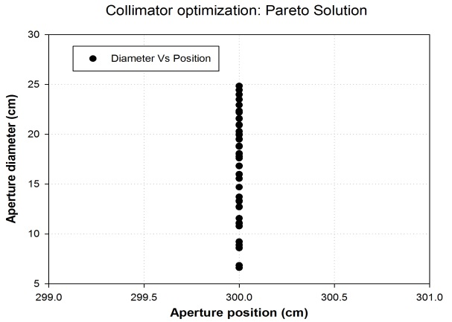
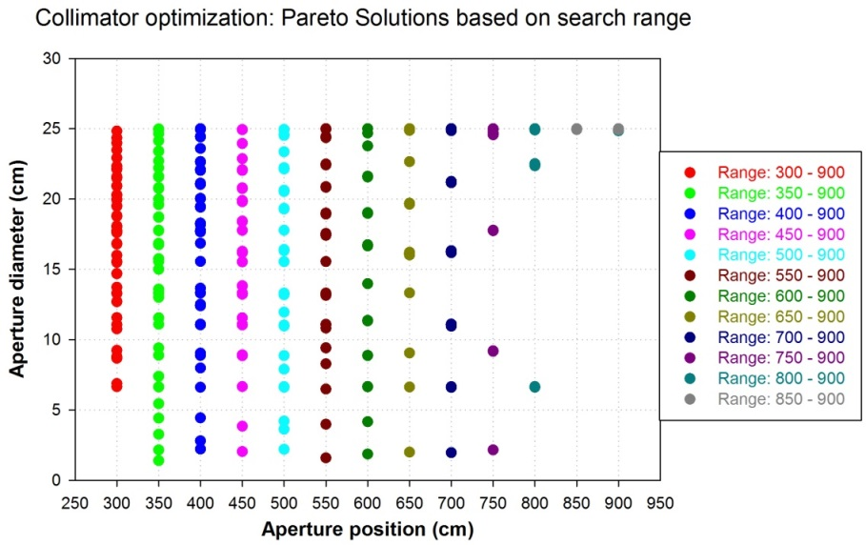
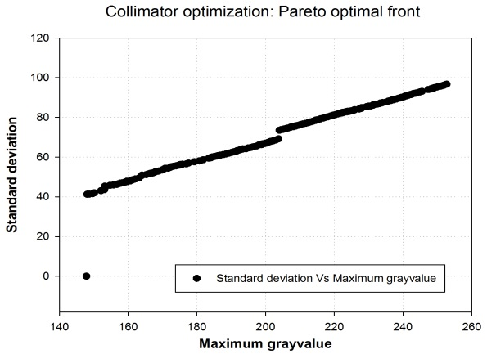
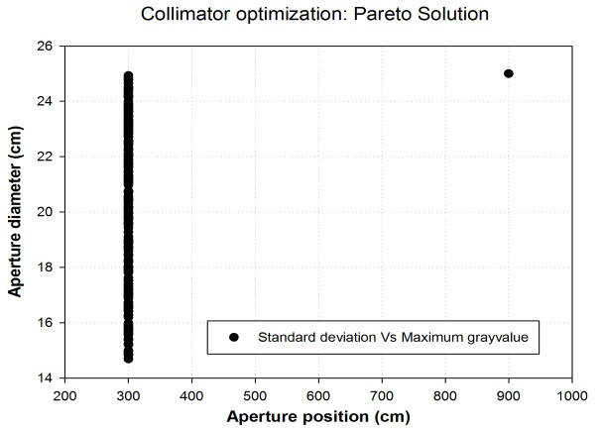
OPTIMISATION
EXAMPLE OF COLLIMATOR OPTIMISATION: NRAD
PARETO SOLUTIONS
BEST APERTURE POSITION ALWAYS CLOSE TO THE NEUTRON SOURCE

Slide 16
CONCLUSION
The collimator simulator:
Successfully tested and benchmarked against experimental and MCNP results.
Easy to use for any radiographer
The PSO based Optimizer:
Successfully tested on 48 different mathematical test functions for multi-objective optimization problem.
Collimator optimizer:
Provides Pareto-optimal solutions to be used in the design of a collimator or during the experiment (robust collimator)
Observation:
Optimization results showed that the best position for the aperture is close to the neutron source.

Slide 17
THANK YOU

